Slide 1
CALICE Overview
David Bailey, Manchester

Slide 2
Themes
Hardware
  MAPS
  DAQ
  Glue/Mechanics
Physics
  Ongoing studies
  Eagerly anticipated results and upcoming conferences
Future
  DevDet etc.

Slide 3
MAPS
Selected highlights...
  Anne-Marie

Slide 4
DAQ
Hardware
  Marc
  Maurice/Bart
Software
  Valeria & Tau

Slide 5
DAQ Architecture
ASICs
…
ASICs
ASICs
DIF
DIF
DIF
LDA
Clock /
Fast
Control
CCC-link
Data-link
ODR
ODR
PC
Store

Slide 6
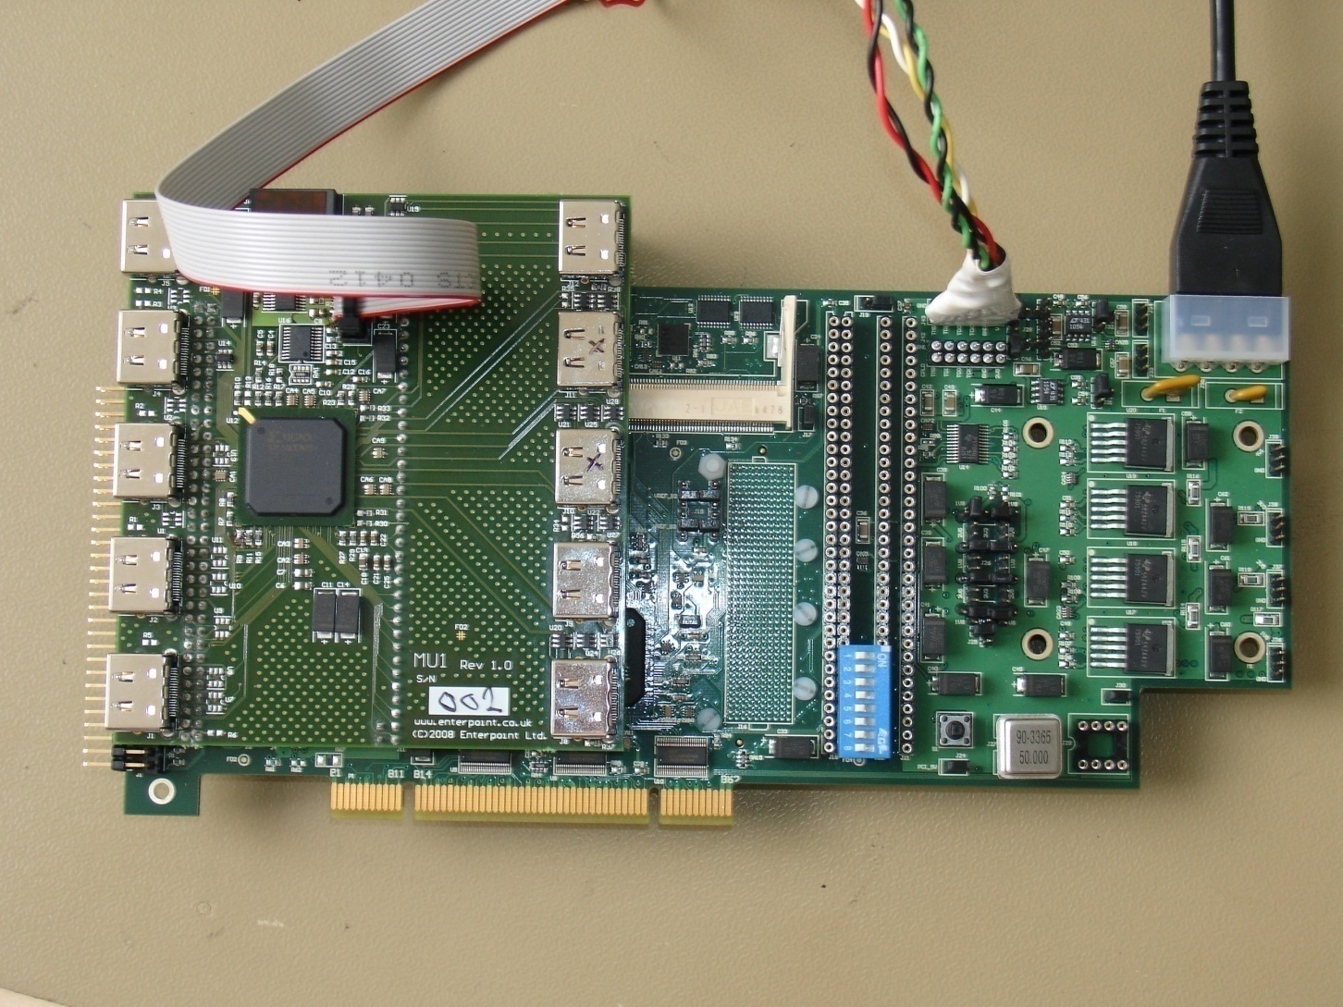
LDA Hardware Delivered

Slide 7
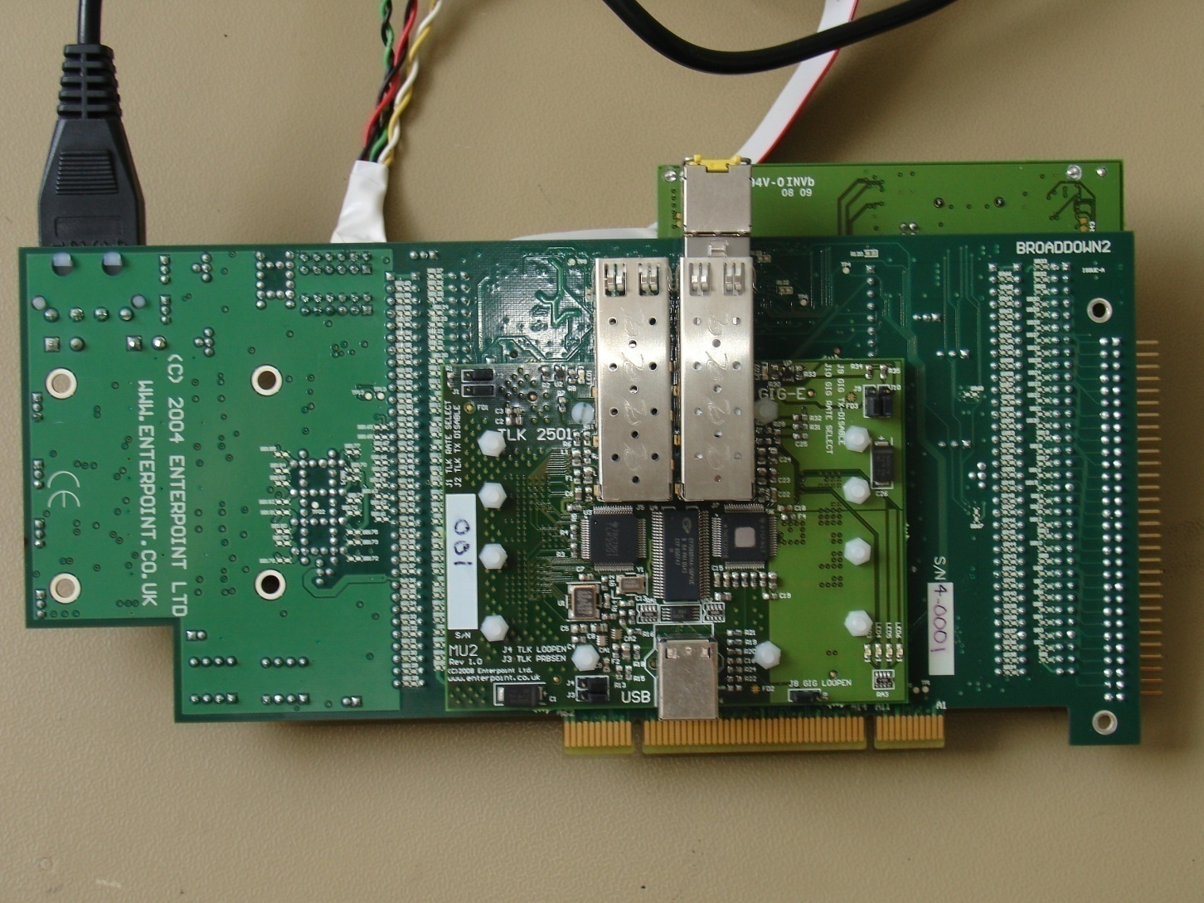
LDA Hardware

Slide 8
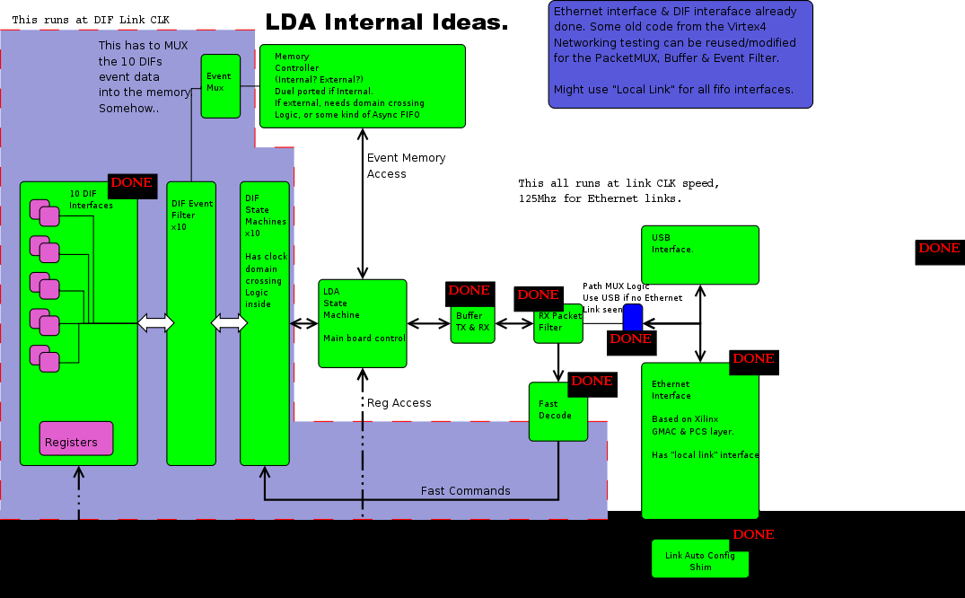
Firmware

Slide 9
ECAL SLAB Interconnect
DAQ Architecture - Overall view
~150 VFE ASICs on each side of SLAB
LDA
ODR
DIF
SLAB
LDA
DIF
SLAB
DIF
SLAB
LDA
DIF
SLAB
DIF
SLAB
LDA
DIF
SLAB

Slide 10
ECAL SLAB Interconnect – Why Multi-Rows?
How to read them out – single path or in 4 rows?
ASU(n)
ASU(n+1)
ASU(n)
Single path
4 rows
Per ASU: L ~ 720mm, C ~ 72pF
Per ASU: L ~ 180mm, C ~ 18pF
Per Slab of 9 ASUs:
L ~ 6.5m, C ~ 650pF
Per Slab of 9 ASUs:
L ~ 1.6m, C ~ 160pF
Do these look BIG ??

Slide 11
ECAL SLAB Interconnect
We have been looking at using “Bridges” to jumper multiple connections between adjacent ASUs
The Bridge would be soldered onto pads on the ASU (or DIF) PCB
Each Bridge would provide 30-40 connections
Up to 4 Bridges fit in the width of an ASU
… 1 per path would be an ideal solution ☺☺

Slide 12
ECAL SLAB Interconnect
Short FFC (Flat,Flexible-Cable) Bridges make connections on a 1mm pitch – OK for at least 120 connections
FFC-Bridge
Solder
Track
800um
ASU
ASU
Alternatively the Bridges can be thin PCBs, also with 1mm pitch connections. This gives a mechanical as well as electrical joint
PCB-Bridge
Solder
Track
800um
ASU
ASU

Slide 13
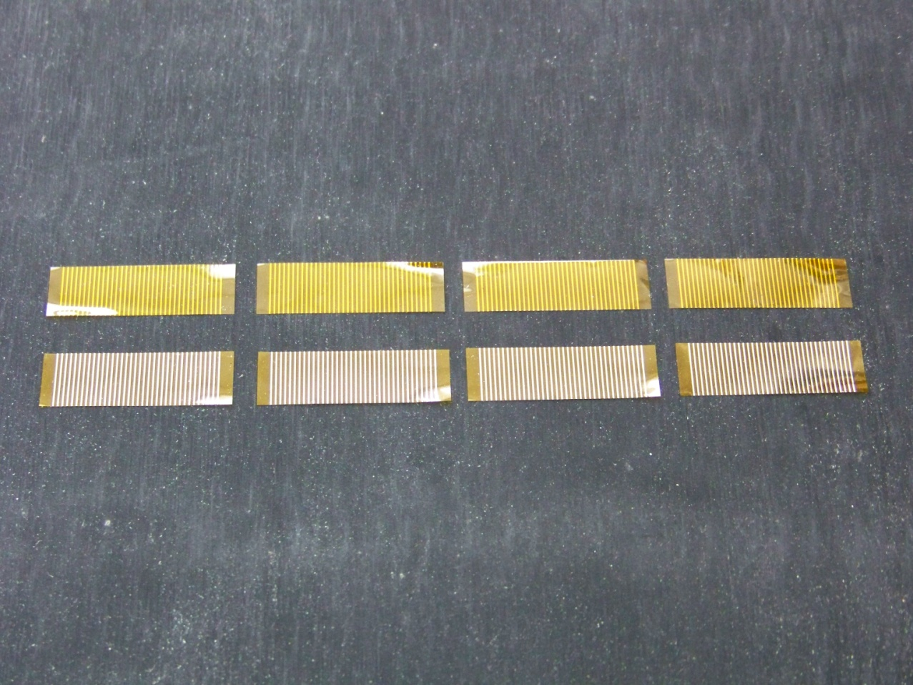
ECAL SLAB Interconnect – Where we are
Top View
Thin traces on Kapton backing
Under View
FFC-Bridges: we have 250 cut, 250 on roll

Slide 14
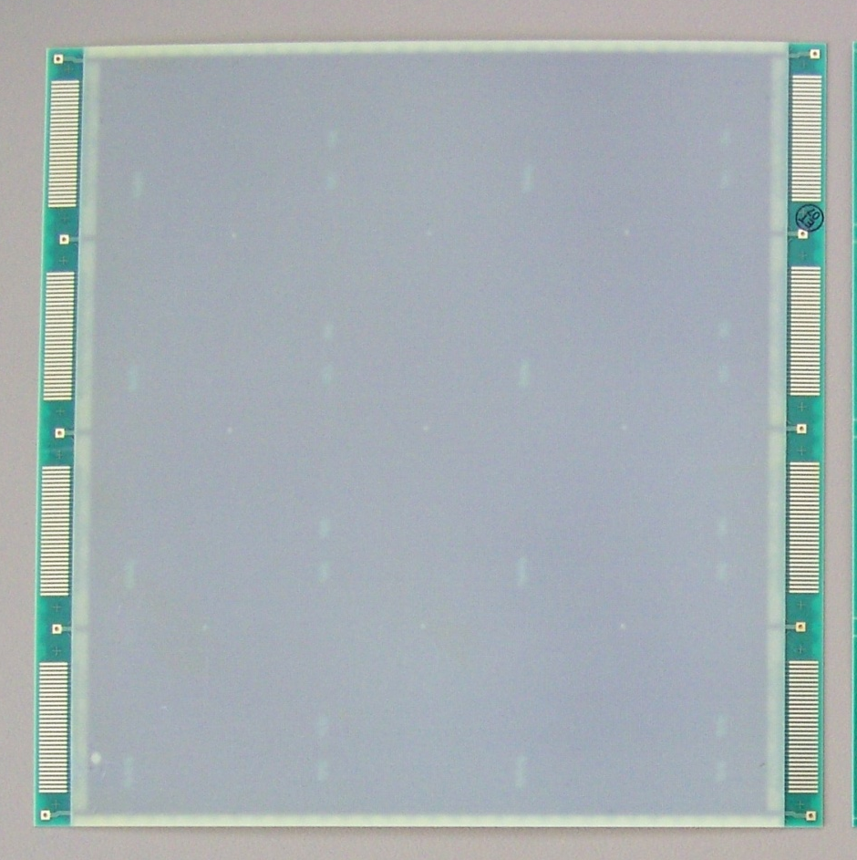
ECAL SLAB Interconnect – Where we are
Top View
Interconnect region 400um
180 x 180mm – as current ASU size
4 identical rows of differential tracks connecting 36 way interconnect pads on left and right
Central region thickened to 800um
Can be sliced into 4 sections, so provides for many trials
Differential tracks have a range of spacings & other charcteristics to test signal propagation and cross-talk
ASU-Test PCB: we have 15

Slide 15
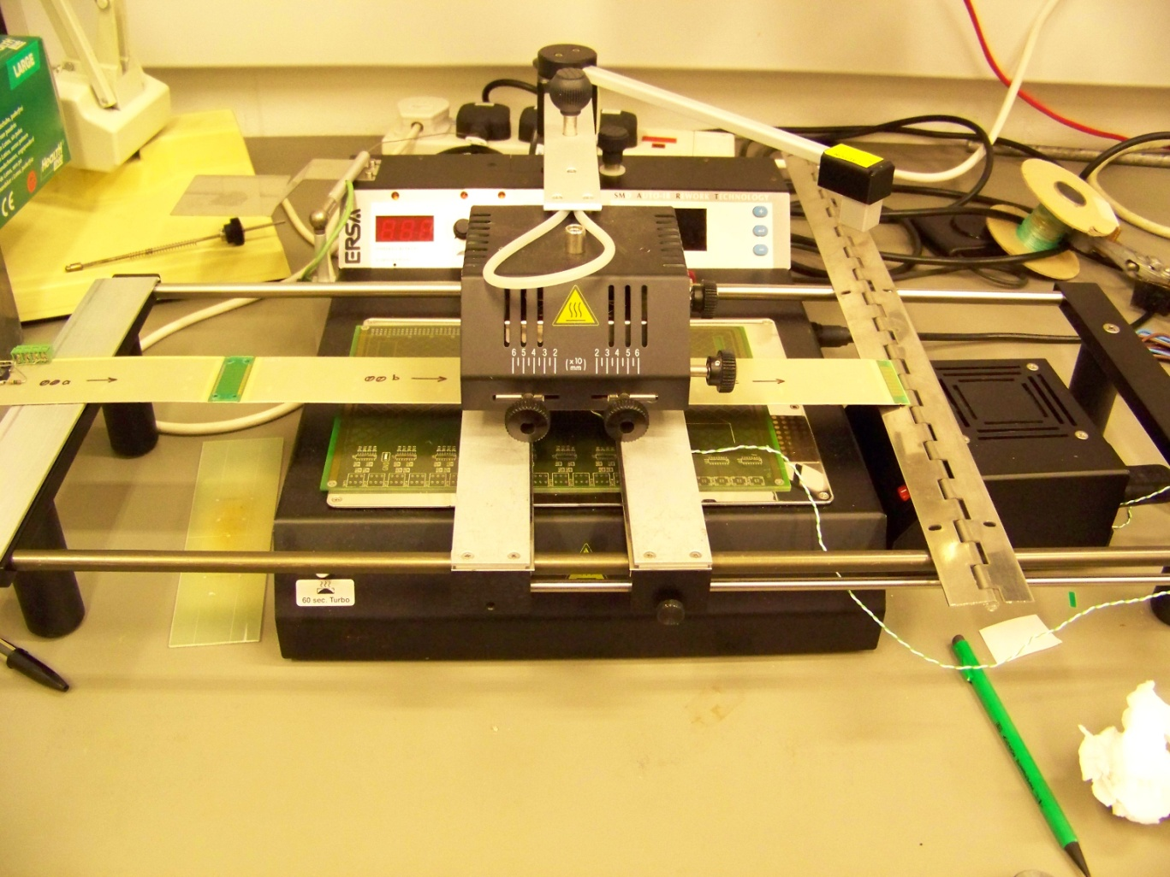
ECAL SLAB Interconnect – Where we are
3 bits of ASU-Test being joined: reflow of 2nd and 3rd
Using the IR Re-work station

Slide 16
ECAL SLAB Interconnect: Conclusions
There are major advantages in using Bridges:
  Removes major bottleneck in number of connections
  Promises greater reliability
  Rework likely to be easier
There’s a lot to be done:
  We are trying out many things
  LAL Mechanical Prototype will also test PCB-Bridge mechanics
We are finding answers:
  1mm pitch connections with continuity and no shorts
  IR re-flow looking very good:
    ERSA Re-work station OK
    Home-brew Imaging IR source may fit well into large-scale assembly procedures: full width re-flow, multiple heads,…

Slide 17
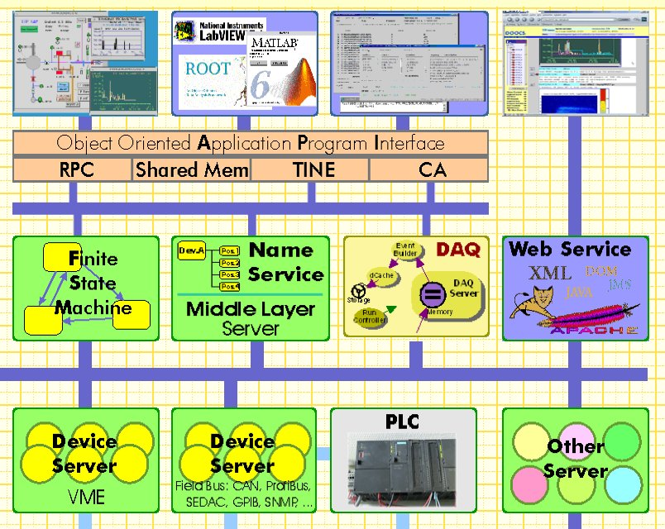
DOOCS overview
3 layers
common APIs
modular design
multi protocol
(RPC, TINE,
EPICS, shared
memory)
device level
(~200 server
types)
middle layer
(FSM, FB, DAQ)
User
Interface
Program
Interface
Middle
Layer
Hardware
interface
hardware

Slide 18
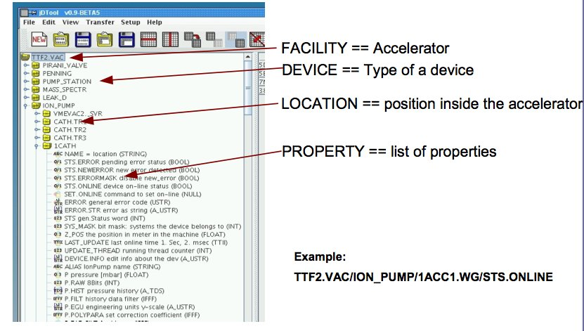
ENS naming service
Example:
CALICE.ECAL/ODR/ODR1/STATUS

Slide 19
ENS naming service: hierachical DAQ system
e.g. ECAL
Slab
send data to DIF by wrapper through ODR and LDA (have switch to configure debugging modes which go directly to the LDA or DIF)
ENS naming service can signal connections by additional properties, e.g. for device DIF:
CALICE.ECAL/DIF/DIF1/ODR_CON
CALICE.ECAL/DIF/DIF1/LDA_CON
CALICE.ECAL/DIF/DIF1/DEBUG_MODE
DIF
LDA
Opto
PC
ODR
Opto
Driver

Slide 20
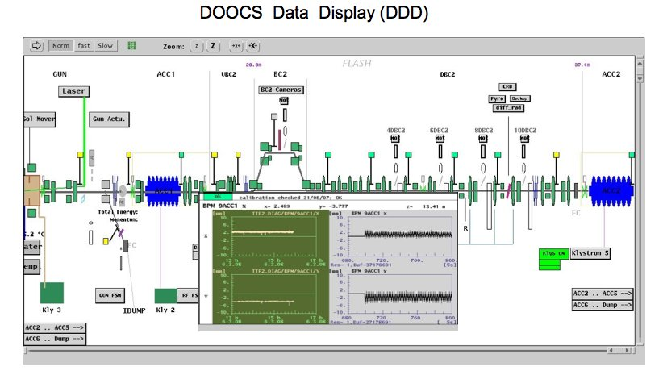
Example of monitoring GUI

Slide 21
Glue/Mechanics
Sticky stuff

Slide 22
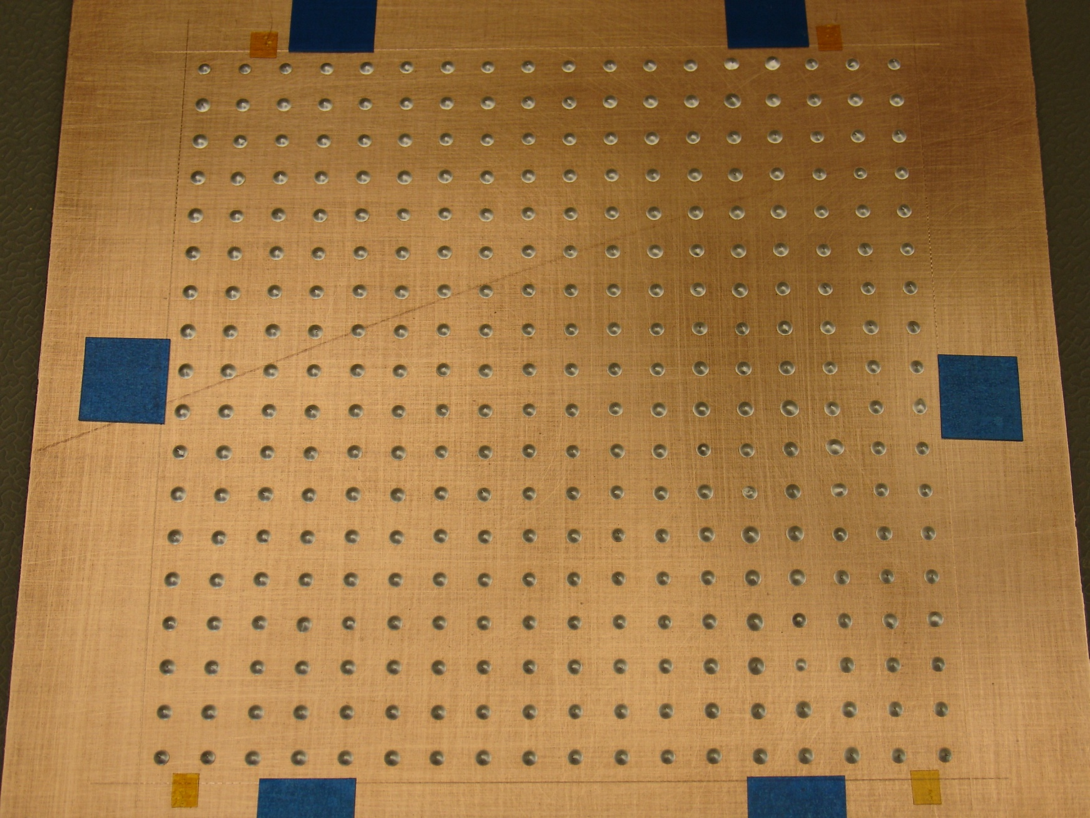
The baseboard before overlaying glass plate

Slide 23
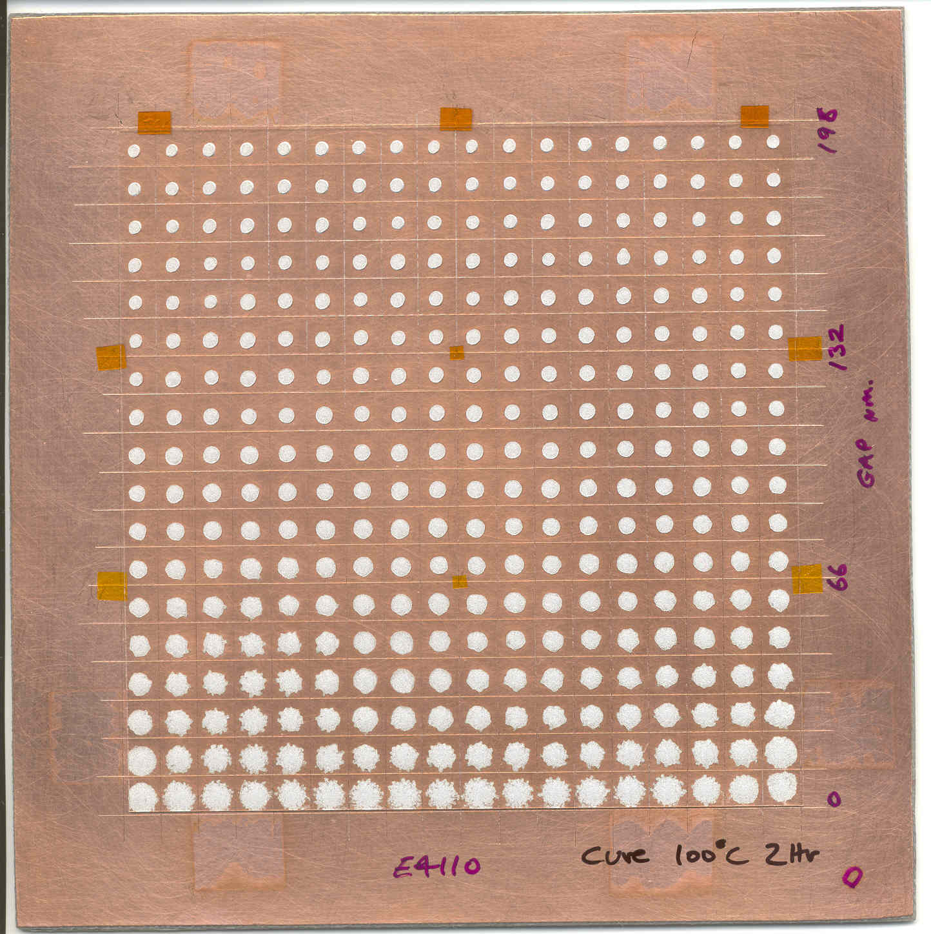
Ø1.6mm
Ø2.0mm
Ø2.5mm
Ø3.6mm
Glass Plate #2
0.2 sec per dot
Mid spacers under plate

Slide 24
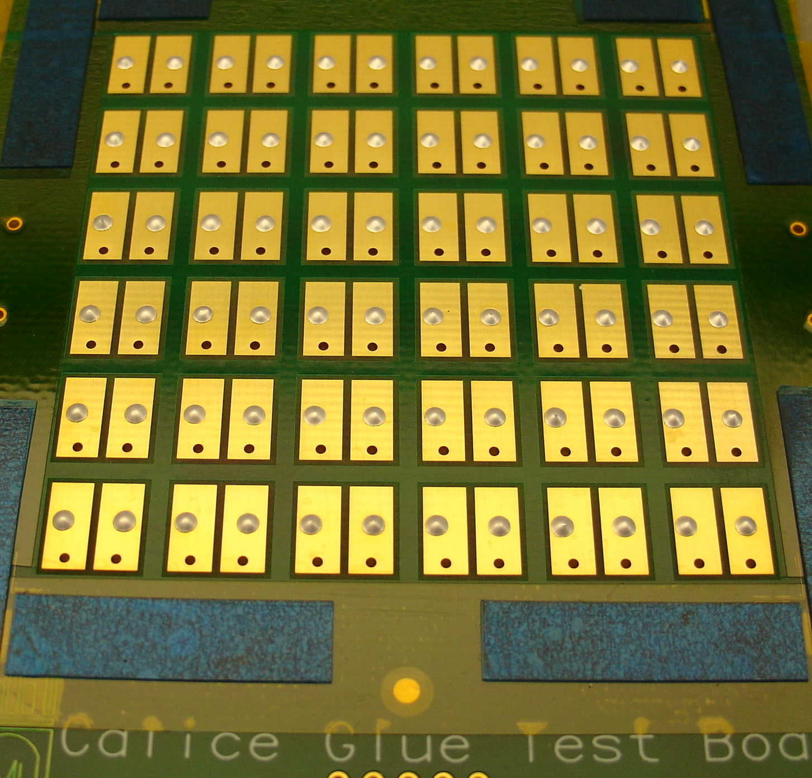
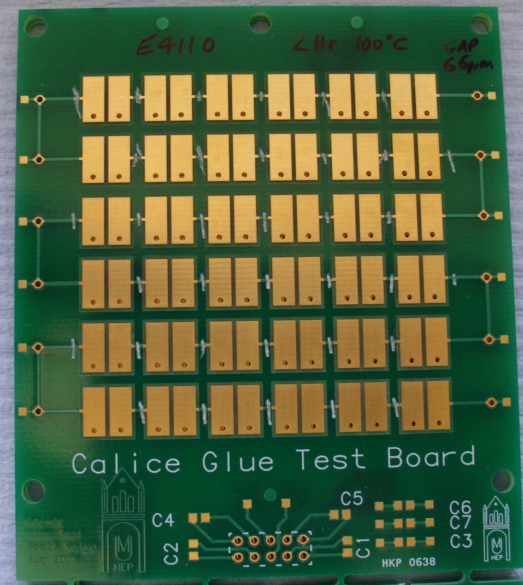
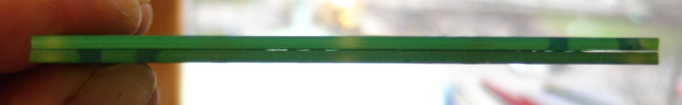
12 x 6 dots @0.2 sec on CALICE test board
Two boards sandwiched together, 66µm gap
Interpad links cut on top board
Resistances between overlapping pads measured –
<0.005Ω per pad

Slide 25
Physics
Neural Networks
G4 physics lists and data

Slide 26
Upcoming Conferences and Plans
Upcoming Conferences
  CALOR’08 (Pavia, 26-30 May)
  ECFA ILC Workshop (Warsaw, 9-12 June)
  NDIP 2008 (Aix les Bains, 15-20 June)
  ICHEP’08 (Philadelphia, 29 July-5 August)
  PSD8 (Glasgow, 1-5 September)
  IEEE (Dresden, 19-25 October)
  IPRD08 (Siena, 1-4 October)
16 Abstracts submitted to CALOR’08; 4 to ICHEP.
Papers/Analysis notes
  ECAL Commissioning paper (Anne-Marie)
  ECAL electron response paper (Cristina)
  Three AHCAL notes planned
  “Final” ScEcal note on 2007 data

Slide 27
Future
DevDet
  UK involved in ECAL and DAQ workpackages
    Low level participation to keep our fingers in the pie...
STFC SOIs
  Due in May
  MAPS and DAQ under consideration

