Slide 1
Trigger Happy:
A light-hearted look at the seriously hard business of hardware triggering
(and how we are trying to make it easier)
Andrew W. Rose

Slide 2
Overview
A Little Technical Terminology
CMS (the important bits)
The CMS data myth
The CMS Level-1 Trigger
So what is so hard?
The tyranny of the links
A future trigger
Summary

Slide 3
Technical Terminology
A little

Slide 4
Terminology
ASIC – Application Specific Integrated Circuit
    An integrated circuit that has been designed to do one specific task
FPGA – Field-Programmable Gate Array
    An array of programmable logic cells joined by a programmable routing mesh
    State-of-the-art devices have O(10⁶) logic cells clockable at O(10⁸) Hz

Slide 5
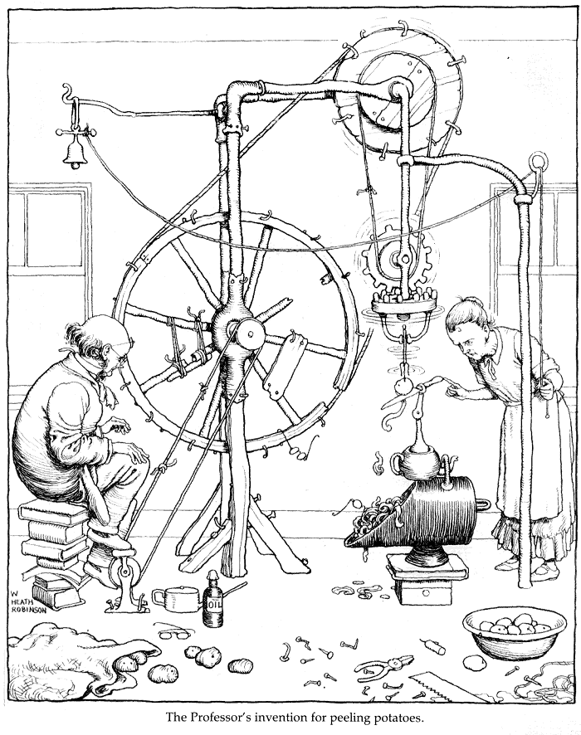
Terminology
Heath Robinson — adj (of a mechanical device) absurdly complicated in design and having a simple function.
[named after William Heath Robinson (1872–1944), British cartoonist]
Collins English Dictionary - Complete & Unabridged 10th Edition, 2009 © William Collins Sons & Co. Ltd.
Any device of dubious construction. In particular, consisting of a multitude different and seemingly incompatible components.

Slide 6
The CMS experiment
(Well, the important bits)

Slide 7
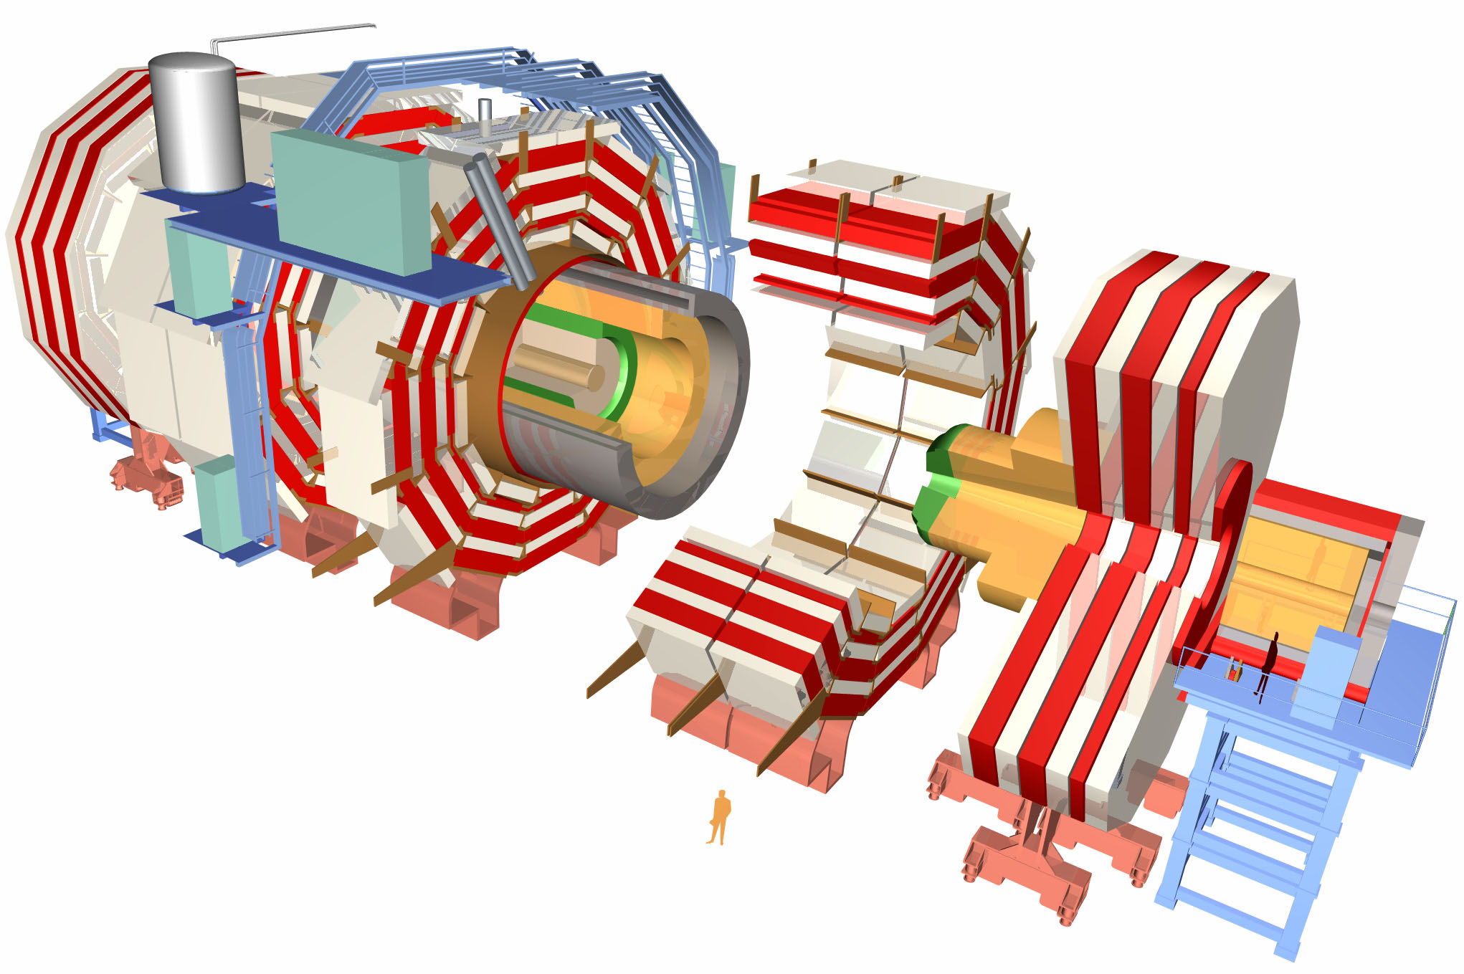
CMS
Data rates with no
zero-suppression
~83k PbWO₄ Ecal Crystals
≡ 40 TBit per second
~15k channel Brass/Plastic sampling HCAL
≡ 10 TBit per second
~568k RPC/DT/CSC Muon channels
≡ 23 TBit per second
~65M Silicon Pixels
≡ 21 PBit per second
~10M Silicon Strips
≡ 4 PBit per second
~3500 physicists/engineers

Slide 8
Data myth
The CMS

Slide 9
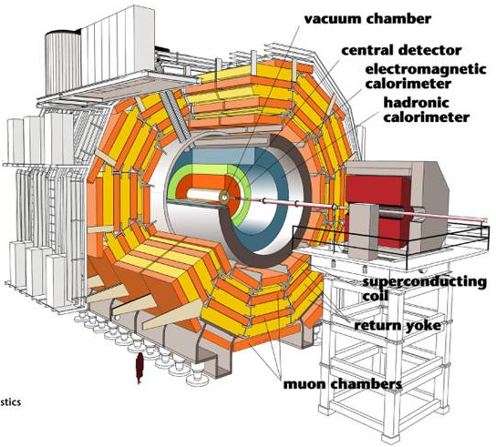
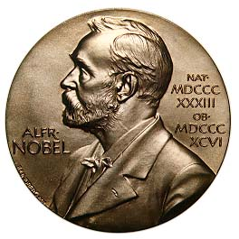

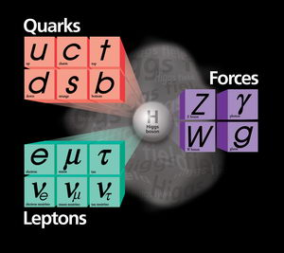
The data myth (as told by pop science publications)
Maybe next year, eh?
The Grid
The future of all science and computing
The Higgs Boson
CMS will find in first week month year 5 years of running

Slide 10
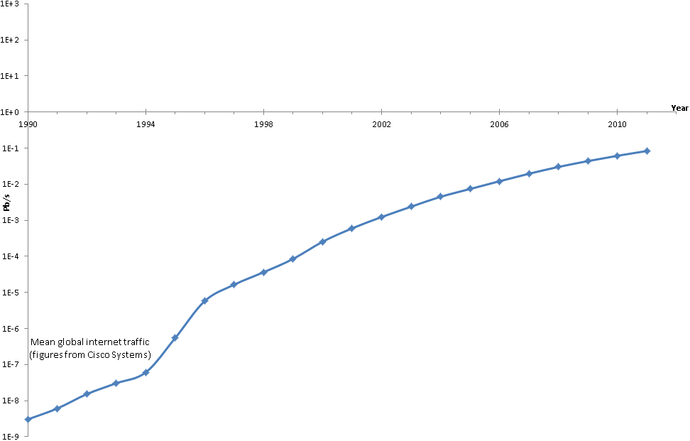
How do you store O(Pb/s) data?
1 Eb/s
CMS Raw
1 Pb/s
CMS zero-supressed
1 Tb/s
1 Gb/s
1 Mb/s

Slide 11
The data myth (as told by physicists)
Something hazy happens here
Higher Level
Trigger (HLT)
Event Reconstruction!
Real Physics!

Slide 12
The data myth – exposed
Higher Level
Trigger (HLT)
Event Reconstruction!
Real Physics!
The Level-1 Trigger (L1T)

Slide 13
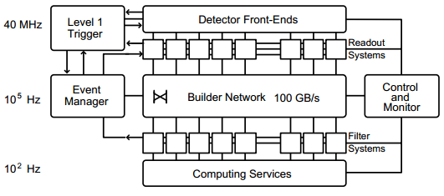
How do you store O(Pb/s) data?
Answer: You don’t! You have to throw most of it away!
Throw away 399/400
Throw away 999/1000

Slide 14
How do you store O(Pb/s) data?
1 Eb/s
CMS Raw
1 Pb/s
CMS L1T in
1 Tb/s
CMS HLT in
1 Gb/s
Tape storage
1 Mb/s

Slide 15
Level-1 trigger
The CMS

Slide 16
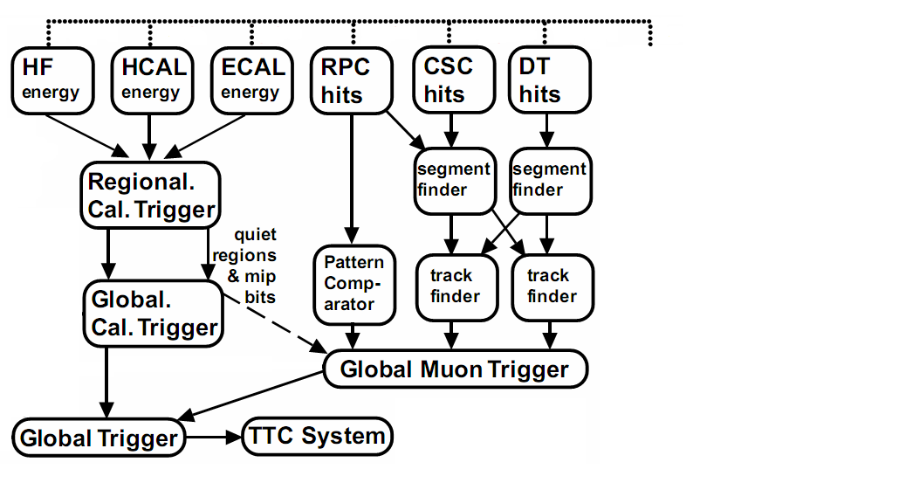
The CMS Level-1 Trigger – Overview
Tracker
DAQ
Discard

Slide 17
The CMS Level-1 Trigger – Overview
Tracker
READOUT
PIPELINE
128 bunch
crossing
(3.2 μs)
DAQ
Discard

Slide 18
The CMS Level-1 Trigger – Overview
CALORIMETER
Tracker
61,200 barrel crystals
21,528 endcap crystals
O(10⁴) HCAL channels
4 non-isolated e/γ
4 isolated e/γ
4 central jets
4 forward jets
4 tau’s
READOUT
PIPELINE
128 bunch
crossing
(3.2 μs)
DAQ
Discard

Slide 19
The CMS Level-1 Trigger – Overview
CALORIMETER
MUON
Tracker
61,200 barrel crystals
21,528 endcap crystals
O(10⁴) HCAL channels
4 non-isolated e/γ
4 isolated e/γ
4 central jets
4 forward jets
4 τ-jets
195,000 DT channels
210,816 CSC channels
162,282 RPC channels
4 μ-tracks
READOUT
PIPELINE
128 bunch
crossing
(3.2 μs)
DAQ
Discard

Slide 20
The CMS Level-1 Trigger – Overview
CALORIMETER
MUON
Tracker
61,200 barrel crystals
21,528 endcap crystals
O(10⁴) HCAL channels
4 non-isolated e/γ
4 isolated e/γ
4 central jets
4 forward jets
4 taus
195,000 DT channels
210,816 CSC channels
162,282 RPC channels
4 μ-tracks
READOUT
PIPELINE
128 bunch
crossing
(3.2 μs)
GLOBAL
DAQ
128 path boolean logic tree
Discard

Slide 21
What is so hard about that?
So…

Slide 22
So what is so hard… how processors work

Slide 23
So what is so hard… how processors work
Stop and Reload
Have a cup of tea
Biscuit, anyone?

Slide 24

So what is so hard… how triggers work
The data keeps on coming, whether you are ready or not
Like one of those tennis machines, except that missing a ball means losing your Nobel prize winning Higgs/SUSY discovery
Med
Fast
Slow
LHC

Slide 25
So what is so hard… how triggers work
The data keeps on coming, whether you are ready or not
Like one of those tennis machines, except that missing a ball means losing your Nobel prize winning Higgs/SUSY discovery
Med
Fast
Slow
LHC

Slide 26
Level-1 trigger
The Current CMS

Slide 27
The CMS Level-1 Trigger – Overview
Tracker
DAQ
O(10) Tb/s data input
Discard

Slide 28
The CMS Level-1 Trigger – A few details
Maryland
Fermilab
Princeton
Minnesota
Boston
Institutions
Rice
UCLA
Florida
Palaiseau
Lisbon
Bari
Warsaw
Bologna
Padova
Wisconsin
Imperial
Vienna
Imperial, Bristol
Vienna
Vienna
Lisbon

Slide 29
The CMS Level-1 Trigger – A few details
ASICs,
Altera+Xilinx
FPGAs
ASICs,
Altera+Xilinx
FPGAs
Processing
ASICs
ASICs
Actel+Altera
FPGAs
ASICs
Xilinx FPGAs
Xilinx FPGAs
Xilinx FPGAs
Altera+Xilinx FPGAs
Altera+Xilinx FPGAs
ASICs, FPGAs

Slide 30
The CMS Level-1 Trigger – A few details
Platform,
Power &
Control
Custom, VME+custom
Custom, VME+custom
Custom,
VME, PMC
Custom,
VME, PMC
Custom,
VME+custom
PMC, VME+custom
VME+USB
PMC, VME+custom
VME+PMC
PMC, VME+custom
PMC, VME+custom
VME+custom

Slide 31
The CMS Level-1 Trigger – A few details
Board
Counts
780 of
2 types
684 of
3 types
198 of
7 types
75 of
5 types
Excluding front-end boards, DAQ boards and 1226 assorted TTC and FPGA daughter cards
288 of
9 types
1342 of 9 types
63 of 1 type
12 of 4 types
4 of 2 types
11 of 7 types
NB. These numbers may be an underestimate if I have missed part of a subsystem

Slide 32
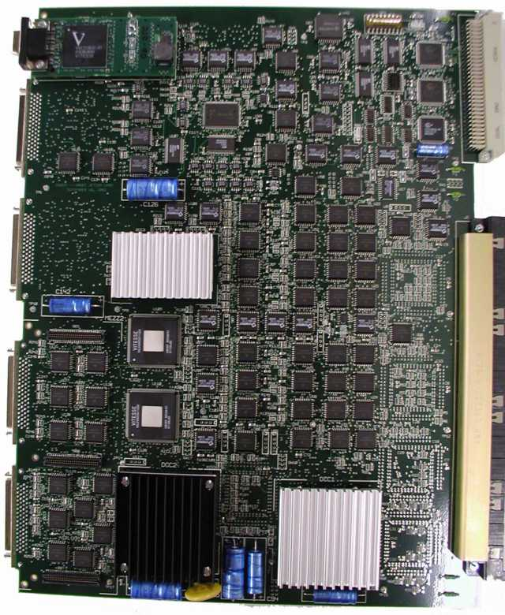
What does these boards typically look like?
The existing RCT Jet summary card
~15Gb/s

Slide 33
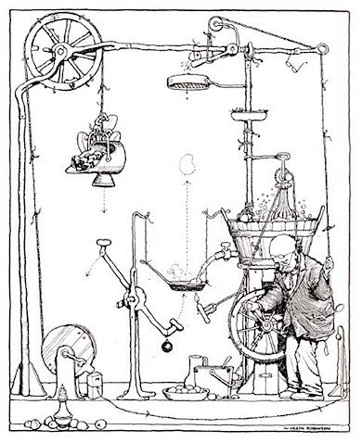
Is this beginning to remind you of anything?
If not, then hopefully one more slide should convince you…

Slide 34
The CMS Level-1 Trigger – A few details
Custom
electrical
+
850nm@
1.6Gb/s
optical
Custom
electrical
+
1310nm@
0.8Gb/s
optical
Data transfer
Custom
electrical
Custom
electrical
Custom
electrical
The only thing missing is a length of knotted string being pulled by a bald man
1.2Gb/s Serial Copper
160MHz Parallel Copper
850nm@3.2Gb/s optical
Various optical
850nm@2Gb/s optical
Multiple custom
backplanes
80MHz Parallel Copper
40MHz Parallel Copper
850nm@3.2Gb/s optical
Custom
Backplane
Custom Backplane
160MHz BPME @1310nm optical

Slide 35
The CMS Level-1 Trigger – status
It is hideous – William Heath Robinson would be proud (or disgusted)
But, to give it it’s dues, it works and it works well

Slide 36
Problems with the current system
ASIC-based systems (i.e. the RCT) have zero flexibility.
The mish-mash of hardware and link formats limits the flexibility of FPGA-based system.
N(different solutions to the same problem) ≥ N(people working on said problem)
Each piece of hardware is really only understood by one person
Each piece of hardware requires different software. How these operate together was added as an after thought.
Large, loosely organized collaboration = no software or firmware reuse.

Slide 37
Lessons learned in building the current system
If you have spare capability in your system, someone will ask you to use it to make up for a deficiency in theirs. So include it from the start.
Standards are there for a reason. If someone says “…but it would be so much easier if we could violate the standard just a little bit…”, shoot them. It’s the kindest thing to do.
Make all software part of a single framework from the start. Zero duplication of code.
Have a central library of firmware components.
And finally…

Slide 38
Lessons learned in building the current system
The key problem is not
the number of components within the system
but
the number of different types of components within the system

Slide 39
So… to reiterate
It is hideous – William Heath Robinson would be proud (or disgusted)
But, to give it it’s dues, it works and it works well

Slide 40
The LInks
The tyranny of

Slide 41
The CMS Level-1 Trigger – A few details
Custom
electrical
+
850nm@
1.6Gb/s
optical
Custom
electrical
+
1310nm@
0.8Gb/s
optical
Data transfer
Custom
electrical
Custom
electrical
Custom
electrical
1.2Gb/s Serial Copper
160MHz Parallel Copper
850nm@3.2Gb/s optical
Various optical
850nm@2Gb/s optical
Multiple custom
backplanes
80MHz Parallel Copper
40MHz Parallel Copper
850nm@3.2Gb/s optical
Custom
Backplane
Custom Backplane
160MHz BPM @1310nm optical

Slide 42
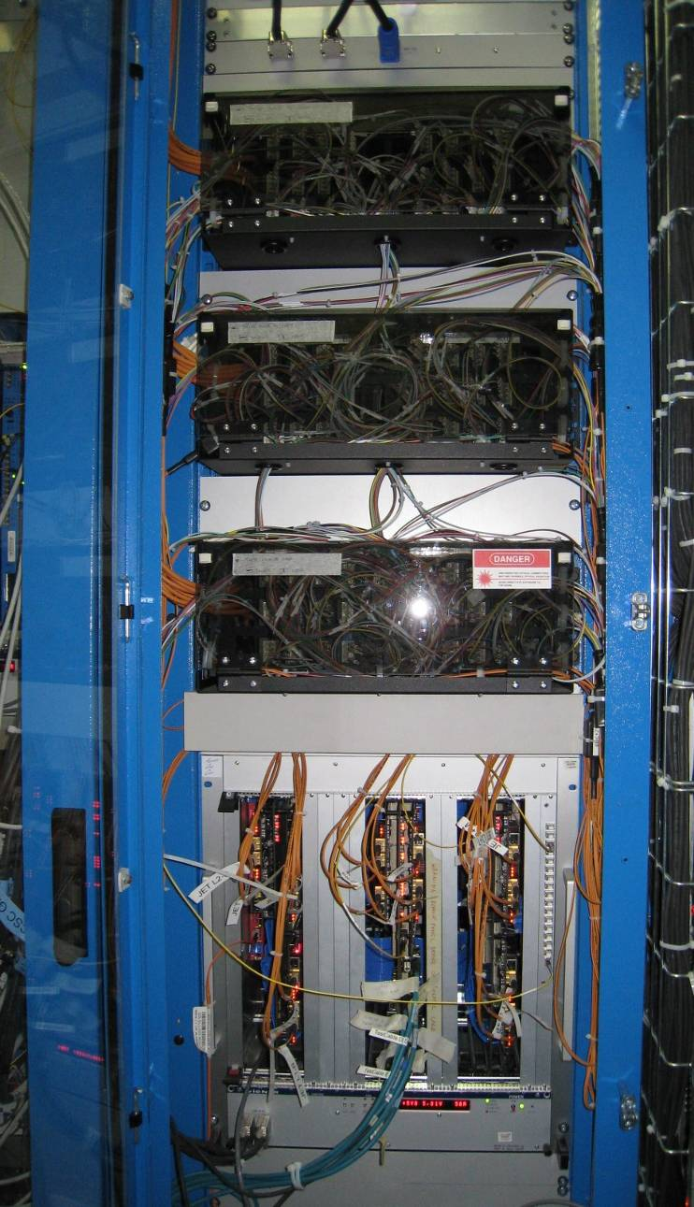
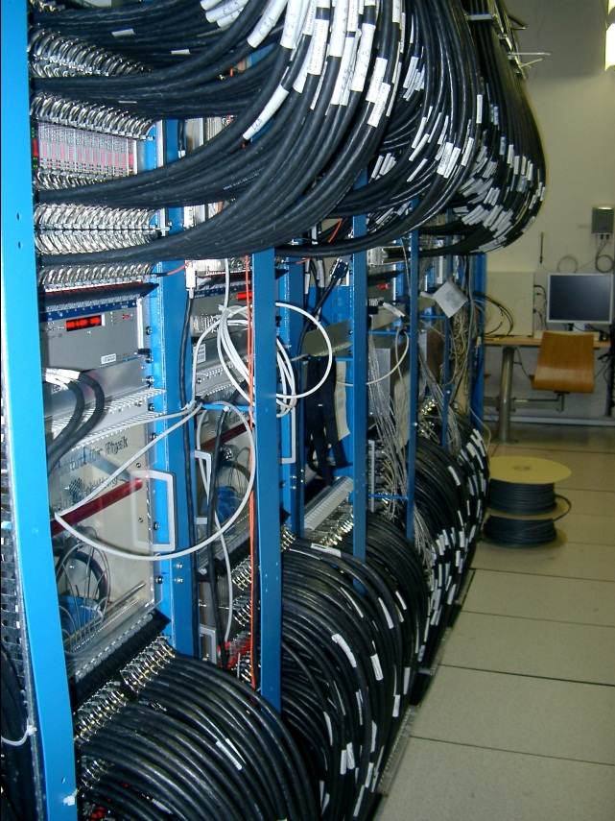
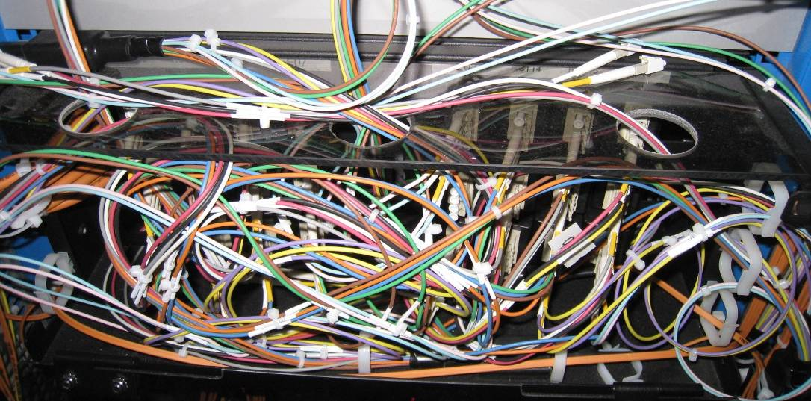
The tyranny of the links:
Calorimeter trigger
RCT
GCT

Slide 43
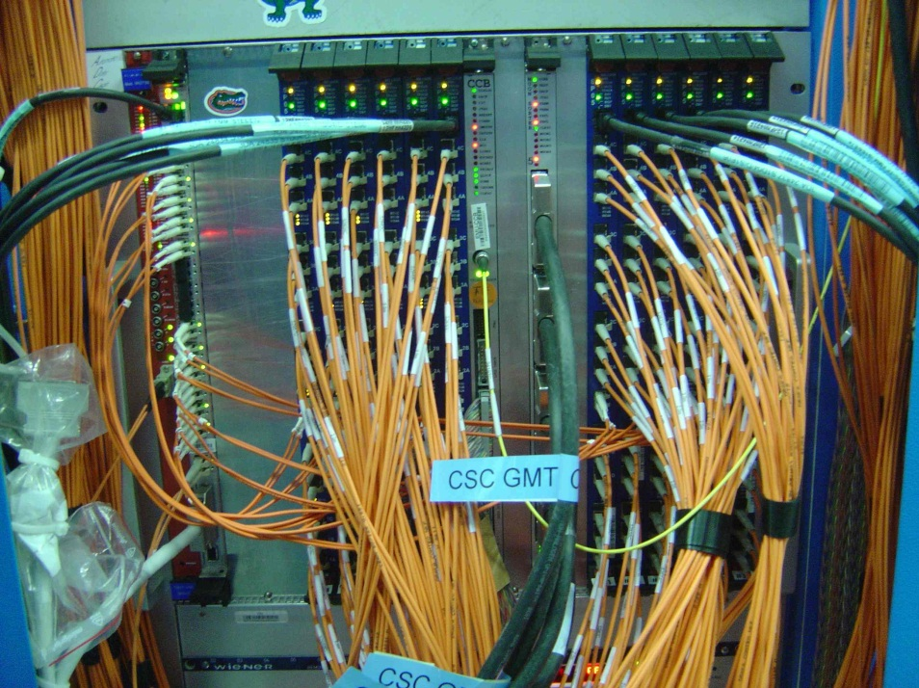
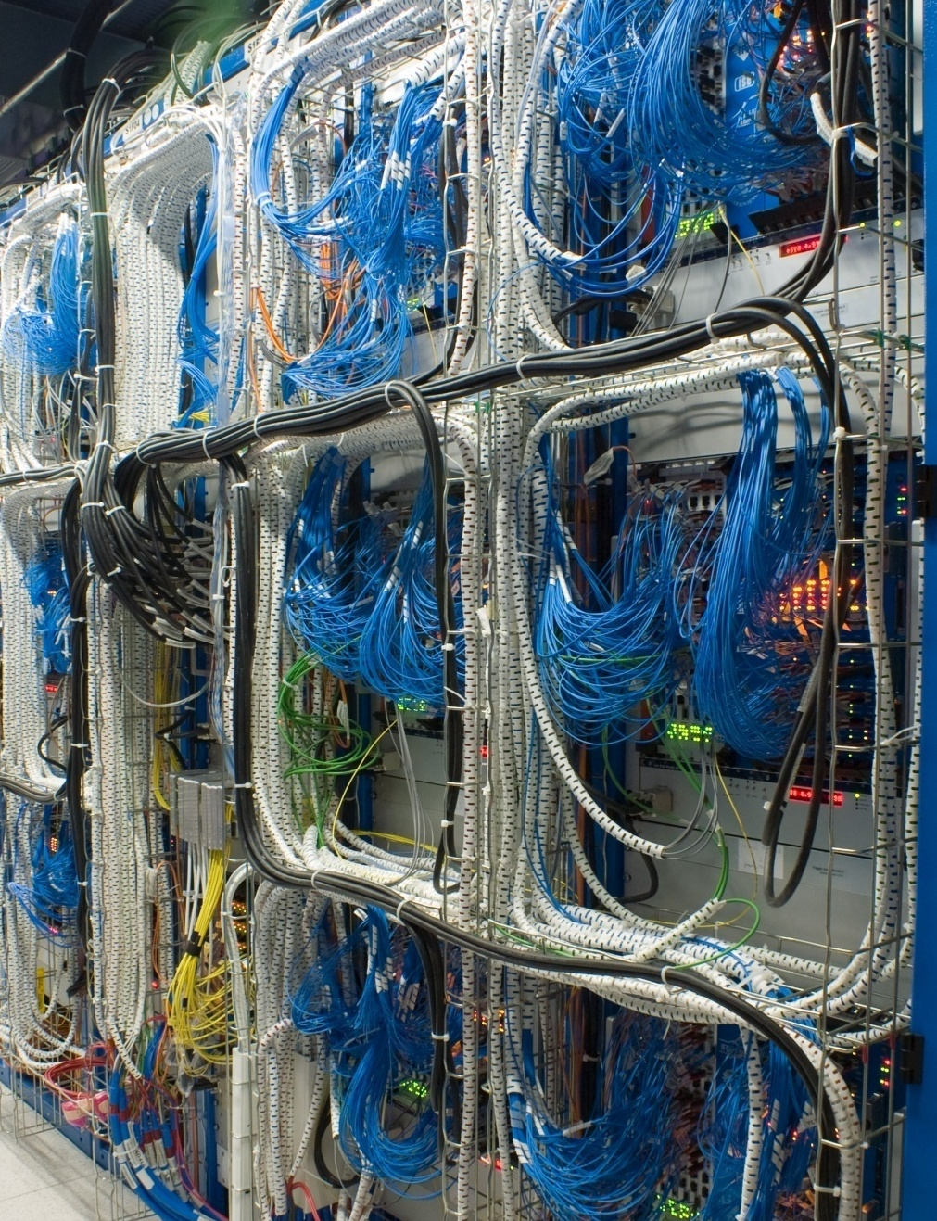
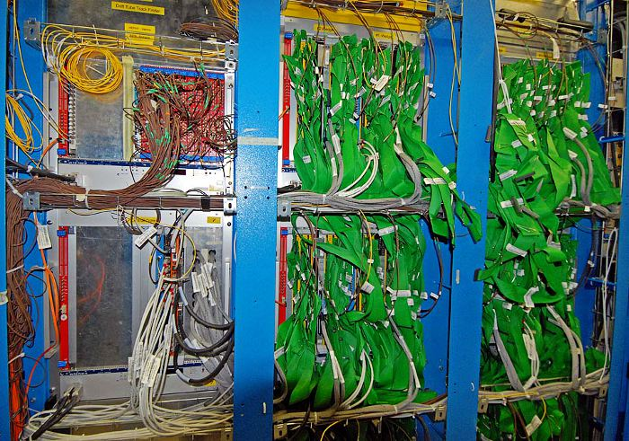
The tyranny of the links:
Muon trigger
CSC Track-finder
DT Track-finder
(aka the green salad or the green spaghetti forests)
RPC Pattern Comparator

Slide 44
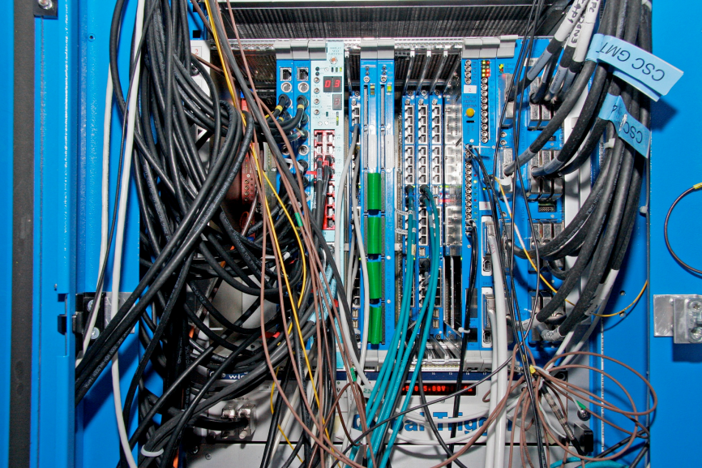
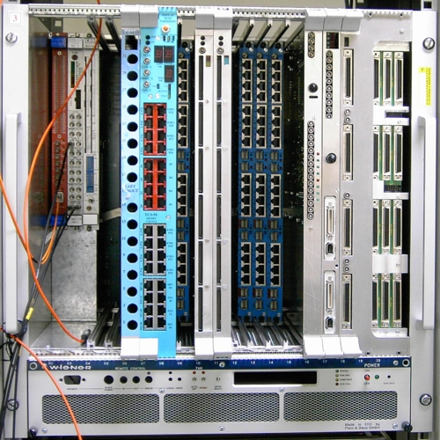
The tyranny of the links:
Global trigger

Slide 45
The tyranny of the links:
How much data can a board receive?
$$N_{bits}= N_{links}×N_{channels/link}×Linespeed×ε_{encoding}×τ_{transmission}$$
1 for traditional serial
12 for parallel optics
≤160 for parallel
1 for parallel
8/10 for any serial
64/66 for “fast” serial (>5Gbit/s)
Only “free” parameter
<160Mbit/s for parallel
>0.48Gbit/s and <10.3Gbit/s for serial (but limited by cost)
For LHC, every board is synchronous and everything is processed “in-time”. This is fixed at 25ns.

Slide 46
The tyranny of the links
But remember…
  Parallel links need big connectors so bandwidth limited by space available on circuit board
  Serial links have a serialization/deserialization latency of
    ~75ns for low line speeds
    possibly up to 125ns for high line speeds
  and we only have 3200ns for the level-1 trigger in total
Running at non-multiples of LHC clock adds realignment latency
And finally, the killer problem…

Slide 47
The tyranny of the links
Say that you have too much data and that you can’t receive enough bits to fit all data onto a single board
You can split processing across multiple boards
Except that you need to handle the boundaries!
Which means either
  Duplicating the data before it reaches your processing cards
  Sharing data between your processing cards
Both of which mean increasing the volume of data going to each board
So you need more links
So you need more boards
Which means more boundaries
Which means more sharing/duplicating
…

Slide 48
The tyranny of the links:
What happens currently?
$$N_{bits}= N_{links}×N_{channels/link}×Linespeed×ε_{encoding}×τ_{transmission}$$
Restricted by available space
Restricted by technology available
Restricted by only feasible architecture
Question:
So, what can you do?
Answer:
Chose the best available technology you can and then throw out as much data as you can get away with until you satisfy your bit-limit
Imagine a “card” with 4 input links and up to 4 output links…

Slide 49
The tyranny of the links:
What happens currently?
3
4
3
1
4
2
1
2
Thrown away enough data now!
3
4
3
1
4
2
1
2
3
4
3
1
4
2
1
2
3
4
3
1
4
2
1
2
4
4
1
2
1
2
3
3
3
4
4
1
2
1
2
3
3
4
3
1
4
2
1
2
BX:1
BX:2
BX:3
BX:4
3
4
4
1
2
1
2
3

Slide 50
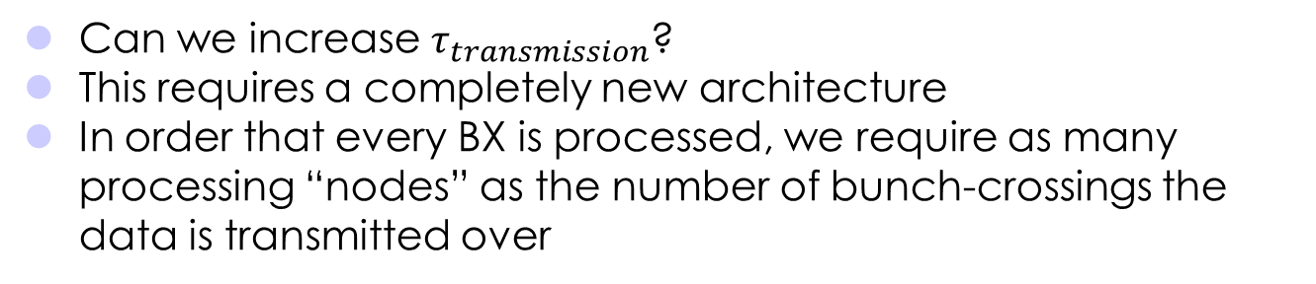

The tyranny of the links:
Can it be broken?
$$N_{bits}= N_{links}×N_{channels/link}×Linespeed×ε_{encoding}×τ_{transmission}$$
Restricted by available space
Restricted by technology available
Restricted by only feasible architecture
Maybe it’s time to start questioning the received wisdom…
Can we increase $τ_{transmission}$?
This requires a completely new architecture
In order that every BX is processed, we require as many processing “nodes” as the number of bunch-crossings the data is transmitted over
Imagine a “card” with 4 input links and up to 4 output links…

Slide 51
The tyranny of the links:
Can it be broken? “Time-multiplexing”
Well… this doesn’t look like a great start – but we’ll come back to it in a minute…
51

Slide 52
The tyranny of the links:
Can it be broken? “Time-multiplexing”
1
5
1
5
1
5
1
5
All data for 1bx from all regions in a single card!
Everything you need!
6
6
6
6
1
2
2
2
2
7
7
7
7
3
3
3
3
4
4
4
4
1
5
1
5
1
5
1
5
All data for 1bx from all regions in a single card!
Everything you need!
6
2
2
6
6
6
2
2
2
7
3
7
3
7
7
3
3
4
4
4
4
1
5
1
5
1
5
1
5
6
6
All data for 1bx from all regions in a single card!
Everything you need!
2
2
6
6
2
2
7
7
3
3
7
7
3
3
4
4
4
4
1
5
1
5
1
1
5
5
6
6
6
6
2
2
2
2
7
7
7
7
3
3
3
3
4
4
4
4
BX:6
BX:1
BX:2
BX:3
BX:4
BX:5
BX:7
52

Slide 53
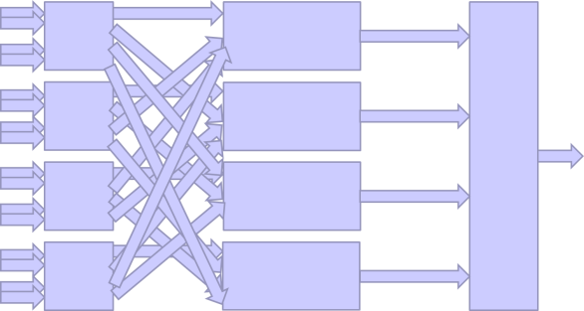
The tyranny of the links:
Can it be broken?
YES!
NO!
Time-multiplexing means that your trigger systems are no-longer limited by the number of links into a board!
No need to throw away data before processing
Time-multiplexing means that you can have up to the raw data-rate throughout your system – this means more links than if you throw data away!
You face the prospect of the demon patch-panel from hell (like below but several hundred times worse)
But it is, at least, a one-off feature

Slide 54
The advantages of time-multiplexing
Eliminates boundaries
  No specialization of hardware for a particular boundary handling situation
    “One-board-fits-all” design
    All specialization is in firmware – complete flexibility
  No duplication of data needed
    Less hardware and fewer links for a given resolution
  No data thrown away
    Should allow better physics
  Equality of data
    Without duplication, all data is equal
    Can easily add new input sources
      Scalability

Slide 55
The advantages of time-multiplexing
Single board design
  Cheaper
    Fewer production runs
    Bulk buying (Bigger Pack – Better Value)
  Risk mitigated
    More time/resources to validate design
    More users become experts
Can also build inline spares into the system to mitigate hardware failure (see spare slides)

Slide 56
A future trigger

Slide 57
Recall
Board
Counts
780 of
2 types
684 of
3 types
198 of
7 types
75 of
5 types
288 of
9 types
1342 of 9 types
63 of 1 type
12 of 4 types
4 of 2 types
11 of 7 types

Slide 58
A future trigger: The IC dream
Mixed new & existing optical links
O(100) of 1 or 2 types
Pre-processor
Pre-processor
Pre-processor
Pre-processor
Pre-processor
Pre-processor
10Gbit/s optical links
12
Processing nodes
12
Processing nodes
Between 24 and 36
of 1 type
10Gbit/s optical links
Final
Processing
Existing electrical links

Slide 59
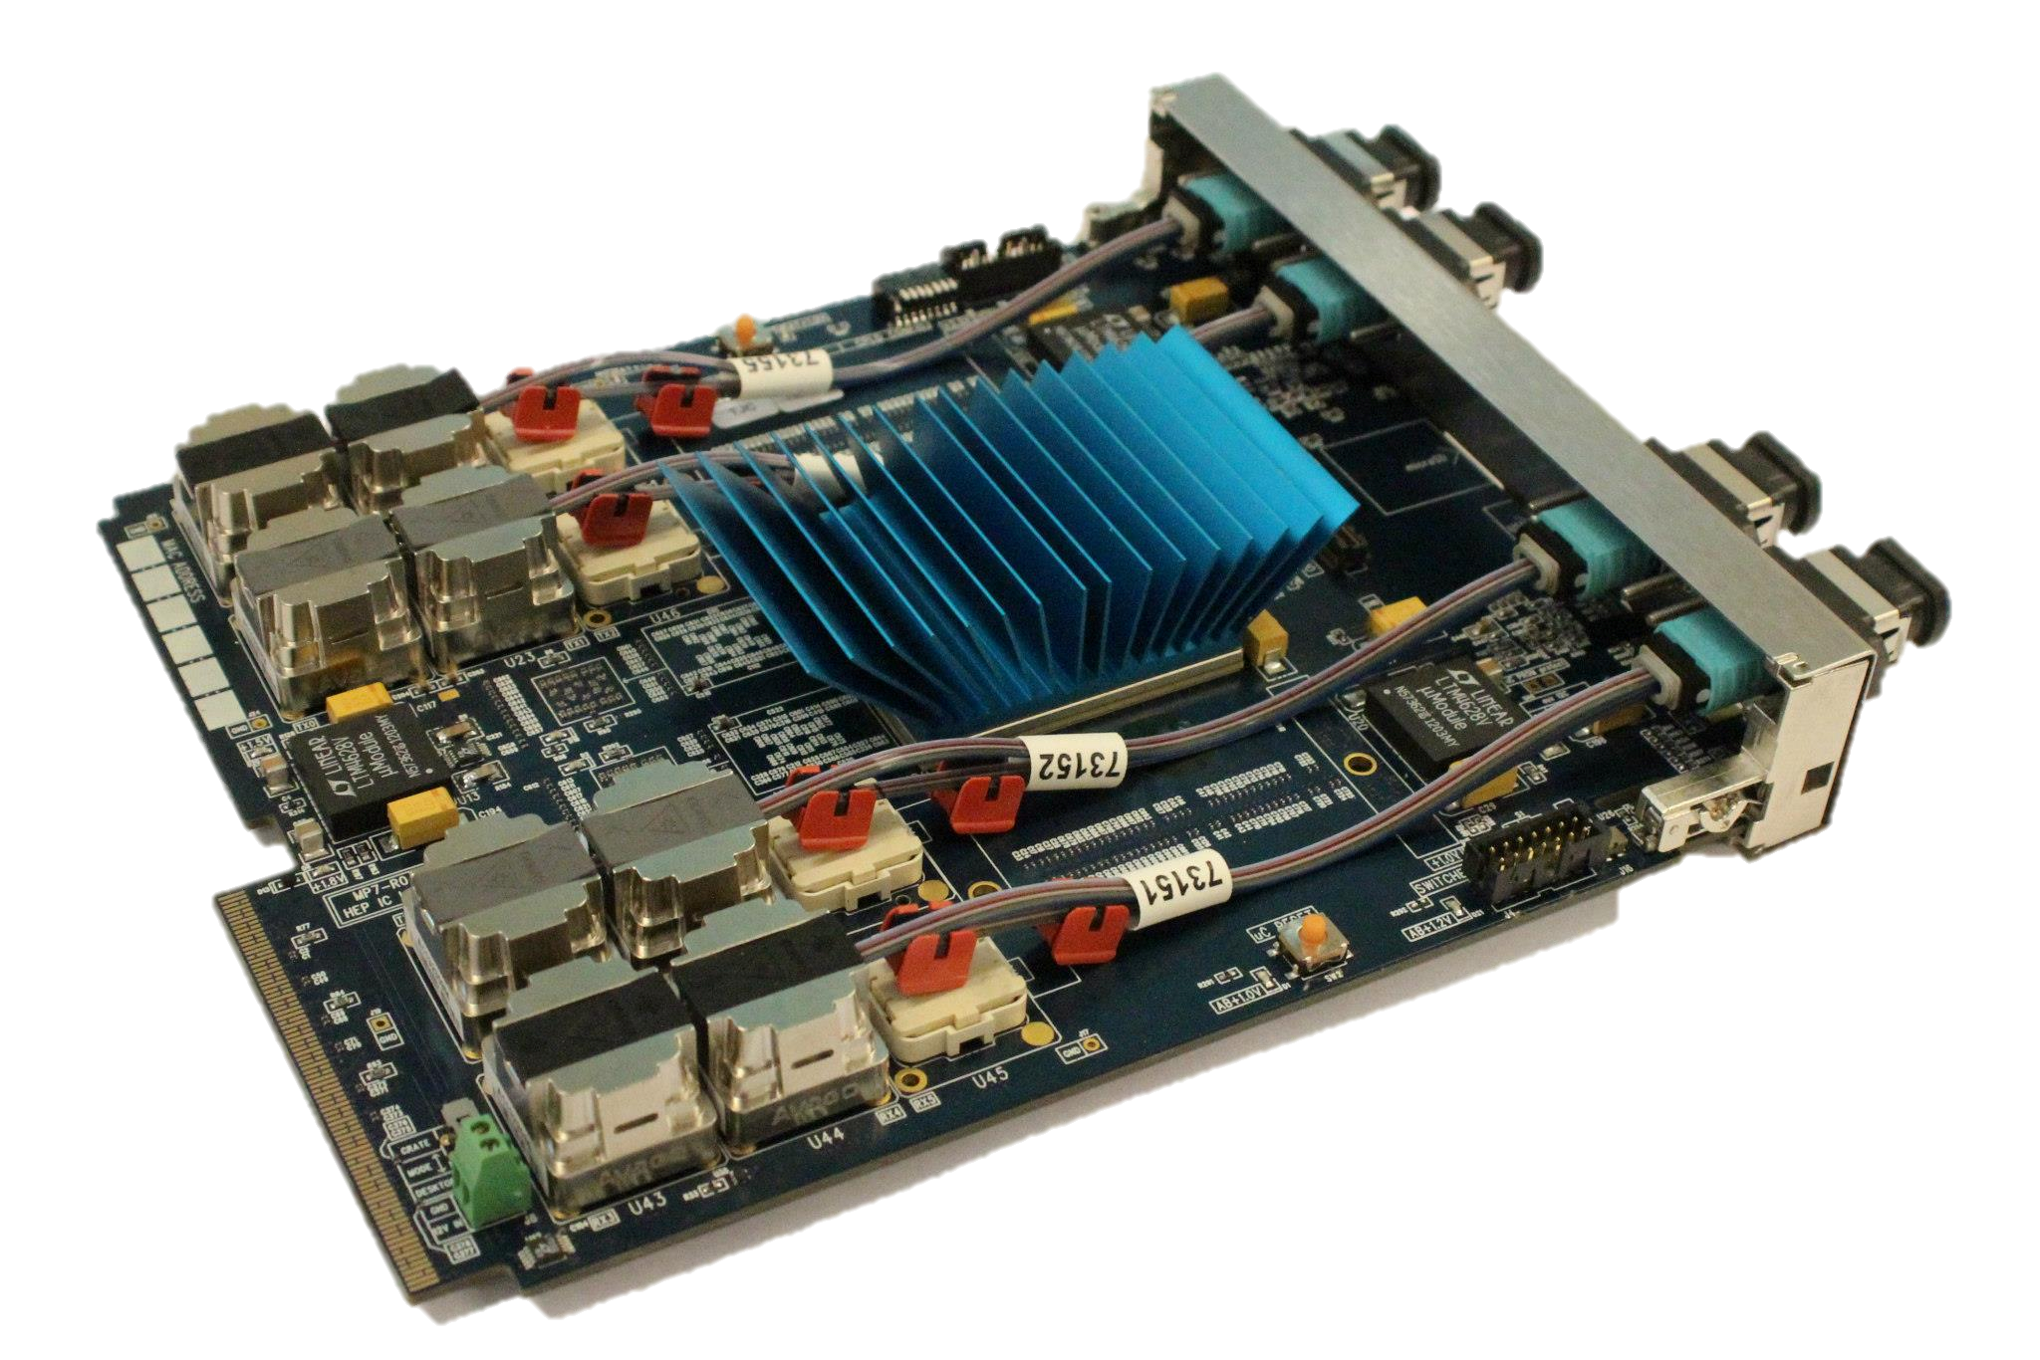

What does the future look like?
The MP7
Designed by G. Iles, J. Jones, A. Rose & S. Greenwood at IC
750Gb/s in and 750Gb/s out
700,000 logic blocks @400MHz
and it looks very pretty

Slide 60
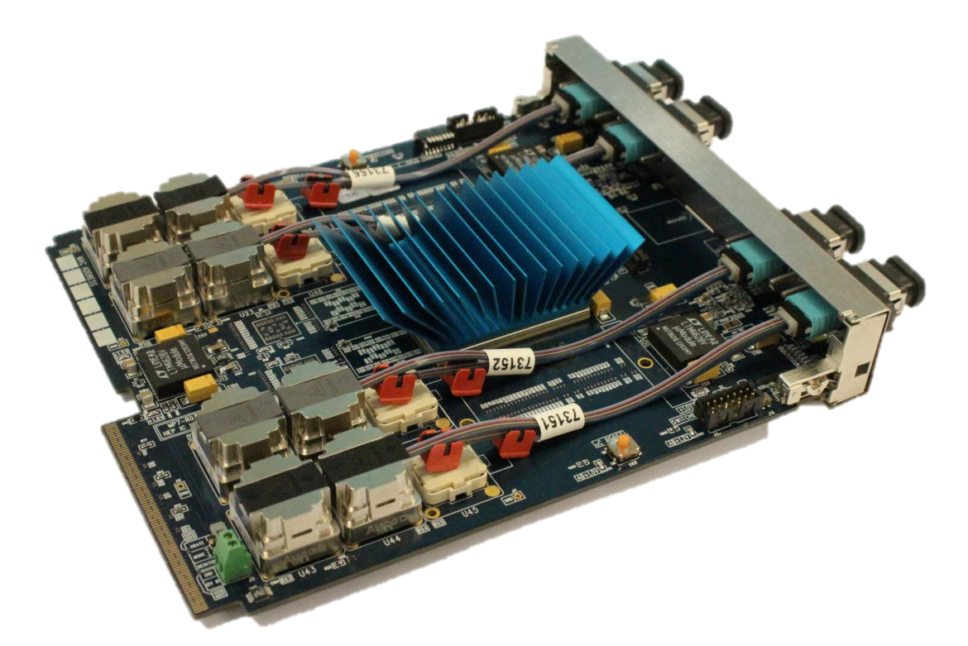
What does the future look like?
The MP7
The current board has 48 (of 72) links. In each direction, that is:
0.5Tb per second
or 30Tb per minute
or 1.8Pb per hour
or 43.2Pb per day
or 0.3Eb per week
Out of the box – We have simultaneously passed ½Exabit in each direction without bit error

Slide 61
How much data is that?
1 Eb/s
1 Pb/s
1 Tb/s
MP7-690
MP7-485
1 Gb/s
1 Mb/s

Slide 62
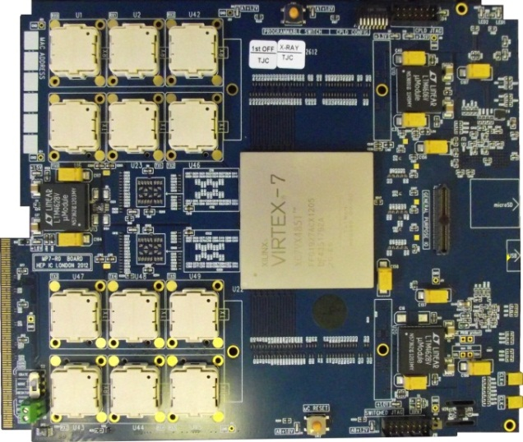
What does the future look like?
The existing RCT Jet summary card
~15Gb/s
TO SCALE
The MP7 : 750Gb/s

Slide 63
Summary
We have a dream
  That dream is a homogeneous, flexible and scalable trigger architecture with inbuilt redundancy
This would
  make life easier for the engineers, technicians and shift’ers
  make life easier for the managers (as cheaper)
  make life better for the physicists (improved performance)
SO… now we “just” have to convince our collaborators and make our way through a minefield of political wrangling's…
…and that makes building
a Tb/s processor board look easy

Slide 65
Spares

Slide 66
The Charge of the Link Brigade
A poem of desperation by John Jones
Half a clock, half a clock,
Half a clock onward,
All in the mapping of Death,
Wired the six hundred,
"Forward the Link Brigade!
Power all the fibres!" he said,
Into the mapping of Death,
Wired the six hundred.
"Forward, the Link Brigade!",
Was there a man dismay'd? (likely)
Not tho' the technician knew,
Some one had blunder'd,
Theirs not to email a reply,
Theirs not to reason why,
Theirs but to ELOG and die,
Into the mapping of Death,
Wired the six hundred.
Gigabits to the right of them,
Gigabits to the left of them,
Gigabits in front of them,
Volley'd and thunder'd,
Storm'd at with '1' and '0',
Boldly they wired and well,
Into the mapping of Death,
Into the mouth of hell,
Wired the six hundred.
Flash'd all their fibres bare,
Flash'd the pigtails in the air,
Bit-bashing all FPGAs there,
Flummoxing an army of shifters, while
All the physics analysis teams pondered,
Plunged in the RCT smoke,
Right thro' the S-LINK bandwidth they broke,
DAQ and trigger rate,
Reel'd at every binary stroke,
Shatter'd and sunder'd,
Then they went back, but not,
Not all six hundred.
Gigabits to the right of them,
Gigabits to the left of them,
Gigabits in front of them,
Volley'd and thunder'd,
Storm'd at with '1' and '0',
While subdetector and shifter fell,
They that had failed so well,
Came thro' the mapping of Death,
Back from the mouth of hell,
All the was left of them,
Just six, but jumbled.
When will their latency fade?
O the wild trigger rates they made!
All the physics analysis teams wonder'd.
Honour the random data they made!
Honour the Link Brigade!
Noble six hundred!

Slide 67
The tyranny of the links:
An aside on multiple processing stages
Bx mod 4 = 1
Bx mod 4 = 1
The demon patch panel from hell is a
“one-off” feature
Bx mod 4 = 2
Bx mod 4 = 2
Bx mod 4 = 3
Bx mod 4 = 3
Bx mod 4 = 0
Bx mod 4 = 0

Slide 68
The advantages of time-multiplexing
In a conventional trigger:
  Loss of a processing node → loss of a physical region
  Trigger result is unreliable
  Affects all bunch-crossings
    Run is lost
In a time-multiplexed trigger:
  Loss of a processing node → loss of 1 bunch-crossing in 10
  Remaining 9/10 bunch-crossings are still reliable
    Loss of efficiency
    But we can include inline-spares which may be switched on during a run and restore efficiency

Slide 69
The advantages of time-multiplexing
7 links
to
each of
4 MP
PP
Main Processor
PP
Demon patch-panel from hell
Main Processor
Final Processor
PP
PP
Main Processor
PP
Main Processor
PP
4 links
from
each of
7 PP
PP
Now at 75% efficiency

Slide 70
The advantages of time-multiplexing
7 links
to
each of
5 MP
PP
Main Processor
Main Processor
PP
Demon patch-panel from hell
Main Processor
Final Processor
PP
PP
Main Processor
PP
Main Processor
PP
5 links
from
each of
7 PP
Main Processor
Unused
Main Processor
PP
Now at 75% efficiency
Efficiency restored

Slide 71
The advantages of time-multiplexing
In a conventional trigger:
  Loss of a processing node → loss of a physical region
  Trigger result is unreliable
  Affects all bunch-crossings
    Run is lost
In a time-multiplexed trigger:
  Loss of a processing node → loss of 1 bunch-crossing in 10
  Remaining 9/10 bunch-crossings are still reliable
    Loss of efficiency
    But we can easily include inline-spares which may be switched on during a run!
      Efficiency restored!

Slide 72
An (even further) future trigger
This part need not change when tracker is added
Triggering Tracker
Pre-processor
Pre-processor
Pre-processor
Pre-processor
Pre-processor
Pre-processor
Pre-processor
Processing nodes
Processing nodes
Processing nodes
Processing nodes
Final
Processing

