Slide 1
CP Violation in B_{s}→J/ψϕ: Evidence for New Physics?
Karen Gibson
University of Pittsburgh
HEP Seminar at Imperial College London
May 9, 2008

Slide 2
Introduction
A man said to the Universe:
“Sir, I exist!”
“However,” replied the Universe,
“The fact has not created in me
A sense of obligation.’”
- Stephen Crane

Slide 3
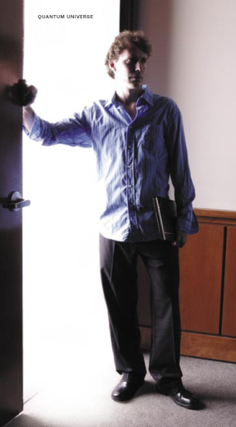
Physics Questions for the 21st Century
Are there undiscovered principles of nature: new symmetries, new physical laws?
How can we solve the mystery of dark energy?
Are there extra dimensions of space?
Do all the forces become one?
Why are there so many kinds of particles?
What is dark matter? How can we make it in the laboratory?
What are neutrinos telling us?
How did the universe come to be?
What happened to the anti-matter?
Quantum Universe (www.interactions.org/pdf/Quantum_Universe_GR.pdf)

Slide 4
Beyond the Standard Model
The search for physics beyond the standard model is pursued through a broad program in HEP
High p_{T} physics
Direct searches for evidence of new physics (SUSY, ???)
Flavor physics
New physics through participation in loop processes could contribute additional CP violating phases
CP violation in B_{s}⁰ meson system is an excellent way to search for new physics
Predicted to be extremely small in the SM, so any large CP phase is a clear sign of new physics!

Slide 5
What Is CP Violation?
CP violation is the non-conservation of charge and parity quantum numbers
Rate of
Rate of
≠
B_{s}⁰
‾B_{s}⁰

Slide 6
CPV in the Standard Model
Described within framework of the CKM mechanism
where λ ≈ 0.23
Imaginary terms give rise to CP violation
Highly suppressed
CPV
Large CPV
Large CPV
Suppressed CPV

Slide 7
Unitarity of CKM Matrix
By construction, CKM matrix must be unitary
V†V=1
Important to check this experimentally!
Evidence of non-unitarity would suggest presence of unknown physics contributions
Can construct six unitarity relations between distinct columns or rows of CKM matrix

Slide 8
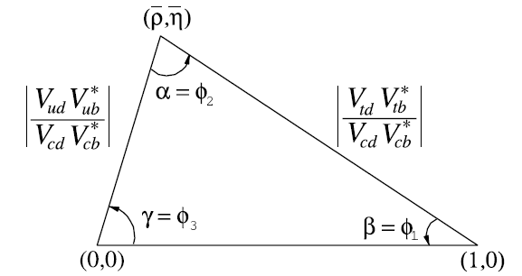
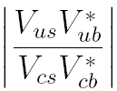
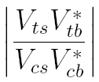
Unitarity Relations in B⁰/B_{s}⁰
β_{s}

Slide 9
CP Violation in B_{s}⁰→ J/ψϕ
⇒ sin(2β)
⇒ sin(2β_{s})
CP violation in J/ψϕ (as in J/ψ K_{s}⁰) due to interference between mixing and decay amplitudes
J/ψ K_{s}⁰ is CP even final state
J/ψ ϕ final state is an admixture of CP even (~75%) and CP odd ( 25%)

Slide 10
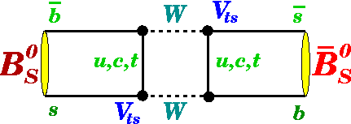
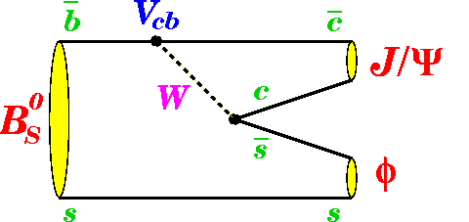
Mixing and Decay in B_{s}⁰
Mixing between particle and anti-particle occurs through the loop processes
Oscillations are very fast-
~3 trillion times per second!
New particles can contribute to box diagram!

Slide 11
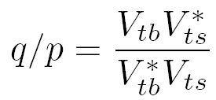
Mixing in B_{s}⁰ Decays
Schrodinger equation governs‾B_{s}⁰- B_{s}⁰ mixing
Mass eigenstates B_{s}^{H} and B_{s}^{L} are admixtures of
flavor eigenstates
where
∆m_{s} = m_{H} – m_{L} ≈ 2|M₁₂|
ΔΓ = Γ _{L} − Γ_{H} ≈ 2|Γ₁₂|cos(ϕ_{s}),
where ϕ_{s}= arg(−M₁₂/Γ₁₂)
Frequency of oscillation between B_{s}⁰ and‾B_{s}⁰

Slide 12
Standard Model CPV in B_{s}⁰ Decays
Assume |λ _{J/ψϕ} | = 1
→ no direct CPV
CP violation in B_{s}⁰→J/ψϕ
CP observable: λ _{J/ψϕ} = e ^{i2βs}
The CP phase in B_{s}⁰→J/ψϕ in the standard model is
Very small SM CP phase!
Note: Im(λ_{J/ψϕ}) = sin(2β_{s}) ≈ 0,
compared to sin(2β) ≈ 0.70 (B⁰→J/ψK_{s}⁰)

Slide 13
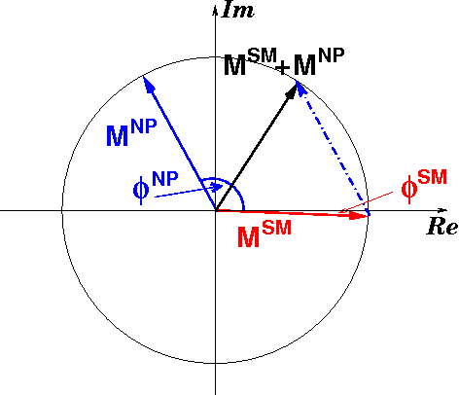
New Physics in B_{s}⁰ Decays
B_{s}⁰ −‾B_{s}⁰ oscillations observed by CDF
Mixing frequency ∆m_{s} now very well-measured
Precisely determines |M₁₂| - in good agreement w/SM pred.
Phase of mixing amplitude is still very poorly determined!
M₁₂ = |M₁₂|e^{iϕm}, where ϕ_{m} = arg( V_{tb}V_{ts}*)²
New physics could produce large CP phase!

Slide 14
CPV in B_{s}⁰ from New Physics
If large new physics phase present in mixing amplitude
ϕ_{s} = ϕ_{s}SM + ϕ_{s}^{NP} ~ ϕ_{s}^{NP}
Can measure ϕ_{s} directly from CP asymmetry in B_{s}⁰ semileptonic decays
Same new physics phase ϕ_{s}^{NP} would add to β_{s}
In B_{s}⁰→J/ψϕ, we would then measure
(2β_{s} − ϕ_{s}^{NP}) ~ −ϕ_{s}^{NP}
Observation of large CP phase in B_{s}⁰→J/ψϕ
⇒ unequivocal sign of new physics

Slide 15
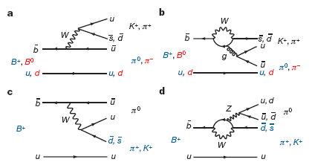
New Physics in Flavor Sector?
Belle/BABAR have seen suggestions of new physics effects in direct CP asymmetry
Asymmetry between B⁰→K⁺π⁻ and‾B⁰ →K⁻π⁺ is opposite to that between B⁺→K⁺π⁰ and B⁻ →K⁻π⁰
ΔA = A_{K+π0} - A_{K+π−} = +0.164 ± 0.037 (Belle)
Effect could be due to presence of NP in electroweak penguin

Slide 16
Measurement Overview
“Men's activities are occupied in two ways -- in grappling with external circumstances and in striving to set things at one in their own topsy-turvy mind.”
- William James

Slide 17
CDF Detector
Calorimetry
Silicon
detector
Drift Chamber
Muon detectors

Slide 18
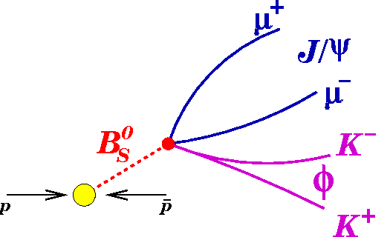
Properties of B_{s}⁰→J/ψϕ Decays
t = m(B_{s}⁰)*L_{xy}(B_{s}⁰→ J/ψϕ)/p_{T}(B_{s}⁰)
Overview of decay
B_{s}⁰ travels ~450 μm before decaying into J/ψ and ϕ
Spin-0 B_{s}⁰ decays to spin-1 J/ψ and spin-1 ϕ
⇒ final states with l=0,1,2
Properties of decay depend on decay time, CP at decay, and initial flavor of‾B_{s}⁰/B_{s}⁰

Slide 19
Experimental Strategy
Reconstruct B_{s}⁰ → J/ψ(→ μ⁺μ⁻) ϕ(→ K⁺K⁻)
Use angular information from J/ψ and ϕ decays to separate angular momentum states which correspond to CP eigenstates
CP-even (l=0,2) and CP-odd (l=1) final states
Identify initial state of B_{s} meson (flavor tagging)
Separate time evolution of B_{s}⁰ and‾B_{s}⁰ to maximize sensitivity to CP asymmetry (sin2β_{s})
Perform un-binned maximum likelihood fit to extract signal parameters of interest (e.g. β_{s}, ΔΓ)

Slide 20
Related Measurements
B_{s}⁰ → J/ψ ϕ decays without flavor tagging
B_{s}⁰ mean lifetime (τ = 1/Γ)
Γ = (Γ_{L}+Γ_{H})/2
Width difference ΔΓ
Angular properties of decay
Decay of B⁰ → J/ψ(→ μ⁺μ⁻ ) K^{*0}(→K⁻π⁺)
No width difference (ΔΓ ≈ 0)
Check measurement of angular properties of decay

Slide 21
Signal Reconstruction
“Begin at the beginning and go on till you come to the end: then stop.”
-Alice in Wonderland

Slide 22
B_{s}⁰→J/ψϕ Signal Selection
Use an artificial neural network (ANN) to efficiently separate signal from background
Use only events which pass J/ψ trigger as input
ANN training
Signal from Monte Carlo reconstructed as it is in data
Background from J/ψϕ mass sidebands

Slide 23
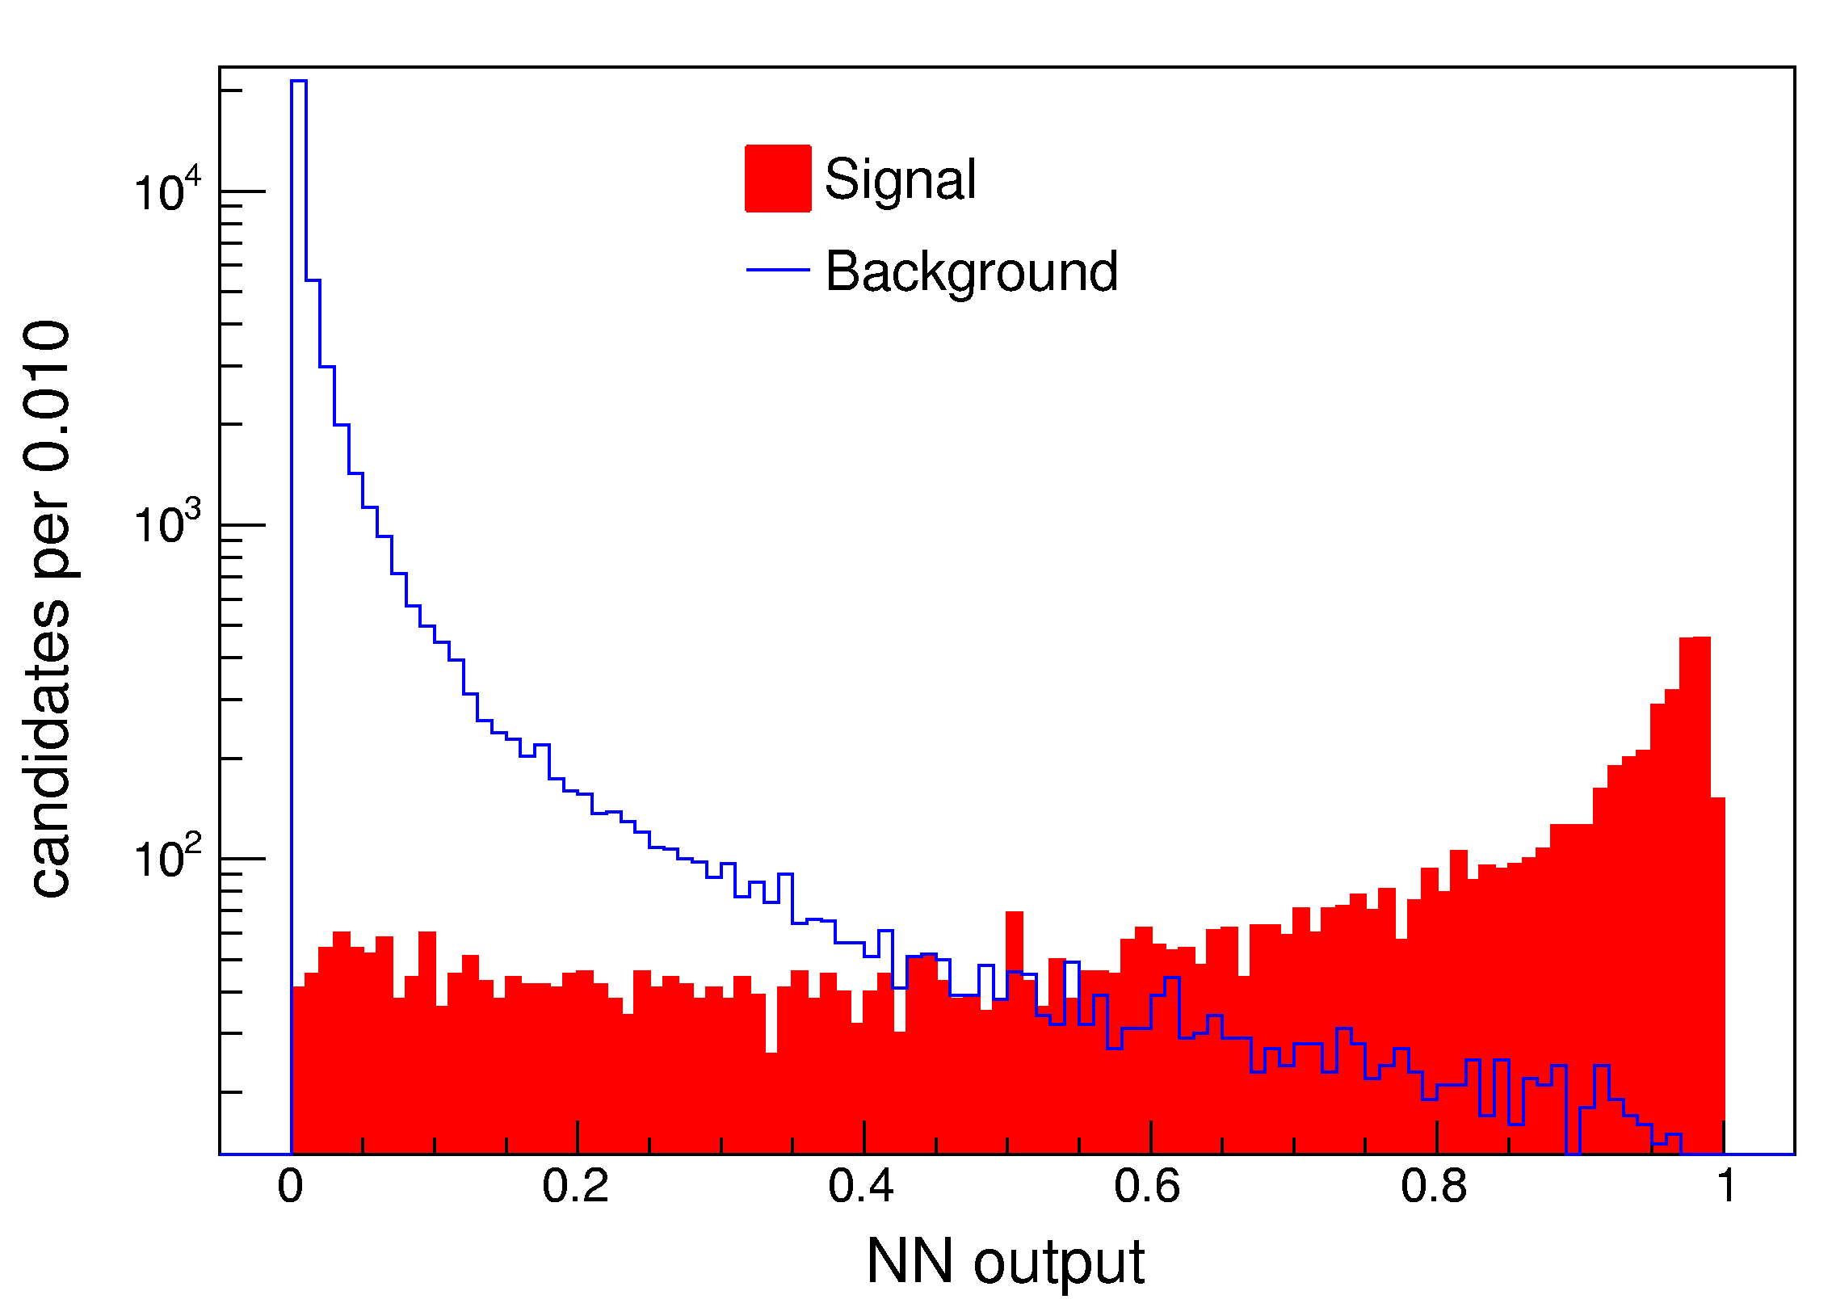
B_{s}⁰→J/ψϕ Neural Network
Variables used in network
B_{s}⁰: p_{T} and vertex probability
J/ψ: p_{T} and vertex probability
: mass and vertex probability
K⁺,K⁻: p_{T} and PID (TOF, dE/dx)
Figure of merit in optimization of ANN selection:

Slide 24
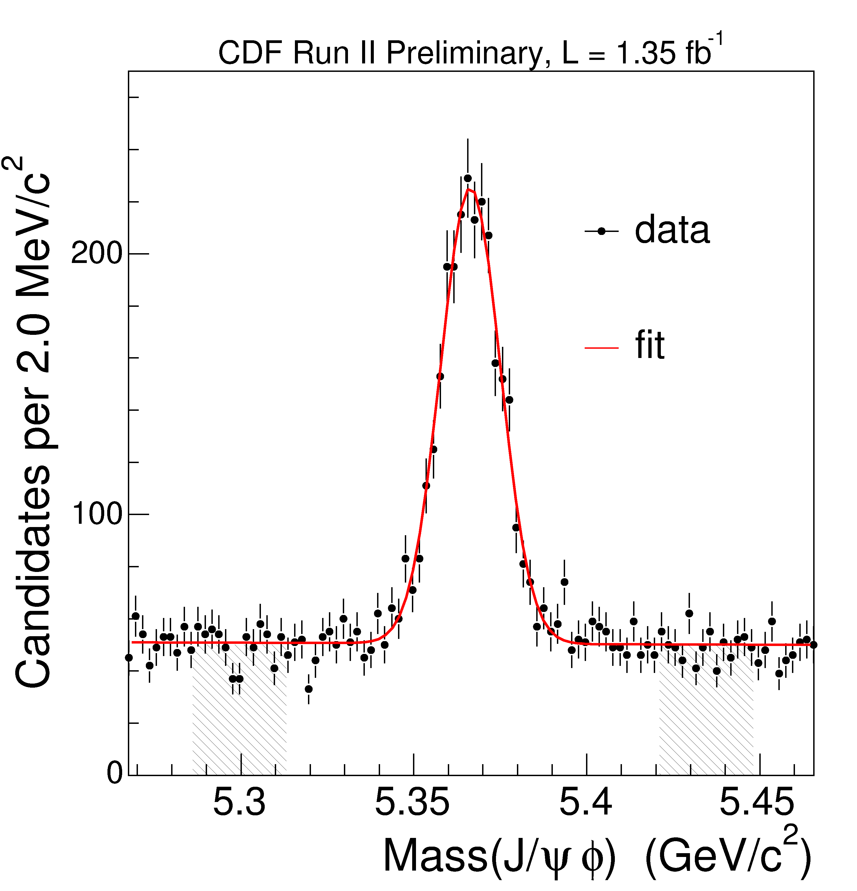
B_{s}⁰→J/ψϕ Signal
N(B_{s}⁰) ~ 2000 in 1.35 fb⁻¹ (with flavor tagging)
2500 in 1.7 fb⁻¹ (without flavor tagging)

Slide 25
B⁰→J/ψK^{*0} Signal
N(B⁰) ~ 7800 in 1.35 fb⁻¹

Slide 26
Angular Analysis of Final States
“[In this business] everybody’s got an angle.”
-Bing Crosby in “White Christmas”

Slide 27
Identify CP of Final States
J/ψ, ϕ vector mesons
→ definite angular distributions for CP-even (S- or D-wave) and CP-odd (P-wave) final states
Use transversity basis to describe angular decay
Express angular dependence in terms of linear polarization
Transversely polarized: A⊥(t) and A║(t)
Longitudinally polarized: A₀(t)
Can determine initial magnitude of polarizations and their phases relative to each other
| A⊥(0)|² + | A║(0)|² + | A₀(0)|² = 1
δ║ = arg(A║(0) A₀*(0)), δ ⊥ = arg(A ⊥ (0) A₀*(0))

Slide 28
Definition of Transversity Angles
J/ψ rest frame
ϕ rest frame
VV final state defines 3D coordinate system

Slide 29
Flavor Tagging
“Time is a sort of river of passing events, and strong is its current; no sooner is a thing brought to sight than it is swept by and another takes its place, and this too will be swept away. ”
- Marcus Aurelius Antonius

Slide 30
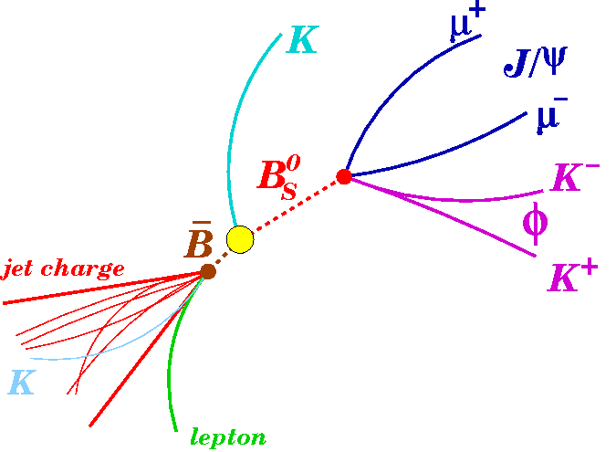
Basics of Flavor Tagging
Same side
Opposite side
b quarks generally produced in pairs at Tevatron
Tag either b quark which produces J/ψϕ or other b quark

Slide 31
Combined Tags
Final Tag
OST
Semilep.
Muon Tag
Semilep.
Electron Tag
SST
SSKT
Jet Charge
Tag
OST
ε = (96±1)%, average D = (11±2)%
SSKT
ε = (50±1)%, average D = (27±4)%
Calibrated only for first 1.35 fb⁻¹ of data

Slide 32
Un-binned Likelihood Fit
“Like stones, words PDFs are laborious and unforgiving, and the fitting of them together, like the fitting of stones, demands great patience and strength of purpose and particular skill.”
- Edmund Morrison (paraphrased)

Slide 33
Overview of Likelihood Fit
Mass (m, σ_{m})
ΔΓ
Proper time
(ct, σ_{ct})
Un-binned Maximum Likelihood Fit
2β_{s}
Trans. Angles
ρ = (cosθ, ϕ, cosψ)
Nuisance params. (e.g. Γ)
Flavor Tagging
(ξ, D)

Slide 34
Signal Probability Distribution
Signal PDF for a single tag
Signal probability depends on
Tag decision ξ={ -1, 0, +1}
Event-per-event dilution D
Sculpting of transversity angles due to detector acceptance, ε(ρ)
ρ = {cos θ_{T}, ϕ_{T}, cos ψ_{T}}
Convolve time dependence with Gaussian proper time resolution function with mean of 0.1 ps and RMS of 0.04 ps
B_{s}⁰
‾B_{s}⁰

Slide 35
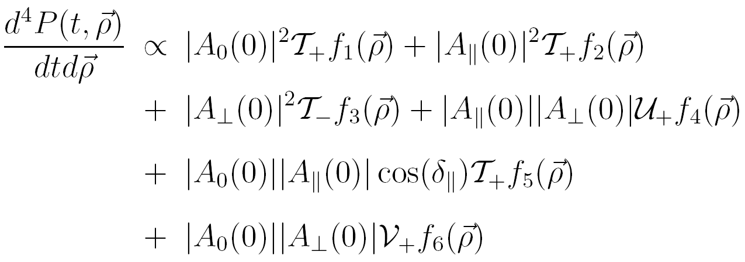
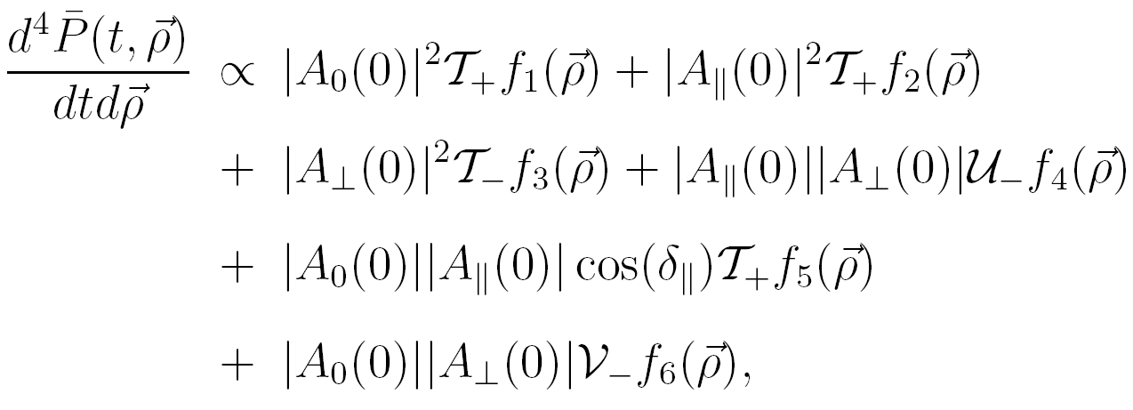
Signal Probability Distribution
General relation for B→ VV
Time dependence appears in T±, U±, V±.

Slide 36
Time-evolution with Flavor Tagging
Separate terms for B_{s}⁰,‾B_{s}⁰
CP asymmetry
Dependence on cos(Δm_{s}t)

Slide 37
Time-evolution without Flavor Tagging
Can’t distinguish between B_{s}⁰,‾B_{s}⁰
CP asymmetry

Slide 38
B_{s}⁰ Lifetime Projection
No flavor tagging,
2β_{s} fixed to SM value

Slide 39
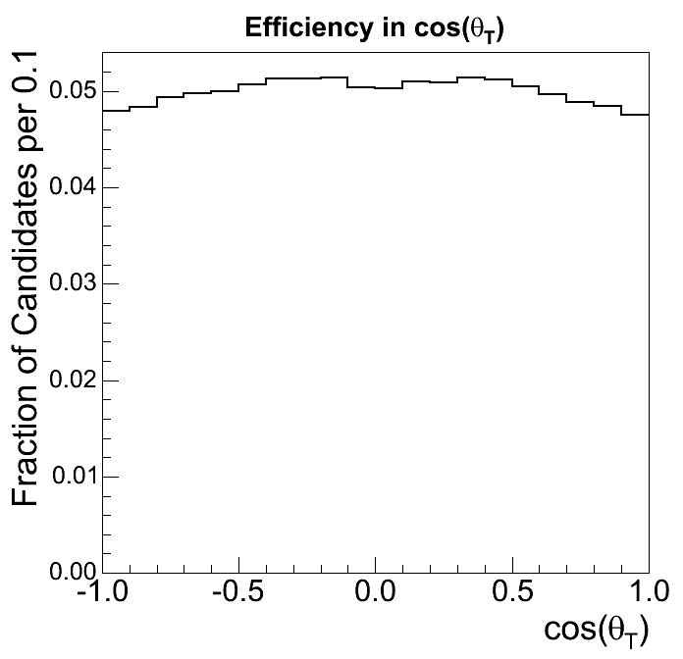
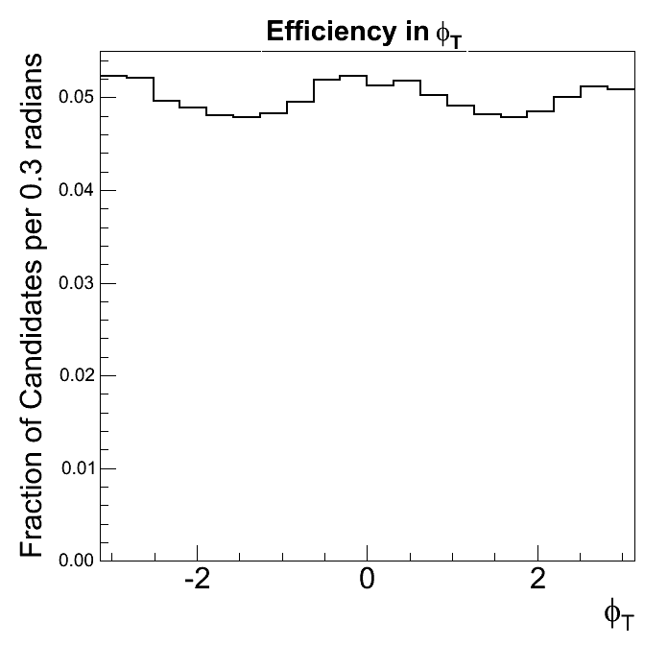
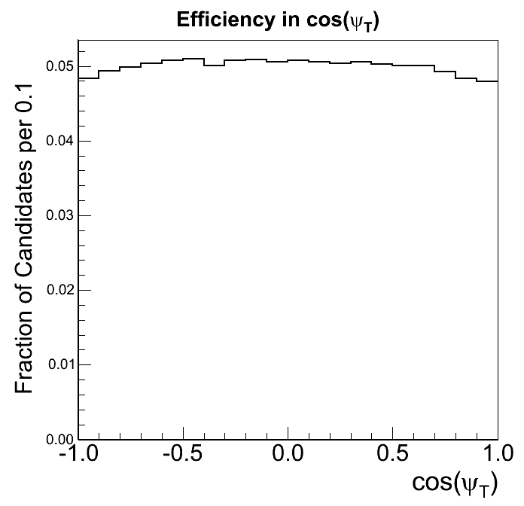
Detector Sculpting of Angles
Use Monte Carlo passed through detector simulation and reconstructed as in data to determine angular sculpting
Deviation from flat distribution indicates detector effects!

Slide 40
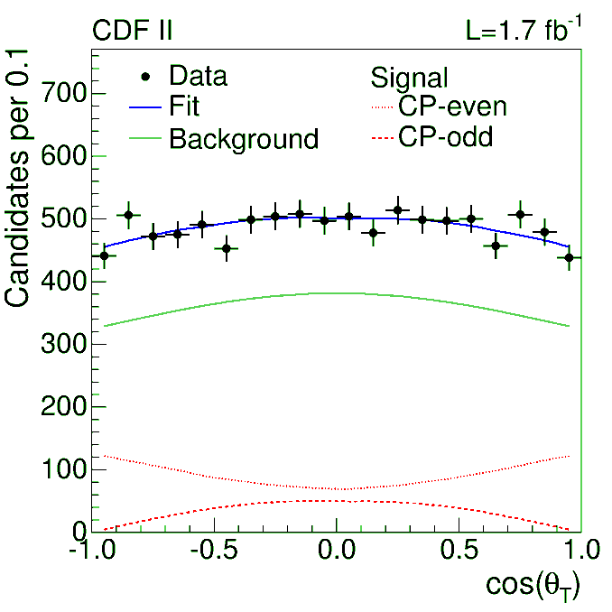
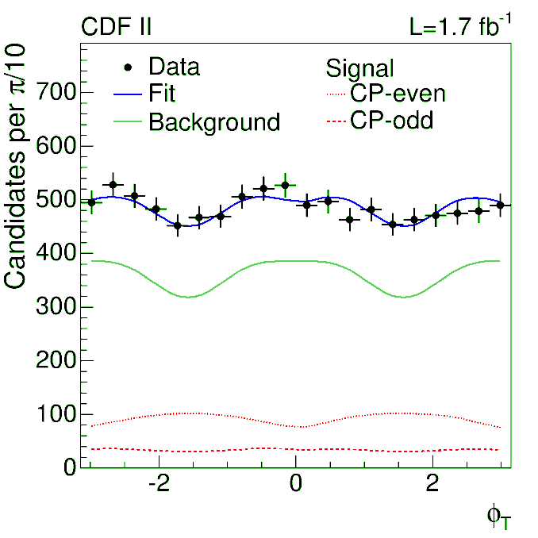
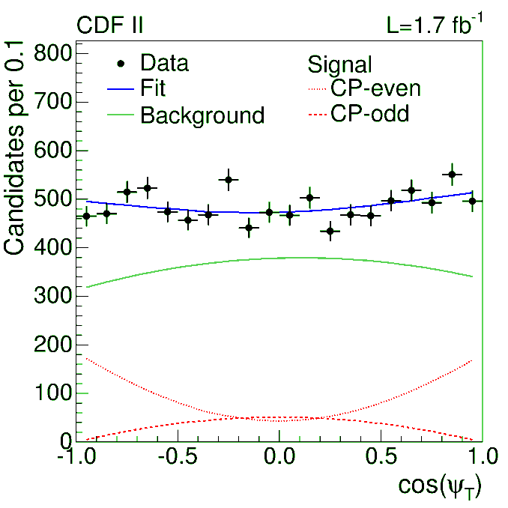
B_{s}⁰ Angular Fit Projections
Uncorrected for detector sculpting effects.

Slide 41
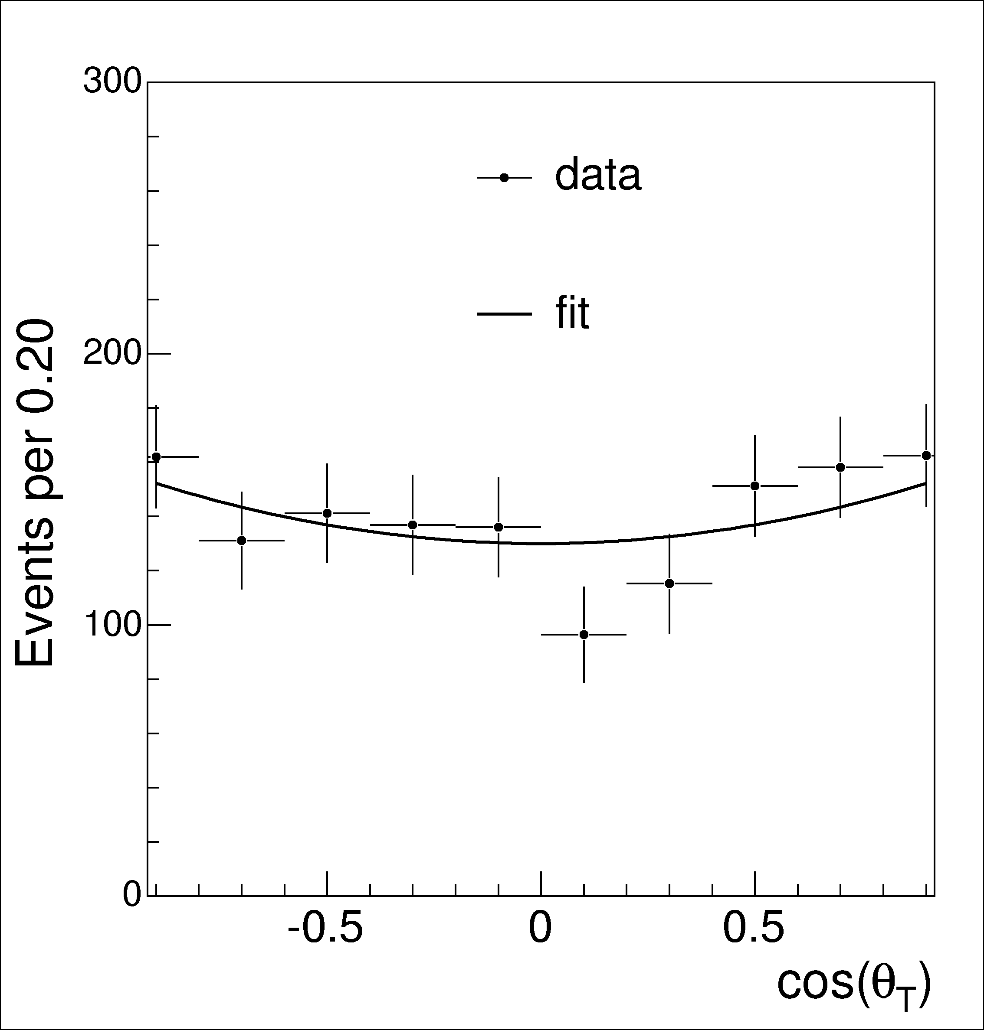
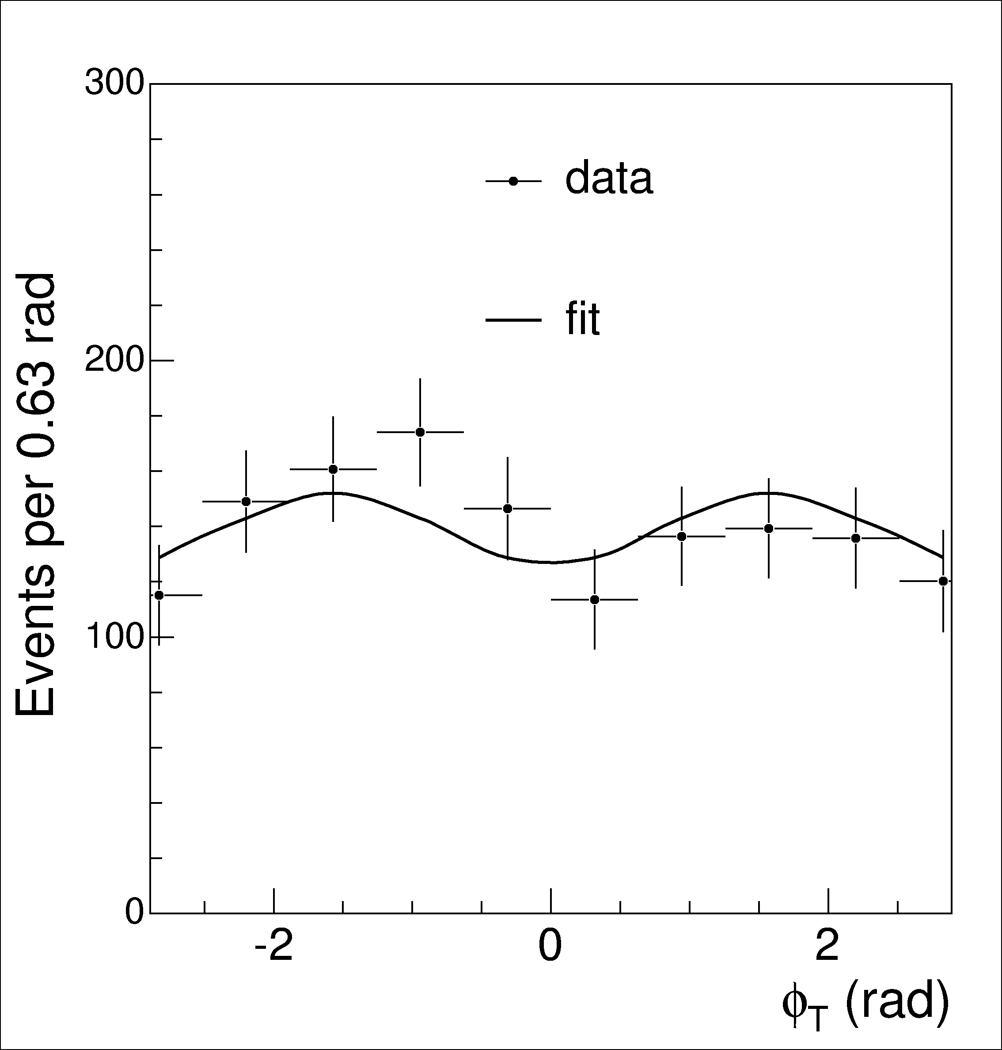
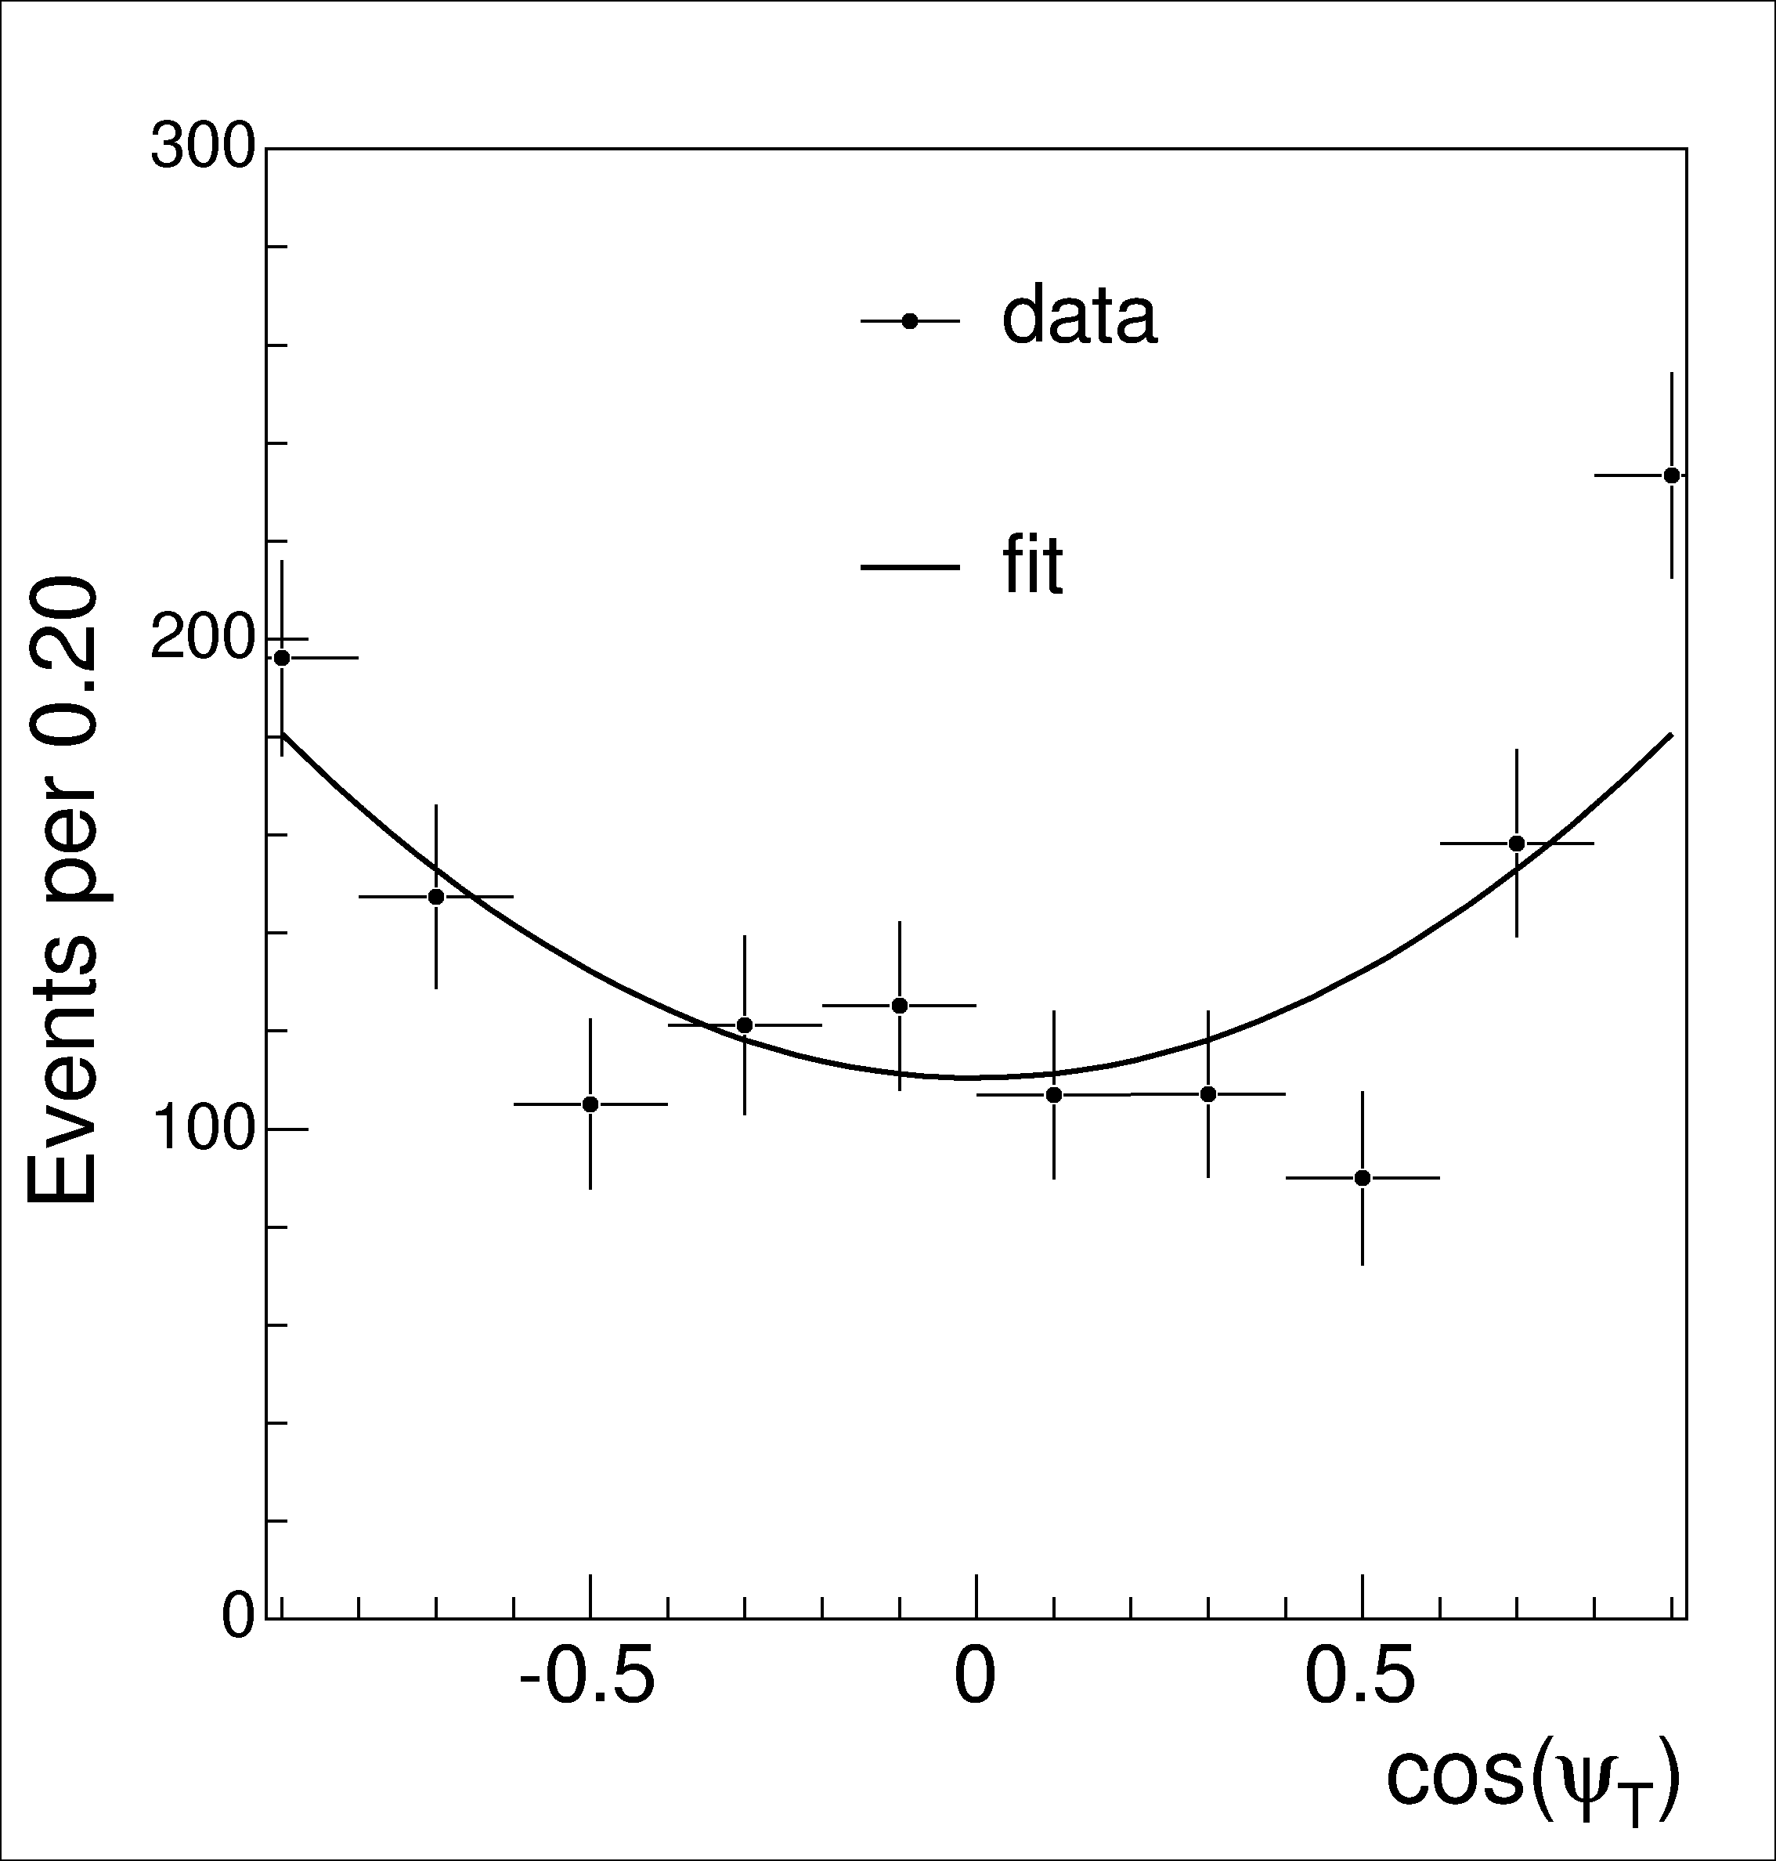
Corrected B_{s}⁰ Fit Projections
Corrected for detector sculpting.

Slide 42
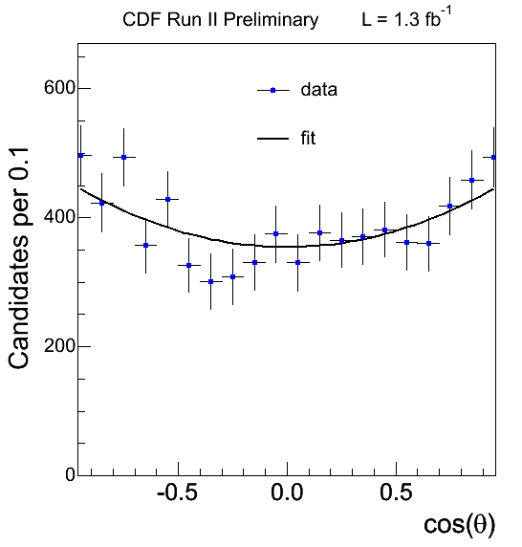
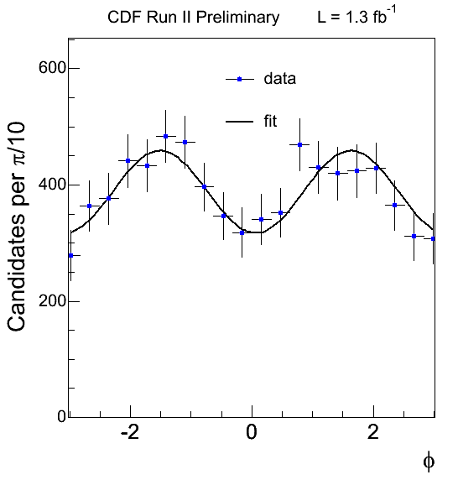
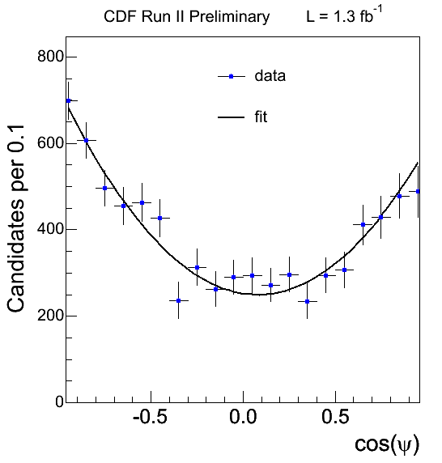
B⁰ Angular Fit Projections
Acceptance corrected distributions- fit agrees well!
Validates treatment of detector acceptance!

Slide 43
Cross-check with B⁰ Decays
Fit results for B⁰ → J/ψ K^{*0}
cτ = 456 ± 6 (stat) ± 6 (syst) μm
|A₀(0)|² = 0.569 ± 0.009 (stat) ± 0.009 (syst)
|A║(0)|² = 0.211 ± 0.012 (stat) ± 0.006 (syst)
δ║ = -2.96 ± 0.08 (stat) ± 0.03 (syst)
δ⊥ = 2.97 ± 0.06 (stat) ± 0.01 (syst)
Results are in good agreement with BABAR and errors are competitive!
Phys. Rev. D 76,031102 (2007)
|A₀(0)|² = 0.556 ± 0.009 (stat) ± 0.010 (syst)
|A║(0)|² = 0.211 ± 0.010 (stat) ± 0.006 (syst)
δ║ = -2.93 ± 0.08 (stat) ± 0.04 (syst)
δ⊥ = 2.91 ± 0.05 (stat) ± 0.03 (syst)

Slide 44
Additional Complications
Two exact symmetries are present in B_{s}⁰→ J/ψϕ when flavor tagging is not used
2β_{s} → – 2β_{s}, δ⊥ → δ⊥ + π
ΔΓ → –ΔΓ, 2β_{s} → 2β_{s} + π
Gives four equivalent solutions in β_{s} and ΔΓ!
Also observe biases in pseudo-experiments for fit parameters under certain circumstances

Slide 45
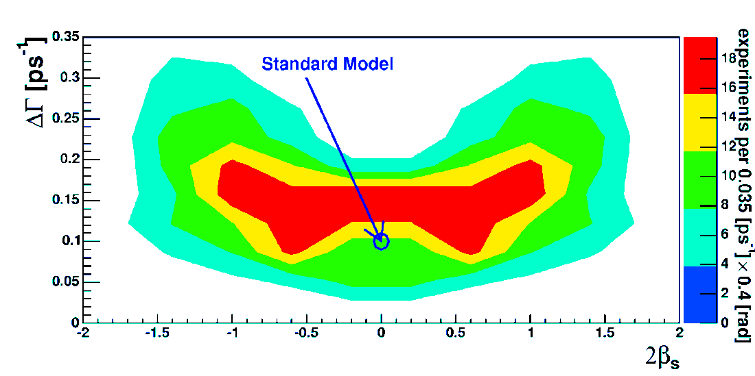
Biases in Untagged Fits
When 2β_{s} floats freely in fit, see significant biases in pseudo-experiments
Due to fact that interference terms are nearly all zero ⇒ No sensitivity to strong phases!!!
Can still reliably quote some point estimates with 2β_{s} fixed to standard model prediction
Mean lifetime, ΔΓ, |A₀(0)|², |A║(0)|², |A⊥(0)|²

Slide 46
Untagged B_{s}⁰ Decays
Fit results with 2β_{s} fixed to SM value (w/1.7 fb⁻¹ of data)
τ(B_{s}⁰) = 1.52 ± 0.04 ± 0.02 ps
ΔΓ = 0.076 ^{+0.059}_{-0.063} ± 0.006 ps⁻¹
Best measurement of width difference, mean B_{s}⁰ lifetime
30-50% improvement on previous best measurements
Good agreement with D0 results (Phys. Rev. D 76, 031102 (2007))
τ(B_{s}⁰) = 1.52 ± 0.08 (stat) ^{+0.01} _{−0.03} (syst) ps
ΔΓ = 0.17 ± 0.09 (stat) ± 0.02 (syst) ps⁻¹
Also measure angular amplitudes
|A₀(0)|² = 0.531 ± 0.020 (stat) ± 0.007 (syst)
|A║(0)|² = 0.230 ± 0.026 (stat) ± 0.009 (syst)
|A⊥(0)|² = 0.239 ± 0.029 (stat) ± 0.011 (syst)

Slide 47
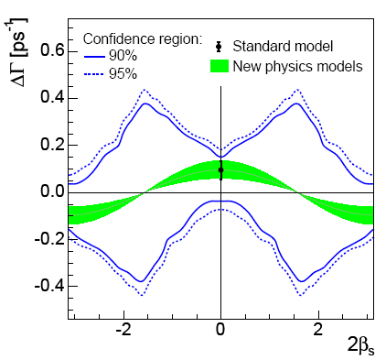
Untagged 2β_{s}-ΔΓ Confidence Region
Quote instead Feldman-Cousins confidence region
Use likelihood ratio to determine probability of result to fluctuate above a given value of input parameters
(p-value)
p-value at standard model point is 22%
ΔΓ = 2|Γ₁₂|cos(2β_{s})

Slide 48
Flavor Tagged Results
“Happiness is a butterfly, which, when pursued, is always just beyond your grasp, but which, if you will sit down quietly, may alight upon you.”
- Nathaniel Hawthorne

Slide 49
Exact Symmetries in Tagged Decays
With flavor tagging, exact symmetry is present in signal probability distribution
2β_{s} → π – 2β_{s}
ΔΓ → –ΔΓ
δ║ → 2π – δ║
δ⊥ → π – δ⊥
Leads to two equivalent solutions in β_{s} and ΔΓ!
Can remove exact symmetry by boxing one of the parameters

Slide 50
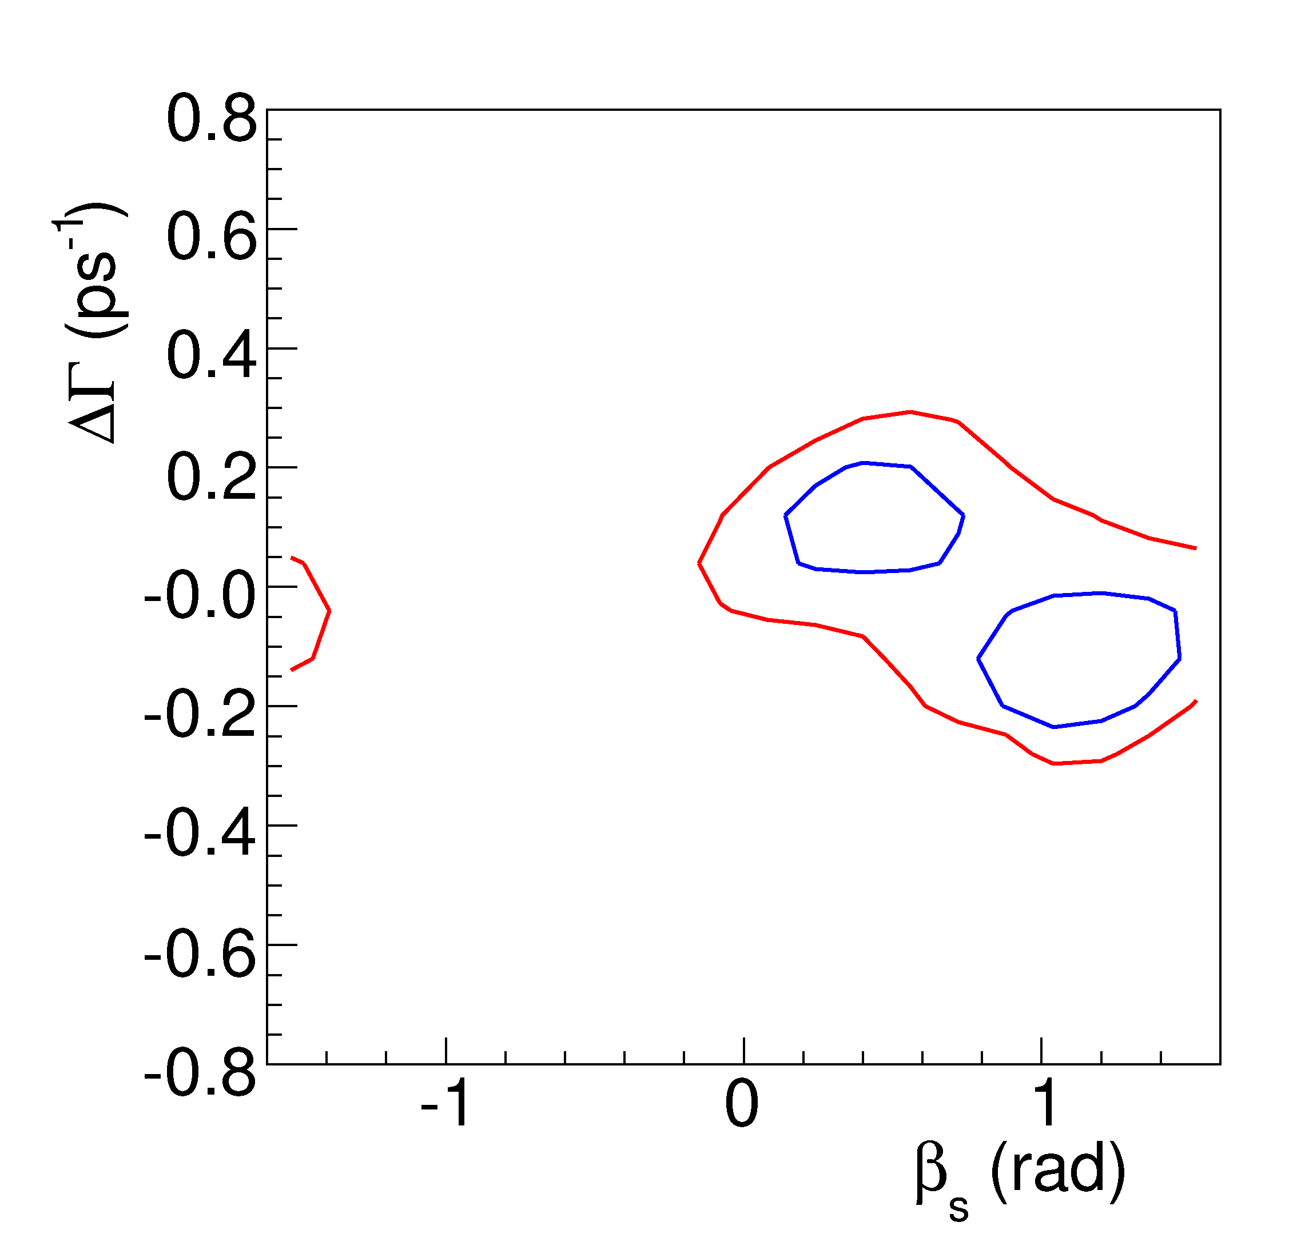
Check Fit with Pseudo-Experiments
Check β_{s}−ΔΓ likelihood profile on Toy MC with exact symmetry removed
Approximate symmetry is still significant with current level of signal statistics!
2ΔlnL = 2.31 ≈ 68% CL
2ΔlnL = 5.99 ≈ 95% CL
Likelihood profile is not parabolic ⇒ cannot reliably separate the two minima!
Generated with β_{s} = 0.40

Slide 51
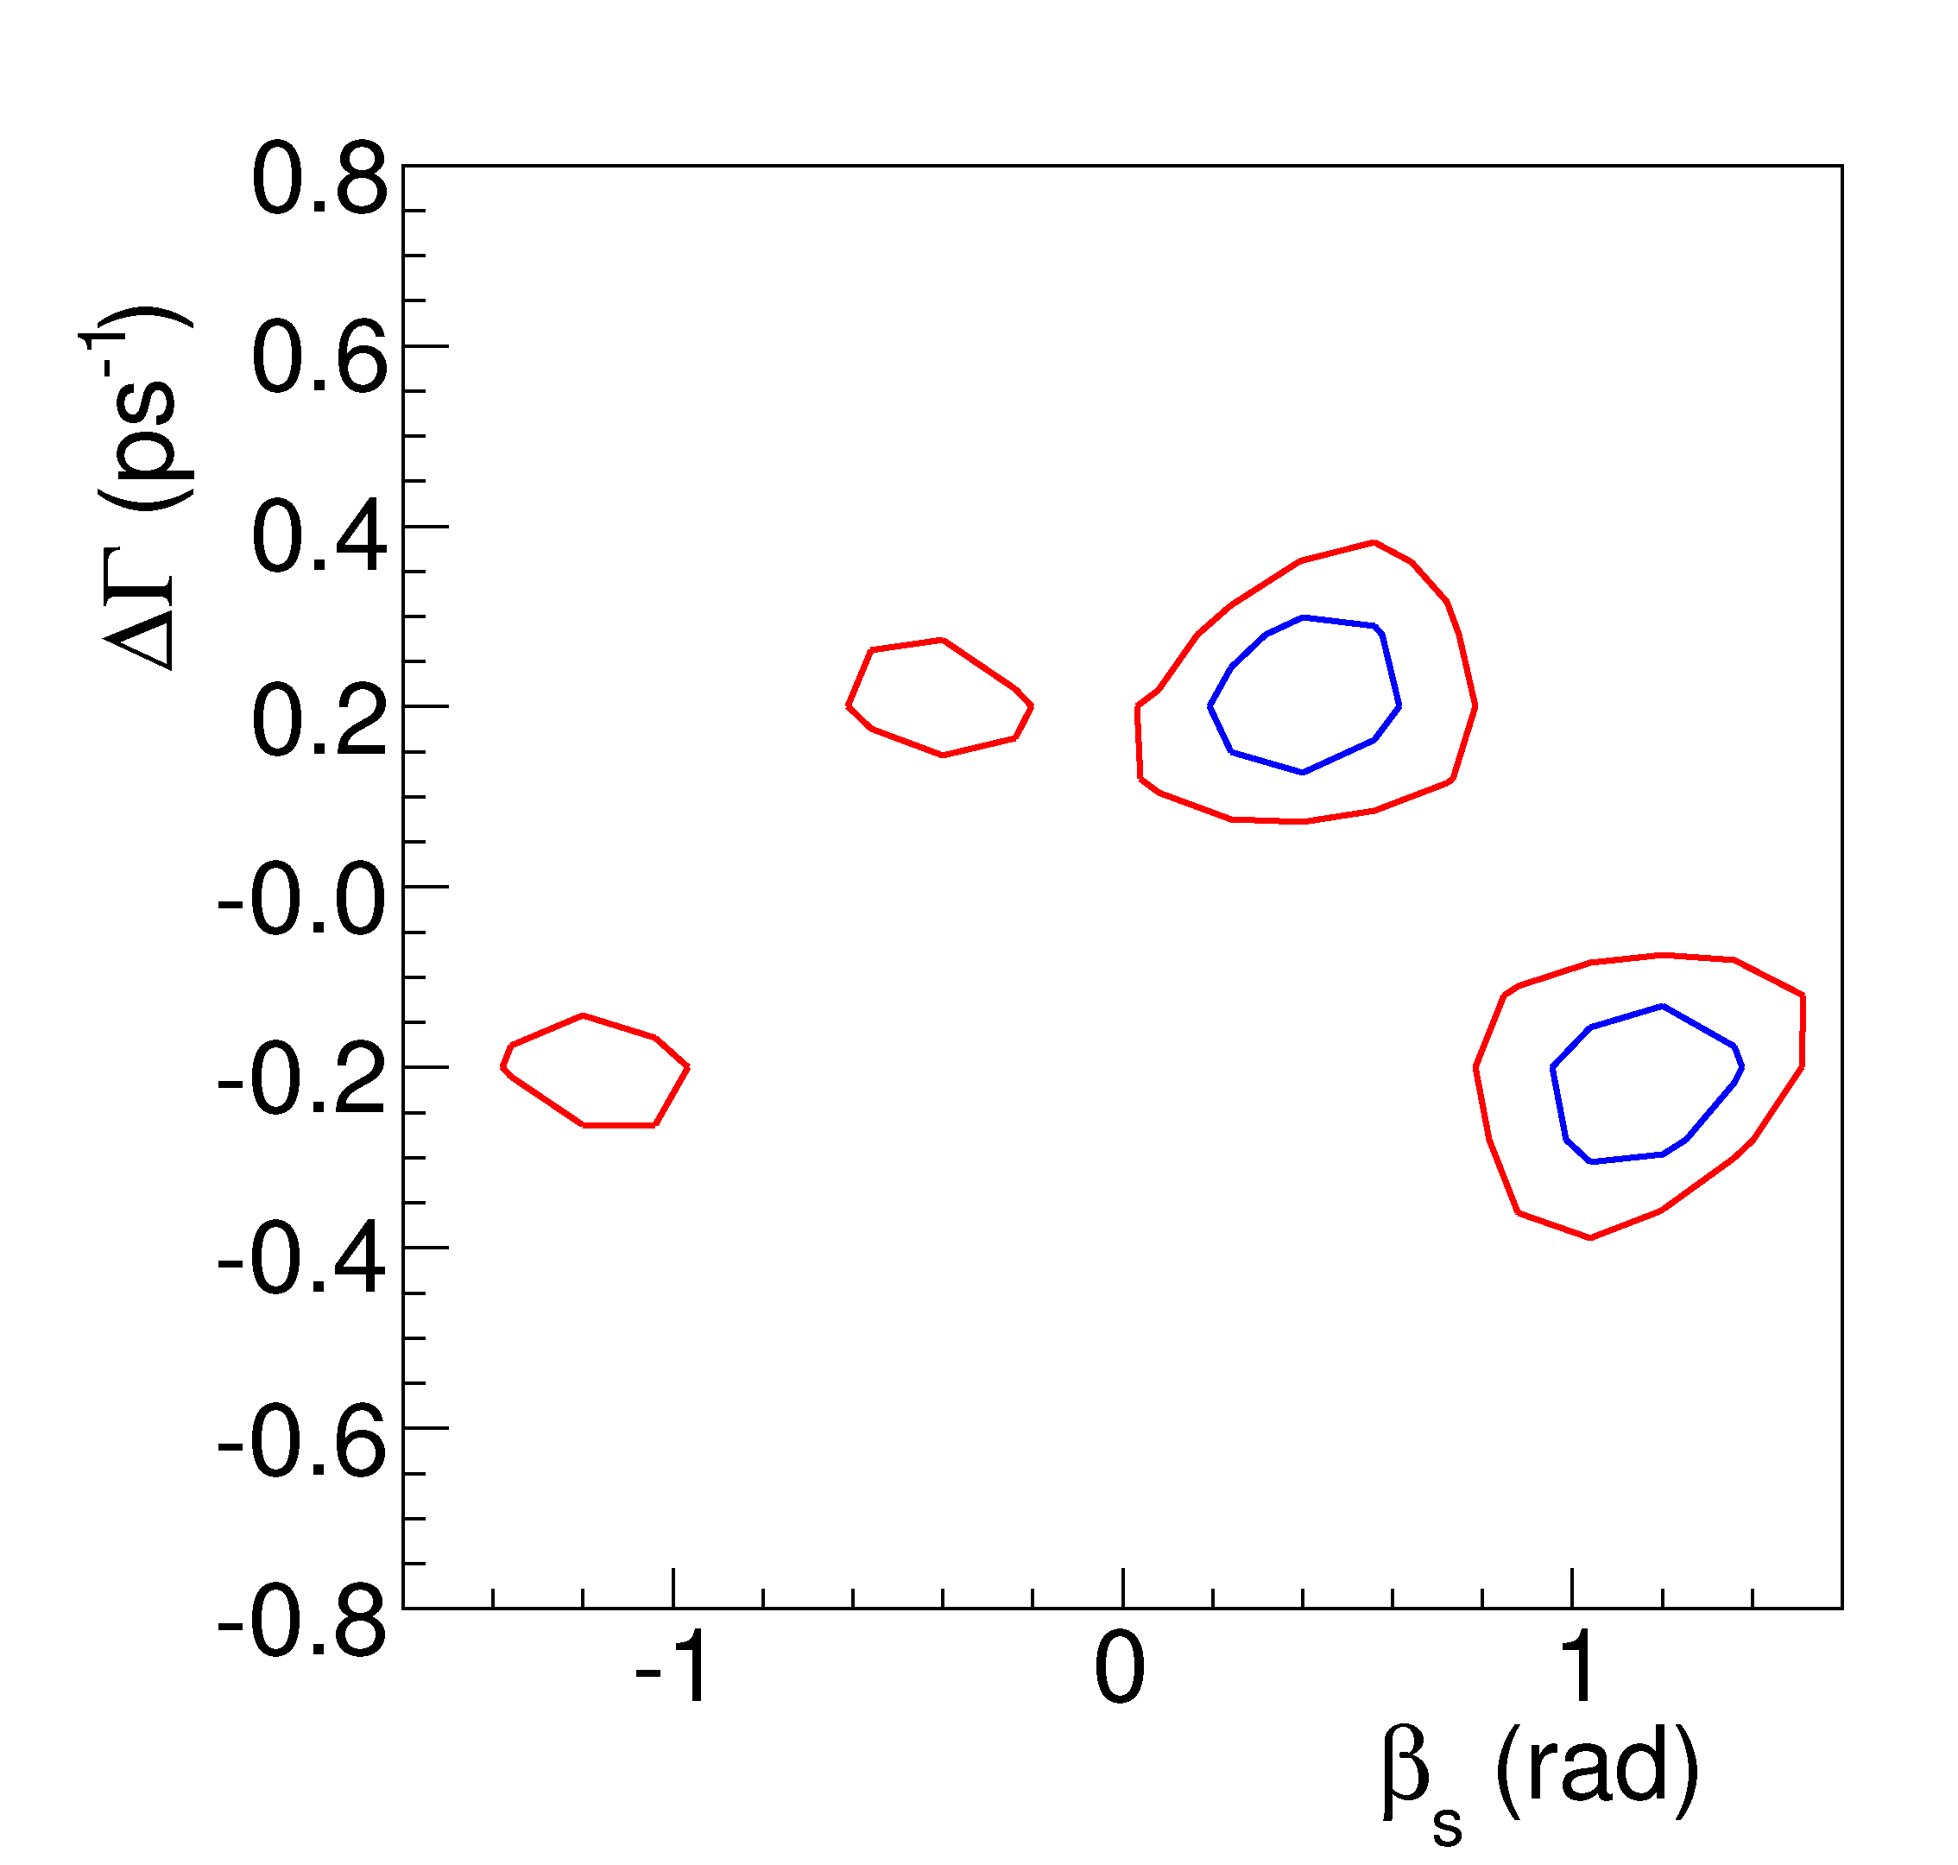
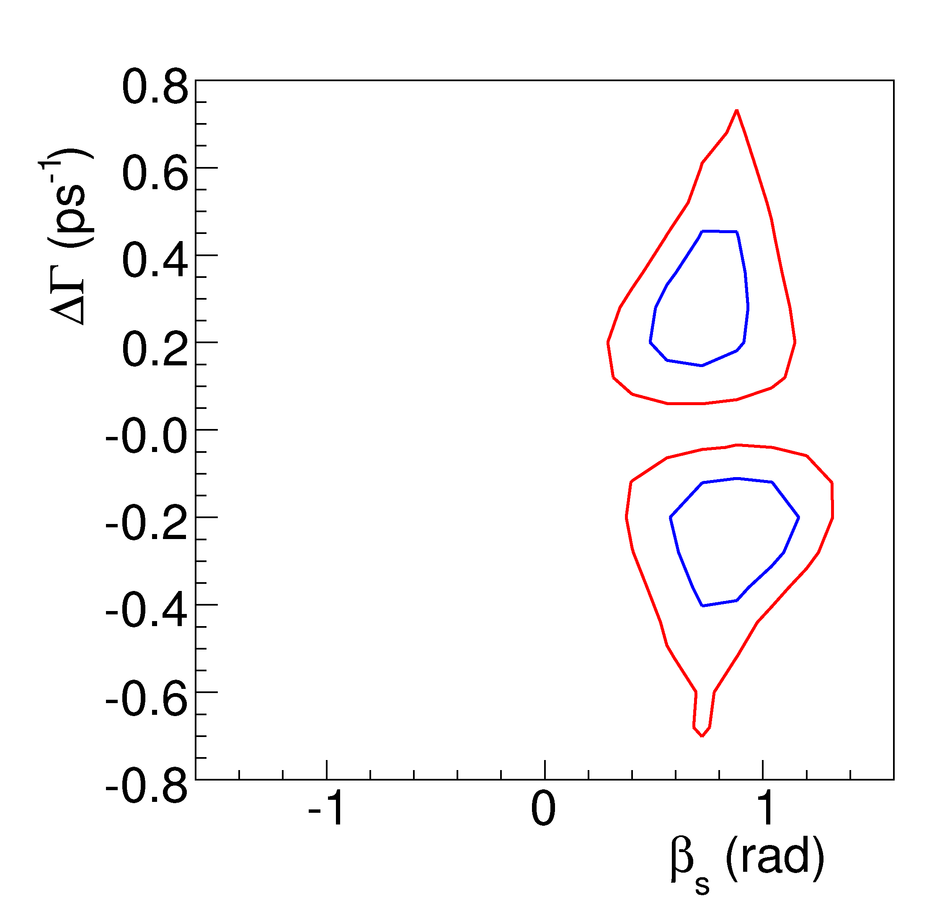
More Pseudo-Experiments
Generated with β_{s} = 0.40
(exceptional case!)
Generated with β_{s} = 0.80
Can see residual four-fold symmetry in some cases!
2ΔlnL = 2.31 ≈ 68% CL
2ΔlnL = 5.99 ≈ 95% CL

Slide 52
Fits with Flavor Tagging
Don’t have parabolic minimum
→ still can’t quote point estimate!
Again quote confidence regions using Feldman-Cousins likelihood ratio ordering method
Confirm coverage of confidence region w/toy MC
2D profile of 2β_{s} vs ΔΓ
1D intervals in 2β_{s}
Quote results with and without external theory constraints

Slide 53
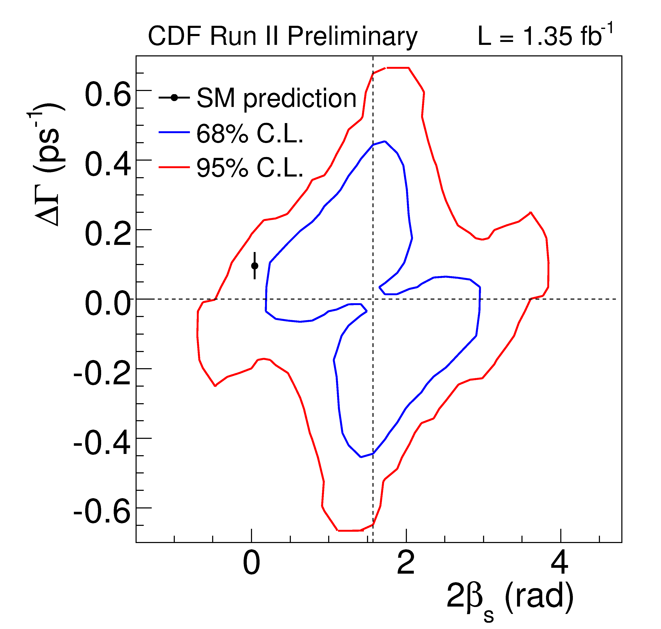
Flavor Tagged Confidence Region
Probability of fluctuation from SM to observation is 15% (1.5σ)

Slide 54
Improvement from Flavor Tagging
With flavor tagging, phase space for 2β_{s} is half that without flavor tagging!

Slide 55
β_{s} 1D Intervals
One-dimensional Feldman-Cousins confidence interval
2β_{s} ∈ [0.32,2.82] at 68% CL
Constraining ΔΓ = 2|Γ₁₂|cos(2β_{s}), where |Γ₁₂| = 0.048 ± 0.018
2β_{s} ∈ [0.24,1.36] ∪ [1.78,2.90]
at 68% CL
Constraining ΔΓ = 2|Γ₁₂|cos(2β_{s}), Γ to PDG B⁰ lifetime, and
δ║ = -2.92 ± 0.11
δ⊥ = 2.72 ± 0.09 ( hep-ex/0411016 )
2β_{s} ∈ [0.40, 1.20] at 68% CL
π
2β_{s}
0
π
2β_{s}
0
π
2β_{s}
0

Slide 56
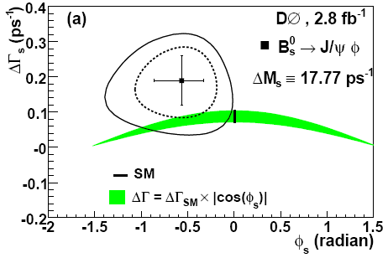
Other Experimental Results
arXiv:0802.2255
D0 has made measurement constraining strong phases to values from B⁰→ J/ψ K^{*0}
This is not a robust assumption!
Also don’t consider possible biases in fit due to complicated nature of likelihood but quote point estimate!
Probably not so bad when phases are constrained, but not sound if phases are allowed to float!

Slide 57
Suggestions of NP in β_{s}
Global fits to β_{s} provide their own hints of NP
UTfit claims >3σ evidence of NP in β_{s} (arXiv:0803.0659)
Uses both CDF and D0 results, incl. B_{s}⁰ lifetime and semileptonic CP asymmetry
Wouldn’t take this combination too seriously, because D0 doesn’t currently report unconstrained result
George Hou had predicted large β_{s} in context of 4th generation quark model in 2006 based on asymmetry in B^{0/+}→Kπ^{+/0} CP asymmetries
Phys. Rev. D 76,016004 (2007)

Slide 58
Looking Forward
“Congratulations, you are one step closer to hitting bottom.”
-Brad Pitt in “Fight Club”

Slide 59
Analysis Updates for Summer
CDF will increase data used by 60%
Look into optimizing selection for sensitivity to β_{s}
Fit for sin2β_{s} and cos2β_{s} independently as cross-check of result
Working on improving tagging power with comprehensive SST/OST combined flavor tag
Working with statisticians to try to develop alternate methods to Feldman-Cousins approach that might also be easy to combine with D0
D0 also promises significantly improved result (more data, more complete treatment of likelihood, etc.)

Slide 60
Exciting Time in Flavor Physics!
Would be super-cool to establish convincing evidence of NP before LHC turns on and/or comes up to design luminosity ☺
Will be great to see results from LHCb with high statistics!
Observation/evidence of NP before LHCb will clearly depend on the combination of a number of results
Even early results from LHCb might need to be combined with Tevatron results for maximal sensitivity

Slide 61
Back-up Slides

Slide 62
Un-binned Likelihood Fit
Fit with separate PDFs for signal and background
P_{s}(m|σ_{m}) – Single Gaussian fit to signal mass
P_{s}(ct, ρ, ξ|D, σ_{ct}) – Probability for‾B_{s}⁰/B_{s}⁰
P_{b}(m) – Linear fit to background mass distribution
P_{b}(ct| σ_{ct}) – Prompt background, one negative exponential, and two positing exponentials
P_{b}(ρ) – Empirical background angle probability distributions
Use scaled event-per-event errors for mass and lifetime fits and event-per-event dilution

Slide 63
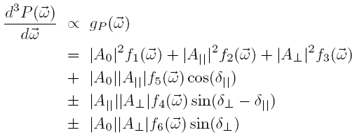
Time-evolution of B⁰→ J/ψ K^{*0}
Sign of last two terms corresponds to sign of the K^{+/−} in the decay
Since ΔΓ = 0, all terms decay as exponential

Slide 64
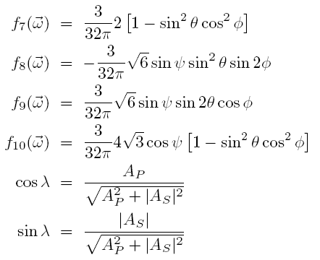
Time-evolution of B⁰→ J/ψ K^{*0}
Need to add S-wave component as well for good fit to cos(ψ)
where

Slide 65
PDF Analytic Normalization
Need to re-normalize PDF after applying efficiencies
Can analytically normalize PDF by fitting angular distributions as functions of real spherical harrmonics and Legendre polynomials
and

Slide 66
Check of Calibration of SSKT
Mixing amplitude consistent with one → SSKT calibration on MC is reasonable!

Slide 67
Check of Tag Asymmetry
Variation of +/- tag dilution calibrations of 20% produces negligible effect on the contour

Slide 68
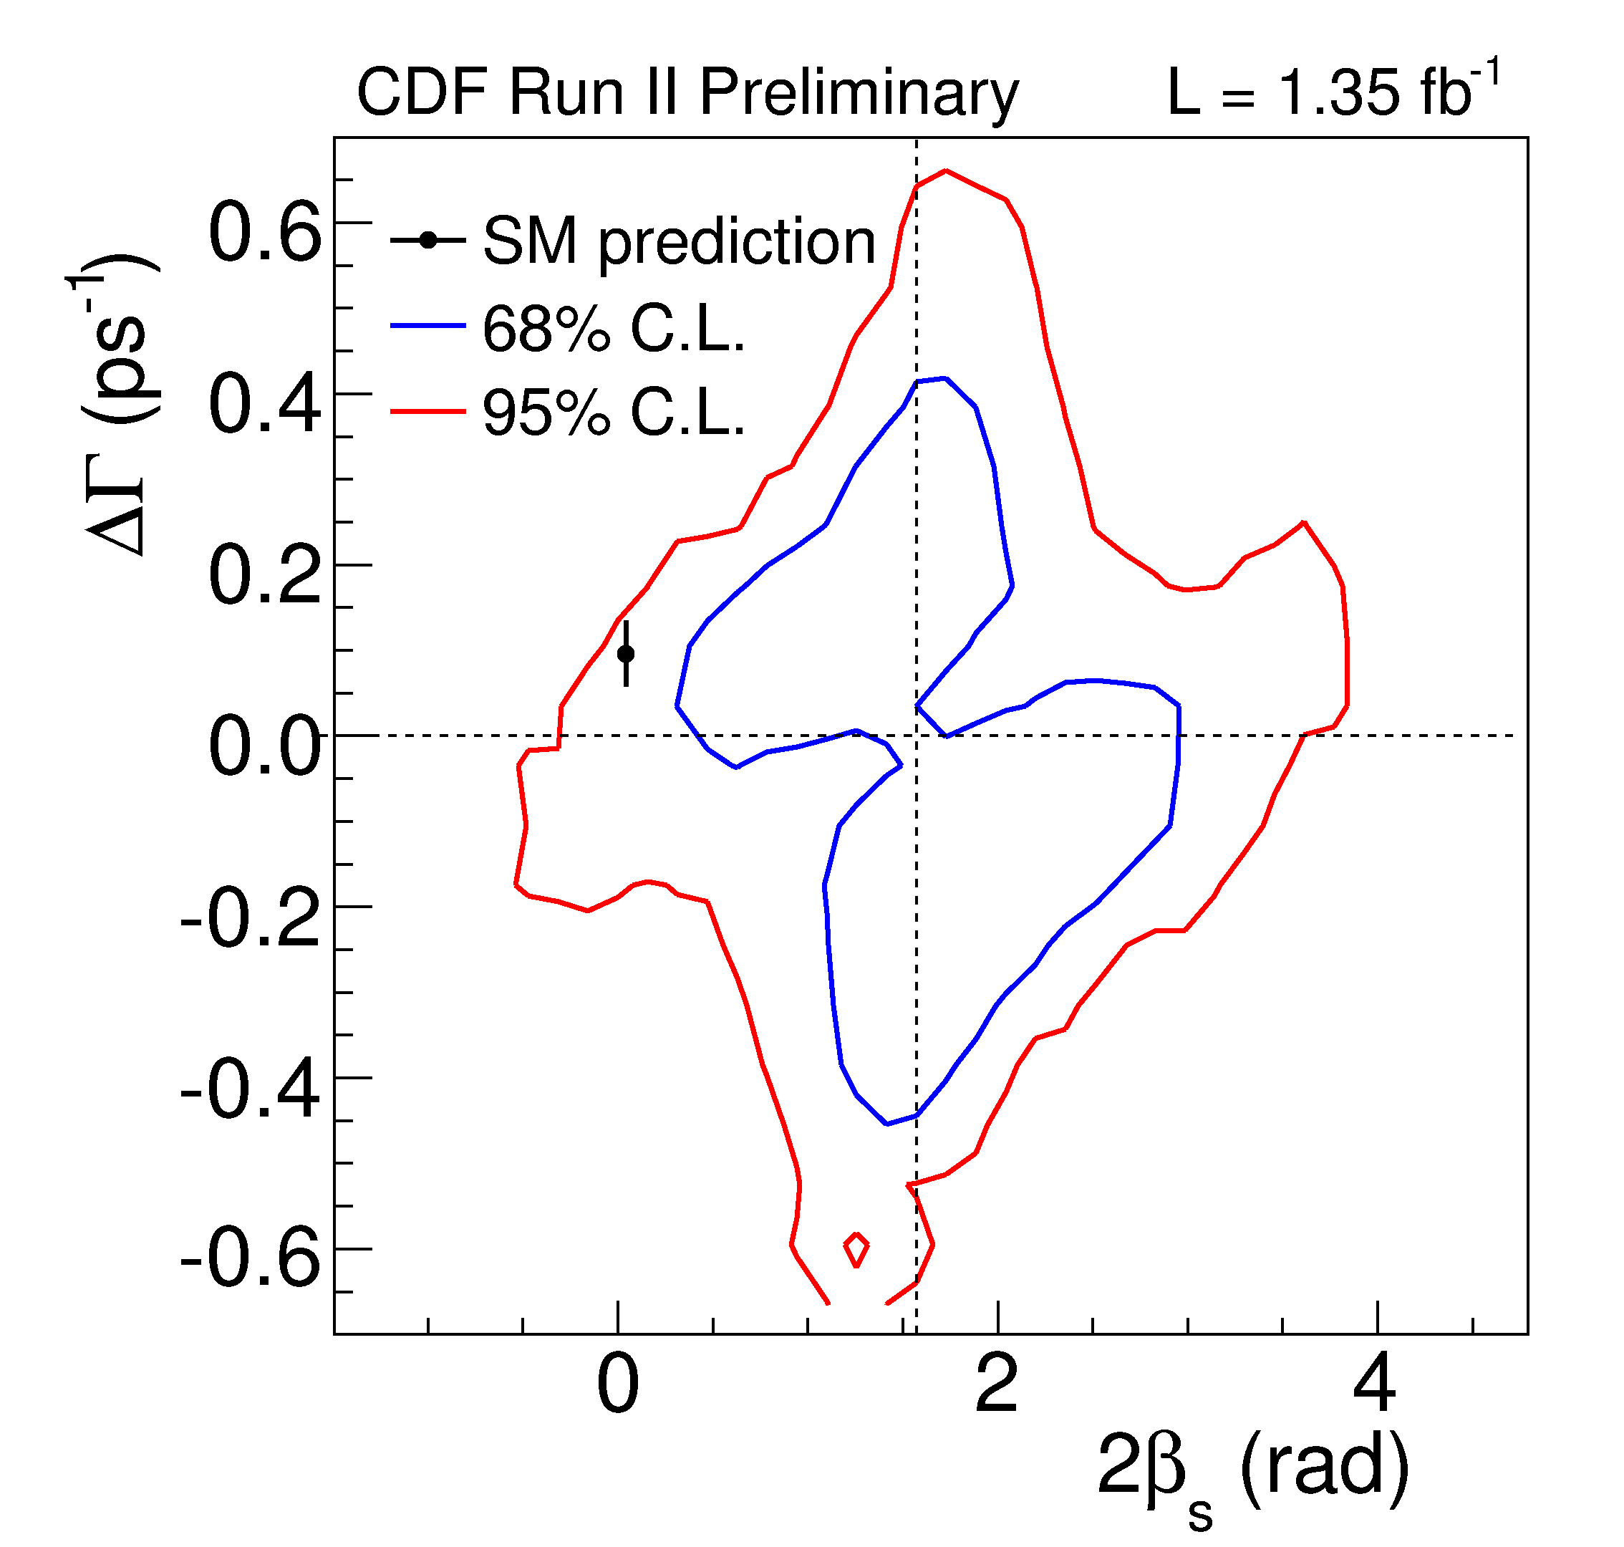
Flavor Tagged B_{s}⁰ Decays
Feldman-Cousins confidence region with
δ║ ∈ [0, π)

Slide 69
Feldman-Cousins Confidence Region
Feldman-Cousins likelihood ratio (LR)
Construct ratio of -2lnL when parameters of interest float freely in fit to -2lnL when parameters of interest are fixed to particular values
Construct same LR in data and in toy MC
Fraction of toys with LR larger than in data determines p-value (1-CL)
Confirm coverage of confidence region by varying nuisance parameters ±5σ from values observed in data

Slide 70
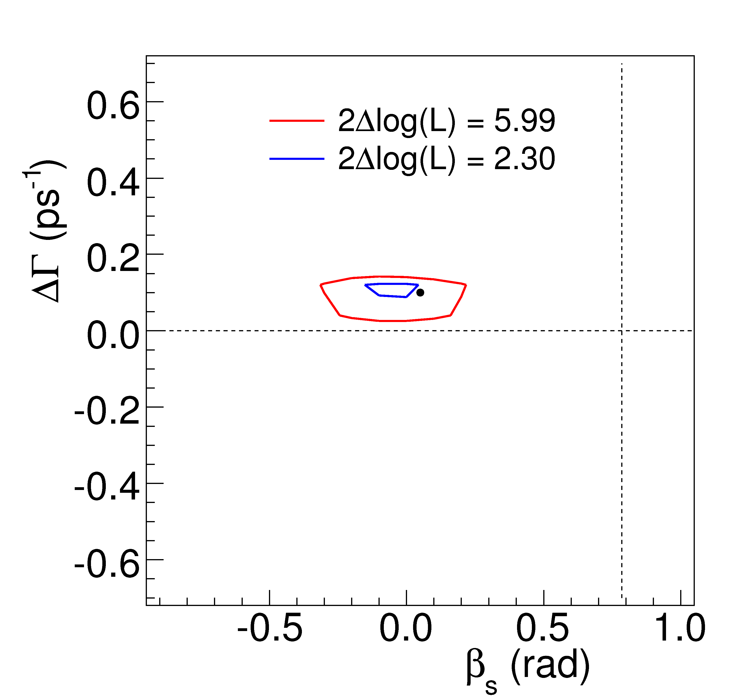
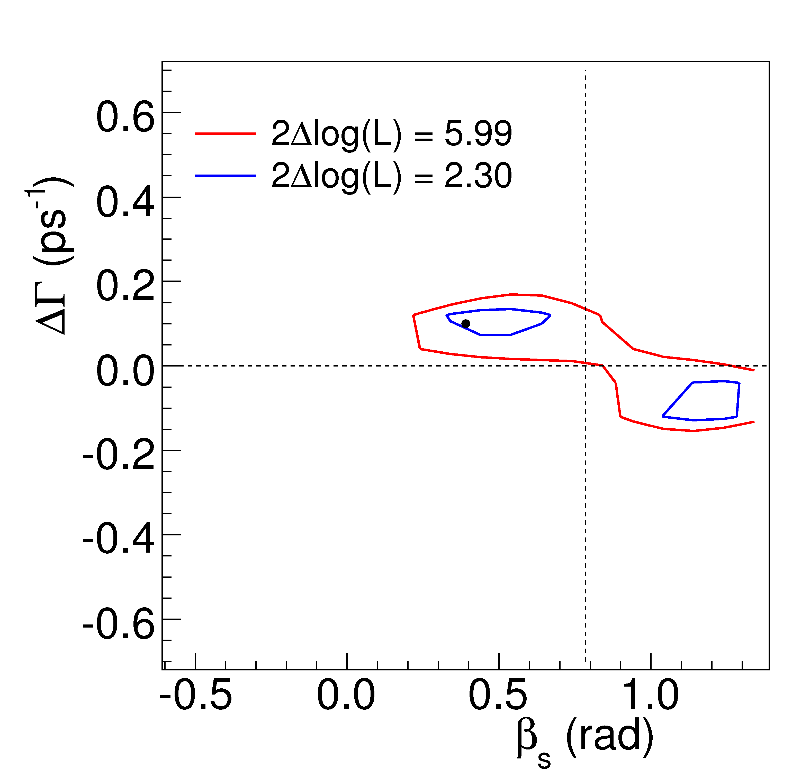
Future Sensitivity
Pseudo-experiments generated with β_{s}=0.02
Pseudo-experiments generated with β_{s}=π/8
Projected Confidence Regions in 6 fb⁻¹ assuming same yield per fb⁻¹ in future and same tagging efficiency and dilution

