Slide 1

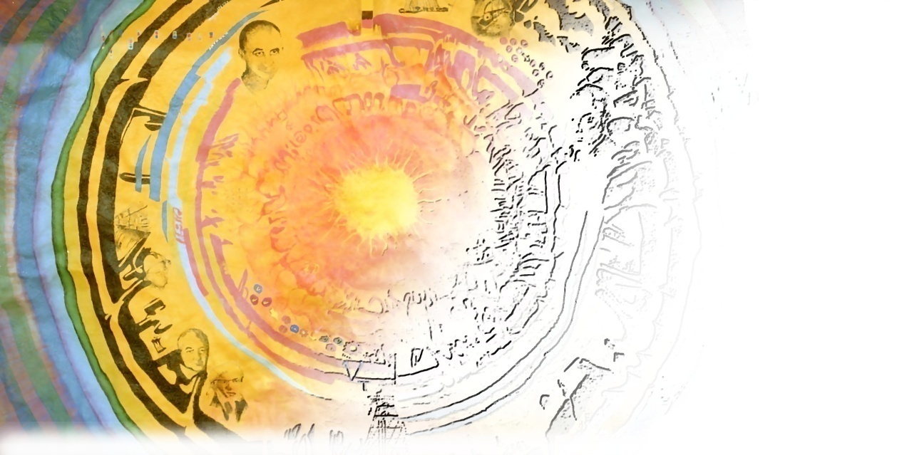
Preliminary Results for CCQE
Scattering with the MINOS
Near Detector
Mark Dorman, UCL
HEP Seminar, UCL, 4th December 2009
1

Slide 2
Introduction NuMI / MINOS CCQE Scattering Theory Data Analysis and Results Summary
Overview
Introduction to the MINOS experiment and NuMI beam
ν_{μ}-CC QE scattering theory and the axial-vector mass
Event selection and data analysis methodology
Axial-vector mass results and systematic errors
Summary and outlook for the analysis
HEP Seminar, UCL, 4th December 2009
2

Slide 3
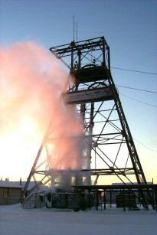
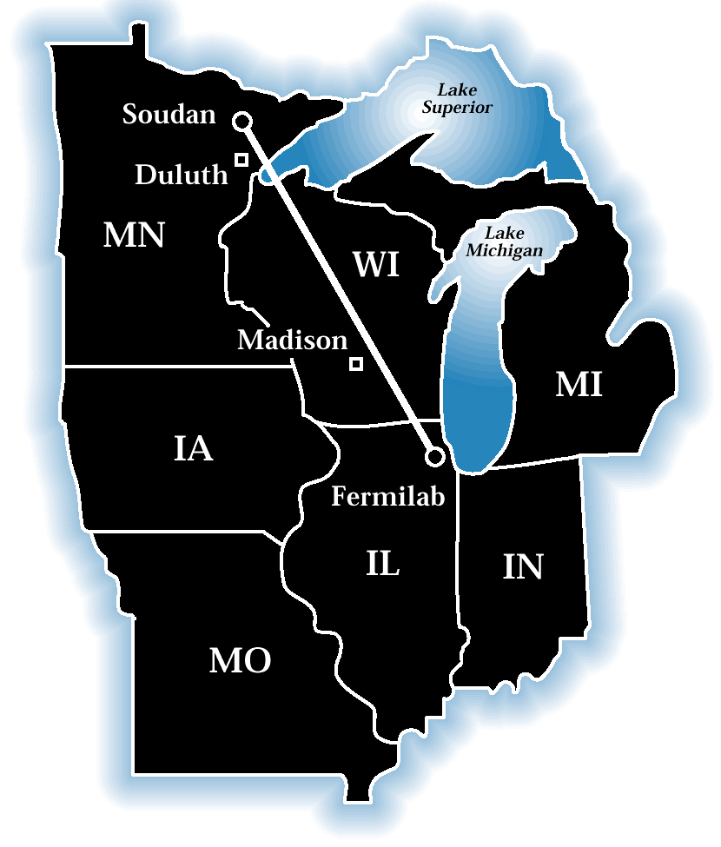
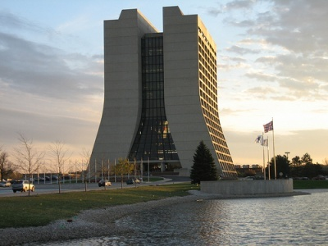
Introduction NuMI / MINOS CCQE Scattering Theory Data Analysis and Results Summary
The MINOS Experiment
The Main Injector Neutrino Oscillation Search.
Neutrino beam is produced using the
Neutrinos at the Main Injector (NuMI)
facility at FNAL.
The beam passes through the
Near Detector (ND) on-site at
FNAL and the Far Detector (FD),
735km away in the Soudan
Underground Mine.
Interesting things happen between the two!
HEP Seminar, UCL, 4th December 2009
3

Slide 4
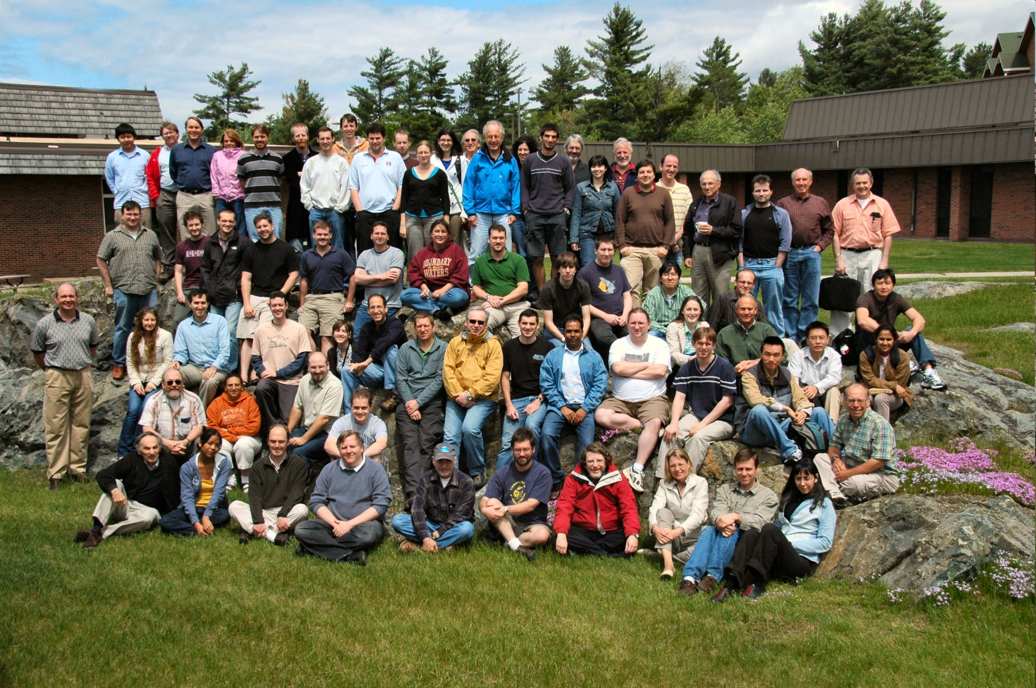





Introduction NuMI / MINOS CCQE Scattering Theory Data Analysis and Results Summary
The MINOS Collaboration
The collaboration comprises ~150 physicists from ~30 institutions.
HEP Seminar, UCL, 4th December 2009
4

Slide 5
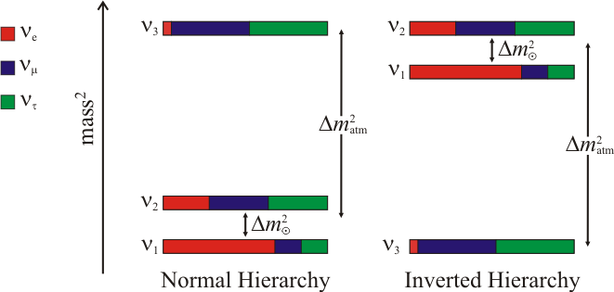
Introduction NuMI / MINOS CCQE Scattering Theory Data Analysis and Results Summary
MINOS Physics Goals
Make precision measurements of
the oscillation parameters Δm² and
sin²(2θ) [ ].
Rule out exotic models such as
neutrino de-coherence or decay.
θ₂₃
(electron, muon, tau flavours)
HEP Seminar, UCL, 4th December 2009
5

Slide 6
Introduction NuMI / MINOS CCQE Scattering Theory Data Analysis and Results Summary
MINOS Physics Goals
Make precision measurements of
the oscillation parameters Δm² and
sin²(2θ) [ ].
Rule out exotic models such as
neutrino de-coherence or decay.
Search for sub-dominant oscillations
at Δm²_{atm} [ ].
θ₂₃
θ₁₃
(electron, muon, tau flavours)
HEP Seminar, UCL, 4th December 2009
6

Slide 7
Introduction NuMI / MINOS CCQE Scattering Theory Data Analysis and Results Summary
MINOS Physics Goals
Make precision measurements of
the oscillation parameters Δm² and
sin²(2θ) [ ].
Rule out exotic models such as
neutrino de-coherence or decay.
Search for sub-dominant oscillations
at Δm²_{atm} [ ].
Search for possible mixing to
sterile neutrinos [ ].
Investigate anti-neutrino oscillations
(CPT test) [ ].
θ₂₃
θ₁₃
(electron, muon, tau flavours)
ND-only measurements of
neutrino interaction physics.
HEP Seminar, UCL, 4th December 2009
7

Slide 8
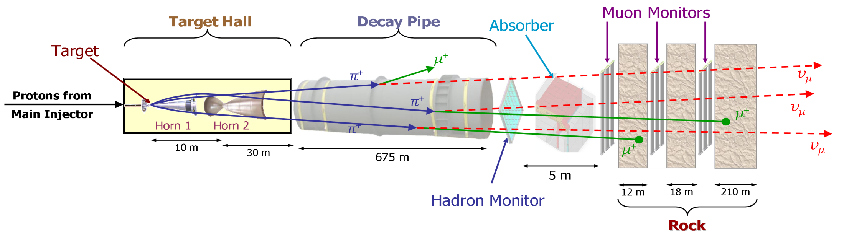
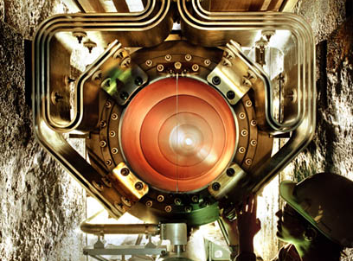
Introduction NuMI / MINOS CCQE Scattering Theory Data Analysis and Results Summary
The NuMI Beam
120 GeV protons are flung at a
graphite target and the resultant
spray of secondary hadrons are
focused by magnetic “horns” and
subsequently decay to neutrinos.
In the nominal low energy beam
configuration the beam comprises
End view
of horn.
HEP Seminar, UCL, 4th December 2009
8

Slide 9
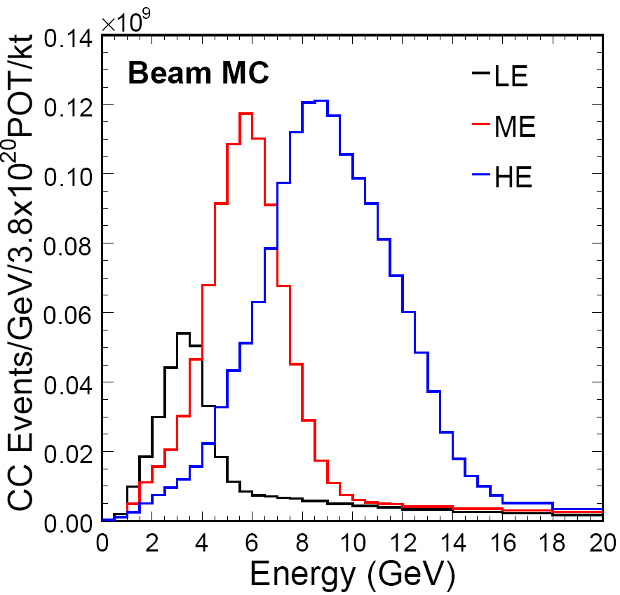
Introduction NuMI / MINOS CCQE Scattering Theory Data Analysis and Results Summary
Variable Beam Energy
The distance between the target and
first horn can be changed to give a
variable beam energy.
We can also vary the current passing
through the horns to further tweak the
energy spectrum or sign-select.
HEP Seminar, UCL, 4th December 2009
9

Slide 10
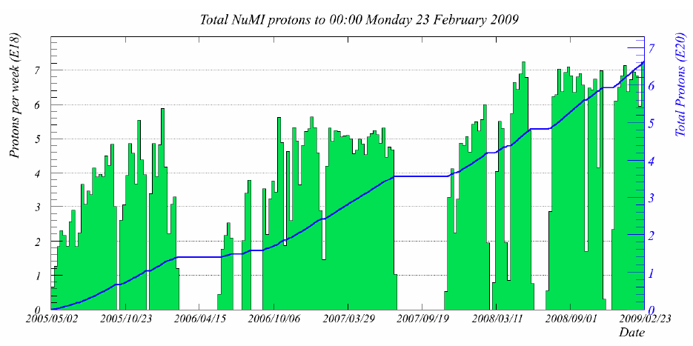
Introduction NuMI / MINOS CCQE Scattering Theory Data Analysis and Results Summary
NuMI Beam Performance
MINOS currently has over 7e20 POT!
2006 CC Publication
Nu08 NC
Nu08 CC
CCQE
Analysis
Total Protons (e20)
RUN I - 1.27x10²⁰ POT
RUN IIa
1.23x10²⁰ POT
RUN IIb
0.71x10²⁰ POT
RUN III
3.0x10²⁰ POT +
Other running, HE beam: 0.15x10²⁰ POT
HEP Seminar, UCL, 4th December 2009
10

Slide 11
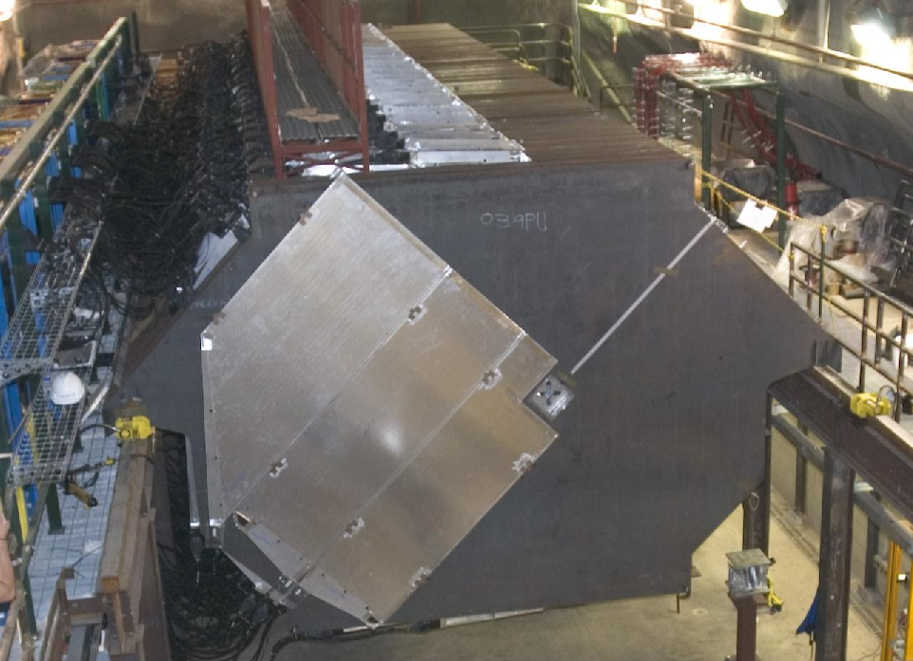
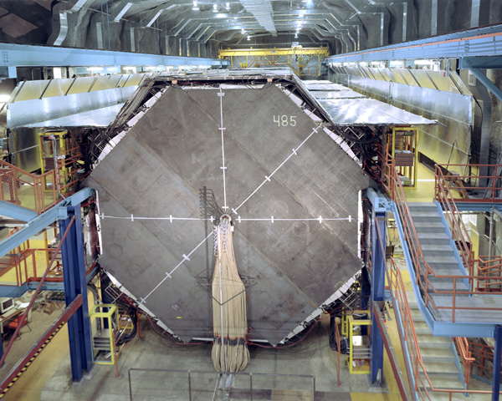
Introduction NuMI / MINOS CCQE Scattering Theory Data Analysis and Results Summary
The MINOS Detectors
Near Detector, 1.0kT
Detectors are massive steel-scintillator
tracking/sampling calorimeters.
Both detectors are magnetised to 1.3T
which allows us to sign-select particles.
The detectors are designed to be as
functionally similar as possible in
order to “cancel” many systematic
errors in oscillation measurements.
The ND sees a much larger rate of
neutrino interactions though.
Far Detector, 5.4kT
HEP Seminar, UCL, 4th December 2009
11

Slide 12
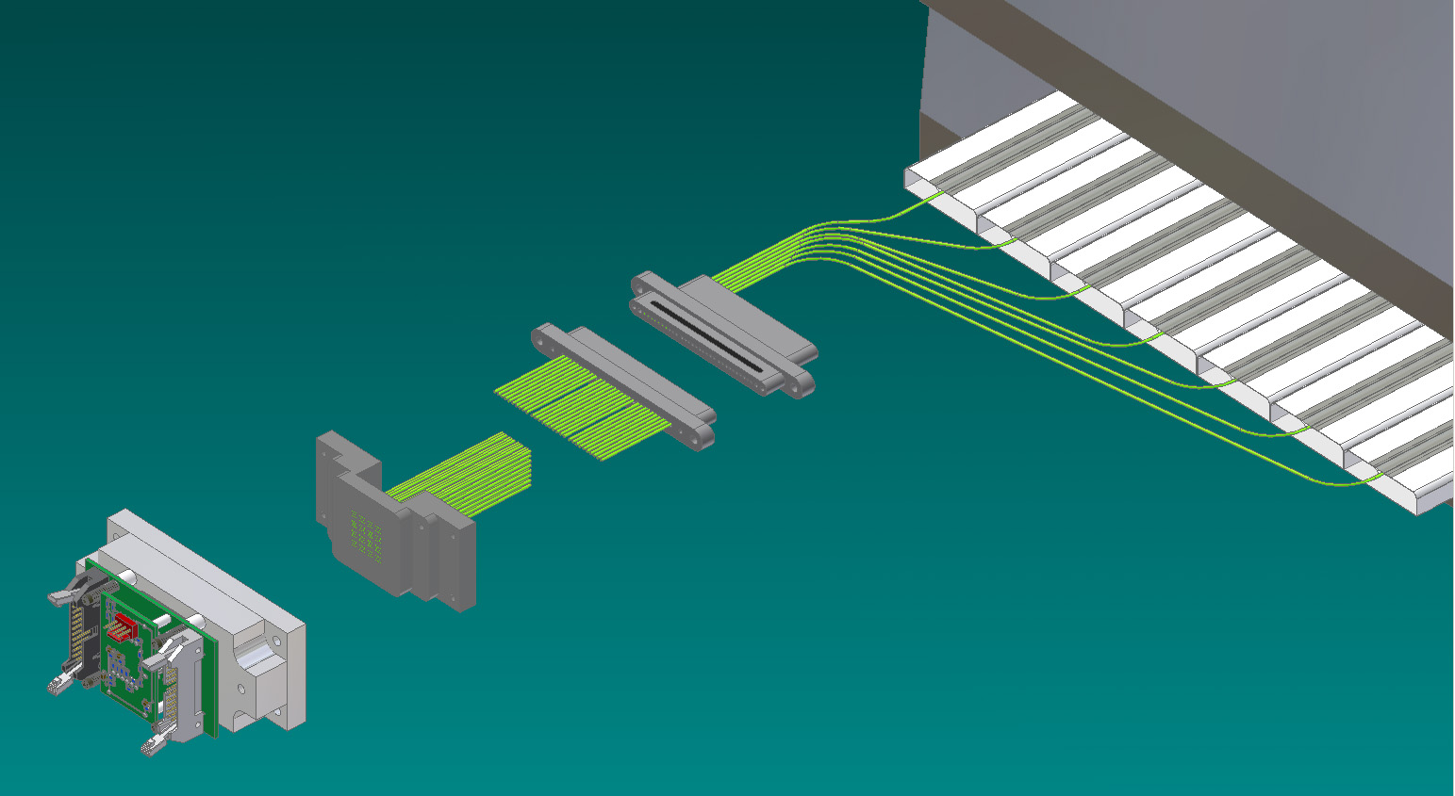
Introduction NuMI / MINOS CCQE Scattering Theory Data Analysis and Results Summary
Detector Technology
Steel Plane
Segmentation:
5.94cm longitudinal
4.1cm transverse
WLS
Fibres
Scint.: 1cm thick, 4.1cm wide
PMT Dark
Box
Readout
Cable
Strips on adjacent planes are
mounted orthogonal to allow
for 3D event reconstruction.
Multi-Anode
PMT
HEP Seminar, UCL, 4th December 2009
12

Slide 13
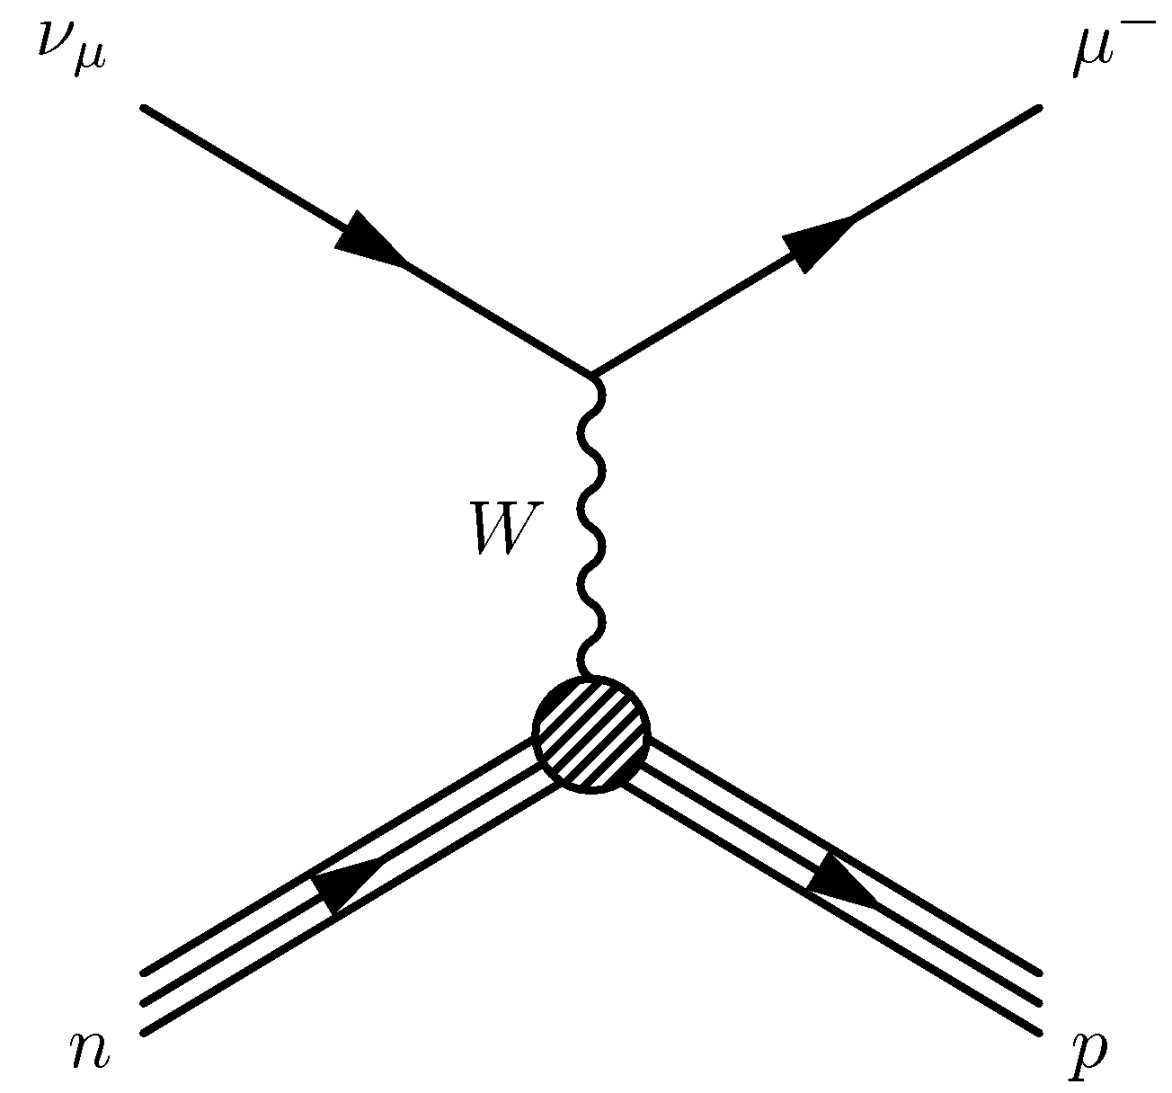
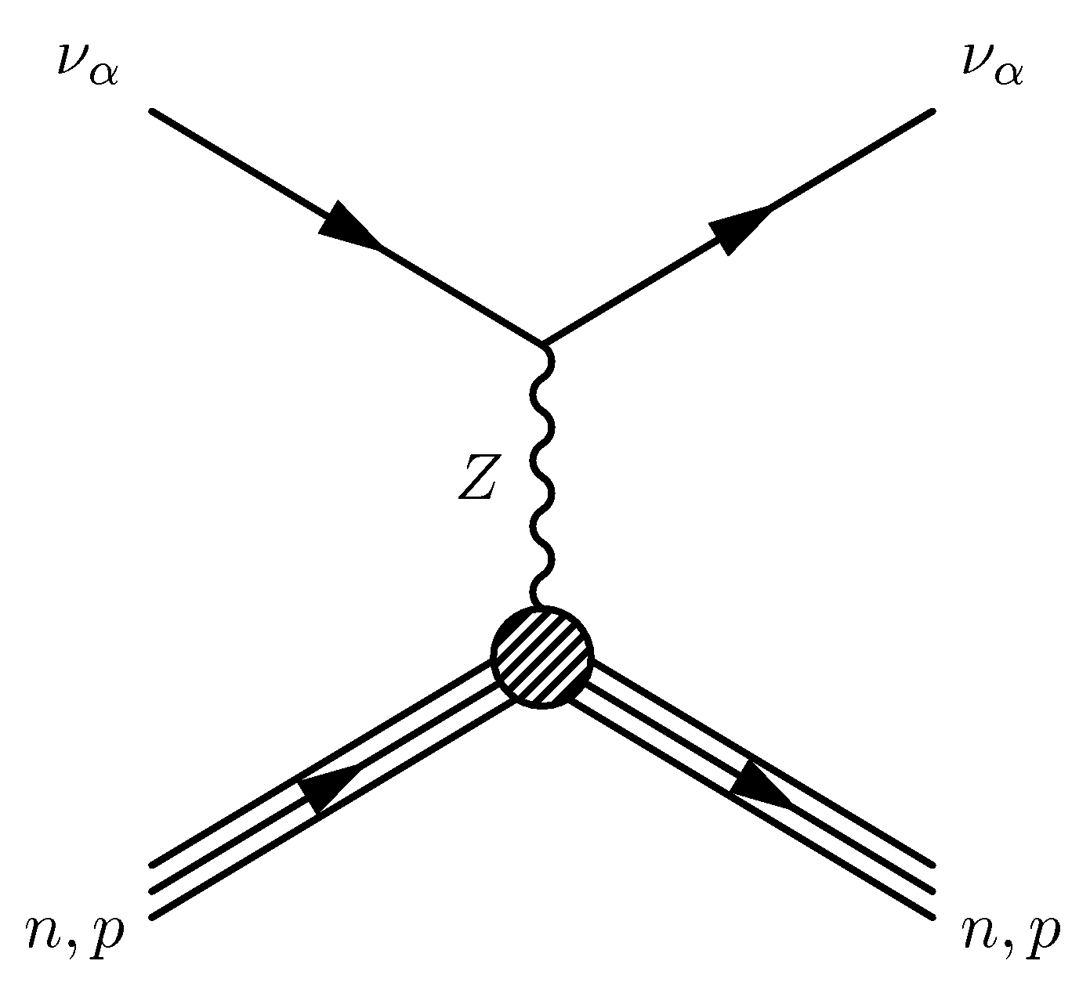
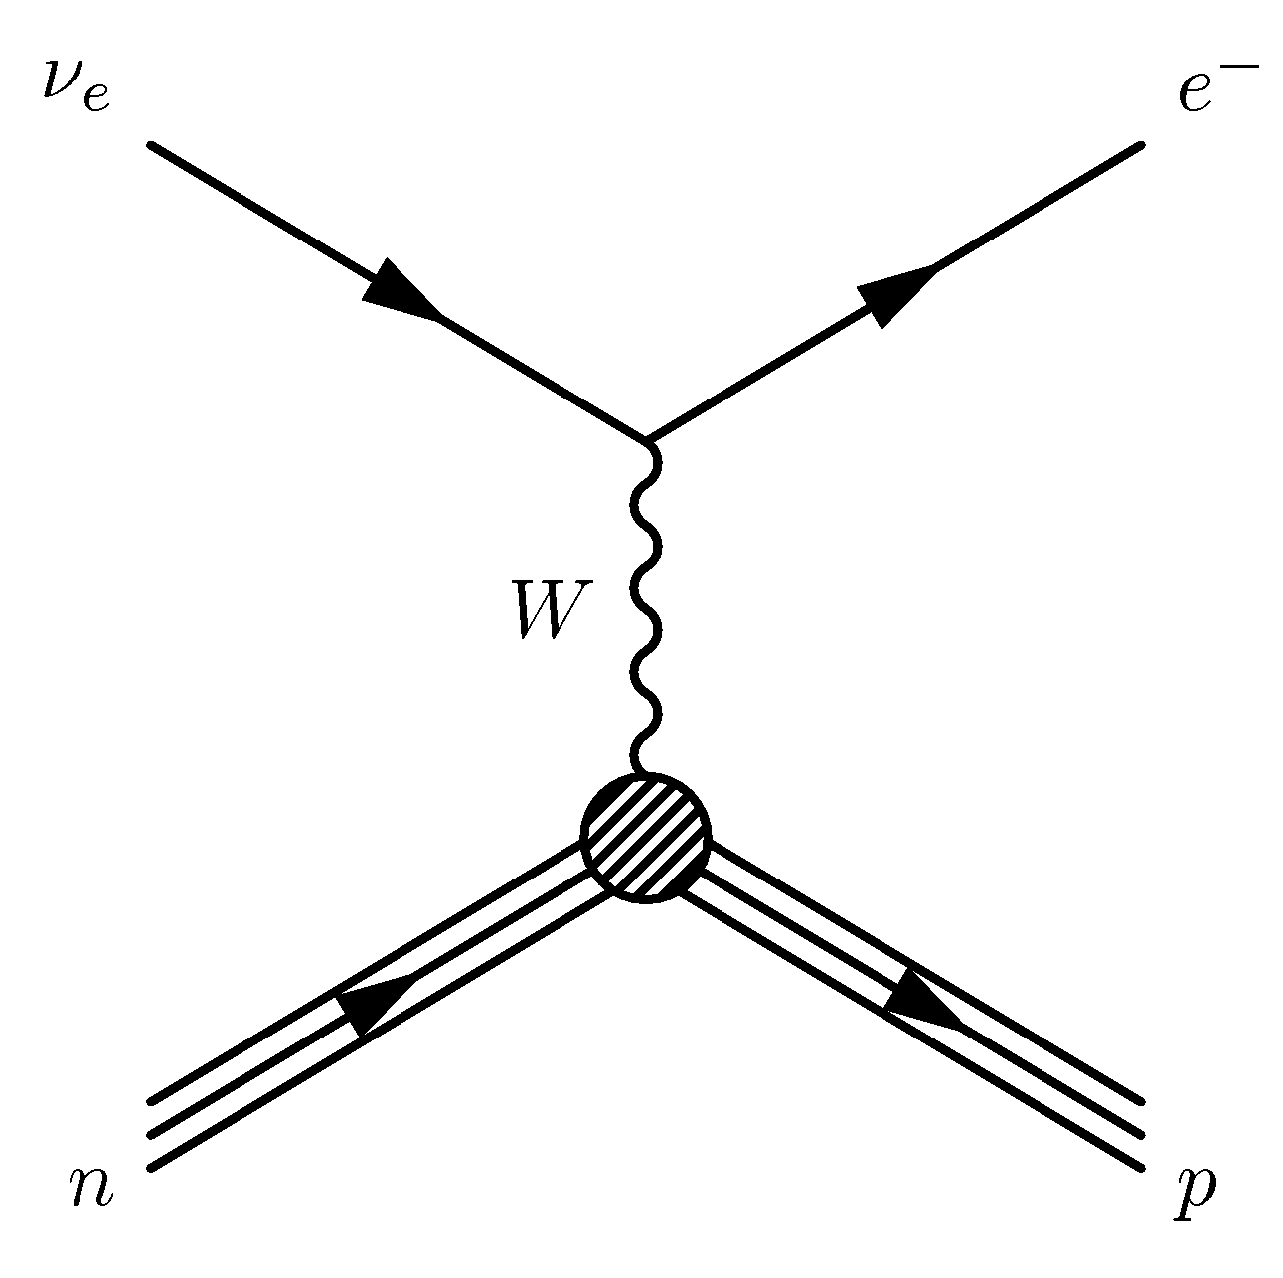
Introduction NuMI / MINOS CCQE Scattering Theory Data Analysis and Results Summary
Events in the MINOS Detectors
ν_{μ}
CC Event
NC Event
ν_{e}
CC Event
3.5m
1.8m
2.3m
What we use for the
sterile neutrino analysis.
What we look for in the
muon neutrino / anti-neutrino
analyses.
What we look for in the
electron neutrino analysis.
HEP Seminar, UCL, 4th December 2009
13

Slide 14
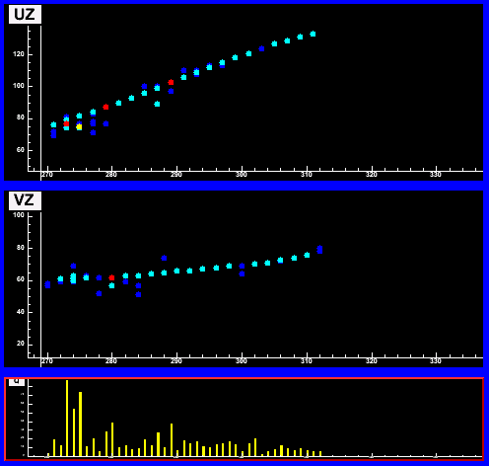
Introduction NuMI / MINOS CCQE Scattering Theory Data Analysis and Results Summary
Events in the MINOS Detectors
ν_{μ}
CC Event
NC Event
ν_{e}
CC Event
3.5m
3.5m
1.8m
2.3m
Long muon track with
hadronic activity at
the vertex.
What we use for the
sterile neutrino analysis.
What we look for in the
muon neutrino / anti-neutrino
analyses.
What we look for in the
electron neutrino analysis.
HEP Seminar, UCL, 4th December 2009
14

Slide 15
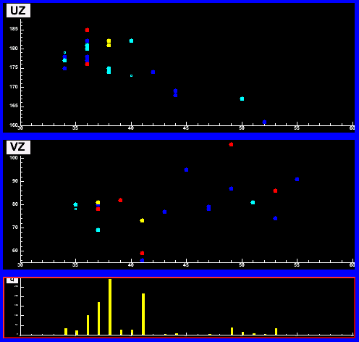
Introduction NuMI / MINOS CCQE Scattering Theory Data Analysis and Results Summary
Events in the MINOS Detectors
ν_{μ}
CC Event
NC Event
ν_{e}
CC Event
3.5m
3.5m
1.8m
1.8m
2.3m
Long muon track with
hadronic activity at
the vertex.
Short event often
with a diffuse shower.
What we use for the
sterile neutrino analysis.
What we look for in the
muon neutrino / anti-neutrino
analyses.
What we look for in the
electron neutrino analysis.
HEP Seminar, UCL, 4th December 2009
15

Slide 16
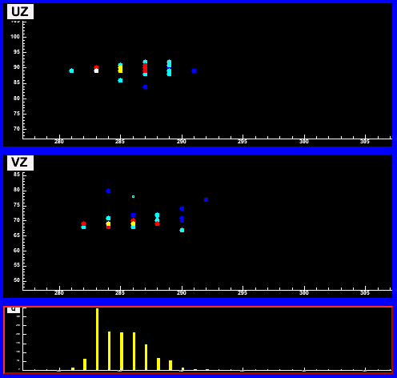
Introduction NuMI / MINOS CCQE Scattering Theory Data Analysis and Results Summary
Events in the MINOS Detectors
ν_{μ}
CC Event
NC Event
ν_{e}
CC Event
3.5m
1.8m
2.3m
Long muon track with
hadronic activity at
the vertex.
Short event often
with a diffuse shower.
Short event with a
compact, EM-like
shower profile.
What we use for the
sterile neutrino analysis.
What we look for in the
muon neutrino / anti-neutrino
analyses.
What we look for in the
electron neutrino analysis.
HEP Seminar, UCL, 4th December 2009
16

Slide 17
Introduction NuMI / MINOS CCQE Scattering Theory Data Analysis and Results Summary
Events in the MINOS Detectors
ν_{μ}
CC Event
NC Event
ν_{e}
CC Event
Muon energy resolution:
6% from range in the detector
13% from curvature in the magnetic field
Shower energy
resolution:
HEP Seminar, UCL, 4th December 2009
17

Slide 18
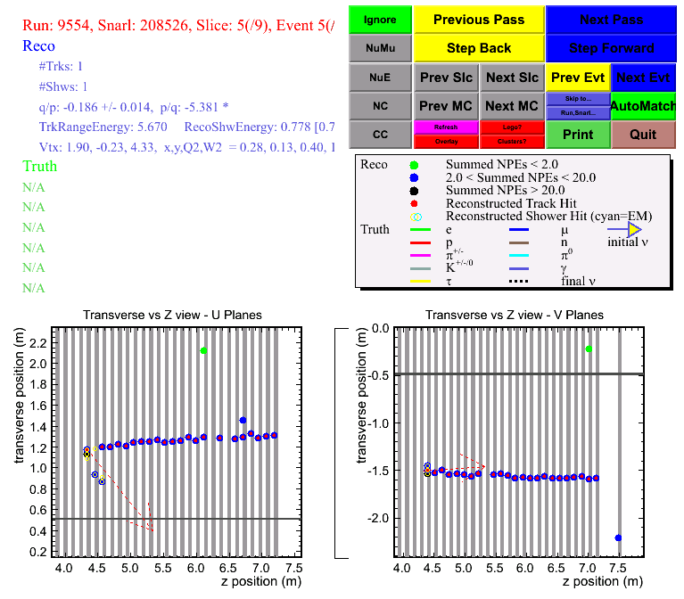
Introduction NuMI / MINOS CCQE Scattering Theory Data Analysis and Results Summary
Candidate CCQE Scattering Event
There are various types of
ν_{μ}-CC scattering that occur
in experiments like MINOS,
the dominant three are:
Quasi-Elastic Scattering:
(target is modified but
does not break up)
Resonance Production:
Increasing invariant mass.
Deep Inelastic Scattering:
(target does break up)
“Small Shower”
HEP Seminar, UCL, 4th December 2009
18

Slide 19
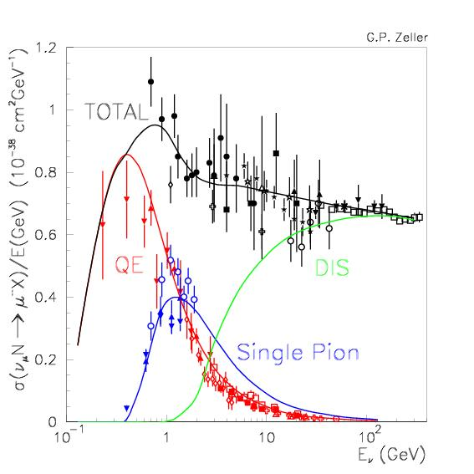
Introduction NuMI / MINOS CCQE Scattering Theory Data Analysis and Results Summary
Why do we care about CCQE?
Dominant interaction mode at low
energy where future experiments
will operate (e.g. T2K, NOvA).
Could be an important systematic
for θ₁₃ measurements but is also
hugely interesting in its own right:
CCQE cross section measurements
have been being made for 40 years
but the devil is in the details…
Fundamental process
Probe axial nature of nucleon
Window onto nuclear effects
…
K2K
NOvA
HEP Seminar, UCL, 4th December 2009
19

Slide 20
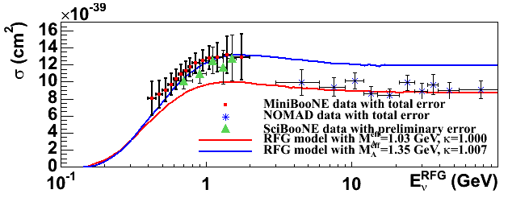
Introduction NuMI / MINOS CCQE Scattering Theory Data Analysis and Results Summary
Why do we care about CCQE?
Cross section is not well understood, for example see recent results from
the MiniBooNE and NOMAD experiments:
Before I talk more about the current status of CCQE cross section
measurements I think we need to take a quick theory diversion…
From T. Katori at NUINT09
MINOS
HEP Seminar, UCL, 4th December 2009
20

Slide 21
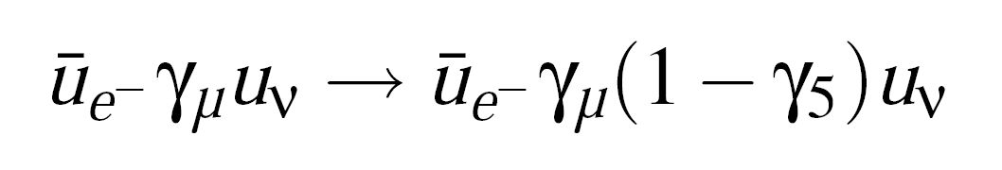
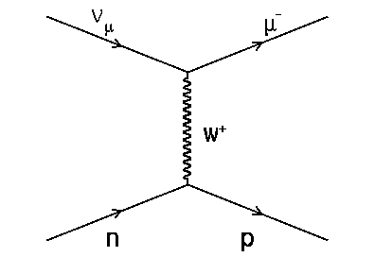
Introduction NuMI / MINOS CCQE Scattering Theory Data Analysis and Results Summary
Towards the CCQE Cross Section
Incorporation of parity violation in
the weak interaction leads to the
V-A form of the weak current:
This is valid for lepton-lepton and quark-quark vertices but how about
a vertex involving nucleons:
Fermi's original
4-vector current
V-A weak current
Additional strong interaction effects must
be taken into account.
We know that such effects conserve the
net electric charge (proton always has
charge +1).
There is no reason to believe the same
is true in the weak interaction.
OK.
Erm…
CCQE Scattering
HEP Seminar, UCL, 4th December 2009
21

Slide 22
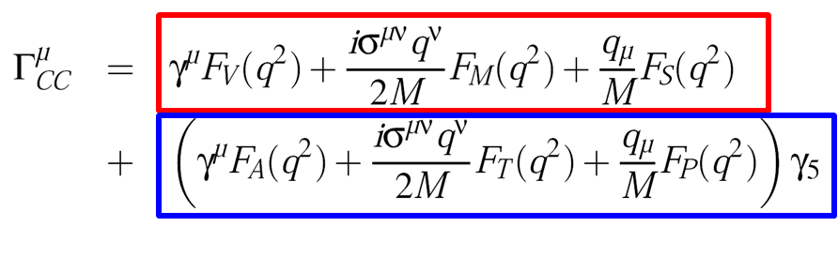

Introduction NuMI / MINOS CCQE Scattering Theory Data Analysis and Results Summary
Nucleon Form Factors
Describe hadronic vertex in terms of nucleon form factors which define
how much of each type of possible weak current contributes to a scatter:
These form factors are
functions of the probe
strength, Q².
where
(V-type and A-type currents)
HEP Seminar, UCL, 4th December 2009
22

Slide 23
Introduction NuMI / MINOS CCQE Scattering Theory Data Analysis and Results Summary
Nucleon Form Factors
Describe hadronic vertex in terms of nucleon form factors which define
how much of each type of possible weak current contributes to a scatter:
These form factors are
functions of the probe
strength, Q².
where
(V-type and A-type currents)
Large Q².
Smaller Q².
Nucleon Nucleon
de Broglie
Relation
Probe sees different levels of nucleon
structure depending upon it’s momentum.
HEP Seminar, UCL, 4th December 2009
23

Slide 24
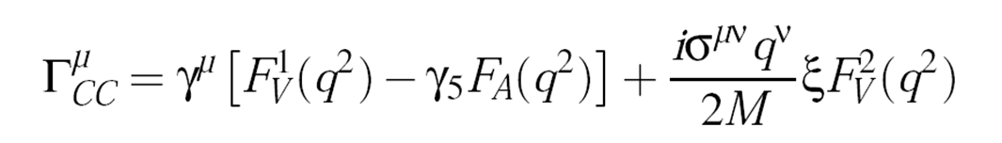
Introduction NuMI / MINOS CCQE Scattering Theory Data Analysis and Results Summary
Nucleon Form Factors
Describe hadronic vertex in terms of nucleon form factors which define
how much of each type of possible weak current contributes to a scatter:
These form factors are
functions of the probe
strength, Q².
In practice, only 3 of the form factors are non-zero:
where
(V-type and A-type currents)
Multiplied by lepton
mass in cross section so
neglected for our muons.
Well measured through
electron scattering experiments.
Not well measured and only neutrino
scattering experiments can extract F_{A}(Q²).
HEP Seminar, UCL, 4th December 2009
24

Slide 25
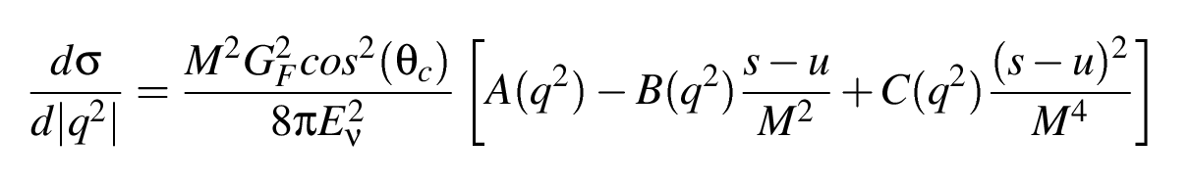
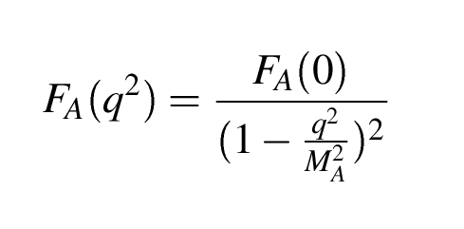
Introduction NuMI / MINOS CCQE Scattering Theory Data Analysis and Results Summary
σ_{CCQE} and the Axial-Vector Form Factor
CCQE Differential Cross Section
A, B and C are functions of the form
factors and, in particular, depend on:
Well known from neutron
β-decay experiments.
The axial-vector mass
for CCQE scattering.
“Dipole Form”
HEP Seminar, UCL, 4th December 2009
25

Slide 26
Introduction NuMI / MINOS CCQE Scattering Theory Data Analysis and Results Summary
σ_{CCQE} and the Axial-Vector Form Factor
CCQE Differential Cross Section
A, B and C are functions of the form
factors and, in particular, depend on:
So we know the vector form factors and F_{A}(0) => the uncertainty in
this cross section is dominated by the uncertainty on the value of the
axial mass.
Dipole form looks a bit like a propagator.
Could think of M_{A} as the mass of the
exchanged boson corresponding to the
axial-vector part of the weak interaction.
HEP Seminar, UCL, 4th December 2009
26

Slide 27
Introduction NuMI / MINOS CCQE Scattering Theory Data Analysis and Results Summary
Nuclear Effects
Of course in experiments we are not scattering off
quarks, or even nucleons, but from nuclei.
Nuclear effects become important at very
low Q² (where we are interacting with a
number of nucleons bound in a nucleus).
Nuclear effects modify the cross section.
Most neutrino event generators model
their nuclei and the associated effects
using the relativistic Fermi gas model.
In MINOS the neutrinos are scattering off
iron nuclei - heavy!
Smaller Q².
Nucleon
Nucleus
Low Q².
“Fermi Motion”
HEP Seminar, UCL, 4th December 2009
27

Slide 28
Introduction NuMI / MINOS CCQE Scattering Theory Data Analysis and Results Summary
The Fermi Gas Model and Pauli-Blocking
All momentum levels below the Fermi
momentum, k_{F}, are filled.
Apply Pauli-exclusion principle to the
nucleons: identical fermions can’t
occupy the same quantum state.
So any CCQE interaction which leaves the final state nucleon with
momentum below k_{F} is considered to be “Pauli-blocked” (in the
event generators this is essentially a Heaviside function).
Fermi gas model takes care of other nuclear effects too, things like the
Fermi motion of nucleons etc. Final state interactions in the nuclear
medium are treated separately (will come back to this later).
p
k_{F}
x
“Fermi Sea”
HEP Seminar, UCL, 4th December 2009
28

Slide 29
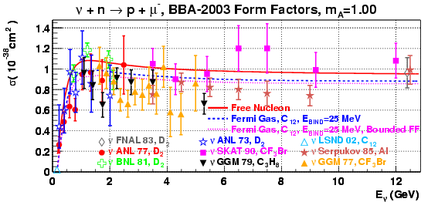
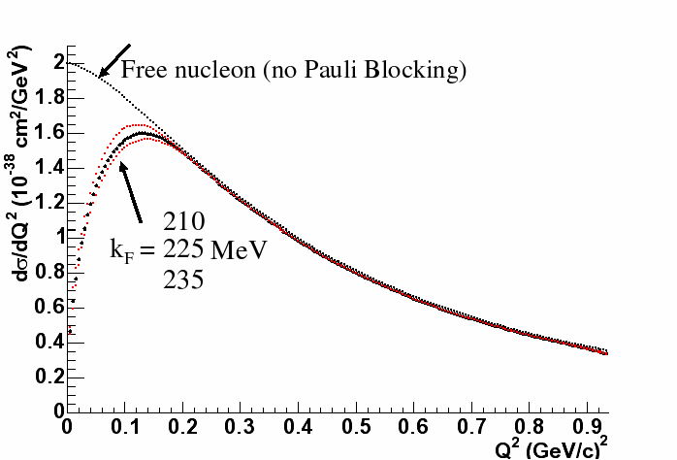
Introduction NuMI / MINOS CCQE Scattering Theory Data Analysis and Results Summary
Impact of Pauli-Blocking
Significant
effect on
cross section!
Nuclear effects result in a somewhat uniform decrease in the cross section
as a function of energy but are
limited to the low Q² region.
HEP Seminar, UCL, 4th December 2009
29

Slide 30
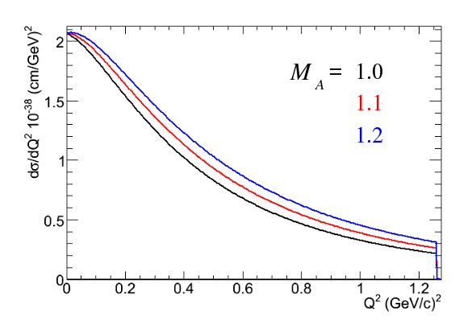
Introduction NuMI / MINOS CCQE Scattering Theory Data Analysis and Results Summary
A Generic Axial Mass Measurement
The CCQE differential cross
section with respect to Q²
depends upon M_{A}…
Changes in the value of M_{A}
affect both the shape and rate
of the cross section – it is these
effects that give sensitivity.
Possible analysis choices:
… can measure M_{A} by looking
at the Q² distribution for
CCQE scattering events.
If you don’t have a good flux
measurement you can use a
shape-only fit for M_{A}.
1 GeV neutrinos on free nucleon.
Fermi gas is too simplistic – can either ignore the low Q² region in fits
or try to modify the CCQE sample at low Q² with another parameter.
HEP Seminar, UCL, 4th December 2009
30

Slide 31
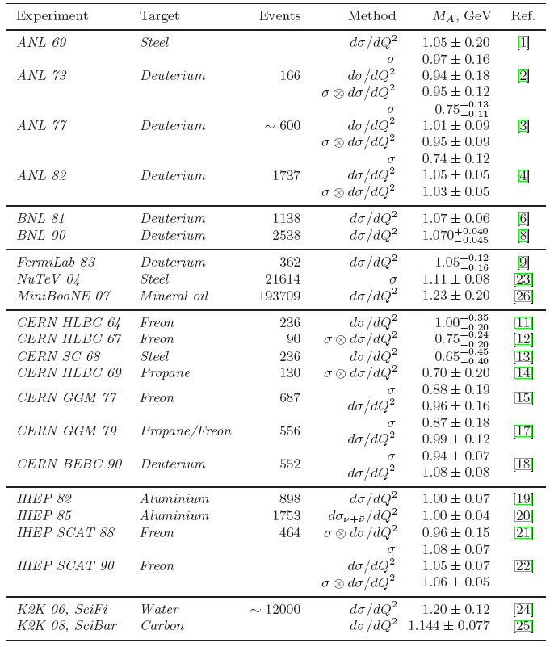
Introduction NuMI / MINOS CCQE Scattering Theory Data Analysis and Results Summary
Current Status of Axial Mass Results
Lyubushkin et al. arXiv:0812.4543
Also:
MiniBooNE: 1.35+-0.17 (NUINT09)
NOMAD: 1.05+-0.07 (above paper)
World average (circa 2002):
1.026 +- 0.021 GeV
Complications:
Target nucleus
Energy range
Kinematic resolution
Shape v.s. rate
Input vector form factors
Number of CCQE events
=>M_{A} is effective parameter?
?
HEP Seminar, UCL, 4th December 2009
31

Slide 32
Introduction NuMI / MINOS CCQE Scattering Theory Data Analysis and Results Summary
MINOS CCQE Analysis Overview
MINOS has been going flowchart crazy recently so here it is…
Measurements of the absolute flux
at the MINOS ND down to the lowest
energies are currently being performed.
(>3 GeV recently published for
neutrinos, >5 for anti-neutrinos)
As such we have performed a shape
based measurement of M_{A}^{QE}.
Take Data! Select ν_{μ}–CC events. Select CCQE sub-sample.
Tune flux model.
Shape-only fits for M_{A}^{QE}.
Estimate systematic errors.
HEP Seminar, UCL, 4th December 2009
32

Slide 33
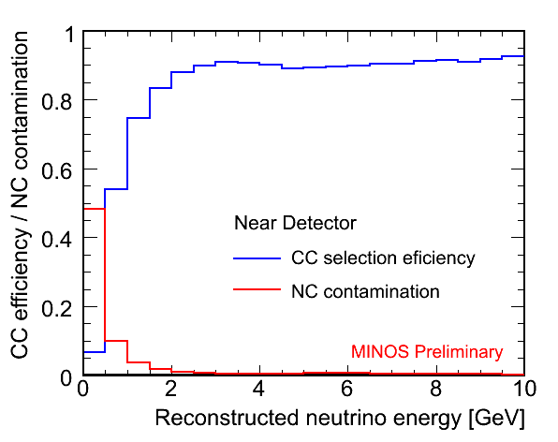
Introduction NuMI / MINOS CCQE Scattering Theory Data Analysis and Results Summary
Selecting ν_{μ}–CC Events
We first remove the majority of NC events by requiring a reconstructed
track and then further enrich the sample using a nearest neighbour
technique (kNN).
The kNN combines variables that differentiate between muon tracks and
the pion or proton tracks that can be reconstructed in NC events.
ND
ND
Good agreement
between data
and MC.
CC Selection Efficiency
NC Contamination
HEP Seminar, UCL, 4th December 2009
33

Slide 34
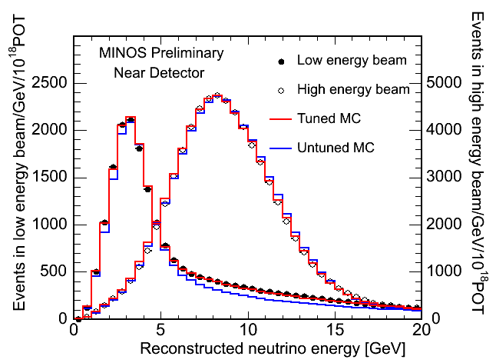
Introduction NuMI / MINOS CCQE Scattering Theory Data Analysis and Results Summary
Flux Model Tuning
Different beam configurations
sample different regions in
parent hadron x_{f} and p_{T}.
We fit the data and tune our
FLUKA hadron production
model.
The fits also include nuisance
parameters for beam optics
effects, cross sections and
ND energy scales.
This flux-tuning procedure has been very successful and all of the MC
distributions shown in my talk will use the tuned hadron production model.
HEP Seminar, UCL, 4th December 2009
34

Slide 35
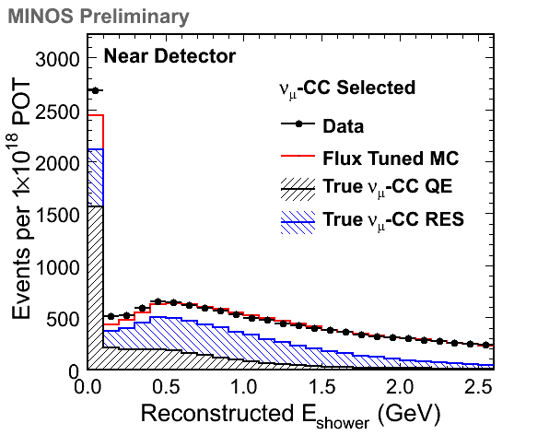
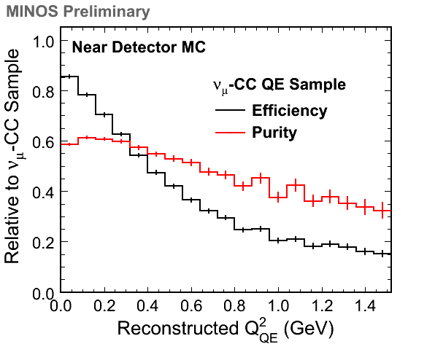
Introduction NuMI / MINOS CCQE Scattering Theory Data Analysis and Results Summary
Selecting ν_{μ}–CC QE Events
We select a QE-enriched sample using a simple cut on the hadronic
shower energy and only consider events with muons that stop in the ND:
E_{had} < 250 MeV for QE sample
Efficiency: 53%, Purity: 61%
HEP Seminar, UCL, 4th December 2009
35

Slide 36
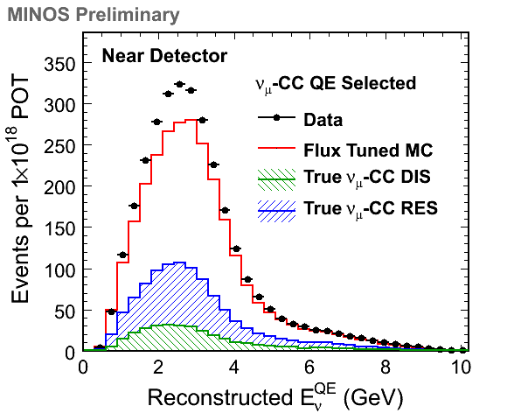
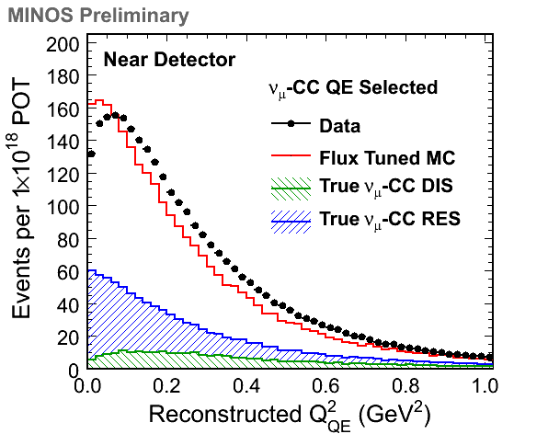
Introduction NuMI / MINOS CCQE Scattering Theory Data Analysis and Results Summary
Data/MC Comparison for CCQE Sample
“QE-assumed kinematics.”
HEP Seminar, UCL, 4th December 2009
36

Slide 37
Introduction NuMI / MINOS CCQE Scattering Theory Data Analysis and Results Summary
Data/MC Comparison for CCQE Sample
Total # of events selected:
Data: 344,736
MC: 292,501
Data wants more low Q² suppression
and a flatter spectrum at higher Q².
HEP Seminar, UCL, 4th December 2009
37

Slide 38
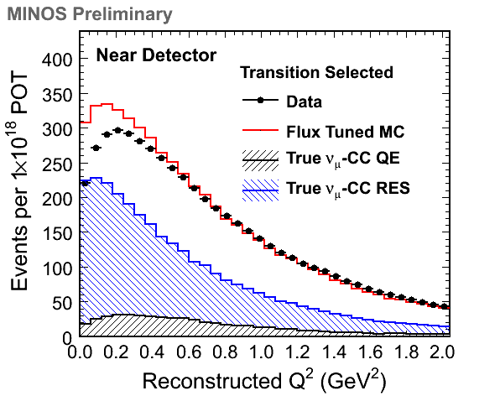
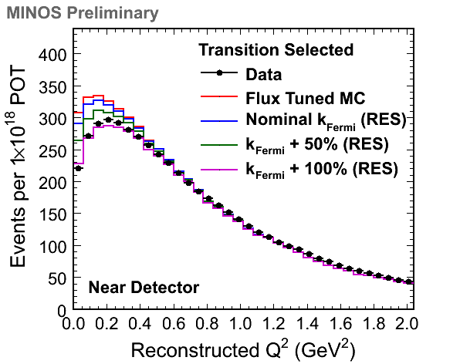
Introduction NuMI / MINOS CCQE Scattering Theory Data Analysis and Results Summary
Understanding the Resonances
We can select a resonance enhanced
sample using W cuts and see large
differences between data and MC
in the low Q² (nuclear effect) region.
Suggests a mis-modeling of nuclear
effects for resonance interactions. No
Pauli-blocking of resonance events in the
default MC –> turn on for CCQE analysis.
HEP Seminar, UCL, 4th December 2009
38

Slide 39
Introduction NuMI / MINOS CCQE Scattering Theory Data Analysis and Results Summary
Fitting for an Effective M_{A}^{QE}
Use MINUIT to minimize:
Fit
parameters
Shift in systematic
parameter j from nominal
# observed
events in bin i
# expected
events in bin i
1σ error
for systematic
parameter j
MC normalization
Will show results from 2 shape-only fits to Q²_{QE} (>0.3 and >0.0 GeV²).
The most important systematic effects are considered directly in the
fits whilst other uncertainties are studied via their impact on the fit results.
Based on observations of the resonance sample we apply Pauli-blocking
to the resonance interactions. We also apply a correction for the
Coulomb interaction between the nucleus and outgoing lepton.
HEP Seminar, UCL, 4th December 2009
39

Slide 40
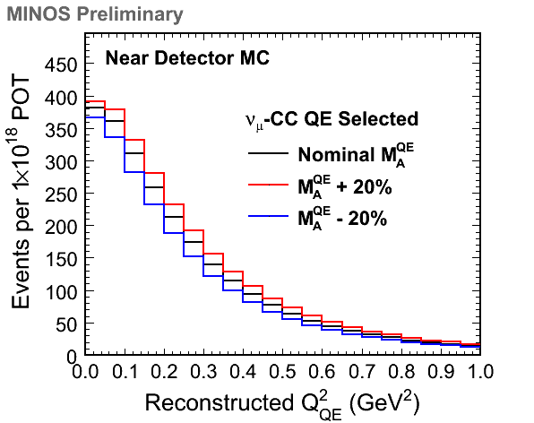
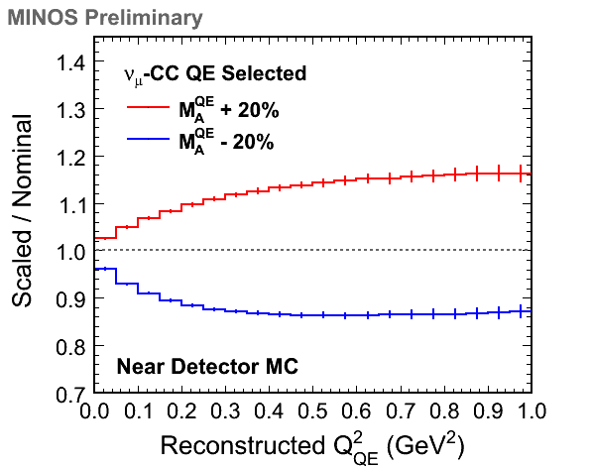
Introduction NuMI / MINOS CCQE Scattering Theory Data Analysis and Results Summary
Fit Parameter: M_{A}^{QE}-Scale
Nominal = 0.99 GeV
Treated as a free parameter in the fits. The effect on the QE sample is
asymmetric due to the non-QE background. Note that these figures are
absolutely normalized although the fits only consider the Q² shape.
HEP Seminar, UCL, 4th December 2009
40

Slide 41
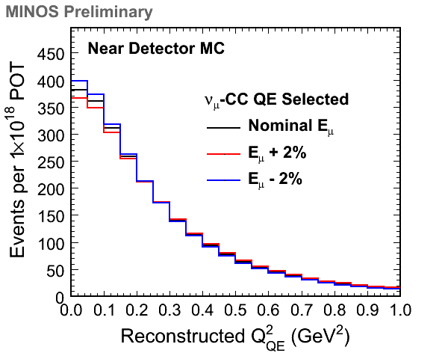
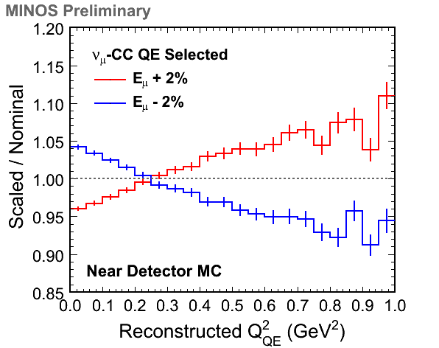
Introduction NuMI / MINOS CCQE Scattering Theory Data Analysis and Results Summary
Fit Parameter: Muon Energy Scale
Nominal = 1.00
We take a 1σ error of 2% for use in the penalty term (this is the
published MINOS uncertainty for stopping muons). This parameter
changes Q² via the muon-only kinematic reconstruction.
HEP Seminar, UCL, 4th December 2009
41

Slide 42
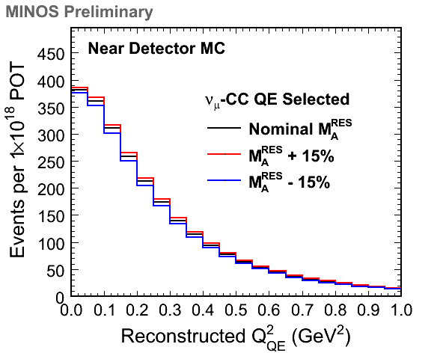
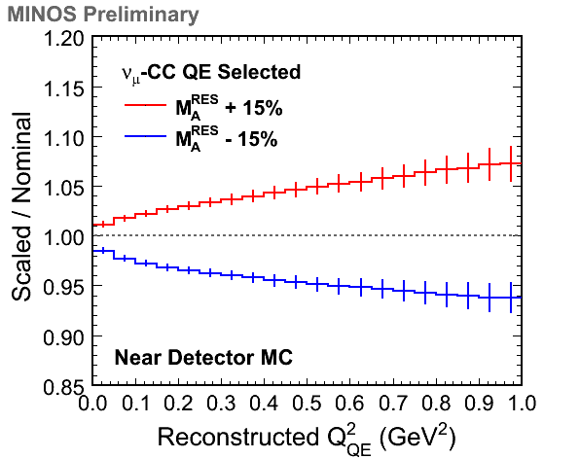
Introduction NuMI / MINOS CCQE Scattering Theory Data Analysis and Results Summary
Fit Parameter: M_{A}^{RES}-Scale
Nominal = 1.12 GeV
We take a 1σ error of 15% for use in the penalty term (again, this is the
published MINOS uncertainty). This parameter can change both the
shape and rate of the resonance background in the QE sample.
HEP Seminar, UCL, 4th December 2009
42

Slide 43
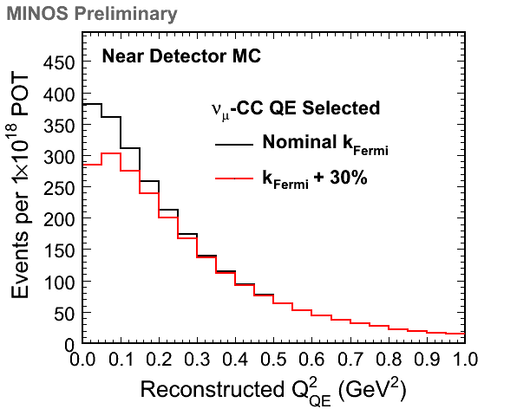
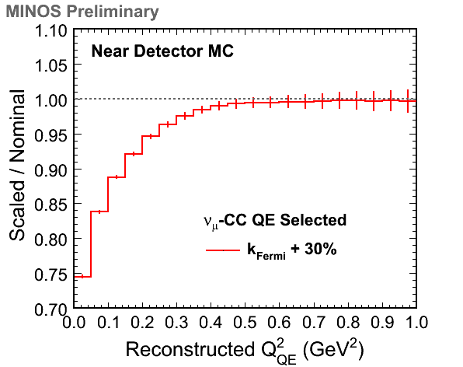
Introduction NuMI / MINOS CCQE Scattering Theory Data Analysis and Results Summary
Fit Parameter: Low Q² Suppression
Nominal = 1.00
We fit a scaling of the Fermi momentum used to Pauli-block QE events.
This is an effective parameter to account for mis-modeled nuclear effects
and is only used when we fit for M_{A}^{QE} below Q²=0.3 GeV².
HEP Seminar, UCL, 4th December 2009
43

Slide 44
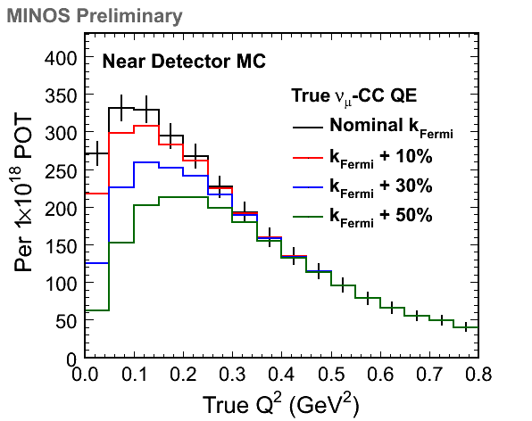
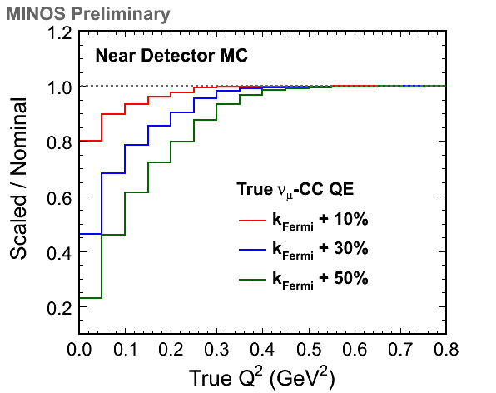
Introduction NuMI / MINOS CCQE Scattering Theory Data Analysis and Results Summary
More on Effective Low Q² Suppression
Now looking at true Q² for true ν_{μ}–CC QE events. We take an assumed
1σ error of 30% on this parameter which corresponds to removing about
50% of the lowest Q² events. There are limitations for this parameter…
HEP Seminar, UCL, 4th December 2009
44

Slide 45


Introduction NuMI / MINOS CCQE Scattering Theory Data Analysis and Results Summary
Examples of Nuclear Model Spread
Benhar and Meloni 2009, 0903.2329[hep-ph]
Butkevich 2008, Phys.Rev.C 78 (015501)
Comparing FG to SF there is a Q² shape change
persisting out to 0.6 GeV². Comparing RFGM to
RDWIA there is only a Q² shape change out to
0.2 GeV².
“Beyond-the-Fermi-gas”
nuclear models.
HEP Seminar, UCL, 4th December 2009
45

Slide 46


Introduction NuMI / MINOS CCQE Scattering Theory Data Analysis and Results Summary
Results for >0.3 GeV² Fit
MINOS Preliminary
Parameter | M_{A}^{QE} (GeV) | E_{μ}-Scale | M_{A}^{RES} (GeV)
Best Fit | 1.256 | 0.988 | 1.065
Reduced χ²: 1.545 -> 0.836
MC Scale Factor: 1.311 -> 1.103
HEP Seminar, UCL, 4th December 2009
46

Slide 47

Introduction NuMI / MINOS CCQE Scattering Theory Data Analysis and Results Summary
>0.3 GeV² Fit Contour and Correlations
Fit Parameter | M_{A}^{QE} Scale | E_{μ} Scale | M_{A}^{RES} Scale
M_{A}^{QE} Scale | 1.00 | -0.62 | -0.55
E_{μ} Scale | -0.62 | 1.00 | -0.12
M_{A}^{RES} Scale | -0.55 | -0.12 | 1.00
MINOS Preliminary
Contour drawn from MINUIT and minimized at every point with respect
to the other fit parameter; the M_{A}^{RES}-scale. There is a relatively strong
anti-correlation between these two fit parameters.
HEP Seminar, UCL, 4th December 2009
47

Slide 48
Introduction NuMI / MINOS CCQE Scattering Theory Data Analysis and Results Summary
Systematic Errors and >0.3 GeV² Result
Change in both data and
MC -> sanity check.
Systematic Source | Positive Shift (GeV) | Negative Shift (GeV)
QE Selection Cut | 0.018 | 0.033
Hadronic Energy Offset | 0.045 | 0.047
Final State Interactions | 0.042 | 0.042
DIS Cross Section | 0.033 | 0.035
Flux Tuning | 0.025 | 0.025
QE Nuclear Effects | 0.000 | 0.077
RES Nuclear Effects | 0.000 | 0.021
Quadrature Sum | 0.076 | 0.115
Re-weight the MC
for changes to the
normalization of low
multiplicity channels.
Vary flux tuning using
errors from beam fits
(and from not using
them at all).
MINOS Preliminary
Effective M_{A}^{QE} = 1.26 ^{+0.12}_{-0.10} (fit) ^{+0.08}_{-0.12} (syst) GeV
MINOS Preliminary
HEP Seminar, UCL, 4th December 2009
48

Slide 49
Introduction NuMI / MINOS CCQE Scattering Theory Data Analysis and Results Summary
Systematic Errors and >0.3 GeV² Result
Includes effects such
as mis-calibration and
mis-reconstruction.
Systematic Source | Positive Shift (GeV) | Negative Shift (GeV)
QE Selection Cut | 0.018 | 0.033
Hadronic Energy Offset | 0.045 | 0.047
Final State Interactions | 0.042 | 0.042
DIS Cross Section | 0.033 | 0.035
Flux Tuning | 0.025 | 0.025
QE Nuclear Effects | 0.000 | 0.077
RES Nuclear Effects | 0.000 | 0.021
Quadrature Sum | 0.076 | 0.115
Changes to intra-nuclear
re-scattering parameters
such as pion elastic or
in-elastic scattering, charge
exchange, secondary pion
production, the formation
time and nucleon absorption.
Investigated via changes
to the value of the Fermi
momentum used to apply
Pauli-blocking.
MINOS Preliminary
Effective M_{A}^{QE} = 1.26 ^{+0.12}_{-0.10} (fit) ^{+0.08}_{-0.12} (syst) GeV
MINOS Preliminary
HEP Seminar, UCL, 4th December 2009
49

Slide 50
Introduction NuMI / MINOS CCQE Scattering Theory Data Analysis and Results Summary
Intra-Nuclear Re-Scattering (FSI)
Hadron mean free path is of order fm.
Many possibilities to mask the primary
interaction (approximately 40% in Iron).
FSI change both the final hadronic state
multiplicities and observable kinematics.
or
or
or…
Muon
Neutrino
Proton
Neutron
Neutron
Pion
HEP Seminar, UCL, 4th December 2009
50

Slide 51


Introduction NuMI / MINOS CCQE Scattering Theory Data Analysis and Results Summary
Results for >0.0 GeV² Fit
MINOS Preliminary
Parameter | M_{A}^{QE} (GeV) | E_{μ}-Scale | M_{A}^{RES} (GeV) | k_{Fermi}- Scale
Best Fit | 1.192 | 0.988 | 1.112 | 1.284
Reduced χ²: 216.5 -> 1.023
MC Scale Factor: 1.180 -> 1.140
HEP Seminar, UCL, 4th December 2009
51

Slide 52


Introduction NuMI / MINOS CCQE Scattering Theory Data Analysis and Results Summary
>0.0 GeV² Fit Contours
Contours are drawn from MINUIT and minimized at every point with
respect to the other fit parameters; the M_{A}^{RES}-scale and either the QE
Fermi momentum scale or stopping muon energy scale.
HEP Seminar, UCL, 4th December 2009
52

Slide 53
Introduction NuMI / MINOS CCQE Scattering Theory Data Analysis and Results Summary
Systematic Errors and >0.0 GeV² Result
Systematic Source | Positive Shift (GeV) | Negative Shift (GeV)
QE Selection Cut | 0.027 | 0.066
Hadronic Energy Offset | 0.065 | 0.075
Final State Interactions | 0.079 | 0.079
DIS Cross Section | 0.026 | 0.025
Flux Tuning | 0.044 | 0.044
RES Nuclear Effects | 0.023 | 0.000
Quadrature Sum | 0.120 | 0.137
The results and
uncertainties
from the two fit
configurations
are very
consistent!
MINOS Preliminary
Effective M_{A}^{QE} = 1.19 ^{+0.09}_{-0.10} (fit) ^{+0.12}_{-0.14} (syst) GeV
MINOS Preliminary
Additional systematic error is
increased due to inclusion of
low Q² region.
Fit errors are reduced because of the
extra statistics from the low Q² region.
HEP Seminar, UCL, 4th December 2009
53

Slide 54


Introduction NuMI / MINOS CCQE Scattering Theory Data Analysis and Results Summary
Comparison of Fit Results
Left figure shows the two sets of fit results along with the errors returned
by the fits and points showing the nominal parameter values and input
1σ errors. Right figure shows an overlay of 1σ contours from the fits.
HEP Seminar, UCL, 4th December 2009
54

Slide 55
Introduction NuMI / MINOS CCQE Scattering Theory Data Analysis and Results Summary
Summary
From a fit above the region where we might expect serious nuclear
effect mis-modeling we find a best fit effective
M_{A}^{QE} = 1.26 ^{+0.12}_{-0.10}^{+0.08}_{-0.12} GeV best represents our data.
From a fit above Q²=0.0 GeV² we find that a best fit effective M_{A}^{QE}
= 1.19 ^{+0.09}_{-0.10}^{+0.12}_{-0.14} GeV, along with an effective low Q² suppression
given by taking a Fermi momentum scaling of 1.28 higher than nominal,
best represents our data.
The MINOS preliminary results, on Iron and at higher energy than K2K
and MiniBooNE (2.5 GeV peak with most data from 1-6 GeV), show the
same trends as these experiments.
Our data wants more low Q² suppression, consistent with a ‘beyond the
Fermi Gas’ nuclear model. The shape of the Q² spectrum requires an
increase in the relative number of high Q² events, which we accomplish
in our model by increasing M_{A}^{QE}.
HEP Seminar, UCL, 4th December 2009
55

Slide 56

Introduction NuMI / MINOS CCQE Scattering Theory Data Analysis and Results Summary
Analysis Outlook Part 1
There are a number of routes for extending and improving this analysis:
use of additional data (we have over 5 times the amount of low energy
running as well as data from alternate beam configurations)
potential measurement with anti-neutrino QE events using the 6%
contribution of anti-neutrinos to our beam
investigation of absolute rate and absolute cross section
improved QE selection:
We are developing an entirely
complimentary QE selection
procedure that looks for proton
tracks. In particular, this
sample has a higher Q² reach.
HEP Seminar, UCL, 4th December 2009
56

Slide 57




Introduction NuMI / MINOS CCQE Scattering Theory Data Analysis and Results Summary
Analysis Outlook Part 2
Currently putting together a paper in which we hope to include some
statement about deviations from the dipole form for F_{A}:
Where the c_{i} are the
“pole coefficients”.
HEP Seminar, UCL, 4th December 2009
57

Slide 58
Introduction NuMI / MINOS CCQE Scattering Theory Data Analysis and Results Summary
Final Remarks
Accurate knowledge of the CCQE cross section is both important for
current and future neutrino oscillation measurements but is also very
interesting in it’s own right.
Understanding CCQE events involves nuclear and particle physics
theory as well as knowledge from a wide variety of experimental
results – complicated but interesting!
The CCQE cross section really is a hot topic in neutrino physics at the
moment – can look forward to lots of new input from experiments like
T2K and, in particular, the Minerva experiment at Fermilab over the
coming years.
Any questions?
HEP Seminar, UCL, 4th December 2009
58

Slide 59
Introduction NuMI / MINOS CCQE Scattering Theory Data Analysis and Results Summary
Backup Slides
HEP Seminar, UCL, 4th December 2009
1

Slide 60


Introduction NuMI / MINOS CCQE Scattering Theory Data Analysis and Results Summary
Detector Calibration
LED-based light injection system
and cosmic muons track channel
gains over time.
Cosmic ray muons remove variations
between and along strips.
HEP Seminar, UCL, 4th December 2009
2

Slide 61


Introduction NuMI / MINOS CCQE Scattering Theory Data Analysis and Results Summary
The Calibration Detector
60 Planes
PMTs
1m
Uses both
ND and FD
electronics
Optical
Cables
A dedicated detector that took data
at the CERN PS and provides the
absolute energy calibration for MINOS.
HEP Seminar, UCL, 4th December 2009
3

Slide 62

Introduction NuMI / MINOS CCQE Scattering Theory Data Analysis and Results Summary
Event Generation
NEUGEN3 event generator
QE: BBA05 vector form factors,
dipole F_{A} with M_{A}^{QE} = 0.99 GeV
Resonances: Rein-Seghal model
DIS: Bodek-Yang modified LO
model, tuned to e and n data in
resonance/DIS overlap region
Coherent production
Nuclear model: relativistic Fermi
Gas (Pauli-blocking of QE)
FSIs: nucleons and pions
Hadronization: KNO-scaling -> PYTHIA/JETSET as W increases
σ_{CC}/E
Total
QE
Single
Pion
E_{ν} (GeV)
HEP Seminar, UCL, 4th December 2009
4

Slide 63

Introduction NuMI / MINOS CCQE Scattering Theory Data Analysis and Results Summary
CC Sample Kinematic Coverage
Sample | Selection Criteria | % of Tuned MC
Safe DIS | Q>1, W>2 | 32
Low Q² DIS | Q<1, W>2 | 12
Transition | 1.3<W<2 | 24
QE / Δ | W<1.3 | 32
The MINOS ND sees
interactions over a
large region of x and Q².
These sub-samples correspond roughly to kinematic regions where the
event generator is using a different piece of the interaction model.
HEP Seminar, UCL, 4th December 2009
5

Slide 64

Introduction NuMI / MINOS CCQE Scattering Theory Data Analysis and Results Summary
MiniBooNE Result (Pre-NUINT09)
Phys. Rev. Lett 100 (2008) 032301
On Carbon
Extra low Q²
suppression
wanted by data.
Region below
0.2 is fit with
κ ( = extra
Pauli-blocking) .
M_{A}^{QE} = 1.23 ± 0.2
HEP Seminar, UCL, 4th December 2009
6

Slide 65

Introduction NuMI / MINOS CCQE Scattering Theory Data Analysis and Results Summary
K2K Result
Phys. Rev. D 74 (2006) 052002
On Oxygen
Extra low Q²
suppression
wanted by data
but no attempt
to include in
model or fit.
Region below
0.2 is not fit.
M_{A}^{QE} = 1.20 ± 0.12
HEP Seminar, UCL, 4th December 2009
7

Slide 66


Introduction NuMI / MINOS CCQE Scattering Theory Data Analysis and Results Summary
>0.3 GeV² Fit: Absolute Normalisation
MC is now normalized to the POT of the data. The best fit parameters
do not fully correct the rate but systematic errors, such as from the flux
and intra-nuclear re-scattering, would likely cover the difference.
HEP Seminar, UCL, 4th December 2009
8

Slide 67


Introduction NuMI / MINOS CCQE Scattering Theory Data Analysis and Results Summary
>0.0 GeV² Fit: Absolute Normalisation
MC is now normalized to the POT of the data. The best fit parameters
do not fully correct the rate but systematic errors, such as from the flux
and intra-nuclear re-scattering, would likely cover the difference.
HEP Seminar, UCL, 4th December 2009
9

Slide 68
Introduction NuMI / MINOS CCQE Scattering Theory Data Analysis and Results Summary
>0.0 GeV² Fit: Correlation Matrix
Fit Parameter | M_{A}^{QE} Scale | E_{μ} Scale | M_{A}^{RES} Scale | k_{Fermi} Scale
M_{A}^{QE} Scale | 1.00 | -0.71 | -0.53 | -0.85
E_{μ} Scale | -0.71 | 1.00 | -0.09 | 0.55
M_{A}^{RES} Scale | -0.53 | -0.09 | 1.00 | 0.26
k_{Fermi} Scale | -0.85 | 0.55 | 0.26 | 1.00
MINOS Preliminary
HEP Seminar, UCL, 4th December 2009
10

Slide 69

Introduction NuMI / MINOS CCQE Scattering Theory Data Analysis and Results Summary
Comparison of Systematic Shifts
Comparison of the shifts in the best fit M_{A}^{QE} for the two fits along with
the quadrature sum of the positive and negative shifts in each case.
HEP Seminar, UCL, 4th December 2009
11

