Slide 1
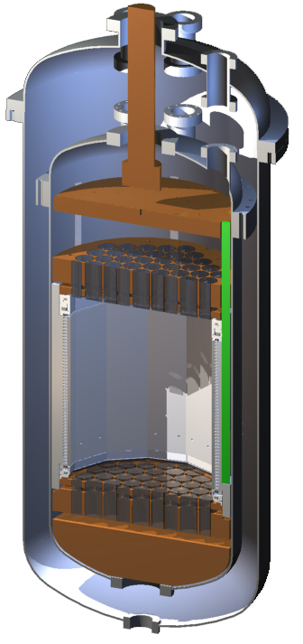
Evidence and Motivation
Dual-phase Noble Liquid Detectors
Initial Work

Slide 2
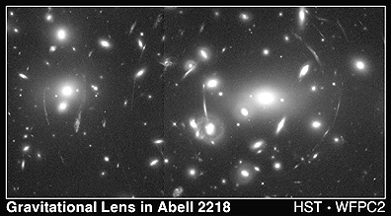
Evidence for Dark Matter
Astronomical Evidence
Galaxy Cluster masses
Galaxy rotation curves
Gravitational lensing
Cosmological Evidence
Cosmic Microwave Background (CMB)
Want to find direct evidence, measure local dark matter in the Galaxy

Slide 3
Properties of Dark Matter
Main properties:
Interact “weakly” with ordinary matter
Electromagnetically neutral
Massive
Stable
Candidates:
MACHOs
Massive Compact Halo Objects
WIMPs
Weakly Interacting Massive Particles
Other Particles

Slide 4
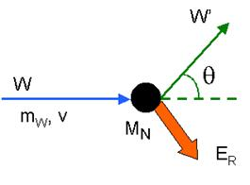
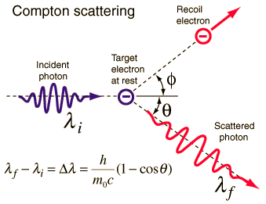
Direct Detection
Look for interaction in detector material
Signal
Nuclear recoil from WIMP collision
Gives ionisation, scintillation and phonons.
Background
Other nuclear recoils
Electron recoils

Slide 5
Two-Phase Noble Liquid Detectors
Discriminate electron recoils
Different amounts of ionisation and scintillation
Other recoils look like signal
Need to minimise radioactivity

Slide 6
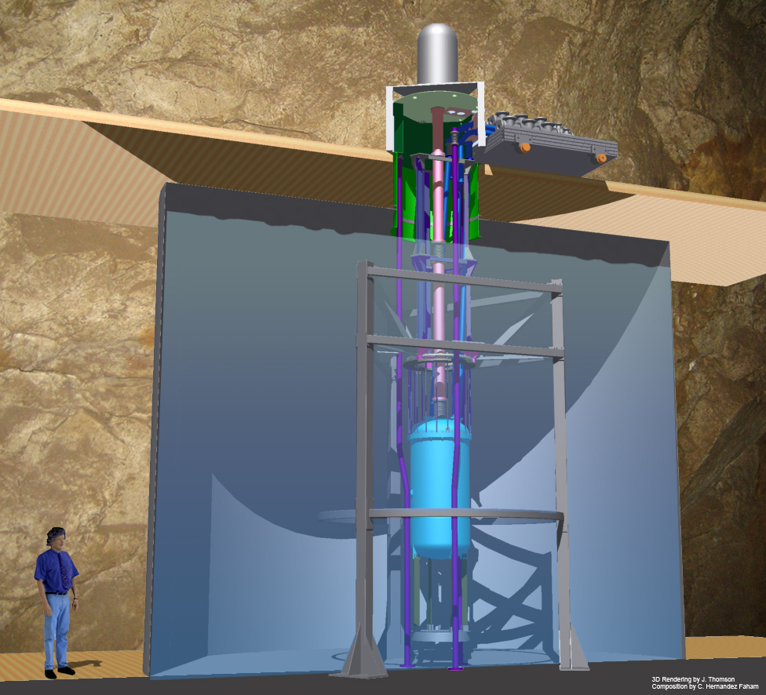
LUX Experiment
Large Underground Xenon
370 kg with 100-150 kg fiducial mass (self-shielding)
Two arrays of 61 PMTs
HV Feedthrough
Cryostats
PMTs
My involvement
Data analysis
Simulation
Operations support
LXe
Recirculation and Heat Exchanger

Slide 7
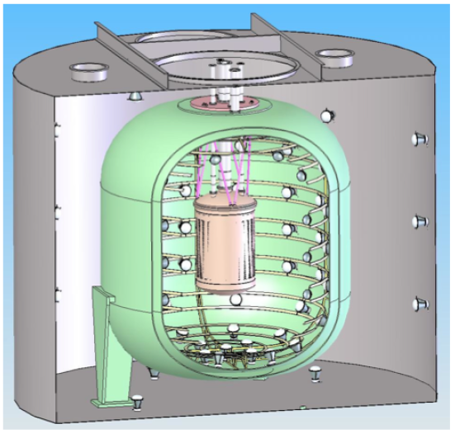
LZ Experiment
LUX-ZEPLIN
Combination of LUX and ZEPLIN collaborations
Builds on previous LUX and ZEPLIN technology
Same site – use previous infrastructure
LZ
LUX
120 cm
49 cm
Working on R & D
Use two-phase xenon chamber at Imperial

Slide 8
Electroluminescence Studies
Design work for LZ
ZEPLIN-III achieved a high signal discrimination
Was this due to the high field, or an effect of the geometry?
Simulated scenarios
ZEPLIN-III
LUX Grid

Slide 9
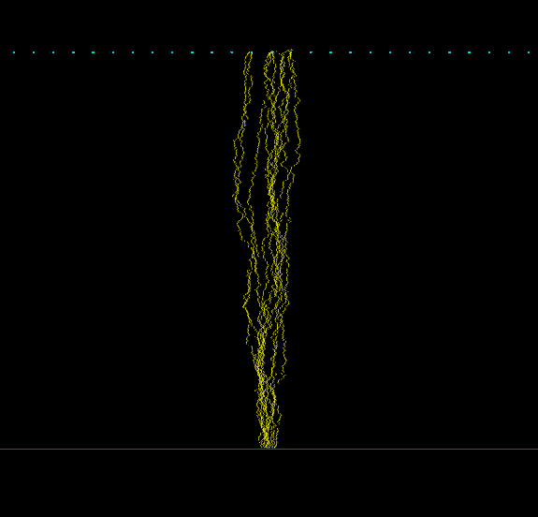
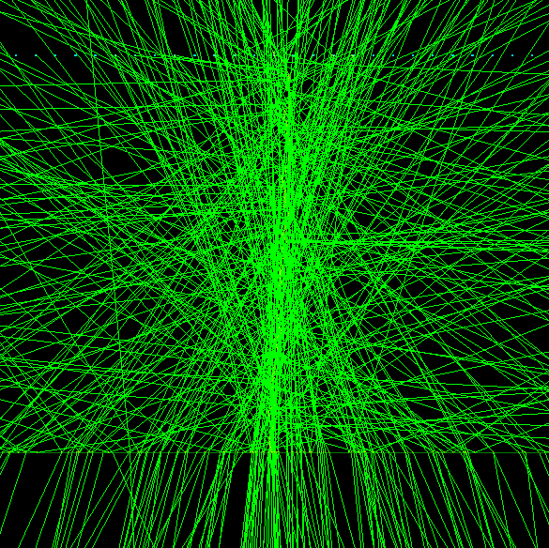
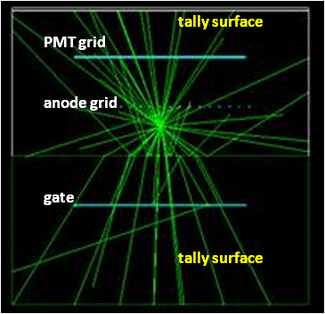
Method
Anode Grid
Gas
Liquid
Photon emissions
Propagation
Count photons and
find variance

Slide 10
Results
ZEPLIN-III
LUX Grid
Total Variance = 5.72 %
Total Variance = 2.49%
Variance for each PMT array was similar to ZEPLIN-III
Two PMT arrays improved it

Slide 11
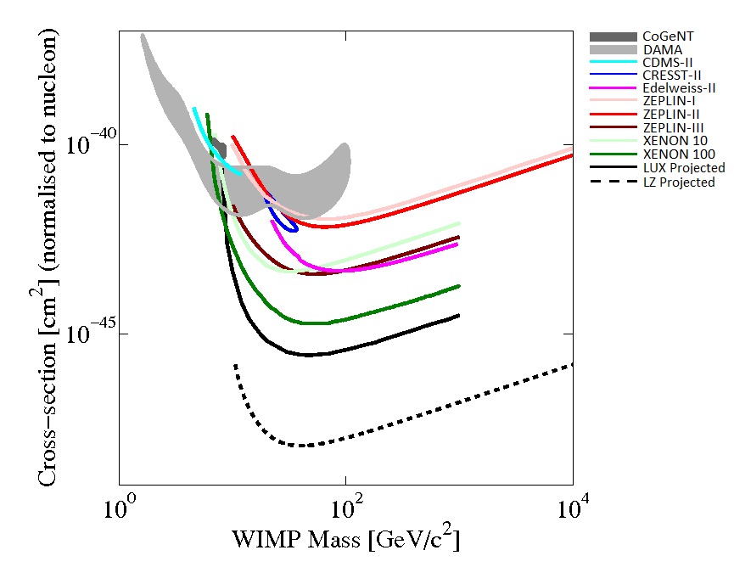
Conclusions
Electroluminescence studies:
Anode grid does not spoil resolution
Two PMT arrays improves resolution
LUX is filled – now turning on
LZ currently being designed
Cross-section [cm²]
(normalised to nucleon)
WIMP Mass [GeV/c²]

Slide 12
Backup Slides

Slide 13
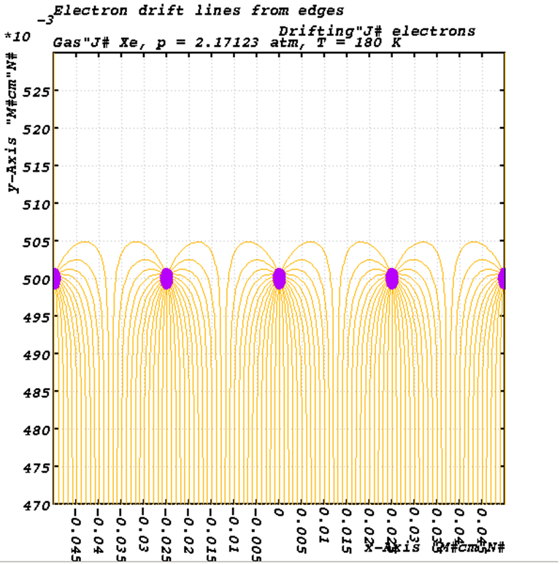
Electroluminescence Studies
Garfield++
Calculates electric fields
Magboltz for properties of the gas
Drifts electrons through the chamber
Drift lines for wire grid

Slide 14
Results
ZEPLIN-III geometry
30% reflectivity from copper anode
Variance at Production
Variance after Propagation
Number of Events
Photons Emitted
Photons at Bottom Tally

Slide 15
Results
LUX geometry with wire grid
25% reflectivity from the steel wires
Variance at Production
Variance after Propagation
Number of Events
Photons Emitted
Total Photon Tally

Slide 16
Results
LUX geometry with wire mesh
25% reflectivity from the steel wires
Variance at Production
Variance after Propagation
Number of Events
Photons Emitted
Total Photon Tally

