Slide 1
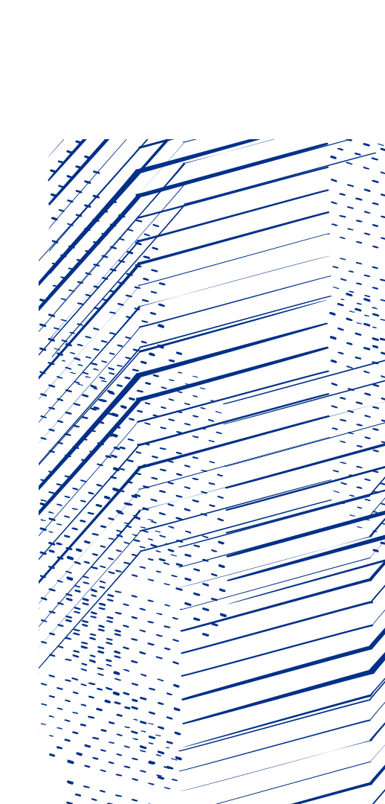
Applied Machine Learning
For Particle Accelerators
Amelia Pollard
Imperial College London seminar
November 6th, 2024
Notes:
Hello, my name is Amy Pollard, and I'm the resident machine learning researcher at ASTeC
This talk is going to be about machine learning for particle accelerators and the work we've been doing at Daresbury Laboratory.

Slide 2
Contents
A quick intro to CLARA
What is machine learning?
Machine learning for accelerators
ML @ Daresbury
Virtual Diagnostics
Anomaly Detection for RF Breakdowns
Laser Pulse Shaping
Hysteresis Modelling
Notes:
Okay, so I'm going to begin with a little introduction to CLARA – that's the accelerator at the Daresbury Laboratory, then I'll cover a bit about some fundamentals of machine learning, and finally I'll explain how we've applied machine learning at Daresbury for the accelerator.
Hopefully I've timed all this right and we should be wrapped up in 45 minutes and leave a bit of time for questions.

Slide 3
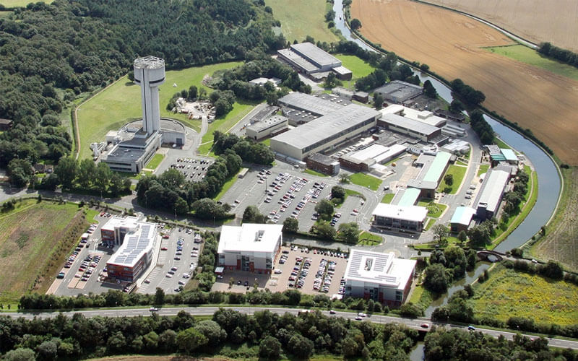
CLARA @ Daresbury
Notes:
This is Daresbury Laboratory. It's home to quite a few facilities, working on everything from quantum computing to cancer research, but the main focus for us is that large warehouse looking building in the middle which houses CLARA.
You may also notice the large tower, it previously held an enormous tandem Van De Graaff accelerator which is now decommissioned. This was formally the Nuclear Structure Facility, and used 22 million volts to accelerate a variety of ions to 44MeV per charge state. It's very cool to look around if you ever get the chance to visit. There's a huge SF6 chamber and charge collecting belt running up the whole length of the tower.

Slide 4
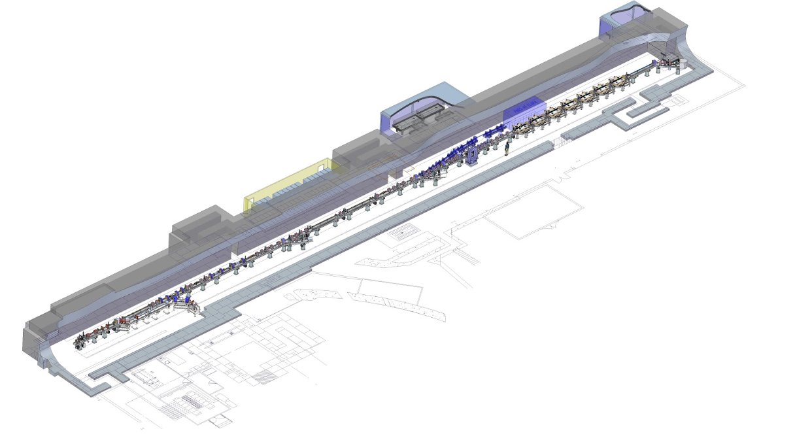
CLARA @ Daresbury
Research & User Facility
Compact Linear Accelerator for Research and Applications (CLARA) is an advanced electron accelerator test facility hosted at Daresbury Labatory.
Previously operating at 10 Hz at 50 MeV, with a nearly complete project to expand to 250 MeV at 100 Hz and incorporate a high-power laser system, beamline, and experimental area called FEBE.
In addition to its primary goal of demonstrating novel accelerator technologies, it also provides high quality electron beams for user experiments from a wide range of disciplines.
Now has a more general remit than originally envisaged as a FEL test facility – but very relevant for UK XFEL
Notes:
CLARA is the Compact Linear Accelerator for Research and Applications. Designed, built, and operated by ASTeC – that's the Accelerator Science and Technology Centre. Physicists sure love acronyms.
As you might imagine from the name, ASTeC's primary goal is developing new technologies for accelerators, however we're also a user facility that provides electron beams to chemists, biologists, physicists, etc for research.
Up until 2022, CLARA operated at 50MeV at 10Hz, however we shut down for a few years to do upgrades to 250mev @ 100Hz. Those upgrades are practically complete and we're just conditioning the RF cavities now with the expectation of beam in early 2025.

Slide 5
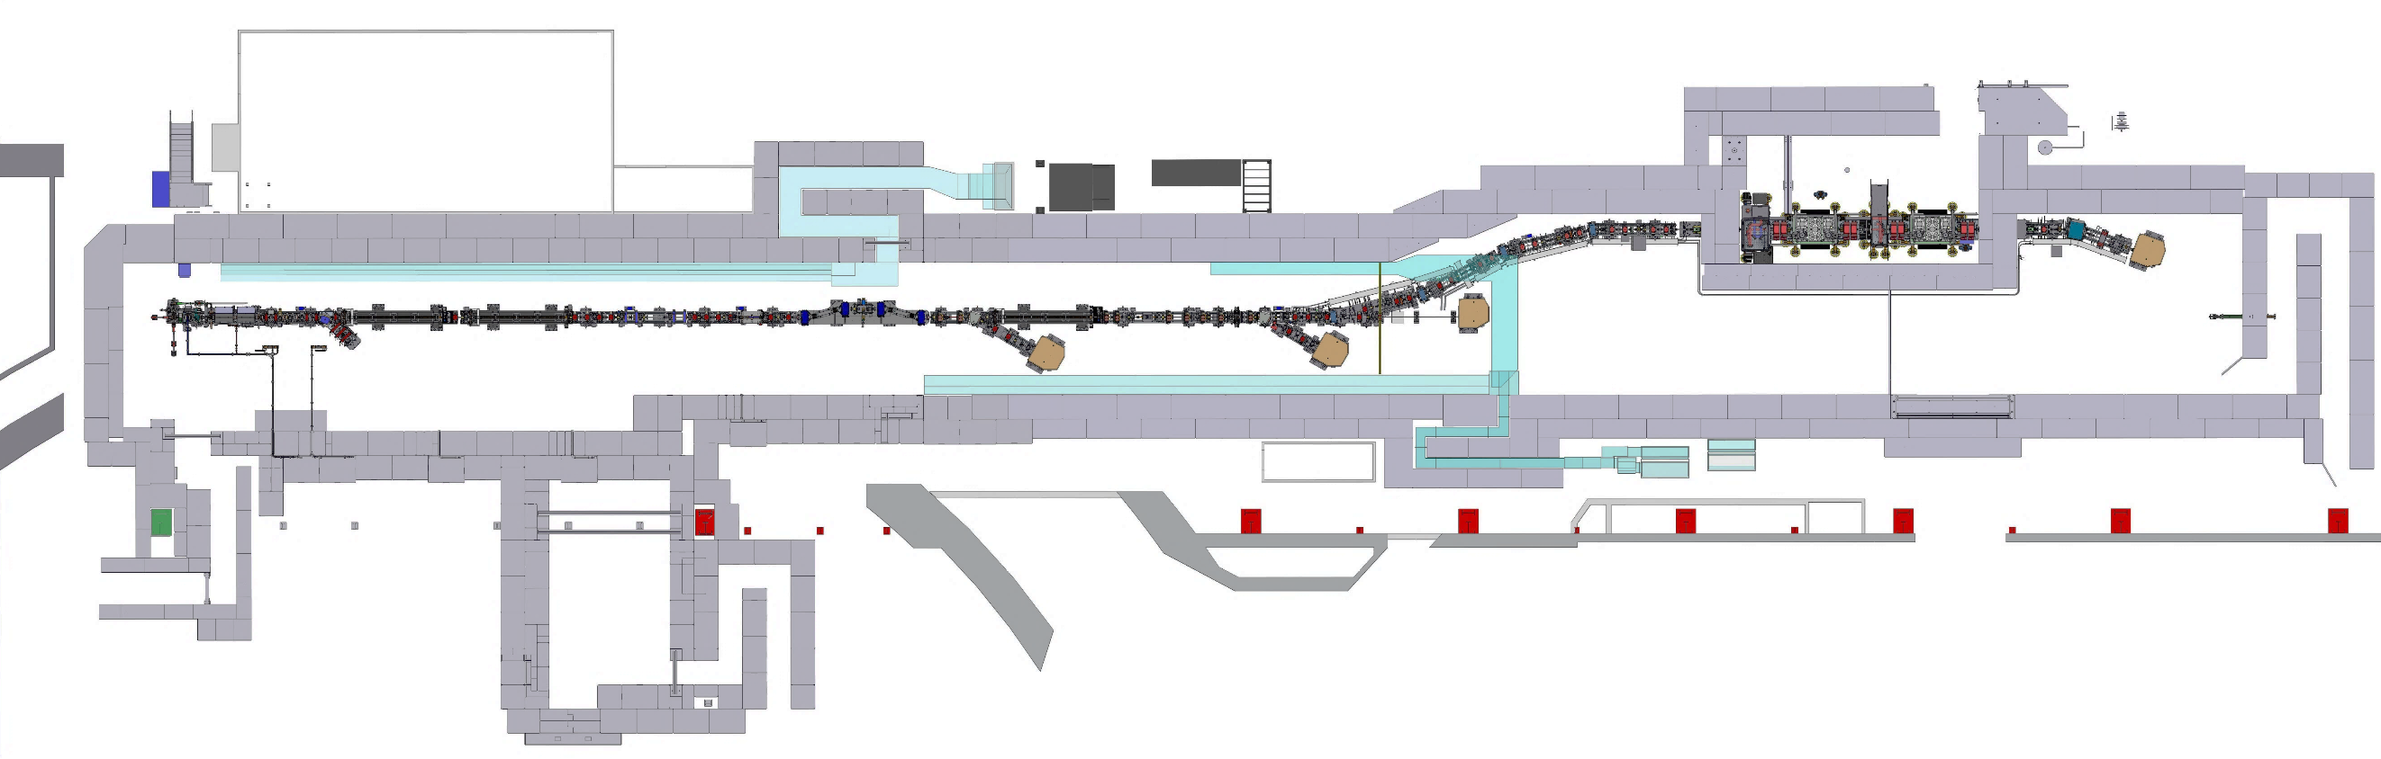
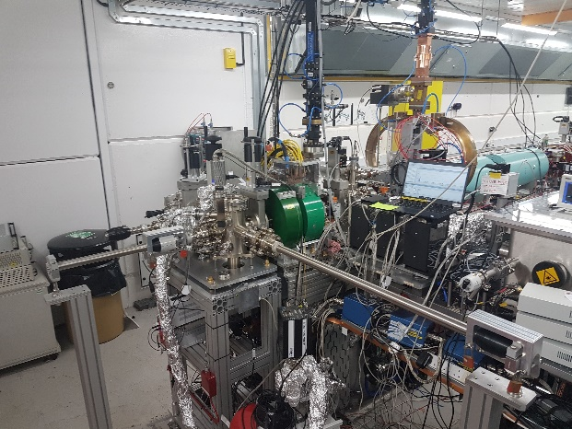
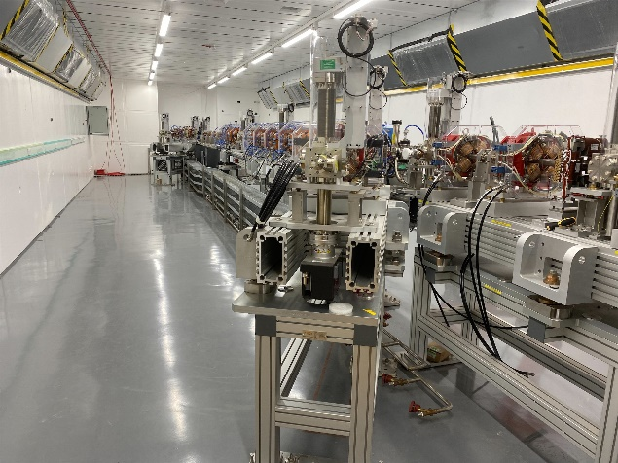
CLARA @ Daresbury
FEC1 Exp. Chamber
FEC2 Exp. Chamber
Shield Door
LATTE Lab
FEBE Arcline
Shutter S1
Shutter S2
FEBE Hutch
Gun
Linac1
Linac2
Linac3
Linac4
TDC1
FMBOX1 Laser Chamber
FMBOX2 Laser Chamber
FEBE Beam Dump
4HC
VBC
VELA
CLARA
e-beam
SP2 Beam Dump
SP3 Beam Dump
Straight-on Beam Dump
~90m
PHASE 1 50 MeV, 250 pC at 10 Hz ACHIEVED (2017).
Beam delivered to users from 2018-2022.
PHASE 2 250 MeV, 250 pC at 100 Hz.
Currently being installed.
User programme expected to start in 2025.
Access to 100 TW Laser.
Notes:
Daresbury has played host to a number of accelerators over the years, and CLARA initially began life as a parallel construction next to the VELA machine, with some shared components. This was the phase 1 construction at 50MeV.
As I mentioned, we've now expanded to 250MeV, adding 3 additional normal conducting linacs, a transverse deflecting cavity, 3 beam dumps as sites for user experimentation, and the FEBE hutch.
FEBE is an enormously powerful laser system: a 120TW Ti:Sapphire pulsed laser that is injected into the beam line for a variety of experiments, including plasma wakefield research. As a result the FEBE hutch has additional radiation shielding to compensate for the radiation that will be produced at energies up to 1GeV.

Slide 6
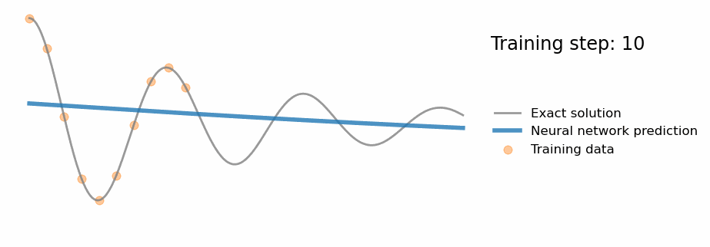
What is Machine Learning?
At its core, machine learning is about creating models that approximate functions by learning from data
Attribution: So, what is a physics-informed neural network? - Ben Moseley. https://benmoseley.blog/my-research/so-what-is-a-physics-informed-neural-network/
Notes:
Okay, now you know about the machine we've been working with, let's get to the topic proper: First – what is machine learning?
At it's core, machine learning is about creating models that approximate functions by learning from data. You have some ground truth function parameterised by your data's features, and your machine learning system which takes those features and attempts to approximate that ground truth function. How that function approximation is done is what separates the different techniques from each other.
Here I show an animation taken from Ben Mosely's blog on physics informed neural networks, which demonstrates the wonders and pitfalls of this function approximation very nicely.
This is showing the predictions of a neural network as it learns to fit data taken from a ground truth function. The blue line is the output of the neural network, the grey line is the ground truth (which in reality is rarely known), and the yellow spots are the training data.
You can see that the training data covers only a part of the underlying ground truth function, and so the neural network learns to approximate only that section. We would say that this model generalises poorly.
To get a more general approximation more training data would be needed, or alternatively you could incorporate more information into the model by using a technique such as a physics informed neural network, where you incorporate physical constraints into your loss function.

Slide 7
What is Machine Learning?
Machine learning is a huge field encompassing many techniques
For applied sciences, we generally want to focus on control systems, diagnostics, and anomaly detection.
Lots of complex math under the hood
… but you don't need to understand the math to use it!
Notes:
Machine Learning is a huge field. I just showed an example using a simple neural network, but there's a great many more techniques from clustering to random forests. I'd likely need the full day to just summarise them all, so I'm afraid we'll have to skim!
Fortunately in the applied sciences, and particularly in accelerator work, we are primarily concerned with augmenting control systems, speeding up simulations, and preventing faults. As such we can somewhat narrow the field to a few major areas. For control systems: predictive models, for diagnostics: generative models, and for anomaly detection: auto-regressive models. These aren't small areas of research, each one could easily be the focus of a career, but at least we don't need to know everything.
On the topic of knowing everything, there's rather a lot of math under the hood of most of these systems – but thanks to the excellent frameworks that have been created you don't need to know most of it to use it! Though I would recommend some basic familiarity if you're going to!

Slide 8
Techniques You Need To Know About
Bayesian Optimisation
Neural Networks (gradient descent)
PINNs
Genetic Algorithms
Reinforcement Learning
Notes:
I really want to emphasise that this is only a tiny fraction of the possibilities of ML, please don't leave this seminar thinking you can only do neural networks! Often the simpler techniques will produce surprisingly good results. Here's a few I really recommend familiarising yourself with, not only because they're powerful, but because they make up a large part of the research in applied ML for physics right now.

Slide 9
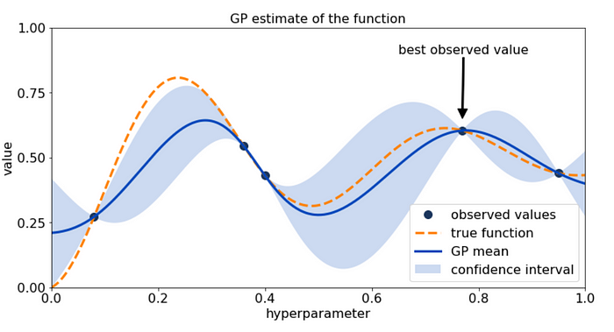
Techniques You Need To Know About
Bayesian Optimisation
Notes:
Bayesian Optimisation is a great first go-to technique for a lot of physics problems
The core concept of the technique is that it uses past observations to approximate a function which describes likely future optimal points with uncertainty, and then measures the function at those points to inform the function approximation further.
It has a few great advantages:
Low setup complexity. It's very easy to plug a handful of parameters into a black box function and slap bayesian optimisation on there
Uncertainty prediction. The model predicts uncertainty alongside its function prediction, allowing you to measure confidence in the model's prediction
Low sampling requirements. It usually takes less than a hundred measurments for a bayesian opt algorithm to converge, which is great if your simulations or experiments are expensive!
Disadvantages:
Limited parameters. Any more than 10 parameters to optimise over and you are going to run into memory problems very quickly and the number of samples required increases exponentonally with the number of parameters

Slide 10
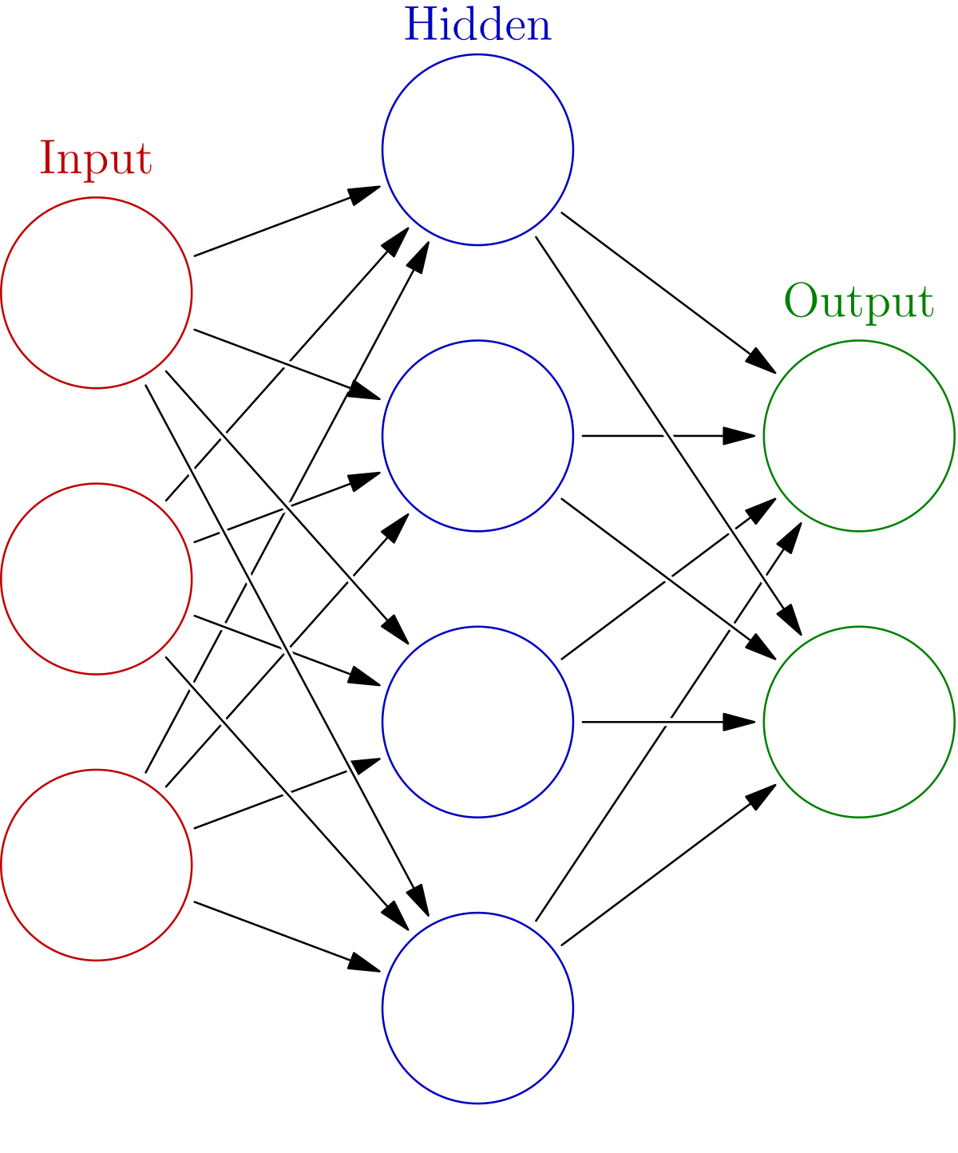
Techniques You Need To Know About
Neural Networks
Notes:
This is the one everyone is excited about, and which Hinton and Hopfield just (somewhat controversially) won a Nobel for.
Based on a simplified model of human neurons, each neuron generates a non-linear combination of its inputs, and a network of these together can model essentially any function.
Each neuron has individual weights for each of its inputs, and the network is trained by applying corrections to those weights through the magic of backpropagation of errors – essentially you (or more typically, the framework you're using) calculate the derivative of the loss function with respect to each weight of the network. As the network's predictions produce errors, the magnitude of those errors is applied as a correction proportionally to each weight that contributed to it. By this method, the network gradually reduces the error in its predictions, until it learns a good approximation of the ground truth function. This is gradient descent -
Some pitfalls with this technique:
You need good, comprehensive data. As much as you can possibly get, but at the very least an order of magnitude more than the number of features you have. That's a rule of thumb, but that's been my experience. It's also important that the data covers a wide range of points in the space. As I showed on that early slide, if you only cover a small part of the function space you're only going to learn that small part of the ground truth function.
I would also advice that you don't get too caught up in architecture. You can and should start with a very simple model first. Architecture is for improving results. Ditto for loss functions.

Slide 11
Techniques You Need To Know About
PINN: Physically Informed Neural Networks
Differentiable Simulation
PDE
Notes:
The major thing about back prop is that the loss function needs to be differentiable. As a result of this you can incorporate partial differential equations from physics systems (ie, conservation of energy) or even entirely differentiable physics simulations into your loss function to inform the training.
This allows neural networks to learn with much less data, and can counter the overfitting problem I showed in that earlier slide. This is commonly known as physically informed neural networks, or PINNs
As an example of this, if you imagine a neural network learning to predict the next step In some complex simulation, say the three body problem, you know that all valid solutions must satisfy conservation of energy and so incorporating a deviation from that conservation of energy term into your loss function will force the network towards areas of the solution space where that condition is satisfied, thus less data is needed to train, it's quicker, and much more likely to converge on a useful solution.

Slide 12
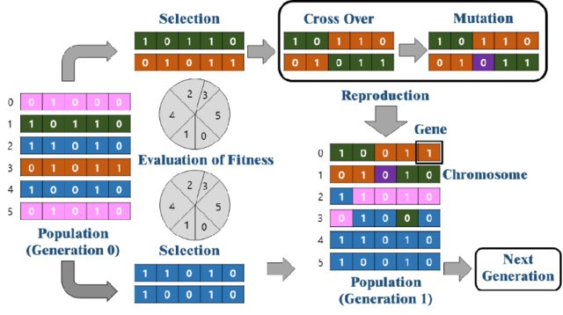
Techniques You Need To Know About
Genetic Algorithms
Park, Gun, Ki-Nam Hong, and Hyungchul Yoon. "Vision-based structural FE model updating using genetic algorithm." Applied Sciences 11.4 (2021): 1622.
Notes:
Most of the physicists I've talked to seem to be aware of these, but I'll give you a quick overview anyway: Essentially we take the principle of survival of the fittest and apply it algorithmicly to a population of potential solutions to a given problem. So for example, you have some fitness function like a simulation that measures the acceleration of a bunch through a cavity, and it's parameterised by the geometry of that cavity as described by a handful of variables. You begin by creating a population of random configurations, test them all for fitness, and then select the top 10% or so to carry on to the next round unchanged, the remaining top 40% ​get "crossbred" generating a new population and the bottom 50% get replaced entirely by randomly generated new ones. You run this iteratively until the top fitness plateus, and then select your best candidate.
This technique is good for generating a paretofront diagram, as you collect a lot data as it runs and can find multiple configurations that maximise different elements of your fitness function (generally if you have multiple components to your fitness function we call this a Multi-Objective Genetic Algorithm or MOGA). However, because you need to run your fitness function for every member of the population in every iteration it can be computationally expensive and therefor slow. As a technique, it's well applied to problems with a large number of parameters and a reasonably fast simulation. Especially good if the simulation lends itself well to multi=threading, as you can evaluate each member of the population concurrently.

Slide 13
Techniques You Need To Know About
Reinforcement Learning
State
Policy
Action
Notes:
Reinforcement learning treats problems as a decision process. If you have some state graph where transitions between states are actions that the model can take, the RL model attempts to learn a policy function that will maximise some reward value.
Essentially the model learns a relationship between state, action, and reward.
This is fantastic for something like a control system. You plug your reinforcement learning model into your accelerator controls and attempt to maximise say, charge transport – how much charge makes it from your gun all the way to the beam dump. The model takes in current observables like beam position monitors, inputs from screens, what have you – and then using that state information, predicts an action that will result (either immediately or eventually) in maximal reward (ie, good charge transport).
A significant advantage of these models is that they can handle small amounts of drift from their training set. Say a focussing magnet has been slightly demagnetised by the beam, or just has some hysteresis variation – these models are frequently able to compensate for this small variation in state.
However these models are *hard* to train and require a lot of data – way more than most other approaches. As such they are challenging to practically deploy. A good way to get around this data availability challenge is to train a model on simulated data first, and fine-tune it on the target machine, but that's still a lot of simulations to run.

Slide 14
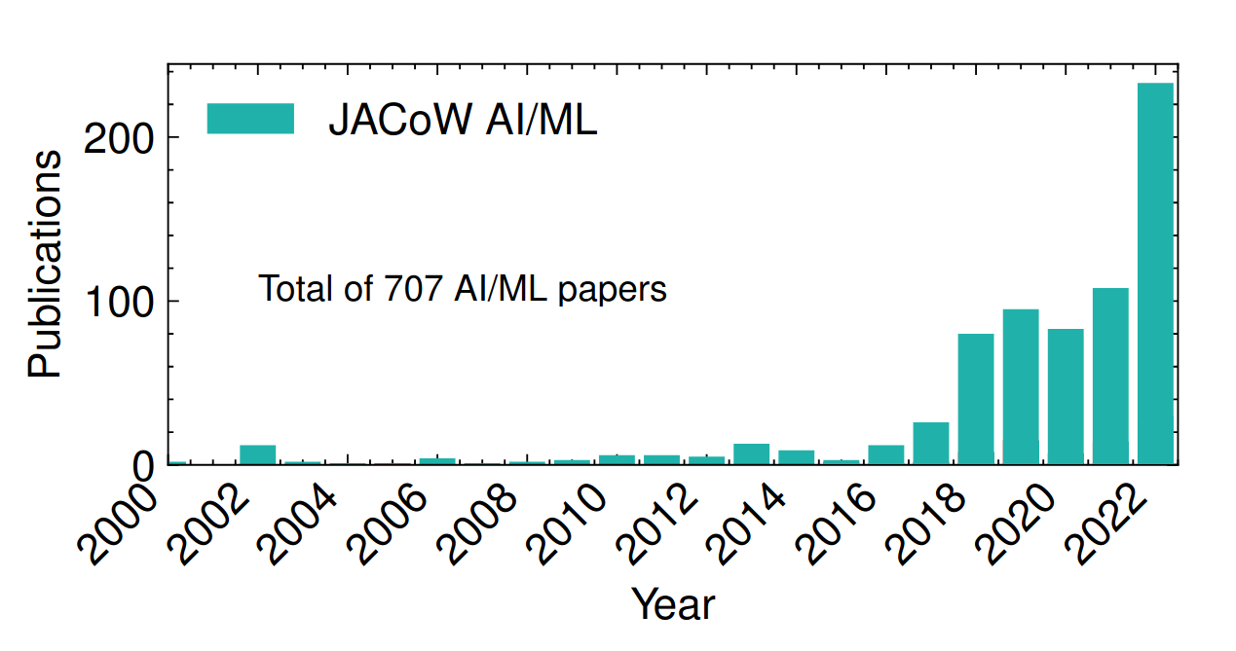
State of the Field
Machine learning has had a significant impact on accelerator science in recent years
Garcia, A. Santamaria, et al. "The reinforcement learning for autonomous accelerators collaboration." Proc. IPAC'24: 1809-1812.
Notes:
Machine learning has had an enormous impact on the field of accelerator science in recent years. The number of ML papers at major accelerator conferences like IPAC have only been going up. All the major labs have a machine learning group.
I admit, some of it is hype bleedover from the recent successes in natural language processing, but there are a lot of legitamite and powerful uses for ML techniques in the sciences, and specifically in accelerator physics.
There's a lot of papers just applying Bayesian Optimisation to everything from lattice design to beam positioning. There was a paper published just a month ago in nature on using stable diffusion for virtual diagnostics. There's a lot of low-hanging fruit still, and simply applying techniques from the wider ML field to physics problems and exploring how that performs is very much research worth doing.

Slide 15
Machine Learning at Daresbury
Notes:
Alright, now you've got some idea of the general state of the field, here's what we've been up to at Daresbury.

Slide 16
Virtual Diagnostics
Anomaly Detection
Automated Control
Notes:
The ML research we've done at Daresbury generally falls into three camps:
-Virtual diagnostics, which allows operators to view hidden machine state information, usually by extrapolating that state from observable parameters
-Anomaly detection, which enables monitoring of hard-to-quantify systems, sometimes even allowing for prediction of faults before they occur, and
-Automated control, which saves operator time by having ML systems automatically optimise machine parameters for specific goals
By combining each of these categories, we hope to eventually achieve end-to-end automation of the entire accelerator. Our end goal is for operators and users to merely specify their target properties and the various control systems will find a configuration which achieves this while monitoring and correcting for any faults automatically.

Slide 17
Virtual Diagnostics
Notes:
Let's begin with the work we've done on virtual diagnostics. The primary use of virtual diagnostics is to learn relationships between easily measurable or configurable machine parameters, and measures that are difficult to observe or inherently destructive.

Slide 18
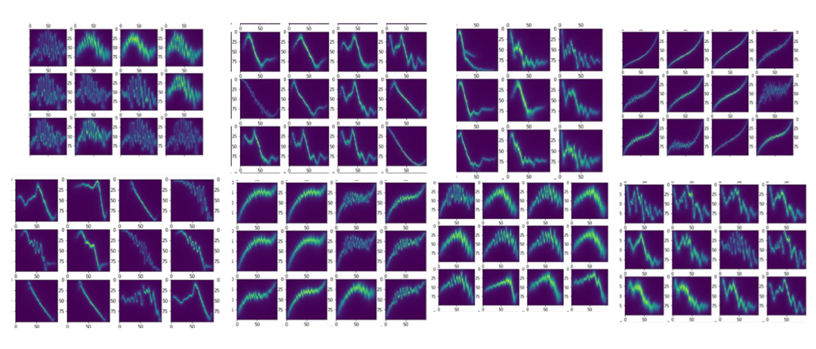
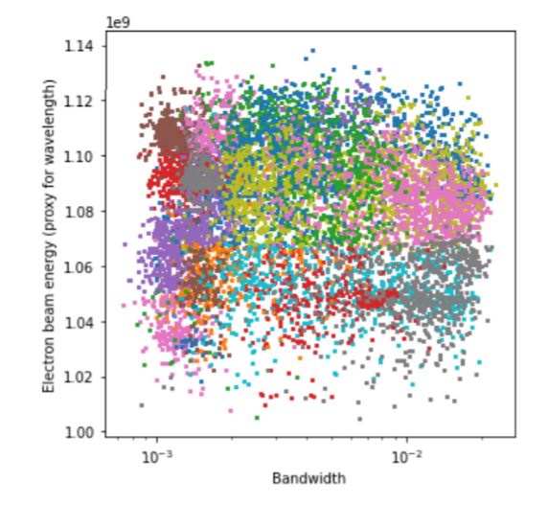
Prediction and Clustering of Longitudinal Phase Space Images and Machine Parameters Using Neural Networks and K-Means Algorithm
Maheshwari, Minerva, et al. "Prediction and Clustering of Longitudinal Phase Space Images and Machine Parameters Using Neural Networks and K-Means Algorithm." Proc. IPAC’21 (2021): 3417-3420.
Notes:
So I'll start off with a very simple example, using clustering to predict machine parameters from longitudinal phase space graphs and the reverse, using a deep neural net to predict phase space graphs from machine parameters. This was some quite early work that was done by a year in industry student, Minerva, and it really goes to show the power of even simple techniques.
Longitudinal phase space is the measure of the electron bunch's energy along the bunch temporally. It's basically impossible to measure this non-destructively as far as I'm aware, and it's incredibly useful for calculating beam dynamics.
You can see here some of the LPS graphs organised by the cluster they're in, and on the right there, how those clusters align with measurables for an FEL, in this case electron beam energy.
Such a model allows an operator to target a specific phase space distribution by predicting control parameters that would achieve similar phase space distributions, or even potentially use the difference between the predicted and observed values to find sources of drift in the accelerator. This work used a relatively simple technique, and achieved very strong results, and really speaks to the accessibility and power of basic machine learning. All that was used here was a series of simulation codes to generate the longitudinal phase space graphs, a simple clustering algorithm to predict machine parameters, and a simple neural network model to predict graphs from parameters.

Slide 19
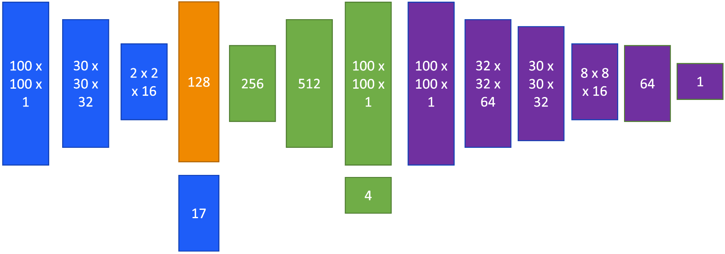
Learning to Lase: Machine Learning Prediction of FEL Beam Properties
Pollard, A. E., D. J. Dunning, and M. Maheshwari. "Learning to Lase: Machine Learning Prediction of FEL Beam Properties." Proc. ICALEPCS'21 (2021).
CVAE model produces better images than DNN, but still blurred
Adversarial training leads to the generation of images which are almost indistinguishable from simulation.
Ground Truth
Encoder
Decoder
Prediction
Combining a conditional variational autoencoder with a generative adversarial network to build a CVAE-GAN by affixing a discriminator to a CVAE model and training the model adversarially.
Image © STFC John Dawson
Discriminator
Notes:
Now those simple models do have limitations, and Minerva's work did highlight some shortfalls of a basic neural network for predicting the LPS graphs from machine parameters. The results tended to lack critical details, and were frequently blurred. As such, we sought to improve the longitudinal phase space graph prediction to increase accuracy and detail in the resulting graphs. We approached this work using a relatively complex neural network model called a CVAE-GAN, which is able to generate realistic, detailed, LPS graphs for a very wide range of possible accelerator configurations. I like showing this example as one where architecture really matters. We had results from the simple model, but they could be improved by a more complex approach.
We started with a conditional variational auto-encoder model, or CVAE. An autoencoder is a model which takes your target as input, compresses it down to a latent space representation, and then reconstructs it. The "variational" part places an additional constraint on the latent space which allows you to treat each compressed feature as a probability distribution, and the conditional part makes that probability distribution conditional on a set of additional input parameters, which in this case was the machine parameters.
You can see on the left there that the results were adequate but not ideal. There was considerable blurring, but the general shape of the predicted LPS graphs was correct and more of the fine details were preserved. We decided to try and get better results by combining the CVAE with a discriminator model which is trained solely on its ability to detect generated data versus real data, we significantly improved our results. This additional discriminator module makes it a GAN, or generative-adversarial network.

Slide 20
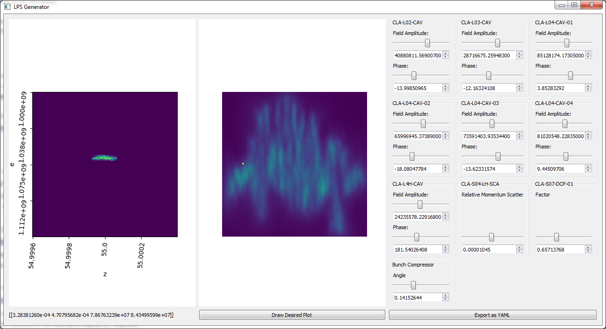
Results
Ground Truth
Real time generation of LPS graphs matching simulation. Milliseconds instead of minutes!
Prediction
Operators can draw their desired graph and get the parameters which closely match it within seconds.
Image © STFC John Dawson
Notes:
And here, you see those improved results. In the top right, you see a pair of rows – the ground truth row is made of samples from the dataset, LPS graphs generated by the ASTRA/ELegant simulation.
The prediction row is the output of the neural network I just described, after being fed the same accelerator parameters as Elegant. In particular, note the high quality on the fine structure details, which are an almost perfect match to simulation. Because neural networks run inference in linear time, we can generate these graphs in milliseconds instead of minutes, so we can do things like putting the model in a nice graphical interface with slide bars, and drag those slide bars around to see how each parameter effects the output, allowing us to observe the longitudinal phase space of a beam in realtime as we vary parameters.
Again, because we can generate these graphs so quickly we can search them rapidly. We added a way for operators to draw their desired LPS graph and find a match for it in seconds using Bayesian Optimisation and image simliarity measures.
These kinds of generative models can seriously augment the speed of simulations - you lose some precision but gain orders of magnitude faster execution time.

Slide 21
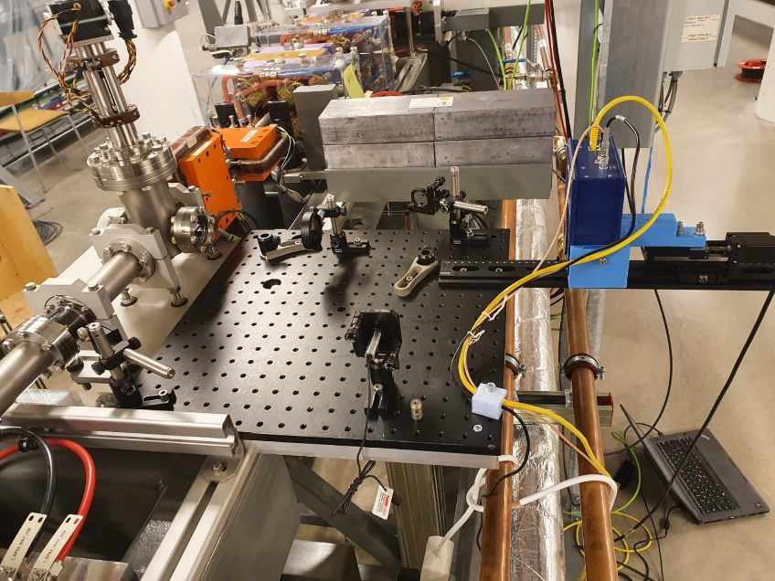
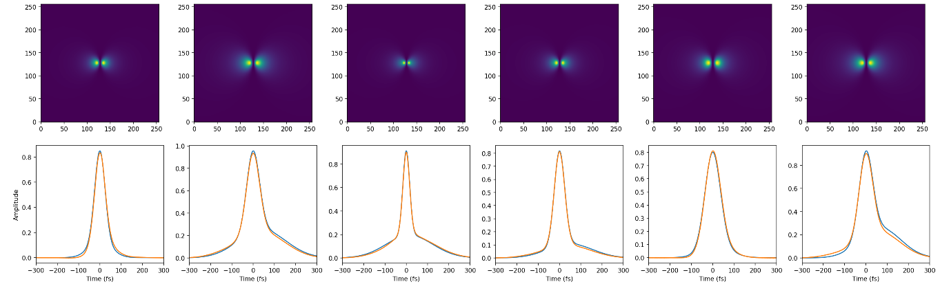
Bunch profile extraction from CTR images @ MAX IV
Wolfenden, J et al. “Broadband Imaging of Coherent Radiation as a Single-Shot Bunch Length Monitor with Femtosecond Resolution”, Proc. IPAC’21 (2021): 2673-5490.
HRFZ Si Lens
Experiment
Blue – Truth
Orange - Prediction
Pyrocam
Notes:
You can also use ML to extract extra information from real measurements. Joe Wolfenden presented work on using a Coherent Transition Radiation monitor and combining this with a machine learning approach to extract the temporal bunch profile.
The CRT monitor is just a thin film placed in the path of the beam which emits light as the beam passes through it. While this allows for parasitic bunch length monitoring, augmenting it with a machine learning approach enables the extraction of the temporal bunch profile.
Again, this is just a simple neural network approach, in this case a convolutional neural net with an input of the CRT image, and output of the parameters of two gaussian functions, and trained on simulated data.

Slide 22
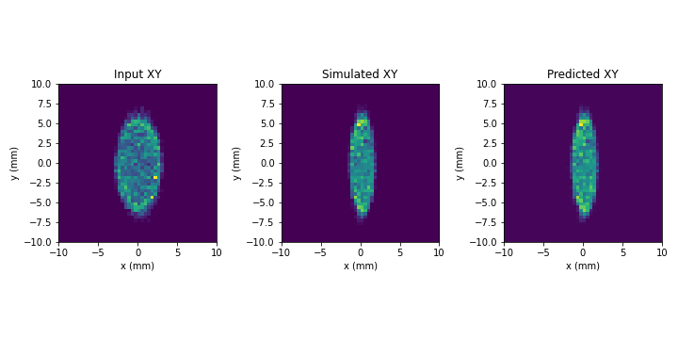
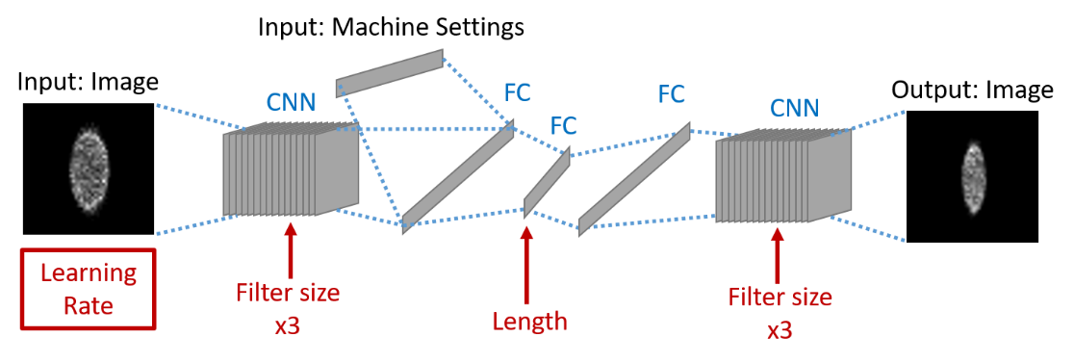
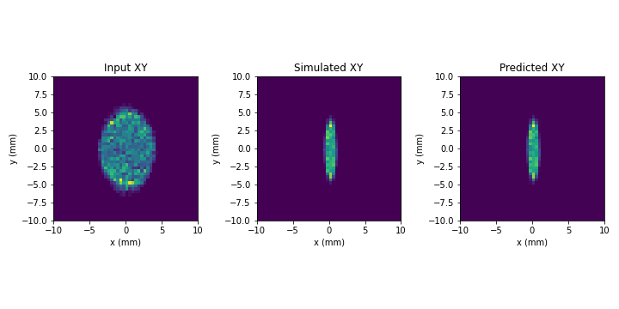
IP beam size virtual diagnostic @ FEBE CLARA
Wolfenden, J et al. “Application of Virtual Diagnostics in the FEBE CLARA User Area” Proc. LINAC’22 (2022).
FEBE CLARA IP – Screens/Quads used in study indicated
CNN/VAE architecture – red items optimised via Hyperband
Example VD output
Pre-IP measurement
Experiments planned at FEBE CLARA and at the ARES linac (DESY)
Post-IP measurement
Notes:
Another critical diagnostic for accelerator operation are screens – at CLARA we use YAG crystals which fluoresce when struck by electrons. This allows us to observe the transverse profile of the beam, though it is a destructive measure. In some areas of the accelerator, it's inconvenient or impossible to have a screen. Joe presented this work at LINAC22 where a pre-interaction point screen was used in combination with machine parameters to predict a post-interaction point screen that could, in theory, be entirely virtual.
By using a conditional variational auto encoder parameterised by the quadrupole strengths between the observation point and the prediction point, the model estimates how the beam will be affected by the magnets. Again, the rapid inference time of neural networks allows for operators to experiment with this in real time.
This work was again demonstrated on simulation data, but experiments are already planned for when FEBE comes online.

Slide 23
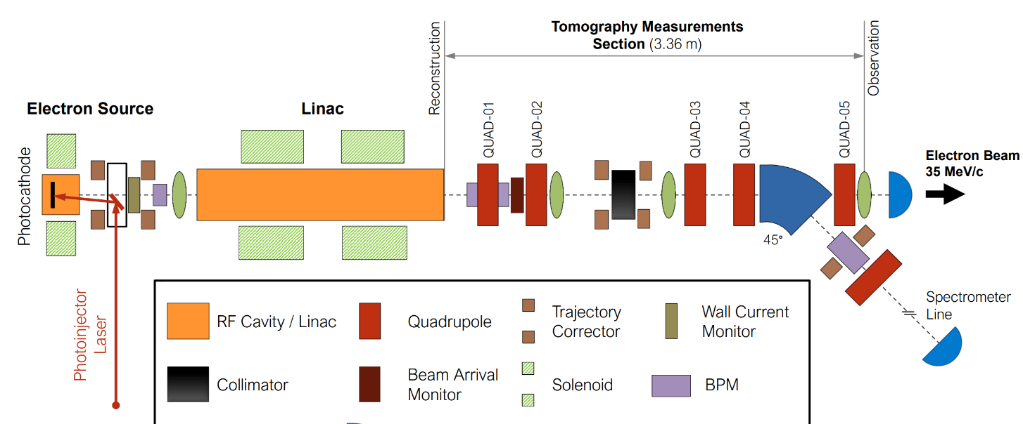
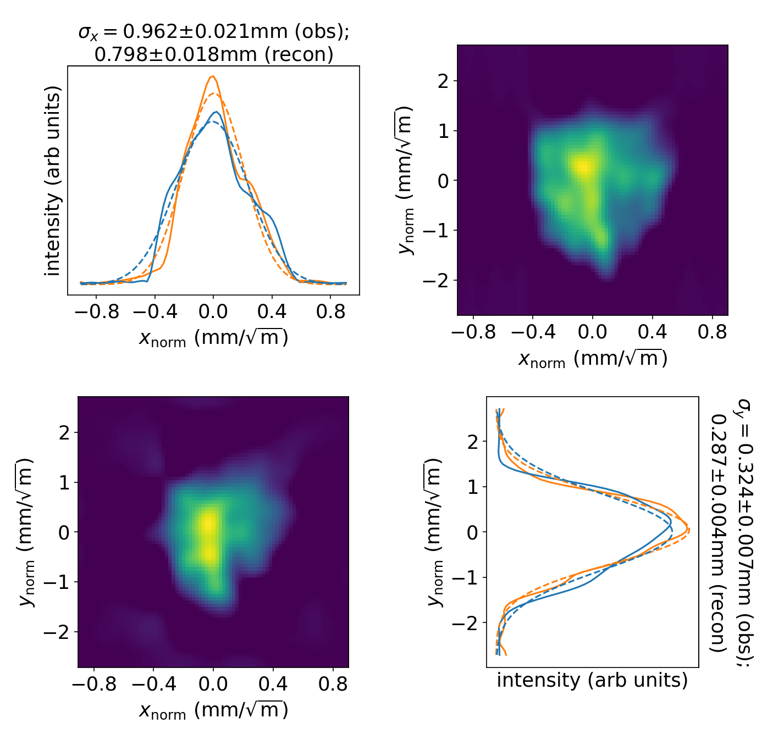
4D transverse phase space tomography on CLARA
Wolski, A et al. “Transverse phase space tomography in the CLARA accelerator test facility using image compression and machine learning” https://doi.org/10.48550/arXiv.2209.00814 (submitted to PRAB) (2022).​
The aim is to reconstruct 4D transverse phase space distribution from quad scan images.
Previous studies have demonstrated use of 4D phase space tomography using a “conventional” algorithm (ART)…
https://doi.org/10.1103/ PhysRevAccelBeams.23.032804
…but data processing is slow, computationally demanding, and results are prone to artefacts.
reconstruction
point
observation
point
Top: 4D phase space at end of linac constructed from beam images at observation point for different quad strengths.
Right: Results validated by transporting phase space to the observation point, and projecting onto the x-y plane.
Andy Wolski et al.
Notes:
Andy Wolski recently presented work on predicting 4D transverse phase space from observations collected from quadrapole scanning.
For those of you who aren't in the know, in accelerator physics we like to know the 6D phase space of the bunch. That's the x,y, and z positions of each particle and the x,y, and z momentum of each particle. As you might imagine, that's frequently hard to figure out.
We can use a technique called quadropole scanning, where you essentially rotate the beam through a number of steps before it hits a screen, and then compile that transverse information into a 4D phase space.
There exists an algorithmic approach to do this, but it is computationally very intensive. Andy's work to use machine learning for this allows us to get the same information in milliseconds, and with fewer steps of the quadropoles.
A dataset was created with 3000 4D phase space distributions generated by superposing multiple 4D Gaussian distributions with random variations in position, shape and intensity. For each, sinograms are obtained by transforming the distribution using phase space rotations (corresponding to the 32 steps in a quadrupole scan), and then projecting the distribution onto the x–y plane at each step.
A deep neural net model then learns the relationship from sinogram to 4D phase space. Thus we can quickly and efficiently predict the 4D phase space tomography without significant compute time of the algorithmic approach.
(4d transverse phase space: x, y, x', y' (transverse dimensions and their rate of change, for immediate emmission and delta of emission)

Slide 24
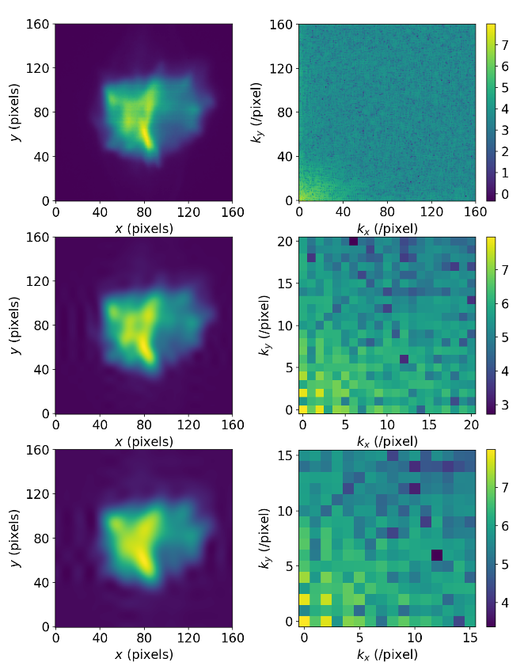
4D transverse phase space tomography on CLARA
Decompressed Image
DCT
Size of neural network reduced through use of image compression (using discrete cosine transforms).
Collect quad scan images (32 steps)
Compress images using DCT
Provide compressed image as input to (trained) neural network
Compressed 4D phase space produced as output
Decompress 4D phase space using IDCT
Andy Wolski et al.
Notes:
And this is just a quick overview of how that's done. Using discrete cosine transforms to compress the image – essentially taking the most significant components of the image as input to the neural network to reduce its dimensionality, and outputting the same components for reconstruction.

Slide 25
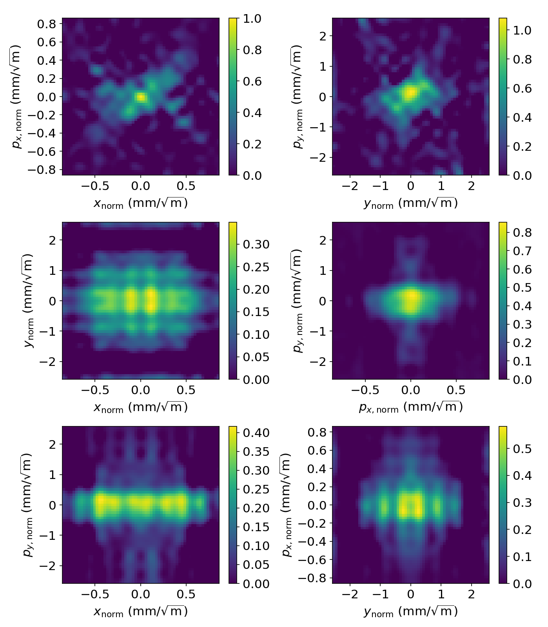
4D tomography: results for 100 pC bunch charge
Algebraic reconstruction tomography
Machine learning
https://doi.org/10.48550/arXiv.2209.00814 (submitted to PRAB)
Andy Wolski et al.
Notes:
You can see here how this approach performs in comparison to an algebraic reconstruction method, with the ML model producing significantly fewer artifacts and doing so much faster.

Slide 26
Anomaly Detection
Notes:
Moving on to anomaly detection. We haven't done much of this at ASTeC yet, but as you might imagine, detecting deviations from normal behaviour before they become a problem can have significant benefits. Machine learning is particularly well suited for this task.

Slide 27
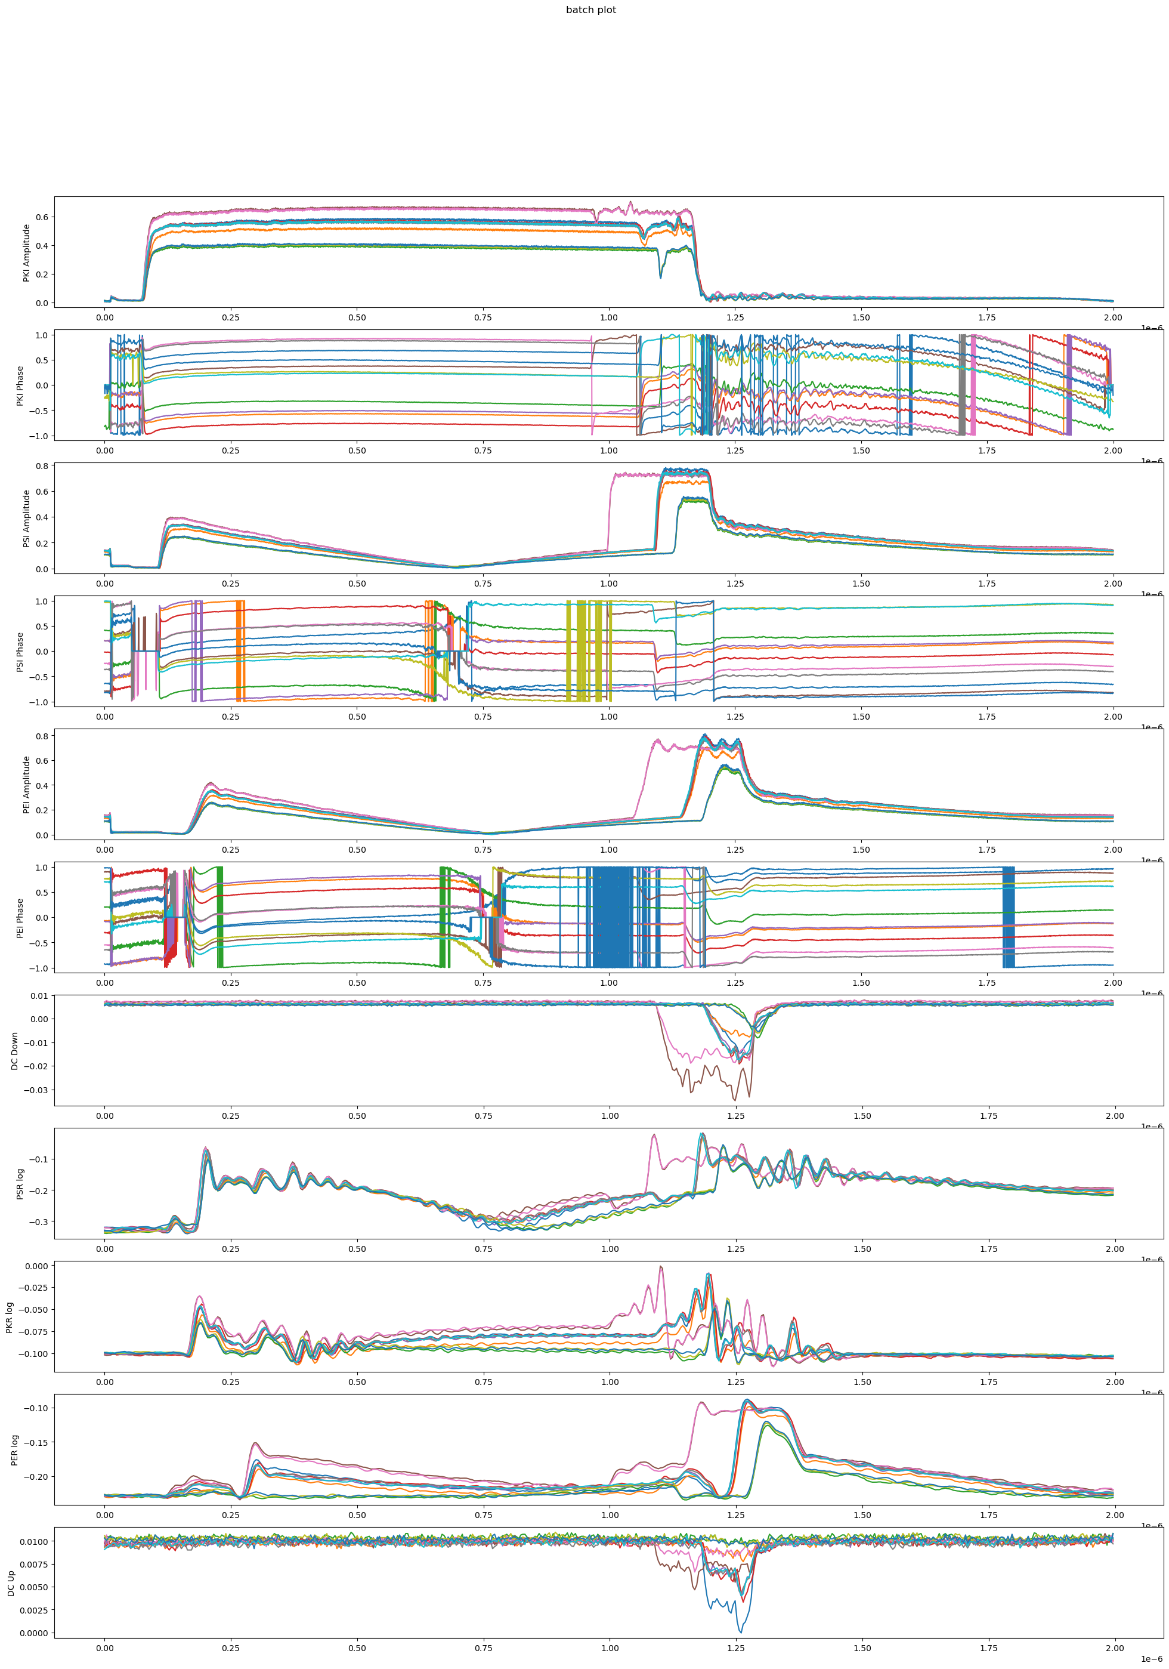
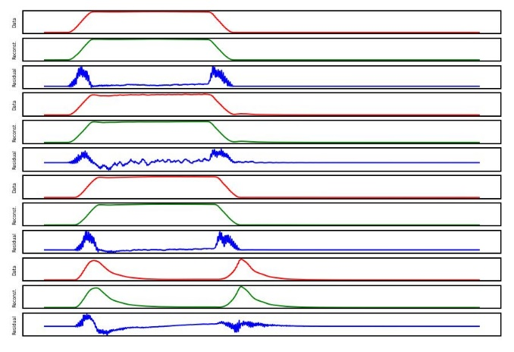
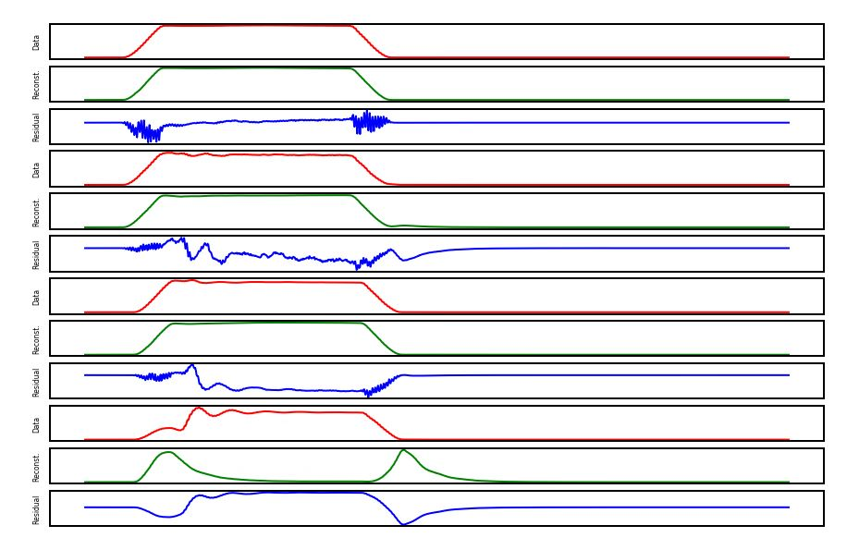
Machine Learning for RF Breakdown Detection at CLARA
Pollard, A. E., A. J. Gilfellon, and D. J. Dunning. "Machine Learning for RF Breakdown Detection at CLARA." Proc. ICALEPCS'21 (2021).
RF cavities experience occasional breakdowns which damage equipment and cause loss of beam time.
Detection and prediction of breakdown events is therefore critical.
Data – Reconstruction = Residual
We have recorded phase and amplitude traces from multiple points in the RF system, and seek to apply machine learning to detect, and hopefully predict, breakdowns.
Image © STFC John Dawson
Healthy Pulse
Breakdown Pulse
Notes:
This work was a collaboration with Tony Gilfellon and SciML on developing a better breakdown detection system using machine learning, with an eye to solving RF breakdown prediction.
RF systems are prone to occasional EM breakdowns which can damage equipment, slow down conditioning, (and are generally to be avoided). The current method for detecting when this has happened is done by masking, and so performs poorly when the RF waveforms are changing for legitimate reasons, for example during conditioning, and fails to capture minor breakdowns which fall under the detection threshold.
For this project, we had two datasets to work with – one for the CLARA 10Hz gun which was collected in-house parasitically, and another for the XBOX test stand at CERN, which was produced by PSI. The model was a simple autoencoder, trained exclusively on healthy non-breakdown signals, with a secondary deep neural network to examine the reconstruction and detect deviations from those healthy signals

Slide 28
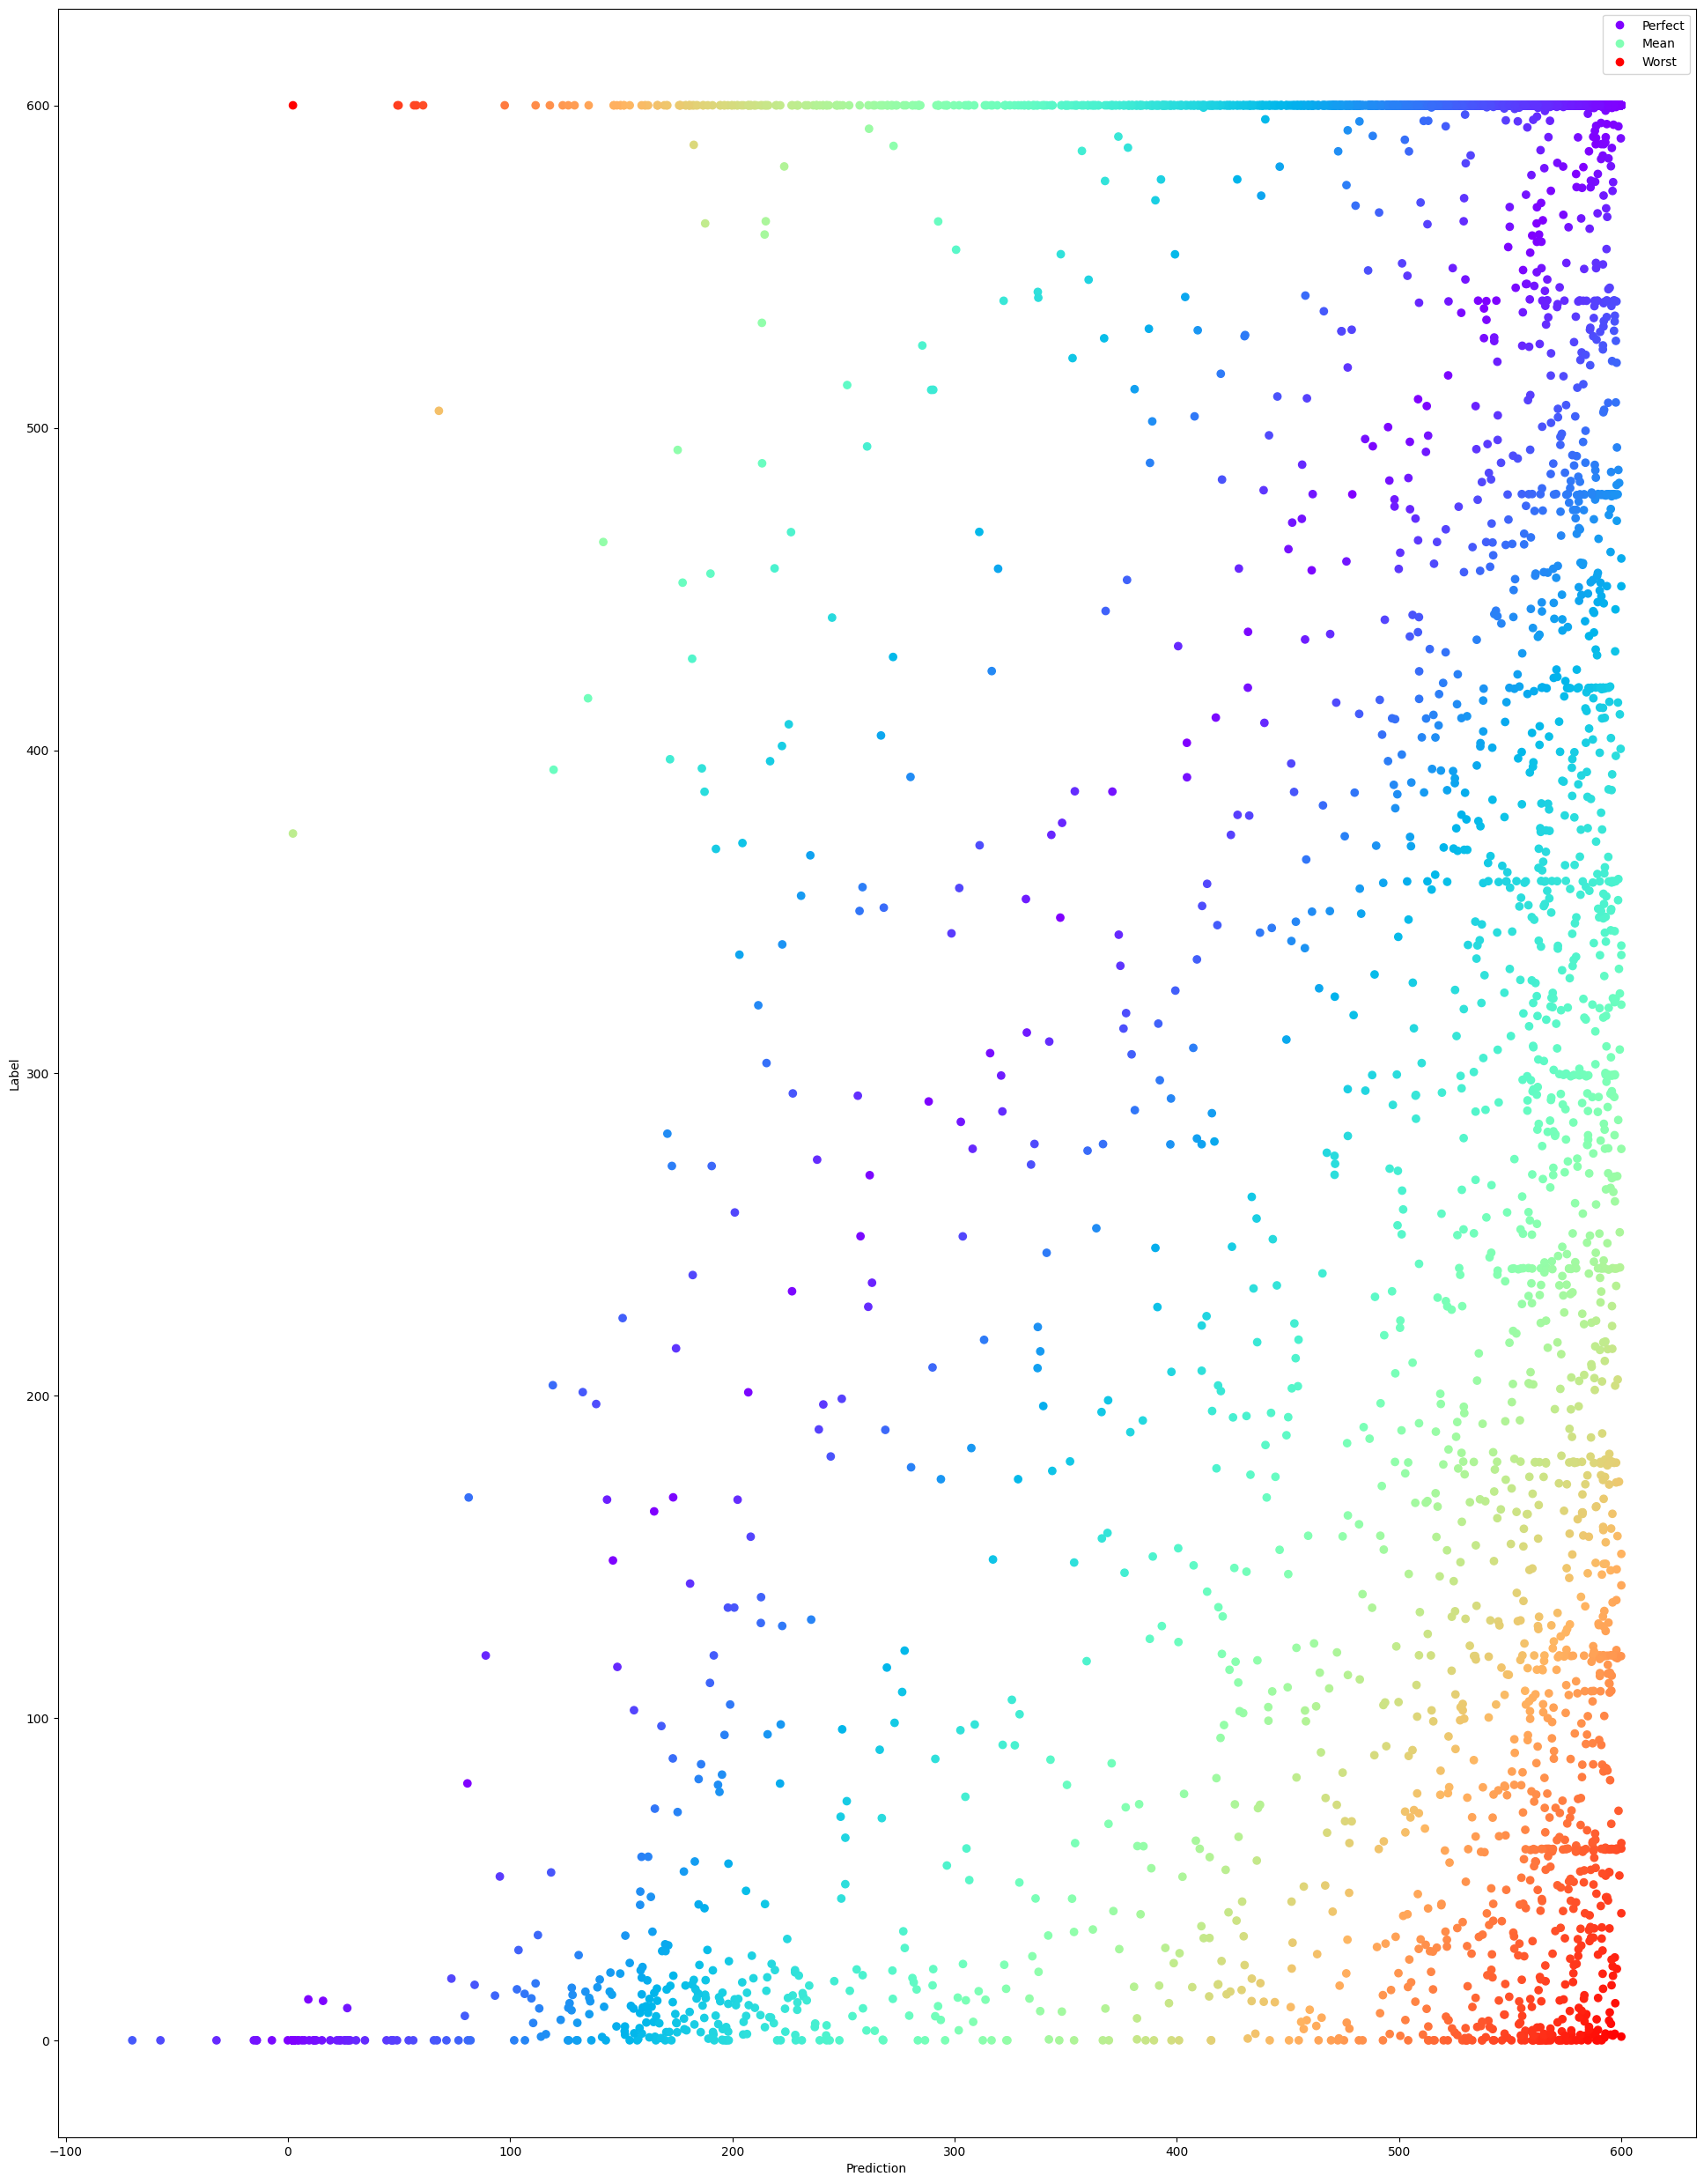
Results
Prediction
We achieve an almost perfect classifier demonstrated on both CLARA and CERN's XBOX2 test stand, with an exceptionally low false positive rate.
Training the network to instead predict time-until-breakdown resulted in overall poor accuracy. 73% prediction of time until breakdown within a 30 second window.
 | Positive | Negative
True | 95.8% | 98.0%
False | 4.2% | 2.0%
 | Positive | Negative
True | 97.9% | 99.6%
False | 2.1% | 0.4%
Time Until Breakdown
CLARA Breakdown Detection
CERN XBOX2 Breakdown Detection
Predicted Time Until Breakdown
Notes:
This approach worked rather well, even allowing for some rudimentary breakdown prediction, though unfortunately not quite enough to deploy in the control room.

Slide 29
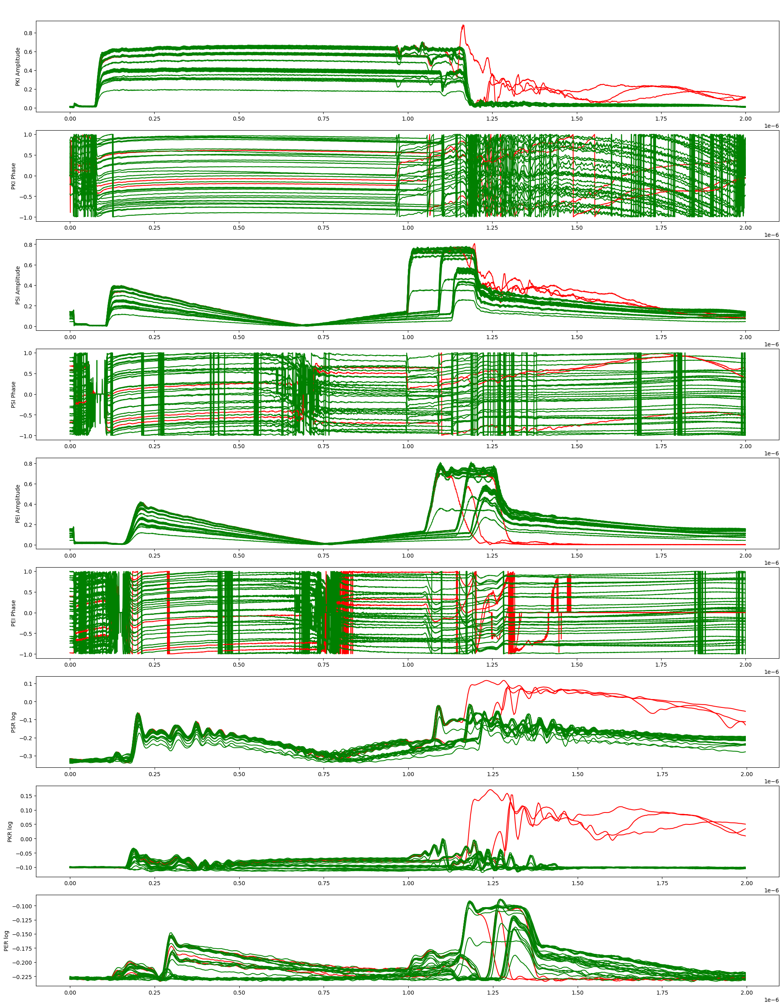
Results
An almost perfect classifier demonstrated on both CLARA and CERN's XBOX2 test stand, with an exceptionally low false positive rate.
 | Positive | Negative
True | 95.8% | 98.0%
False | 4.2% | 2.0%
 | Positive | Negative
True | 97.9% | 99.6%
False | 2.1% | 0.4%
CLARA Breakdown Detection
CERN Breakdown Detection
Notes:
As you can see, our results are pretty great. Especially so when you factor in that approximately half of the false positives detected were actually true positives that were mislabeled by the masking system.

Slide 30
Automated Control
Notes:
And finally we come to automated control systems. Here the idea is that we have some target that we want the machine to reach, and previously that meant operators using intuition and fiddling with the settings to get the desired output. With ML based control systems, we can instead simply tell the ML system what we want, and have it apply the settings required directly – vastly saving on operator time.

Slide 31
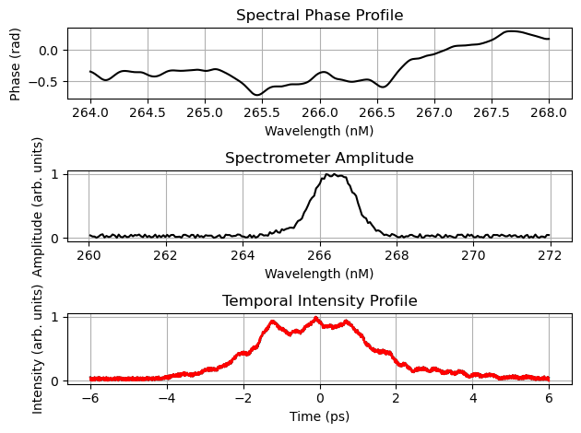
Temporal Laser Pulse Shaping
Pollard, A. E., et al. "Machine Learning for Laser Pulse Shaping" Proc. IPAC'23 (2023)
The shaping of the laser pulse affects the shaping of the electron bunches – another key parameter in FEL lasing.
We can control the temporal intensity profile of the laser using an acousto-optic modulator.
The AOM receives a spectral phase profile and produces a corresponding temporal intensity profile.
A function exists to calculate temporal intensity profile from spectral phase, but not the other way around.
We applied machine learning to enable us to specify an arbitrary temporal intensity profile and generate a spectral phase profile which will generate it.
Notes:
Temporal Laser Pulse Shaping. This project is one of my two major focuses right now.
Our photo-injector laser system has a component called an acousto-optic modulator, which enables temporal shaping of the laser pulse. Unfortunately calculating the driving signal for a specific temporal profile is an ill-posed problem, at least if you want to preserve amplitude.
Machine learning is great for this kind of problem.
The ideal is to be able to generate a spectral phase profile for a given temporal intensity profile, while preserving the total energy of the laser pulse. There are previous works that use iterative algorithms for this, but in addition to being quite slow they have a couple other weaknesses that ML can address.

Slide 32
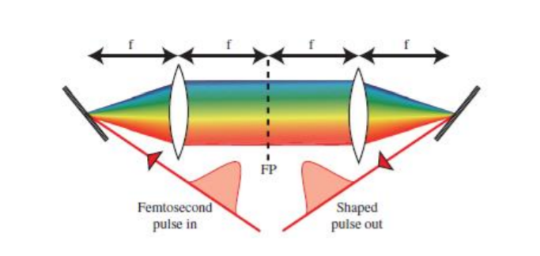
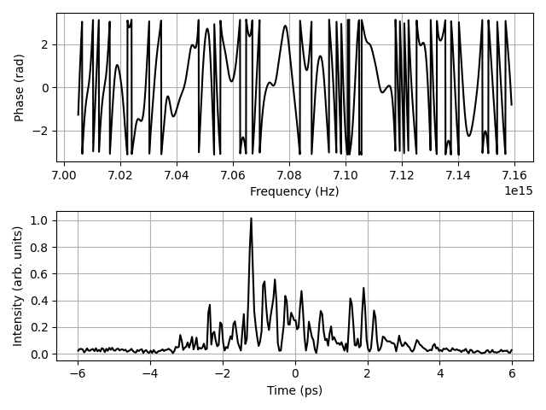
Acousto-Optic Modulator
A crystal at the focus point is driven by a transducer controlled by an FPGA.
Variations in the crystal density caused by the sound waves cause shifts in the spectral phase
Recombining the spectral components results in the shaped temporal pulse
Notes:
This is just a simplified diagram of the acousto-optic modulator. Essentially it splits the incoming laser light into its spectral components, which travel through a crystal at the central focus point. The crystal is driven by a transducer which causes variations in the density of the crystal, which in turn causes shifts in the phase of the spectral components. Recombining those spectral components results in the shaped temporal pulse.

Slide 33
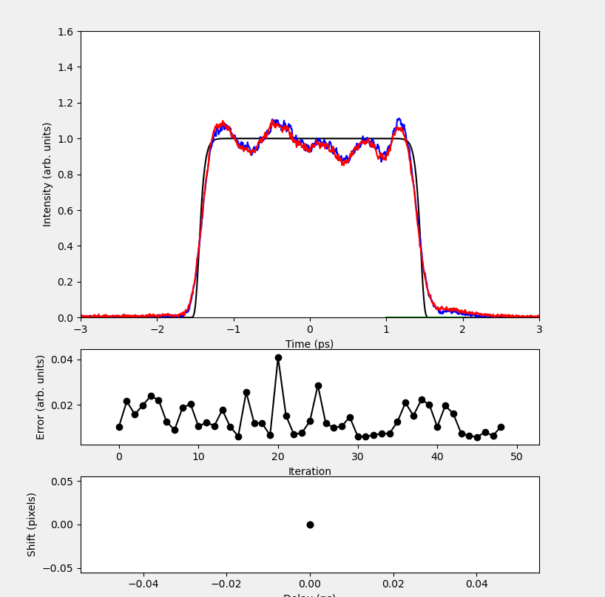
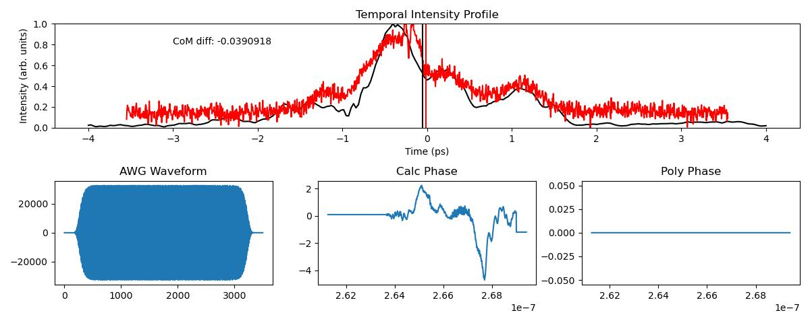
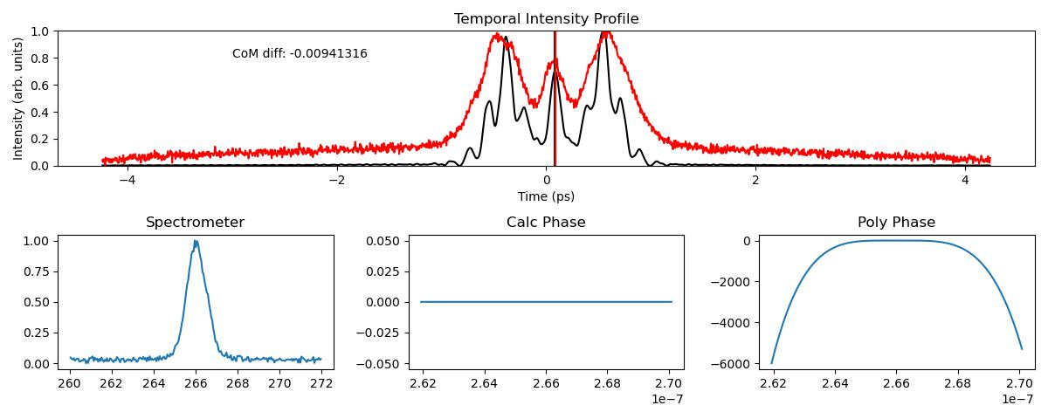
Temporal Laser Pulse Shaping
Using a physically informed neural network, we achieve physically realisable configurations with strong matching in milliseconds.
Deployment is underway, and nearly ready for user-facing work. We can ask for and receive arbitrary temporal intensity profiles within a 10th of a second.
Notes:
By using a differentiable simulation of the optical components we developed a physics informed neural network which predicted control signals for the AOM.
Originally we took the target temporal profile as the only input, but when deployed we found this actually only worked a small amount of the time. One of the major difficulties in deploying machine learning systems to production is that machines drift, sometimes far outside of your training set's range. We found that the laser's spectra was drifting by a small amount over the course of the day, and the AOM was very sensitive to this.
To combat this, we take the previous shot's spectrometer reading as part of the input to the network to compensate for laser drift and jitter.
We take as input the target temporal profile and the spectrometer reading, put those through a neural network, have that output a spectral phase profile, put *that* through a differentiable simulation which predicts the temporal profile, and then use the difference between the input and predicted temporal profile as part of our loss function.
We also add a constraint to the spectral phase profile which limits the maximum gradient, as this is a physical limit of the crystal in the acousto-optic modulator.
This physically informed neural network model incorporates the physical limits of the AOM, as well as the physics of the simulation, and so trains quicker and provides shaping signals which are instantly applicable to the shaper, in contrast with previous methods which generally require many rounds of iteration to achieve results.
We are currently in the process of deploying this system, and we're quite far along with this. It is now possible for a user to specify an arbitrary temporal pulse profile for the PI laser and have it applied in a fraction of second, as well as to have that pattern hold stable shot-per-shot even in the presence of laser jitter.
Future work on this will involve tying the system in to a bunch shape monitor and having the ML system allow for the specification of arbitrary bunch shapes. We're currently applying for funding to recruit a PhD student to investigate temporal shaping of the bunch using this system, and its potential applications to beam dynamics.

Slide 34
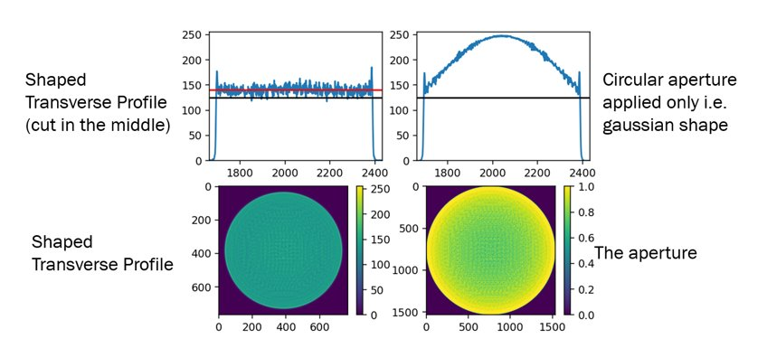
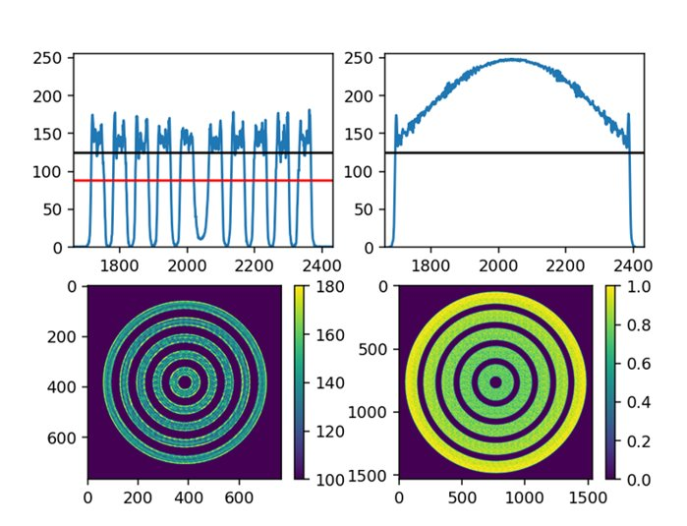
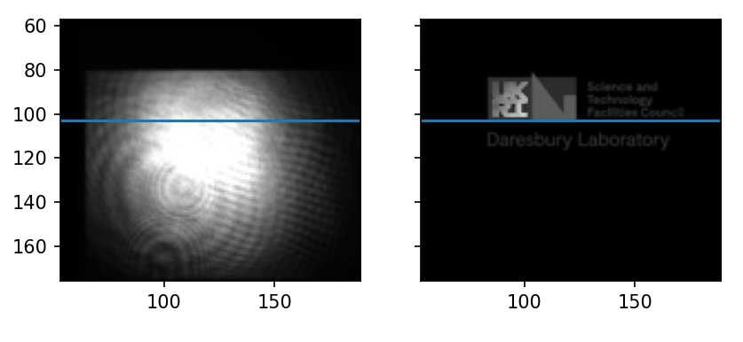
Transverse Laser Pulse Shaping
Using a DMD and a neural network control system to do transverse laser pulse shaping
Laser Pick-off
Shaped Laser Output
Notes:
As an addition to the longitudinal shaping, we also had a year-in-industry student, Ahmed, who developed a machine learning system which interfaced with a digital mirror device to produce high quality 2D shaping and shading of the laser. Here you can see this being used to project the UKRI logo with high fidelity.
This system took as input the pick-off of the laser and the target pattern and produced a control pattern for the DMD which smoothed out noise, corrected for laser breathing, and minimised artifacts from edge interference.
Once deployment is complete and combined with the temporal shaping, this gives CLARA a rather unique ability to have almost full 3D control of the photo-injector laser at femto-second scales. I say almost because the DMD can only change at 30Khz, which means that we can only change the transverse shape per-shot rather than during shots.

Slide 35
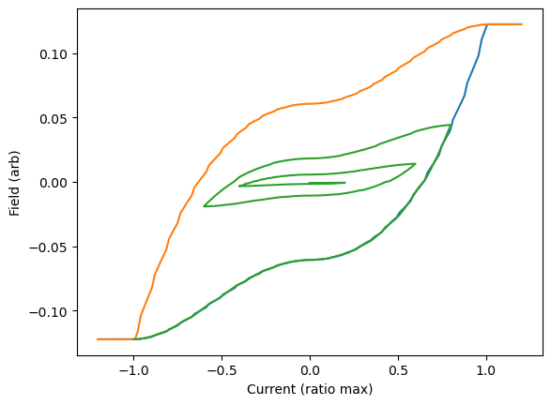
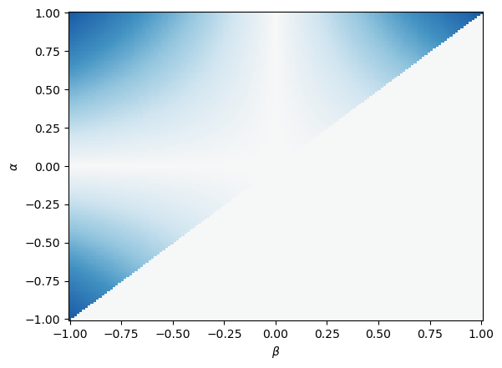
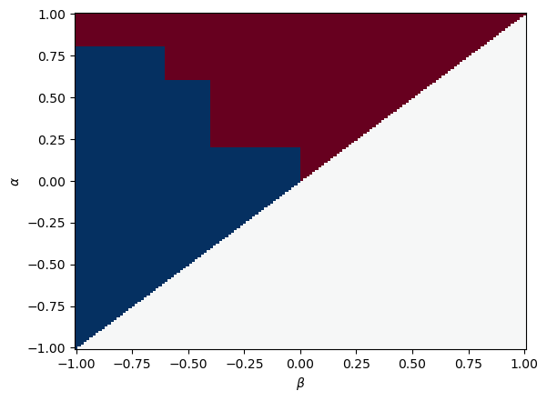
Magnet Hysteresis Modelling
Saved magnet settings on the accelerator aren't particularly reproducible, due to hysteresis.
Operators currently correct for that by degaussing and attempting to achieve the same configuration again from a loaded point, but this is very time consuming.
By predicting the hysteresis values we can return to the exact same field configuration.
Notes:
And finally, we're also actively working on modelling of hysteresis by characterising magnets. This work is still in the early stages but the intent is to use proxy measurements to solve the identification problem of Preisach modelling, allowing us to perfectly characterise magnets that are in place, which should enable the saving and reloading of magnet configurations without needing to retune and degauss every single time. This will be a significant time save for our operators, and should hopefully allow a more intuitive understanding of the accelerator physics because we can think of magnets as being set to field strengths, rather than currents.
I'm sure most of you are familiar with hysteresis curves. It's a pretty widely observed phenomenon in physics. The Preisach model treats each magnet as a collection of hysterons – essentially memory cells, with either a +1 or –1 state. To get the field strength you simply evaluate that double integral, where mu(alpha, beta) is the hysteron density function, and R_alpha_beta encodes the hysteron states given the current history. This video shows the hysteron states multiplied by the density function as a magnet deguausses, with red representing the –1 state and blue, the +1 state. The set of graphs above show the final states, with the hysteresis curve on the left, the density function mu in the
middle, and the hysteron states on the right.
To perfectly characterise a magnet, we need to learn its mu function, the true hysteron desnity function. The hysteron state can be inferred from the current history. The model will learn the hysteron density function through a proxy observation (ie, the kick applied to the bunch), and combines this with the current history of the magnet, then when an operator saves a configuration, instead of storing the current, it will store the predicted field value. Then, when we come to reload we can simply use the current history and the stored field value to restore the magnet to the desired field strength. The hope is that his will save hours of operator time which is normally spent degaussing and retuning magnets between setups.

Slide 36
Magnet Hysteresis Modelling
Notes:
We built a machine learning model which treats the mu function as a learnable matrix, and modified the state transition function to be differentiable. As such we can train the model to learn the mu function using current history and measured field.
And here's it training on a toy example of the problem. The model is fed only the current history of the magnet, and is trained to predict the field. Because we've integrated the Preisach model into the machine learning model, we can visualise the model learning the hysteron density function. The true value is on the right there.
The next step in this research is to train the model by proxy measurements, allowing us to characterise magnets that are in place without needing to take hall probe measurements – a thing that is impossible to do for most magnets in the accelerator.

Slide 37
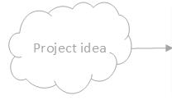
Future Works on CLARA
(Simulation)
PI laser pulse shaping
PI laser pulse shaping -> electron bunch shaping
Integrated model surrogate model
RF breakdown prediction
Integration of ML live RF breakdown classifier into NO-ARCv2 conditioning code
Longitudinal diagnostics for FEBE e.g. using CTR
Broader RF fault detection/ correction system
Magnet Hysterisis Prediction & Compensation
Electron diffraction artefact removal
Emittance measurement (tomography)
RF Cavity Shape Optimisation
Notes:
As you've seen, there's been quite a lot of work using machine learning going on at Daresbury, so to give a bit of perspective, we've got this lovely project timeline. As you can see, the laser pulse shaping is our most advanced project. It's practically ready for users.
RF breakdown detection is not far behind, as is the hysteresis modelling.
We've got quite a few more projects lined up, and hopefully should be getting through most of those in a year or two, so look out for our papers on those!

Slide 38
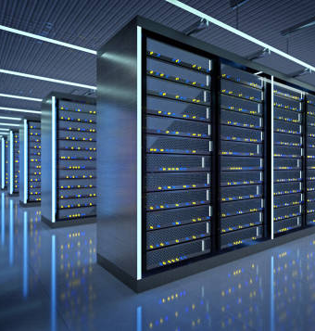
Current Challenges
Deployment is very hard!
Rapid inference requires FPGA expertise
High quality data is scarce
Most accelerators weren't built with ML in mind
Notes:
Before I conclude I'd just like to talk about some of the challenges we're facing.
The first is that deployment is a hard problem. It is relatively easy to make a simple model that can match your data, especially simulated data, but handling machine drift, changes in configurations, or even just previously unobserved parameter regions can be extremely difficult. We encountered this when working on the laser pulse shaping initially, and that's what led us to integrate the spectrometer readings.
Also for live deployments for anomaly detection, we need high repetition rate inference. For that we need to deploy machine learning to FPGAs. FPGA expertise is uncommon and that means that it can be difficult to find staff with the technical expertise needed to implement these machine learning algorithms at repetition rates exceeding 50Hz
High quality data is the lifeblood of ML, and it is sometimes quite difficult to collect. As I'm sure you know accelerators generate huge quantities of data, but frequently to store it we need to do so sparsely. Either experiments discard large quantities of data or it's compressed lossily. For something like RF waveforms, recording a full duty cycle can result in terabytes a day, and the infrastructure to store that much data is not cheap.
With ML really only coming to the forefront in the last decade or so, most modern accelerators were not built with ML in mind. Sensors and data collection were largely added as afterthoughts, or if they were already in place, they were not intended to be used for the kinds of data processing we need. We've been working around this and using what data we can, but also pushing for ML to be considered during the design phase of accelerators. Fortunately both the RUEDI and UK XFEL projects which Daresbury play big parts in have taken this to heart.

Slide 39
Publications
Maheshwari, Minerva, et al. "Prediction and Clustering of Longitudinal Phase Space Images and Machine Parameters Using Neural Networks and K-Means Algorithm." Proc. IPAC’21 (2021): 3417-3420.
Wolfenden, J et al. “Broadband Imaging of Coherent Radiation as a Single-Shot Bunch Length Monitor with Femtosecond Resolution”, Proc. IPAC’21 (2021): 2673-5490.
Pollard, A. E., D. J. Dunning, and M. Maheshwari. "Learning to Lase: Machine Learning Prediction of FEL Beam Properties." Proc. ICALEPCS'21 (2021).
Pollard, A. E., A. J. Gilfellon, and D. J. Dunning. "Machine Learning for RF Breakdown Detection at CLARA." Proc. ICALEPCS'21 (2021).
Pollard, A. E., et al. "Machine Learning Approach to Temporal Pulse Shaping for the Photoinjector Laser at CLARA." Proc. IPAC'22 (2022)
Dunning, D.J et al. “Machine Learning Developments for CLARA” Proc. FEL’22 (2022).
Wolfenden, J et al. “Application of Virtual Diagnostics in the FEBE CLARA User Area” Proc. LINAC’22 (2022).
Wolski, A et al. “Accelerator beam phase space tomography using machine learning to account for variations in beamline components” Journal of Instrumentation, Volume 19, (2024)
Pollard, A. E., et al. "Machine Learning for Laser Pulse Shaping" Proc. IPAC'23 (2023)
Notes:
This is a list of all the publications mentioned in this talk.

Slide 40
Thanks for your attention!
Notes:
And that's everything! Thanks for your attention, and feel free to ask questions if you have them.

Slide 41
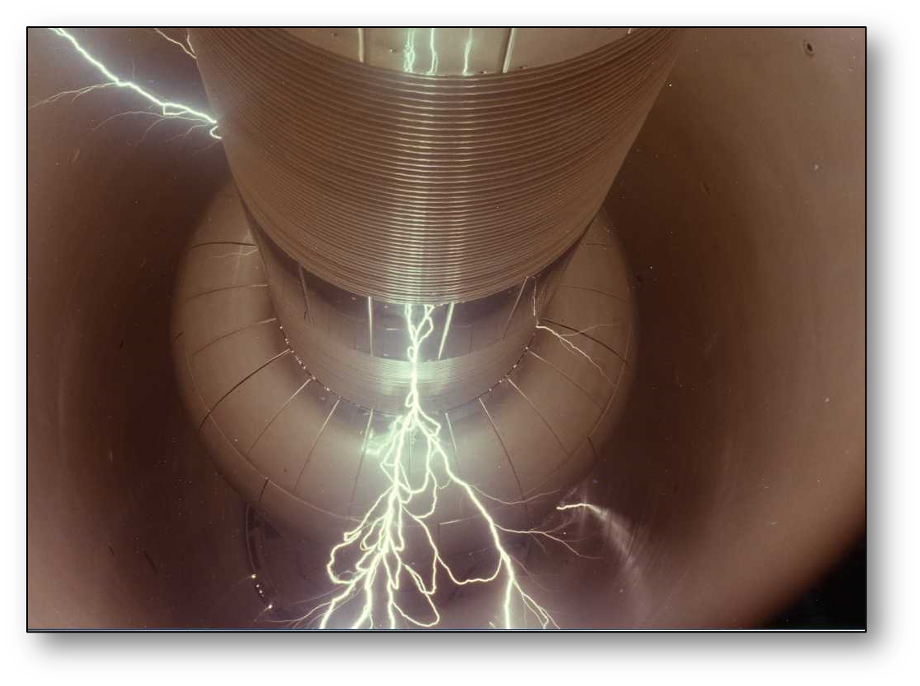
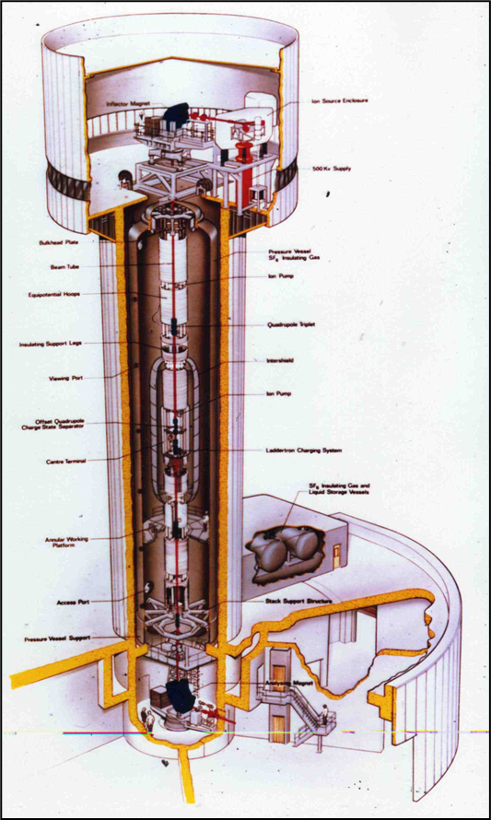
Notes:
Also here's some cool pictures a colleague sent me when I was confirming a few details about the tower. You're looking here at a cross sectional diagram of the tower and the breakdowns that happened when they tried to run the thing at 30 million volts.

