Slide 1

SHiP
Search for Hidden Particles
Eric van Herwijnen (Imperial College London)
October 2025

Slide 2
Beginning of SHiP: 2012
Higgs discovered!
  Triumph of SM
But three major problems:
  SM -> ‘God is a weak left-hander’. However: neutrinos have mass!
  Baryon asymmetry. Where are all the anti baryons?
  Dark Matter. What is it?

Slide 3
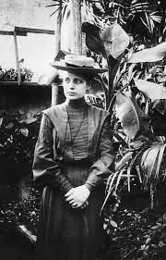
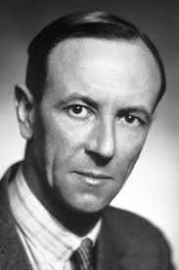
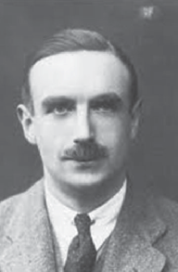
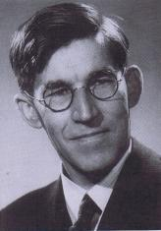
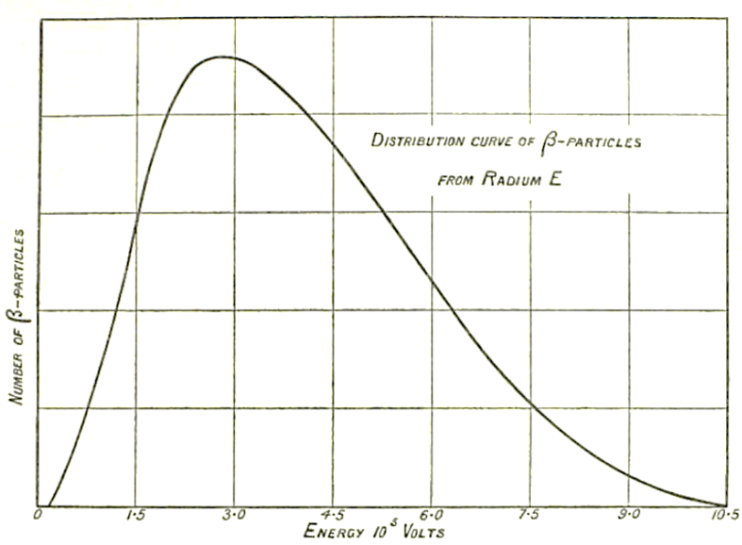
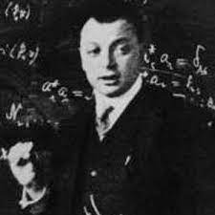
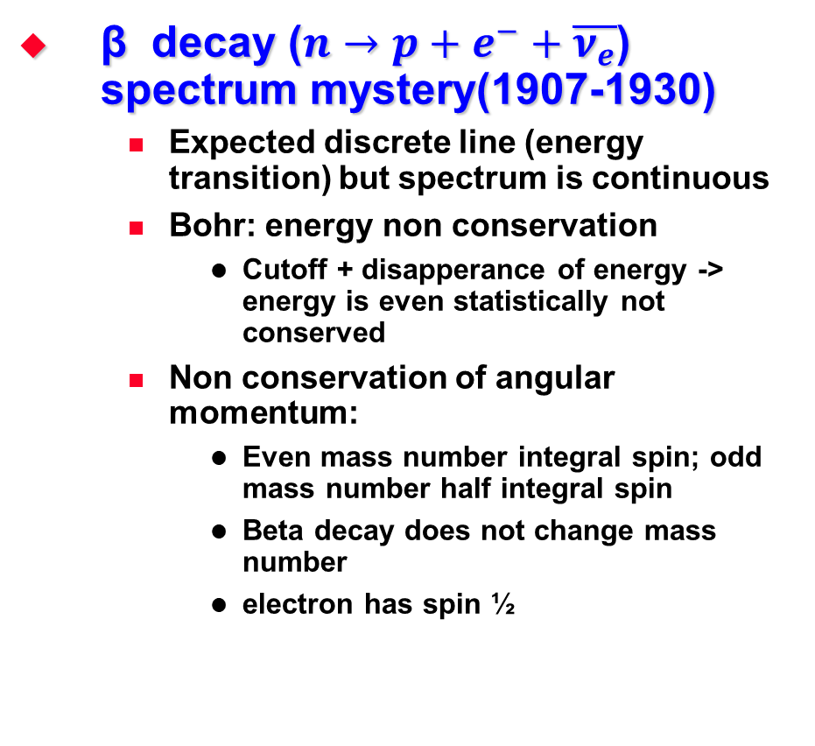
Neutrinos
β decay ($n→p+e^{−}+\overline{ν_{e}}$) spectrum mystery(1907-1930)
  Expected discrete line (energy transition) but spectrum is continuous
  Bohr: energy non conservation
    Cutoff + disapperance of energy -> energy is even statistically not conserved
  Non conservation of angular momentum:
    Even mass number integral spin; odd mass number half integral spin
    Beta decay does not change mass number
    electron has spin ½
A third particle:
the neutrino
(with spin ½)!

Slide 4
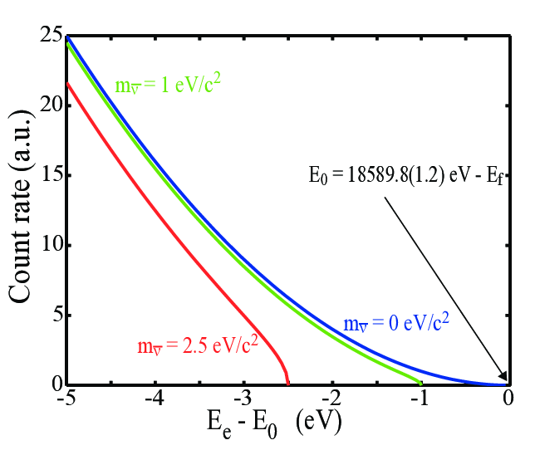
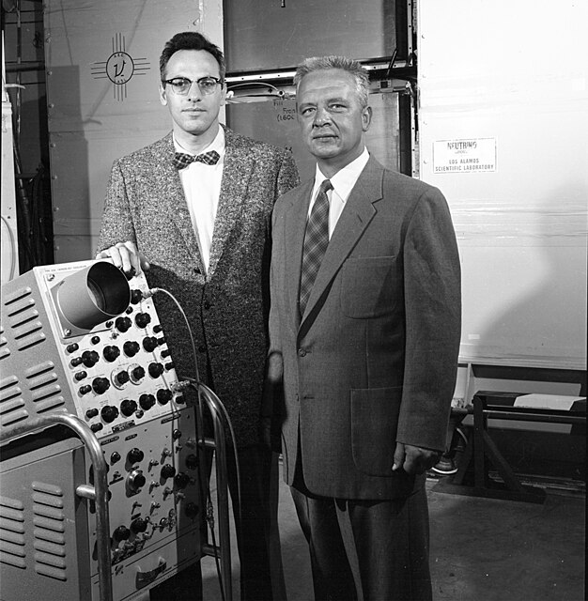
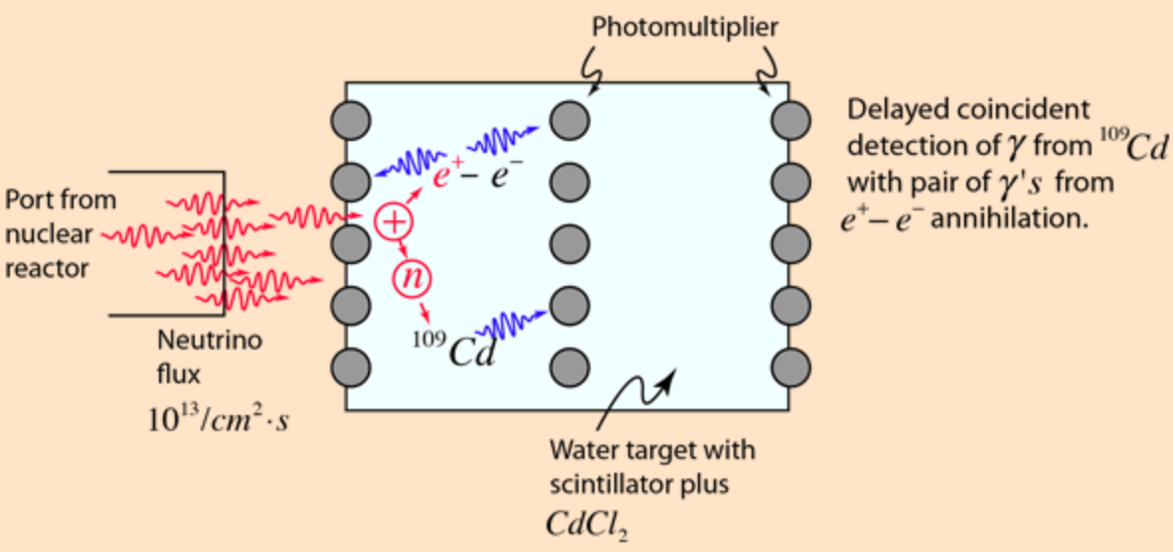

They exist and have mass
Pauli: < 0.01 m_{p}
  Everything comes to him who knows how to wait
  More on m_{ν} later
1956 (F. Reines and C.L. Cowan)
$\overline{ν_{e}} + p→n+e^{+}$
$n+{}_{}^{108}{Cd}→{}_{}^{109}{Cd∗}→{}_{}^{109}{Cd}+γ$

Slide 5
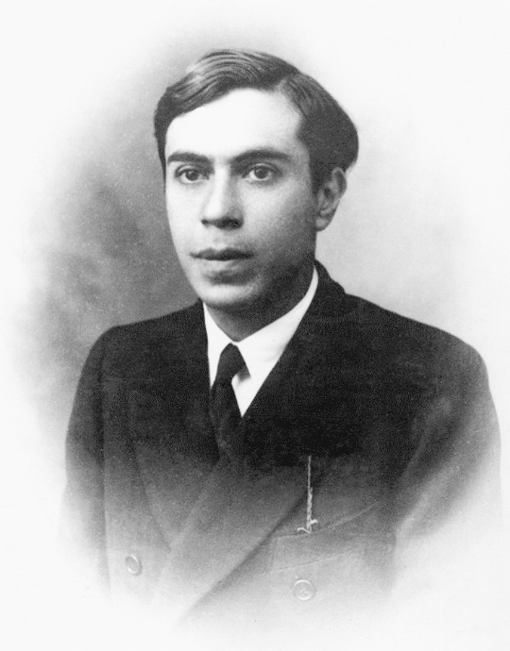
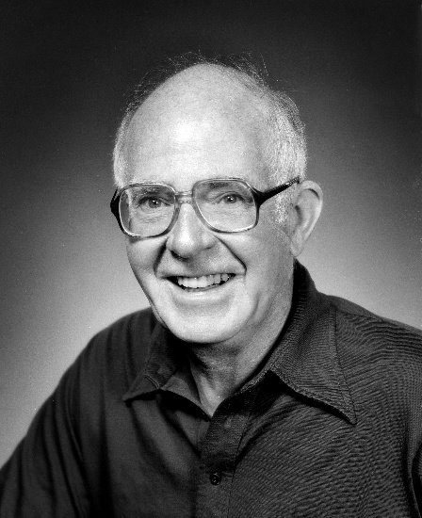
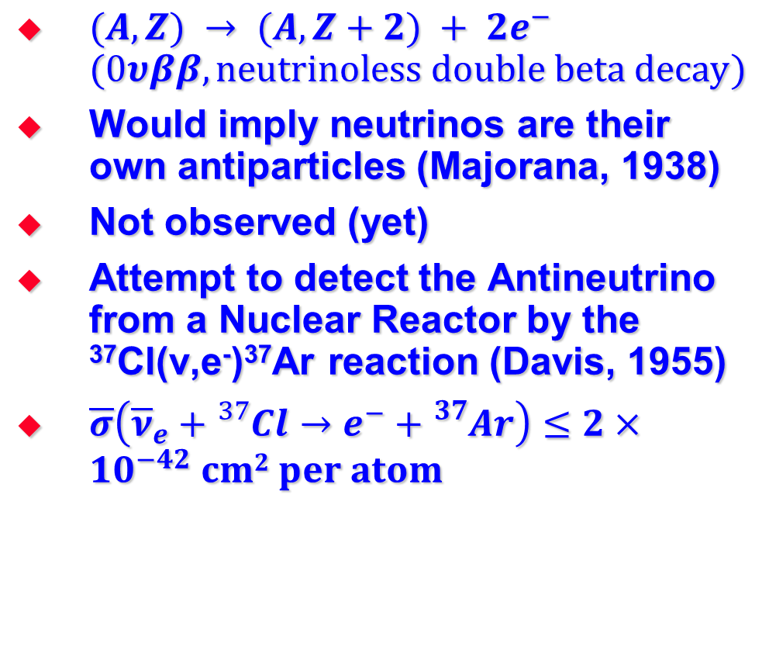
$$ν≠\overline{ν}$$
$(A,Z) → (A,Z+2) + 2e^{−}$ $(0υββ, neutrinoless double beta decay)$
Would imply neutrinos are their own antiparticles (Majorana, 1938)
Not observed (yet)
Attempt to detect the Antineutrino from a Nuclear Reactor by the ³⁷Cl(ν,e⁻)³⁷Ar reaction (Davis, 1955)
$\overline{σ}\left({\overline{ν}}_{e}+{}_{}^{37}{Cl}→e^{−}+{}_{}^{37}Ar\right)≤2×10^{−42} cm2 per atom$

Slide 6
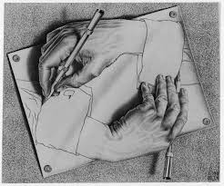
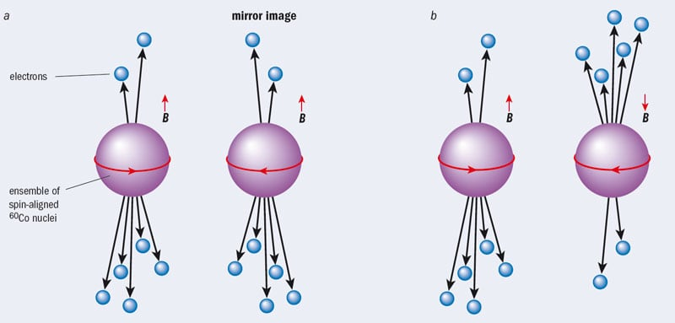
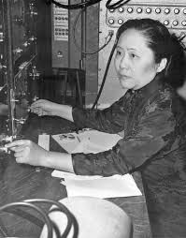

Parity not conserved
1957, C.S. Wu. ${}^{60}Co→^{60}Ni+e^{−}+{\overline{ν}}_{e}$
Electrons always emitted opposite to direction of nuclear spin
No right-handed neutrinos!
(if parity conserved)
Observed: parity NOT conserved

Slide 7
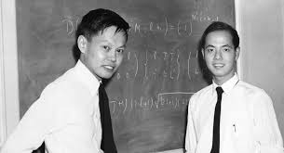
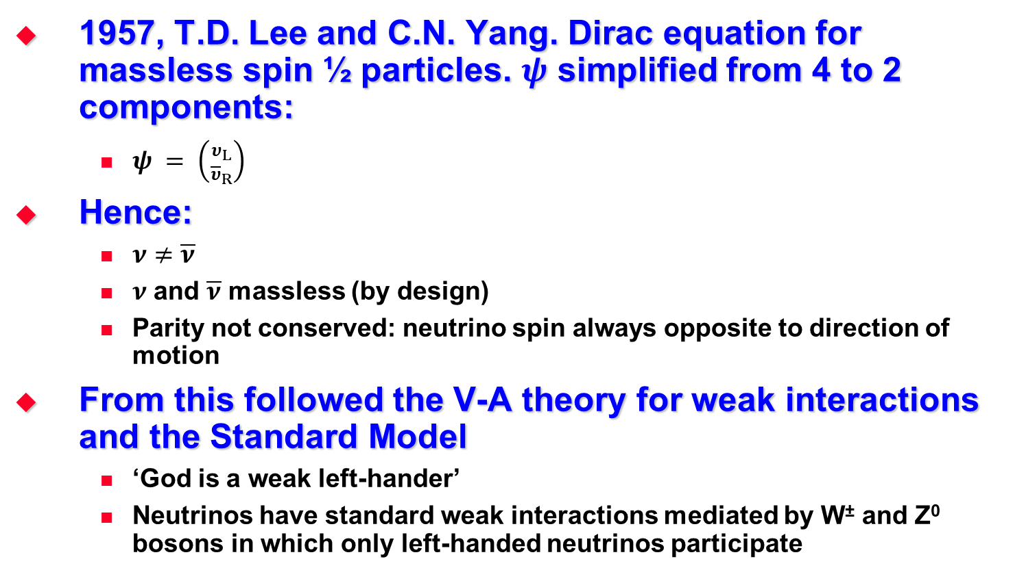

Two component $ν$ theory
1957, T.D. Lee and C.N. Yang. Dirac equation for massless spin ½ particles. $ψ$ simplified from 4 to 2 components:
  $ψ = \left({υ_{L} \atop {\overline{υ}}_{R}}\right)$
Hence:
  $ν≠\overline{ν}$
  $ν$ and $\overline{ν}$ massless (by design)
  Parity not conserved: neutrino spin always opposite to direction of motion
From this followed the V-A theory for weak interactions and the Standard Model
  ‘God is a weak left-hander’
  Neutrinos have standard weak interactions mediated by W± and Z⁰ bosons in which only left-handed neutrinos participate

Slide 8
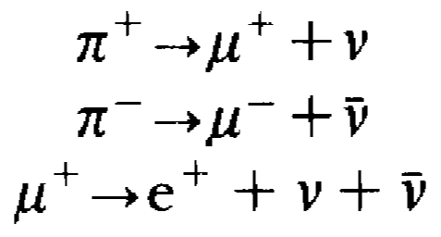
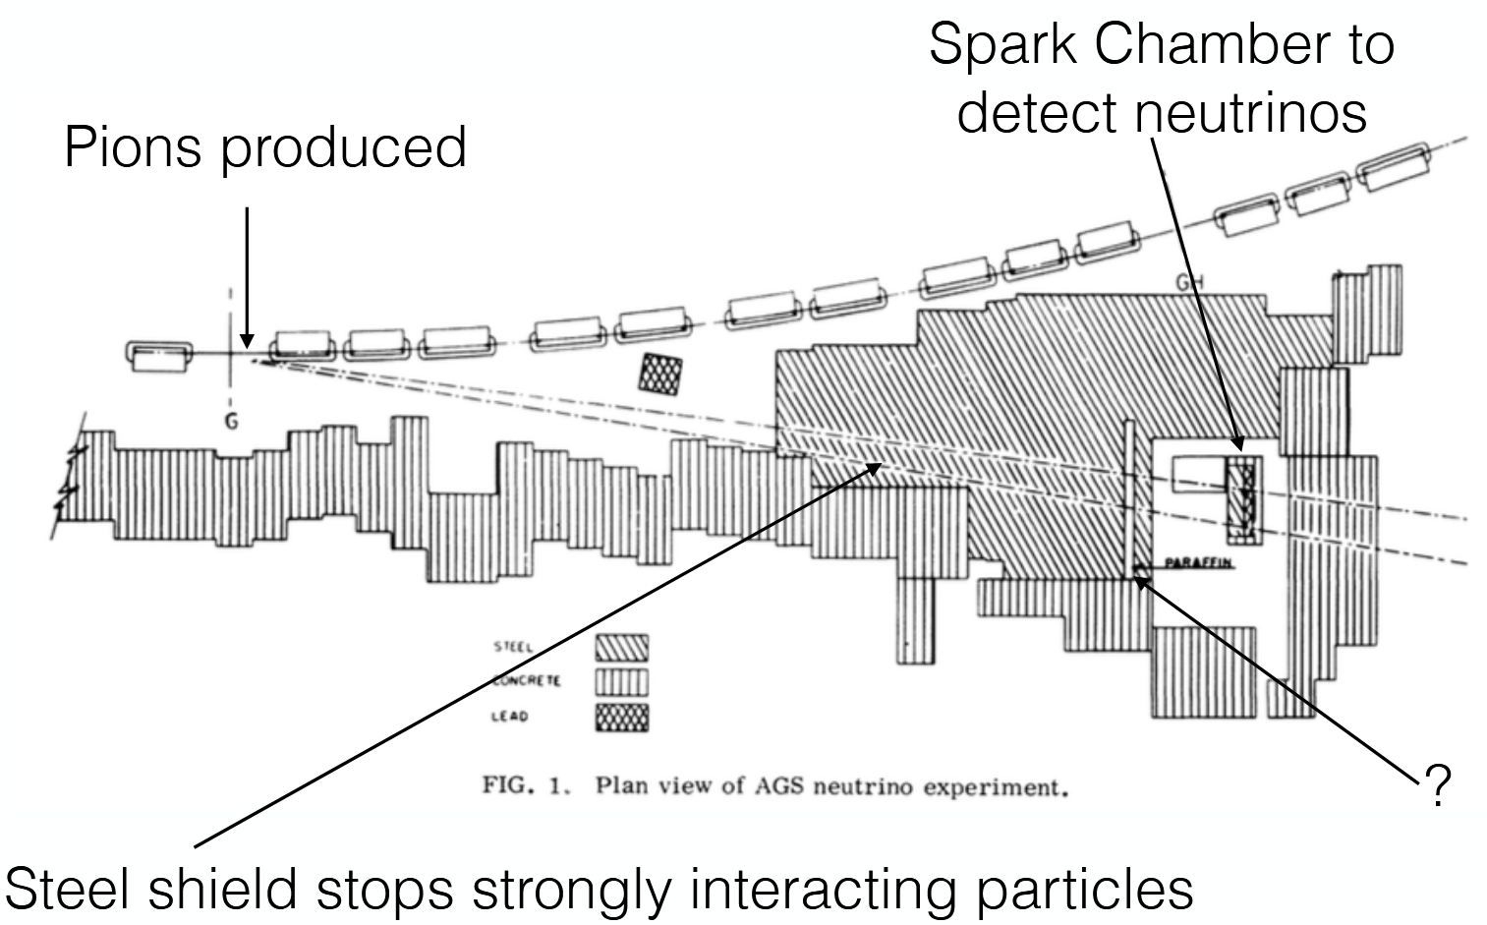
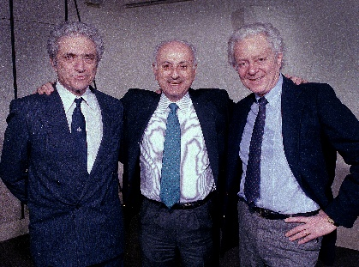
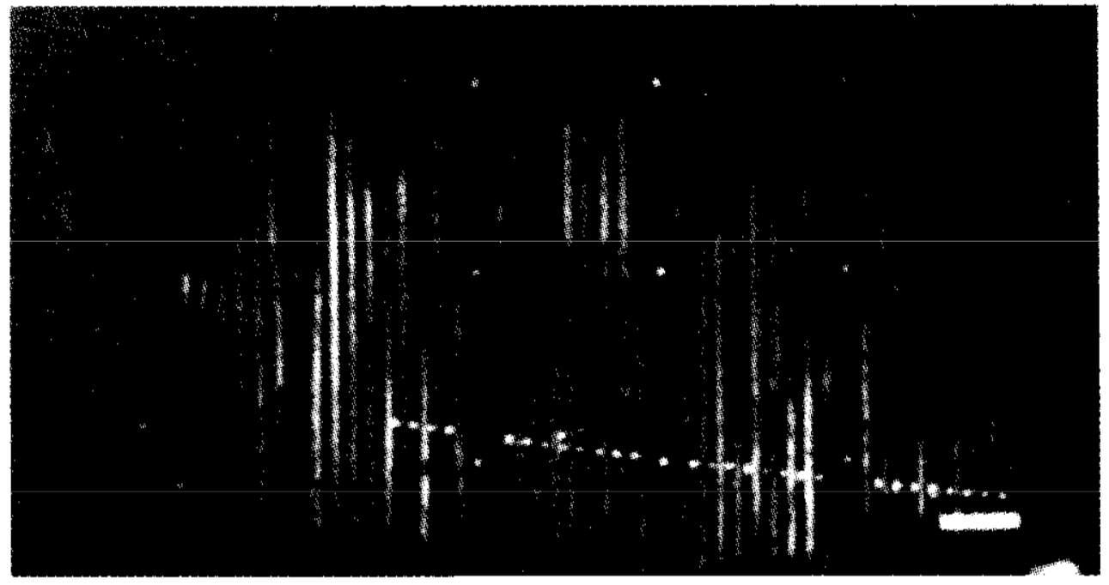
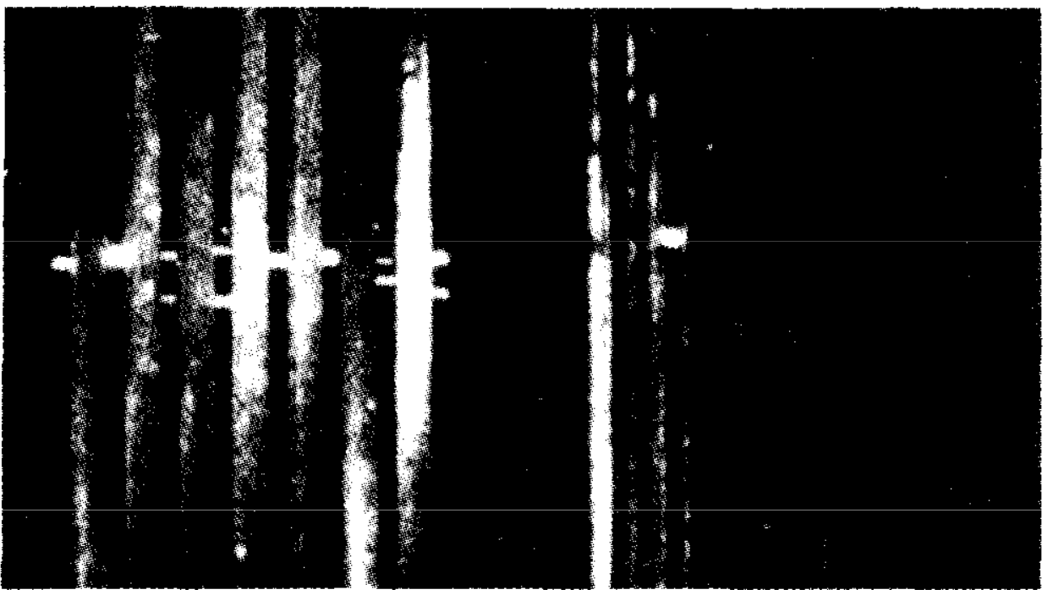
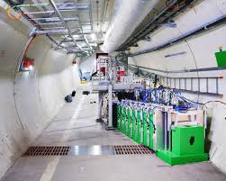
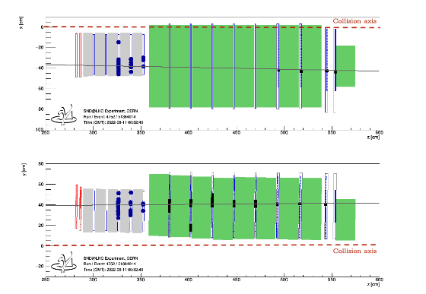
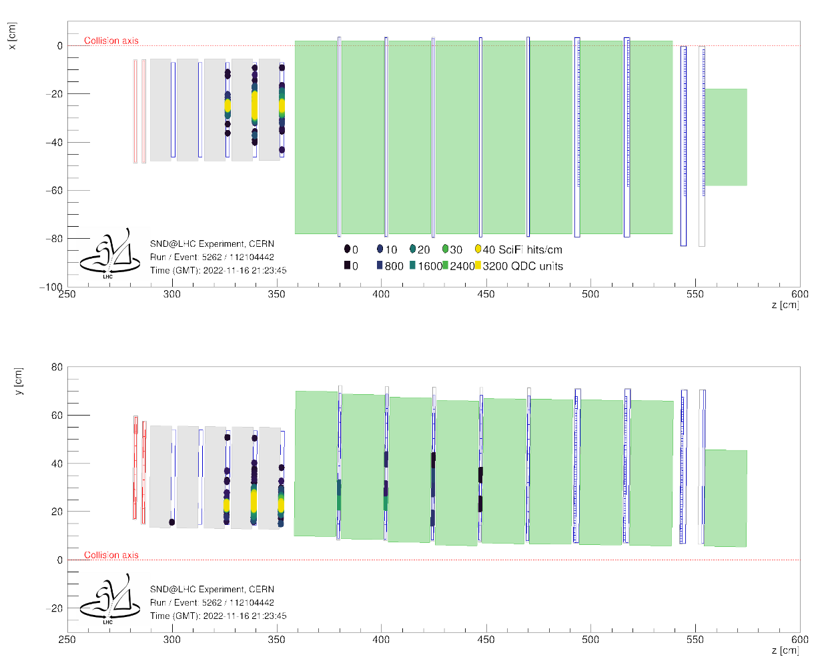
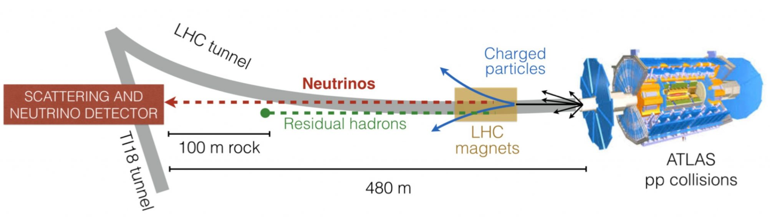




$ν_{e}$ and $ν_{μ}$
1962. J. Steinberger, M. Schwartz, L. Lederman
  The first high energy neutrino beam
2025. SND@LHC
(Be target)
15 GeV proton beam
Single track events $→μ$ from $ν_{μ}$ ints
Shower $→e$ from $ν_{e}$ ints
$$ν′s from b and c$$

Slide 9
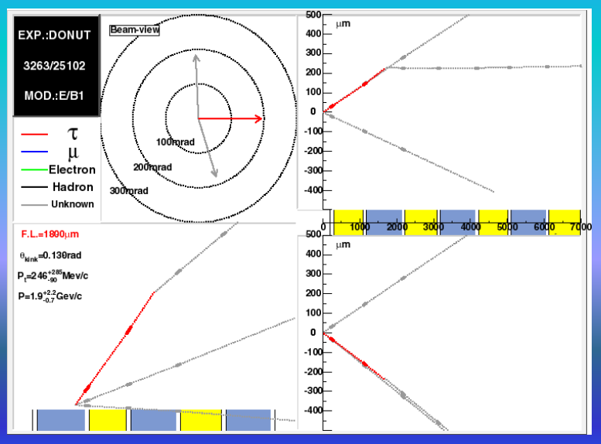
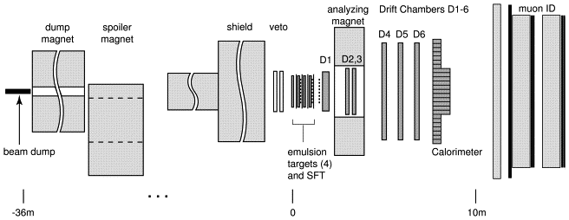
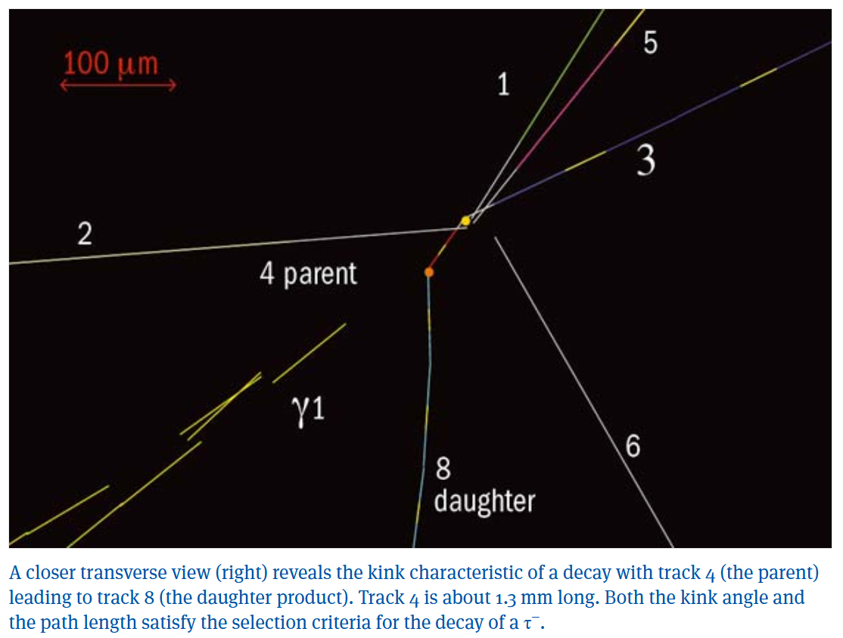
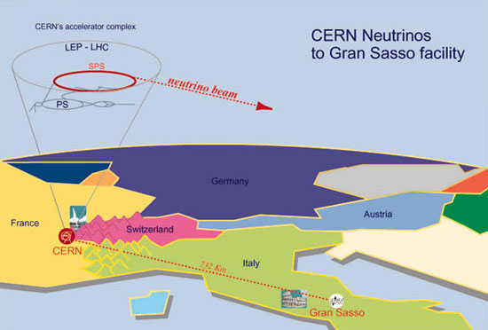
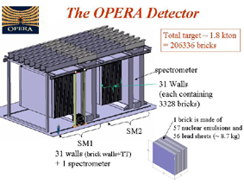


$ν_{e} , ν_{μ}$ and $ν_{τ}$
2000. Donut
2010. Opera
$$D_{s }→τ +\overline{ν_{τ}} ;τ→ν_{τ}$$
800 GeV protons
→
${ν_{μ}→ν}_{τ};ν_{τ}CC int→τ→ν_{τ}$+ h

Slide 10

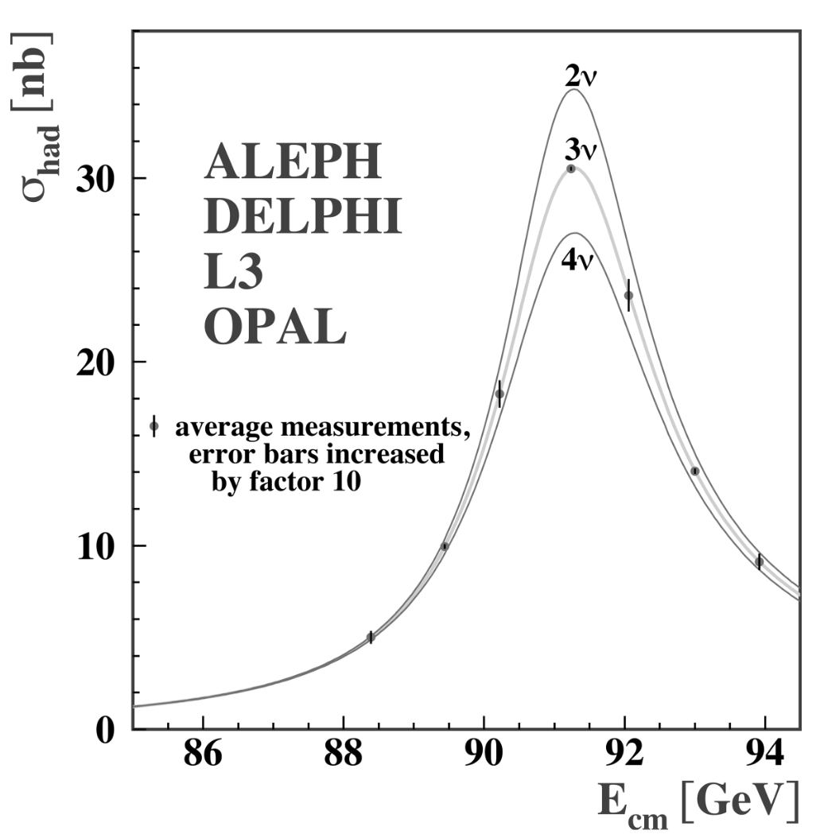

Three $ν$flavours
1990. LEP and SLC
Z linewidth shape

Slide 11
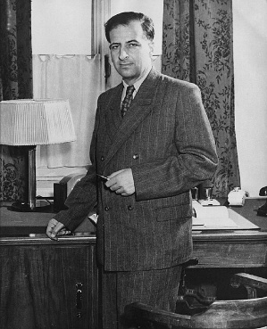
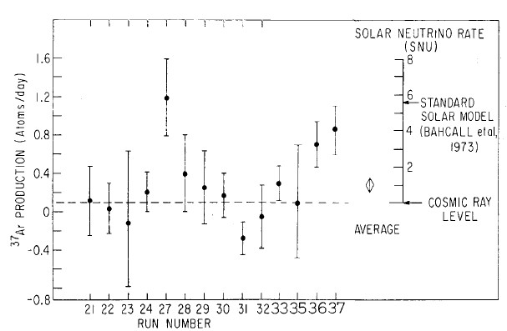
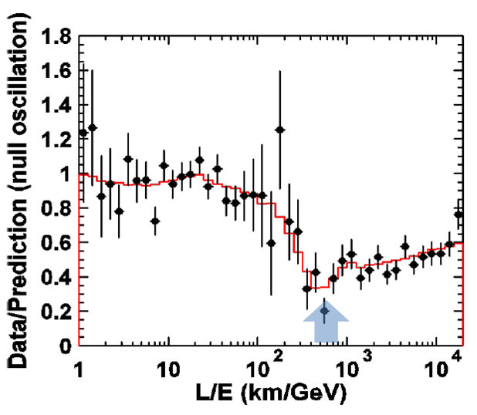
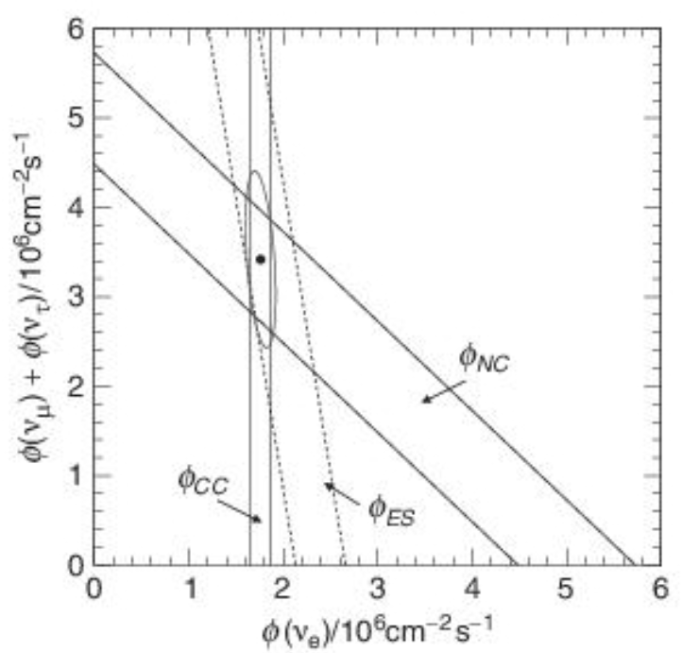
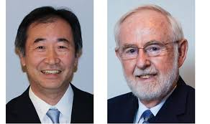

Neutrino oscillations
Hydrogen burning in sun (pp cycle)
  high flux of $ν_{e}$ (mainly from ${}_{5}^{8}B→{{}_{4}^{8}{B^{∗}} + e}^{+}+ν_{e}$)
Homestake, Kamiokande (1968)
  deficit of $ν_{e}$‘s (‘solar’ neutrino problem)
SNO (2001): $ν_{e}$ vs total $ν$ flux
  Large $ν_{μ}/ν_{τ}$ component
Atmospheric neutrinos (Super Kamiokande, 1998)
  $ν_{μ}$ from cosmic rays $π→μ+ν_{μ}$ and $μ$decay
1957. B. Pontecorvo
T. Kajita
A. McDonald

Slide 12
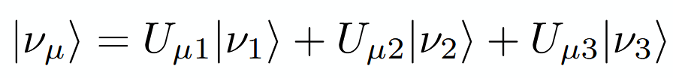



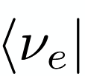
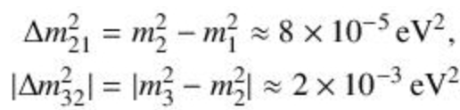
Neutrino masses
Flavour states superposition of mass states
Propagation phases are different ->state evolves over time
  , ,
Projection over
Oscillation probability proportional to mass² differences
From measurements:
PPG (2024):

Slide 13

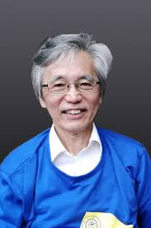

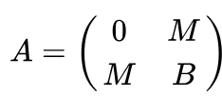



Seesaw mechanism
1977. P. Minkowski, 1981. T. Yanagida
Neutrinos can acquire (‘Dirac’) mass via Higgs mechanism in SM:
Right handed neutrinos must exist
  But, left handed neutrino masses are very small (~O(eV))
  Hence, another mechanism required
  Each neutrino flavour has a very heavy right handed ‘Majorana’ partner
  Right handed fermions: Y_{w} = 0, I_{w} = 0 → no SM interactions (‘sterile’)
  Also called Heavy Neutral Leptions (HNLs)
Eigenvalues of when B>>M: ,

Slide 14

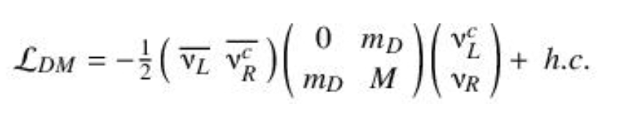
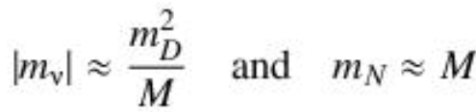


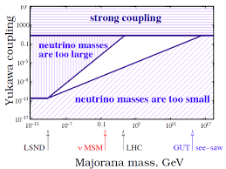
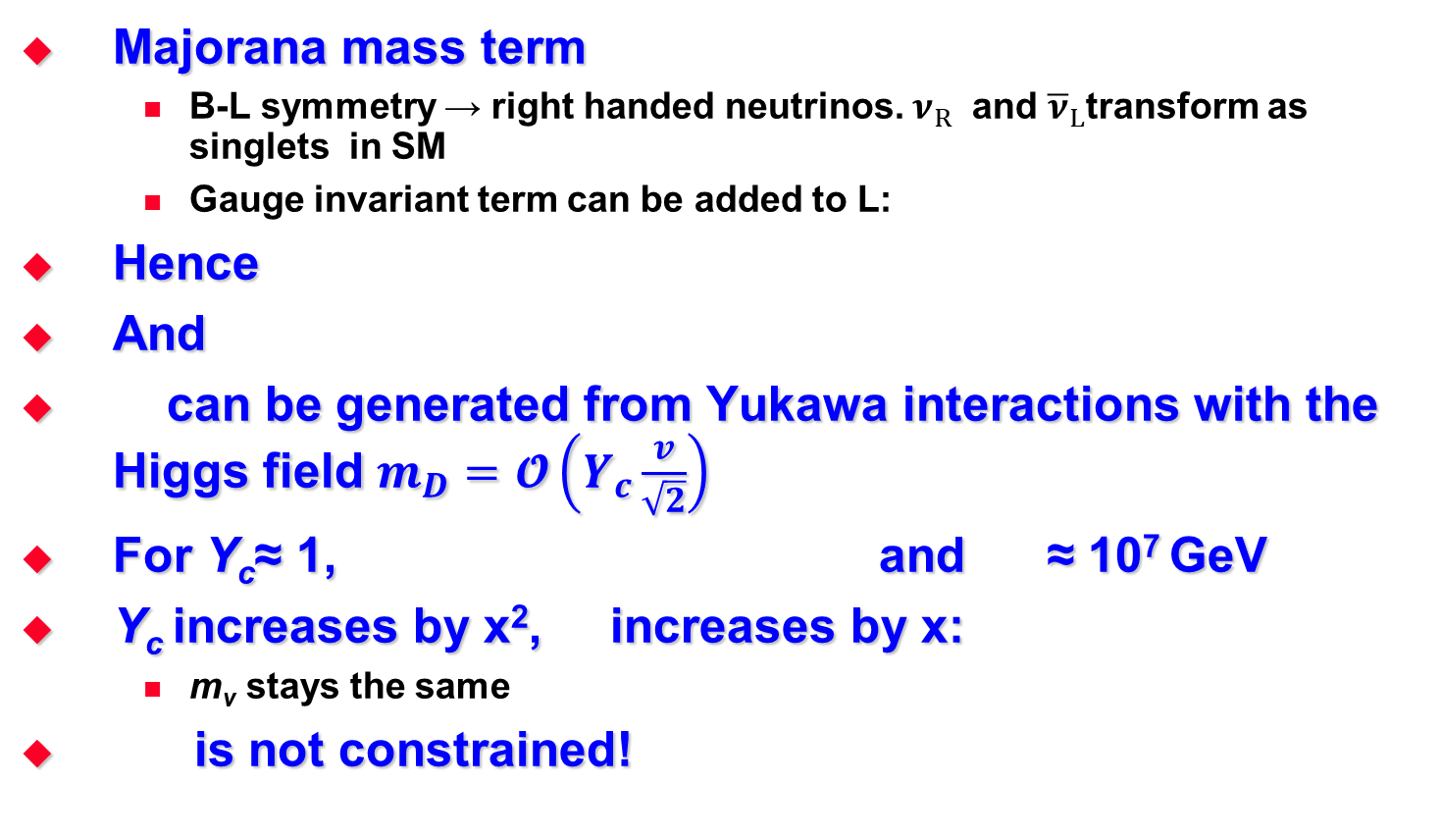
Seesaw and neutrino masses
Majorana mass term
  B-L symmetry → right handed neutrinos. $ν_{R}$ and ${\overline{ν}}_{L}$transform as singlets in SM
  Gauge invariant term can be added to L:
Hence
And
can be generated from Yukawa interactions with the Higgs field $m_{D}=𝓞\left(Y_{c}\frac{v}{\sqrt{2}}\right)$
For Y_{c}≈ 1, and ≈ 10⁷ GeV
Y_{c} increases by x², increases by x:
  m_{ν} stays the same
is not constrained!

Slide 15



Search for neutrino decay
1982. M. Gronau. Fermilab-Pub-82/52-thy
  Searching for Heavy Unstable Neutrinos
1984. F. Vanucci et al. CERN PS 191
  0.56 x 10¹⁹ POT
  p + (Be) target → $π,$ K → ${e/μ ν}_{h}$ + …
  0 events below K. First exclusion plots!

Slide 16
Baryon Asymmetry of the Universe
Sakharov conditions for baryon asymmetry satisfied by seesaw:
  HNLs created in the early universe. Extra complex phases in Yukawa couplings → CP violation → L violation
  Complex vacuum structure in SM → L violation transferred to baryons due to equilibrium sphaleron processes → B violation
  HNLs out of thermal equilibrium for T>O(100) GeV (decay rate not as quick as the Hubble expansion)

Slide 17

Non-baryonic Dark Matter
‘Weak’ gravitational lensing
  Strongest evidence for dark matter. Look at many clusters of galaxies.
Vera Rubin:
  5 times more dark matter than baryonic matter
Warm Dark Matter candidates:
  Stable sterile neutrinos with m ~ O(1keV)
From cosmology: 2.6 keV < m < 5 keV

Slide 18




$ν$MSM
2005. M. Shaposhnikov et al.
SM with right-handed Majorana HNLs: $N_{1},$ $N_{2}$ and $N_{3}$:
PL B620 (2005) 17

Slide 19








Predictions from $ν$MSM
Dark matter→3 $N$
  Only 2 N incompatible with oscillation data
Lightest active neutrino mass
  and
$N_{1}$ light, $O(1 keV)$ : dark matter candidate
  Could be found by X-ray observatories
  3.5 keV emission line
$N_{2,3}$ degenerate, $O\left(100 MeV−few GeV\right)$:
  Give active neutrino masses via see-saw
$N_{2,3}$ increased CP violation:
  leptogenesis →baryogenesis
arXiv:1402.4119 (2015)

Slide 20



Further constraints on N_{2,3}
BAU generation: mixing angle of N_{2,3} to active neutrinos not too large
Neutrino masses: mixing angle of N_{2,3} to active neutrinos not too small
Excluded by neutrino oscillations
Excluded by neutrino oscillations
PRD 87 093006 (2013)

Slide 21





$HNL$ production and decay
Production:
  Via kinematically allowed weak decays of mesons and baryons
    p + target (dump) → ($π,$ K, charm for$M_{HNL}<2 GeV$, beauty for $M_{HNL}<5 GeV$) + …, and then hadron → N + …
Signal: spontaneous appearance of SM particles
  Production:
  $$Br\left(D→HNL X)\sim {10}^{−8}\text{−}{10}^{−12}\right)$$
  $$Br\left(B→HNL X)\sim {10}^{−12}\text{−}{10}^{−16}\right)$$
  Decay:
  $$Br(HNL→μ\left(e\right)π)\sim 0.1−50\%)$$
  $$Br(HNL→μ\left(e\right)ρ)\sim 0.5−20\%)$$
  $$Br(HNL→μeν_{e})\sim 1−10\%)$$
HNL
HNL
Yukawa coupling to Higgs vev
HNL
HNL

Slide 22



Back to 2012
D. Gorbunov, M. Shaposhnikov: 2012 ESPPU proposal
Daniel Treille (CMS)
  Remembers paper on $ν$MSM
    Very large decay length of HNLs
    Produced in Charm and Beauty
  Discusses with Hans Dijkstra (LHCb) the possibility of an experiment in one of the side tunnels at LHCb

Slide 23

SHiP: Search for Hidden Particles
2013. Expression of Interest to SPSC
Many years of optimizing, designing, testbeams, writing and persuading (one document per year in CDS)
  Start of search for Feebly Interacting Particles (FIPS)
  FASER, Facet, Mathusla, Codex-b, Anubis, Shadows, Hike, Klever …
2024. SHiP approved as NA67

Slide 24


Where?
High Intensity upgrade of the SPS beam line
ECN3
SPS
FRANCE
SWITZERLAND
LHC

Slide 25

How? SHiP techniques
Visible decay to SM particles
  Hidden Sector Decay Detector (HSDD)
Scattering off atomic electrons and nuclei
  Scattering and Neutrino Detector (SND)

Slide 26



HSDD Sensitivity
Sensitivity depends on:
  Yields (protons on target)
    ${2×10}^{20}$ p.o.t in 5 years ${\sim 10}^{18}$ $c\overline{c}$; ${\sim 10}^{14}$ $b\overline{b}$ (50x more than HL-LHC)
    Thick target (15 $λ$): stop $π$’s and K’s before decay
    High A&Z (W): maximize production cross sections
  Acceptance (lifetime & angular coverage)
  Background level
$D→μ HNL X, HNL→μπ$, $N\left(pot\right)=2× {10}^{20}$ (5 years running)
$$U_{μ}^{2}$$ | $$M_{HNL}$$ | $$n(HNL)$$
$${10}^{−8}$$ | 1 GeV | 120
$${10}^{−7}$$ | 1 GeV | 12000

Slide 27

HSDD Backgrounds

Slide 28

HSDD Sensitivities

Slide 29



SND Neutrino physics
$≃{10}^{6 }$[$ν_{e}$+${\overline{ν}}_{e}$] + ${10}^{7 }$[$ν_{μ}$+${\overline{ν}}_{μ}$] + ${10}^{5 }$[$ν_{τ}$+${\overline{ν}}_{τ}$] interactions
LDM scattering off atomic electrons and nuclei
  Electron shower and nothing else
SND@LHC Run 4 upgrade: a SHiP prototype

Slide 30


Target
Tungsten 150 cm long (15 $λ$), 25-35 cm diam
  Maximise heavy flavour production cross section
  $𝓞(2)$ cascade enhancement
  Stop $π$’s and K’s before decay
Beam power: 750 kW
  He cooled
  5cm sweep radius

Slide 31




Muon shield
10¹¹/s muons expected after target
  $π$, K, $ρ$, $ω$ and charmed meson decays
Avoid combinatorial background
  Fully warm: $𝓞(80 kHz)$ in tracking stations
Opposite polarity magnets
  Avoids muons bending back
Various options under study
  Super conducting first section
Fully warm

Slide 32

SND inside the muon shield
Most downstream magnet of the muon shield

Slide 33



Fully SC muon shield (upgrade?)
No hadron absorber
Magnet directly following the target
Cylindrical/Oval yokeless design
Superconducting HTS cable
Two designs (~10m long, 2-3m diam):
  Oval with solenoid
    $𝓞(50 kHz)$ in tracking stations
    Good performance but field everywhere
    0,28 GJ stored energy
  Round CCT with large diameter
    $𝓞(200 Hz)$ in tracking stations
    Best performance but high stored energy (1.26 GJ)

Slide 34



Upstream Background Tagger
Position and timing of particles entering decay volume
  MRPC 1.5x1.2 m
  Straw Tubes
    5mm straw
    6 planes vuw

Slide 35


Decay Volume
Maximize signal yield without producing background
Tagging of $μ$and $ν$induced background
He filled balloon
Supported by aluminium boxes
Support for liquid scintillator for the Surround Background Tagger

Slide 36


Helium balloon

Slide 37


Spectrometer Straw Tracker
Good spatial resolution ($𝓞(120μm))$
Minimize multiple scattering

Slide 38






Spectrometer magnet
Energy Efficient Super Ferric Dipole
MgB₂ wires He cooled (20K)
$\int{BdL≈ 0.5 Tm}$ over 5m
Yoke weight 652 t
Yoke weight 514 t
Histogram of the integrated field on the longitudinal direction

Slide 39

Timing Detector
< 100 (50) ps to reduce combinatorial dimuon background
Active area 4m x 6m
Scintillating bars r/o by SiPM arrays

Slide 40


Particle Identification
Sampling ECAL and HCAL
  $μ/π$ separation
  Scintillators read out by SiPMs
ECAL with High Precision Layers
  1-3 MicroMeGas HPLs
  Good angular resolution < 5mrad
  To reconstruct neutral final states ($γγ$)

Slide 41

Timeline & Cost
Start of datataking in Run 4: 2032
Construction cost estimate (to the Collaboration): $\sim 30M ChF$ (initially), $\sim 50M ChF$(complete installation)

Slide 42
Conclusions
Why does the SM not explain massive neutrinos?
  Most obvious place to search for new physics!
Including right handed sterile neutrinos in the SM:
  Can give mass to active neutrinos via seesaw
  Explain the BAU
  Provide a candidate for Dark Matter
SHiP designed to search for these (and other) particles:
  Fully exploits the current CERN accellerator complex
  Within a realistic budget
  On a reasonable timescale

Slide 43
Backup

Slide 44

Physics signals and background
Signals: HNL=Heavy Neutral Lepton, NEU=neutralino, DP=Dark Photon, PNGB=Pseudo-Nambu Goldstone Boson, HP=Higgs Portal, CS=Chern-Simons, HSU=Hidden SUSY, LDM=Light Fark Matter
Background: RDM=random di-muons from the target
Cuts: IP=impact parameter at the target, CPV=charged particle veto, NT=neutrino interaction tagger, VP=photon veto, TI=timing cuts, P=total momentum cuts of the daughters, POA=1 particle outside acceptance, PID(µπ)= probability that a µ is misidentified as π or kaon.

