Slide 1
GridPP DIRAC
Daniela Bauer & Simon Fayer

Slide 2
The GridPP DIRAC instance
The GridPP project is a collaboration of 19 UK universities
The GridPP DIRAC instance is the main entry point for access to UK (and a limited number of non-UK) resources for non-LHC VOs with UK stakeholders
Currently supports 17 VOs:
  5 main users: lz, pheno, na62, dune, snoplus
  2 small users: gridpp, vo.moedal.org
  2 VOs 'resting': lsst, comet.j-parc.edu
  2 VOs being weaned off the WMS: t2k.org, mice
  1 VO being commissioned: solid experiment
  5 (very small) VOs: Candidates for removal

Slide 3
What's new ?
Since the DIRAC Workshop 2016
  Improved upgrade procedure
  First large scale use of our DIRAC instance: DUNE
  LZ: GridPP DIRAC as part of the LZ UK data centre
  EL7
  Containers

Slide 4
Maintaining GridPP DIRAC
Dev
(anything goes)
Pre-Prod
(mostly works)
Production
(always works)
We don't upgrade often enough
(yet?) to justify a fully integrated
test suite.
Having said this, the test script catches
a lot of 'surprises'.
DIRAC releases seem more stable
than at the last workshop.
python based test script:
  installs a fresh UI (version, lcgBundle)
  full job submission chain:
    sandboxes, data access
  basic data management:
    file add, remove, register and replicate

Slide 5
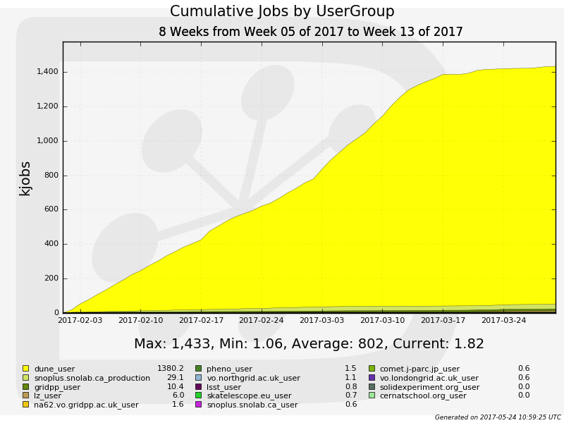

GridPP DIRAC Usage
JOBS

Slide 6
What have we learned from DUNE ?
DUNE is a Neutrino experiment currently being built in South Dakota and Fermilab.
Data stored at Sheffield, analysis run all over the UK.
This was the first time we had 100000+ jobs waiting and ~4400 jobs simultaneously running.
Our DIRAC instance held up, but we hit queue limits at sites.
Networking was not a problem.

Slide 7
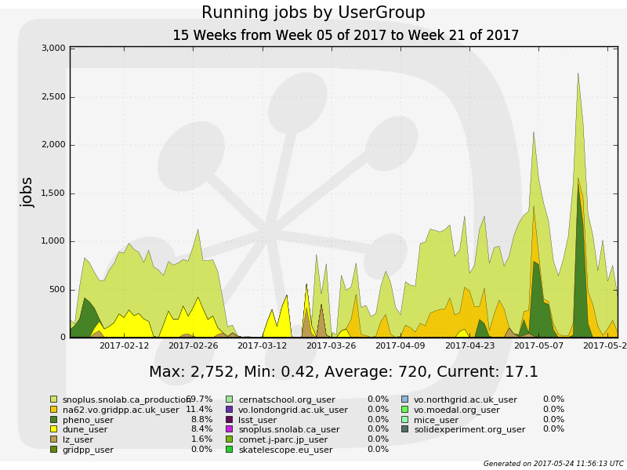
VOs using GridPP DIRAC
Wrt 2016:
- lsst
+ dune
+ na62
database crash

Slide 8

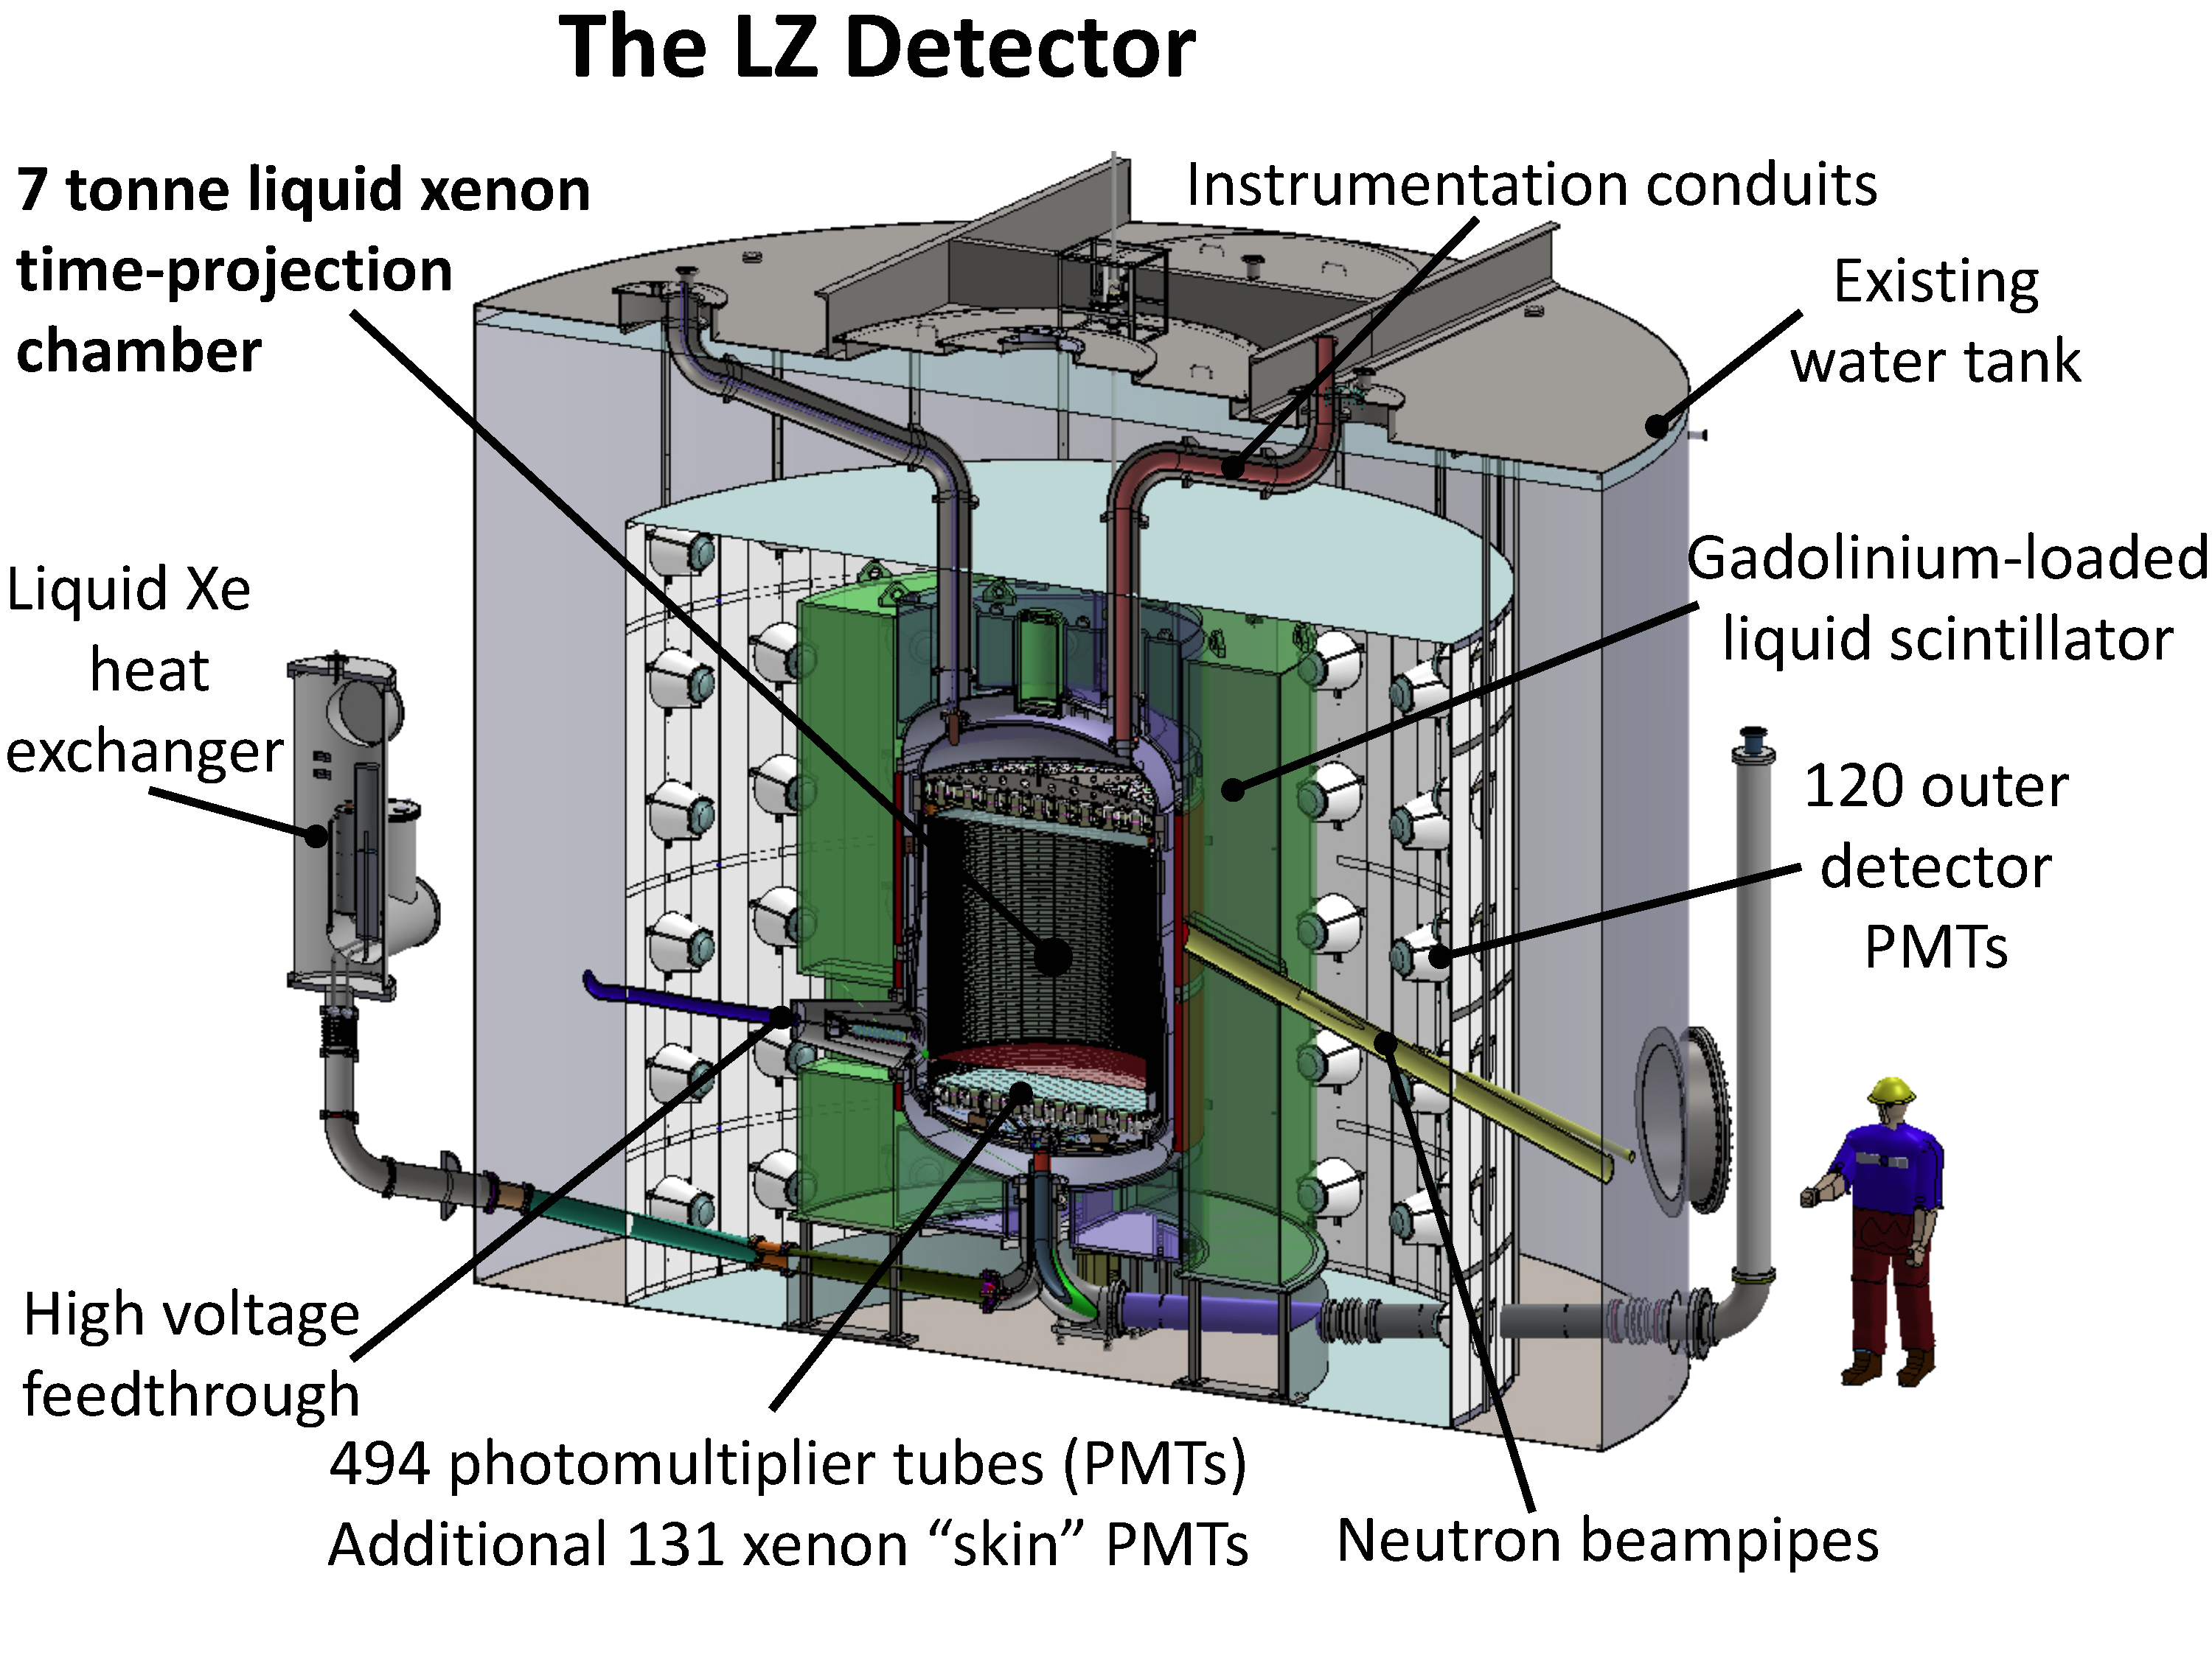
The LZ experiment
Dark Matter experiment
looking for WIMPs
located in a mine
in South Dakota.

Slide 9
LZ: The UK Data Centre
The UKDC based at Imperial College will hold a complete copy of the LZ data.
CPU to analyse this data and for Monte Carlo production will be provided by GridPP sites.
LZ has been successfully using GridPP resources via DIRAC for over a year.
We expect LZ to leave the 'small VO' remit by 2020 at the latest.

Slide 10
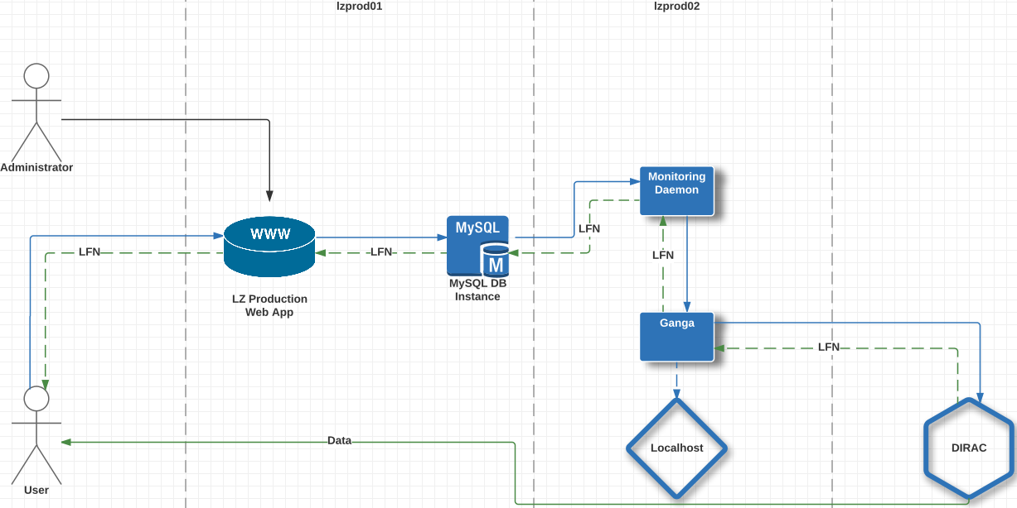
LZ Submission System: Behind the scenes
Integration with
GridPP DIRAC

Slide 11
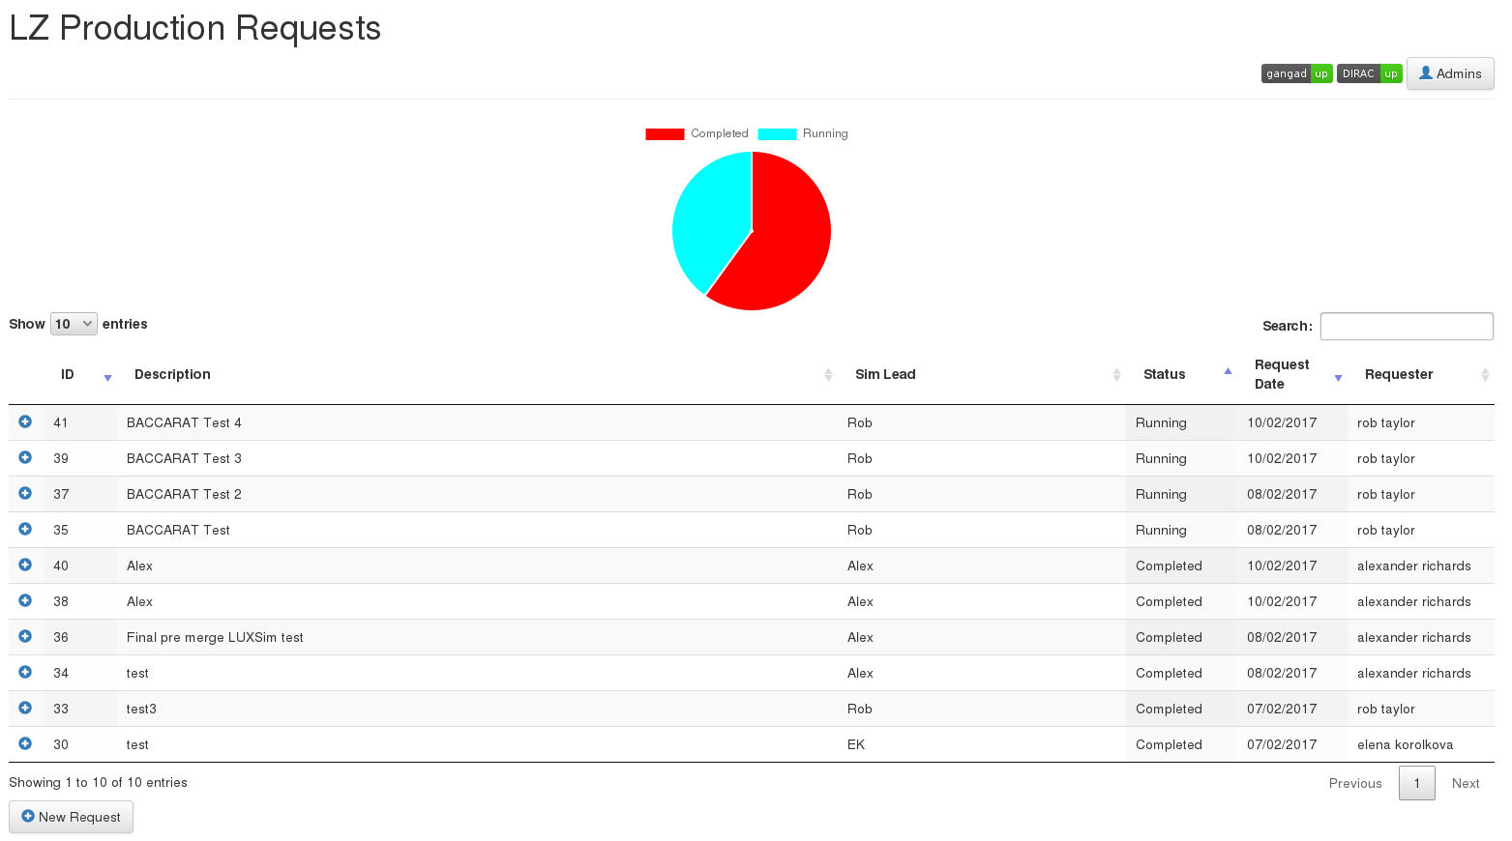
LZ: Production requests web interface

Slide 12
EL6 to EL7 transition
Three sites in the UK currently have EL7 resources:
  ECDF: EL7 only (shared cluster)
  Imperial: 1/3 of all worker nodes are EL7
  Liverpool: EL7 test queue
It's not going well.

Slide 13
GridPP EL6/EL7 selection
In the GridPP module we squash all operating systems variations to “EL6” or “EL7”.
User can select either “EL6” or “EL7” or “AnyPlatform” by setting:
  e.g. Platform = “EL6” in a JDL
If no Platform is set the system defaults to EL6 to comply with current user expectations.
We have not been able to run production on EL7 queues due to gfal2 stage out problems (nagios tests pass).

Slide 14
Containers
Yes, we have some.
CMS requires Singularity on EL7.
Some VOs (e.g. LZ) require EL6 for the foreseeable future.
LZ are planning to use Shifter with docker images at NERSC.

Slide 15
Containers ?
Is there any plan for a container supporting DIRAC pilot ?
  User picks a platform (e.g. EL6)
  If a site supports containers, the pilot should start a container matching the requested platform
  Currently there is no way for sites to advertise that they support containers (can we use software tags ?)
  Bonus feature: Let users specify their own container image

Slide 16
Containers
If there is any interest, we have written a proposal at:
  https://github.com/ic-hep/DIRAC/issues/79
We'd be happy to code (and document) it.

Slide 17
Conclusions
It's getting better.
We are now mainly new stuff work, rather than fixing old bugs.
gfal2 is the bane of my existence.

