Slide 1
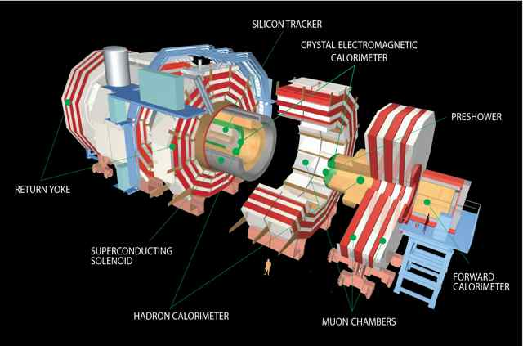
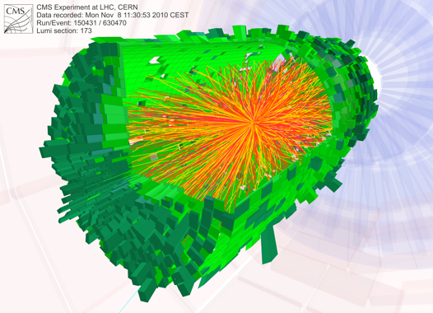
UK CMS Upgrade Oversight Committee
Geoff Hall
2 March 2011
University of Bristol
Brunel University
Imperial College London
Rutherford Appleton Laboratory

Slide 2
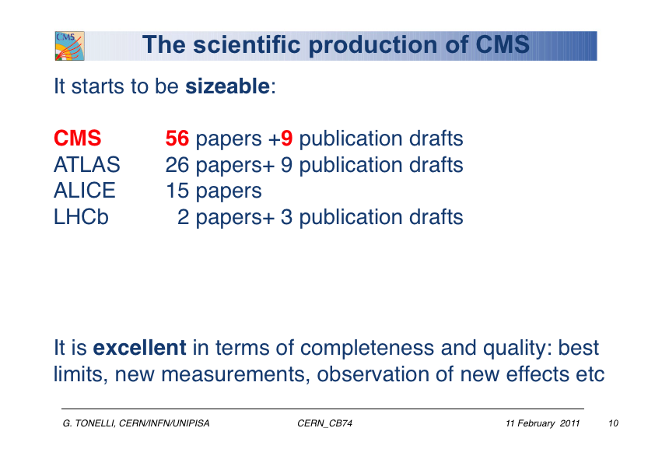
Overview
CMS status
LHC status and future plans
UK R&D progress report
Finances
Future
CMS plans
UK CMS plans
Issues

Slide 3
CMS status
2010 was a very successful year for CMS and LHC: 43pb⁻¹ pp
+ 8.3 µb⁻¹ Pb-Pb
extremely promising couple of years (and more) ahead
LHC in Technical Stop to 18 February
now preparing for beams – cosmic tests and mid-week global runs
stable beams now expected by 4-5 March
expect gradual start followed by rapid increase in bunches & luminosity
CMS undertook maintenance interventions
went almost completely according to plan
interventions increased fluid leak rate in Tracker in one line
believed to be related to pressure changes, to be controlled better in future
In 2012 LHC will be operational
Two ~continuous years of all systems working efficiently
Slip of later schedule (tbc)

Slide 4
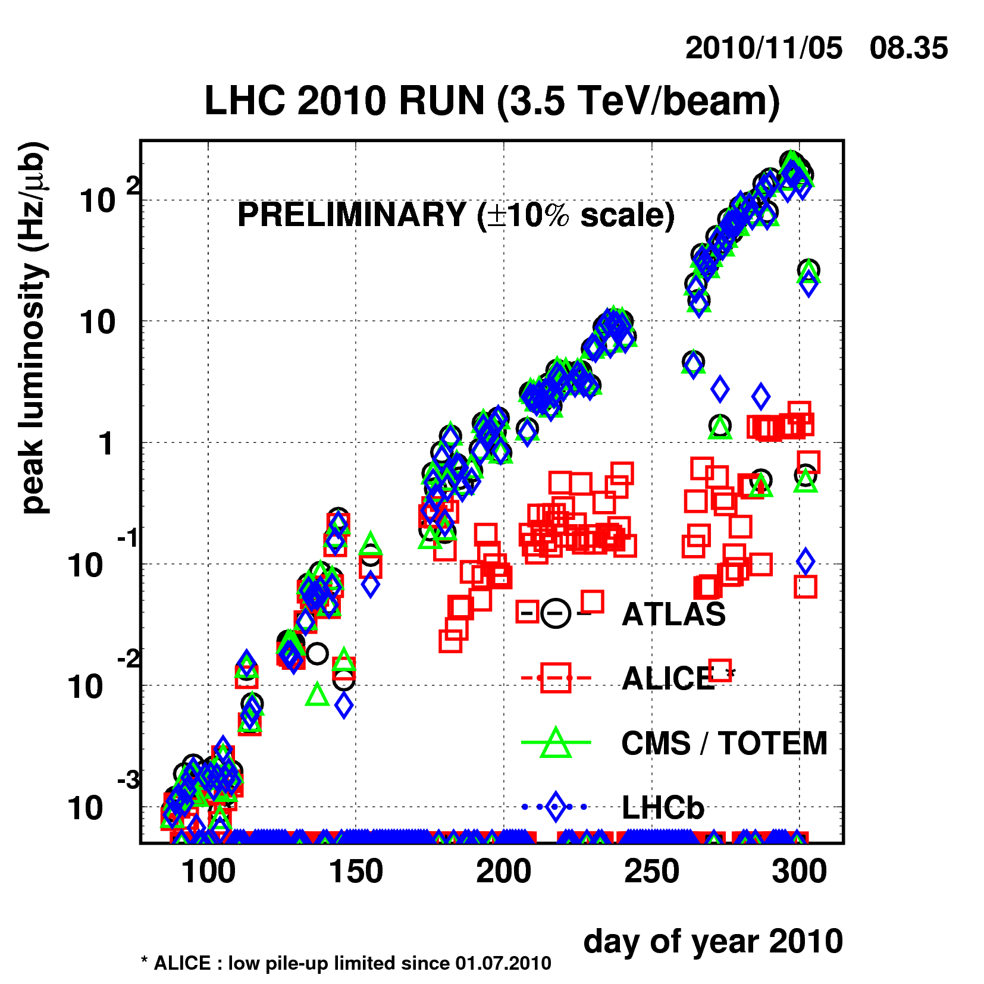
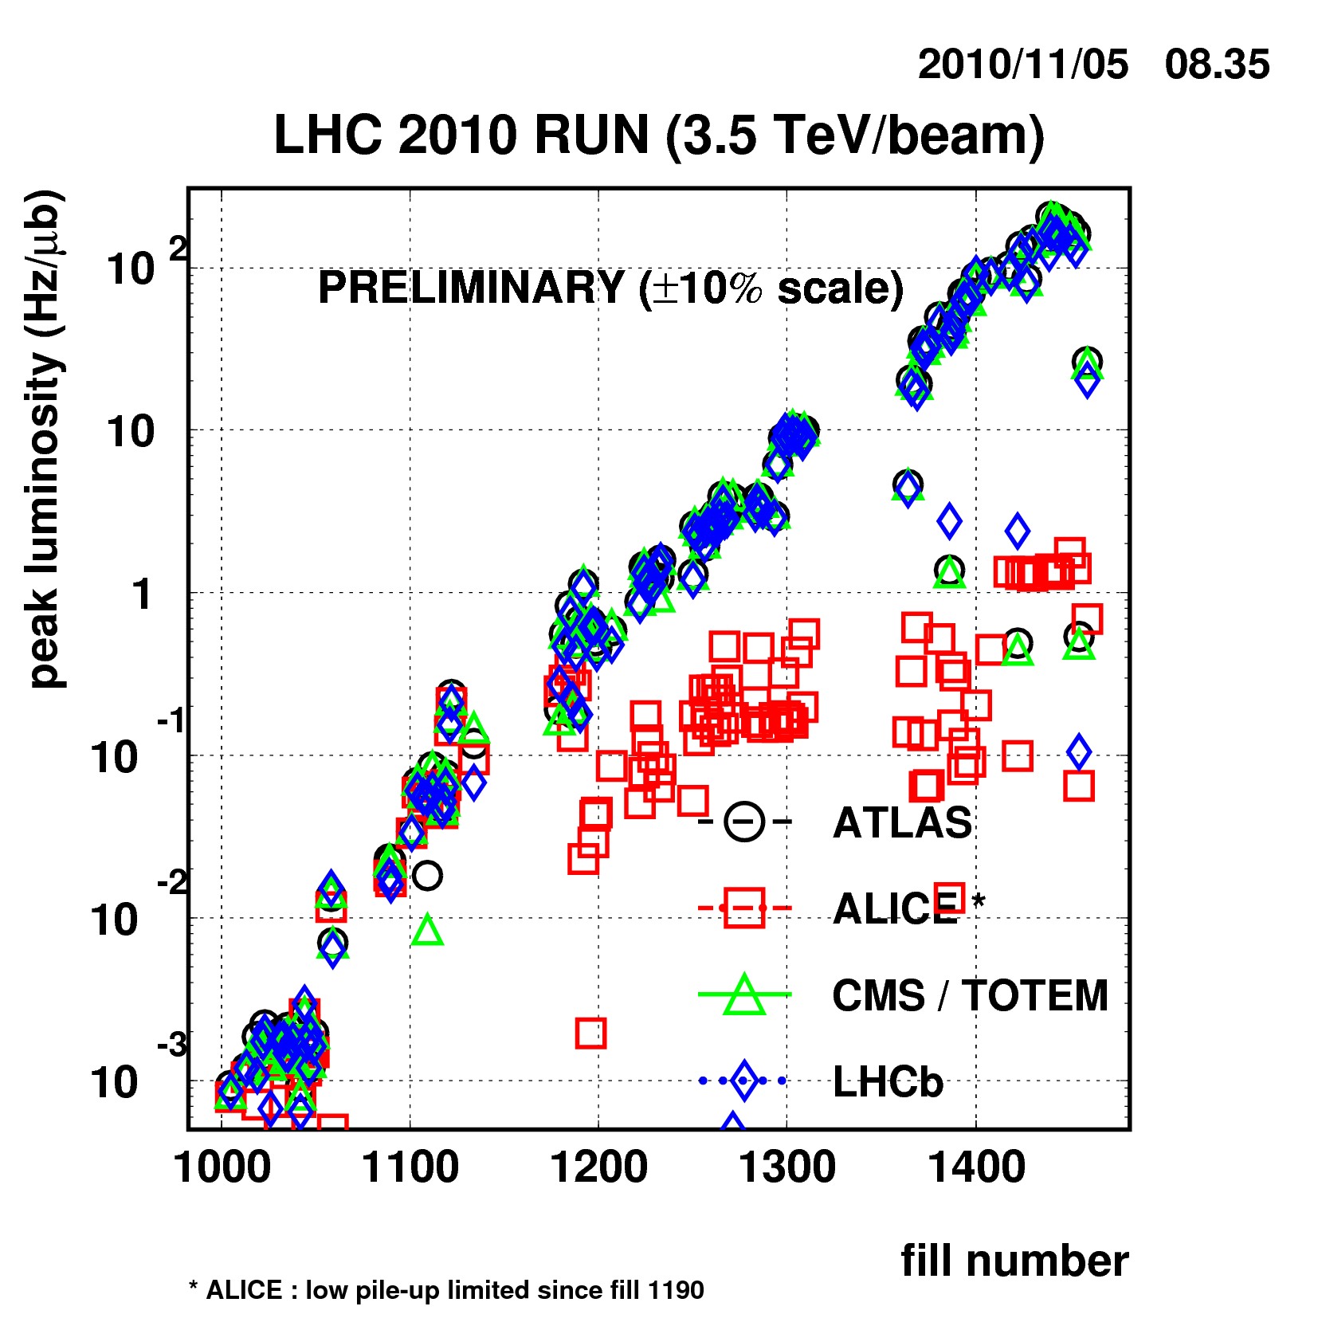
2010 peak luminosity (protons)
M F-L Chamonix report
1e32Hz/cm²

Slide 5
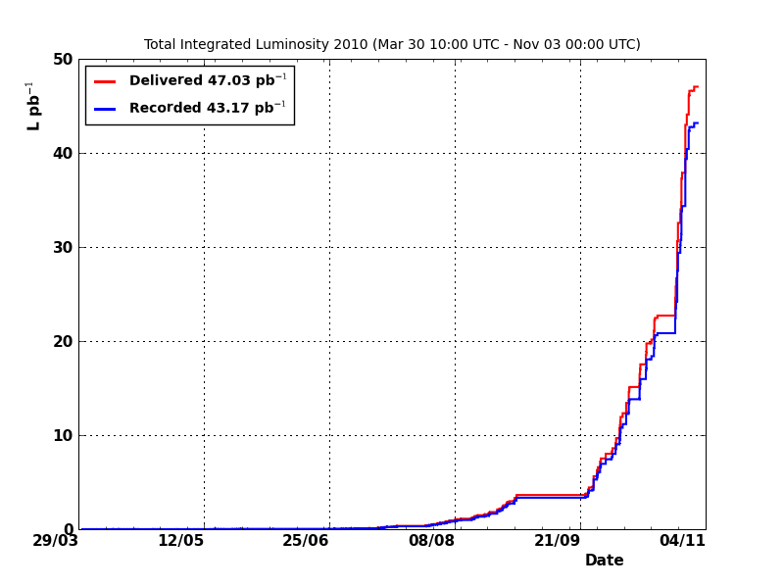
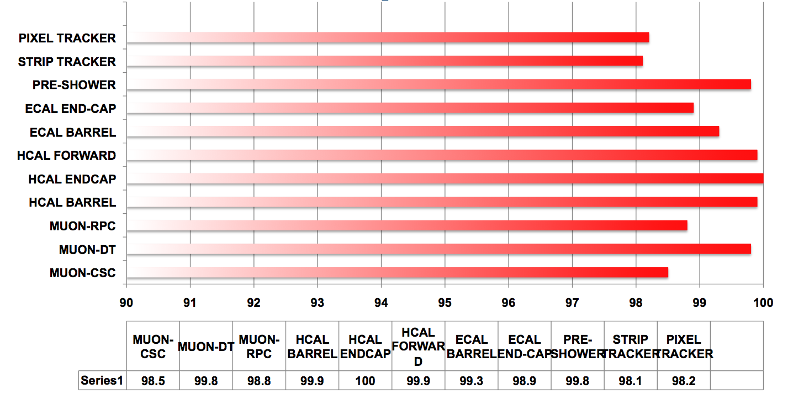
LHC and CMS operations in pp.
About 47pb⁻¹ delivered by LHC and ~43pb⁻¹ of data collected by CMS. Overall data taking efficiency ~92%. 6pb⁻¹ of data integrated in a good fill. Excellent performance in coping with more than 5 order of magnitude increase in instantaneous luminosity.
L≈ 2x10³²cm⁻²s⁻¹
L≈ 10²⁷cm⁻²s⁻¹
Average fraction of operational channels per CMS sub-system still ~99%. A few problems here and there. Last few days of pp running tested 50ns filling scheme. Vacuum (e-cloud) worse than at 150ns. 75ns vacuum much better. 800 bunches OK.

Slide 6
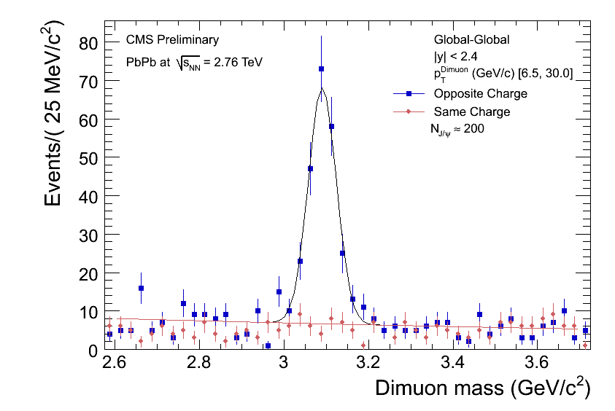
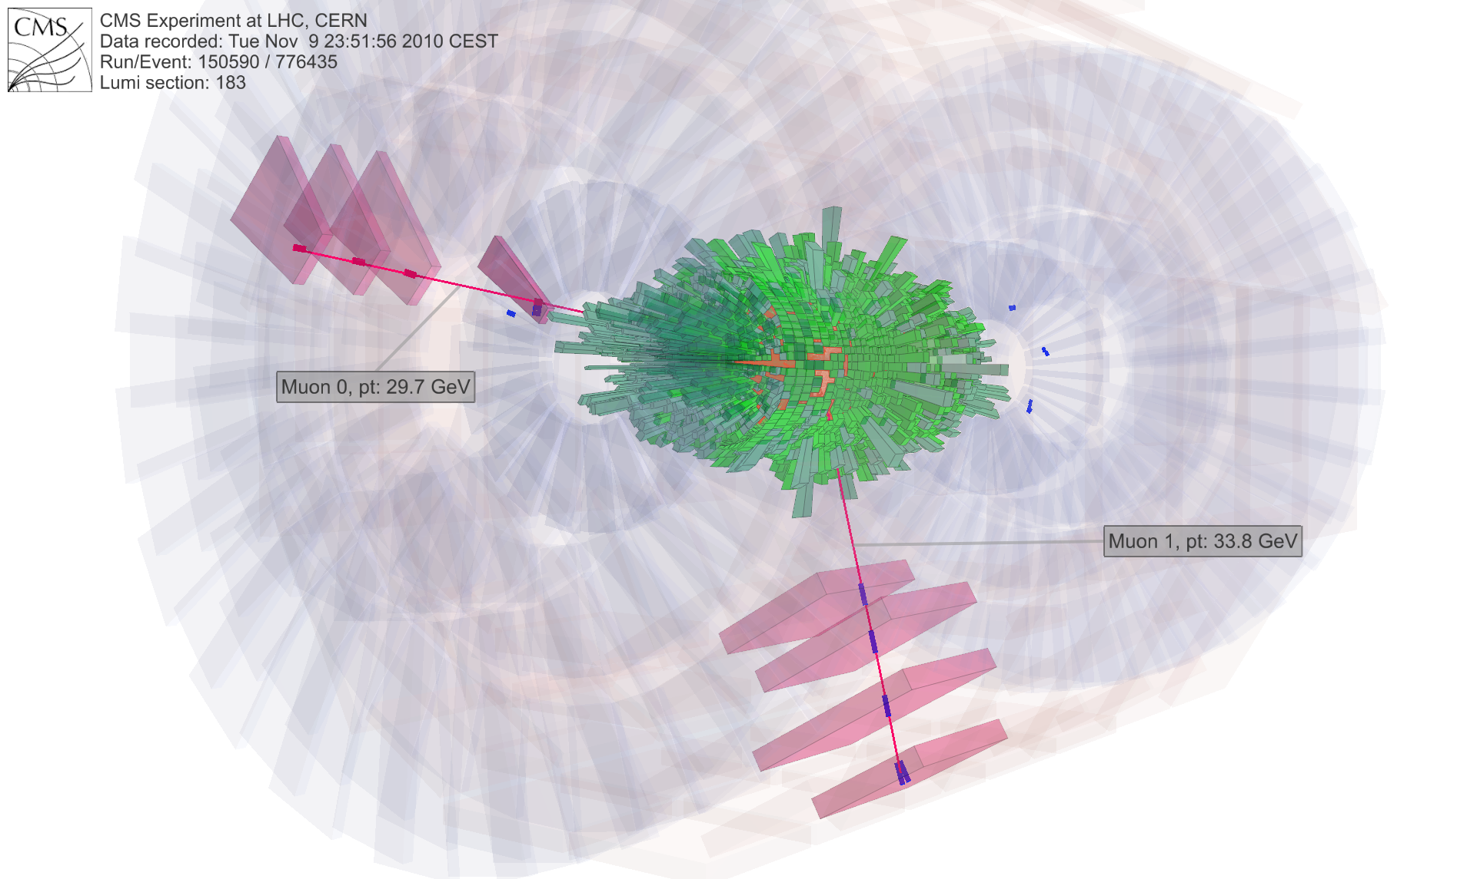
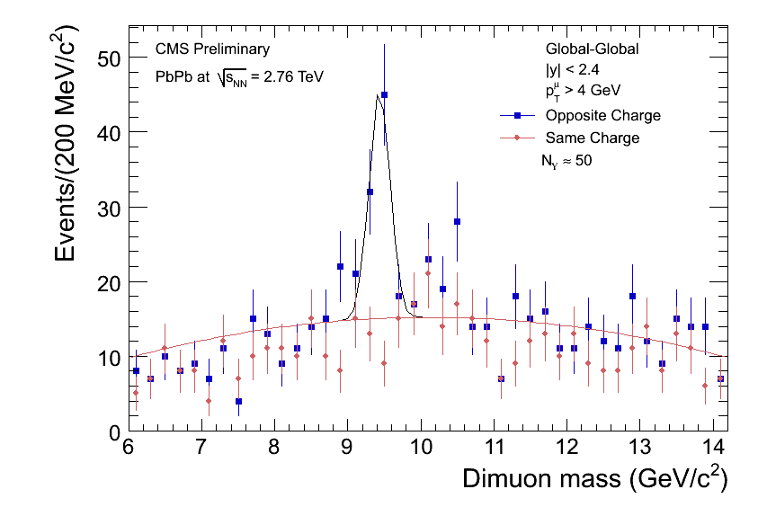
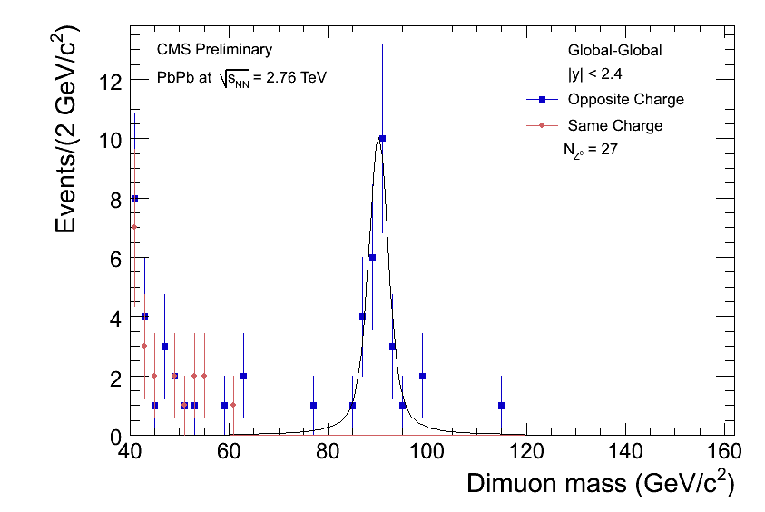
First CMS results in HI: Z and di-muons.
J/ψ
Υ
Z
First observation of Z bosons produced in HI collisions and very good chance to study in detail suppression mechanisms of quarkonia in HI collisions.

Slide 7
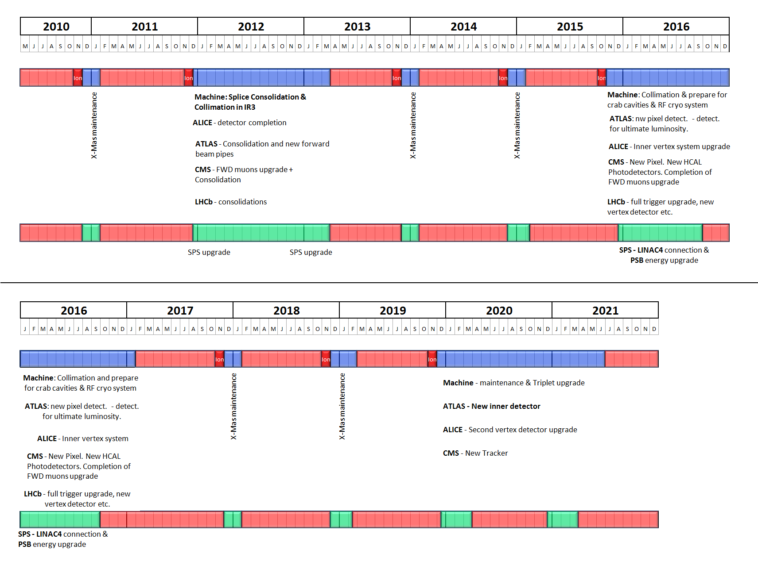
The 10 year technical Plan
July 2010
S Myers ICHEP 2010

Slide 8
LHC status and future plans
Reached L = 2 x 10³² cm⁻²s⁻¹ at end 2010
Increase to ~10³³ cm⁻²s⁻¹ during 2011 remaining at 3.5 + 3.5 TeV
1 fb⁻¹ by end 2011 (expectation management)
conditions for 2012 not yet defined
after 2012, dates uncertain until new 10-year plan defined
2013-14: Shutdown for at least 19 months for splices and maintenance
Beyond this point, ~ one year delay on previous dates seems likely

Slide 9
Decisions from Chamonix
1) LHC will run at 3.5 TeV per beam in 2011
2) Interbunch-spacing in 2011 will be ≤ 75ns
We'll run very likely at 75ns with scrubbing done at 50ns. If the scrubbing will work very well we will try to run at 50ns.
3) The baseline beam parameters in 2011
1.2x10exp11 p/bunch; beta* 1.5m; emittance 2.5microns
With 900 bunches, this will allow us to exceed 10E33.
The plan is to reach this peak luminosity sometime in May. We might have 0.5-1fb⁻¹ of data before the summer conferences.
Summary from G Tonelli

Slide 10
Decisions from Chamonix
4) Goals
a) the official goal for 2011 will stay at 1fb⁻¹
b) internal un-official goal – try to gain factors on this
To be explored:
a) increase the number of days for physics (135/264)
b) increase of the bunch population 1.4-1.5 E11
c) reduce beta* to 1.2m
d) reduce emittance to below 2microns.
e) increase number of bunches to 1404 if 50ns is feasible.
5) 2012 will be a year of physics
Goals for 2012 depend strongly on 2011 performance but target of >10fb⁻¹ is considered realistic.
Summary from G Tonelli

Slide 11
Decisions from Chamonix
6) There will be a serious impact on our plans for the Upgrade both for LS1 and LS2.
the first long shutdown (LS1) will be postponed to 2013. The length of the 2013 shutdown will be very likely more than a year. A very complex series of activities must be accommodated.
There are different scenarios leading to an interval that could exceed 2 years (physics to physics). A review of planning to be made before June.
There will be an impact also on the subsequent long shutdown (LS2) that will likely slip.
Proposal: keep the Technical Proposal for the Upgrade as it is.
Evaluate a few urgent actions: procurement of a new beam-pipe for LS1.
Re-discuss the timing of pixel project, HBSiPMs and trigger.
Prepare a new plan compatible with a new schedule for LS1/LS2.
Summary from G Tonelli

Slide 12
Decisions from Chamonix
7)HI-LHC ≥2020+
with the new operational/measured parameters of LHC the perspectives of delivering more than 300fb⁻¹/year sometime after 2020 seem to be more realistic: there was quite some optimism in the performance of HI-LHC.
8) Heavy- Ion runs
2011 a factor 3-5 more integrated luminosity (but could be higher)
2012 feasibility study for p-PB collisions (very challenging)
Summary from G Tonelli

Slide 13
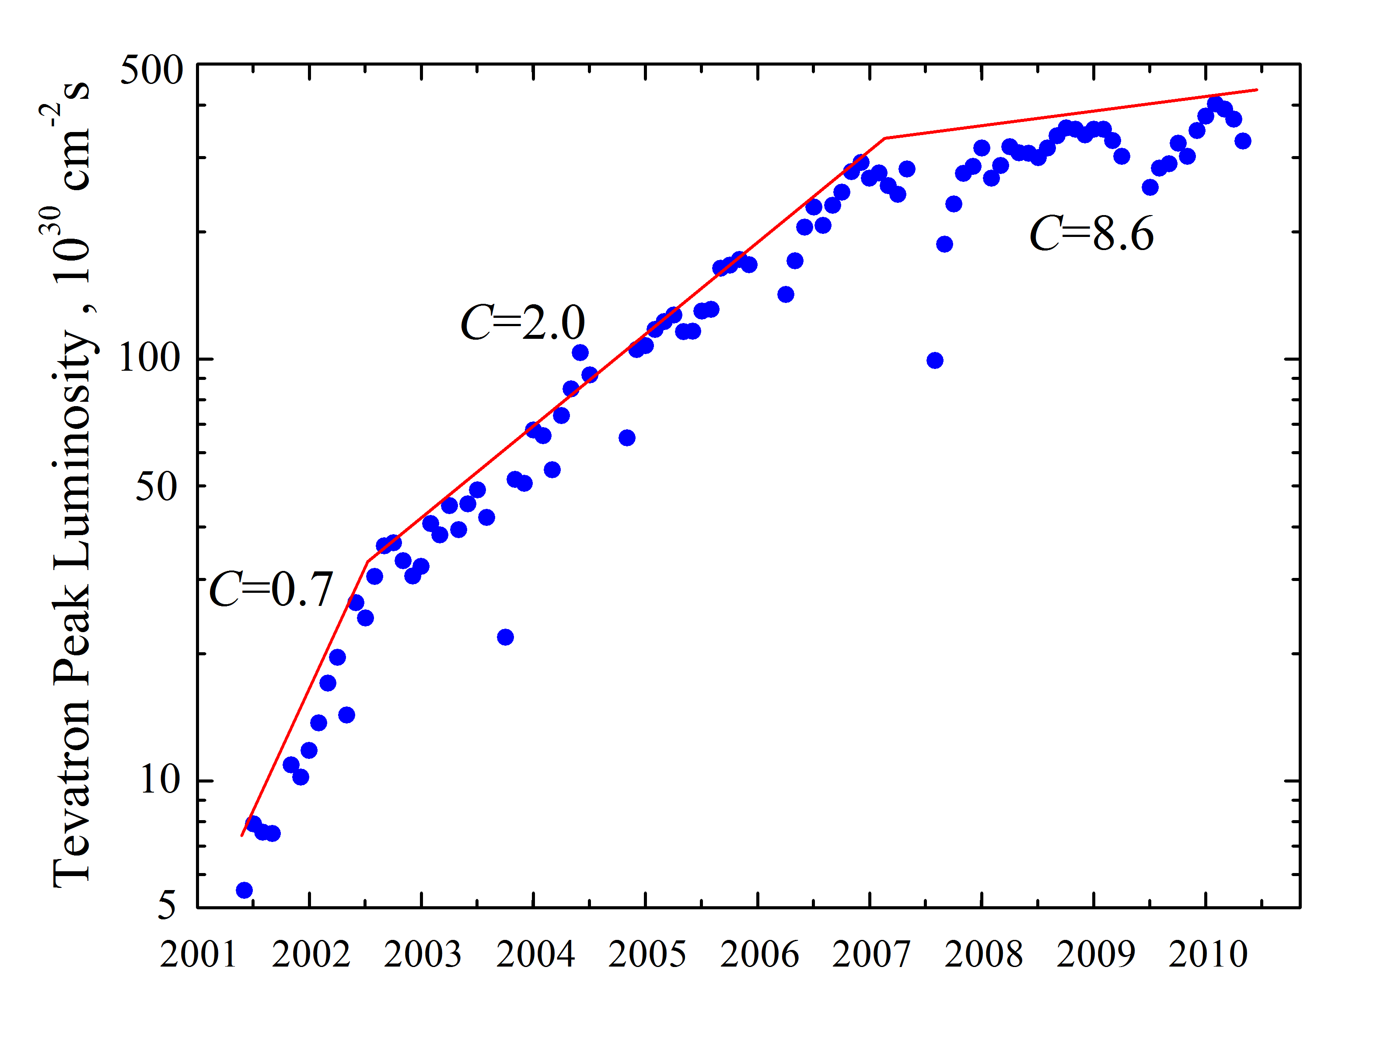
Tevatron Run II
comparison with experience
“Just Operations”
Phase
Startup
phase
Progress, Developments
and Upgrades phase
V Stiltsev FNAL
Chamonix 2011
most likely LHC schedule will be subject to further changes
- added explicit risk to register

Slide 14
UK & CMS upgrade progress
WP1
much progress with WP3 on online software for trigger
simulations for Phase I pixel and physics studies underway
WP2
3-4 months delay in CBC delivery to Imperial – but now under test
successful beam tests, which prepared telescope for future measurements
WP3
minor revisions of Mini-T5 prior to larger scale tests
good progress with algorithms and software infrastructure
CMS Technical Proposal submitted to LHCC
physics case needs more simulation support

Slide 15
WP1 Status
Project goals
Simulation / optimisation of upgraded tracker & trigger
Physics simulations of upgraded detector
Online & offline software / firmware for upgraded Phase-I electronics
Highlights in the last months:
Upgrade Technical Proposal simulations
Release of online software & firmware framework
Plan for upgrade software convergence
Layout study contributions
Recent start of pixel readout
Upcoming activities
Support / evolution of online framework
Detailed physics studies beyond TP
Detailed physics case for Phase-I trigger upgrade

Slide 16
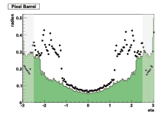
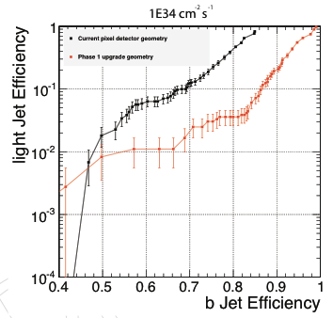
Highlight: Upgrade TP
Phase-I Upgrade Technical Proposal
Submitted to LHCC November 2010; incisive + helpful feedback received
Physics performance studied in progress (addendum due March 2011)
UK WP1 contributions (summary of two years’ work)
Development of flexible tracker software framework [Reid, Grimes]
Performance studies of four-layer tracking [Grimes, Goldstein]
Definition of physics case and exemplar channels [Newbold]
Proposal for trigger online software [Rose, Frazier, Newbold]
Integration of upgrade software releases [Newbold]
Pixel upgrade performance:
a) Material budget (old vs new)
b) b-tag performance (old vs new)

Slide 17
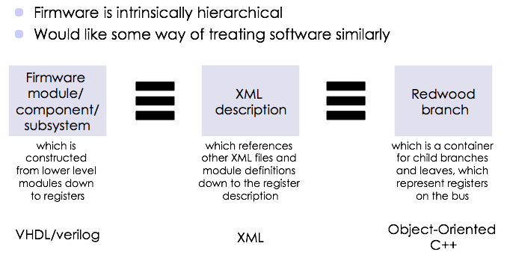
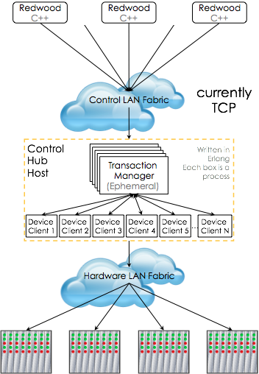
Highlight: Trigger Software / Firmware
Coherent online software / firmware
[Rose, Frazier, Newbold, Brooke]
Covers Phase-I trigger, but potentially all uTCA developments
Reduces effort for online components substantially w.r.t. existing CMS system
First formal release made Feb 2011
Being evaluated by external CMS groups

Slide 18
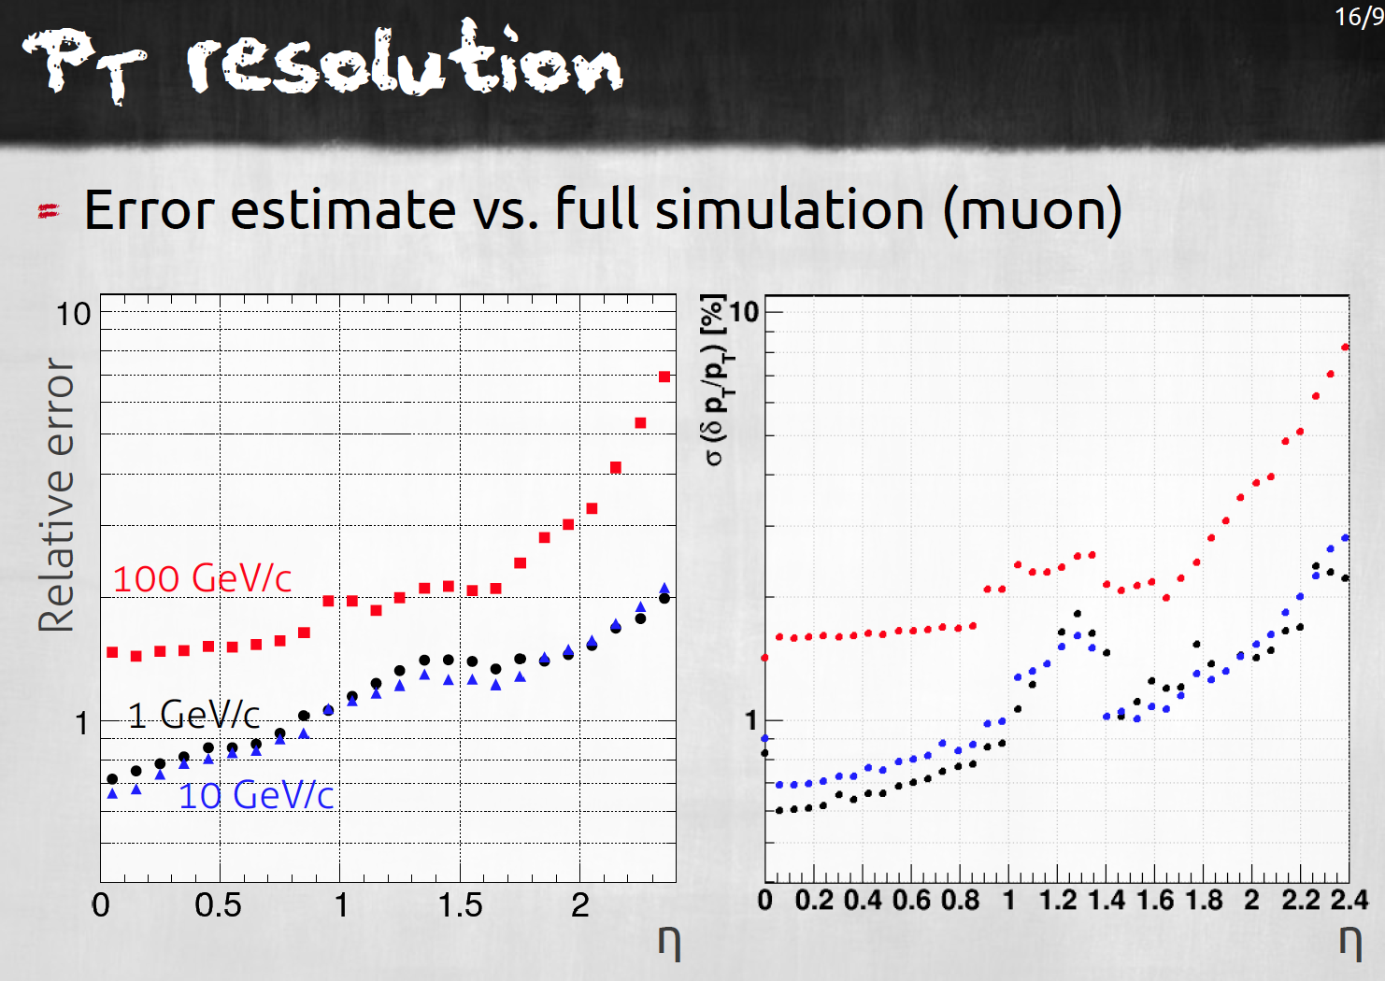
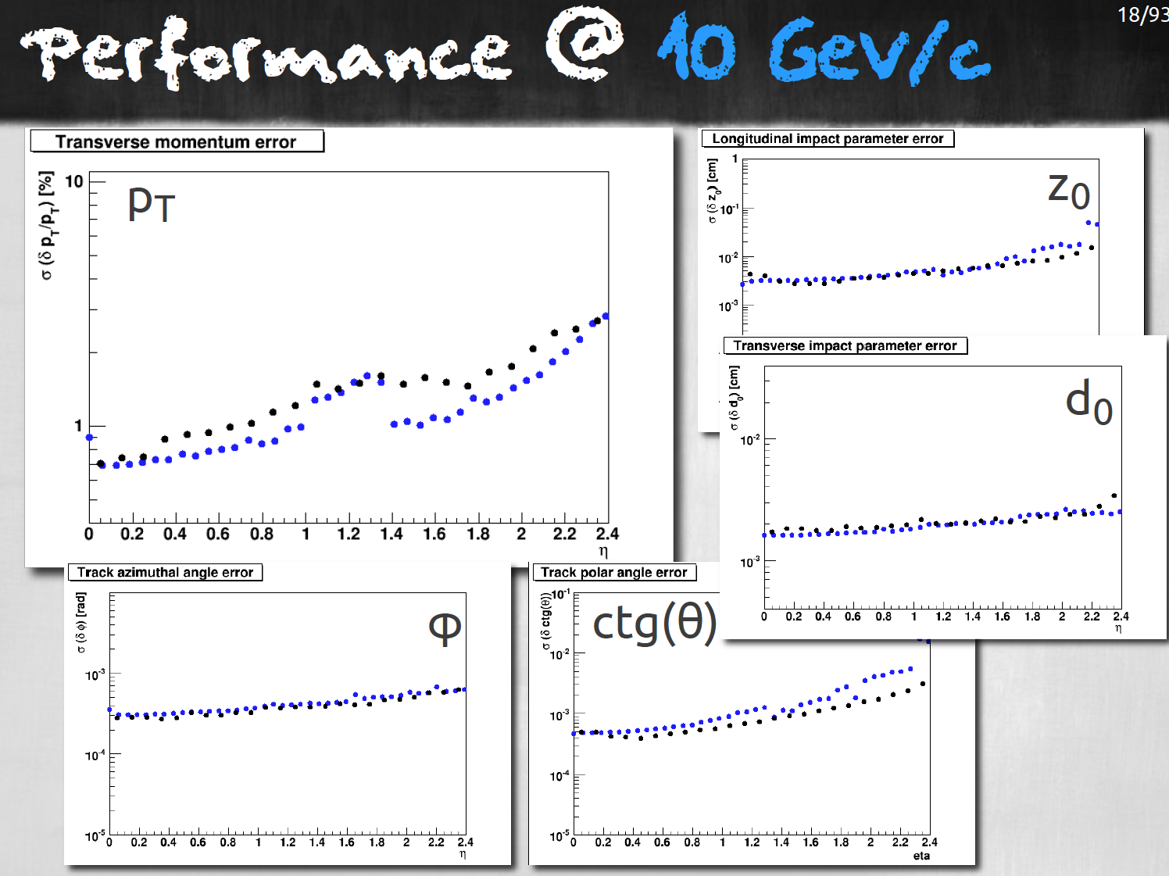
WP1 related - Tracker layout studies
Tool developed over last 1-2 years (S Mersi et al, CERN) to compare layouts
super-fast, but realistic, modelling of different layout alternatives
supplemented by calculations predicting detector resolution (G Hall)
full physics studies are only feasible for optimising one chosen design
so comparative layout evaluations are vital for selecting practical optimum
Example results for present Tracker –
demonstrating level of accuracy

Slide 19
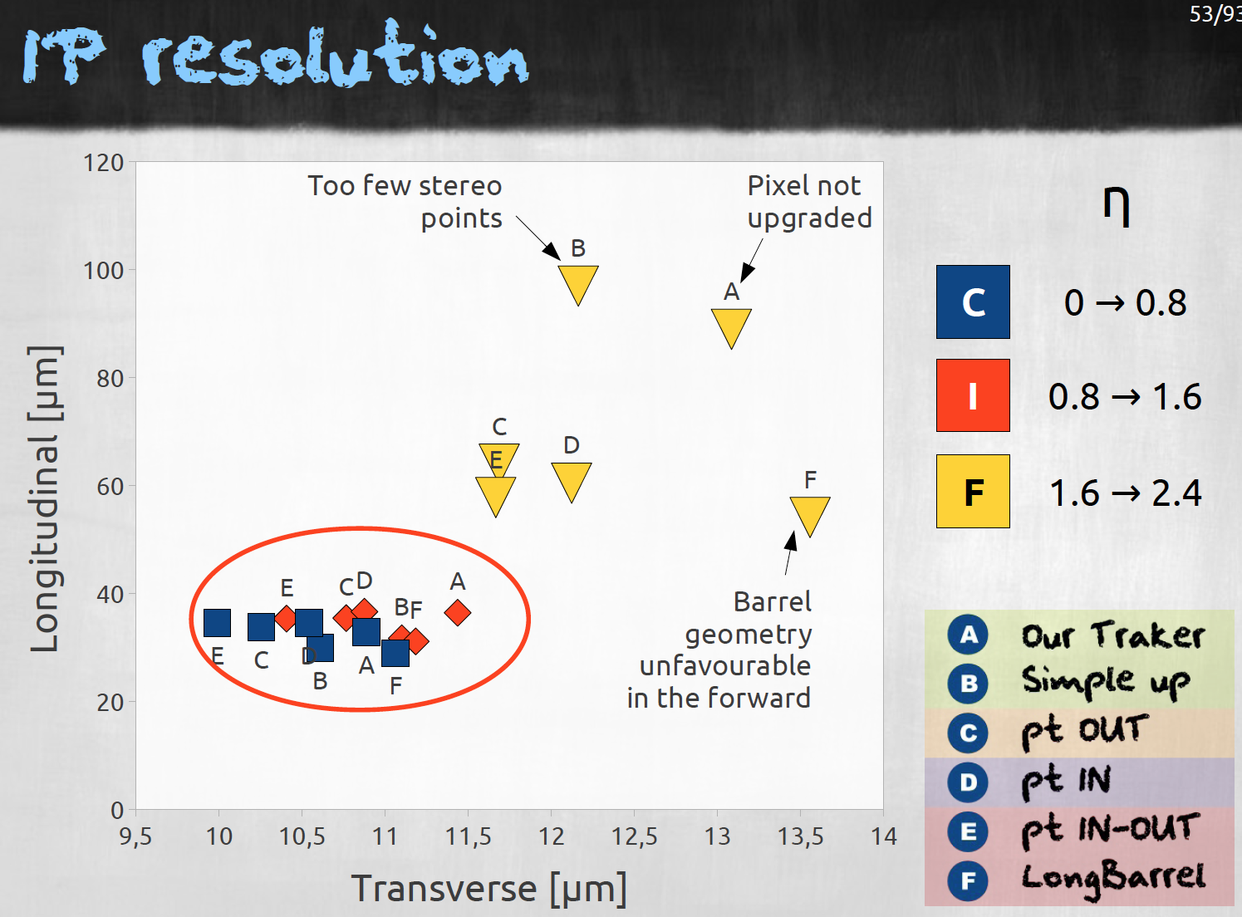
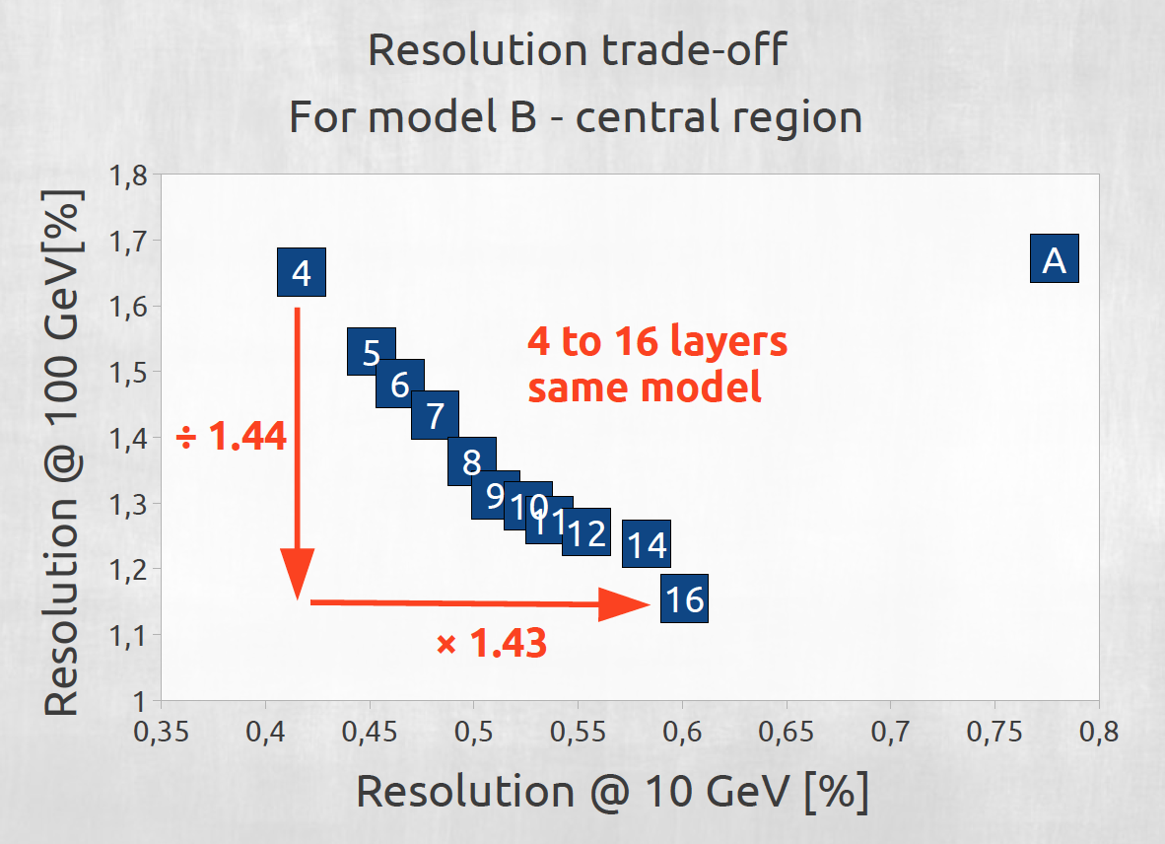
Tracker layout comparisons
Examples of comparisons of possible future layouts (S Mersi, CERN)
key point was to model multiple scattering correctly (and future material budget!)
allow to understand layout impact on power (in detail), channel count, no. layers, material, angular, impact parameter and momentum resolution, impact of trigger layers,…
A= Present tracker

Slide 20
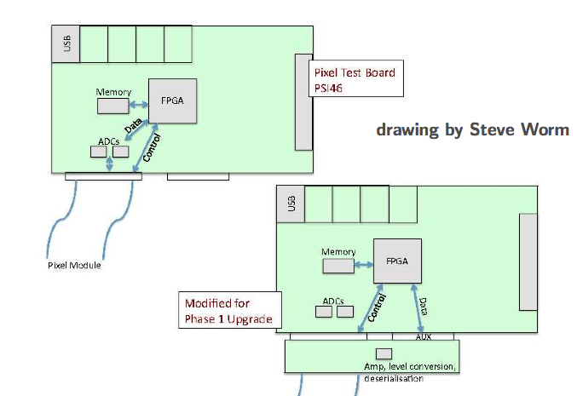
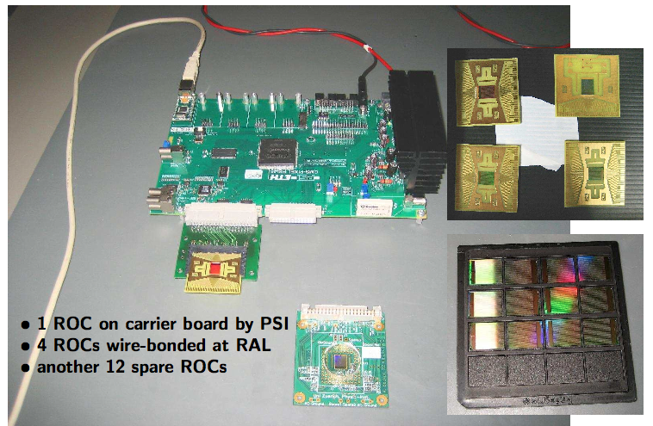
New activity: Pixel Readout
Work recently begun
[Harder, Durkin, Worm]
Possible route to role in pixel readout
Not envisaged in WP1 proposal
doesn’t yet have plan or deliverables
funding: staff only at present

Slide 21
Whither WP1?
Current situation
Project has coherently shifted / grown in scope
A reflection of evolving goals of the overall CMS project
Close links developed to WP2 & WP3 work
Current manpower funding formally ends in Q4 2011
We have taken responsibility for deliverables to CMS
Online software / firmware; upgrade offline software
Forward look
We believe WP1 activities are timely, relevant, highly visible in CMS
Current funding can be stretched until Q1 2012
If sufficient flexibility is allowed by STFC
Need to re-synchronise WP1 with project
ends early but work is needed
Review project structure – WP1 has added a new activity
not a natural place, and not yet funded

Slide 22
WP2
ASIC (CBC) development (M Raymond, L Jones)
CBC submitted on MPW early July
Expected back end October
Unexpected high volume of business at foundry, which delayed this run
Cutting of wafers in January, die arrived 12 February, tests began 15 Feb
Beam telescope for module tests (M Raymond, M Pesaresi, J Fulcher, W Ferguson, G Hall, O Zorba)
commissioned in UA9 crystal channeling studies for LHC collimation
Future FED development (J Coughlan, M Siyad)
initial evaluation of GBT firmware
Module and system development
Collaboration with other CMS institutes, especially CERN, ongoing
Decisions following CBC tests on priorities for next steps

Slide 23
CBC layout
2.5 -> 1.25 DC-DC
128 inputs, 50 mm pitch
back edge pads mostly power
SLVS data out, clock and trigger in
I2C slow control
power features included
DC-DC switched capacitor (CERN)
low dropout linear regulator
uses CERN bandgap for reference
7 mm
data
CBC O/P Data Frame
pipeline
&
buffers
clock
amplifiers & comparators
trigger
I²C, reset
dig. header
128 digital bits
~ 3.5 µs
linear regulator for front end
bandgap
bias generator
4 mm

Slide 24
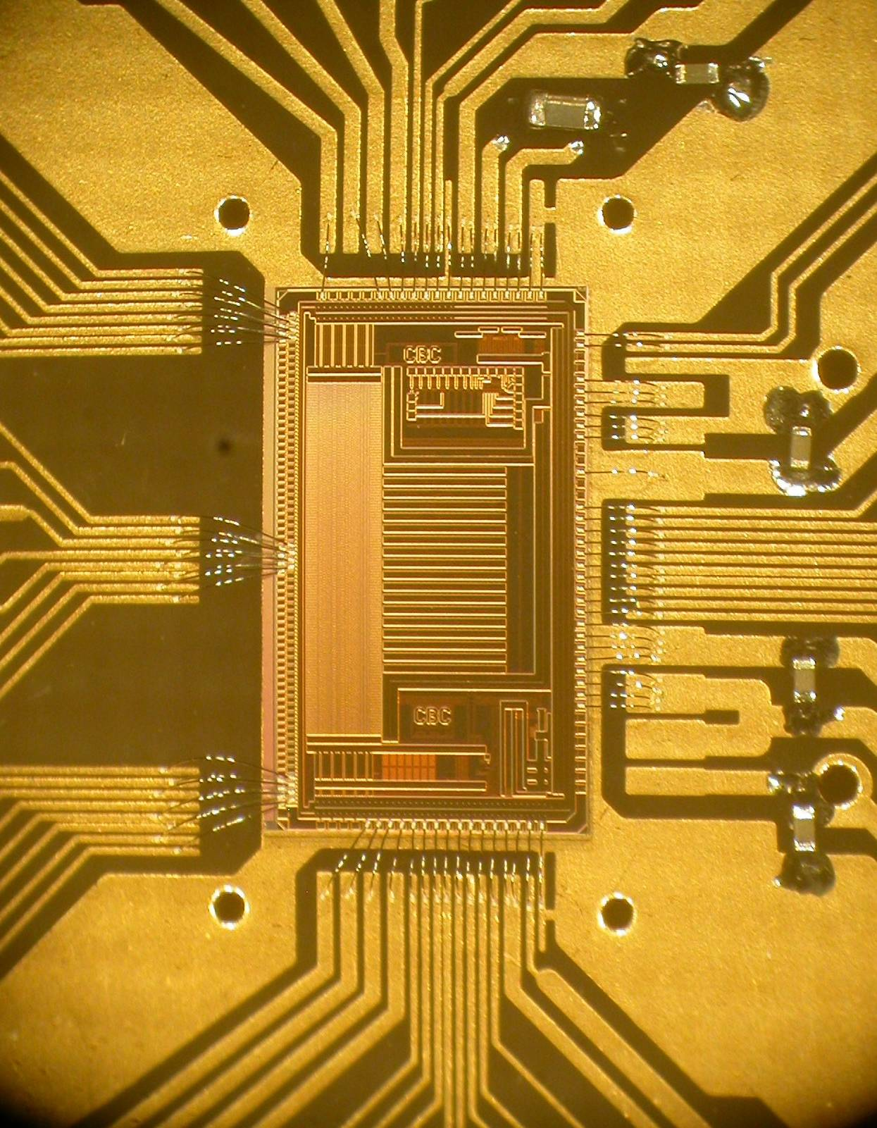
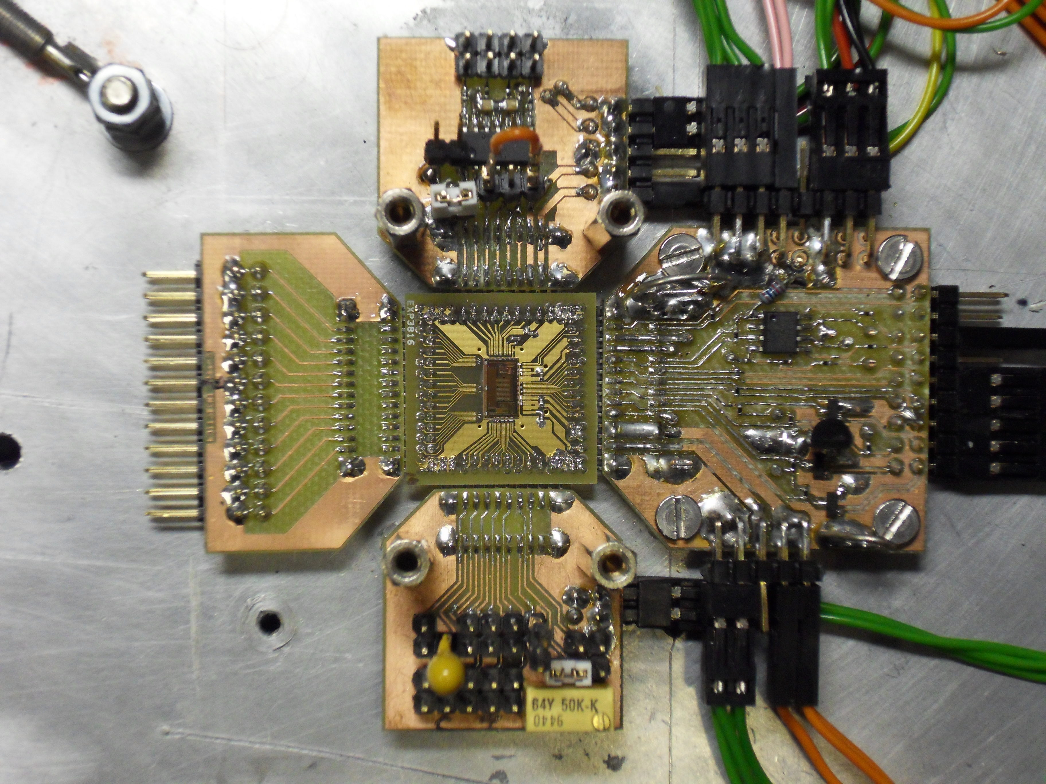
test setup
dummy channel
interface board
fast & slow control
& data out interface
test
charge
injection
CBC test board
~ 22 x 22 mm²
bias generator
test board

Slide 25
CBC testing status (M Raymond)
early results promising
~ 7 days testing so far
signal size ~ 1.5 fC
fast & slow interfaces
fully functional
power consumption low
< 500 mW / channel target
can inject signals and see output data
detailed study not yet begun but results seem close to expectations
signal amplitude, noise
some issues with bias generator can be fixed with simple workarounds
will not affect test programme
yield probably high
no failures from 6 plugged in so far
many months testing expected…
scope picture of digital header followed by “hits” produced by test pulse input feeding every 8th channel

Slide 26
CBC plans
Evaluation studies - ~1 year
laboratory tests
module development – CERN + CMS collaboration
beam tests – requires module and new DAQ (APVe)
SEU studies
CBC design options – two major lines
C4 (coarse pitch, low cost) bump bonded variant
collaboration with CERN and others
CBC + cluster finding, trigger logic
double-layer, pT selection module
collaboration with Lyon, CERN
aim for submissions at end 2011

Slide 27
Beam telescope
Constructed in preparation for future module tests
benefits from CMS Tracker DAQ hardware, software – and expertise
FED, APV25s, 100m fibres, custom control system, multi-core PCs
fully commissioned DAQ, with high rate compared to other systems
ready for CBC module tests, later this year
to be adopted for other CMS Tracker tests in future
upstream
downstream
XY Plane 1
XY Plane 2
UV Plane 4
Trigger Scintillators
Crystal
XY Plane 3
XY Plane 5
Goniometer
10,289mm
9,960mm
p⁺ beam
295
mm
416
mm
214
mm
Granite Table

Slide 28
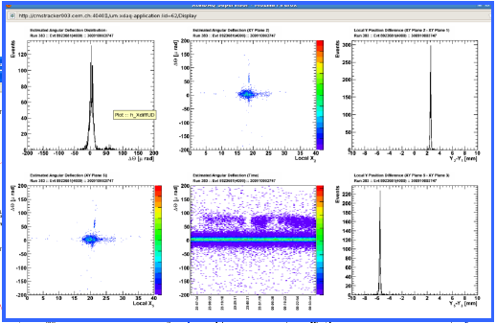
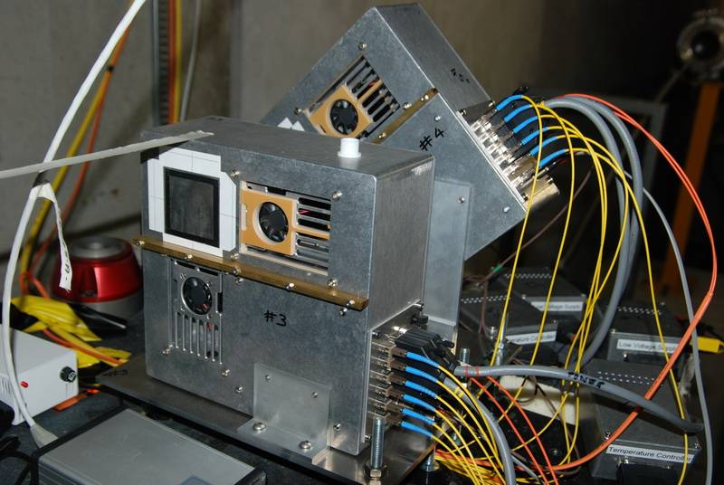
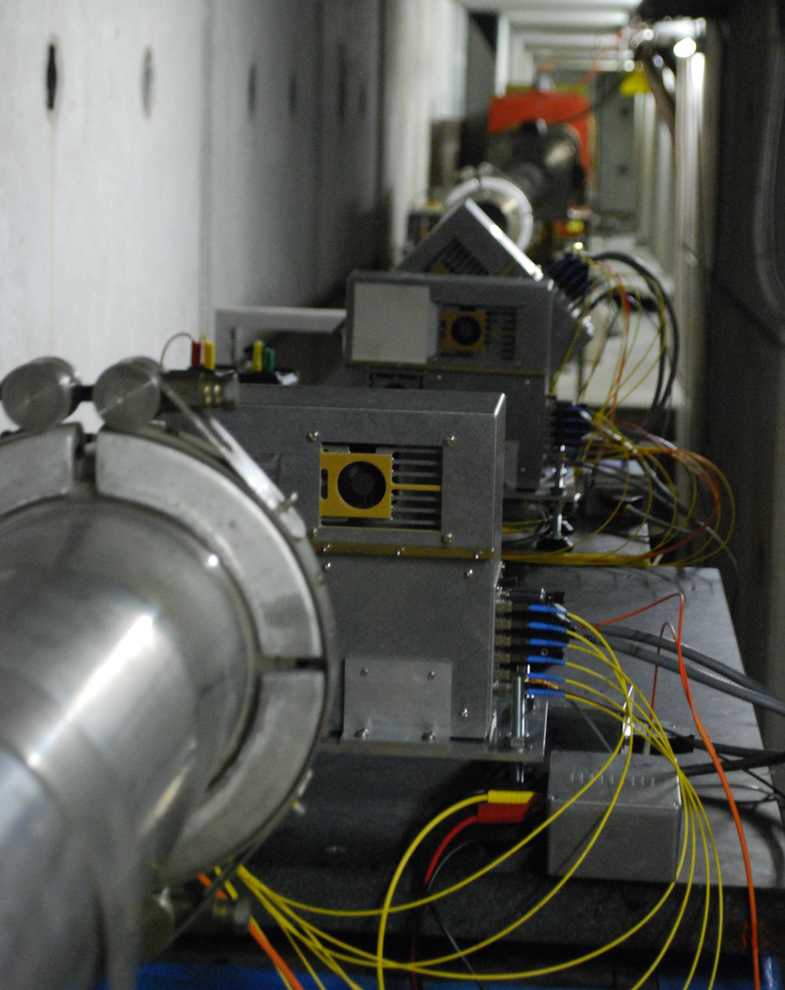

Telescope Performance
System performed well
excellent angular & spatial resolution
~7µm, 5.2µrad (two arms)
full CMS-based DAQ and monitoring
high rate ~7kHz, to be increased further
JINST paper ready to submit

Slide 29
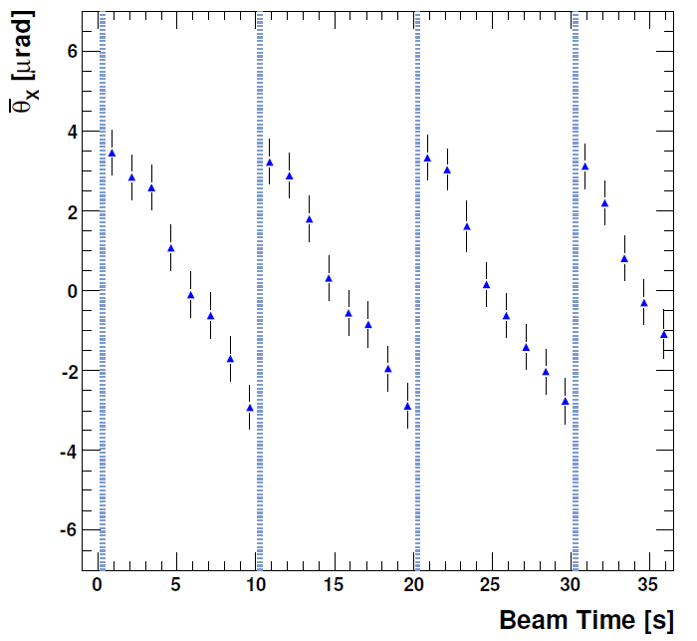
Beam Measurements
Periodic beam deflection discovered
During data analysis, a shift in the beam direction was discovered over the course of a run
Beam deflection is periodic with period equal to that of spill (~10s)
Total deflection measured at 6.5μrad in x and 2.5μrad in y over a spill
Will clearly increase divergence – and possibly other channeling measurements to date, or in future

Slide 30
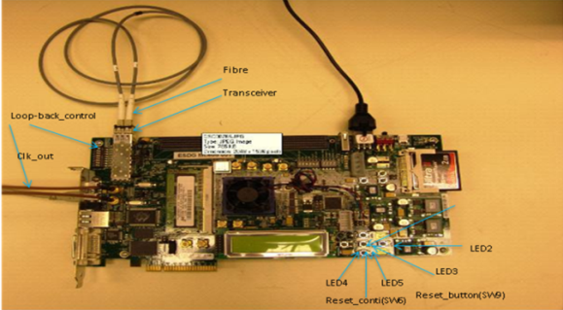
sFED developments
Develop firmware VHDL modules and test on commercial FPGA development boards (M Siyad, J Coughlan: RAL TD)
Full time engineer on project since September
Ported CERN Giga-Bit Transceiver (GBT) FPGA Kit to Xilinx Virtex 6
CERN FPGA implementation of GBT ASIC logic
Adapted design from electrical to optical fibre SFP+ transceiver links
Report written and adapted design submitted to CERN GBT group
Currently developing FPGA VHDL design
interface GBT data links to ultra-fast external memory interfaces
Next steps:
integrate with CMS Ethernet controls software
port design to Mini-T card at RAL
when available

Slide 31
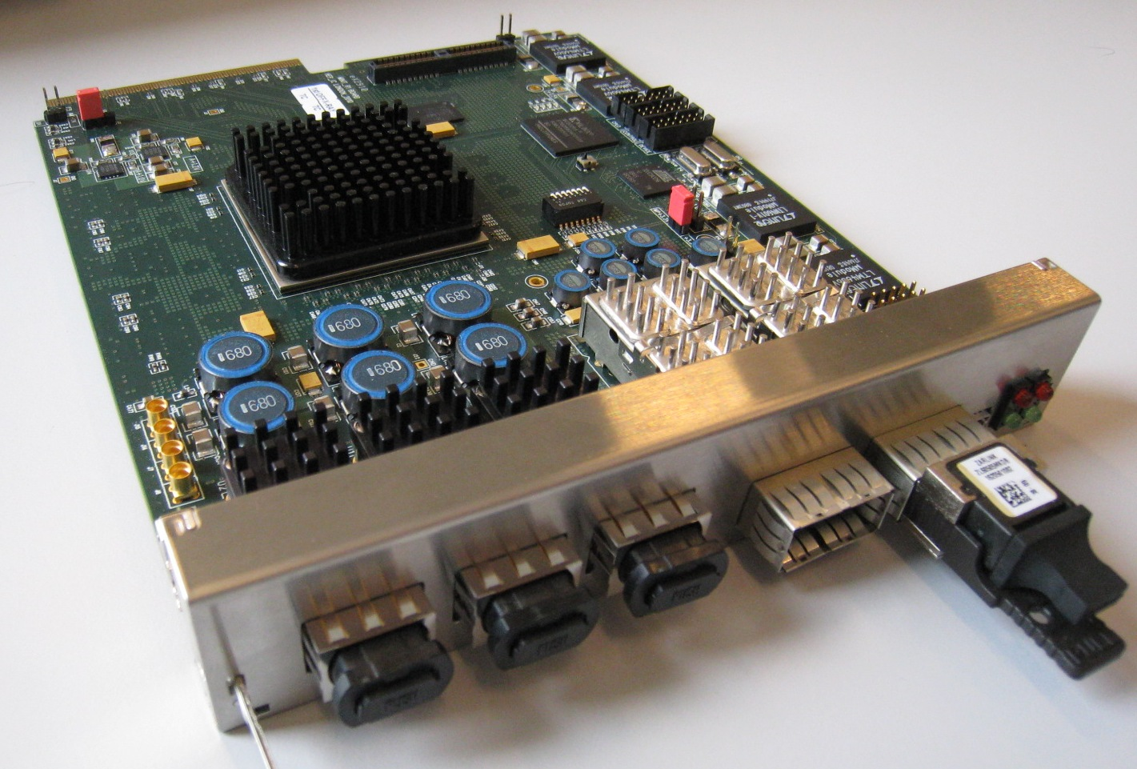
WP3: Trigger Development
Demonstrator system
MINI-T5: Virtex 5 based MicroTCA card (160Gb/s and 100Gb/s optics)
Proposed novel trigger architecture to CMS
CMS Note submitted
Discussion on upgrade trigger architecture is under way
Playing a substantial role in system design (G Iles)
Proposed MicroTCA card for Clock, Control, DAQ
Implemented by E Hazen (Boston, US)
Organising common aspects (e.g. crate purchase)
Supplying advanced Hardware Access Library (A Rose, R Frazier)
Software collaboration between WP1 and WP3
Based on protocol from J Mans (Minnesota, US)

Slide 32
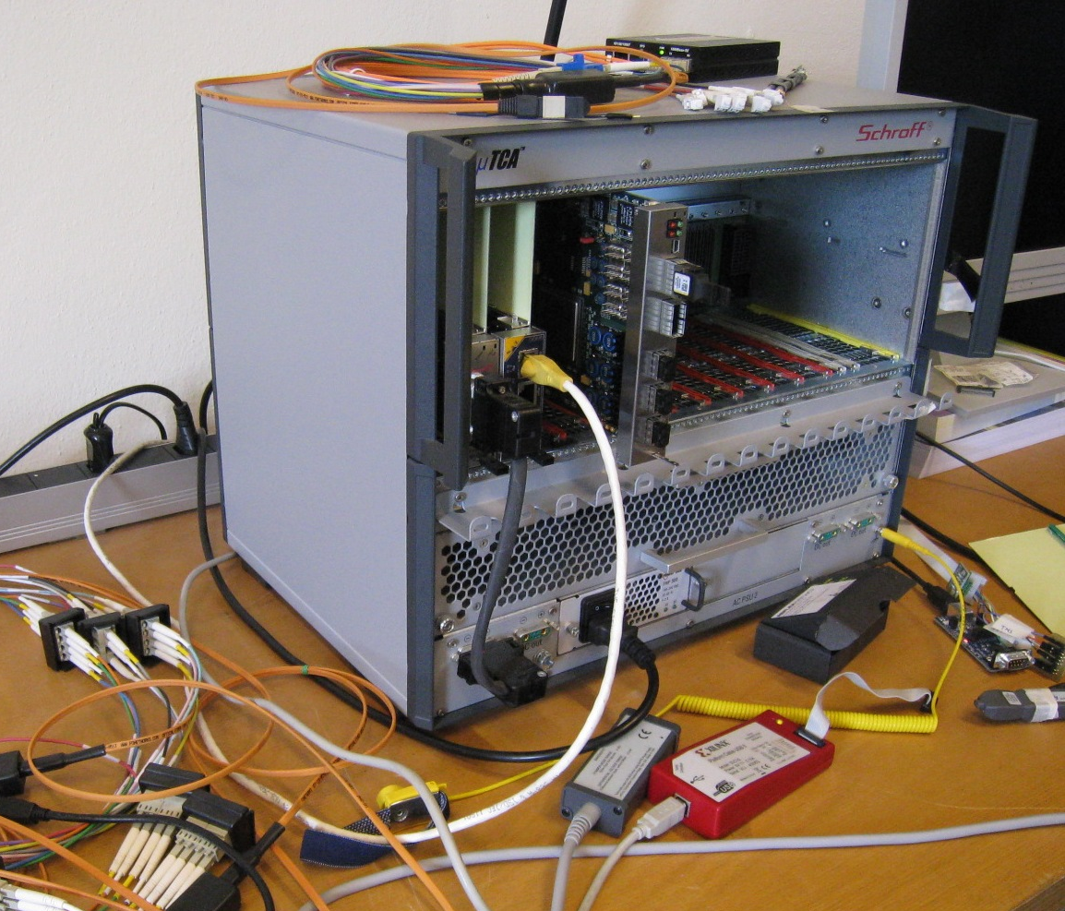
WP3: Demonstrator System
Two cards produced:
Rev 0: Original
Rev 1: Alternate optics (supply issue)
New manufacturing run in a few weeks
Rev 2: QDR II ram added (request)
Will make approx 12 cards if all OK
Enables large scale system test
Firmware infrastructure
Complete (link setup, DAQ, control)
Firmware algorithms
Elec/Tau complete (based on Wisconsin 2x2 cluster algo)
Algo size and speed not an issue

Slide 33
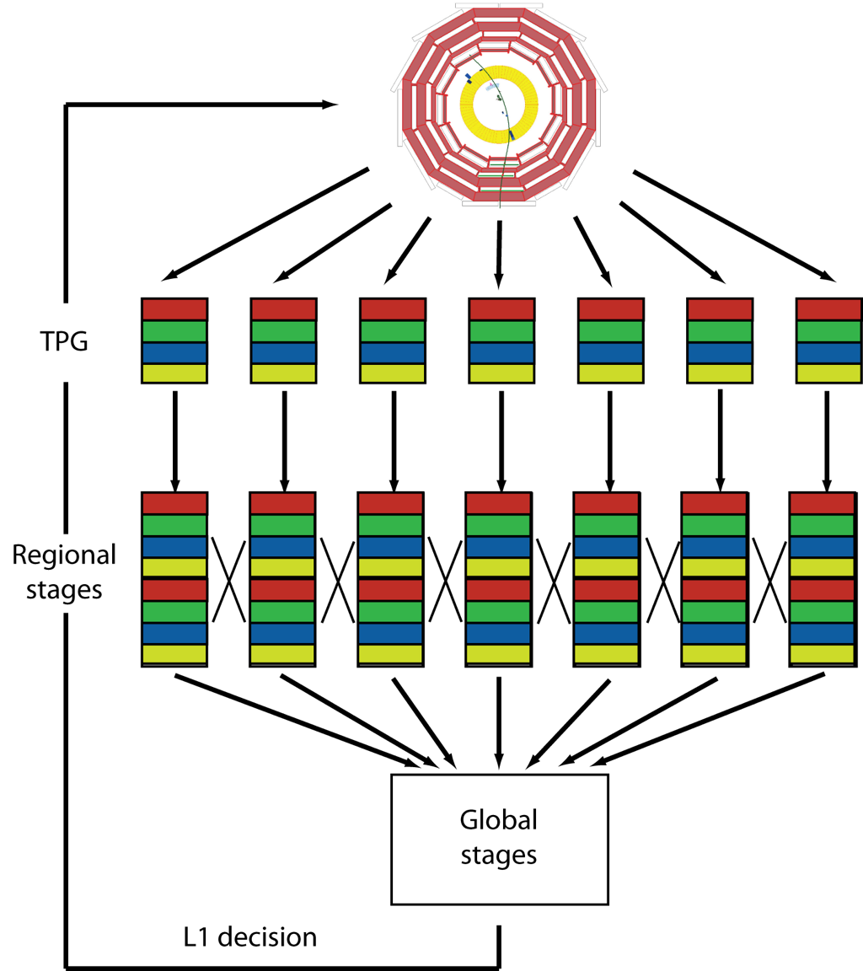
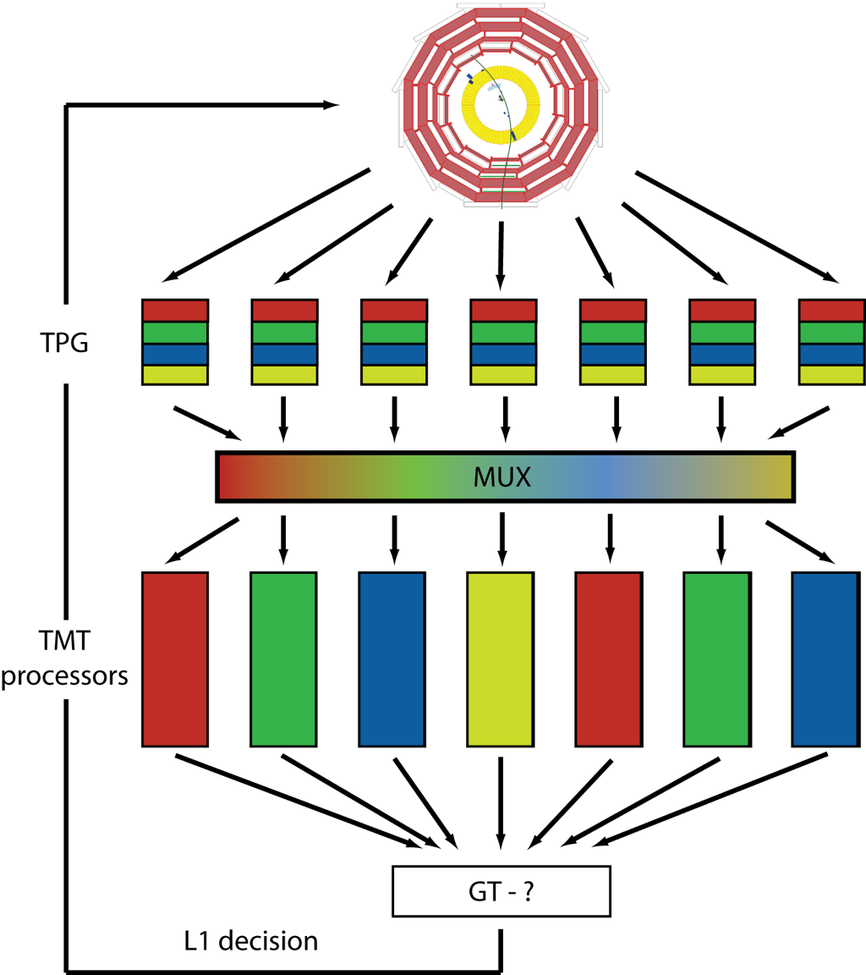
Time-Multiplexed Trigger: Concept
The key problems of triggering remain the same as in 1995
Concentration of dataflow into a single processor
Limitations on algorithms due to internal bandwidth limits
Understanding and optimising what is going on

Slide 34
WP3: 2011 Plans
Two parallel developments
(a) System Tests
Most infrastructure in place or soon to be (e.g. crate, hub, etc)
Start in earnest in April (MINI-T5:Rev2 cards back)
Initial 6-12 months, moving towards final system
(b) Final Hardware design
Based on Virtex 7
Some dependence on architecture choice
Primarily number of 10G links (x36 or x48)
Choice: Balance - Cost, BRAM, Logic and Links
CMS collaboration: Wisconsin, (Vienna) + UK

Slide 35
CMS planning
New pixel detector project well defined
4 barrel layers + 2 x 3 endcap disks
Significant contributions “guaranteed” from existing collaborators, plus some new partners (DESY, Aachen, CERN, Taiwan, Italy) with clear roles
stronger physics case needed to demonstrate cost/benefit
Upgraded Calorimeter trigger
architecture under discussion
physics studies to justify
More detailed long term plan to be defined
be ready for worse case conditions 2 x 10³⁴ cm⁻²s⁻¹ & 50ns bunch spacing
LHC planning must precede CMS
Long term R&D (full Tracker and trigger) remains very high priority
potential Tracker risk if cooling is problematic
must also plan cautiously, despite excellent performance to date

Slide 36
Possible UK contributions to future CMS
Trigger effort has strong UK support, based on more advanced progress than elsewhere in hardware/firmware/software
good existing collaboration to build on (Wisconsin, Vienna,…)
Tracker: development of eventual detector is long term – but cannot be deferred
CBC, module, FED and DAQ: contributions and strong collaboration (esp. CERN)
must not forget DAQ upgrade and its likely impact
Is there scope for UK contribution to Phase I pixel system?
interest from RAL PPD
Continuity of funding required to match timing of proposal for construction & long term R&D
proposed bridging the gap for next tranche to start ~ April 2013
proposal ~ early 2012

Slide 37
WP evolution
We have been flexible in use of WP1 staff at RAL PPD to cope with a difficult funding period
but need to cleanly distinguish new staff entering project and ensure WP1 deliverables are met
propose a separate WP for evaluation of pixel contribution
new milestone added for provisional project outline:
should evaluate feasibility & cost in first instance
WPs also have different end dates
logical at approval but no longer fits needs
WP1, WP2, WP3 already adapted to long term CMS requirements
Pixel WP needs similar coherence
plan, deliverables and funding – if demonstrated to be feasible
Possible next steps
bridging funds to, say, Mar 2013 to match proposal for long term R&D and construction funding
submission early 2012, giving time for CMS decisions on overall LHC schedule

Slide 38
Summary
Continued good progress
CBC delayed but good progress in early testing - next steps reasonably clear
Trigger progress very good, and sound basis for contribution to CMS upgrade
CMS and LHC upgrade planning
schedule uncertain again, for a few months
Finances
spending gradually increasing, with larger commitments expected in 2011/12
Working Margin (£230k) not yet touched
Use of RAL PPD staff
distinguish staff entering project in new WP (& milestones)
understand effort available for WP1
Bridging to next period for construction and long term
SSC & budget reporting – well known problem
Staff changes
O Zorba left, interviews for replacement imminent

Slide 39
Further information

Slide 40
CBC testing programme
baseline performance (conventional (clean) powering scheme)
digital functionality
fast (Ck/T1 - SLVS) & slow control (I2C) interfaces setup and operation
analogue functionality
amplifier pulse shape, noise, linearity,..
CIN dependence, signal polarity dependence, across chip & chip-to-chip uniformity
leakage current tolerance
comparator
timewalk, threshold tuning and uniformity, hysteresis
all above will depend on bias generator settings
=> large parameter space to cover
power consumption
powering options studies
supply sensitivity with/without various on-chip options
longer term
temperature effects (~ all of above vs. T), tests with sensors, radiation: ionizing & SEU sensitivity, test beam

Slide 41
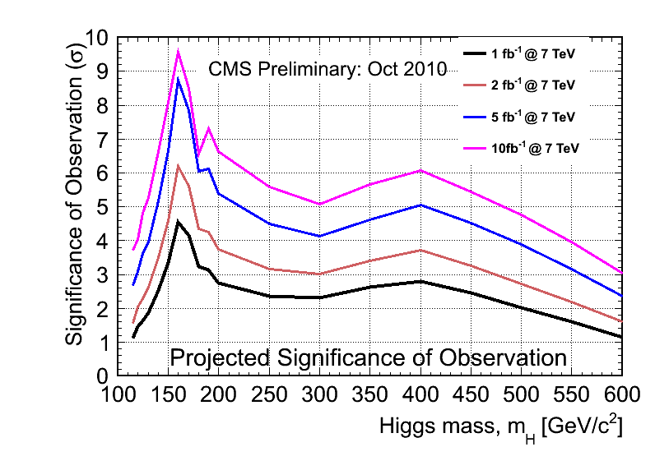
Sensitivity: 1,2,5,10 fb⁻¹ @7 TeV

