Slide 1
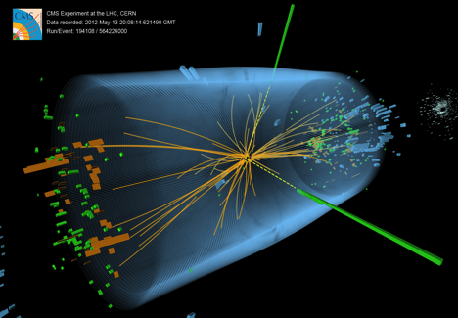
UK CMS Upgrade Oversight Committee
27 May 2015
University of Bristol
Brunel University London
Imperial College London
Rutherford Appleton Laboratory

Slide 2
Overview
Snapshots of LHC & CMS status
CMS and LHC are well into recommissioning phase
Summary of UK upgrade project
Recent WP progress
Finances

Slide 3
2015 LHC schedule
as of 4 May
Generally good progress
few week slippage compared to Nov 2014
physics foreseen from 1 June
but..

Slide 4
CMS WGM 4 May
CERN Bulletin 22 May: no beam losses at obstacle in latest intensity tests

Slide 5
CMS WGM 4 May

Slide 6
CMS WGM 4 May

Slide 7
CMS WGM 4 May

Slide 8
Forward calorimeter decision
High Granularity option chosen mainly for risk reasons
employs similar technology to Tracker (silicon, CO₂, ASICs)
T. Virdee interim PM
possible UK role under consideration
significant supplementary funding via ERC, plus PRD post

Slide 9
UK R&D status

Slide 10
Last 6 months
WP2:
continued steady progress with CBC3 design
expected CBC3 submission Feb 2016 in MOSIS run
First series of FC7 production complete but unexpected problems
WP3: progress towards installation of TDR trigger
UK Stage-1 commitments essentially complete
UK Layer-2 for 2016 trigiger in place and being commissioned
details to follow
WP2 & WP3: progress on TMTT studies
CMS TP delayed to LHCC to June 2015
decision on forward calorimetry made April 2015, endorsed CB 8 May

Slide 11
Overview of CBC activities
CBC2 characterization complete (reported last time)
including ionizing irradiation (to 180 Mrads!) and SEU testing
results informing CBC3 design
CBC2 based module tests continue
mini-module with irradiated sensors in test beam in June
full-size module test beam in November
CBC3 design now in full flow
all modifications and additional features agreed with CMS systems team collaborators
specification document complete and circulated

Slide 12
CBC3 status
Nearest
Neighbour
Signals
40 MHz Region
design work progressing
main new features are:
stub address generation & transmission off-chip @ 320 Mbps
longer L1 pipeline (12.8 usec)
higher L1 trigger rate capability (up to 1 MHz)
major new blocks are:
stub gathering logic
complete
data packet assembly & transmission
at advanced stage
review meetings held at key stages to monitor progress
40 MHz
Differential
Clock
Front End
Amplifiers
DLL
254
v_{th}
v_{th}
512 Deep
Pipeline (12.8µs)
+
32 Deep
Buffer
← 254 Channels →
Stub Gathering Logic
Channel Mask
Offset Correction & Correlation
PISO Shift Register
Hit Detect
v_{th}
Cluster Width Discrimination
1
v_{th}
Comparators
320 MHz
SLVS
Clock
Pipeline
Control
Test
Pulse
Generator
Nearest
Neighbour
Signals
Bias
Generator
Bend lookup formatting
Data Packet
Assembly &
Transmission
Stub &
L1 Data
DLL
Band-gap
320 MHz
Region
Fast Control
SLVS
Input
VDDA
1.0 V
VDDD
1.2V+/-10%
I2C Registers
LDO
Slow Control
I²C
Complete
Preliminary Layout
In progress
To do

Slide 13
CBC3 plan
2014
2015
2016
2017
2018
CBC3 design & production
CBC3 in hand
CBC3 test (& modules based on CBC3)
CBC4 design & test
engineering run
modules based on CBC2
concentrator prototype in FPGA
modules based on CBC3 and concentrator ASIC
(need to integrate DC-DC and link components)
ready for
production
plan to submit CBC3 through MOSIS in February
limited number of chips but ~ half the cost of full wafer run
can expect chips in hand ~ May
(small schedule slippage but have to comply with fixed submission dates)

Slide 14
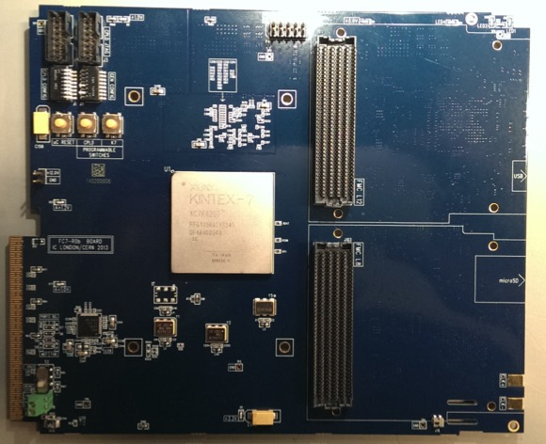
FC7
Problems discovered in boards built for TCDS project
upgraded CMS TTC system, on tight schedule

Slide 16
with help from Xilinx failure analysis

Slide 17
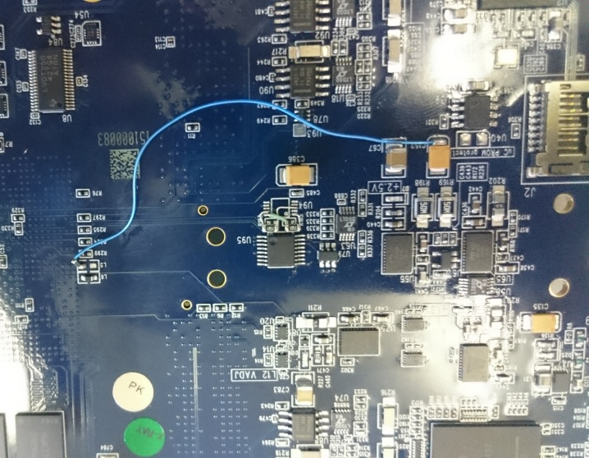
FC7 current status
Problem is now believed to be understood but proceeding with caution
simple repair to existing boards
however stressed boards likely to have been damaged
error corrected in layout for R2
design modified to be conservative in all respects
internal design review with CERN, and some outside experts, April
replacements underway
existing design, with correction for urgent
needs (TCDS and pixel prototyping) reordered
R2 ready for submission very soon
Some important lessons everywhere
listed in report

Slide 18
WP3 objectives and status
Calorimeter trigger status
to be updated orally at meeting
review held April – report not yet issued
commissioning status (Stage-1 & TDR)
Plan B readiness
all MP7s required for UK commitments delivered
but some manufacturing issues and PCB material is under consideration for the future, as with the FC7

Slide 19
2016 Calorimeter Trigger Milestones
Milestones related to CTP7
25.10.2014 3 CTP7s at CERN
15.11.2014 4 CTP7s at CERN (includes the previous)
20.01.2015 8 CTP7s at CERN (includes the previous)
28.01.2015 12 CTP7s at CERN (includes the previous)
25.03.2015 28 CTP7s at CERN (includes the previous)
08.04.2015 36 CTP7s at CERN (includes the previous)
Milestones related to commissioning of the trigger
22.12.2014 Layer-2 – Patch Panel – Layer-1 Commissioned
16.01.2015 oSLB and HF uHTR systems commissioned
19.01.2015 Layer-2 – Patch Panel – Layer-1 Connected to uGT
25.11.2014 First Version of CTP7 firmware (incl. input playback)
09.03.2015 Final Version of CTP7 firmware (except DAQ link)
17.02.2015 Final design of Algorithms and data format defined
Decision to upgrade 2016 trigger inputs from ECAL and HCAL
17.06.2015 B/E uHTR system connected to the trigger - Commissioned
02.09.2015 System ready for parallel data taking

Slide 20
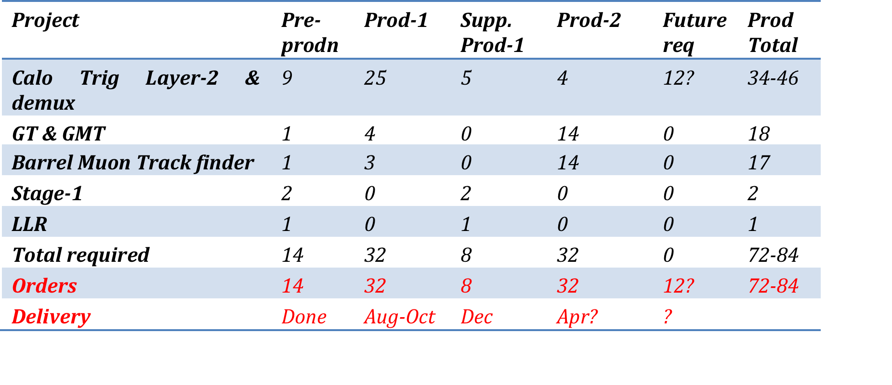
MP7 order status
Following prototyping/pre-production, two orders of 16 boards
Prod-1: 16 delivered (Hapro) + 16 from Exception, essentially complete
a bit of a struggle with UK company
Hapro orders of 8 + 32 launched in 2014 (Prod-2 and Supp Prod-1)
assembly error with first 8, so delay
now complete
manufacturing error with pre-series cards of 32 order.
delay while new PCBs procured, delivery in August

Slide 21
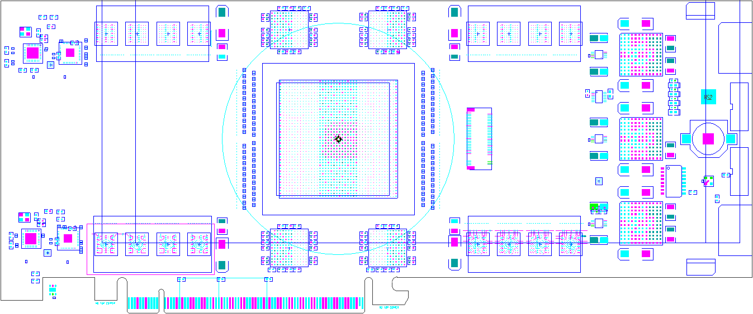
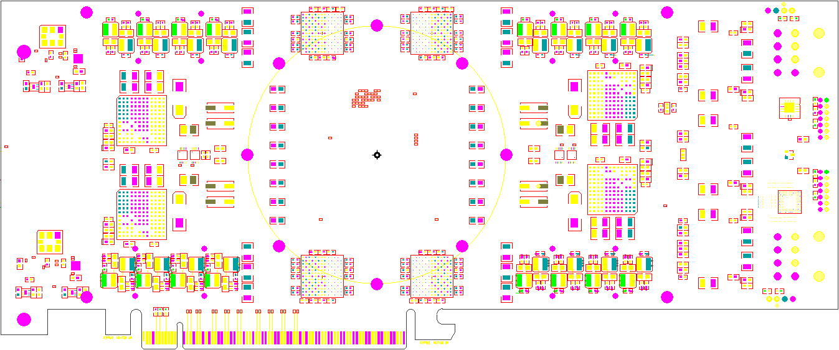
MP-Ultra: Successor to the MP7
Successor to the MP7 based on Xilinx Ultrascale and Ultrascale+ FPGAs
Up to 96+96 (Tx+Rx) links at up to 16Gbps: bandwidth > 1.5+1.5 Tbps
8Gb of RLDRAM3 in four independent banks
PCIe form-factor – easier to manufacture than µTCA
Two variants planned spanning 3-generations/families of FPGA:
48-link variant – very low-cost with maximal logic/bandwidth ratio
96-link variant (Ultrascale FPGA) – maximum bandwidth
96-link variant (Ultrascale+ FPGA) – maximum bandwidth & logic
Top
Bottom

Slide 22
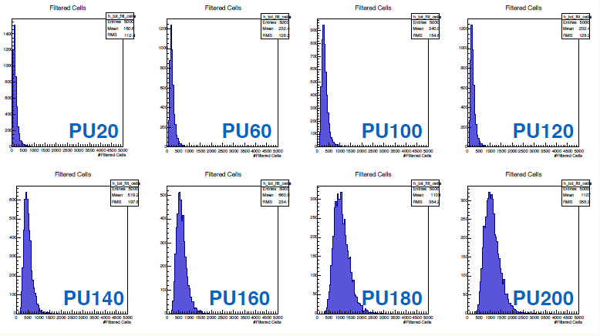
Track-trigger progress
Now quite substantial UK-wide activity focusing on
simulations
algorithms for track finding in FPGA
firmware design
implementation in MP7 demonstrator system
Target: working demonstrator by August
of course with limited objectives compared to final system

Slide 23
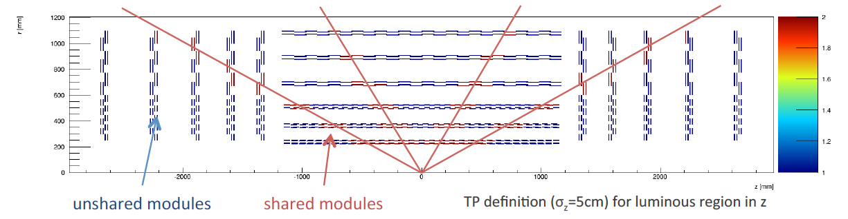
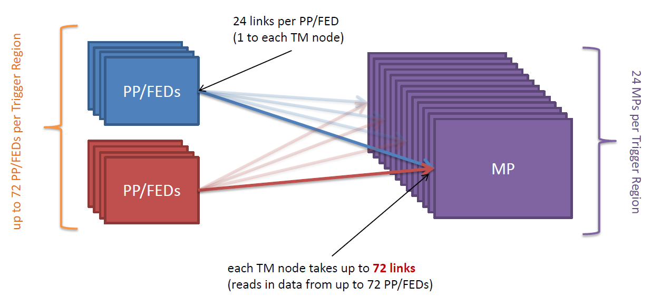
Layout of fully Time-Multiplexed Track-Trigger
Focusing on demonstration of the concept
entire tracker could be read out by MP7-like processing cards
requires ~200 cards, segmented into 5 η regions
module sharing
≤ 2 regions
simpler architecture
no deghosting
sharing defined by large luminous region in z
feed time-multiplexed data to regional processors
TM period of 24-36 BX possible using MP7s

Slide 24
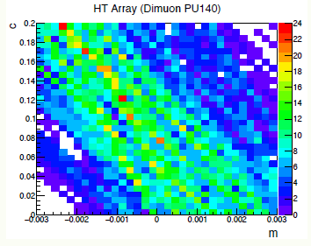
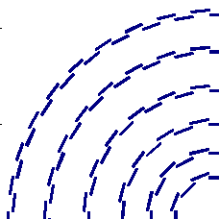
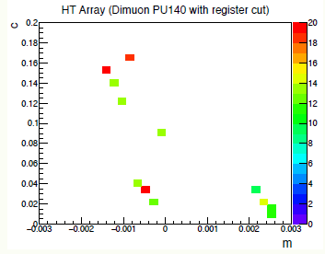
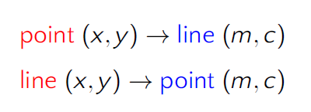
Track-finding in FPGA
Hardware requirements already feasible, but processing in FPGA very challenging
exploring Hough transform approach:
line in real space -> point in inverse space
pipelined dataflow
natural with TM
matches FPGA needs
find stubs in 2D
2D histogram
selection to reduce number of candidates
valid track where lines intersect
i.e. stubs which share the same (m,c)

Slide 25
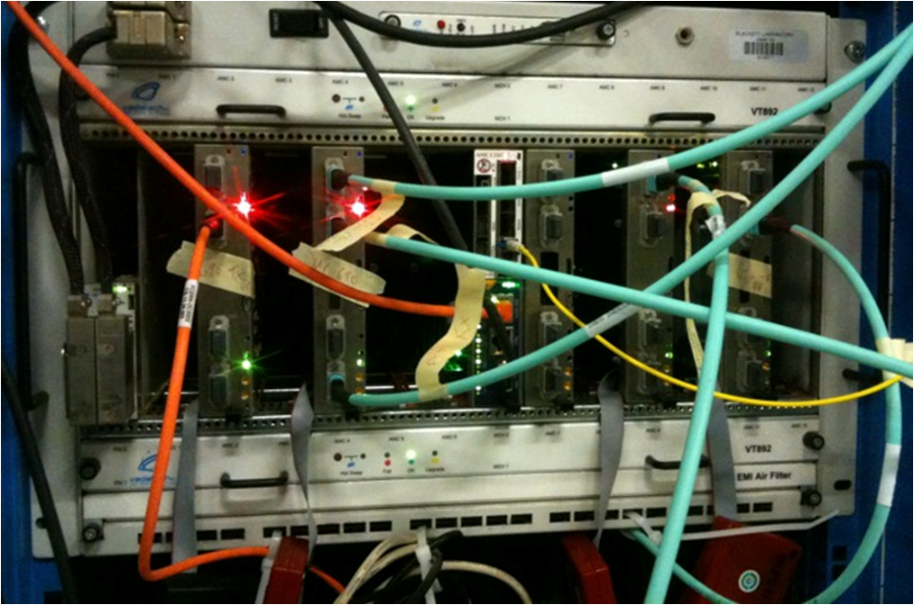
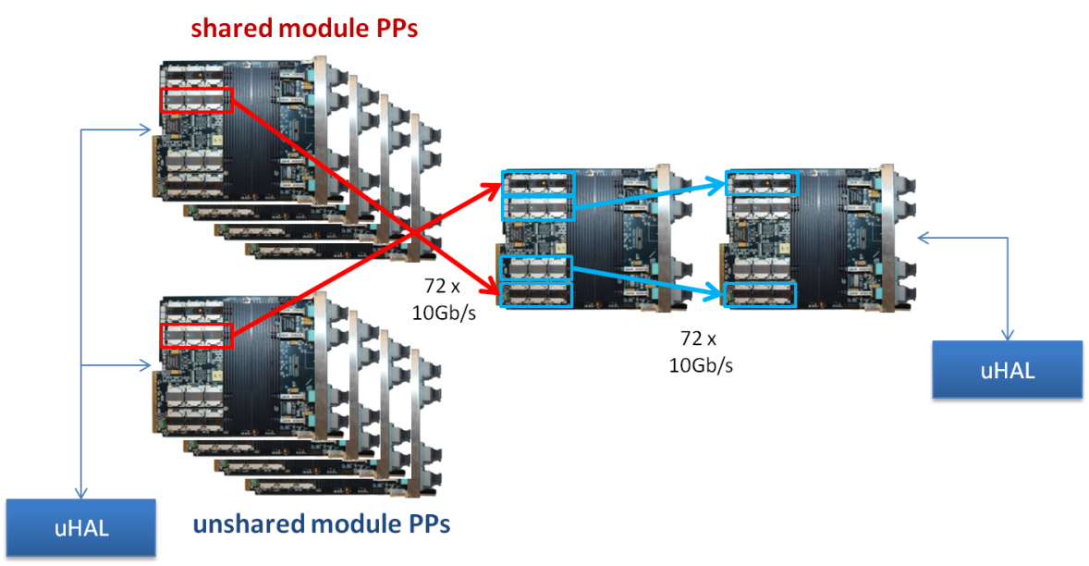
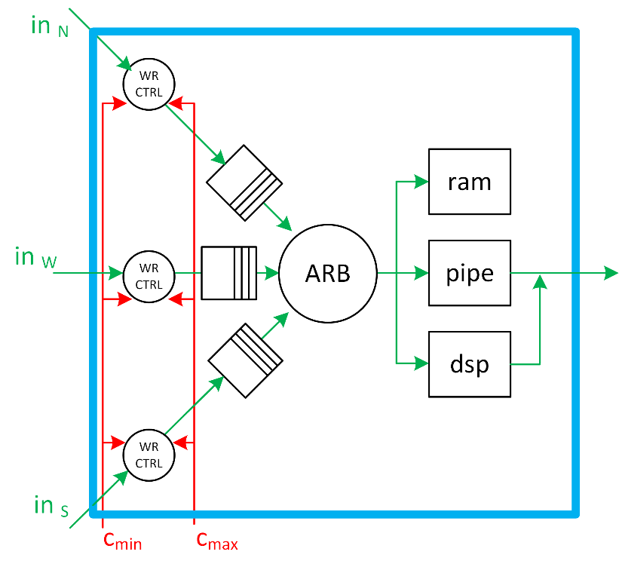
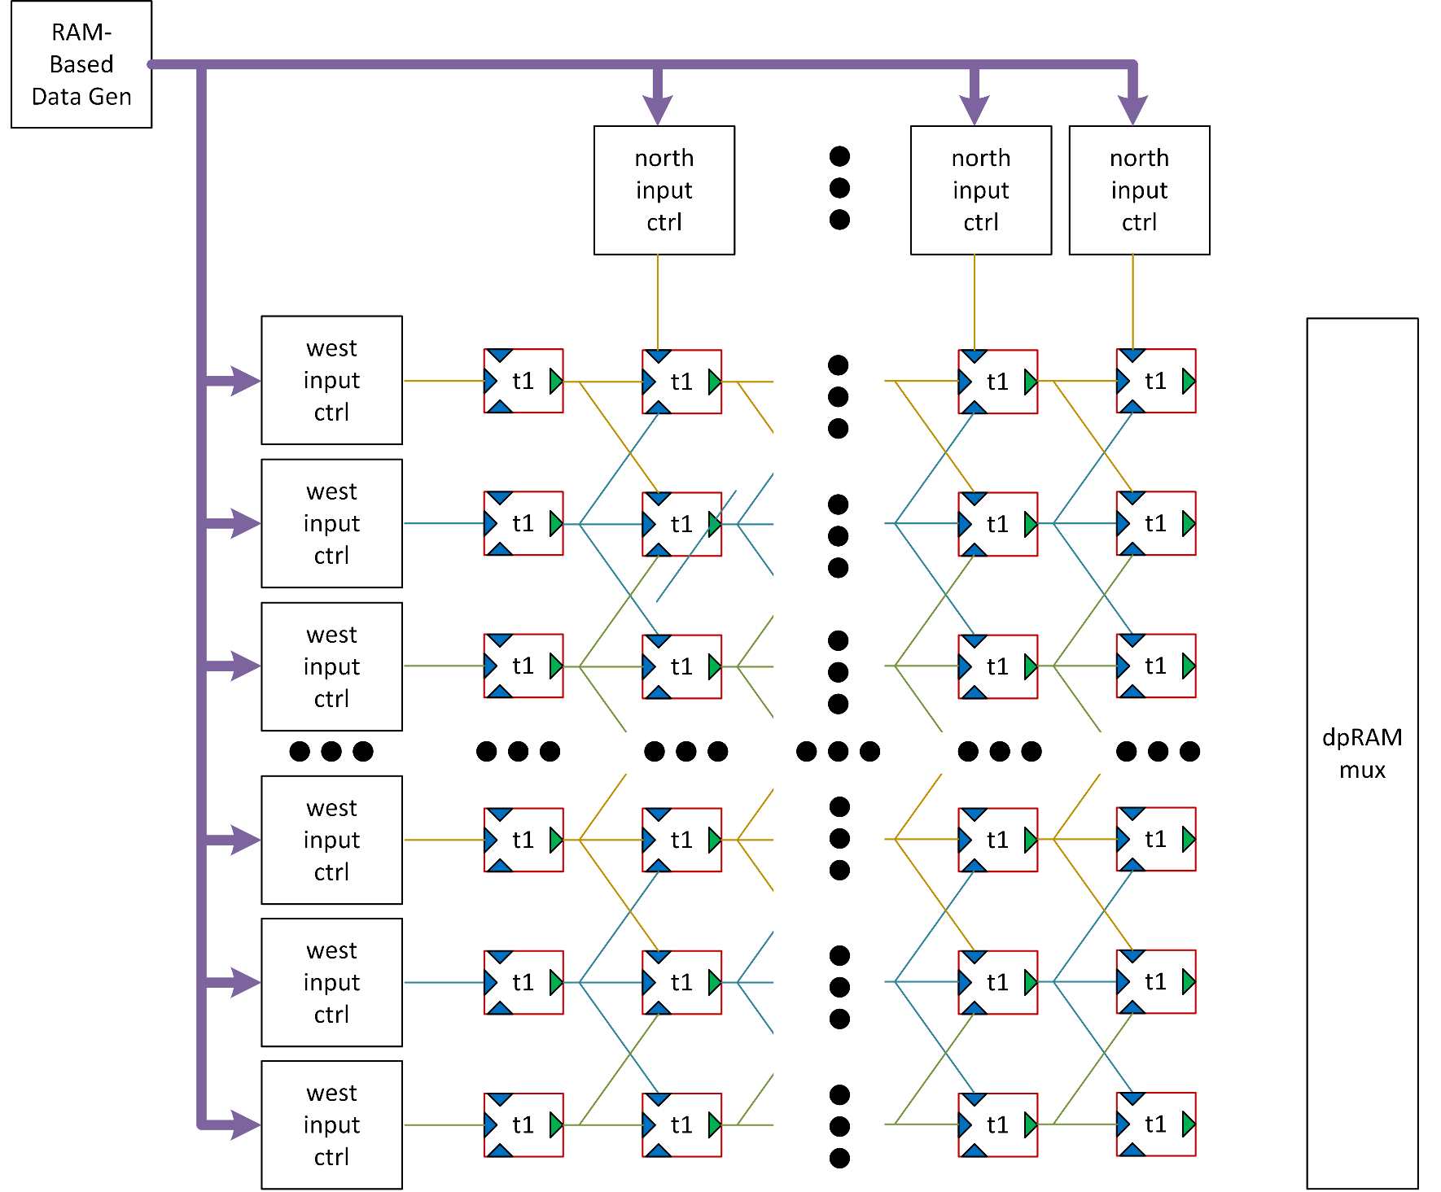
Status of demonstrator
Hardware exists in working form (from calo trigger)
adapt for track-trigger time slice
software validation under way
Firmware implementation of Hough array ready
self-filling systolic array
integrating with infrastructure firmware

Slide 26
Finances
Expenditure – no special issues
Staff expenditure essentially as foreseen
including slight ramp-up in RAL TD, matching our delivery plan
Travel also as foreseen – further LTA commitments under way
Materials & equipment
WP2:
CBC3 manufacture early 2016
WP3:
For purchases via CERN (FC7 & MP7) direct invoicing to Imperial now working well

Slide 27
Conclusions
Milestones
reported in document
Risks
register revised
no new risks, but MP7 and FC7 issues have materialised
Trigger project in crucial commissioning phase
SP team has been playing significant role

Slide 28
Further information

