Slide 1
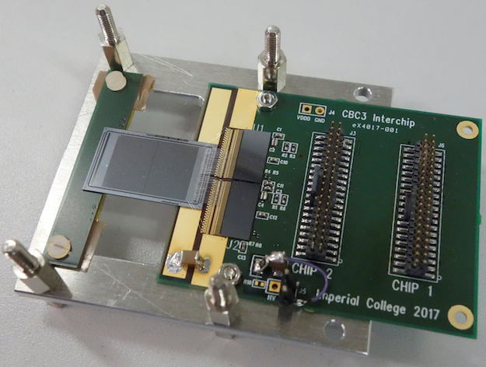
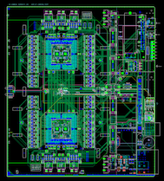
UK CMS Upgrade Oversight Committee
30 May 2018
University of Bristol
Brunel University London
Imperial College London
Rutherford Appleton Laboratory

Slide 2
Overview
Snapshots of LHC & CMS status
LHC delivered 50 fb⁻¹ p-p in 2017
2018 LHC start up has proceeded very well – already 10 fb⁻¹ p-p @ 13 TeV by 17 May
nice status report in CERN Bulletin 15 May
The pixel problem of failing DC-DC converters was unresolved by examination, although the failure mode of the ASIC was identified – but not why.
All units replaced in YETS
New CMS SP elected, from Sep 2018: Roberto Carlin (Italy)
Deputies: P McBride (FNAL), L Malgeri (CERN)
Summary of progress in UK upgrade project
UK CMS Construction project proposal reviewed by PPRP
Now awaiting decisions

Slide 4
Some new results currently being obtained from additional devices inserted in CMS.

Slide 6
News on upgrades
HGCAL TDR submitted and reviewed
Approved by LHCC
Significant CMS activity on construction preparations and planning
Many projects to manage, all at different stages, even if approved
e.g. tracker organisation recently refined (next slide)
One relevant consequence concerns approaching contracts and planning (our) future activities to match them, e.g. CBC
However, no major issues at this stage for R&D
Preparing reviews, as in the past, to monitor progress

Slide 8
from D. Contardo CMS UG coordinator
MB 22 May

Slide 9
UK R&D status

Slide 10
Last 6 months
WP2: Tracker ASIC and readout
In-house module and 2CBC3 2S-module tested in beams at end of 2017
CBC3.1 design changes completed, and submitted for manufacture
Delivery projected for 25 June
WP3: future hardware
Considerable progress with new ATCA hardware, and infrastructure
WP4: HGCAL
TDR submitted and approved, putting project on official footing
UK work in optimising performance continuing to produce results
WP5: L1 track-finder
Work on system development now progressing rapidly
Stress test was proposed for FPGA track finder to confirm risks are low
Some initial results from simulations

Slide 11
WP2: CBC3 summary
All design changes incorporated into chip, vsn 3.1
Submitted for manufacture early February
Some administrative delays, so accepted 30 March with delivery 25 June.
“delivery” means with bump metallisation completed
This could be the final iteration and mask set for production
An order of 24 CBC3 wafers left foundry 16 May for bump metallisation
Intended for module assembly prototyping
Expected transport to CERN 26 June
Wafers shared with CERN SCA chip (not usable), so 186 CBC3 per wafer
Sufficient for many prototype modules to be constructed
With CBC3s from engineering run, should be plenty for module prototyping despite Pactech metallisation problems
Progress will be limited by other components, not CBC

Slide 12
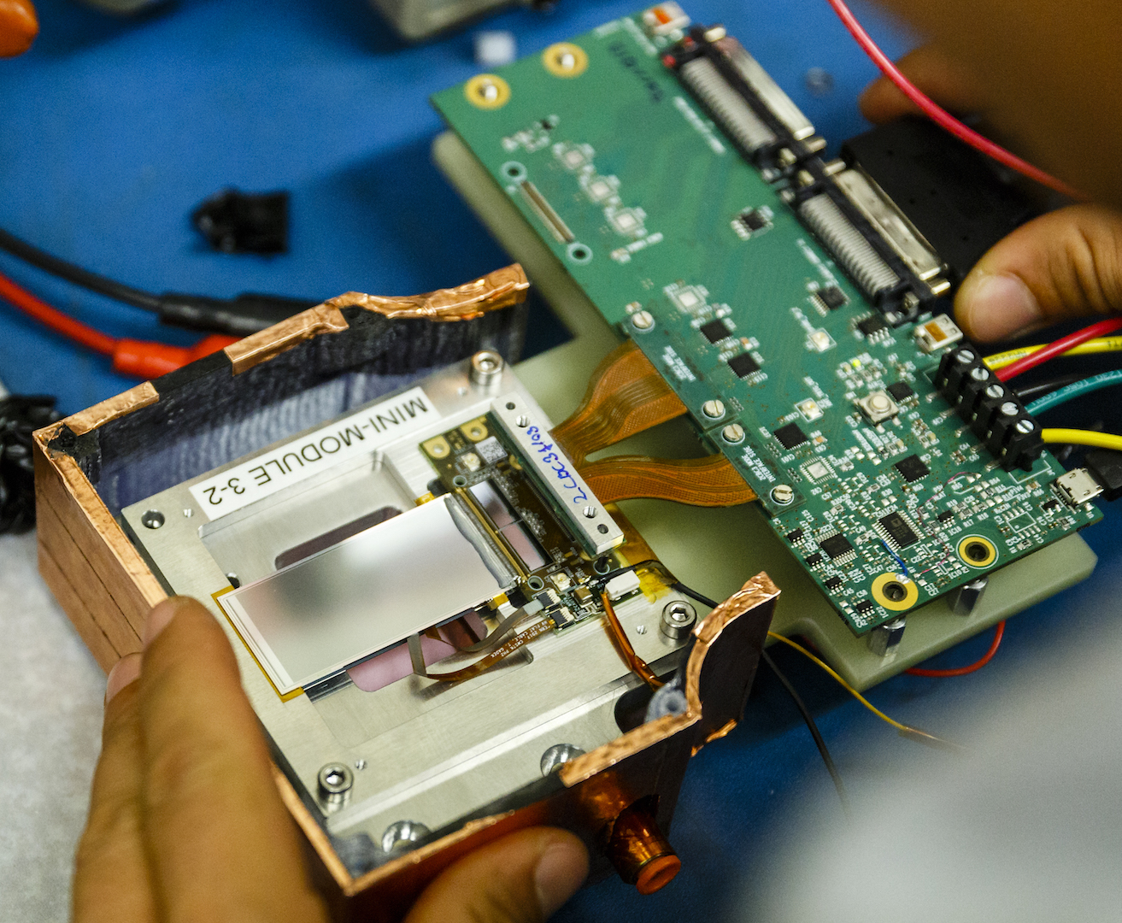
Recent CBC3 beam tests
Successful 2CBC3 2S-mini module test at FNAL in December
120 GeV p beam
Included operation at -20C
Local pixel telescope allowed good track reconstruction
Still much more to be tested in future
e.g. high rate with pileup, and full geometrical coverage evaluation
Full size 8CBC3 module
expected in autumn

Slide 13
Results from December FNAL beam test of 2CBC3 module

Slide 14
WP2 future
2S module development continues with CBC3
Many components not final
including hybrid where some fabrication problems were experienced
Concentrator (CIC) chip remains main concern; first submission due end July
CBC3.1 verification (Q3 2018)
Preparing station for CBC3 and CBC3.1 to identify KGD by automatic probing
Planning final series of TID, low T, SEU tests to confirm changes
Operation on full size module with sensor should provide final validation
Production manufacture
Task for construction project, from April 2019
But given delays with other parts, start date is uncertain
Early ramp up useful to preclude (unexpected) manufacturing problems (cf. APV25)

Slide 15
WP3: future hardware
Serenity ATCA prototype delivered
Minor layout or manufacturing errors found but easily usable
Layout issues fixed on recent respin, but some (annoying) assembly errors
Testing is progressing rapidly, including software and firmware development
Recently FPGAs on daughter cards mounted and exercised
Regular coordination meetings steering the activities

Slide 16
WP3: future hardware
Two strands of development
Demo Systems : Firmware & Software
Q1 2018: Slow control and build tools for Xilinx UltraScale Devices
Q2 2018: Basic infrastructure for algorithm development
Serenity Prototype : Hardware
Q2 2018: Provide Serenity hardware with low level firmware, plus basic infrastructure developed from “demo systems”
On schedule to meet milestones
Demo Sys
Prototype
2018
Final Prototype: Generic
2019
Pre-Production: Specialisation
2020

Slide 19
WP3: future hardware
Deliver final prototype, including full infrastructure by Q2 2019
Challenging in many aspects, particularly hardware delivery
Distribute to several groups
Alternative processing nodes
VU9P (TIFR) and KU15P (KIT) FPGAs
Clock quality analysis (Saclay)
Integration tests in CERN
Continued firmware & software development
Demo Sys
Prototype
2018
Final Prototype: Generic
2019
Pre-Production: Specialisation
2020

Slide 20
WP3: future hardware
Activities now broader than just UK
Participants from India (TIFR), Germany (KIT), France (Saclay), Greece (Ioannina) and Italy (INFN)
Bi-weekly forum to coordinate the activities
Started November 2017
Working better than expected in most aspects
e.g. collaboration on processing nodes, timing analysis, firmware

Slide 21

WP4: HCGAL TDR
Main recent focus for HGCAL has been the TDR
Submitted: Nov 2017
Technical review by LHCC: Dec 2017 – Feb 2018
Project review (cost, schedule, effort, risks) by UCG: Mar – Apr 2018
Approval by CERN RB: Apr 2018, announced after OsC report submitted
As part of TDR, milestones and project organisation were reviewed and refined
T. Virdee remains as overall Project Manager
C. Seez and P. Dauncey remain as coordinators of the physics/reconstruction and trigger, respectively
The next major milestone is the EDR in mid 2020
Must demonstrate use of Serenity for HGCAL BE

Slide 22
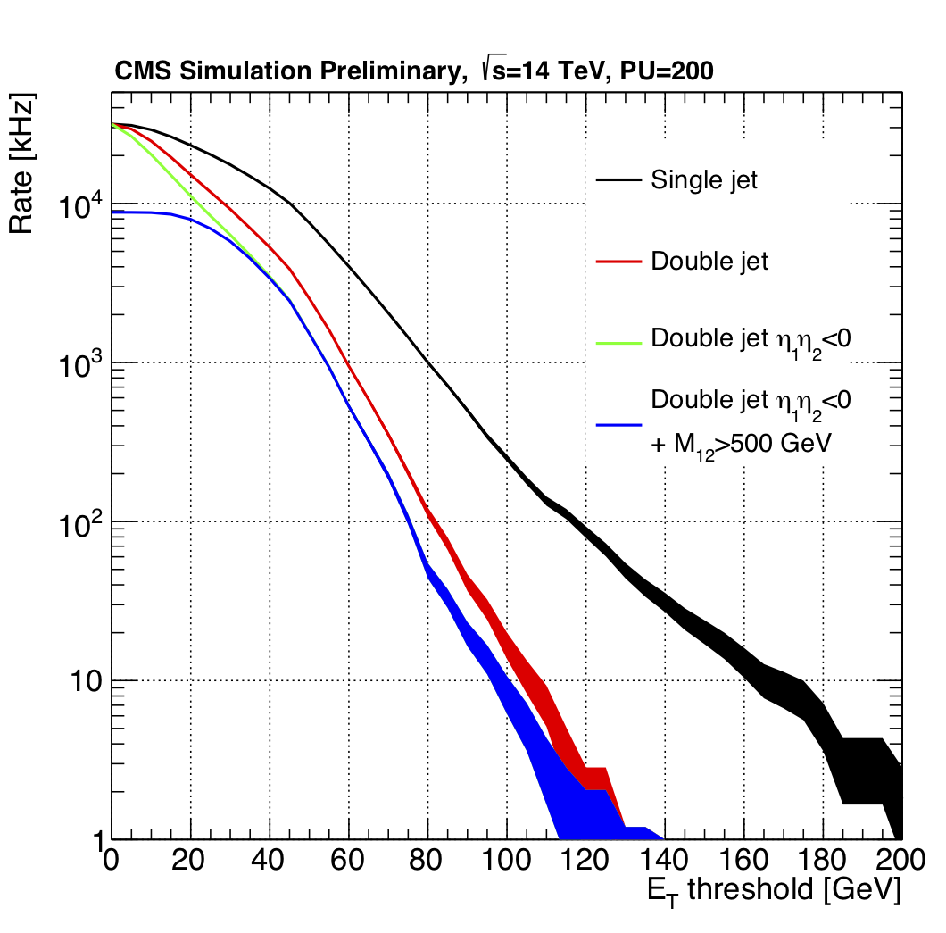
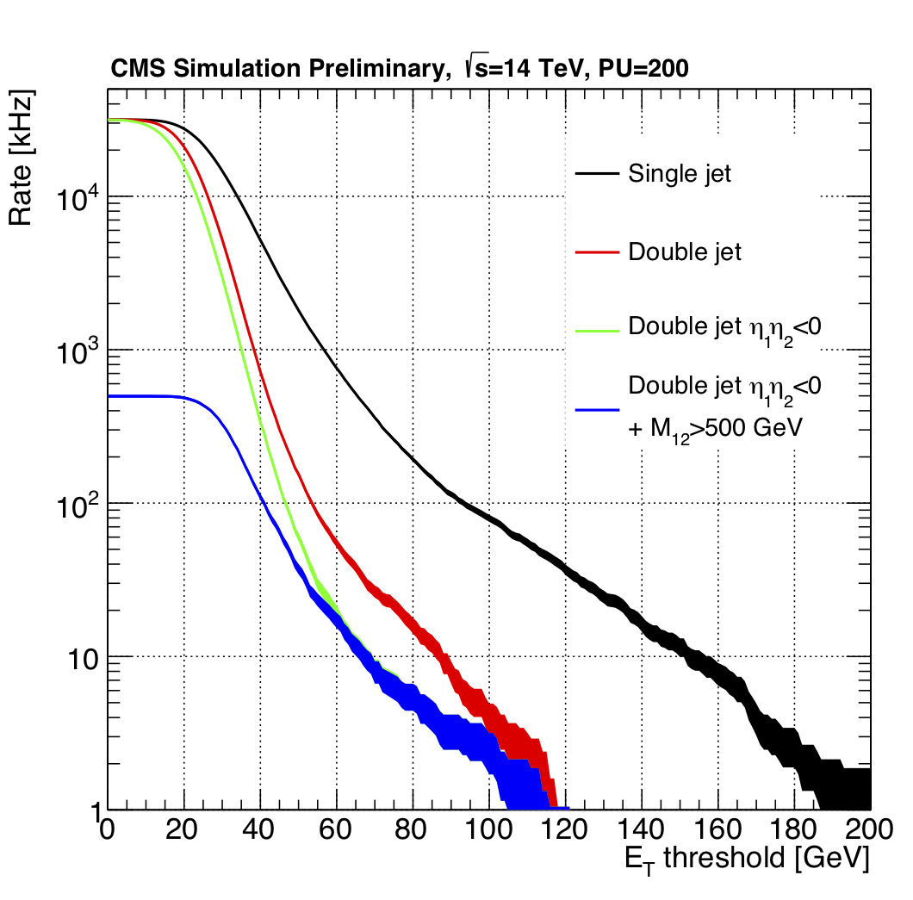
WP4: HGCAL design studies
UK design studies have continued since the TDR
Looking at detector/trigger optimisation to improve on TDR performance
Physics/reconstruction studies of depth segmentation underway
Absorber thicknesses as a function of depth
UK development of flexible standalone simulation for earlier studies has proved essential for rapid variation of thickness parameters
Critical for finalising mechanical support structure; complete within 2018
Trigger clustering performance
Do 2D clustering within each layer, then 3D clustering across layers
Small change to 2D clustering algorithm resulted in significant improvement in pileup rejection
Now working on 3D algorithm
Jet b/g rates: Old 2D
Jet b/g rates: New 2D

Slide 23
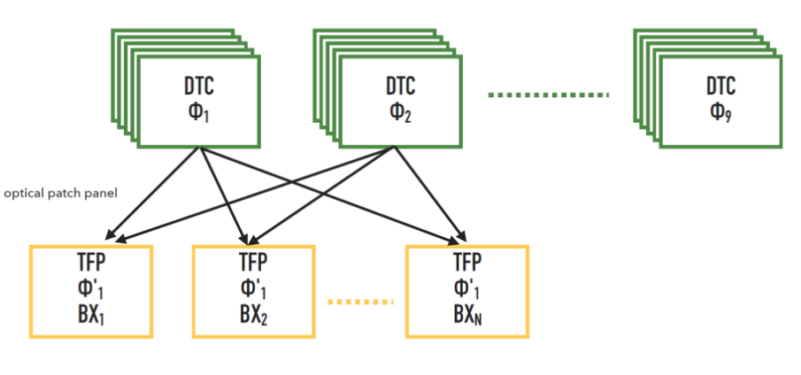
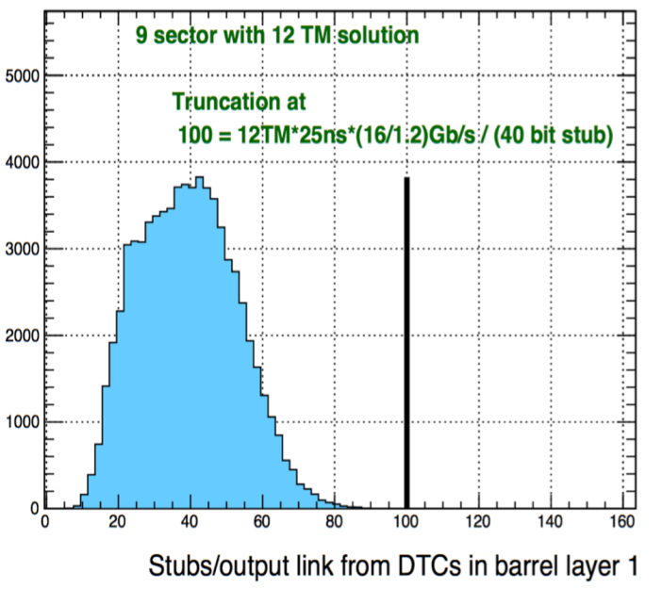
WP5: L1 track finder
System Architecture
Aim to pin down specifications of hardware, system design and interfaces by mid-2019 (CMS milestone)
Main consideration is margin & flexibility/scalability
Cooling margin in blades, crates & racks
Bandwidth margin:
detector -> DTCs -> TFPs -> L1 correlator
FPGA resource usage and margin
Flexibility for additional processing or utilisation of newer FPGAs at later date
Working closely with WP3
Bandwidth simulation studies between DTC and TFP

Slide 24
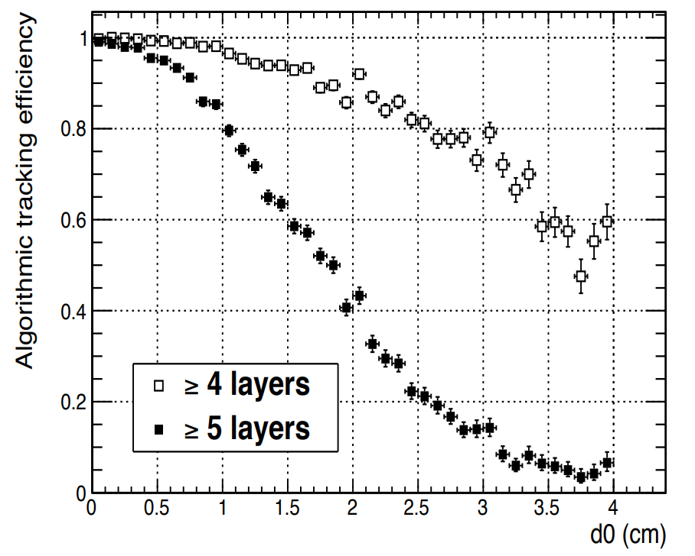
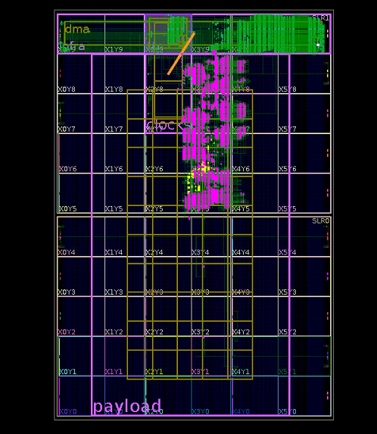
WP5: algorithms and firmware
Adapting and optimising TF algorithms to new system constraints and L1 requirements
Porting algorithms to Ultrascale/+ FPGA architectures
including targeting higher operating frequencies
Adapting track finding algorithms to reconstruct tracks with displaced vertices in x-y (aids electron track reconstruction, DM searches, etc)
Geometric Processor (GP) routes data according to η-φ tracking sector – now running in Ultrascale infrastructure (WP3)

Slide 25
L1 track-finder stress test
Proposed to simulate system beyond actual operational expectations
To confirm that no dramatic failure mode might have been overlooked
even though fairly extreme conditions already well studied in hardware and software
Early results already look very promising

Slide 26
UK construction project
Proposal to PPRP submitted October, previously reported
Reminder: Construction WPs, plus management activity
WP2: Common technology
WP3: Silicon tracker
WP4: Calorimetry
WP5: Trigger
Reviewed by visiting panel and all questions answered.
Now awaiting outcome
Would like soon to begin planning transition into construction project

Slide 27
Conclusions
No actions from November meeting
Financial status
Expenditure within targets with part of WA still available
On track to conclude project within budget, and fully spent
Part of WA for CBC design work and travel has been committed
agreed with STFC how to handle this
Largest financial uncertainty concerns any requirement for CBC3.1
Should be clarified by end of 2018
Minor revised risk register, with explanations in report
We believe project is approaching a satisfactory conclusion in its final year

Slide 28
Further information

Slide 29
WP3: future hardware
Spare Pictures
MP-Ultra
2016
Building Blocks
Service Card
2017
Full Prototype / Demo Sys
Demo Sys
Prototype
2018
Final Prototype: Generic
2019
Pre-Production: Specialisation
2020

