Slide 1
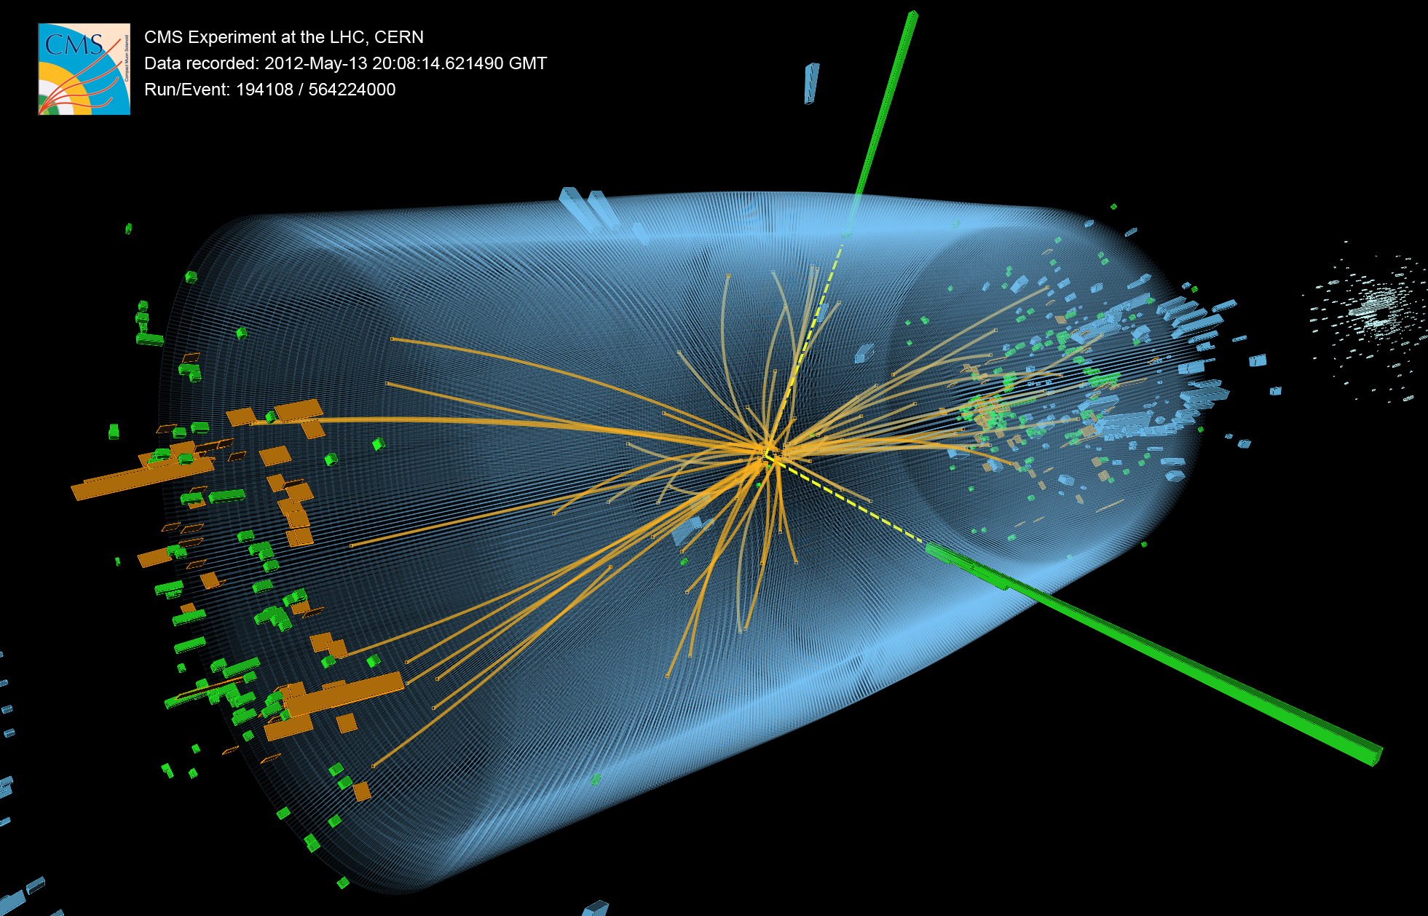
UK CMS Upgrade Oversight Committee
Geoff Hall
25 September 2012
University of Bristol
Brunel University
Imperial College London
Rutherford Appleton Laboratory

Slide 2
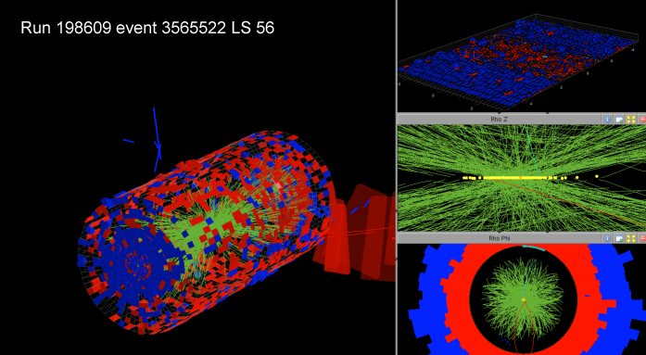
Overview
CMS status
LHC status and future plans
Revisit motivation for upgrades, in view of PPRP proposal
Review R&D background and current status
Recent WP progress
Finances
78 events pileup!

Slide 3
CMS status

Slide 4
Current Operational Status*
Pixel Tracker | Strip Tracker | Preshower | ECAL Barrel | ECAL Endcaps | HCAL Barrel | HCAL Endcaps | HCAL Forward | HCAL Outer | Muon DT | Muon CSC | Muon RPC
97.1% | 97.75% | 97.1% | 99.16% | 98.54% | 99.92% | 99.96% | 99.88% | 96.88% | 99.1% | 97.67% | 98.2%
*As of June 15 2012

Slide 5
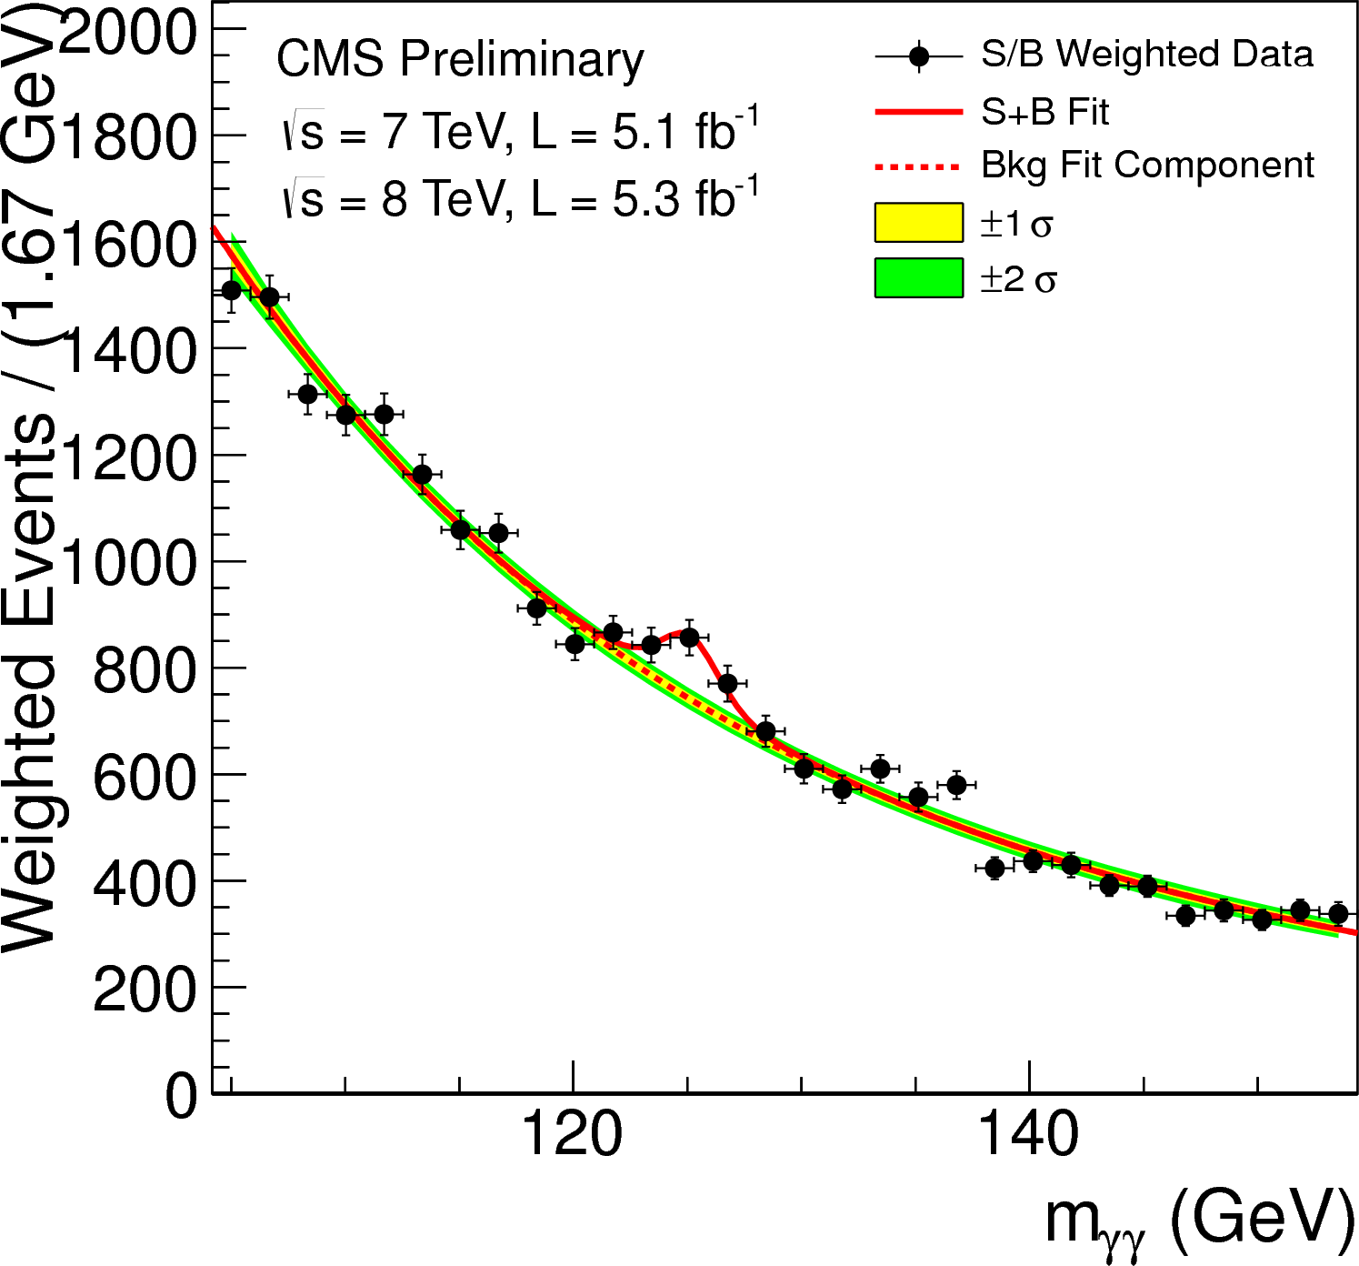
4 July 2012
half design energy,
one third of integrated luminosity
five times higher pileup
than originally expected

Slide 6
New physics
CMS has already made one major discovery
still to prove it is a Higgs boson by measuring all its properties and couplings
it was expected to require much more data
CMS has excluded large areas of phase space for the simplest SUSY models and new heavy vector bosons
moving on to more complex models where mass of putative Higgs may give hints (“natural” SUSY)
many other physics papers published…
Further investigations require much more data
eg 2012 data insufficient to prove if 125 GeV boson spin 0 or 2
searching for rare phenomena: ~2B events will be stored in 2012

Slide 7
lhc status

Slide 8
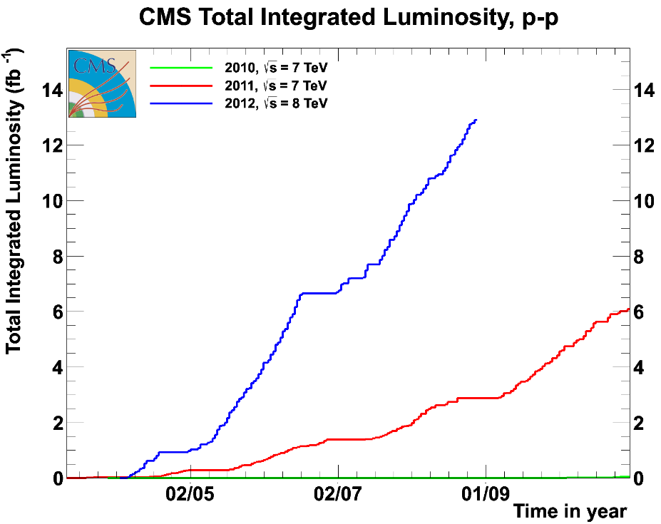
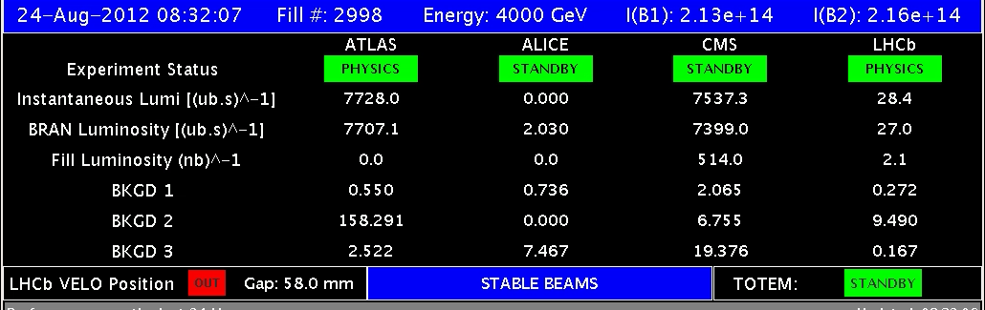
Comparison 2010 – 2011 - 2012
2010: 0.04 fb⁻¹
Machine commissioning
2011: 6.1 fb⁻¹
Production
2012: 13 fb⁻¹ so far
Higher energy
Smaller beta*
Increased bunch current
8

Slide 9
LHC future plans
LHC operational conditions in 2012
8 TeV, 50ns bunch spacing, L_{inst}~8 x 10³³ cm⁻²s⁻¹
target ~25 fb⁻¹ with LS1 delayed 6 months
Long term plan: Long Shutdowns (later dates may change)
LS1: March 2013-2015 - upgrade to full energy
14 TeV, 25 (50?) ns bunch spacing, L_{inst}< 2.5 x 10³⁴ cm⁻²s⁻¹
LS2: 2018 - improve collimation and other machine elements
14 TeV, L_{inst}< 4(?) x 10³⁴ cm⁻²s⁻¹
LS3: 2022 - upgrade for very high luminosity
14 TeV, L_{inst}~5 x 10³⁴ cm⁻²s⁻¹ (levelled)
LHC machine consistently outperforming expectations
no scope for relaxation if physics reach to be maximised

Slide 10
Motivation for Upgrade

Slide 11
The need for upgrades
CMS and the LHC are working so well, with outstanding results, so why is an upgrade needed?
maintain physics performance in high pile-up conditions
trigger must maintain low p_{T}/E thresholds and 100 kHz rate
inner detector will be damaged by radiation
pixel tracker loses data at high rate
Why is it needed now? (+ time needed to build the systems)
luminosity much higher than expected, and much sooner
pile-up has dramatic impact on trigger
tracking degrades significantly
original designs were limited by technology of the time
Eventually (~2022) a brand new tracker is required
must be ready for large scale production by 2017

Slide 12
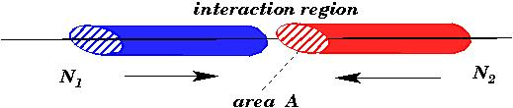
Luminosity
Nearly all the parameters are variable (and not independent)
Number of bunches per beam k_{b}
Number of particles per bunch Ν
Normalised emittance ε_{n}
Relativistic factor (E/m₀) γ
Beta function at the IP β *
Crossing angle factor F
Full crossing angle θ_{c}
Bunch length σ_{z}
Transverse beam size at the IP σ*
Total Intensity
Beam Brightness
Energy
Interaction Region
θ_{c}
Presently F ≈ 0.8

Slide 13
Comparison with nominal & pile-up
pile-up ≈ number of events per bunch crossing
ie µ = Nσ
Tracker also sees particles looping in B field
For same L, 2x bunch spacing -> 2x pile-up
CMS designed for 14 TeV, L = 10³⁴ cm⁻²s⁻¹ and 25 ns
Parameter | 2010 | 2011 | 2012 | Nominal
N ( 10¹¹ p/bunch) | 1.2 | 1.5 | 1.6 | 1.15
k (no. bunches) | 368 | 1380 | 1380 | 2808
Bunch spacing (ns) | 150 | 75 / 50 | 50 | 25
ε_{n} (µm rad) | 2.4-4 | 1.9-2.4 | 2.2-2.5 | 3.75
β* (m) | 3.5 | 1.5 → 1 | 0.6 | 0.55
L (cm⁻²s⁻¹) | 2×10³² | 4.0×10³³ | 7.6×10³³ | 10³⁴
μ | 3 | 19 | 35 | 23
13

Slide 14
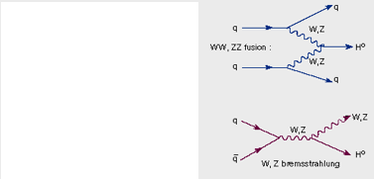
Examples of physics impact
Tracker degradation gives overall loss of data/quality
and, e.g., significant losses of b quark jets
Potential losses at trigger level
WH associated production
trigger on W (single e/µ) to measure H properties without bias
p_{T} thresholds will rise significantly before LS2 (next slide)
For Higgs couplings measurements
may only be possible using VBF production topology
trigger on correlations between jets, especially forward jets
pile-up is extreme.

Slide 15
Sample trigger menu from current L1 trigger
Algorithm | 8 TeV 7E33 ~25 PU |  | 14 TeV 2E34 50 PU
 | Thresh (GeV) | Rate (kHz) | Thresh (GeV) | Rate (kHz)
Single EG | 22 | 10 | 46 | 10
Single IsoEG | 18 | 9 | 31 | 9
DoubleEG | 13, 7 | 9 | 22, 12 | 9
Single Muon | 16 | 9 | 50 | 9
Dble Muon | 10, open | 5 | 35, open | 5
EG+Mu | 12, 3.5 | 3 | 21, 6 | 3
Mu+EG | 12, 7 | 2 | 25, 15 | 2
SingleJet | 128 | 2 | 188 | 2
DoubleJet | 56 | 10 | 132 | 10
QuadJet | 36 | 2 | 96 | 10
Double Tau | 44 | 2 | 56 | 2
MET | 36 | 7 | 84 | 7
HTT | 150 | 2 | 511 | 2
Example 14 TeV trigger menu
Using current bandwidth allocation
Based on MC - still needs to be fully validated & finalised
Single lepton thresholds are very high
Combined rate of current single lepton triggers only
~ 140 kHz at 14 TeV 2E34
Cannot maintain current thresholds with current L1 trigger at 14 TeV 2E34
Multi-jet trigger thresholds affected by both √s and PU

Slide 16
IMPACT on cms

Slide 17
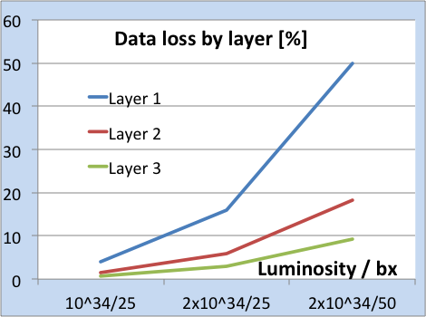
Tracking at high pileup
Tracking efficiency is reduced – affects everything
Fake track rates are increased
Primary vertices merge
Resolution worsens, due to wrong hits
Increased CPU and memory use
Inner pixel layers: dynamic data loss affects track seeding

Slide 18
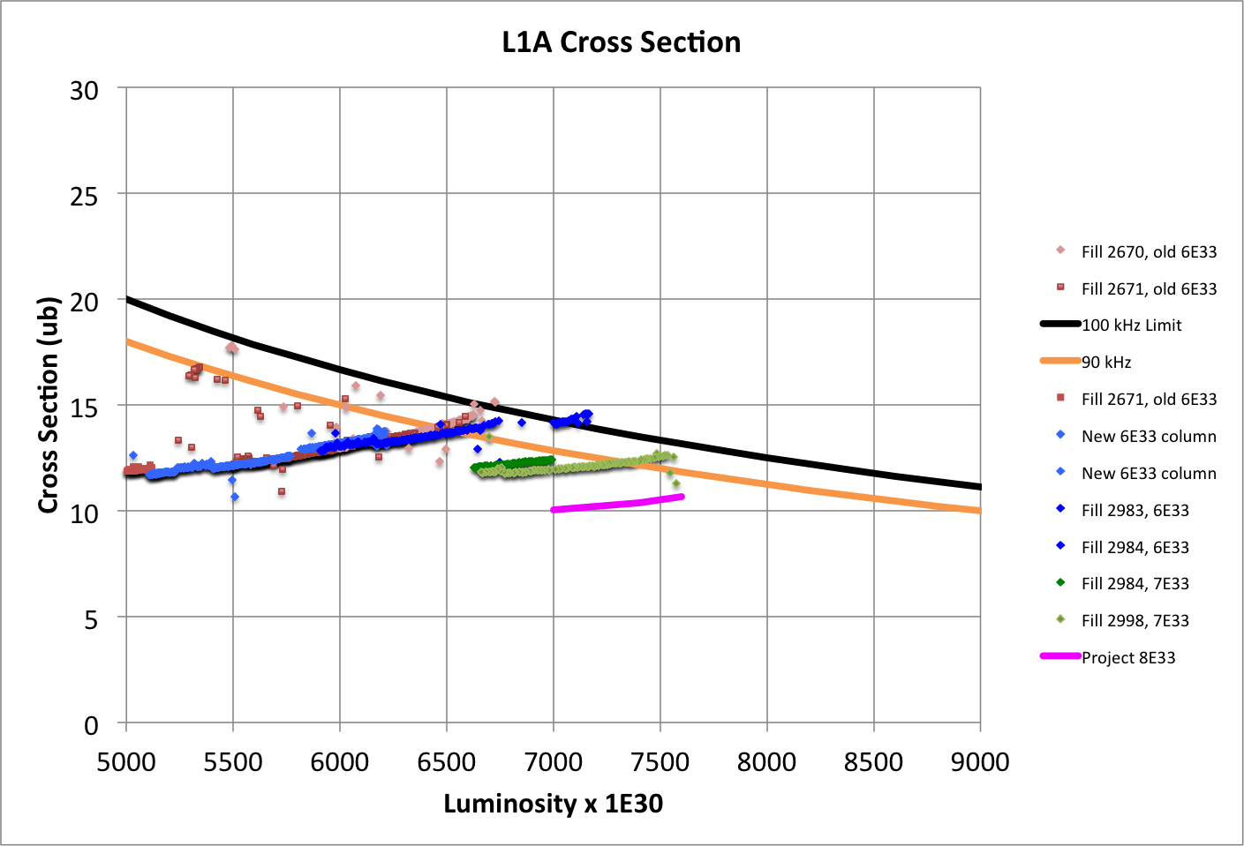
L1 Total Cross Section vs. Luminosity (Limits of Prescale Columns)
“6E33” column to
6.7E33
“7E33” column to 7.7E33
100 kHz^{(*)}
“8E33” column to ~8.4E33
90 kHz
(*) Deadtime limits to 90 kHz

Slide 19
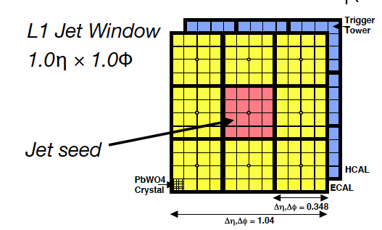
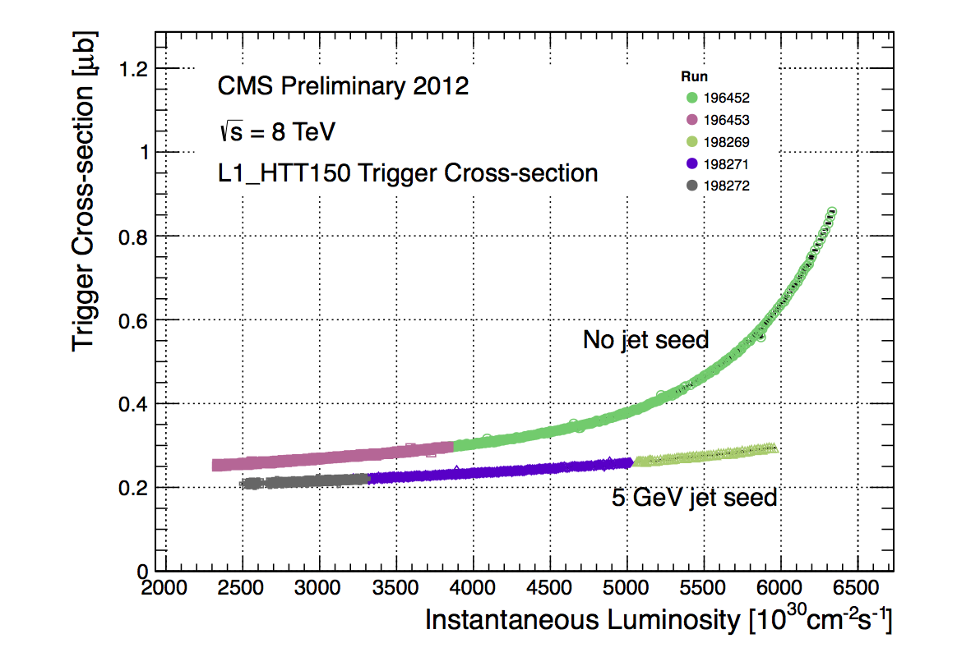
Improved Pile-up Handling in L1 Jets
Increased jet seed threshold to 5 GeV in Global Calorimeter Trigger since June Technical Stop
Significantly reduces exponential rise in xsec
GCT team

Slide 20
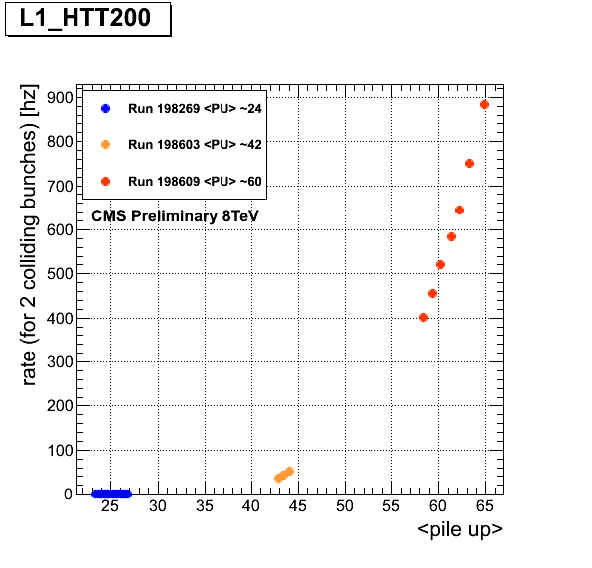
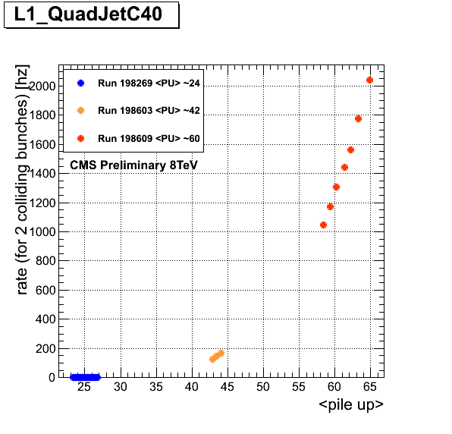
But… Problem is only Postponed…
Blow-up seen to return at higher pile-up (special fills)
Can further increase the seed threshold and jet threshold in HT
But better yet is an upgraded L1 trigger !
0.5 MHz @ 50 ns !
C.Battilana
Lumi @ 50ns: 1E34 1.4E34

Slide 21
UK R&D since 2009

Slide 22
UK CMS upgrade R&D achievements
WP1 – software and simulations
IPbus (µTCA control) (10/11) adopted as common CMS-wide standard (02/12)
simulation studies for trigger and tracker upgrades in TDRs (09/12)
WP2 – Outer microstrip tracker readout
CBC 128 channel ASIC (03/11) developed in single design iteration & evaluated
CBC2 256 channel ASIC submitted (07/12), with trigger data, due (10/12)
DAQ & FED studies, with CBC module beam tests (09/11)
WP3 – L1 calorimeter trigger system
Mini-T5 (02/10) & MP7 (07/12) processor boards delivered and working
CMS review recommended UK hardware for future baseline (12/11)
original new trigger architecture proposed (02/11) and demonstrated (03/12)
WP4 – pixel DAQ
Long experience in Tracker DAQ and DQM
UK proposal to design and deliver new pixel FED accepted (11/11)
modified trigger hardware, IPbus and pixel ROC test beam experience (7/12)

Slide 23
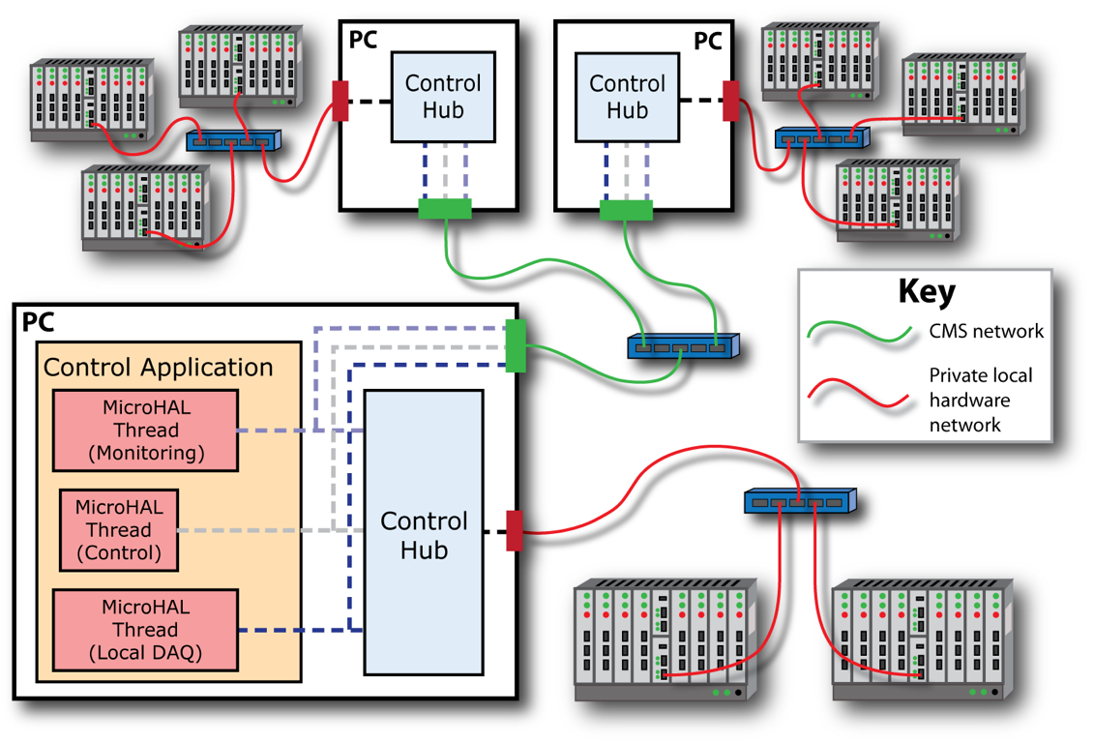
Online Control System
IPbus: scalable, hierarchical software/firmware system

Slide 24
Track reconstruction code optimisation
Example of ongoing efforts to improve high pile-up performance
also relevant to current operation
New search method to reduce time spent in the two [pixel] triplet seed generators based on k-D trees
Using k-D tree code in both generators gives significant decrease in CPU time
negligible reduction in tracking efficiency
 | Standard | Large Tip k-D tree | LargeTip and HLT k-D tree
LargeTIPGenerator | 3.94% (28s) | 0.83% (6s) | 0.84% (6s)
HLTGenerator | 1.37% (10s) | 1.38% (10s) | 0.74% (5s)
CombinedHitGenerator | 5.31% (38s) | 2.20% (16s) | 1.58% (11s)

Slide 25
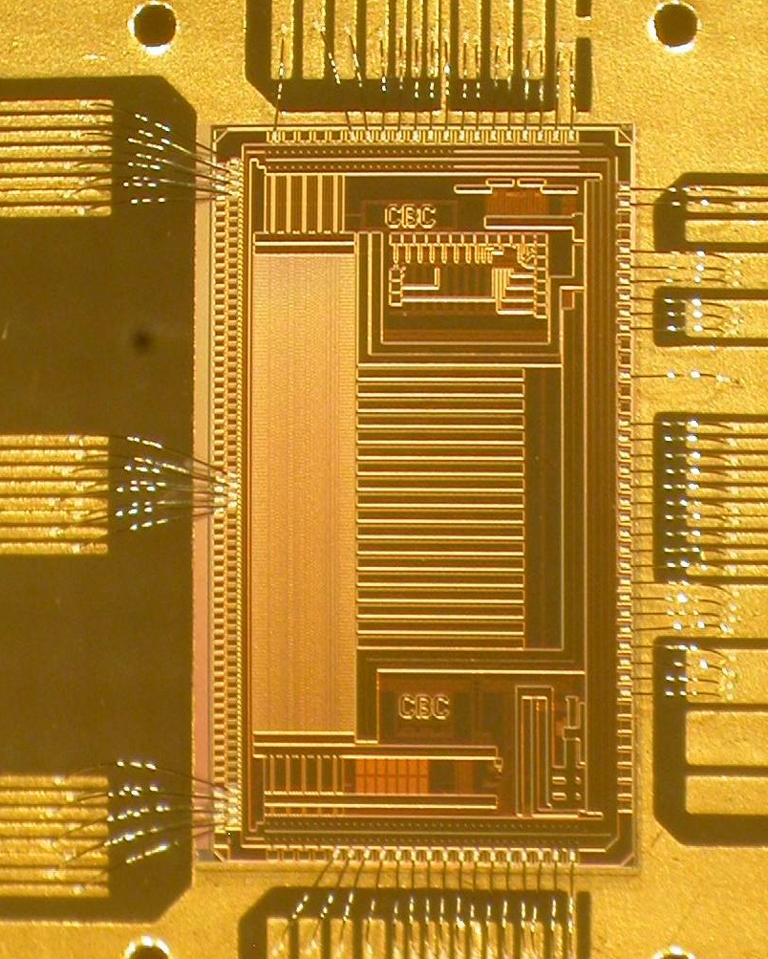
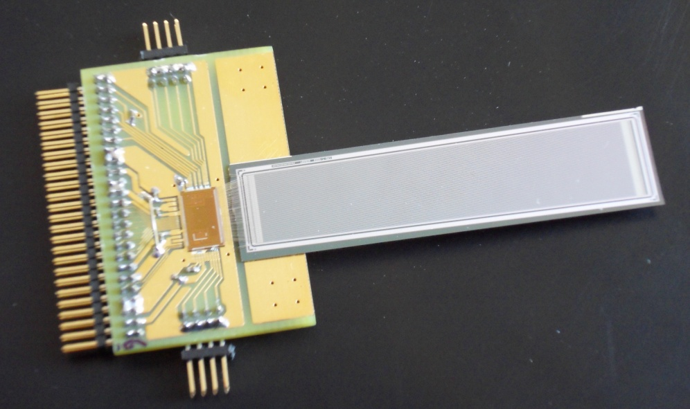
WP2: Phase II Outer Tracker readout
beam profile
CMS Binary Chip: 130nm CMOS
128 channel binary ASIC, non-zero suppressed
Amplifier, pipeline, memory, logic, control
many new features, excellent performance
tested in beam with 5cm µstrips
APV plane
CBC sensor
5 mV / division
p-on-n
150 mm pitch
320 µm thick
5 cm

Slide 26
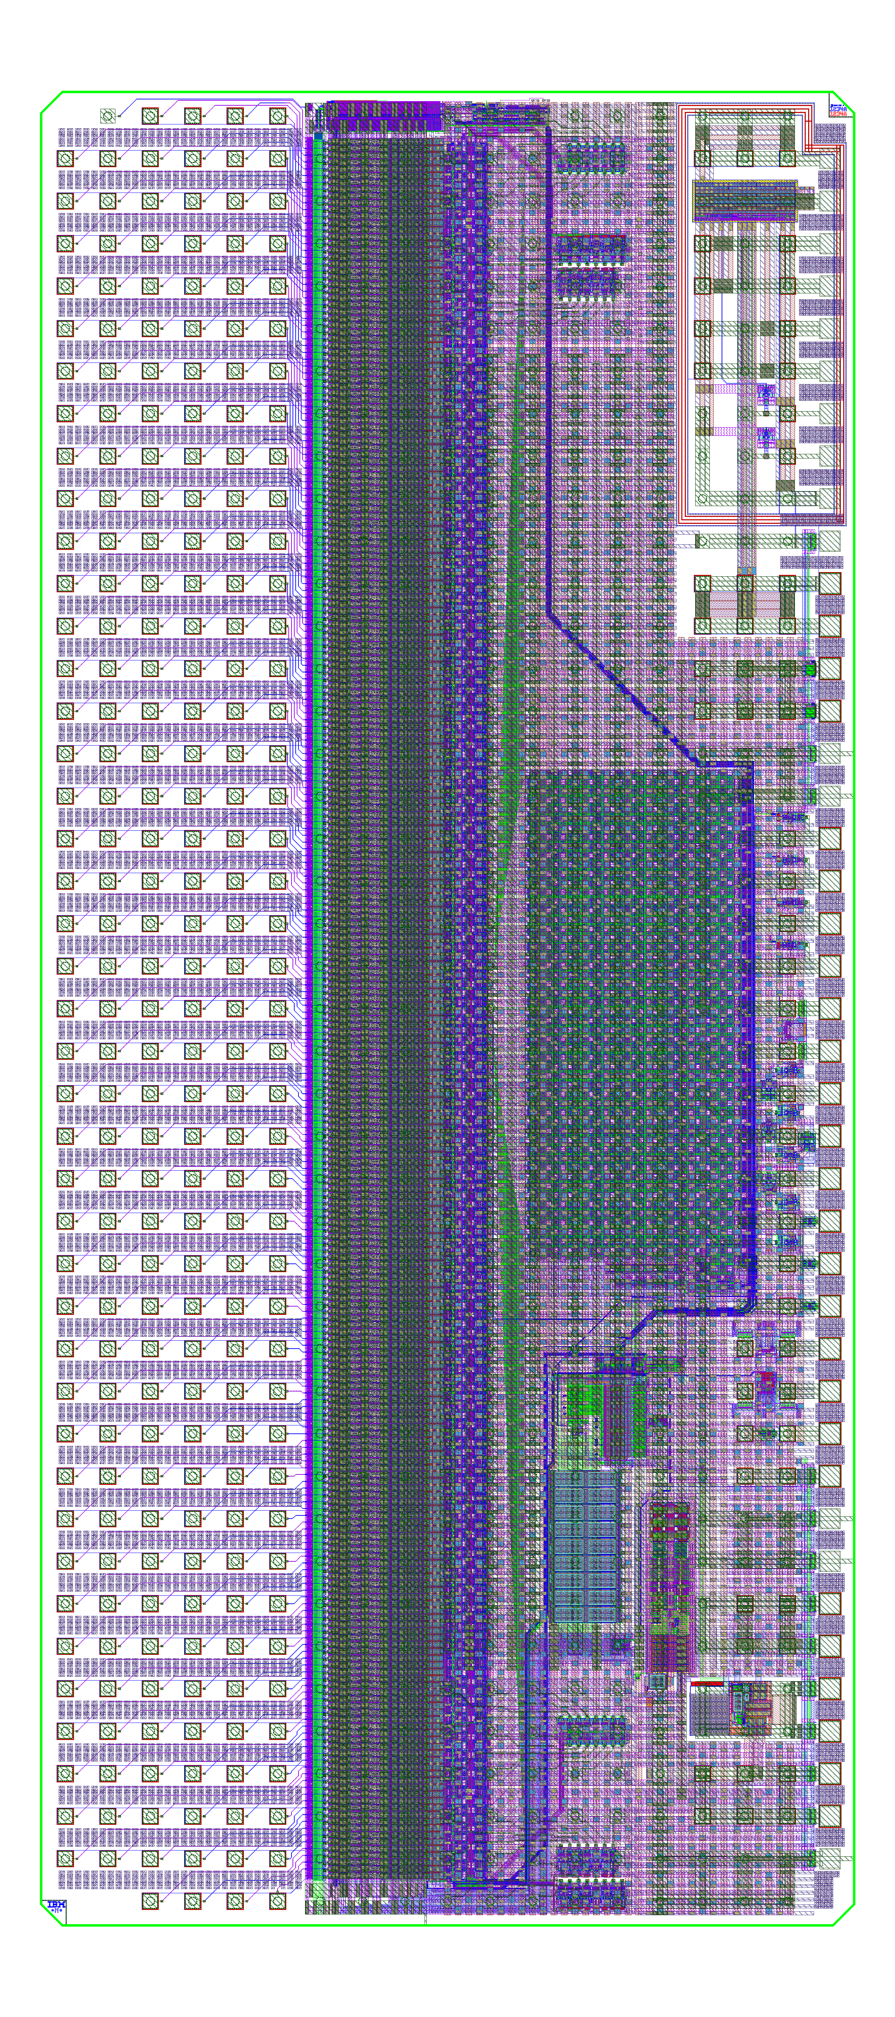
CBC2 design
250 µm pitch C4 layout
back edge wire-bond pads for wafer probe
254 channels
allows correlation between 127 top & 127 bottom strips
architecture based on CBC prototype
front end, pipeline, readout architecture, powering features, …..
submitted July 2012
wafers expected ~ October
tested, functional CBC2 is final deliverable of current Upgrade programme
11 mm
5 mm

Slide 27
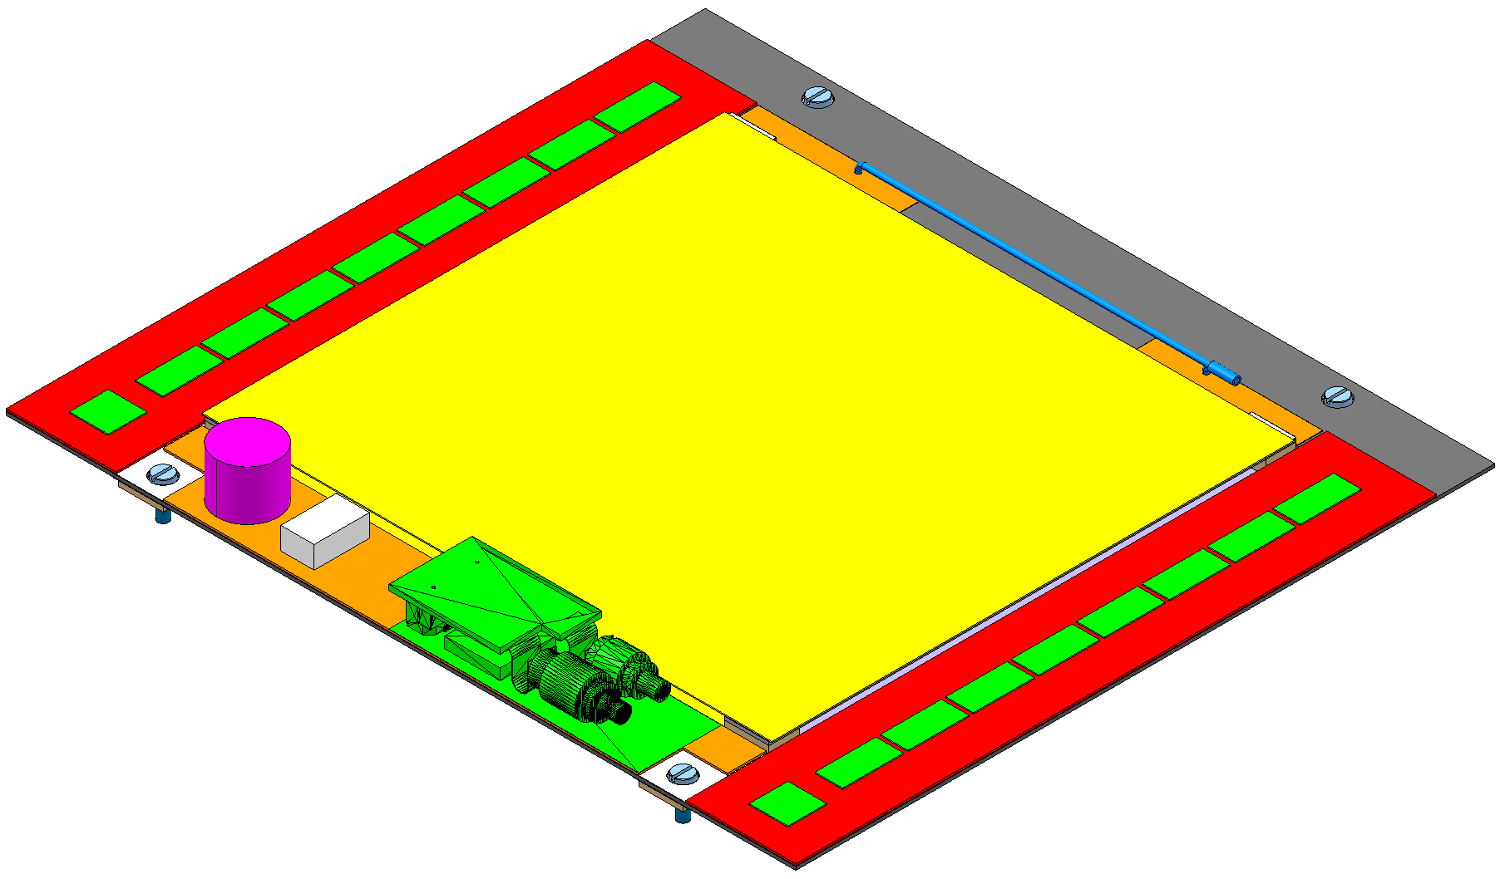
2S PT-module with CBC2
Track & trigger module under development with CERN, Lyon, ..
CBC2 logic correlates hits on two sensors to reject those from low p_{T} tracks
many issues to construct such a module
two layers of sensors
chips on top surface only
signals from lower sensor
via’d through substrate
8 x 254 channel chips
bump-bonded to hybrid
concentrator
&
controller
~5 cm
~5 cm
90 µm pitch strips
sensors wire-bonded
above and below
8 x 254 channel chips
bump-bonded to hybrid
27

Slide 28
WP3: calorimeter trigger
Brand new architecture proposed (but hardware is agnostic)
possible because of technology progress (FPGAs & links)
TMT = boundary-less calorimeter processing
decision postponed but concern about trigger after LS1 growing
actions to install complete new optics advancing
Demonstrator using mini-T5 (Virtex-5 FPGA)
emulates ¼ of present CMS calorimeter trigger
TMT versions of present algorithms (much faster)
HL-LHC algorithms already in firmware
latency (potential concern) measured
MP7: final board delivered August 2012 (Virtex 7 FPGA)
already producing impressive results in very early tests

Slide 29
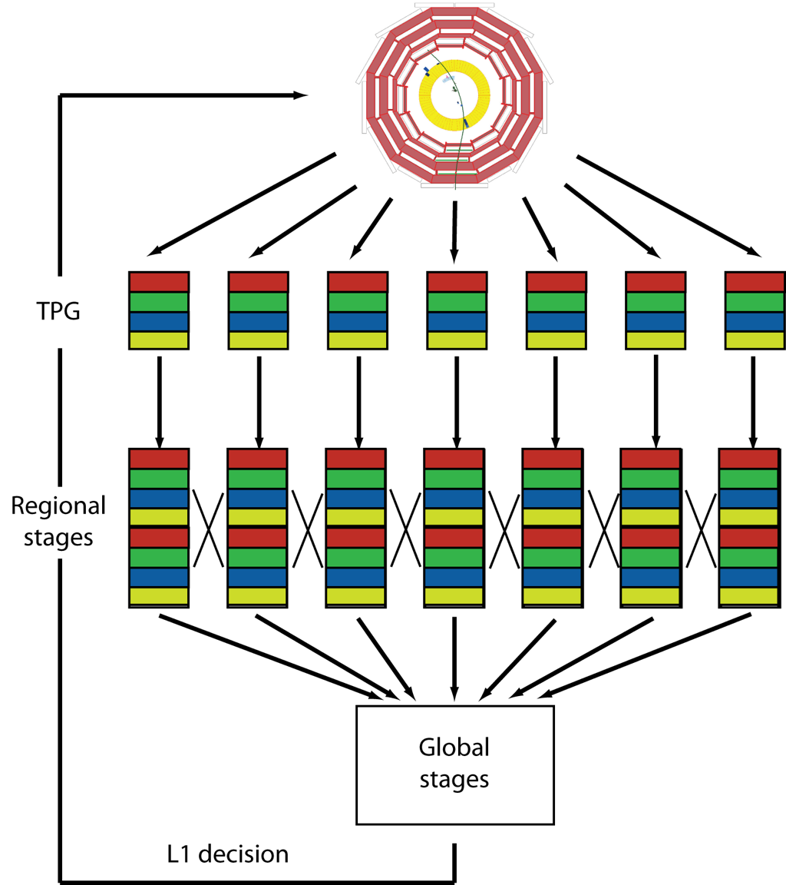
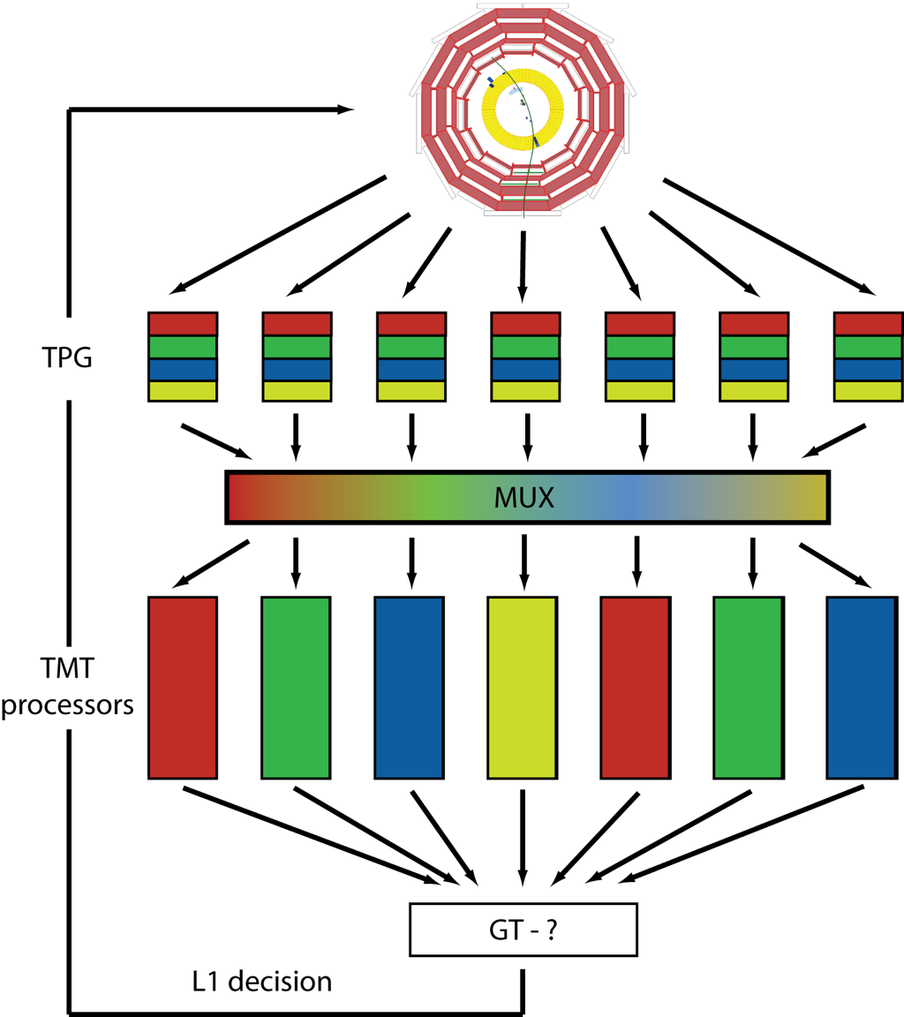
Trigger Architecture
Options: Conventional Trigger vs Time Multiplexed Trigger
TMT: all calorimeter data to single processor
Allows more flexibility in trigger design & avoids boundaries and data sharing
CT
TMT

Slide 30
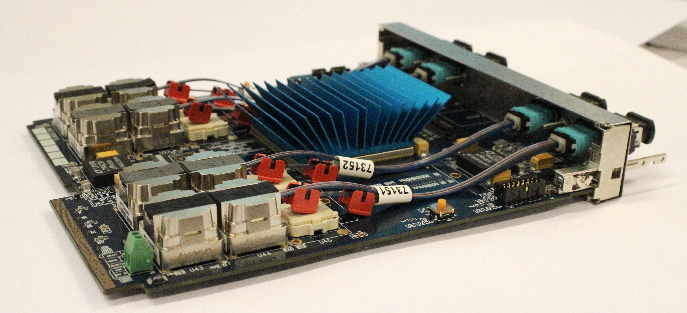
MP7 Prototype Preliminary Results
1Tb/s - All 96 optical links operating at 10Gb/s simultaneously
x4 bandwidth of any previous card in CMS
1.0 - 1.4 Tb/s of optical I/O (Tracker FED ~ 25 Gbps)
(TWEPP 2012 suggests this board is well in advance of anything else…)
All peripherals operating (RAM, CPLD, MMC, etc)
Cooling will be improved
verify contributions to power consumption when diagnostics available

Slide 31
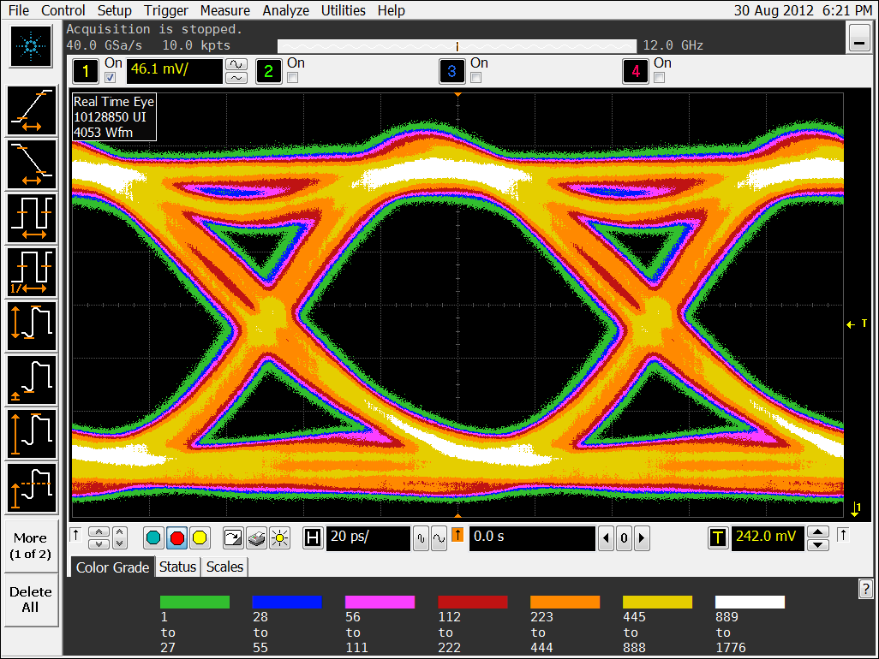
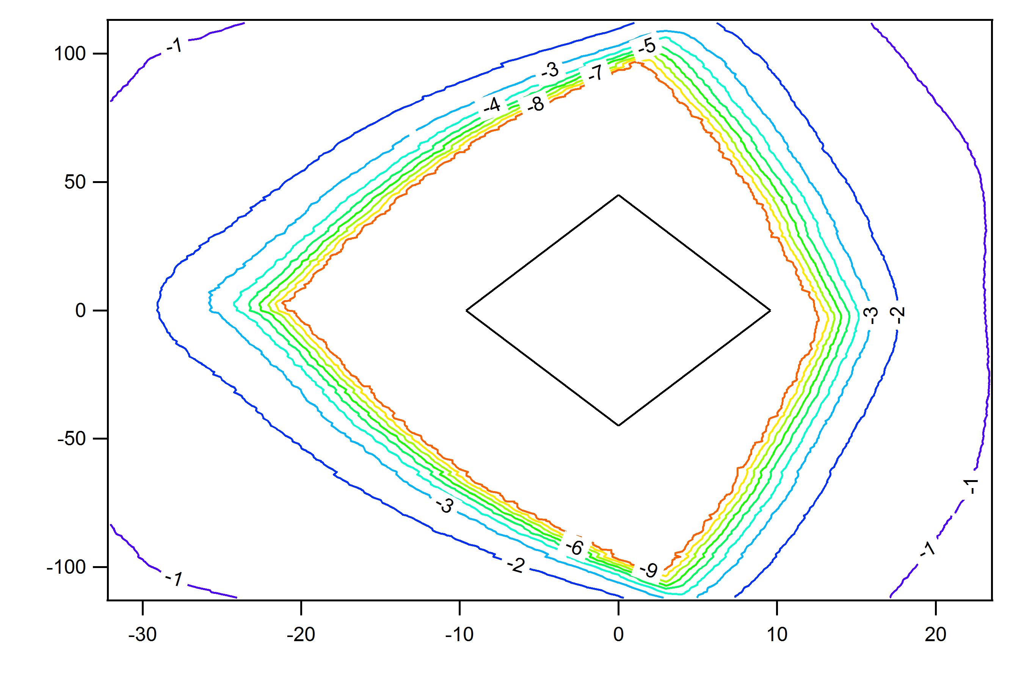
MP7 - Preliminary results
Clean optical eye (left) and electrical received eye (right).
pre-emphasis in the optical receiver, should improve the eye even more.
PCB manufacturing improvements are possible should we need them.

Slide 32
Demonstrator
ECAL & HCAL Trigger Primitive Data would enter here
MINI-T5 (6x PreProcessors)
PP0
PP1
PP2
PP3
PP4
PP5
PP0
PP0
x 24 Pre-Processors
1/4 CMS at 24 bit/tower resolution for every 6th BX
Patch Panel
MINI-T5
(Main Processor)
MINI-T5
(Main Processor)
x 2 Main-Processors
MINI-T5
(Global Trigger)
MCH
Standard Services
AMC13
Custom Services

Slide 33
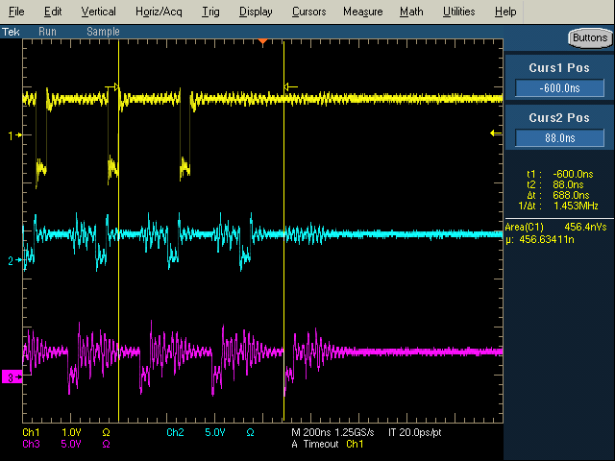
Latency – Time-Multiplexed CMS GCT
PP algo
PP GTX
MP GTX
MP Align
MP Algo
MP GTX
GT GTX
GT Align
Total latency is:
1 Link latency (PP to MP) | 6.5 BX | 161.6ns
1 Algorithm latency | 3.7 BX | 92.8ns
1 Link latency (MP to GT )† | 7.5 BX | 182.4ns
1 Time-Mux period | 10 BX | 250 ns
Total | 27.7 BX | 686.8 ns
PP output valid flag
MP output valid flag
Look at that – the maths works, phew! ☺
GT input valid flag
†Making allowances here for the firmware bug

Slide 34
WP4: pixel DAQ
Pixel detector will be replaced at end of 2016
improved performance for high pile-up environment
TDR released with UK proposal for pixel FED & DAQ responsibility
subject to PPRP approval
builds on UK expertise in Tracker DAQ and R&D to date from all existing WPs, with sharing by all UK groups
WP1: IPbus & simulations
WP2: SFED development
WP3: mini-T5/MP7 hardware & firmware
Very positive response from CMS
UK is highly regarded, and we gain expertise in strategic area
strengthens pixel project & matches long term µTCA adoption (we are “experts”)

Slide 35
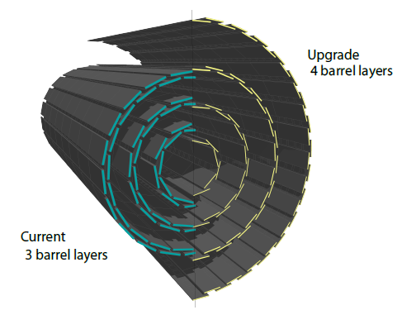
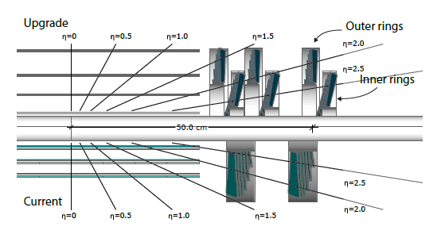
Phase I pixel upgrade
Replacement is a lower mass detector with 4 barrel layers and 3 endcap disks per side
less material & better layout means less conversions & interactions
better IP resolution and b-tagging efficiency
improved seeding efficiency & lower fake rates from extra tracking layer
4th layer provides better track projection to the strip tracker
higher readout efficiency and less deadtime with new ROC and digital readout chain

Slide 36
Phase I pixel upgrade
Dots – Upgrade
Green – Current
100 PU
Radiation length vs. Eta
substantially reduced detector mass, despite twice number of channels
CO₂ cooling, improved mechanics, optimised layout of services
b-jet efficiency improvement of 30%, for a 1% fake rate at 100 PU

Slide 37
New ROC and readout chain
New ROC and readout scheme required for efficient operation up to 100 PU
estimated ~50% data loss at 100 PU (50 ns bunch spacing, 2x10³⁴ cm⁻²s⁻¹ at r = 3.9cm)
requirement is for < 3% data loss at new 2.9cm reduced radius
160 Mbps digital readout at ROC
data on a module multiplexed and encoded onto twisted fibre with new TBM
token in
160 Mbps data
TBM
OH
optical link to FED
ROC
400 Mbps 4b/5b encoded data
token out
new optical hybrids for high speed digital transmission at 400 Mbps
- increased buffer sizes and improved hit buffering architecture in ROC
- 8 bit ADC to digitise pulse height information within ROC
module
service cylinder

Slide 38
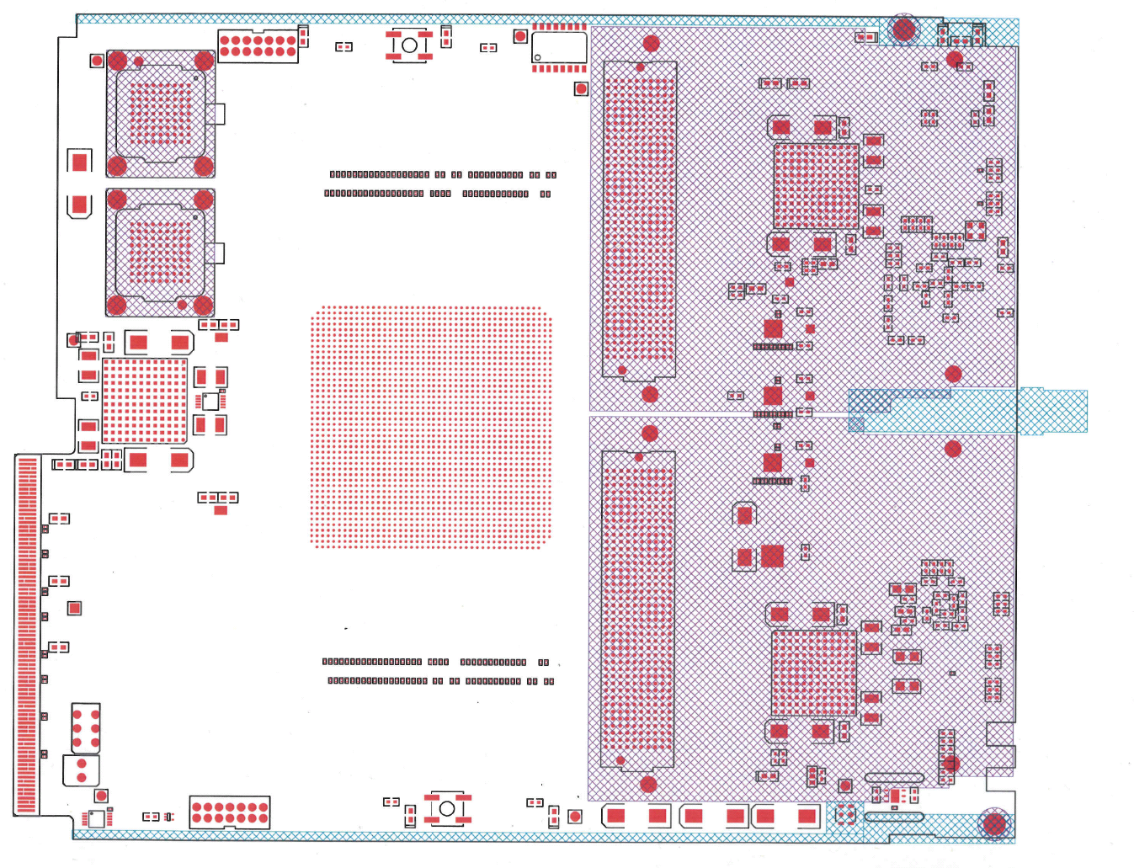
Phase I pixel FED
New DAQ required
new digital optical links
more channels so higher data throughput
FED prototype based on MP7
mezzanine cards for prototyping and maximum flexibility
reusing MP7 design mitigates risk and benefits from firmware & software investment
FMC1
FMC2

Slide 39
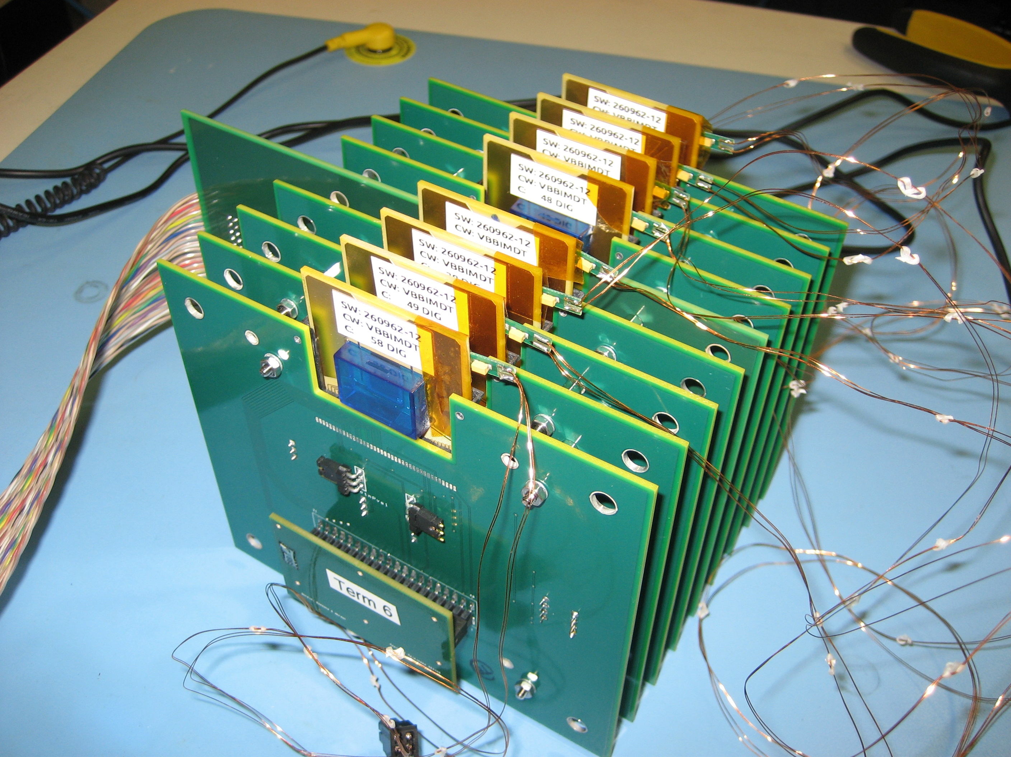
Pixel beam telescope
Modular system
Variable number of ROCs
Variable readout system
Standard ROC carriers
Easy to replace ROCs
Successfully used in beam test in July 2012

Slide 40
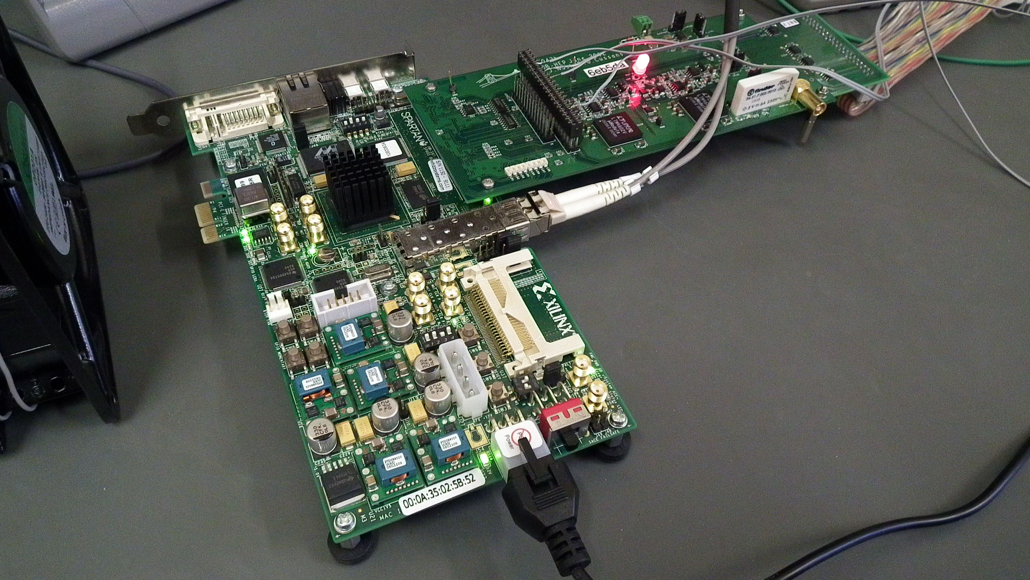
Pixel DAQ board
First FED firmware test bed
Xilinx evaluation board with custom adapter
First application
high rate test beam in October

Slide 41
PPRP proposal: Work Programme
Builds and continues R&D progress to date
detailed plans based on (best knowledge of) CMS schedule
WP2: prepare for construction of Phase II tracker
WP3: construct new calorimeter trigger
WP4: deliver pixel FEDs and implement new DAQ

Slide 42
WP2 objectives: next ~ 6 years
complete CBC development for SS-pT module
bring chip to final state ready for mass production
develop hardware & software for mass production test
extensive experience from LHC production
major role in definition, construction and evaluation of prototype modules
in collaboration with groups responsible for other module components
contribute to ancillary chips development and PS-pT (strixel layer) module
contribute to tracker construction
procurements, integration and commissioning
Geoff Hall
CMS UK OSC Mar 2012
42

Slide 43
WP3 deliverables
No | Month | Deliverable
M3.1 | 9 | Updated algorithms and software for current L1 calo trigger
M3.2 | 15 | CMS L1 Calo trigger ready for post-LS1 running
M3.3 | 24 | Design studies for > 2x 10³⁴ cm⁻²s⁻¹ trigger ready; architectural choices made by CMS; sign-off point on > 2x 10³⁴ cm⁻²s⁻¹hardware production
M3.4 | 40 | Hardware systems ready for > 2x 10³⁴ cm⁻²s⁻¹ trigger
M3.5 | 48 | > 2x 10³⁴ cm⁻²s⁻¹ trigger in operation
M3.6 | 60 | Technical design of post-LS3 trigger complete; sign-off point on LS3 prototype production
M3.7 | 72 | Delivery of track trigger prototype
Geoff Hall
CMS UK OSC Mar 2012
43

Slide 44
WP4 deliverables
No | Month | Deliverable
M4.1 | 6 | prototype FMC-FED hardware available
M4.2 | 18 | standalone prototype FED, multi ROC readout
M4.3 | 18 | standalone prototype FEC, multi-module control
M4.4 | 24 | demonstrator FED & FEC with readout & control of pilot blades
M4.5 | 24 | demonstrator fast link integrated with central DAQ hardware
M4.6 | 33 | final FED hardware ready for production
M4.7 | 39 | final firmware & software for full system ready for deployment
M4.8 | 45 | delivery of full Pixel DAQ
Geoff Hall
CMS UK OSC Mar 2012
44

Slide 45
Summary
Very good progress continues in all WPs
6 year plan now incorporated in PPRP bid, which is under review
CMS and LHC upgrade planning
pixel TDR released, Trigger TDR ~March 2013
Finances
spending increased: commitments on MP7 & CBC2
Working Margin now £120k and will reduce in remaining 6 months
Need more MP7s for new demonstrator
Reserve in case of CBC2 problems
SSC reporting changed again: no PPD staff costs visible
Travel now handled by universities
Not yet finished the R&D but the UK investment has been timely, immensely helpful and put us in a strong position for the future.
Thanks!

Slide 46
Further information

Slide 48
Long Shutdown 1
End March 2013 – November 2014
Consolidation for 6.5 – 7.0 TeV operation
Measure all splices and repair defective ones
Repair of magnet interconnects after 2008 event with new design (clamp, shunt)
Finish installation of pressure release valves
Exchange of weak cryo-magnets and DFBAs
Relocation of equipment to reduce radiation effects on electronics
Installation of collimators with integration beam position measurement, injection absorbers refurbishment
Injection kickers reduction of heating
Experiments consolidation and upgrades
Plus a lot of other work ongoing
Cryogenics, Quench Protection, electrical infrastructure, cooling & ventilation, Radio Frequency, beam dump absorber & magnet, change of dump switches (radiation), electron cloud mitigations …
48

Slide 49
Potential Performance after LS1
Determined by the performance of the injector chain
Different collimator scenarios, not detailed here
LHC Injector Upgrade (LIU) fruits after LS2
 | Number of bunches | β* [m] | Half X-angle [μrad] | Ib SPS | Emit SPS [um] | Peak Lumi [cm-²s⁻¹] | ~Pile-up | Int. Lumi [fb⁻¹]
25 ns | 2800 | 0.50 | 190 | 1.2e11 | 2.8 | 1.1e34 | 23 | ~30
50 ns | 1380 | 0.40 | 140 | 1.7e11 | 2.1 | 1.8e34 β* level | 81 β* level | ?
25 ns low emit | 2600 | 0.40 | 150 | 1.15e11 | 1.4 | 2.0e34 | 48 | 52
50 ns low emit | 1200 | 0.40 | 120 | 1.71e11 | 1.5 | 2.2e34 | 113 | ?
Presently at 4 TeV, β* = 0.6 m, half X-angle 145 μrad

Slide 50
Latency – Time-Multiplexed CMS GCT
Original GCT timing specification
BX 0 |  |  |  |  |  |  |  |  |  | BX 10 |  |  |  |  |  |  |  |  |  | BX 20 |  |  |  |  |  |  |  |  |  | BX 30
Source card |  | Source to Leaf card link |  |  |  | Leaf card deserialization |  |  |  | Jet Finder Algorithm |  |  |  |  |  |  |  |  |  |  | Wheel card |  |  | Concentrator card |  |  |  | Concentrator to GT link |  |  | GT deserialization
TMT GCT timing using Mini-Ts
BX 0 |  |  |  |  |  |  |  |  |  | BX 10 |  |  |  |  |  |  |  |  |  | BX 20 |  |  |  |  |  |  |  |  |  | BX 30
 |  | PP to MP link, deserialization and alignment |  |  |  |  |  | Jet Finding (1-3) |  |  |  | Sort 1D |  | MP to GT link, deserialization and alignment
 |  |  | PP to MP link, deserialization and alignment |  |  |  |  |  | Jet Finding (4-6) |  |  |  | Sort 1D |  | MP to GT link, deserialization and alignment
 |  |  |  | PP to MP link, deserialization and alignment |  |  |  |  |  | Jet Finding (7-9) |  |  |  | Sort 1D |  | MP to GT link, deserialization and alignment |  |  |  |  |  | Sort in other direction (if necessary)
 |  | Time Muliplexing |  |  | PP to MP link, deserialization and alignment |  |  |  |  |  | Jet Finding (10-12) |  |  |  | Sort 1D |  | MP to GT link, deserialization and alignment
 |  |  |  |  |  | PP to MP link, deserialization and alignment |  |  |  |  |  | Jet Finding (13-15) |  |  |  | Sort 1D |  | MP to GT link, deserialization and alignment
 |  |  |  |  |  |  | PP to MP link, deserialization and alignment |  |  |  |  |  | Jet Finding (16-18) |  |  |  | Sort 1D |  | MP to GT link, deserialization and alignment
Data flow through one Main Processor
Using the 6 data frames needed instead of the 10 used in the demonstrator system
Fixing the GT deserialization bug
Adding the 1D sort
TMT latency, 23 BX

Slide 51
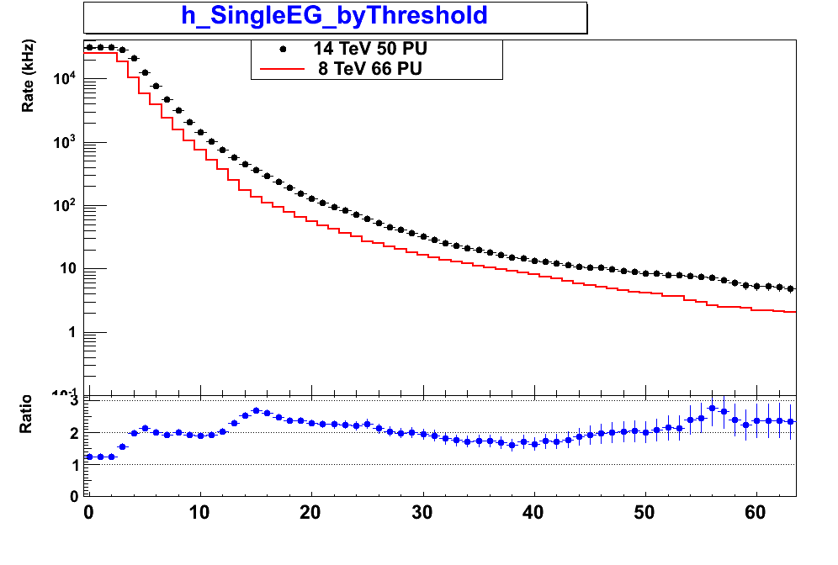
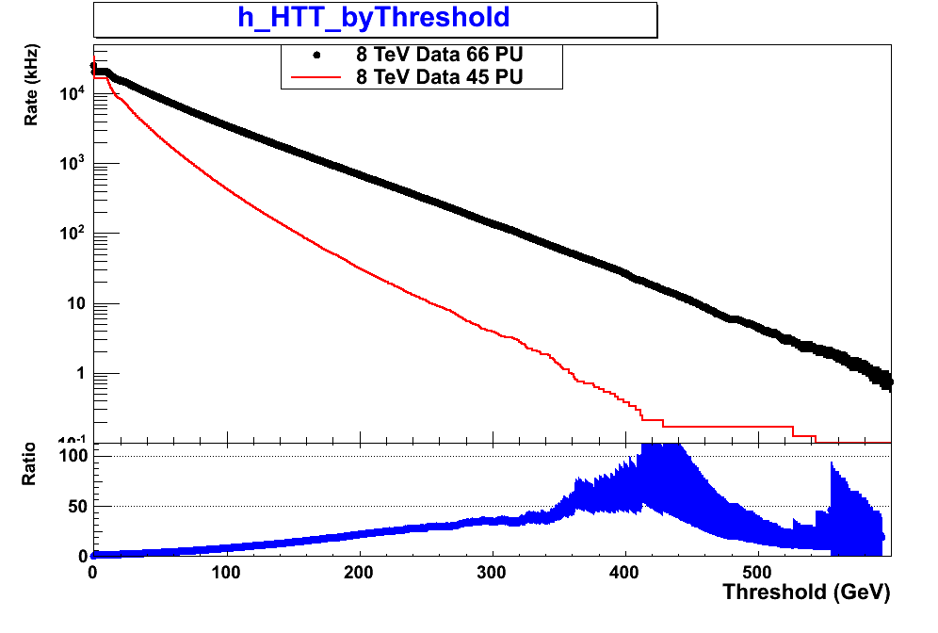
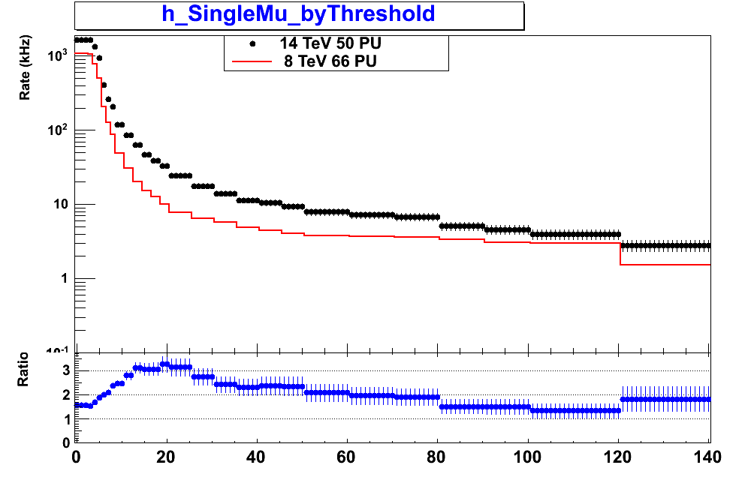
Sample trigger rates from current L1 trigger
Rates shown for Linst=2×10³⁴cm⁻²s⁻¹
Single e/γ trigger
Black - 14 TeV MC (50 PU)
Red - 8 TeV data (66 PU)
HT (ET sum of jets)
Black - 8 TeV data (66 PU)
Red - 8 TeV data (45 PU)
Single muon trigger
Black - 14 TeV MC (50 PU)
Red - 8 TeV data (66 PU)
Jet trigger rates strongly dependent on PU
Poor control of lepton rates at high thresholds due to poor pT resolution

Slide 52
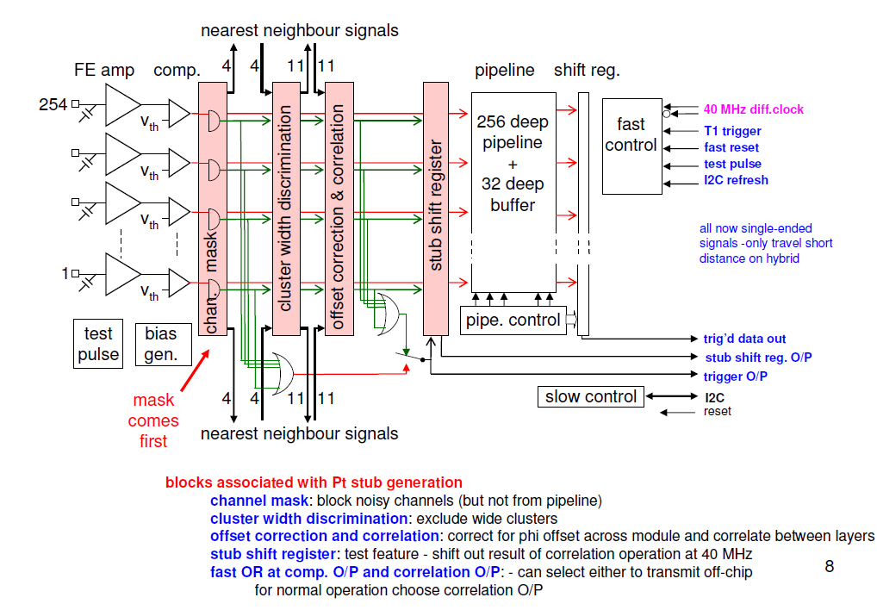
CBC Architecture
Notes:
Could use fastOR and an external Read for readout of coincidence data:
Always @(fastOR posedge)
if (Read==0) write data;
else;
Always @(read posedge) readout data;
Always @(read negedge) reset data;

Slide 53
simplified WP2 Gannt
CBC2
available
here
2013
2014
2015
2016
2017
CBC3 design & production
CBC4 design & production
CBC4 full wafer masks and engineering run
CBC2 test
CBC3 test
CBC4 test
CBC2-based module studies
CBC3-based module studies
CBC3 should be very close to final chip - available late 2014
includes architecture for formation and high speed transmission of stub information
CBC4 pre-production iteration (2015/16) allows final bug fixes before full-wafer engineering run in 2017
Geoff Hall
CMS UK OSC Mar 2012
53

