Slide 1
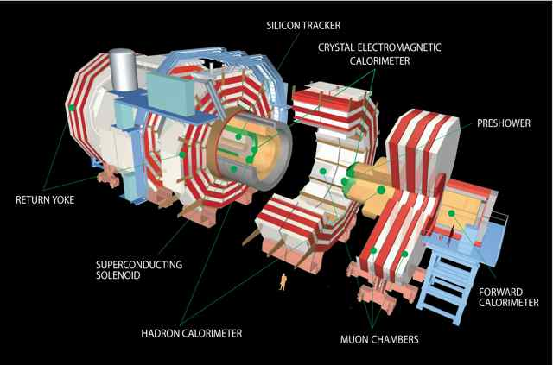
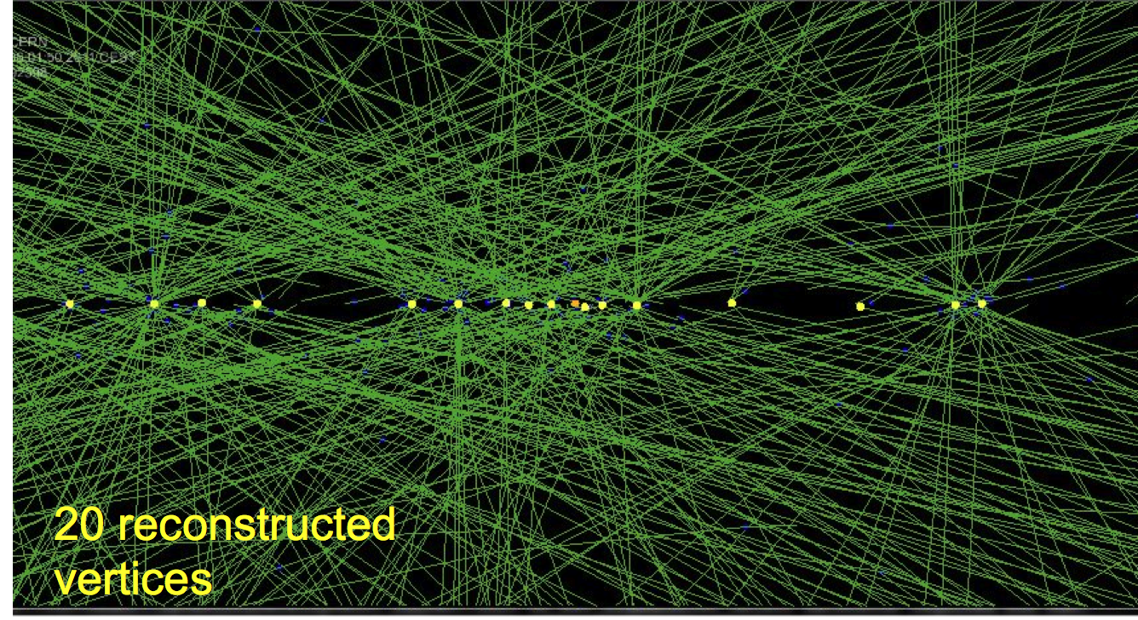
UK CMS Upgrade Oversight Committee
Geoff Hall
5 October 2011
University of Bristol
Brunel University
Imperial College London
Rutherford Appleton Laboratory

Slide 2
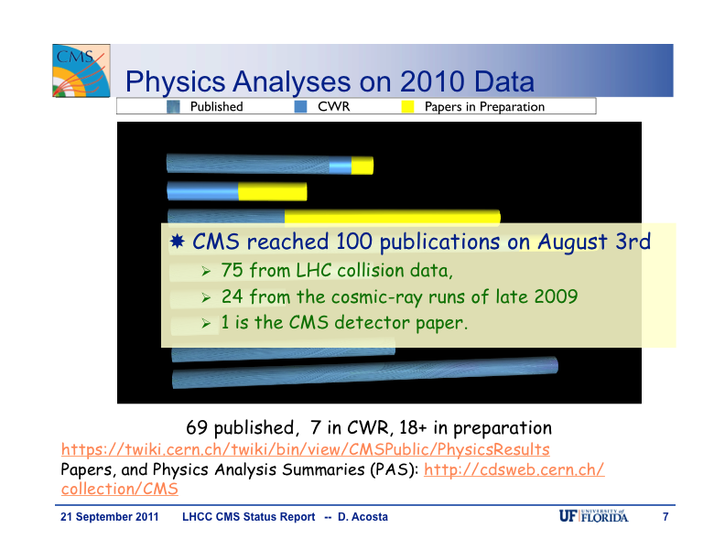
Overview
CMS status
LHC status and future plans
UK R&D progress report
Finances
Future
CMS plans
UK CMS plans
Issues

Slide 3
CMS status
2011 has progressed very well indeed
conservative LHC performance assumptions have proved to be so
LHC (recent summaries at EPS and Sept LHCC)
instantaneous luminosity records continue to be broken
takes time to recover from MDs but performance is excellent
5 fb⁻¹ very likely by end of p-p running
Physics
steady, high output of publications
Detector
efficient operation, with no significant problems

Slide 4
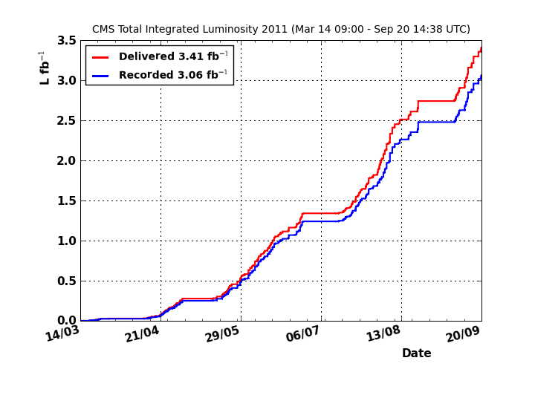
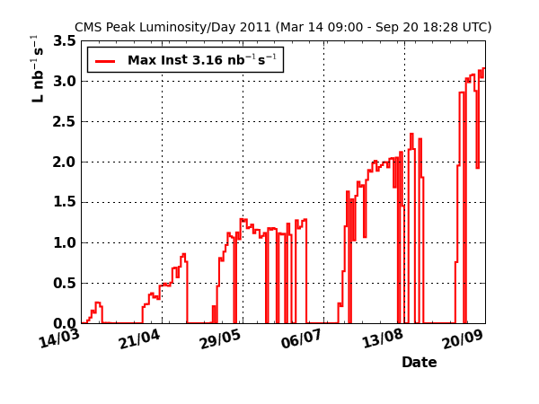
LHC operation
CMS perspective
Prompt recovery from the last Technical Stop. β*=1m commissioned.
New record inst. Luminosity 3.29x10³³ [cm⁻²s⁻¹]. New records in integrated luminosity delivered in a single fill (117.4pb⁻¹ ); recorded by CMS (113.4pb⁻¹) 96.5% efficiency.
3.41fb⁻¹ delivered by LHC and 3.06fb⁻¹⁾ recorded by CMS (90% eficiency).
707pb⁻¹ delivered in 13 days (54pb⁻¹/day and 37 days to go).
By maintaining or increasing this pace it seems possible to reach or exceed 5fb⁻¹ by the end of October.

Slide 5
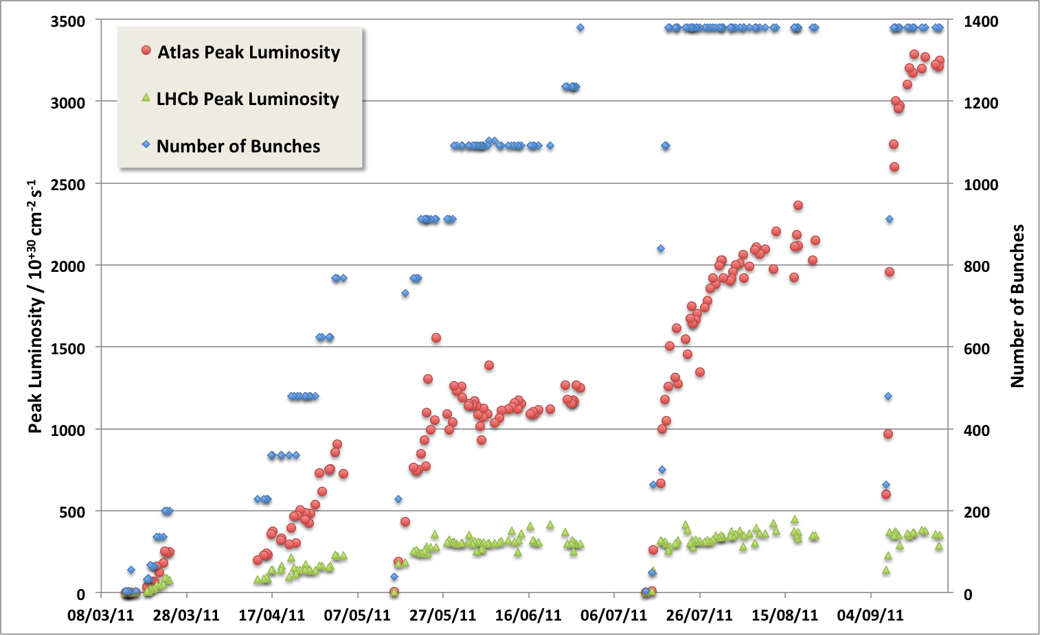
LHC Status : 2011 – so far …
Machine perspective
Last LHCC
75 ns
50 ns
Intermediate energy run, technical stop, scrubbing
MD, technical stop
Mini-Chamonix
MD, technical stop
MD, technical stop
Emittance
reduction
Intensity Ramp Up
β* = 1m

Slide 6
LHC future plans
LHC operational conditions in 2012 still to be defined
possible increase in energy
to be evaluated at Chamonix 2012 (Feb)
operation at 25 or 50 ns?
Latest 10 year plan presented at EPS in July
Long Shutdown dates
LS1: 2013-2014 (2012-2013 in July 2010 planning)
LS2: 2018 (2016)
LS3: 2022- (2020- )
significant delays compared to previous plans – impact under study
complex mixture of scheduling, budgeting, technical considerations

Slide 7
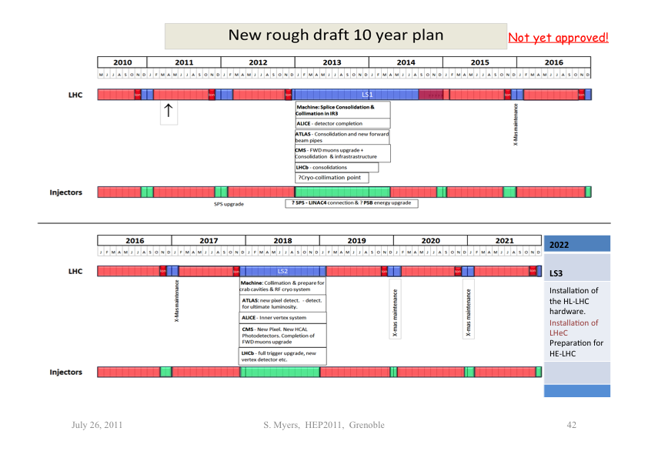
Previous schedule in backup slides

Slide 8
UK & CMS upgrade progress
WP1
contributions to CMS Tracker software optimisation and performance studies
continued excellent collaboration with WP3 firmware and software
WP2
excellent CBC results from detailed testing
CBC-sensor module operated in test beam in September
progress with FED-related firmware
WP3
further production of Mini-T5
demonstrator system in operation in lab
excellent promise for Time Multiplexed Trigger architecture
WP4 - new pixel-related activity
early foundations laid for DAQ involvement, in common project
the word “excellent” may be overused above but genuinely indicates the promise for UK role in CMS upgrade

Slide 9
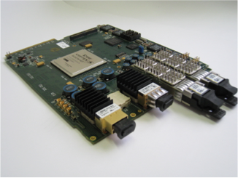
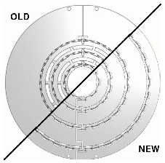
WP1: Overview
Triggering
Provision of online software & ‘core’ firmware
MicroHAL / IPbus system becoming widely adopted
Emphasis on support & incremental improvements to performance / functionality
Studies of upgrade L1 calo trigger algorithms
Note published on upgrade architectures
Including near- and longer-term upgrades for calo, muons, tracking
Tracking (Phase 1)
Optimisation / layout studies continue after TP
Optimisation of tracking algos & code performance
Integration of upgrade and baseline tracking code
New techniques to validate tracking performance
Significant work for near-term high PU runs
‘Upgrade’ issues now becoming relevant in 2011

Slide 10
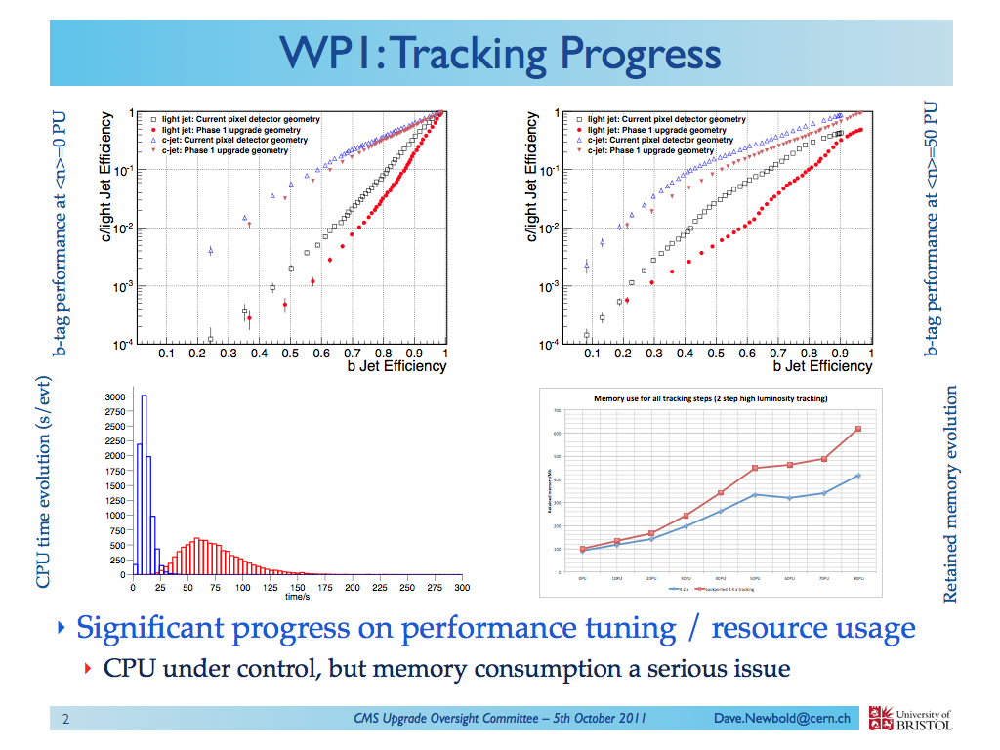
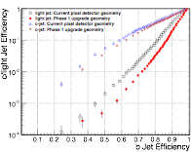
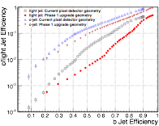
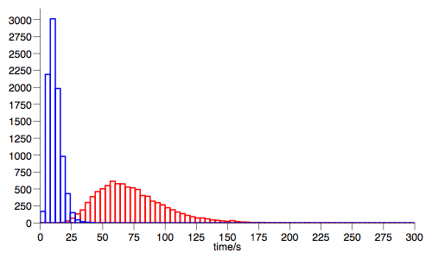
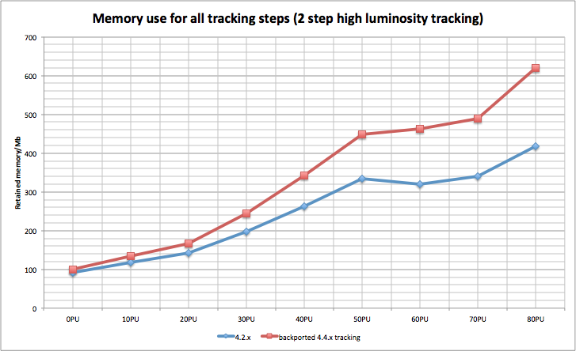
WP1: Tracking Progress
b-tag performance at <n>=0 PU
b-tag performance at <n>=50 PU
CPU time evolution (s/evt)
Retained memory evolution
Significant progress on performance tuning / resource usage
CPU under control, but memory consumption a serious issue

Slide 11
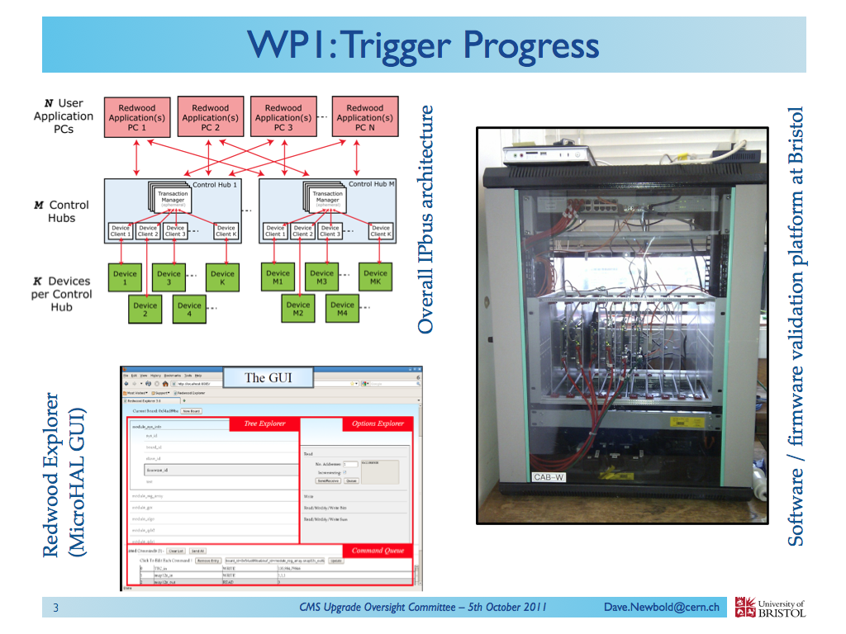
WP1: Tracking Progress
b-tag performance at <n>=0 PU
b-tag performance at <n>=50 PU
CPU time evolution (s/evt)
Retained memory evolution
Significant progress on performance tuning / resource usage
CPU under control, but memory consumption a serious issue

Slide 12
WP2
Detailed testing of CBC
select a few example results
last report showed results from first week only
radiation tests – total dose and SEU – for 2012
temperature studies ongoing – (Bristol: looks good)
Module and system development
continues with other CMS institutes, especially CERN
aiming for short-strip PT modules for triggering and tracking
expect to use C4-type bump bonding
discussions on how to adapt also for a strixellated trigger module

Slide 13
CBC principal results
More details and plots in backup slides
Fast low power (SLVS) and slow (I2C) interfaces
data/clock/trigger and control
Binary, so scan thresholds for gain and linearity (“S-curves”)
individual channel thresholds tuned for uniformity
Powering
chip includes LDO regulation (excellent performance) and DC-DC conversion (very promising but details of impact under investigation)
Power consumption
analogue in good agreement with simulations
digital much less than (pessimistic) estimates: <50µW/channel
P_{total} < 180 + 21 x C[pF] µW/channel - ie. < 300µW for C = 5 pF

Slide 14
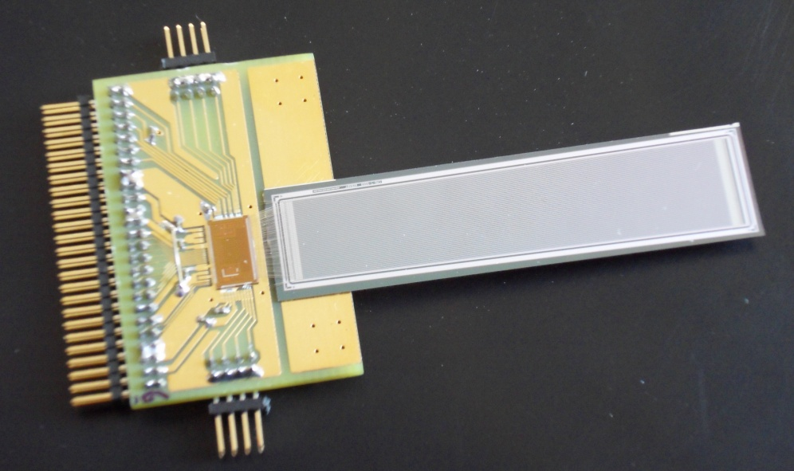
CBC-sensor module
Lab measurements with Sr β source and time-stamped scintillator trigger
σ_{noise} = 836 e
sweep comparator threshold for pulse height spectrum
p-on-n
150 mm pitch
320 mm thick
5 cm

Slide 15
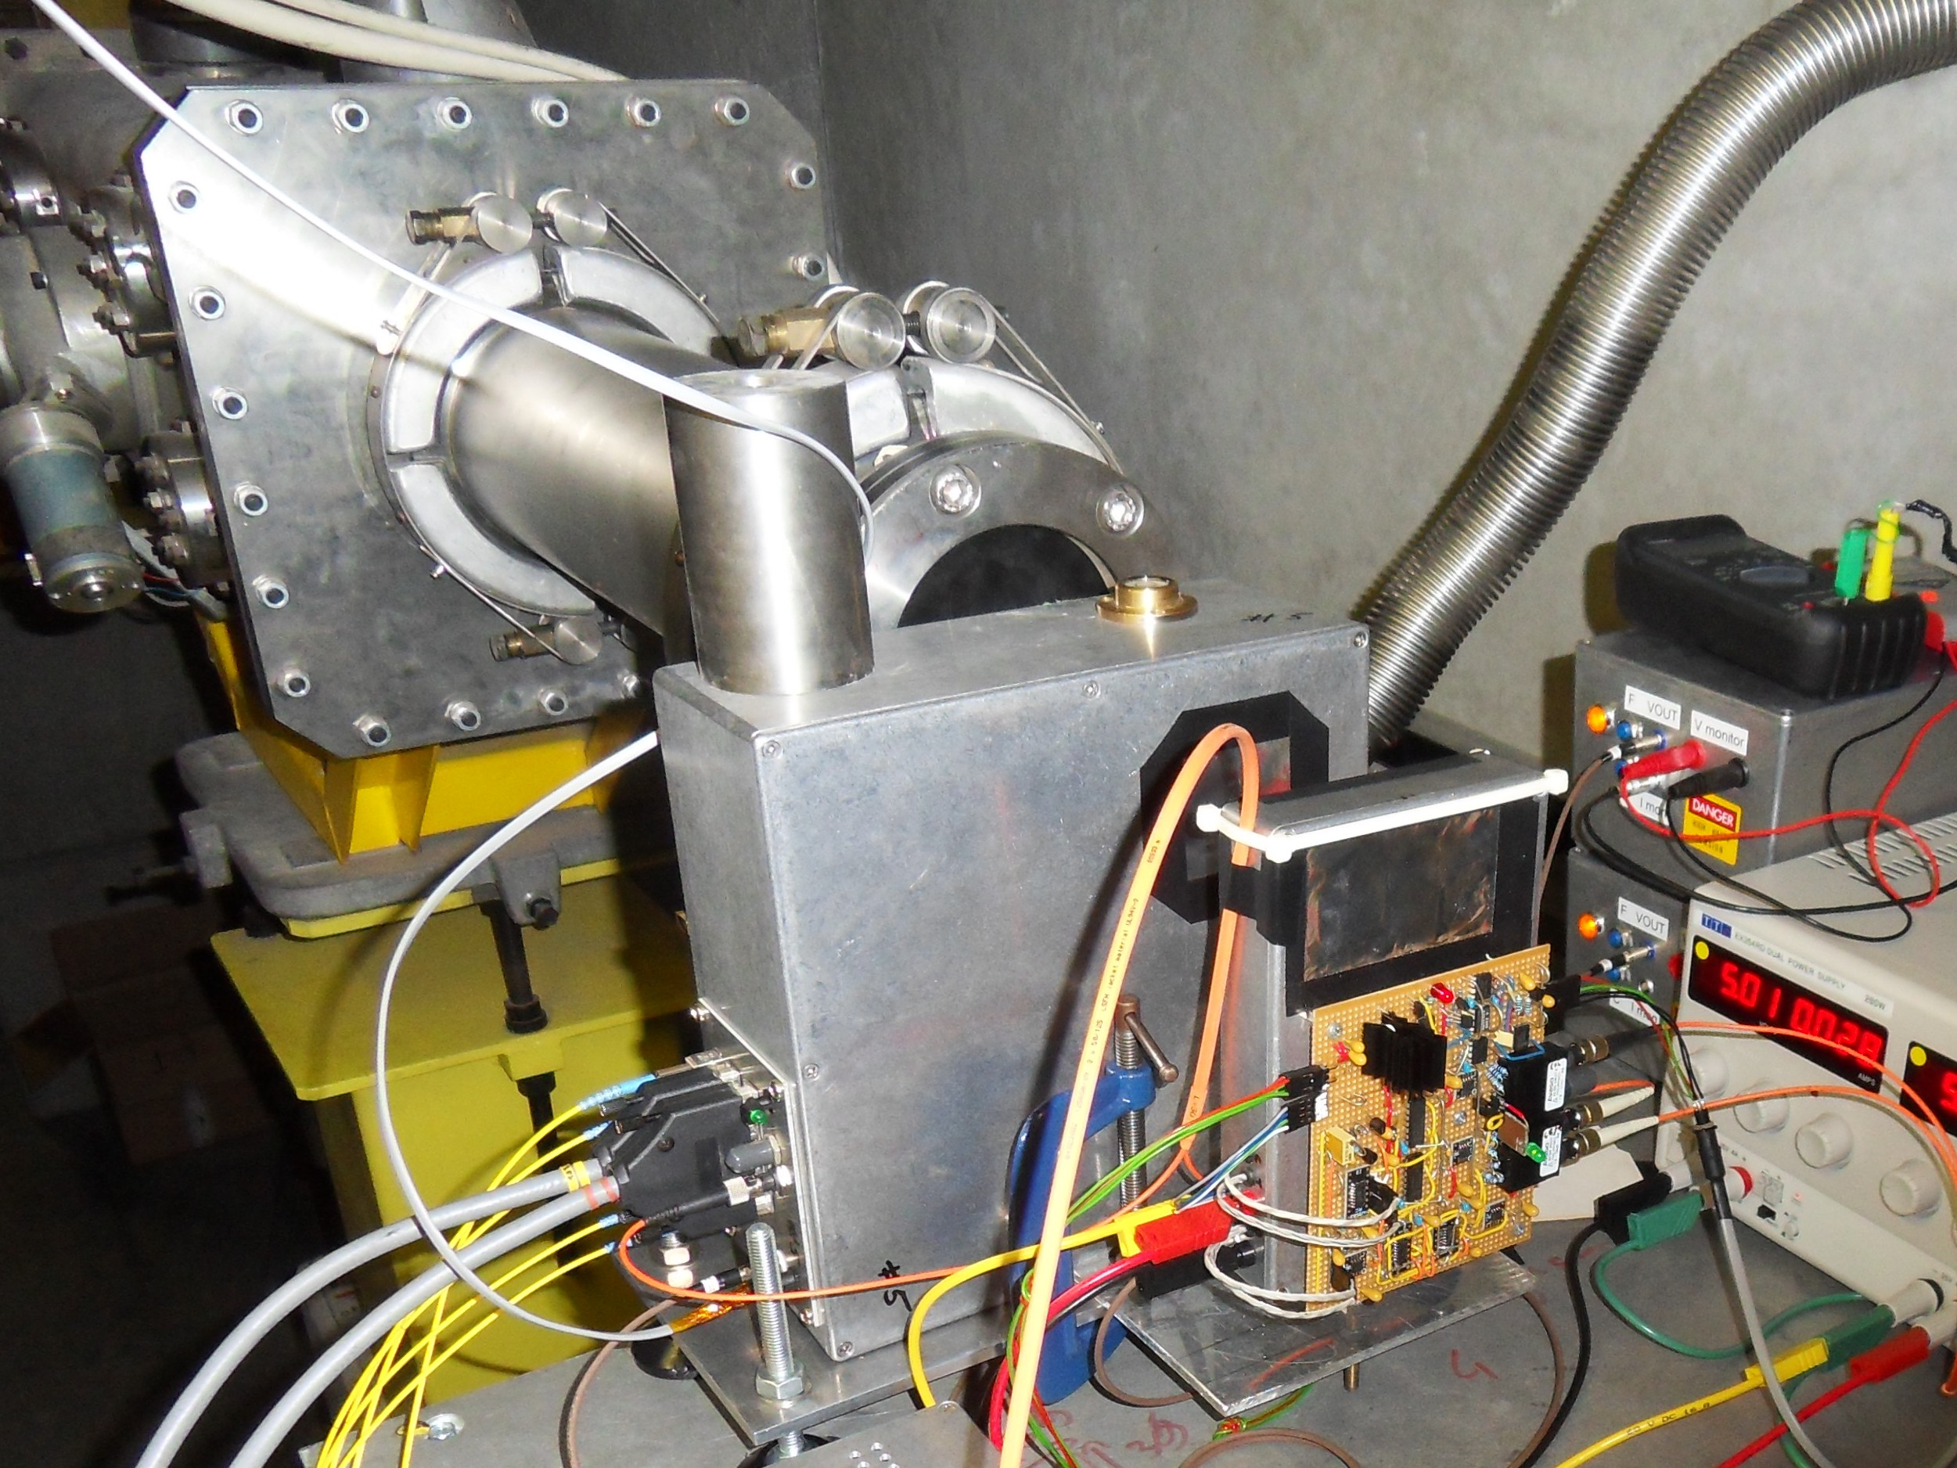
beam profile
test beam - first results
APV plane
CBC sensor
5 mV / division
15

Slide 16
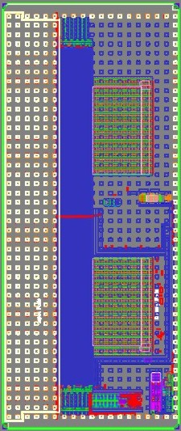
Next CBC design
C4 (coarse pitch, low cost) bump bonded
double-layer, short-trip pT module
submission Q1 2012
V1
128 channels wirebond:
50 µm pitch
7mm x 4mm
V2
256 channels bump-bond:
250 µm pitch
11.4mm x 4.75mm
layout by
Davide Braga (RAL)

Slide 17
WP2: SFED Progress
GBT FPGA Interface:
CERN GBT module design ported to Xilinx Virtex 6 development board
Memory Interface FPGA Firmware
Implemented DDR3 Memory Interface.
Based on Xilinx Virtual FIFO core.
Made benchmark measurements.
Adapting for multiple GBT streams.
PC Controls
Integrated the CMS IPbus control firmware.
Adapted Python scripts.
Allows control and monitoring via GbEthernet.
Makes design compatible with Mini-T card.
Carried out short feasibility study for Pixel Readout card
Virtual FIFO DDR3 Interface

Slide 18
WP2: SFED Plans 2012
Port GBT and Memory Interface to Mini-T5 µTCA card:
establish µTCA crate with Mini-T hardware and firmware.
Adapt existing design for QDRII memory added to Mini-T5.
Test data transfer over Mini-T5 optical links.
Integrate SFED firmware with CBC module control and readout
Work towards system test.
Possible test with CERN GLIB µTCA card
Virtex 6 with DDR3.
Develop FPGA Mezzanine Card for CBC link interface
Now ready to integrate activity more into mainstream
profit from WP1 & WP3 progress

Slide 19
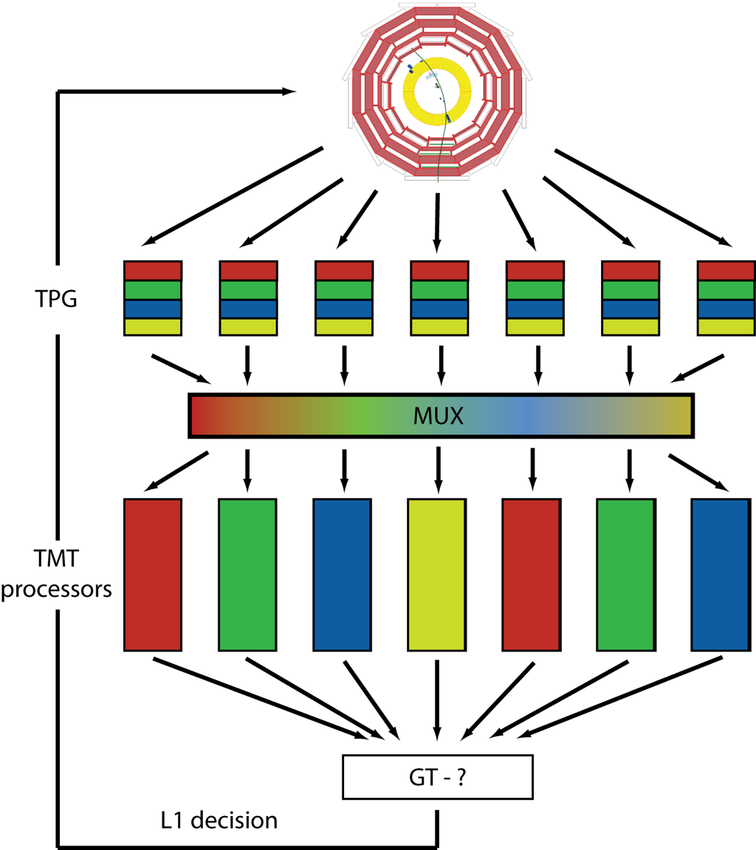
WP3: Trigger Development
Demonstrator system
Operating in lab, with firmware, and well supported software framework from WP1 collaboration
Architecture decision imminent
(by Christmas?)
CMS review committee formed with mandate from Trigger PM
First meeting 14 October, with presentations

Slide 20
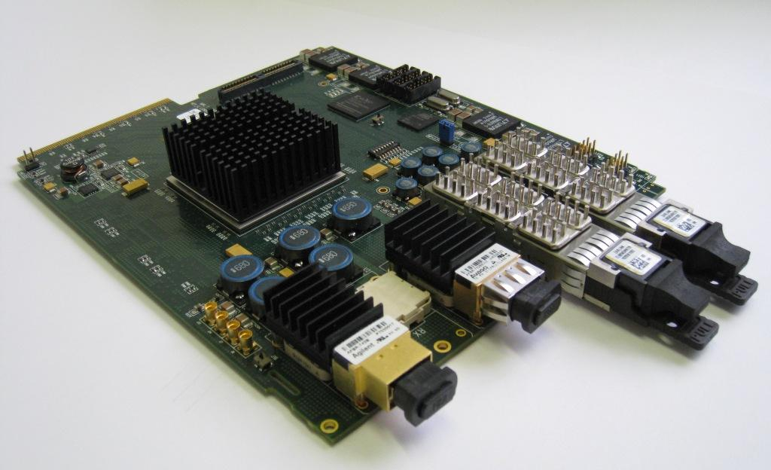
WP3: MINI-T5 Development
Three card types produced:
Rev 0: Original
Rev 1: Alternate optics (supply issue)
Rev 2: QDR II RAMs added (request)
12 Rev-2 cards manufactured with the target FPGA
3 batches of R2 cards (2+5+5) to mitigate risk
10 pass all basic tests (i.e Optical links, QDR II, PROM, uC, CPLD, Ethernet)
2 will require rework because of faulty power modules
Core development system at Imperial will require 6-8 cards.
Additional cards distributed to Bristol, RAL, and CERN (Meyrin and Integration Hall)

Slide 21
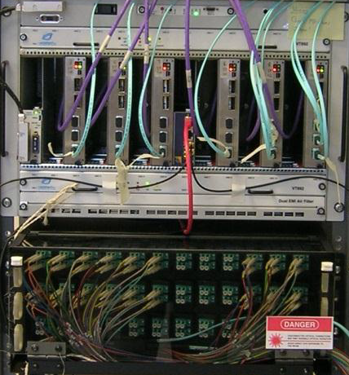
WP3: Demonstrator System
All parts installed except US card (AMC13)
should arrive within a few months (prototypes exist)
Parts include hardware such as MINI-T5, but also less visible parts, such as MicroHAL (communication & control system) and the firmware
Gain experience of all aspects of complete system
Communication, Fast Control & Feedback, Clock, System Updaters…

Slide 22
WP3: Demonstrator System (continued)
Control infrastructure (PC + software)
…includes all the key hardware of a full time-multiplexed system:
24 independent pre-processor firmwares spread across 4 Mini-T5 boards
2 of the 12 outputs from each pre-processor firmware connected to optical fibre
“Cross-over” of links in optical patch-panel
2 main processor boards each receive 24 fibres, one from each pre-processor firmware
Send test patterns to demonstrate correct interconnection and synchronization
Send Monte-Carlo data to demonstrate receipt of an entire event and to test algorithms
Pre-processor
Pre-processor
Pre-processor
Pre-processor
Pre-processor
Optical Patch-Panel
Pre-processor
Main processor
Pre-processor
Pre-processor
Pre-processor
Pre-processor
Pre-processor
Pre-processor
Pre-processor
Pre-processor
Pre-processor
Pre-processor
Pre-processor
Pre-processor
Main processor
Pre-processor
Pre-processor
Pre-processor
Pre-processor
Pre-processor
Pre-processor
LHC clock + synchronization system
Has successfully demonstrated transmission, capture and synchronization of time-multiplexed data

Slide 23
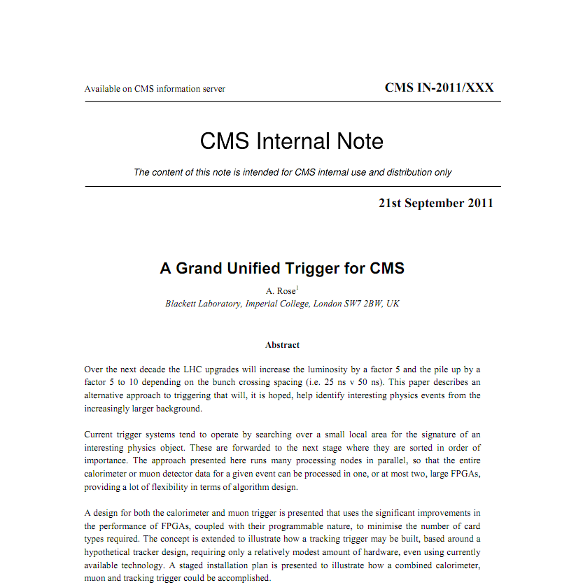
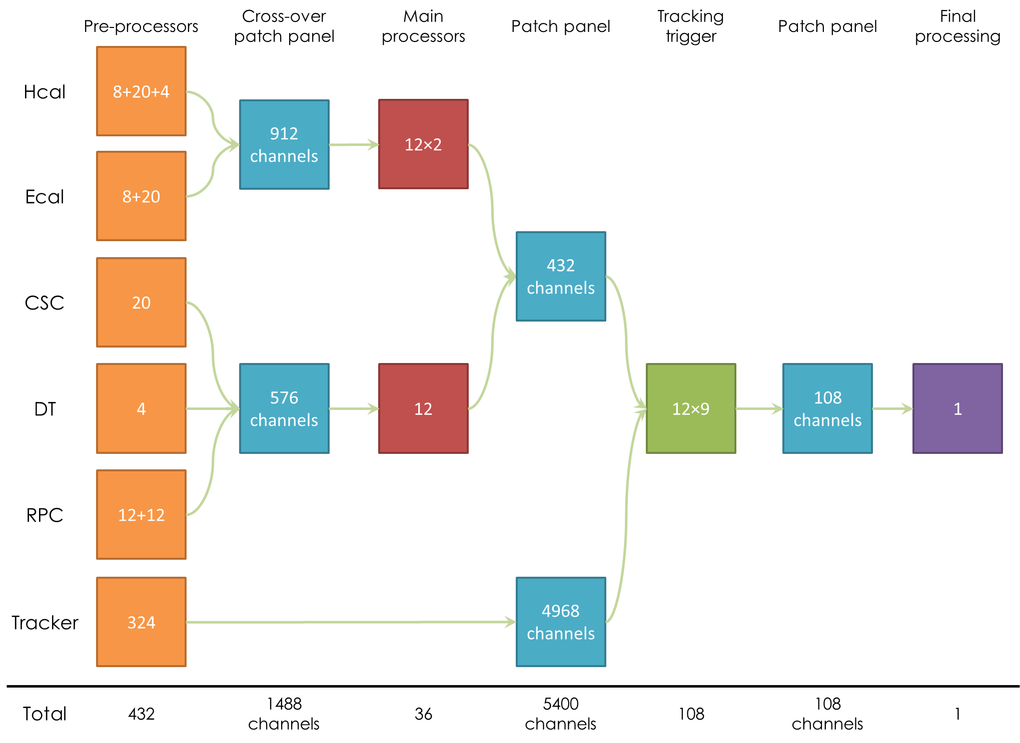
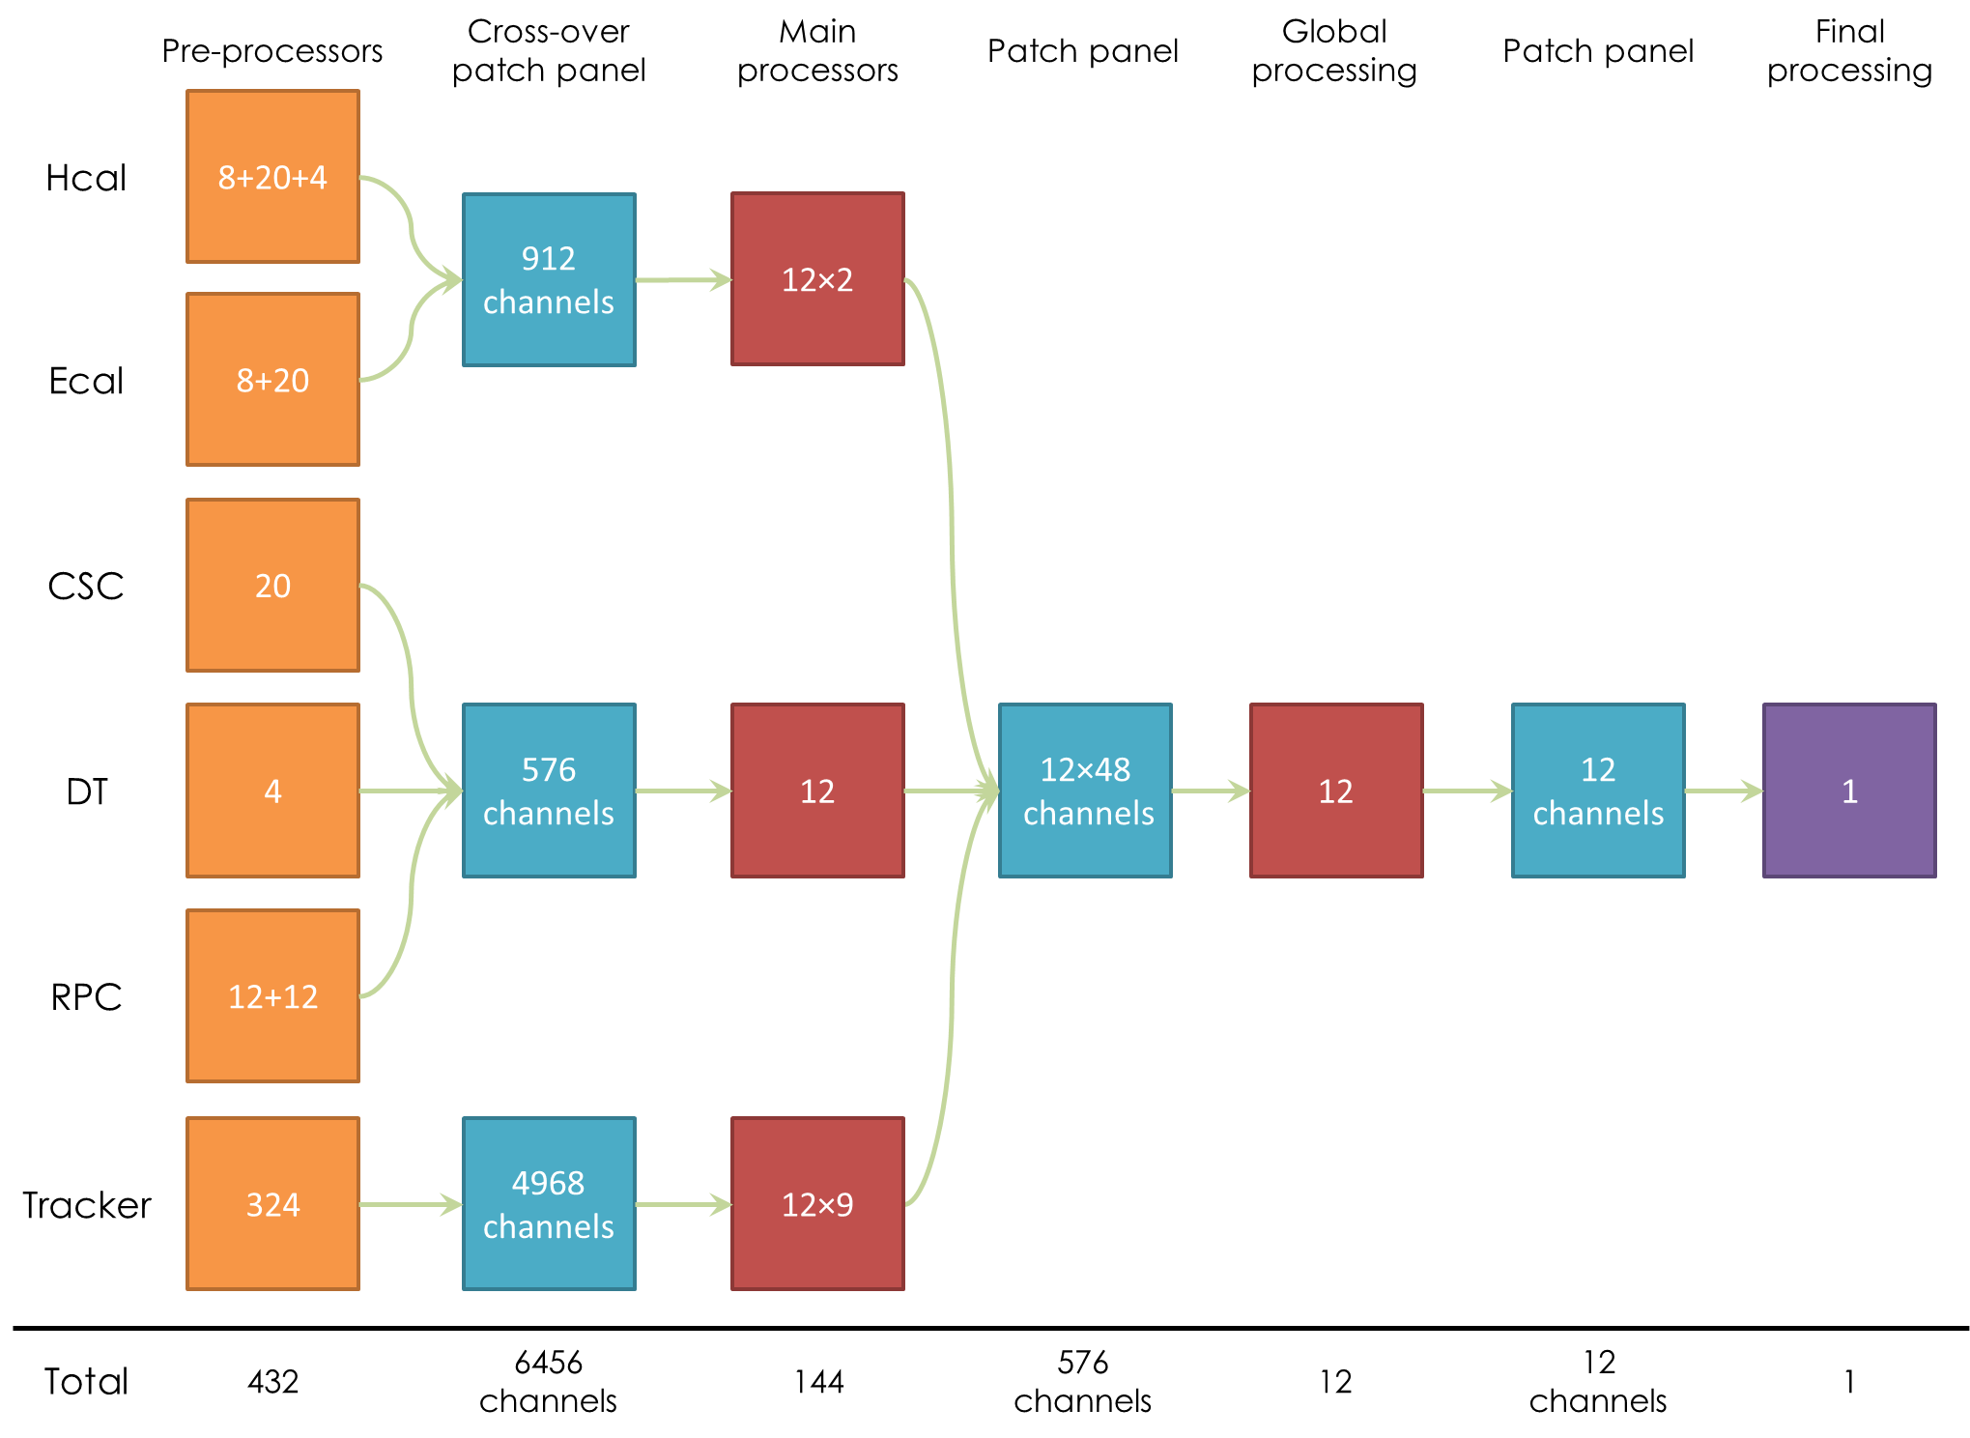
WP3: Triggering strategy development
A Rose
Beyond the Phase I upgrade
Comprehensive study looks at underlying assumptions for triggering and limitations of the current system
CMS muon trigger may be built with the same hardware as the CMS calorimeter trigger
Fewer card types = lower technological risk, lower production cost, better validation, easier to maintain
requires approx. ¼ as many new boards for trigger upgrades as a conventional trigger architecture
shows potential to adapt generic tracking trigger

Slide 24
WP3: 2012 Plans
Demo/Dev system will continue to play an important part
Limited number of Main-Processors in test system allows us to create many virtual PPs in a single card.
Can simulate the detector with RAMs and play data through time multiplexer and test algorithms.
Focus has now shifted to final system and hardware requirements
Despite preference for TMT, developments remain flexible wrt choice of architecture (i.e. Conventional or Time-Multiplexed Trigger)

Slide 25
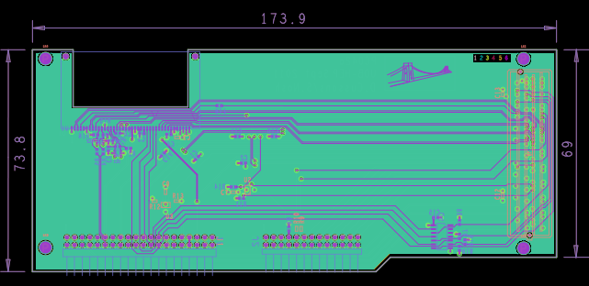
WP4 : pixel detector DAQ and test system
RAL PPD has been exploring opportunities to contribute to pixel testing
with objective of eventual role in pixel DAQ (requested by pixel management)
K Harder, T Durkin, G Zhang, D Sankey
Upgrade of existing USB test board
developing new version to match digital ROC – first versions in hand
firmware under development
Expect working system within weeks
allows months of testing before next ROC available

Slide 26
WP4 future plans
Near term
firmware & software for digital DAQ test boards
contribute DAQ hardware & firmware in beam tests of new ROC in 2012
Longer term - depending on resources - under discussion
DAQ for pilot blade test
contribute to modified FEDs with digital readout
Proposal to strengthen overall DAQ activities with working group covering both SST and pixels
builds on existing strengths (Tracker FEDs, APVe, ReTri)
and staff with relevant expertise:
J Fulcher, M Pesaresi,… (Imperial - Tracker)
K Harder et al (RAL PPD)
with other potential interested parties (Bristol, RAL TD WP2)

Slide 27
CMS planning
FNAL Upgrade workshop Nov 2011
Phase I progress and preparation of detailed scheduling
Phase II R&D, including detailed discussions of track-triggering
Funding
provisional (ie subject to FA approvals) money matrix at next RRB
Upgraded Calorimeter trigger
architecture decision is crucial to planning the PPRP bid
Tracker planning
FED back-end upgrade almost certain & UK pixel role to be confirmed
best addressed by common DAQ team effort, which is now beginning
Long term R&D remains very high priority
emphasis on track-trigger matches UK interests

Slide 28
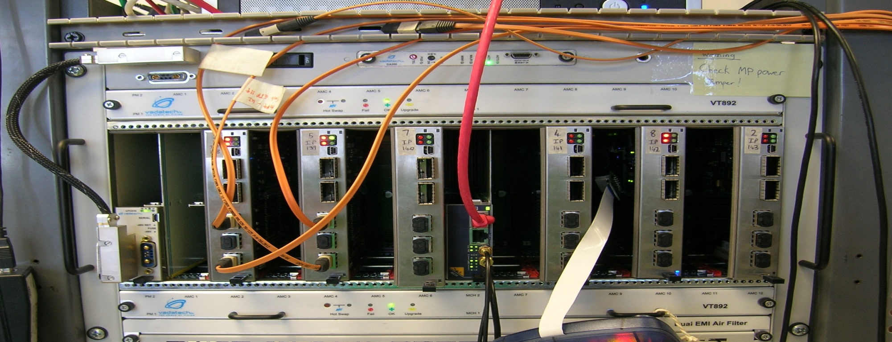
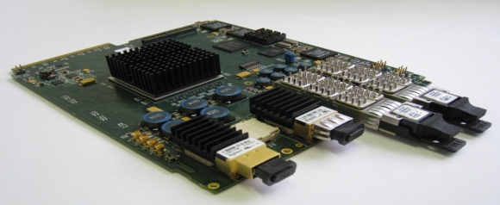
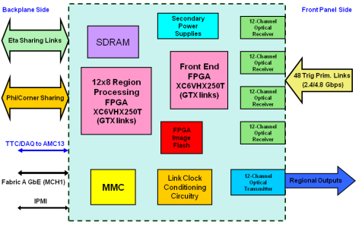
Calorimeter Trigger Designs
Jordan Nash LHCC Sept 2011
Several prototype uTCA trigger cards have been built and have been shown to work. Working demonstrators at the crate level exist also.
Two calorimeter trigger architectures are under consideration.
We have organised a review for the two Calorimeter Trigger architectures. The aim of the review is:
to select the architecture which best serves CMS for the next decade.
Produce a plan for the two relevant groups (Wisconsin-Imperial) to work together towards the final design.

Slide 29
Trigger Upgrades Schedule
2011:
Produce the first Prototypes of OptoSLB (Lisbon)
Design the first SP for the CSC trigger (Florida)
2012:
Working versions of OptoSLB and SP cards
Start Production and testing for both
Will need to procure a number of uTCA crates
Test CSC SP board
2013-2014 LS1.
Install OptoSLBs at P5 – ECAL ONLY
Install Trigger Fibers from both HCAL uTCA and ECAL OptoSLB at P5.
Install the trigger crates at P5.
Connect CSC SP and test using the fibers from the detector electronics
Meeting this schedule enables us to produce and commission the new trigger electronics in parallel with data taking in the 3-4 year period after the start of the 14 TeV run in 2014.
Jordan Nash LHCC Sept 2011

Slide 30
UK upgrade planning
Activities now clear and coherent
Trigger Phase I, Tracker Phase II, DAQ for pixel+SST
with long term vision for track-trigger based on all of above
PPRP proposal
prepare Q1 2012 (in parallel with Rolling Grant)
submit end Q1, early Q2 (tbc)
should ensure funding in institutions by end Q1 2013 – (STFC to endorse)
State of UK groups
Imperial – stretch funds to end of grant [A Rose-> Zorba (RG) appointment]
Bristol – key posts end soon – Frazier, Grimes
Brunel – WP1 staff funding now exhausted
RAL PPD – anomalous re funding and currently subject to uncertainty
i.e. RG posts but treated as project-like, so permanent staff funded on “new” funds, requiring PPRP approval
PPD review reported. Implementation tbd.

Slide 31
WP1: Future
Current WP1 planning:
One post (I. Reid) has ended; two Bristol posts end in Q1-2012
Work at Brunel continues on best-effort basis using temporary funds
Capital and consumables funds remain
The financial situation with RAL posts is unclear
Use of remaining funds
We have requested permission to move remaining funds to posts
This will give us between 3-6 months additional effort
2012 and beyond
We have important and highly visible responsibilities in upgrade software
Demonstrated by the take-up of UK deliverables across the CMS upgrade effort
We anticipate a new funding request (across all upgrade activities) in 2012
However, all WP1 posts are likely to end before new funds are in place
We wish to explore how this work can be maintained in the long term
As an essential part of a coherent future UK upgrade construction project

Slide 32
Bridging funding request
Additional slides to be presented at the meeting

Slide 33
Summary
Very good progress continues in all WPs
CMS and LHC upgrade planning
schedule changed again, but clear picture beginning to emerge
Finances
spending increased, larger commitments expected in 2012
Working Margin (£230k) reduced to £210k
Bridging to next period for construction and long term
discussion today
RAL PPD
crucial to understand resources available

Slide 34
Further information

Slide 35
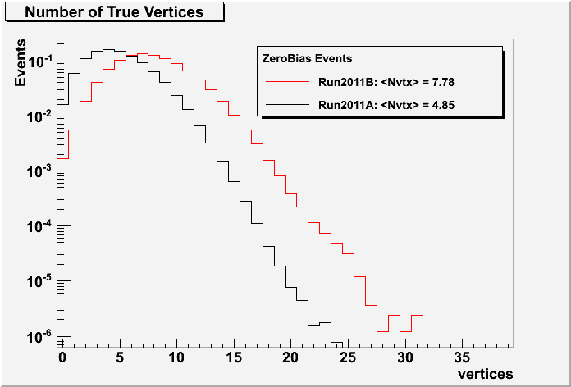
Pile-Up
The number of reconstructed vertices after the August Technical Stop increased by factor 1.5 (β*=1.5m →1m )
Fills start with ~15 pile-up interactions
Vertex reconstruction still quite linear with luminosity
Total inelastic cross section also has been measured from pile-up
σ_{inel}(pp)= 68.0 ± 2.0 (Syst) ± 2.4 (Lum) ± 4 (Extrap.) mb.
after
before
Averaged over fills.
N_{rec}~ 0.7 x N_{pu}
(PAS FWD-11-001)

Slide 36
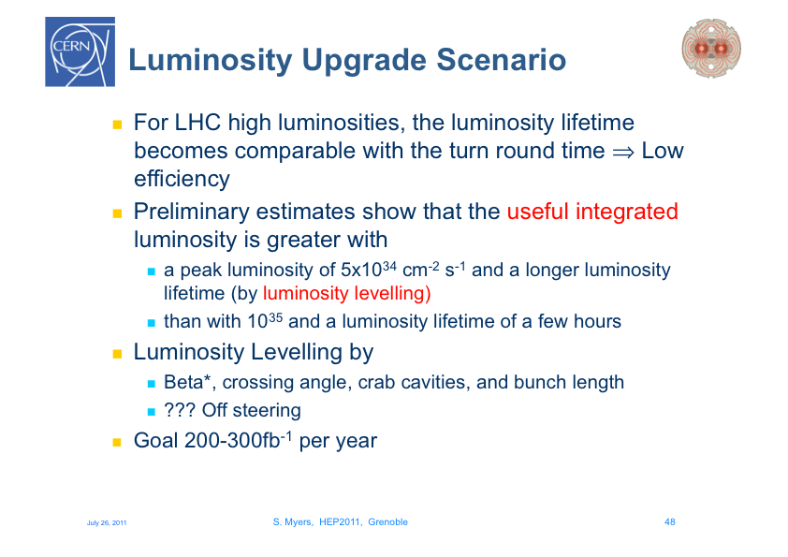

Slide 37
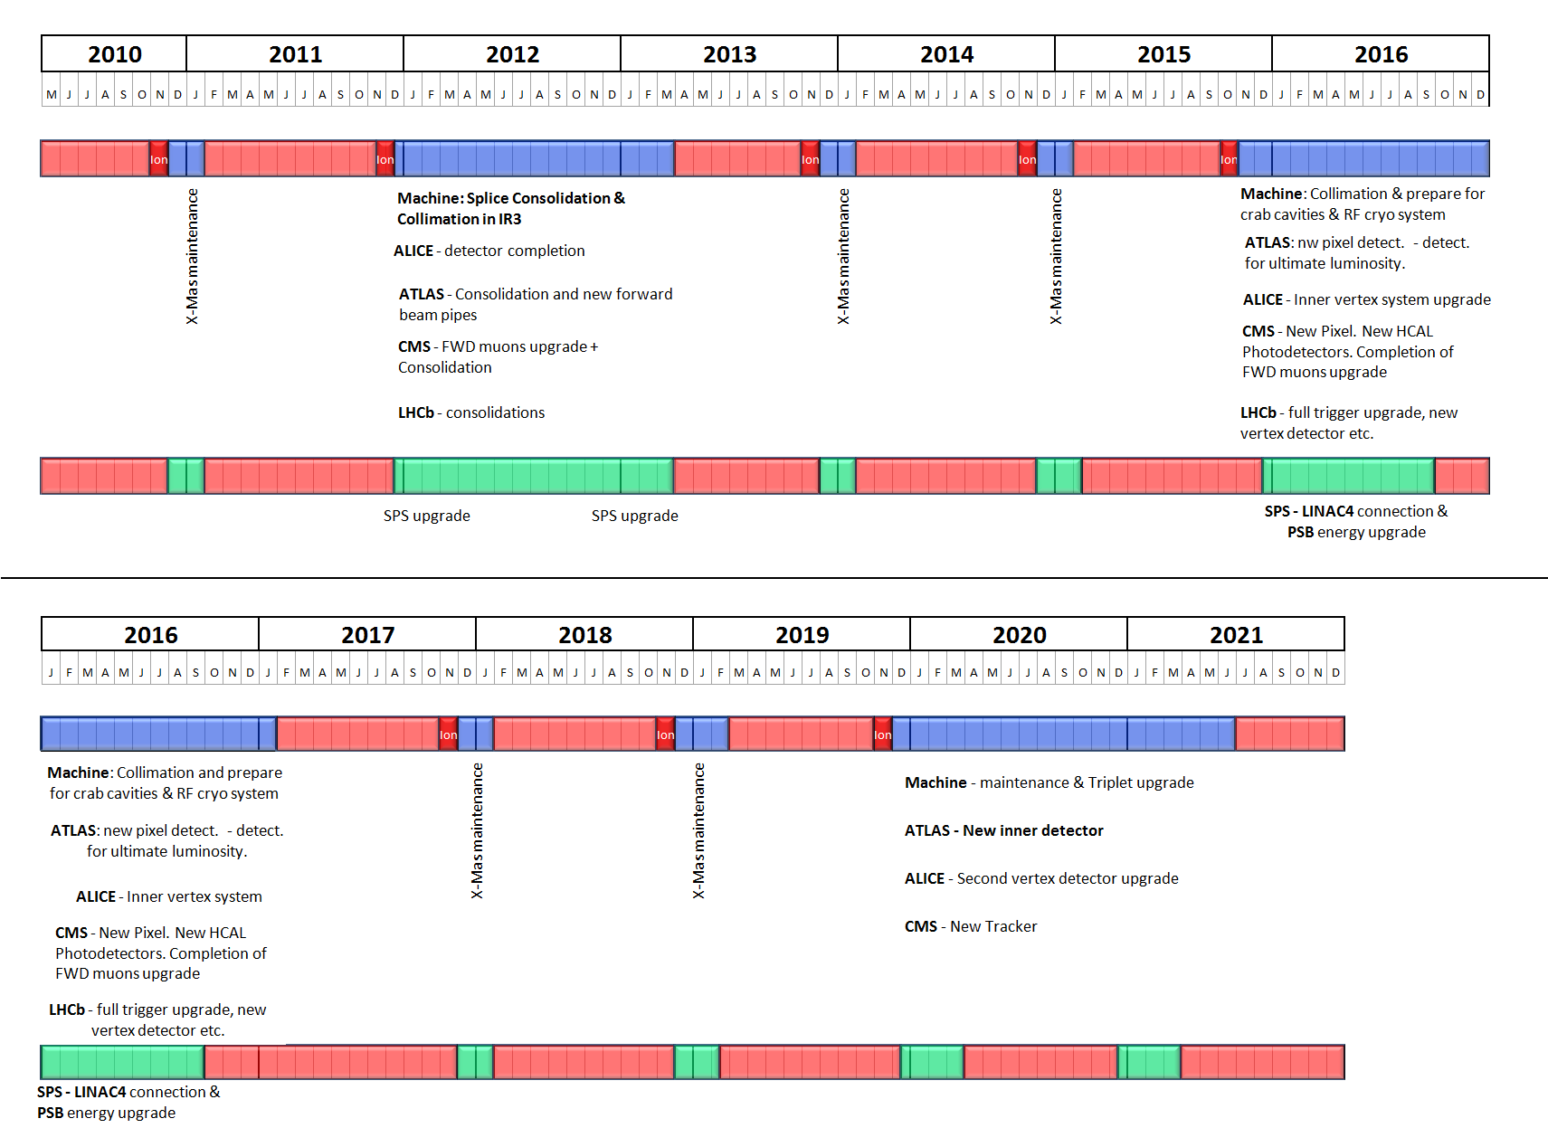
The 10 year technical Plan
July 2010
S Myers ICHEP 2010

Slide 38
CBC – basic functionality
SLVS Fast interface: Clock, Trigger, data
I2C slow interface: program settings
output data frame
12 bit header
2 error bits
8 bit pipeline address
128 channel binary data
1st header
1 fC signal
injected on
one channel
2nd header

Slide 39
S-curves and gain
electrons mode
gain ~ 50 mV / fC
signals in range 1 - 8 fC
in 1 fC steps
holes mode
gain ~ similar
dynamic range more
limited - but still linear
in region where
normal comp. threshold
will be set
39

Slide 40
comparator - threshold uniformity & tuning
all channels have same global threshold
individual channel tuning achieved by
introducing programmable offset at
postamp output
128 registers, 8-bit precision
before tuning pk-pk threshold spread ~30 mV
(< 1 fC)
tuning reduces spread to ~ mV level
128 comparator channels threshold tuning
before
events above threshold
after
Vdda
from
postamp
16k
V_{CTH}
2k
4k
comparator global threshold [mV]
8k
500k
postamp O/P
O/S adjust
8-bit value
(per channel)
16k
16k
4-bits
hysteresis
select
40

Slide 41
Final system
Spare
PP crate
heat exchanger
8U
PP crate
heat exchanger
8U
From HCAL
and ECAL
PP crate
heat exchanger
8U
50U 19” rack
4x Patch Panel
4x4U=16U
144 fibre ports
(12x12)
MP crate
heat exchanger
8U
MP crate
heat exchanger
8U
Spare
Spare
To Global Trigger
Assigning 16bits per tower: 36 Pre-Processor cards and 12 Main-Processor cards in 2 racks.

Slide 42
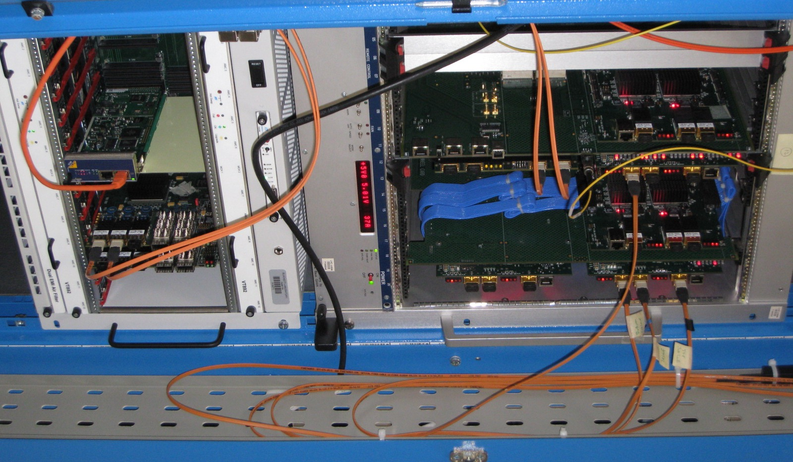
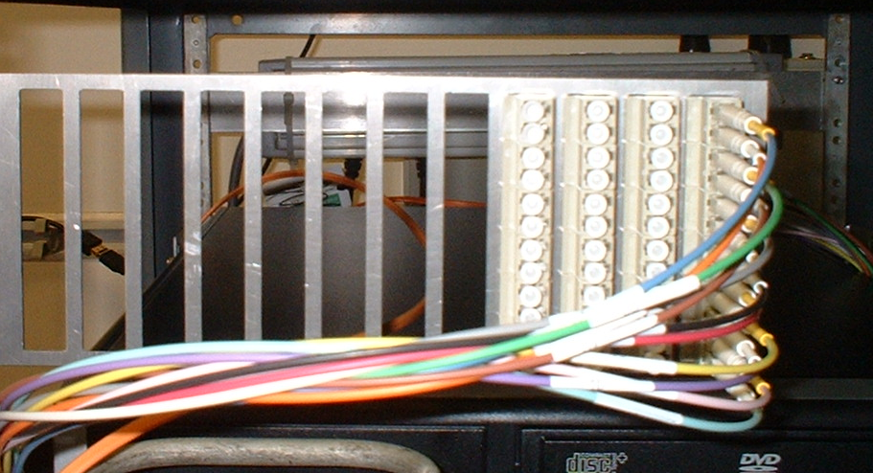
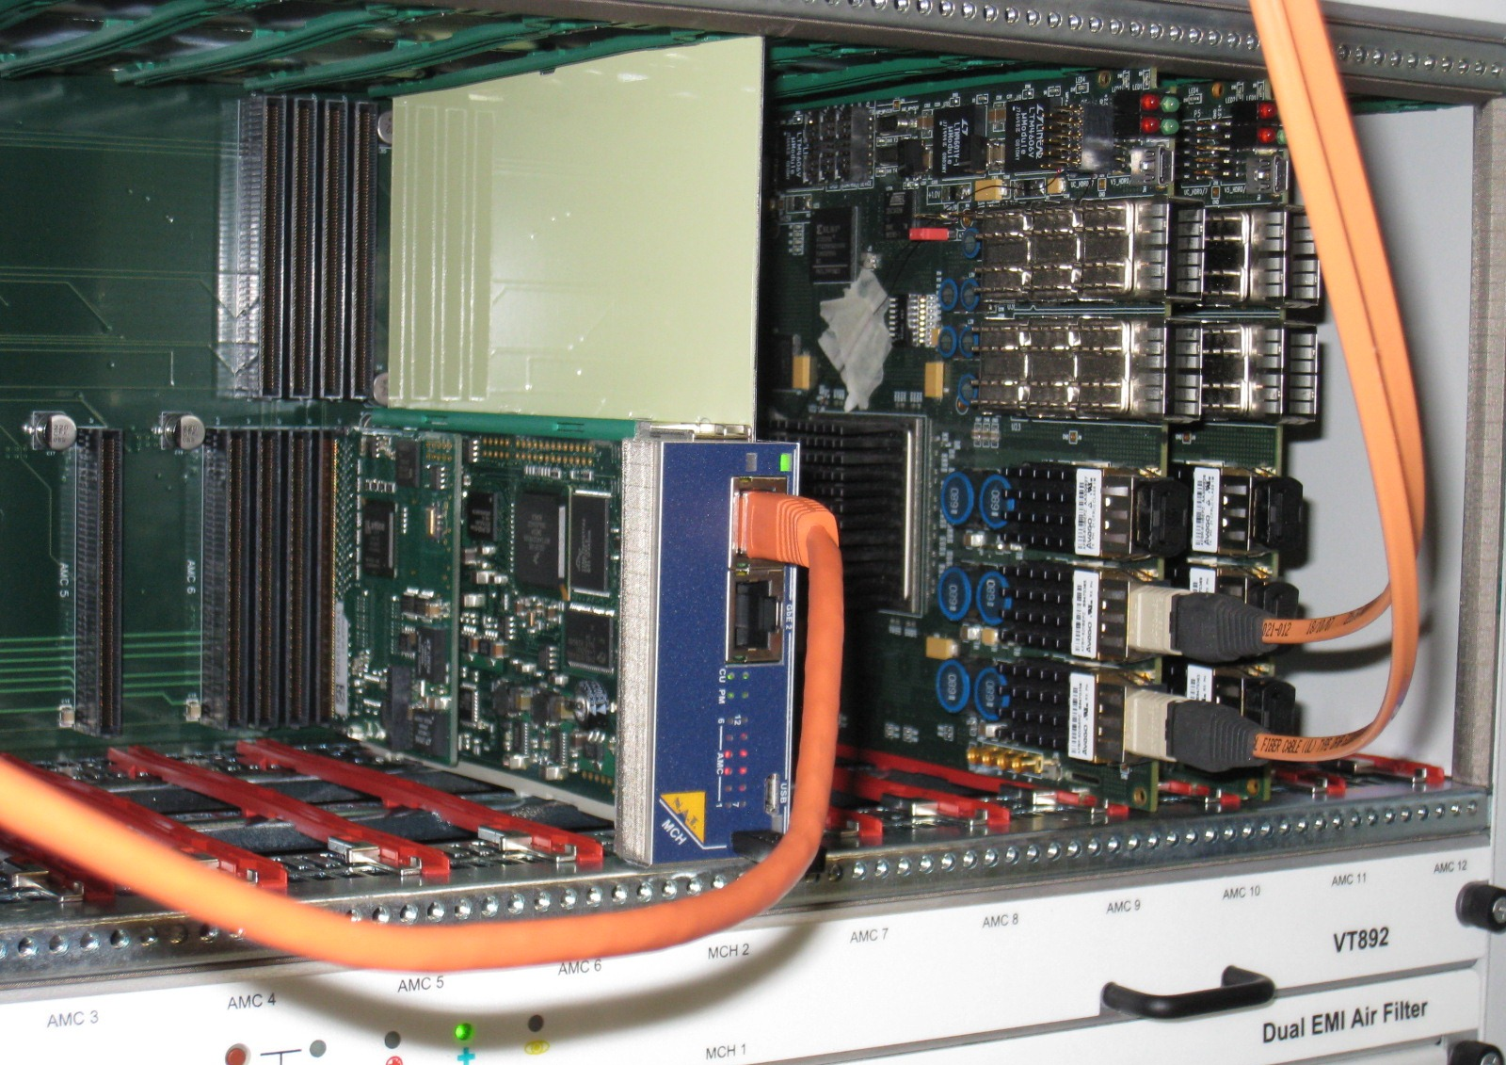
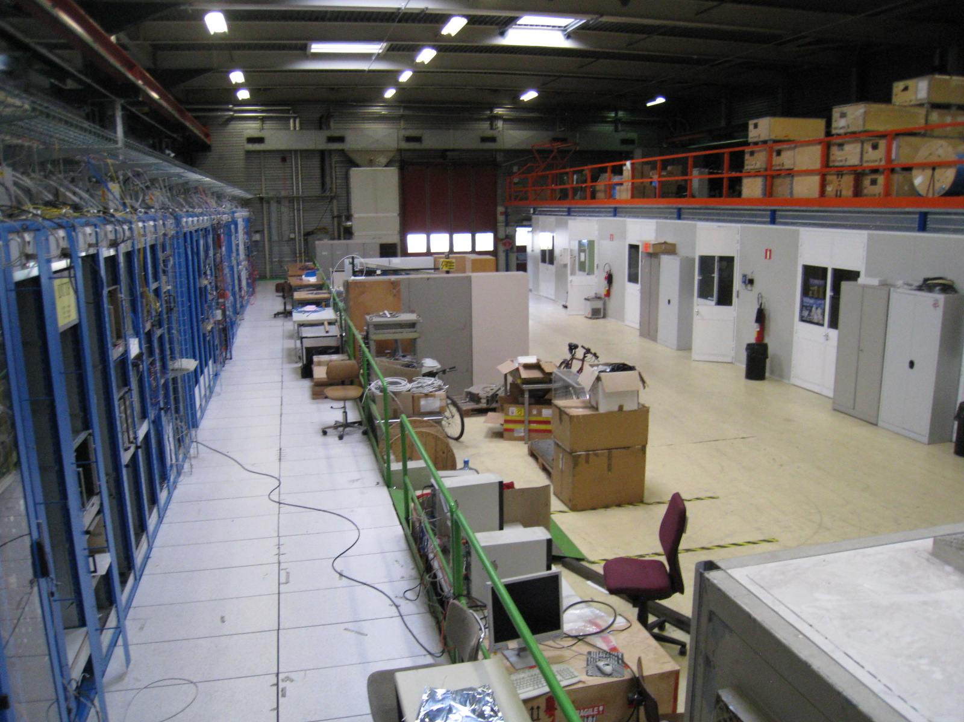
WP3 Extra pics
Considering practical aspects of final system
e.g. custom ultra high density patch panels
Small demo system in CMS test & dev area (904, CERN)
Allows inter-system testing

Slide 43
WP4: Pixel detector DAQ and test systems
RAL group is in charge of test DAQ systems for phase 1 pixel upgrade activities and will contribute to full pixel DAQ.
Current project: DAQ testboard upgrade for digital chips:
Faster output (USB2) for DAQ testboard:
Built two working prototypes.
Now working on firmware to optimize throughput.
Deserializing input adapter for digital chip:
Three assembled PCBs expected at RAL today.
Deserializer firmware works in simulation.
Adapter also compatible with analog chip
(for detailed testing before availability of digital chip).
Digital chip/module emulator:
Based on FPGA evaluation board.
Several 100 example readouts in memory.
Up to 400 Mbit/s output stream.
Hardware and firmware ready for testing.
Expect to have a working readout system for digital chips in a few weeks.
Allows several months of testing before arrival of first chips.
05 Oct 2011
43

Slide 44
WP4: Pixel work plan
Near-term programme:
Develop firmware+software for digital DAQ testboards
For UK and for PSI hardware
Responsibility for DAQ hardware and firmware in
first beam tests of the new digital readout chip (2012)
Longer term:
providing DAQ for pixel pilot blades
(needs prototype of digital FED)
modification of pixel FEDs for digital readout
(potentially a full redesign later on:
Combine FED and FEC?
Common (or similar) design for pixel and strip FEDs?
CMS is forming a working group looking to combine upgrade efforts for pixel and strip tracker DAQ. Some upgrades required very soon because limitations almost hit even with current beam conditions.
K. Harder (RAL) represents pixel upgrade community
UK planning to play a role in defining and building new
readout system (hardware, firmware, software)
05 Oct 2011
44

Slide 45
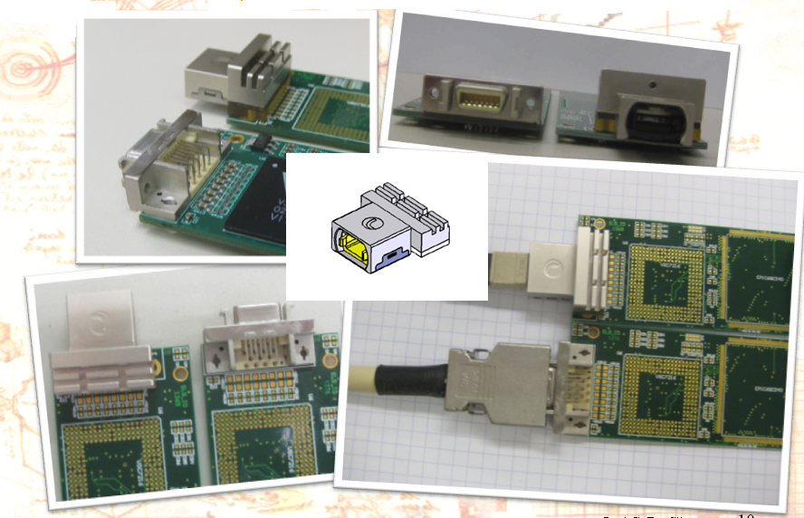
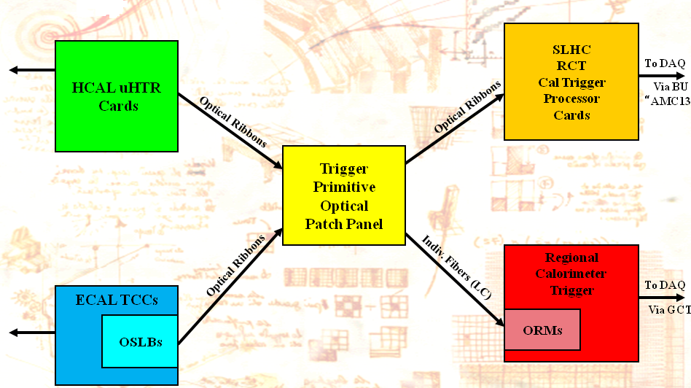
ECAL–Trigger Interface - OptoSLB
Converts ECAL copper signals to 4.8 GBps optical and allows to keep using the current ECAL Trigger electronics after 2014.
Bought 4 optical devices for evaluation.
Design effort for the card has started.
First prototypes have been promised late in 2011 early 2012.
Production should start in 2012.
Jordan Nash LHCC Sept 2011

