Slide 1
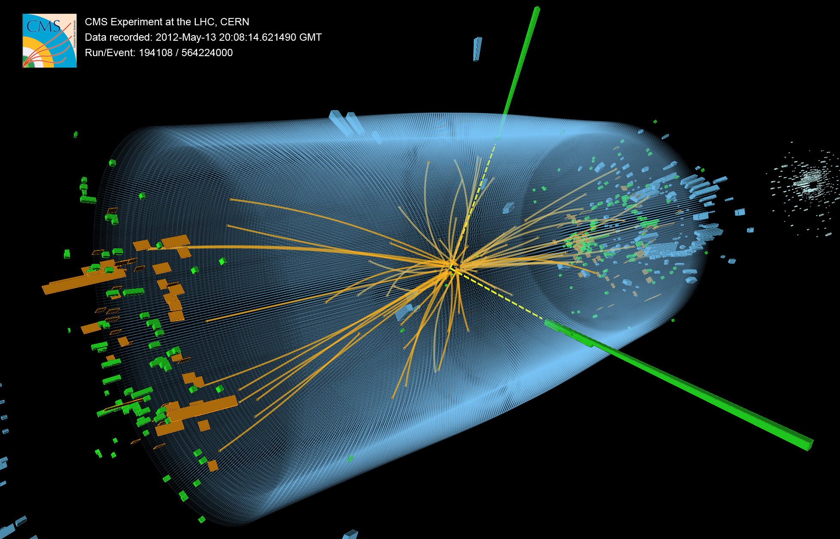
UK CMS Upgrade Oversight Committee
Geoff Hall
12 November 2013
University of Bristol
Brunel University
Imperial College London
Rutherford Appleton Laboratory

Slide 2
Overview
Snapshots of CMS & LHC status
Recent summaries at October RRB & ECFA HL-LHC workshop
LHC: LS1 on schedule and machine very confident to be ready for restart
Plans beyond that are still uncertain
funding & scheduling issues
overview of experiment requests compiled by S Bertolucci for RRB
Summary of UK upgrade project
Recent WP progress
Finances and other issues

Slide 3
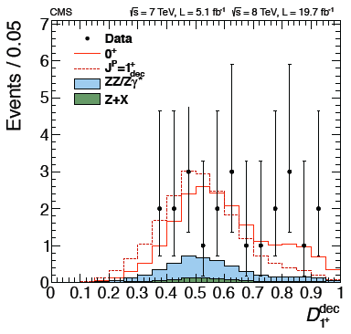
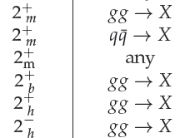

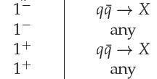

Spin-Parity
Notable recent results
0⁺ vs. 0⁻
0⁺ vs. 2⁺
CMS
0⁺ vs. 1⁺
CMS
2q =
0⁻ Excluded @ 99.8% CL
New Spin 2 Exclusions
ALL ARE CONSISTENT
WITH J^{P} = 0⁺
New Spin 1 Exclusions
3

Slide 5
F Bordry

Slide 7
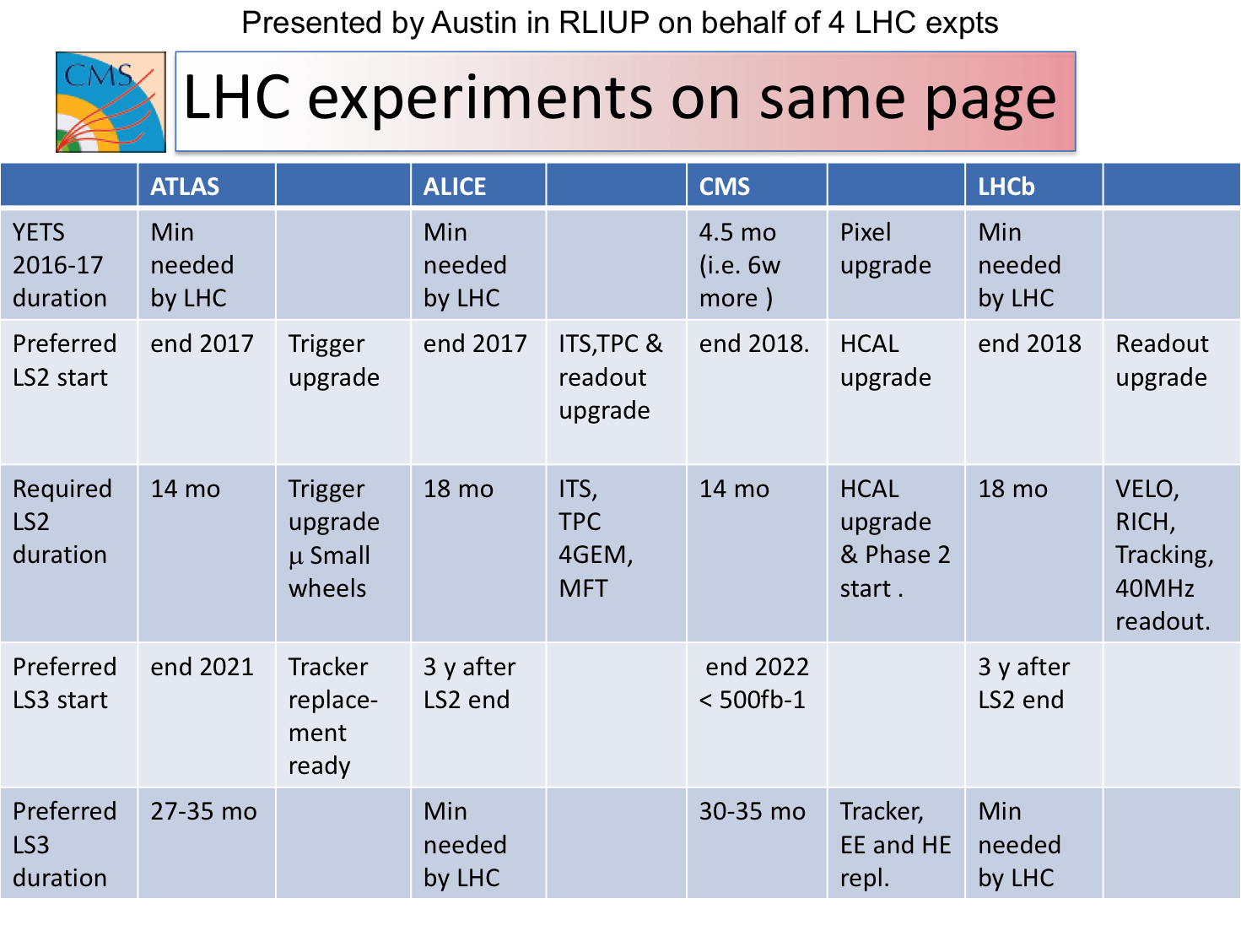

Slide 9
CMS Status in a Nutshell
Phase 1 Upgrades
Common item costs were reviewed and revised downward
Much progress and on schedule
Long Shutdown 1 (LS1), including many phase 1 upgrade tasks
Work goes well
Run 1 Physics
Analyses well on track to meet our goals
Run 2 Preparations
Progress on cpu-efficiency, tools and procedures
Phase 2 Upgrades
Preliminary scope and cost has been documented, presented today
9

Slide 10
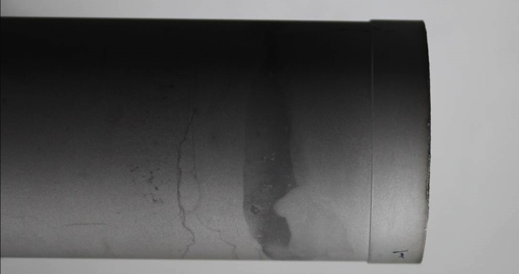
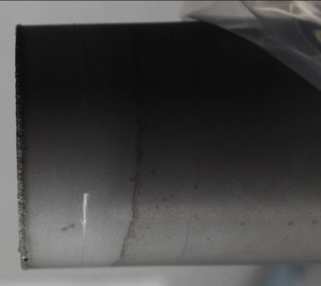
Technical Coordination: LS1 project
Cost to complete LS1 common project is within original estimates.
Activities at P5: On-going with good progress
Tracker colder
ME 1/1 revision
HCAL revision part I
YE4 installation
Other activities progressing well too
CSC assembly, testing, installation
RPC assembly and testing
Pixel cooling system pre-assemblies
Beampipe
All OK, except for delay recovering beampipe incident, again!
On two occasions, during removal from the EB welding-facility, pipe broke at a weld.
Discussing with vendor to make sure to get it right this time.
Specialized tooling for conical section probably necessary
Still can make schedule if it does not happen a third time.
All costs being borne by vendor
Cylinder
Cone
10

Slide 11
CMS Upgrade program in one slide
LS1 consolidation: Complete/consolidate for nominal LHC beam conditions: Prepare for: 13 TeV, 10³⁴ Hz/cm² , Ave. Pileup (<PU>)∼25
Complete Muon system (4th endcap station) and improve readout electronics
Replace HCAL photo-detectors and backend electronics in a couple of regions
Make it possible to operate the Tracker at -20∘C
LS1
2013-14
Phase 1 upgrades: Prepare for 1.6 x 10³⁴ Hz/cm² , <PU> ∼40, ≤ 200 fb⁻¹ by LS2 Prepare for 2.5 x 10³⁴ Hz/cm², <PU> ∼ 60, ≤ 500 fb⁻¹ by LS3
New L1-trigger system ready for 2016 data taking
New Pixels ready for installation in 2016/17 Year End Technical Stop (YETS)
Install new HCAL photodetectors and electronics in 2015 YETS and LS2
LS2
2018
Phase 2 upgrades: Prepare for ≳ 5 x 10³⁴ Hz/cm², PU 140 to 200
Total of 3000 fb⁻¹ in ∼10 yrs operation
Replace subsystems that no longer function due to radiation damage
Tracker including Pixels, Endcap calorimeters
Maintain physics performance at very high PU
New Electronics and Trigger, enhanced detector coverage
LS3
2022-23
11

Slide 12
CMS Phase 2
The minimal set of upgrades that replace degraded systems and provide requisite physics sensitivity for the highest priority physics goals in the face of 140 pileup events per bunch crossing, and to assure the ability to run up to at least 3000 fb⁻¹
12

Slide 13
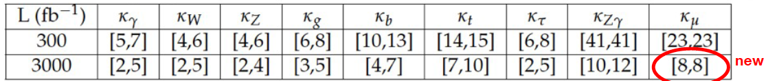
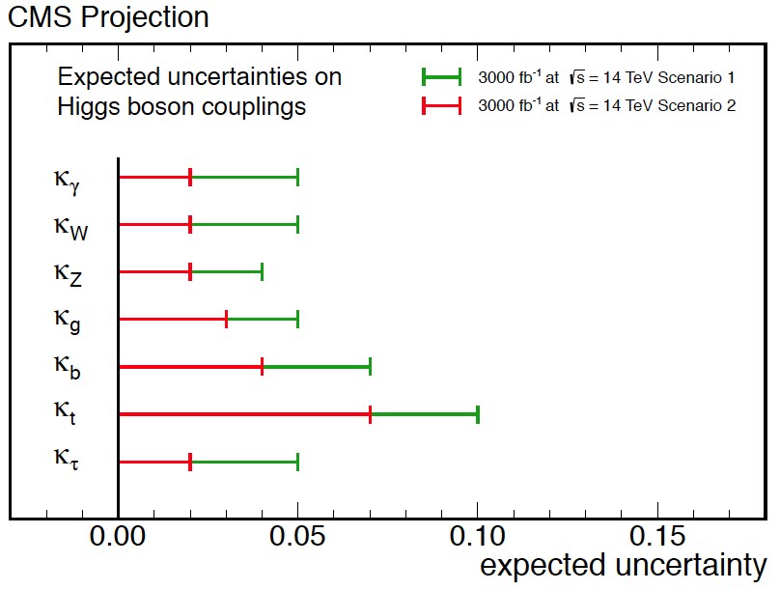
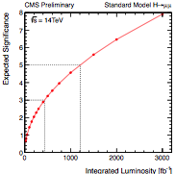
CMS@HL-LHC
Projections for Higgs couplings
2-10% with HL-LHC
Rare Higgs decays studied*
H → µµ at > 5σ with HL-LHC
Low Mass Stops
Already with 300 fb⁻¹, discovery potential direct production mode up to ~900 GeV
2-10% precision on Higgs couplings
*to appear in final draft of WP
13

Slide 14
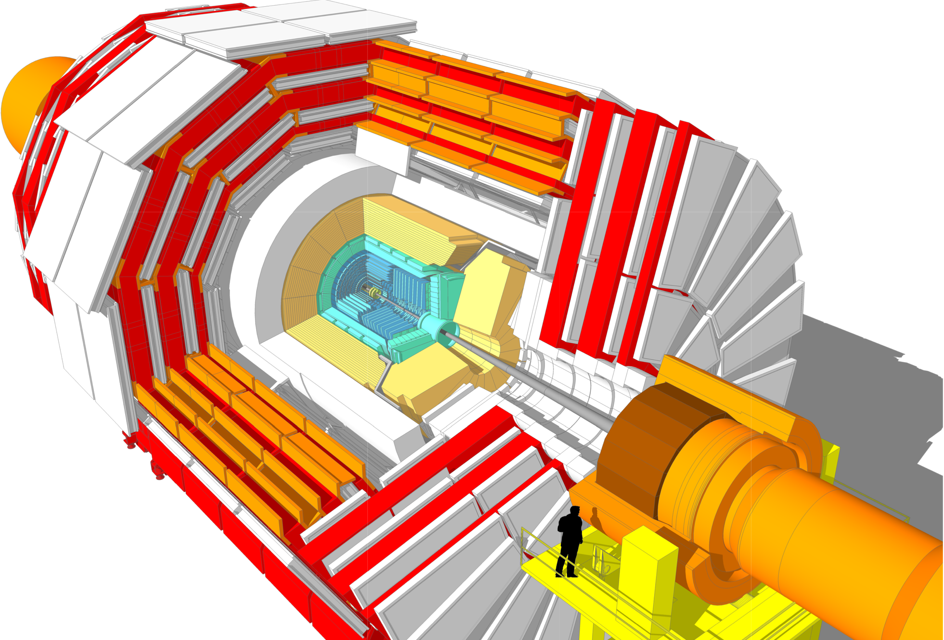
Phase 2 Upgrades
Tracker
Muon system
Higher granularity
Less material
Better p_{T} resolution
Extended η coverage
Track trigger at L1
GEM Glass RPCs
Extended η coverage
New DT minicrates
Trigger/DAQ
New FE and RO
L1 up to 1 MHz
HLT up to 10 KHz
Tracking at L1
Replace Endcap Calorimeters

Slide 15
CMS Phase 2: Conclusions Thus Far
Systems that do not need to be replaced
Barrel calorimeters, HF and muon chambers will perform to 3000 fb⁻¹
Systems that must be replaced are
Tracking system and Endcap calorimeters must be upgraded in LS3
Neither survives much beyond LS3
Endcap calorimeters:
Extensively studied ways to recover EE crystals.
No practical solution found.
With phase 1 upgrades the HE survives until LS3 but not much beyond.
Electronics for specific subsystems
Relatively new requirement
15

Slide 16
Phase 2 Tracker: conceptual design
Higher granularity, less material
Track reconstruction at PU 140 and beyond
2 sensor “Pt-modules” to provide L1 trigger information at 40 MHz for Pt≥2GeV
Pixels: sensors 100 µm thick
Smaller pixels: ~30 x 100 µm
4 barrel layers, 10 disks to cover up to ∣η∣= 4
R&D activities: All components
Sensors and readout electronics
Prototype of 2S modules ongoing
BE track-trigger tbd
Trigger - major new endeavour
Trigger track selection in FE
“stub”
y
z
x
16

Slide 17
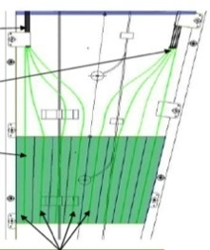
Endcap Calorimeters
Early stage. R&D urgent
Two approaches
Maintain tower geometry - develop rad-tolerant solutions for 3000 fb⁻¹
EE towers e.g. in Shashlik design (crystal scintillator: LYSO, CeF)
Te build HE with more fibers, and rad-tolerant scintillator
Alternative geometry/concepts
Potentially improved performance and/or lower cost
Dual fiber read-out: scintillation & Cerenkov (DROC) – alla DREAM/RD52
Particle Flow Calorimeter (PFCAL) – following work of CALICE
17
Notes:
Dual fiber read-out: scintillation & Cerenkov (DROC) – following work of DREAM/RD52
using doped/crystal fibers - allows e/h correction for improved resolution
Particle Flow Calorimeter (PFCAL) – following work of CALICE
using GEM/Micromegas – fine transverse & longitudinal segmentation to measure shower topology

Slide 18
Phase 2 Cost Exercise
Used reasonable assumptions
Materials, channel counts, etc.
No contingency included
Breakdown of costs
Replacement of radiation damaged detectors ~ 75%
Retaining performance in very high pileup environment ~ 15%
Extending coverage < 10%
Staging under study
Options are limited
18

Slide 19
Phase 2 Spending Profile
Profile driven to a large extent by the LS3 start and duration
Tracker and Endcap calorimeters need to be competed in LS3
An extra year flattens the profile. Diminishing impact beyond that.
Phase 1: 66% of spending will be complete by end of 2014
Representative spending profiles for different schedules for LS3
Blue = the current LHC baseline schedule. Orange and Purple represent alternative LS3 dates.
19

Slide 20
UK R&D status

Slide 21
Evolution of objectives
Original goal
new – improved - tracker with similar angular coverage, constrained by re-using existing services
provide some part of tracker data to L1 trigger to contain rate to 100 kHz
More recent developments
Baseline Tracker design now adopted
“conventional” barrel-endcap layout looks optimal
but CMS exploring enhancing forward region physics as well as standard physics programme
uncertainty if L1-track triggering will reduce rate to 100 kHz in 6.4µs
ideas (and detector requirements) not yet validated by simulations
possible objective of L1 readout up to 1 MHz/10-20µs
both approaches require on-detector data reduction

Slide 22
WP2 objectives and status
Complete CBC & 2S-module development for construction project
development, with collaborators, of 2S module, and evaluation studies
to be ready for mass production with hardware and software for large scale acceptance tests
contribute to PS-module readout development
FC7 for CBC module readout
generic-type board, to be utilised by multiple projects, in collaboration with CERN
Good progress with CBC2 evaluation
chip is functioning well and suitable for prototypes
2 wafers so far tested. Plenty of chips in hand
First (ever!) beam test of PT-module imminent
DESY 25-30 November

Slide 23
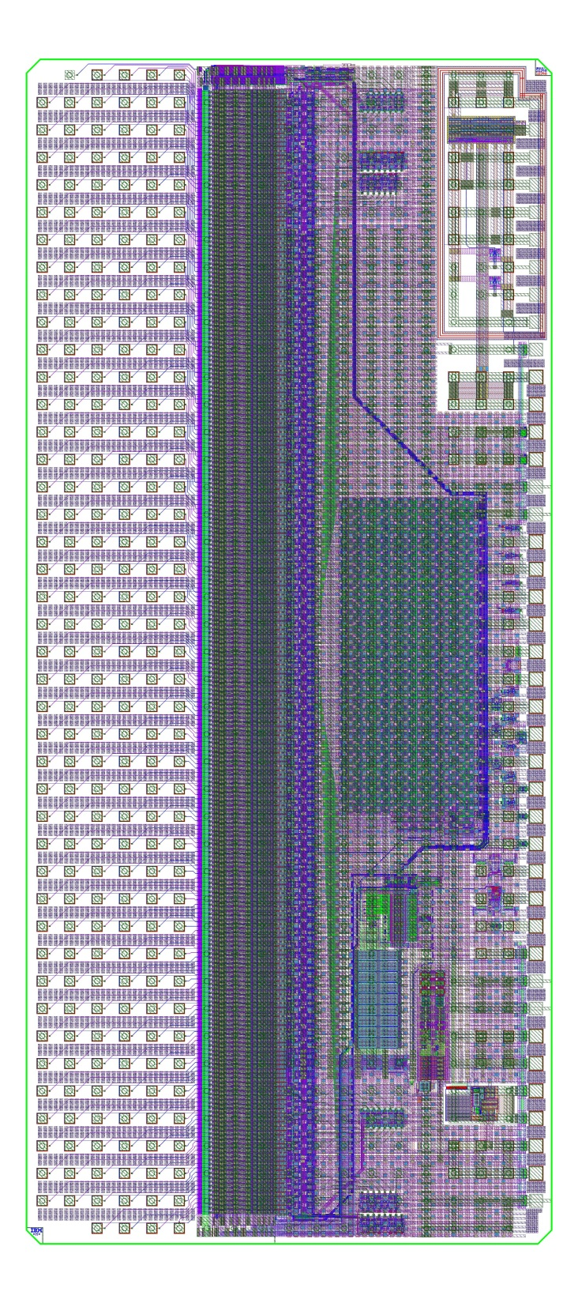
CBC -> CBC2: New features
5 mm
Reminder only
inter-
chip
signals
DC-DC
250µm pitch C4 layout
aim for commercially assembled module
some gains in bond inductance
back edge wire-bond pads for wafer probe
254 channels for 127 + 127 strips
correlation logic for stub formation
between top & bottom strips
vetoes wide clusters
Test pulse
no time to implement on CBC
& other minor circuit improvements
Improved DC-DC (CERN)
received Jan 2013 – fully functional
11
mm
254
inputs
pipeline
+
buffering
CWD, offset correction and colleraltion logic
254 amplifier/comparator channels
bias gen.
bandgap
inter-
chip
signals
LDO

Slide 24
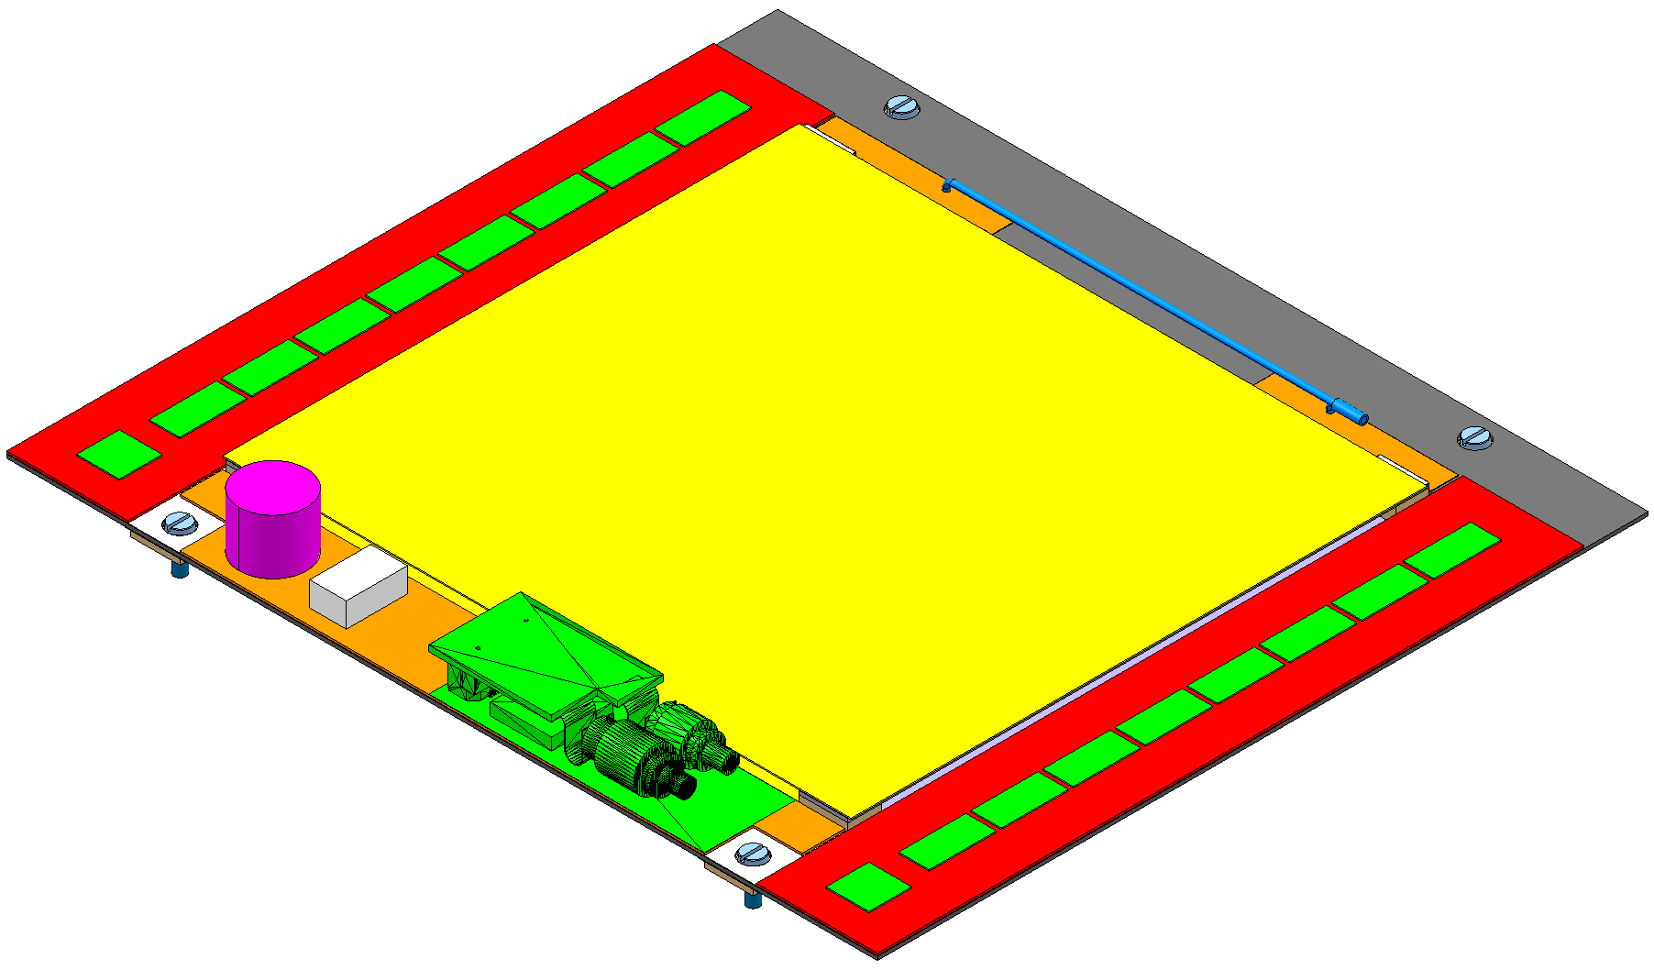
2S PT-module with CBC2
Reminder only
Track & trigger µstrip module for outer tracker region
CBC2 logic correlates hits on two sensors to reject those from low p_{T} tracks
low mass, high density interconnect layer
two layers of sensors
chips on top surface only;
signals from lower sensor
via’d through substrate
8 x 254 channel chips
bump-bonded to hybrid
concentrator
&
controller
~5 cm
~5 cm
90 µm pitch strips
sensors wire-bonded
above and below
8 x 254 channel chips
bump-bonded to hybrid
24

Slide 25
Stub finding Logic
Stubs shift register
Individual mask for noisy channels
→254b from I2C reg.
(can be also used to inhibit coincidence logic)
Need to be able to inhibit stub shift register operation
→1b EN from I2C reg.
254-OR of channel outputs to signal any activity on chip
127-OR of stubs to control the stubs SR readout
latch
@40MHz

Slide 26
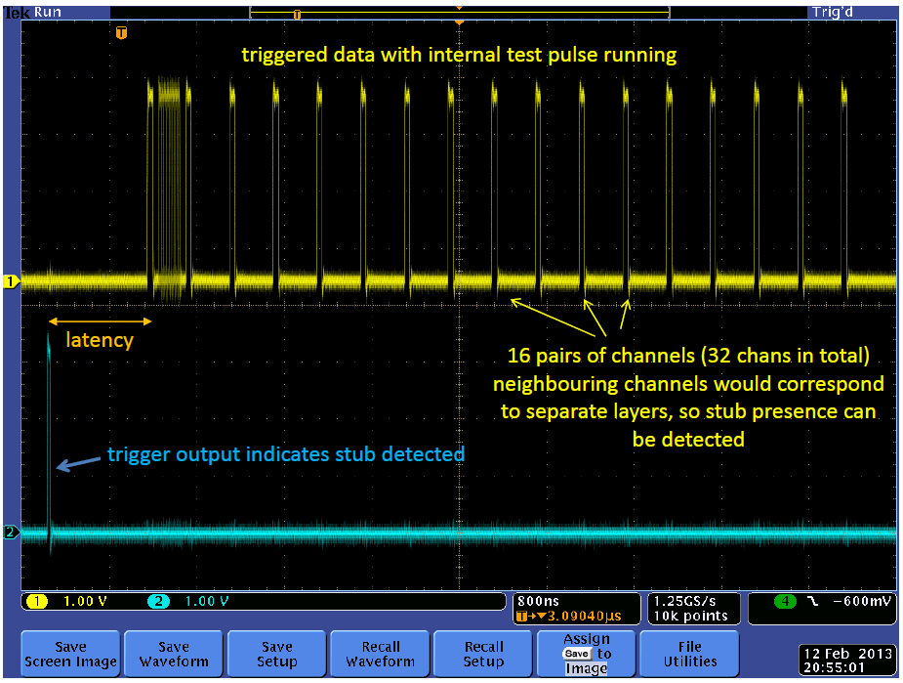
Result with test pulse
shown in March OSC
23
12
22
11
21
11
20
10
19
10
18
9
17
9
16
8
15
8
14
7
13
7
12
6
11
6
10
5
9
5
8
4
7
4
6
3
5
3
4
2
3
2
2
1
1
1
channel
on chip
channel
on layer 2
Proves basic functionality
8 test
groups
channel
on layer 1

Slide 27
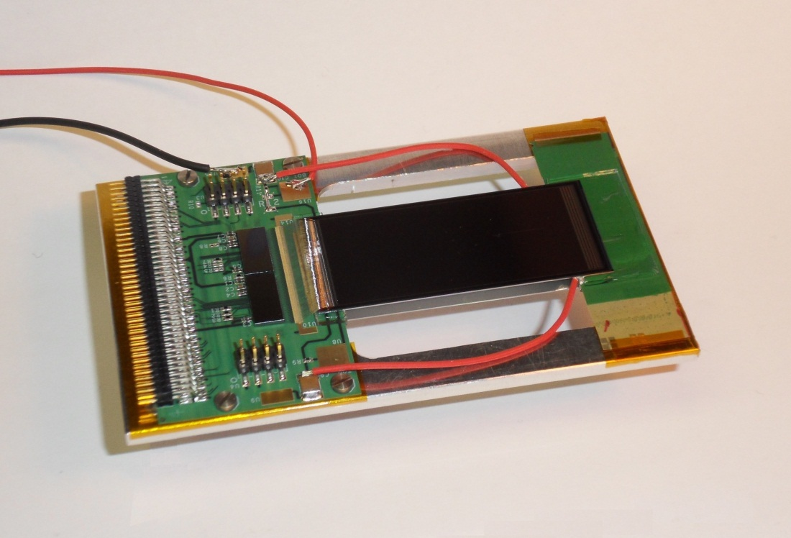
2S mini-module
Several prototypes assembled with two sensors
Under test in lab since July
Preparing for DESY beam test in two weeks time

Slide 28
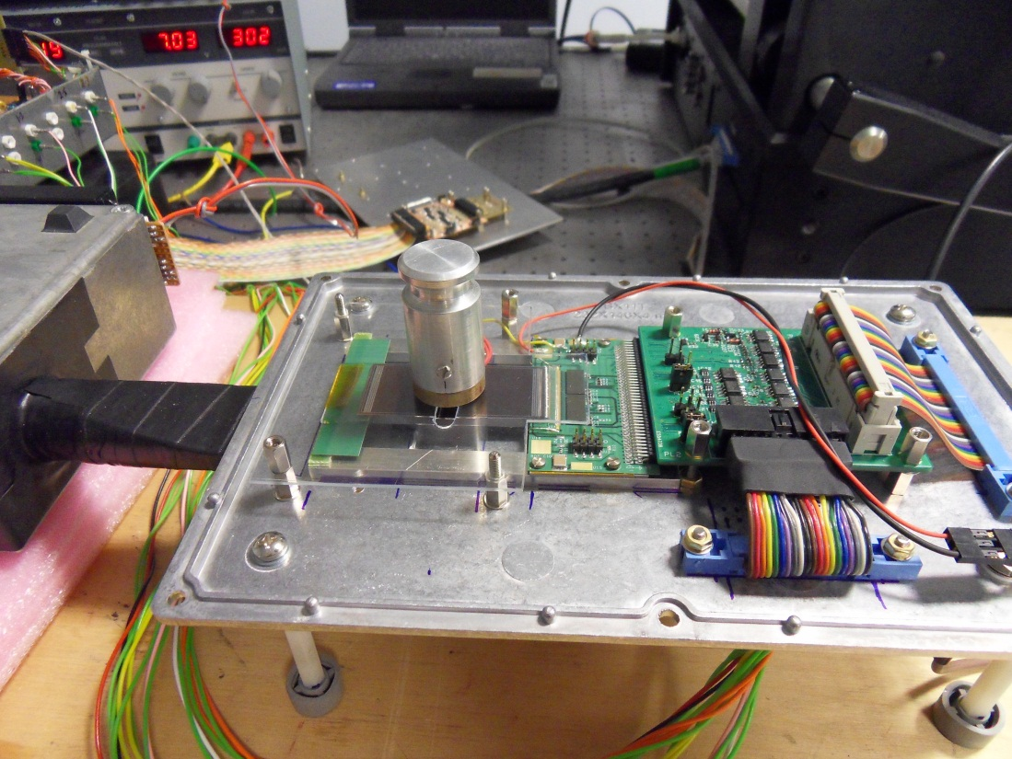
2S mini-module in lab
Some illustrations of logic tests using β source follow

Slide 29
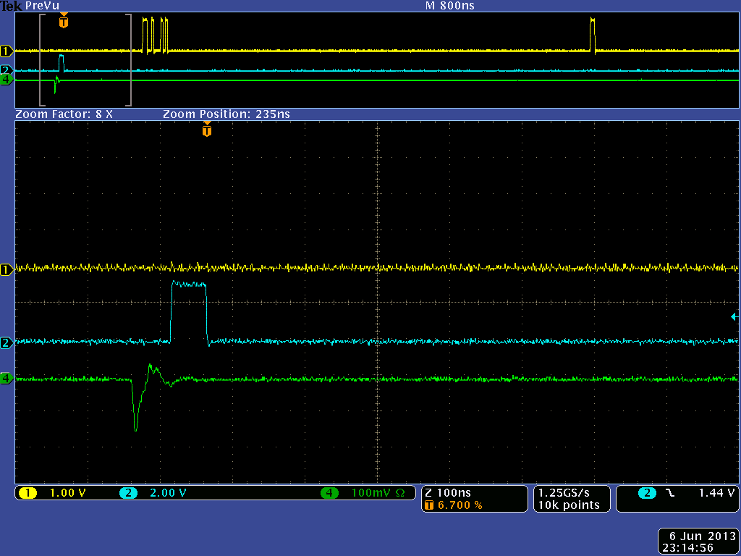
CBC2 triggered data output
hits in the data stream
CBC2 trigger output
scintillator/PM signal

Slide 30
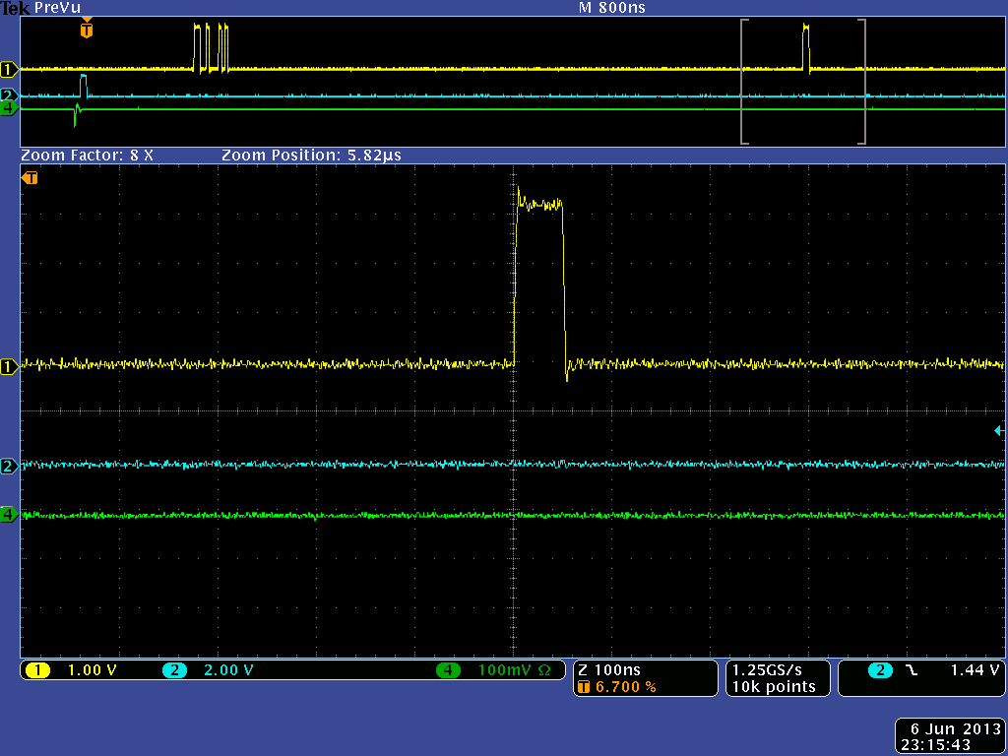
CBC2 triggered data output
50 ns
2 consecutive hits
=> track passed through
strips directly above
each other

Slide 31
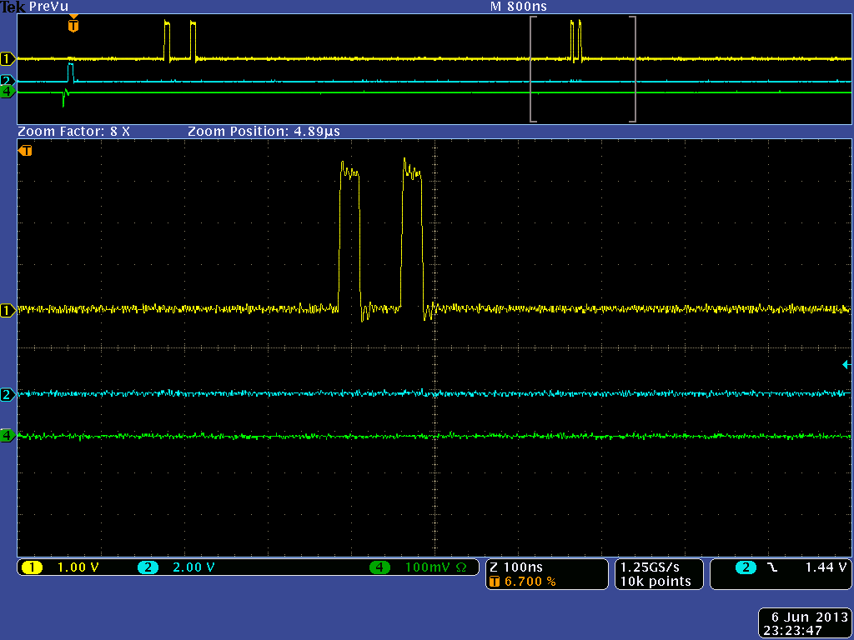
single strip clusters
offset by 1 strip
75 nsec

Slide 32
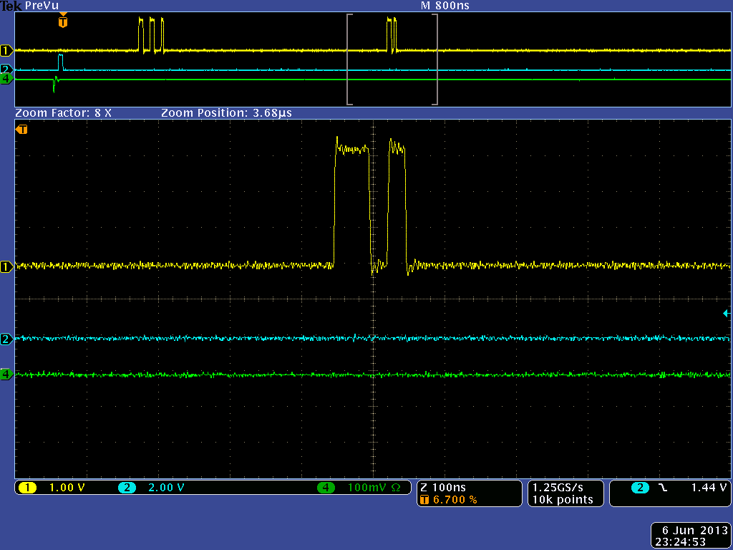
2 strip cluster in one plane
correlates with 1 strip cluster
in the other

Slide 33
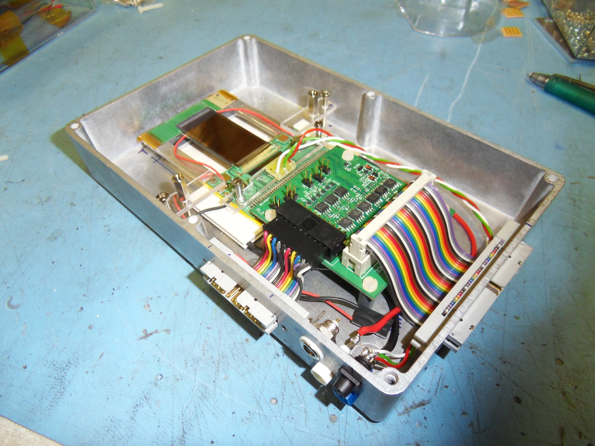
test-beam module
Level Shift
hybrid temperature
sensor
Peltier
Control &
Readout
(LVDS)
LV power

Slide 34
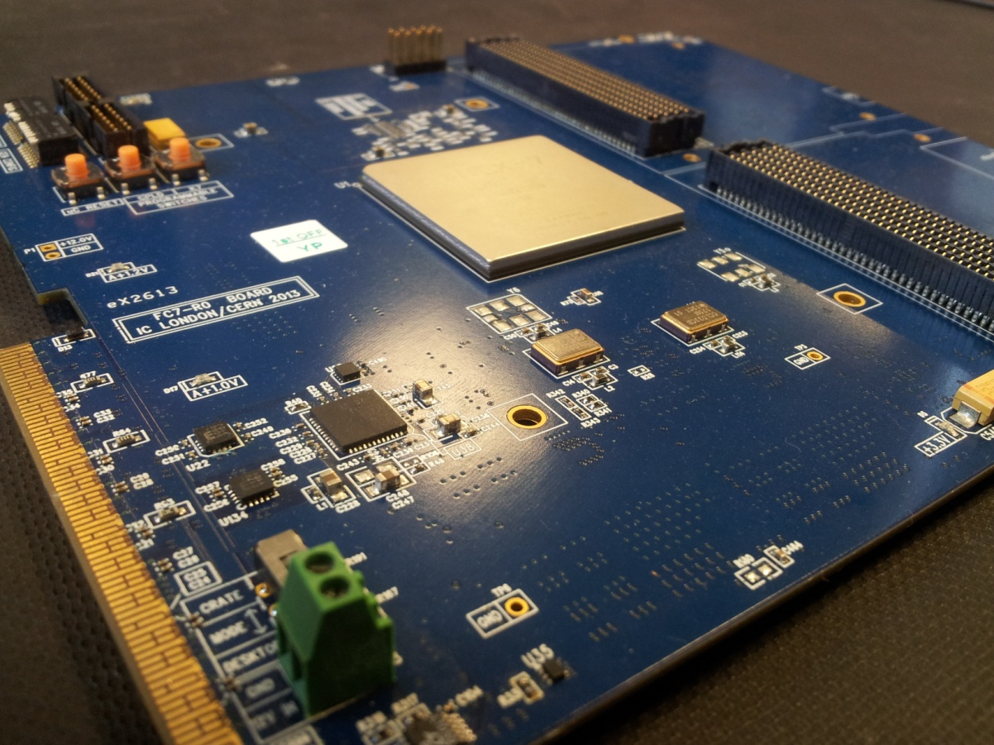
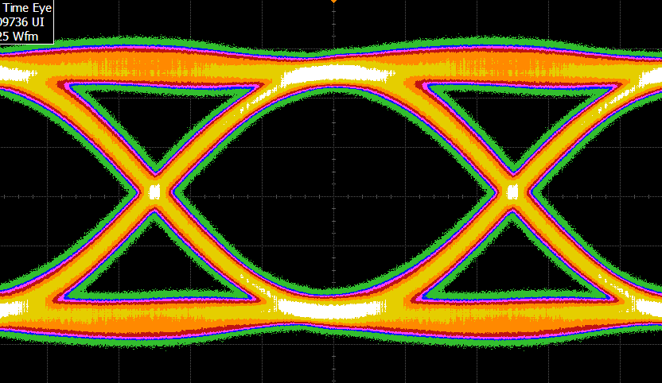
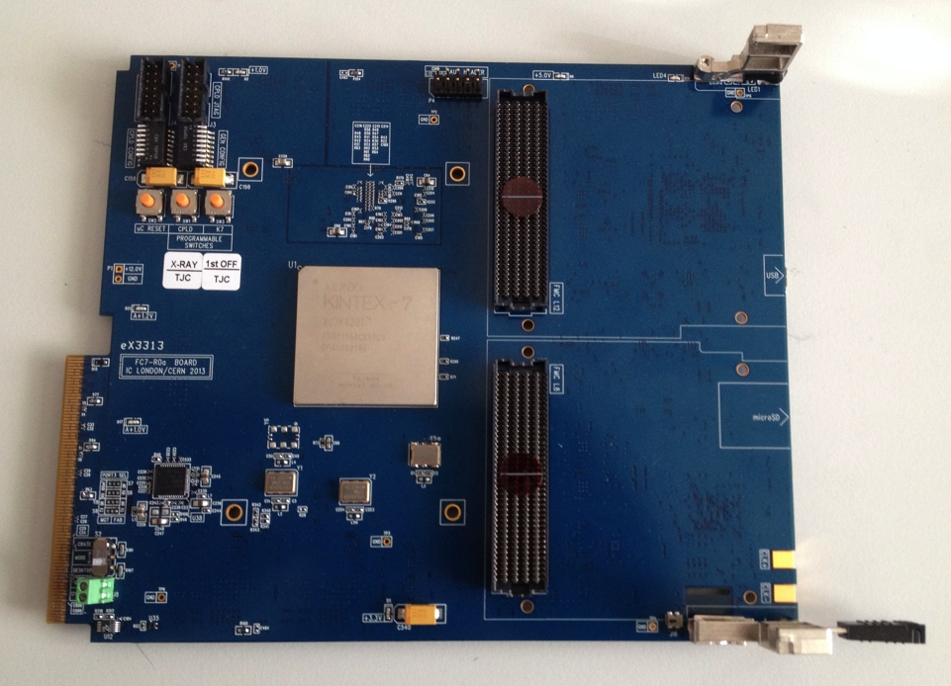
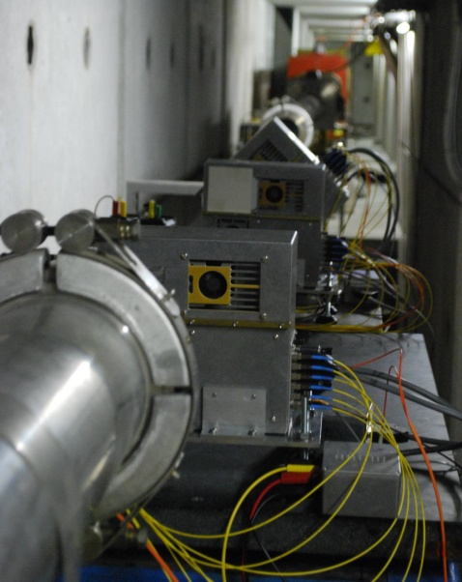
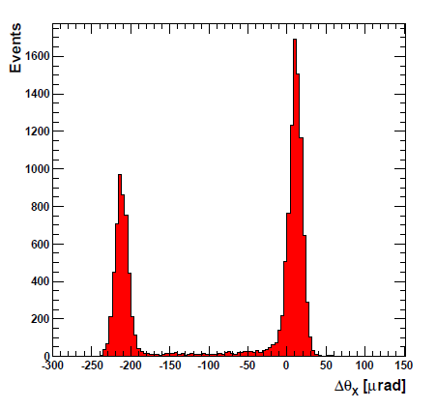
FC7
new generic µTCA DAQ board
flexible – support two FMC-compatible mezzanine cards accessible from the front panel, compatible with µTCA and µTCA for CMS
will replace TTC system in 2014,
pixel FEDs & FECs in 2017;
future DAQ for Phase II proto-CBC modules
status: first prototypes passed initial testing, all serial links running well at 10Gbps, all I/O validated
0.2 Tb/s bandwidth over 20 front panel serial links
128 front panel user I/O, up to 1.2 Gb/s per pair
M. Pesaresi (Imperial)
P. Vichoudis (CERN PH-ESE)
CMS upgrades – beam telescope
for qualifying CBC ASICs & prototype modules in beam
also used for making precise measurements on performance of next generation LHC collimators

Slide 35
Rough road map
CBC1
- analogue front end in 130nm
wirebonded
binary logic
- L1 triggered readout only, non-sparsified
2011
as foreseen in proposal
CBC2
C4 bump-bonded
full hit correlation logic
L1 triggered non-sparsified readout, fast trigger OR
2012
2013
2S-Pt prototype module studies
2014
CBC3
full readout architecture defined
final data format
additional correlation logic
2015
2S-Pt final module studies
2016
CBC4
optimisation
final version
2017
start production

Slide 36
WP2 planning
CMS goals based on TP [2014] and Tracker TDR [2016], then construction
Excellent CBC progress begs some questions:
can we rely on this schedule, given planning & funding situation?
will be CBC be ready too soon? could the requirements change?
will engineering effort be used too soon?
can the tracker construction (or TDR) start without proven PS module?
no urgency at present for CBC3
would finalise data format and improve a few details
plenty of CBC chips available for modules
much to be done in evaluation both module and chip
2S and logic performance
SEU and irradiation
review milestones and objectives in coming months before next OSC

Slide 37
WP3 objectives and status
Improvement of calorimeter trigger for next running period
based on
Time Multiplexed Trigger (now adopted)
commissioning in parallel with operation of existing trigger
Design of track-trigger for HL-LHC
and technology demonstrator
Recent progress
Very successful TMT slice test at end September
UK hardware used for both Layer 1 & Layer 2
A lot learned about firmware & tools
Algorithms implemented and latency measured
Significant simulation work on future algorithms
Several iterations of MP7
some fabrication issues which need care, but not show-stoppers

Slide 38
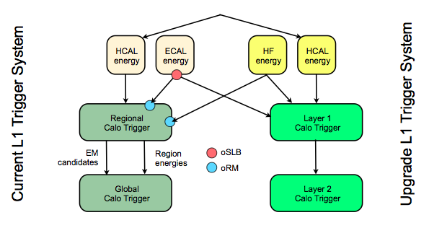
Overview: calorimeter trigger
A Tapper
LHCC referees meeting May 2013
Commissioning of calorimeter trigger in parallel in 2015
Necessary to install oSLB/oRM during LS1 (complex operation)
Necessary to install passive optical splitters for HCAL (LS1 and YETS

Slide 39
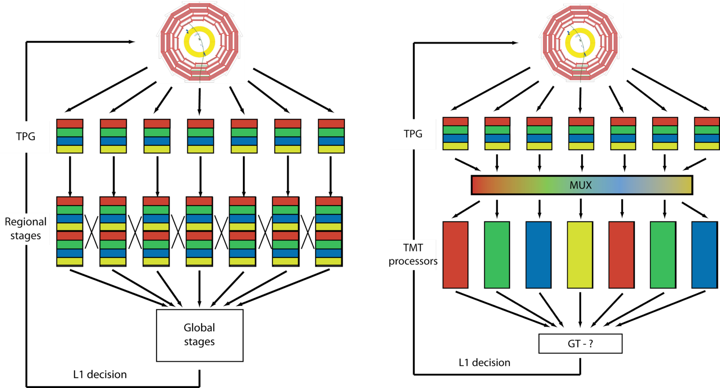
Time-multiplexed trigger
The Time-multiplexed architecture allows all data to arrive in geometric order:
Towers at given φ are always the same bits on the same optical links
Towers arrive in order of increasing |η|
This converts a 2D geometric problem to a 1D problem
Also only need to develop 1 FPGA design
DEMUX
L1 decision
GT
Conventional Trigger
Time-Multiplexed Trigger
Chosen by CMS as architecture of Phase 1 Trigger upgrade
Project milestone from TDR to demonstrate working concept in September 2013
TMT test took place starting 30th September in building 904
Bristol, Imperial, RAL, LLR involved
Complete set of results @
https://indico.cern.ch/getFile.py/access?contribId=6&sessionId=1&resId=0&materialId=slides&confId=277887

Slide 40
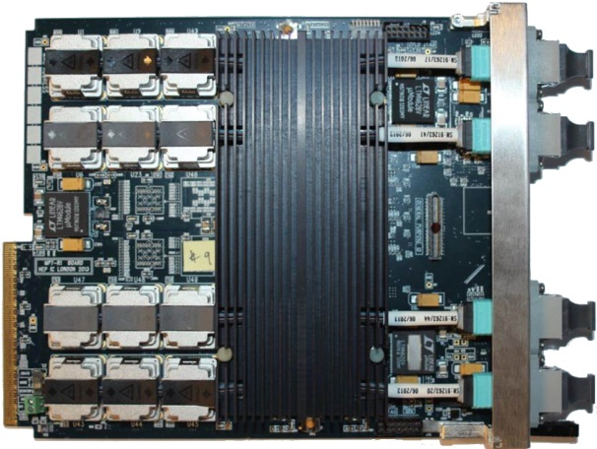
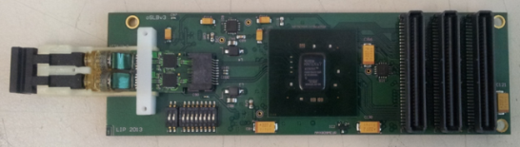
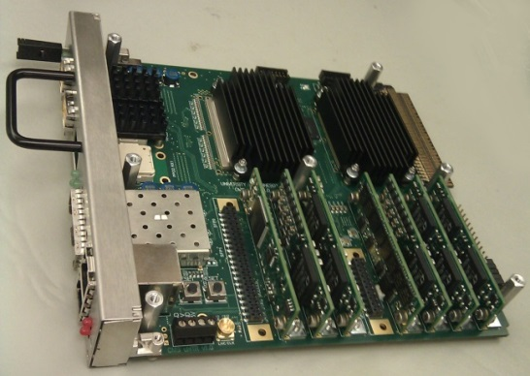
TMT layout
MP7’s used here as PP’s, CTP7’s to be used in final system
TPG input to PP not part of test
Test set-up @ 904
PP-B
oSLB
Simulating multiple PP cards with a single MP7
uHTR
MP
Demux
Simulating multiple PP cards with a single MP7
PP-T

Slide 41
Results compared to objectives - 1
The stability of the MP7 links was extensively tested several times overnight for 8 hours at a time, 72 links operating, monitoring the CRC counters and the alignment flags.
0 CRC errors 0 alignment errors

Slide 42
Algorithms used in TMT test
Clusters
2x2 clusters
Overlap filtering and e/γ/τ identification logic available but not used
Candidates sorted in φ by E_{T} before output
Sort in η available but not used to increase statistics for validation
Jets
8x8 circular jets (biggest under consideration)
Candidates sorted in φ by E_{T} before output
Sort in η available but not used to increase statistics for validation
Sums
Scalar and vector sum of energy in each φ ring of towers
Number of “towers over threshold” in each ring calculated (potential PU estimator)

Slide 44
WP3 planning
Issues for calorimeter trigger
US readiness & funding
CTP7 for Layer 1 is only at layout stage (just gone to fabrication)
Planning for 2015
US proposed short term interim upgrade but all aspects of development (hardware, firmware, software) are late and behind full upgrade planning
oSLB and oRMs installation in LS1 is crucial for full upgrade
EDR 12 & 13 November
propose revision of planning when outcome is known
Discussions started for HL-LHC Track-trigger planning
in Tracker community. MP7/TMT are promising test-bed

Slide 46
Finances
All RA posts now filled
Expenditure as expected
continuing orders of MP7 and FC7 prototypes
µTCA hardware
materials for 2S-modules and beam test
Looking for OSC feedback on
financial table format
how to include CG grant spending
milestone reporting
risk register

Slide 47
Conclusions
The next phase of the project is well on track
continued good progress
Main issues concern adaptation to LHC schedule
it is unlikely that there will be much new information about long term schedule and planning very soon
perhaps at next RRB?
Propose revision of milestones within next six months
expect feedback from trigger EDR and possible strategic decisions
evaluate options for Phase II tracker developments

Slide 48
Further information

Slide 49
Stub logic features
Cluster width
exclude clusters wider than 3 strips
Offset correction and correlation
programmable window, selects pT
up to +/-8 channels
programmable offset, adjust lateral displacement
up to +/-3 channels
p = ∞
offset
R-φ view
n+1
channel
comparator
outputs
1/2/3 strip
cluster on
channel n
n
IP
n-1

Slide 50
CBC3
analogue front end amplifier
re-examine pulse shape for dead-time issue
maybe postamp feedback resistor tweak necessary
check optimum input transistor dimensions for 5 cm strips
5 pF was original target
try and adjust for 1.0 V operation
can’t guarantee success
comparator
2 comparators/channel? 5 sigma and 3 sigma thresholds?
(1 chan > 5σ) OR (2 neighbours > 3σ)=> hit
some issues of what to do with comparator outputs
5/3 sigma pipeline, or 2x pipeline
what to do with 5 sigma neighbouring 3 sigma (different combinations)
more signals to cross chip boundaries?
likely extra 50 uW / channel
biases
linear enough? monotonic enough? enough resolution?
hit detect
keep existing circuit but plan to run in variable mode only
then need additional circuit to suppress hips - if comparator output high for longer than 3 BXs (4 BXs?)
mask to pipeline
needed somewhere if moving to sparsified system, not necessarily on CBC but probably best place
can be separate to mask for correlation logic
pipeline
length increase to 25 usec or thereabouts
issues of SEU and ionizing sensitivity (if minimum size devices)
trigger rate capability to 1 MHz
output data format
how many lines at what rate?, differential/single-ended? - baseline 12 lines @ 160 Mbps
offset correction
4 domains / chip (only 2 in CBC2)
correlation
+/- 8 channels, ½ strip resolution => 8 bit address
5 bit bend information
priority encoding of highest 3 pT stubs (Mephisto)
slow ADC?
with “band-gap accuracy” can at least
get an accurate value for the voltage biases
probably useful but is it worth it?
probably not if have to develop from scratch

Slide 51
module test-beam system
bias
bias
GLIB
+9V
hybrid temp.
stabilisation
(Peltier)
hybrid LV
power (1.2,
3.3, +/-5)
+6V
-5V
can use I2C to monitor
1.2 and 3.3 currents and
hybrid temperatures
mains
plug
power
supplies
RJ45 cable
(~ 10m )
I2C hub
+5V

Slide 52
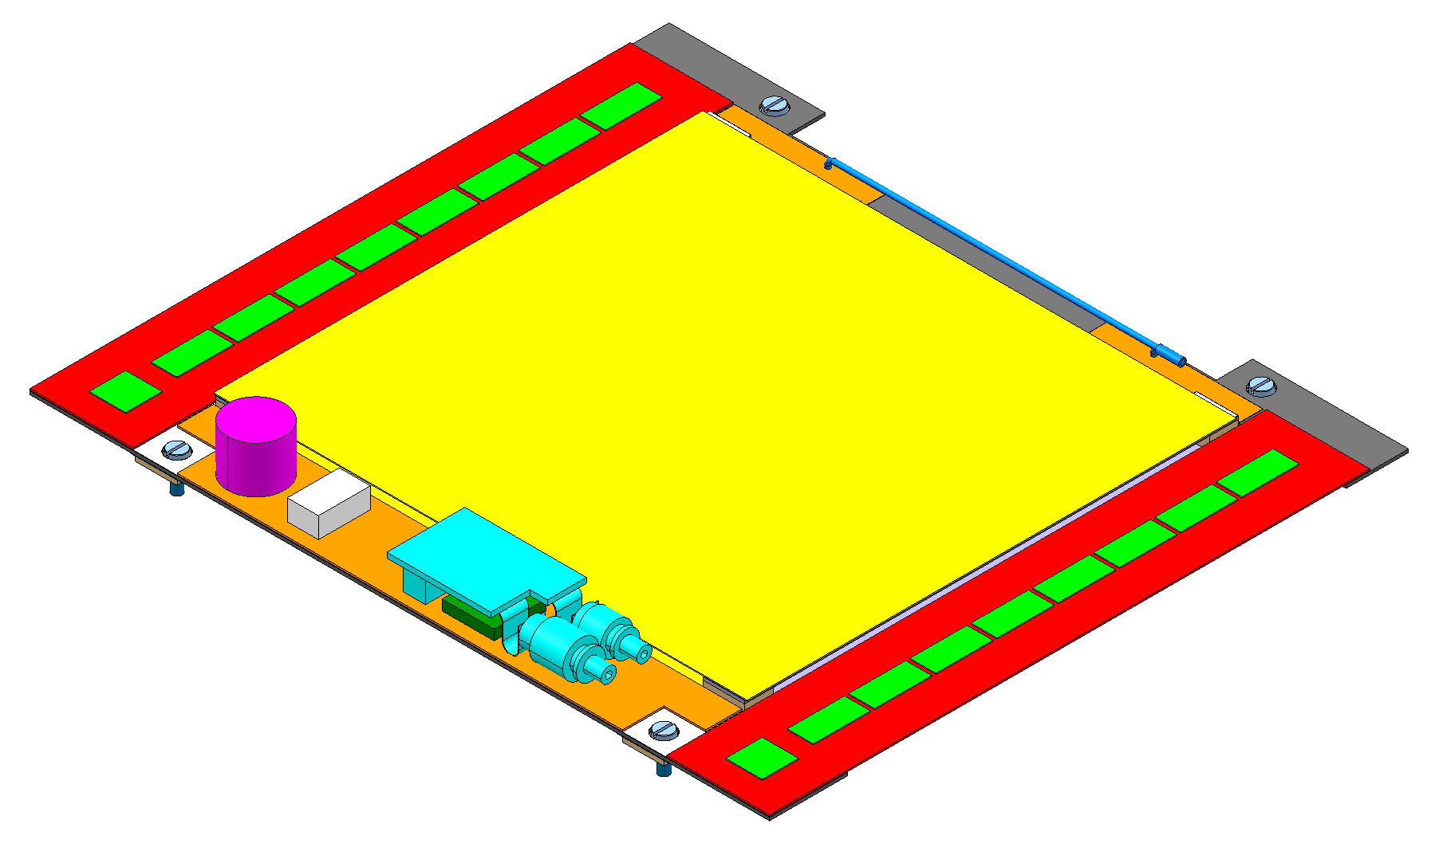
CBC3 - the “final prototype”
n+1
2 strip cluster
centred on
n and n+1
next version of chip should incorporate all features required for HL-LHC
final choices for front end
½ strip cluster resolution
2 strip cluster position assigned to mid-point
stub data definition
8 bits address (for ½ strip resolution) of cluster in bottom layer
5 bit bend information
address of correlating cluster in top layer
stub data formatting & transmission to concentrator
13 bit / stub, up to 3 stubs/BX => 39 bits
+1 bit unsparsified L1 triggered readout data
=> 40 bits / 25 nsec
e.g. 10 lines at 160 Mbps (per chip)
other useful features
e.g. slow ADC to monitor bias levels
…
n
1 or 3 strip
cluster centred
on channel n
n-1
5 bits to describe correlating cluster
address in top layer window
top
bottom
8 bits to describe cluster
address in bottom layer
CBC
127
CBC
CBC data to concentrator
CBC
S1
S1
S1
S1
S1
S1
S1
S1
B1
B1
CBC
25 ns
B1
B1
B1
S2
S2
S2
S2
S2
S2
S2
CBC
25 ns
S2
B2
B2
B2
CBC
B2
B2
S3
S3
S3
S3
10 lines / CBC
S3
S3
S3
S3
B3
B3
B3
B3
B3
R
CBC
CBC
concentrator

Slide 53
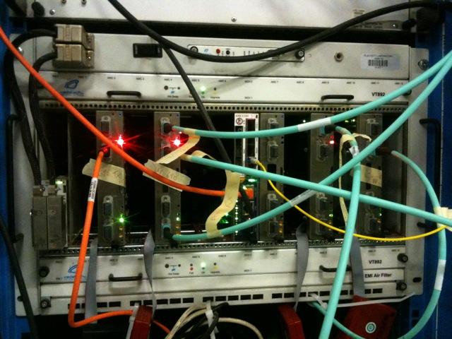
TMT-test setup @ 904
PP - T
MP
DEMUX
PP - B
- 720 Gbps of data going through the MP board
- The MP is processing data from the entire calorimeter

Slide 54
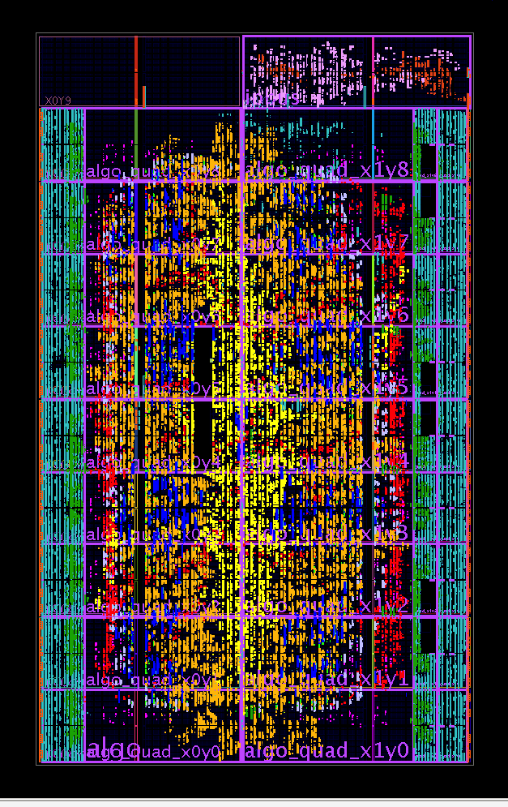
Floorplan of FPGA
DAQ
Communication
Algorithms
Infrastructure
Clusters
MGT’s
Towers
Buffers
Jets
Sorting

Slide 55
Resource usage of FPGA
Entire FPGA
 | Infrastructure | Algo + Infrastructure
Registers | 9% | 21%
LUTs | 19% | 36%
DSPs | 0% | 8%
BRAM | 12% | 12%
All Algos and Infrastructure: 7 hour build-time
Algo area only
 | Infrastructure
Registers | 20%
LUTs | 35%
DSPs | 13%
BRAM | 0%

Slide 56
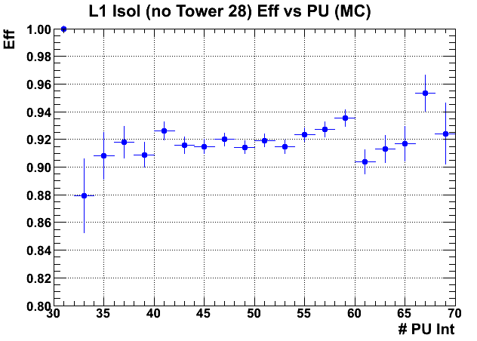
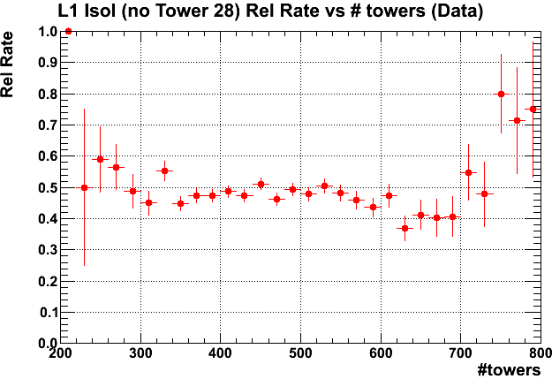
E/gamma Algorithm
ϕ
Baseline Stage 2 EG algorithm :
2x2 Trigger Tower clusters
Cluster position reported to ½ tower precision
Default isolation region : 5η x 9ϕ towers
Current focus on PU subtraction for isolation
Need to estimate the 90% percentile of PU ET distribution
# towers over threshold shown to work well (below)
Currently evaluating a range of other algorithms
η
✦
ΔR ~ 0.18
Efficiency & rate stable with PU using # towers as estimator

Slide 57
Jet Algorithm
ϕ
η
Baseline stage 2 jet algorithm :
N x N tower circular jets (up to 8x8)
Approximates a fixed cone algorithm
As for EG, current focus is PU subtraction
Need to determine mean ET of PU distribution
EG/jets may need different PU estimation methods
Range of algorithms under study
Expect to choose baseline algorithm soon
7x7 tower circular jet
ΔR ~ 0.3
# towers above threshold
∑ET
Performance of different estimators for Nvtx

