Slide 1
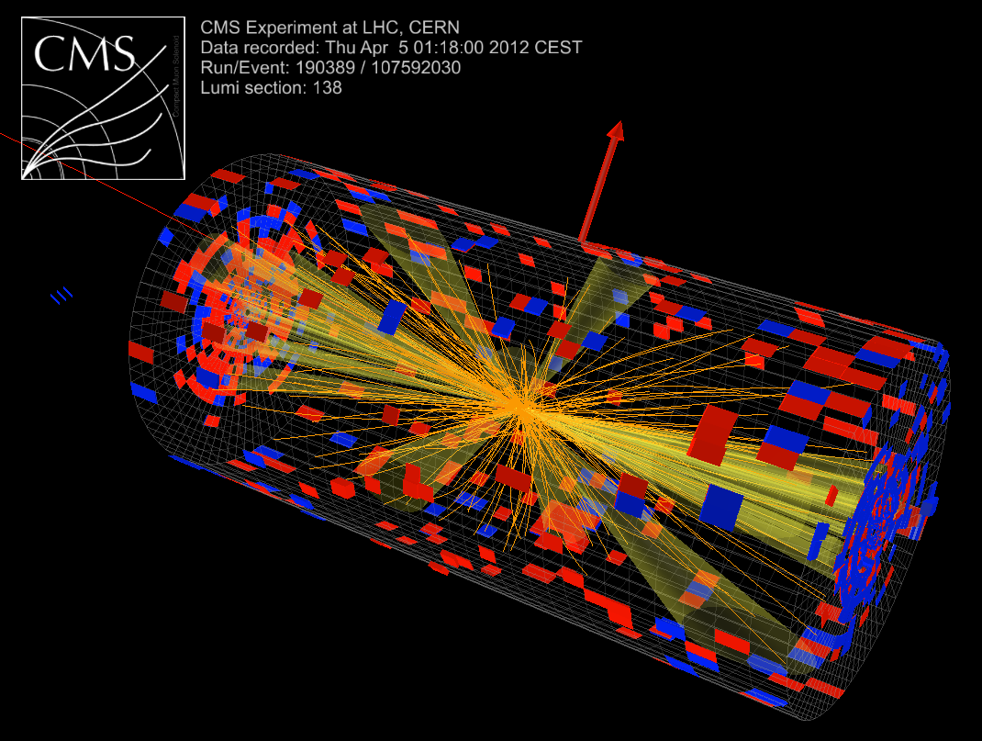
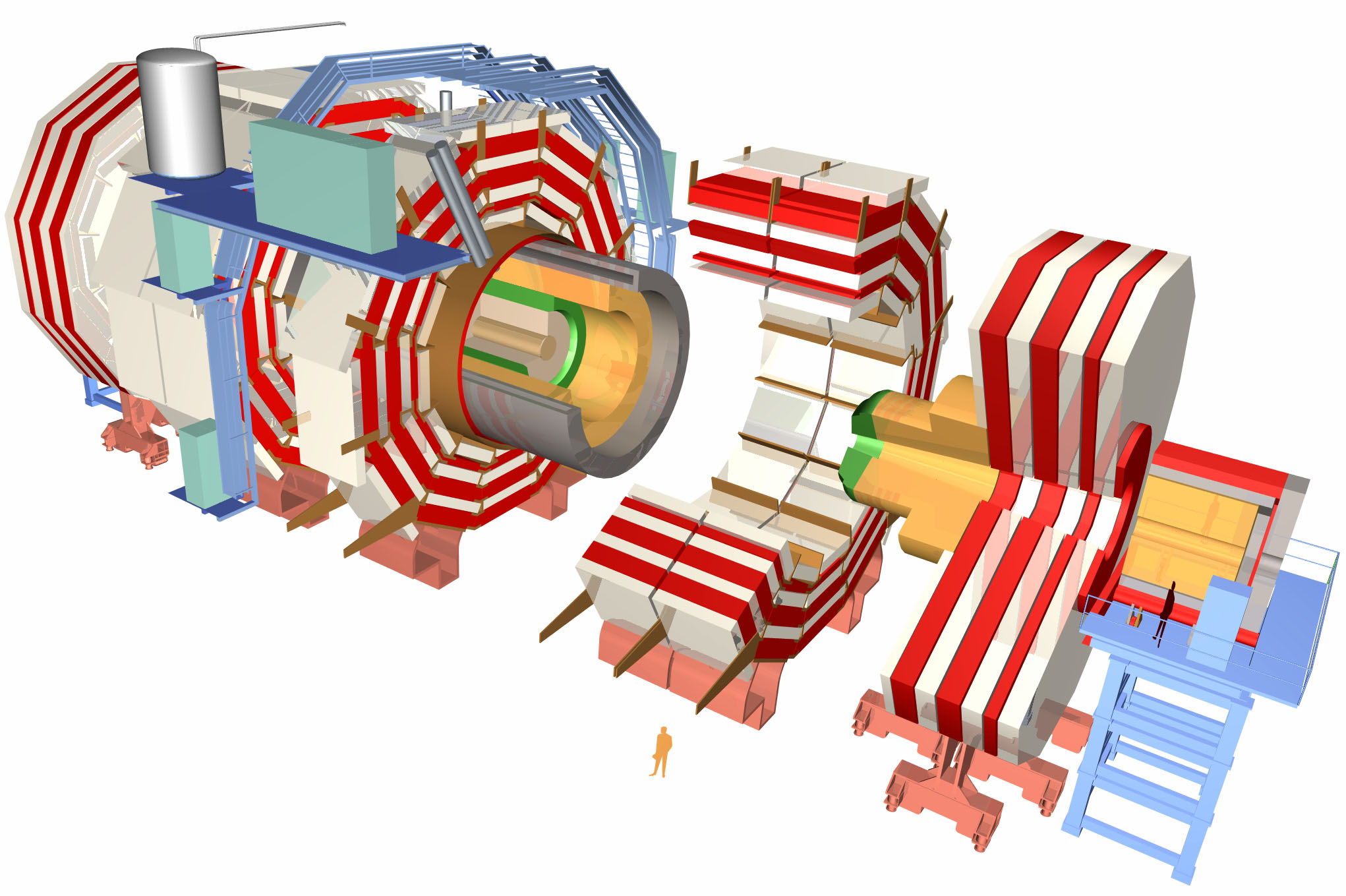
UK CMS: Status and plans
8 TeV !
Status of LHC & CMS
UK projects
Physics plans
Requests for support

Slide 2
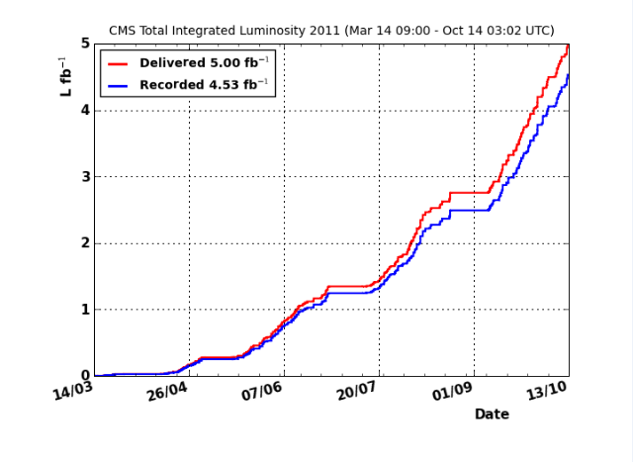
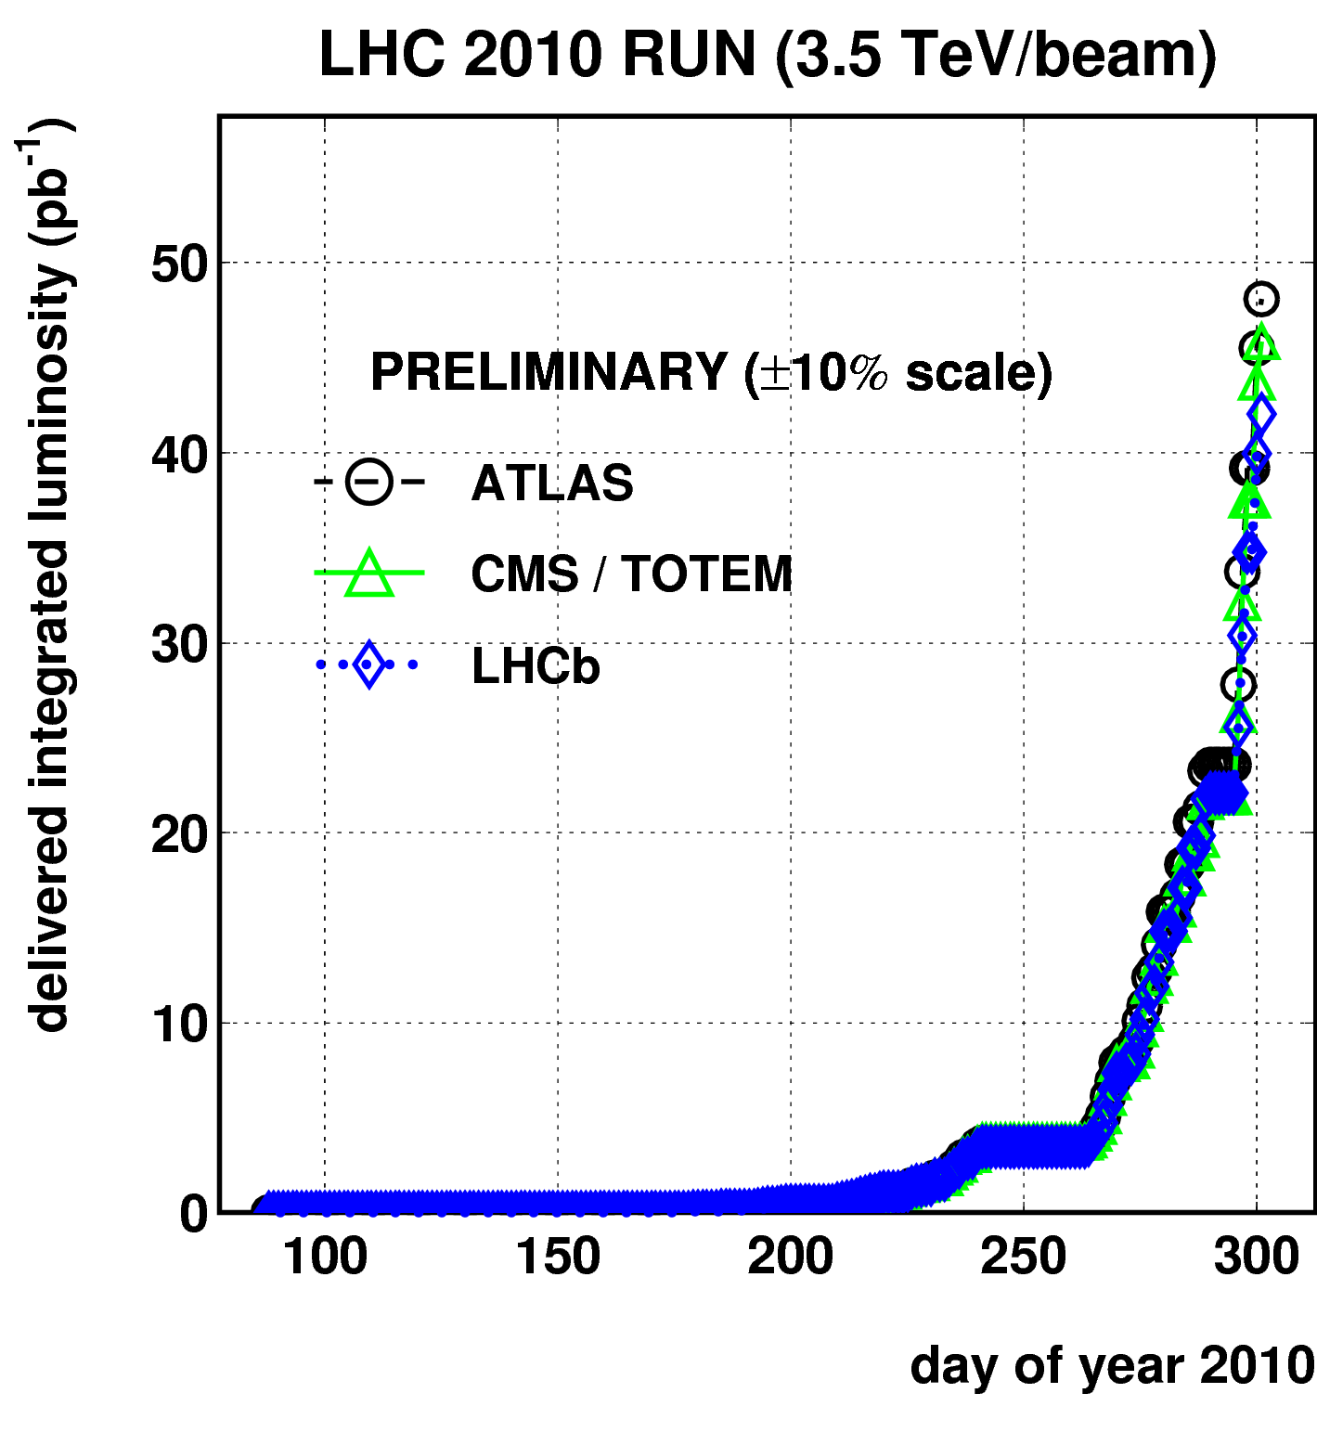
LHC performance
Integrated luminosity plots speak for themselves – superb !
2010: 5 orders of magnitude in 200 days, 50 pb⁻¹, half in last week
2011: ~2010 per day
60pb⁻¹/day average

Slide 3
CMS status
xx

Slide 4
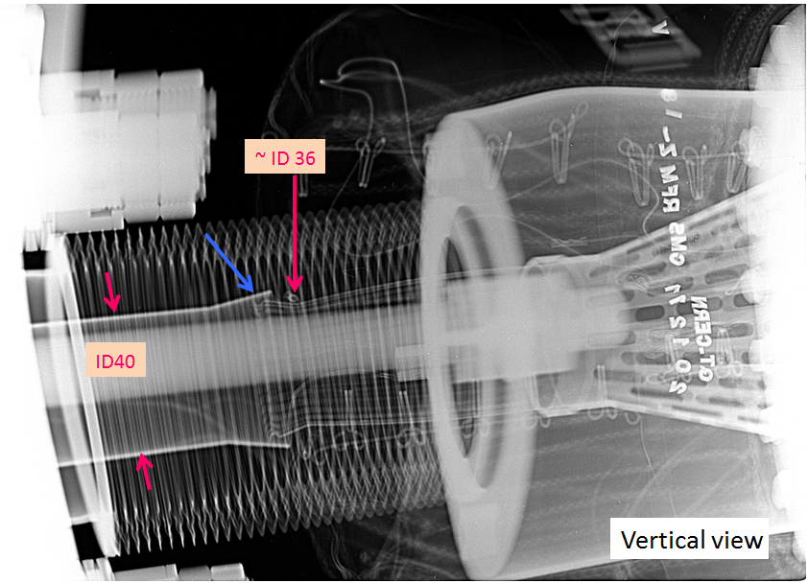
However, should not be complacent…
One potential risk to data seems to be solved…
Unexpected pressure rise (10⁻⁶ mbar) observed in close to CMS:
bad RF contact (x-rays inspection)
Interventions in P2, P8, P5 (CMS) to resolve RF finger issues
Luminosity related beam-gas interactions & consequent pixel resynchs were serious concern at the end of 2011
CMS

Slide 5
UK responsibilities
Operation of systems critical to successful CMS operation
based on UK deliverables, with many key staff who are crucial
Endcap ECAL – 14648 PbWO4 crystals & vacuum phototriodes
Operation, EE HV system, performance
Tracker – 9.3M µstrips, largest CMS DAQ system
440 Front End Driver boards - firmware, software, hardware
75,000 APV25: calibration, monitoring, optimising performance
Global Calorimeter Trigger – heart of trigger
80 digital boards - firmware, software, hardware
Calorimeter trigger implementation and monitoring
Computing support – data transfer, MC samples and analysis
shared UK Tier-1, 2 UK Tier-2 sites
Offline, as well as online, software
Data Quality Monitoring is important for good physics

Slide 6
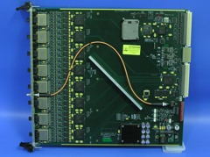
Tracker
Continued excellent performance – contributes to all physics
Main UK tasks in DAQ & DQM: steady attention to FED operation & performance, adapting to changes in CMS operations
Preparation for -20°C operation in LS1

Slide 7
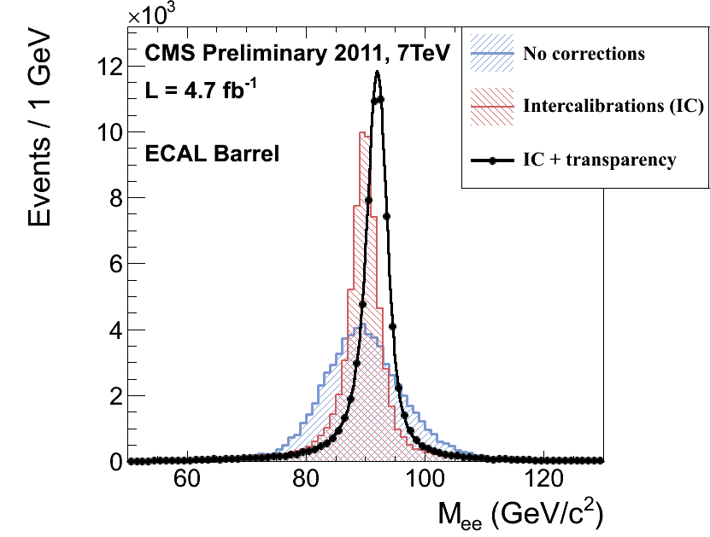
ECAL
Impact on many physics areas
W/Z, Higgs, Z’, …
Optimisation of performance
Calibration
Monitoring for short & long term

Slide 8
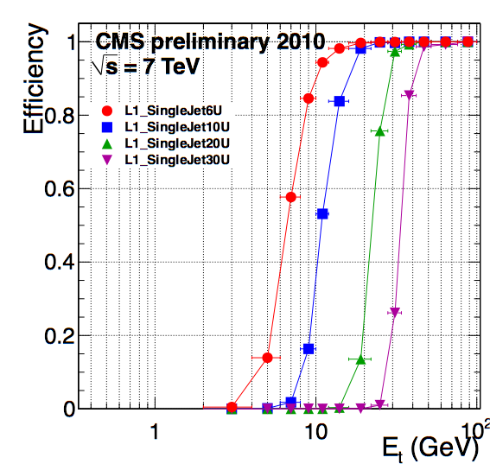
Global Calorimeter Trigger (GCT)
Central role in CMS data taking and physics analysis
All discovery channels searching for electrons, photons, jets and missing energy
Vital to provide uninterrupted service
Team at CERN providing round-the clock support
Less than 1% of CMS downtime in 2011 from GCT
Well understood performance vital ➔
Prompt analysis team at CERN to react quickly
Flexibility and rapid response to requests
for new/improved algorithms
Improvements to hadronic tau finding
New algorithm for missing energy from jets added
Improvements to jet algorithm being investigated for high pile-up in 2012 running

Slide 9
Physics Status

Slide 10
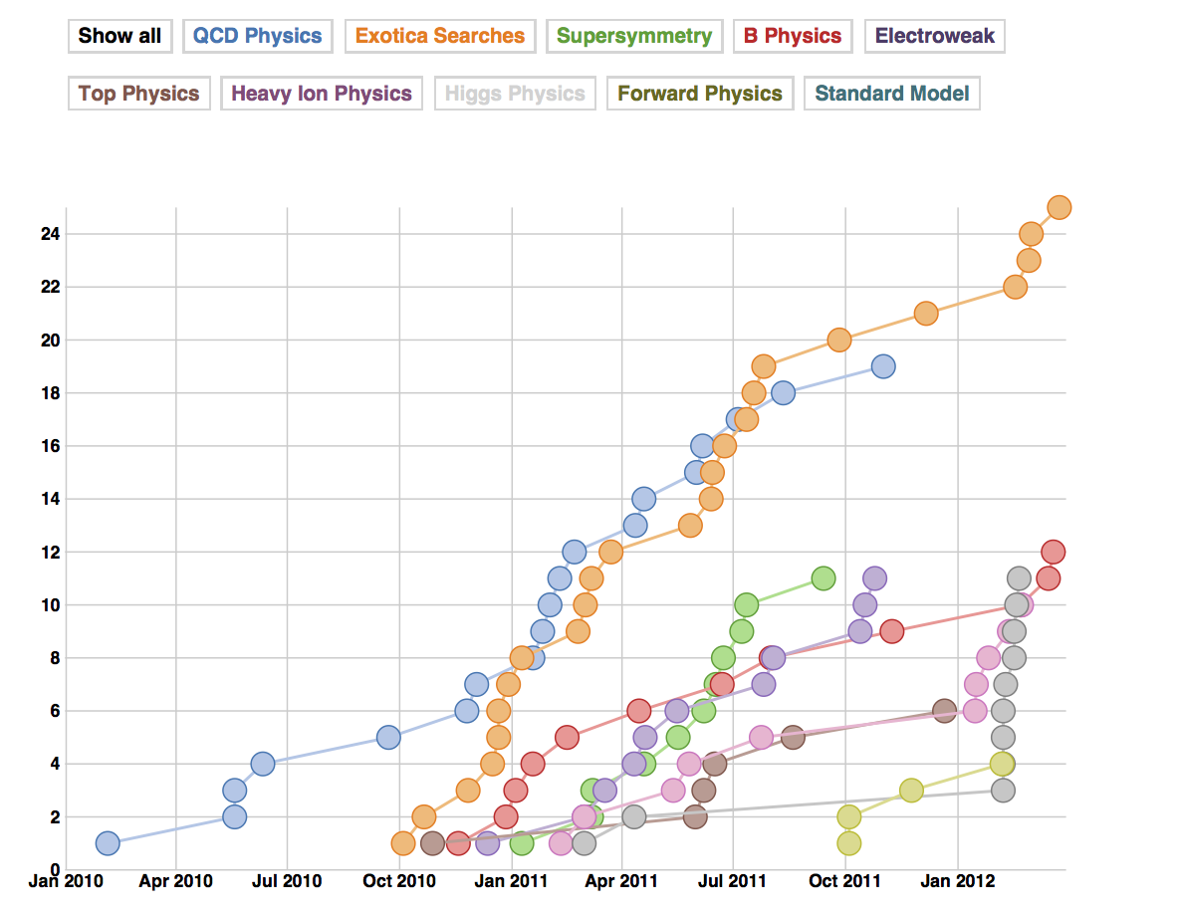
CMS Physics Publications

Slide 11
Physics overview
Significant UK effort in major topical areas
UK physics activities closely match detector responsibilities
Table from PPGP 2009
Have delivered according – quite closely - to plan
Higgs advanced more rapidly than expected in 2011
But we were ready to play a big role
SM | W & Z cross-sections Triple gauge couplings Top cross-section
BSM | Heavy resonances to electrons SUSY searches Long lived particles, eg Hidden Valley, stopped gluinos
Higgs | Long standing expertise particularly in H→ ττ channels Complex final states for non-SM, eg qqh, CPX Higgs

Slide 12
Electroweak Highlights
Strong contribution from
Imperial group in 2010
J. High Energy Phys. 01 (2011) 080
J. High Energy Phys. 10 (2011) 132

Slide 13

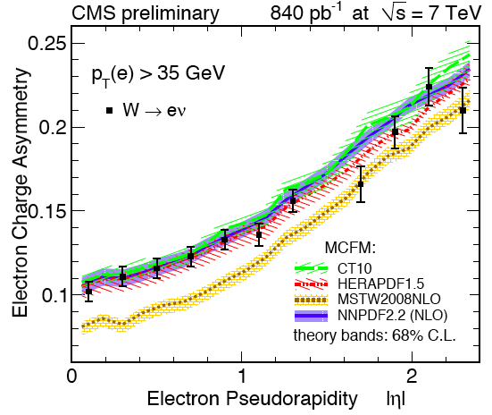
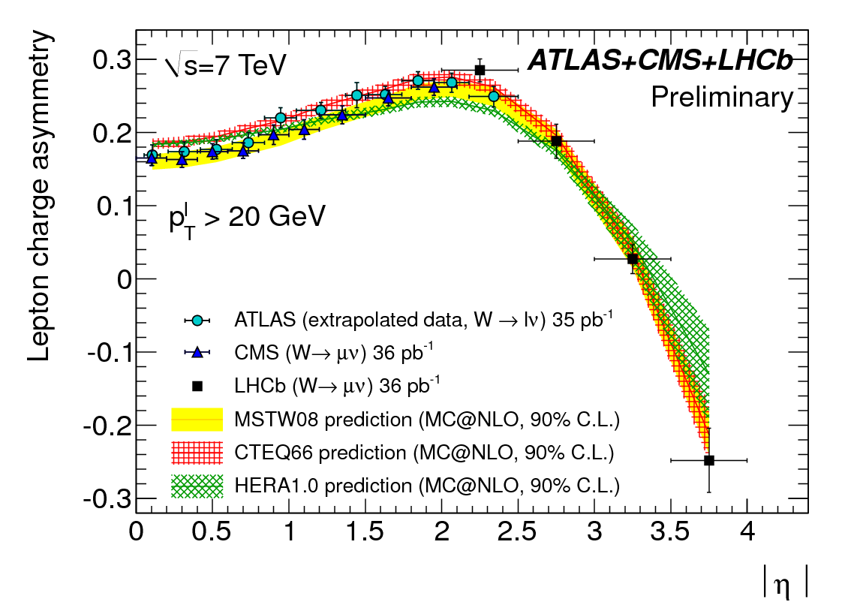
W charge asymmetry
High precision measurement of W lepton charge asymmetry
new inputs to the parton distribution function global fits.
Imperial group
CMS JHEP04 (2011) 050
CMS PAS SMP 12-001 to be submitted for publication
most precise measurement to date

Slide 14
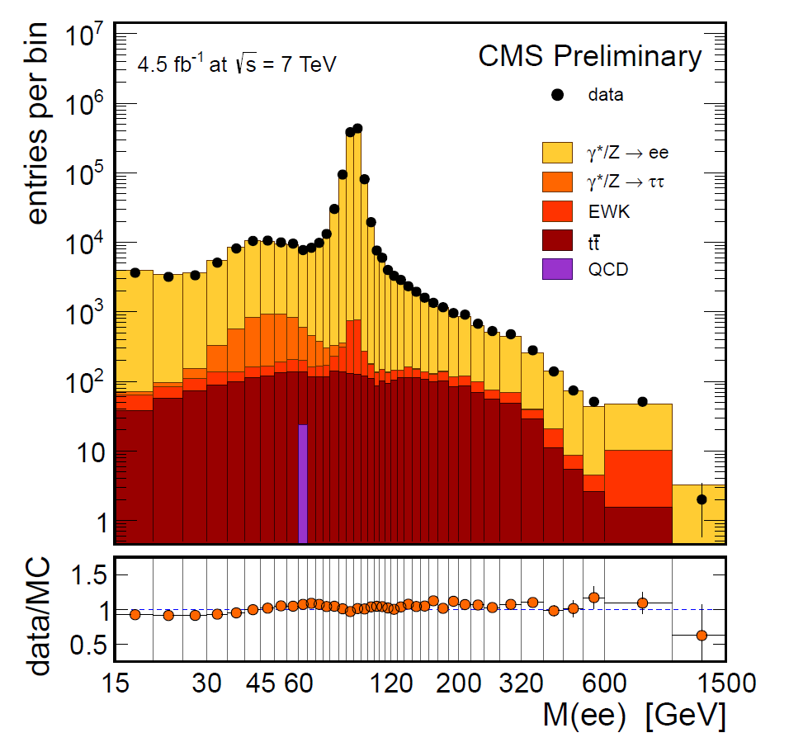
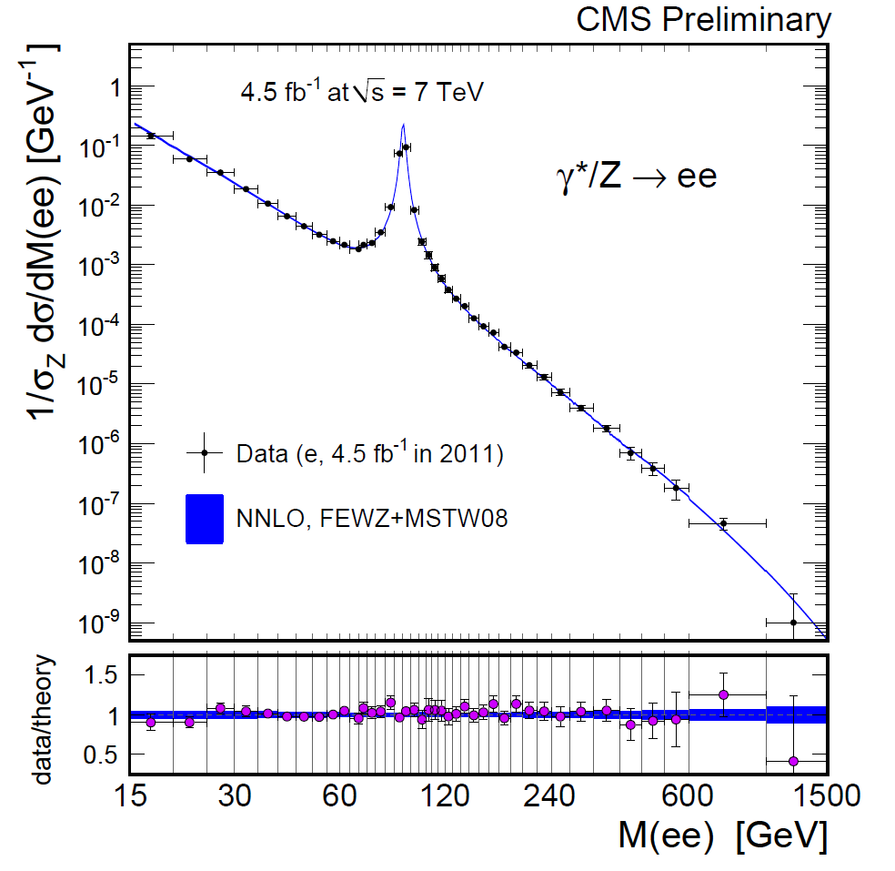
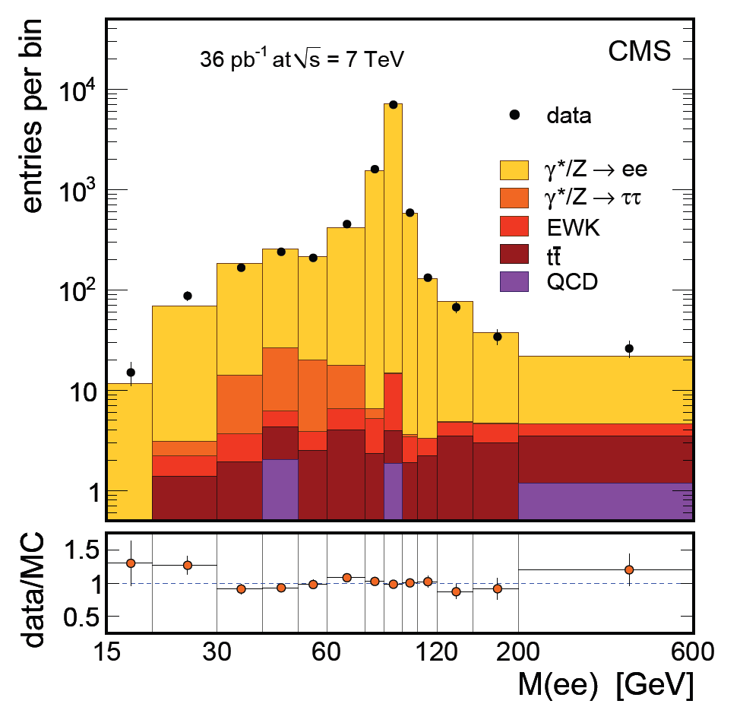
EWK – Drell-Yan
DY cross section measurement. Publication 2010 & 2011
Electron analysis major contribution from RAL.
Exploited expertise developed for Z’ search analysis

Slide 15
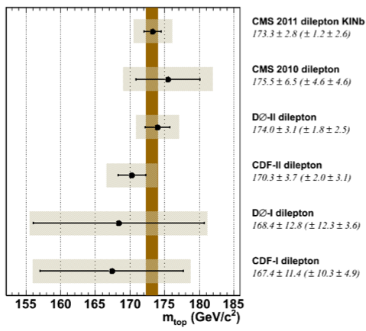
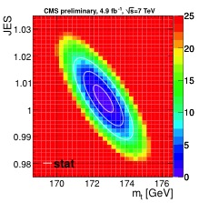
Top Mass
Top mass in l+jets channels with full 2011 dataset
Likelihood method simultaneously fitting the top mass and Jet Energy Scale
Best mass determination in the dilepton channel to date
TOP-11-015
TOP-11-016
Very significant contributions by Bristol and Brunel
e.g. Phys.Rev.Lett. D84 (2011) 092004
CMS average : 172.6 ± 0.4 ± 1.2 GeV
Tevatron average: 173.2 ± 0.6 ± 0.8 GeV

Slide 16
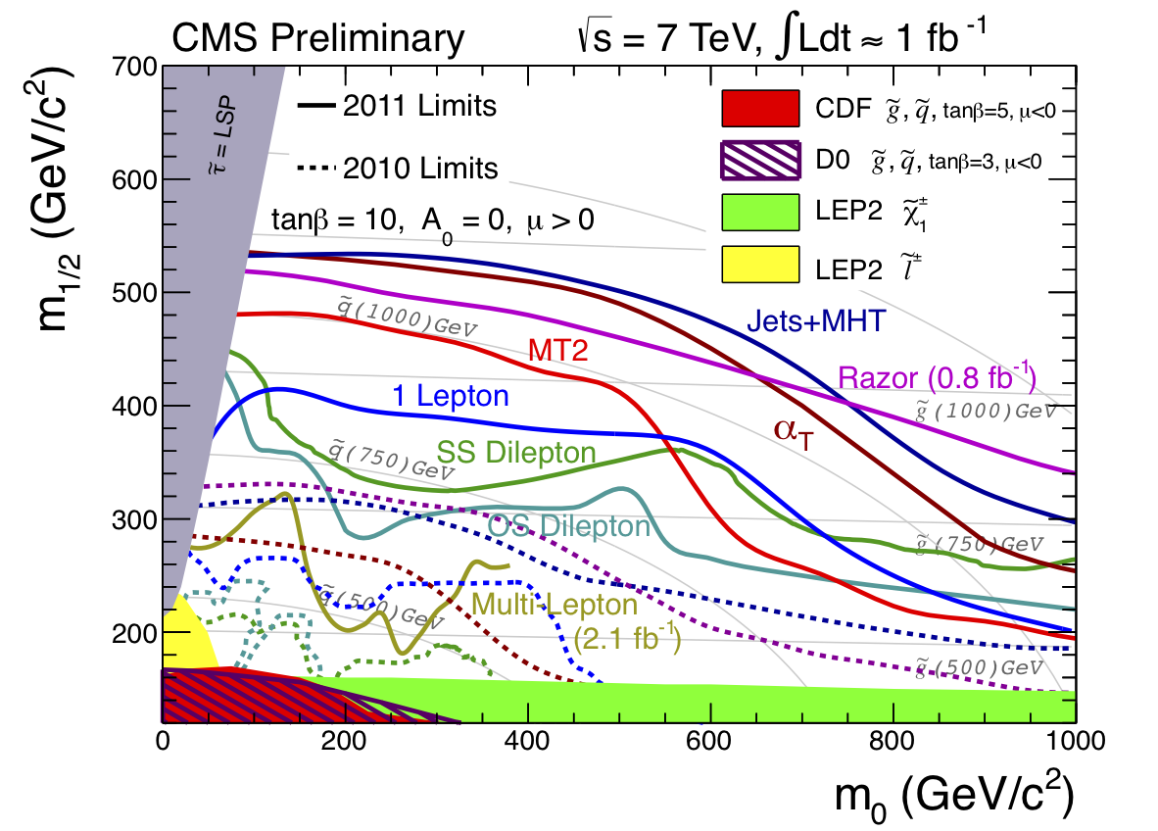
CMS SUSY Searches with 1 fb⁻¹ (Summer 2011)
Impressive amount of SUSY
Topology Searches
UK CMS a key player.
No sign of SUSY (yet).
Most of these searches
continue to be updated,
so far to 5 fb⁻¹
Observed limits from several 2011 CMS SUSY searches plotted in the CMSSM (m₀,m_{1/2}) plane

Slide 17
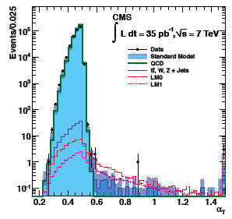
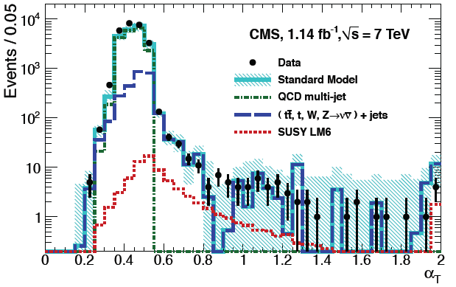
First SUSY Search
H_{T}>350 GeV, 2 Leading jets E_{T}>100GeV (⎮η⎮<2.5)
Other jets E_{T}>50 GeV (⎮η⎮<3
[1] 2010
35 pb⁻¹
[2] 2011
1.1 fb⁻¹
[1] Phys. Lett. B698:196-218 (2011): >150 citation – best cited CMS paper:
First SUSY search at the LHC
[2] PRL 107, 221804 (2011): > 100 citations – 3rd best cited paper of CMS:
First SUSY analysis probing the 1 TeV mass scale
Imperial and Bristol are spearheading this effort.

Slide 18
From W Polarisation to SUSY Searches
Established that W mainly left-handed polarised in pp collisions (2010)
Use this to carry out a new powerful 1 Lepton SUSY search (2011)
CMS 35 pb⁻¹
2010
Single Lepton SUSY search
Phys.Rev.Lett.107
:021802,2011
W+
SUS-12-010
6σ from zero
H_{T}>1000
Right Handed
Left Handed
Activity led by Imperial SUSY group

Slide 19
Exotica Landscape

Slide 20
Exotica Landscape
Major contributions from
Bristol and RAL groups: e.g.
JHEP. 05 (2011) 093
PRL 106 (2011) 01180
PRL 107 (2011) 201804

Slide 21
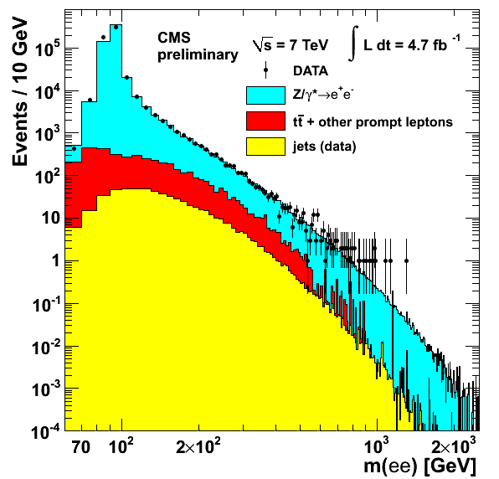
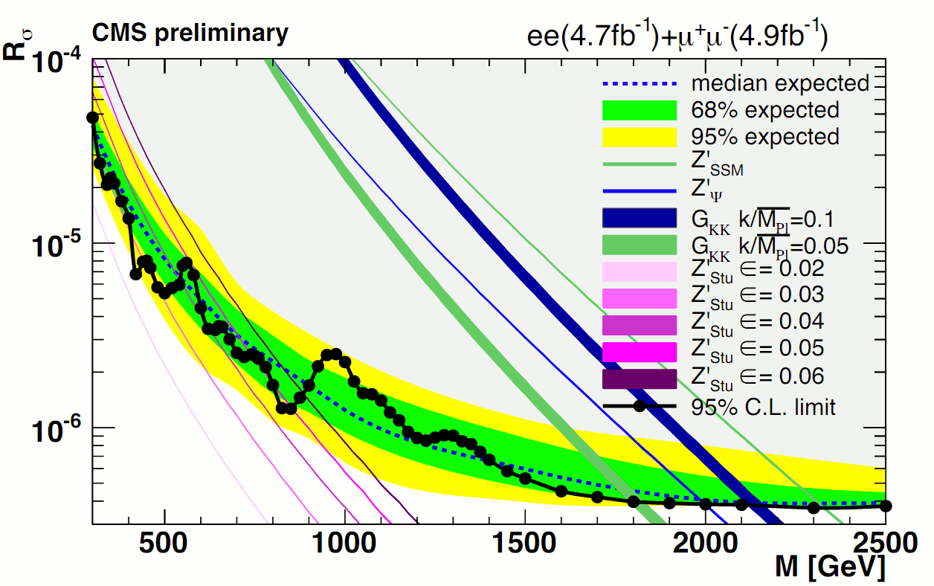
Exotic analyses
Considerable UK leadership of Exotic BSM analyses
RAL and Bristol leading 8 analyses
3 publications using 2010 data.
Further publications with 2011 plus other analyses
Z’ search “flagship” analysis. Pubs (2010 & 2011)
Search for very long lived stopping gluinos. Pub (2010)
Generic search for boosted Z bosons e.g. Excited quarks
Search for Quantum Black Holes
Long lived particle to jets
Long lived particles to leptons
Search for leptonic jets e.g. Hidden Valley models
Search for mono-jet events. Publication (2010)
Leadership (5 individuals) of groups overseeing analyses containing a resonance and any long lived particle
Exotics convener 2012-13

Slide 22
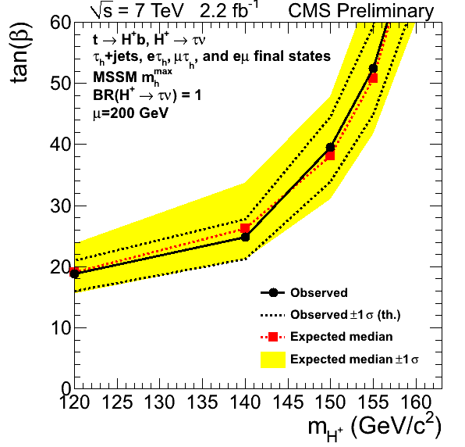
Higgs boson searches
5 fb⁻¹ of data made 2011 exciting for Higgs searches
Very interesting CMS results presented at summer conferences
UK (Imperial) contributions in τ and γγ channels and in combination
Results for the full year shown in December
SM Higgs boson excluded at 95% CL
in the mass range 127–600 GeV
Exclusion region in MSSM (m_{H+}, tanβ) space for the MSSM m_{h}^{max} scenario

Slide 23
Higgs: CMS Papers submitted February 2012
Mode | Mass Range | Data Used (fb⁻¹) | Mass resolution | Document
H → γγ | 110-150 | 4.8 | 1-3 % | arXiv:1202.1487
H → bb | 110-135 | 4.7 | 10 % | arXiv:1202.4195
H → ττ | 110-145 | 4.6 | 20 % | arXiv:1202.4083
H → WW → 2l 2ν | 110-600 | 4.6 | 20% | arXiv:1202.1489
H → ZZ → 4l | 110-600 | 4.7 | 1-2% | arXiv:1202.1997
H → ZZ → 2l2τ | 190-600 | 4.7 | 10-15% | arXiV:1202.3617
H → ZZ → 2l2j | 130-165/200-600 | 4.6 | 3% | arXiv: 1202.1416
H → ZZ → 2l2ν | 250-600 | 4.6 | 7% | arXiv: 1202.3478
5 exclusive final states
9 exclusive final states
5 exclusive final states
5 exclusive final states
3 exclusive final states
8 exclusive final states
6 exclusive final states
2 exclusive final states

Slide 24
H→γγ
Results for 2011 data to be published in PLB
For Moriond: further 20% improvement in sensitivity using multivariate techniques (Imperial played leading role)
Exclusion of SM Higgs at 95% CL:
110.0-111.0, 117.5-120.5, 128.5-132.0, 139.0-140.0 and 146.0-147.0 GeV
Small excess at 125 GeV
H→γγ limit for Moriond
Great interest in 2012 data!
Combined CMS channels

Slide 25
Future plans

Slide 26
Expectations for 2012
Operation with 4 TeV, 50 ns, 1380 bunches, 1.6 10¹¹ p, 2.5 µm
First stable beam collisions 5 April
150 days p-p operation
Improvements in restarts after MDs
Target 15 fb⁻¹
Challenging (but tolerable) pile-up conditions
Beta* [cm] | Collimators | Peak Lumi [cm-²s⁻¹] | Int. Lumi [fb⁻¹] | Pile-up | Increase in peak
90 | Intermediate | 5.1e33 | 12.1 – 14.5 | 26
70 | Tight | 6.2e33 | 14.7 – 17.6 | 31 | +22%
60 | Tight | 6.8e33 | 16.2 – 19.3 | 35 | +10%

Slide 27
Pileup Studies for Physics
CMS Studied <PU> ~25
Impact on low mass Higgs
H → γγ sees about 15% equivalent lumi loss
Worse for H → ττ, WW
No optimizations as yet
No significant impact on precision top physics
No significant impact on B_{d/s} → μμ

Slide 28
Data parking
Proposal to CMS from UK, now supported by LHCC
CMS has the capability to park data at up to 600 Hz
These provide the opportunity of a much-extended CMS physics programme in the two-year long shutdown
from precision SM measurements to possible discoveries
Case studies of
SUSY: compressed spectra (w/wo 3rd Gen squarks) ~ 50 Hz
VBF Higgs inclusive: Higgs properties & decay modes: ~100 Hz
B-Physics: precision measurements & searches ~ 75 Hz
Additional data parking projects are currently under study
Expect ~500 Hz total
Prioritize and ramp up during early 2012 run

Slide 29
Future programme
Build on well established foundations which have clear direction
2012 further focus on discovery physics
eg Higgs search, SUSY and heavy vector boson
after 2012 data parking will allow exploration of many corners
good links to theorists via London Centre for TeraUniverse Studies and NExT institute
Detector activities to maintain performance
14 TeV and, by 2016, > 10³⁴ cm⁻²s⁻¹, perhaps with 50 ns
trigger optimisation and preparation for upgrades
ECAL & Tracker recovery of channels and preparations for low T operation

Slide 30
Request for resources
M&O funds (CMS has no common fund)
M&O B sub-detector expenses shared by (weighted) author numbers
these are obligatory contributions to shared CMS costs
includes modest engineering support for ECAL, Tracker
small additional expenses
Travel
LTA posts are crucial to our activities for M&O responsibilities and important roles in physics analysis
supplemented by short term travel
Computing
T1 & T2 support delivers UK obligations with fewer staff than elsewhere
Staff - our success and high profile in CMS results from them
continue to hold many positions of responsibility at all levels

Slide 31
Summary
UK CMS has been able to successfully carry out its planned physics programme described in 2009 bid for support
with even more progress in Higgs searches than expected then
There is a strong linkage between physics and UK detector commitments
which are a proportionate share of common CMS costs
Similarly strong programme outlined for future, including
Higgs discovery or exclusion in 2012
physics analysis during LS1, benefiting from parked data
detector activities to maintain CMS performance
upgrade bid building on R&D activities to be submitted for Sep PPRP

Slide 32
Backup

Slide 33
SUSY

Slide 34


First SUSY Search: α_{T}
Kinematic variable α_{T}
Exploits QCD di-jet properties
jets are balanced in p_{T}
back-to-back in φ
jet
LSP
LSP
jet
jet
jet
Define: H_{T} = Σp_{T}(j_{i}), MH_{T} = |-Σp_{T}(j_{i})|, ΔH_{T}=E_{T}(pj₁)-E_{T}(pj₂)
αT for dijets:
αT for n jets:
Expectation for QCD: α_{T} = 0.5
Jet mis-measurements: α_{T} < 0.5
(form two pseudo-jets – defined by balance in “pseudo-jet” H_{T} = ΣE_{T})
inspired by
L. Randall & D. Tucker-Smith, Phys.Rev. Lett. 101 (2008) 221803

Slide 35
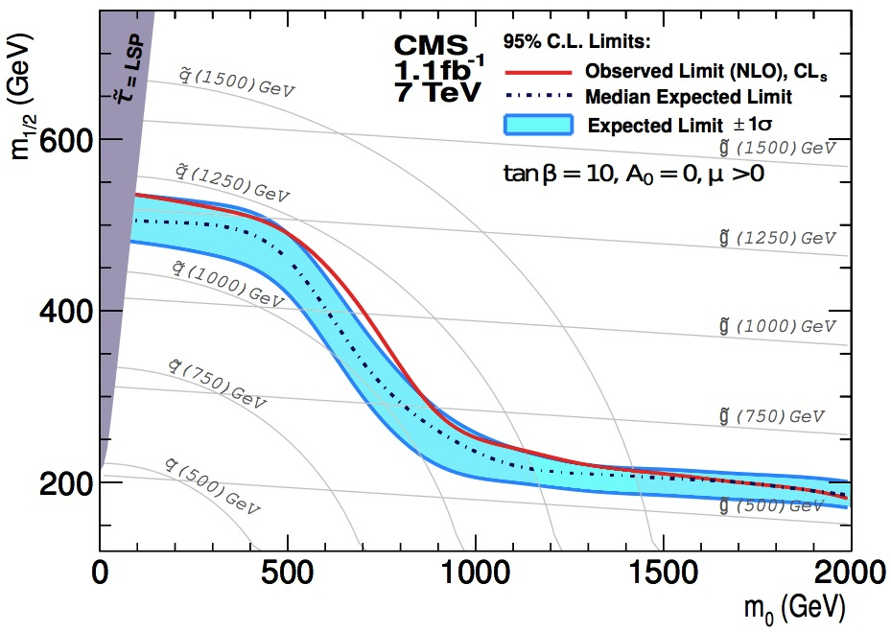
Approaching the 1 TeV Mass Scale
Observed limit Summer 2011 (1.1/fb)
Limit in 2010
(0.035/fb)
500 GeV
squark mass
1 TeV squark mass in CMSSM

Slide 36
SUSY Searches
SS dileptons
Single Lepton
SUS-11-010
SUS-12-010
Exclusion region in CMSSM
Same-sign isolated leptons
(e, μ, or τ_{h}), jets and MET
H_{T}>1000
Multiple search regions in the (H_{T}, E_{T} miss ) plane

Slide 37
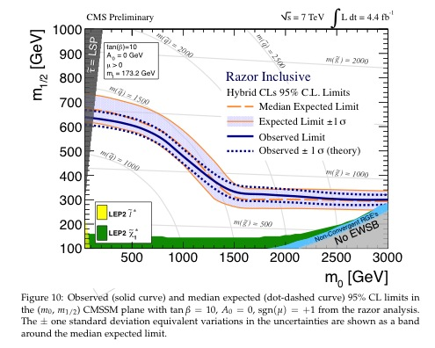



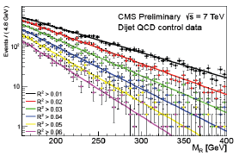
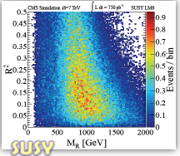
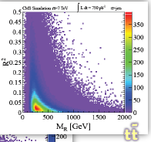
CMS Inclusive Razor
Search in 0,1,2 lepton events
SUS-12-005
Razor variables:
Form 2 mega-jets: j1 and j2
Boost to Razor “R” frame: p_{z} =0
Define M_{R}, M_{T}^{R} and R
M_{R} ≈ Energy of the 2 LSP’s in rest frame of the mother sparticle
M_{T}^{R} ≈ Average transverse mass of LSP’s
Great Signal/Background Separation in (R²,M_{R}) plane
SUSY
For various cuts on M_{R} (R), the differential distribution of R (M_{R}) has simple single or double exponential shape for backgrounds
tt
Notes:
he kinematic consistency of the selected events is tested against the hypothesis of heavy particle pair production using the dimensionless razor variable R, related to the missing transverse energy E_{T}^{miss}. The new physics signal is characterized by a broad peak in the distribution of M_{R}, an event-by-event indicator of the heavy particle mass scale. This approach is complementary to E_{T}^{miss} based searches.

Slide 38
EXOTICA

Slide 39
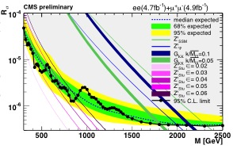
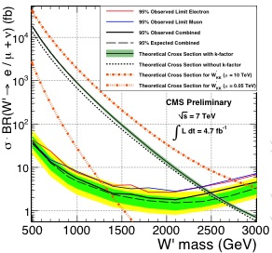
Searches for W’/Z’
Full 2011 statistics; best limits to date (in the 2.2-2.5 TeV range)
EXO-11-024
EXO-11-019

Slide 40
HIGGS

Slide 41
Higgs Updates: since February submissions
Standard Model
Next generation H → γγ based on MVA techniques
Associate production: WH → WWW(3l3ν), Wττ
Added H → ττ → μμ
Full combination
Beyond the Standard Model
H → γγ optimized for Fermiophobic Higgs
Full combination: Fermiophobic and SM4
Charged Higgs: t→ Hb (with 2/fb)
Doubly charged Higgs to dilepton
a₀ → μμ

Slide 42
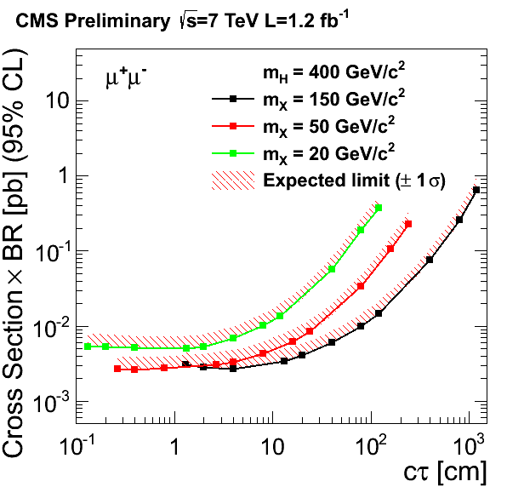
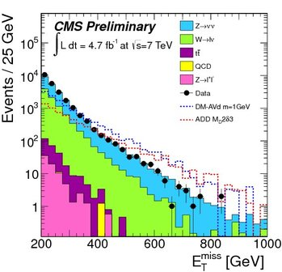
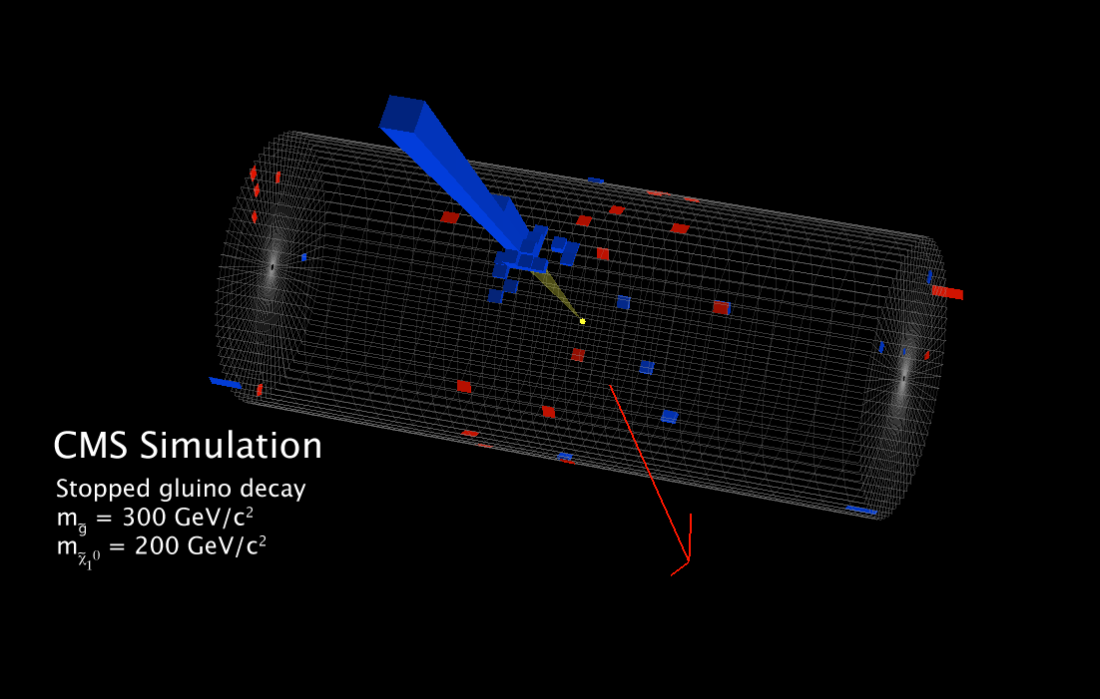
Exotics analyses
Cross section limit
long lived particle to muons
Missing ET in mono jet search
Long lived stopping gluino
Work on phenomenology with theorists in the NExT Institute (4 recent publications)
Recent work includes phenomenology of Z’ models, interference in W’ searches, NLO corrections to D-Y spectra, QBH simulation.

Slide 43
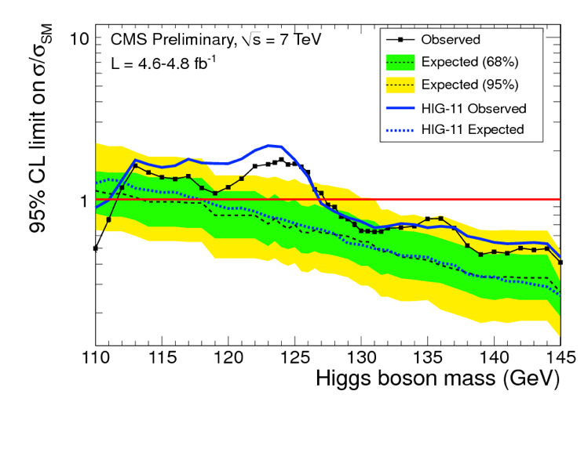
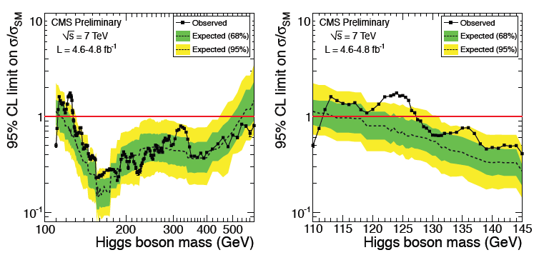
New Combination
Published
Expected exclusion 114.5 - 543 GeV
Observed exclusion 127.5 - 600 GeV

Slide 44
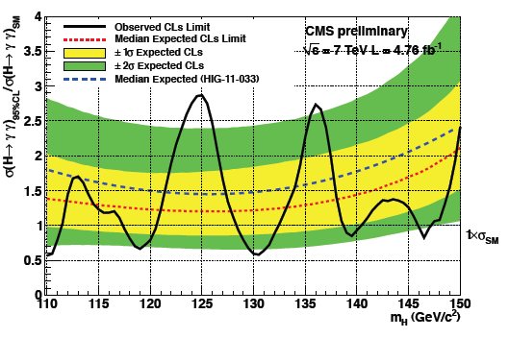
H → γγ MVA Results
The Imperial group is one of the key players
In H->gg and H->tautau analysis.
e.g. arXiv:1202.1487 [hep-ex]
(accepted by PLB for publication)
MVA’s for vertex ID, γ and γγ ID
Complementary analyses
Baseline: Polynomial fit of mass spectrum
Cross-check: More sophisticated technique uses sideband subtraction technique without parameterization
VBF again split off separately
Dominates in vicinity of 124-125 GeV
110-111, 117.5-120.5, 128.5-132, 139-140, 146-147 GeV
SM Higgs excluded at 95% CL.
Local significance drops
3.1σ → 2.9σ
LEE significance
1.8σ → 1.6σ
(range 110-150 GeV)

Slide 45
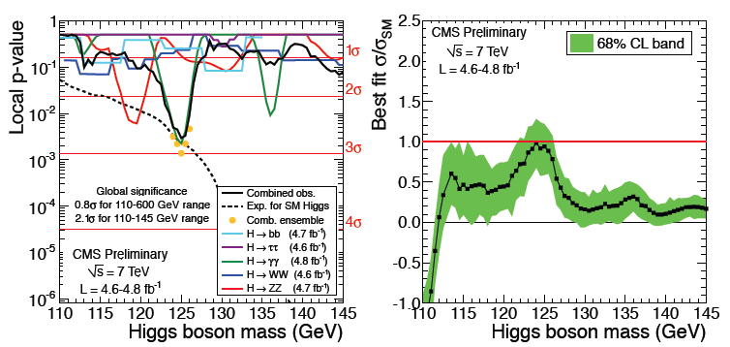
New Combination: p-vals and SM consistency
Local p-value 2.8σ
Global p value 0.8σ (110-600 GeV)
Global p-value 2.1σ (110-145 GeV)

Slide 46
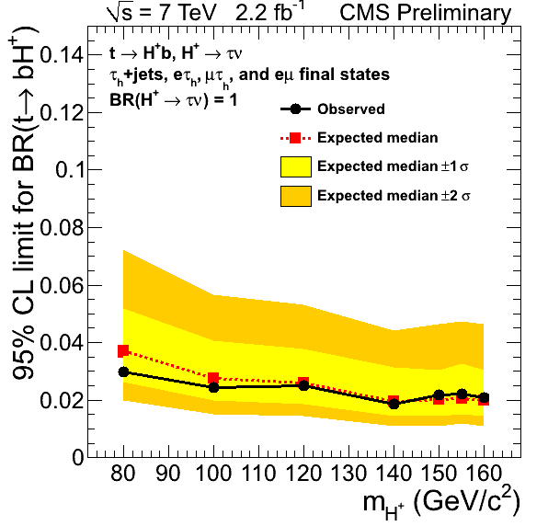
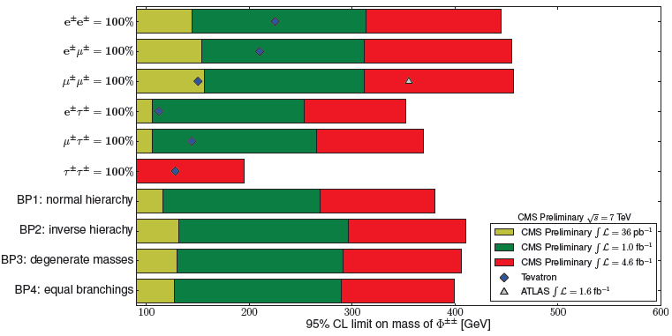
Charged and doubly charged Higgs
tt→H⁺bW⁻b, H⁺bH⁻b
with H⁺→τν
Search channels
τ_{h} + jets
τ_{h} + e, τ_{h} + μ
e + μ
t → bH⁺→ bτν
Systematics limited
⇒ only 2.2 fb⁻¹ used
Doubly charged Higgs
No signal
But in all channels CMS has world’s best limits
New: Φ⁺⁺ → τ⁺τ⁺ decay
Φ⁺⁺ → l⁺l⁺
Strong contribution of Imperial Higgs group

Slide 47
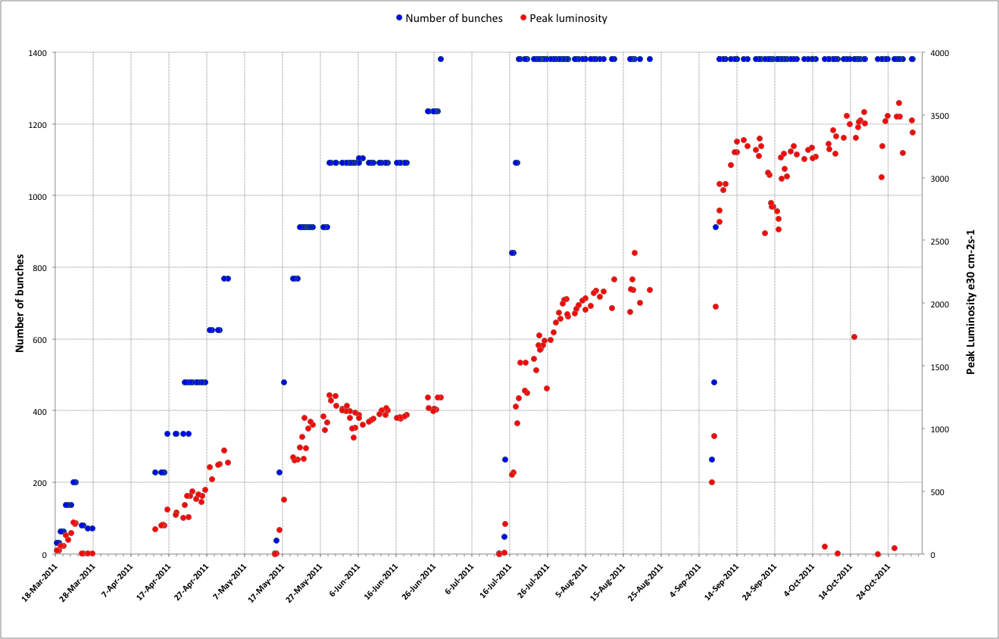
2011 – recap
75 ns
50 ns
Squeeze further
Increase number of bunches
Increase bunch intensity
Scrubbing
Reduce beam size from injectors
Initial
commissioning

Slide 48
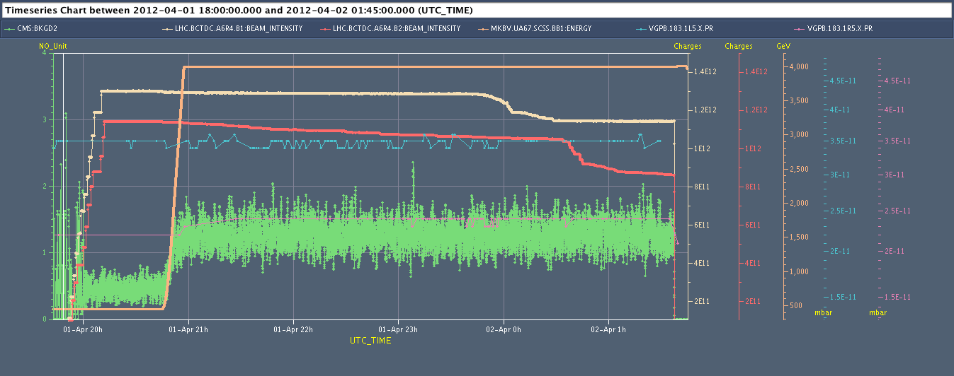
..and vacuum is ok so far
Courtesy N. Bacchetta
FILL 2444
10¹² P
LEFT -IP5 3.5 10⁻¹¹ mbar
Right -IP5 2.5 10⁻¹¹ mbar
BKGD1 shows a value of around 1.3 Hz/1E11 protons. This is consistent with 2011 data (when no problems with vacuum)
Vacuum at 18.3m OK so far ( but last year the vacuum increase on the right end side of CMS had a threshold at about ~3-4E13 protons per beam so we need ~200 bunches to check whether we are OK now)

Slide 49
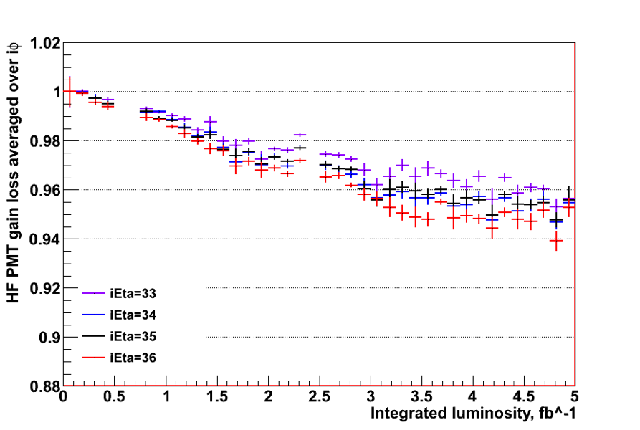
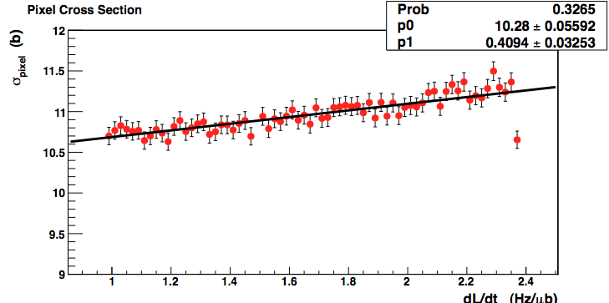
HF based Luminosity
HF gain loss effect
Non linear PU effect
Two sources of drift with respect to fixed calibration points (VdM scans) were found:
A loss in the HF PMT gains that is almost linear with integrated luminosity, directly affecting the luminosity measurement
A non-linearity in the pileup correction, initially obtained from a low pile-up fill.

Slide 50
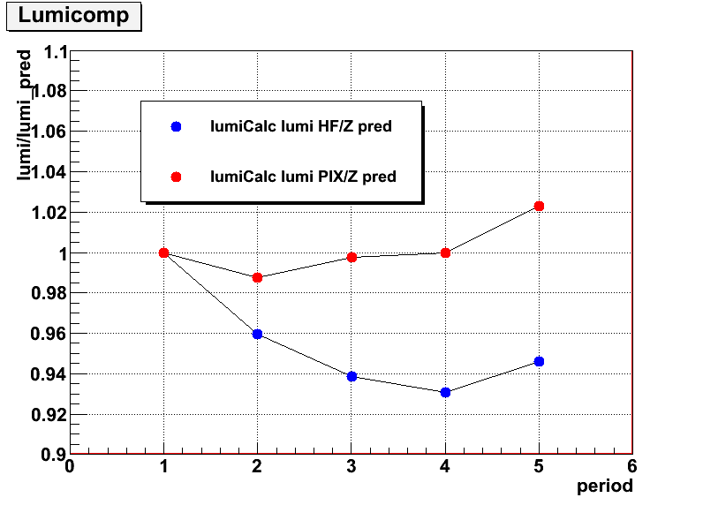
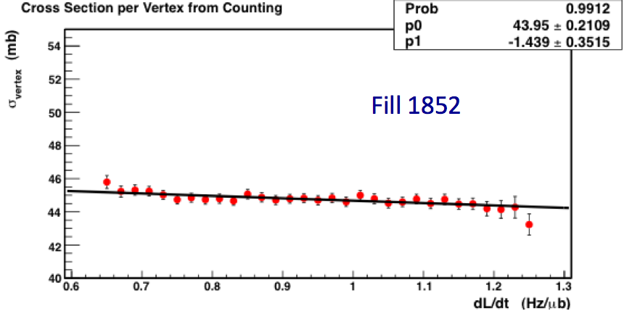
New: pixel based luminosity
CMS developed new method based on pixel cluster counting:
High granularity ⇒ low occupancy ⇒ largely unaffected by pileup
Efficiency monitored with no sign of any gain change during the year.
Used vertex counting as an independent cross-check.
Used SM candles to independently verify the stability of the luminosity measurements.
HF/Z-prediction
Pix/Z-prediction
Vertex Counting:
Slope as expected
(vertex merging)
Spread due
to known inefficiency
2011 ∫Ldt is ~7% higher than previously reported.
Systematic uncertainty is now 2.2% dominated by VdM scans variations.

