Slide 1
Introduction

Slide 2
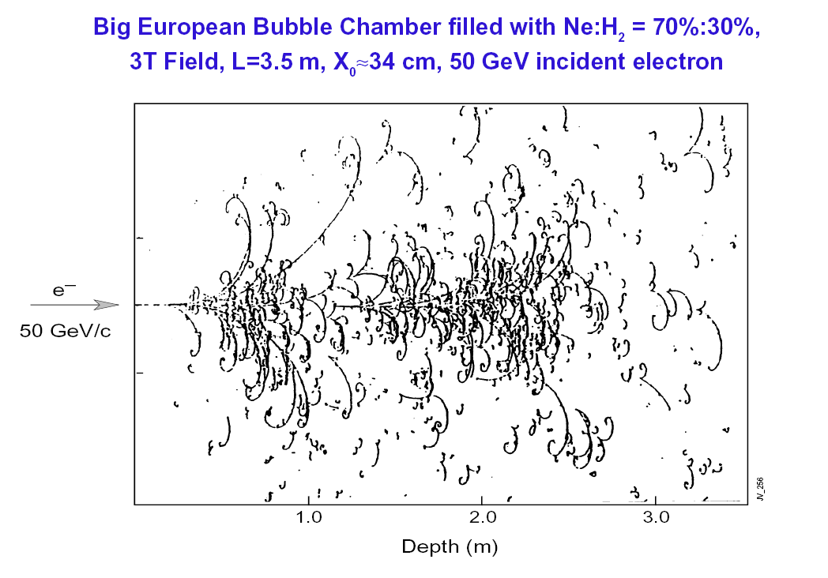
Calorimetry: what?
Measure energy deposited in material by particles which give rise to electromagnetic or hadronic showers
Electrons, photons and hadrons (including neutral hadrons)
e
GEANT shower Monte Carlo
(PbWO₄ crystal)

Slide 3
Calorimetry: why?
Fractional, or relative, energy resolution improves with energy — in contrast to measurements of a magnetic spectrometer
The size required increases only like log(E)
Calorimeters can:
Measure energy of jets
Measure missing transverse energy
Neutrinos etc
Provide fast, efficient, and selective trigger output
Measure position
Measure time
σ/E(p)
Magnetic
spectrometer
Calorimeter
E(p)

Slide 4
Calorimetry: how?
Need: Material in which shower takes place, and a way to obtain a signal to measure the shower – for example:
Ionization
Liquid argon, silicon wafer, various gasses and gas mixtures…
Scintillation
Plastic scintillator, various (inorganic) crystals…
Cerenkov radiation
Lead glass, water, air…
Sampling calorimeter has dense material to keep the shower compact, and the shower is sampled with an active material
e.g. plastic scintillator, liquid argon, silicon wafer etc etc
Homogeneous calorimeter is entirely composed of active material
e.g. lead glass, lead tungstate crystals, water…
Electromagenetic calorimeters designed to measure electrons and photons
Hadron calorimeters designed to measure hadronic showers
In general purpose HEP experiments: calorimetery system

Slide 5
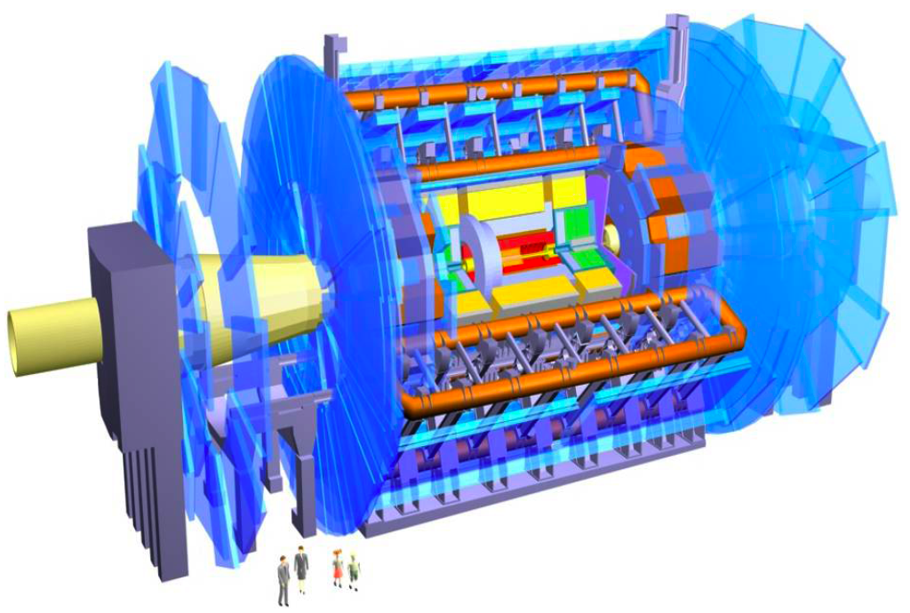
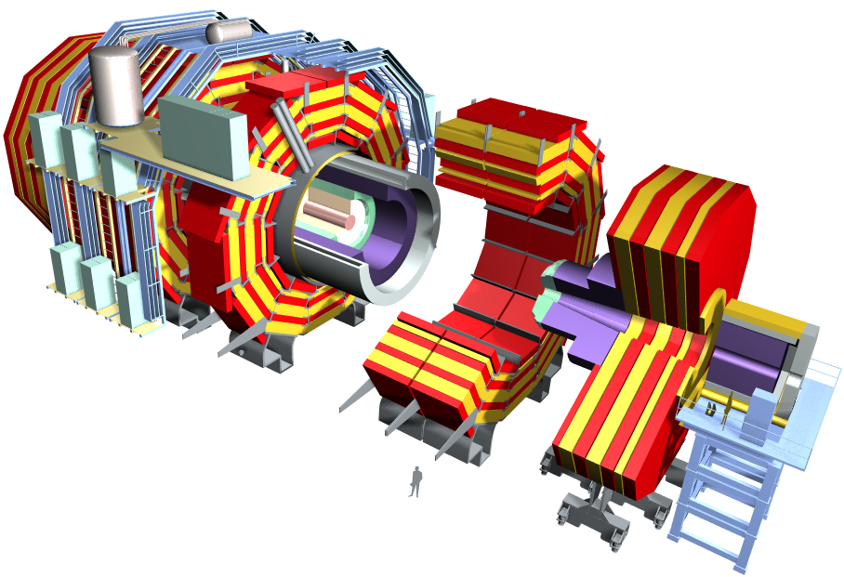
General purpose detectors for LHC
Atlas
CMS

Slide 6
Electromagnetic showers

Slide 7
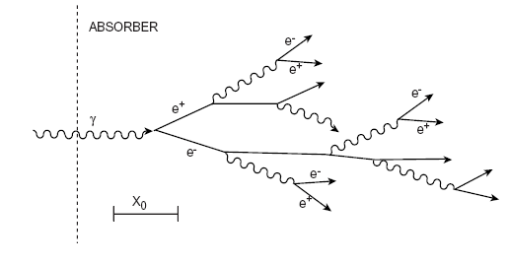
Electromagnetic showers
Electromagnetic showers result from electrons and photons undergoing bremsstrahlung and pair creation
For high energy (GeV scale) electrons bremsstrahlung is the dominant energy loss mechanism
For high energy photons pair creation is the dominant absorbtion mechanism
Shower development governed by these processes

Slide 8
Electromagnetic shower development
Radiation length (X₀) defined to be the distance over which an electron looses all but 1/e of its energy
Useful approximation:
Rough derivation in [1]; more precise approximation in [2]
Critical energy (E_{c}) defined to be where energy loss due to radiation and energy loss due to ionization are equal
Other, more precise, approximations in [2]
E > E_{c}
E < E_{c}

Slide 9
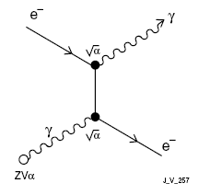
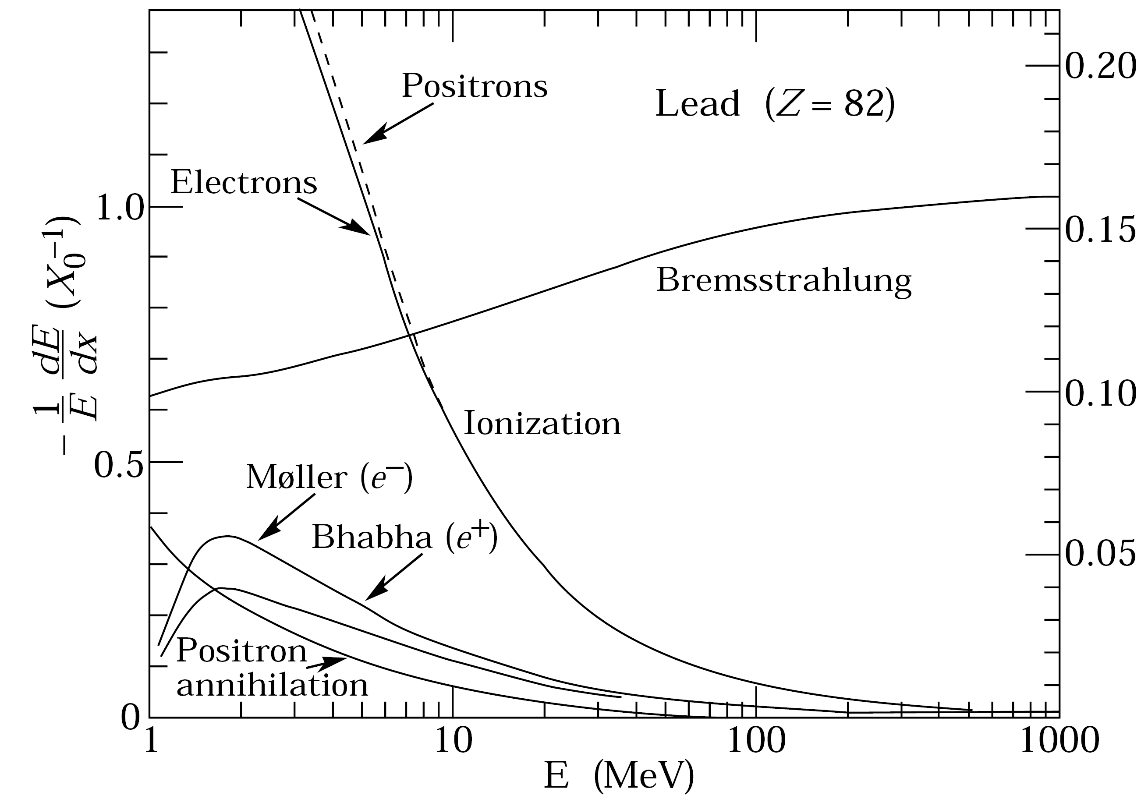
Energy loss in matter: electrons
Bremsstrahlung in the
Coulomb field of the nucleus
Fractional energy loss: electrons
E_{c}

Slide 10
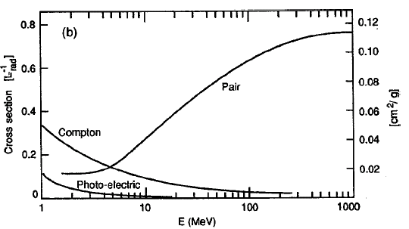
Energy loss in matter: photons
Pair Production
Occurs in the electric field of the nucleus (if E_{γ} > 2m_{e}c²)
Probability of conversion in
1 X₀ is e^{-7/9}
Can define mean free path:
Compton scattering
Photoelectric effect
Fractional energy loss:
photons

Slide 11
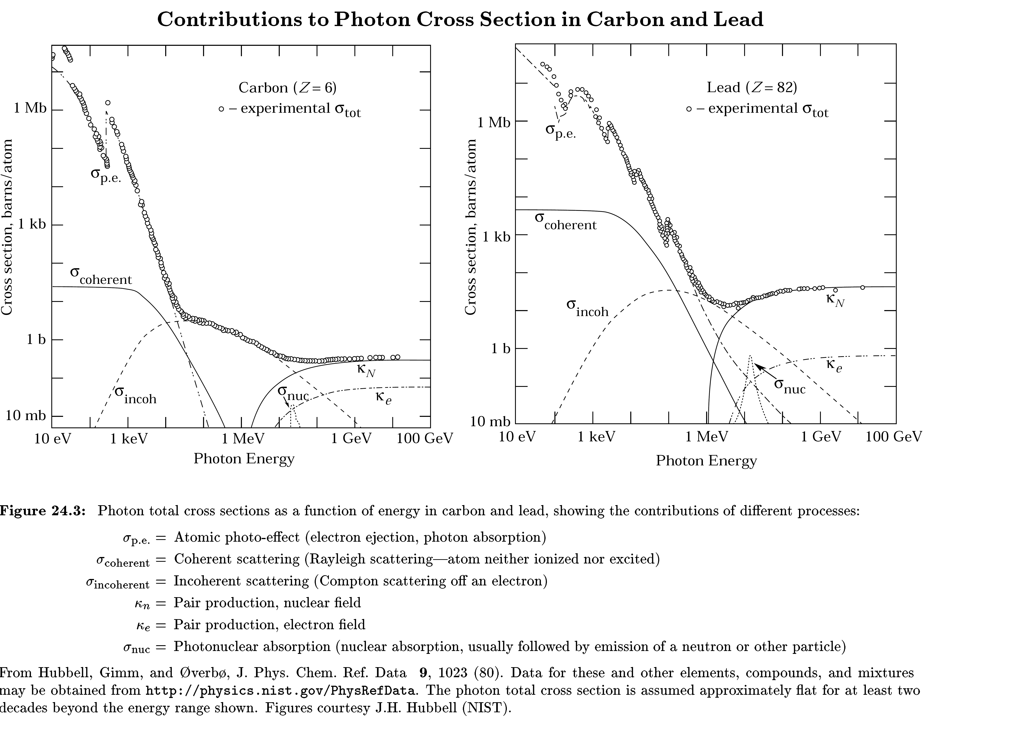

Slide 12
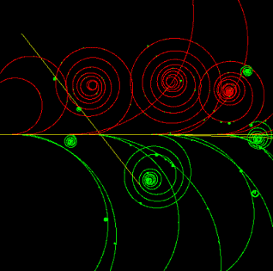
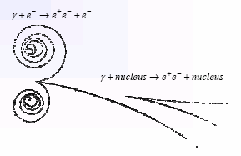
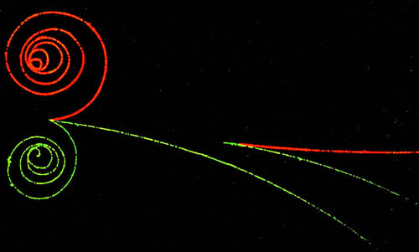
Pair production/conversion
The pair are emitted in the direction of the photon: θ ~m_{e}/E_{γ}
The electrons from the photoelectric effect and from Compton scattering are more or less isotropic

Slide 13
Longitudinal development
The multiplication of the shower continues until the energies fall below the critical energy, E_{c}
A simple model of the shower uses variables scaled to X₀ and E_{c}
Electrons loose about 2/3 of their energy in 1X₀, and the photons have a probability of 7/9 for conversion: X₀ ~ generation length
After distance t:
When E=E_{c}, ~shower maximum:

Slide 14
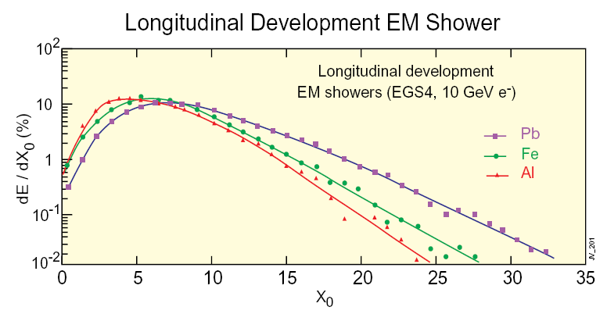
Longitudinal development
Higher Z materials have lower E_{c}
Scaling of longitudinal development with X₀ only holds approximately:
Lower E_{c} ⇒ multiplication continues to lower energies and electrons continue radiating down to lower energies

Slide 15
Lateral development
Molière radius, R_{m}, scaling factor for lateral extent, defined by:
Gives the average lateral deflection of electrons of critical energy after 1X₀
90% of shower energy contained in a cylinder of 1R_{m}
95% of shower energy contained in a cylinder of 2R_{m}
99% of shower energy contained in a cylinder of 3.5R_{m}
Width of core controlled by multiple scattering of e±
Width of periphery controlled by Compton photons

Slide 16
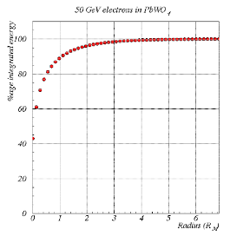
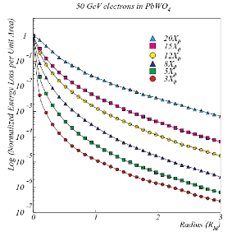
e.m. showers: lateral spread
Lateral shower shape: to very good approximation is invariant with energy
Infinitely long cylinder

Slide 17
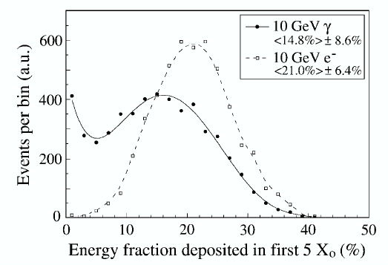
e.m. showers: further issues
Shower processes are intrinsically linear and proportional to incoming particle energy
Electromagnetic calorimeters are intrinsically linear
Keeping them so makes demands on shower containment, readout devices, and associated electronics
Photon showers develop slightly deeper than electron showers
Because of distance before first conversion
Depth of photon showers fluctuate more than electron showers
Photons
Electrons

Slide 18
Hadronic showers

Slide 19
Hadron showers
Hadronic cascades develop in an analogous way to e.m. showers
Strong interaction controls overall development
High energy hadron interacts with material, leading to multi-particle production of more hadrons
These in turn interact with further nuclei
Nuclear breakup and spallation neutrons
Multiplication continues down to the pion production threshold
E ~ 2m_{π} = 0.28 GeV/c²
Neutral pions result in an electromagnetic component (immediate decay: π⁰→γγ) (also: η→γγ)
Energy deposited by:
Electromagnetic component (i.e. as for e.m. showers)
Charged pions or protons
Low energy neutrons
Energy lost in breaking nuclei (nuclear binding energy)

Slide 20
Hadronic shower development
Simple model of interaction on a disk of radius R: σ_{int} = πR² ∝ A^{2/3}
σ_{inel} ≈ σ₀A^{0.7}, σ₀ = 35 mb
Nuclear interaction length: mean free path before inelastic interaction
Mean transverse momentum resulting from interaction <p_{T}> ~ 300MeV
This is about the same magnitude as the energy lost traversing 1λ for typical materials

Slide 21
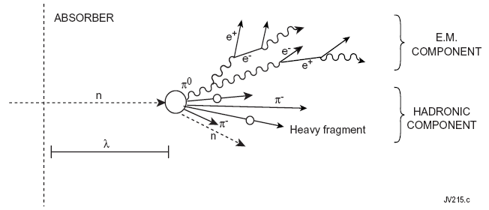
Hadronic cascade
As compared to electromagnetic showers, hadron showers are:
Larger/more penetrating
Subject to larger fluctuations – more erratic and varied

Slide 22
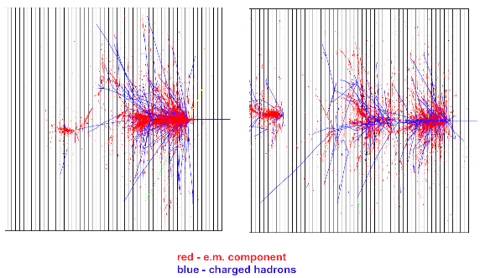
Hadron showers
1.
2.
Individual hadron showers are quite dissimilar

Slide 23
Table of physical properties
 | Z | ρ (g.cm⁻³) | E_{c} (MeV) | X₀ (cm) | λ_{int} (cm)
Air |  |  |  | 30 420 | ~70 000
Water |  |  |  | 36 | 84
PbWO₄ |  | 8.28 |  | 0.89 | 22.4
C | 6 | 2.3 | 103 | 18.8 | 38.1
Al | 13 | 2.7 | 47 | 8.9 | 39.4
L Ar | 18 | 1.4 |  | 14.0 | 84.0
Fe | 26 | 7.9 | 24 | 1.76 | 16.8
Cu | 29 | 9.0 | 20 | 1.43 | 15.1
W | 74 | 19.3 | 8.1 | 0.35 | 9.6
Pb | 82 | 11.3 | 6.9 | 0.56 | 17.1
U | 92 | 19.0 | 6.2 | 0.32 | 10.5
PDG booklet a good source for more/similar numbers

Slide 24
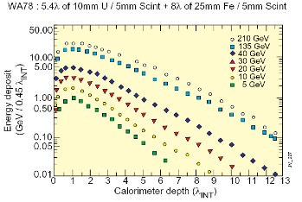
Hadron shower longitudinal profiles
Longitudinal profile
Initial peak from π⁰s produced in the first interaction
Gradual falloff characterized by the nuclear interaction length, λ_{int}
As with e.m. showers: depth to contain a shower increases with log(E)

Slide 25
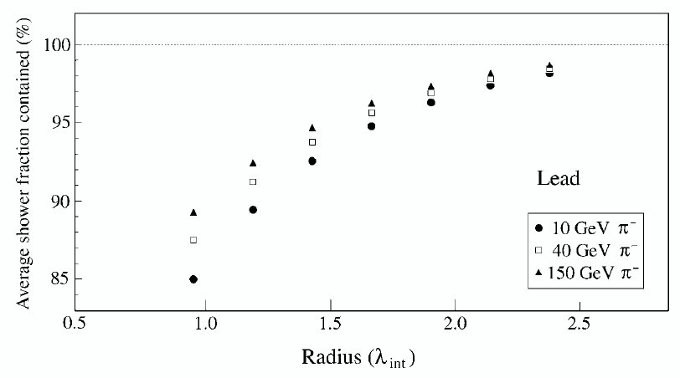
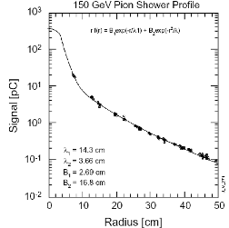
Hadron shower transverse profiles
Lateral profile
Mean transverse momentum from interactions, <p_{T}> ~ 300 MeV, is about the same magnitude as the energy lost traversing 1λ for many materials
So radial extent of the cascade is well characterized by λ
The π⁰ component of the cascade results in an electromagnetic core
0.5
1.0
1.5
2.0
λ_{int}
120 GeV π⁻
Lateral containment increases with energy

Slide 26
Energy resolution

Slide 27
Energy resolution
Usual parameterization for calorimeters:
a: Stochastic (or “sampling”) term
accounts for statistical fluctuation of the number of primary signal generating happenings
b: Noise term
electronics noise (i.e. its energy equivalent)
pileup (other energy entering the measurement area)
c: Constant term
non-uniformity of signal generation or collection
intercalibration errors
other fluctuations directly proportional to energy; fluctuation in the e.m. component in hadronic showers

Slide 28
Stochastic processes
Even in homogeneous calorimeters where the calorimeter consists entirely of active material, the energy is “sampled”
The measurement counts the occurrence of a process
So there is an error proportional to √n (where n is the number of occurances)
Example:
In a lead glass calorimeter the signal detected is Cerenkov radiation
Cerenkov radiation produced by e± with β > 1/n, i.e E > 0.7MeV
So, at most, 1000/0.7 ≈ 1400 independent particles per GeV produce light
Fluctuation = √1400/1400 ≈ 3%
Signal in photodetector is only ~1000 photoelectrons/GeV, which provides a further fluctuation (photostatistics) √1000/1000 ≈ 3%
Thus overall resolution from lead glass calorimeter: σ/E ≈ 5%/√E

Slide 29
Stochastic term: homogeneous calorimeters
Smallest stochastic term obtained by counting the most numerous processes
Example: collecting electrons liberated by ionization in Ge crystals (at 77°K)
Where W is the mean energy to liberate an electron
But the total energy does not fluctuate, and since a large fraction goes into the liberation of electrons the resolution is improved by a factor, F (the Fano factor)
In Ge measure σ=178eV for E_{γ} = 100 keV
Without Fano factor: W=2.96 eV ⇒ σ ≈ 540 eV

Slide 30
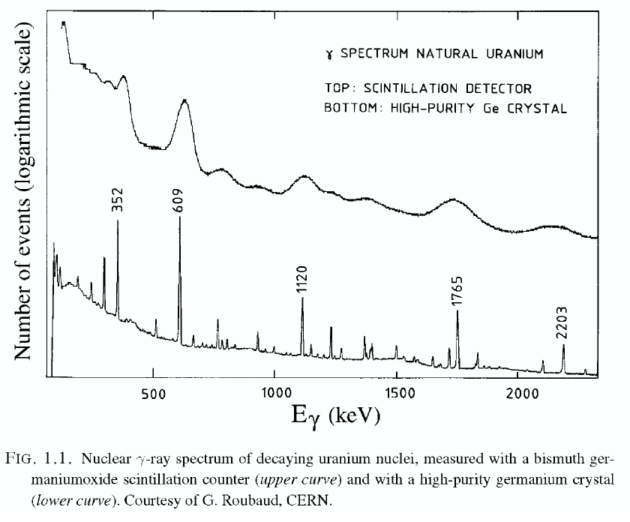
Ge crystals

Slide 31
Sampling calorimeters
The energy may be sampled by active layers interposed between dense high Z absorber materials
e.g. plastic scintillator layers between layers of Pb etc
Stochastic term depends upon a) the granularity of the sampling and b) the fraction of energy deposited in the active material
If energy loss in the active layers is small compared to loss in absorber, the number of charged particles crossing the active layer is n ≈ E/ΔE_{abs}, and ΔE_{abs} = t_{abs} (dE/dx)
Thus σ/E = √n/n ≈ t_{abs}/√E
Using the fraction of energy sampled, f_{samp}, as a parameter a generally valid formula for the stochastic contribution is:
Where ΔE_{cell} is the energy deposited in a unit sample (absorber+active layer)

Slide 32
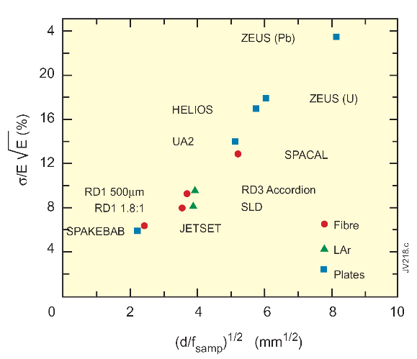
d/f_{samp}
Stochastic term reduced by:
Increasing sampling fraction
Increasing sampling frequency
d is thickness of active layer
f_{samp} is sampling fraction

Slide 33
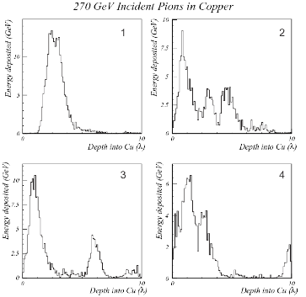
Hadronic energy resolution
Hadronic calorimeters are (almost) always sampling calorimeters
Fluctuations in the visible energy have more sources:
Sampling fluctuations (same as for sampling e.m. calorimeters)
Fluctuations between the electromagnetic and hadronic components
(and also between the different elements of the hadronic component)
Size of e.m. component, F₀, determined mainly by the first interaction
Considerable shower to shower fluctuations
4 different showers:

Slide 34
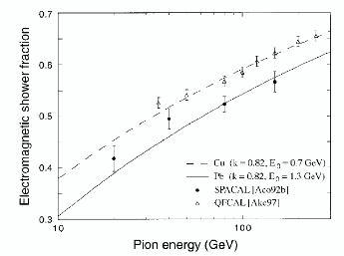
Hadronic showers: e.m. component
On average 1/3 of the mesons produced at each interaction will be π⁰s (π⁺, π⁰, and π⁻ equally produced)
And then some more in the next generation…
Assume that a fraction, f₀, of e.m. energy is produced at each interaction:
1st generation: f₀
2nd generation: f₀ +f₀(1-f₀)
Call F₀ the fraction of e.m. energy in the shower:
F₀ = f₀Σ(1-f₀)^{n-1} after n generations
F₀ = 1 - (1-f₀)^{n}
So:
At low energy F₀ ≈ f₀
At very high energy F₀ → 1

Slide 35
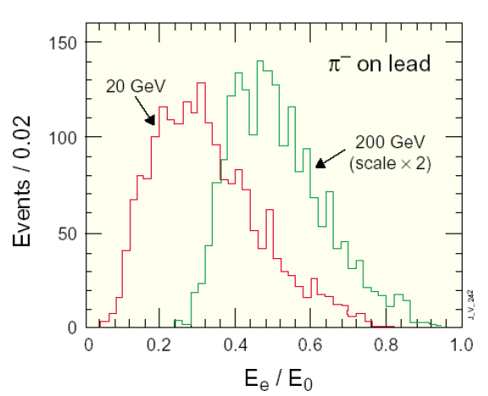
Electromagnetic fraction
Large event to event fluctuation in F₀
Average value of F₀ increases with energy

Slide 36
Hadronic energy resolution
In general, the electromagnetic and hadronic responses of the calorimeter are different
In a calorimeter system the electromagnetic and the hadronic sections may have different values of e/h
If e/h=1 the calorimeter is said to be compensating
If e/h is far from 1, this has serious consequences for performance:
Energy resolution is non-Gaussian
E_{e}/E_{π} ≠ – the response to hadrons differs from the response to electrons and depends on energy
Non-linear response to hadrons
Event to event fluctuations of F₀ contribute to the energy resolution

Slide 37
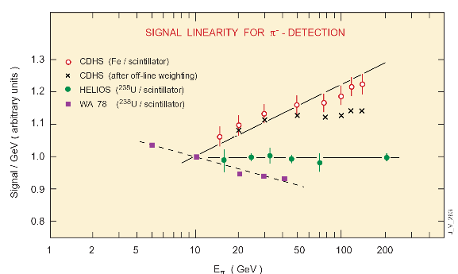
A consequence of e/h ≠ 1

Slide 38
Compensation [1]
e/h can be inferred from the energy dependent e/π ratio using a formula for F₀
Example of energy dissipation in a Pb absorber:
42% invisible energy (nuclear breakup)
43% charged particles
12% neutrons with KE ~ 1 MeV
3% γ’s with E ~ 1 MeV
The large fraction of invisible energy means that hadronic calorimeters tend to be “undercompensating” (e/h>1)
(E in GeV)

Slide 39
Compensation [2]
Three ways of achieving compensation have been observed/used:
Boost non-e.m. response by using depleted uranium (²³⁸U)
Extra energy contribution to the hadronic component from fission of nuclei
Suppress the e.m. response
e.g. thin layers of plastic scintillator in a calorimeter with high Z absorber
Boost the response to low energy neutrons
e.g. active medium containing hydrogen

Slide 40
Jet energy resolution
In HEP experiments hadron calorimeters are used primarily for reconstruction of jets
Generally: calorimeter systems (e.m. + hadronic calorimeter)
For example: jet energy estimated by summing energy contained in a cone of radius ΔR=√(Δη²+Δϕ²)
Also: missing transverse energy
Jet energy resolution limited by effects from:
Details of algorithm used to define the jet (the parameters controlling the algorithm in the example above)
Fluctuations in the content of the jet (fluctuation in jet fragmentation)
Fluctuations of the underlying event (hadron colliders)
Fluctuations in pileup (hadron colliders at high luminosity)
Magnetic field (sweeps charged particles out of cone)

Slide 41
Energy flow
Another approach to improving jet energy resolution and missing E_{T} resolution in general purpose detectors is to use the information from the tracker
Low p_{T} charged hadrons are generally much better measured by tracking system than by the hadron calorimeter
Approach called “energy flow” or “particle flow”
Need to sort out calorimetric energy deposited by charged hadrons, from that produced by photons/pizeros – also energy deposited by neutral hadrons
Emphasis of calorimetry for particle flow is fine granular for pattern recognition and separation of individual particle showers
Current R&D for highly granular calorimeters at future possible linear colliders reported at calorimetry conferences e.g. Calor 2010 http://bes3.ihep.ac.cn/conference/calor2010/ have particle flow in mind

Slide 42
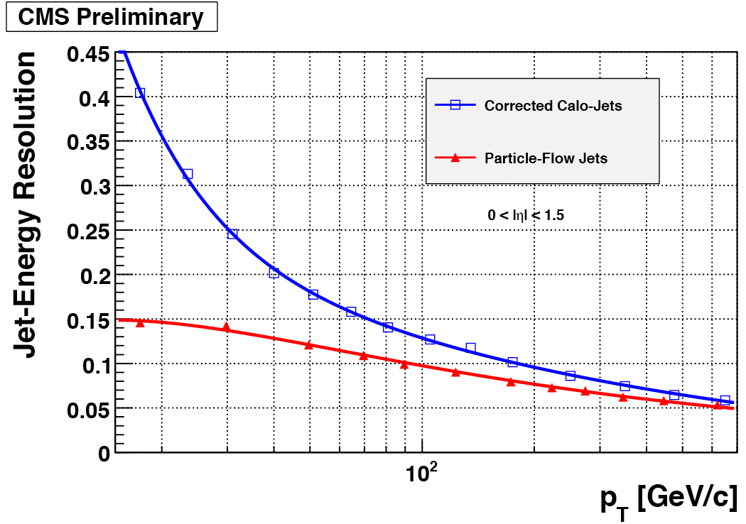
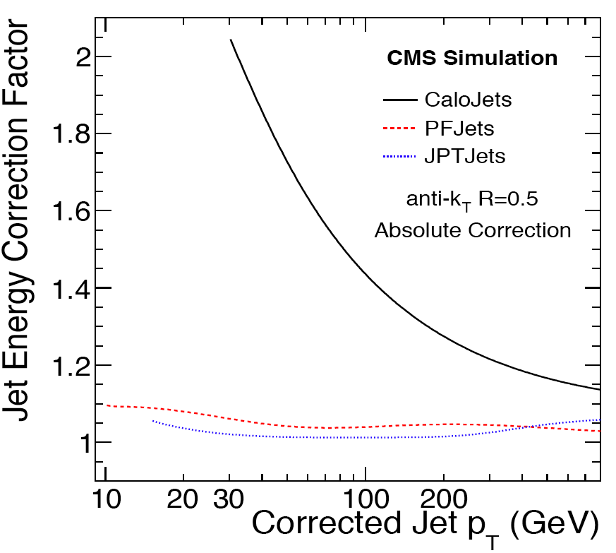
Example of particle flow in CMS
Both the “jets plus tracks” and the more ambitious particle flow (which aims to give a complete event description in terms of particles) provide an improved jet energy resolution – particularly at lower jet E_{T}
Already validated with data – for example in E_{T}^{miss} resolution for W→lν events

Slide 43
Signal detection

Slide 44
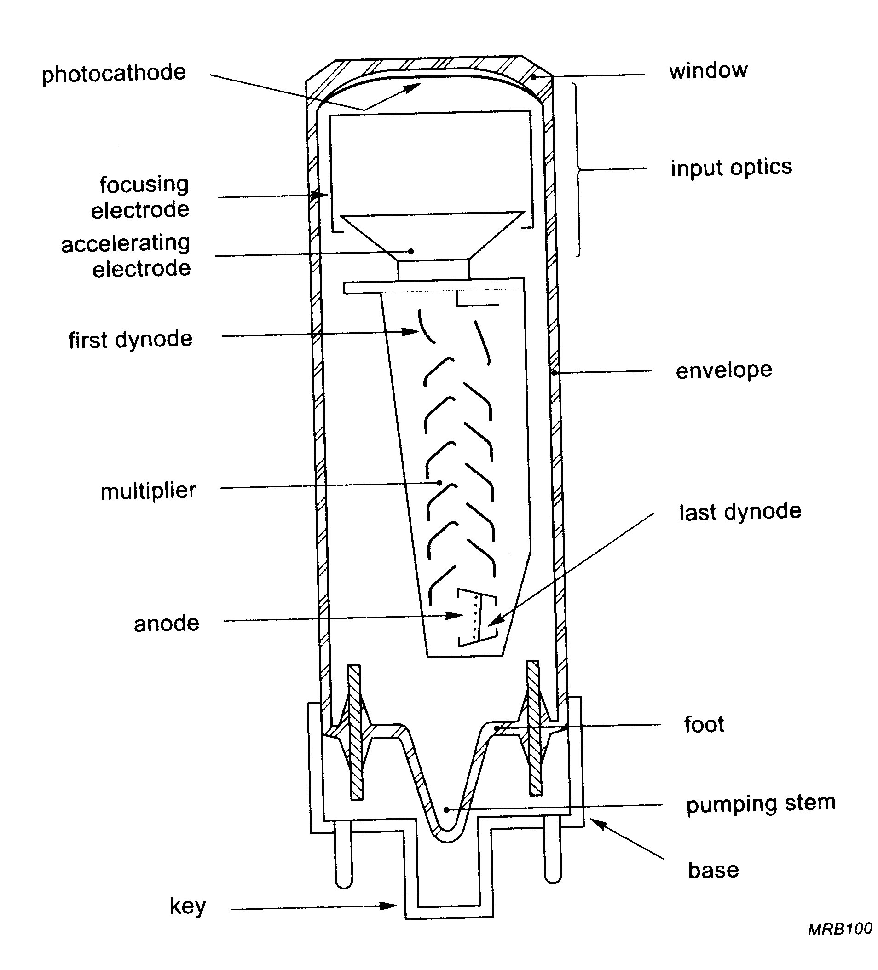
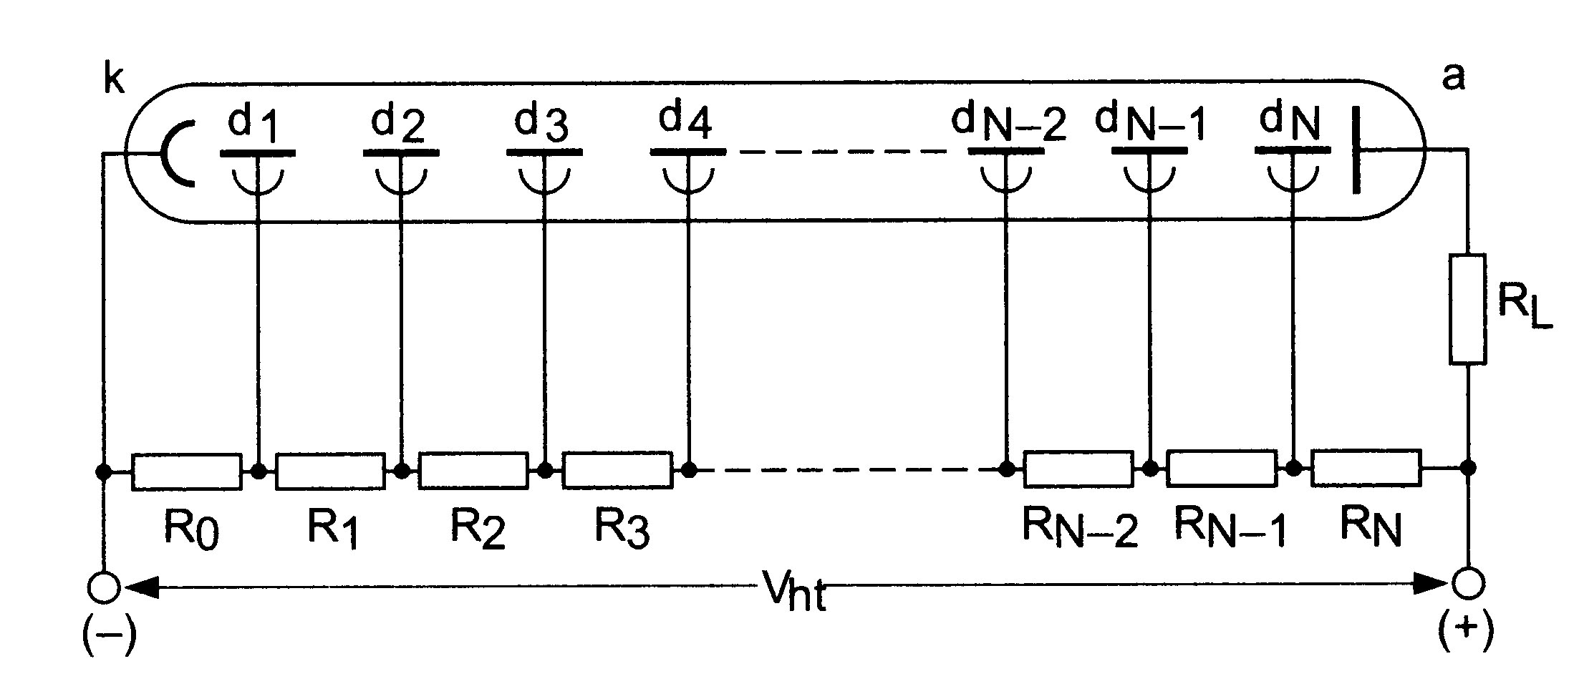
Photomultiplier tubes
Light signal transformed to electrical signal
Vacuum device
Emission of photoelectrons from a photocathode
Acceleration and multiplication at dynodes
Gain G=Πg_{i} (10⁴ – 10⁸)
Sensitive to magnetic fields

Slide 45
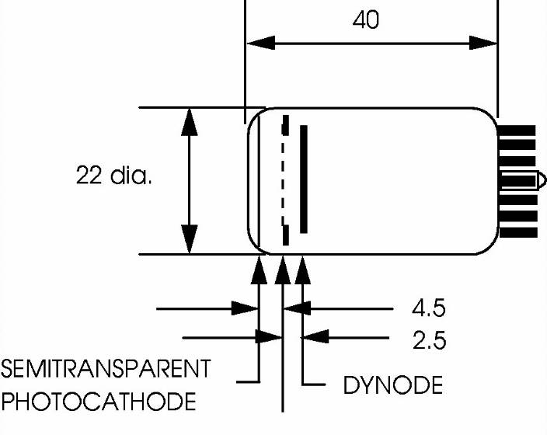
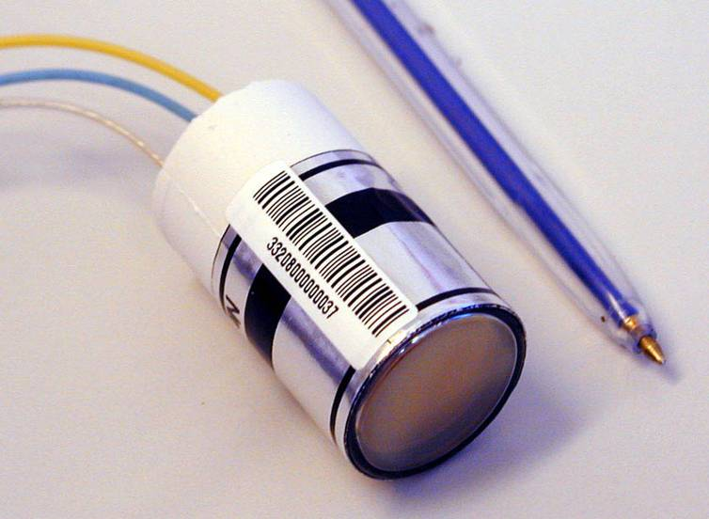
Vacuum Phototriodes (VPTs)
Single stage photomultiplier tube with fine metal grid anode
Can be arranged to be largely insensitive to ~axial magnetic fields
φ = 26.5 mm
MESH ANODE
In CMS ECAL (endcap):
B-field orientation favourable
Gain 8 -10 at B = 4 T
Radiation hard (UV glass window)
Active area of ~ 280 mm²
Q.E. ~ 20% at 420 nm

Slide 46
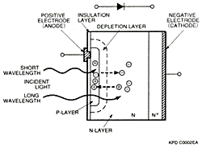
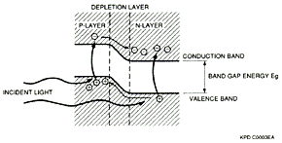
Silicon photodiodes
Incident photons create electron-hole pairs
Quantum efficiency ≈ 80%
Gain = 1
Used for detection of scintillation light in L3 (BGO) and BaBar (CsI) crystal calorimeters

Slide 47
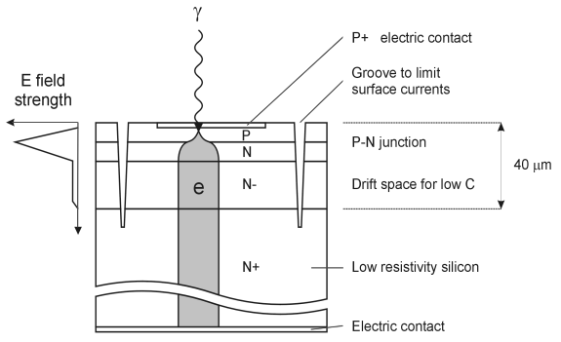
Avalanche Photodiodes (APDs)
2 APDs (each 5 x 5 mm) mounted in capsule for gluing to crystal
Photo-electrons from thin 6 μm p-layer induce avalanche at p-n junction
Electrons from ionising particles traversing the bulk are not amplified (insensitive to shower leakage)

Slide 48
Hybrid Photodiode
Hybrid Photodiode: HPD
Photocathode → acceleration of photoelectrons → detection by silicon photodiode
Possibility of multichannel readout in compact device:
Example below (CMS HCAL) has fiberoptic front window, conventional photocathode, pixelated diode (19 channels/device).
Diode Layout
19 x 5.5mm

Slide 49
Liquid ionization chambers
LAr gap
Current rise time: ~ 1 ns
But:
Total charge collected in 400 ns → slow
→ Difficult for LHC…
t_{D} ≈ 400 ns
for gap = 2 mm and
HV=2kV (v_{d} ≈ 5 mm/μs)

Slide 50
Obtaining a fast response
Integrate the current over time t_{p} << t_{D} (t_{p} ~ 40 ns)
Bipolar shaper response
to triangular signal
S/N is smaller than in the case t_{p}=t_{D}
→ detector response
time is not t_{d} but t_{p}
~30 smaller for 40 ns than
for 400 ns

Slide 51
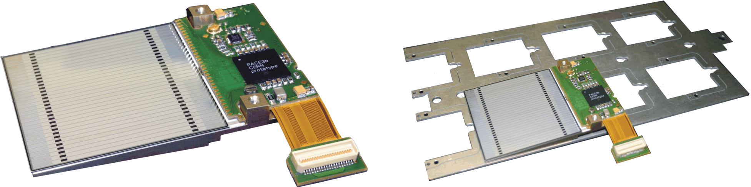
Silicon diode detectors
Detect ionization (electron-hole pairs) in a thin layer of silicon caused by passage of an ionizing particle
Sensitive region of silicon wafer (200-500μm) can be subdivided in strips read out separately (also used for tracking detectors)
Used in CMS for a preshower detector
Preshower detectors:
Fine lateral granularity measurement early in the shower
Active area of 1 wafer is 61x61mm²
Divided into 32 strips (1.9mm pitch)
In CMS endcap:
2X₀ Pb, Si layer, 1X₀ Pb, Si layer

Slide 52
Readout electronics
The electrical signals usually require amplification before digitization (PMs an exception)
For LHC experiments this amplification needs to be fast while keeping electronics noise small
Bunch crossings every 25 ns
For LHC experiments: signal digitization synchronized to bunch-crossings
Not all bunch-crossings are read out and built into an “event”
Temporary storage of signals (awaiting the trigger decision) can be analogue or digital (before or after digitization)
Use of the calorimeters to provide a trigger imposes further requirements
Trigger requires sums of channels
Summing can be done before or after digitization

Slide 53
Off
Detector
TBM
CPU
ROD
TTC
SPAC master
16bits
80MHz
ATLAS Larg accordion readout chain
On the
cryostat
In liquid argon

Slide 54
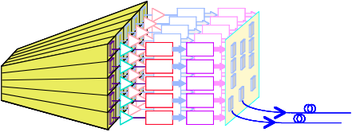
CMS ECAL readout
Front End card
(FE)
Trigger Sums
Data
Trigger Tower (TT)
Very Front End card (VFE)
Trigger primitives computed on the detector
Command & control via token ring
Modularity: Trigger Tower (25 channels in Barrel)
5 VFE Boards (5 channels each) / 1 FE Board
1 Fibre sends trig primitives (every bunch Xing)
1 Fibre sends data (on Level1 accept)
HV
x12
2
12 bits
1
Logic
x6
12 bit ADC
0
2 bits
MGPA
x1
APD/VPT
VFE architecture for single channel

Slide 55
Calorimeters: examples

Slide 56
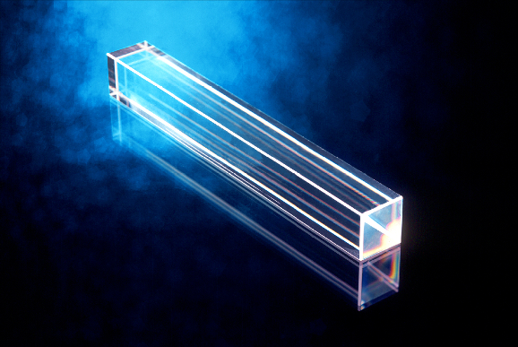
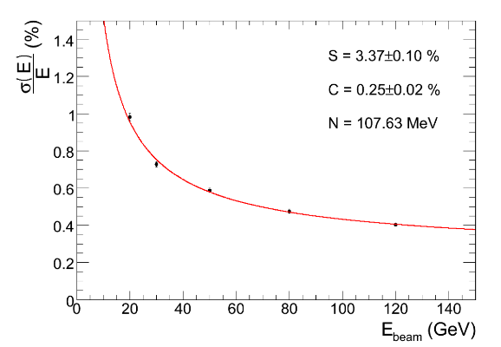
Homogeneous calorimeters
Lead glass and crystals (OPAL, CMS, KTeV, Babar)
Cerenkov and scintillation
Noble liquids (NA48, ICARUS) [i.e. liquified noble (inert) gasses]
Ionization detectors (although noble liquids also scintillate)
Water (Super Kamiokande)
Even air… (HESS, EUSO)
Stochastic term
Constant term
Noise term
CMS ECAL
PbWO₄

Slide 57
Mass Produced Crystals
 | NaI(Tl) | CsI(Tl) | CsI | BaF₂ | BGO | PWO(Y) | LSO(Ce) | GSO(Ce)
Density (g/cm³) | 3.67 | 4.51 | 4.51 | 4.89 | 7.13 | 8.3 | 7.40 | 6.71
Melting Point (ºC) | 651 | 621 | 621 | 1280 | 1050 | 1123 | 2050 | 1950
Radiation Length (cm) | 2.59 | 1.86 | 1.86 | 2.03 | 1.12 | 0.89 | 1.14 | 1.38
Molière Radius (cm) | 4.13 | 3.57 | 3.57 | 3.10 | 2.23 | 2.00 | 2.07 | 2.23
Interaction Length (cm) | 42.9 | 39.3 | 39.3 | 30.7 | 22.8 | 20.7 | 20.9 | 22.2
Refractive Index ª | 1.85 | 1.79 | 1.95 | 1.50 | 2.15 | 2.20 | 1.82 | 1.85
Hygroscopicity | Yes | Slight | Slight | No | No | No | No | No
Luminescence ^{b} (nm) (at peak) | 410 | 550 | 420 310 | 300 220 | 480 | 425 420 | 402 | 440
Decay Time ^{b} (ns) | 230 | 1250 | 30 6 | 630 0.9 | 300 | 30 6 | 40 | 60
Light Yield ^{b} (%) | 100 | 165 | 3.6 1.1 | 36 3.4 | 21 | 0.29 .083 | 83 | 30
d(LY)/dT ^{b} (%/ ºC) | ~0 | 0.3 | -0.6 | -2 ~0 | -1.6 | -1.9 | ~0 | -0.1
Experiments | Crystal Ball | CLEO BaBar BELLE BES III | KTeV | TAPS (L*) (GEM) | L3 BELLE PANDA? | CMS ALICE PrimEx PANDA? | - | -
ª: at peak of emission
^{b}: slow/fast component.

Slide 58
Crystal calorimeters
Crystal calorimeters
Excellent energy resolution possible
Fine lateral granularity and hermeticity
No longitudinal segmentation
Lead tungstate
Fast
Dense
Radiation hard
Low light yield
Temperature dependent

Slide 59
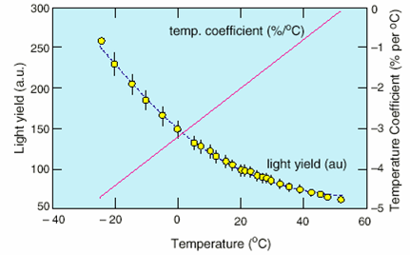
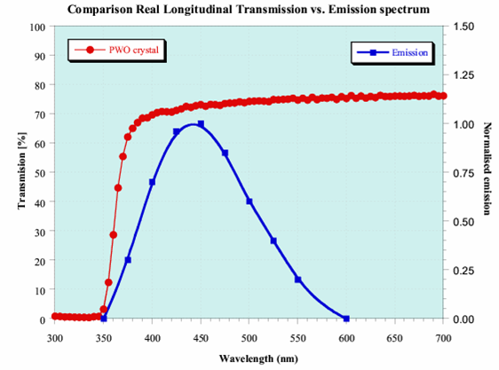
Lead tungstate properties
Fast light emission: ~80% in 25 ns
Peak emission ~425 nm (visible region)
Short radiation length: X₀ = 0.89 cm
Small Molière radius: R_{M} = 2.10 cm
Radiation resistant to very high doses
But:
Temperature dependence ~2.2%/^{O}C
Stabilise to ≤ 0.1^{O}C
Formation and decay of colour centres in dynamic equilibrium under irradiation
Precise light monitoring system
Low light yield (1.3% NaI)
Photodetectors with gain in B-field

Slide 60
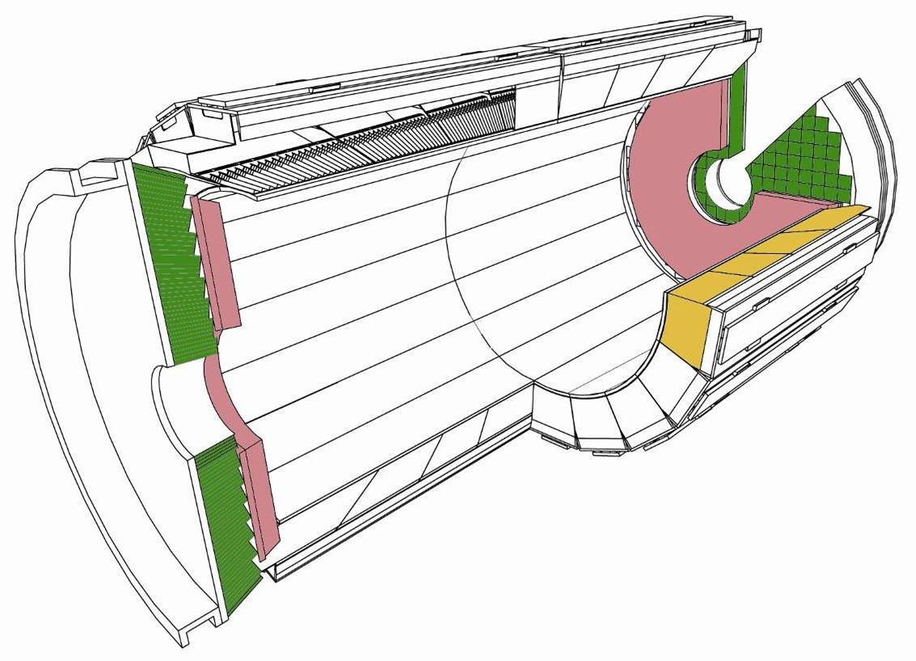
CMS ECAL
Compact, homogeneous,
within magnet, precise
Barrel: 36 Supermodules (18 per half-barrel)
61200 Crystals (34 types)
~ 24 x 24 x 230 mm³ (25.8 X₀)
Avalanche photo-diodes
Fast, high granularity
Radiation “hard”
4 Modules per Supermodule
90 tonnes
Endcaps:
14648 Crystals (1 type)
30 x 30 x 220 mm³ (24.7 X₀)
Vacuum photo-triodes
Pb/Silicon pre-shower for π°/γ discrimination (3 X₀)
3.6 m
7.9 m
All channels’ gains
monitored with laser
Crystals point 3º off vertex

Slide 61
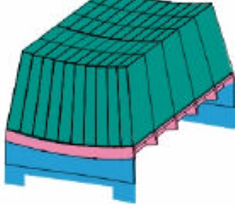
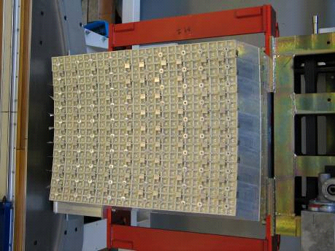
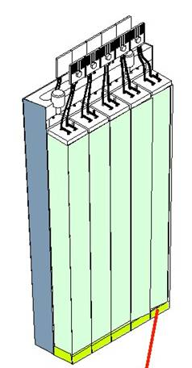
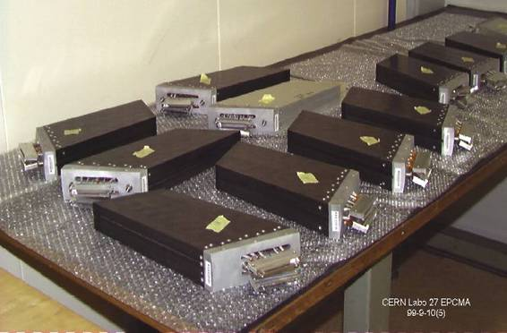
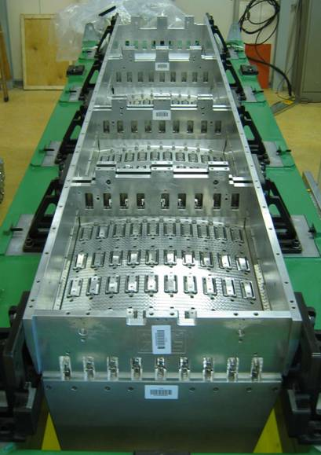
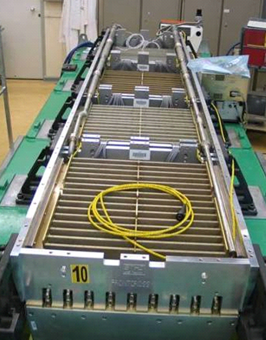
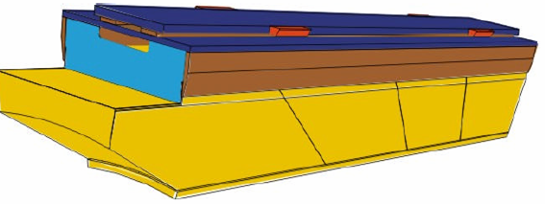
CMS ECAL construction: Barrel
Module: 400/500 crystals
Sub-module: 10 crystals
Bare SM
SM with cooling
Super-module: 1700 crystals

Slide 62
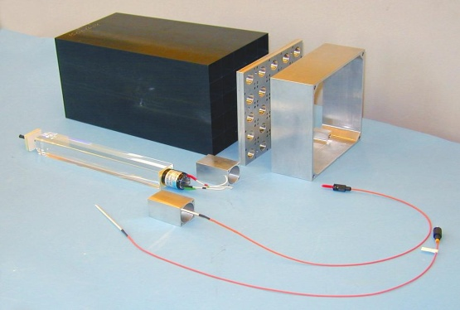





CMS ECAL construction: endcap
Supercrystal: 25 crystals
endcap crystals
Assembly jig
Supercrystal mounting on a Dee backplate
Cooling, electronics & optical readout
A completed Dee with all Supercrystals
Notes:
62

Slide 63

CMS ECAL Barrel

Slide 64





CMS ECAL endcap
Dee lowering and rotation
Dee mounting on HE
Notes:
64

Slide 65

ATLAS liquid argon e.m. calorimeter
Sampling calorimeter with Pb absorber
Accordion geometry:
Short signal leads
No dead space for cables
Longitudinal segmentation by cutting electrodes

Slide 66



The ATLAS Forward and Hadronic Calorimeters
FCAL End View
Forward Calorimeter (FCal)
3 wheels per endcap (10λ)
Cu matrix for the first wheel (2.6λ, 28X₀)
W matrix for the other two wheels (2x 3.7λ)
Hadronic Endcap Calorimeter (HEC)
2 wheels per endcap (10λ), 32 modules each
Cu absorbers (25mm and 50mm thick)
Each gap consists of 4 sub-gaps of 1.85mm
LAr gap FCAL 1/2/3: 250/375/500 µm
FCAL1 Anode Structure
HEC module

Slide 67

ATLAS barrel calorimeter being moved to the IP

Slide 68


CMS HCAL (Barrel)
Sampling calorimeter: brass (passive) & scintillator (active)
Coverage: |η|<1.3
Depth: 5.8 λ_{int} (at η = 0) segmentation: φ x η =
Resolution: ~ 90 %/√E 0.087x0.087
Completed & inserted into coil
17 layers longitudinally φ x η = 4 x 16 towers

Slide 69




CMS HCAL
Plastic scintillator and Cu (brass) sampling calorimeter
Wavelength shifting fibre in a “σ” groove
Spliced to clear fibre for transmission to HPDs
Installing Megatile
Inspecting Tile

Slide 70
Other topics
Particle ID
Both electron/hadron separation, and jet/γ and π⁰/γ separation
Can use:
Longitudinal shower development
Lateral shower development
“Preshower” device giving fine lateral position information early in the shower development can help
Matching of energy to tracking device measurement of momentum
Matching of position of track to position of shower
Isolation
Position measurement
Calibration
Monte Carlo simulation of electromagnetic showers (excellent) and of hadronic showers (not quite so good…)

Slide 71
Further information
1. T. S. Virdee, Lectures on Calorimetery at Nato Summer School,
St Croix. Writeup at: http://cmsdoc.cern.ch/~virdee/stcroix.all.pdf
2. Particle Data Group, Review of Particle Physics — (i.e. the full text form, not the booklet) — comes out every 2 years. Published by European Physics Journal, C
3. Richard Wigmans, “Calorimetry”, Oxford, 2000

