Slide 1
Gaseous Detectors

Slide 2
Overview
Basic principles
Avalanche multiplication (increasing the signal)
Time evolution of the signal
Gas mixtures
Wire chamber detectors:
Multiwire proportional chambers (MWPCs)
Drift chambers
Cathode strip chambers
Time projection chambers (TPCs)
Recent developments:
Microstrip gas chambers (MSGCs)
Gas electron multipliers (GEMs)

Slide 3
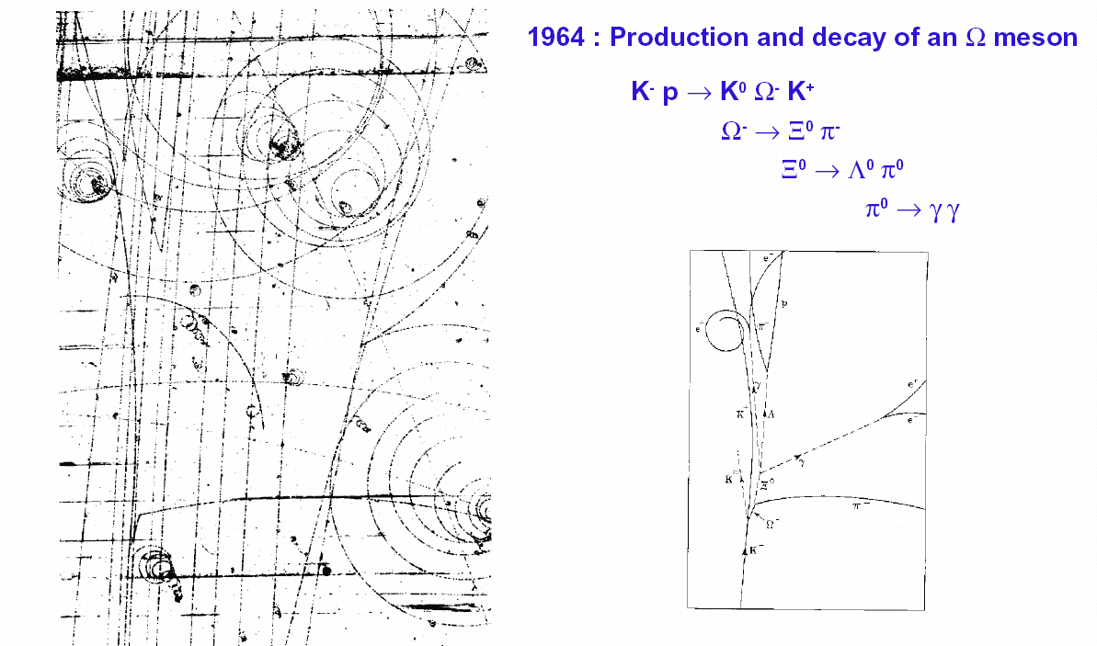
Introduction
Fast charged particles ionize atoms of gas
Ionization can be detected and used to infer the “track” of the particle
The classic “tracking device” was the bubble chamber
Limitations:
Track information recorded on photographic film and must be analyzed frame by frame
Only sensitive for a short period of time (liquid must be in a superheated phase)
Selective trigger cannot be used

Slide 4
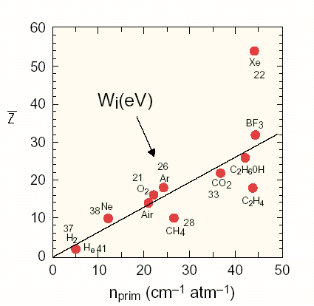
Ionization and Energy Loss
If W is the energy required to create an ion electron pair then the total primary ionization is:
n_{prim} = ΔE/W
where ΔE is the energy
lost by the particle
The total number of ions is 3 to 4*n_{prim} so only ~100 pairs are created per cm
It is necessary to amplify the signal.
Electronic amplifiers have inherent noise equivalent to ~1000 input electrons so other techniques are needed.

Slide 5
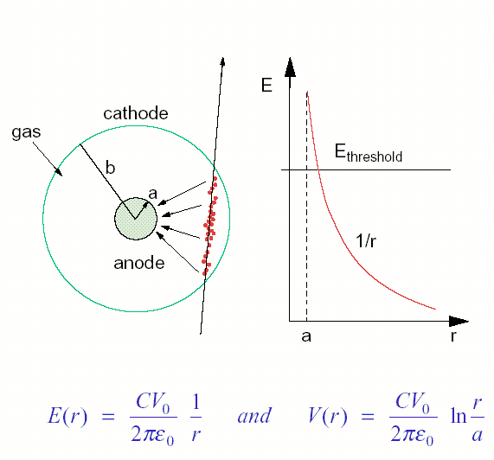
Avalanche Multiplication
The trick is to use avalanche multiplication of ionisation in the gas. This can be achieved by accelerating the primary ionisation electrons in an electric field to the point where they can also cause ionisation
The number of ion pairs is controlled by the applied voltage and the radius of the anode and can rise exponentially.
Electric field
CV₀ = linear charge density
at electrodes

Slide 6
Avalanche Multiplication
Probability that an electron will produce an ionising collision with an atom in distance dr:
N_{a} is the no. of atoms per unit volume
σ_{i} is the cross-section for ionization by collision
is the first Townsend ionisation coefficient
It represents the number of ion pairs produced per unit length
Usually varies with the electric field and so varies with r.
α=1/λ where λ is the mean free path length
The change in the no. of electrons dn is:
For a uniform field:
In general:
α = N_{a}σ_{i}
r_{c} = radius at which E=E_{c} (critical
value for which avalanche
multiplication starts)
a = radius of anode

Slide 7
Avalanche Multiplication
The gain, or gas amplification factor, is:
This is a constant for a given detector, hence such a detector is called a “proportional counter”
Measured voltage pulse is proportional to the total primary ionization, which is in turn proportional to the total energy loss of the incident particle
Measured voltage pulse is also proportional to CV₀
Some typical values:
50% (90%) of electrons are produced within 2.5 (10) μm of the sense wire
r (μm) | E(kV/cm) | α (ion pairs/cm) | λ (μm)
10 | 200 | 4000 | 2.5
20 | 100 | 2000 | 5
100 | 20 | 80 | 125
200 | 10 | ~1 | 1000

Slide 8
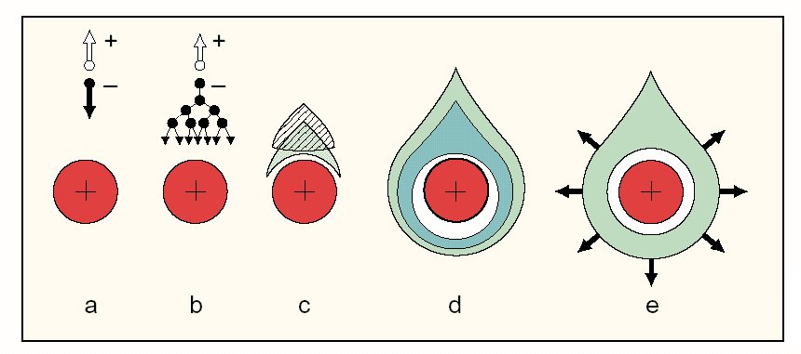
Time Development of the Signal
The signal on the electrodes is induced by the movement of ions and electrons as they drift towards the cathode and anode respectively rather than by collection of charge a the electrodes
The electrons are collected very fast (in ~1ns) while drifting over the few m drift distance, while the positive ions drift slowly towards the cathode.
It is the ion drift which determines the time development and the size of the induced signal. The electrons induce very little signal.

Slide 9
The Induced Signal
Consider a simple case of an anode of radius a and a cathode of radius b. The electric field and the potential are:
Now consider a shell of moving charges all produced at a distance λ from the wire.
Potential energy of a charge Q at radius r:
If the charge is moved by distance dr, the change in potential energy is:
If the total capacitance of the system is lC where l is the length, then the induced signal potential (voltage pulse) is:
where
V₀=V(b) is the applied potential and V(a)=0
ε₀ is the dielectric constant for the gas (≈8.85pF/m)

Slide 10
The Induced Signal
Ion contribution to the signal:
Electron contribution:
Total signal:
The contribution from the electrons, which move a very small distance, is small

Slide 11
Time Development of the Signal
Consider now only the drift of +ve ions. The drift velocity is given by:
So:
Radius of the shell at time t is:
where  is the ion mobility (~1cm²/V/s)
E is the electric field strength and
P is the pressure
where

Slide 12
Time Development of the Signal
Signal at time t is:
Induced current is:
The total drift time T is given from r(T)=b:
where

Slide 13
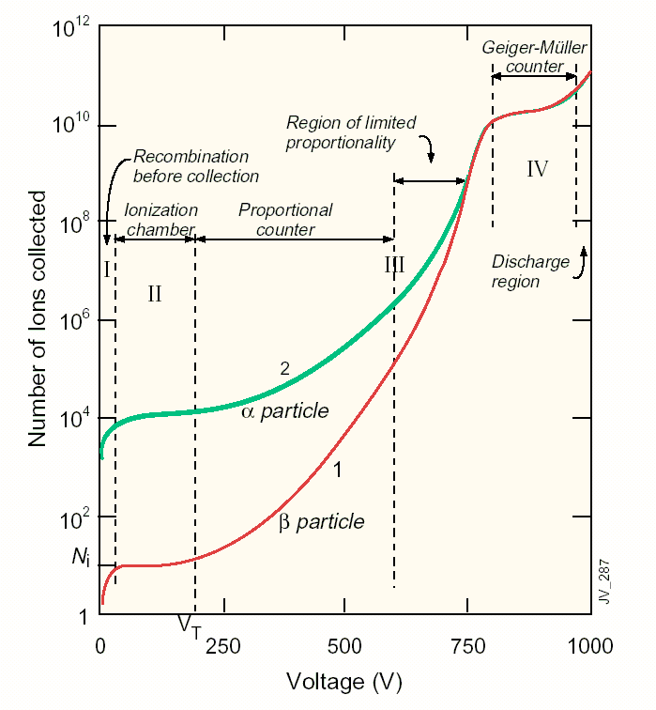
Modes of Operation
Region I: At very low voltage charge begins to be collected but recombination dominates
Region II: All electron-ion pairs are collected before recombination (plateau)
Region III: Above the threshold voltage V_{T} the field is strong enough to allow multiplication and in the proportional mode gains >10⁴ can be achieved with the detected charge proportional to the original energy deposition.
Eventually the proportionality begins to be lost due to space charge build-up around the anode which distorts the E field.
Region IV: In the Geiger-Muller mode photons emitted from the de-exciting molecules spread to other parts of the counter triggering a chain reaction with many avalanches along the length of the anode
Size of the induced signal in independent of the original energy deposition

Slide 14
Choice of Fill Gas
Avalanche multiplication occurs in all gases but there are specific properties required from a “magic” gas mixture
Low working voltage (low ionization potential)
Stable operation at high gain
High rate capability (fast recovery)
Good proportionality
Noble gases are usually the principal components of a useful gas
No molecules to absorb energy in inelastic collisions
Argon gives more primary ionization than Helium or Neon
Kr and Xe are better and have been used but they are expensive
However a chamber full of argon does not produce stable operation and suffers breakdown at low gain:
High excitation energy for noble gases (11.6eV for Ar) means that UV photons emitted from atoms excited in the avalanche process have enough energy to eject photoelectrons from the cathode material
Photoelectrons initiate further avalanches.
Process becomes self-sustaining  continuous discharge.

Slide 15
Gas Mixtures
The situation can be improved by the addition of various polyatomic gases which have many non-radiative vibrational and rotational excited states covering a wide range of energies
e.g. methane (CH₄), isobutane (C₄H₁₀), CO₂
In general the time for the emission of a photon is long compared to the average time between collisions and the energy is transferred into these modes. Thus the emission of UV photons is “quenched”.
Common example gas mixture is 90% Ar, 10% CH₄
Such quenching gases can greatly improve the stability of operation but can also lead to other problems in the presence of high fields, radiation and small levels of impurities
e.g. dissociated molecules can recombine resulting in the formation of solid or liquid polymers on the electrodes - carbon fibre “whiskers”
Inorganic gases can be added to the mixture to prevent this, e.g. CF₄
e.g. ATLAS TRT uses 70% Xe, 20% C0₂, 10% CF₄

Slide 16
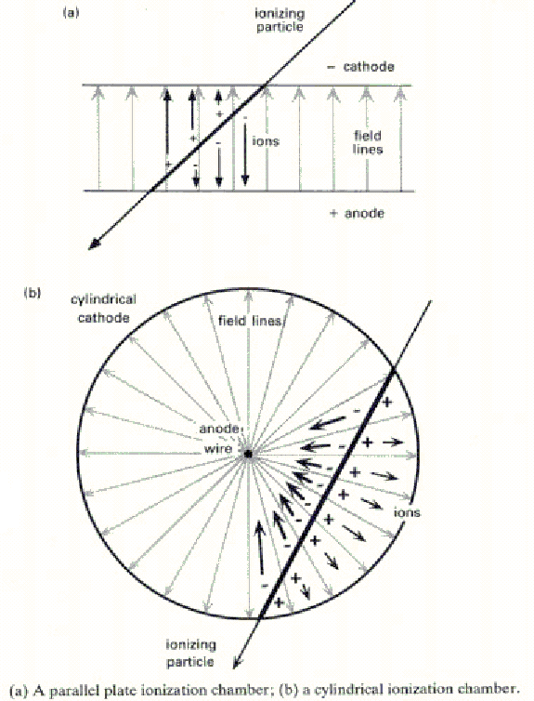
Detector Examples
Many geometries of wires and planes have been used, e.g.
ALICE parallel plate chambers
ATLAS straw tubes
Choice of design is governed by factors such as available space, material in the active region, mechanical support, rate, cost etc.
In general the length of anode wires is limited by their mechanical stability so that intermediate supports must be introduced.

Slide 17
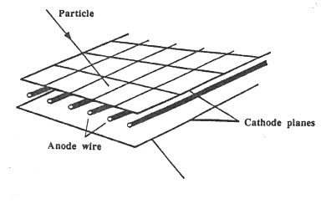
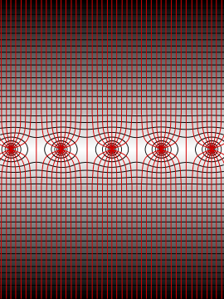
Multiwire Proportional Chambers (MWPC)
Invented at CERN by Georges Charpak in 1968
Showed that an array of many closely spaced anode wires in the same chamber can act as independent proportional counters
Plane of equally spaced anode wires between two cathode planes
Typical wire spacing 2mm, typical cathode gap width 7-8mm

Slide 18
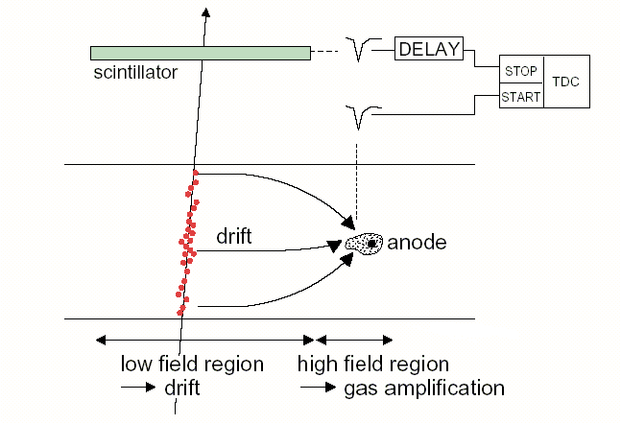
Drift Chambers
The original wire chambers were “digital” devices in that only a “hit” on a particular wire was recorded
Position resolution limited by density and precision of the wires
In drift chambers, the primary ionization electrons diffuse towards the anode under the influence of the electric field in a finite time which, if it can be measured, can be used as an indication of the distance of the track from the anode
As electronics has become more sensitive it is also possible to implement multi-hit capabilities (registering sequences of avalanches).
Allows long drift paths and fewer wires and electronic channels but imposes other constraints
An external timing reference is needed
Can be the interaction time (e.g. in colliders) or can be taken from another detector (as shown).

Slide 19
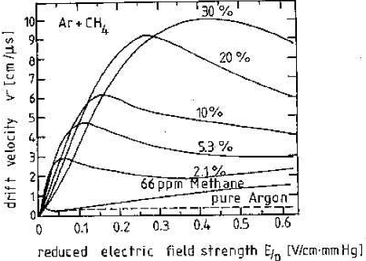
Drift Gases
Since accurate measurement of drift velocity is required, the choice of gas mixture is particularly important for drift chambers
High purity gas is required. The drifting electrons can be captured by electronegative impurities and the problem rises with drift length
A high drift velocity allows higher data rates but may reduce precision
Drift velocity saturation (v_{drift} no longer increasing with increasing E) at a reasonably low field is an advantage because it reduces the sensitivity to voltage, field variations, temperature etc
Note that even a small component of molecular gas substantially increases v_{drift} w.r.t. pure Ar.

Slide 20
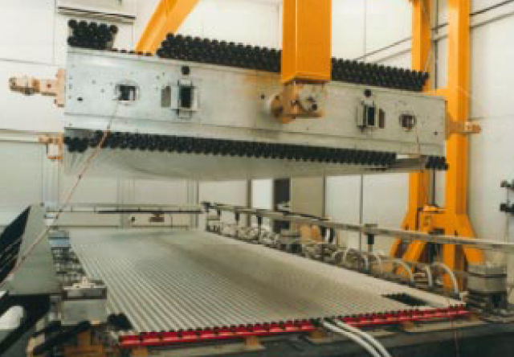
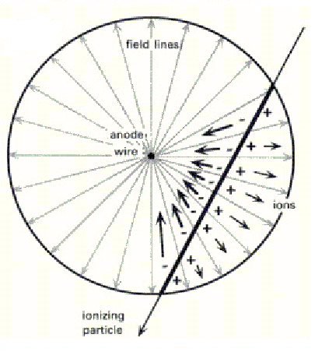
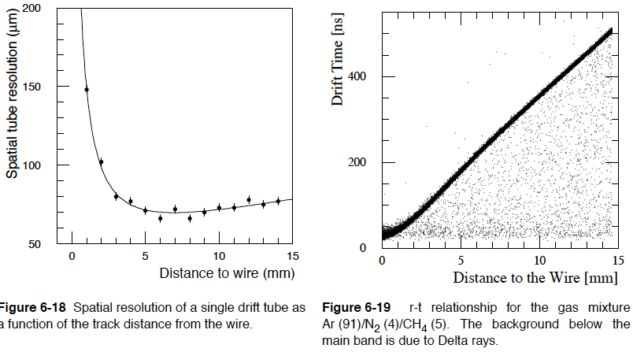
Example: ATLAS Muon Drift Tubes
Parameter Design Value
Gas Mixture Ar / N₂ / CH₄
91%/ 4%/ 5%
Gas Pressure 3bar absolute
Track ionisation 330/cm
Gas gain 2 x 10⁴
Wire potential 3270V
Electric Field at the wire 205 x 10³V/cm
Electric Field at the wall 340V/cm
Maximum Drift time 500ns
Average drift velocity 30μm/ns
Resolution 80 μm

Slide 21
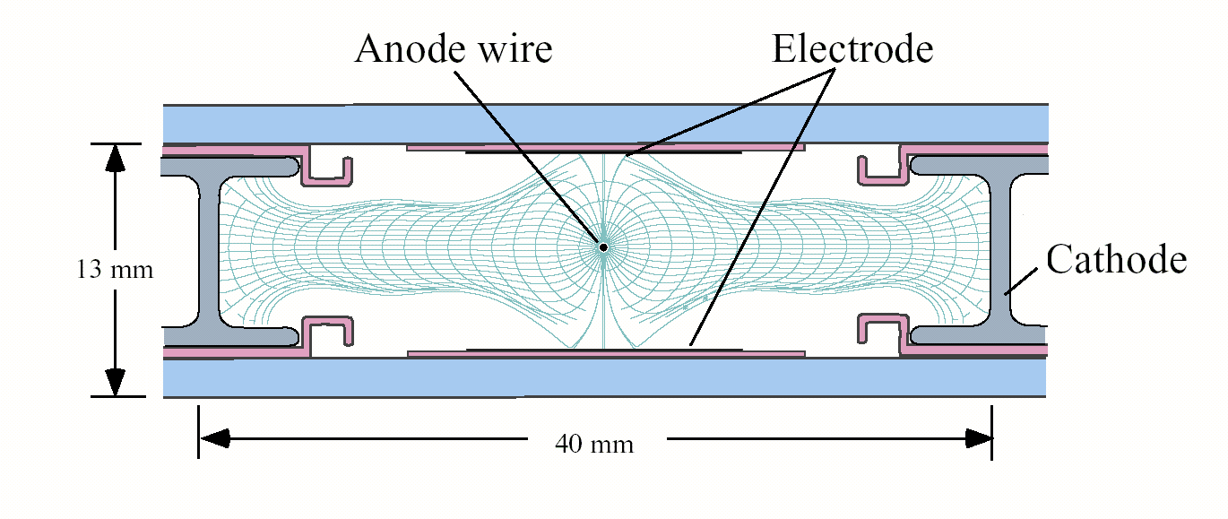
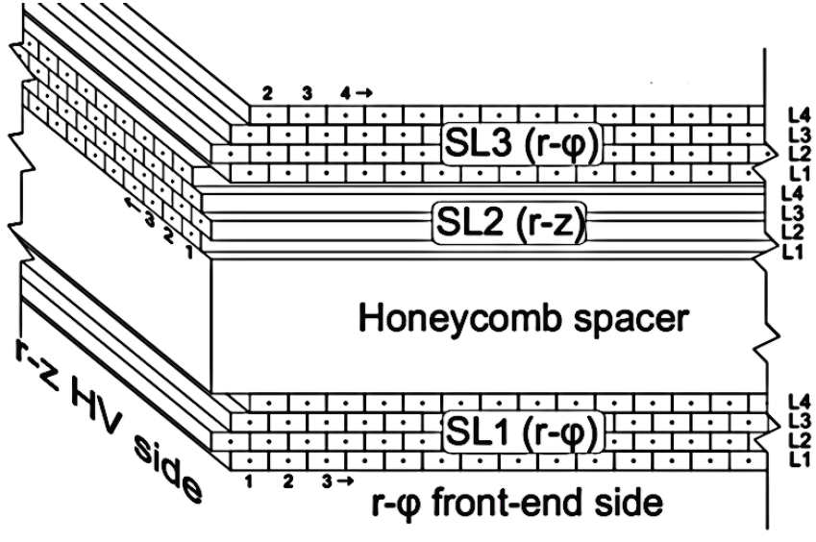
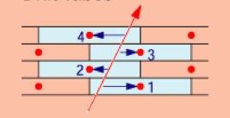
More Complex Geometry: CMS Muon DTs
Additional field shaping electrodes ensure a linear space-time relationship:
Operating parameters:
Alternating layers oriented perpendicular to each other give measurement in 2 dimensions
Drift lines
Isochrones
Gas Mixture | Ar/CO₂ (85%/15%)
Wire voltage | +3600
Electrode strip voltage | +1800
Cathode strip voltage | -1200
Gain | 9x10⁴

Slide 22
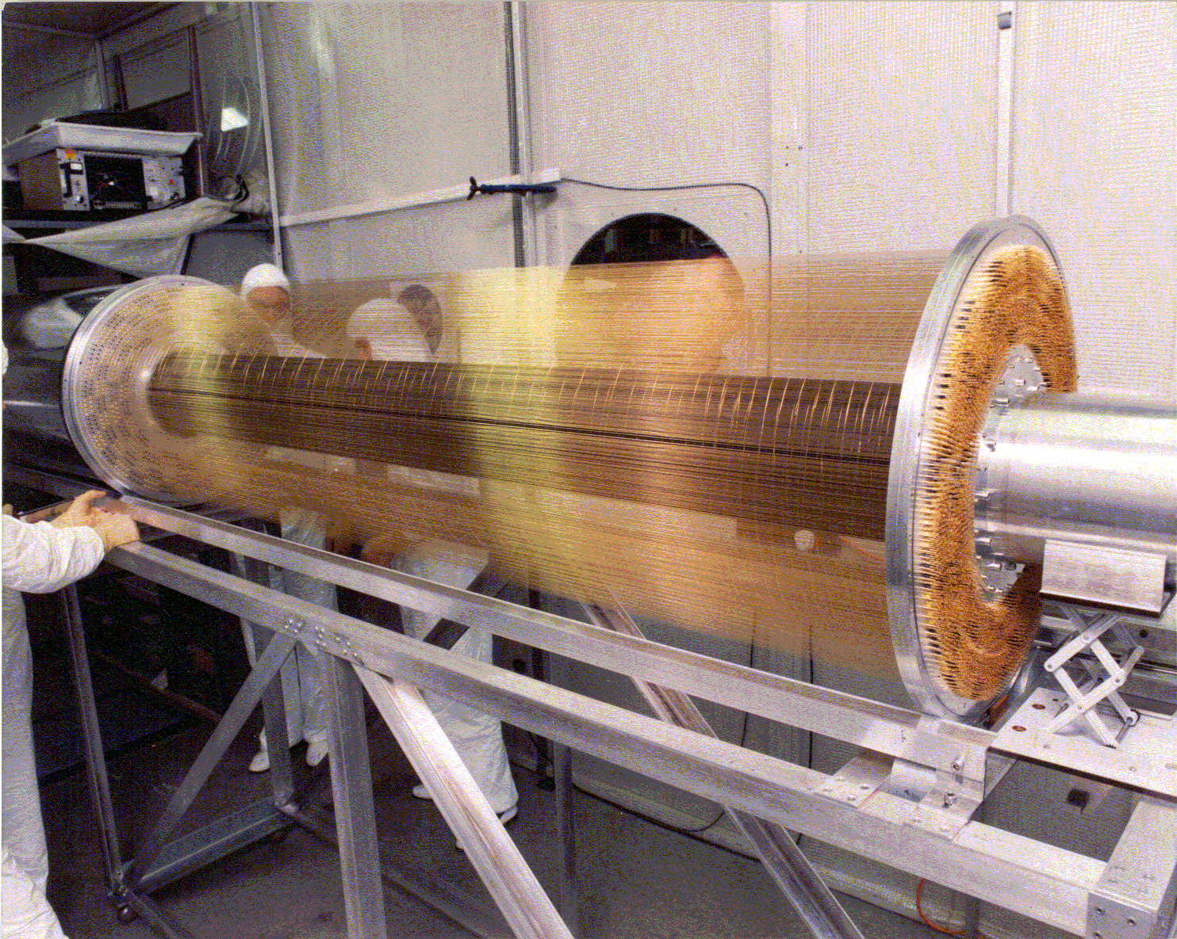
Two Dimensional Readout: Use of Timing
Example: ALEPH Inner Tracking Chamber
See it in the foyer!
Note that c≈1ns/m so cm precision requires 50ps timing resolution
960 anode wires 2m long with 6 cathode wires per anode forming a hexagonal cell
Small cells to allow the calculation of a fast trigger
Second coordinate readout by timing also available to the trigger system
Ar/CO₂ (80%/20%) gas mixture at atmospheric pressure
Drift coordinate precision about 200m, 2nd coordinate 5cm

Slide 23
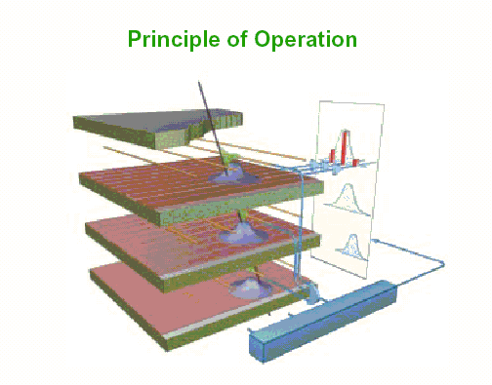
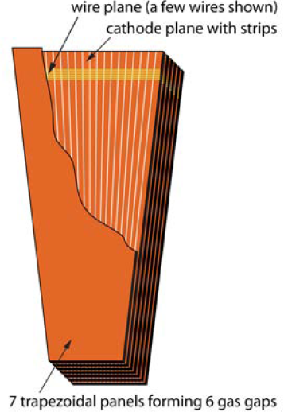
Two Dimensional Readout: Cathode Strips
So far we have talked only about reading out from the anode but a signal is also induced in the cathode. Signals can be detected in several strips of a segmented cathode and the position deduced by interpolation of the signal on several strips.
CMS Cathode Strip Chambers
(Muon endcaps)

Slide 24
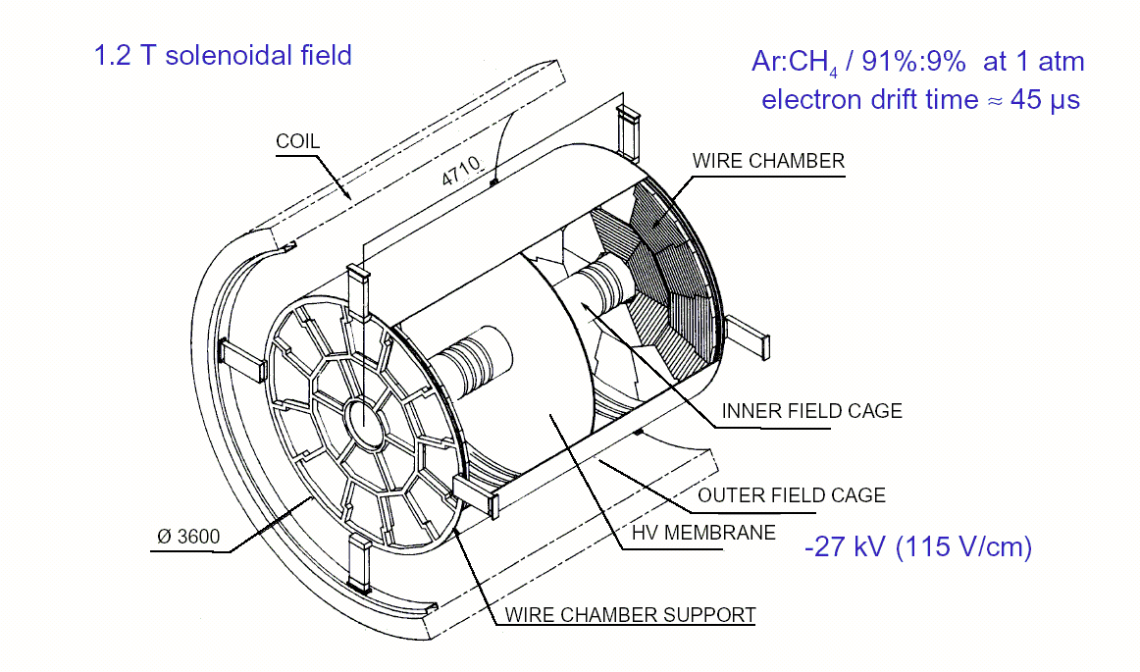
Time Projection Chambers
This technology gets close to being the electronic equivalent of the bubble chamber
The basic structure is a large gas filled cylinder with a thin central membrane held at a high voltage
Ionization electrons drift all the way to the end plates where amplification
rφ resolution 170μm
Z resolution 740 μm
occurs on anode wire planes, with readout normal to the wires on cathode pads
The same track is sampled many times so the pulse size distribution gives a measure of dE/dx. This requires precise channel to channel calibration and gain control.

Slide 25
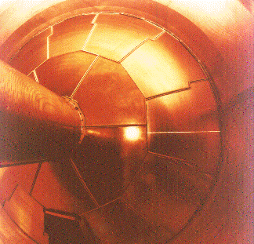
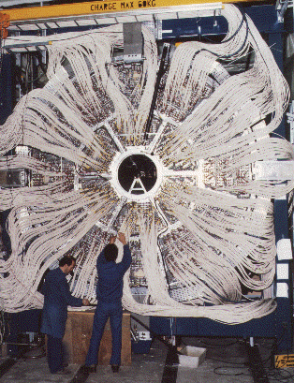
Time Projection Chambers (contd)
Note that the electric and magnetic fields are parallel and must be very homogeneous to permit accurate reconstruction. Laser “tracks” are used for calibration and alignment but extracting good calibration constants is tricky.
Diffusion of the drifting electrons would normally smear out the measured track but the magnetic field limits this by causing the electrons to spiral in the drift direction
ATLAS TPC
ATLAS TPC

Slide 26
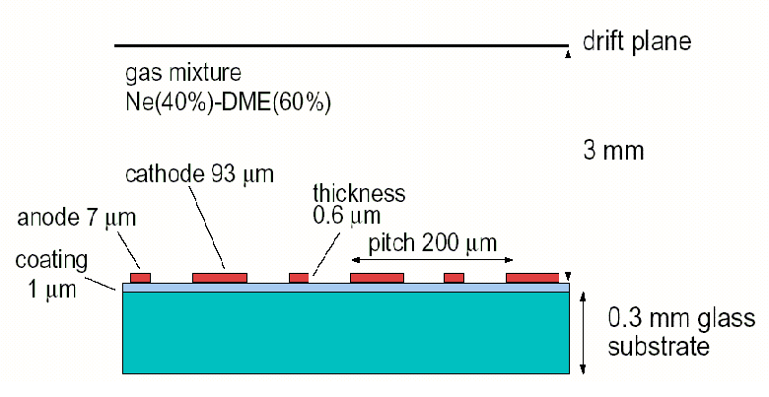
Microstrip Gas Chambers
MSGSs rely on micro-electronics technology, using precision (1-2m) lithographic techniques, to overcome two major limitations of MWPCs:
Spatial resolution orthogonal to the wire is limited by the wire spacing (>1mm)
Rate capability is limited by the long ion collection time (tens of µs)
Alternating narrow anode strips and wider cathode strips deposited on an insulator by photolithography
Were proposed as a solution for the CMS outer tracking but were dropped in favour of silicon because it was felt that the technology was not sufficiently mature
CMS design:
Anode: 0V
Cathodes: –520V
Drift cathode: -3500V
Gain ~2000
Rates up to 10⁶ particles/mm²/s

Slide 27
MSGCs (contd)
Cathode strips are arranged between the anode strips for an improved field quality and to improve the rate by fast removal of positive ions
Reduced dead time between signals
Rate and spatial resolution improved w.r.t. MWPCs by more than an order of magnitude
Spatial resolution can be a few tens of microns
Segmentation of the cathodes also possible to allow 2-dimensional readout

Slide 28
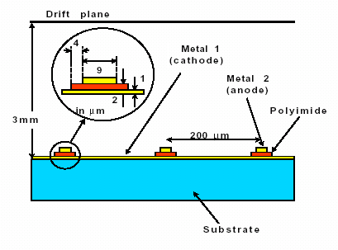
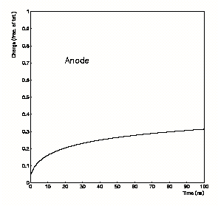
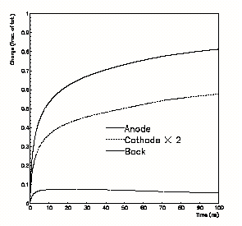
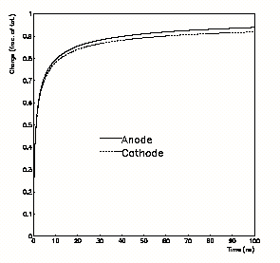
Micro-Gap Chambers
Enhanced type of MSGC with anode and cathode separated by a layer of insulating film
Comparison of the time development of the induced charge on the electrodes of various chambers:
MWPC
MSGC
MCG

Slide 29
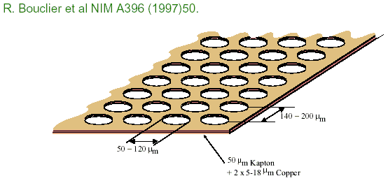
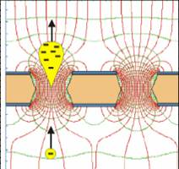
Gas Electron Multiplier (GEM)
Thin layer of insulating foil coated on both sides with metal film
Contains chemically produced holes of size ~50-100μm
The two metal films are have different voltages, creating a strong E field in the holes
Gas multiplication avalanche occurs when a charge passes through a hole

Slide 30
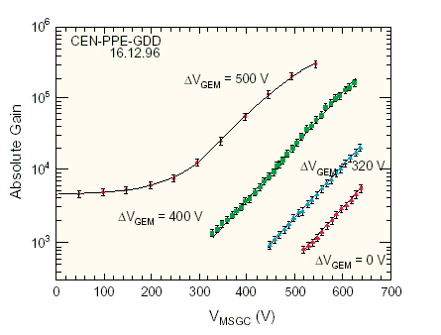
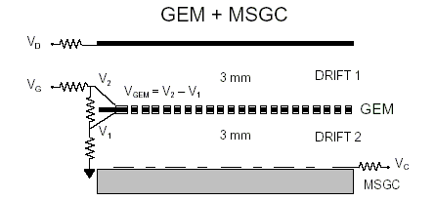
GEMs (contd)
Use in combination with MSGC to achieve high gain with small applied voltage

