Slide 1

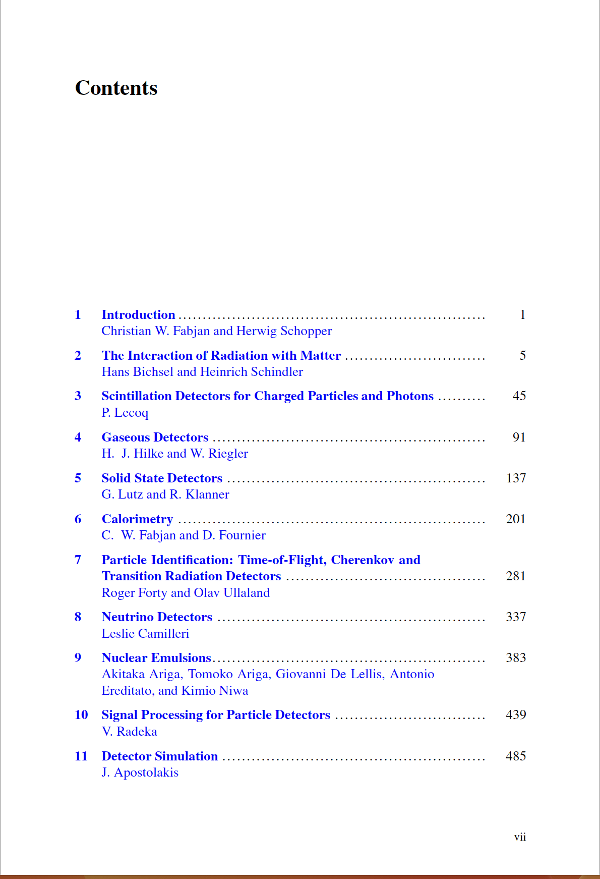
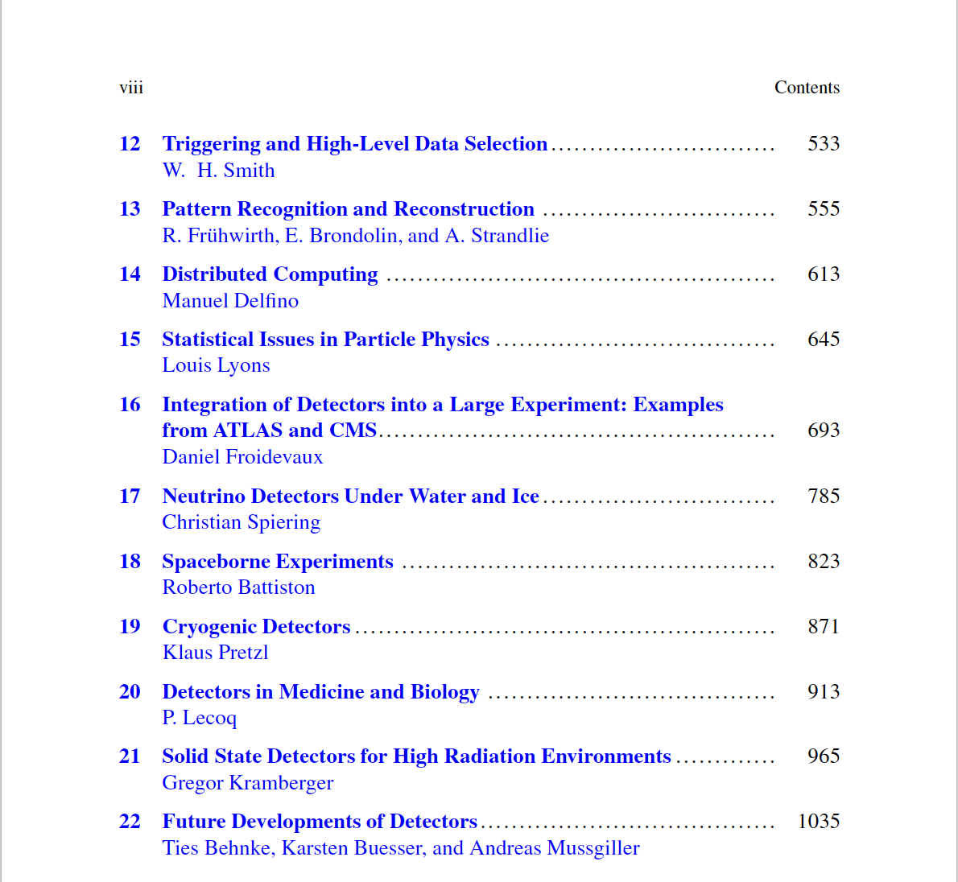
Reference material
Strongly recommended open access book https://doi.org/10.1007/978-3-030-35318-6

Slide 2
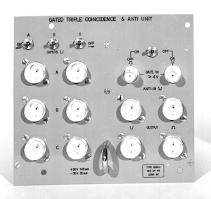
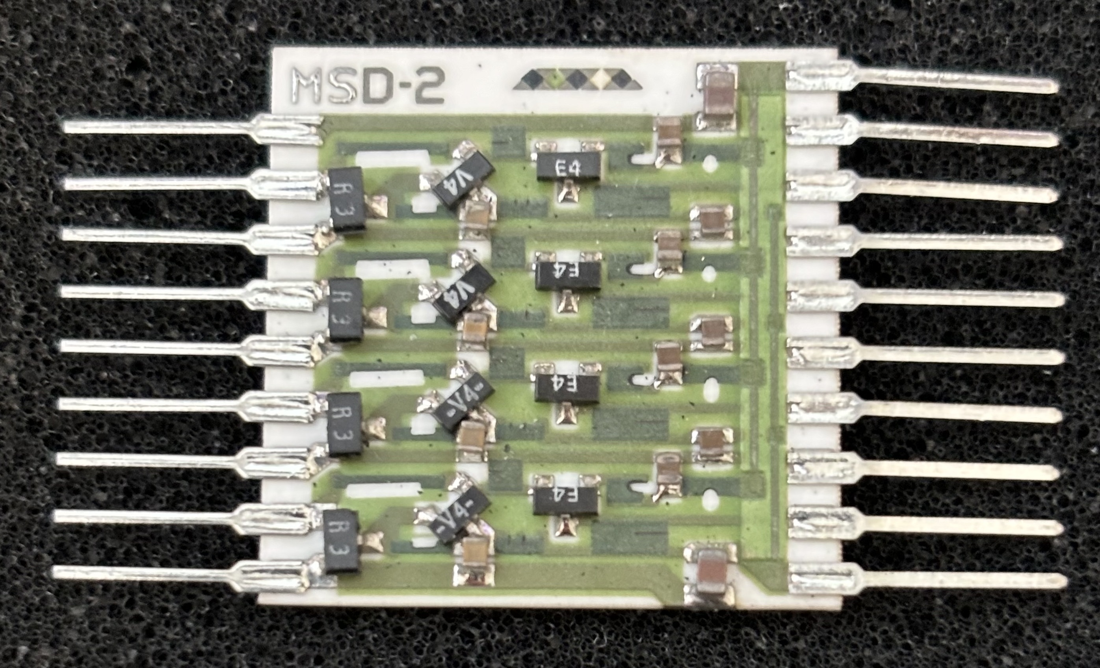
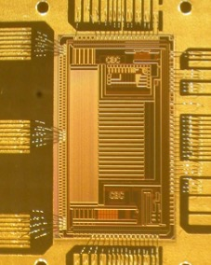
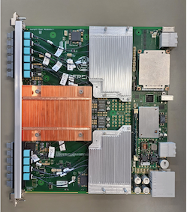
A brief history of electronics for particle physics selected from some recent conference talks
Geoff Hall
For more details and references see
“The evolution of particle physics electronics”
JINST_103P_1025 has been published as: 2025_JINST_20_C12006
https://doi.org/10.1088/1748-0221/20/12/C12006

Slide 3
My involvement
SLAC: triggered rapid-cycling bubble chamber 1975-1982
  the charm era, but only our final experiment observed charm ~1981
    γp –> charm : < 100 events from ~2M triggered photos
    triggered on tracks using NOVA mini-computer, algorithm in assembler code (2ms)
    various hardware projects, including Cerenkov counters with PM readout
NA14’: first UK project to use silicon detectors, started ~1981: γp –> charm
  Our first silicon microstrips manufactured by Micron Semiconductor
    initially very basic design, based on MOS process devised by J Kemmer
  UK contribution to NA14’ cancelled before telescope operated!
    but experiment continued
  I became involved with many silicon detector projects, leading to SSC & LHC preparations
    radiation damage studies, initially of silicon, then FE electronics
  CMS since 1992 – in many activities

Slide 4
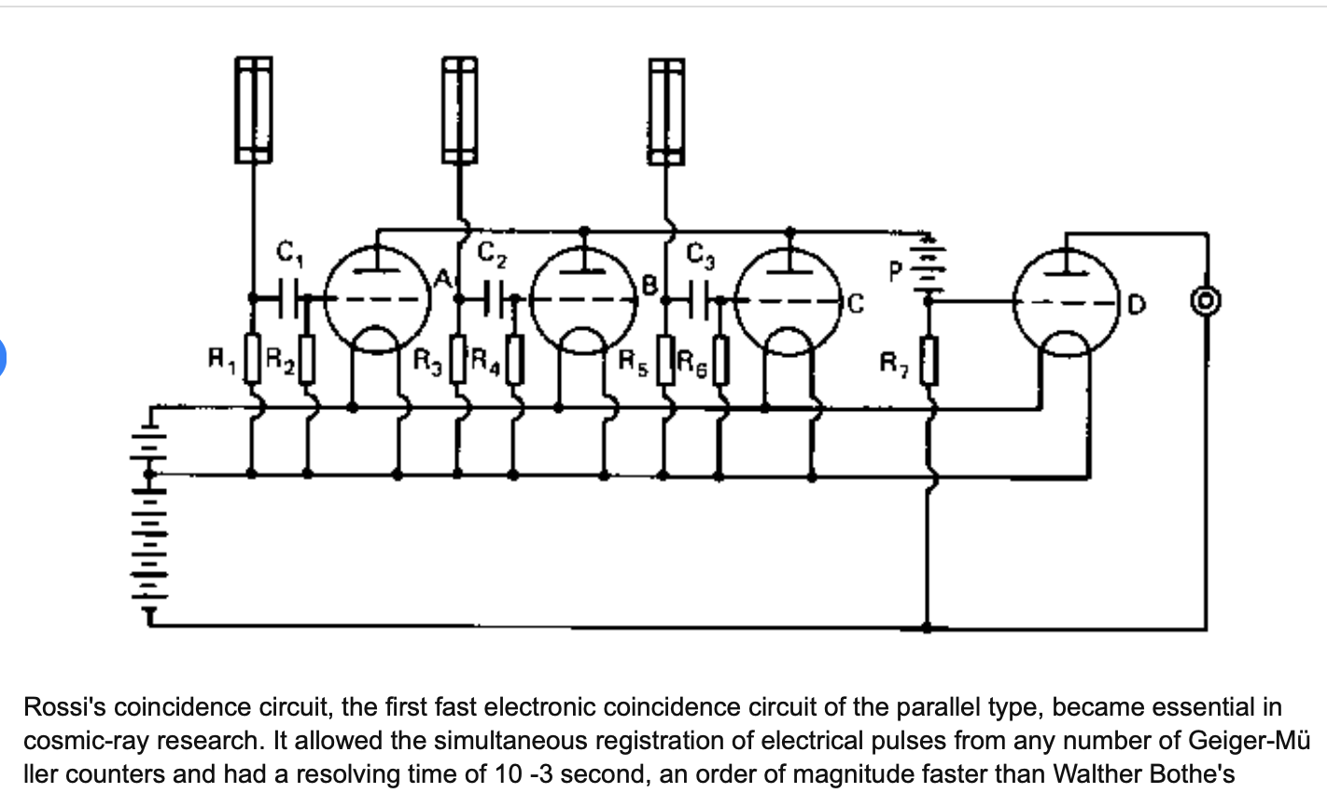
Pre-CERN
Bruno Rossi was the pioneer
  coincidence circuit (1930) triggering using Geiger counters and valves
    Quickly adopted, e.g. Blackett & Occhialini (1932) triggered cloud chamber in a magnetic field to observe the positron (but scooped by Anderson to publish)
  earlier triggers not electronic
triode vacuum tubes
“The consequent variation of the anode current was detected acoustically by a telephone.”
Bothe and Geiger defined a coincidence using electrometers recorded on fast photographic film - when both counters showed a signal within a 1 ms interval

Slide 5
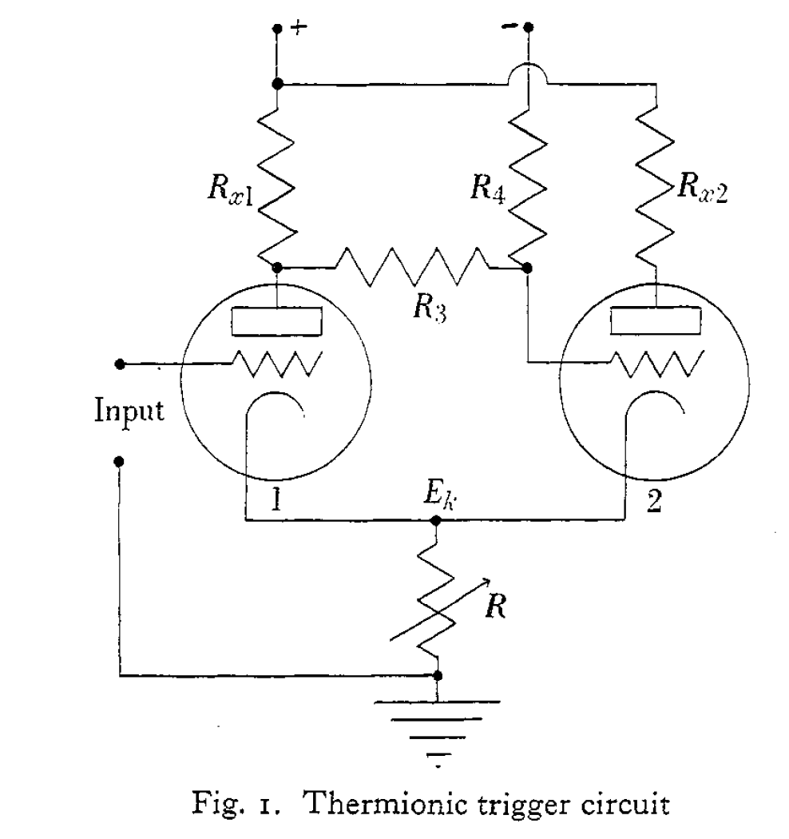
Some subsequent developments
HEP toolkit
Electronic counter – Wyn-Williams (1931)
  to record numbers of events with “mechanical counting meter” (octal)
Schmitt trigger (1937) - comparator with hysteresis
  threshold crossing circuit using valves -> 1-bit A-D conversion
TDC – invented by Rossi (1940) but kept secret during the war years
ADC – Wilkinson (1949)
  A stable 99-channel pulse amplitude analyser for slow counting
All vacuum tube (valve) based
  shrinkage began…
from E. Heijne EPS Workshop 2013

Slide 6
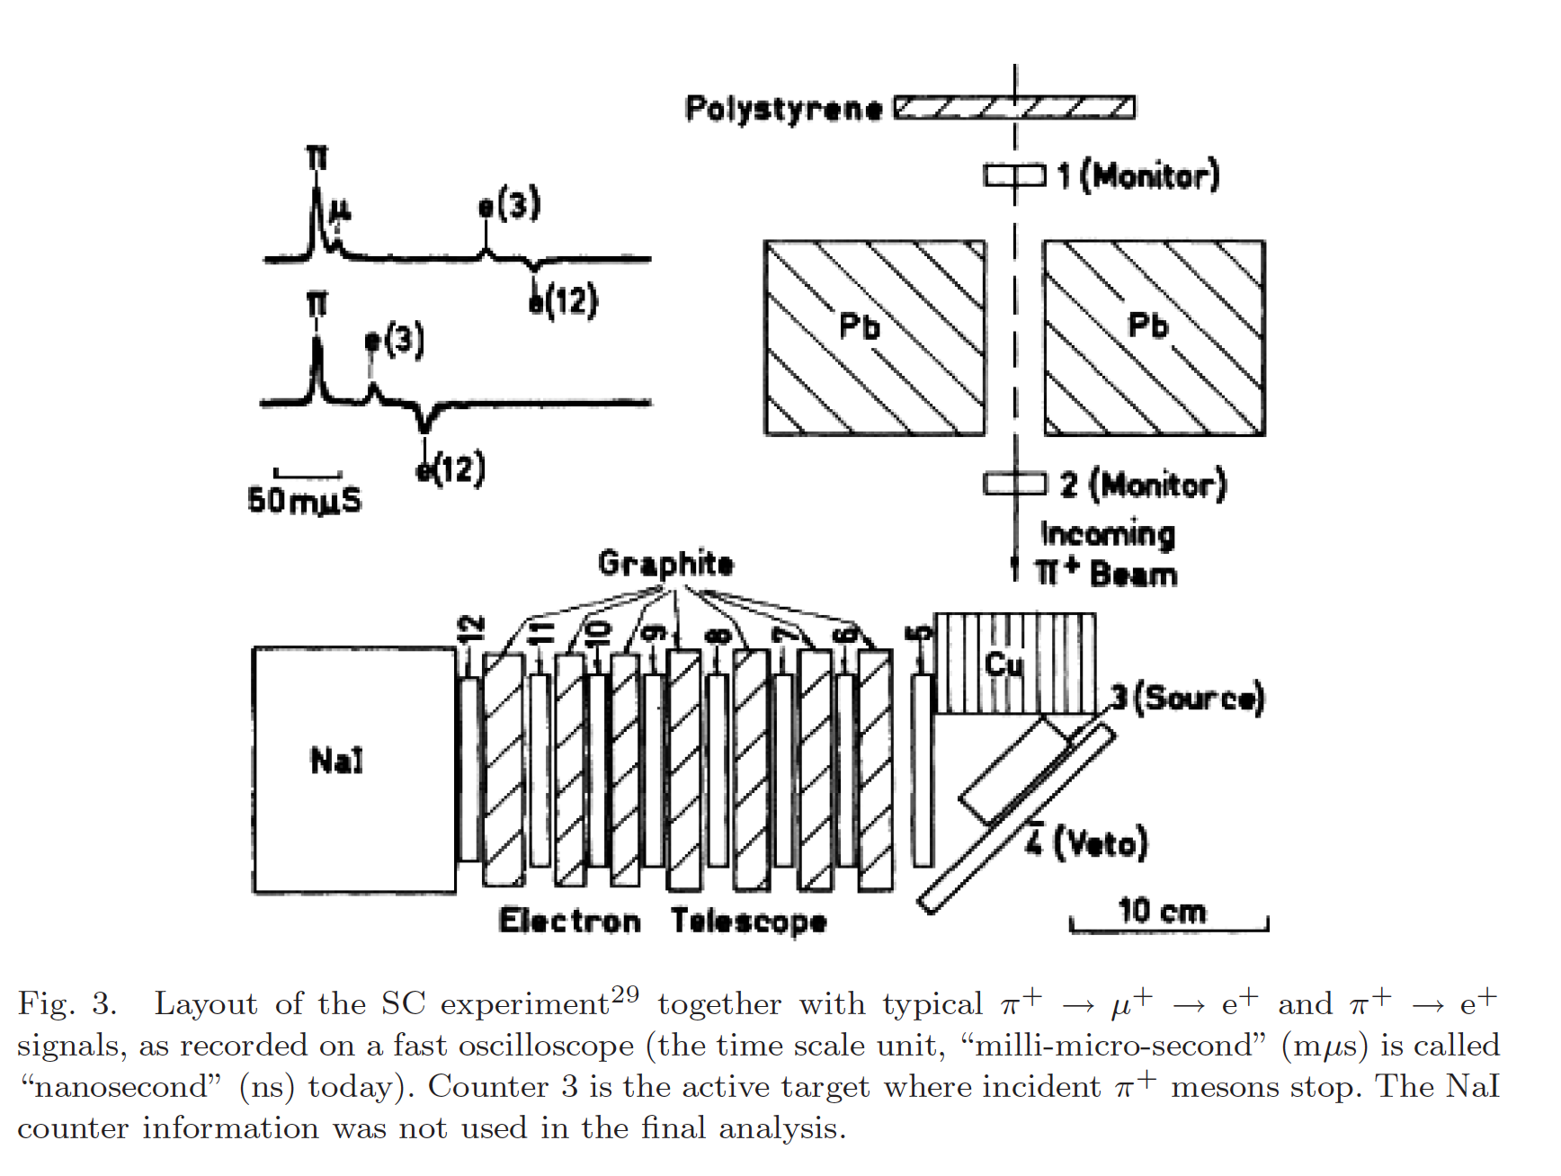

Early CERN
Fidecaro et al. Discovery of $π→eν$ decay 1958
  need to distinguish from $π→μ →e$
events recorded on fast oscilloscope – few per hour –photographically
π⁺ stopped in active target – plastic scintillator + PM – opened ~150 ns gate for oscilloscope
“positron detection efficiency… Monte Carlo program … at CERN when the first electronic computer [my emphasis] (British-made Ferranti-Mercury…) was installed”
electronics?

Slide 7
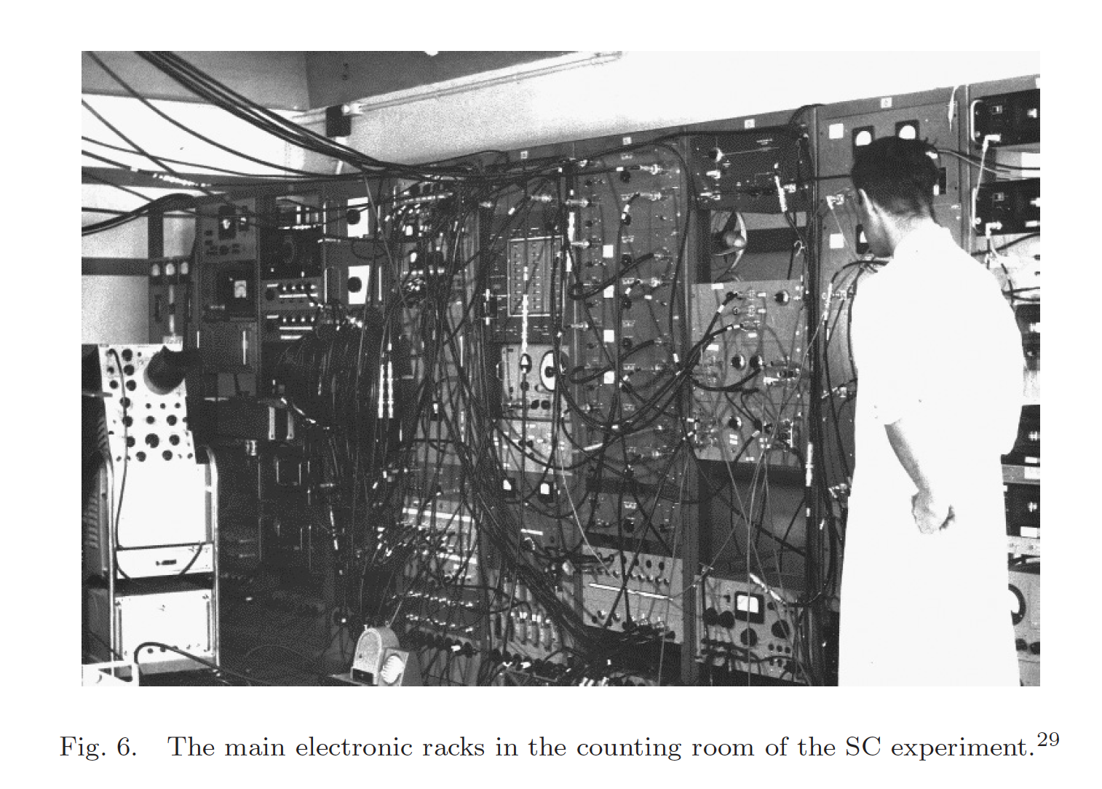
$π→eν$ experiment electronics
Not so different from today?

Slide 8
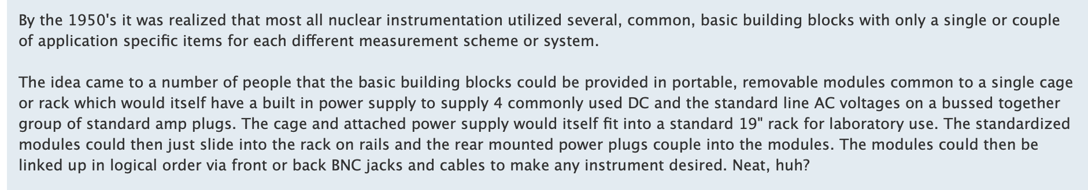
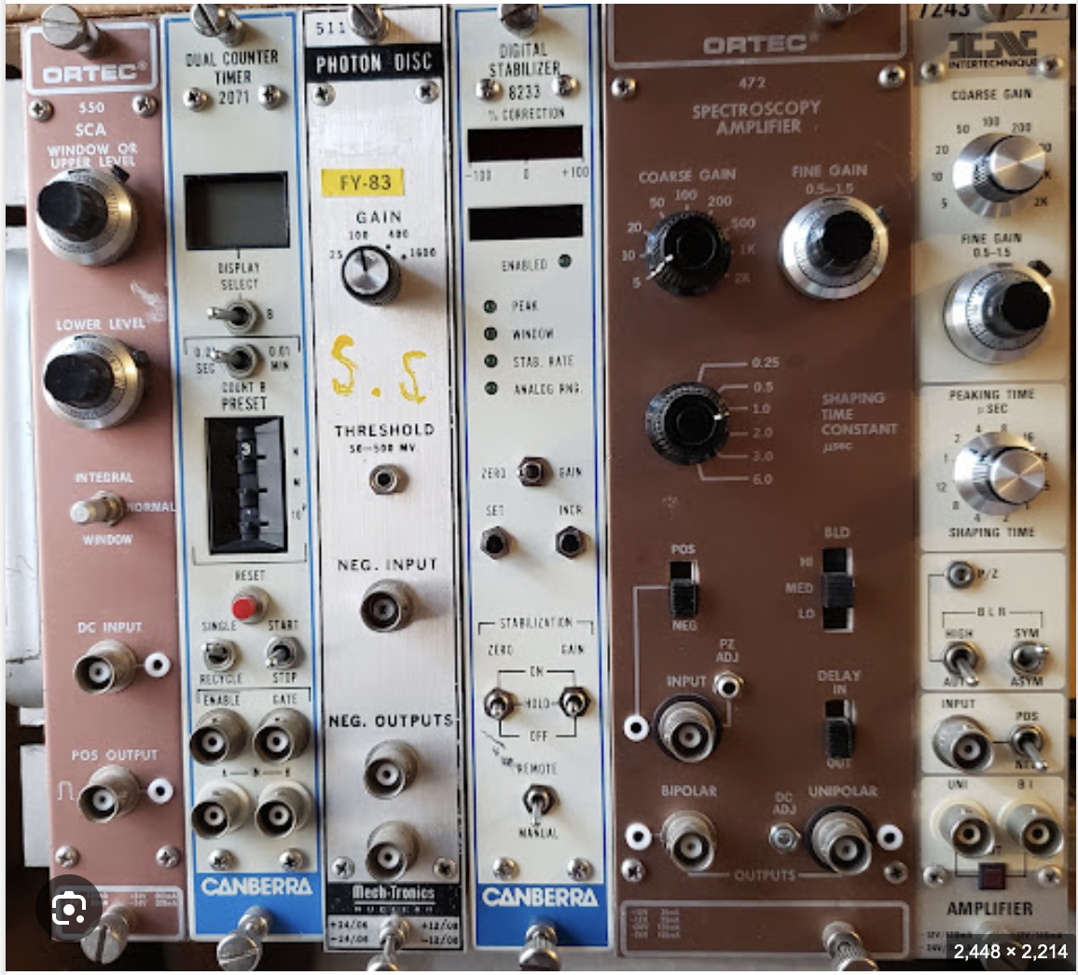
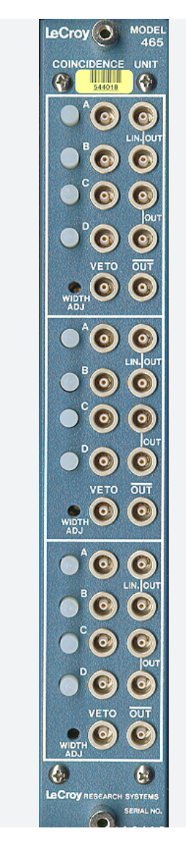
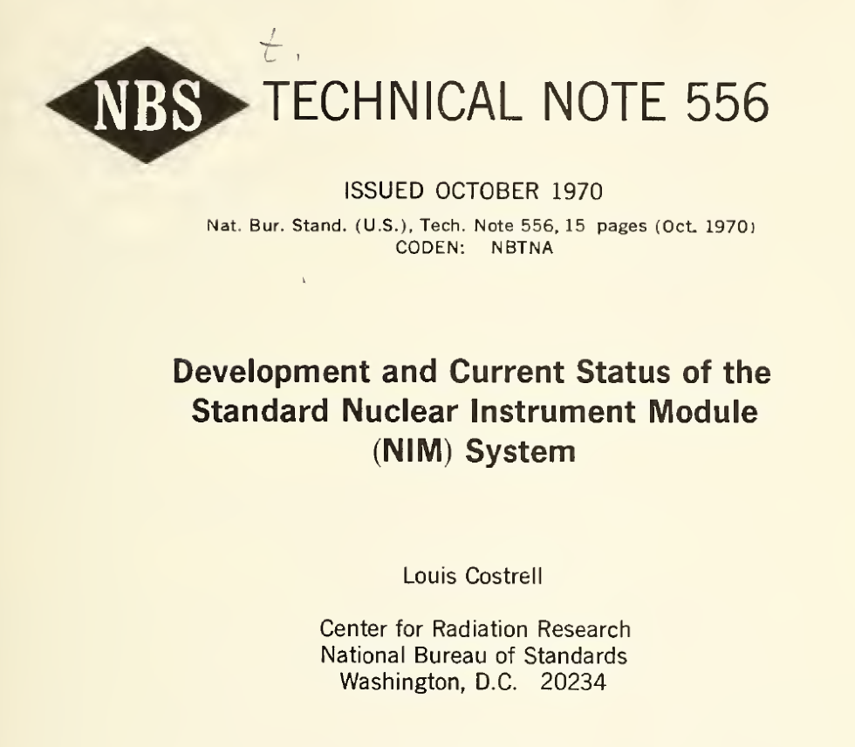
NIM (Nuclear Instrumentation Module) era
with the invention of the bipolar transistor, more shrinkage began

Slide 9
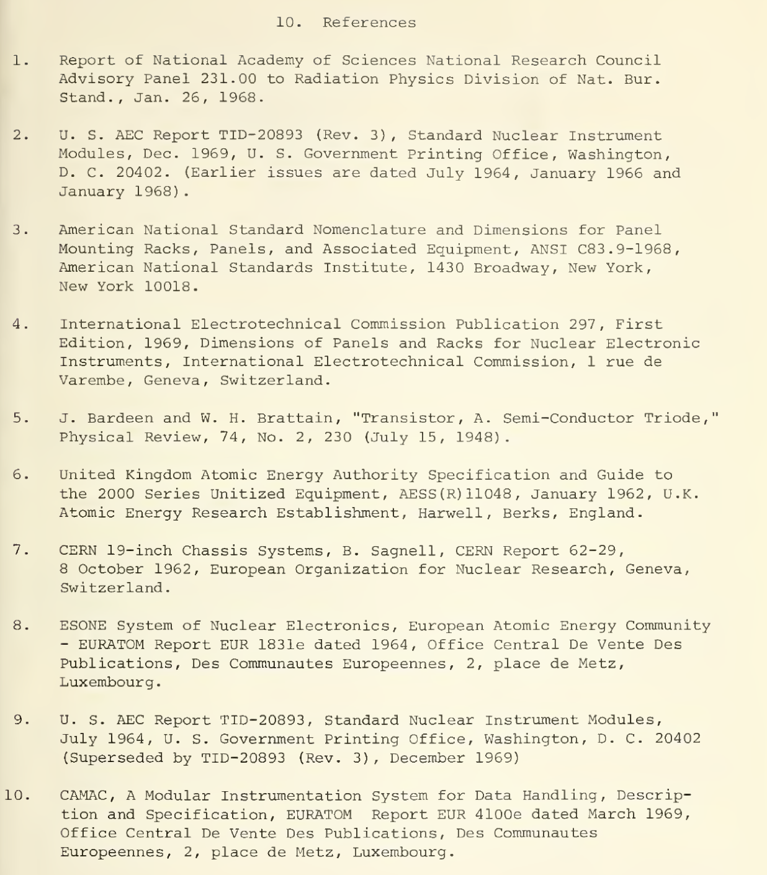
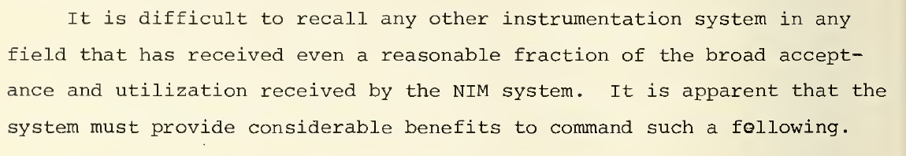
NIM and miniaturisation
“Though transistors are extremely small compared to vacuum tubes and consume far less power, transistorized instruments that emerged in the 1950 's were nonetheless constructed in a manner quite similar to that of their vacuum tube predecessors. Thus the instruments utilized 19-inch front panels and contained their own dc power supplies operated from the ac line. It rapidly became apparent that such construction was quite uneconomical and inefficient, that a number of transistorized instruments in modular form could be accommodated in the space occupied by a single 19-inch panel, and that a single dc power supply…”
Popular too…

Slide 10
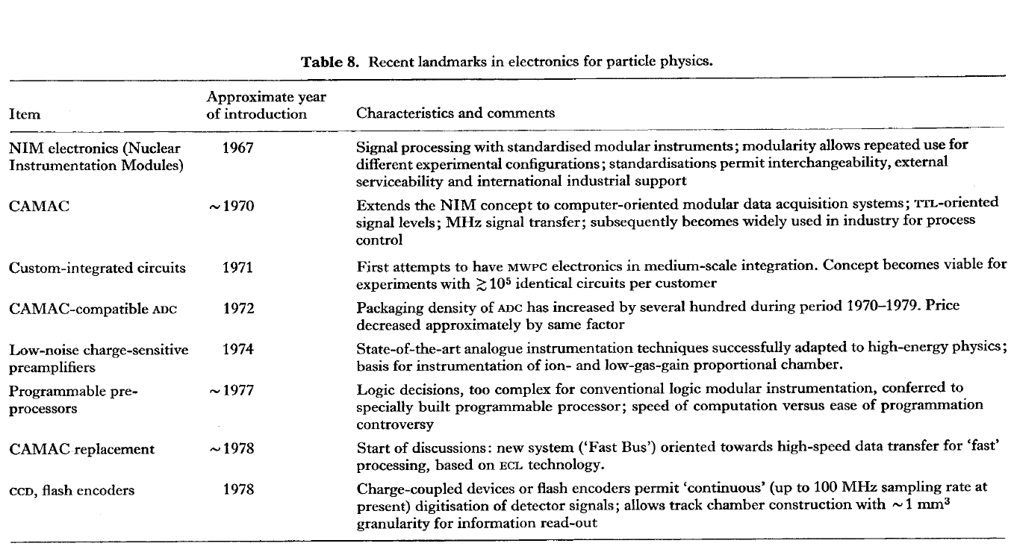
As seen in 1980
“Particle detectors” C W Fabjan and H G Fischer 1980 Rep. Prog. Phys. 43 1003
Report dominated by gaseous detectors, but also Cerenkov, TR and hadronic and EM calorimetry. Electronics is discussed under detector systems.
What happened next?

Slide 11
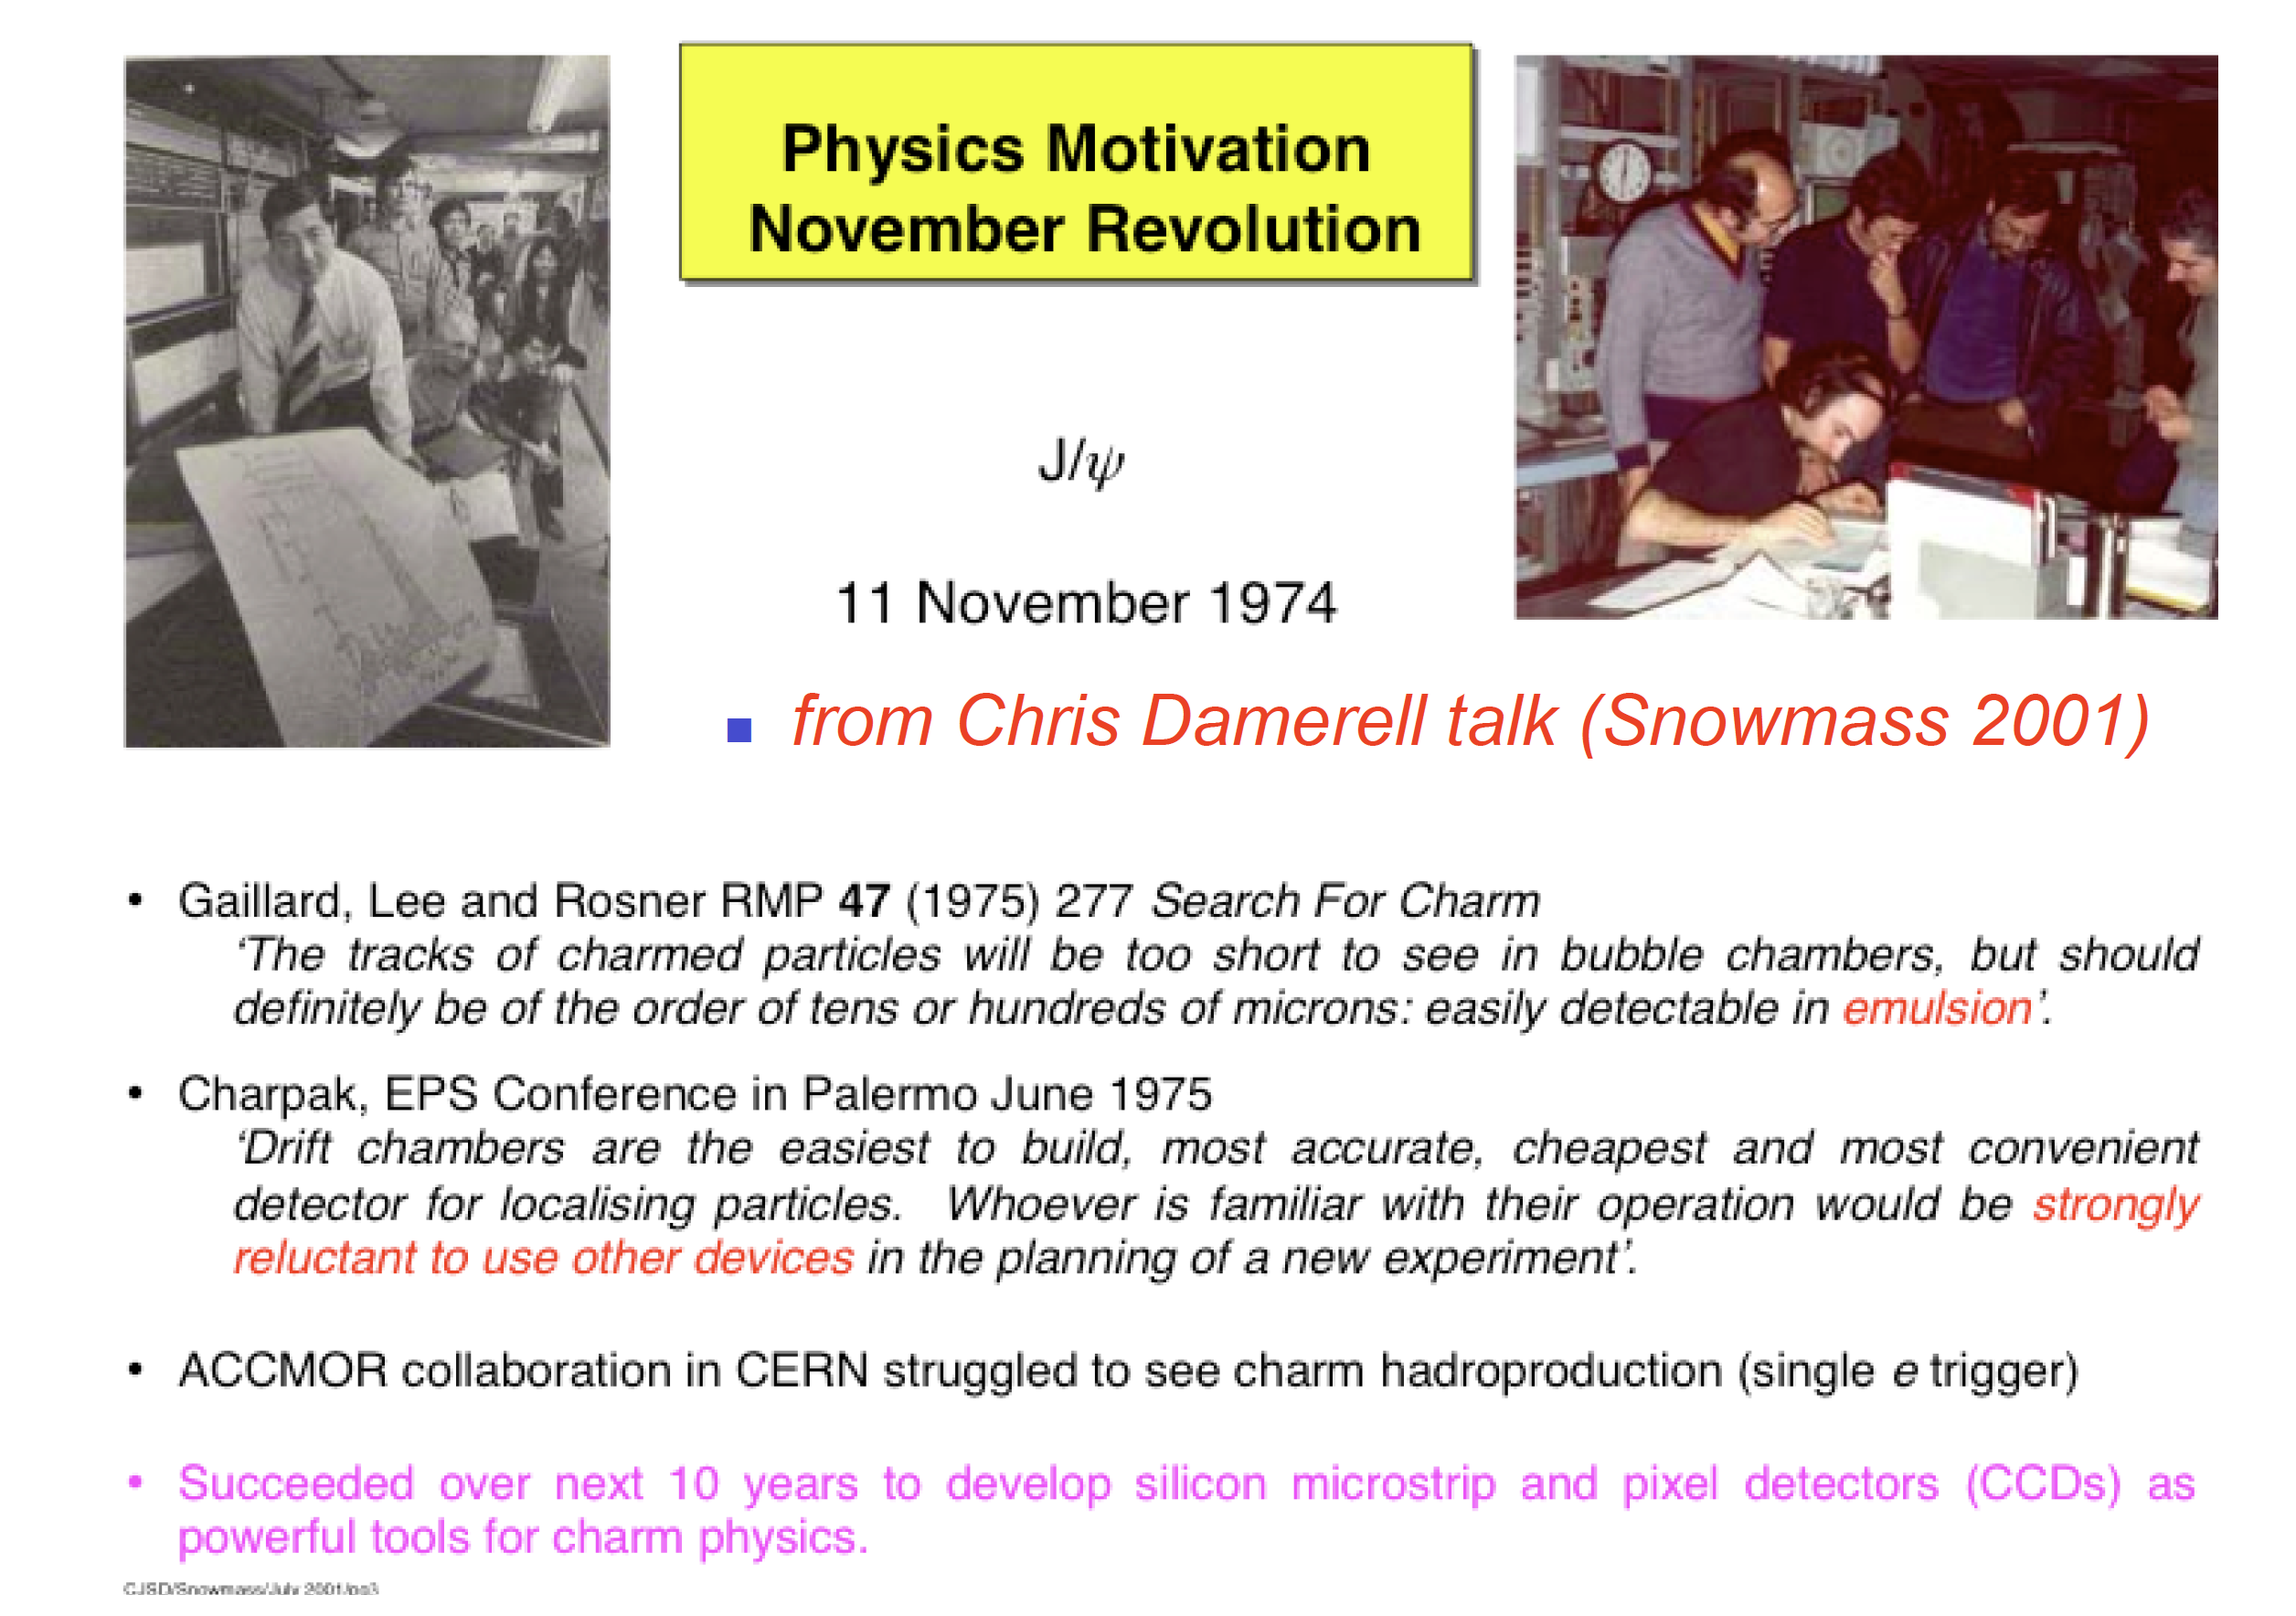
In fact, it had already happened!
The driving force behind many electronics developments since the mid-1980s. Would it have happened anyway?

Slide 12
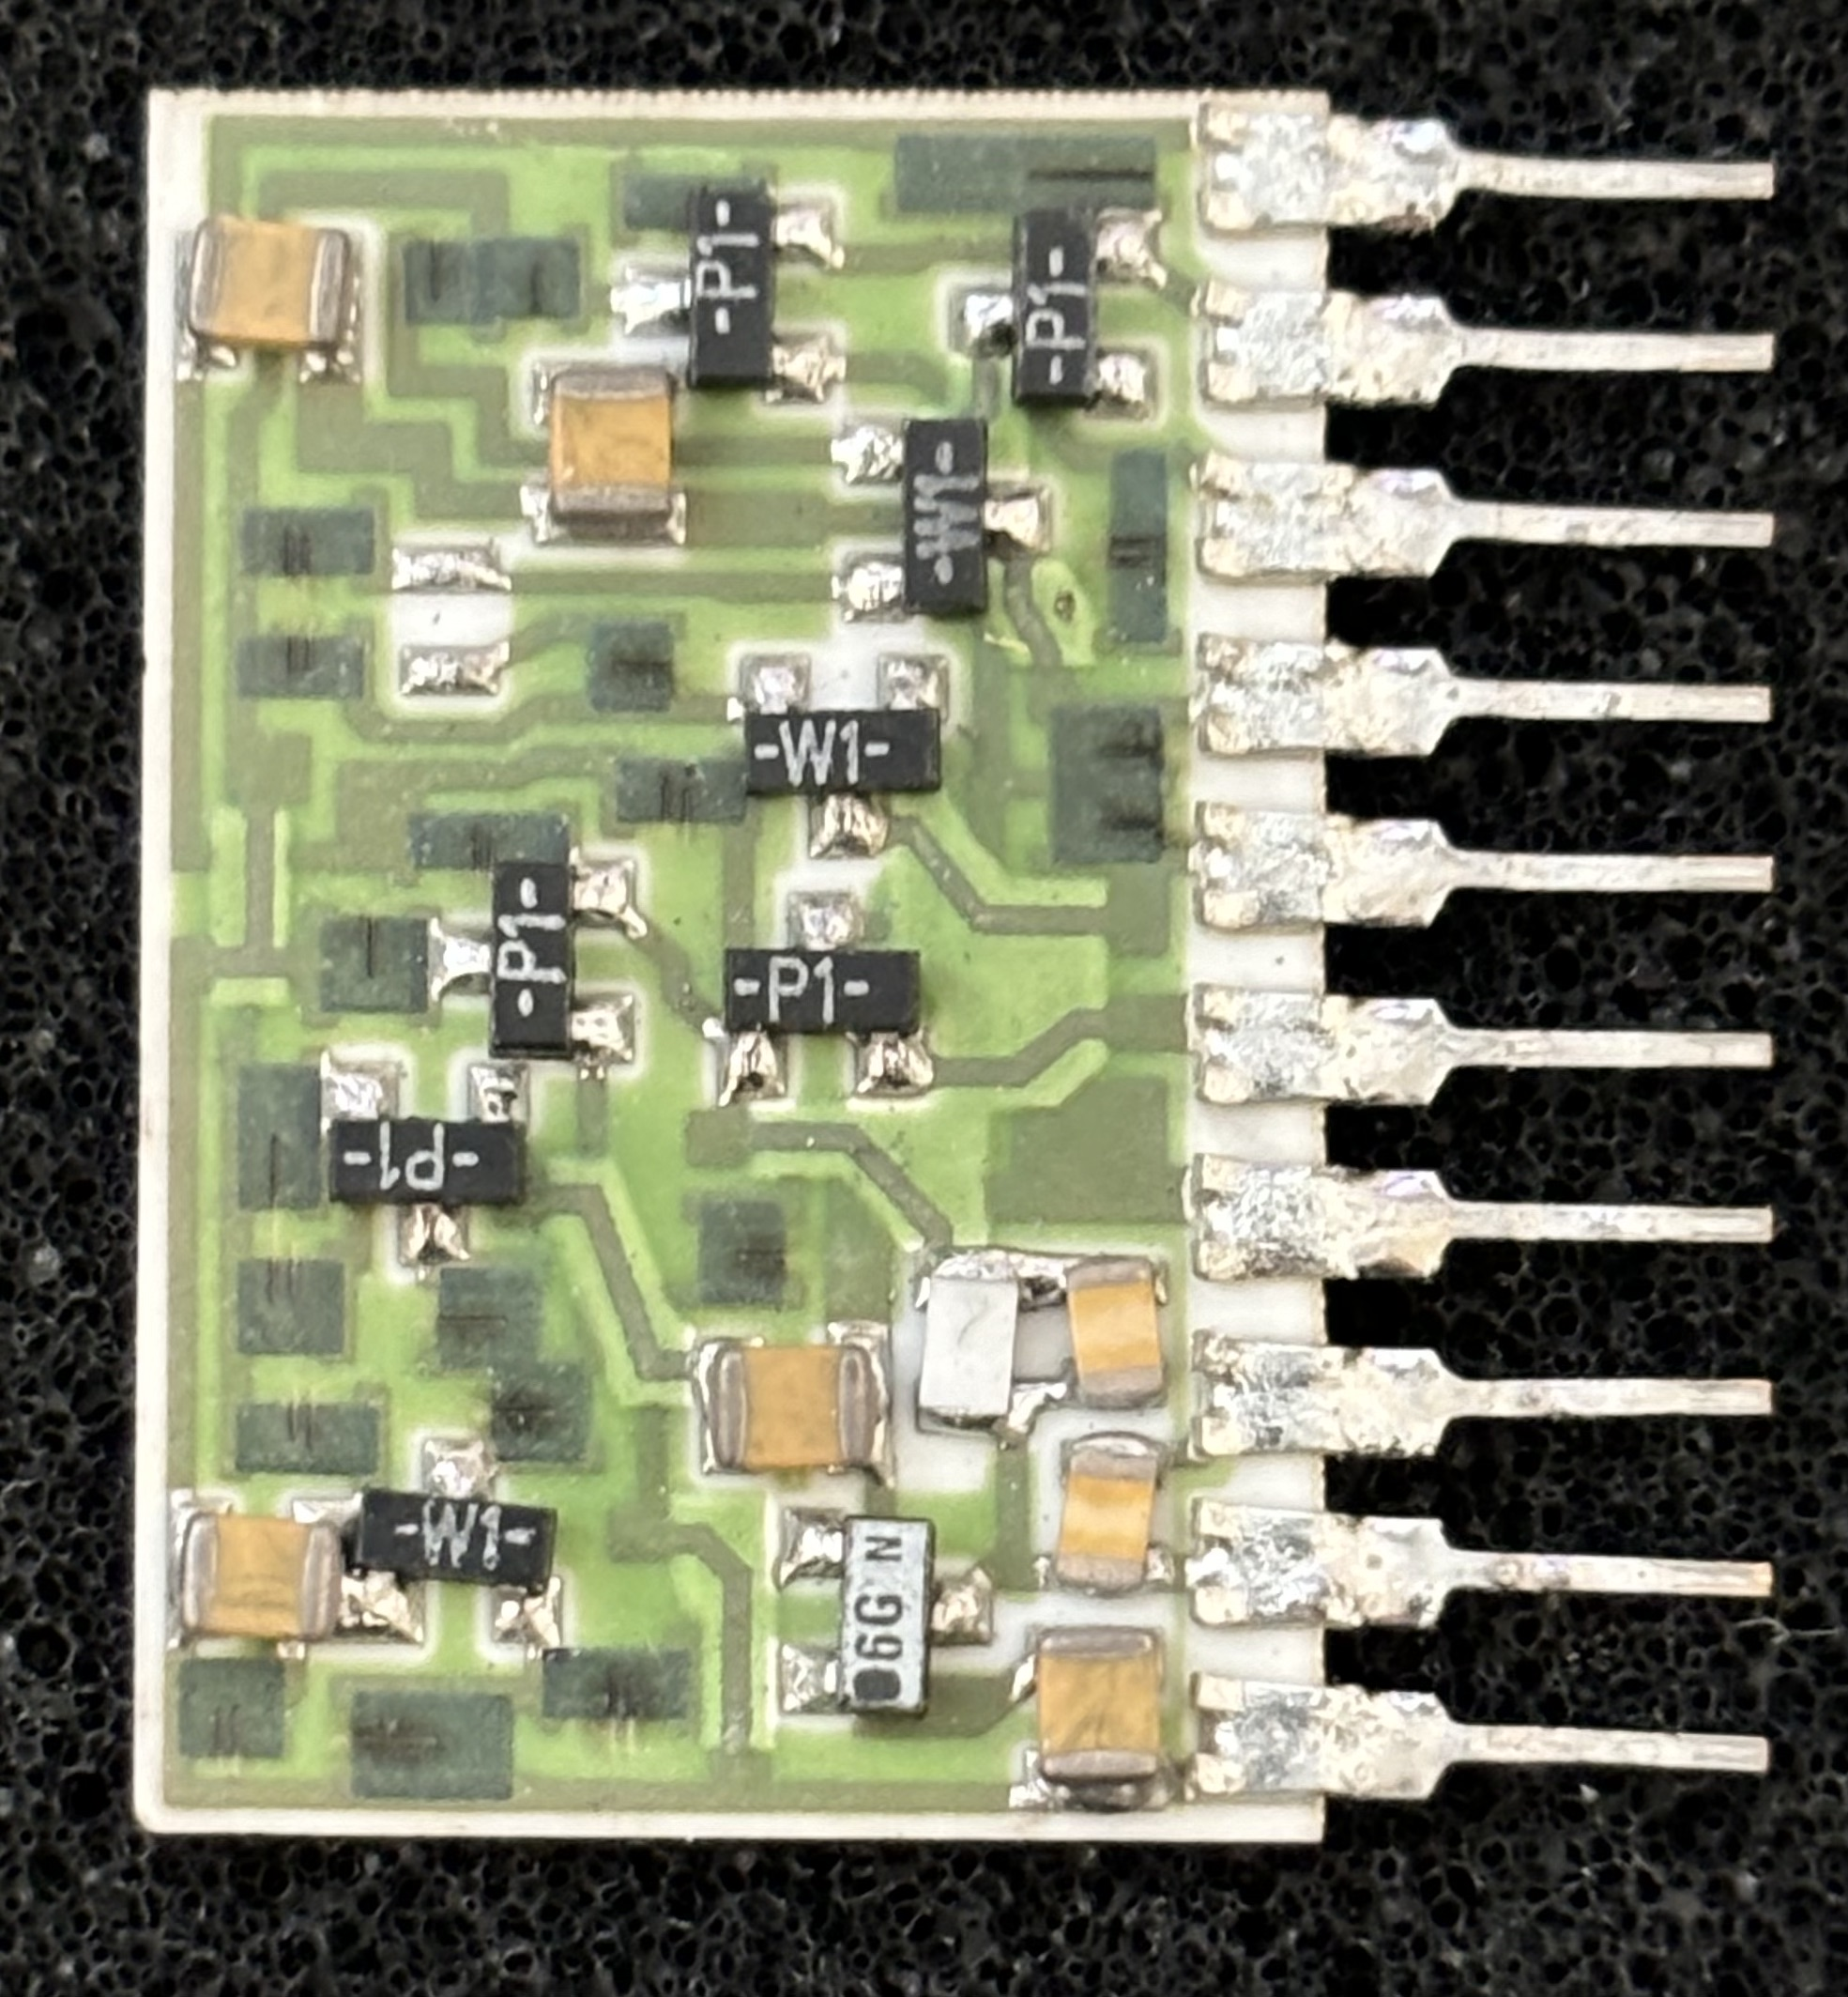
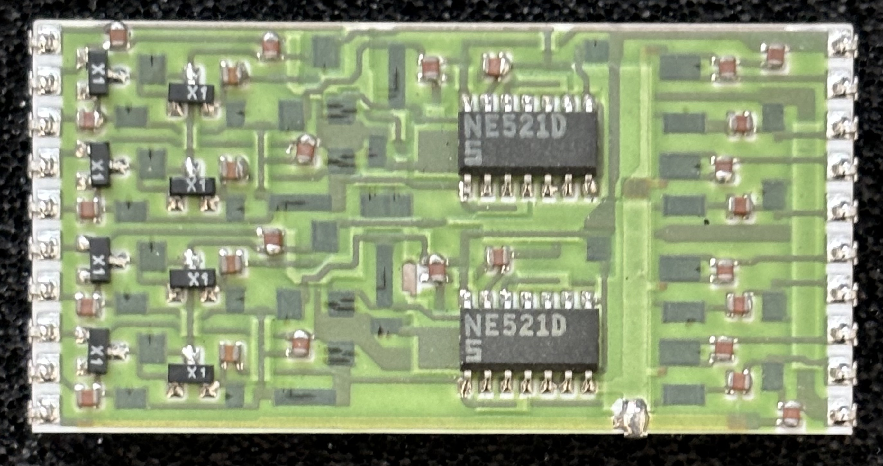
1980s custom integrated circuits
Hybrid thick film ceramic circuits
  from LABEN (1958-2004) LABoratori Elettronici e Nucleari
    merged into Alcatel Alenia Space
Quad bipolar preamplifier
Single channel JFET-bipolar preamplifier
Pitch of pins = 0.1 inch
Quad bipolar-IC comparator
shaper discriminator
Not small enough for colliding beam experiments!

Slide 13
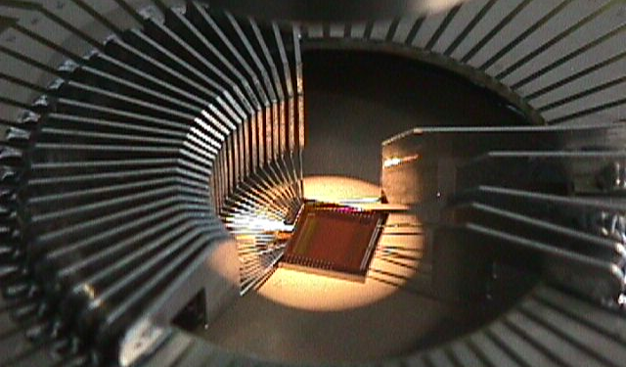
The ASIC era
Application Specific Integrated Circuit
  customised electronic circuit for a well-defined requirement
  generally manufactured in CMOS
Pros of ASICs
  can be optimised for demanding requirements: size, power, functions, performance,…
  miniature – large numbers of channels
  very dependable manufacturing quality with low unit cost on large scale
  radiation hardness now understood, and can be excellent in commercial processes
Cons of ASICs
  Big development investment required in both time and cost
  Unchangeable once complete, unless a lot of flexibility built-in (adds complexity)
  Substantial design and evaluation requiring specialist skills (industry pays well!)
Well matched – and essential! - to the later LHC era

Slide 14
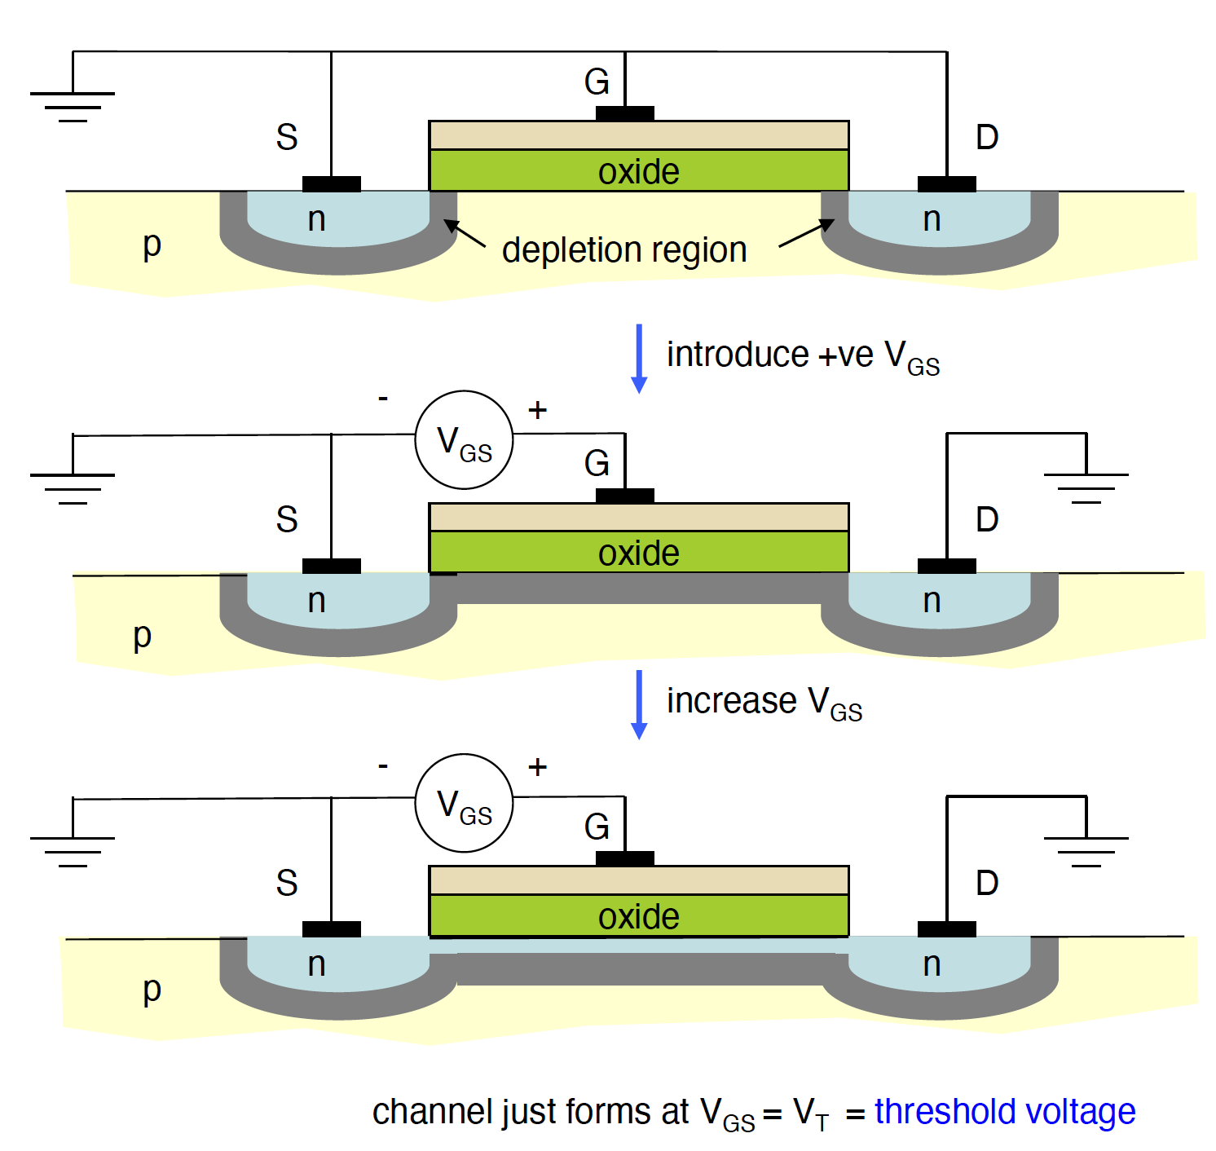
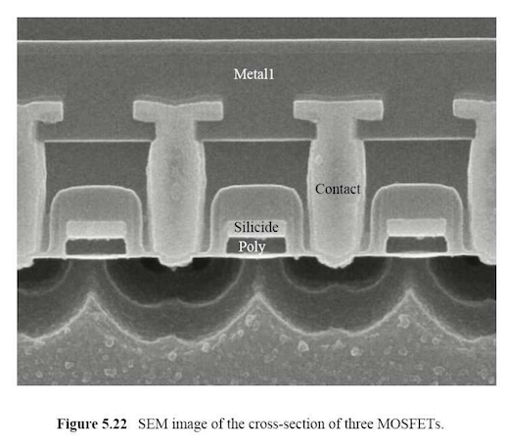
MOSFETs – in principle and practice
Transistor is simple device: layout and behaviour, especially digital
  but also many good analogue properties, if needed
1990s: many investigations of noise vs power, radiation tolerance in multiple processes

Slide 15
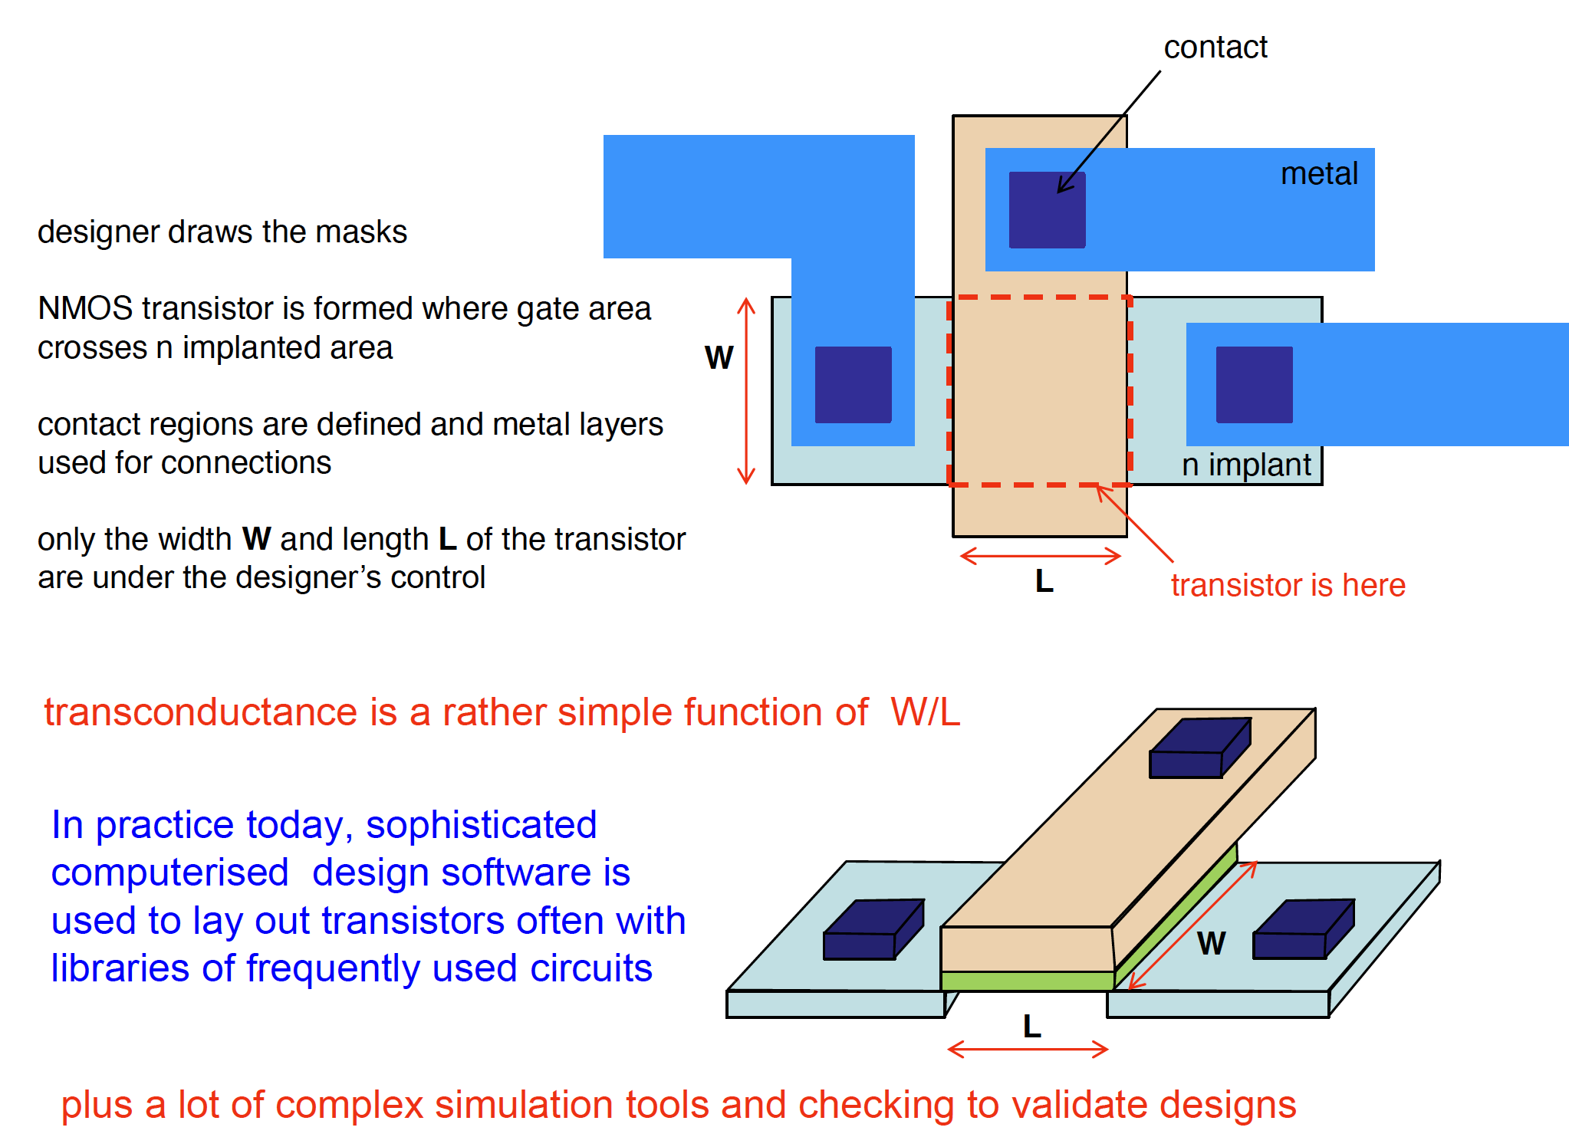
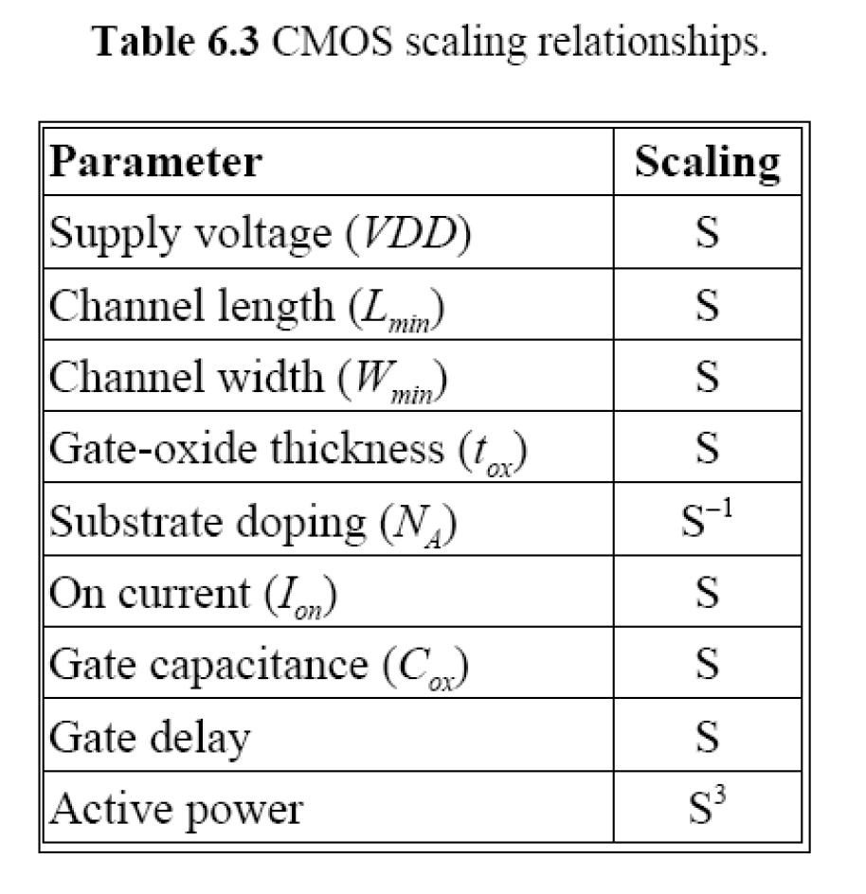
MOSFET design
It really was like this around 1985! Our engineers were learning this new technology.
Circuit properties mainly scale with feature size
L, W, t_{ox}, V =>
L/S, W/S, t_{ox}/S, V/S

Slide 16
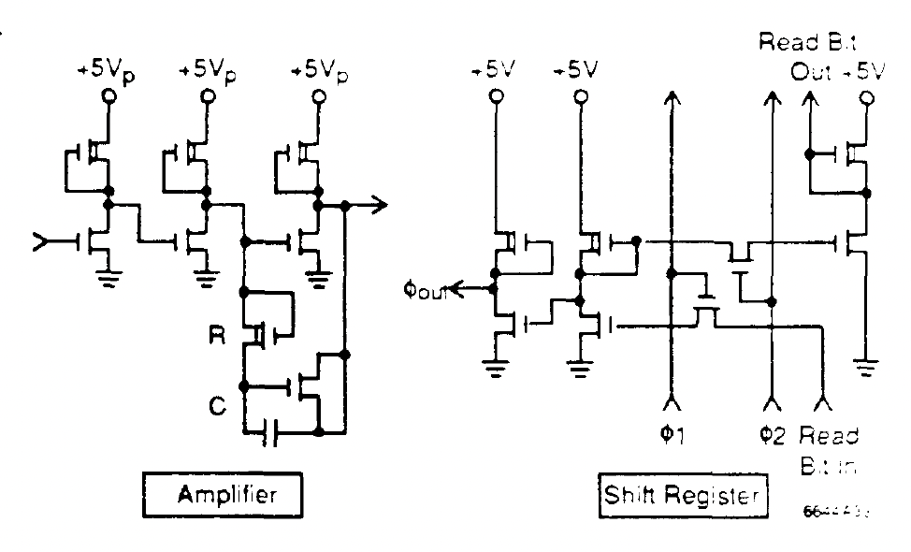
A very brief history
1984 - first HEP ASIC: Microplex at SLAC (California!) Mark-II silicon vertex detector
  NMOS only : 128 channel - amplifier, Sample-Hold, DCS processing, multiplexing.
    34 mm² , 5μm university lab process, 14 mW/ch. Pioneers learned from first principles!
Late 1980s: MX3, MX7, CAMEX64 - LEP silicon vertex detectors
  Commercial CMOS, initially ~3μm and later 1.5μm => 1-2 mW/channel
    Amplifiers: integrators with switched capacitor filters. Switching noise injected during the amplifier reset subtracted due to its very reproducible behaviour. t_{rise} ≈ 400 ns, t_{int} ≈ 1.8 µs
1988: SVX ASIC for CDF (& L3) – memory & sparsification
  amplifier, comparator, multiplexer, nearest neighbour logic, pedestal subtraction
    128 channels in 3 µm CMOS t_{int} ≈ 200 ns, t_{sample} ≈ 0.5 µs
1990: Amplex for UA2 Si pads - feedback resistors using FETs
  16 channel 3µm CMOS, precise control of non-linear R
    more conventional RC filters implemented: τ_{peak} = 0.75 µs
Early 1990s – LHC developments began
  originally 66 MHz beam crossing rate, later 40 MHz => τ ≈ 25 ns
    almost x 10⁶! - from 120 Hz at Mark-II in a decade
    but 1-2 µm processes
Some of this is covered in this paper, and its references
  G.Hall and A. A. Grillo, ASICs for LHC intermediate tracking detectors, Nucl. Instrum. Meth. A1050 (2023), 168115 doi:10.1016/j.nima.2023.168115
Part of the Microplex circuit

Slide 17
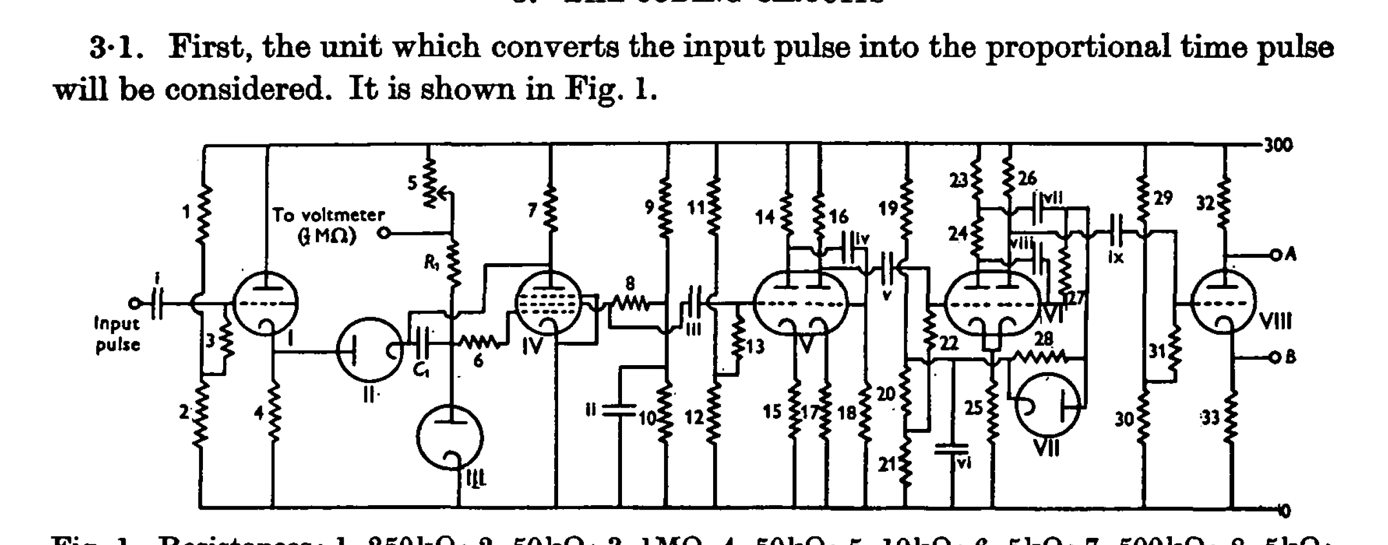
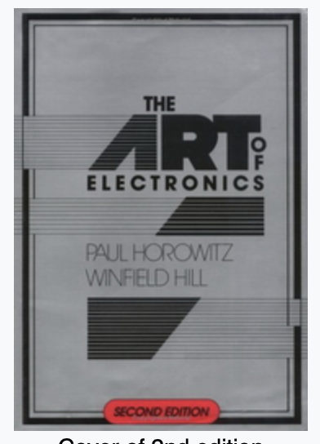
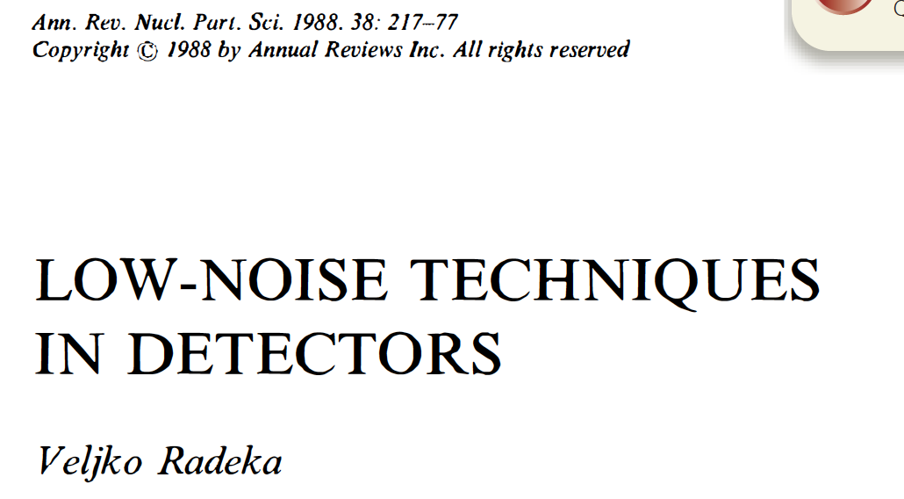
The low noise era
We owe a lot to the early nuclear physicists and engineers
  e.g. the design of the Wilkinson ADC, based on valve circuits, is far from simple
Most of the literature on signal processing originates in the 1960s & 1970s.
  e.g. Radeka, Goulding, Gatti, Manfredi, Kandiah,…
In my case, also:

Slide 18
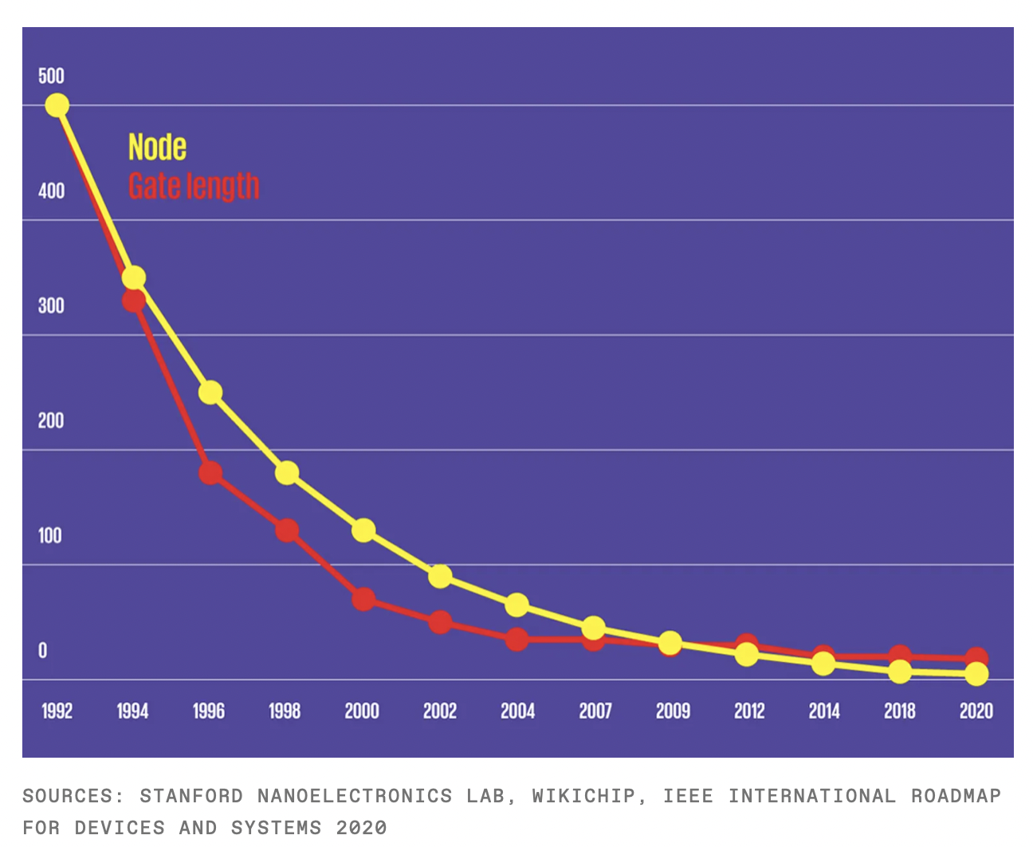
ASIC technology progress
In 1998 we were designing the APV25 for CMS in 0.25 µm
  finalised 2000/2001
We started designing the CBC chip in 2010, in 130 nm
  “completed” CBC3.1 in 2018/2019
Today HEP is designing in 65 nm
  Some are testing the water with 28 nm
Note the lag to HEP
Date is probably first use in the most advanced fabrication facilities

Slide 19
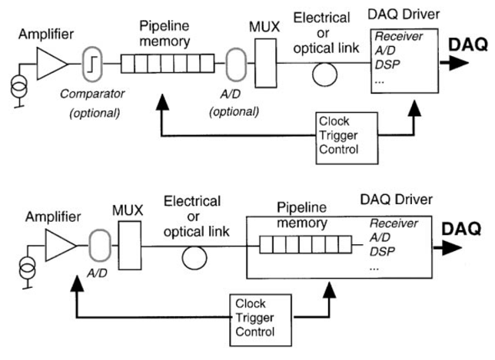
LHC era
Developments initially driven mainly by trackers and ECALs
  Amplifiers, data conversion and FE storage, data transfer, ….
  Clock and control, Trigger
Many possible design choices, e.g.:
    analogue/digital/binary
    performance
    commercial or custom
    radiation tolerance
    power, cost, risk …
ASICs came first but other things were essential too, especially
  optoelectronics
  trigger processors
  computer technology evolution
a couple of possible variants

Slide 20
How did we get to where we are today?
Sponsored R&D (US SSC detector R&D 1988, CERN DRDC 1990)
  essential because SSC/LHC detectors were unbuildable
  serendipity: mass commercial electronics era -> internet age
    1980s-1990s: RISC processors, PCs, Apple desktops, WWW, modems, mobile phones, laptops,…
  all were driving greater miniaturisation
    many “invisible” components, like connectors, packaging, batteries…
Integrated circuit electronics
  emergence of accessible ASIC processes, and design tools
  significant investment in training of new generation of engineers as designers
Several crucial areas - commercially driven - not by HEP

Slide 21
Example: CMS silicon µstrip tracker ASICs
Began in 1991 in RD20 DRDC project
  series of prototype chips in supposed rad-hard 1.2 µm technology, 32- then 128-channel
  by 1997: APV6 might have been a candidate for final system
    many irradiation studies of single transistors (noise) and chip performance
  Along the way, some important innovations
    programming chip parameters via serial command interface (I2C) using software control
      hugely beneficial in accelerating chip configuration and evaluation
      simple signal processing on chip
Bad luck in September 1997
  Foundry move of 1.2 µm process reduced radiation tolerance (marginal anyway)
Followed by good luck
  Unexpected positive CERN results on 0.25 µm radiation tolerance
In 1998 switched to “standard commercial” process
  how was that possible?

Slide 22
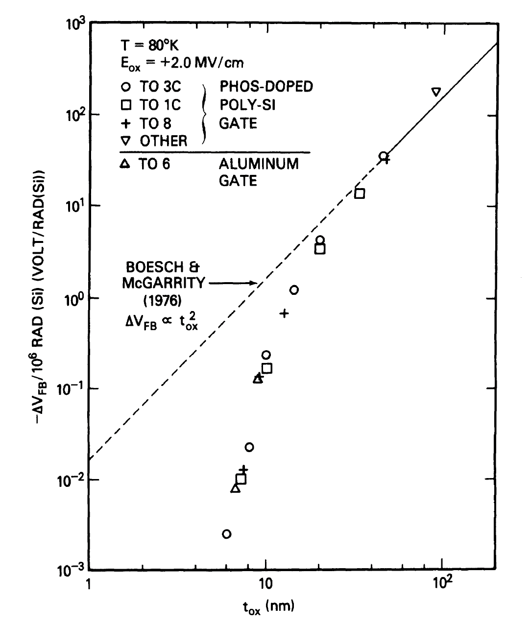
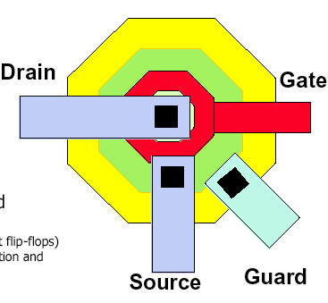
Radiation behaviour of commercial CMOS
Evidence of radiation tolerance in mid-1980s, improving with thinner oxides
  tunnelling of carriers reduces trapped oxide charge
  but confusing results from commercial chip evaluations
negative effects attributed to leakage paths around NMOS transistors
  cured in CERN 1997 with enclosed gate geometry
∆V_{FB}/Mrad vs t_{ox}
This was a hugely important breakthrough
N. Saks et al.
IEEE TNS (1984)

Slide 23
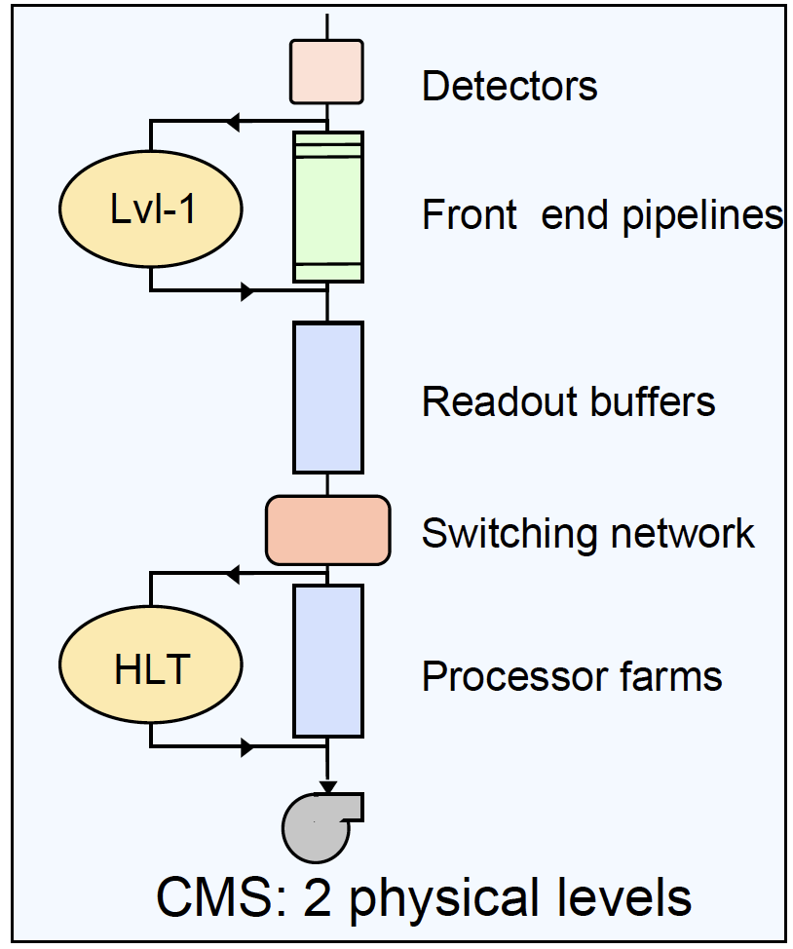
Other important technologies
Two other crucial technologies evolved rapidly during the LHC preparations
  exploiting the ASIC revolution
Optoelectronics – i.e. fibre optic links
  almost non-existent in 1990
  now 25 Gbps links, and infrastructure, are commonplace
  immense benefits in power, material, lack of noise transfer
Programmable digital logic
  1980s – board-based logic assembled from arrays of digital chips
  FPGAs evolved to (probably) allow all(?) trigger logic and flexible DAQ
No totally free lunch though
  challenges of power, cooling, connectivity, specialist skills,…

Slide 24
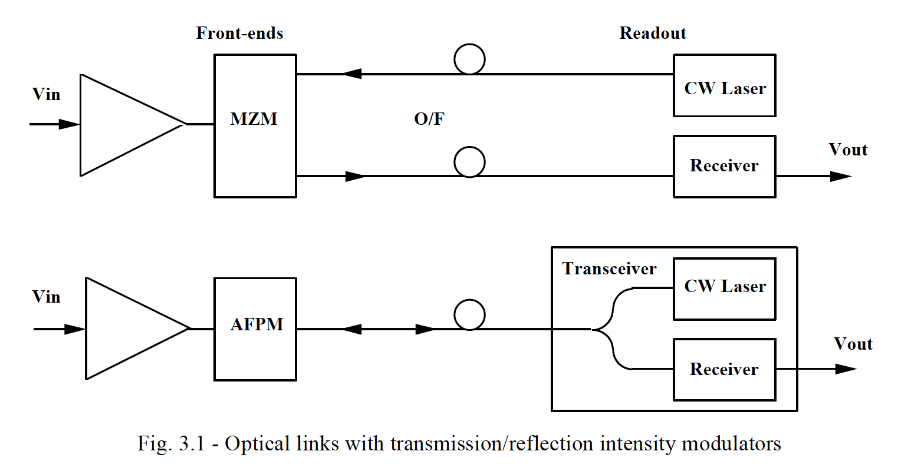
Opto-electronics
B. Leskovar (1990) SSC workshop
  Optical data transmission at the SSC IEEE Trans.Nucl.Sci. 37 (1990) 271-287
    extremely detailed discussion, including radiation hardness issues
Many DRDC projects started in 1991, including RD12 & RD23
  RD12 proposed optical distribution of TTC signals at the LHC
    commercial parts using 1300 nm lasers and SM fibres, but not radiation hard
  RD23 proposed optoelectronic modulators for data transmission inside the experiments
    technologies: LiNbO₃ and Multi Quantum Well reflective modulators
LiNbO₃ well established but several drawbacks
  bulky, polarisation maintenance, cost
MQW attractive but more speculative
  very reliant on commercial device progress
Other technologies became accessible
  Fabry-Perot edge emitters, VCSELs
  both successfully deployed in CMS & ATLAS

Slide 25
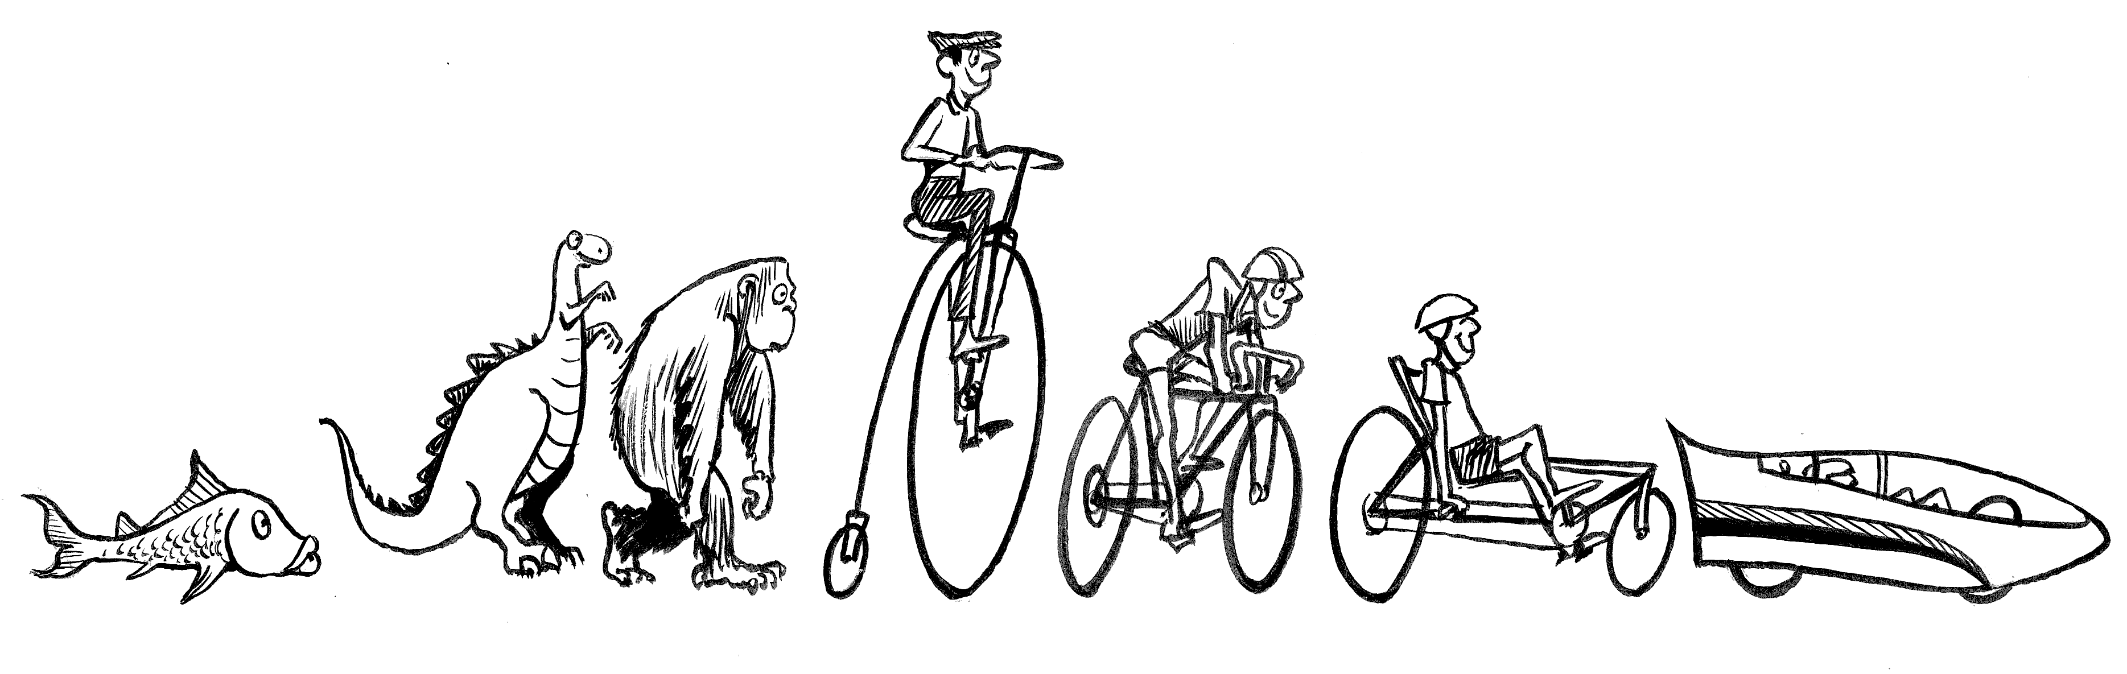
Importance of optoelectronics
Advantages of optical data transfer
  (much) reduced material in cables
  lower power (probably by a big factor)
  (much lower) risk of excess noise and (likely greatly) improved signal integrity
  higher (total) bandwidth
  standardisation – a big step forward
    e.g. CMS used the same technology for tracker (40 MHz analogue) and ECAL (800 Mbps)
fortunately we did not have to make the comparisons in practice

Slide 26
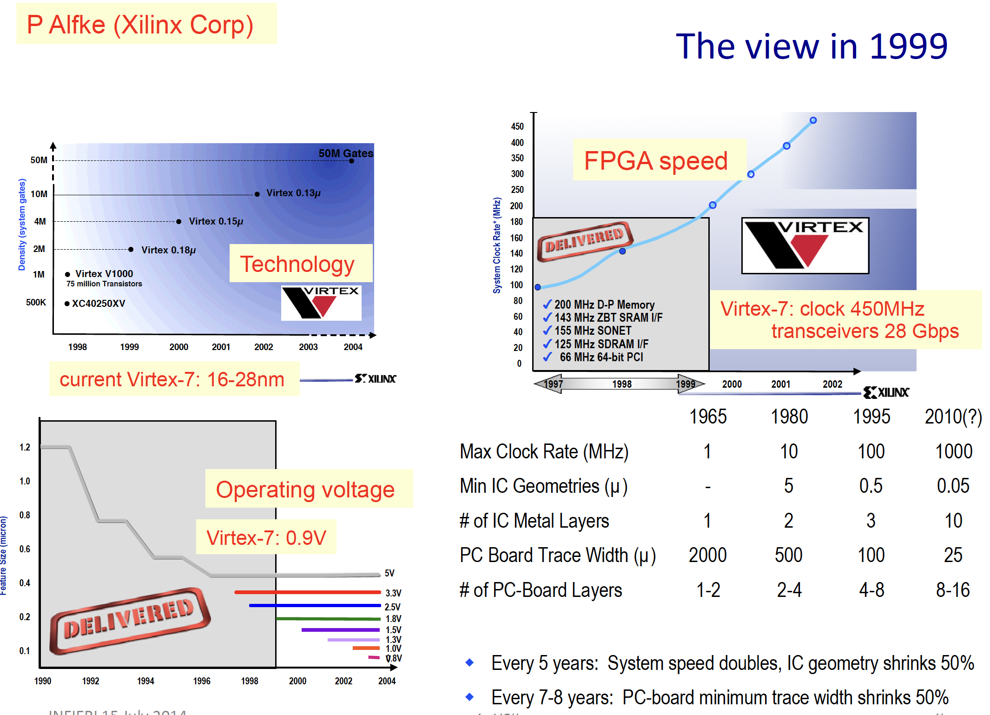
Digital processing & FPGAs
1980s: board based processors
  COTS: various processor technologies: RISC, transputers, microprocessors, ….
  custom: assemble arrays of digital chips to implement required logic
1990s: technology evolution
  commercial switches, networks, fast links, traffic management, ever faster computers,..
    but not sufficient for first level triggers:
  Programmable chips materialised
    Field Programmable Gate Arrays
2010+:
  huge progress with FPGAs
    speed, BW, connectivity, flexibility,…
  feasible that most L1 triggers could be FPGA-based
    but many practical issues of cooling, optical connectivity, board design, programming, complexity, …

Slide 27
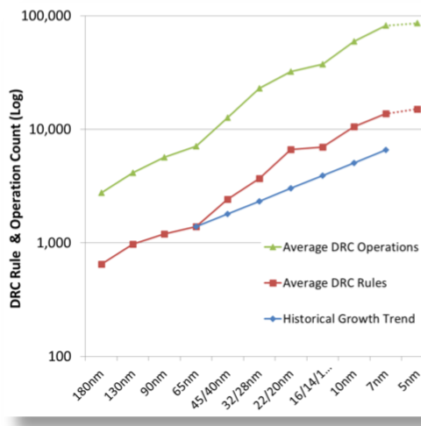
How to succeed in this world?
Today’s designs are remarkably successful
  Quality of design tools
  Quality of manufacture
  Experienced designers
  Comprehensive simulations
  Prototyping
  Careful evaluation (eventually in situ)
  Financial investment!
Evolution of ASIC design rules
Another price to be paid =>
NB log scale

Slide 28
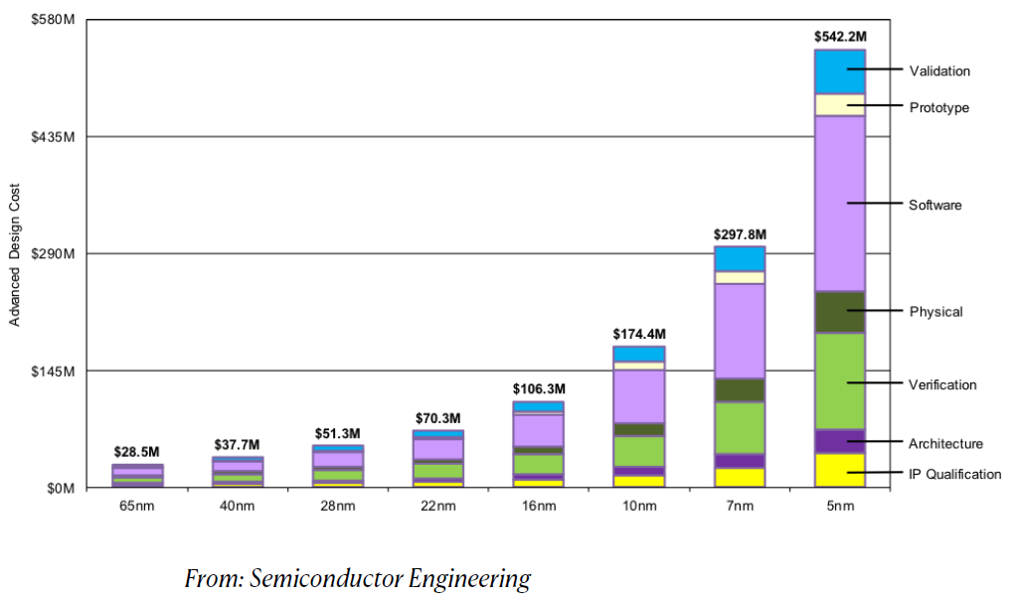
Costs cannot be ignored
Not just financial
Design costs vs ASIC technology node
This probably applies everywhere in our electronics – industry too

Slide 29

Some conclusions
Our electronics has changed dramatically in CERN’s lifetime
  but the objectives (e.g. triggering, position, time and energy measurement) remain
The LHC fortuitously coincided with the internet era
  explosion of relevant technology development – high volume, low unit cost
    much of it accessible to small users, such as HEP
  it is arguable that the biggest changes in detector technology were in electronics
    it has enabled implementation of increasingly complex functionality
BUT greater complexity = longer development times and more resources
  higher risk and less flexibility for small projects
  How to manage this for the next generation?
Not to be forgotten
  electronics is commercially driven
  and cannot be assumed to align with science

