Slide 1
Basic Concepts of Charged
Particle Detection:
Part 1

Slide 2
Overview
This lecture is part of a topical course on instrumentation
Two introductory lectures will focus on the interaction of charged particles with matter in a general sense
Subsequent lectures in this course will cover specific types of detector:
Gaseous detectors (tracking) - D. Futyan
Electromagnetic & Hadronic Calorimetry - C.Seez
Semiconductor detectors and electronics - G. Hall and M. Raymond
Particle ID - D. Websdale
Low level triggering and DAQ, inc FPGAs - A Tapper, J Fulcher, G Iles

Slide 3
Overview
Lecture 1:
Concepts of particle detection: what can we detect?
Basic design of particle detectors
Energy loss of charged particles in matter: Bethe Bloch formula
Lecture 2:
Energy loss through Bremsstrahlung radiation (electrons)
Momentum measurement in a magnetic field
Multiple Coulomb scattering - effect on momentum resolution

Slide 4
Literature
Text books:
W. R. Leo, Techniques for Nuclear and Particle Physics Experiments, 2nd edition, Springer, 1994
C. Grupen, Particle Detectors, Cambridge University Press, 1996
K. Kleinknecht, Detectors for Particle Radiation, 2nd edition, Cambridge University Press, 1998
R.S. Gilmore, Single particle detection and measurement, Taylor&Francis, 1992
Other sources:
Particle Data Book (Phys. Rev. D, Vol. 54, 1996)
https://pdg.web.cern.ch/pdg/2010/reviews/rpp2010-rev-passage-particles-matter.pdf
R. Bock, A. Vasilescu, Particle Data Briefbook
http://www.cern.ch/Physics/ParticleDetector/BriefBook/

Slide 5
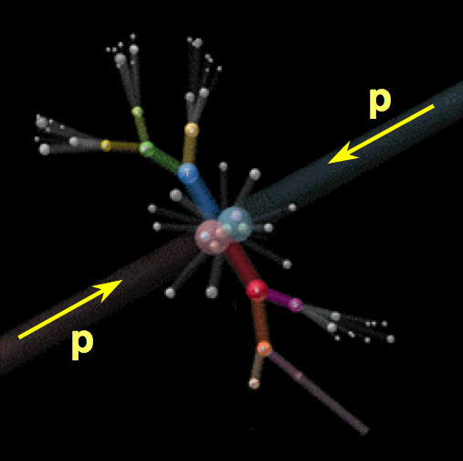
What can we detect?
Only the final decay products are observed in the detector
In order to reconstruct information about the original particles produced in the interaction, need to identify the particle type and measure the energy, direction, charge and of all final state products as precisely as possible.

Slide 6
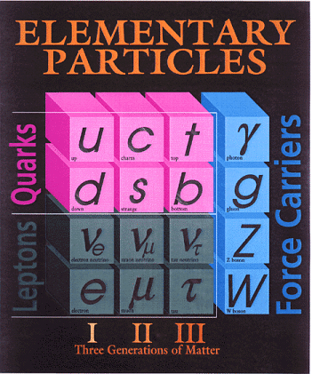
What can we detect?
Directly observable particles must:
Be long lived (cτ sufficient to pass through sensitive elements of the detector)
Undergo strong or e.m. interactions
We can directly observe:
electrons
muons
photons
neutral and charged hadrons / jets
π⁰, π±, K⁰, K±, p, n,…
Many physics analyses treat jets from quark hadronization collectively as single objects
Use displaced secondary vertices to identify jets originating from b quarks (“b-tagging”)
We can indirectly observe long lived weakly interacting particles (e.g. neutrinos) through missing transverse energy
H⁰

Slide 7
Basic Concept of HEP Detectors
Particle detectors need to provide:
Detection and identification of different particle types (mass, charge)
Measurement of particle momentum (track) and/or energy (calorimeter)
Coverage of full solid angle without cracks (“hermiticity”) in order to measure missing E_{T} (neutrinos, supersymmetry)
Fast response (LHC bunch crossing interval 25ns!)

Slide 8
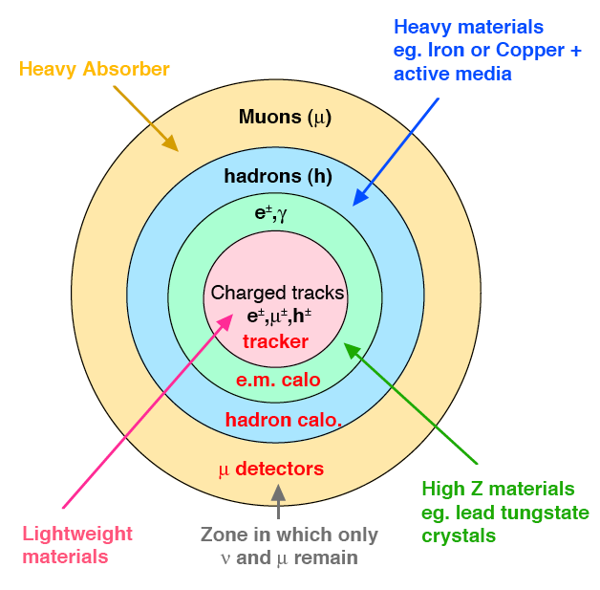
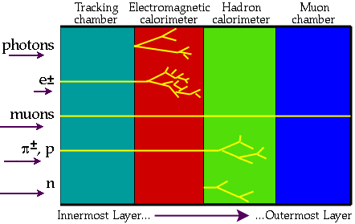
Basic Concept of HEP Detectors
Detectors are designed be able to distinguish between the different types of object (e±,γ,μ±,hadrons)
Many HEP detectors have an onion like structure:

Slide 9
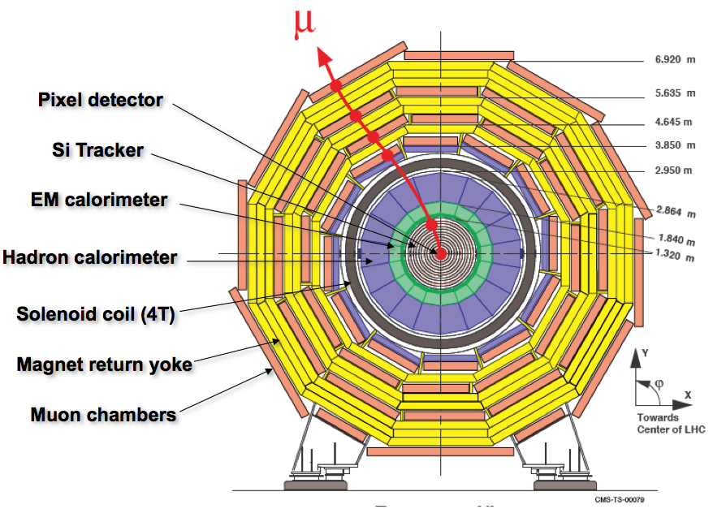
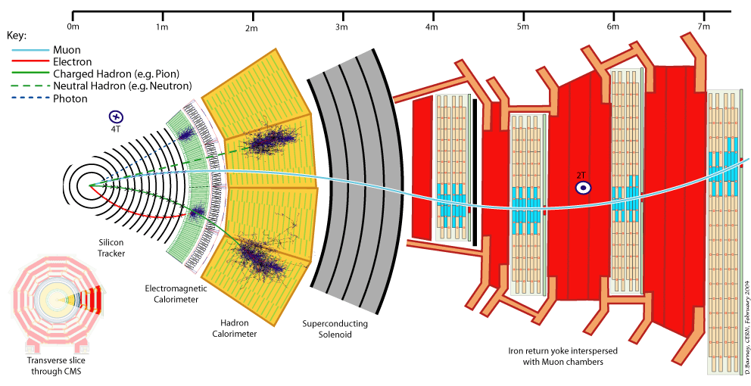
Example: The CMS Detector

Slide 10
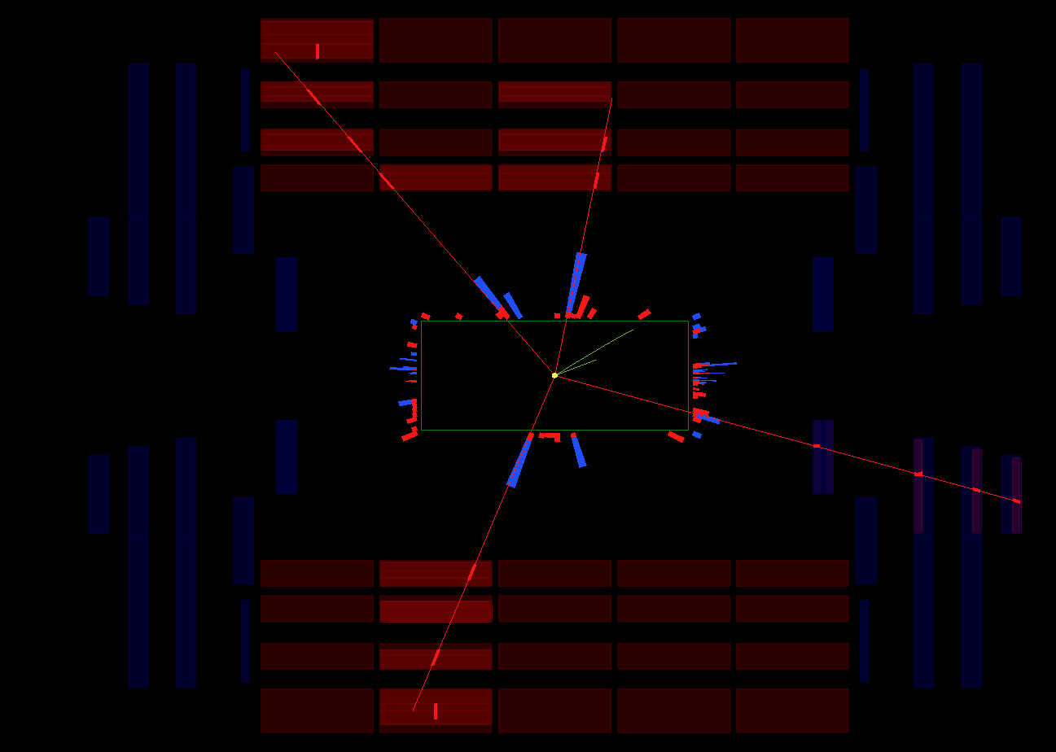
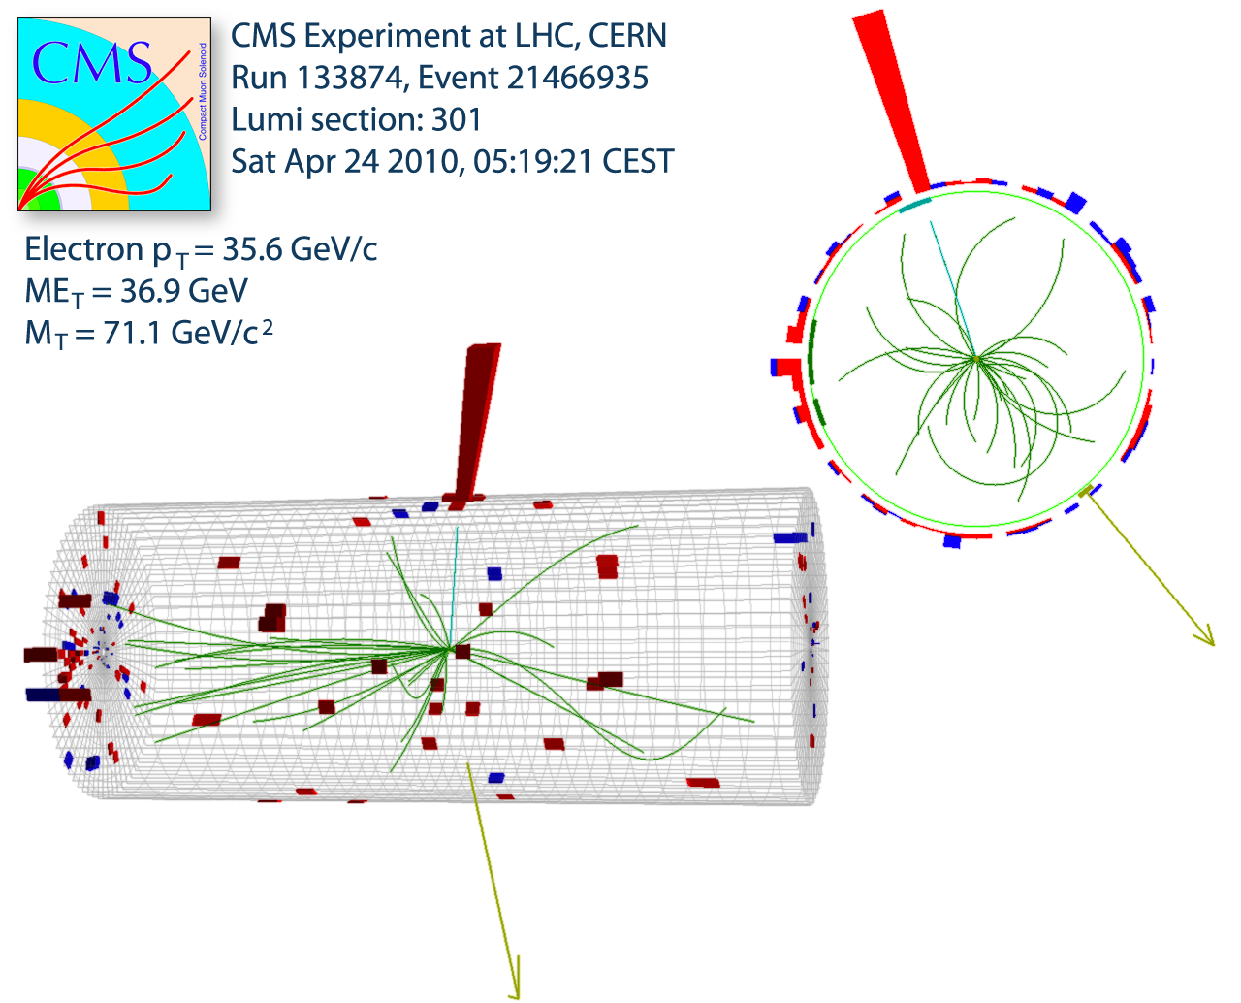
Some event displays from CMS

Slide 11
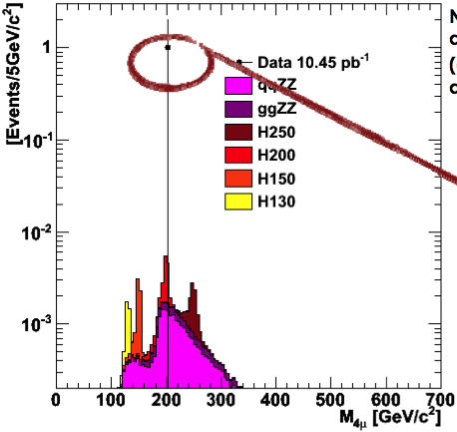
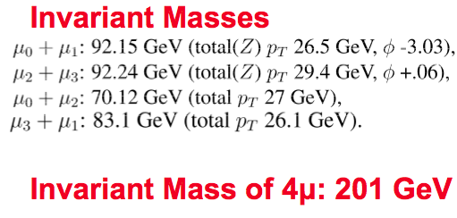
Some event displays from CMS
ZZ→4μ
W→eν

Slide 12
Reminder of Definitions and Units
Energy and Momentum:
energy E: measure in eV
momentum p: measure in eV/c
mass m_{o}: measure in eV/c²

Slide 13
Detection of Charged Particles
Ultimately all detectors end up detecting charged particles:
Photons are detected via electrons produced through:
Photoelectric effect
Compton effect
e⁺e⁻ pair production (dominates for E>5GeV)
Neutrons are detected through transfer of energy to charged particles in the detector medium (shower of secondary hadrons)
See lecture on calorimetry
Charged particles are detected via e.m. interaction with electrons or nuclei in the detector material:
Inelastic collisions with atomic electrons → energy loss
Elastic scattering from nuclei → change of direction (see Lecture 2)

Slide 14
Energy Loss of Charged Particles in Matter
For moderately relativistic charged particles other than electrons (“heavy charged particles”) almost all the energy loss is through Coulomb interaction with the atomic electrons.
This interaction is inelastic: The energy transferred to the electrons causes them to be either:
ejected from the parent atom (hard collision) - ionization
or:
excited to a higher energy level (soft collision) - excitation
Energy transferred in each collision much less than particle’s total KE, but no. of collisions / unit length is very large
e.g. 10MeV proton completely stopped by 0.25mm of Cu

Slide 15
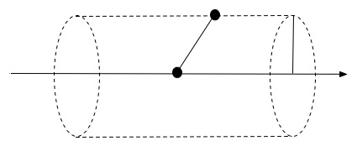
Classical Case: Bohr’s Calculation (Leo p.22)
Consider heavy particle, mass m, charge ze, velocity v.
Atomic electron at distance b from particle trajectory:
Impulse transferred to the electron:
Gauss Law:
e
ze
m
b
x
v

Slide 16
Classical Case: Bohr’s Calculation
Energy transfer:
For electron density N_{e}, energy lost to all electrons at distance between b and b+db in thickness dx:
Note: m_{e} in denominator
⇒ collisions with nuclei (m>>m_{e}) give negligible contribution to energy loss
b_{max} and b_{min} are the limits for which the equation at the top of the slide is valid

Slide 17
Classical Case: Bohr’s Calculation
Substituting: and (classical electron radius)
b_{min} is b for which ΔE(b) has it’s maximum possible value, which occurs for a head on collision. Classically, this is ½m_{e}(2v)² = 2m_{e}v². The relativistic form approximates to 2γ²m_{e}v².

Slide 18
Classical Case: Bohr’s Calculation
b_{max}: interaction time b/γv should be less than the mean orbital period of atomic electron 1/ν in order for electron to absorb energy (“adiabatic invariance”):
Substituting b_{min} and b_{max}:
This is Bohr’s classical formula for energy loss for heavy charged particles
Valid for very heavy particles e.g. α-particle or heavier nuclei
For lighter particles e.g. proton, need QM treatment

Slide 19
Bethe Bloch Formula
Full quantum treatment is complicated. Result is the Bethe-Bloch Formula for “stopping power”:
Where:
X = ρx, where ρ is the density of the absorber material
N_{A} = Avagadro no.
= classical electron radius = 2.82x10⁻¹³ cm
z = charge of incident particle in units of e
Z, A = atomic no. and atomic weight of the absorber
T_{max} = maximum kinetic energy which can be imparted to a free electron in a single collision. For heavy particles (m>>m_{e}), T_{max} = 2m_{e}c²β²γ²
Units: MeV g⁻¹ cm²
constant 4πN_{A}r_{e}²m_{e}c² = 0.31 MeV g⁻¹ cm²

Slide 20
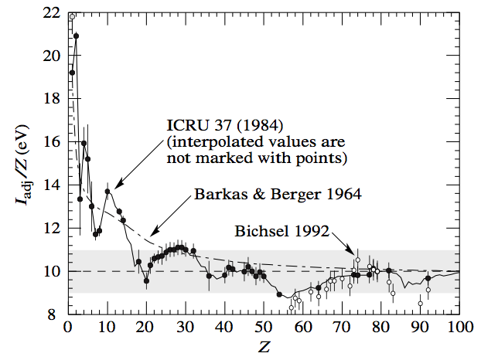
Bethe Bloch Formula: Excitation Potential
I = Mean Excitation Potential - determined empirically for different materials from measurements of dE/dx. An approximate relation is:
I≈I₀Z^{0.9}, with I₀=16 eV

Slide 21
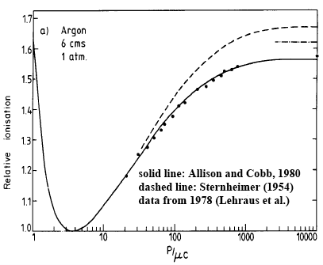
Bethe Bloch Formula: Density Effect
δ = density effect: due to polarization of atoms in the medium caused by E field of the particle, more distant atoms are shielded from the full E field intensity - contribute less to energy loss
Important at high energies. Value is material dependent (depends on density)
No density effect
With density effect

Slide 22
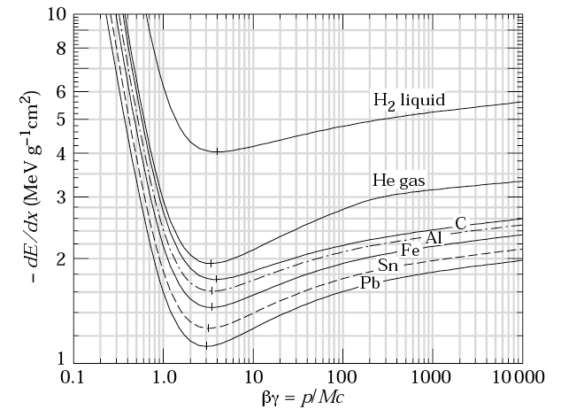
Bethe Bloch Formula
Only valid for “heavy” particles (m≥m_{μ}) i.e. not electrons
For a given material, dE/dX depends only on β − independent of mass of particle
First approximation: medium characterized by electron density ~Z/A
Z/A = 1
“Fermi plateau”
at large β
Z/A~0.5
“log relativistic rise”
βγ ≈ 3-4 (v≈0.96c)
Minimum ionizing particles, MIPs
“kinematical term”
~ 1-2 MeV g⁻¹ cm²
True for all particles
with same charge

Slide 23
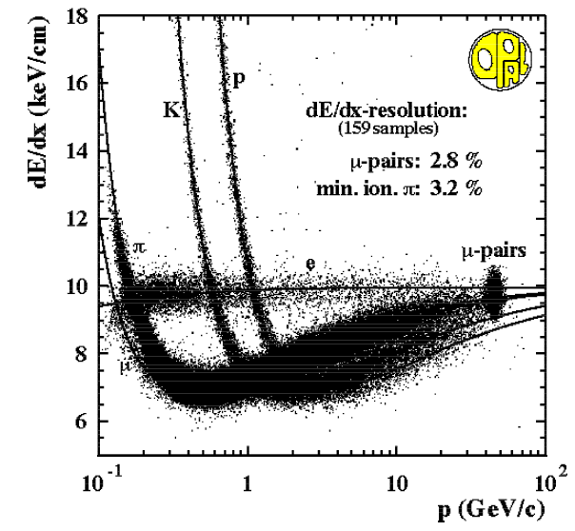
dE/dX and Momentum
For a given medium, dE/dX depends only on β
β=p/mc => for given momentum, β and hence dE/dX are different for particles with different masses:
Ar/CH₄ (80%/20%)
Measurement of both p and dE/dX can be used to distinguish between different types of charged particle, especially for energies below minimum ionizing value:

Slide 24
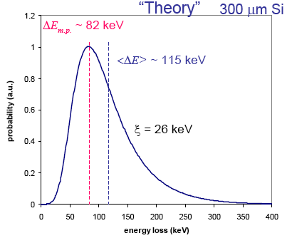
Landau Distribution
Bethe Bloch formula gives average energy loss
Fluctuations about the mean value are significant and non-gaussian
Collisions with small energy transfers are more probable
Most probable energy loss shifted to lower values
Below excitation
threshold
Gaussian fluctuation
“Landau Tail”

Slide 25
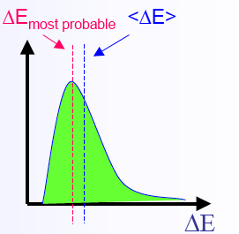
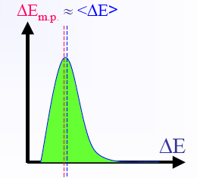
Landau Tails
Real detector measures the energy ΔE deposited in a layer of finite thickness δx.
For thin layers or low density materials:
Few collisions, some with high energy transfer.
Energy loss distributions show large fluctuations towards high losses
Long Landau tails
For thick layers and high density materials:
Many collisions
Central limit theorem: distribution → Gaussian
e⁻
δ electron

Slide 26
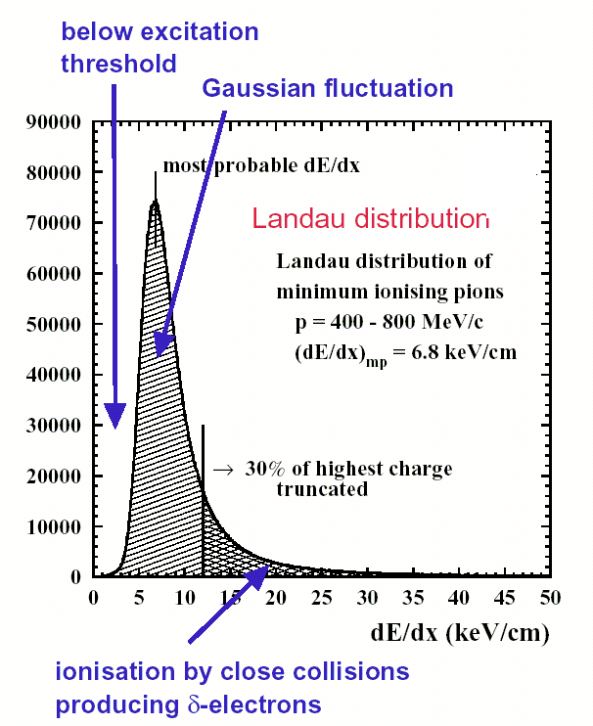
Landau Tails
An approximation to the probability of ejecting a δ-electron of energy E is:
where
Restricted dE/dX: mean of truncated distribution excluding energy transfers above some threshold
Useful for thin detectors in which δ-electrons can escape the detector (energy loss not measured)

Slide 27
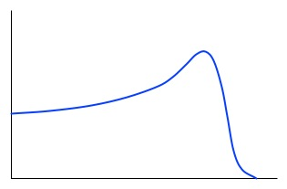
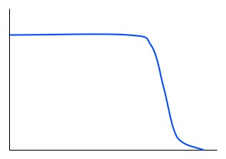
Range
As a heavy particle slows down in matter, rate of energy loss increases, since dE/dX ∝1/β²
Most of the energy loss occurs at the end of the path
As a result, a beam of mono-energetic stable charged particles will travel approximately the same distance in matter - referred to as the range
Medical application: treatment of tumors
Mean
range
dE/dX
Transmitted
Fraction
“Bragg curve”
Penetration depth
Penetration depth

Slide 28
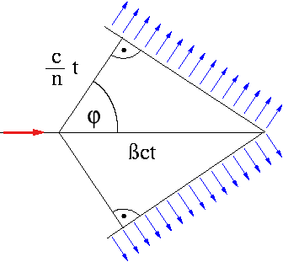
Cherenkov Radiation
Ionization or excitation through collisions is the dominant mechanism for energy loss for heavy charged particles
An additional mechanism, useful in particle detectors, is Cherenkov radiation - occurs if the particle is moving faster than the speed of light in the medium:
The charged particle polarizes atoms in the medium which return rapidly to the ground state, emitting radiation. An electromagnetic shock wave is the result:
refractive index
Coherent conical
wavefront

Slide 29
Cherenkov Radiation
Wavefront (analogous to shock wave for supersonic aircraft) is emitted at a well defined angle w.r.t. the trajectory of the particle:
Can determine β by measuring θ_{C}. If momentum is measured independently, can measure the mass of the particle.
Energy loss is small compared to collision energy loss and is already taken into account in the Bethe Bloch formula.

Slide 30
Next Lecture
Lecture 1:
Concepts of particle detection: what can we detect?
Basic design of particle detectors
Energy loss of charged particles in matter: Bethe Bloch formula
Lecture 2:
Energy loss through Bremsstrahlung radiation (electrons)
Momentum measurement in a magnetic field
Multiple Coulomb scattering - effect on momentum resolution
Interaction of photons

