Slide 1
Basic Concepts of Charged
Particle Detection:
Part 2

Slide 2
Overview
Lecture 1:
Concepts of particle detection: what can we detect?
Basic design of particle detectors
Energy loss of charged particles in matter: Bethe Bloch formula
Lecture 2:
Energy loss through Bremsstrahlung radiation (electrons)
Momentum measurement in a magnetic field
Multiple Coulomb scattering - effect on momentum resolution
Interaction of photons

Slide 3
Energy Loss of Electrons and Positrons
Electrons lose energy through ionization as for heavy charged particles, but due to small mass additional significant loss through bremsstrahlung radiation.
Total energy loss:

Slide 4
Energy Loss Through Ionization for Electrons
Ionization loss for high energy electrons (»1MeV) can be approximated by Bethe Bloch formula with β=1, z=1:
Approximate and only valid for high energy. Full treatment requires modification of the Bethe Bloch formula due to:
Small electron mass: assumption that incident particle is undeflected during collision process is not valid
Collisions are between identical particles - Q.M. effects due to indistinguishability must be taken into account.
e.g. see Leo p.37
NB. T_{max}=T_{e}/2, where T_{e} = KE of incident electron

Slide 5
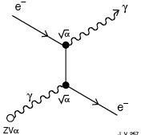
Bremsstrahlung Radiation
Emission of e.m. radiation arising from scattering in the E field of a nucleus in the absorber medium.
Classically, can be seen as radiation due to acceleration of e⁺ or e⁻ due to electrical attraction to a nucleus.
Radiative energy loss dominates for electrons for E > few 10s of MeV.

Slide 6
Energy Loss Through Bremsstrahlung
α = Fine structure constant:
Note that (recall )
⇒ Bremsstrahlung only significant for electrons/positrons
For E < ~1TeV, electrons/positrons are the only particles in which radiation contributes significantly to energy loss.

Slide 7
Radiation Length
Define Radiation Length, X₀:
Radiation length is the the mean distance over which a high-energy electron loses all but 1/e of its energy by bremsstrahlung.
e.g. Pb: Z=82, A=207, ρ=11.4 g/cm³:
X₀ ≈ 5.9 g/cm²
Mean penetration distance: x = X₀/ρ = 5.9/11.4 = 5.2mm
where
⇒
Units of X₀: g cm⁻²
Divide by density ρ to get X₀ in cm

Slide 8
Comparison with Energy Loss Through Ionization
Compare:
Rapid rise of radiation loss with electron energy
Almost all energy of electron can be radiated in one or two photons! In contrast ionization loss quasi-continuous along path of particle.

Slide 9
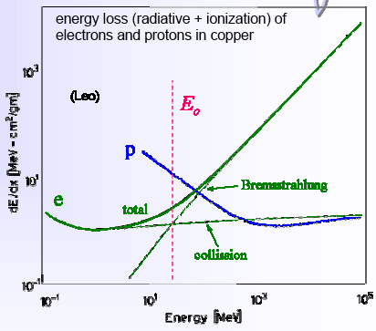
Critical Energy
Critical energy is energy for which:
E.g. E_{C} for electrons in Cu(Z=29): ~20 MeV
Energy loss through bremsstrahlung dominates for E > few 10s of MeV.
e.g. electrons in LHC events: tens of GeV ⇒ bremsstrahlung completely dominates.

Slide 10
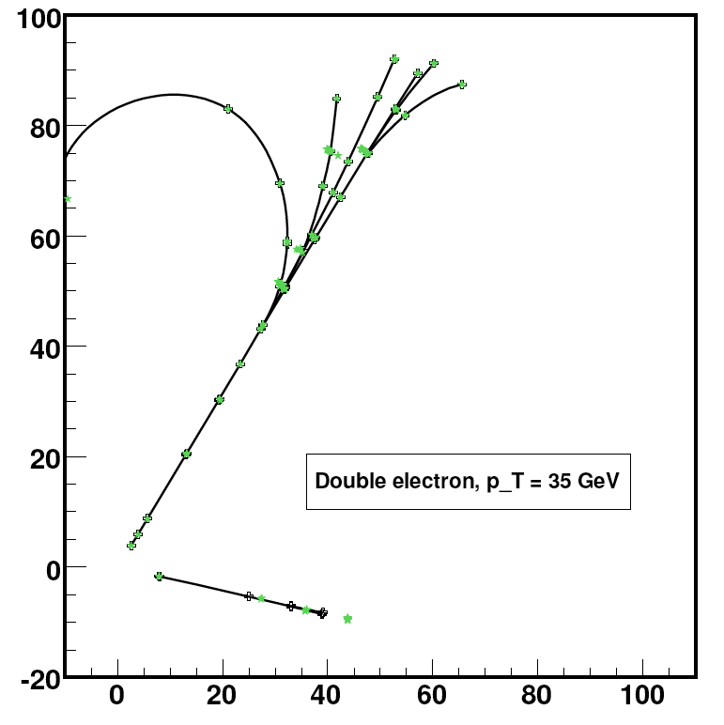
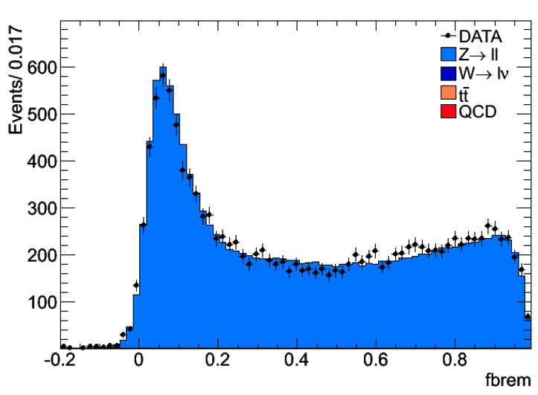
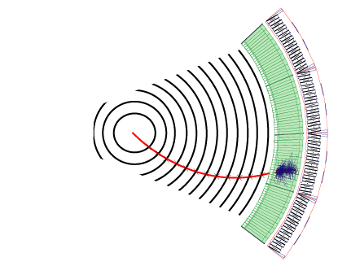
Example: Bremsstrahlung in CMS
Electron must traverse ~1X₀ of material in the inner tracker (13 layers of Si strip detectors) before it reaches the electromagnetic calorimeter.
On average, about 40% of electron energy is radiated in the tracker
Spray of deposits in the ECAL - must be combined to give calorimeter energy measurement.
Momentum at vertex should be determined from track curvature before 1st bremsstrahlung emission.

Slide 11
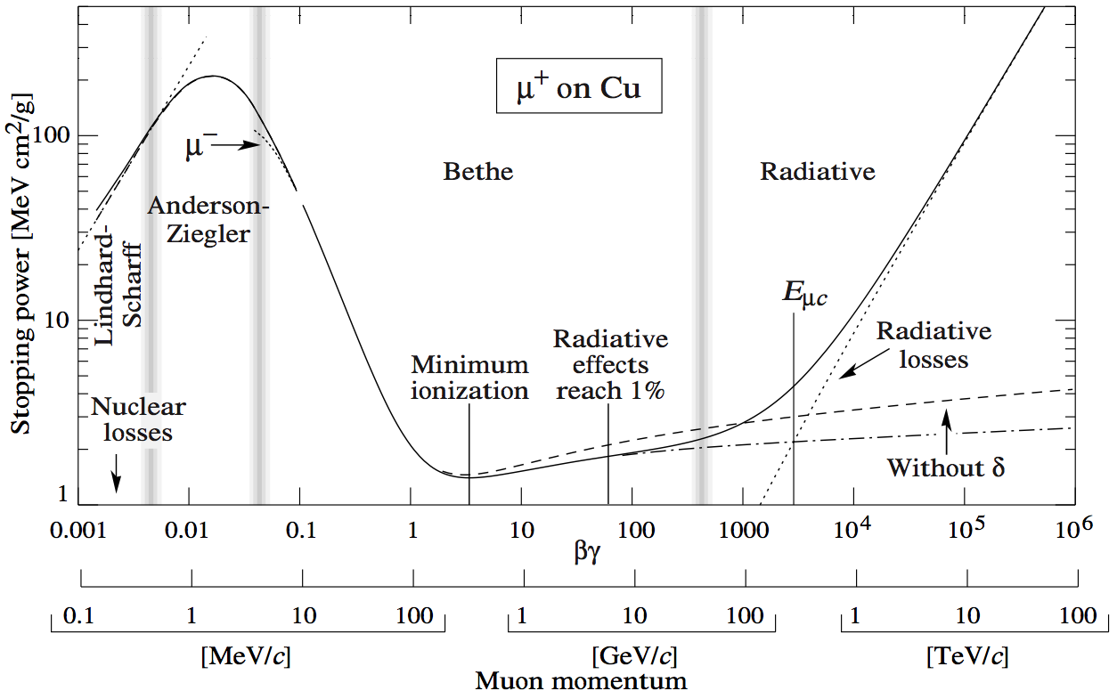
Full Energy Loss Spectrum for Muons
-dE/dX for positive muons over 9 orders of magnitude in momentum:

Slide 12
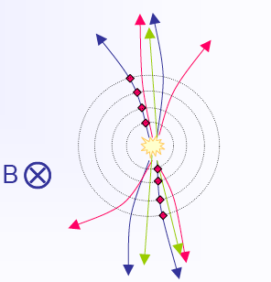
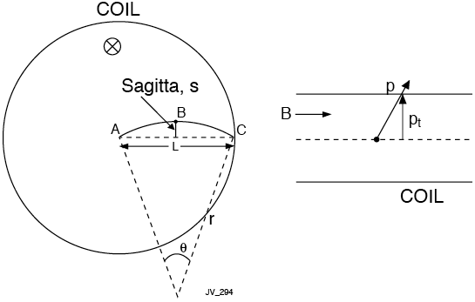
Momentum Measurement in a Magnetic Field
⇒
⇒
⇒
e.g. s = 3.75 cm
for p_{T}=1 GeV/c,
L=1m and B=1T
⇒

Slide 13
Momentum Measurement Error
Determination of sagitta from 3 measurements:
Momentum resolution:
Momentum resolution degrades linearly with increasing momentum, and improves quadratically with the radial size of tracking cavity.
For N equidistant measurements, one obtains (R.L. Gluckstern, NIM 24 (1963) 381):
e.g. σ(pT)/pT = 0.5% for p_{T}=1 GeV/c, L=1m, B=1T, σ_{x} = 200 μm and N=10
x
2
s
1
3
⇒

Slide 14
Multiple Coulomb Scattering
In addition to inelastic collisions with atomic electrons (i.e. ionization - Bethe Bloch), charged particles passing through matter also suffer repeated elastic Coulomb scattering from nuclei.
Elastic Coulomb scattering produces a change in the particle direction without any significant energy loss.
Change in direction caused by multiple Coulomb scattering degrades the momentum measurement.

Slide 15
Single Scattering
Individual collisions governed by Rutherford scattering formula:
Does not take into account spin effects or screening
Although single large angle scattering can occur for very small impact parameter, probability that a single interaction will scatter through a significant angle is very small due to 1/sin⁴(θ/2) dependence.
For large impact parameter (much more probable), scattering angle is further reduced w.r.t. Rutherford formula due to partial screening of nuclear charge by atomic electrons.

Slide 16
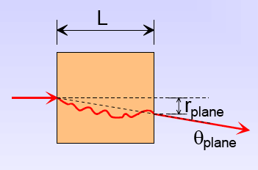
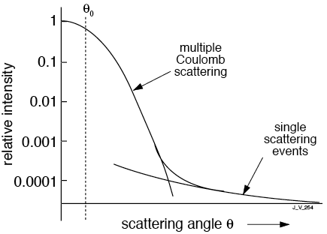
Multiple Coulomb Scattering
As a particle passes through a thickness of material, combination of a very large number of small deflections results in a significant net deviation - multiple coulomb scattering
Small contributions combine randomly to give a Gaussian probability distribution:
where
Plane of
incident
particle
(⊥ to B field)
(Gaussian)
θ_{plane} is projection of true space scattering angle onto plane of incident particle.
plane

Slide 17
Effect of Multiple Scattering on Resolution
Approximate relation (PDG):
Apparent sagitta due to multiple scattering (from PDG):
Contribution to momentum resolution from multiple scattering:
i.e.
Charge of incident particle
Radiation length of absorbing material
using
i.e.
Independent of p!

Slide 18
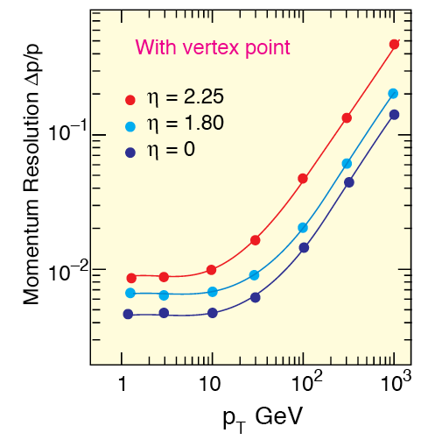
Effect of Multiple Scattering on Resolution
Estimated Momentum Resolution
vs p_{T} in CMS
Example:
p_{T} = 1 GeV/c, L = 1m, B = 1 T, N = 10, σ_{x} = 200μm:
For detector filled with Ar, X₀ = 110m:

Slide 19
Momentum Measurement Summary
Tracking detector design:
High B field. e.g. CMS: 4 Tesla
Large size e.g. CMS tracker radius = 1.2m
Low Z, low mass material. Gaseous detectors frequently chosen e.g. ATLAS Ar (91% of gas mixture) X₀=110m

Slide 20
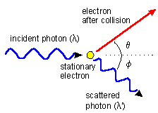
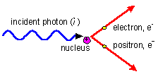
Interaction of Photons
No E field => inelastic collisions with atomic electrons and bremsstrahlung which dominate for charged particles do not occur for photons
3 main interations:
1) Photoelectric effect (dominant for E<100keV):
Photon is absorbed by an atomic electron with the subsequent ejection of the electron from the atom.
2) Compton scattering (important for E~1MeV):
Scattering of photons on free electrons
(atomic electrons effectively free for
E >> atomic binding energy)
3) Pair production (dominant for E>5MeV)
Photon is converted into an electron-positron pair

Slide 21
Interaction of Photons
Result of these 3 interactions:
1) Photons (x-rays, γ-rays) much more penetrating in matter than charged particles
Cross-section for the 3 interactions much less than inelastic collision cross-section for charged particles
2) A beam of photons is not degraded in energy as it passes through a thickness of matter, only in intensity
The 3 processes remove the photon from the beam entirely (absorbed or scattered out).
Photons which pass straight through have suffered no interaction so retain their original energy, but no. of photons is reduced.
Attenuation is exponential w.r.t. material thickness:
Absorption coefficient

Slide 22
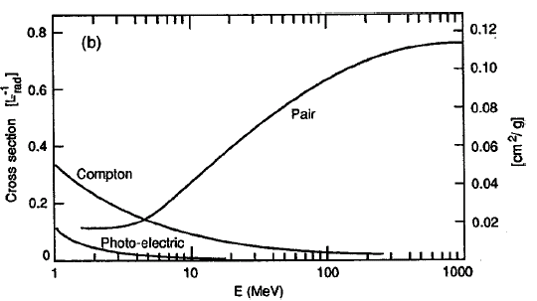
γ→e⁺e⁻ Pair Procution
For energies > a few MeV, pair production is the dominant mechanism:
In order to conserve energy and momentum, pair production can only occur in the presence of a 3rd body, e.g. an atomic nucleus.
e.g. CMS ECAL: PbW0₄ crystals - dense material with heavy nuclei
In order to create the pair, photon must have energy E>2m_{e}c² i.e. E>1.022MeV.

Slide 23
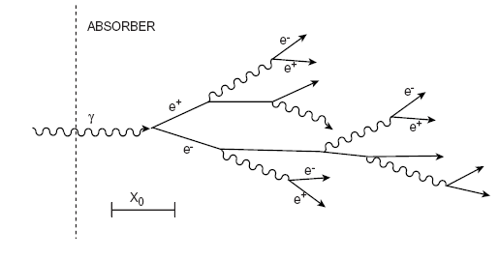
Electron-Photon Showers
Combined effect of pair production for photons and bremsstrahlung for electrons is the formation of electron-photon showers.
Shower continues until energy of e+e- pairs drops below critical energy
See lectures on Calorimetry (Chris Seez)

