Slide 1


The COherent Muon to Electron Transition (COMET) Experiment
Ajit Kurup
Nuclear and Particle Physics Divisional Conference of the Institute of Physics
6th April 2011

Slide 2
Introduction
Brief introduction to muon to electron conversion and the aims of COMET Experiment.
Experimental overview.
Some R&D projects.
PRISM – going beyond the sensitivity of COMET.
Summary and future plans.

Slide 3
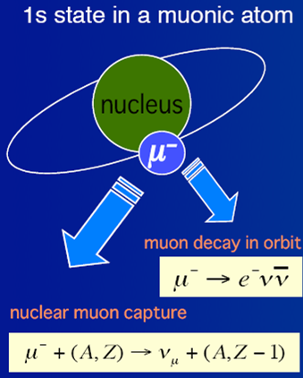
What is Muon to Electron Conversion?
Neutrino-less conversion of a muon into an electron in the presence of a nucleus.
For muonic atoms
  Muon decay μ⁻ → e⁻ ν_{e} ν_{μ}
  Nuclear capture μ⁻ (A,Z) → ν_{μ} (A,Z-1)
  Muon to electron conversion μ⁻ (A,Z) → e⁻ (A,Z)
    Not allowed in SM.
    Electron energy depends on Z (for Al, E_{e} = 105 MeV)
    Nucleus coherently recoils off outgoing electron, no breakup.
New physics
μ
e
W

Slide 4
What is Muon to Electron Conversion?
Neutrino-less conversion of a muon into an electron in the presence of a nucleus.
For muonic atoms
  Muon decay μ⁻ → e⁻ ν_{e} ν_{μ}
  Nuclear capture μ⁻ (A,Z) → ν_{μ} (A,Z-1)
  Muon to electron conversion μ⁻ (A,Z) → e⁻ (A,Z)
    Not allowed in SM.
    Electron energy depends on Z (for Al, E_{e} = 105 MeV)
    Nucleus coherently recoils off outgoing electron, no breakup.
If we include neutrino mixing in the SM, muon to electron conversion is <10⁻⁵²
  Sensitive to physics beyond the SM.
    SUSY, Compositeness, Heavy ν, Z’
    2nd Higgs doublet, leptoquarks, etc.
mixing
Q(m_{ν} /m_{W})⁴
ν_{μ}
ν_{e}
μ
e
W

Slide 5
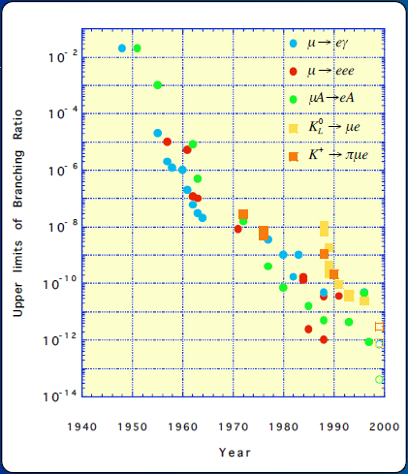
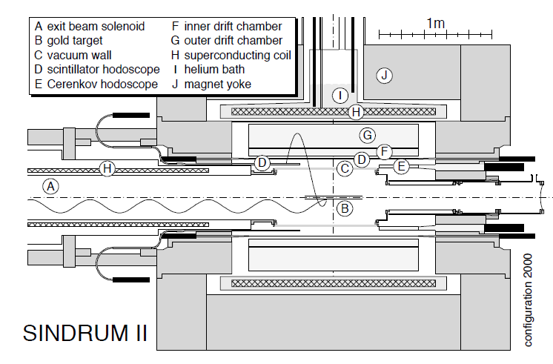
Brief History of Muon to Electron Conversion
A. Lagarrigue et C. Peyrou, Compt. Rend. Ac. Sc., 234, 1873 (1952).
  Looked at cosmic ray muons stopping in copper and tin screens. → BR < 2x10⁻²
Current best limit is < 7x10⁻¹³ by SINDRUM II (2006).
  Muon beam from a cyclotron using a gold target.

Slide 6
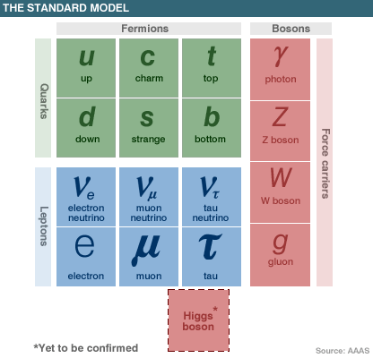
Why Measuring Muon to Electron Conversion is Important!
Lepton sector is not fully described by the SM!
  Observation of neutrino oscillations is direct evidence that neutrinos have mass and violate lepton flavour number.
Next-generation experiments can expect 10⁴ improvement in sensitivity!
  Mainly due to accelerator technology advances from R&D for the Neutrino Factory.
Complementary to measurements at the LHC
?
?

Slide 7
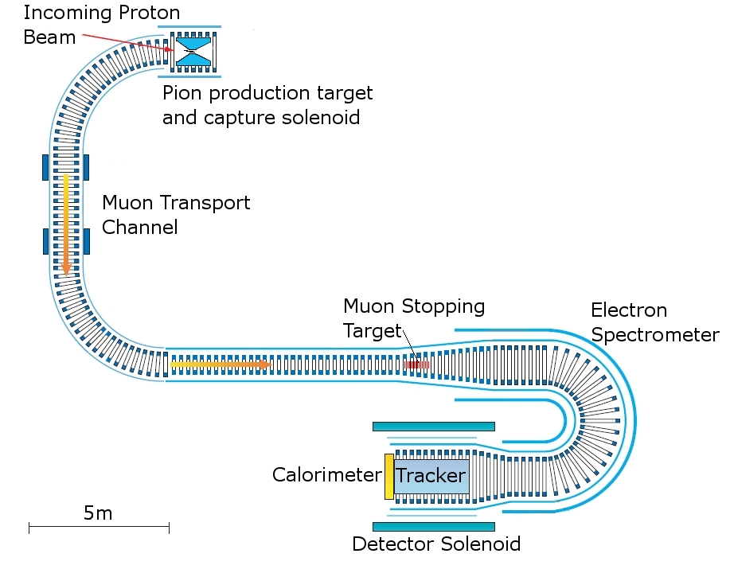
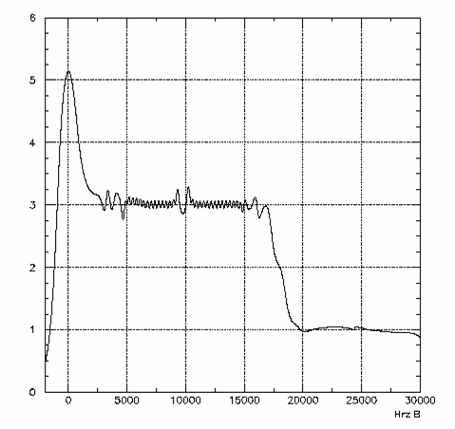

COMET
6
5
4
Muon stopping target
3
Magnetic Field (T)
2
Electron Spectrometer
and detector solenoid
1
Pion capture
solenoid
Muon transport
channel
s (m)
0
0
5
10
15
20
25
30
Aim for single event sensitivity of <10⁻¹⁶ (10⁴ improvement on SINDRUM II).
1
1
B(μ⁻ + Al→ e⁻ + Al) ~
=
= 2.6G10⁻¹⁷
< 6G10⁻¹⁷ (90% C.L.)
N_{μ} H f_{CAP} H A_{e}
2G10¹⁸ H 0.6 H 0.04

Slide 8
COMET Collaboration
I. Sekachev
T. Hiasa
T. Itahashi
Saitama
Tohoku
S. Mihara

Slide 9
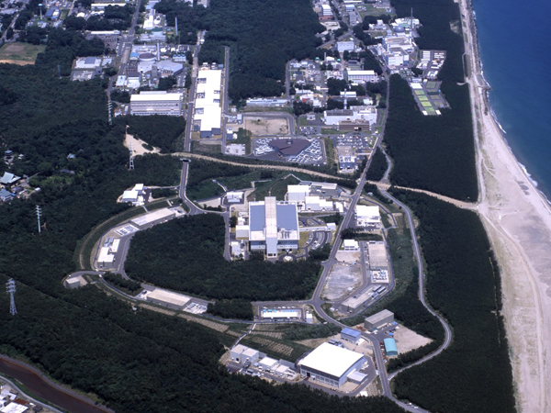

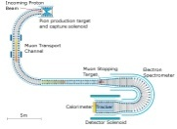
COMET at J-PARC
Proton beam design parameters
Accelerator-Driven Transmutation Experimental Facility
Linac
Beam Power | 750 kW
Beam Energy | 30 GeV
Average Current | 25μA
Neutrino Facility
3 GeV Synchrotron
COMET beam requirements
Beam Power | 56 kW
Beam Energy | 8 GeV
Average Current | 7μA
Materials and Life Science Facility
Slow-extracted proton beam.
8 GeV to suppress anti-proton production.
Main Ring (30 GeV Synchrotron)
Hadron Experimental Facility
COMET

Slide 10
Challenges for COMET
Need for high intensity muon beam
  Many challenges from an accelerator physics perspective.
  Intense proton beams.
  Very cleanly pulsed proton beam (extinction <10⁻⁹).
    Need extinction device?
  Superconducting solenoid in high radiation environment.
  Transportation and momentum selection of large emittance pion/muon beams.
Detector systems.
  Extinction measurement device.
  0.4% momentum resolution for ~105MeV/c electrons.
  Fast, highly-segmented calorimeter.
Notes:
Will give a flavour of some of the on going R&D.

Slide 11
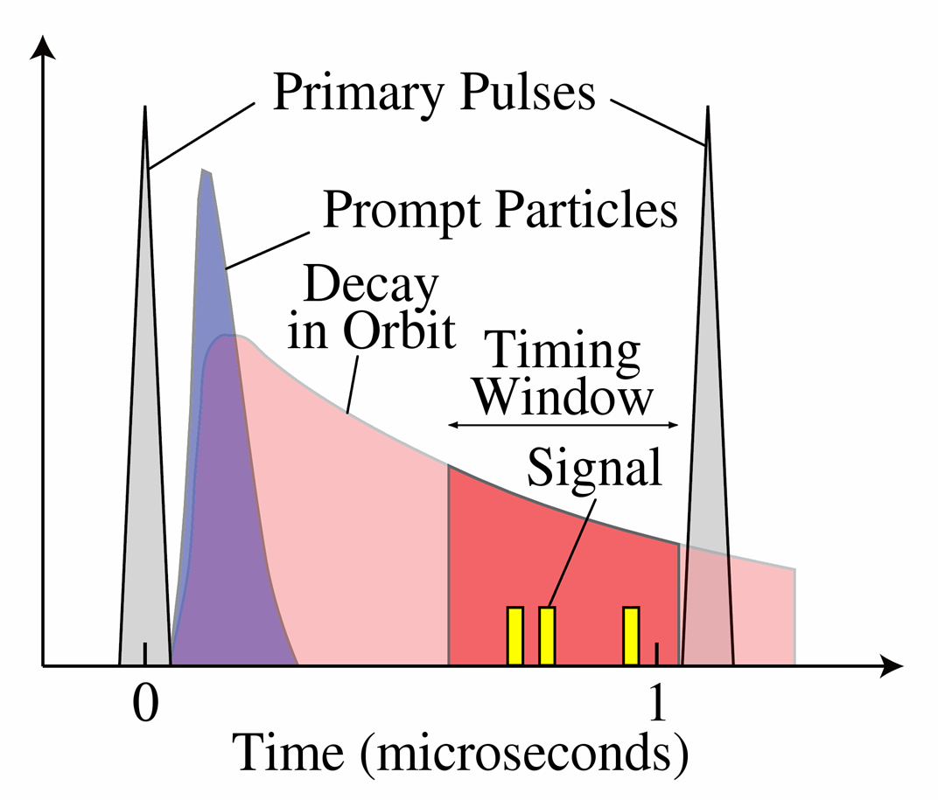
Proton Beam for COMET
Pulse structure mainly determined by muonic lifetime which is dependent on the stopping target Z. For Al lifetime is 880ns.
Extinction is very important!
  Without sufficient extinction, all processes in the prompt background category could become a problem.
Intrinsic extinction of J-PARC’s main ring is around 10⁻⁷. (Need additional factor of 10⁻²).
  Possible solution is to use an AC dipole.
  Or, it may be possible to alter extraction kicking configuration to kick out empty buckets.
100ns

Slide 12
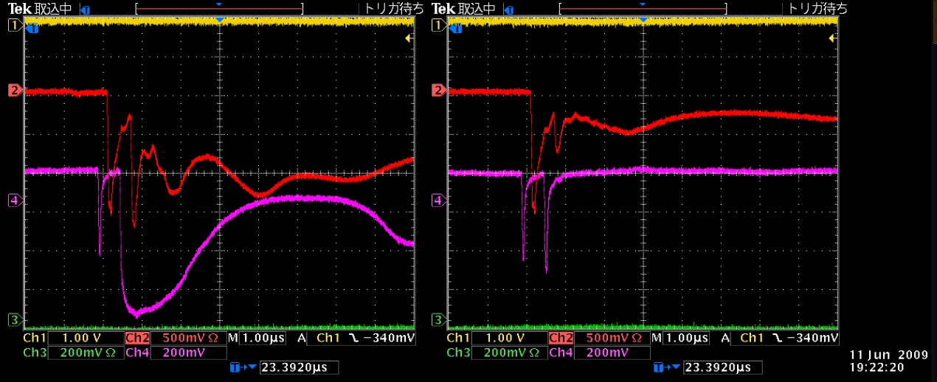
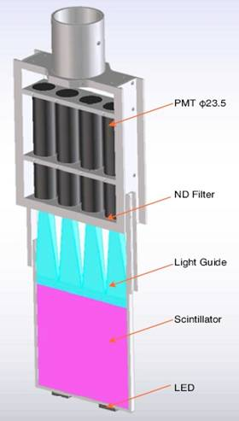
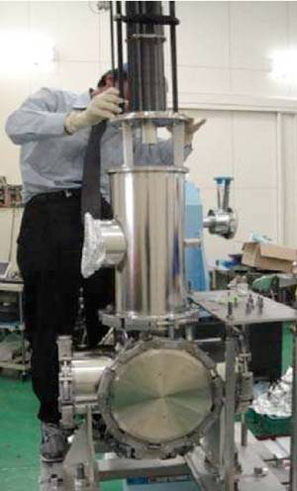
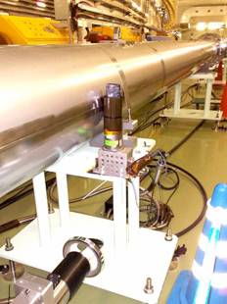
Proton Extinction Measurement
Need to measure extinction level.
Requires 10⁹ dynamic range and timing resolution of ~10ns.
On going R&D at JPARC main ring.
  Scintillator hodoscope placed in main ring abort line.
Gating PMT development.
Residual beam measurement with one filled, one empty bucket (left) and both buckets empty (right).
Extinction monitor installed in the J-PARC main ring abort line
New monitor with moving stage and gate valve.

Slide 13
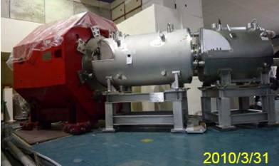
Magnet Prototype
Muon Science Innovative Commission (MUSIC) at Osaka University.
Similar to pion capture section in COMET but at lower intensity and momentum.
400MeV,1μA protons → 10⁹ μ/s
  World’s most intense muon source!
Solenoid Coil
Field on axis | 2 T
Bore Diameter | 480mm
Length | 200mm
36°
Dipole Coil
Field on axis | 0.04 T
Aperture | 420mm
Length | 200mm
No. of Layers | 6
1580 mm
Magnet design done in collaboration with Toshiba

Slide 14
Electron Spectrometer
1T solenoid with additional 0.17T dipole field.
Vertical dispersion of toroidal field allows electrons with P<60MeV/c to be removed.
  reduces rate in tracker to ~1kHz.

Slide 15
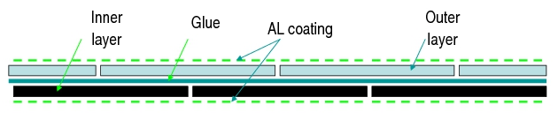
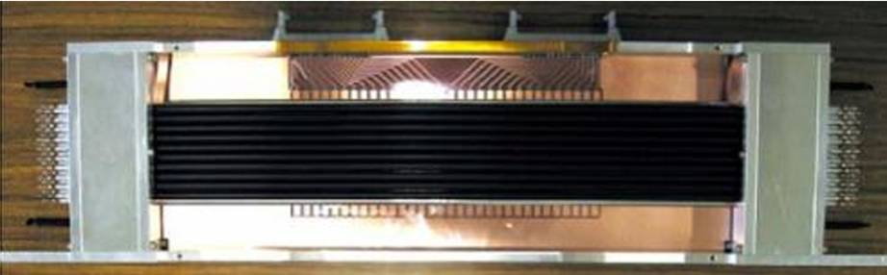
Tracker
Requirements
  operate in a 1T solenoid field.
  operate in vacuum (to reduce multiple scattering of electrons).
  800kHz charged particle rate and 8MHz gamma rates
  0.4% momentum and 700μm spatial resolution.
Current design utilises straw tube chambers
  Straw tubes 5mm in diameter. Wall composed of two layers of 12μm thick metalized Kapton glued together.
5 planes 48cm apart with 2 views (x and y) per plane and 2 layers per view (rotated by 45° to each other).
Straw wall
cross-section.
350mm long seamless straw tube prototype.

Slide 16
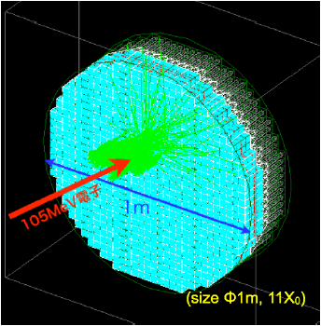
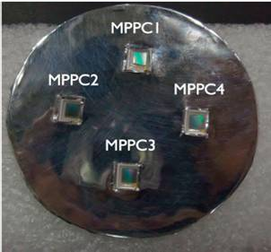
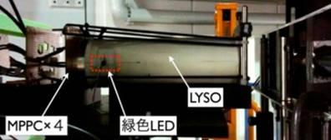
Calorimeter
Measure energy, PID and give additional position information. Can be used to make a trigger decision.
5% energy and 1cm spatial resolution at 100MeV
  High segmentation (3x3x15 cm³ crystals)
Candidate inorganic scintillator materials are Cerium-doped Lutetium Yttrium Orthosilicate (LYSO) or Cerium-doped Gd₂SiO₅ (GSO).
Favoured read out technology is multi–pixel photon counters (MPPC).
  high gains, fast response times and can operate in magnetic fields.
BEAM
LED
100 MeV electron beam tests at Tohoku University

Slide 17
Other Detectors
Cosmic ray veto counters.
  Needs to cover a large area.
  Efficiency 99.99%.
Muon intensity monitor.
  X-rays from stopped muons.
Calibration system for electron momentum.
  Use pions?
  Electron linac?
Late-arriving particle tagger in muon beamline.
  Only active after main beam pulse.
  Momentum? PID?
  Silicon pixels or diamond pixels?
  Design being done in the UK.

Slide 18
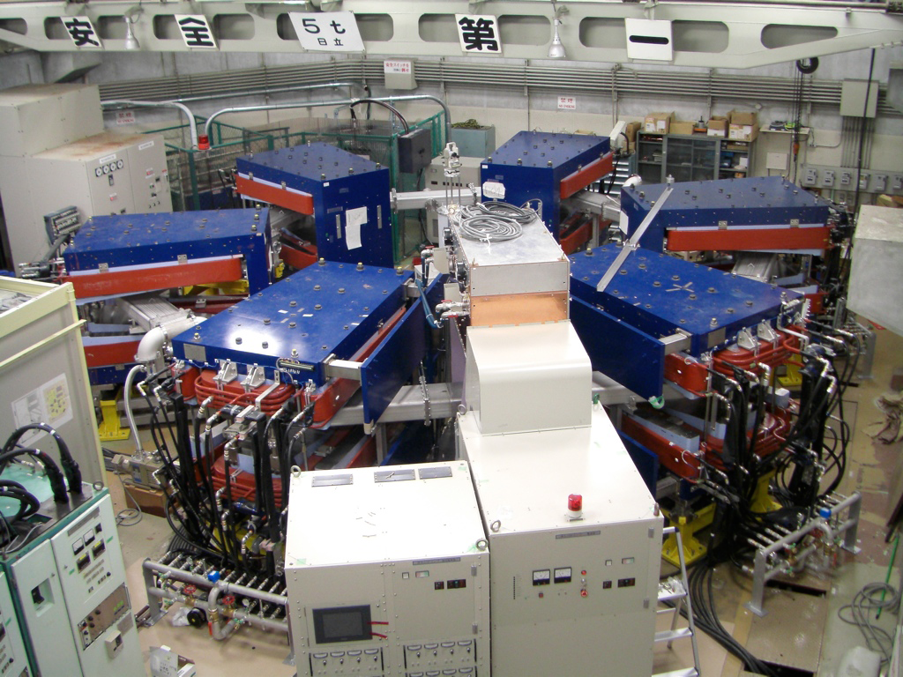
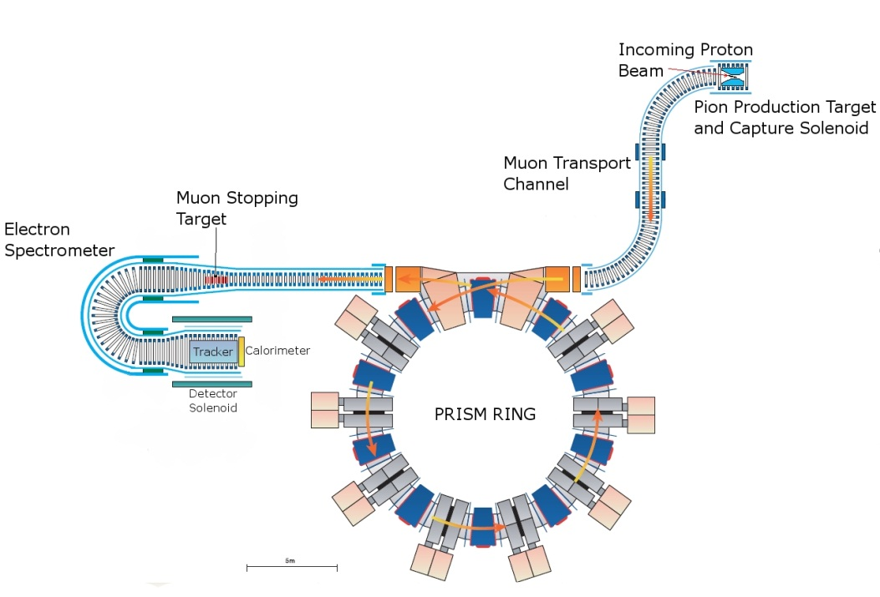

PRISM – Beyond COMET
10² better sensitivity than COMET mainly due to use of a fixed-field alternating gradient accelerator.
    Reduce momentum spread from 20% to 2%.
    Reduce pion survival probability.
PRISM task force aims to address technological issues that have to be solved in order to realise PRISM.

Slide 19
Summary and Future Plans
COMET is an exciting project to work on!
  Promises factor 10⁴ improvement on current best limit.
  Accelerator is intimately linked to the detector systems.
To achieve sensitivity requires the development of accelerator and detector technology.
  Intense, cleanly pulsed, proton beams.
  Superconducting solenoid technology.
  Transport channels for large emittance beams.
  Tracker technology, cost-effective calorimeter technology, late-arriving particle tagger.
COMET has Stage-1 approval from J-PARC and the Technical Design Report is planned to be submitted in 2011.
PRISM could be an even better muon to electron conversion experiment.
  Requires pushing the boundaries of accelerator technology.

