Slide 1
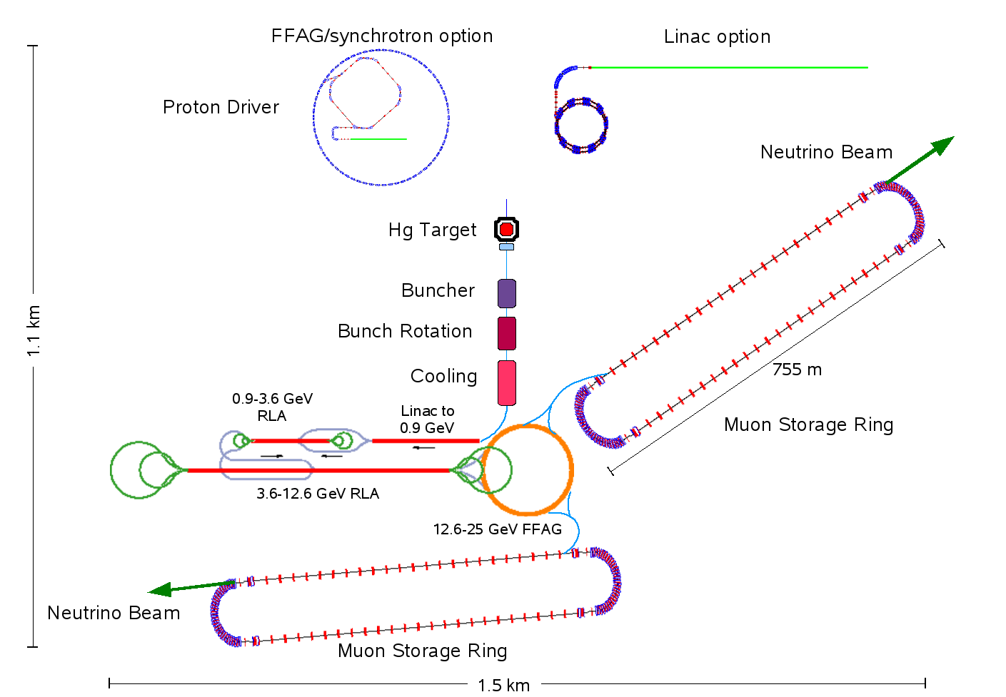
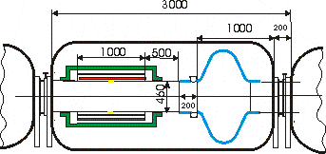
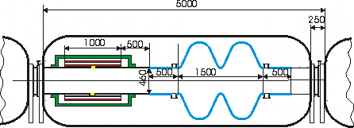
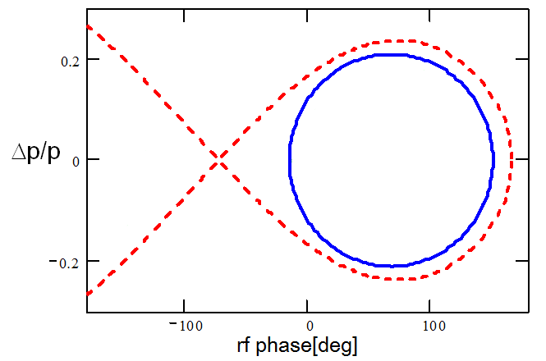
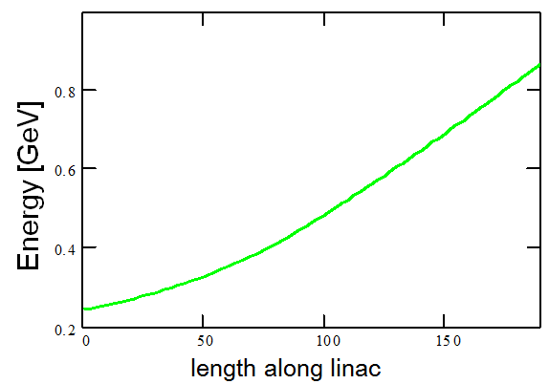
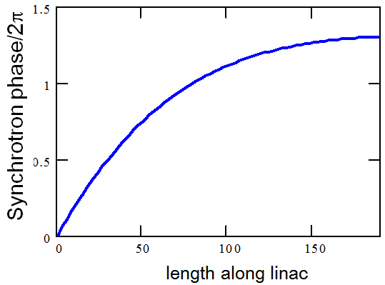
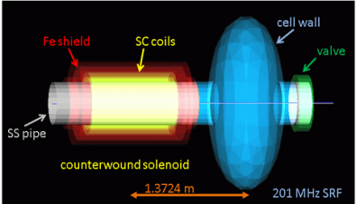
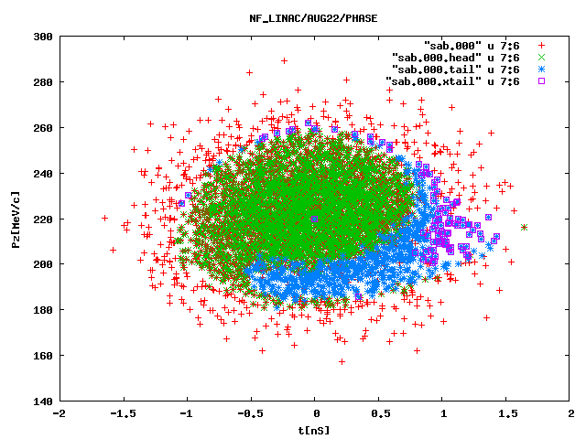
The Muon Linac for the International Design Study for the Neutrino Factory.
Ajit Kurup, C. Bontoiu, M. Aslaninejad, J. Pozimski, Imperial College London.
Bogacz, V. S. Morozov, Y.R. Roblin Jefferson Laboratory
K. B. Beard, Muons, Inc.
ABSTRACT
The first stage of muon acceleration in the Neutrino Factory utilises a superconducting linac to accelerate muons from 244 MeV to 900 MeV. The linac was split into three types of cryomodules with decreasing magnetic fields and increasing amounts of RF voltage but with the design of the superconducting solenoid and RF cavities being the same for all cryomodules. The current status of the muon linac for the International Design Study for the Neutrino Factory will be presented including a final lattice design of the linac and tracking simulations.
UPDATED DESIGN
The old linac design utilised three cryomodules (referred to as short, intermediate and long) to match the change in the relativistic beta as the muons are accelerated. The short module used for low beta has only one RF cavity whereas the other two cryomodules have two RF cavities. The short and intermediate cryomodules have RF cavities with an aperture radius of 23cm whereas the long cryomodule has an aperture radius of 15cm, to give a higher gradient. However, the aperture of the long cryomodule is the same as the required acceptance and so it was decided to redesign the lattice of the linac to use only short and intermediate cryomodules to allow a margin for error and minimise the possibility of the beam scraping the superconducting cavity and solenoid. The length of the linac has subsequently decreased from 218m to 192m.
 | Linac Section | Cell Length | No. of Solenoids | No. of RF Cavities
 | Short | 3m | 6 | 6
 | Intermediate | 5m | 8 | 16
 | Long | 8m | 20 | 44
 | Short | 3m | 24 | 24
 | Intermediate | 5m | 24 | 48
Old
Design
New
Design
Short Cryomodule
Intermediate Cryomodule
Longitudinal phase space showing the required acceptance at 95% (blue circle) and the bucket separatrix (red curve) for the 201MHz cavity with a gradient of 15MV/m.
Variation of the beam energy as a function of length along the linac.
Variation of the synchrotron phase as a function of length along the linac.
SUMMARY
A new design of the muon linac for the Neutrino Factory has been completed resulting in a linac shorter than the previous design. Lattice calculations have been done and preliminary tracking simulations show signs of longitudinal phase space filamentation. Further tracking studies are underway to optimise the phasing of the cavities to improve the transmission efficiency of the linac and to use a more realistic input beam from the output of the preceding ionization cooling channel.
A cost estimate for the Neutrino Factory needs to be presented in the Reference Design Report which will be completed in 2013. Work on costing the linac has started with defining the breakdown structure of its components, which needs to include all items from the cryomodules to heating and ventilation services for the linac tunnel.
Longitudinal phase space at the end of the linac using 10⁴ particles tracked with ELEGANT (left), OptiM (middle) and G4beamline (right).
25
25
Size_X[cm]
Size_Y[cm]
0
0
Ax_bet
Ay_bet
Ax_disp
Ay_disp
192
0
24 short cryomodules
24 intermediate cryomodules
G4beamline simulation showing the initial position, in P_{z}-t phase space, of muons that do not make it to the end (in red) and muons that are in the main body, tail and extreme tail (in green, blue and mauve respectively) of the bunch at the end of the linac.
Beta functions calculated by OptiM including RF cavity phasing.
The beam starts off at 72$°$ off-crest and ends up being on-crest.
Muons, Inc.

