Slide 1
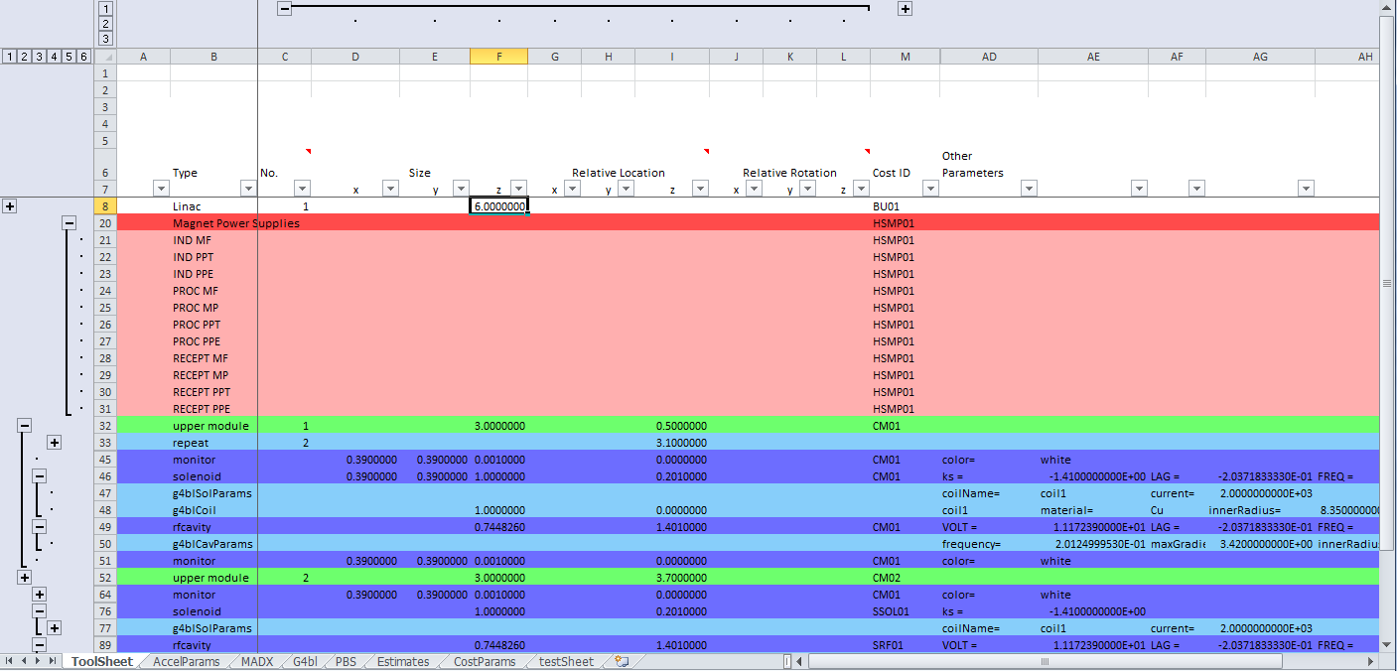
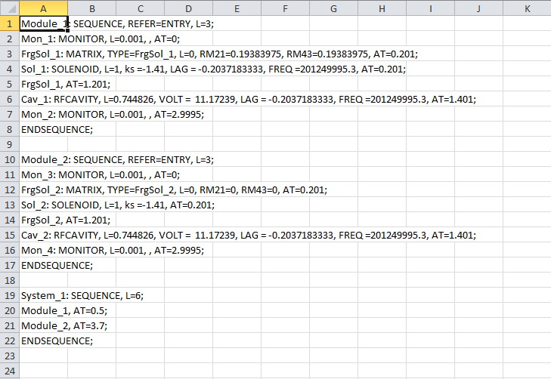
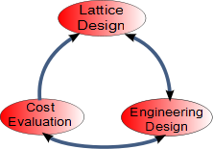
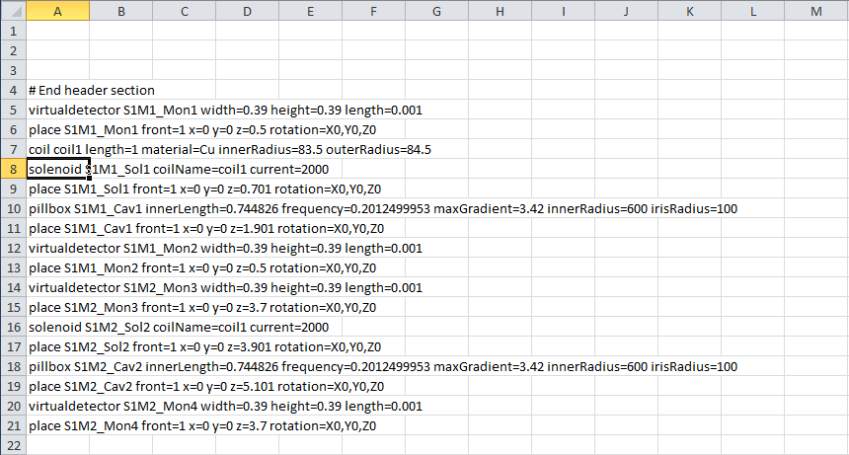
An Accelerator Design Tool for the International Design Study for the
Neutrino Factory
Ajit Kurup, Imperial College London
P. Bonnal, B. Daudin, J. De Jonghe, CERN
ABSTRACT
A tool has been developed to simplify the accelerator design process from the lattice design, through tracking simulations with engineering features, to costing the Neutrino Factory. The aim of this tool is to facilitate going through the design loop efficiently and thus allow engineering features to be included early on in the design process without hindering the development of the lattice design.
The tool uses a spreadsheet to store information about the accelerator and can generate MADX input files, G4beamline input files and interfaces with the costing tool developed by CERN. Having one source for the information simplifies going between lattice simulations, tracking simulations and costing calculations and eliminates the possibility of introducing discrepancies in the design.
COMMON INFORMATION STRUCTURE
The information needed to describe and accelerator in the ADT is broken down into 3 basic levels. These correspond to a physical hierarchy of building, module and component. Components (level 3) can be beamline elements such as magnets, RF cavities, etc. Modules (level 2) contain components and their dimensions reflect the space needed to have the component in the beamline, e.g. the size of a module for a magnet will including its yoke and support structure not just the size of the field volume. A building (level 1) contains modules and its dimensions reflect space needed for ancillary equipment such as vacuum gate valves, magnet power supplies, etc. Additional levels below the component level contain details for tracking simulations (level 4) and for costing purposes (level 5). This hierarchy is implemented in the spreadsheet using groups.
DESIGN LOOP
To reach the final design it may be necessary to go through this design loop several times. In going between each phase, the exchange of information between accelerator physicists and engineers could be cumbersome and the conversion of information between different formats could lead to errors or omissions.
MADX INTERFACE
The ADT can create a MADX sequence file from the information stored in the spreadsheet. A VBA macro parses the spreadsheet and creates a series of sequences that follows the level 1, 2 and 3 structure of the spreadsheet. Higher levels are ignored. The type of a level 3 entry must correspond to a known type and specifies what beamline element to include in the sequence.
G4BEAMLINE INTERFACE
The ADT can create a G4Beamline input file from the information stored in the spreadsheet. Here the G4beamline input follows a linear format and does not have the level 1, 2 and 3 hierarchy other than implicitly in the names automatically generated for each beamline element. Certain level 3 entries must be followed by additional entries at level 4 in order to provide required information for G4beamline.
CERN COSTING TOOL (CCT) INTERFACE
Within the CCT a project is broken down into sets of grouped components. This structure was chosen to be the same as the hierarchy defined for the ADT. Each component is then split into three phases, industrialisation and tendering; procurement; and reception. Each phase has its own associated material costs and technician and engineering manpower. The information that needs to be provided to the CCT has been grouped into higher level columns and rows within the ADT. Thus, these can be hidden when only the physics or engineering design is being considered. A VBA macro is used to translate the information in these higher levels into the format required by the CCT.
ADDITIONAL FEATURES
A macro to copy and link sections, which is useful for repeating structures.
The use of a parameters sheet and named cells to store variables in a compact location.
A macro to automatically highlight rows at the appropriate level, which makes reading the spreadsheet easier.

