Slide 1
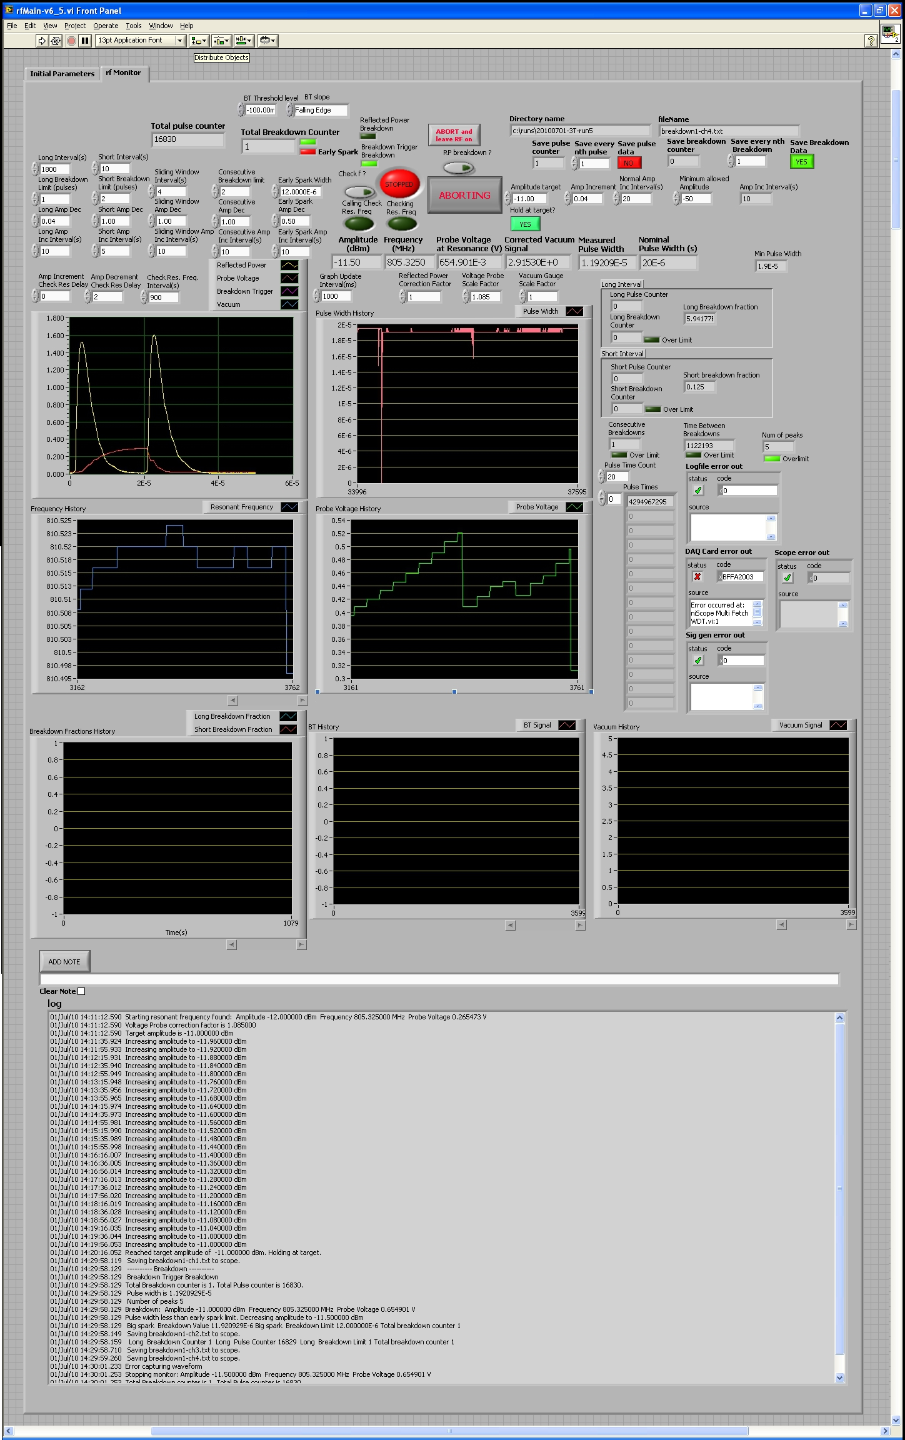
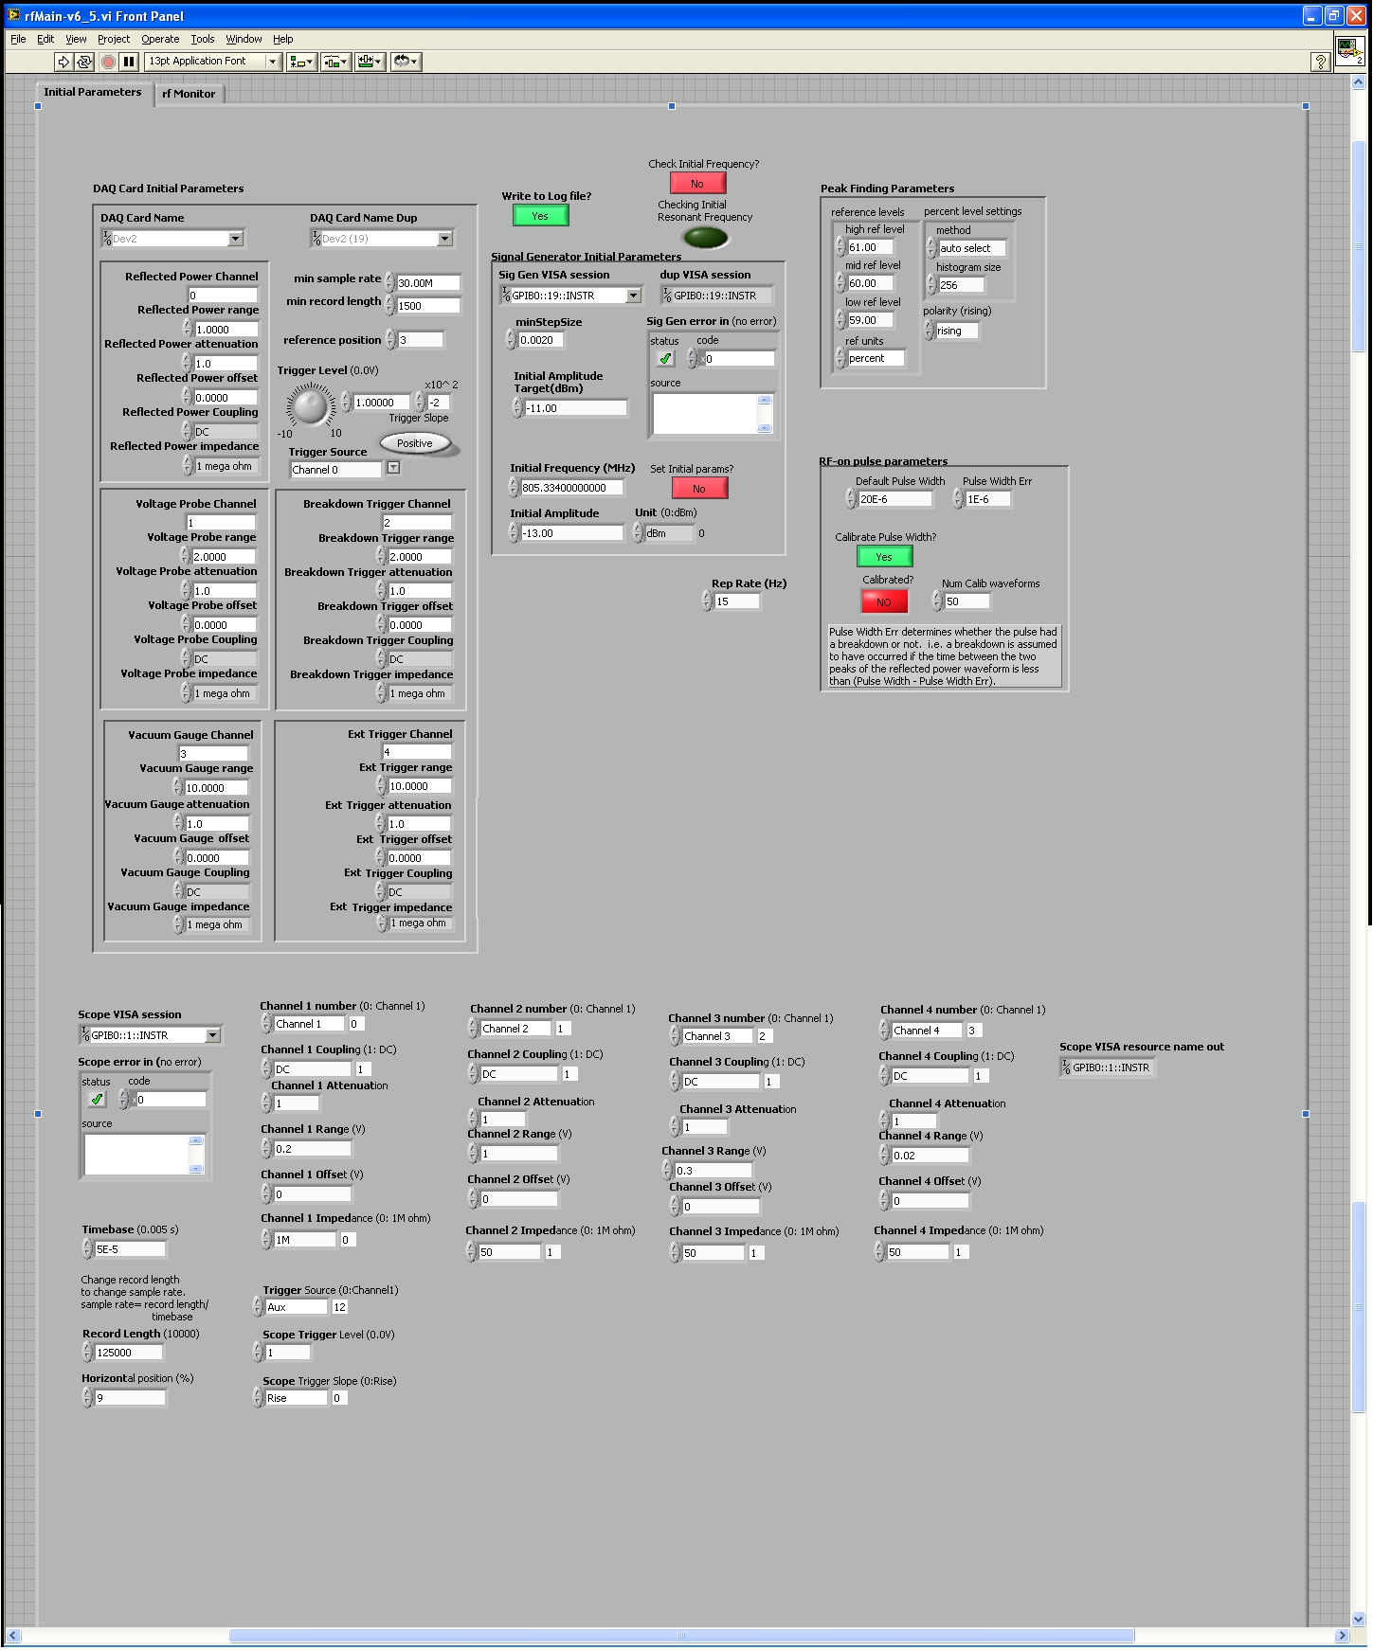
An Automated Conditioning System for the MUCOOL Experiments at Fermilab
Ajit Kurup, Imperial College London.
ABSTRACT
The MUCOOL project aims to study RF cavities for the Neutrino Factory and the Muon Collider. The large emittance muon beams in these accelerators require high-gradient RF cavities at low-frequencies and they need to operate in the presence of relatively strong magnetic fields. MUCOOL is conducting a number of tests on 805MHz and 201 MHz cavities in order to develop a technology that can meet all of these requirements. An automated conditioning system was developed for the 805MHz test program for MUCOOL. This system was designed to replicate the logic a human operator would use when conditioning an RF cavity and to provide automated logging of the conditioning process.
Fast ~-30dBm
attenuator
(threshold between reflected power peaks)
Fast Switch
(vacc > 6X10^-8 torr ||
2 consecutive breakdowns)
10Hz clock
Modulator
OLD SETUP
Power
Amplifier
Klystron
Control
Electronics
Waveguide
Signal
Generator
ACNET
forward power
Analogue
Oscilloscope
reflected power
Directional Coupler
vacuum probe
Cavity
voltage probe
NEW SETUP
Fast ~-30dBm
attenuator
(threshold between reflected power peaks)
Fast Switch
(vacc > 6X10^-8 torr ||
2 consecutive breakdowns)
10Hz clock
Modulator
Power
Amplifier
Klystron
Control
Electronics
Waveguide
Signal
Generator
Digital
Oscilloscope
Envelope
Filter
forward
power
Analogue
Oscilloscope
Directional Coupler
reflected
power
ACNET
vacuum probe
Cavity
voltage probe

