Slide 1
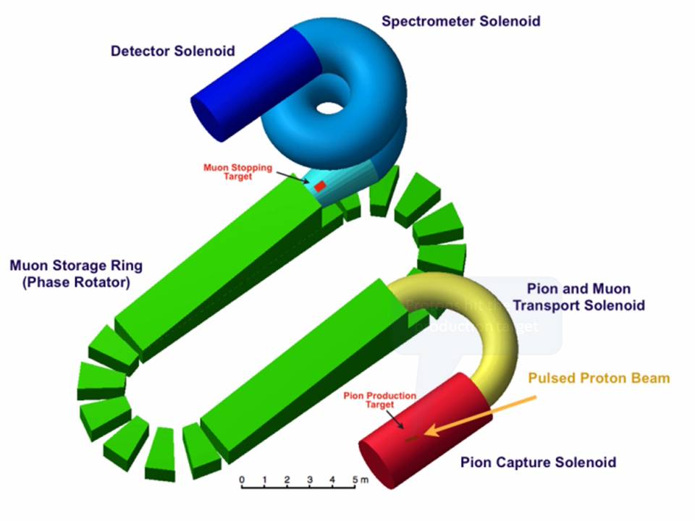
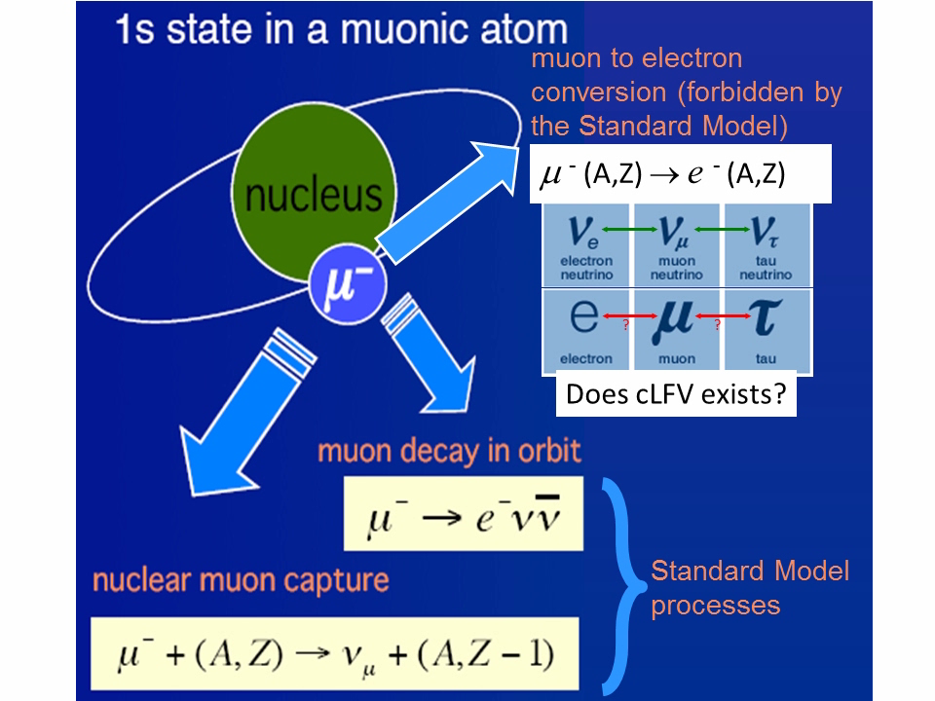
Muon to Electron Conversion

Slide 2
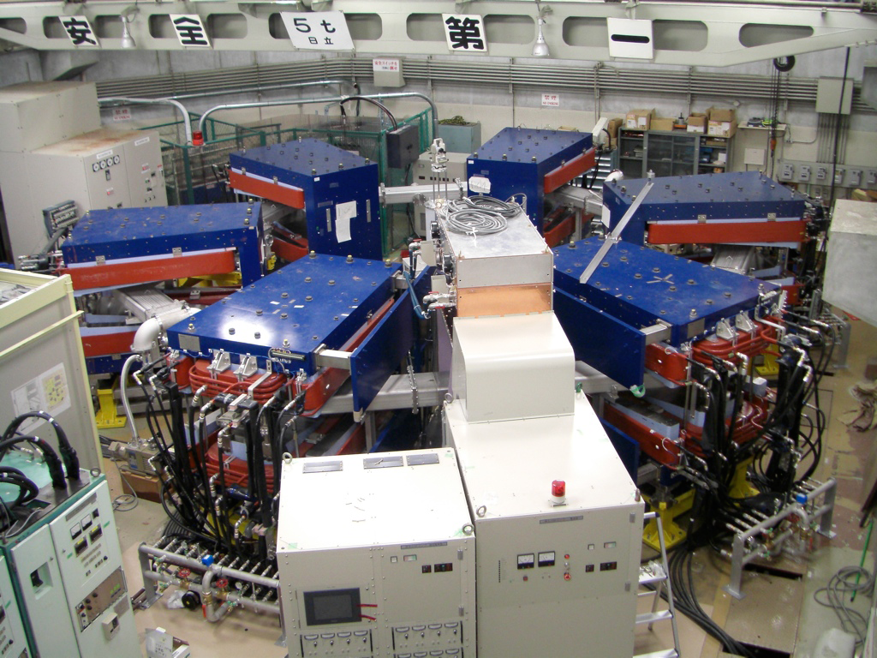
Demonstration Experiment at Osaka
Original design uses 10 cells. Demonstration experiment used 6 cells.
Use ²⁴¹Am alpha source (200 MeV/c degraded to 100 MeV/c with Al foil).
Can locate position and angle of source.
Study closed orbits, dynamic aperture and tune.
 | 10-cell Ring | 6-cell Ring
Particle | muon | alpha
Momentum (MeV/c) | 68 | 100
Radius (m) | 6.5 | 3.5
Number of cavities | 8 | 1
Number of field clamps | 20 | 2

Slide 3
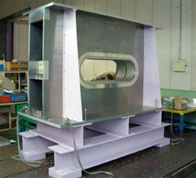
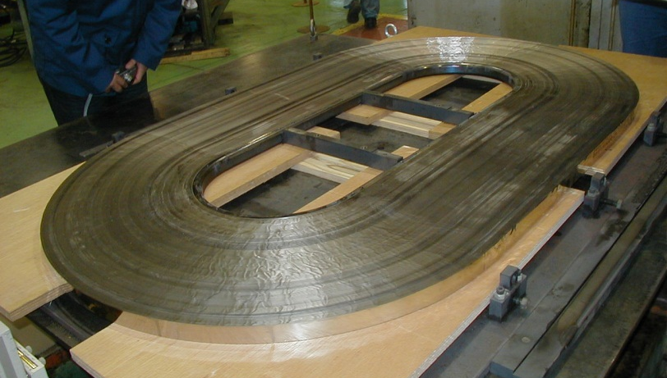
Demonstration Experiment at Osaka
PRISM Prototype Cavity
High fields at low frequencies.
Wide band operation (low Q).
Core made of magnetic alloy ribbon.
kV
1.0m
nsec
Sawtooth Approximation
0.33m
Cores per cavity | 4
Shunt Impedance | 400 Ω
RF frequency | 2.1 MHz
Field Gradient | 100 kV/m
Duty Factor | 0.3%
1.0m
1.7m
1.8m
0.35m

Slide 4
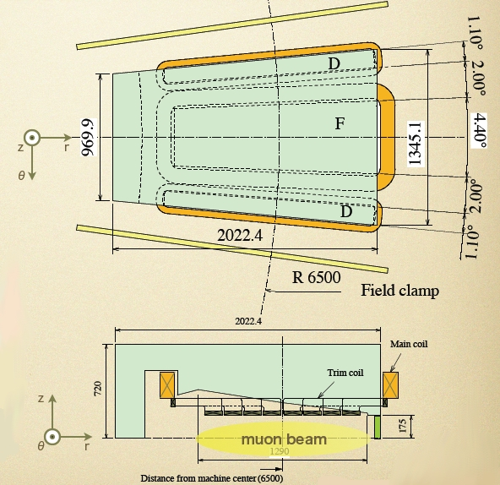
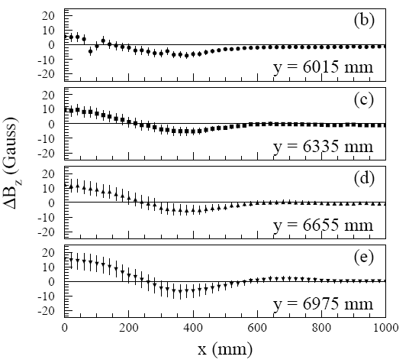
Demonstration Experiment at Osaka
ΔB_{z} = Measured B_{z} – TOSCA B_{z}

Slide 5
PRISM Task Force
Aims
  Address the technological challenges in realising an FFAG based muon-to-electron conversion experiment,
  Strengthen the R&D for muon accelerators in the context of the Neutrino Factory and future muon physics experiments.
Areas of activity
  The physics of muon to electron conversion.
  Proton source, pion capture, muon beam transport, injection and extraction and FFAG designs.
  FFAG hardware systems R&D.

Slide 6
PRISM Task Force Goals
Match beam from pion production target to phase rotator ring.
Investigate alternative phase rotation solutions other than the baseline scaling FFAG ring.
Find solutions for injection and extraction of a large emittance beam.
Find technological solutions for high-gradient RF cavities at low (i.e. few MHz) frequency.

Slide 7
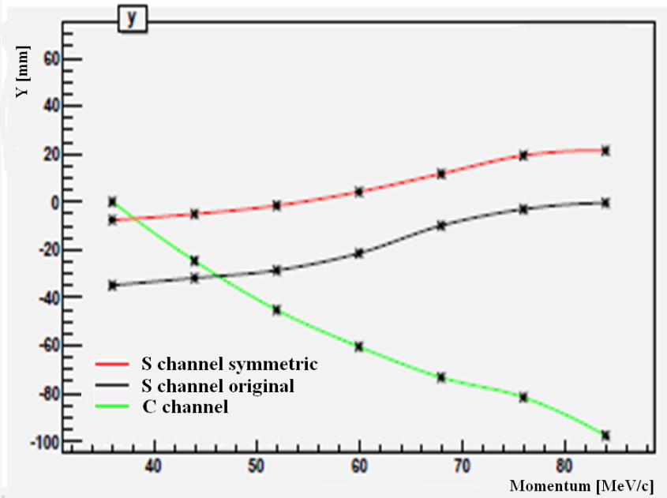
Matching to the FFAG
Beam from pion production target is captured in a solenoid channel.
It is then transported to the FFAG in a bent solenoid channel.
  Two scenarios considered:
    S-shaped and C-shaped.
      S-shaped with correcting dipole field performs best.

Slide 8
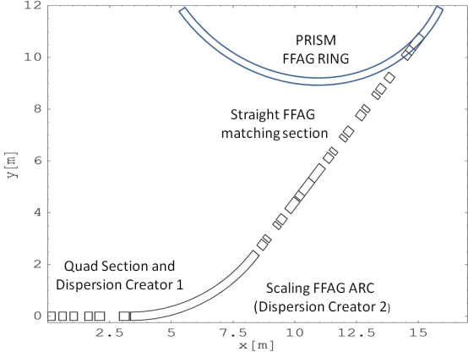
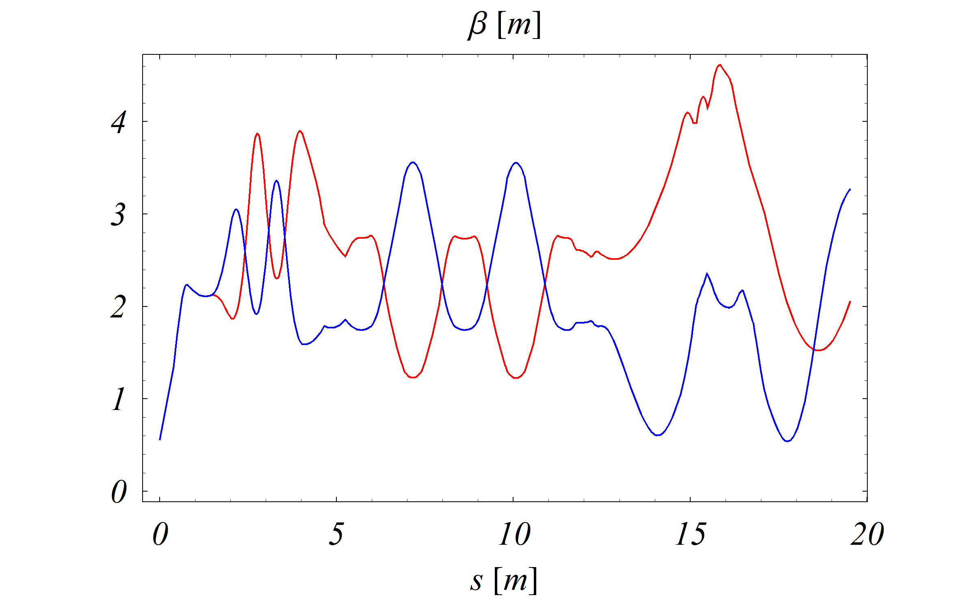
Matching to the FFAG
One of the main goals is to match the dispersion of the solenoid channel to that of the FFAG.
In order to match the beam from the solenoid channel to the FFAG an alternating gradient quadrupole channel is used.
Horizontal (red) and vertical (blue) betatron functions in the PRISM front end. The starting point corresponds to the end of the adiabatic solenoidal switch.

Slide 9
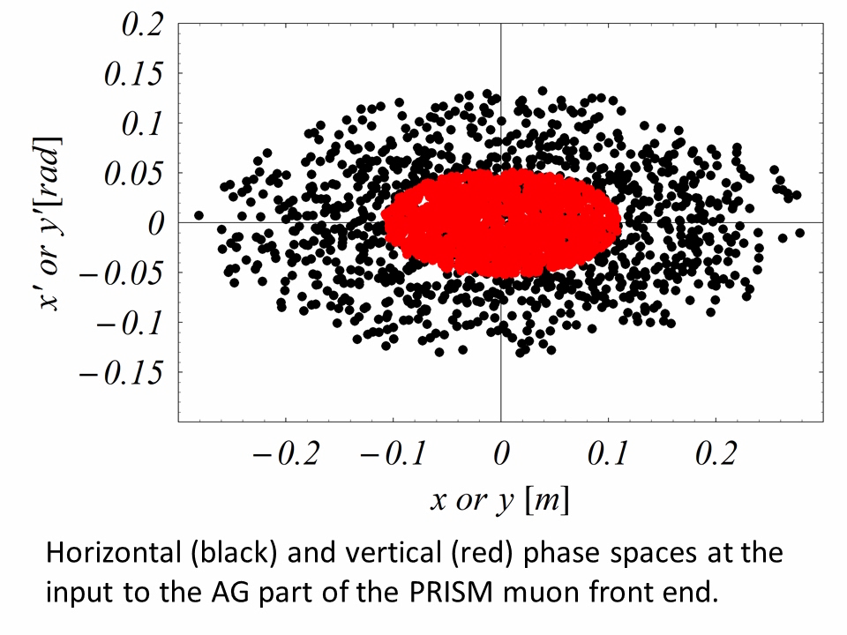
Matching to the FFAG
One of the main goals is to match the dispersion of the solenoid channel to that of the FFAG.
In order to match the beam from the solenoid channel to the FFAG and alternating gradient quadrupole channel is used.

Slide 10
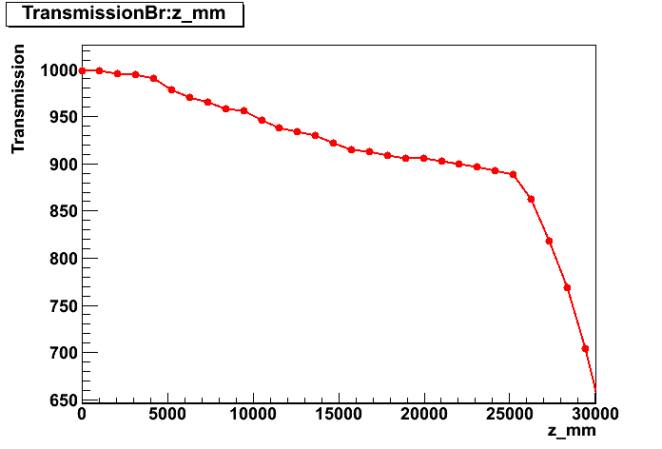
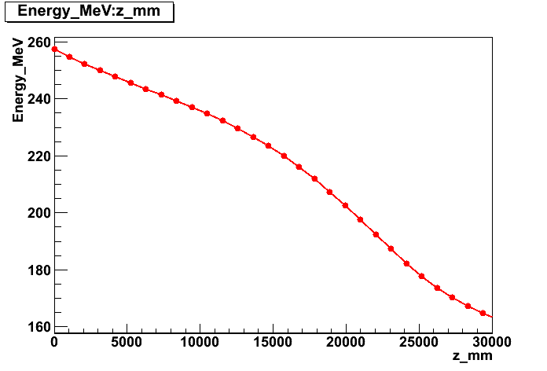
Alternative Front-End
Capture forward going particles.
  Increased particle rate.
  Higher momentum particles can lead to more backgrounds.
Use a cooling channel like in the Neutrino Factory.
Bucked coil
cooling lattice.
Transmission vs z (mm)
Energy (MeV) vs z (mm)

Slide 11
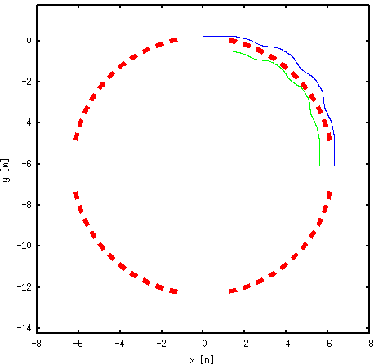
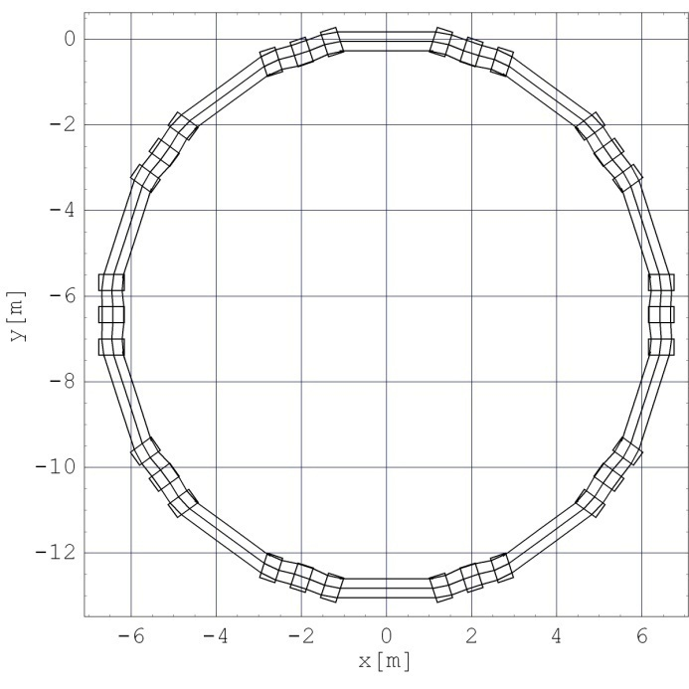
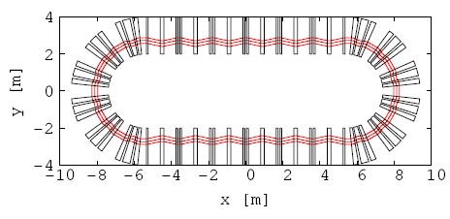
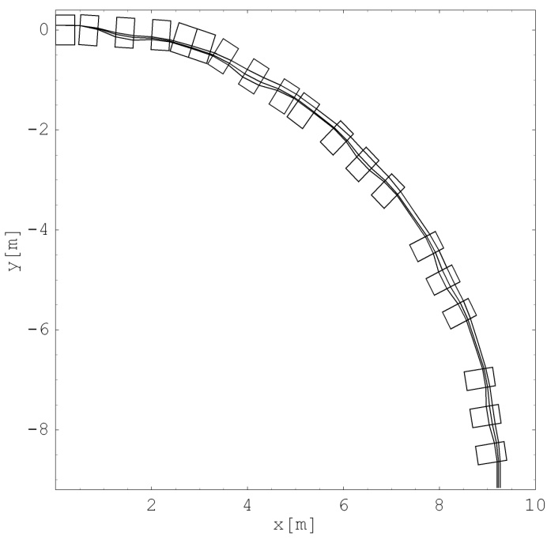
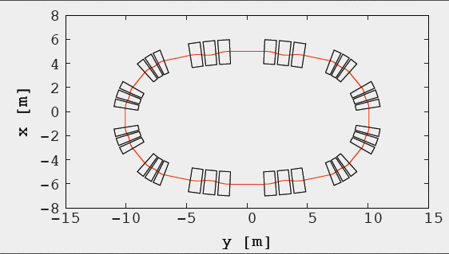
Alternative Ring Designs
Investigate rings that could have larger dynamical acceptance.
Investigate rings that could have easier injection/extraction.
Scaling Superperiodic
Non-Scaling
Advanced scaling FFAG
Advanced NS-FFAG
Egg-shaped scaling FFAG

Slide 12
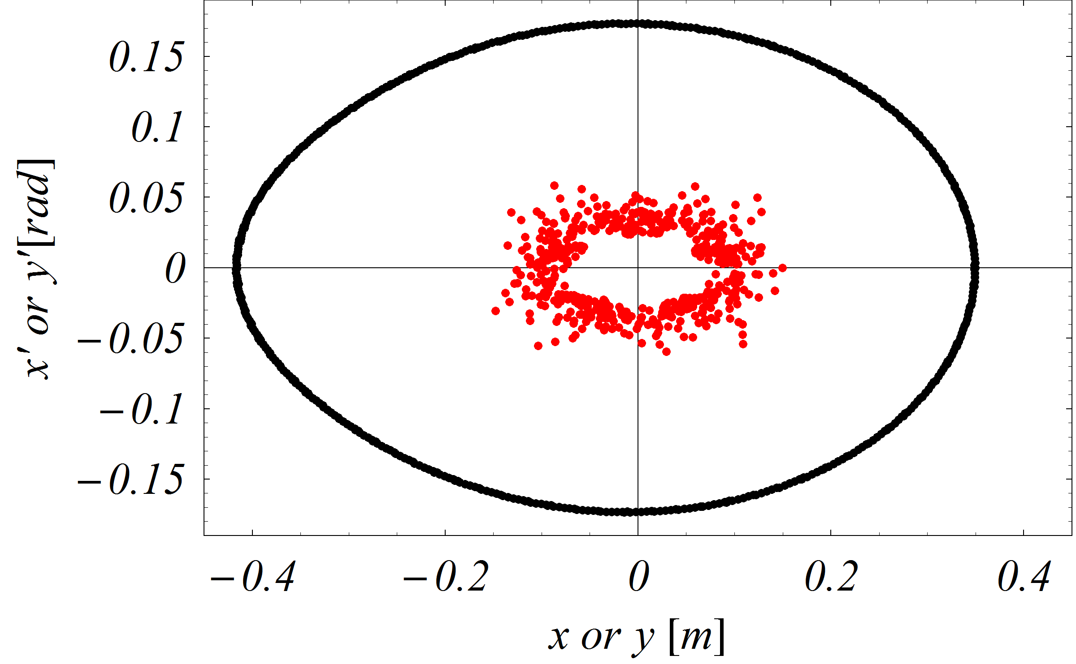
Alternative Ring Designs
Investigate rings that could have larger dynamical acceptance.
Investigate rings that could have easier injection/extraction.
→ Promising FDF scaling triplet design.
Dynamical acceptance of the new FDF scaling FFAG ring for PRISM in horizontal (black) and vertical (red) planes respectively. Horizontal position is presented subtracting the mean closed orbit.

Slide 13
Summary
PRISM/PRIME aims to probe cLFV with unprecedented sensitivity (single event - 3×10⁻¹⁹).
Many aspects of the reference design was proven (e.g. phase rotation, magnet design, RF system, etc.) by the accelerator R&D at RCNP, Osaka University.
The PRISM Task Force continues to address the remaining feasibility issues.
The PRISM Task Force aims to demonstrate the feasibility via a Conceptual Design Report, to be published next year.
Please take a look at other PRISM posters:
  MOPPC032 Injection and Broadband Matching for the PRISM Muon FFAG.

