Slide 1
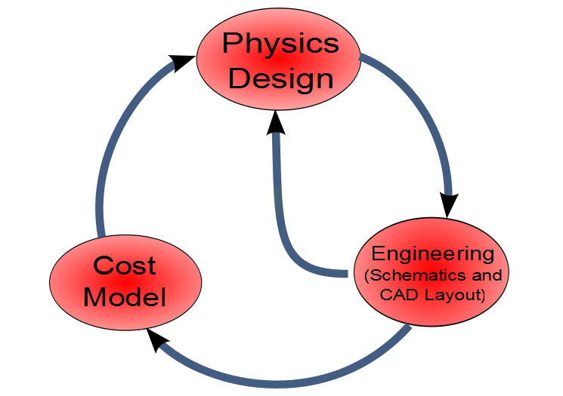
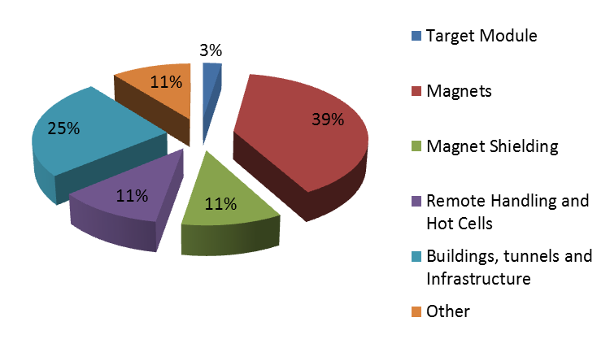
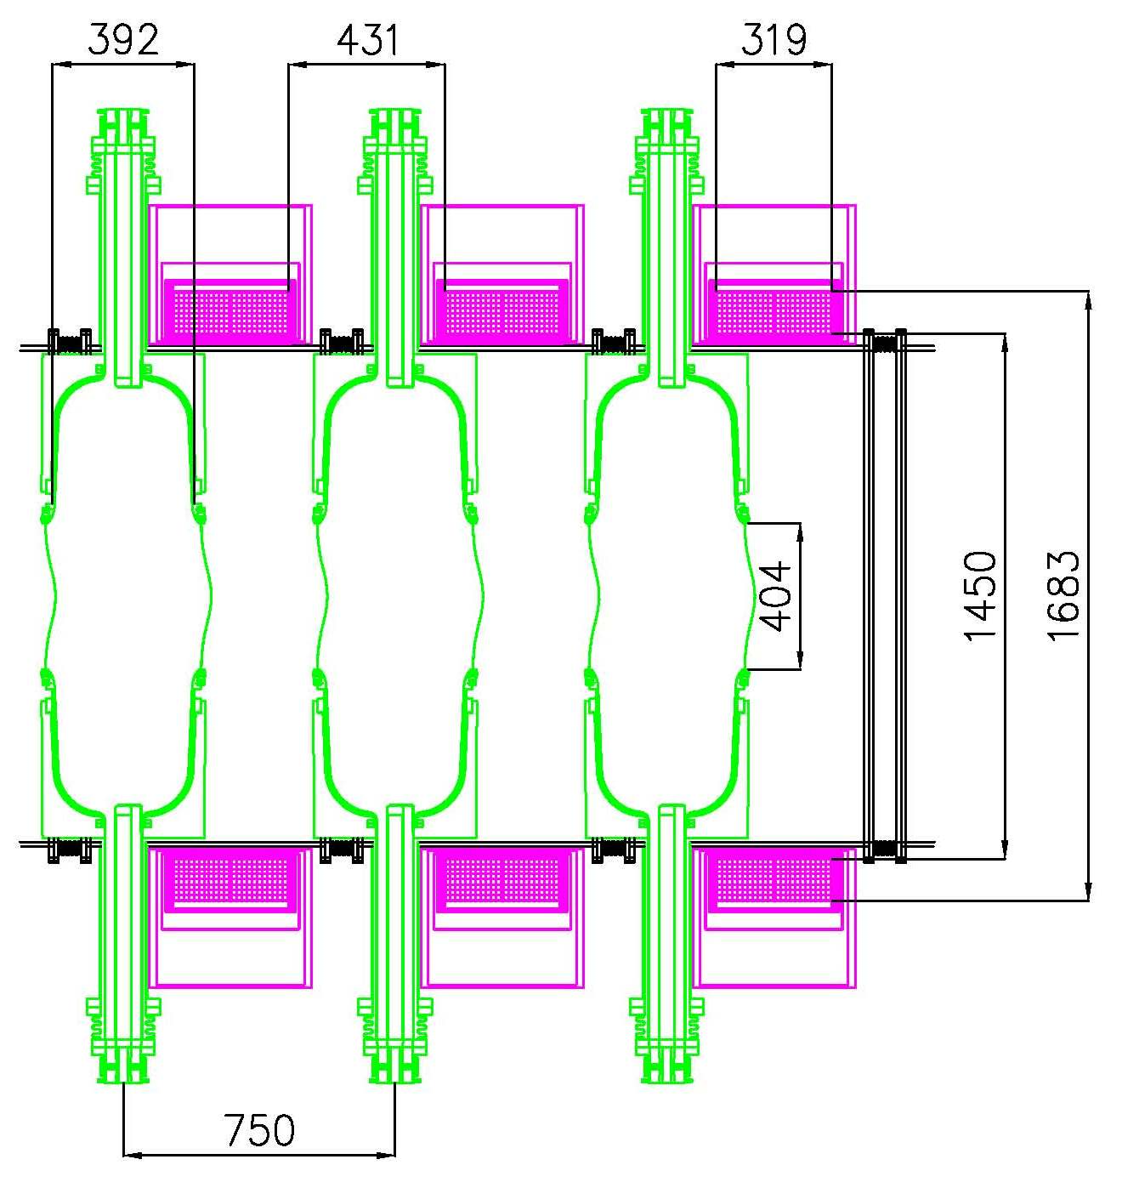
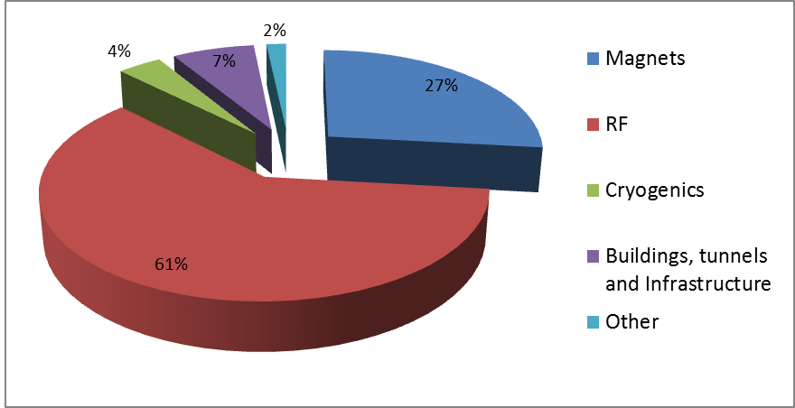
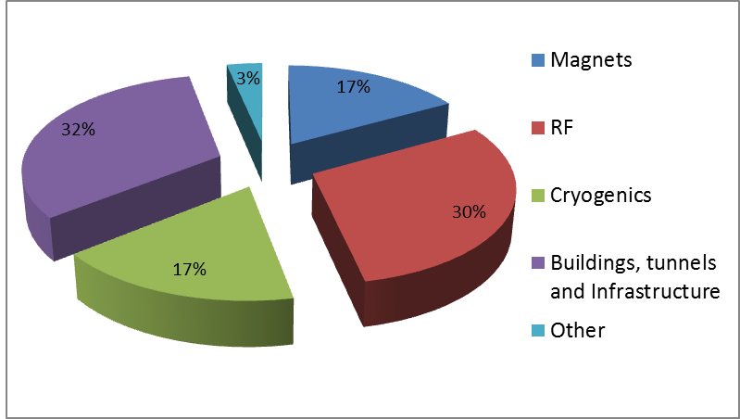
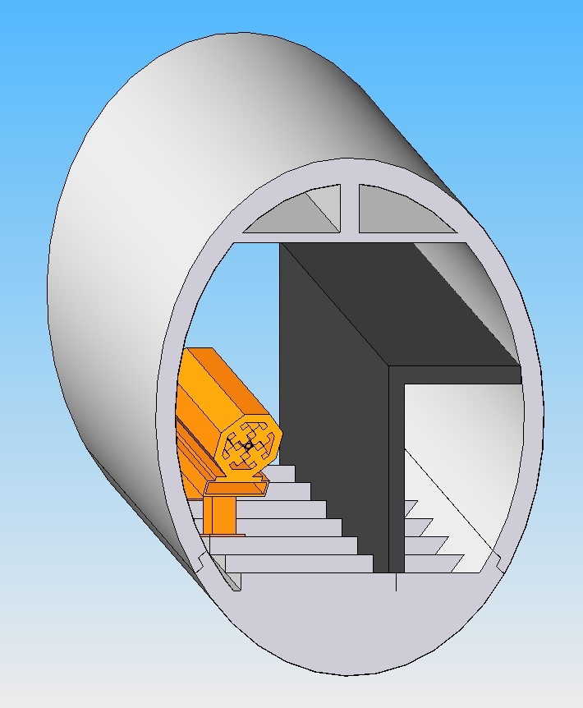
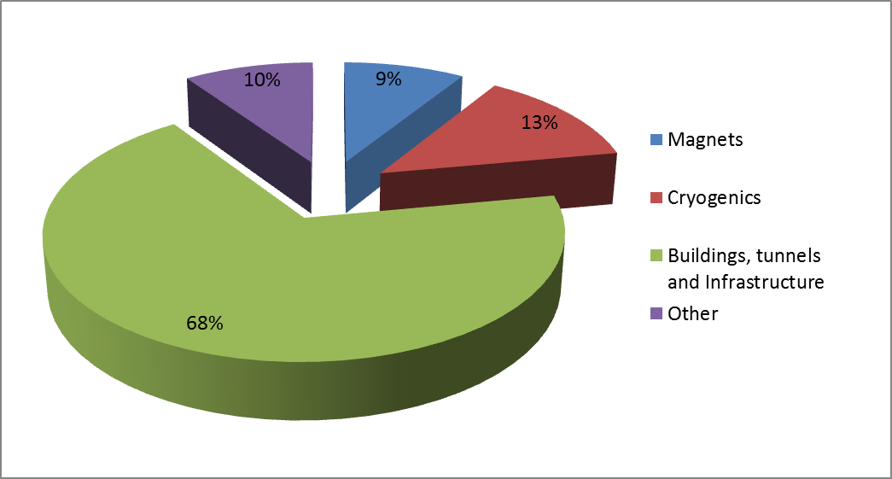
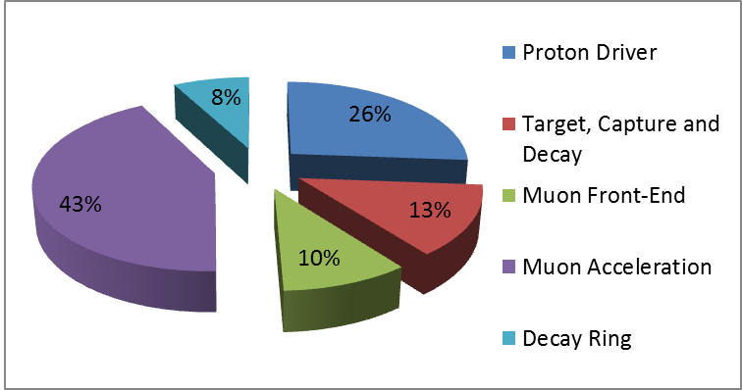




Costing Methodology and Status of the Neutrino Factory.
Ajit Kurup, Imperial College London.
Neil Bliss, Norbert Collomb, Alan Grant, STFC/DL, Daresbury.
ABSTRACT
The International Design Study for the Neutrino Factory will produce a reference design report in 2013 that will contain a detailed performance analysis of the Neutrino Factory and a cost estimate. In order to determine the cost a number of engineering features need to be included in the accelerator physics design, which can require the physics design to be re-optimised. The cost estimate is determined in such a way as to make efficient use of the engineering resources available and to simplify the process of modifying the physics design to include engineering features.
This poster presents details of the methodology used to determine the cost estimate and the current status of each subsystem.
PROTON DRIVER
There are three options for the proton driver: a Project-X based option at Fermilab; an SPL based option at CERN; and an ISIS upgrade option at RAL.
Each proton driver option will have parts that are specific to the NF and these will be costed for the IDS-NF.
Starting with the physics design, engineering features are added and schematic drawings and CAD layouts are produced.
This could have an impact on the physics design → modifications.
A cost model can then be constructed → cost performance analyses → potential modifications of the physics design.
The Neutrino Factory utilises a variety of technologies so the cost model has to be tailored for each system.
General costing methodology for the IDS-NF.
TARGET, CAPTURE AND DECAY
Focus on costing the baseline option of the liquid mercury jet.
The volume of mercury for the IDS-NF target is similar to that of SNS → the cost estimate based on the as-built cost of the SNS target module.
Cost of the superconducting magnets = a normal conducting equivalent cost per kg + cost attributed to the volume of superconductor.
High-level breakdown of the three proton driver options for the IDS-NF.
Magnet shielding cost is based on an average cost per kg for tungsten.
The civil engineering of the target hall and remote handling requirements are based upon recent design studies for future multi-megawatt proton target stations, e.g. LBNE.
Costs have been estimated by scaling by length.
MUON FRONT-END
Technology is similar to that used for the MICE experiment → buncher, phase rotator and cooling section module cost based on the MICE modules.
Frequency of the cavities in the buncher through to the cooling section vary from 320 MHz to 201 MHz whereas the cavities in MICE are all 201 MHz.
For the purposes of costing it is assumed that this variation in frequency will not significantly affect the cost.
Other costs such as cryogenics and diagnostics have been scaled from the FFAG cost model.
MUON ACCELERATION
Engineering effort has focussed on the details of the FFAG.
  For the purposes of costing, the same technology as the J-PARC neutrino beam combined function superconducting magnets was chosen. This allows estimating the cost based on as-built costs.
  The technology for the producing high-gradient superconducting 201 MHz cavities is less well understood.
  In the past niobium sputtered onto copper cavities have been used but these have not been able to deliver the gradients required at 201 MHz.
  In the absence of a technological solution, a cost model was developed based upon engineered solutions for next-generation light sources.
  The civil engineering was also estimated based upon detailed engineering studies for a next-generation light source.
  The cost model for the linac and RLAs is based on the cost model for the FFAG.
  The linac and RLAs were originally vertically stacked, which may be more expensive from the perspective of distribution of RF and cryogenics → horizontal layout, which requires a small modification to the design of the injection chicanes of the RLAs.
Schematic drawing of a buncher module.
MUON DECAY RING
Design presented in the Interim Design Report required two racetrack rings (each approximately 760m long and 85m wide), one tilted at 36$°$ and the other tilted at 18$°$.
Having the beam line inclined at such an angle will provide challenges for the installation and maintenance of components and some effort has gone into investigating solutions for this.
The cost of the magnet system and civil engineering was estimated based upon experience of costing the ILC.
Other costs such as cryogenics and diagnostics have been scaled from the FFAG cost model.
Cryostat Insulating vacuum chamber
Thermal transition
4K - 293K
Beam vacuum chamber
RF Input Coupler
2.5K He Pipes
F Magnet
D Magnet
F Magnet
Cavity
Location for BPM
4K He Chamber
Location for BPM
Location for beam screen,
vacuum equipment
Thermal shield (40 – 60K)
Crane on ceiling
HVAC, He extraction
Schematic drawing of the FFAG cell.
Maintenance Access
Personnel enclosure
SUMMARY
Much progress has been made towards including engineering features in the physics design of the Neutrino Factory and developing cost models.
In light of recent measurements of the neutrino oscillation parameter $θ13$, the baseline physics design of the IDS-NF has changed.
This has simplified the design, requiring a lower muon beam energy and only one decay ring → the decay ring and final muon acceleration section has to be re-optimised.
36 degree inclination
4.5m Internal Diameter
This will not affect the methodology used to cost the Neutrino Factory.
Work is on-going to complete the cost estimate for the current baseline of the IDS-NF and this will be published in the EUROnu final report.
Conceptual drawing of the cross-section of the decay ring tunnel.
Relative costs of the subsystems.

