Slide 1
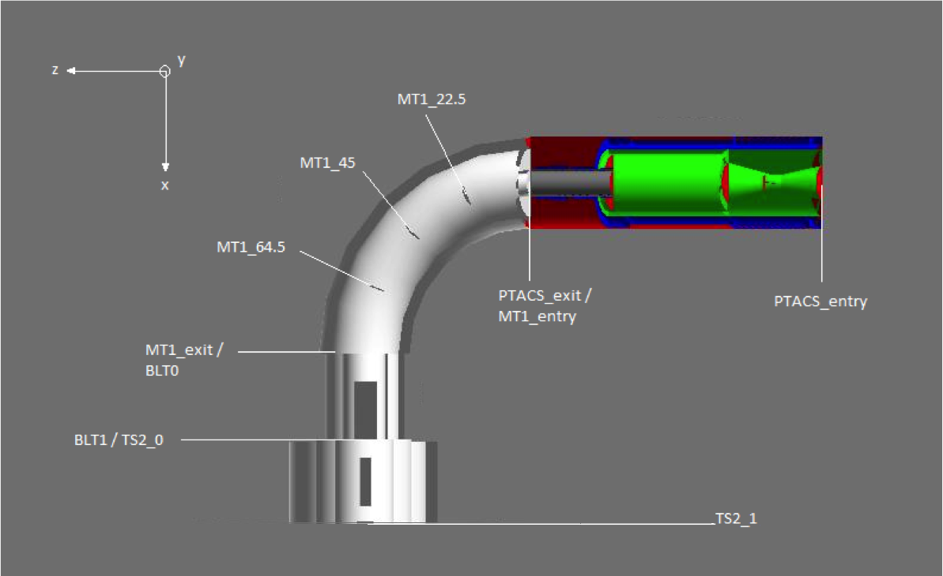
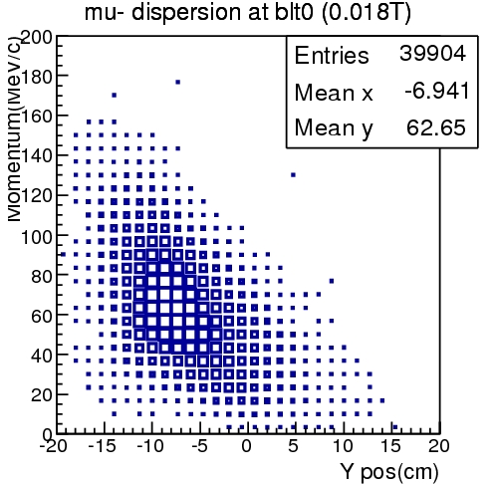
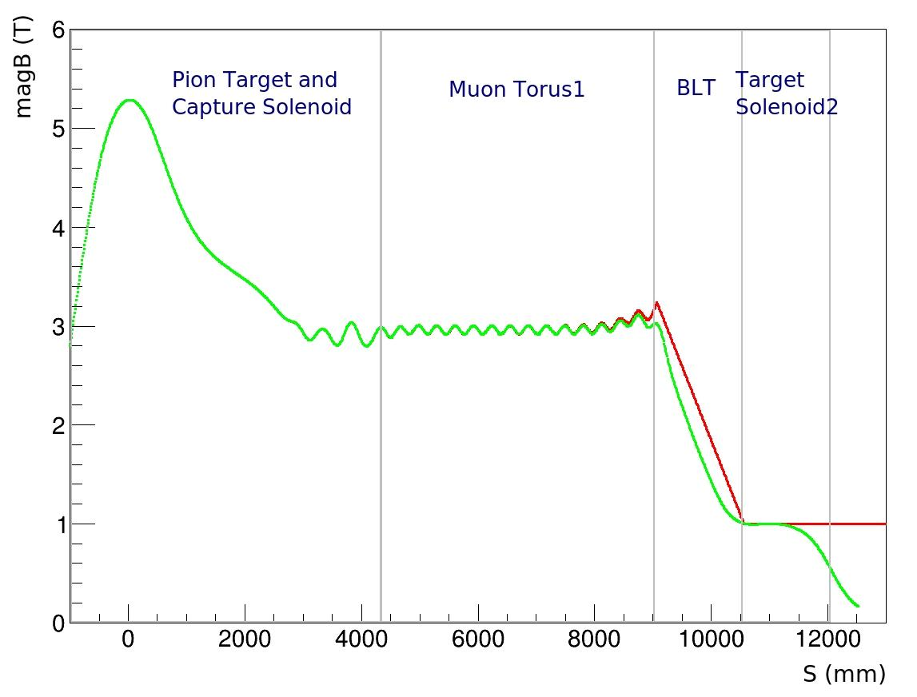
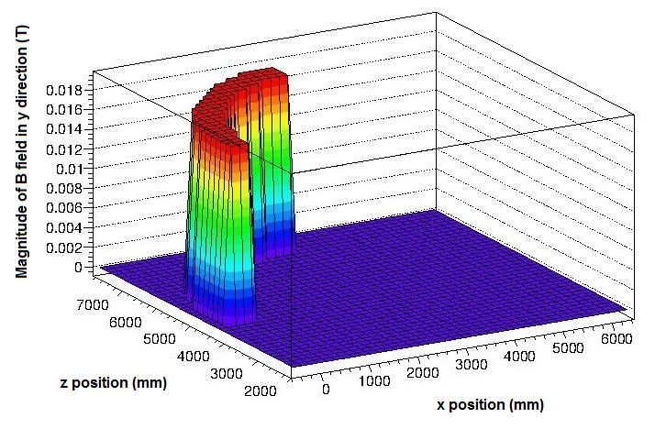
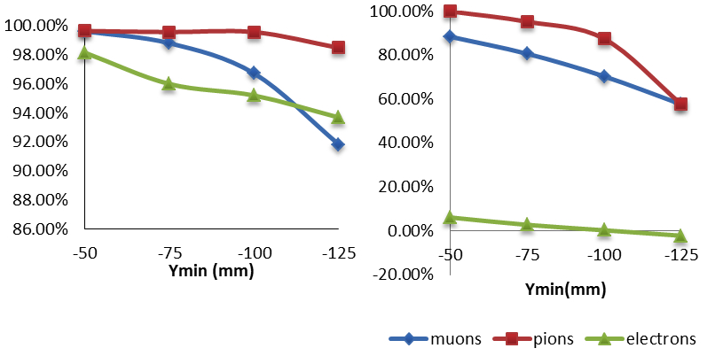
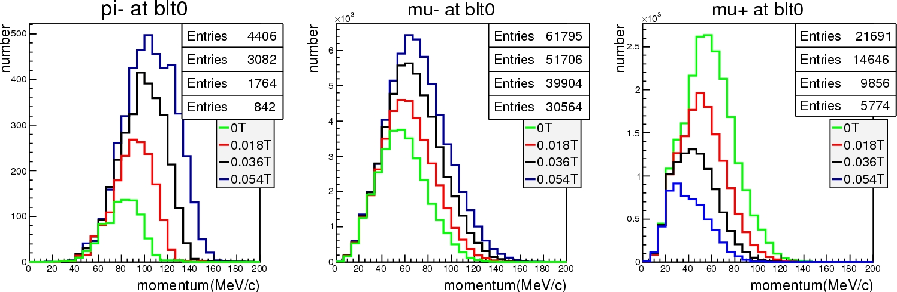
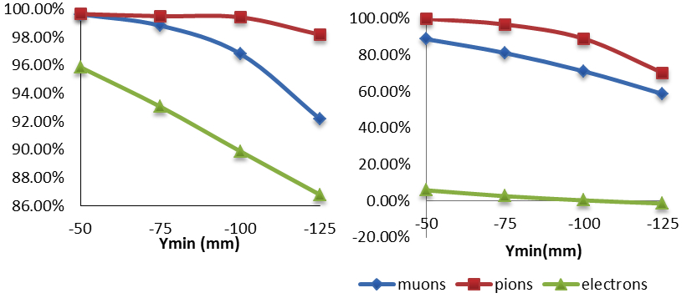
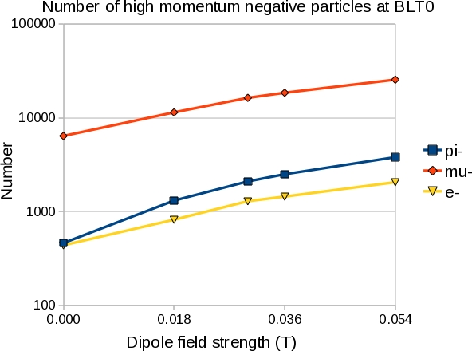
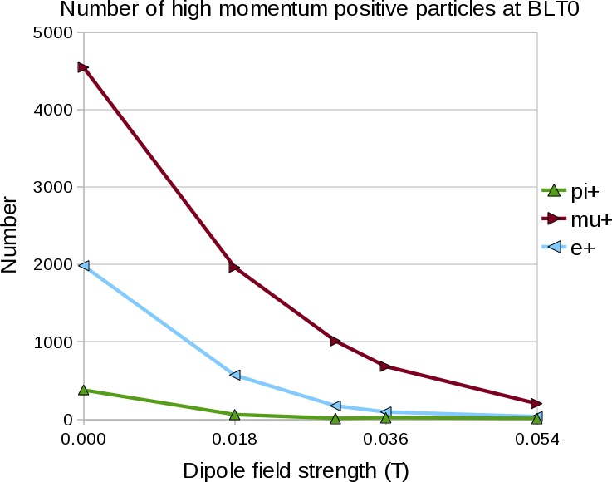




OPTIMISATION OF THE BEAM LINE FOR COMET PHASE-I
A. Kurup, I. Puri, Y. Uchida, Y. Yap, Imperial College London, UK
R. B. Appleby, S. Tygier, The University of Manchester and the Cockcroft Institute, UK
R. D’Arcy, A. Edmonds, M. Lancaster, M. Wing, UCL, UK
ABSTRACT
The COMET experiment will search for very rare muon processes that will give us an insight into particle physics beyond the Standard Model. COMET requires an intense beam of muons with a momentum less than 70 MeV/c. This is achieved using an 8 GeV proton beam; a heavy metal target to primarily produce pions; a solenoid capture system; and a curved solenoid to perform charge and momentum selection.
It was recently proposed to build COMET in two phases with physics measurements being made in both phases. This requires re-optimising the beam line for a shorter curved solenoid. This will affect the pion and muon yield; the momentum distributions at the detector; and the collimator scheme required. This paper will present the beam line design for COMET Phase-I, which aims to maximise the yield for low momentum muons suppressing sources of backgrounds in the beam.
INTRODUCTION
The COherent Muon to Electron Transition (COMET) experiment aims to measure the conversion of muons to electrons in the presence of a nucleus. This process is forbidden by the Standard Model (SM) of particle physics. However, models that go beyond the SM such as supersymmetric theories predict this process to exist with a branching ratio that may be in the range 10⁻¹³–10⁻¹⁵. COMET aims to achieve a sensitivity of <10⁻¹⁶ and thus will be able to observe conversions at this level. It was recently decided to construct the COMET experiment in two stages, with the ability to search for muon to electron conversion in both stages. COMET Phase-I will also allow performance measurements of the beam line, which will be very important to understand sources of backgrounds for COMET Phase-II. Searching for muon to electron conversion in COMET Phase-I, however, requires re-optimising the beam line.
The figure on the left shows the layout of COMET Phase-I. The beam line up to the end of the muon torus will be the same as COMET Phase-II. The muon torus in Phase-I only bends through 90º whereas in Phase-II there are two 90º sections. This means the separation of particles caused by the vertical dispersion of the bent solenoid will be less in Phase-I. Thus, the beam will contain more background particles that could fake the signal of muon to electron conversion. The number of background particles could be reduced by re-optimising the dipole field applied over the length of the muon torus and the beam collimator.
Pion production and
capture solenoid
Muon torus
Pion production target
Matching solenoid
Collimator
Stopping target
solenoid
Stopping target
COLLIMATOR
MAGNETIC FIELD
Pions
Muons
Electrons
Dispersion of negatively charged muons after the muon torus with the default dipole field of 0.018T.
On-axis solenoid field for COMET Phase-I (green line). The red line shows a simplified, hard-edged, version of the matching and stopping target solenoid fields.
Dipole field applied to muon torus section.
Momentum of muons, pions and electrons just before the collimator (i.e. after the muon torus).
High-momentum particles
Low-momentum particles
Negative Pions
Negative Muons
Positive Muons
Vacuum
R_{max}
R_{min}
Collimator material
Y_{min}
Schematic diagram of the COMET beam collimator.
Percentage of high-momentum (left) and low-momentum (right) particles that are absorbed by the tungsten collimator for different values of Y_{min}. (Including the production of secondary electrons.)
Momentum distribution of negative pions and muons and positively charged muons at the end of the muon torus for different dipole fields.
High-momentum particles
Low-momentum particles
Negatively charged particles
Positively charged particles
Ymin = -125
Ymin = -100
Ymin = -75
Ymin = -50
Momentum of muons after the tungsten collimator for different values of Y_{min}.
Percentage of high-momentum (left) and low-momentum (right) particles that are absorbed by the aluminium collimator for different values of Y_{min}. (Including the production of secondary electrons.)
Numbers of high-momentum negatively charged (left) and positively charged (right) particles at the end of the muon torus as a function of dipole field.

