Slide 1
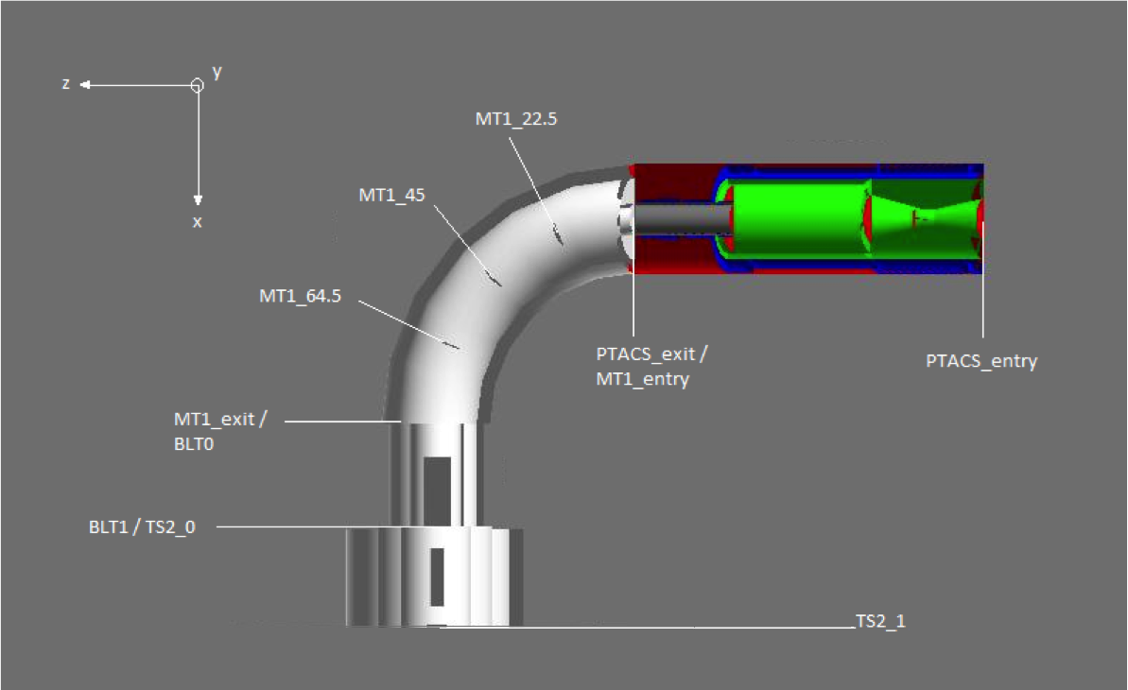
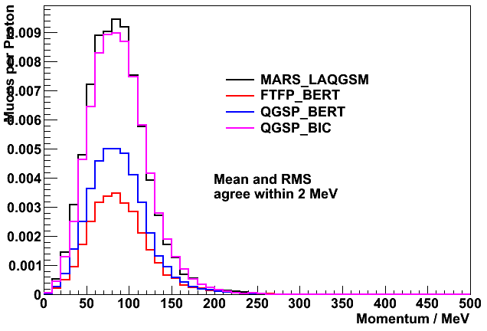
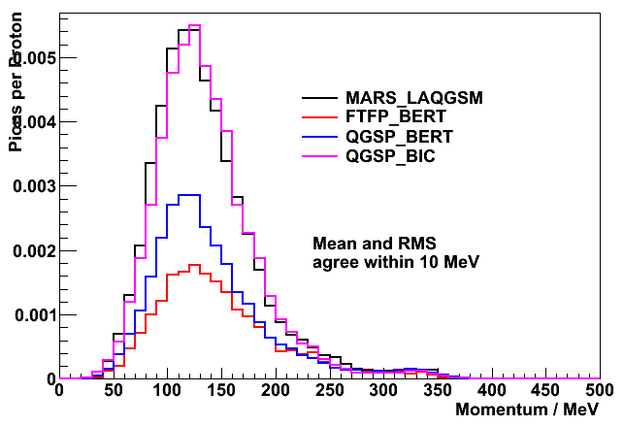
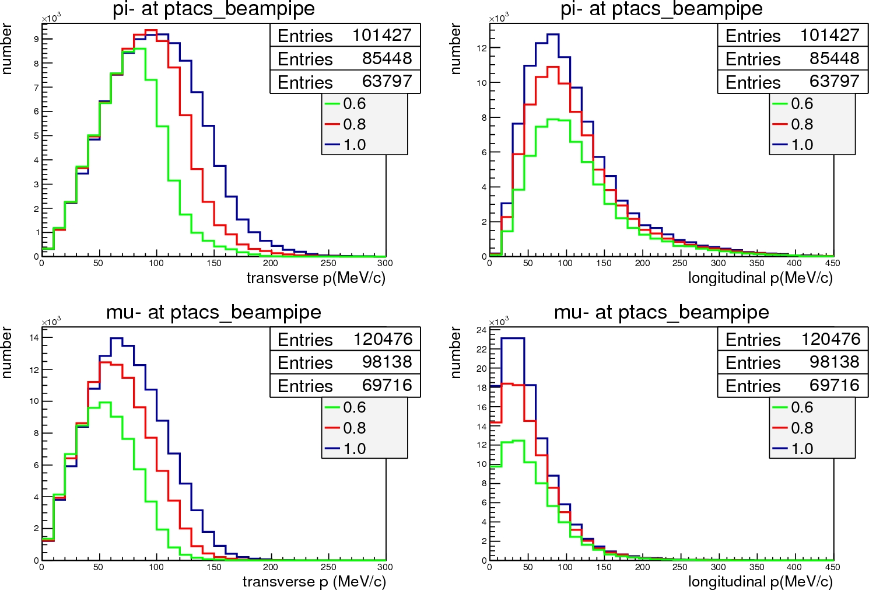
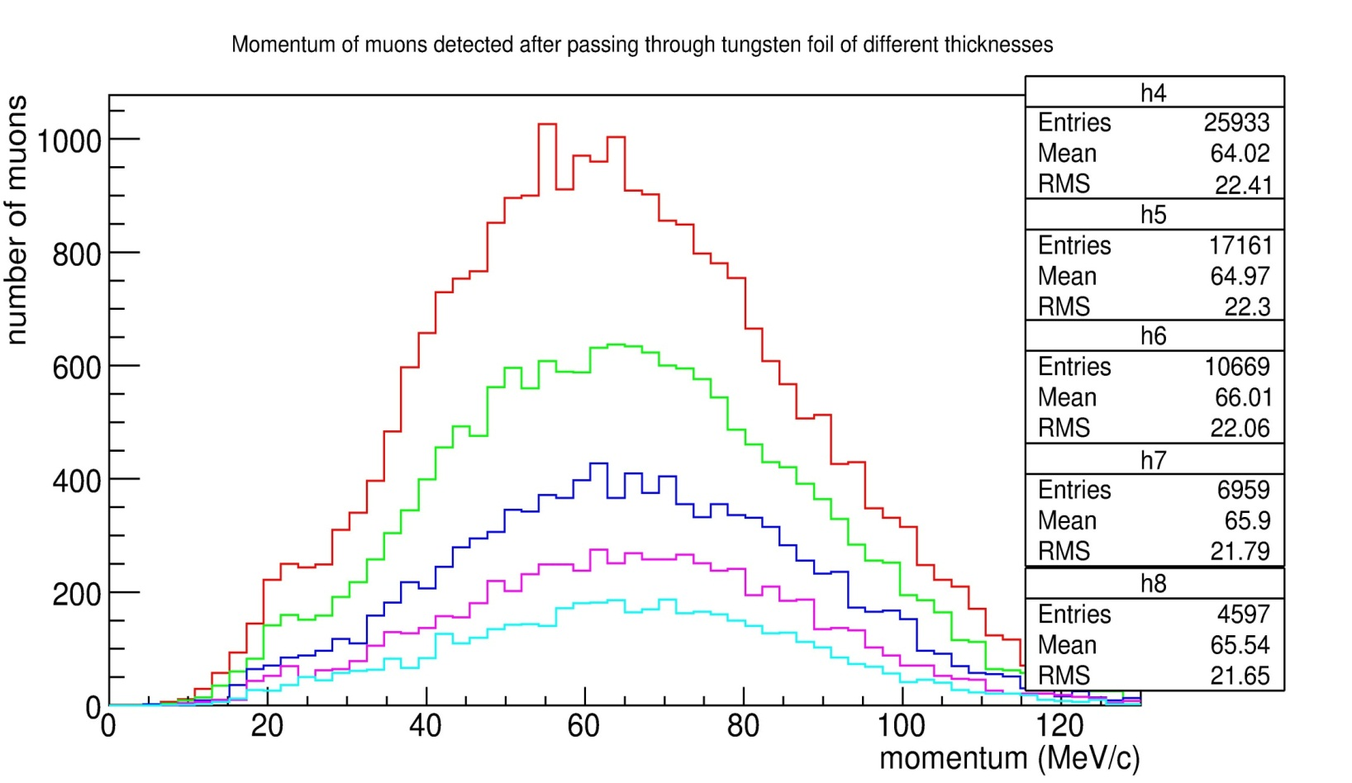
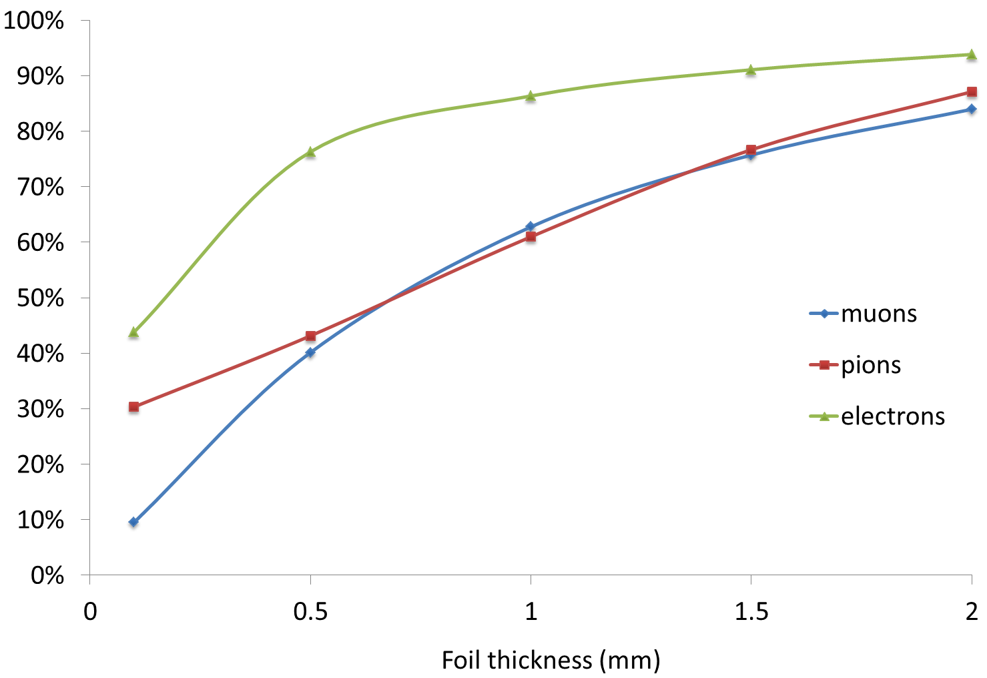
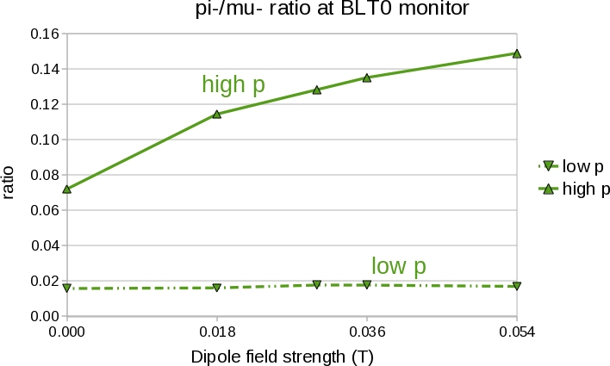
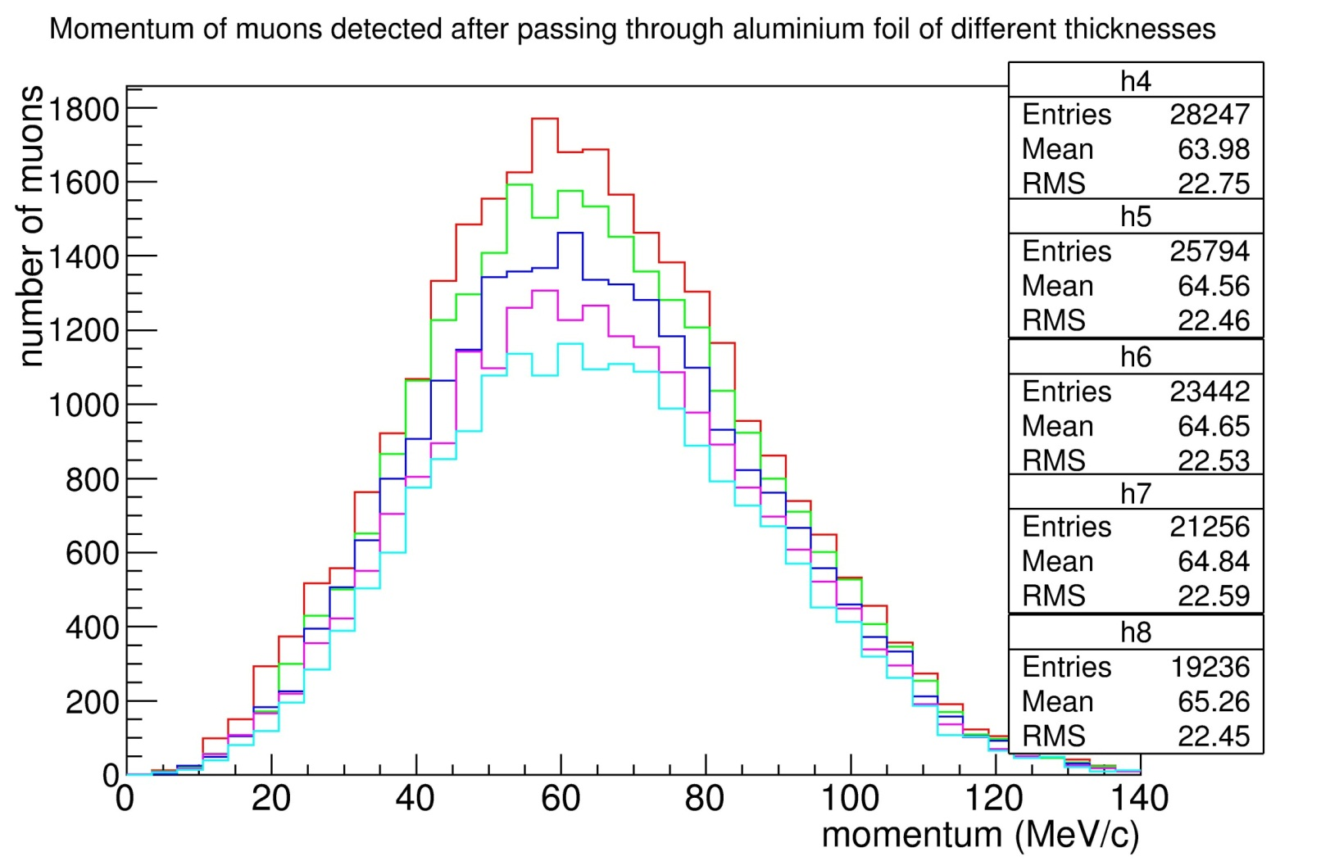
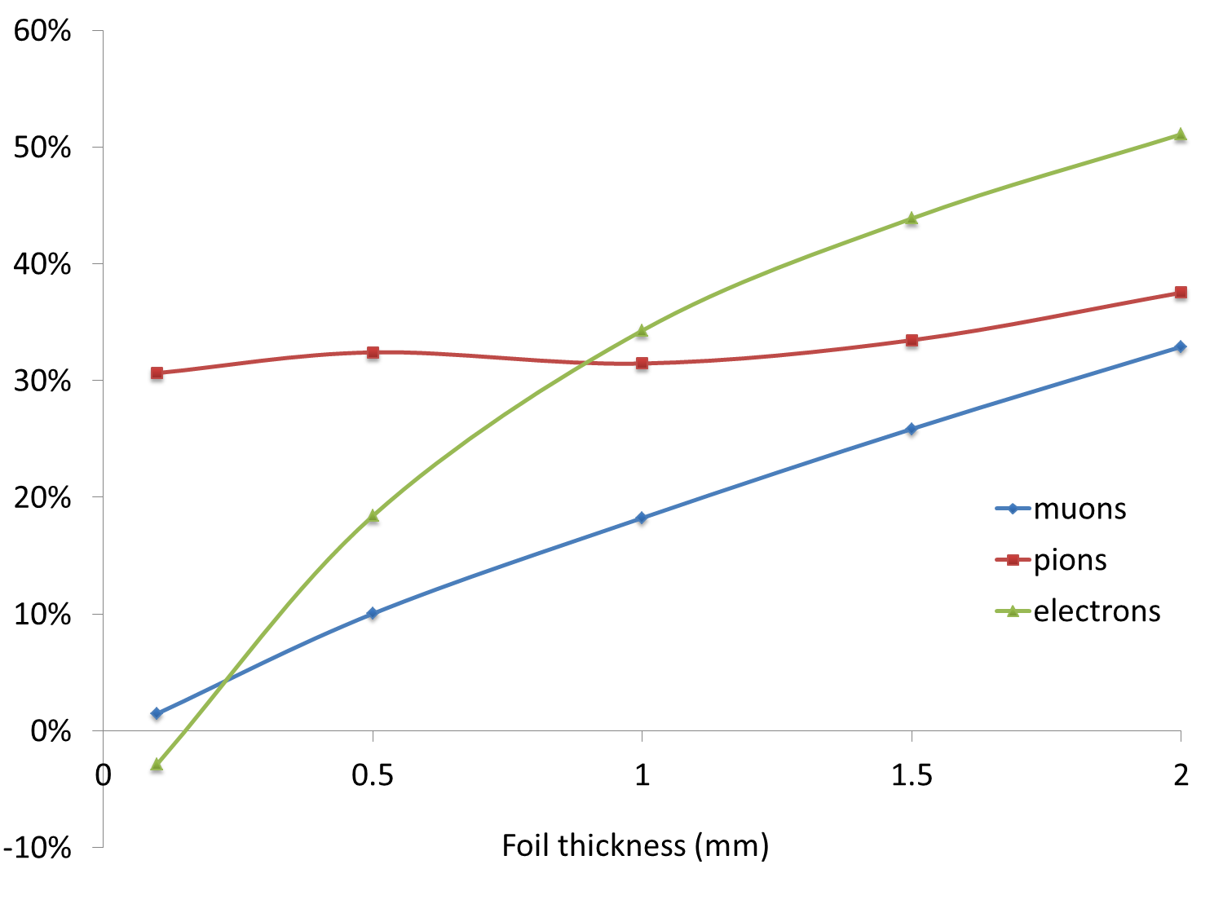
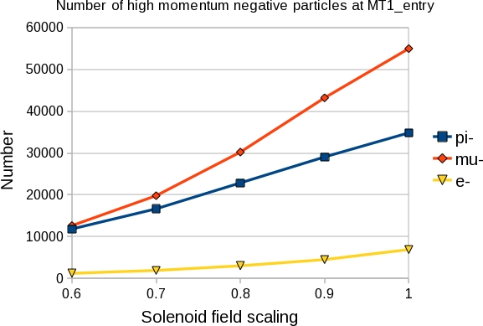
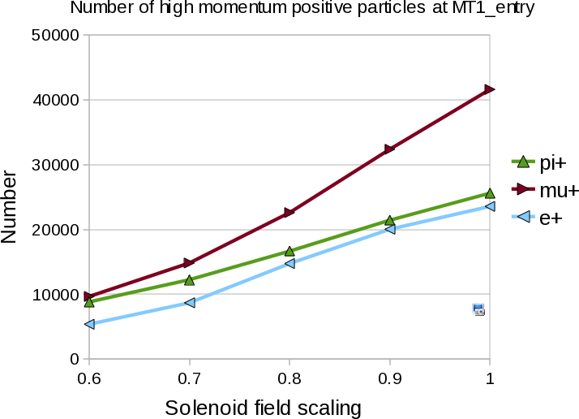




LARGE EMITTANCE BEAM MEASUREMENTS FOR COMET PHASE-I
A. Kurup, I. Puri, Y. Uchida, Y. Yap, Imperial College London, UK
R. B. Appleby, S. Tygier, The University of Manchester and the Cockcroft Institute, UK
R. D’Arcy, A. Edmonds, M. Lancaster, M. Wing, UCL, UK
ABSTRACT
The COMET experiment will search for very rare muon processes that will give us an insight into particle physics beyond the Standard Model. COMET requires an intense beam of muons with a momentum less than 70 MeV/c. This is achieved using an 8 GeV proton beam; a heavy metal target to primarily produce pions; a solenoid capture system; and a curved solenoid to perform charge and momentum selection.
Understanding the pion production yield and transport properties of the beam line is an important part of the experiment. The beam line is a continuous solenoid channel, so it is only possible to place a beam diagnostic device at the end of the beam line. Building COMET in two phases provides the opportunity to investigate the pion production yield and to measure the transport properties of the beam line in Phase-I. This paper will demonstrate how this will be done using the experimental set up for COMET Phase-I.
INTRODUCTION
The COherent Muon to Electron Transition (COMET) experiment aims to measure the conversion of muons to electrons, in the presence of a nucleus, with an unprecedented sensitivity of <10⁻¹⁶.
The details of the COMET Phase-I beam line can be found in WEPEA074. The figure on the left is a schematic of the beam line. COMET Phase-I will provide an invaluable opportunity to make measurements of the beam line that are not possible to do after the full COMET beam line has been constructed.
Since the COMET beam line is a large aperture, continuous solenoid channel, accurate simulation of transport properties is dependent on knowing the field precisely. It will be difficult to measure this as the solenoids will be closely coupled and there will be no option for placing complex beam diagnostic equipment between cryostats. In addition to this, the beam will occupy the whole aperture and will consist of multiple species. This means it will be very difficult to measure the transport properties along the length of the beam line after it has been installed.
In order to get an understanding of the performance of the beam line, it will be possible to vary certain parameters of the magnets, such as magnetic field strength, and to the measure a corresponding effect at the end of the transport channel. By making several measurements with different types of changes it may be possible to characterise the performance of the beam line in order to understand the background processes that can create electrons that could be mistaken to have come from muon to electron conversion. In addition to this, there is some uncertainty as to the precise composition of the beam due to different models giving different predictions for the production of hadrons in this momentum range. It will therefore be important to be able to measure the production rates and spectra in order to understand potential sources of background particles.
Pion production and
capture solenoid
Muon torus
Pion production target
Matching solenoid
Thin absorber
Stopping target
solenoid
Stopping target
HADRON PRODUCTION
Muons
Pions
Muons
Pions
Flux of particles through the target.
Momentum distribution of muons and pions at the entrance of the muon torus produced by different MARS and Geant4 models. The vertical scale is normalised to the number of primary protons used in the simulation.
Momentum distribution of muons and pions at the entrance of the muon torus produced by the FLUKA default (fluka_nd) and precision (fluka_prec) models. The vertical scale is normalised to the number of primary protons used in the simulation.
ABSORBER
FIELD VARIATIONS
Transverse momentum of Pions
Longitudinal momentum of Pions
0.1mm
0.5mm
1.0mm
1.5mm
Transverse momentum of Muons
Longitudinal momentum of Muons
2.0mm
Momentum of muons after the tungsten absorber for different thicknesses.
Percentage of pions, muons and electrons stopped by the tungsten absorber for different thicknesses.
The negatively charged pion to muon ratio for high-momentum and low-momentum particles at the end of the muon torus for different dipole fields.
Effect of scaling the capture solenoid field on the momentum distribution of negatively charged pions and muons at the entrance of the muon torus.
0.1mm
0.5mm
1.0mm
1.5mm
2.0mm
Momentum of muons after the aluminium absorber for different thicknesses.
Percentage of pions, muons and electrons stopped by the aluminium absorber for different thicknesses.
Effect of scaling the capture solenoid field on the number of negatively charged particles at the entrance of the muon torus.
Effect of scaling the capture solenoid field on the number of positively charged particles at the entrance of the muon torus.

