Slide 1
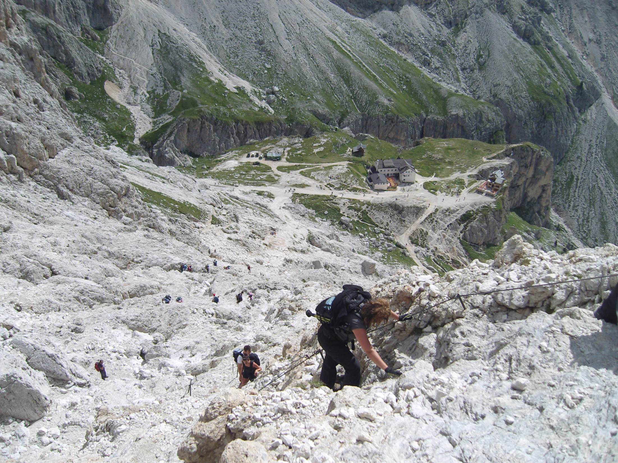
Neutrino interaction systematics for future experiments:
The path forward
NuInt14, 19/5/2014
D.Autiero, IPNL Lyon

Slide 2
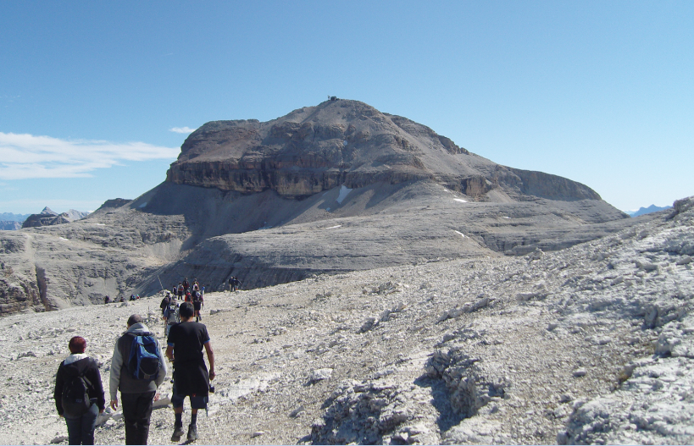
We are entering in a new era for long-baseline experiments which will be addressing the determination of the MH and CP violation
It is a very exciting period but also needing strong efforts towards high precision measurements
→ Requiring:
CP
a) a very accurate knowledge of neutrino fluxes and cross sections (strong weight in counting measurements dominated by rate accuracy)
b) a stronger use of spectral information with high energy resolution (L/E shape, first and second maxima)
In both cases systematic effects are limiting the CP sensitivity and need special efforts
From the point of view of neutrino interaction physics case b) brings back to the multi-GeV energy domain, less affected by nuclear effects, which are stronger in the sub-GeV region, neutrino energy determined by calorimetry (see also talk by C. Adams)

Slide 3
C.Adams

Slide 4
M. Bass

Slide 5
M. Bass

Slide 6
Matter effects mimic CP violation
→ They have to be accurately measured and subtracted in order to look for CP
Amplitude increasing
linearly with L/E
Larger CP asymmetry at second maximum, matter asymmetry dominating around the first maximum
A lot of information is contained in the shape around the first and second maximum
→ Direct measurement of the energy dependence (L/E behaviour) induced by matter effects and CP-phase terms, independently for ν and anti-ν, by direct measurement of event spectrum

Slide 7
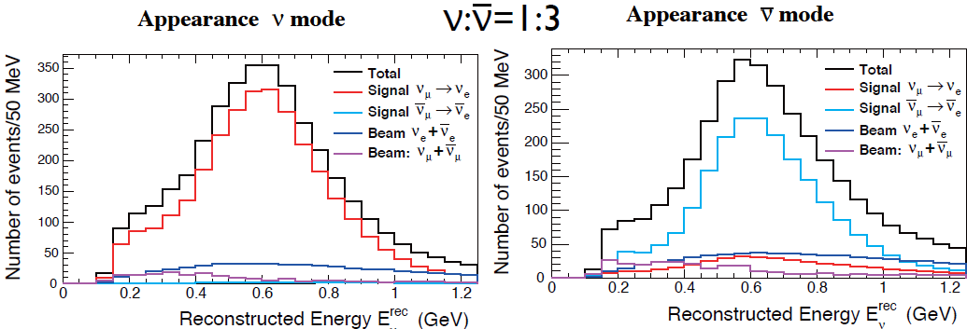
Hyperk:
Continuation of measurements in sub-GeV region
Mostly « counting , high statistics experiment »
MH to be known to avoid a systematic bias
HyperK 10 years at 750 kW
Systematic uncertainties based on:
T2K experience (see T. Dealtry talk)
WC ND
study of atmospheric neutrinos control sample in FD
total 3.3%
on nue rate

Slide 9
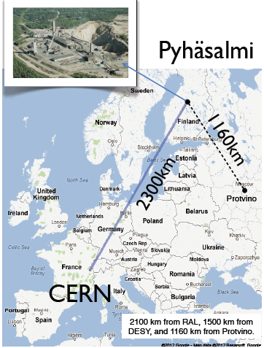
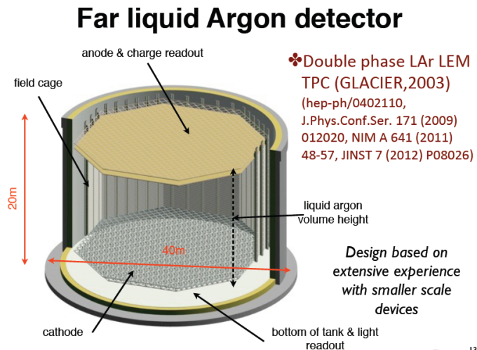
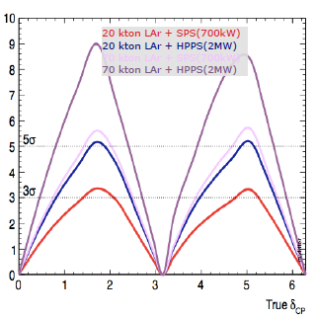
LAGUNA-LBNO:
A very long baseline neutrino experiment:
Determination of neutrino mass hierarchy
Search for CP violation
Proton decay
Atmospheric and supernovae neutrinos
L/E shape, 1st and 2nd max, ν/anti-ν asymmetry
→Complementary approach to HK:
CP measurable already with neutrinos
Staged search for CP violation:
LBNO Phase I:
20 kton double phase LAr TPC,
SPS beam 750 kW, 1.5E20 pot/year
75% nu, 25% antinu
unambiguous mass hierarchy determination (>5σ)
(median in 2years, guaranteed in 5years)
71% (20%) CP coverage at 90% (3σ), <10 years
LBNO Phase II:
20+50 kton detectors, 2MW HP-PS
Further beam optimizations under study

Slide 10
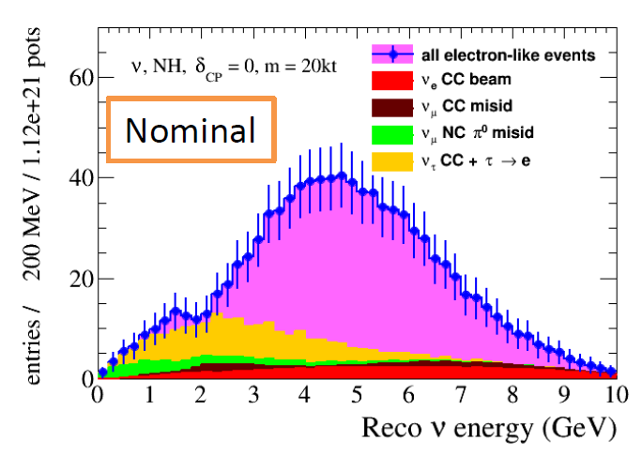
LBNO, nominal beam, 20 kton, 10 years, 75% neutrinos, δ=0
τ→e
141 evts
νe CC osc.
668 evts
NC 44 evts
νe CC 78 evts
νμ CC 30 evts

Slide 11
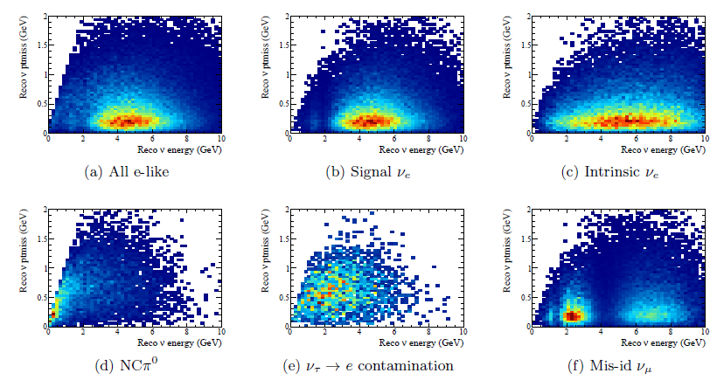
τ→e events
S/B discrimination in
two dimensions
Fit of the oscillation parameters in bins of Visible energy, Missing Pt for nue appearance
→ Much lower weight of tau events
Simultaneous fit of appearance/disappearance
The LBNO far detector will measure a large tau appearance sample given the higher energy/longer baseline and constraint the cross sections
(e.g. 770 nutau CC interactions will occur in 7.5 years with the neutrino beam during phase I)
The tau normalization is assumed to have 50% uncertainty at the beginning for the MH determination and then and 20% for CP

Slide 12
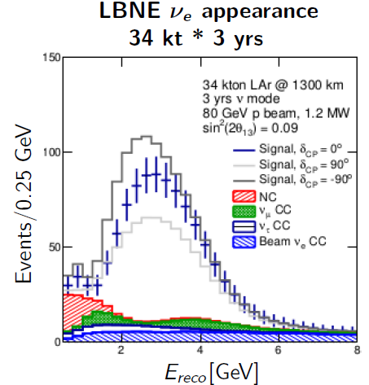
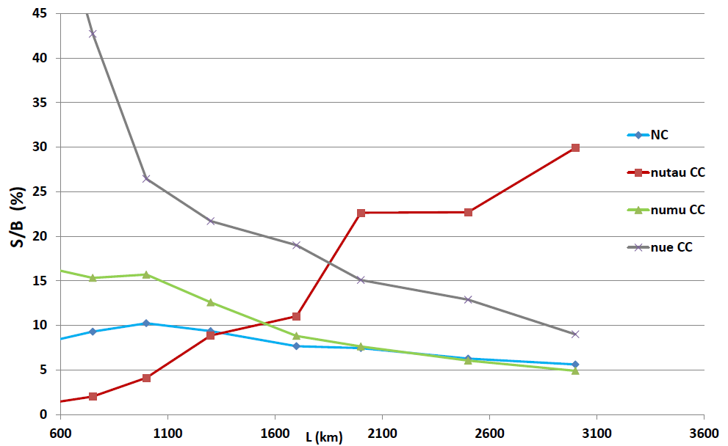
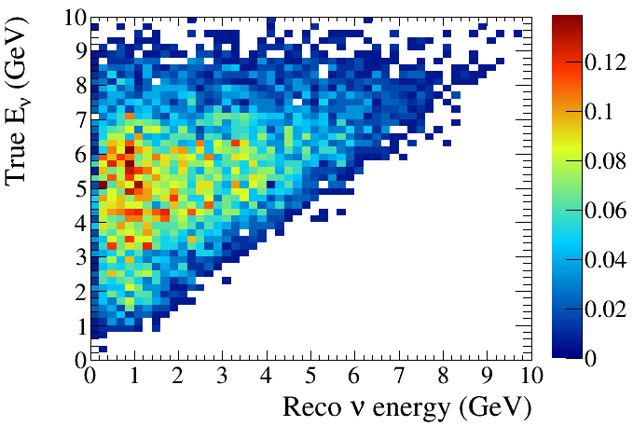
NC bck events and pi0 production cross-sections as a function of neutrino energy
Smaller fraction of NC events in LBNO wrt LBNE, trend reproduced by LBNE study as a function of L
Related to flux (1/L²) and cross-sections with strong non-scaling component tending to enhance low E-rec at high E-nu

Slide 13
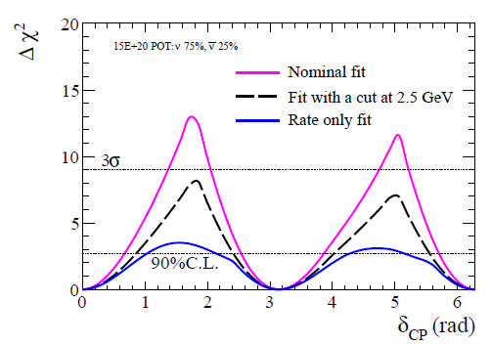
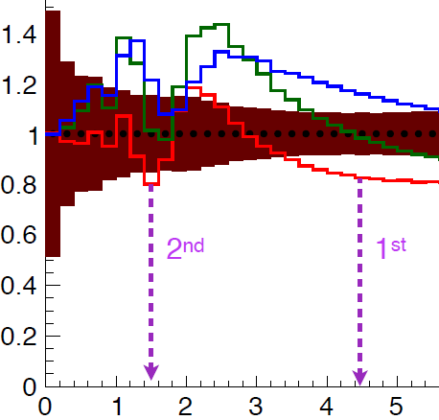
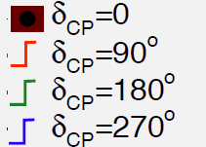
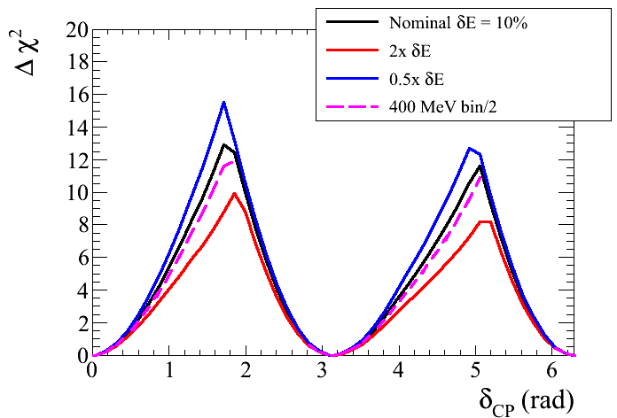
LBNO: high energy LB beam → coverage of two osc. maxima, good energy resolution
A world of useful information and full test of the 3 neutrinos paradigm !
E>2.5 GeV
Rate only
Flatter ‘’rate dominated’’ region
→ larger syst. effects related to normalization
Measurement of L/E pattern independently for nu and nubar for the first and second maxima
→ vs a counting experiment (rate only)
The importance of the second maximum: rather rich CP-dependent features are present at energies below the first maximum
→ vs 1st max only (E>2.5 GeV)
20%
The importance of energy resolution 10% vs 20%

Slide 14
LBNO systematics
a) Oscillation parameters →
LBNO sensitivity conservatively computed with actual uncertainties, being updated with projected uncertainties:
Parameter
Central value
Uncertainties
b) Experimental systematics:

Slide 15
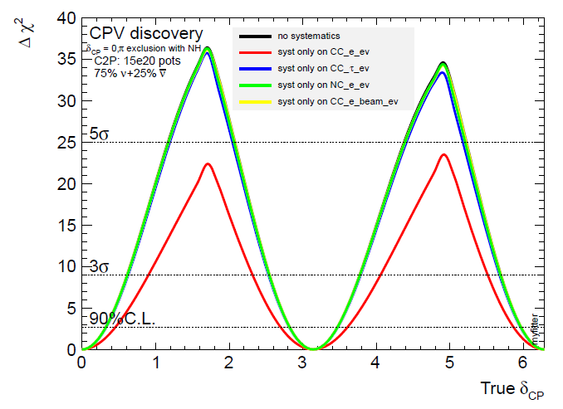
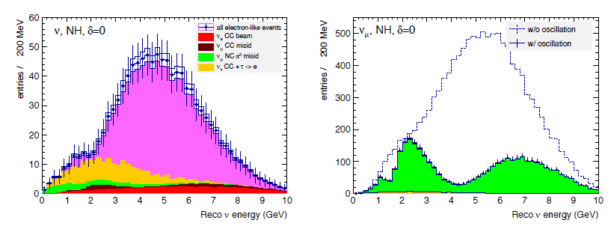
Without systematic errors the 20 kton detector in LBNO phase 1 could achieve 5 sigma on CP in 10 years !
The most important systematic effects are related to the knowledge of the absolute rate of nue CC events
The most important oscillation parameters are θ₁₃ and θ₂₃
Effect of variation of all normalization errors by +- 1 sigma in fully correlated way on appearance and disappearance spectra
Negligible effects on disappearance

Slide 16
LBNO/LBNE different assumptions for CP systematics:
 | LBNO | LBNE
Signal norm. | 5% | 1%
Nue bck | 5%
NC and CC bck | 10% | 5% on total bck
Tau bck | 20%
In both cases (LBNO/LBNE) systematic errors refer to normalizations uncertainties which not affect the shape. The work on shape related systematics is starting (see talk by M.Bass)
LBNO systematics are based on conservative assumptions which can be achieved on the basis of past experience with the present knowledge.
Despite more conservative systematics the CPV sensitivity is still kept high in LBNO by a large weight on the exploitation of the second maximum (at higher energy) and L/E pattern
It is not obvious at the moment how to achieve a level of systematics at 1% level on the signal normalization, independently on the ND this will also depend on the knowledge of the σ_{e}/σ_{μ} cross section ratios.

Slide 17
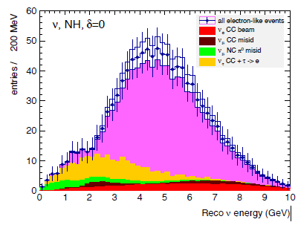
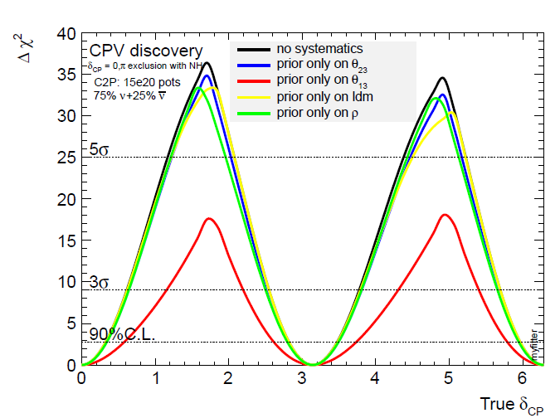
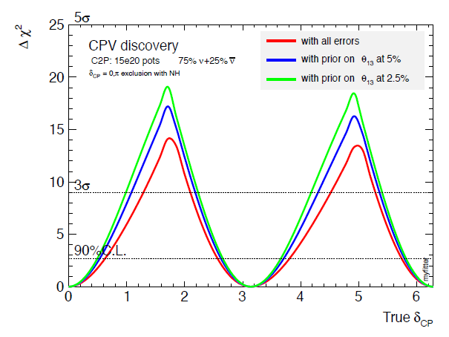
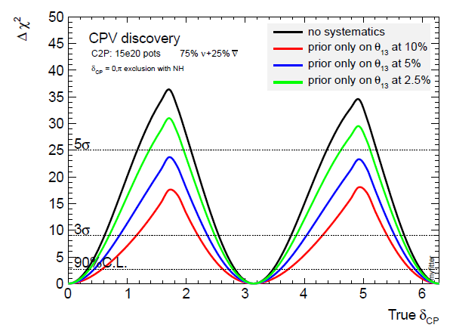
Systematics on oscillation parameters
+- 1 σ
θ₁₃ providing the largest effect
Next update

Slide 18
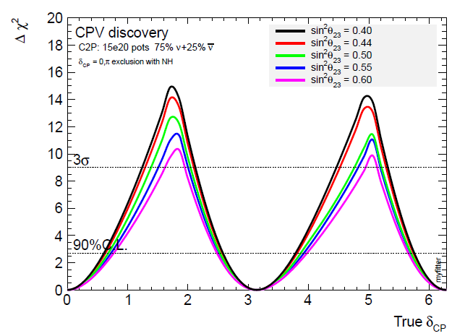
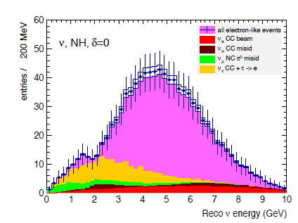
Precision to δ decreases with increasing θ₂₃ within the allowed region
Increasing θ₂₃
+- 1 σ

Slide 19
CPV expected systematics assessment in LBNO
Chosen conservative errors, They may be improved with dedicated hadroproduction and neutrino cross-section measurements.
This point has however to be demonstrated and it does not look obvious at the moment
Expected knowledge in the actual scheme:
Knowledge of the absolute rate of oscillated nue CC events (5%)
ND measurement of numu flux, oscillation parameters, (rates yet affected by σ_{e}/σ_{μ})
2) Knowledge of beam nue CC bck (5%)
ND measurement of nue CC
3) NC/CC bck (10%)
Measurement of pi0 production cross section at the ND with GAr target
WA105, electron candidates search on secondary interactions with pi0 production
4) nu-tau CC cross section (20%),
constrained by tau sample studies in the far detector
5) Hadronic energy scale, energy resolution,
Measurements with WA105

Slide 20
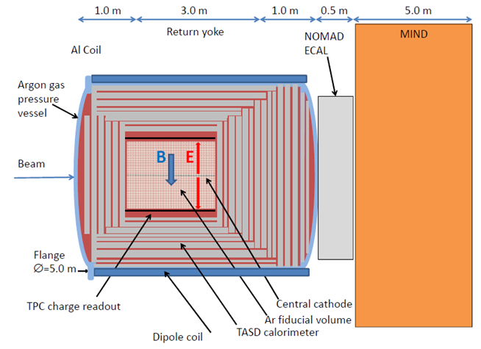
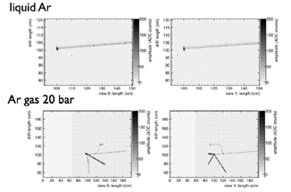
LBNO Near Detector
Same nuclear target as FD (GAr) at high pressure
Magnetized detector
Good energy resolution as for far detecor and full coverage calorimetry
Measurement of numu(bar) CC, nue(bar) CC, NC, pi0 production
Fluxes and cross sections, similar procedures as for ND280 (see talk by T.Dealtry)
+ possible hadron production experiment

Slide 21
LBNO-DEMO/WA105 (approved experiment at CERN) see talk by S. Murphy

Slide 22
LBNO LAr demonstrator at CERN (LBNO-Demo/WA105)
Configuration: 6×6×6m³ active volume LAr TPC detector with double phase + charge amplification + 2-D collection readout PCB anode. Exposure to charged hadrons beam (1-20 GeV/c)
Purpose:
Full-scale demonstrator of the R&D on all the technologies studied in LAGUNA-LBNO for the construction of a large and affordable underground LBNO far detector:
LNG tank construction technique (with non evacuated detector)
Purification system
Long drift
HV system 300-600 KV
Double-phase readout
Readout electronics
2) Assess the TPC performance in reconstructing hadronic showers (the most demanding task in reconstructing neutrino interactions):
Measurements in hadronic and electromagnetic calorimetry and PID performance
Full-scale software development, simulation and reconstruction to be validated and improved
→ Fundamental step for the construction of the final LBNO detector
Most advanced full proof prototyping program (no equivalent)

Slide 23
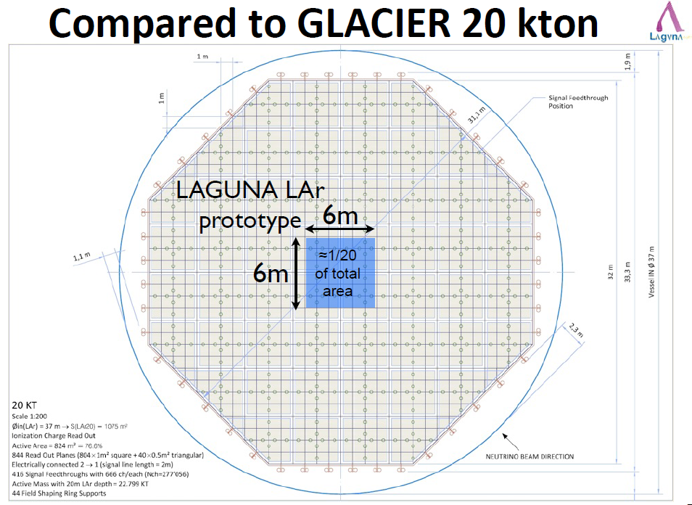
300k
readout channels

Slide 24
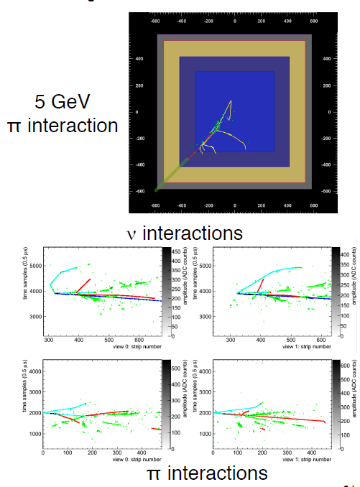
Hadronic interactions in WA105
Hadronic energy scale and resolution assessment (hadronic system is the most difficult part to measure in neutrino interactions)
Study of secondary hadronic interactions in neutrino events and related cross sections
Energy flow and Pt balance at hadronic interaction vertices
Application of gamma conversion rejection criteria at secondary vertices of hadronic interactions which are a control sample free of electrons (gap, dE/dx, search for γ partners) see also talk by C. Adams → combine with pi0 production measurement of ND
Hadronic showers fully contained in the 4x4 m2 Glacier readout unit

Slide 26
Conclusions:
Systematic errors are a limiting factor for the CP violation reach in future LBL experiments. In particular the knowledge of the absolute rate of nue CC events.
This stresses the importance of the ND as well as the determination of other ingredients, as the σ_{e}/σ_{μ} cross-sections ratio
It is challenging to demonstrate a control of systematics at ~1% level on the signal normalization. At present it looks more conservative to assume a larger level of systematics which can be achieved on the basis of past experience and put more weight on the exploitation of the second maximum at higher energy
The ND should be built as close as possible to the far detector, at least with the same nuclear target for FSI, some aspects can be investigated with hadronic beams on sufficiently large replicas of the FD from the point of view of hadronic showers containment
The new LBL experiments based on the measurement of L/E patterns and the exploitation of the information of energy spectra determined with calorimetric measurements will move back to the multi-GeV region, less affected by nuclear effects and watching the interplay between QE, RES and DIS

Slide 27
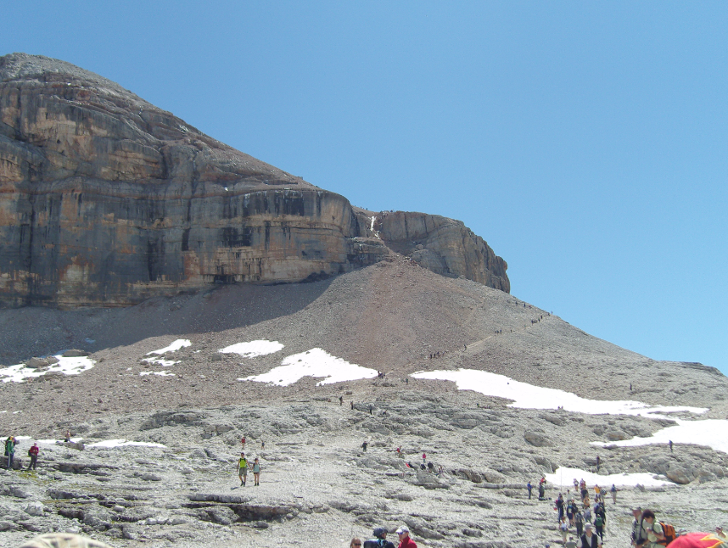
Thank you
(the crowded path forward)

Slide 28
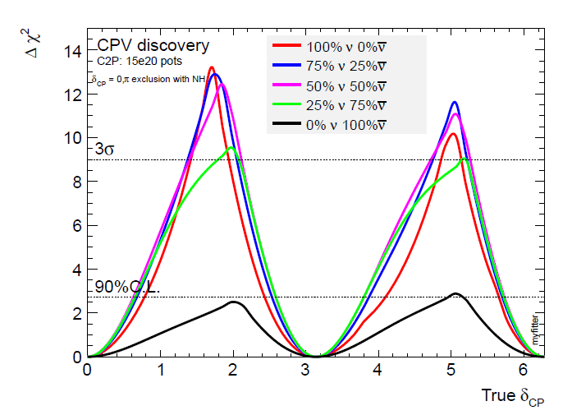

Slide 29
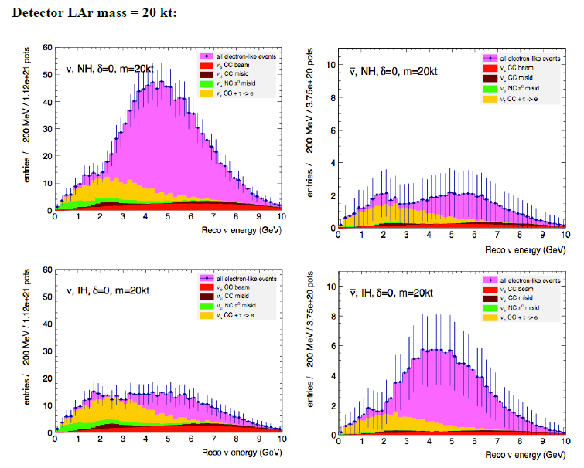

Slide 30
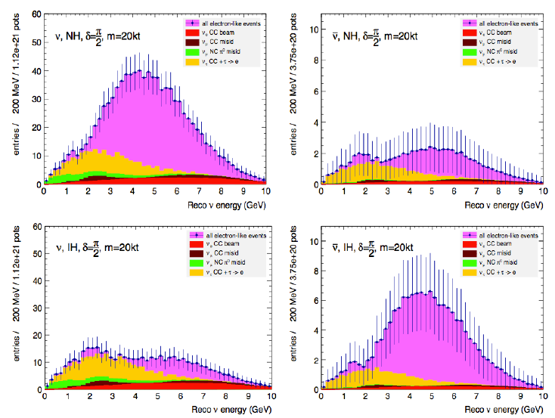

Slide 31
