Slide 1
Status of Costing the Neutrino Factory Accelerator Facility
Ajit Kurup
9th Plenary Meeting of the IDS-NF
8th October 2012

Slide 2
Introduction
What will be presented in the EUROnu costing report (i.e. updates since IDS-NF P8).
Summary tables.
Caveats and missing items.
Uncertainty on the item cost.
All numbers are preliminary!
What needs to be done for the RDR.
Adding more engineering detail.
Cryogenics, electrical and RF.
Improve the way in which uncertainty is handled.
Schedule and proposed milestones.
Summary.

Slide 3
Staff Costs and Uncertainty in the EUROnu Report
Staff costs was estimated as a percentage of the material cost depending on the complexity of the item.
The uncertainty (i.e. the error in the cost estimate) was also estimated as a percentage of the material cost depending on the complexity of the item.
The item cost is reported as a lower bound and an upper bound. The lower bound is given by the item cost and the upper bound is (cost+uncertainty).

Slide 4
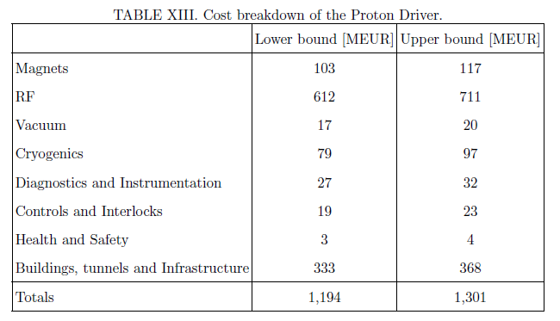
Proton Driver
Major changes since P8:
Accumulator and compressor rings.
Transfer line to the target and final focus.

Slide 5
Proton Driver
Caveats
Design of the accumulator and compressor rings and the transfer line and final focus are preliminary.
The transfer line may require a beam dump and collimation system.
The accumulator and compressor rings are assumed to be housed in separate tunnels, though they could be within one tunnel with a larger diameter.
Vacuum; cryogenics; diagnostics and instrumentation; Controls and Interlocks; and Buildings, tunnels and Infrastructure costs for the Accumulator ring, compressor ring and the Transfer Line and final focus are based on the FFAG cost model and need engineered solutions.
Magnet costs for the accumulator and compressor rings are based on averaged as-built costs of magnets with varying specifications.
Compressor cavity modules and power supply costs are based on as-built costs for a similar system.
Diagnostics and interlocks might not be included in the SPL cost estimate.
Buildings, tunnels and Infrastructure costs include the SPL costs for consultants, the ejection of Isolde and dumps.
Missing items
Accumulator and compressor rings and transfer line and final focus power supplies and distribution.
Mechanical, survey and alignment.
Civil engineering services for the SPL.

Slide 6
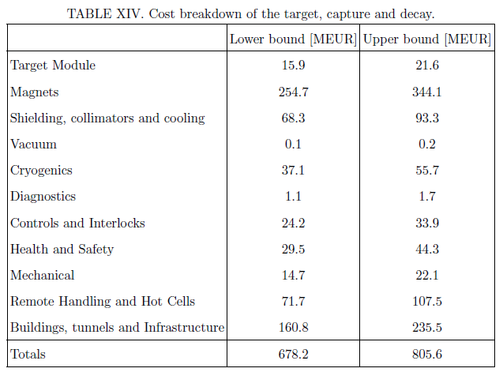
Target, Capture and Decay System
Major changes since P8:
Magnet power and cryogenic costs.

Slide 7
Target, Capture and Decay System
Caveats
Target module cost is based on a closed loop mercury jet as opposed to an open mercury jet. An engineering design of the current design needs to be done in order to cost it accurately.
Cost of the solenoids is based on the mass of the conductor, insulation and steel required. Cost of the cryostats and shielding vessels are not included.
Cost of the cryogenics and magnet power are crude estimates.
The magnet shielding only includes the cost of tungsten needed.
Cost of tungsten was taken to be the mean of ungraded and 90\% purity tungsten.
The current design of the chicane is unfeasible and so the cost estimate was based on a more expensive technology using superconducting solenoids and tungsten shielding even though this is unlikely to be the used in the final design.
The solenoid shielding may require helium gas cooling which has not been included.
Vacuum, electrical services and diagnostics costs were estimated from the FFAG cost model.
Cryogenic costs were estimated from the FFAG cost model by scaling with the ratio of the heat loads.
Controls and interlocks; health and safety; mechanical alignment; remote handling and hot cells; and buildings, tunnels and infrastructure were based on (by scaling with length) the estimated costs for a 2MW, low-Z target hall.
The crane limit for the current target hall design is 50 tons whereas it is likely that a crane limit of 200 tons is needed in order to place the capture solenoids.
Need to consider radiological differences in going from a low Z target to a high Z target though the shielding of the solenoids could reduce concrete shielding requirements.
Potential legislative costs in going from a 2MW facility to a 4MW facility and legislative costs for liquid mercury.
Missing items
Decommissioning of the target module.
Cooling of the copper magnets.
Proton absorber. This is likely to be a water cooled beryllium plug with an average power of 100kW to dissipate.

Slide 8
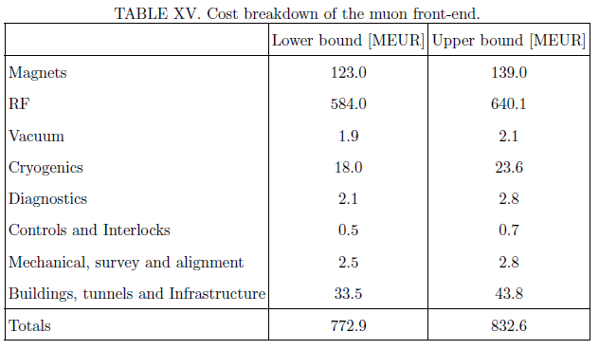
Muon Front-End
Major changes since P8:
Corrected RF power requirement.

Slide 9
Muon Front-End
Caveats
May need to consider space for tuning arms for the RF cavities.
RF frequencies and cavity sizes are needed for the buncher and phase-rotator. It was assumed that this would not increase the cost and it may reduce the cost since the other frequencies are higher than 201MHz.
Assume cost difference between beryllium windows (included in the cost) and LiH windows (used as the absorber) is small.
A hot cell might be needed for the first absorber in the cooling channel.
Physics redesign, to allow for engineering requirements, is ongoing and could have an effect (expected to be small) on the cost.
More than one RF power amplifier is needed per cavity for the phase rotator and cooling sections. This could be improved by using a different technology (currently under investigation) and thus the cost could be reduced.
Missing items
Magnet power supplies and distribution.

Slide 10
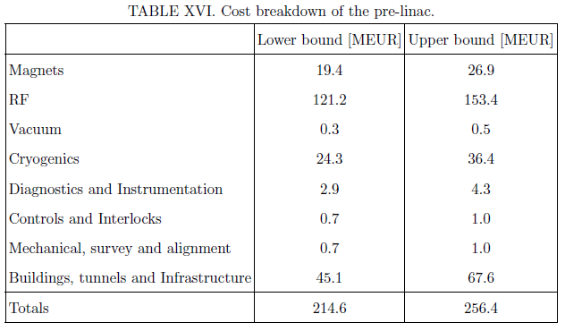
Muon Acceleration
Pre-linac
No major changes since P8.

Slide 11
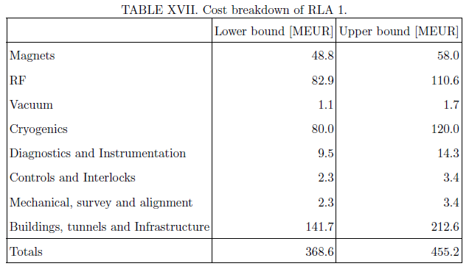
Muon Acceleration
RLA 1
Major changes since P8:
Missing magnet costs.

Slide 12
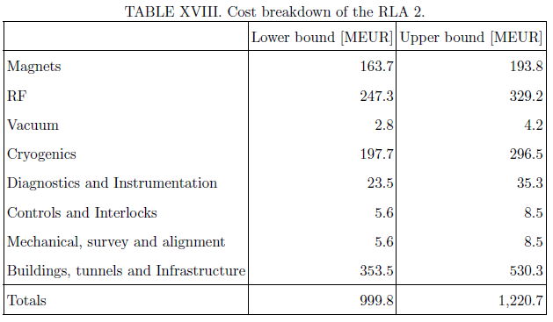
Muon Acceleration
RLA 2
Major changes since P8:
Missing magnet costs.
Transfer line to the decay ring.

Slide 13
Muon Acceleration
Caveats
All costs have been scaled from the FFAG cost model unless otherwise stated. This assumes a similar beam line composition (per metre) to the FFAG.
The pre-linac solenoid costs have been scaled by length from the cost of the capture solenoids.
It has been assumed that the RF cavities for the pre-linac and RLAs cost the same as the FFAG RF cavities.
The aperture for the pre-linac cavities is bigger than the FFAG cavities but the gradient is less. The difference in cost is assumed to be small.
It has been assumed that the cost of a single-cell cavity (in the pre-linac) is half of a double-cell FFAG cavity.
It has been assumed that one RF power system can power 4 single-cell cavities.
It has been assumed that there is no transfer line between the pre-linac and RLA 1.
The length of the transfer line from RLA 2 to the muon decay ring has been crudely estimated. The cost of the beam line components for the transfer line was based on as-built costs of a higher momentum proton beam transfer line based at CERN from 2002 (and includes an average CHF:GBP exchange rate for 2002 and a UK based inflation factor).
Missing items
Magnet power supplies and distribution.

Slide 14
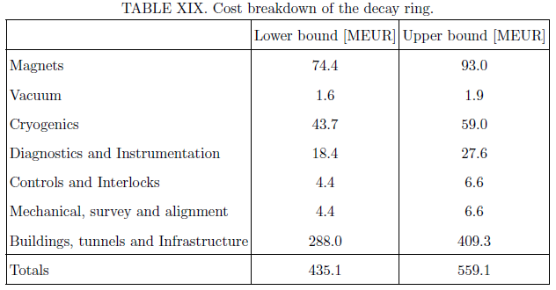
Muon Decay Ring
Major changes since P8:
Redesign of the ring for 12.6GeV
Near detector civil engineering.

Slide 15
Muon Decay Ring
Caveats
Magnet costs have been scaled from the magnet costs for an electron machine.
The cost of the near detector caverns (6m wide by 6m high) is assumed to be the same as the decay ring tunnel (4m diameter).
Missing items
Device to measure the energy of the muon beam.

Slide 16
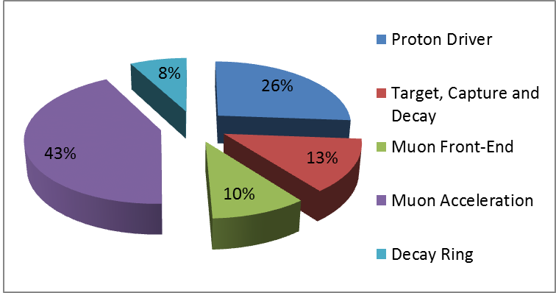
Relative Cost of Systems at P8

Slide 17
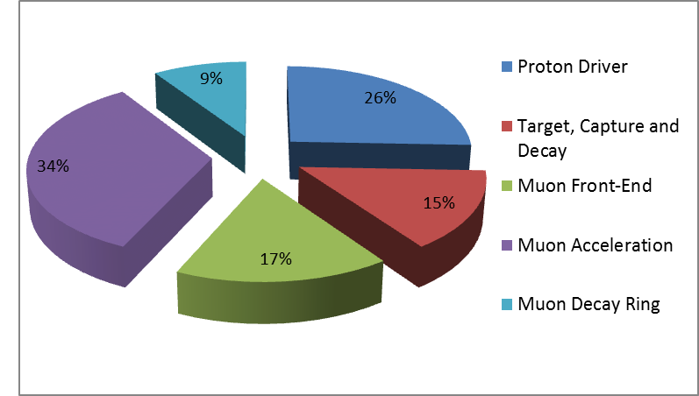
Relative Cost of Systems in EUROnu Report

Slide 18
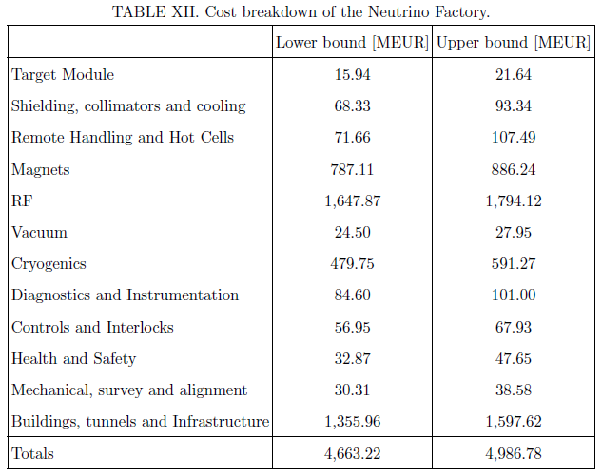
Cost of Systems in EUROnu Report

Slide 19
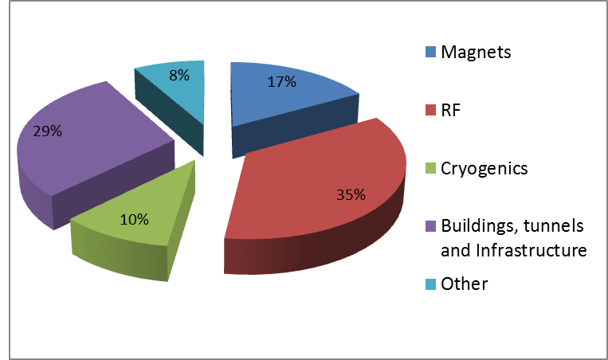
Relative Cost of Systems in EUROnu Report

Slide 20
Plan for the RDR
Add more engineering detail.
Cryogenics, electrical and RF expertise available at Daresbury for this financial year (i.e. until April 2013).
Need to fix design asap.
Cost the other PD options.
Improve the way in which uncertainty is handled.
Errors are summed in quadrature.
Assumes Gaussian error distribution.
This was thought to be the best option given the resources available for all three facilities.
Follow guidelines from the US Government Accountability Office (provide guidelines for the DOE) ?
Need to specify error distribution for each item and then run MC analysis.
Any other recommendations for how to tackle this are welcome.

Slide 21
Summary
A lot of work has been done with the limited resources available.
Thanks to engineers at Daresbury.
EUROnu report will be completed soon.
Need to fix design for the RDR in order to make best use of the engineers at Daresbury.
Aim to have final costs around May 2013.
Staging scenario?

