Slide 1
Neutrinos from Stored Muons νSTORM
ν physics with a μ storage ring

Slide 2
Motivation
The idea of using a muon storage ring to produce neutrino beams for experiments is not new
50 GeV beam – Koshkarev @ CERN in 1974
1 GeV – Neuffer in 1980
nuSTORM can:
Address the large Δm² oscillation regime and make a major contribution to the study of sterile neutrinos
Either allow for precision study (in many channels), if they exist in this regime
Or greatly expand the dis-allowed region
High-Precision ν interaction physics program
ν_{e} and ν_{e}-bar cross-section measurements
Provide a technology test demonstration ( μ decay ring) and μ beam diagnostics test bed
Provide a precisely understood ν beam for detector studies

Slide 3
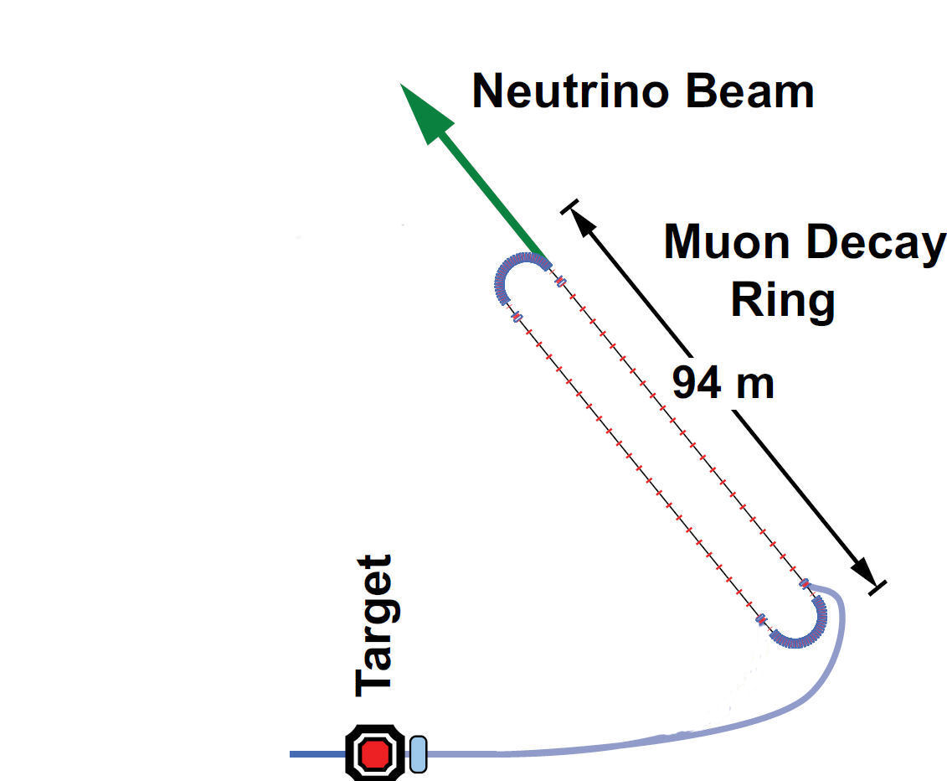
Baseline(s)
100 kW Target Station
Assume 60 GeV proton
Fermilab PIP era
Ta target
Optimization on-going
Horn collection after target
Li lens has also been explored
Collection/transport channel
Stochastic injection of π
At present NOT considering simultaneous collection of both signs
Decay ring
Large aperture FODO
Racetrack FFAG
Instrumentation
BCTs, mag-Spec in arc, polarimeter
150 m

Slide 4
FODO Decay ring
Alex Bogacz
JLAB
3.8 GeV/c ± 10% momentum acceptance, circumference = 350 m

Slide 5
The Physics Reach

Slide 6
Assumptions
N_{μ} = (POT) X (π/POT) X ε_{collection} X ε_{inj} X (μ/π) X A_{dynamic} X Ω
10²¹ POT in 5 years of running @ 60 GeV in Fermilab PIP era
0.1 π/POT (FODO)
ε_{collection} = 0.8
ε_{inj} = 0.8
μ/π = 0.08 (γct X μ capture in π → μ decay) [π decay in straight]
A_{dynamic} = 0.75 (FODO)
Ω = Straight/circumference ratio (0.43) (FODO)
This yields ≈ 1.7 X 10¹⁸ useful μ decays
þ
Ao Liu
Fermilab/UI
þ

Slide 7
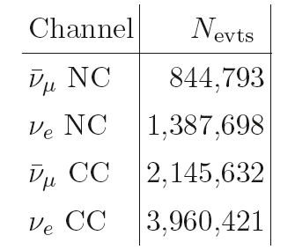
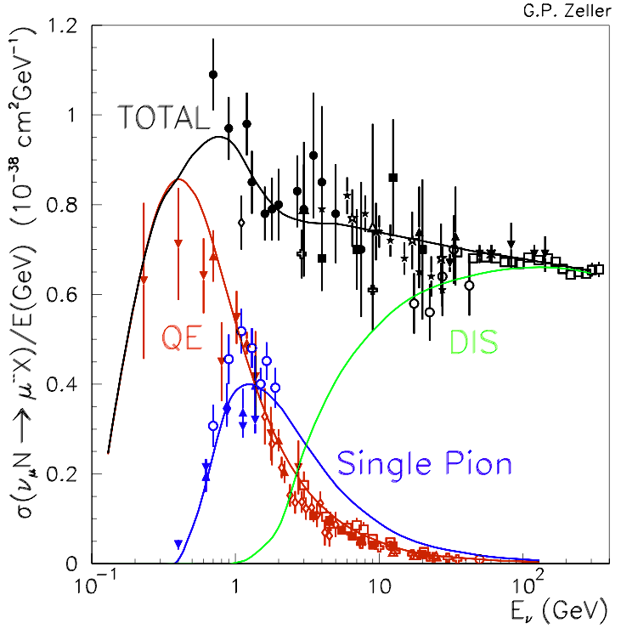
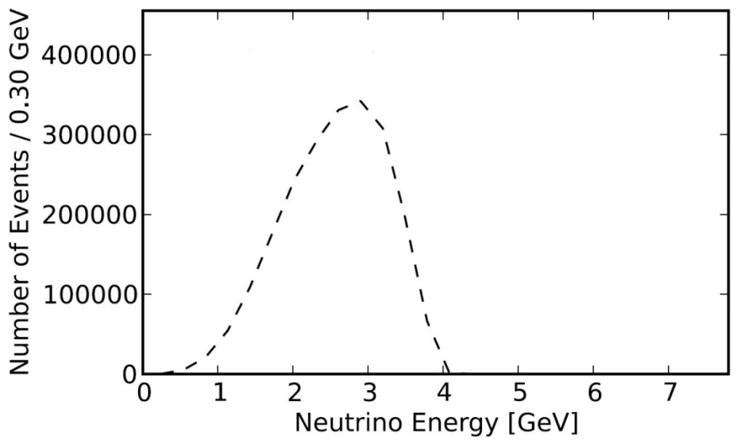
E_{ν} spectra (μ⁺ stored)
Event rates/100T
at ND hall 50m
from straight with
μ⁺ stored
ν_{e}
ν_{μ}-bar

Slide 8
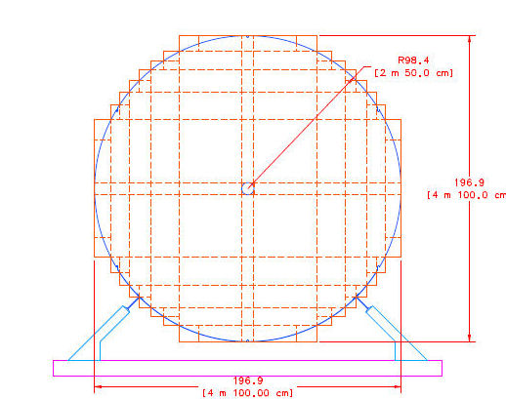
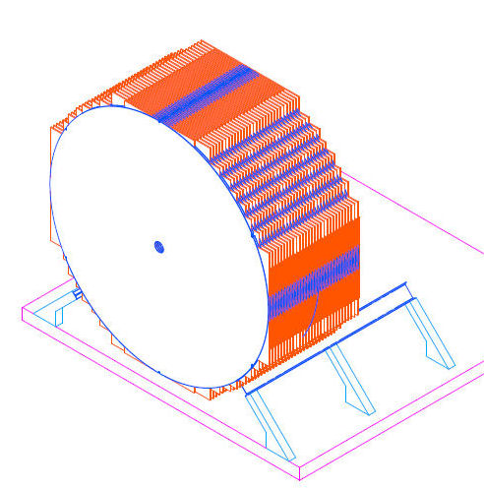
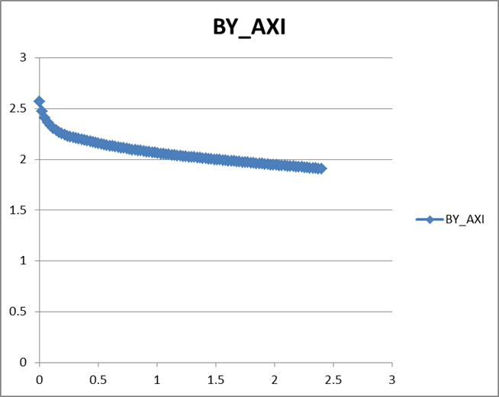
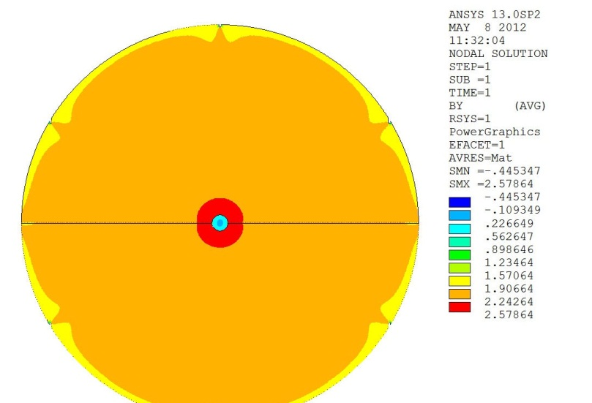
Baseline Detector Super B Iron Neutrino Detector: SuperBIND
Magnetized Iron
1.3 kT
Following MINOS ND ME design
1-2 cm Fe plate
5 m diameter
Utilize superconducting transmission line for excitation
Developed 10 years ago for VLHC
Extruded scintillator +SiPM
20 cm hole
For 6-8 turns
of STL

Slide 9
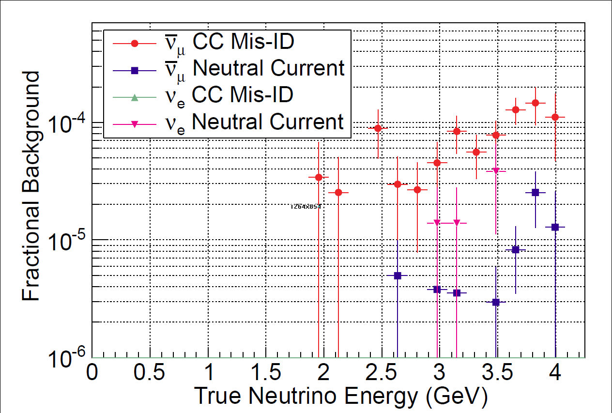
Backgrounds
Ryan Bayes
Glasgow
Left: 1 cm plates Right: 2 cm plates

Slide 10
Raw Event Rates
3+1
Assumption
Appearance channels

Slide 11
ν_{e} → ν_{μ} appearance CPT invariant channel to MiniBooNE
2 cm plate

Slide 12
ν_{e} → ν_{μ} appearance CPT invariant channel to LSND/MiniBooNE
Chris Tunnell
Oxford
3+1
Assumption

Slide 13
Required μ charge mis-ID rate needed for given sensitivity

Slide 14
Comments on ν beam
Although the primary beam is from μ decay, at the beginning of π injection into the first straight, π ® μ ν_{μ} may offer the opportunity to study ν_{μ} ® ν_{e} appearance
Capture transport line reduces ν_{e} background from K decay by factor of roughly 100

Slide 15
Project Considerations

Slide 16
Siting Concept
Steve Dixon (Fermilab FESS) will discuss tomorrow

Slide 17
Preliminary Cost Estimate
Major Components
Beamline, Target Station & Horn
Transport line
Decay ring
Detectors (Far & Near)
Project Office
Total
Basis of Estimation (BOE)
Took existing facilities (MiniBooNE beam line and target station, MINOS detector, vetted magnet costing models, μ2e civil construction costs, EuroNu detector costing, have added all cost loading factors and have escalated to 2012 $ when necessary.
$30M
9
54
18
15
$126M

Slide 18
Moving Forward
Why we are here

Slide 19
® Full Proposal
June 2012 PAC response to nuSTORM presentation
The combination of a clear resolution of the short-baseline neutrino anomalies, the precise measurements of the neutrino cross sections, and the synergy with neutrino-factory technology makes this a potentially attractive project.
From Pier
As you see, the Committee was quite intrigued by the possibility of the nuSTORM approach to resolving the short-baseline neutrino anomalies and its being a stepping stone toward use of neutrino-factory technology.
So,
Although we do not have a mandate ($$$), there is recognition of the power of the concept and encouragement to proceed to a full proposal.
In addition, nuSTORM has been included in the European Strategy for Particle Physics document.

Slide 20
Moving forward:
Facility
Targeting, capture/transport & Injection (Ao Liu, S. Striganov)
Need to complete detailed design and simulation
Mike Geelhoed (external beams) – beam line
AD Mech – Target station
Decay Ring optimization (Ao Liu)
Continued study of both RFFAG & FODO decay rings
Decay Ring Instrumentation (AD Instrumentation – G. Tassotto)
Define and simulate performance of BCT, Magnetic-spectrometer, etc.
Produce full G4Beamline simulation of all of the above to define ν flux
And verify the precision to which it can be determined.

Slide 21
Moving forward:
Detector simulation
For oscillation studies, continue MC study of backgrounds & systematics
Start study of disappearance channels
Event classification in the reconstruction needs optimization.
Currently assumes "longest track" is interaction muon.
Plan to assign hits to and fit multiple tracks.
Vertex definition must also be improved.
Multivariate analysis.
For cross-section measurements need detector baseline design
Learn much from detector work for LBNE & IDS-NF
Produce Full Proposal for June 2013 PAC Mtg.

Slide 22
nuSTORM: Boiler plate
nuSTORM mailing lists (on listserv.fnal.gov):
NUSTORM (general collaboration ML)
NUSTORM_DETECTOR
NUSTORM_FACILITY
NUSTORM_SOFTWARE
Setting DocDB & WEB page (Fermilab hosted)

Slide 23
nuSTORM: Conclusions
The Physics case:
Initial simulation work indicates that a L/E ≈ 1 oscillation experiment using a muon storage ring can confirm/exclude at 10σ (CPT invariant channel) the LSND/MiniBooNE result
ν_{μ} and (ν_{e} ) disappearance experiments delivering at the <1% level look to be doable
Systematics need careful analysis
Detailed simulation work on these channels has not yet started
Cross section measurements with near detector(s) offer a unique opportunity
The Facility:
Presents very manageable extrapolations from existing technology
But can explore new ideas regarding beam optics and instrumentation
Offers opportunities for extensions
Add RF for bunching/acceleration/phase space manipulation
Provide μ source for 6D cooling experiment with intense pulsed beam

