Slide 1
Muon Decay Ring Tunnel
Norbert Collomb STFC Technology
22nd August 2011

Slide 2
Content
Muon Decay Ring (MDR) Tunnel layout
Challenges
CERN reference
Possible Solutions
Discussion

Slide 3
Muon Decay Ring (MDR) Tunnel layout
Racetrack layout
Long Straights 800 m long (‘Conventional’ Quadrupoles and Drifts)
Matching Sections before and after each Arc (Superconducting and conventional magnets)
2 Arcs consisting of Superconducting Quadrupole and Dipole magnets
No information pertaining to Diagnostics, Injection or other systems is known at this stage

Slide 4
Muon Decay Ring (MDR) Tunnel layout
The image depicts an Anamorphic view of the Muon Decay Ring with the Y scale twice the X scale
2 Arc Sections
4 Matching Sections
2 Long Straight Sections
Magnets: | Defocusing Quad (Arc) | Focusing Quad (Arc) | Dipole (Arc) | Focusing Quad (LS) | Defocusing Quad (LS) | Dipole (MS) | Focusing Quad (MS) | Dipole (MS) | De/Focusing Quad (MS) | Defocusing Quad (MS) | Dipole (MS) | Magnet Cryogenic Modules
Field/Gradient: | -23.77 | 24.18 | -4.27 | 0.464 | -0.464 | 0.35 | 4.1 | -1.9 | 11.6 | -9.2 | -0.64 | Arc: 58 double + 4 single
Type: | SC | SC | SC | NC | NC | NC | SC | SC | SC | SC | NC | MS: 20 various single
QTY: | 60 | 60 | 60 | 48 | 48 | 4 | 4 | 4 | 8 | 4 | 4 | 82

Slide 5
Challenges
Need to transport modules from access shaft to location
Installation is “simple” as it can be carried out in series
Replacement modules need different transport system and tunnel layout (maybe)
Size of modules drives access shaft and associated cost
Legislation needs to be adhered to (Fire, He, etc)

Slide 6
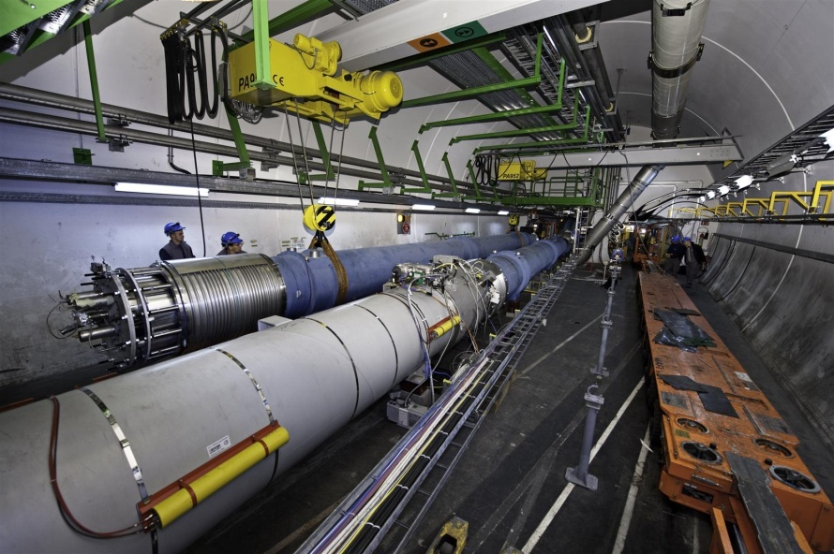
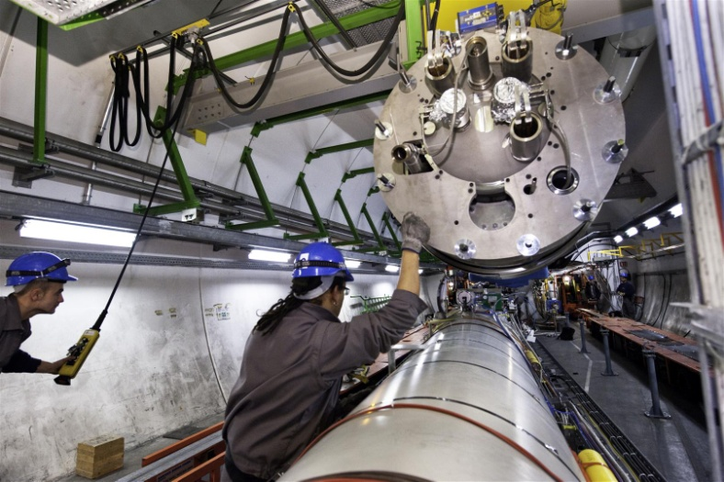
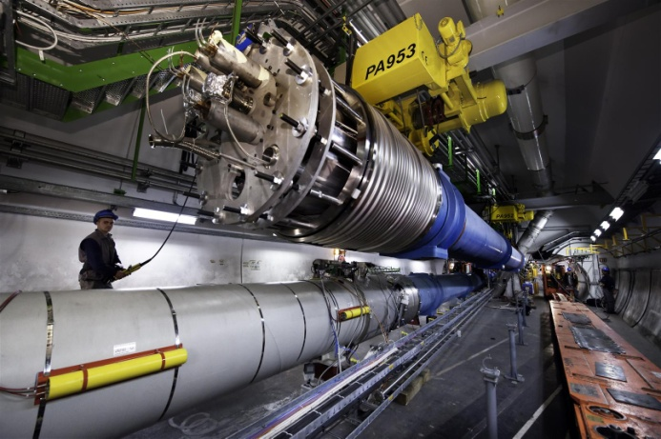
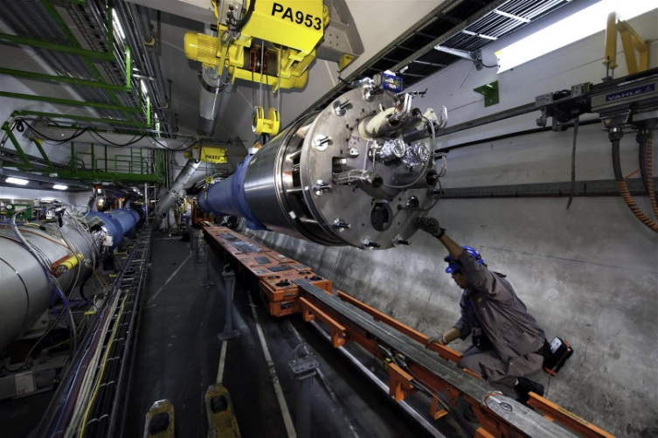
CERN reference
1
1. Wheel in new or replacement module.
2
2. Lift new or replacement module over existing items.
3
3. Note Gantry cranes (9m spacing) for one module.
4
4. Position module using crane.

Slide 7
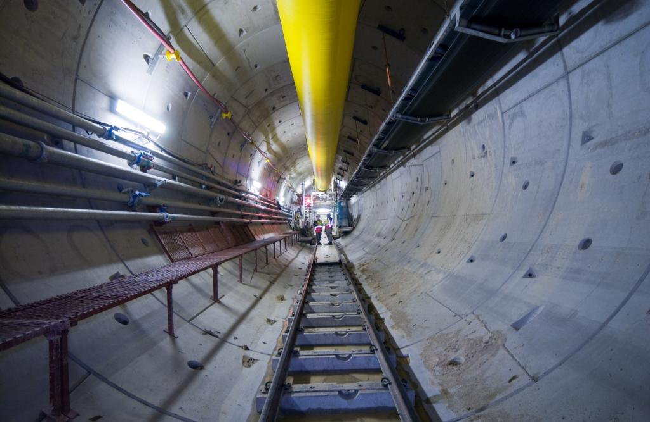
CERN reference
CERN have adopted a TBM with pre-cast segmental lining.
The He extraction system is not shown. A new system was introduced after the 19th September 2008 incident.

Slide 8
Solutions
Follow CERN approach (but smaller tunnel) if ring is horizontal
If ring is inclined (triangle solution requires compound angles) the arrangement could be as shown in following slide (30 degree inclination)
Lessons learned from CERN with respect to Health and Safety and Legislation will help reduce cost and time
Surface buildings may require localisation (Water, Cryo, Power, etc)

Slide 9
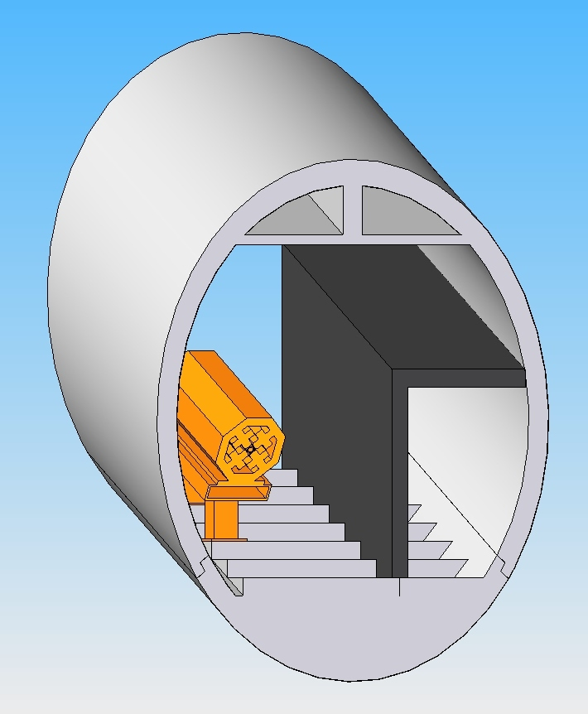
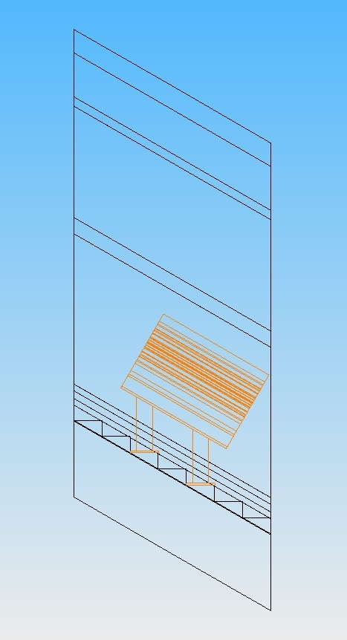
Solutions
Crane, Transport on ceiling?
HVAC, He extraction
Steps:
200mm Rise,
345mm Go
1.5m Quad representation
Maintenance Access
Personnel enclosure
4.5m Internal Diameter
Towards centre of racetrack
30 degree inclination

Slide 10
Discussion
There are many details still unknown and CERN may be able to provide guidance
Legislative advice on Safety (number of alcoves, Emergency egress, extraction, etc.)
Surface Buildings (Cooling Towers, Power Station and Cryogenics Plant)
Heating – Ventilation – Air Conditioning (HVAC)
Survey and Alignment
Lighting, Water and Cabling

