Slide 1



High Energy Acceleration
in Non-Scaling FFAG
Update
J. Pasternak, Imperial College London / RAL STFC
Work in collaboration and with contributions from:
M. Aslaninejad (IC), J. Scott Berg (BNL),
N. Bliss (STFC/Technology/DL) C. Bontoiu (IC),
M. Cordwell (STFC/Technology/DL), D. Kelliher (ASTeC/STFC/RAL),
S. Machida (ASTeC/STFC/RAL), H. Witte (JAI-Oxford)
19.04.2012, IDS-NF meeting, Glasgow

Slide 2
Outline
Introduction.
Layout and optics.
Acceleration simulation.
Injection/extraction.
Effect of septum fields.
Conclusions and future plans.

Slide 3
Introduction
New IDS-NF baseline.
Number of cells | 67 m
Circumference | 669 m
RF voltage | 1.1956 GV
Max field in F magnet | 4.4 T
Max field in D magnet | 6.2 T
F magnet radius | 16.1 cm
D magnet radius | 13.1 cm
Muon decay | 7.1 %
Injection energy | 12.6 GeV
Extraction energy | 25 GeV
Non-scaling FFAG is selected for the final muon acceleration at the Neutrino Factory.
Advantages include:
Allows very fast acceleration (~12 turns).
Large dynamic aperture due to linear
magnets + high degree of symmetry.
More turns than in RLA – more efficient
use of RF – cost effective.
Quasi-isochronous – allows fixed
frequency RF system.
Orbit excursion and hence magnet
aperture smaller than in the case of a
scaling FFAG – cost effective.
Principles of NS-FFAG are now being
tested during ongoing EMMA commissioning.
Recent progress:
Acceleration studies
Effect of septum stray fields on the
accelerated orbit
Costing model (discussed by N. Bliss)
19.04.2012, IDS-NF meeting, Glasgow

Slide 4
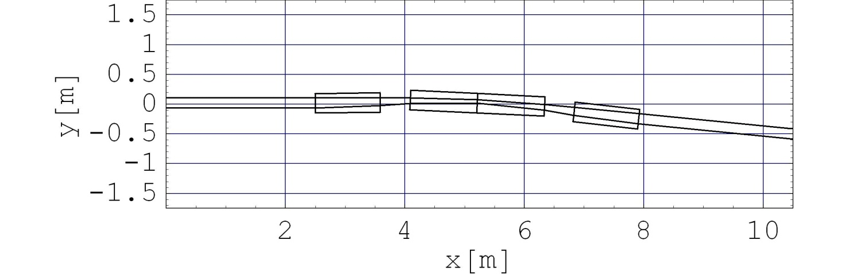
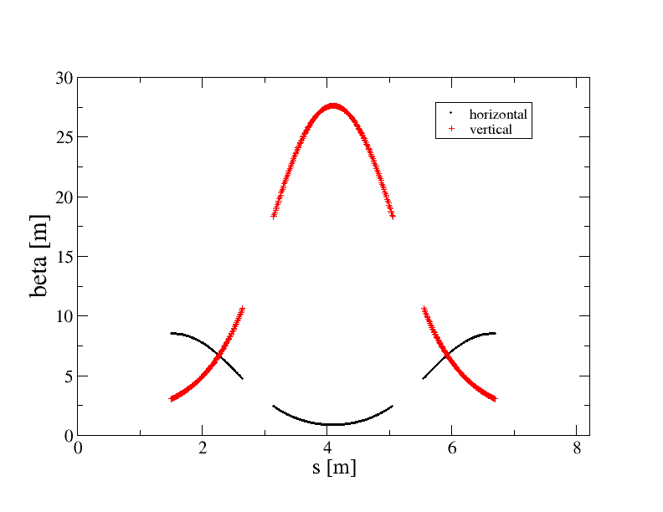
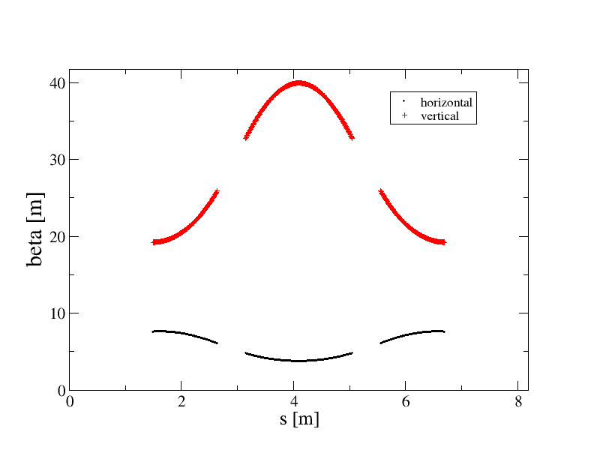
Layout and optics
Center of
the long drift
F
D
F
Orbit
excursion
Beta functions at injection
Beta functions at extraction

Slide 5
Beam Optics and Acceleration
ToF [ns]
H
Tune per cell
V
Kinetic Energy [GeV]
Kinetic Energy [GeV]
[MeV]
time [ns]

Slide 6
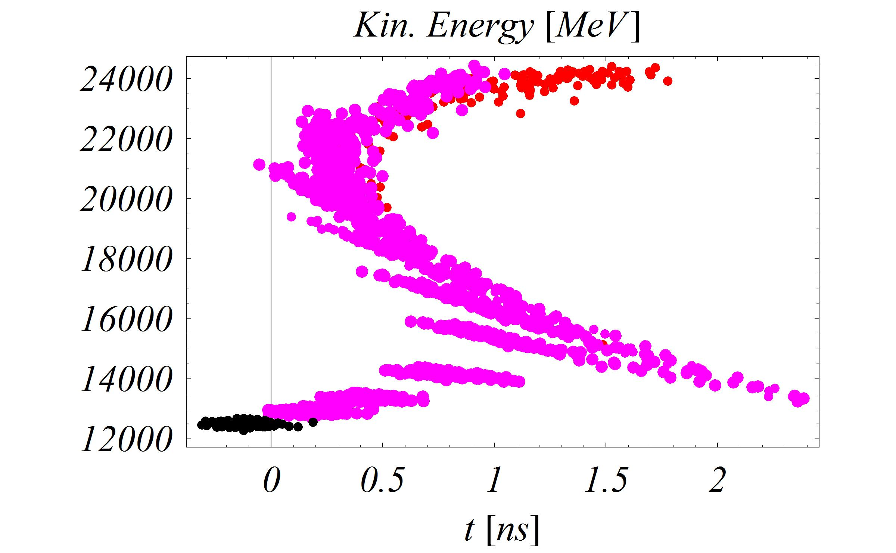
Acceleration studies:
6D tracking, full transverse emittance, Gaussian distribution,
RF synchronization at 21 GeV
Muons with
a large momentum
spread!
Potential problem
for the septum
operation!

Slide 7
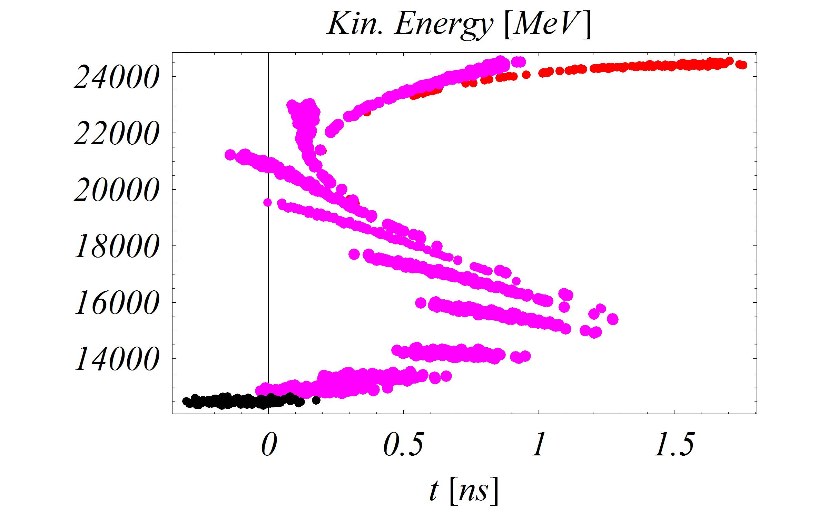
Acceleration studies (2):
6D tracking, small transverse emittance, Gaussian distribution,
RF synchronisation at 21 GeV
The effect seems to be coming from
Non-zero chromaticity (ToF varation with the transverse amplitude) +
distortion of the serpentine channel (to be further investigated).

Slide 8
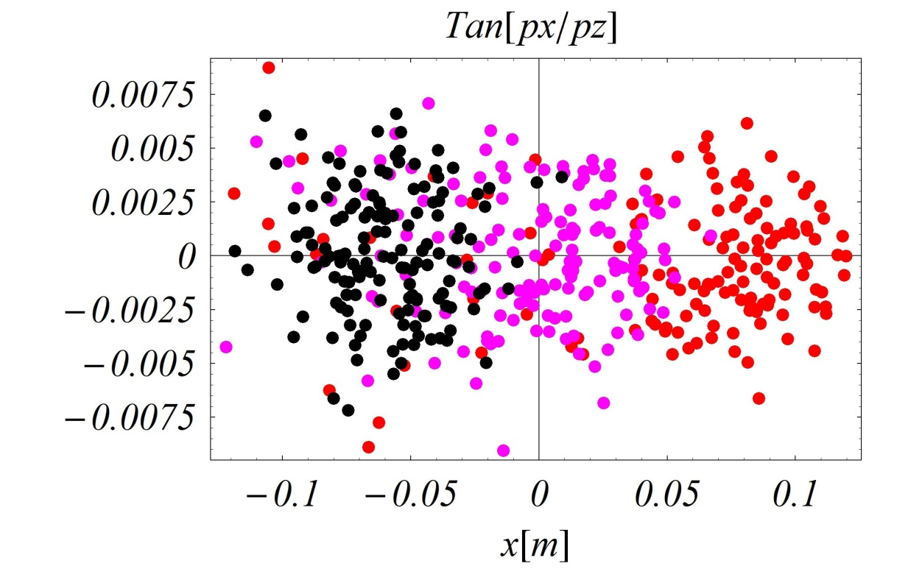
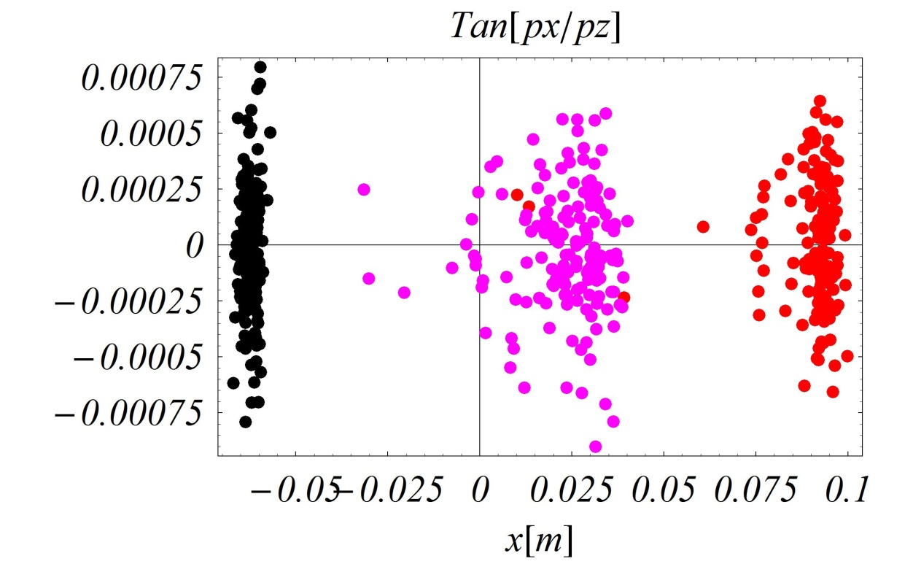
Acceleration studies (3):
6D tracking, full versus small transverse emittance,
Gaussian distribution, horizontal plane
Large emittance
Small emittance

Slide 9
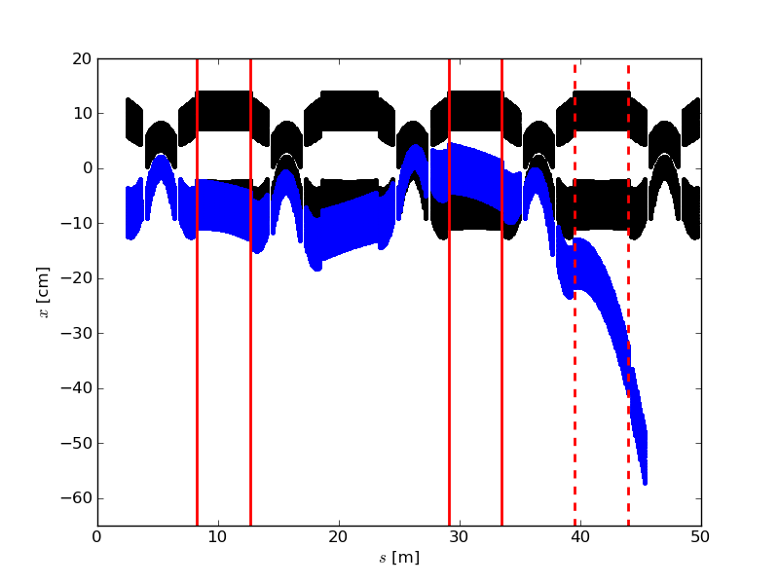
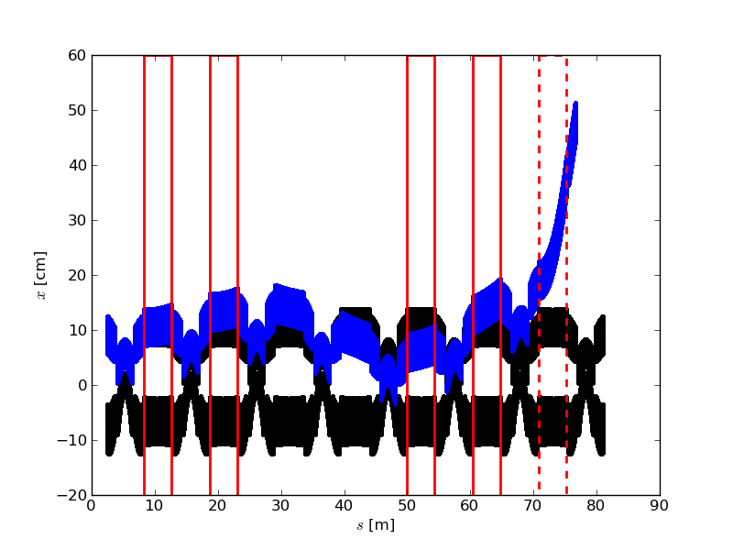
Injection/Extraction geometries
Injection
Septum
Extraction
Septum
Injection
Plane | Horizontal
No. Kickers | 2
Kicker field (T) | 0.089
Kicker Polarity | +0+
Septum field (T) | 0.92
Kickers
Extraction
Plane | Horizontal
No. Kickers | 4
Kicker field (T) | 0.067
Polarity | ++00++
Septum field (T) | 1.76
Septum field was limited to 2 T by the stray fields studies (see next slides).
Both injection and extraction are in the horizontal plane (minimal additional magnet
aperture needed and no generation of the vertical dispersion).
Larger apertures in the special magnets witch are needed have been calculated.

Slide 10
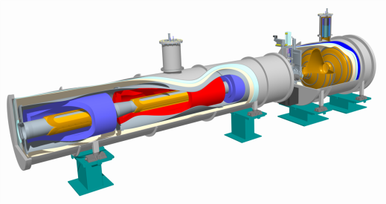
Towards engineering design
RF
cavity
F
D
F
Magnet Block
Start of the engineering effort!
Effective drift length reduced to 4m
(due to space for the cryostat and flanges).
Kicker field increased 0.106 T
Extraction septum field to 1.94 T.
Injection/extraction still feasible!

Slide 11
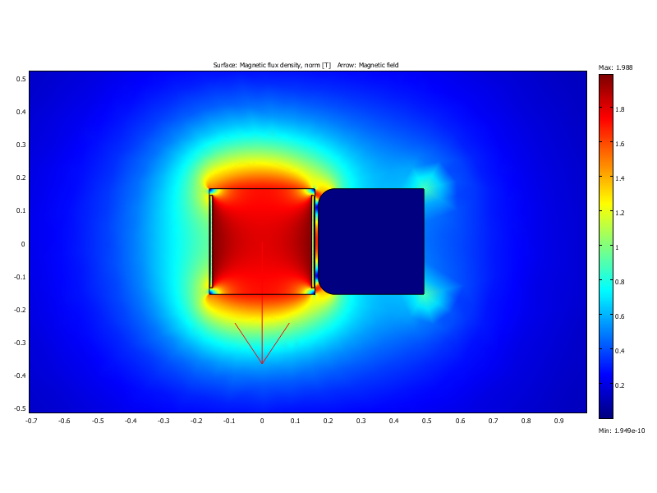
Septum geometry
The goal of the study was to limit the field leakage from
the septum to the circulating beam region.
We were using COMSOL and performed 2D simulations.
Starting point was a basic „C-shape” septum magnet.
Iron was introduced all around the circulating beam.
Iron was replaced by the soft magnetic cobalt-iron-alloy
with high saturation limit.
Chamfer was introduced.
Circulating beam
area
Extracted
beam area
Yoke

Slide 12
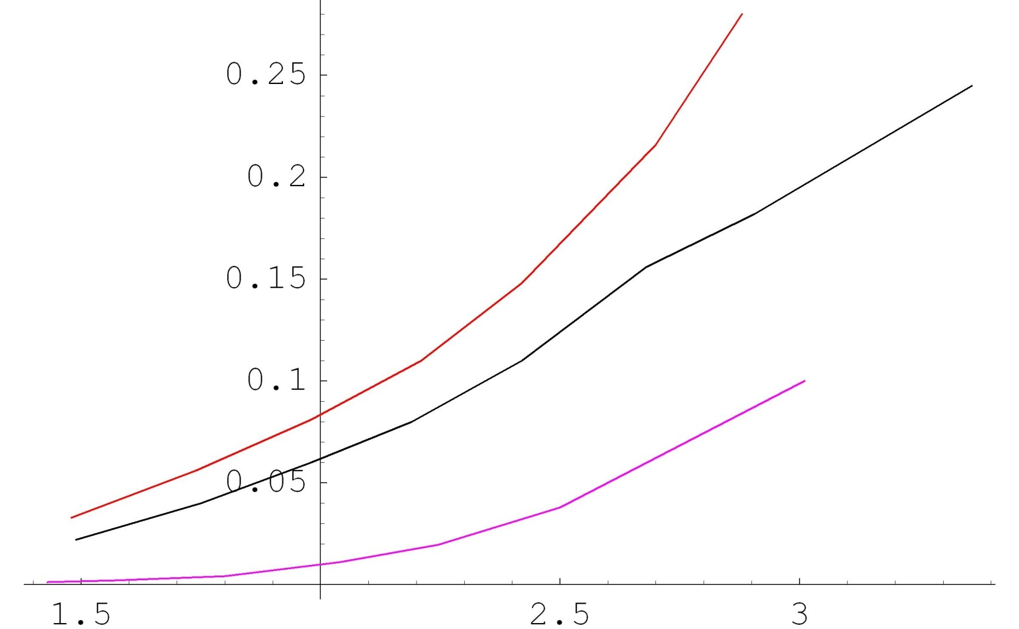
Septum Field Leakage
iron
Leaking field, T
Advanced material
Advanced material
+ chamfer
Septum field, T
The advanced material is the soft magnetic cobalt-iron-alloy
(VACOFLUX 50 from www.vacuumschmelze.de)
We may still look for more advanced materials.

Slide 13
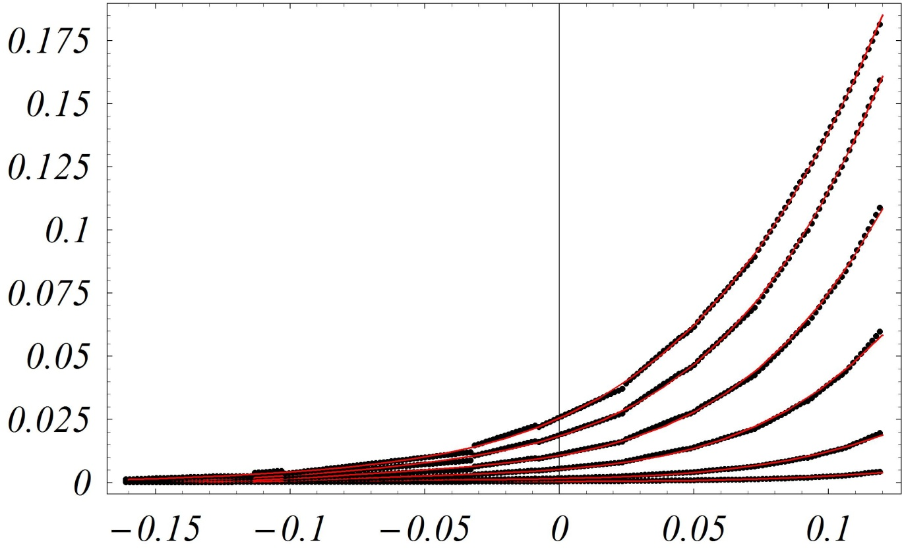
Effect of Septum Field Leakage
Stray fields have been generated using COMSOL
Multipoles have been fitted to the numerical points up to the decapole.
3.9 T
3.5 T
Leaking field, T
3.1 T
2.6 T
2.2 T
1.8 T
Injection
Septum

Slide 14
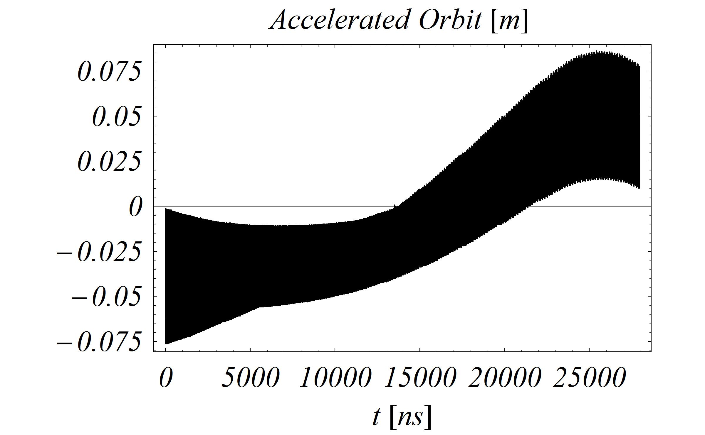
Effect of Septum Field Leakage (2)
Septum field zero, no leckage.

Slide 15
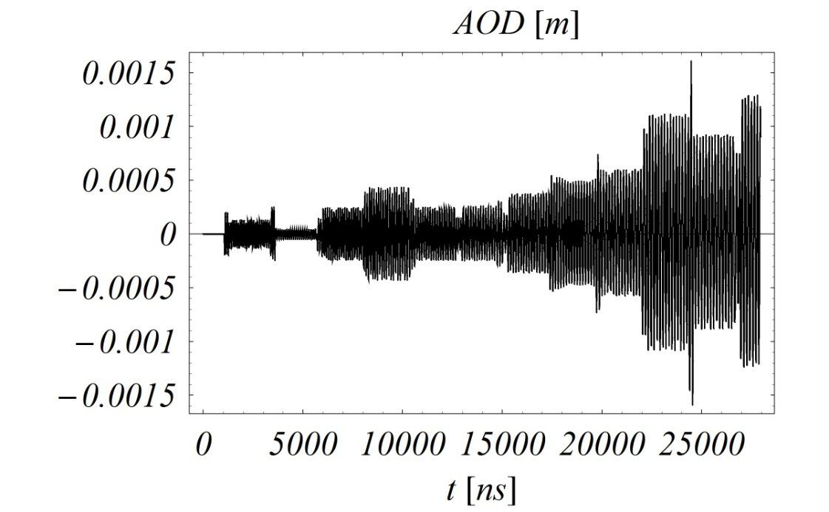
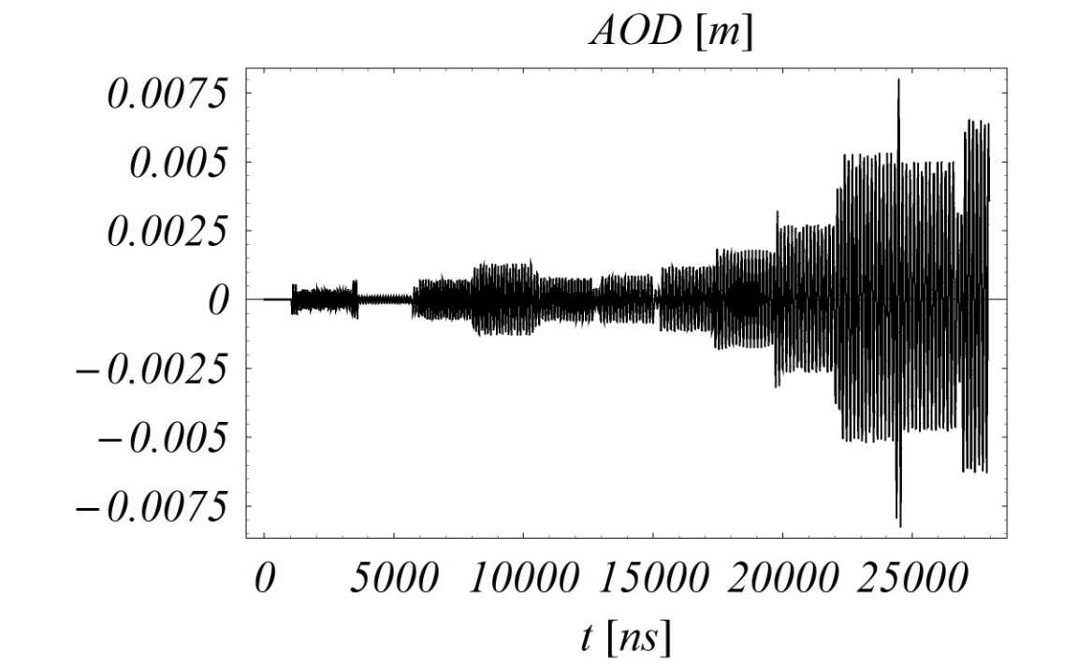
Effect of Septum Field Leakage (3)
AOD – Accelerated Orbit Distortion
1.8 T case
2.2 T case
With the model of the leaking field
described by the magnet with the
fitted multipole expansion.
No other errors included.
Acceleration shifted to 24 GeV (?).

Slide 16
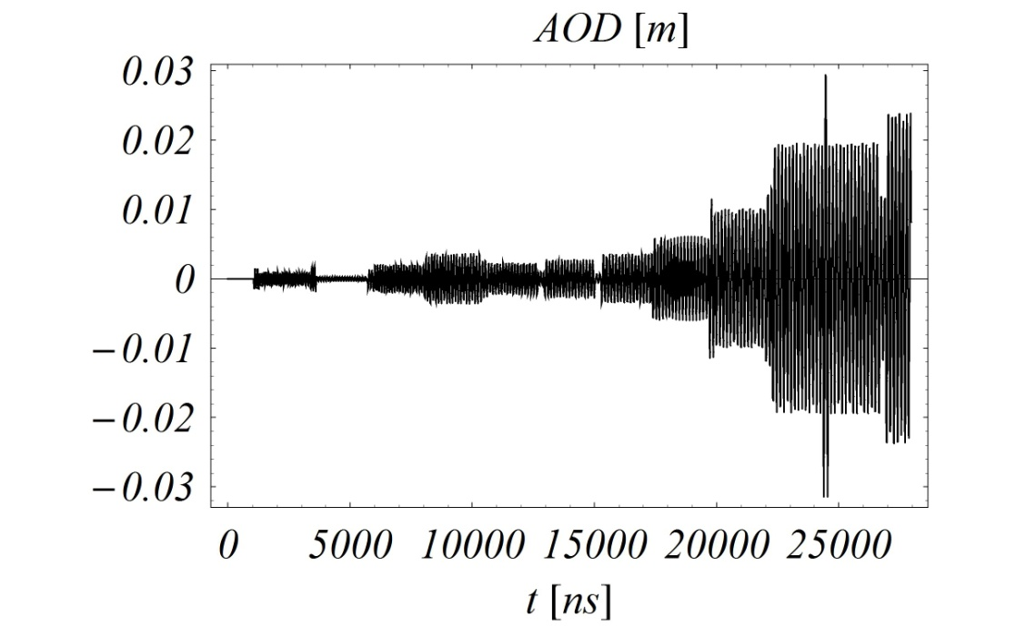
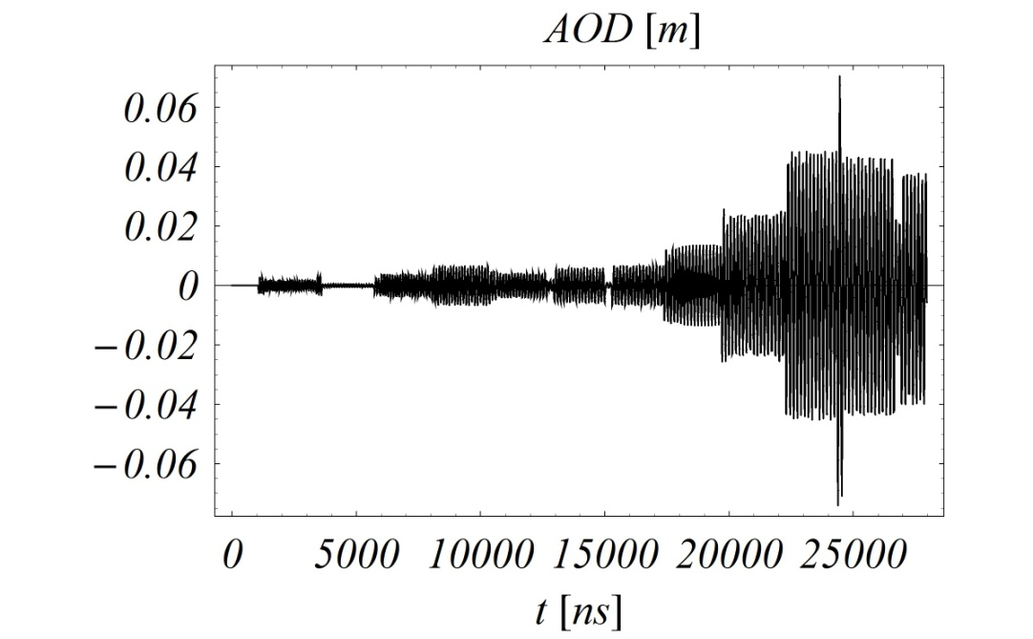
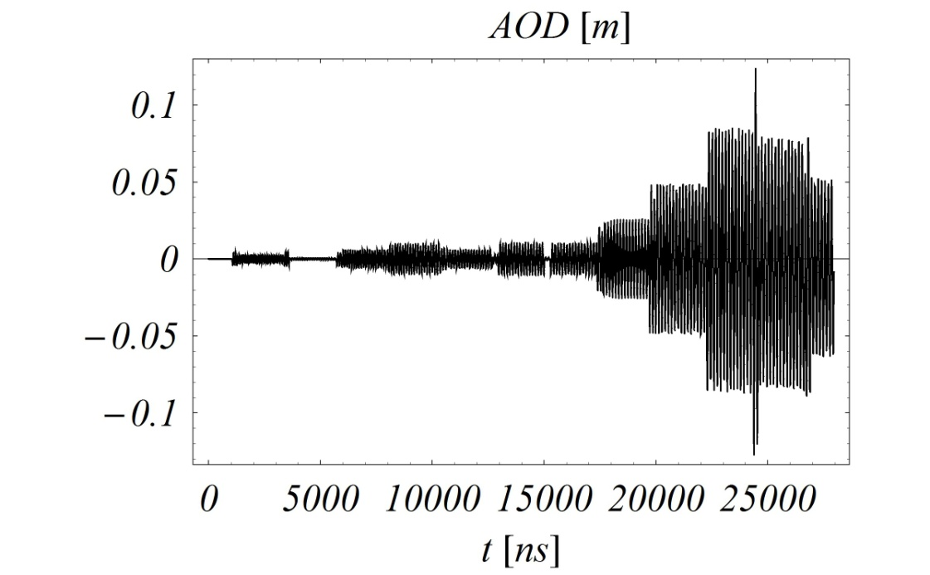
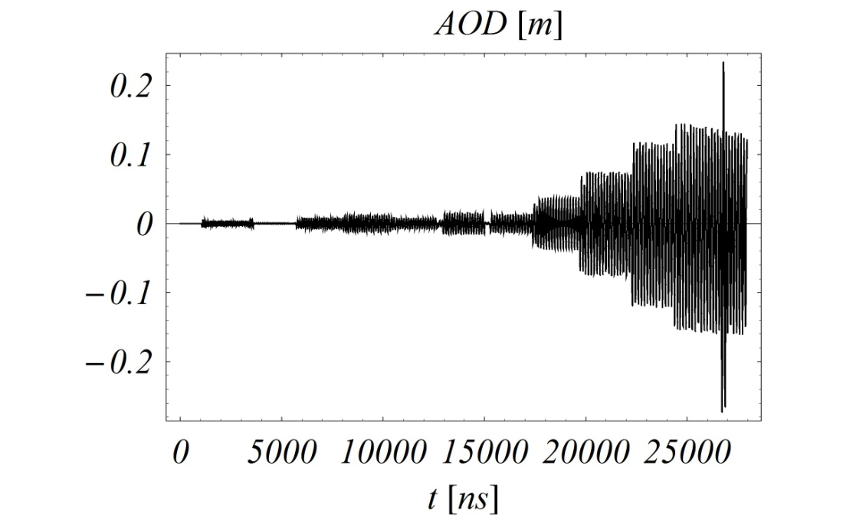
Effect of Septum Field Leakage (4)
2.6 T case
3.1 T case
3.5 T case
3.9 T case

Slide 17
Summary
The acceleration studies proof that the machine can accelerate the beam to the 25 GeV, but more longitudinal
dynamics re-optimisation is needed to reduce the momentum spread. In particular this effect may be an issue for the superconducting septum operation.
Effect of septum stray fields on the accelerated orbit have been evaluated. The expected distortion is of the order of a few mm for the baseline septum field. Options with higher
septum fields are ruled-out, unless stray fields could be better
controlled. This confirms our previous change of baseline!
The preliminary conceptual designs of machine subsystems were produced, but more definitions are needed.
Real engineering effort has been started!
Costing model has been created!
Future plans -> next slide!

Slide 18
Future plans
Beam dynamics studies (chromacity correction,
error study, estiamtion of magnet tolerances etc.).
Design of the transfer lines.
The realistic kicker design (internal cell configuration).
3D septum simulations.
Feasibility of the cryogenic design of the septum
and its quench calculations (including the beam loss).
Update of the main magnets geometry
with the good field quality (possibly including
higher order multipoles for chromaticity correction).
Alternative main magnet designs (collaboration is very
welcome!).
Updates on costing.
In fact we need to think what to do in the case of the large θ₁₃!

