Slide 1

Status of Costing the Neutrino Factory Accelerator Facility
Ajit Kurup
8th Plenary Meeting of the IDS-NF
18th April 2012

Slide 2
Introduction
Summary of what has been done so far on costing the accelerator facility.
  Won’t discuss numbers but will go over what has been costed and show the cost drivers for each subsystem.
  What pieces of information are missing or requires effort to investigate in detail.
Not all options have been included in the first pass costing. Focussing on the SPL Proton driver option (since this is more urgent for EUROnu) and the liquid target option (as this is the baseline).
Relative cost of the subsystems for the whole accelerator facility.
  With caveats and excluding transfer lines.
Schedule and milestones.
Summary.

Slide 3
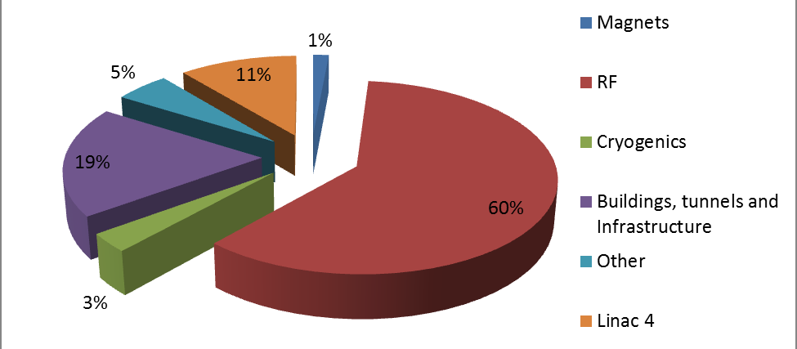
Proton Driver
The cost of the SPL has been published in sLHC-Project-Note-0037 .
  Does not include cost of existing Linac 4 (added above) but does include cost to upgrade it.
Cost of accumulator and compressor rings not included.
  Tunnel diameter is based on ISR which is 15m.
  Need details of magnets and RF.

Slide 4
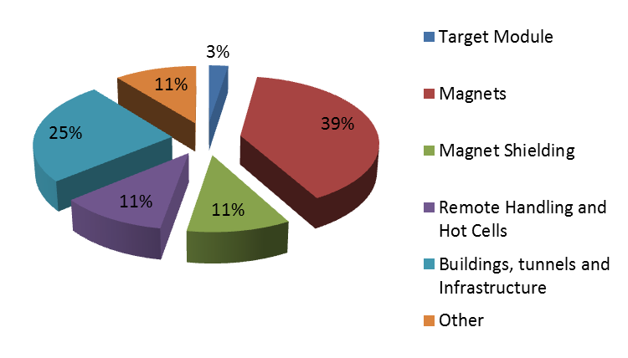
Target, Capture and Decay System

Slide 5
Target, Capture and Decay System
Liquid mercury baseline option.
  Based on as built cost of SNS target (information from Van Graves).
  Volume of mercury is similar.
Capture solenoid and taper to 1.5T design and costing by Bob Weggel.
  Estimate based on material costs (superconductor, copper, stainless steel, etc.)
  Need to include cost to power the magnets, cost to cool copper magnets and cryogenics.
  Tungsten shielding included.

Slide 6
Target, Capture and Decay System
Chicane and proton absorber design by Chris Rogers.
  Design is work in progress.
  Included in cost estimate using crude scaling of decay section solenoids by me.
  Tungsten shielding for superconducting coils included but this may change.
Decay section from Bob Weggel
  Same details as the capture solenoid.
All other costs scaled from LBNE design.

Slide 7
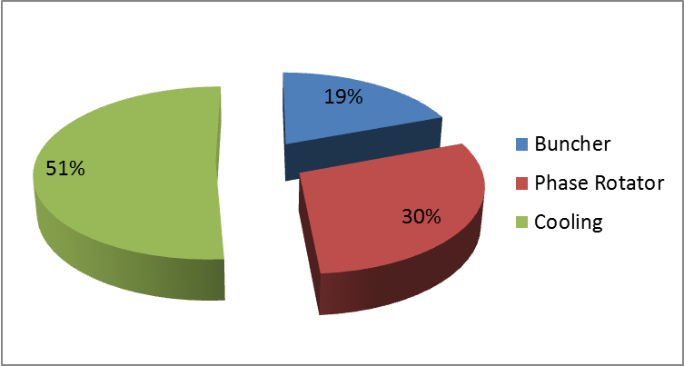
Muon Front-End
Engineering features being included by Alan Grant from Daresbury.
Cost of magnets+RF modules from Alan based on experience with MICE.
Other costs based on Neil’s FFAG cost model.

Slide 8
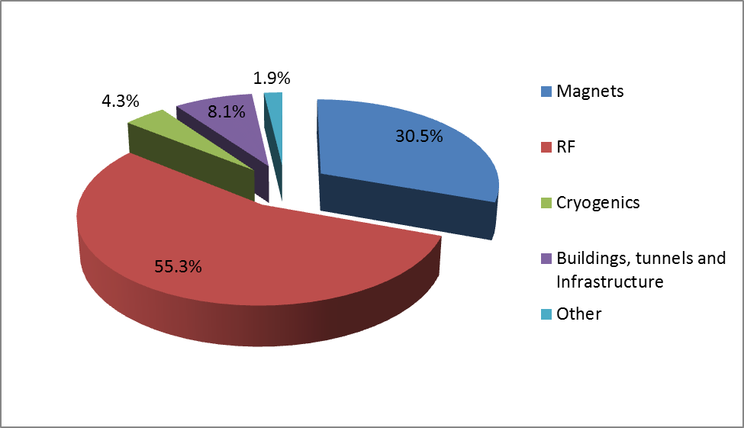
Buncher

Slide 9
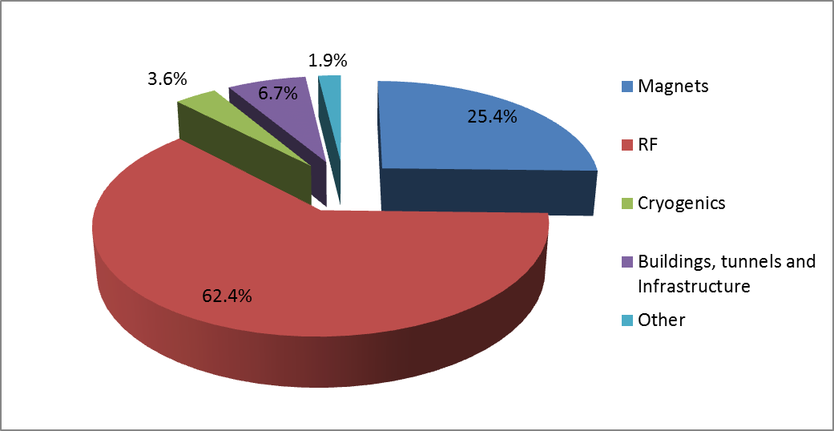
Phase-Rotator

Slide 10
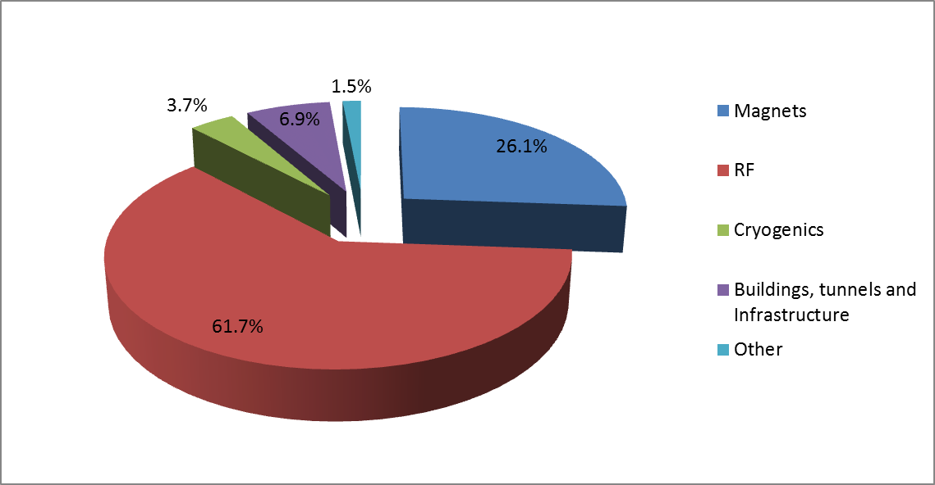
Cooling

Slide 11
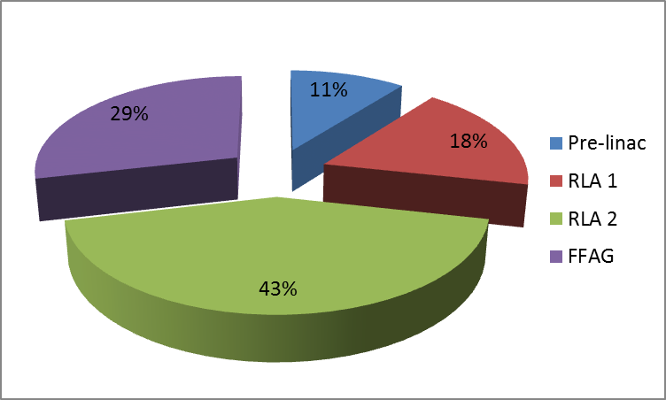
Muon Acceleration

Slide 12
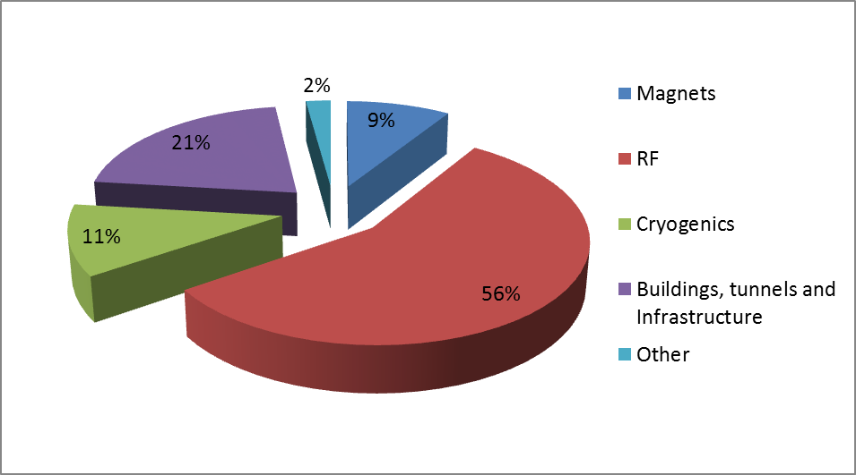
Muon linac
Linac solenoids based on capture/decay solenoids.
All other costs based on FFAG cost model.

Slide 13
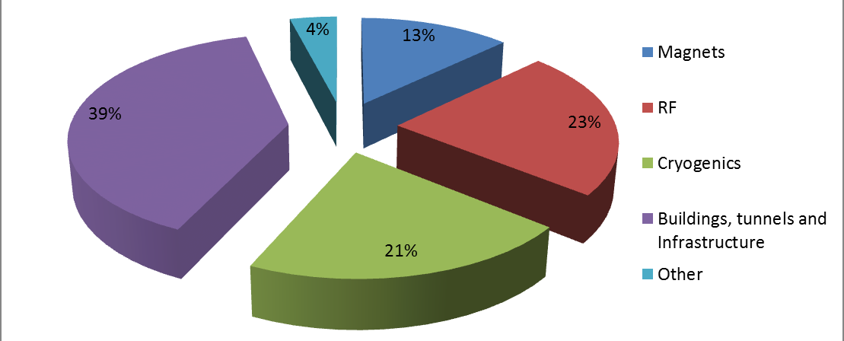
RLA 1
Includes injection chicane.
Magnet costs scaled from decay ring estimates from Norbert.
  Some magnets have not been included yet.
All other costs based on FFAG cost model.
  Thus, building is assumed to be cut and cover and not vertically stacked.
  Building scaled by total length.

Slide 14
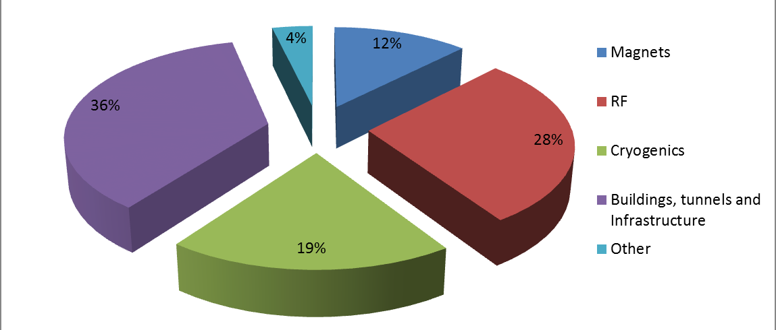
RLA 2
Includes injection chicane.
Magnet costs scaled from decay ring estimates from Norbert.
  Some magnets have not been included yet.
All other costs based on FFAG cost model.
  Thus, building is assumed to be cut and cover and not vertically stacked.
  Building scaled by total length.

Slide 15
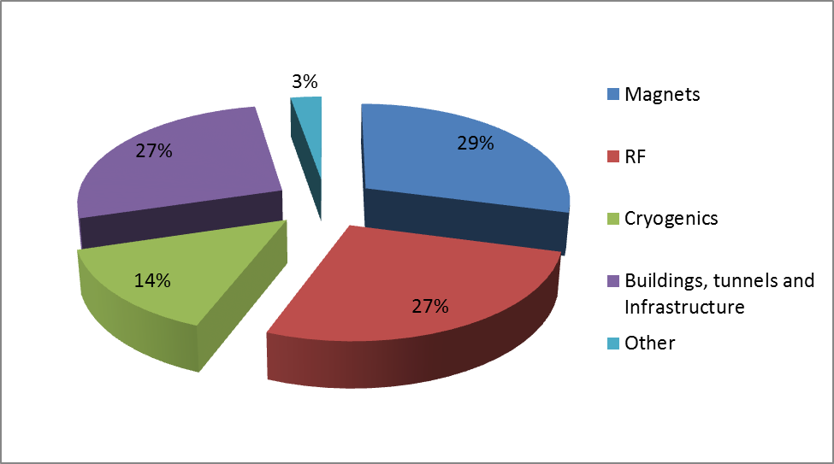
Muon FFAG
All costs based on FFAG cost model.

Slide 16
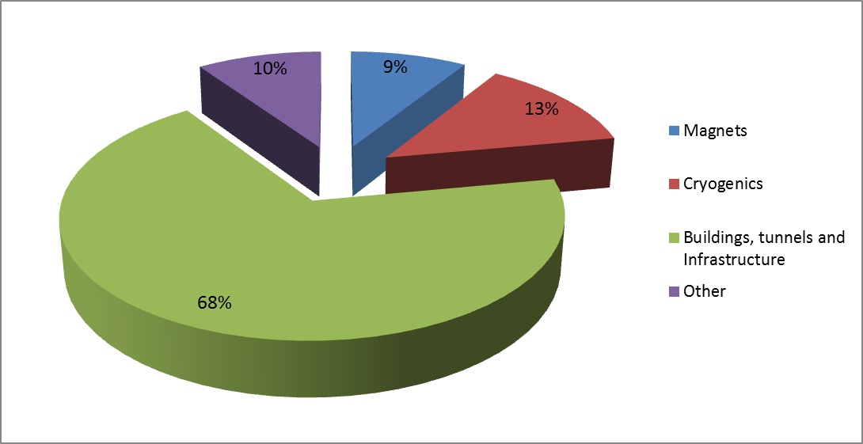
Muon Decay Ring
Magnets and tunnelling costs from Norbert Collomb.
  Some magnets have not been included yet.
  Cryogenic building costs not included.
All other costs based on FFAG cost model.

Slide 17
Some Caveats
Scaling of magnet costs may not be appropriate in some cases.
  i.e. Scaling with length.
Cost of magnet power supplies not included for most systems.
Better estimate of cryogenic heat load needed for most systems.
SC RF technology for muon acceleration still very much in R&D stage.
Target module costs require inflation from 2006.
Tungsten shielding estimates based on average cost of ungraded and class 1. (difference ~25%).
LBNE target hall not designed for liquid mercury and also has crane limit of 50 tons (NF would need >250 tons).
Chicane and proton absorber technology may change. Could increase cost.
Muon front-end requires redesign of lattice. Could increase length (probably only by few %).
Aperture for the linac cavities is bigger but gradient is less and there are one-cell cavities.
  Assume cost of one-cell cavity is half of 2-cell cavity.
  Assume one RF power system can power 4 one-cell cavities.
Some magnet costs missing from RLAs and the decay ring.
Cryogenic building costs not included for the decay ring.
  Only needed for the arcs.
Costs scaled from FFAG cost model is based on length and so assumes similar composition (e.g. density of magnets and RF) of the beam line.
Decay ring magnets scaled from ILC.
Transfer lines not included.
Radiation shielding for muon acceleration system buildings?
All costs are preliminary. Your investment may go up as well as down!

Slide 18
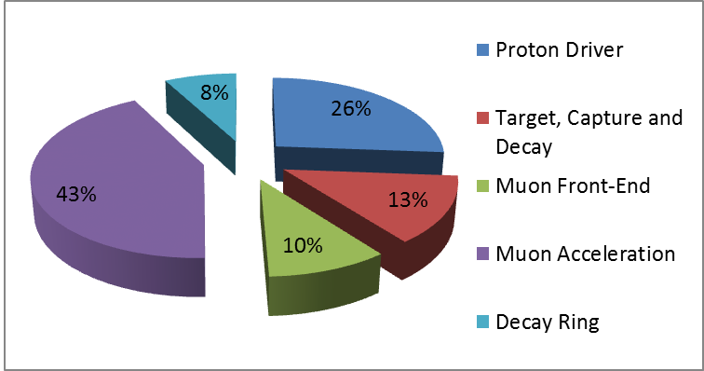
Relative Cost of Systems

Slide 19
Schedule and Milestones
June 2012 – “1.5 pass” cost estimate.
  For EUROnu report.
  Design should be complete (i.e. no holes)
  Include info from CERN about tunnelling, cabling, project phases, etc.
  June Dec 2012 – “Second pass” cost estimate
  More accurate information. (i.e. better than naïve scaling with length).
  Design should be closer to being finalised.
April 2013 – “Third pass” cost estimate.

Slide 20
Summary
A lot of work has been done with the limited resources available.
Some support from CERN civil engineering to cost tunnels only and CERN cite schematic.
Will need to update details for EUROnu report.
Much to do to reduce number of caveats between now and December.

