Slide 1
Concluding remarks

Slide 2
Contents:
θ₁₃ and the IDS-NF baseline
Opportunities and increments
How we left it at IDS-NF #7 and goals for #8
Costing exercise and RDR timeline
ICFA, taking an interest …
Next meetings

Slide 3
Baseline revision
Concluding remarks:

Slide 4
New IDS-NF baseline:
Reasoning:
  Set oscillation maximum at ~5 GeV:
    Chosen to be “far enough” from detector threshold;
  Implies source-detector distance of ~2000 km
    Need to consider surface detector
  Implies stored-muon energy of 10 GeV
Hence, IDS-NF 2012/3.0:
  Source:
    10 GeV stored muons;
    10²¹ muon decays (total) per 10⁷ s year
  Detector:
    100 kT MIND at 2000 km

Slide 5
New IDS-NF baseline:
Reasoning:
  Set oscillation maximum at ~5 GeV:
    Chosen to be “far enough” from detector threshold;
  Implies source-detector distance of ~2000 km
    Need to consider surface detector
  Implies stored-muon energy of 10 GeV
Hence, IDS-NF 2012/3.0:
  Source:
    10 GeV stored muons;
    10²¹ muon decays (total) per 10⁷ s year
  Detector:
    100 kT MIND at 2000 km

Slide 6
Accelerator facility & EUROnu final report:
EUROnu final report due to be complete 31Aug12;
  EUROnu final meeting June 2012, so essentially work must be complete by June;
  Too little time to work through changes to accelerator facility and to revise cost estimate
  So, proposed compromise:
IDS-NF 2012/3.1 (for EUROnu):
  Source:
    12.6 GeV stored muons;
    10²¹ muon decays (total) per 10⁷ s year
  Detector:
    100 kT MIND at 2000 km

Slide 7
Charges to working groups:
PPEG:
  Review optimization to identify optimum
    Or demonstrate breadth of sweet point
    Include consideration of NSI
Accelerator w/g:
  Review muon acceleration scheme
Detector w/g:
  Consider in detail feasibility of surface detector
  Review optimization of MIND for 10 GeV stored muons

Slide 8
Achievement of our goals
Concluding remarks:

Slide 9
How we left it at IDS-NF#7 and goals for IDS-NF#8
IDS-NF#8
Seek to agree elements of incremental approach
  Includes “1-increment” approach
RDR and costing:
  Identify items where specification is not complete and define timeline for closing specification
  First iteration of costing will be reviewed in “extended SG” on Friday afternoon
Position paper:
  My view is “yes”:
    Needs to be short;
      Produce template by Friday?
RDR timeline follows
Much discussion:
  RDR: IDS-NF 3.0
  Incremental approach:
    May have merit to exploit opportunities, so:
      “Must not be clueless”
      But remain focused on IDS-NF baseline
RDR and costing:
  Update of RDR and costing timeline follows;
  Excellent discussion in Accelerator w/g has led to identification of missing elements
  Costing for EUROnu requires care
  “Set fair” for cost review this afternoon
Position paper:
  Headings and lead authors will be discussed in SG this afternoon
RDR timeline …

Slide 10
Costing exercise and RDR timeline:

Slide 11
ICFA
Concluding remarks:

Slide 12
IDS-NF and ICFA:
Despite some scepticism:
  Perceive it to be beneficial that ICFA takes an interest in lepton-flavour physics and neutrino physics;
  We are interested in an independent review of the RDR;
Therefore:
  Seek to influence the development of ICFA’s interest in and activity in support of our efforts and our field

Slide 13
Next meetings:
Introduction and aims:

Slide 14
Next meetings:
IDS-NF plenaries:
  #9:
    October 2012; US
      FNAL, dates to be proposed by Alan Bross
  #10:
    April 2013; Europe
      Volunteers needed

Slide 15
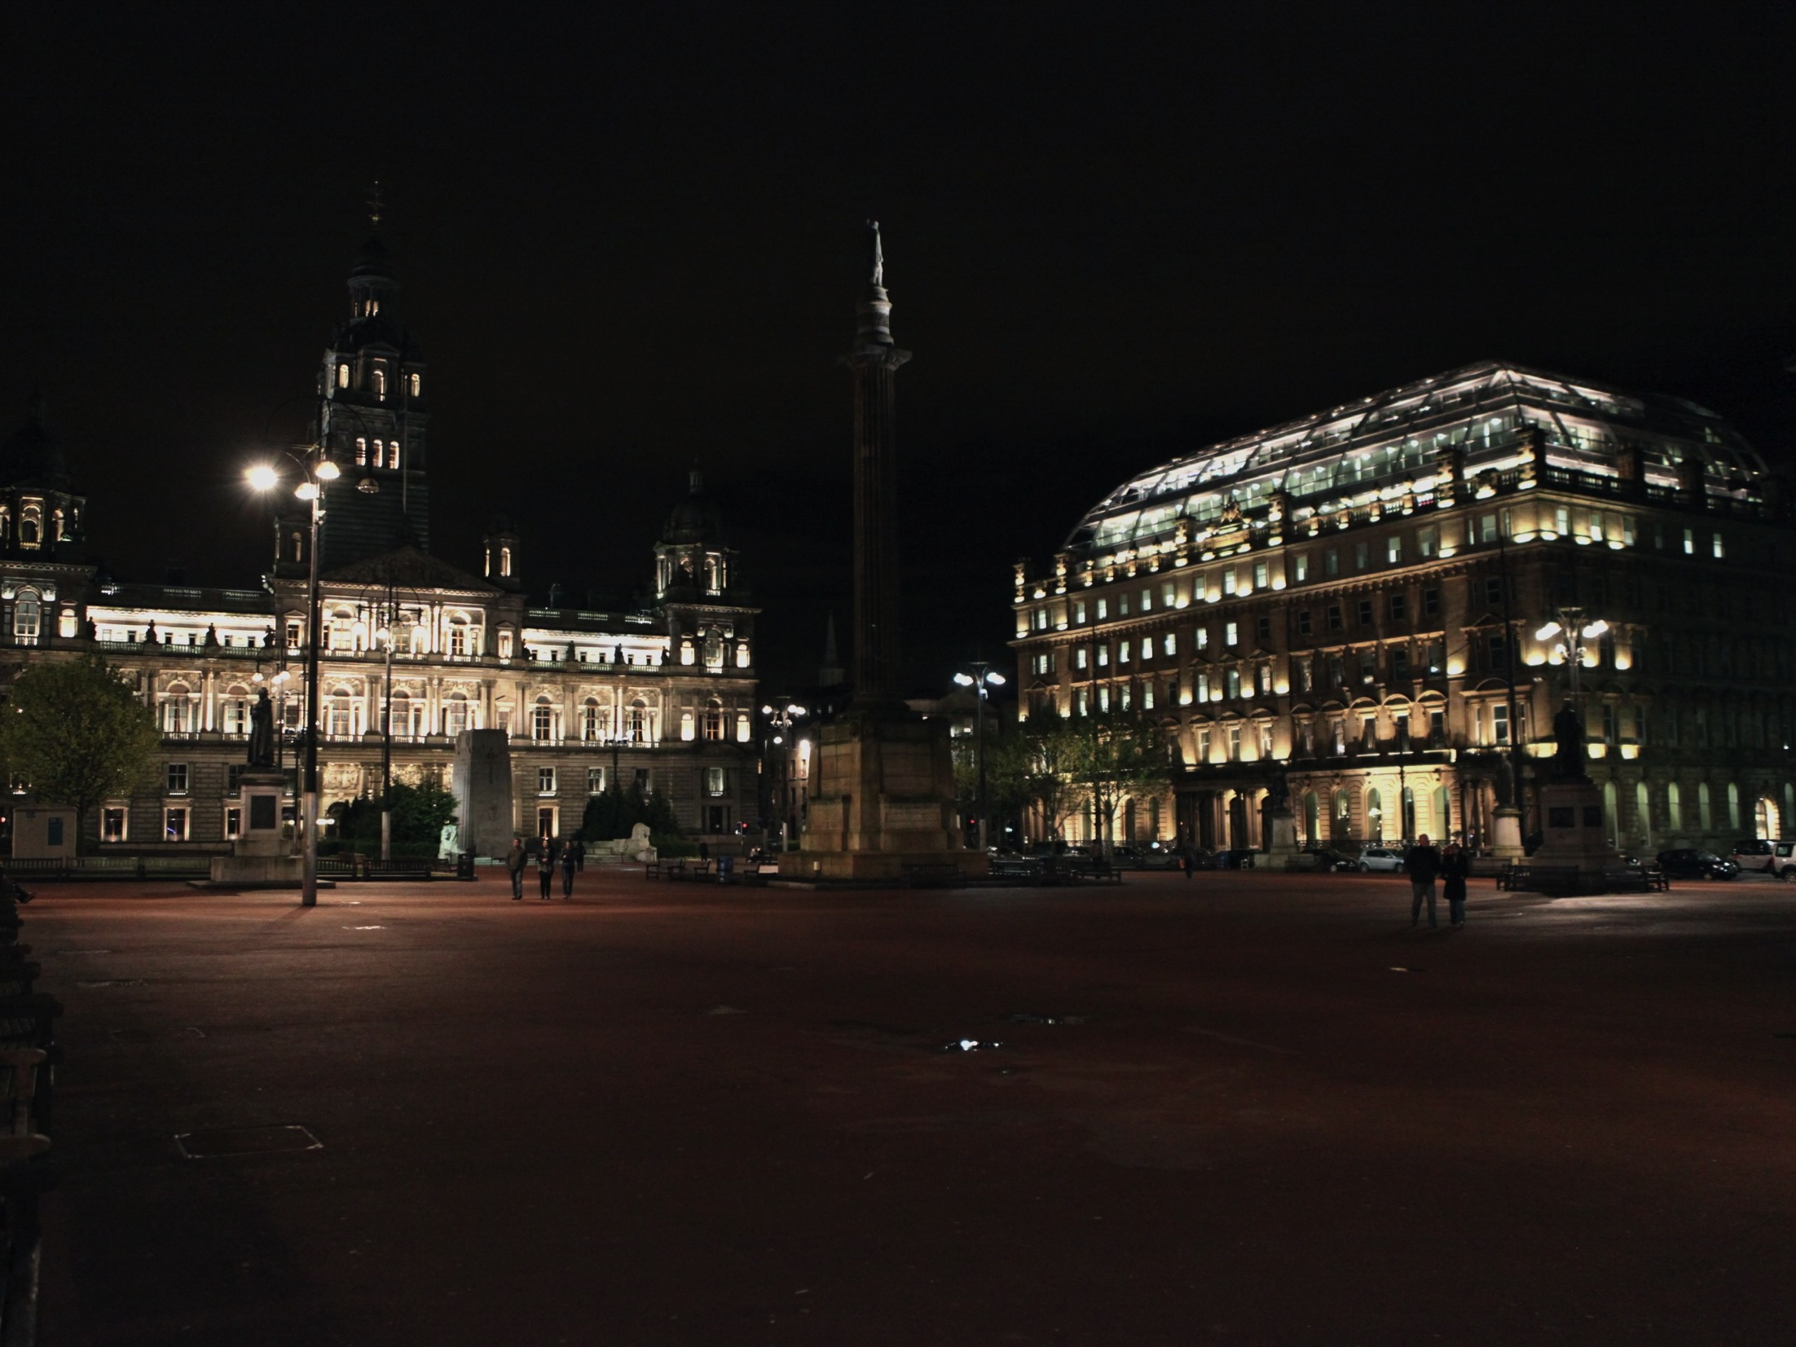
And finally…
Many thanks to:
  Valerie Flood
    Paul Soler and Ryan Bayes and Andrew Pickford (IT)
For this excellent, well organized meeting

