Slide 1
Detector Working Group Summary
&
Plans

Slide 2
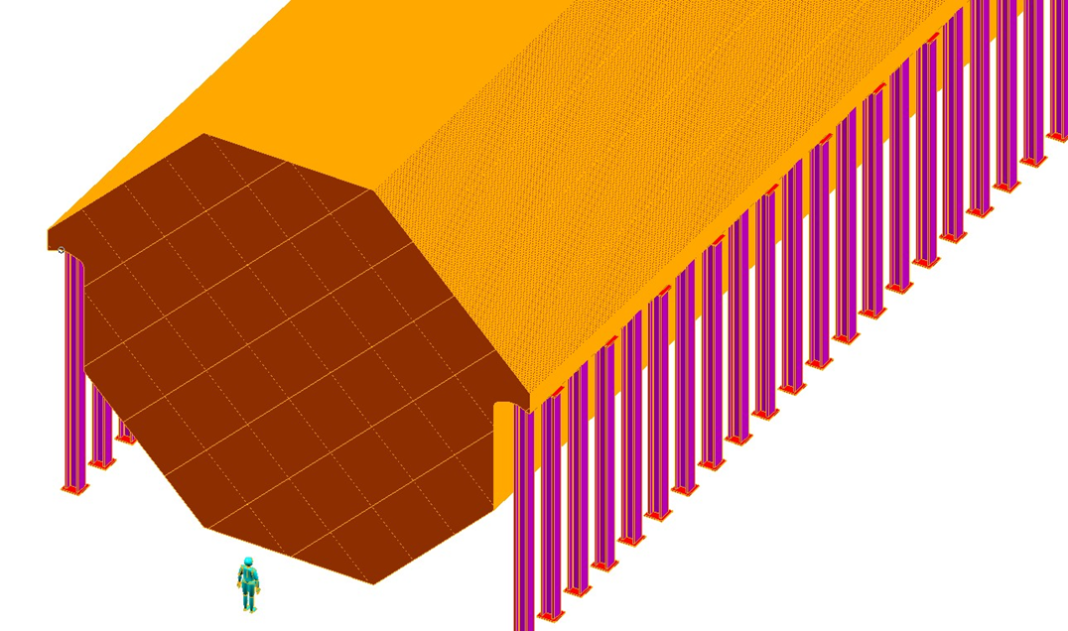
Far Detector
MIND
  Baseline has not changed
  R&D limited
  Costing in place
  Sensitivity analysis for new E_{μ} (10 GeV(ish)) needs to be done
    This is important, but we do not expect surprises

Slide 3
Near Detectors
Two Options
  HighResMNu (developed for LBNE)
  SciFi
HIResMNu
  Straw tracker, EM Calor, TRD and μ spectrometer
  Meets all needs for ND
  Detector technology exists
  Costed

Slide 4
Near Detectors II
SciFI
  20 stations of scintillating fiber trackers
  5 cm thick active (scintillator) absorbers
  Dipole field
  Also appears to meet NF ND needs
  Little required R&D
  Not yet costed

Slide 5
I could end here, but we did have an extended discussion regarding the VLENF
First Step towards THE NF?

Slide 6
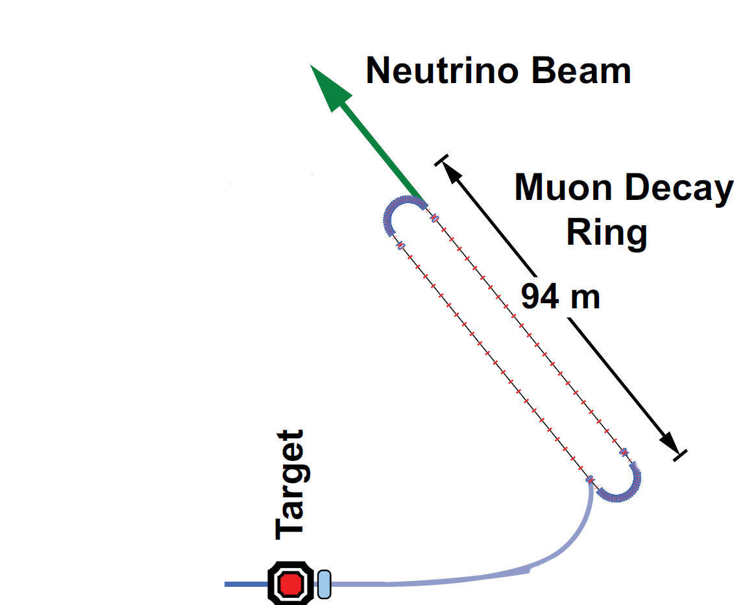
Baseline(s)
100 kW Target Station
  Assume 60 GeV proton
    Fermilab PIP era
  Be target
    Optimization on-going
  Li Lens or horn collection after target
Collection/transport channel
  Two options
    Stochastic injection of π
    Kicker with π → μ decay channel
    At present NOT considering simultaneous collection of both signs
Decay ring
  Large aperture FODO
  Racetrack FFAG
  Instrumentation
    BCTs, mag-Spec in arc, polarimeter
108 m

Slide 7
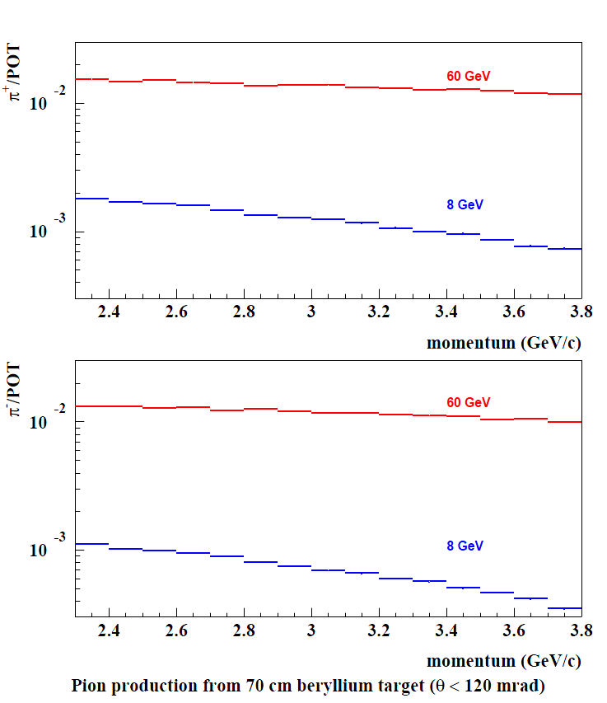
π production
Sergei Striganov
Fermilab
In momentum range
2.7 < 3.0 < 3.3
Obtain
0.11 π⁺/pot
0.10 π⁻/pot
with 60 GeV p
What Fraction of this can we
actually accept and transport?

Slide 8
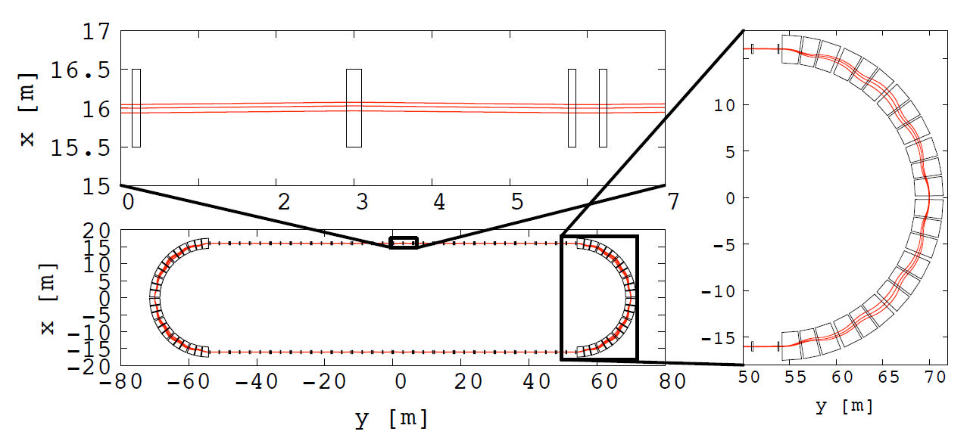
FFAG Racetrack
Lagrange & Mori
Kyoto
δp/p ≈ 15%
acc-kurri – 1119-01-2011
2 GeV/c
Low dispersion in straight

Slide 9
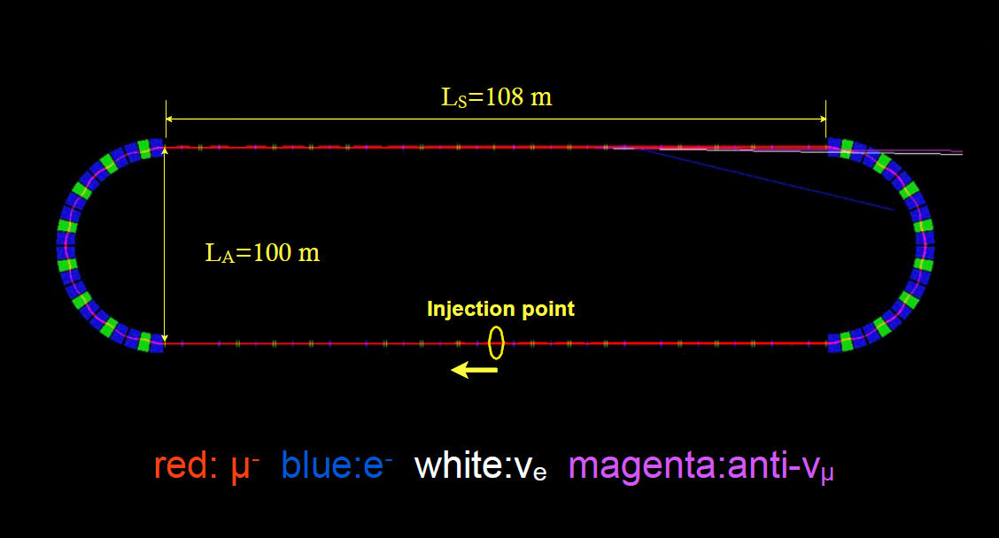
RFFAG Tracking Studies
Akira Sato
Osaka

Slide 10
Assumptions
N_{μ} = (POT) X (π/POT) X ε_{collection} X ε_{inj} X (μ/π) X A_{dynamic} X Ω
  10²¹ POT in 5 years of running @ 60 GeV in Fermilab PIP era
  0.1 π/POT
  ε_{collection} = 0.9
  ε_{inj} = 0.9
  μ/π = 0.08 (γct X μ capture in π → μ decay) [π decay in straight]
    Might do better with a π → μ decay channel
  A_{dynamic} = 0.9 (from G4Beamline simulation)
  Ω = Straight/circumference ratio (0.34)
This yield 2 X 10¹⁸ useful μ decays

Slide 11
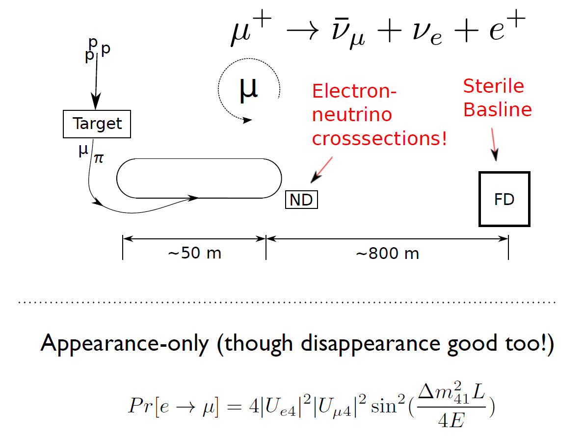
Experimental Layout
Appearance
Channel:
ν_{e} → ν_{μ}
Golden Channel
Must reject the
“wrong” sign μ with
great efficiency
100
Why ν_{μ} → ν_{e}
Appearance Ch.
not possible

Slide 12
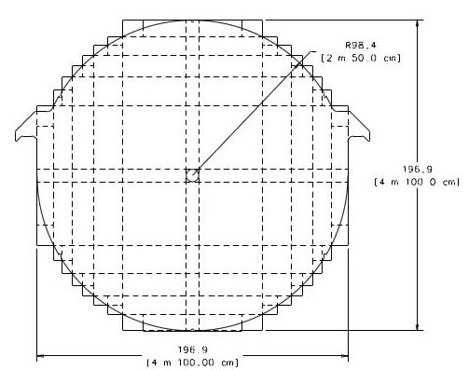
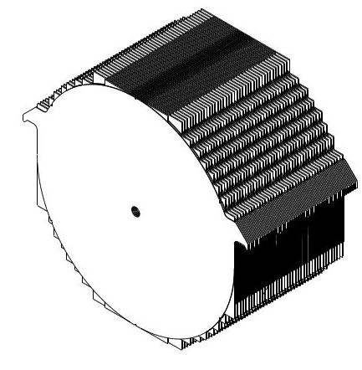
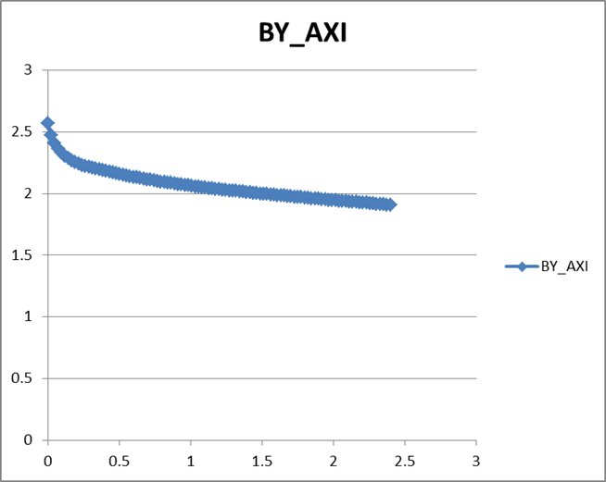
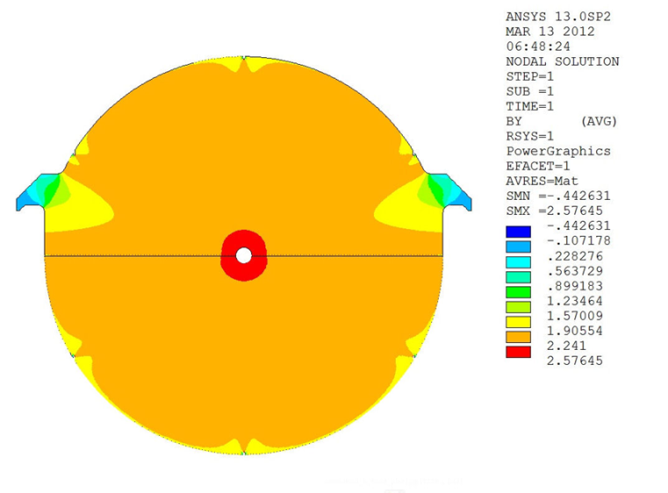
Baseline Detector
Super B Iron Neutrino Detector: SuperBIND
Magnetized Iron
  1 kT fiducial volume
    Following MINOS ND ME design
    1 cm Fe plate
    5 m diameter
  Utilize superconducting transmission line for excitation
    Developed 10 years ago for VLHC
  Extruded scintillator +SiPM
20 cm hole
For 3 turns
of STL

Slide 13
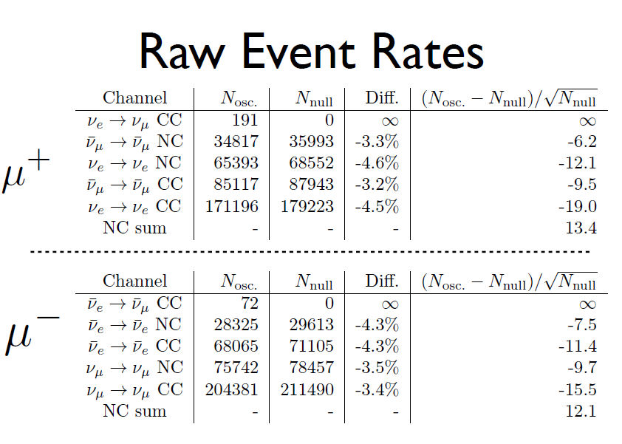
Event Rates

Slide 14
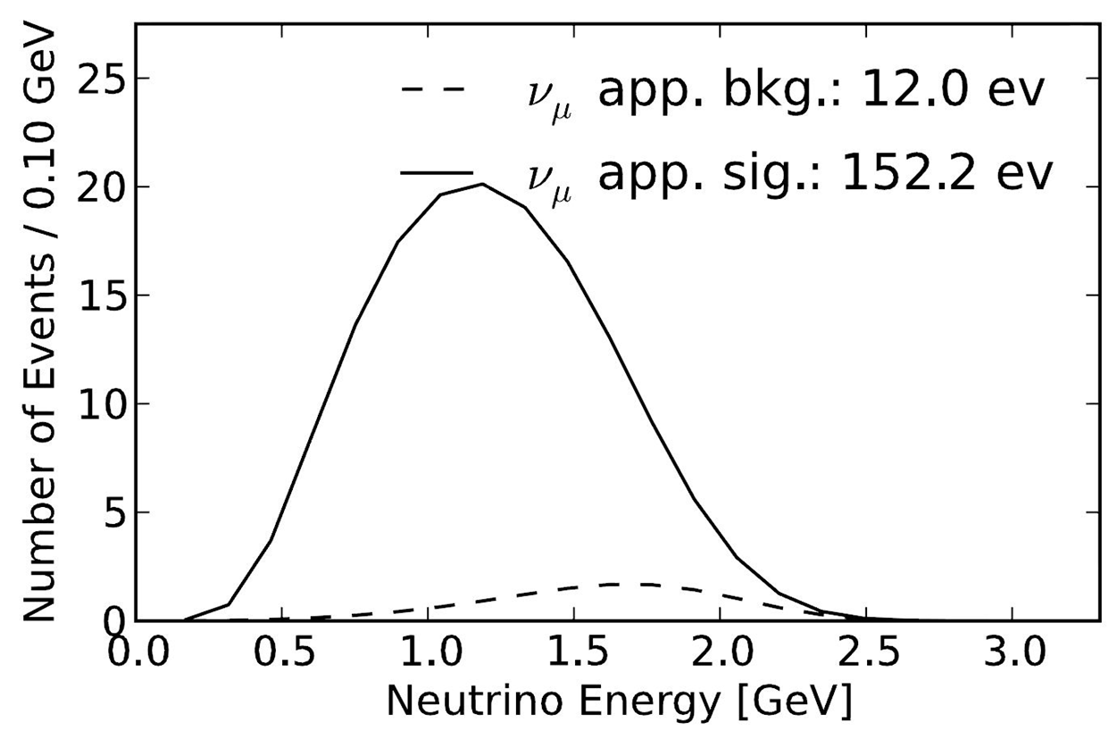
Appearance Channel

Slide 15
Sensitivity – ν mode
CPT invariant to LSND/MinBooNE
Chris Tunnell
Oxford

Slide 16
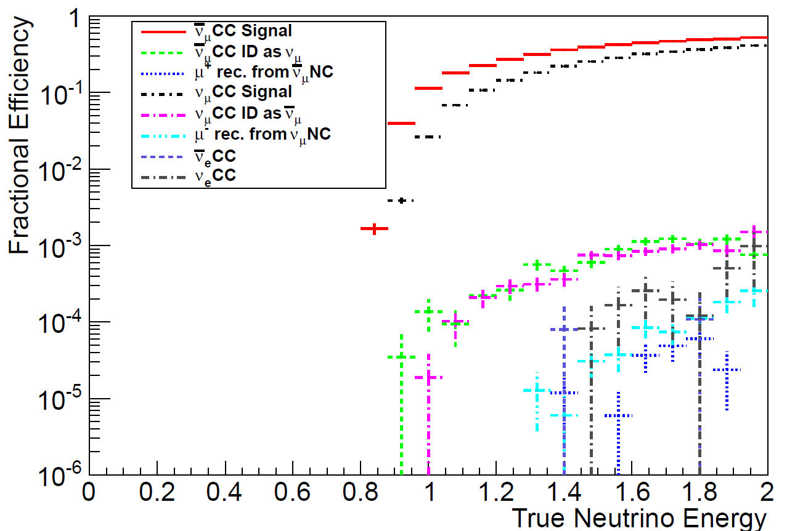
But……
Ryan Bayes
Glasgow
But, so far, we
Have not reached the
Eff/bkg rej. We want/need
Change E_{μ} from 2 GeV
To
3 GeV

Slide 18
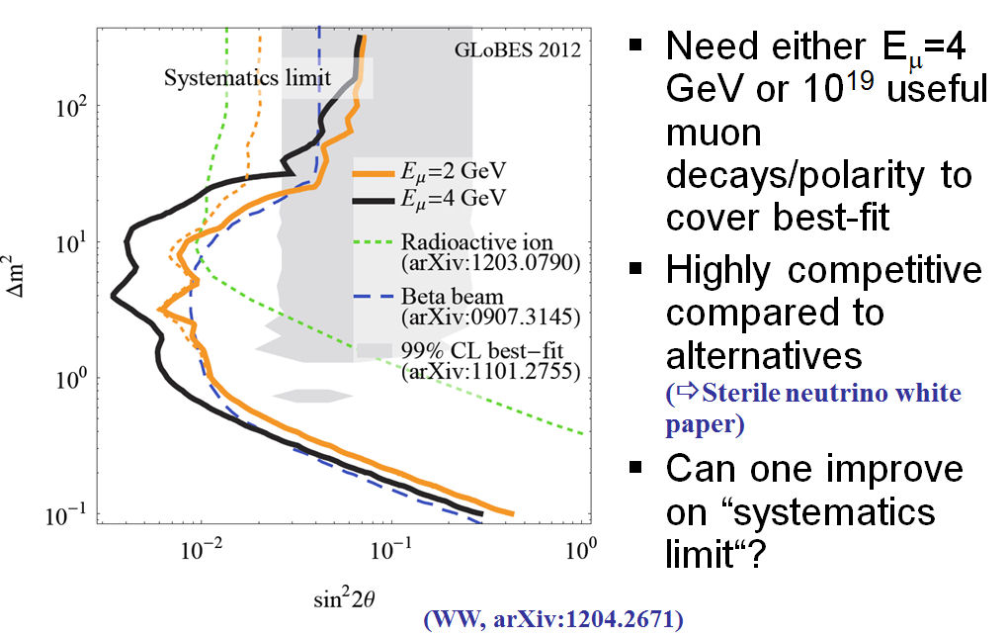
ν_{e} Disappearance
Walter Winter
JM-UW

Slide 19
Outlook
Future Work:
Facility
  Targeting, capture/transport & Injection
    Need detailed design and simulation
  Decay Ring optimization
    Continued study of both RFFAG & FODO decay rings
  Decay Ring Instrumentation
    Define and simulate performance of BCT, polarimeter, Magnetic-spectrometer, etc.
  Produce full G4Beamline simulation of all of the above to define ν flux
    And verify the precision to which it can be determined.

Slide 20
Outlook II
Future Work:
Detector simulation
  For oscillation studies, continue MC study of backgrounds & systematics
    Also investigate disappearance channels
  In particular the event classification in the reconstruction needs optimization.
  For cross-section measurements need detector baseline design
    Learn much from detector work for LBNE & IDS-NF
      Increased emphasis on ν_{e} interactions, however
    Near Detector hall could be envisioned as ν detector test facility

Slide 21
VLENF can do both ν_{e} and ν_{μ} disappearance, in both polarities
VLENF can cover ν_{e} disappearance best-fit
VLENF outperforms basically any alternative setup
(⇨ Sterile neutrino white paper) in which there are 21 experimental possibilities discussed.

Slide 22
A NF by any other name is still a NF
I have felt strongly that whatever we call this effort, NF should be in the name
However, recent events have changed my mind
What is unique?
  A new way to produce high-energy νs
νSTORM
Neutrinos from STORed Muons
Thanks to Joachim

Slide 23
Conclusions
νSTORM:
Delivers on the physics for the study of sterile ν
  Offering a new approach to the production of ν beams and will allow us to confirm/exclude LSND/MiniBooNE ν-bar data
Can add significantly to our knowledge of ν cross-sections, particularly for ν_{e} interactions
Provides an accelerator technology test bed
  But can also utilize existing accelerator infrastructure
Provides a powerful ν detector test facility
First step on a long Journey?

Slide 24
END

