Slide 1
Precision on leptonic mixing parameters
Andrea Donini (CSIC, IFT/IFIC)
in collaboration with
P. Coloma, E. Fernández Martínez and P. Hernandez,
arXiv:1203.5651 [hep-ph]

Slide 2
Present status on θ₁₃
Global analysis, 2008:
T2K, 2011:
MINOS, 2011:
D-Chooz, 2011:
Daya Bay, 2012:
RENO, 2012:
θ₁₃ is different from zero at more than 5σ

Slide 3
Is precision an issue?
Question first asked during the last stages of ISS
In the hadronic sector, precision on the CKM matrix elements is a requirement for:
  model building
  new physics searches
Precision on θ₁₃ will play the same role
Precision on δis a different issue: the CP discovery potential is strongly affected by the true δvalue

Slide 4
Comparing facilities
The different neutrino oscillation facilities are usually compared on the basis of:
  their CP discovery potential (i.e. their capability to distinguish a non-vanishing CP violation from δ= 0, π)
  sensitivity to the mass hierarchy
  sensitivity to deviations from θ₂₃ maximal mixing
  others…
We propose to compare them also on the basis of the precision on θ₁₃ and δ

Slide 5
Assumptions
To perform our comparison, we assume that:
  the hierarchy is measured, either by the experiment under study, or by its combination with planned experiments such as T2K/NOνA or with atmospheric neutrino data
  no octant degeneracies are taken into account
  the intrinsic degeneracies are solved by the experiment under study (always true with a few exceptions that will be discussed)

Slide 6
Observables
We consider:
  the relative error on θ₁₃
  the absolute error on δ
We marginalize over atmospheric and solar parameters and over the matter density
We compare three kinds of technologies:
  Super-Beams: T2HK, LBNE, LBNO (C2P/SPL)
  Beta-Beams: γ=100 and γ= 350 with He/Ne
  Neutrino Factory: E_{μ} = 10 GeV and E_{μ} = 25 GeV
  (one-baseline only, as the magic baseline detector is not needed anymore)

Slide 7
Precision bands

Slide 8
Scaling of
If is statistics-dominated:
If is dominated by the systematic error on the signal:
If is dominated by the background (and the background isθ₁₃–independent):

Slide 9
: Super-Beams
Daya Bay
now
Background-dominated errors
extrapolated
Systematics-dominated errors
Statistics-dominated errors

Slide 10
β-beams and ν-factories
All setups: statistics-dominated errors

Slide 11
Scaling of Δδin vacuum
For a narrow on-peak beam, combining neutrinos and anti-neutrinos we get (in vacuum):
A strong dependence of Δδon the true value ofδis found.
If the beam is broad, the divergence at δ = ±π/2 smooths out.

Slide 12
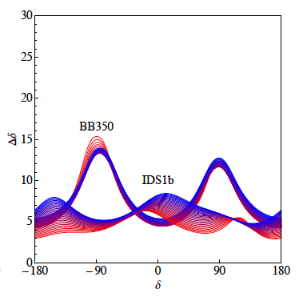
Scaling of Δδin matter
(different lines stand for different θ₁₃)
Matter has two effects:
(1) peaks in Δδmove;
(2) the δ-dependence softens.

Slide 13
Δδ: Super-Beams

Slide 14
Δδ: β-beams and ν-facts

Slide 15
Comments
Beta-beams precision is strongly affected by the δ- dependence of Δδ
  very good precision around δ= 0,π (this is why they have a CP-fraction similar to Neutrino Factories)
  rather poor precision for δ= ±π/2
The γ = 100 β-beam suffers from unsolved intrinsic degeneracies forδ~ ±π/2. This problem can be alleviated by a more refined detector analysis or by combining with the SPL
The NuFact precision depends significantly on the matter uncertainty (shown results are for 2%)

Slide 16
Conclusions
Among the considered setups, Neutrino Factories (either 10 or 25 GeV) are the only ones that can reach a precision onθ₁₃ better than reactors (Δθ₁₃/θ₁₃~ 1.5%)
The error on δat “short” baseline setups (T2HK, SPL, beta-beams) depends strongly on δand it is rather poor for δ~±π/2. At “long” baseline setups (LBNE,C2P and neutrino factories), matter effects smooth out this dependence.
A Δδ~ 5° can be reached for δ~±π/2 at Neutrino Factories (Δδ~ 7° for any δ).

Slide 17
Backup slides

Slide 18
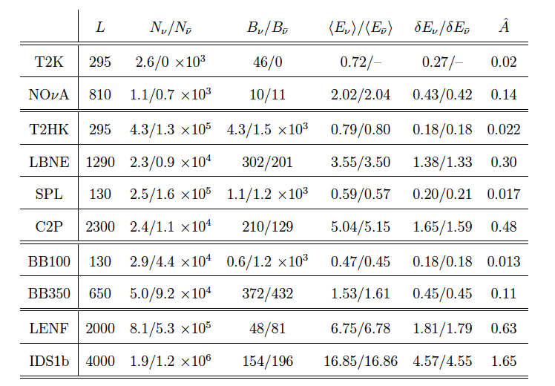

Slide 19
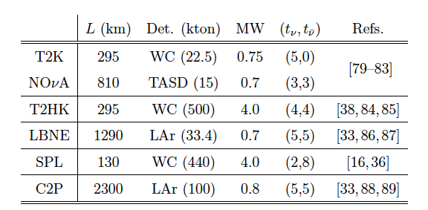
SB Setups definition
 | T2HK | LBNE | C2P | SPL
Pots |  | 7.3 10²⁰ | 1 10²¹ | 5.6 10²²

Slide 20
Systematics at SB
Correlated bins: 5% normalization errors over signal and background
Uncorrelated channels
If possible, more sophisticated analysis and near detector taken into account

Slide 21
BB details
Better errors: 2.5% over the signal, 5% over the background (that, however, is much smaller)
Standard fluxes: 1.1 (2.9) 10¹⁸ Ne/He decays per year

