Slide 1
IDR Costing Exercise
IDS-Neutrino Factory
My presentation today
Some general remarks
What needs to be done for the IDR costing?
  What we can realistically expect for the IDR –expectation bar !
Methodology to adopt for the cost evaluation – IDR and beyond
      Cross-check existing (or to come) cost evaluations of various systems
      How to go around cases where no cost evaluation is available within the IDR timescale
Ilias Efthymiopoulos, Pierre Bonnal – CERN

Slide 2
Some general remarks
A cost estimate in the IDR or other public document should refer to a given project (i.e. neutrino source + detectors) to achieve a given physics performance
  Consistency throughout the document: physics, detector, accelerator
  Different options can be included but in a clear way not to confuse the readers

Slide 3
Some general remarks
We should present an objective cost, i.e. what we estimate with today’s knowledge will be needed to build the facility
  do not hide complications or unknowns → risk register
Is there a ceiling for the total cost of a NF we should respect?
  Can we present a ≥ 10 GUSD project?
  Present the full project → we’ll do staging if asked, do not provoke it from the beginning
  Apply confidentiality to cost figures until costing exercise is completed
If we present a cost in the IRD, we must:
  Explain differences (not necessarily in the text) wrt to previous study
    Factor wrt to 1.8GUSD (accelerator only)?
  Establish a budget control to monitor thereafter the cost of the project
    Any cost increase must be justified
    Technical solutions should involve cost considerations

Slide 4
What needs to be done for the IDR?
Getting a complete costing for the facility would be rather challenging
  Collective effort, needs engineers not only physicists!
IDR is an intermediate document → preliminary cost estimate
  Do we all have it clear what is the IDR, what’s next, what’s the RDR?
    New physics in between – new (likely) political decisions ?
  Do we want to show numbers at this stage?
Demonstrate to possible funding agencies that a certain level of maturity in matters of costing is achieved
Hope:
  Establish baseline : parameters + documentation on choices wrt options
  Complete PBS and identify cost drivers
  Provide means to evaluate options wrt cost
  Indicate methodology to address risk register and mitigation solutions

Slide 5
NF costing: methodology to adopt
Start from the baseline (+and options)
Establish the Project Breakdown Structure
  Describes the components of the baseline: sub-systems, sub-sub-systems etc.
  Start with Cristian’s file → load it to Costing Tool
For each of them, identify activities to perform – Work Breakdown Structure
  Include Engineering activities
    EMC studies, radiation hardness of equipment, accelerator & detector physics optimization,
    safety/environment engineering, risk analysis, commissioning, ramping-up, etc.
    Apply a global approach if not explicitly studied : +40% on material cost
  Do not include operation costs, dismantling costs
Then try to evaluate costs associated to these activities, by all means
  Setup and adopt common rules

Slide 6
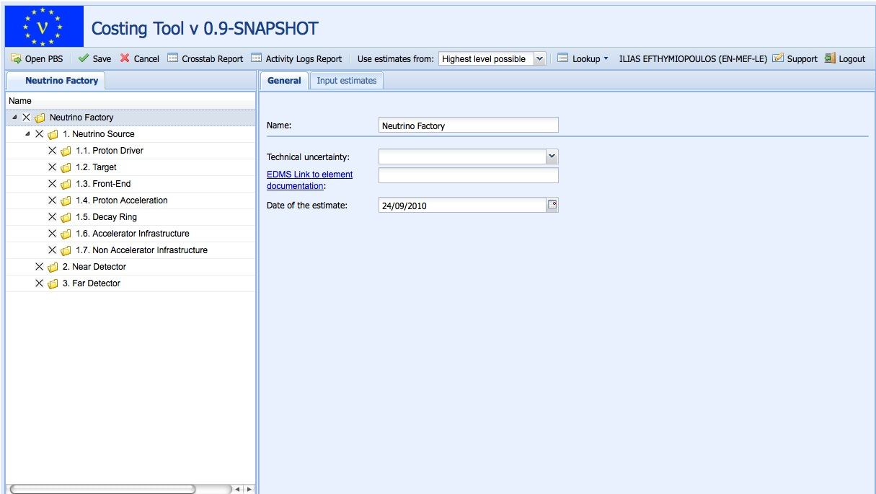
NF costing: CERN costing tool

Slide 7
NF costing: methodology to adopt
At (sub-)system level
  If analytical approach possible:
    Detailed design + tendering + contracting / Manufacturing design + tooling procurement
    Raw material + manufacturing costs / Quality control + logistic
    Installation + pre-commissioning
  If not possible: global approach.
Create an Assumption Data Sheet
  Sourcing of the data/figures:
    Derived from previous projects
    Derived from analytical tool such as DFM/A…
    Quotes from manufacturers
  Monetary figure + currency + date + location
    E.g. 5 M US$ of 1997 ; Illinois USA
    300 k CHF of 2007 ; Geneva CH
Economical/financial factors taken care within the costing tool:
  location, FX, price escalation…

Slide 8
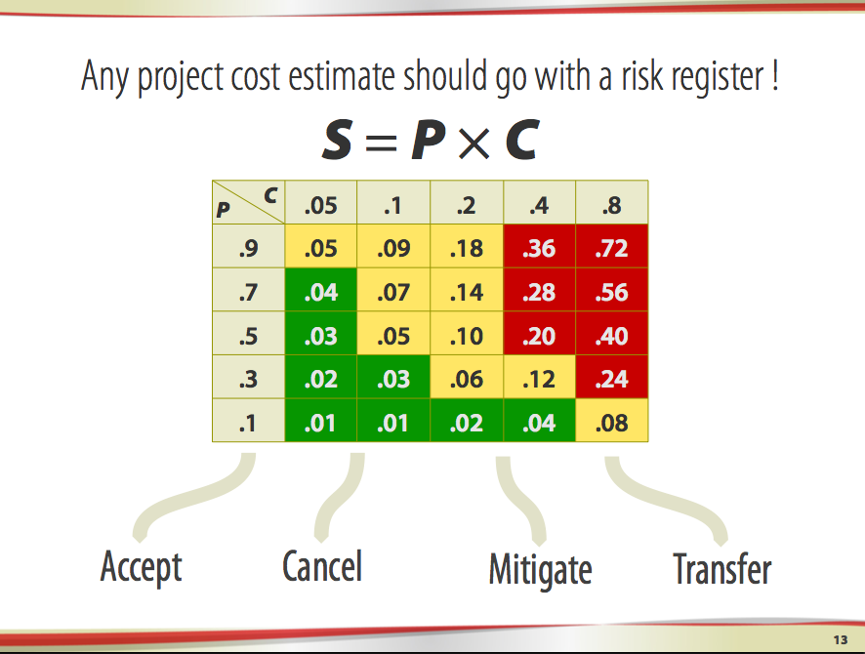
NF costing: methodology to adopt
Risk Register
Do we need a general risk register for the project?
Risk register where no technical solution is available

Slide 9
NF costing: methodology to adopt
Options : justify options in the project based on
  Expected improvements in technology
  Performance improvement that justifies the study
  Possible cost reduction
    Note: our estimates will be ±50%, the same with the cost reduction option → how to argue with such errors?
Cost aggregation by blended sub-system cost estimates
  And choice or options
De-contextualization: we should find a context-free aggregation summary
  Totals in NFC (Neutrino Facility Currency) or IMU (Imaginary Monetary Unit)
    e.g. 1 NFC = x USD + y EUR + z JPY
  Location = Neutrino Facility land where cost rates are ⅓ USA costs + ⅓ Europe costs + ⅓ Japan cost

Slide 10
NF costing: methodology to adopt
What’s next:
Release Guidelines for cost estimating
  including template for Assumption Data Sheet
Complete and upload Cristian’s PBS in CERN Costing tool
Send you PBS for acceptation
Send you draft pre-filled Data Sheet for Annotation, Amendment, Augmentation
You complete whatever available – return it!
Then upload this data in the CERN Costing tool

Slide 11
And then ……

