Slide 1
Introduction and aims:

Slide 2
Contents:
The Interim Design Report
Large ϴ13 and incremental approach
Preparing the ground for the RDR
Next meetings and timeline

Slide 4
Interim Design Report
Introduction and aims:

Slide 5
2010/11 the year of the IDR:
Last IDS-NF plenary was Sep10 at RAL
Since then:
  IDR writing w/s
    #1 Dec10 at Imperial
    #2 Jan11 at FNAL
  IDR posted as IDS-NF-020, Mar11
  Rehearsals for ECFA neutrino panel review, Apr11
  ECFA panel review: 5th and 6th May at Daresbury Laboratory
  25May11: costing w/s at CERN

Slide 6
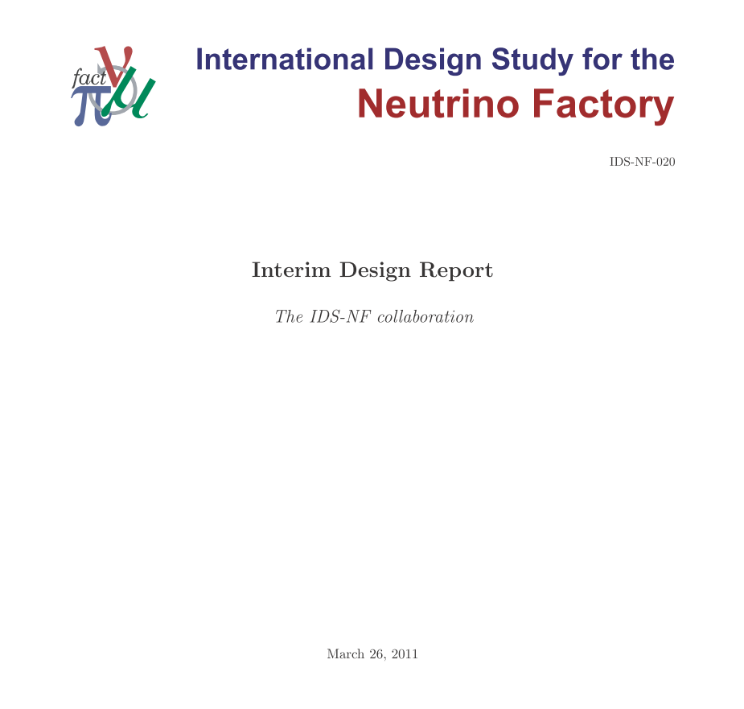
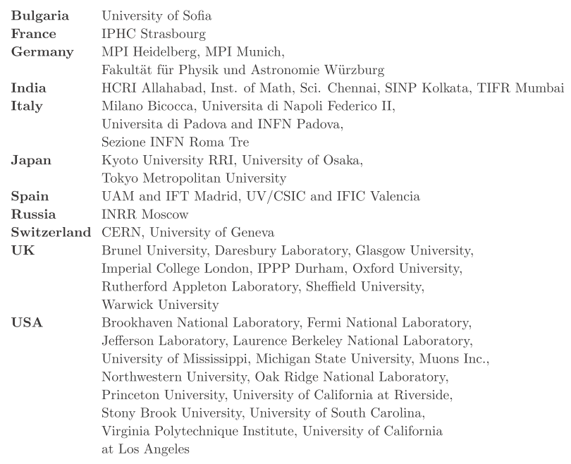
https://www.ids-nf.org/wiki/FrontPage/Documentation/IDR

Slide 7
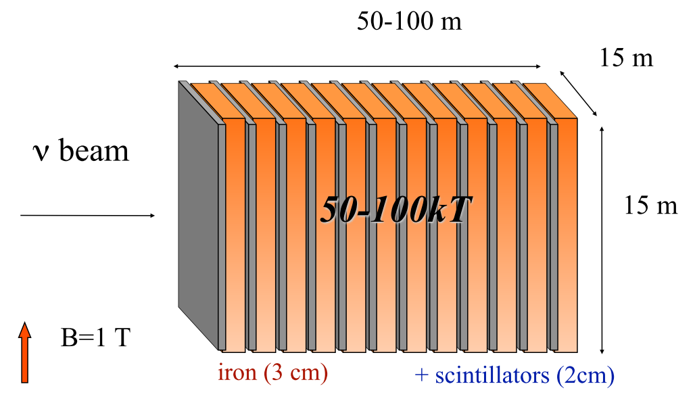
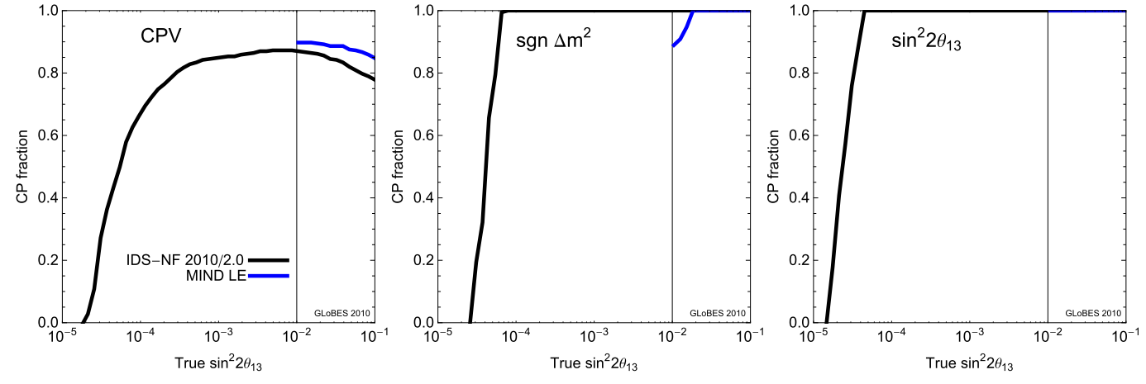

Slide 8
ECFA Neutrino Panel:
Panel met on the 5th and 6th of May at DL:

Slide 9
Reprise: ToR and membership:

Slide 10
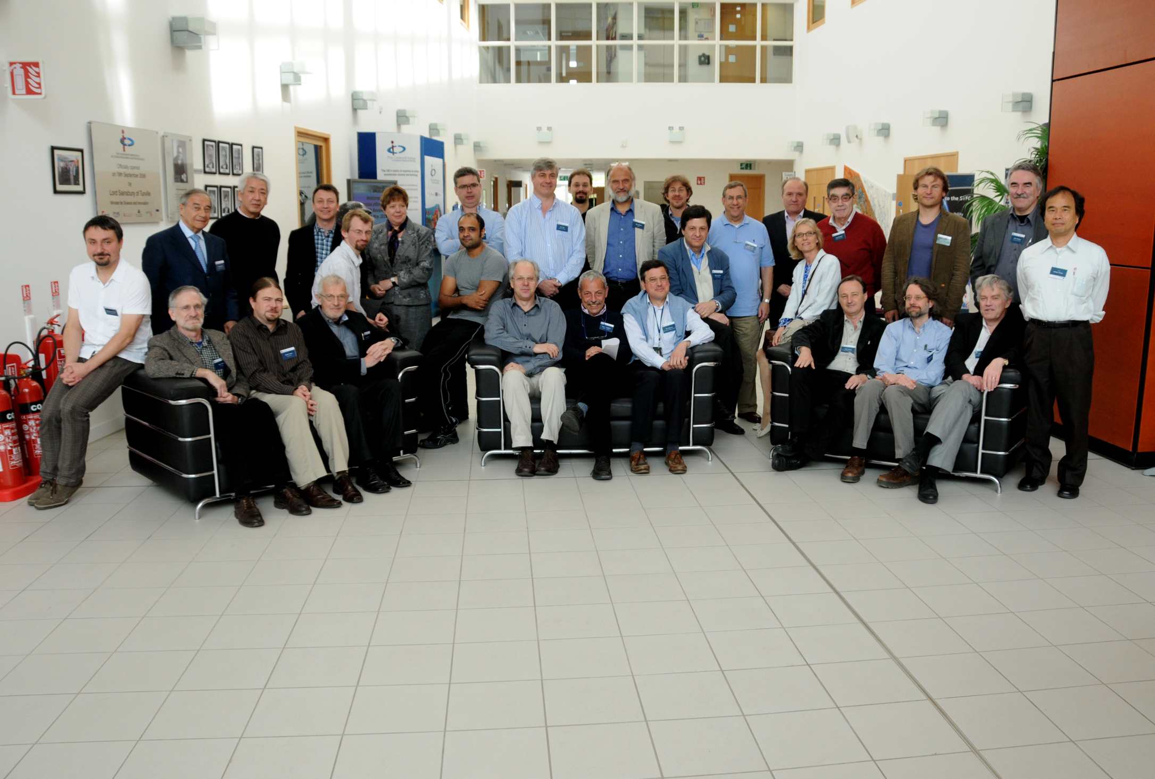

Slide 11
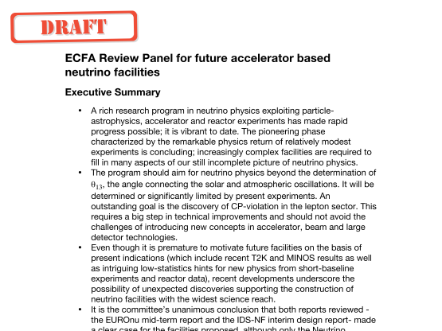

Slide 12
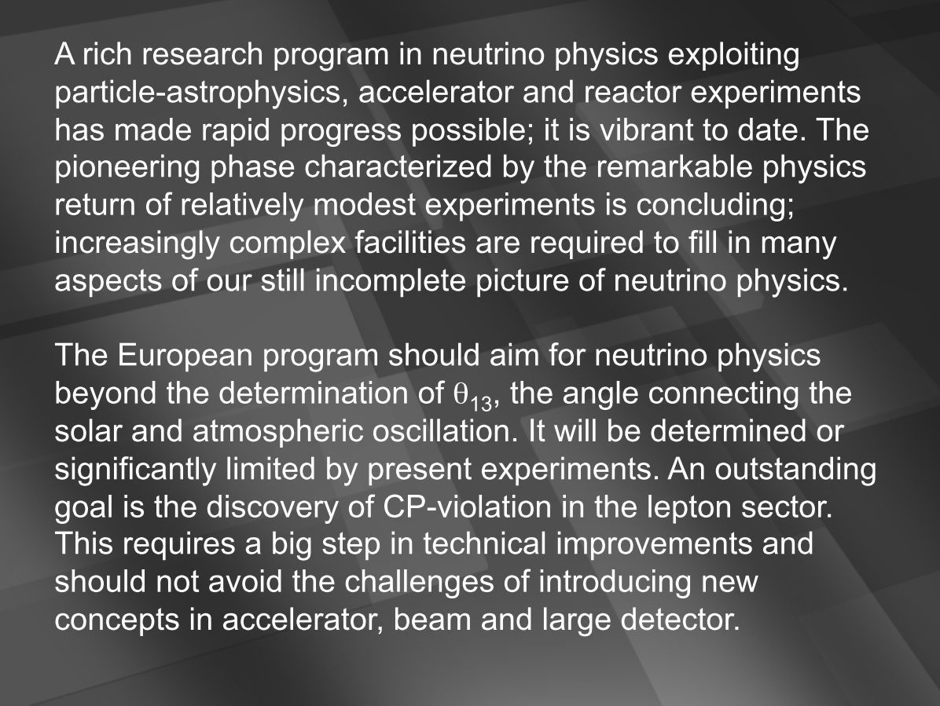

Slide 13
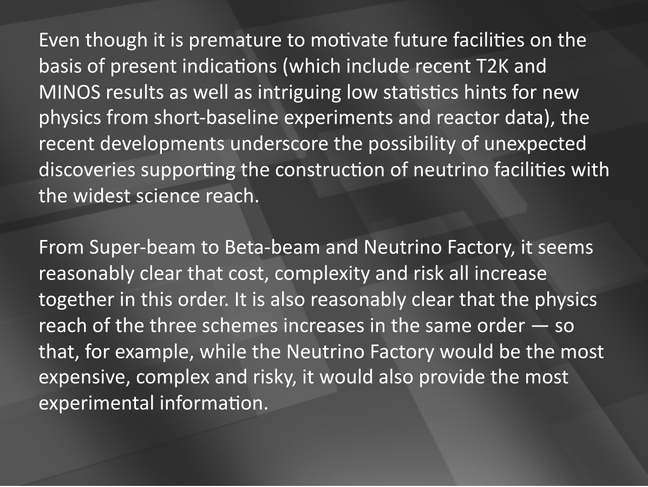
Note: cost estimation is goal of IDS-NF and EUROnu
so community comment likely to be to express this
conclusion as an opinion rather than a fact.

Slide 14
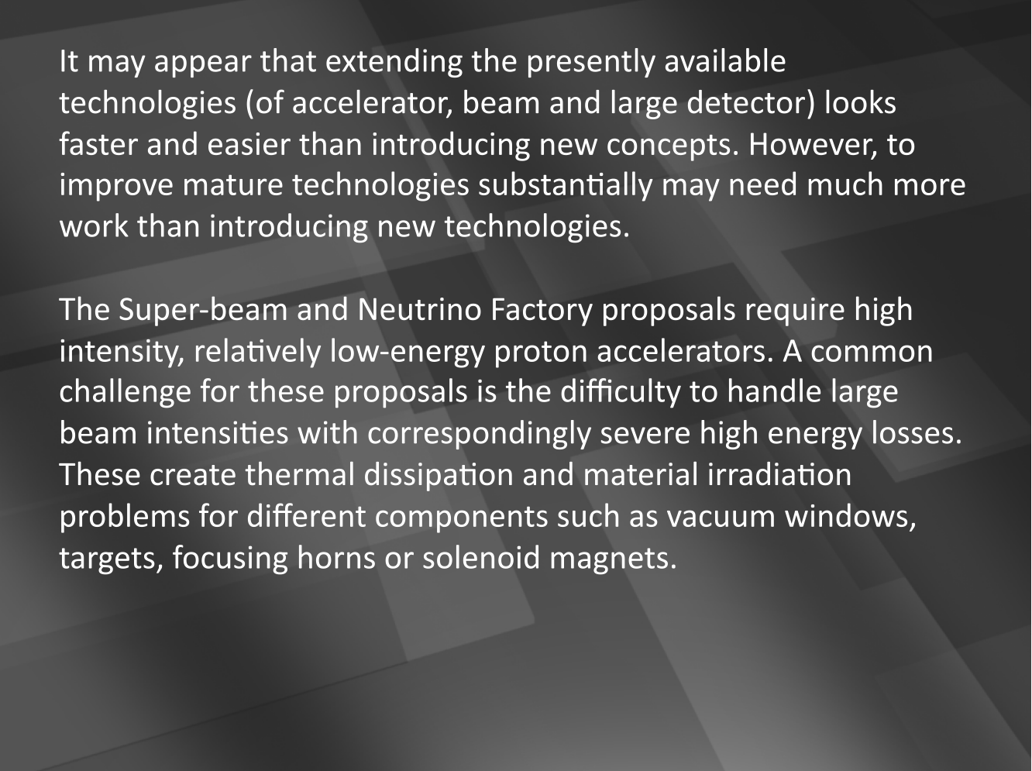

Slide 15
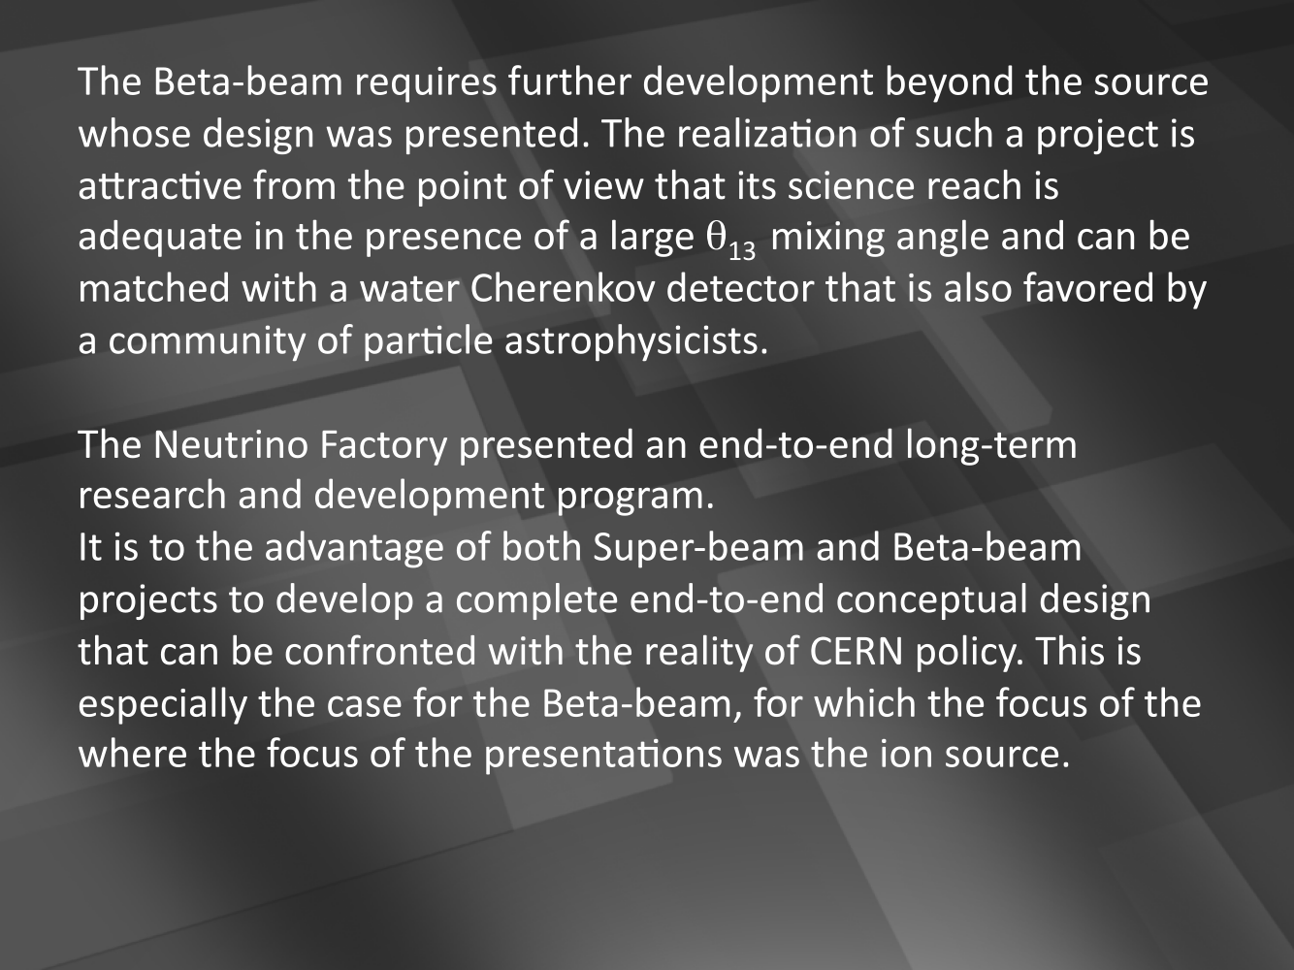

Slide 16
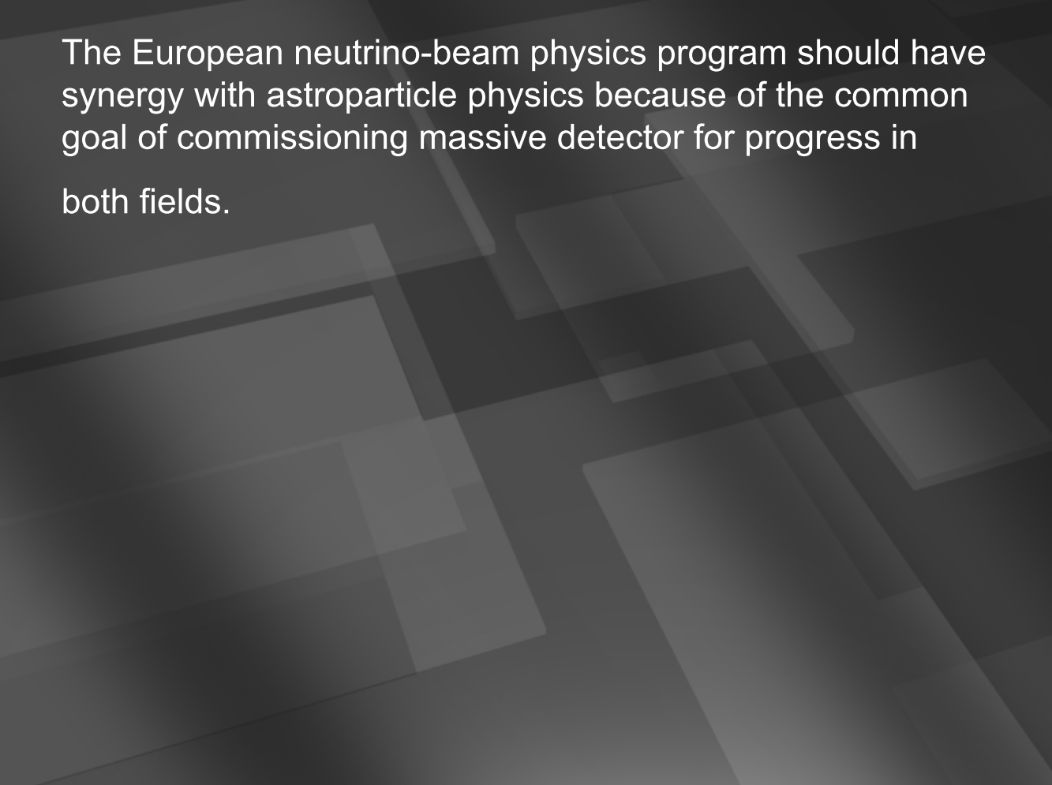
In addition; in the report but not presented in Grenoble:
  For the specific beam options presented in the reports under review, the relatively short baseline from CERN to Fréjus is not optimal.
  No matter how it is implemented, this neutrino program presents challenges and risks that are very significant, but the scientific rewards in terms of new physics are potentially even greater.

Slide 17
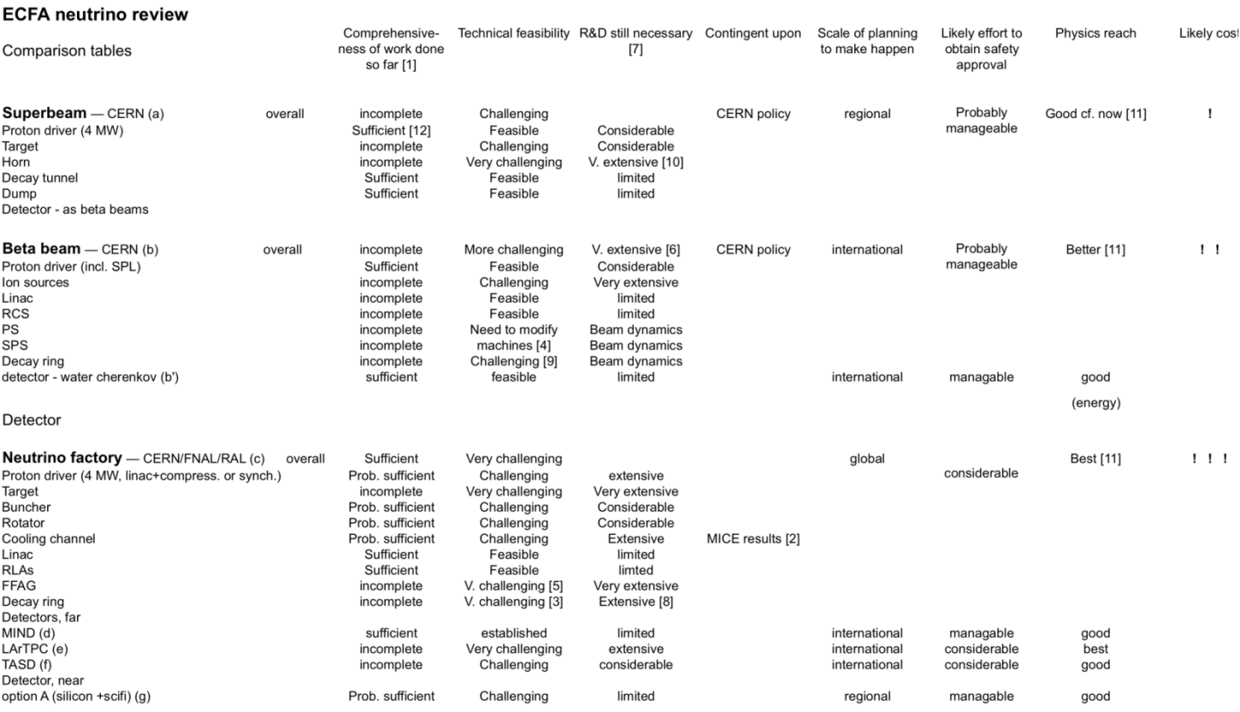

Slide 18
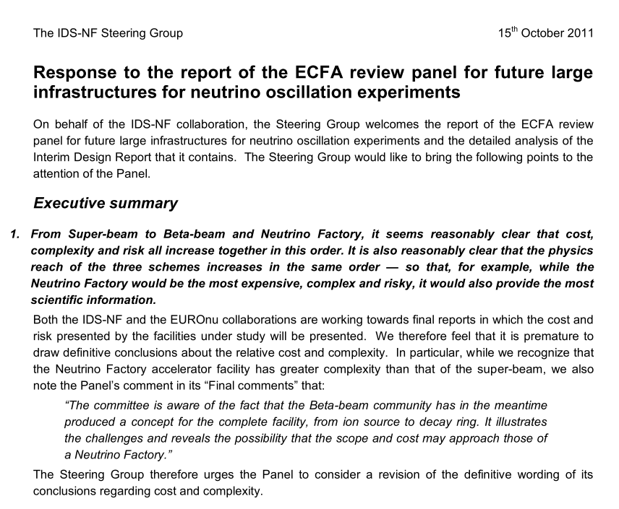

Slide 19
Beyond the IDR:
Now must finish the IDR:
  Issue to resolve at this meeting:
    Should the IDR be published in a refereed journal
  Publication as laboratory/EUROnu report:
    Issues with CERN Yellow Report:
      Internal refereeing process; re-formatting required:
        All leads to delay and RDR is coming soon
      S. Gilardone proposal: present as a CERN-NuFact note
    Laboratory note numbers from BNL, FNAL, RAL, …
    EUROnu note number
Important now to build momentum towards RDR:
  This meeting is the spring board …
Preparing the ground for the “receipt” of the RDR:
  ICFA has asked for a presentation on the IDS-NF at its next meeting in February 2012:
    Opportunity for us to present our message …

Slide 20
Large θ₁₃ and incremental approach
Plenary sessions 2 and 3
Introduction and aims:

Slide 21
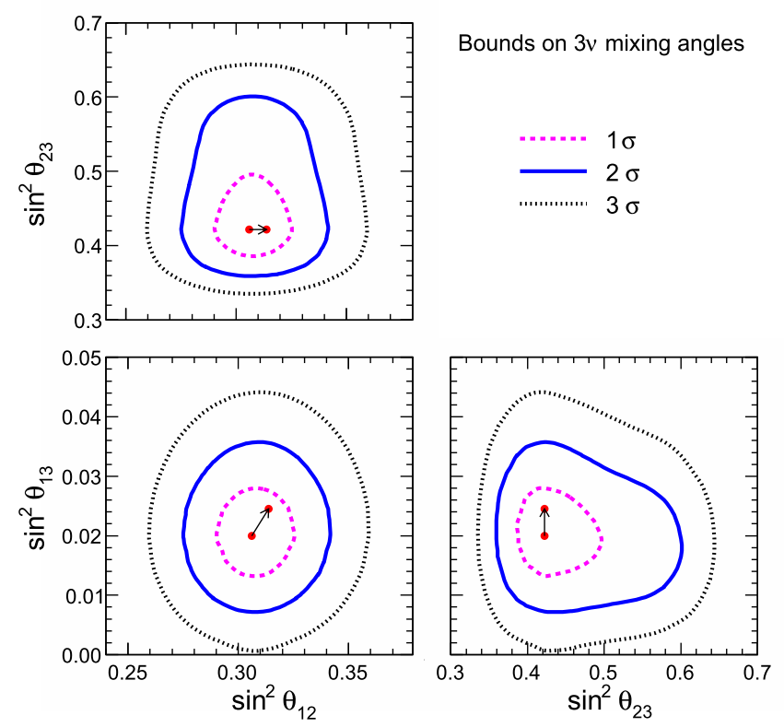
θ₁₃:
Global analysis of oscillation data, including recent T2K and MINOS data, indicate evidence for θ₁₃ > 0 at 3σ
Fogli, Lisi, Marrone,
Palazzo, Rotunno
Exciting new data!
If confirmed, makes discovery of CP possible:
  Almost certainly at Neutrino Factory
  Increases motivation for precision determination of parameters and search for “non-standard effects”

Slide 22
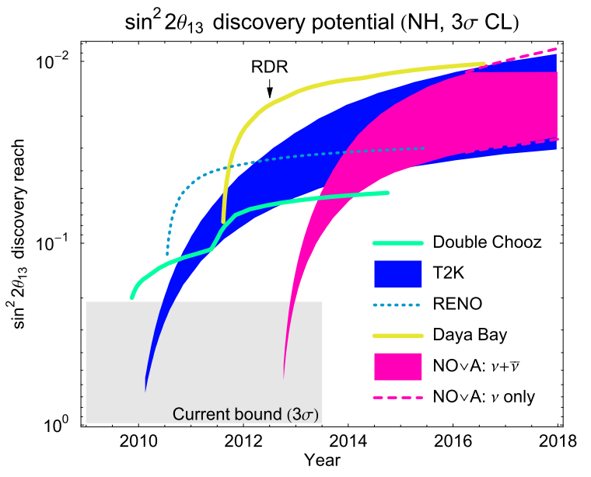
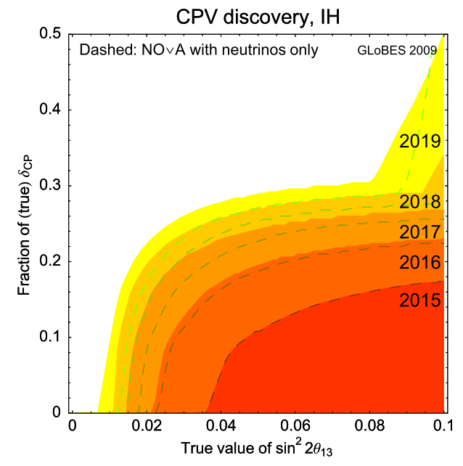
Evolution:
Reactor data will soon shed additional light on θ₁₃;
Next generation experiments required to measure θ₁₃;
  Ideal:
    Can optimize Neutrino Factory specification
Programme for next 10 years includes:
  Reactor neutrino experiments—ν_{e} disappearance
  Long-baseline super-beam experiments—ν_{e} appearance
Can the muon-storage-ring community contribute to this in the short term?

Slide 23
Muon storage rings for neutrino physics:
We have shown that the Neutrino Factory is the tool of choice for studies of neutrino oscillation:
  No matter what the value of θ₁₃
    But requires θ₁₃-dependent optimization
Muon storage ring provides unique opportunity:
  Measure ν_{e} and ν_{μ} cross sections with great precision in one experiment:
    Important contribution to improving the precision of the present and next generation of reactor and superbeam experiments
  Possibly also definitive search for sterile neutrinos and resolution of LSND and MiniBoone effects
  Incrementally implement the Neutrino Factory
    Culmination (one or two baselines, final energy) depends on what is found
Is this the bones of an incremental programme?
Should we embrace it as we prepare the RDR?

Slide 24
Preparing the ground for the RDR
Plenary sessions 4 (costing), 5 (w/gs) and 6 (RDR planning)
Introduction and aims:

Slide 25
Reference Design Report:
Must contain:
  Cost analysis:
    Discussion of costing “in plenary” starts in earnest at this meeting
  Baseline and options:
    Discuss once more our approach to options;
  Performance:
    Respond to evolution in knowledge of ϴ₁₃
Must define:
  The project we want to carry out:
    Initial stages, including:
      Neutrino-physics programme,
      Pre-construction R&D and R&D required for final stages
    Decision points and ‘roadmap’
      Influenced by measurements
Development and content of RDR will depend on:
  Degree to which we embrace an incremental approach; and
  The details of the incremental programme
Need to agree timeline for RDR at this meeting
[Plenary session 6]
Engage with the “customers” for the RDR:
  Including:
    Neutrino and HEP communities via workshops and conferences;
    Laboratories (FNAL, …); and
    “Bodies”, e.g. ECFA, ICFA, …
    European Strategy update

Slide 26
Next meetings and timeline:
Introduction and aims:

Slide 27
IDS-NF plenary meetings:
IDS-NF plenaries:
  #8:
    April 2012, in conjuction with EUROnu annual meeting;
  #9:
    October 2012; US
  #10:
    April 2013; Europe of Japan
      This is the meeting at which we shall have to have agree the content of the RDR so that we can deliver it by the end of summer 2012
Goal:
  Arrive at plenary dates by the end of the meeting

