Slide 1
Status of Costing the Neutrino Factory Accelerator Facility
Ajit Kurup
7th Plenary Meeting of the IDS-NF
17th October 2011

Slide 2
Introduction
Overview of what needs to be done for the RDR.
How this fits in the context of EUROnu.
CERN costing tool.
Brief status of the NF accelerator systems.
Where we are with collecting the information needed.
Detailed status tomorrow.
Schedule and milestones.
Summary.

Slide 3
The RDR, EUROnu and the CERN costing tool
30% error costing (as stated in note IDS-NF-001) for the RDR [end of 2013].
Costing is organised through EUROnu which also covers a CERN based superbeam and beta-beam.
To provide a common basis to compare these different facilities EUROnu will use the CERN costing tool (CCT) (originally developed for CLIC) to take care of the “accounting” aspect.
This means the costing must be done in a way compatible with the CCT (project phases, etc.)
One “minor” complication is that EUROnu is to finish by September 2012!

Slide 4
Methodology
The NF is broken down into systems and each system into components that we can find known costs for.
Won’t work for everything as almost as every system of the NF accelerator includes some unknown technology but much can be done using this method.
NEED ENGINEERS NOT PHYSICISTS BUT WE HAVE VERY LIMITED RESOURCES TO BUY ENGINEERING TIME.
Some limited effort available at Daresbury (Neil Bliss and Norbert Collomb, maybe others?)
Effort promised by CERN.

Slide 5
Breakdown Structure for the CCT
First task was to determine information required for the CCT and it’s breakdown structure.
Each item has 3 project phases.
Industrialisation and tendering; procurement; and reception.
The NF is broken down into subsystems with a separate section for common hardware and services.
Specialised H&S items to be included with the relevant component.
Identified Cost Focal Points (CFPs).

Slide 6
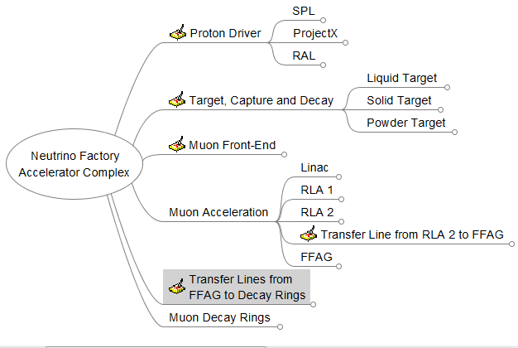
Breakdown Structure

Slide 7
The Proton Driver
Ion source to the downstream face of the last magnet of the final focus.
The building housing the final focus is part of the TCD. Ancillary buildings and services for the final focus are included in the PD.
All transfer lines must be included (e.g. transfer line to the final focus.)
SPL + rings (Important for EUROnu)
R. Garoby and S. Gillardoni
ProjectX + rings
K. Gollwitzer
RAL
J. Pozimski, J. Pasternak and J. Thomason

Slide 8
The Target , Capture and Decay System
From the downstream face of the last magnet of the final focus to the downstream face of the last magnet of the last magnet of the decay section.
Must include space for the final focus and space for H&S for final focus but actual H&S are included in PD.
Solid target
R. Edgecock
Powder target
C. Densham
Liquid target (baseline design and main focus)
H. Kirk and K. MacDonald
Capture system
H. Kirk and K. MacDonald (and/or B. Weggle?)
Decay section
C. Rogers

Slide 9
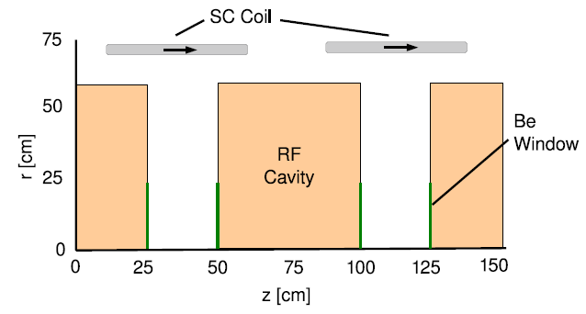
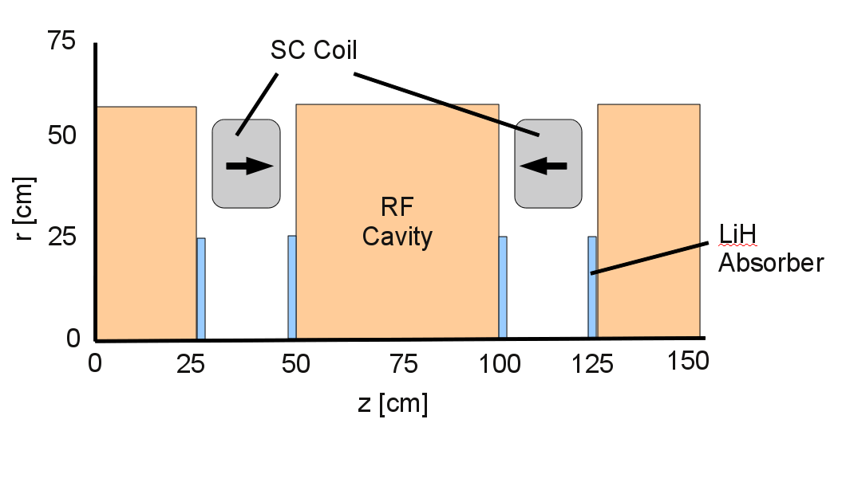
The Muon Front-end
From the downstream face of the last magnet of the decay section to the downstream face of the last module of the cooling section.
Buncher, phase-rotator and cooling
C. Rogers and G. Prior
Buncher Cell and Cooling Cell from the IDR

Slide 10
The Muon Acceleration System
From the downstream face of the last module of the cooling section to the downstream face of the last magnet of the FFAG extraction line.
Linac, RLA 1 and RLA 2
A. Kurup
Transfer lines to the FFAG
J.S. Berg
FFAG
J.S. Berg and N. Bliss

Slide 11
The FFAG to Decay Rings Transfer Lines
μ⁺ μ⁻ transfer lines from the downstream face of last magnet in the FFAG extraction line to the front face of the first magnet of the decay ring injection system.
Will be one of the last bits to be designed.
J.S. Berg

Slide 12
The Muon Decay Rings
Front face of the first magnet of the injection line through the whole ring, including all diagnostic/detector devices and the beam abort.
MDR 1 and MDR 2
D. Kelliher and N. Collomb

Slide 13
Schedule and Milestones
Nov/Dec 2011 - “Interviews” with CERN
December 2011 – Costing Workshop at CERN
Have layout of the whole NF to determine buildings, tunnels, etc.
June 2012 – “Second pass” cost estimate.
Design should be complete (i.e. no holes)
Include info from CERN about tunnelling, cabling, project phases, etc.
April 2013 – “Third pass” cost estimate.

Slide 14
Summary
Breakdown structure has been defined.
In the process of getting the details of the up-to-date designs and putting them in the ADT (see talk tomorrow).
Once this is done we can start pricing items and work out where any holes are.
Will need engineering support for RF, vacuum and cryogenics.
Next EUROnu costing workshop in December.
Aim to have these details in order to determine sizes of the systems. (Make use of support from CERN).

