Slide 1
First thoughts on RDR organization:

Slide 2
Contents:
IDS-NF mandate and timeline
What we heard at IDS-NF #7 and implications
Costing exercise and RDR timeline
Next meetings

Slide 3
IDS-NF mandate and timeline
First thoughts on RDR organization:

Slide 4
IDS-NF Interim Design Report roadmap
IDS-NF plenary
Mumbai
12-14 October 2009
FNAL
0810 April 2010
RAL
23-25 September 2010
Evaluation
IDR complete
Convergence
Preparation

Slide 6
What we heard at IDS-NF #7 and implications
First thoughts on RDR organization:

Slide 7
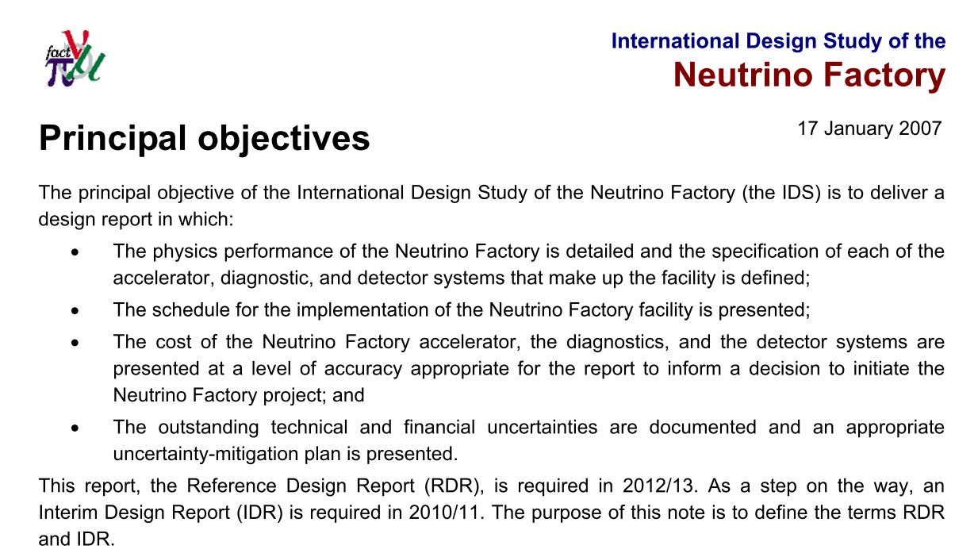
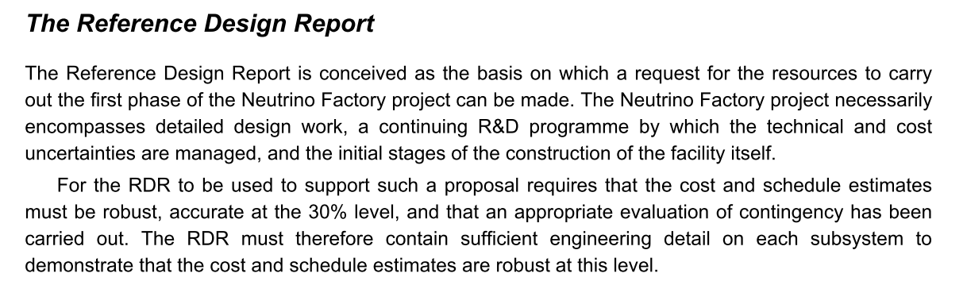
IDS-NF-001
See later

Slide 8
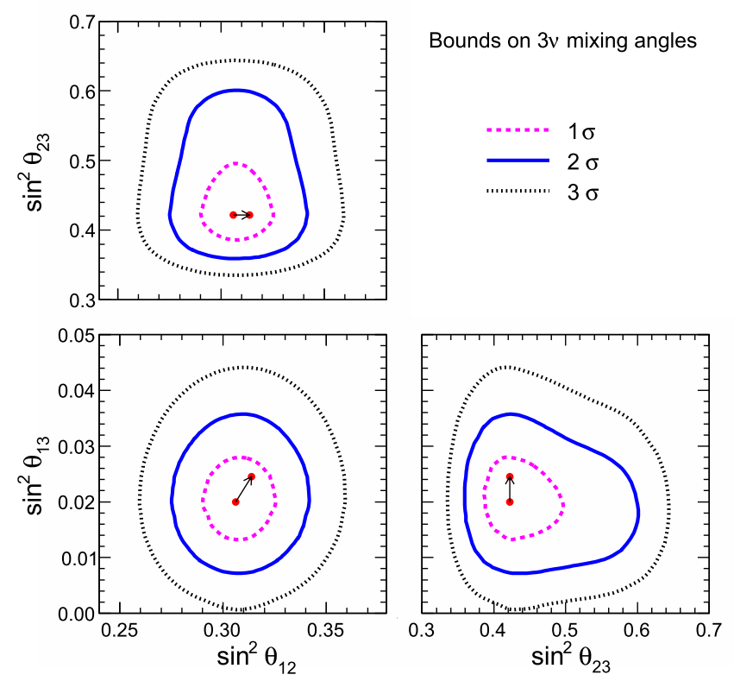
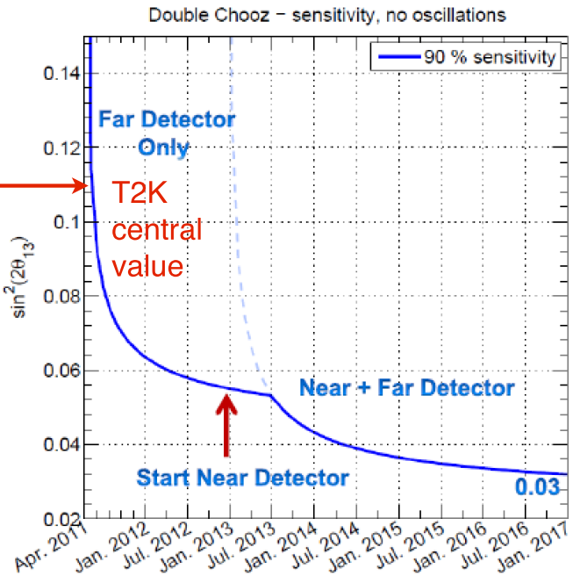
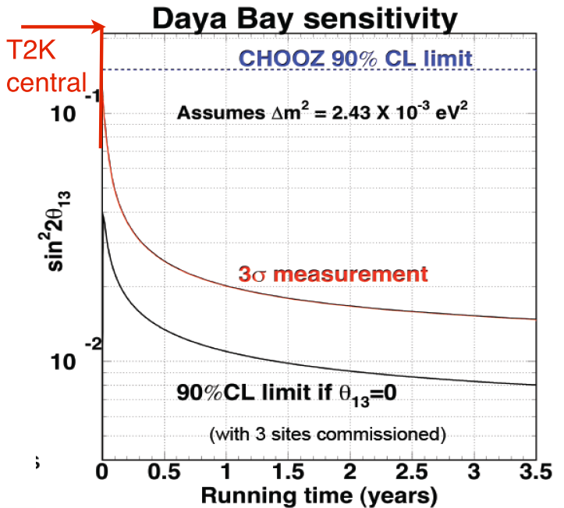
What have we heard (1)? θ₁₃:
So, if θ₁₃ is indeed ~0.2,
expect confirmation
in (perhaps less than) a
year
Of course, T2K will also contribute on this timescale

Slide 9
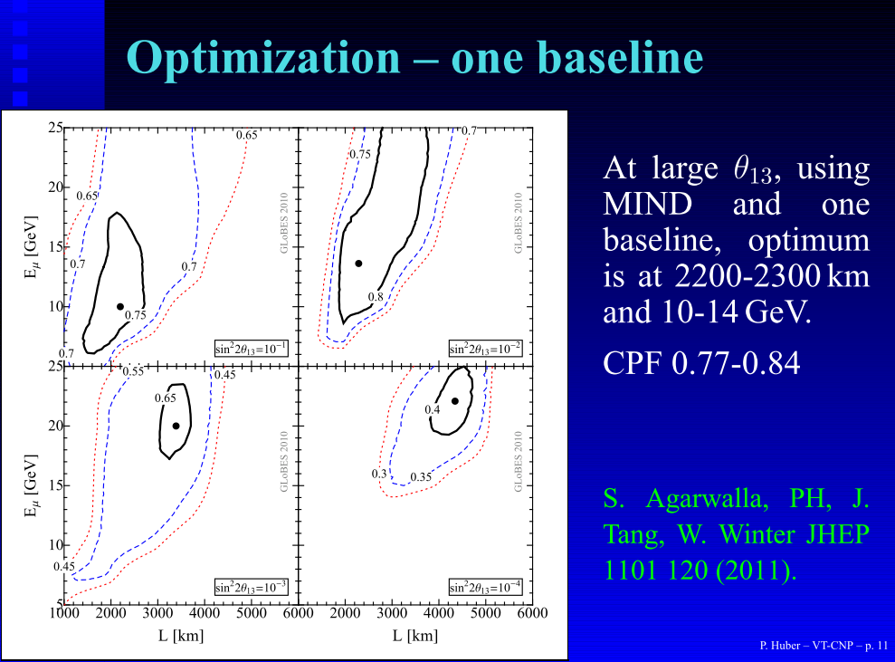
What have we heard (1)? θ₁₃:
If θ₁₃ is “large”:
  Optimization gives:
    Baseline: 1,400—2800 km;
    Energy: 6—18 GeV

Slide 10
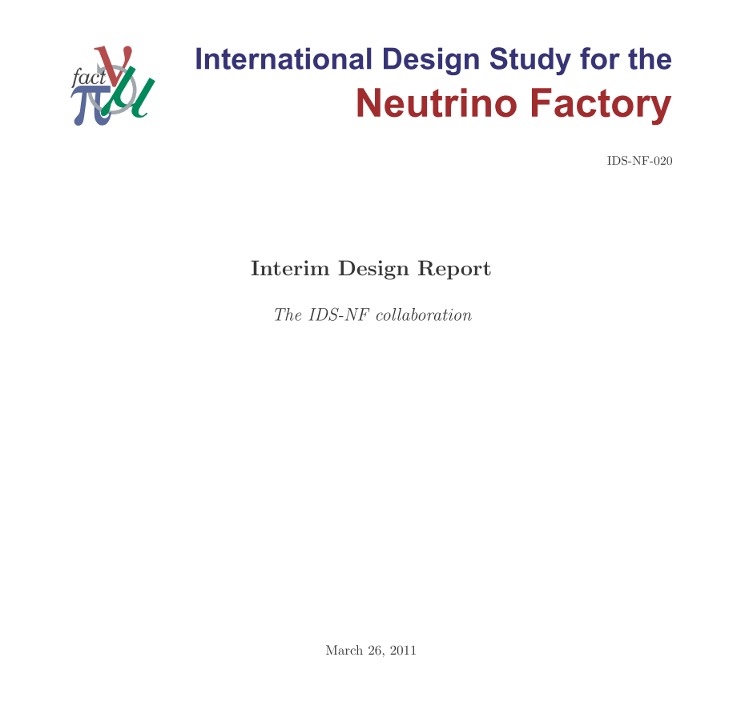
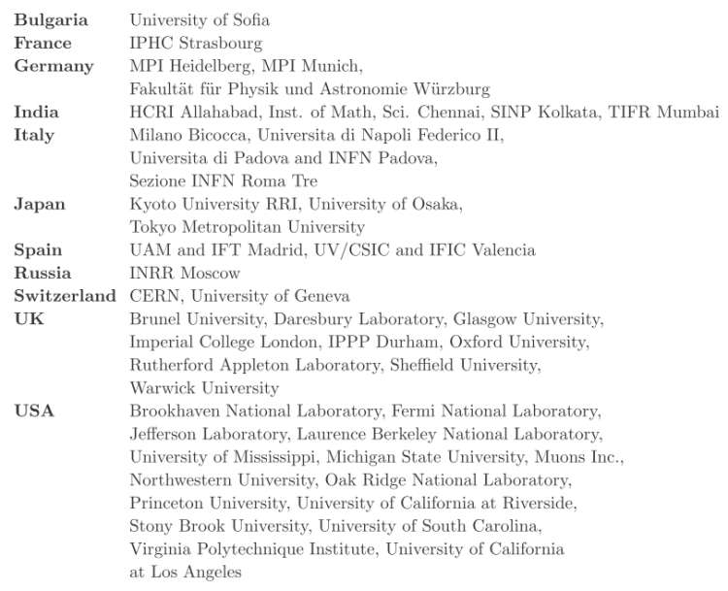
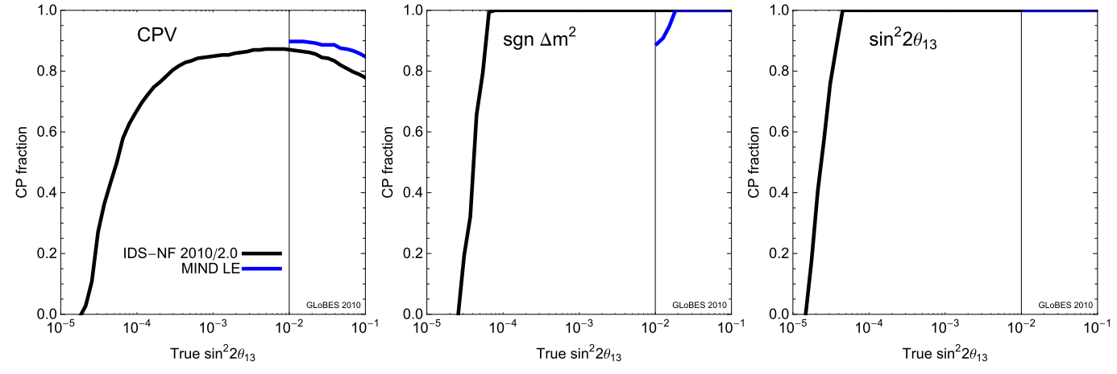
https://www.ids-nf.org/wiki/FrontPage/Documentation/IDR

Slide 11
Consequence for RDR:
Expect more information on θ₁₃ in the next year:
  Could be definitive
  Could gradually reduce in significance
So, need to begin to prepare the ground:
  PPEG:
    Review optimum
    Consider precision
      And systematics
    Consider non-standard
  Accelerator:
    Consider/evaluate options for delivery of 6—18 GeV stored muons
  Detector:
    Evaluate limits from energy threshold and energy resolution if muon energy is at the low end of the range

Slide 12
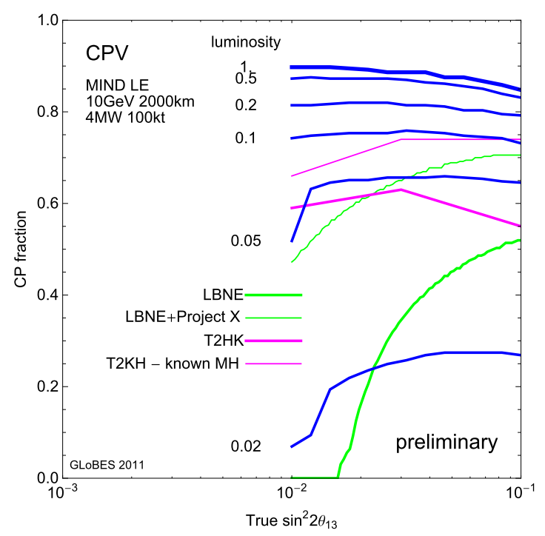
What have we heard (2)? Incremental:
10²¹
10²⁰
5 × 10¹⁹
Incremental increase in reach?

Slide 13
What have we heard (2)? Incremental:
If indication of large θ₁₃ is confirmed, competition will be to:
  Search for CP violation
  Determine mass hierarchy
  Search for non-standard effects
Neutrino Factory is competitive with 10²⁰ (5×10¹⁹) muon decays per year
Is there a benefit from presenting a staged approach?
  Must present full facility (i.e. 10²¹ muon decays per year), but
  If steps can be justified on physics grounds and have substantial cost advantages then an incremental development may be appropriate
So, need to evaluate options:
  Accelerator:
    Consider strategies to deliver: 5×10¹⁹; 1×10²⁰; 5×10²⁰; 1×10²¹
  Detector:
    Evaluate feasibility of surface detector:
      Scalability of detector
      “Free” choice of baseline
  PPEG:
    Review/evaluate physics case for each of the above options
    Review systematics analysis from above

Slide 14
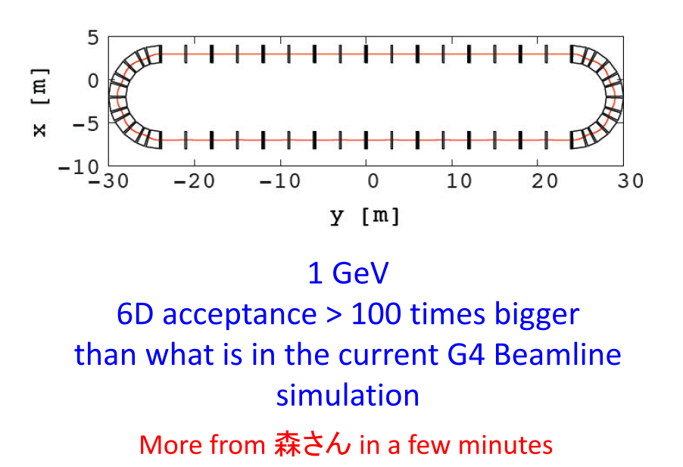
What have we heard (3)? Storage ring:
10²¹
10²⁰
5 × 10¹⁹
Opportunity:
  Cross sections
    Especially ν_{e}
  Resolution of LSND/MiniBoone anomolies
    But high confidence level required!
Part of a “muon storage ring for particle physics” programme, but not a Neutrino Factory
  In context of RDR this is:
    Essential measurement programme
    RDR facility
  rather than a step towards the Neutrino Factory

Slide 15
Costing exercize and RDR timeline
First thoughts on RDR organization:

Slide 16
Costing exercise:
Work has started:
  Of high quality, but, limited resources
Complication now with the evaluation of the incremental programme for which the critical issues are:
  First-rate physics case for each increment
  Cost increments and integral
Responsibilities defined:
  Proton Driver
    RAL: Pozimski, Pasternak, Thomason
    Project X: Gollwitzer
    SPL: Garobi, Gillardoni
  Target
    Liquid: Kirk, MacDonald; Solid: Edgecock; Powder: Densham
  Front-end
    Rogers; Prior
  Linac and RLAs
    Kurup
  FFAG
    Berg; Bliss
  Decay rings
    Collomb; Keliher
Prioritization
Who does what
Panel required?

Slide 17
RDR timescale:
Working backwards:
  RDR should be ready Q2/Q3 2013
    Defined in “charge” and in IDR
  Resolution of specification required (latest) one year from now
  Must stick to A.Kurup’s costing schedule so that we’re at a second iteration on the costing exercise one year from now
Next IDS-NF meeting:
  Decide whether we produce a “position paper” in 2012
    May be required in Europe in the context of the Strategy Update in any case
Need to provide ourselves with a flow-chart

Slide 18
Publishing the IDR; discussion
First thoughts on RDR organization:

Slide 19
Publishing the IDR:
IDR will be published in the arXiv and as laboratory reports
Issue is whether to publish IDR as a whole
  Many individual contributions have been published by the responsible individuals
  Strong encouragement for other contributions to be published in this way so that those responsible receive appropriate recognition
So, the issue we need to address is:
  Should we submit the IDR as a whole to a refereed journal in addition to the planned publication on arXiv etc.

Slide 20
Next meetings:
First thoughts on RDR organization:

Slide 21
Publishing the IDR:
IDS-NF plenaries:
  #8:
    April 2012, UK
  #9:
    October 2012; US
  #10:
    April 2013; Europe

