Slide 1
Close-out and thanks:

Slide 2
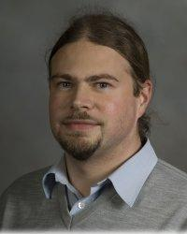
Thanks to:
Patrick Huber and Virginia Tech group for a well organized and exciting meeting!
  Excellent organization by
  Robyn Smyth …

Slide 3


