Slide 1
CMS Calorimeter Trigger Upgrades
Andrew Rose – Imperial College, London
on behalf of the CMS Level-1 trigger collaboration

Slide 2
Overview
So many triggers, so little time
Hardware for upgrades
Time-multiplexed triggering
Status of the TMT concept
Firmware
Conclusions

Slide 3
So many triggers, so little time

Slide 4
The CMS Calorimeter Trigger
ECAL
energy
HCAL
energy
HF
energy
Mitigate risk by building upgrade in parallel:
Current system, albeit modified, remains operational in parallel
TDR upgrade
All inputs in optical format
Full tower-level information available in processor cards
Interim trigger for 2015
Improve processing of existing RCT
Backup solution for 2015 running
For use if the current trigger cannot cope and full upgrade not yet available
Regional Calorimeter Trigger
e/γ
Jets
Global Calorimeter
Trigger
Existing hardware

Slide 5
Recommissioned existing trigger
ECAL
energy
HCAL
energy
HF
energy
Regional Calorimeter Trigger
e/γ
Jets
Global Calorimeter
Trigger
oRM
oSLB
oRSC
Existing hardware
New hardware

Slide 6
TDR trigger upgrade
ECAL
energy
HF
energy
HCAL
energy
Calorimeter Trigger
Layer 1
Tower-level granularity data
Calorimeter Trigger
Layer 2
oRM
oSLB
oRSC
Existing hardware
New hardware

Slide 7
Interim (back-up) trigger for 2015
ECAL
energy
HCAL
energy
HF
energy
Regional Calorimeter Trigger
Finer granularity data
Interim Calorimeter Trigger
oRM
oSLB
oRSC
Existing hardware
New hardware

Slide 8
Schedule
The schedule for the calorimeter trigger upgrades is defined in the TDR:
Slice-test of the TDR trigger design – July 2014
All hardware installed at P5 – November 2014
Commissioning in parallel with the existing trigger – 2015
Fully commissioned and operational – January 2016
The interim trigger for 2015 has a deadline for the completion of commissioning of 31st March 2015

Slide 9
Hardware for upgrades

Slide 10
oSLB and oRM
ECAL
energy
HCAL
energy
HF
energy
oSLB
Regional Calorimeter Trigger
Global Calorimeter
Trigger
oRM

Slide 11
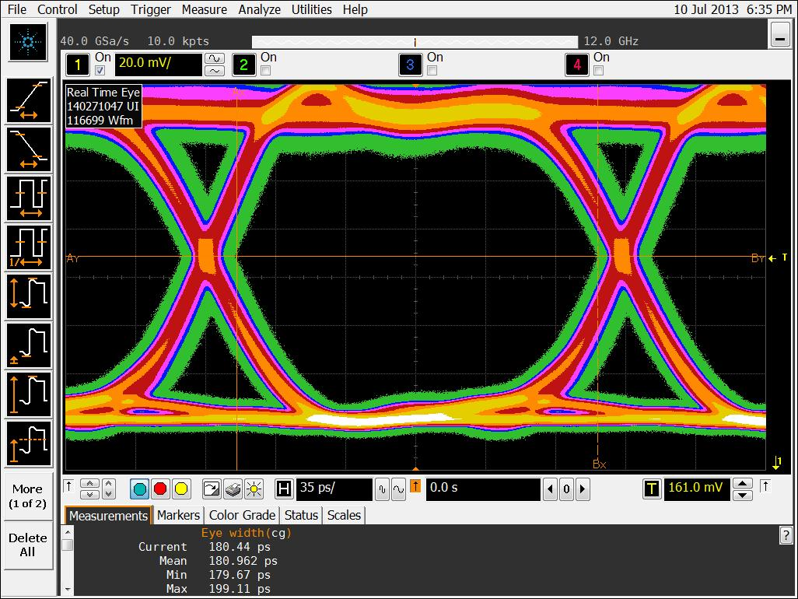
oSLB and oRM
Kintex-7 FPGAs
Mount on existing VME cards, replacing copper links
Have now been manufactured
Installation pending an installation readiness review
oSLB
oRM
oSLB @ 4.8Gb/s

Slide 12
μHTR
ECAL
energy
HCAL
energy
HF
energy
Regional Calorimeter Trigger
Global Calorimeter
Trigger

Slide 13
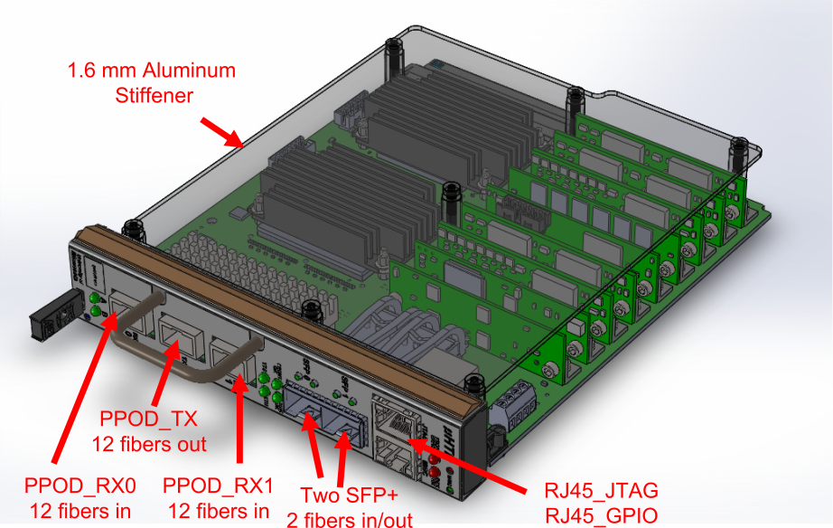
μHTR
2× Virtex-6 FPGAs
Cost-optimised
One-for-one replacement of existing HTR cards
Modular design with services on mezzanine cards
Mixed PPod and SFP+ optics

Slide 14
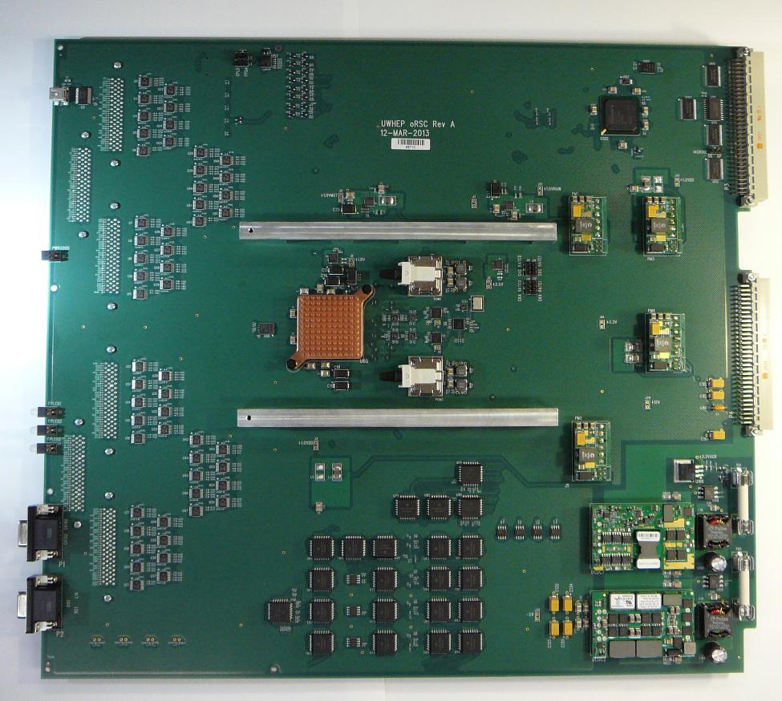
oRSC
ECAL
energy
HCAL
energy
HF
energy
Regional Calorimeter Trigger
Global Calorimeter
Trigger

Slide 15
oRSC
Kintex-7 FPGA
VME interface card
Fits in current RCT crates
18 cards in total
Provides RCT output in optical format to:
Existing GCT Leaf cards
Interim trigger processor
Waiting on integration tests before final manufacturing ordered
ECL
to
LVTTL translators
Kintex-7
XC7K355T
FPGA
Spartan-6
VME Interface
Avago MiniPOD
Tx Modules
RCT
Clock Interface (NECL)

Slide 16
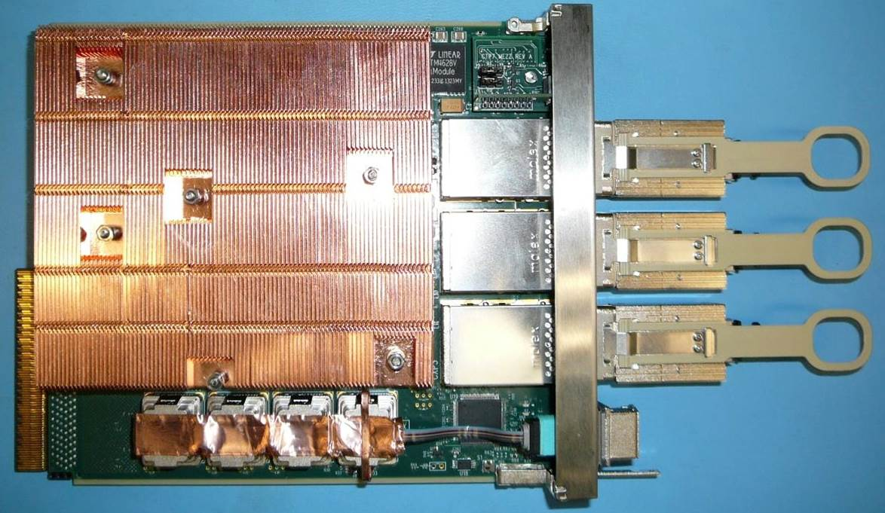
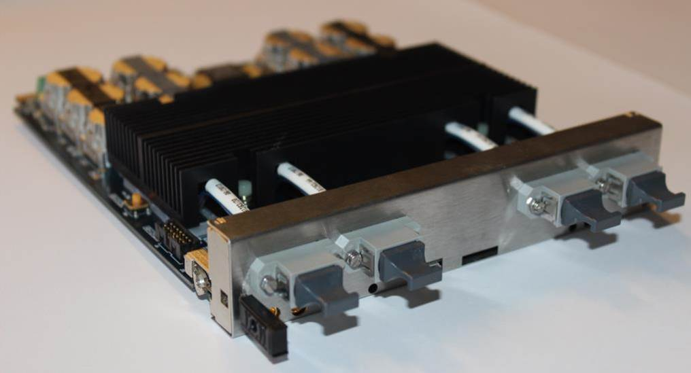
TDR trigger upgrade
University of Wisconsin
CTP7
ECAL
energy
HF
energy
HCAL
energy
Calorimeter Trigger
Layer 1
Calorimeter Trigger
Layer 2

Slide 17
CTP7
Based on Virtex-7 XC7VX690T FPGA
Zynq processor running Xilinx PetaLinux for service tasks
Baseline Layer 1 hardware
Backplane communication on Ports 12-15 & 17-20 for use with semi-custom VT894 crate
Auxiliary power connector on front-panel
Custom-designed heatsink
Two prototypes in hand
36Tx+36Rx links on 3 CXP modules
Heat Sink
12Tx+31Rx links on MiniPODs

Slide 18
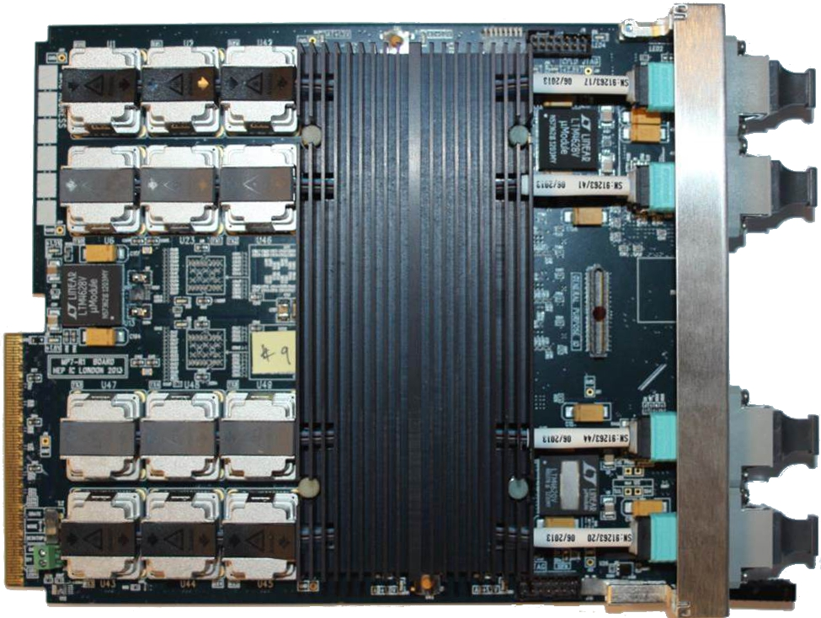
1.8Tb/s optical signal processor
72Tx+72Rx links at 12.5Gbps
Xilinx Virtex-7 FPGA:
XC7VX485T or XC7VX690T
On-board firmware repository
2×144Mbit 550MHz QDR RAM
Been in hand for nearly two years
Continuous testing over that period
Very well understood
Extensive software and firmware
Currently in manufacture, formally procured through CERN purchasing
10 Gbps
12.5 Gbps

Slide 19
An observation…
With the recent up-turn in the global economy, many boards which have gone out for manufacturing recently are suffering long lead-times on components!
Manufacturing, testing and installation schedules need to take this into account!

Slide 20
Time-multiplexed triggering

Slide 21
Conventional trigger
Data is processed in regions
Boundaries between regions must be handled by sharing or duplicating inputs
Volume of data reduced at each stage by selecting and discarding candidates
When volume of data has been sufficiently reduced it can be passed to the global trigger
Conventional Trigger

Slide 22
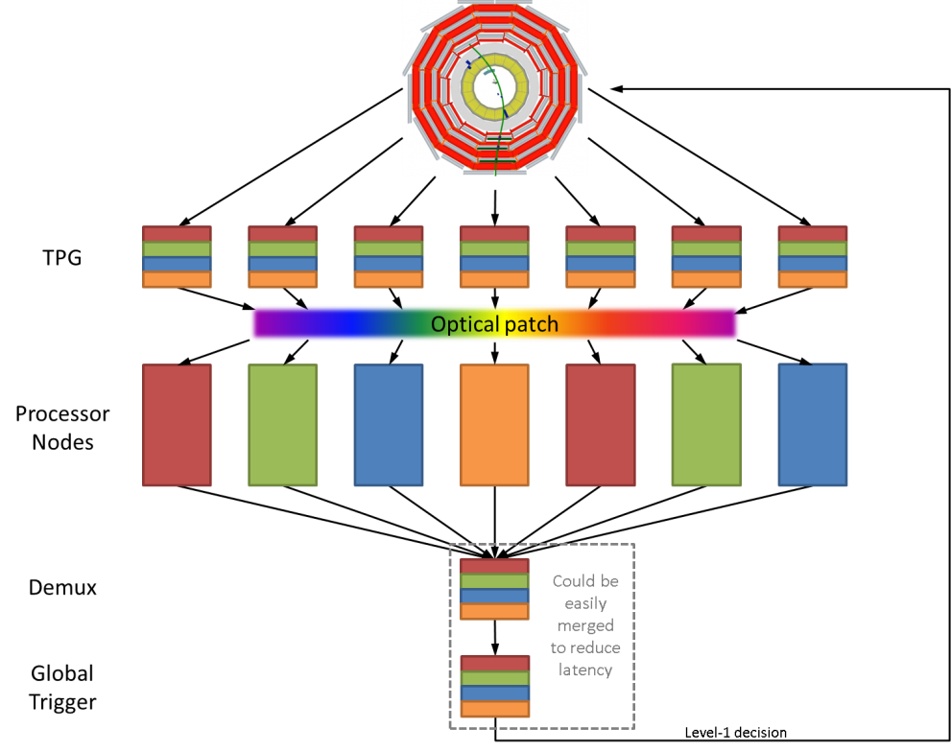
Time-multiplexed trigger
Data from an event is buffered and retransmitted to the first processing node over N bunch crossings
Data from the next event is buffered and retransmitted to the second processing node, again, over N bunch crossings
Process is repeated in round-robin fashion across ≥N processing nodes
Because both algorithm latency and data volume are constant, dataflow is fully deterministic and no complex scheduling mechanism is required
Time-Multiplexed Trigger

Slide 23
Why TMT?
The Time-multiplexed architecture allows all data to arrive in geometric order:
Towers at given φ always occupy the same bits on the same optical links
Towers arrive in order of increasing |η|
This converts a 2D geometric problem to a 1D problem
This allows all algorithms to be fully pipelined†:
The processing is localised
Fan-outs reduced
Routing delays minimised
Register duplication eliminated
Also only need to develop one FPGA design
†That is, pipelined at the full data rate, not at the bunch-crossing rate

Slide 24
Status of the TMT concept

Slide 25
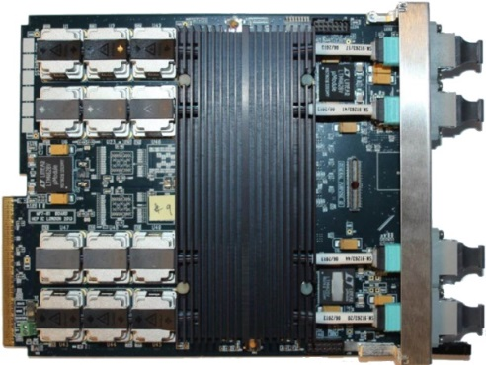
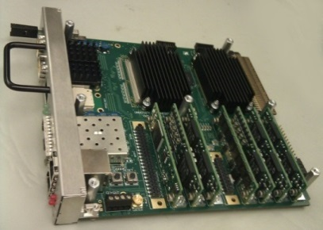
Status of TMT: Integration test @ B904
TPG input to PP not part of test
Test set-up @ 904
PP-B
MP7’s used here as PP’s
Simulating half of the PP cards with a single MP7
oSLB
uHTR
MP
Demux
Simulating half of the PP cards with a single MP7
PP-T

Slide 26
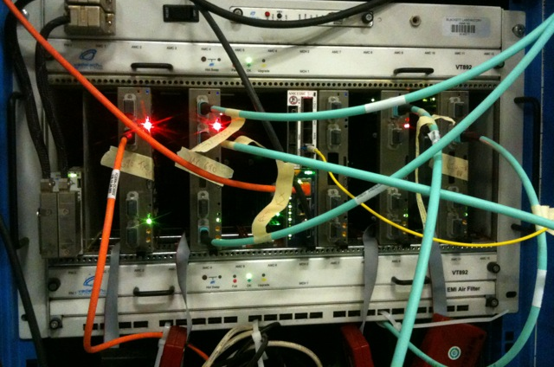
Status of TMT: Integration test @ B904
PP - T
MP
DEMUX
PP - B
720 Gbps of data going through the MP board
The MP is processing data from the entire calorimeter

Slide 27
Status of TMT: Algorithms
All algorithms operate on tower-level information at 240MHz
Compact objects – e/γ/τ
Use the 2×2 Wisconsin clustering algorithm
Baseline algorithm currently in CMSSW
Extended objects – Jets
Use an 8×8 tower circular jet
Equivalent to cone jet (r=0.35)
Other algorithms available
Global objects – Ring sums
Use full granularity equivalent of what is done in current trigger

Slide 28
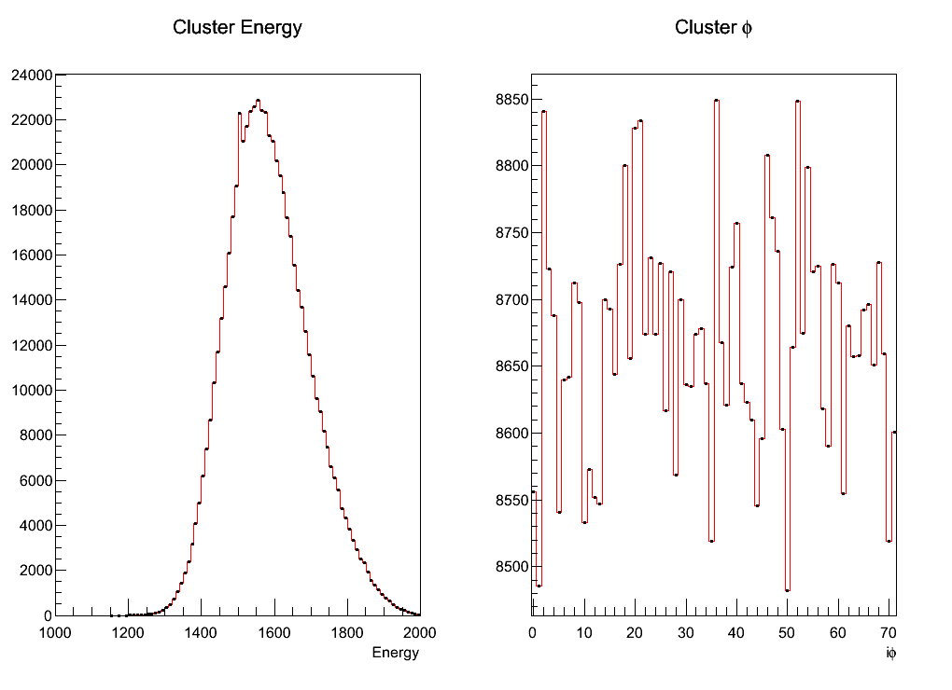
Status of TMT: Results
Random data passed through an emulator was used in the testing of the algorithms
Clustering algorithm (2x2)
Data injected into PP
Time-multiplexed
Optical Fibre
Sort
Capture
Compared emulated results (solid line) with those from the MP7 (markers): C++ emulator and hardware match precisely
System latency lower than TDR prediction
No link-errors, no CRC-errors and maintained alignment after a week of operation

Slide 29
Lessons learned from test
Floor-planning
Huge impact on algorithm design
Structure the algorithm to map optimally onto the FPGA
Reduces risk that after many hours of routing 6 million nets just 1 or 2 fail to meet timing - exceedingly annoying
Significant timing improvement
Only viable if signals remain relatively local
Full pipelining of algorithms is essential - even relatively innocuous looking fan-outs in chips this large have the potential to kill off the entire design
uHAL and IPbus are working well, and have made debugging and multi-user crate access both possible and easy
AMC13 has worked extremely well for us during the test

Slide 30
Firmware

Slide 31
Firmware
MP7 is a completely generic optical-stream processor
Being used in at least 5 roles in the CMS trigger upgrades
Interim trigger processing hardware
TDR trigger processing hardware
Drift-Tube Track-Finder
Global Muon Trigger
Global Trigger
Having common hardware platform obviously helps with maintainability
How to collaboratively develop firmware is not a trivial problem!

Slide 32
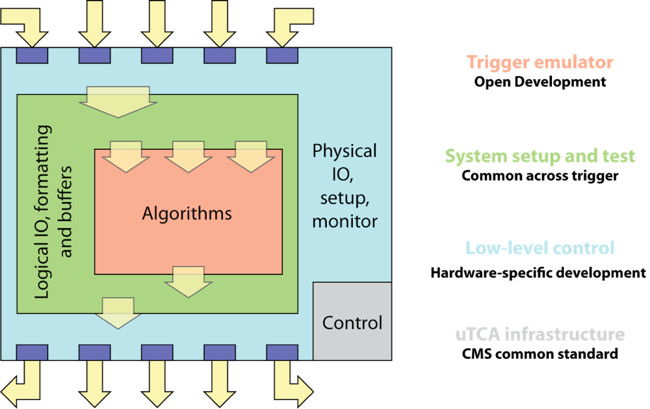
“Base Firmware” Concept

Slide 33
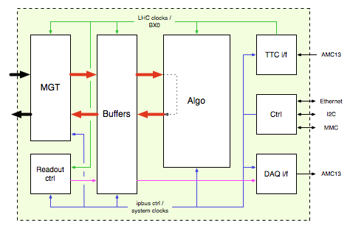
Implementation Status
Done & Tested
in B904
Done & Tested in B904
Done & Tested in B904
(development of new algorithms is ongoing)
Done & Tested in B904
Done & Tested in B904
Work in
progress
(Dasgupta)
Development with BU

Slide 34
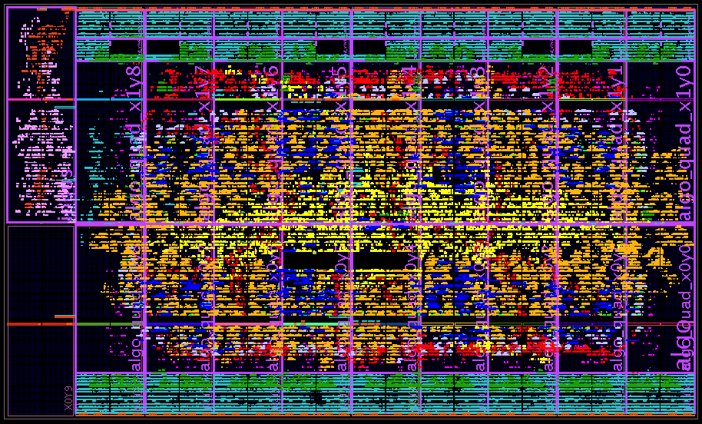
Floorplan of FPGA: Integration Test

Slide 35
Floorplan of FPGA
Clusters
Jets
Towers
Sorting
MGTs and DAQ buffers
Communication
Algorithms
DAQ
(work in progress)
MGTs and DAQ buffers

Slide 36
Resource usage of FPGA
Resource | Fraction of Entire FPGA |  | Fraction of Algorithm Area used
 | Used for infrastructure | Used for algorithm + infrastructure
Registers | 9% | 21% | 20%
LUTs | 19% | 36% | 35%
DSPs | 0% | 8% | 13%
BRAM | 12% | 12% | 0%
All Algorithms and Infrastructure:
7 hour build-time
Much better than the >24 hours reported elsewhere

Slide 37
Software

Slide 38
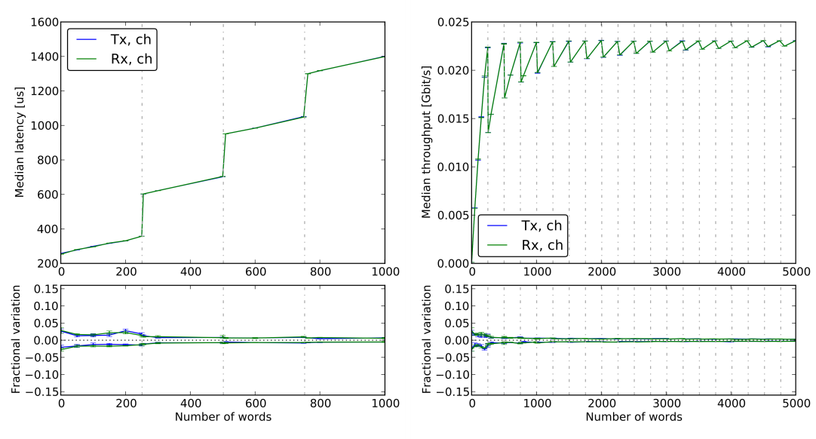
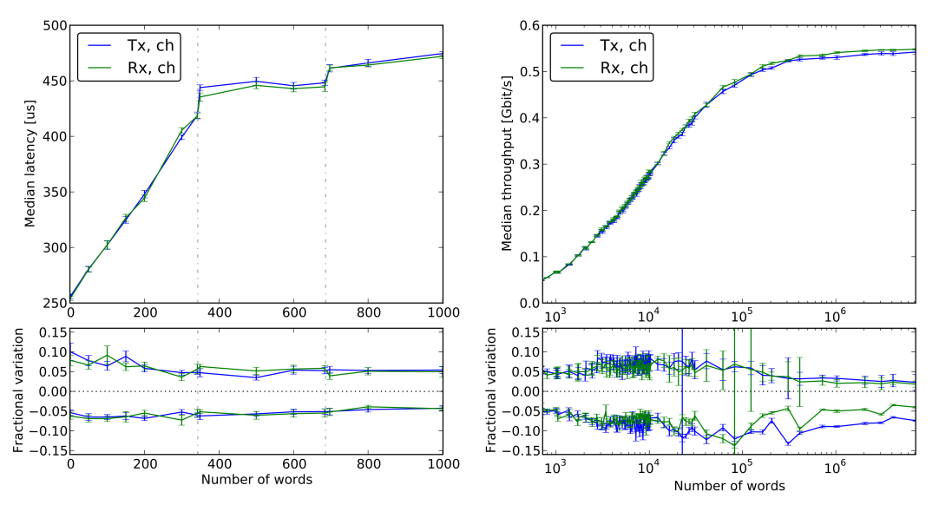
IPbus/uHAL
IPbus 2.0 – 01/13
IPbus and uHAL, which are supported as part of the UK calorimeter trigger upgrade program, have been widely adopted outside its original scope
A very large effort has gone into optimization & reliability over the last year:
Read/write bandwidths both now exceed 0.55Gbps
Retry mechanism works perfectly on networks with 10% packet loss. Mechanism should work identically for higher loss rates.
University of Wisconsin have a preliminary TCP implementation for embedded processors (e.g. ZYNQ)
Bandwidth tests show rates of 3-4MB/s (0.024-0.032Gbps)
~2.5 FTEs
IPbus 2.2 – 01/14
Plots courtesy of T. Williams

Slide 39
SoftWare for Automating conTrol of Common Hardware
buffer
control
serdes
IPbus and uHAL have rationalized hardware access
Can we rationalize board control S/W?
MP7, CTP7, MFT7 are all very similar
One software class to control them all?
Can we use the same software model for production and testing?
Standardize the concept of 'test‘
(what goes in, what goes out)
Introduce flexible system-wise tests:
from {system A, buffer X} to {system B, buffer Y}
Requires rationalizing DAQ, data-packing and data-unpacking!
input links
Algorithm(s)
memory
output links
serdes
buffer
DAQ
Above: Common Board Model, Below: System Model
L1 System
Common across L1
Write once and reuse everywhere
Exposable via network interface
API
SubSystem
API
Board
API
Control Functions
Subsystem specialisation
uHAL
Hardware

Slide 40
Conclusions

Slide 41
Conclusions
All hardware for the CMS Calorimeter Trigger upgrade now in hand, albeit having undergone varying degrees of testing:
TDR upgrade: μHTR, oSLB, oRM, CTP7, MP7
Interim trigger for 2015: oRSC, MP7
The baseline architecture is a Time-Multiplexed Trigger
The Time-Multiplexed Trigger Integration test at B904 last September was a great success
Many lessons were learned which reaffirmed the motivations for choosing the TMT architecture over a conventional architecture
Have developed a model for collaborative development of firmware
uHAL and IPbus v2 work very well and are being widely adopted outside their original scope

