Slide 1
Triggering at the LHC: Past, Present & Future
Andrew Rose

Slide 2
Acknowledgement
My thanks to Maxeler Technologies who are sponsoring my participation at HPSP14

Slide 3
Overview
The CMS experiment
The challenge
The CMS trigger – conceptually
The CMS trigger – Run 1: The Past
What is it?
Lessons which (should) have been learned
Time-multiplexing & Spatial Pipelining
The CMS trigger – Run 2: The Present
Current state of the system
The CMS trigger – Run 3: The Future
When “Big Data” really means Big Data

Slide 4
The CMS experiment

Slide 5
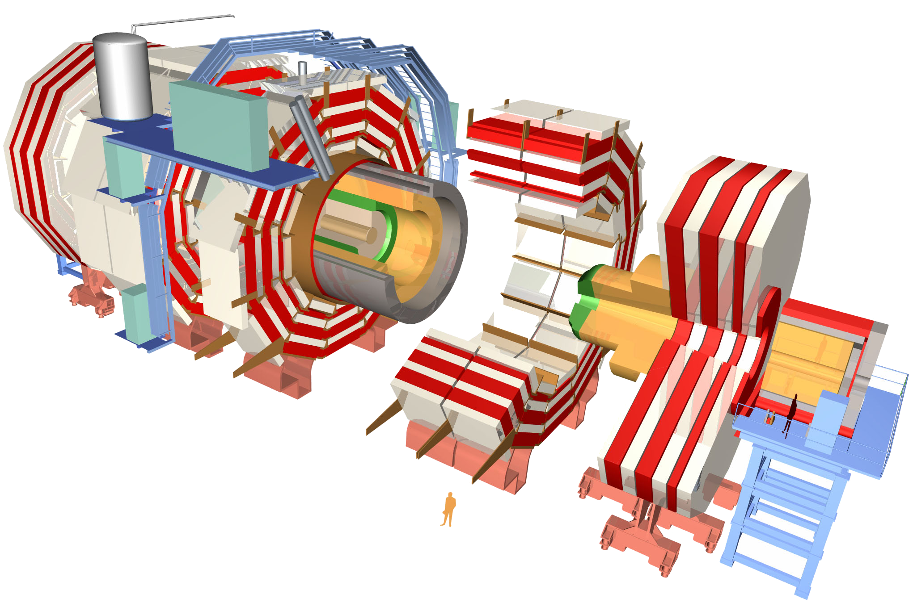
The CMS detector
~83k PbWO₄ Ecal Crystals
~15k channel Brass/Plastic sampling HCAL
~568k RPC/DT/CSC Muon channels
~65M Silicon Pixels
~10M Silicon Strips
~3500 physicists/engineers

Slide 6
The CMS detector
~83k PbWO₄ Ecal Crystals
≡ 40 TBit per second
Data rates with no zero-suppression
~15k channel Brass/Plastic sampling HCAL
≡ 10 TBit per second
~568k RPC/DT/CSC Muon channels
≡ 23 TBit per second
~65M Silicon Pixels
≡ 21 PBit per second
~10M Silicon Strips
≡ 4 PBit per second
~3500 physicists/engineers

Slide 7
The Internet: Visualizing big numbers
1 Eb/s
4 YB/yr
1 Pb/s
4 ZB/yr
1 Tb/s
4 EB/yr
1 Gb/s
4 PB/yr
1 Mb/s
4 TB/yr

Slide 8
CMS: Visualizing the big numbers
1 Eb/s
4 YB/yr
CMS Raw
1 Pb/s
4 ZB/yr
1 Tb/s
4 EB/yr
1 Gb/s
4 PB/yr
1 Mb/s
4 TB/yr

Slide 9
The CMS detector
Selective Readout
~83k PbWO₄ Ecal Crystals
≡ 40 TBit per second
Data reduction
~15k channel Brass/Plastic sampling HCAL
≡ 10 TBit per second
Zero suppression
~568k RPC/DT/CSC Muon channels
≡ 23 TBit per second
Zero suppression
~65M Silicon Pixels
≡ 21 PBit per second
Analogue Pipelines
~10M Silicon Strips
≡ 4 PBit per second
~3500 physicists/engineers

Slide 10
CMS: Visualizing the big numbers
1 Eb/s
4 YB/yr
CMS Raw
1 Pb/s
4 ZB/yr
CMS Zero-suppressed
1 Tb/s
4 EB/yr
1 Gb/s
4 PB/yr
1 Mb/s
4 TB/yr

Slide 11
CMS: Visualizing the big numbers
1 Eb/s
4 YB/yr
CMS Raw
1 Pb/s
4 ZB/yr
CMS Zero-suppressed
1 Tb/s
4 EB/yr
Five orders of magnitude
1 Gb/s
4 PB/yr
Tape storage
1 Mb/s
4 TB/yr

Slide 12
CMS: Visualizing the big numbers
1 Eb/s
4 YB/yr
CMS Raw
1 Pb/s
4 ZB/yr
CMS Zero-suppressed
1 Tb/s
4 EB/yr
A man is too apt to forget that in this world he cannot have everything.
A choice is all that is left him.
Harry Mathews (1930-present)
Five orders of magnitude
1 Gb/s
4 PB/yr
Tape storage
1 Mb/s
4 TB/yr

Slide 13
The CMS trigger

Slide 14
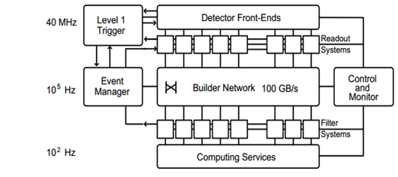
The CMS trigger – Run 1
Level-1 Trigger (L1T)
Throw away 399/400
Throw away 999/1000
Higher-Level Trigger (HLT)
Tape Storage

Slide 15
CMS: Visualizing the big numbers
1 Eb/s
4 YB/yr
CMS Raw
No tracking
Reduce Ecal resolution
1 Pb/s
4 ZB/yr
CMS L1T Input
1 Tb/s
4 EB/yr
CMS HLT Input
1 Gb/s
4 PB/yr
Tape storage
1 Mb/s
4 TB/yr

Slide 16
The CMS Level-1 trigger
61,200 barrel crystals
21,528 endcap crystals
O(10⁴) HCAL channels
195,000 DT channels
210,816 CSC channels
162,282 RPC channels
CALORIMETER
TRIGGER
8 e/γ candidates
4 τ candidates
8 jets candidates
Energy sums
4 muon tracks
MUON
TRIGGER
GLOBAL
TRIGGER
128 path Boolean logic tree
Keep or Discard

Slide 17
The CMS Level-1 trigger
61,200 barrel crystals
21,528 endcap crystals
O(10⁴) HCAL channels
195,000 DT channels
210,816 CSC channels
162,282 RPC channels
CALORIMETER
TRIGGER
8 e/γ candidates
4 τ candidates
8 jets candidates
Energy sums
4 muon tracks
MUON
TRIGGER
GLOBAL
TRIGGER
3.2µs
128 path Boolean logic tree
Keep or Discard

Slide 18
Example: Muon Event

Slide 19
Example: Muon Algorithm
Join the dots
In 3D
In 2Tesla magnetic field (outside solenoid) – curved tracks
Remove duplicate candidates
Sort candidates

Slide 20
Example: Electron/Photon Event

Slide 21
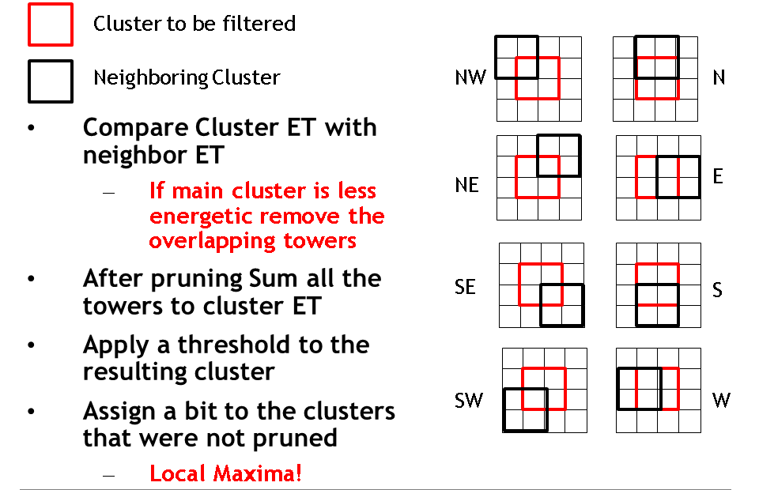
Example: “Simple” e/γ/τ Algorithm
Form 2x2 sums & filter to prevent multiple counting
Calculate energy-weighted position within cluster
Pileup estimation and pileup subtraction
Classify cluster based on E & H components
Count clusters over threshold for surrounding 8x8 region (isolation)
Select e/γ/τ candidates from generic clusters based on the above criteria
Sort the candidates per ring around the detector
Sort the candidates along the detector

Slide 22
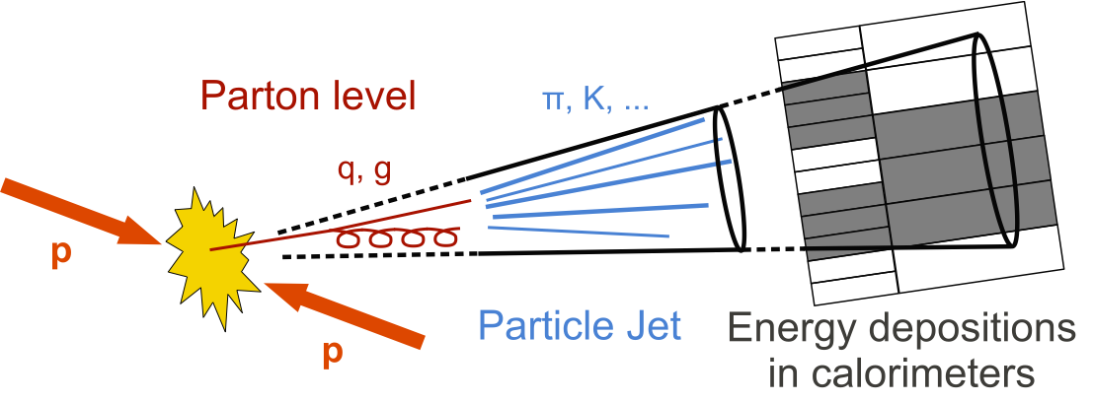
Example: Jet Event

Slide 23
Example: Jet Algorithm
9×9 sum of trigger towers at every site
Fully asymmetric jet veto calculation
Local Pile-up estimation
Full overlap filtering
Pile-up subtraction
Sort the candidates per ring around the detector
Sort the candidates along the detector
P
P
P
P
P
P
P
P
P
P
<
<
<
<
<
<
<
<
<
P
P
≤
<
<
<
<
<
<
<
<
P
P
≤
≤
<
<
<
<
<
<
<
P
P
≤
≤
≤
<
<
<
<
<
<
P
P
≤
≤
≤
≤
C
<
<
<
<
P
P
≤
≤
≤
≤
≤
≤
<
<
<
P
P
≤
≤
≤
≤
≤
≤
≤
<
<
P
P
≤
≤
≤
≤
≤
≤
≤
≤
<
P
P
≤
≤
≤
≤
≤
≤
≤
≤
≤
P
P
P
P
P
P
P
P
P
P
9×9 jet at tower-level resolution

Slide 24
The CMS trigger – Run 1: The Past

Slide 25
Run-1 Trigger Architecture: Conventional
Data is processed in regions
Boundaries between regions must be handled by sharing or duplicating inputs
Volume of data reduced at each stage by coarsifying data or by selecting and discarding candidates
When volume of data has been sufficiently reduced it can be passed to the global trigger
Conventional Trigger Architecture

Slide 26
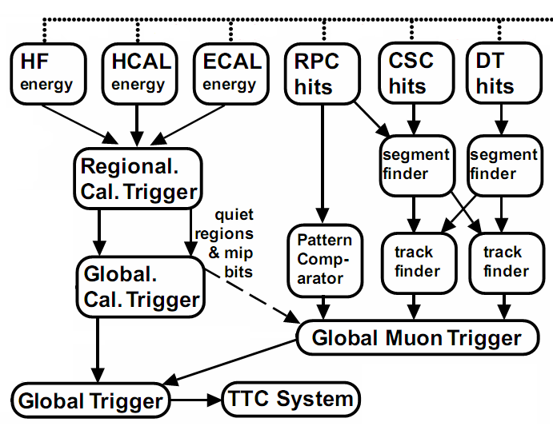
The CMS Level-1 trigger – Run 1

Slide 27
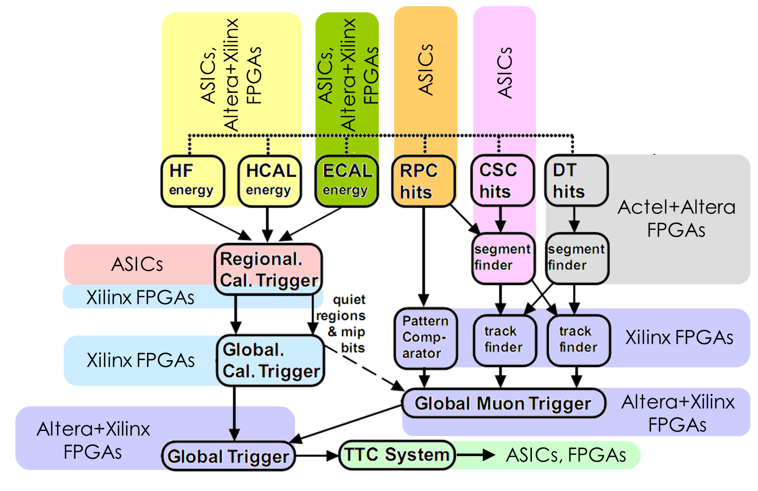
Run 1: Processing Platform

Slide 28
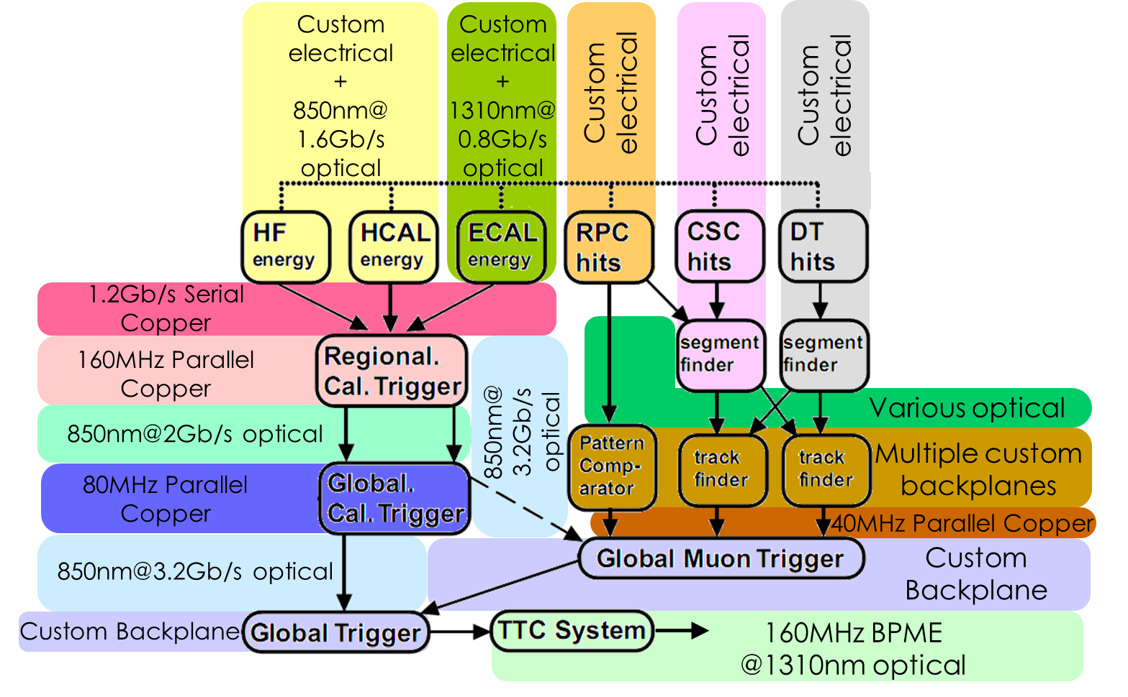
Run 1: Link standards

Slide 29
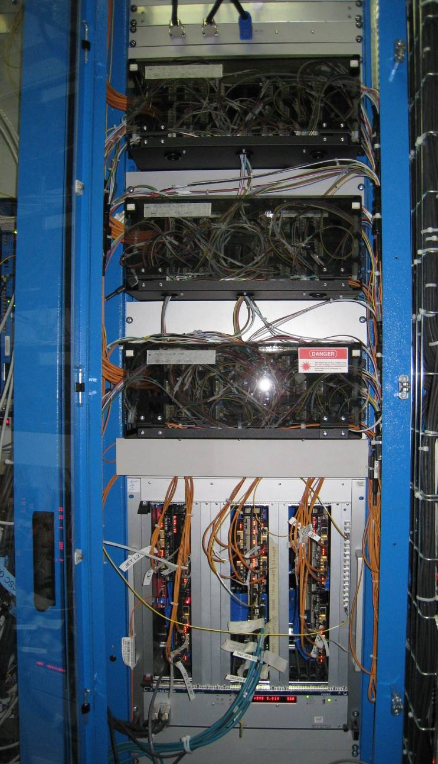
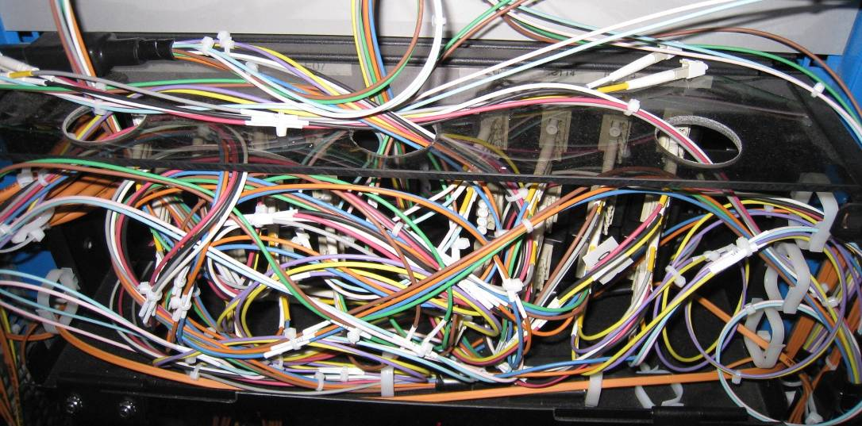
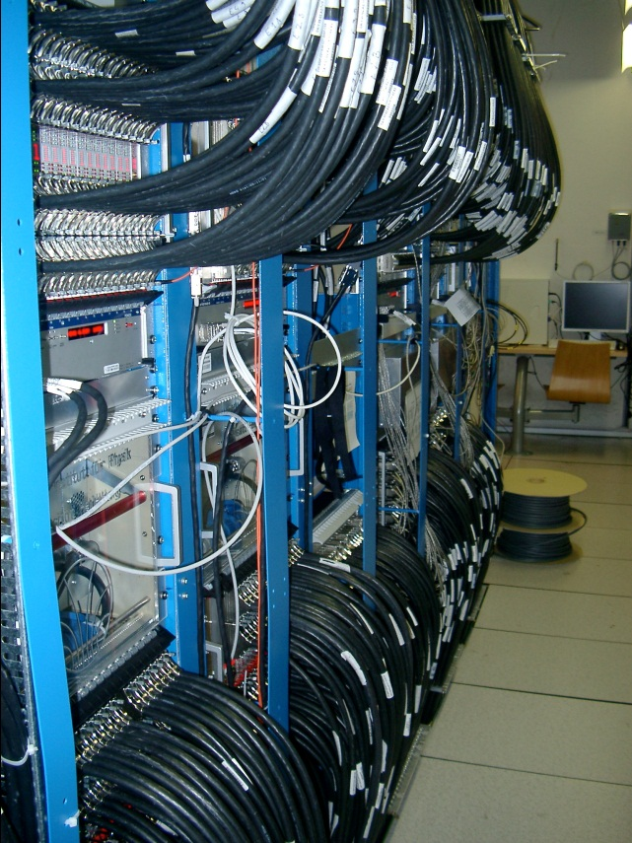
The CMS Level-1 trigger – Run 1
Regional Calorimeter
Trigger
Global Calorimeter
Trigger

Slide 30
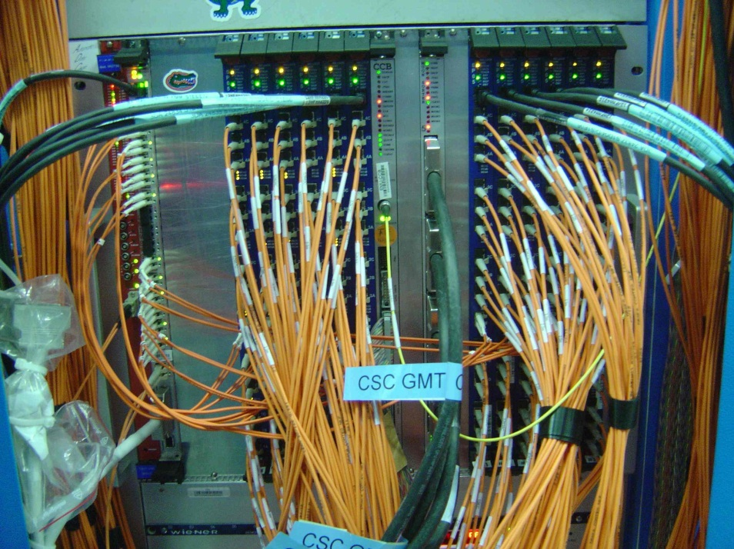
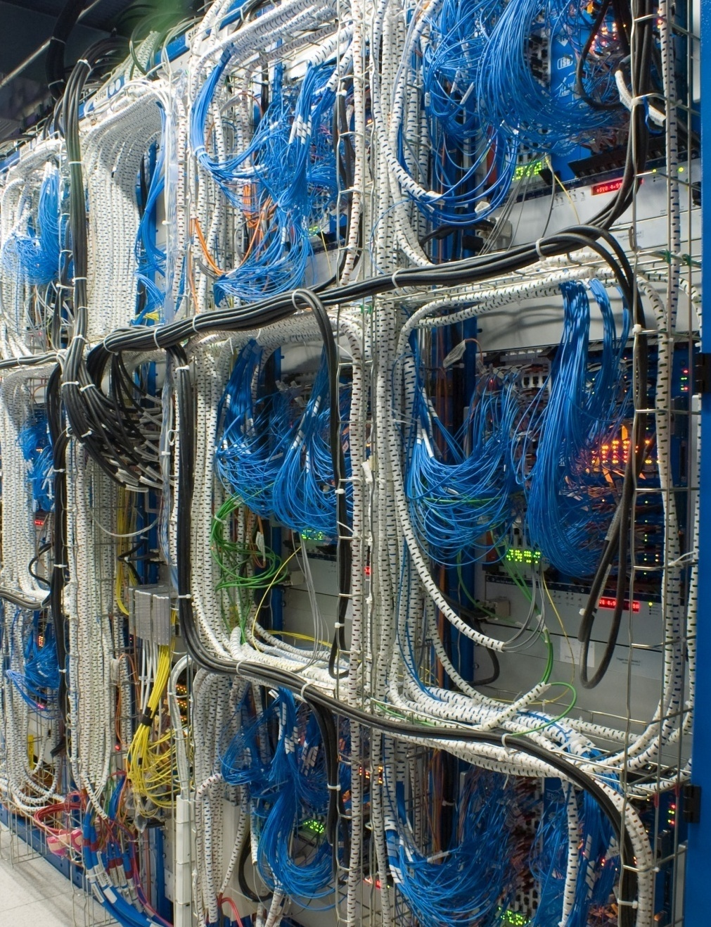
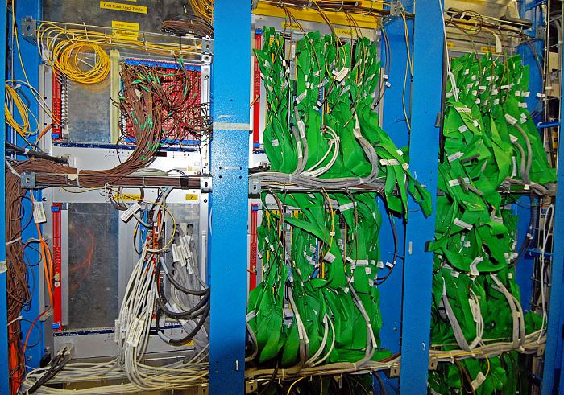
The CMS Level-1 trigger – Run 1
CSC
Trackfinder
RPC
Pattern Comparator
DT Trackfinder
(aka the green salad)

Slide 31
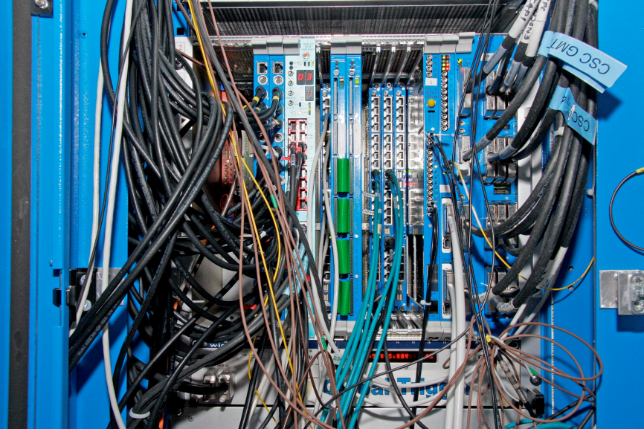
The CMS Level-1 trigger – Run 1
Global
Trigger

Slide 32
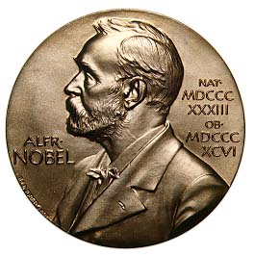
The CMS Level-1 trigger – Run 1
Pros
It works! It contributed to the finding of the Higgs Boson
It has been very reliable

Slide 33
The CMS Level-1 trigger – Run 1
Pros
Cons
It works! It contributed to the finding of the Higgs Boson
It has been very reliable
The inhomogeneity of the links and hardware meant that whenever a change was required during construction, new hardware was required
The number of different board-types means that there is really only one expert per board
Each piece of hardware requires different software. How these operate together was added as an after thought
No software or firmware reuse: Maintainability nightmare

Slide 34
The CMS Level-1 trigger – Run 1
Lessons which (should) have been learned
Cons
The inhomogeneity of the links and hardware meant that whenever a change was required during construction, new hardware was required
The number of different board-types means that there is really only one expert per board
Each piece of hardware requires different software. How these operate together was added as an after thought
No software or firmware reuse: Maintainability nightmare
Build a homogenous system
Build a homogenous system
Think about the system (rather than the components) from the start
Build a homogenous system

Slide 35
So why did CMS end up with such a diverse system?
Boundary-handling
In a conventional trigger architecture, data is processed in regions and the boundaries between regions require very different handling for a calorimeter subsystem than, say, a muon subsystem

Slide 36
So why did CMS end up with such a diverse system?
Boundary-handling
In a conventional trigger architecture, data is processed in regions and the boundaries between regions require very different handling for a calorimeter subsystem than, say, a muon subsystem
Mindset
There is a mindset that the trigger is a “hardware problem”
This was true in the past but not really true now
There is a mindset that software and firmware “come for free”

Slide 37
So why did CMS end up with such a diverse system?
Boundary-handling
In a conventional trigger architecture, data is processed in regions and the boundaries between regions require very different handling for a calorimeter subsystem than, say, a muon subsystem
Mindset
There is a mindset that the trigger is a “hardware problem”
This was true in the past but not really true now
There is a mindset that software and firmware “come for free”
Organizational
Building the trigger was approached like building the detector
The system was divided into chunks first and the interfaces between chunks decided internally by the groups on each side of the boundary.
Within each chunk, the group was free to come up with any solution that worked (see above)

Slide 38
So why did CMS end up with such a diverse system?
Boundary-handling
In a conventional trigger architecture, data is processed in regions and the boundaries between regions require very different handling for a calorimeter subsystem than, say, a muon subsystem
Mindset
There is a mindset that the trigger is a “hardware problem”
This was true in the past but not really true now
There is a mindset that software and firmware “come for free”
Organizational
Building the trigger was approached like building the detector
The system was divided into chunks first and the interfaces between chunks decided internally by the groups on each side of the boundary.
Within each chunk, the group was free to come up with any solution that worked (see above)
Progress is impossible without change, and those who cannot change their minds cannot change anything
George Bernard Shaw (1856-1950)
That is simple, my friend. It is because politics is more difficult than physics
Albert Einstein, 1946

Slide 39
Time-Multiplexing & Spatial Pipelining

Slide 40
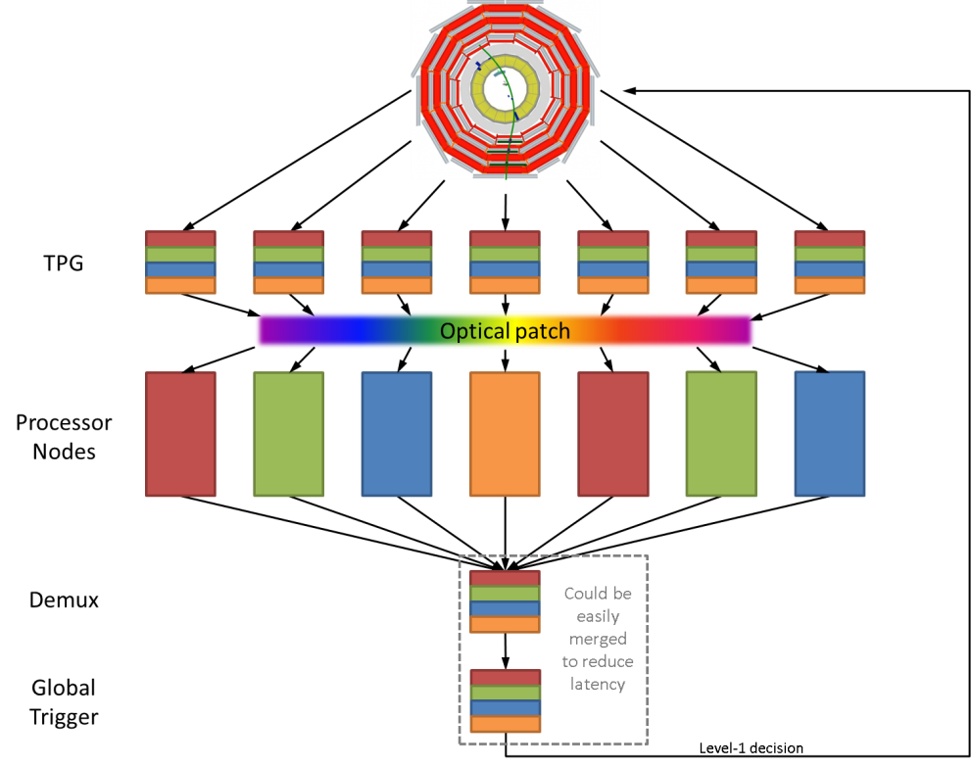
Time-multiplexed trigger
Data from an event is buffered and retransmitted to the first processing node over N bunch crossings
Data from the next event is buffered and retransmitted to the second processing node, again, over N bunch crossings
Process is repeated in round-robin fashion across ≥N processing nodes
Because both algorithm latency and data volume are constant, dataflow is fully deterministic and no complex scheduling mechanism is required
Time-Multiplexed Trigger Architecture

Slide 41
Time-multiplexed trigger
Layer 1
“Preprocessors”
Layer 2
“Processing nodes”
The parallel approach to computing does require that some original thinking be done about numerical analysis and data management in order to secure efficient use.
In an environment which has represented the absence of the need to think as the highest virtue this is a decided disadvantage.
Daniel Slotnick, 1967

Slide 42
The advantages of Time-Multiplexing
Take the principle to its limits: Eliminate the boundaries completely
No specialization of hardware for a particular boundary handling situation
“One-board-fits-all” design
No duplication of data needed
Less hardware and fewer links for a given resolution
No data needs to be thrown away
Should allow better physics
Equality of data
Without duplication, all data is equal
Can easily add new input sources
Scalability

Slide 43
The advantages of Time-Multiplexing
But there is nothing to say that we have to go to that extreme…
We could use Time-Multiplexing to reduce a two-dimensional boundary handling problem to a one-dimensional boundary handling problem
Conventional Boundary Handling
Partial TMT
Boundary Handling

Slide 44
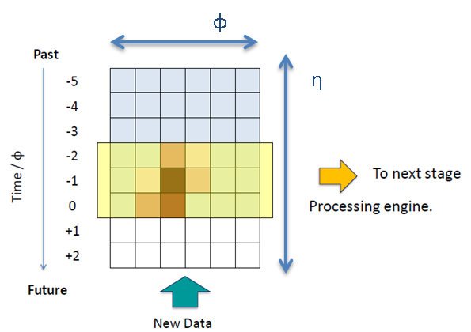
Further advantages of a TM trigger
advantages of a TM trigger?
Architecture is naturally matched to processing of data in FPGAs
Parallel streams with pipelined steps at data link speed
Put to great use in the calorimeter trigger
Reduces a 2D problem down to operations in a single dimension or localised 2D operations

Slide 45
Spatial Pipelining
Because data is buffered in a Time-Multiplexed Trigger and reordered for transmission, it can be sent in the order optimal for processing
If data is arranged suitably, processing begins as soon as the first data arrives…
YOU DO NOT WAIT FOR THE ENTIRE DATA TO ARRIVE BEFORE PROCESSING BEGINS!†
†Bold, red, super-sized and underlined because there are still people in the CMS trigger community who have not understood this and it is important!

Slide 46
Spatial Pipelining – Why bother?
By ordering the data geometrically, this allows all algorithms to be fully pipelined†, which in FPGAs means that:
The processing is localised
Fan-outs reduced
Routing delays minimised
Register duplication eliminated
Experience with Virtex-7 FPGAs has shown that this is VITAL in mapping the design into these very large FPGAs
This will only get more important as devices get larger in future
†That is, pipelined at the full data rate, not at the bunch-crossing rate

Slide 47
Spatial Pipelining – Why bother?
Full Spatial-Pipelining also allows MAXIMAL logic reuse:
Case-study: Electron isolation via counting clusters in a ring
Conventional implementation took >120% of resources available in XC7VX690T FPGA per proposed region
Spatially-pipelined implementation took 1.5% of resources available in XC7VX690T FPGA per TM node
2 orders of magnitude saving if you do it properly

Slide 48
The Amdahl-Slotnick debate, 1967
“The parallel approach to computing does require that some original thinking be done about numerical analysis and data management in order to secure efficient use.
In an environment which has represented the absence of the need to think as the highest virtue, this is a decided disadvantage”
Daniel Slotnick, 1967

Slide 49
Spatial Pipelining – What’s the problem?
You have swapped a spatial axis with the time axis
Positive and negative eta become forward and backward in time
In algorithms, data moving forward in time “interacts” with data moving both forwards and backwards in time
But algorithms are sequential in “real” time – essentially a third time axis
Different granularity data sees time pass at different rates (Time? Which Time?)
Physical data is in registers and transfers between registers also happen in real time but registers occupy physical space within the FPGA and relative spatial placement is important…
Is your head hurting yet?
Forget General Relativity – spatially pipelined firmware is where the real fun is to be had

Slide 50
The CMS trigger – Run 2: The Present

Slide 51
The CMS trigger – Run 2
ECAL
HCAL
HF
CSC
DT
RPC
CuOF
TCC
μHTR
μHTR
MPC
New SC & fan-out
LB
oSLB
Mezzanine
New SC & fan-out
Calo Trigger
Preprocessors
μTF Layer
Endcap
Overlap
Barrel
Calo Trigger
Main Processors
Sorting/Merging Layer (Optional)
Endcap
Overlap
Barrel
Demux
μGMT
μGT

Slide 52
The CMS trigger – Run 2: Systems being upgraded
ECAL
HCAL
HF
CSC
DT
RPC
CuOF
TCC
μHTR
μHTR
MPC
New SC & fan-out
LB
oSLB
Mezzanine
New SC & fan-out
Calo Trigger
Preprocessors
μTF Layer
Endcap
Overlap
Barrel
Calo Trigger
Main Processors
Sorting/Merging Layer (Optional)
Endcap
Overlap
Barrel
Demux
μGMT
μGT

Slide 53
The CMS trigger – Run 2: Hardware platforms
ECAL
HCAL
HF
CSC
DT
RPC
CuOF
TCC
μHTR
μHTR
MPC
New SC & fan-out
LB
oSLB
Mezzanine
New SC & fan-out
Calo Trigger
Preprocessors
μTF Layer
Endcap
Overlap
Barrel
Calo Trigger
Main Processors
Sorting/Merging Layer (Optional)
Endcap
Overlap
Barrel
Demux
μGMT
μGT

Slide 54
The CMS trigger – Run 2: Architecture
ECAL
HCAL
HF
CSC
DT
RPC
CuOF
TCC
μHTR
μHTR
MPC
New SC & fan-out
LB
oSLB
Mezzanine
New SC & fan-out
Calo Trigger
Preprocessors
μTF Layer
Endcap
Overlap
Barrel
Time-Multiplexed
Conventional
Calo Trigger
Main Processors
Sorting/Merging Layer (Optional)
Endcap
Overlap
Barrel
Demux
μGMT
Conventional
μGT

Slide 55
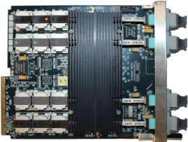
The CMS trigger – Run 2: Hardware platforms
ECAL
HCAL
HF
CSC
DT
RPC
CuOF
TCC
μHTR
μHTR
MPC
New SC & fan-out
LB
oSLB
Mezzanine
New SC & fan-out
Calo Trigger
Preprocessors
μTF Layer
Endcap
Overlap
Barrel
Calo Trigger
Main Processors
Sorting/Merging Layer (Optional)
Endcap
Overlap
Barrel
Demux
μGMT
μGT

Slide 56
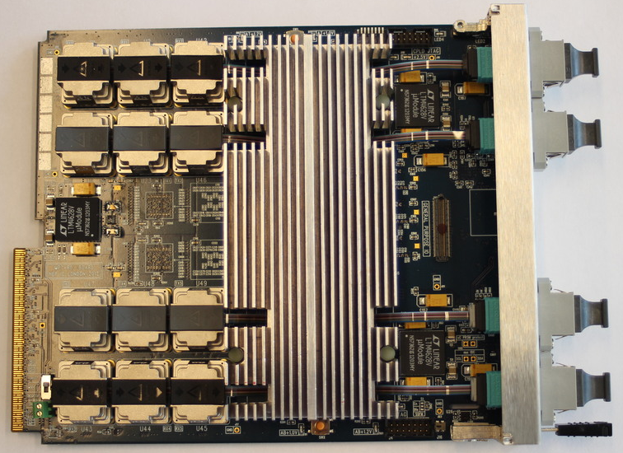
The Master-Processor, Virtex-7 (MP7)
uTCA form factor
72Tx+72Rx 13Gbps optical links
0.9 + 0.9Tb/s signal processor
Xilinx Virtex-7 FPGA
GbE, AMC13/TTC/TTS, PCIe, SAS, SATA, SRIO
On-board firmware repository
Pin-compatible FPGAs allow cost-performance balance
2×144Mbit 550MHz QDR RAM (optional)

Slide 57
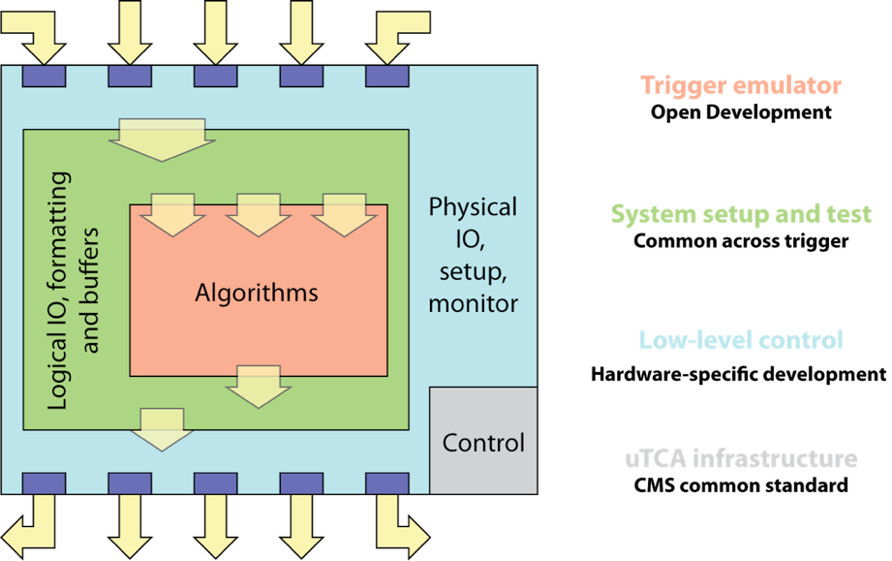
“Base Firmware” Concept

Slide 58
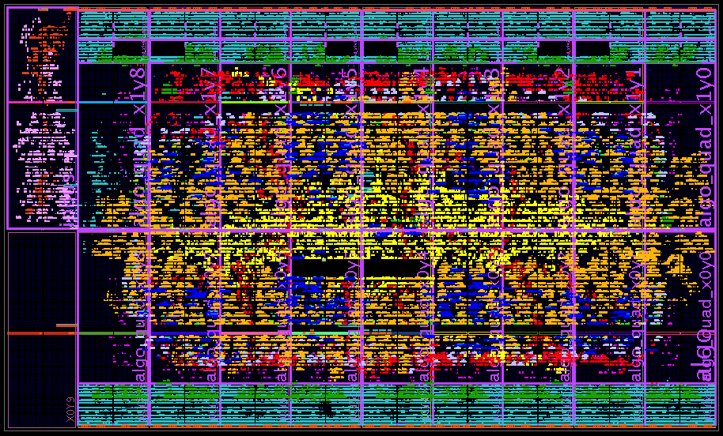
Floorplan of FPGA

Slide 59
Floorplan of FPGA
Total LUT usage: 46%
240 MHz clock
MGTs and DAQ buffers
Communication
Algorithms
DAQ
(work in progress)
MGTs and DAQ buffers

Slide 60
Lessons learned
Floor-planning
Huge impact on algorithm design
Structure the algorithm to map optimally onto the FPGA
Reduces risk that after many hours of routing 6 million nets just 1 or 2 fail to meet timing - exceedingly annoying
Significant timing improvement
Only viable if signals remain relatively local
Full pipelining of algorithms is essential - even relatively innocuous looking fan-outs in chips this large have the potential to kill off the entire design
If you want the most out of your FPGA you really need to think creatively about how you structure your data

Slide 61
The CMS trigger – Run 2: Reality

Slide 62
The CMS trigger – Run 3: The Future

Slide 63
The HL-LHC
LHC Run-2
L = O(10³⁴) cm⁻²s⁻¹
O(10) interactions/bx

Slide 64
The HL-LHC
LHC Run-2
L = O(10³⁴) cm⁻²s⁻¹
O(10) interactions/bx
LHC Run-3
L = O(10³⁵) cm⁻²s⁻¹
O(100) interactions/bx

Slide 65
The CMS detector
Full granularity Ecal included in trigger
~83k PbWO₄ Ecal Crystals
≡ 40 TBit per second
Upgrades relevant to triggering
~15k channel Brass/Plastic sampling HCAL
≡ 10 TBit per second
~568k RPC/DT/CSC Muon channels
≡ 23 TBit per second
Complete replacement of endcap Ecal & Hcal
~65M Silicon Pixels
≡ 21 PBit per second
Tracking included in trigger
~10M Silicon Strips
≡ 4 PBit per second
~3500 physicists/engineers

Slide 66
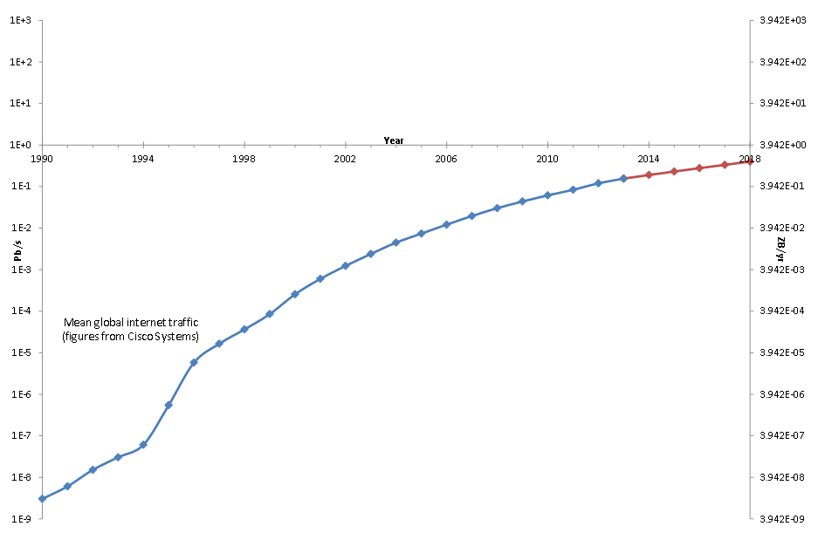
Big Data: Full granularity Ecal
1 Eb/s
4 YB/yr
61,200 crystals @ 1.6Gb/s = 97.92Tb/s = 386 EB/yr
1 Pb/s
4 ZB/yr
Full Granularity Ecal
1 Tb/s
4 EB/yr
1 Gb/s
4 PB/yr
4 TB/yr

Slide 67
Full granularity Ecal: Algorithms
Data is still laid out on a 2D rectilinear grid
Essentially the same as what we do now, only with 5 times the resolution in each direction
Currently, the major question which needs answering is what do the physicists want to do with the extra resolution!

Slide 68
Big Data: Tracking trigger
1 Eb/s
4 YB/yr
15,000 modules @ 5Gb/s = 75Tb/s = 296 EB/yr
1 Pb/s
4 ZB/yr
Tracking Trigger
1 Tb/s
4 EB/yr
1 Gb/s
4 PB/yr
4 TB/yr

Slide 69
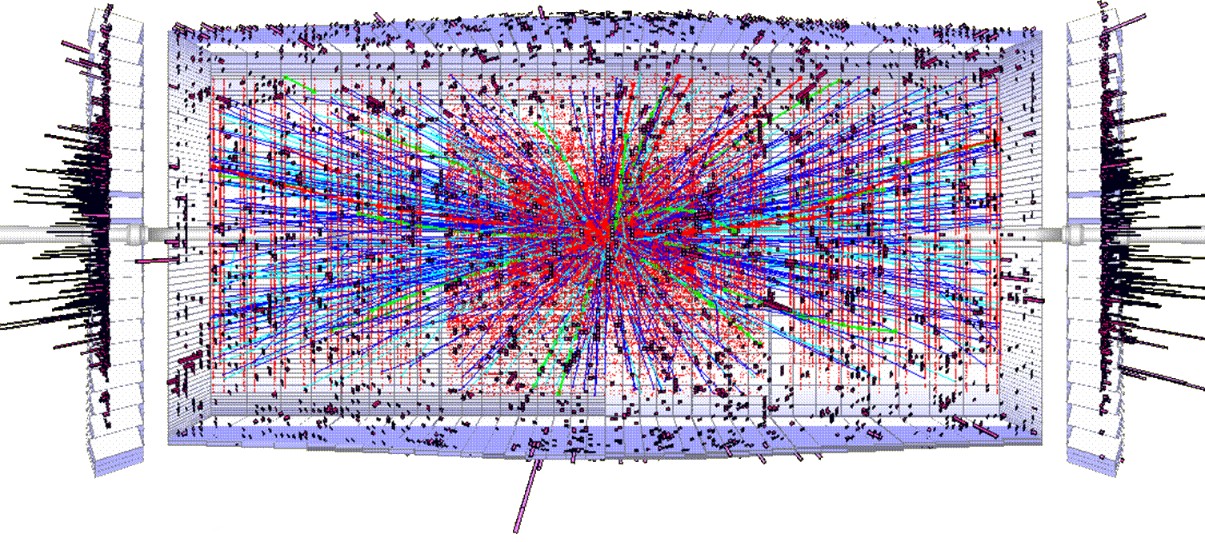
Tracking trigger: Algorithms
Track-finding in a high-occupancy environment is HARD
A lot of fake coincidences, noise, overlaps…
Inside solenoid – 4T magnetic field means highly curved tracks
Hough transform
Road search
Projective Iteration
Other?!
?

Slide 70
Big Data: High-granularity endcap calorimeters (one option)
1 Eb/s
4 YB/yr
30,000 modules @ 10Gb/s = 300Tb/s = 1.2 ZB/yr
1 Pb/s
4 ZB/yr
HGcal
1 Tb/s
4 EB/yr
1 Gb/s
4 PB/yr
4 TB/yr

Slide 71
High-granularity endcap calorimeters : Algorithms
Million dollar question!

Slide 72
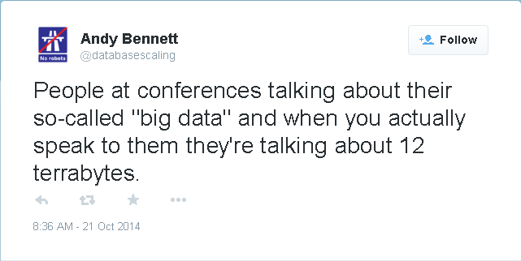
Big Data: Tech buzz-word of the moment
1 Eb/s
4 YB/yr
1 Pb/s
4 ZB/yr
Run-3 L1T Input
8 seconds of data for the CMS Level-1 trigger in Run-1
0.2 seconds of data for the CMS Level-1 trigger in Run-3
4 EB/yr
1 Tb/s
1 Gb/s
4 PB/yr
4 TB/yr

Slide 73
How to approach the problem

Slide 74
How to approach the problem
All new systems will use the GBT link
All sending data at the same order of magnitude
It would be sensible for all systems to use a common back-end to receive the data

Slide 75
How to approach the problem
All new systems will use the GBT link
All sending data at the same order of magnitude
It would be sensible for all systems to use a common back-end to receive the data
We have a system architecture which is scalable to rise to the challenge
We have a system architecture which simplifies boundary handling and is agnostic to the data content
It would be sensible for all systems to use a common trigger platform and common trigger architecture to process the data

Slide 76
The problems needing solving
To overcome the hardware-centric mindset
Requires a model of collaborative firmware development which is as simple (and rigorous) as collaborative software development

Slide 77
The problems needing solving
To overcome the hardware-centric mindset
Requires a model of collaborative firmware development which is as simple (and rigorous) as collaborative software development
To overcome the old organizational model

Slide 78
The problems needing solving
To overcome the hardware-centric mindset
Requires a model of collaborative firmware development which is as simple (and rigorous) as collaborative software development
To overcome the old organizational model
That task could make processing 0.5Pb/s look easy

Slide 79
The problems needing solving
To overcome the hardware-centric mindset
Requires a model of collaborative firmware development which is as simple (and rigorous) as collaborative software development
To overcome the old organizational model
That task could make processing 0.5Pb/s look easy
Thank you

