Slide 1
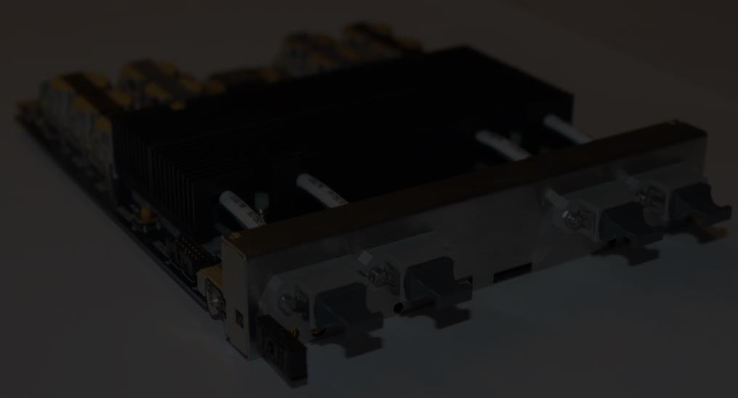
Development and testing of an upgrade to the CMS Level-1 Calorimeter Trigger
Andrew W. Rose
Imperial College, London
On behalf of the CMS L1 Calorimeter Trigger upgrade community

Slide 2
Content
Introduction: The CMS Level-1 Calorimeter Trigger Upgrade
Hardware for upgrades
Hardware testing
System architecture and Firmware
Other work
Conclusions

Slide 3
Introduction

Slide 4
The CMS Level-1 Calorimeter Trigger
ECAL
energy
HCAL
energy
HF
energy
Mitigate risk by building upgrade in parallel
Stage 1 - improve processing of existing RCT
New card converts current system to optical
New HF optical data available
Stage 2 - all inputs in optical format
Current system, albeit modified, operational in parallel
Regional Calorimeter Trigger
e/γ
Jets
Global Calorimeter
Trigger

Slide 5
Stage-1
ECAL
energy
HCAL
energy
HF
energy
Regional Calorimeter Trigger
Calorimeter Trigger
Layer 1
e/γ
Jets
Global Calorimeter
Trigger
Calorimeter Trigger
Layer 2
oRM
oSLB
oRSC

Slide 6
Stage-2
Eventually decommissioned
ECAL
energy
HCAL
energy
HF
energy
HCAL
energy
Regional Calorimeter Trigger
Calorimeter Trigger
Layer 1
e/γ
Jets
Global Calorimeter
Trigger
Calorimeter Trigger
Layer 2
oRM
oSLB
oRSC

Slide 7
Hardware for upgrades

Slide 8

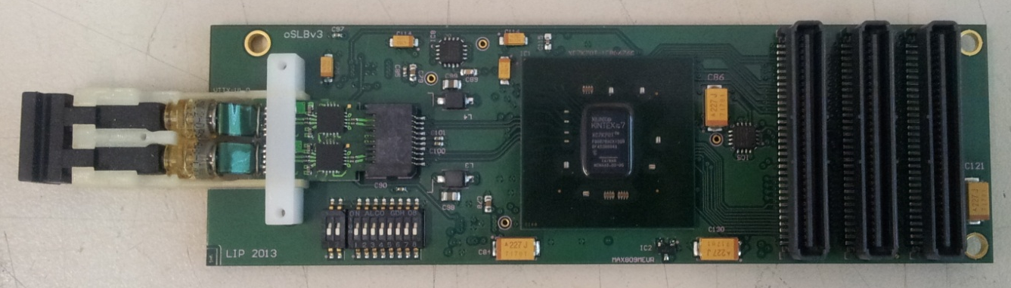
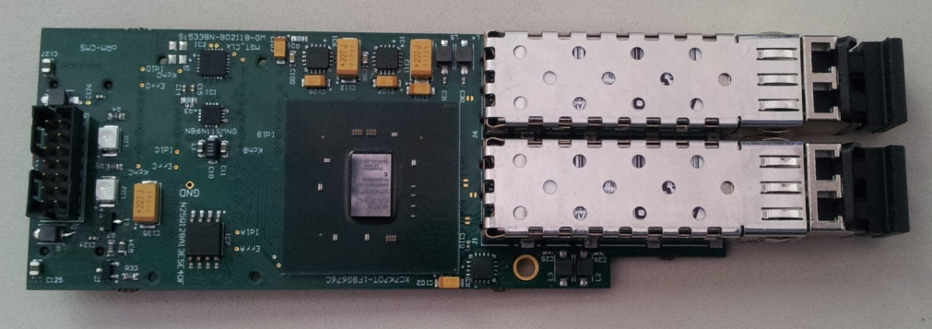

Stage-1: oSLB and oRM
ECAL
energy
HCAL
energy
HF
energy
oSLB
Regional Calorimeter Trigger
Global Calorimeter
Trigger
oRM

Slide 9
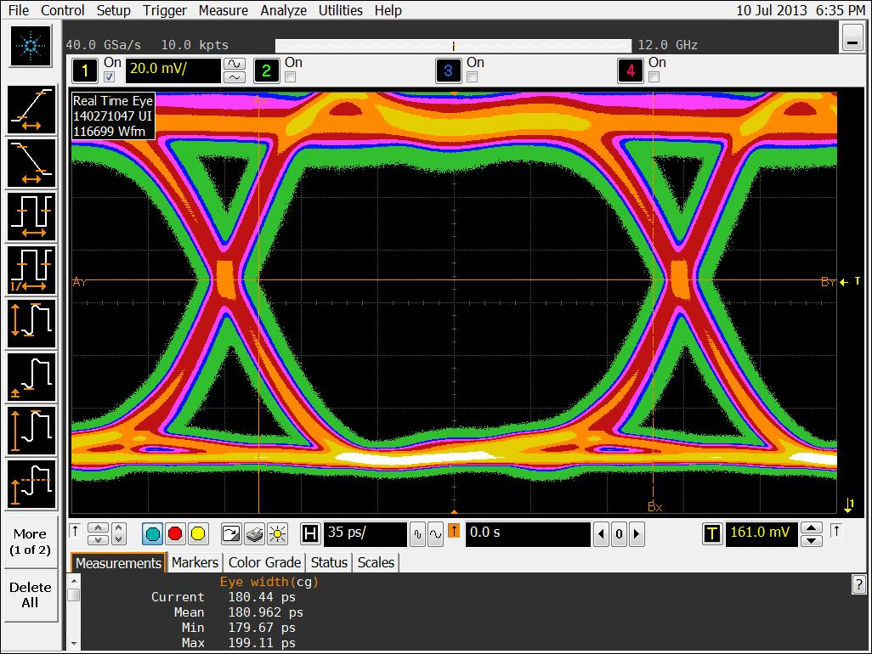
Stage-1: oSLB and oRM
Kintex-7 FPGAs
Mount on existing VME cards, replacing copper links
Testing on-going
oSLB output looks good
Working to improve clock stability in oRM
Latest board-board tests are encouraging
oSLB
oRM
oSLB @ 4.8Gb/s

Slide 10
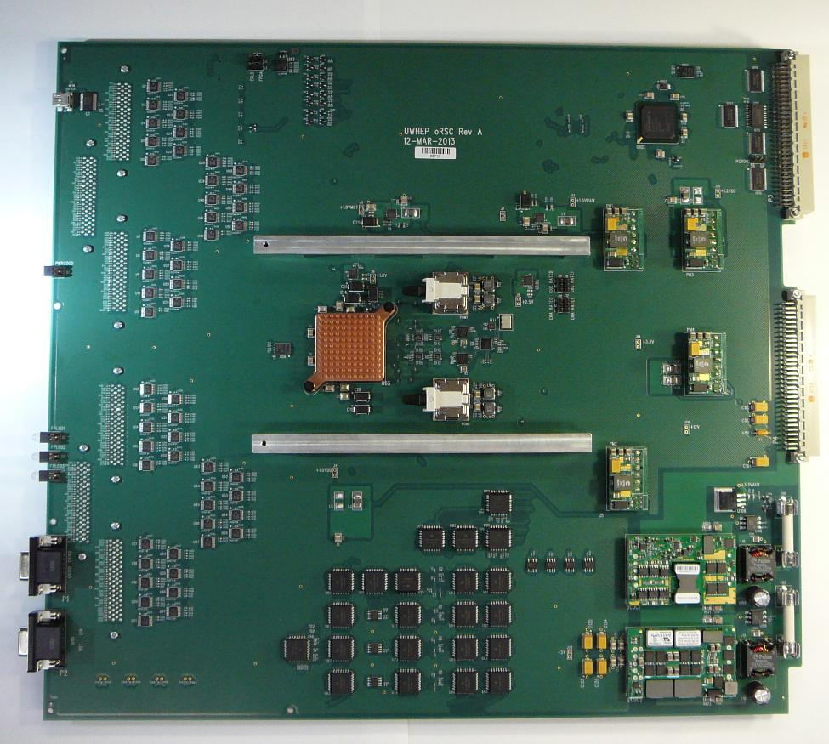
Stage-1: oRSC
ECAL
energy
HCAL
energy
HF
energy
Regional Calorimeter Trigger
Global Calorimeter
Trigger

Slide 11
Stage-1: oRSC
Kintex-7 FPGA
VME interface card
Fits in current RCT crates
18 cards in total
Provides RCT output in optical format to:
Existing GCT Leaf cards
Upgrade Layer-2 cards
Microblaze core running Xilinx PetaLinux for service tasks
ECL
to
LVTTL translators
Kintex-7
XC7K355T
FPGA
Spartan-6
VME Interface
Avago MiniPOD
Tx Modules
RCT
Clock Interface (NECL)

Slide 12
Stage-1: oRSC status
ECL clocks tested – all ok
Reference clocks are fully programmable
Wide range of synchronous and asynchronous link speeds
Next task – test parallel interface from RCT
Considered low risk as similar to previous, non-optical, test board
Expect board to be fully validated during the fall & ready for production run thereafter.
ECL
to
LVTTL translators
Kintex-7
XC7K355T
FPGA
Spartan-6
VME Interface
Avago MiniPOD
Tx Modules
RCT
Clock Interface (NECL)

Slide 13
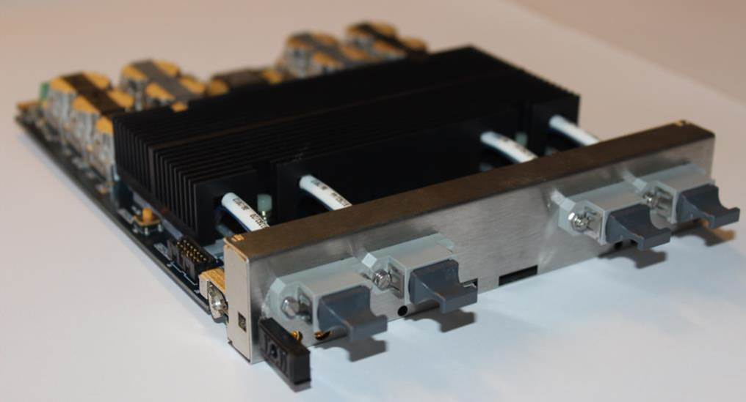


Stage-2
ECAL
energy
HF
energy
HCAL
energy
University of Wisconsin
CTP7
Calorimeter Trigger
Layer 1
Calorimeter Trigger
Layer 2

Slide 14
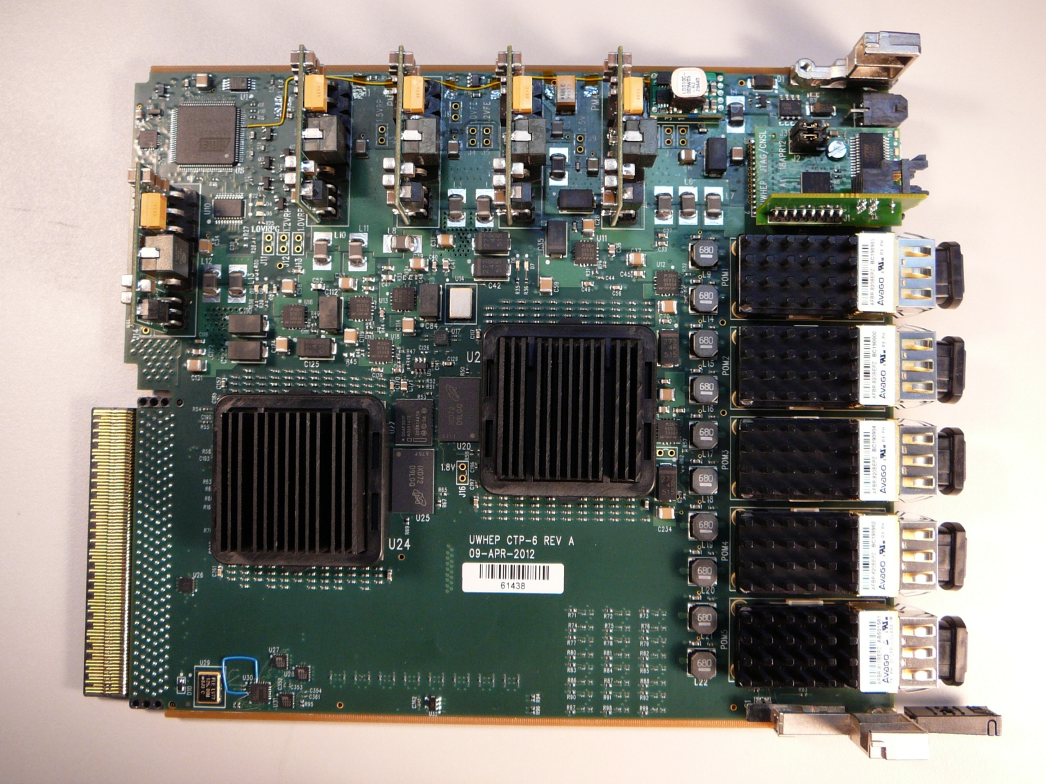
Stage-2: CTP7
Based on Virtex-7 XC7VX690T FPGA
Zynq processor running Xilinx PetaLinux for service tasks
Baseline Layer 1 hardware
Link power distribution to support a mixture of speeds
4.8/6.4 Gbps inputs
9.6/10 Gbps outputs
Schematic design completed
Layout in progress
Component count will be:
Higher than CTP6 (μTCA)
Lower than oRSC (VME)
CTP6
CTP6 – Virtex-6 based prototype for CTP7
See TWEPP 2012:
https://indico.cern.ch/contributionDisplay.py?contribId=86&confId=170595&sessionId=51
https://indico.cern.ch/contributionDisplay.py?contribId=97&confId=170595&sessionId=53

Slide 15

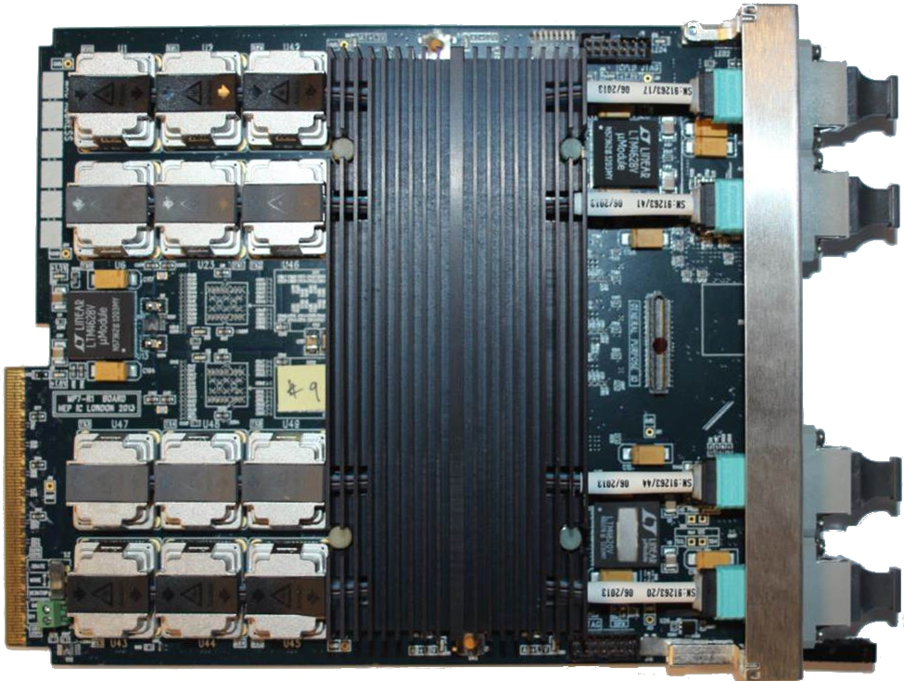
Stage-2:
1.5Tb/s optical signal processor
Xilinx Virtex-7 FPGA:
XC7VX485T or XC7VX690T
Advanced boot-loader & diagnostics (full system test at start-up)
On-board firmware repository
2×144Mbit 550MHz QDR RAM (optional)
Been in hand for over a year
Continuous testing over that period
Very well understood
Extensive software and firmware
Imperial MP7 processor board
See also TWEPP 2012:
https://indico.cern.ch/contributionDisplay.py?contribId=86&confId=170595&sessionId=51
https://indico.cern.ch/contributionDisplay.py?contribId=97&confId=170595&sessionId=53

Slide 16
Hardware testing

Slide 17
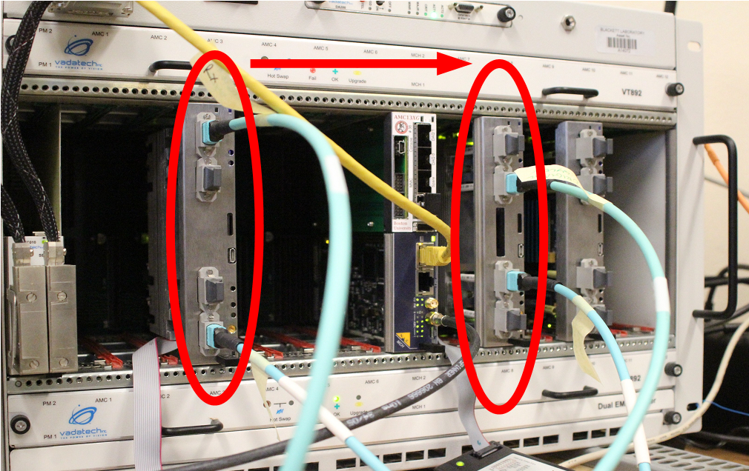

Optical/serial link validation
These boards:
Have a lot of serial links
Run these links fast
Use new form-factor MiniPOD optics
Stringent testing must be board-to-board, not loopback
Scaling effects must be considered
Number of links
Line rate
Cross-generational differences
Transceivers in 7-series FPGAs behave very differently to 5- or 6- series devices
72 @ 10Gb/s → 62.2Pb/day → ~1Eb every 2 weeks
No bit errors

Slide 18
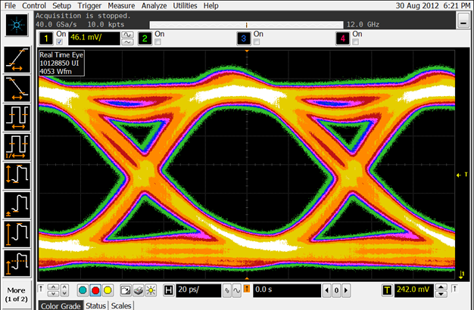
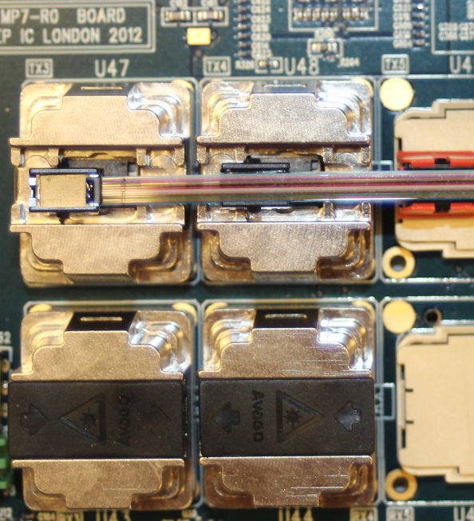
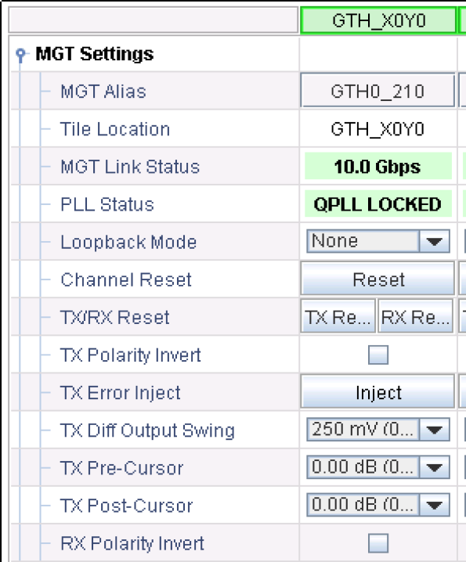
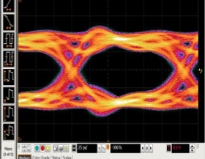
Optical link validation
Optical eye
@ 10Gb/s
MP7 optical links worked perfectly out-of-the-box
MiniPODs are using default pre-emphasis (minimal)
TX differential swing is minimal
No pre-emphasis/de-emphasis in MGTs
oRSC also has working optical links
oRSC
Optical eye
@ 6.4Gb/s

Slide 19
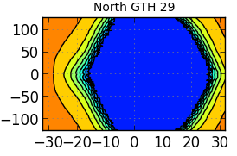
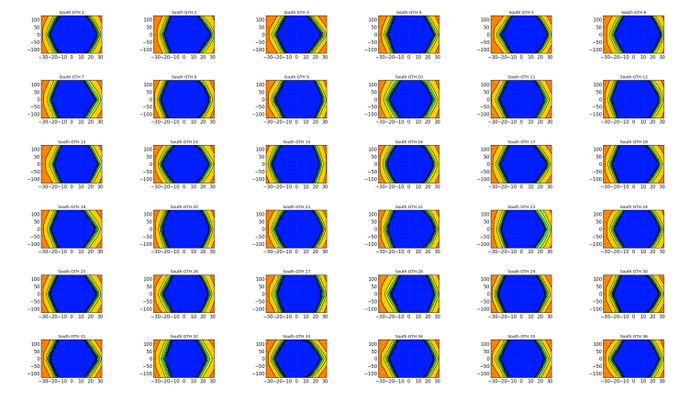
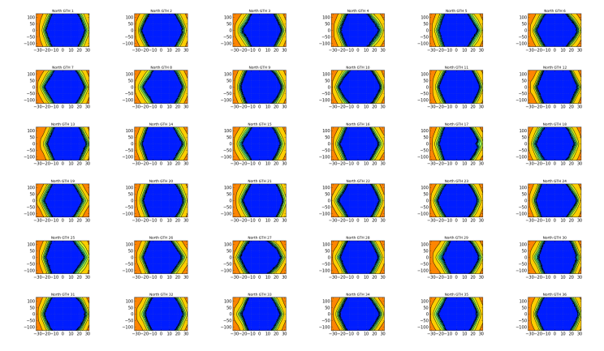
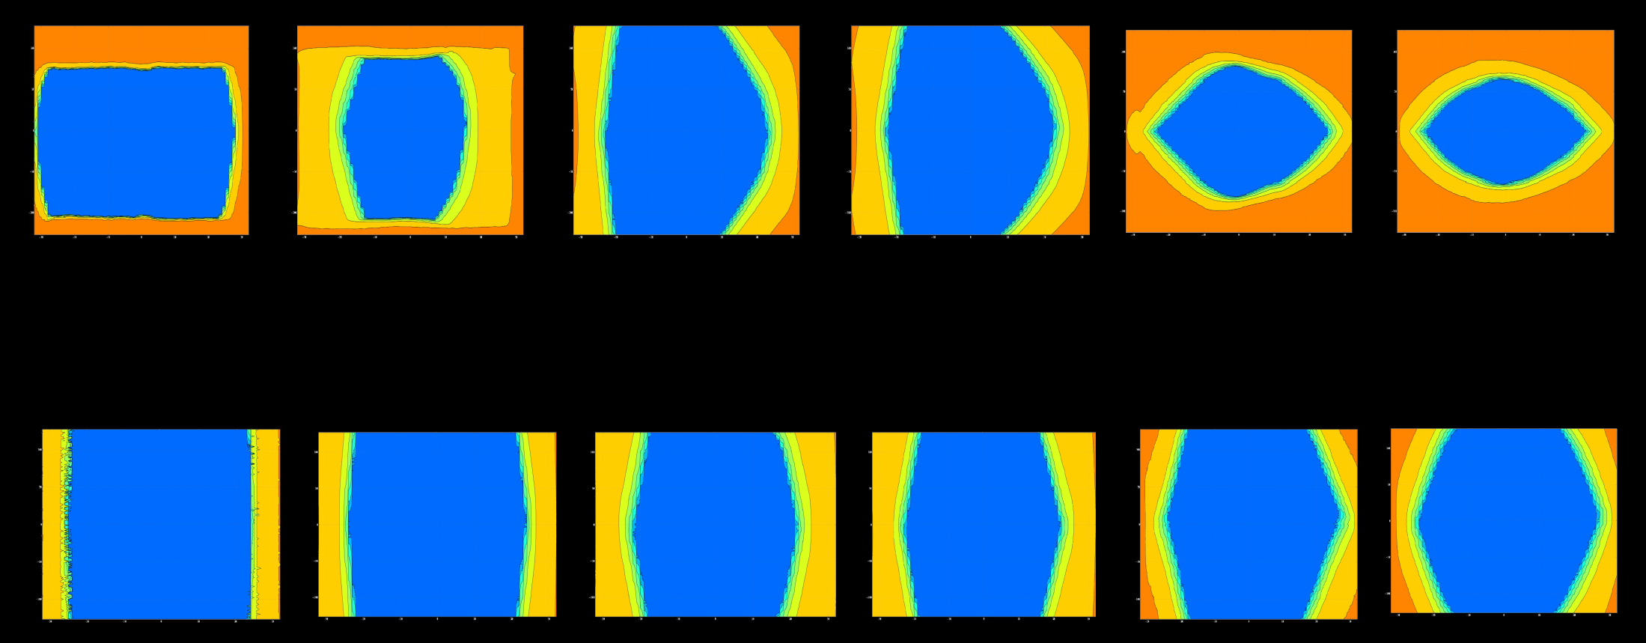
Serial link validation
New feature in Xilinx 7-series is the ability to generate eye-diagrams inside the transceivers themselves
Extensively tested all 72 links running PRBS7 at 10Gb/s, LPM
Various line rates validated, including LHC-synchronous operation
Eye-diagrams for all line-rates meet industry standards
XC7VX485T – GTX transceivers
MGT configuration done at runtime, not build-time, giving significantly greater flexibility and control
O(10¹⁶) bits per link transferred without bit error
1Gb/s
2Gb/s
4Gb/s
5Gb/s
8Gb/s
10Gb/s
XC7VX690T – GTH transceivers
1Gb/s
2Gb/s
4Gb/s
5Gb/s
8Gb/s
10Gb/s

Slide 20
Integration testing
oSLB
µHTR
Homogeneous hardware is easier to test than heterogeneous hardware
Unfortunately CMS trigger hardware is not homogeneous
Integration facility set up at CERN for testing
Testing with deployment infrastructure:
Trigger, Timing and Control (TTC)
Computing, networks, etc.
Internal progress monitoring milestones:
Last, in July
Next, next week
oRM
RCT
oRSC
Layer 1
(CTP7)
CTP6
GCT
Layer 2
(MP7)

Slide 21
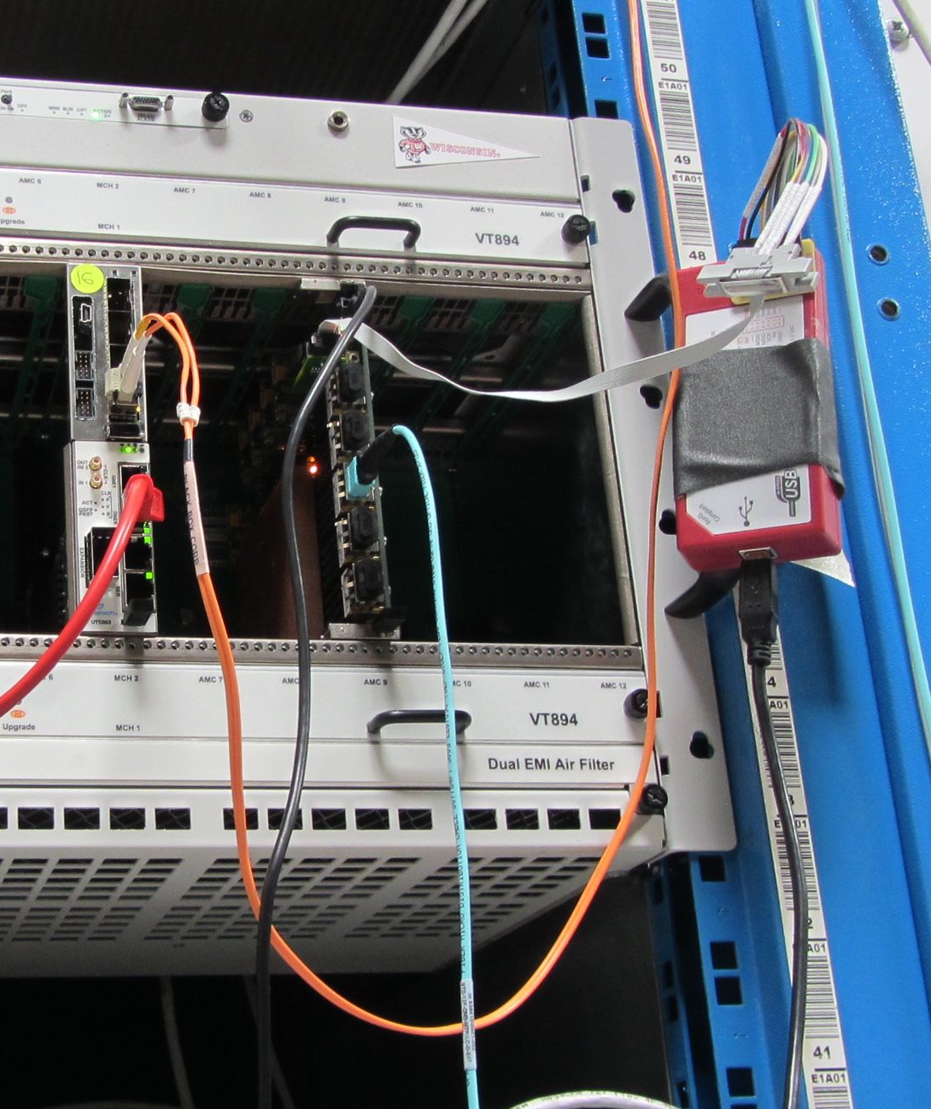
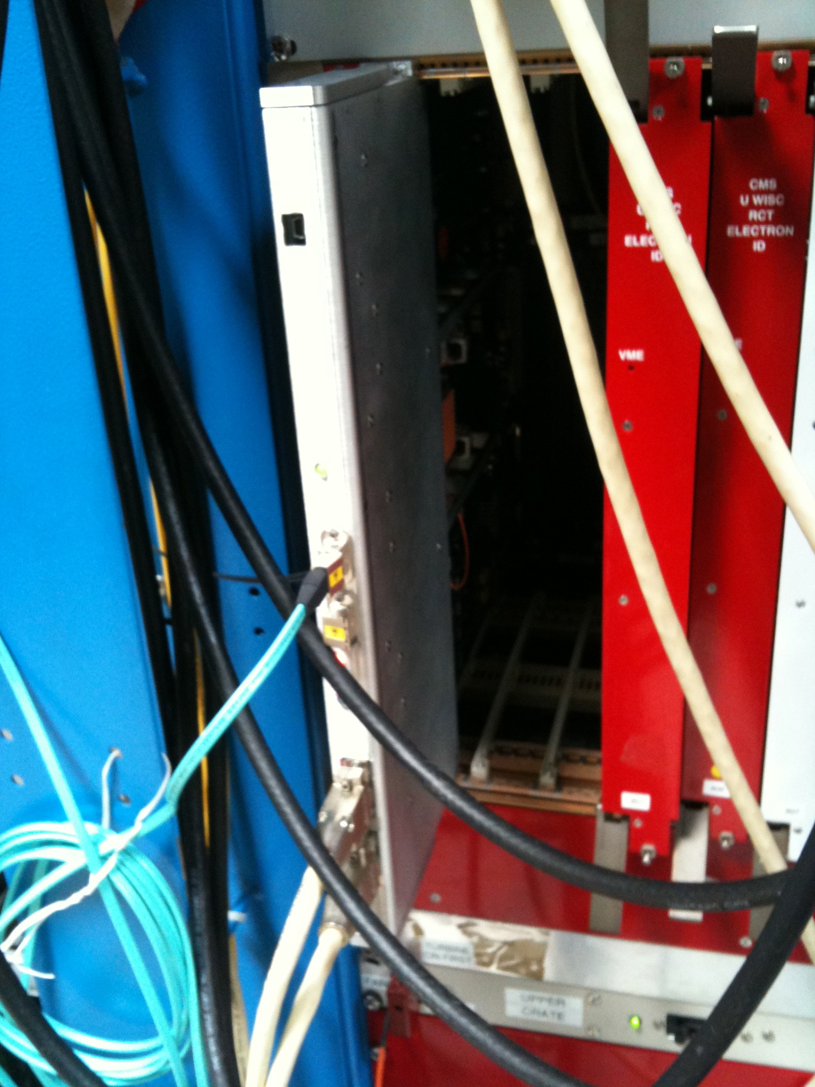
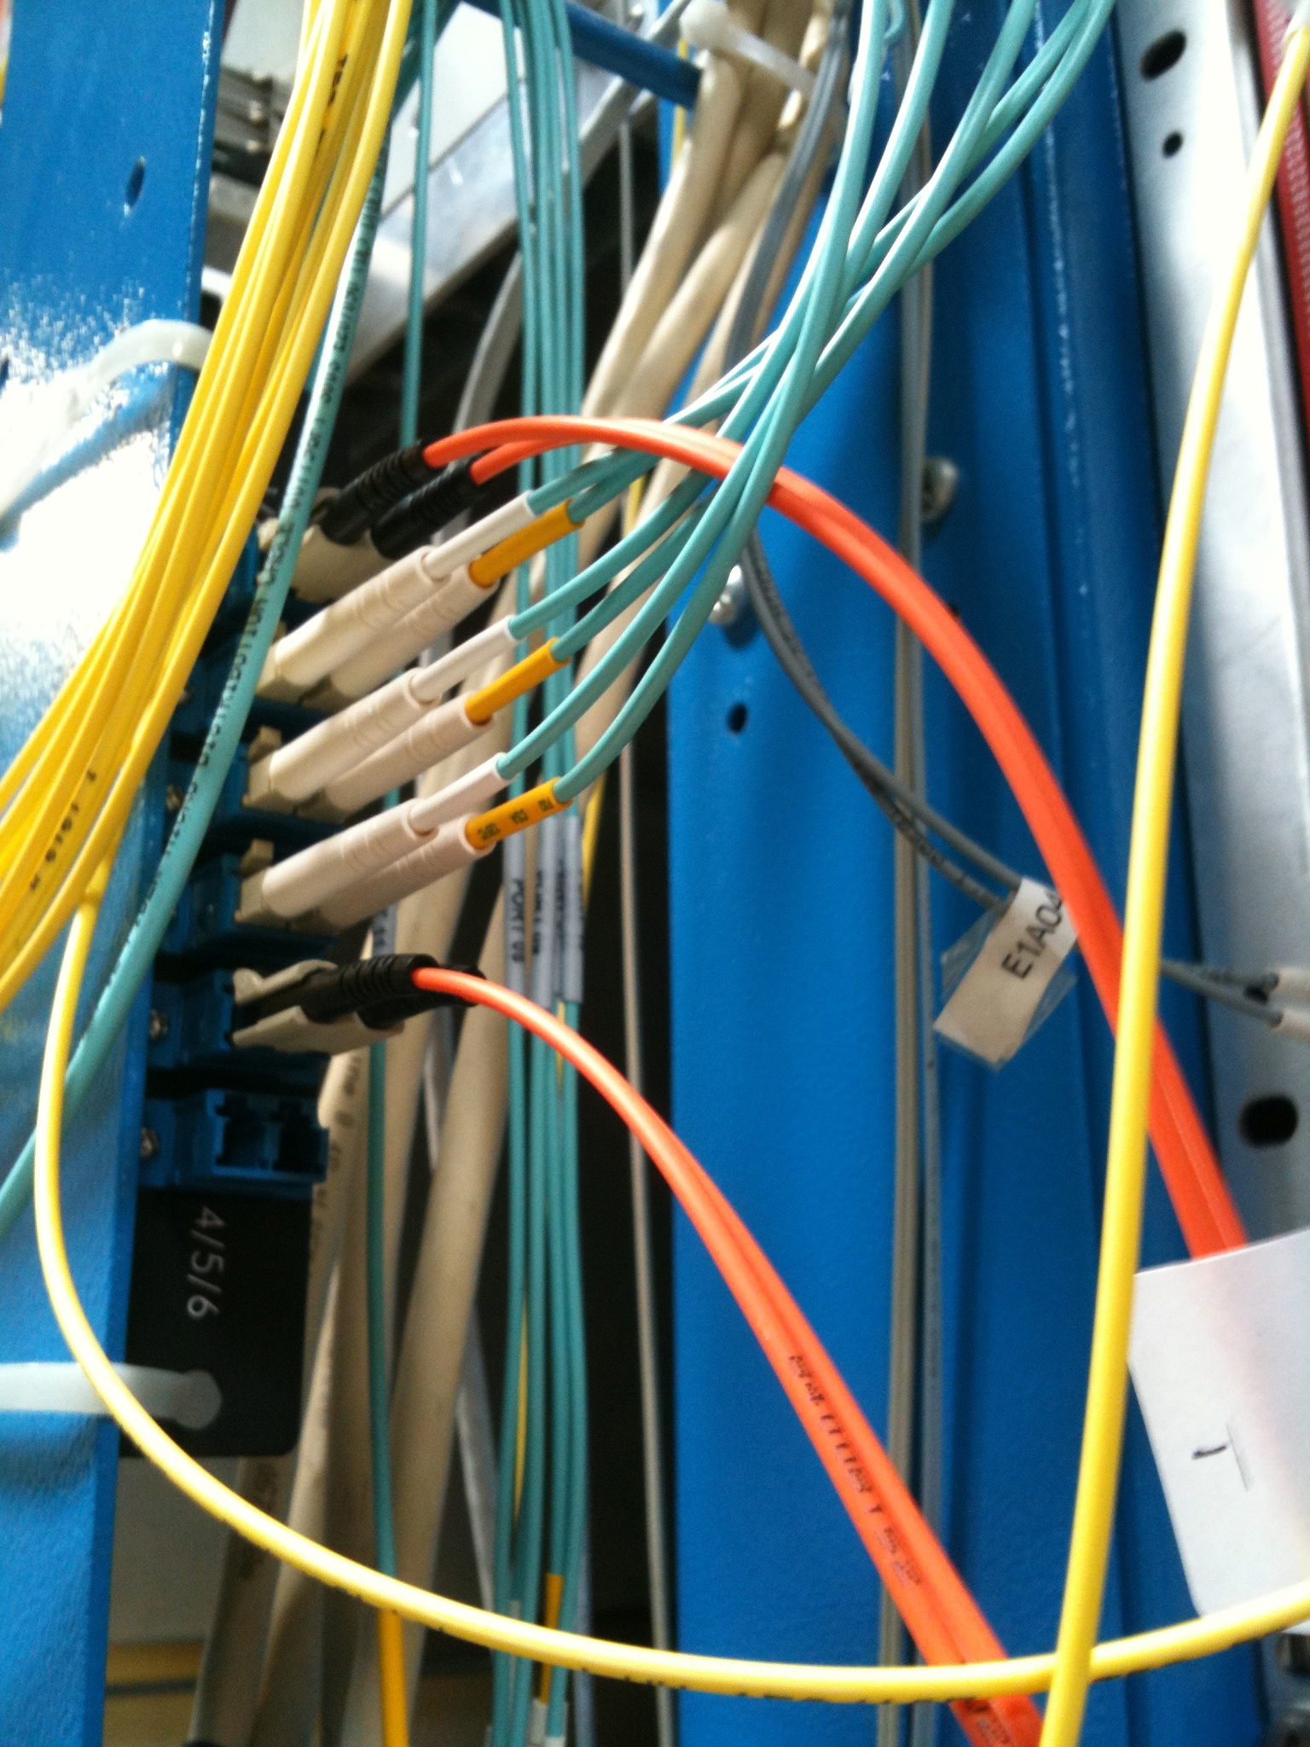
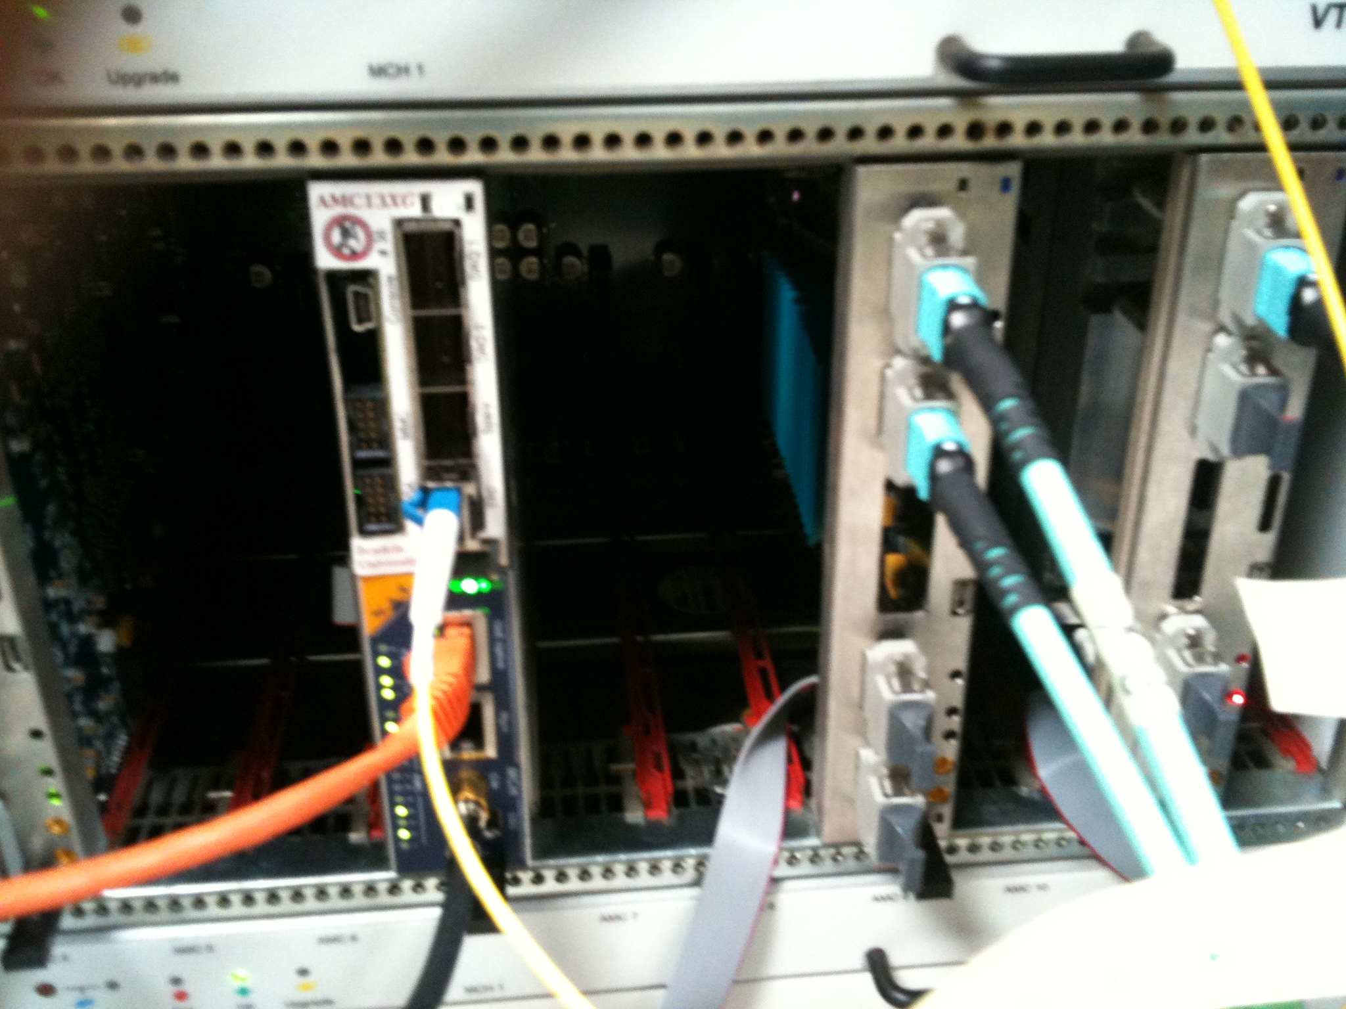
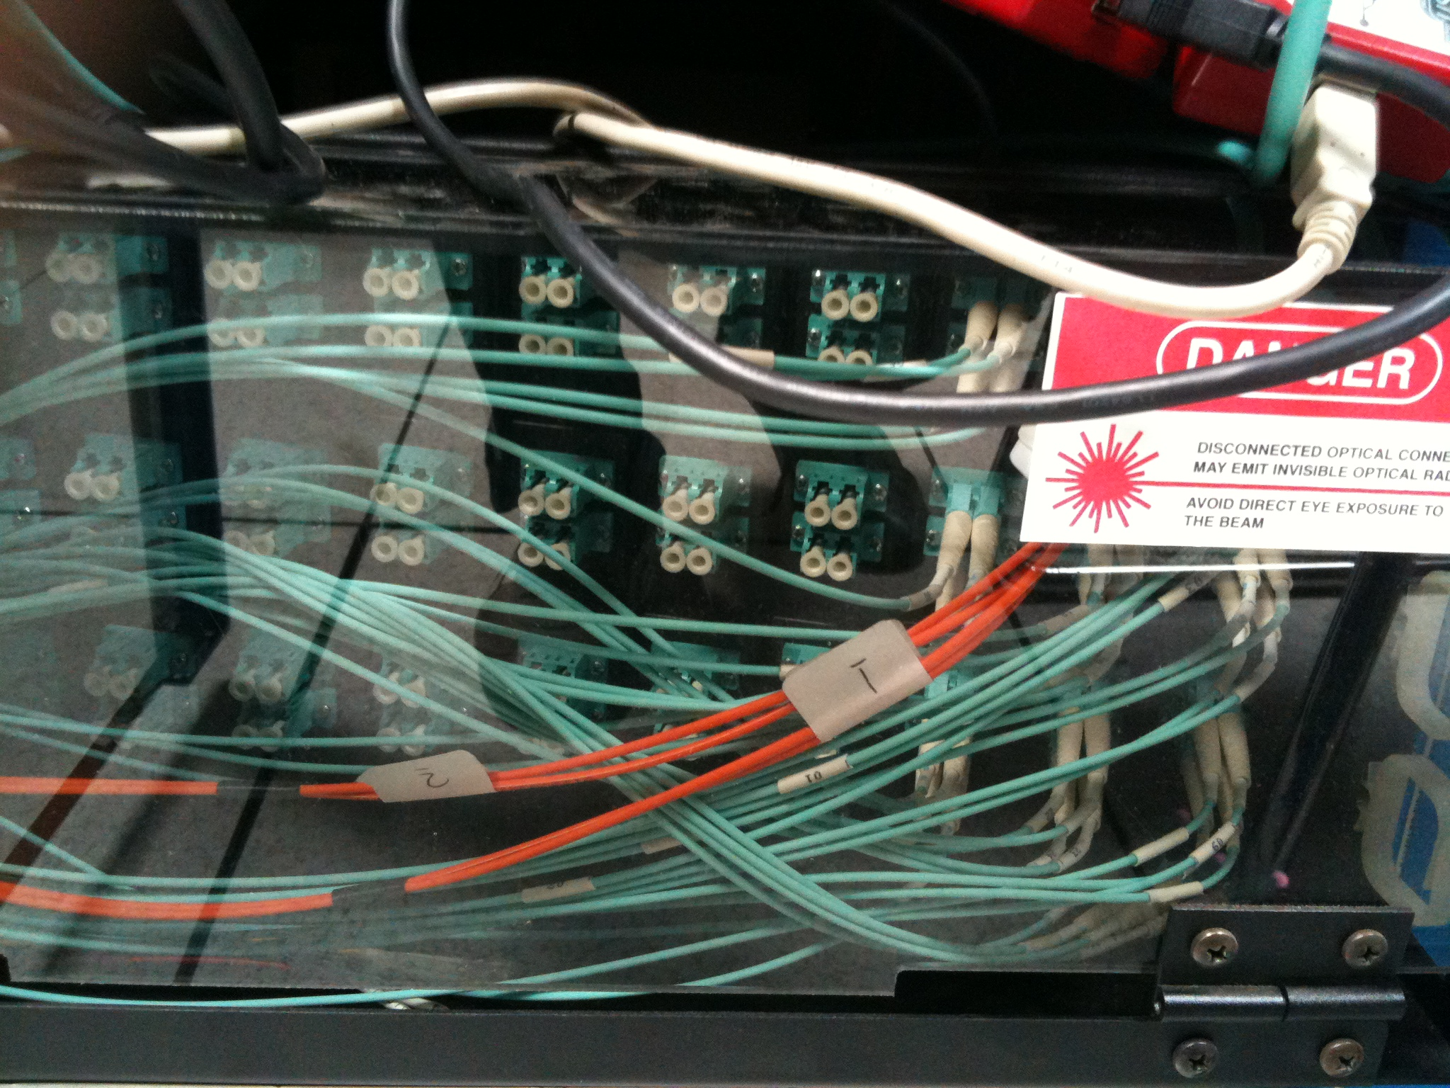
Integration testing
oRSC
Optical patch panel for oRSC
CTP6
Optical patch panel for MP7
Real life is never so neat and tidy

Slide 22
Integration testing: July
July integration test was first scheduled integration test
Focussed on link quality between boards
Follow-up test being scheduled for those tasks not completed in July
Link | Oscilloscope | IBERT | Data patterns | Alignment
oSLB – oRM | ✓ | ✗ | ✗ | ✗
uHTR – oRM | ✓ | ✓ | ✗ | ✗
oRM – RCT | ✗ | – | ✗ | ✗
uHTR – CTP6 | ✓ | ✓ | ✓ | ✗
oSLB – CTP6 | ✗ | ✗ | ✗ | ✗
RCT – oRSC | ✓ | – | ✗ | ✗
oRSC – CTP6 | ✓ | ✓ | ✓ | ✗
oRSC – MP7 | ✓ | ✓ | ✓ | ✗
oRSC – GCT | ✗ | ✗ | ✗ | ✗
CTP6 – CTP6 | ✓ | ✓ | ✓ | ✗
MP7 – MP7 | ✓ | ✓ | ✓ | ✓

Slide 23
System architecture and firmware

Slide 24
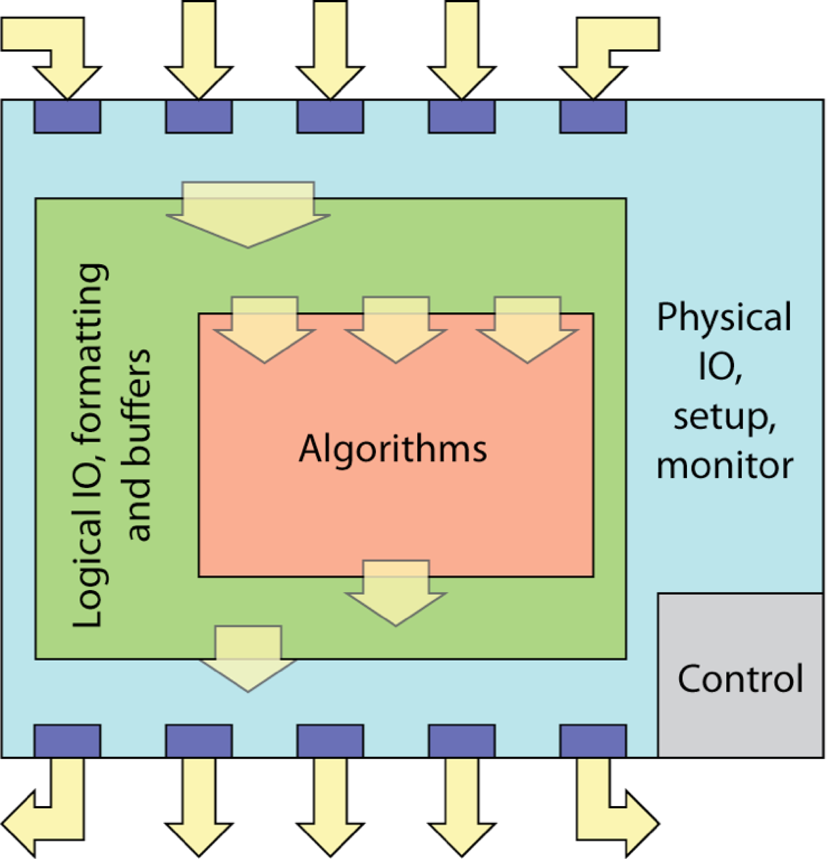



Algorithm firmware
Generic processing boards with single I/O format converts trigger development from a hardware problem to a programming problem
Allows collaborative development of algorithms
Iceberg Technology
Rutherford Appleton Laboratory

Slide 25
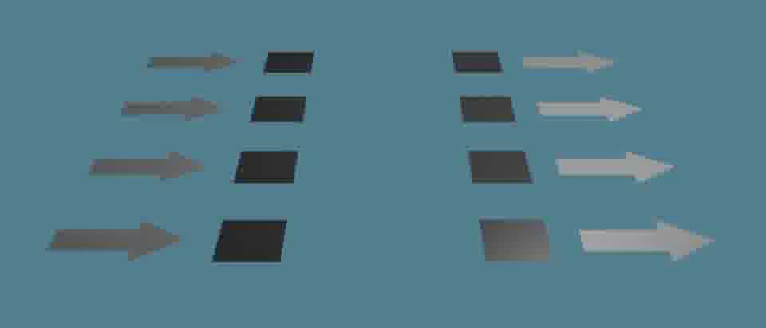
Time-multiplexed trigger
Layer 1
“Preprocessors”
Layer 2
“Processing nodes”
The parallel approach to computing does require that some original thinking be done about numerical analysis and data management in order to secure efficient use.
In an environment which has represented the absence of the need to think as the highest virtue this is a decided disadvantage. Daniel Slotnick, 1967

Slide 26
Algorithm firmware
The Time-multiplexed architecture allows all data arrives in geometric order:
Towers at given φ are always the same bits on the same optical links
Towers arrive in order of increasing |η|
This converts a 2D geometric problem to a 1D problem
This allows all algorithms to be fully pipelined:
The processing is localised
Fan-outs reduced
Routing delays minimised
Register duplication eliminated
Engineers and computer-scientists have long reported that full-pipelining is the preferred design methodology for FPGAs

Slide 27
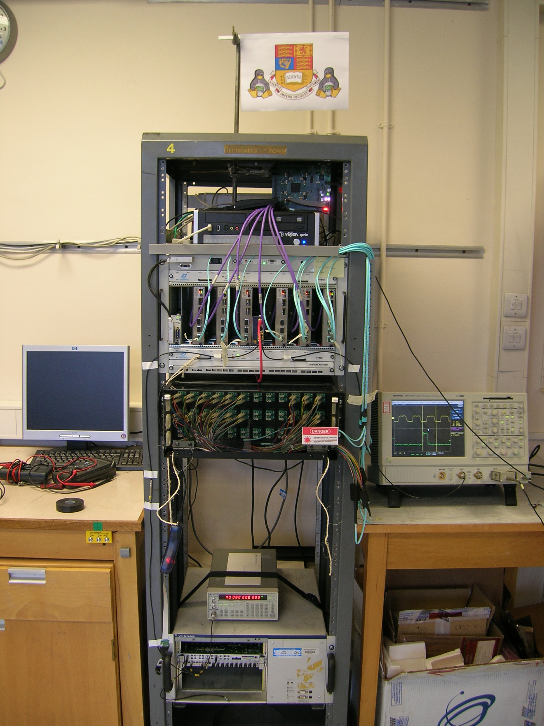
Algorithm firmware
Mini-T5 TMT demonstrator Sept 2011
Time-multiplexed trigger has been demonstrated:
Using existing GCT algorithms on Mini-T5 card
Using baseline upgrade algorithms on Mini-T5 card
Using existing GCT algorithms on MP7 card
September integration test is a test of:
Dataflow from level-1 to level-2 at 10Gbps
Baseline upgrade algorithms in the final processing hardware
Infrastructure, such as computing and TTC
Links
Towers
Ring Segments
Partial
Clusters
Strips
Algorithms available for integration test
Ring Sums
Clusters
Jets (6 types)
e/γ/τ Classifiers
Overlap Filter
Sort
Iceberg Technology
Rutherford Appleton Laboratory

Slide 28
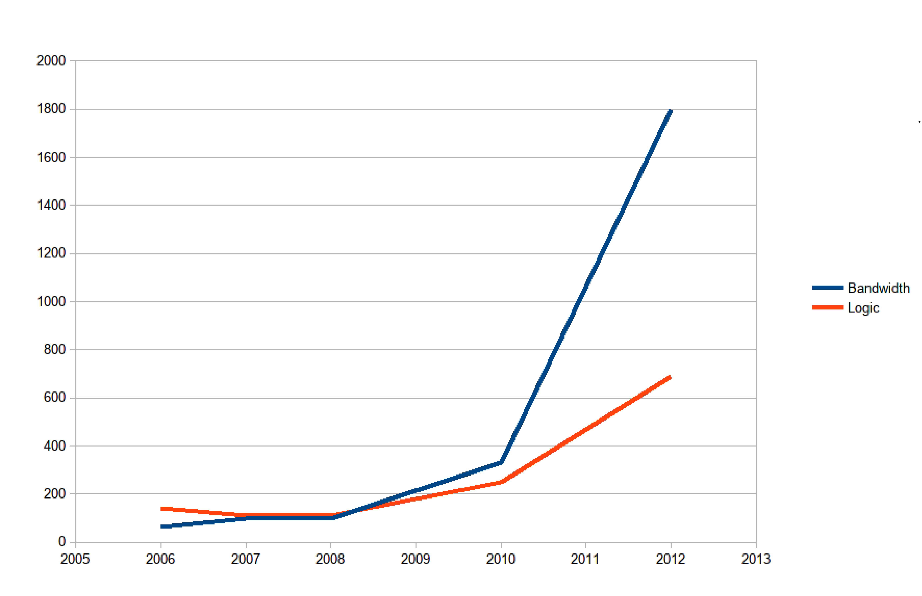
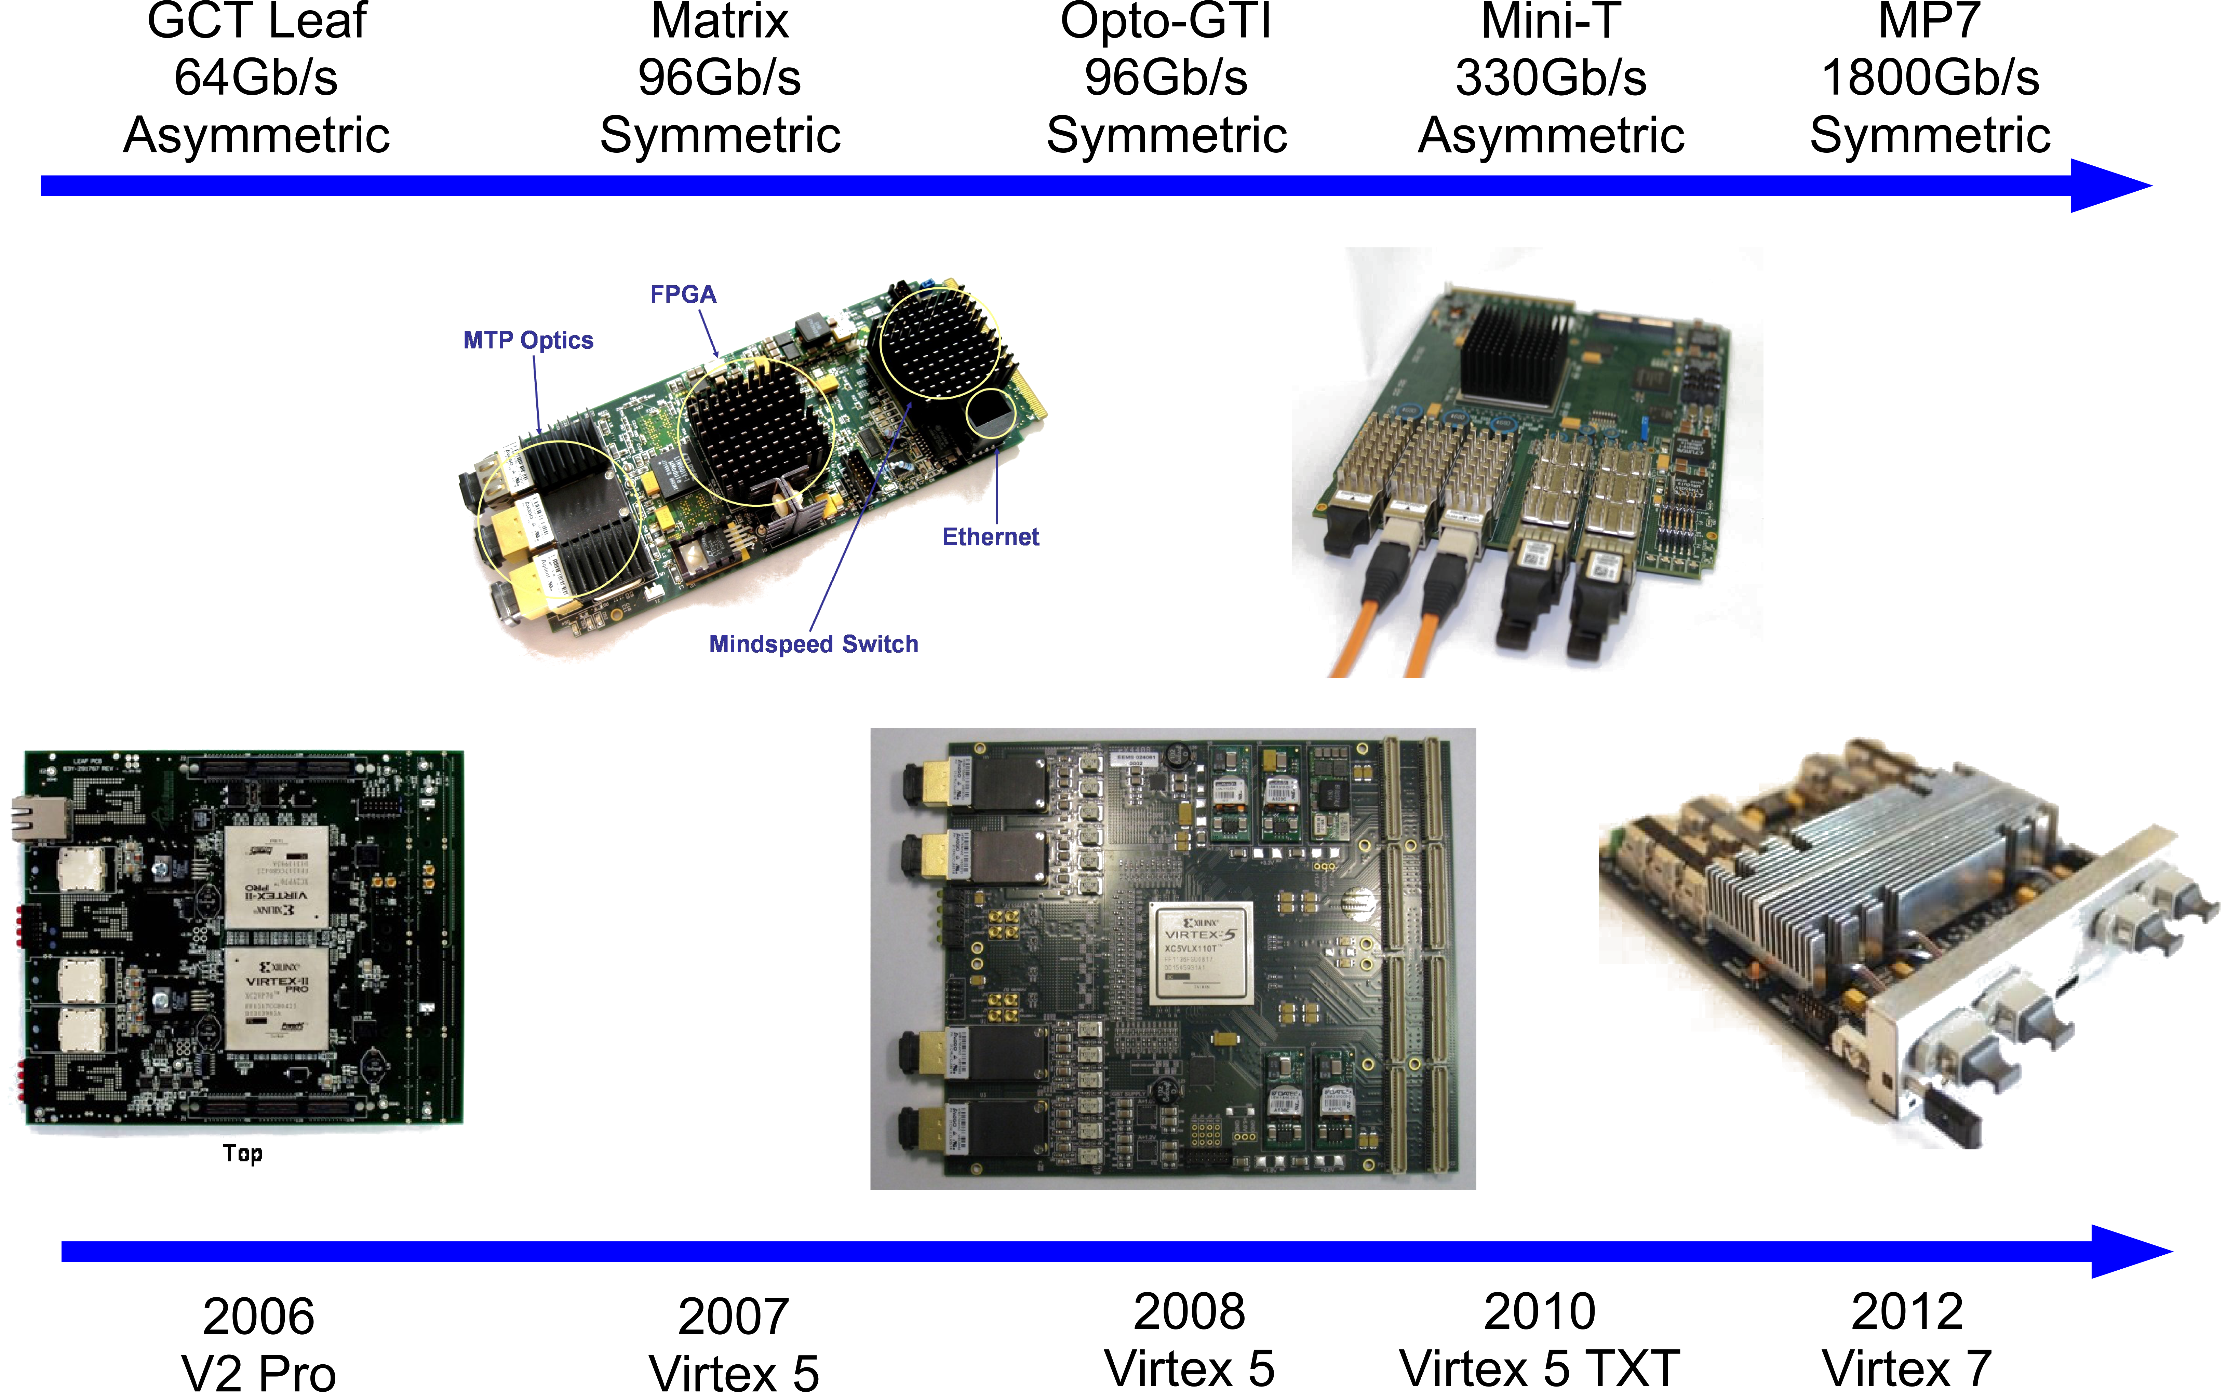
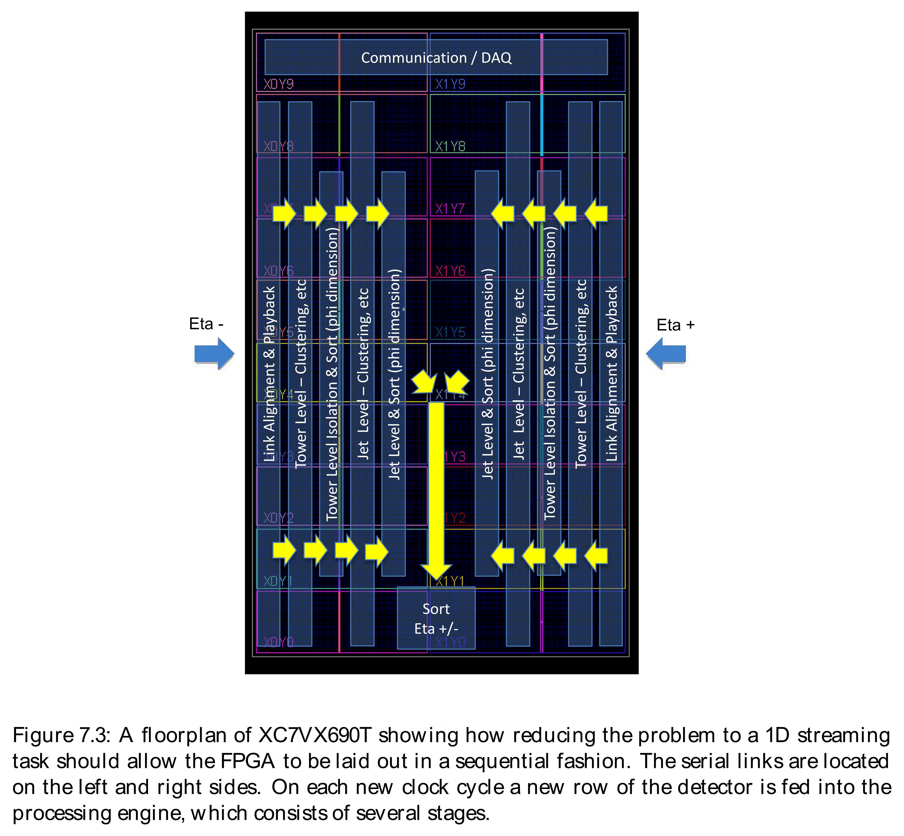
7-series Firmware
Bandwidth
Large 7-series FPGAs are beasts!
Scale of routing problem has outstripped performance of PCs
Xilinx has invested heavily in improving tools
Still have to work a lot harder at optimising designs than we used to
Logic
Conceptual layout of algorithms from the upgrade TDR
Iceberg Technology
Rutherford Appleton Laboratory

Slide 29
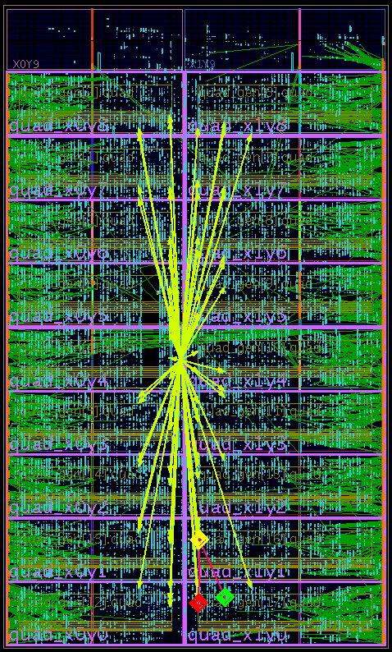
7-series Firmware
Large 7-series FPGAs are beasts!
Image shows Calo trigger main processor
72 input links @ 10 Gbps
250MHz deserialized operation
Build-time: 4-6 hours
Much better than the >24hours reported elsewhere!
Extensive use of floor-planning tools
Localized (fully-pipelined) logic makes this a lot easier
Iceberg Technology
Rutherford Appleton Laboratory

Slide 30
7-series Firmware
Large 7-series FPGAs are beasts!
Image shows Calo trigger main processor
72 input links @ 10 Gbps
250MHz deserialized operation
Build-time: 4-6 hours
Much better than the >24hours reported elsewhere!
Extensive use of floor-planning tools
Localized (fully-pipelined) logic makes this a lot easier
Iceberg Technology
Rutherford Appleton Laboratory

Slide 31
Other work

Slide 32
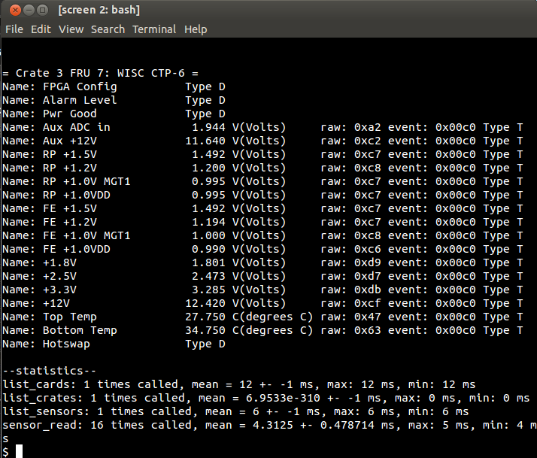
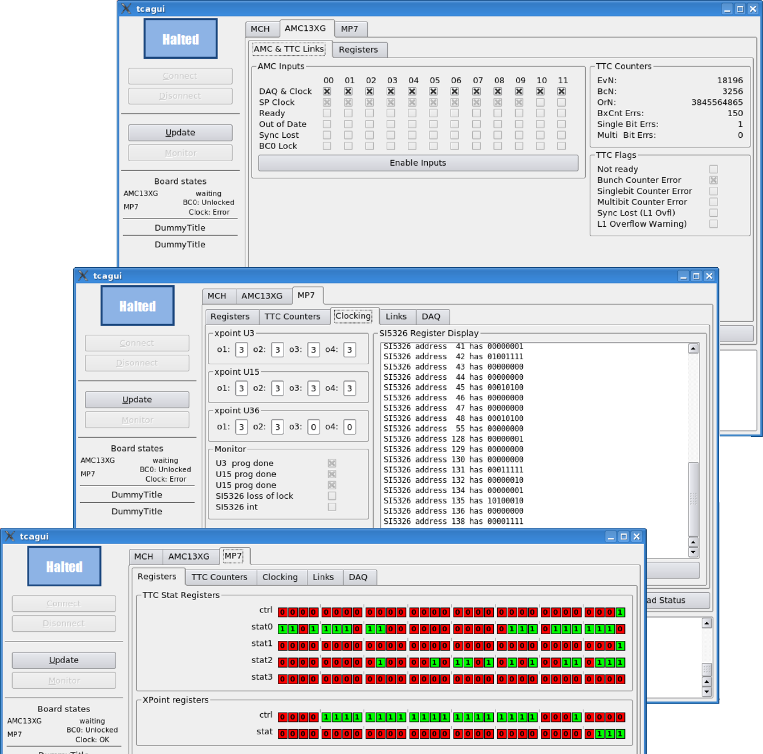
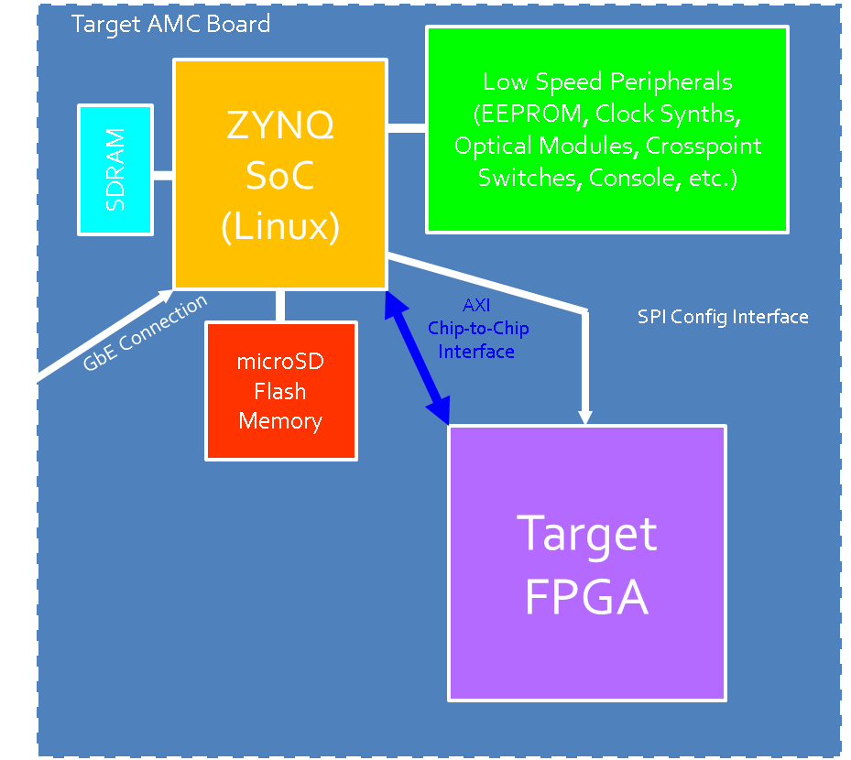
Other work
UW/Desy IPMI system manager
A standardized HAL for µTCA adopted
GUI tools under development
Python bindings
Imperial/Bristol/ RAL/CERN
Plus lots more that didn’t have any pretty pictures
UW have been experimenting with embedded Linux in soft and hard core FPGAs
MP7-XE - optimised for 13Gb/s links

Slide 33
Conclusions

Slide 34
Conclusions
A lot of progress made in the last year!
Hardware in hand
MP7 has been being validated for over a year
oSLB, oRM and oRSC now available and testing on-going
Baseline upgrade architecture and hardware now decided upon
Time-multiplexed Trigger
CTP7 at layer-1
MP7 at layer-2
Can now look more towards systems-level integration
A lot still to do…

Slide 35
Spares

Slide 36
Imperial College London University of Bristol RAL

Slide 37
Time-multiplexed trigger
1
5
1
5
1
5
1
5
All data for 1bx from all regions in a single card!
Everything you need!
6
6
6
6
1
2
2
2
2
7
7
7
7
3
3
3
3
4
4
4
4
1
5
1
5
1
5
1
5
All data for 1bx from all regions in a single card!
Everything you need!
6
2
2
6
6
6
2
2
2
7
3
7
3
7
7
3
3
4
4
4
4
1
5
1
5
1
5
1
5
6
6
All data for 1bx from all regions in a single card!
Everything you need!
2
2
6
6
2
2
7
7
3
3
7
7
3
3
4
4
4
4
1
5
1
5
1
1
5
5
6
6
6
6
2
2
2
2
7
7
7
7
3
3
3
3
4
4
4
4
BX:6
BX:1
BX:2
BX:3
BX:4
BX:5
BX:7

Slide 38
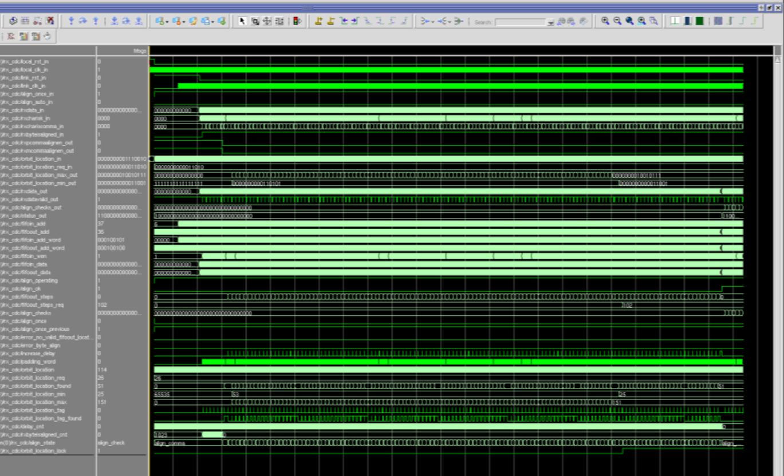
Automated Link alignment firmware
Fixed, low Latency GTX/GTH Serdes Link
Asynchronous or Synchronous with LHC clock
Rx buffer bypassed for low latency & asynchronous clock capability
CRC32 integrity checks
Locks to TTC timing
Spy buffer
Only 256 orbits to align
the entire system
Has been in continuous
use in hardware for over
a month

Slide 39
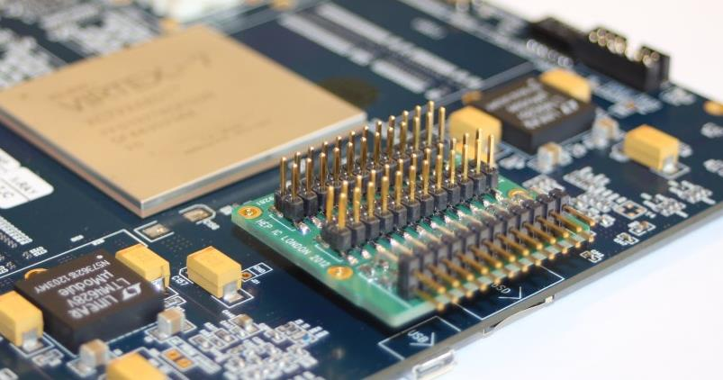
Other tests
All the auxiliary subsystems on the MP7 have also been validated:
Mezzanine I/O
QDR-II+ RAM
Board communication (Ethernet)
USB 2.0 OTG, IPMI, SD card repository (microcontroller)
SPI PROM (protected bootloader)
Thermal dissipation, humidity & temperature monitoring
Power consumption, phasing & monitoring
I/O fan-out mezzanine for debugging
30 differential pairs to/from the FPGA
3v3, 2v5 and 1v8 supplies
Dedicated I2C lines to the microcontroller

Slide 40
On-board Firmware Repository
The MMC on the MP7 also acts as controller of the on-board firmware repository
Loading firmware into the FPGA from the SD-card takes ~3s cf. ~2s using the flash PROM – i.e. no noticeable penalty.
The time taken to write new firmware to the card over IPbus will be measured when the MMC-FPGA IPbus interface is completed (end of month). Should be of the order 1 to 10’s of seconds instead of many minutes for NOR flash.
On-board repository means that once a firmware is written to the board, it need never be written to the board again (roll-back is a change of configuration key)
Because it is SD card based, for new boards the repository can be written directly to the SD card from a PC (this is how the uSD card is used currently)

Slide 41
Firmware Implementation status
Iceberg Technology
Rutherford Appleton Laboratory

Slide 42
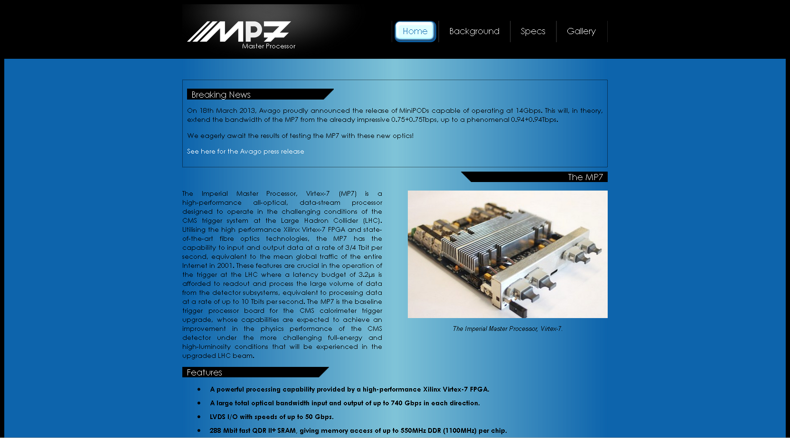
Website
www.hep.ph.ic.ac.uk/mp7

Slide 43
University of Wisconsin

Slide 44
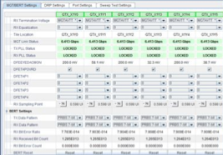
oRSC to CTP6 Integration Test
Performed at CMS integration facility. As close as possible to final operating conditions
Bit error rate < 10⁻¹⁴

Slide 45
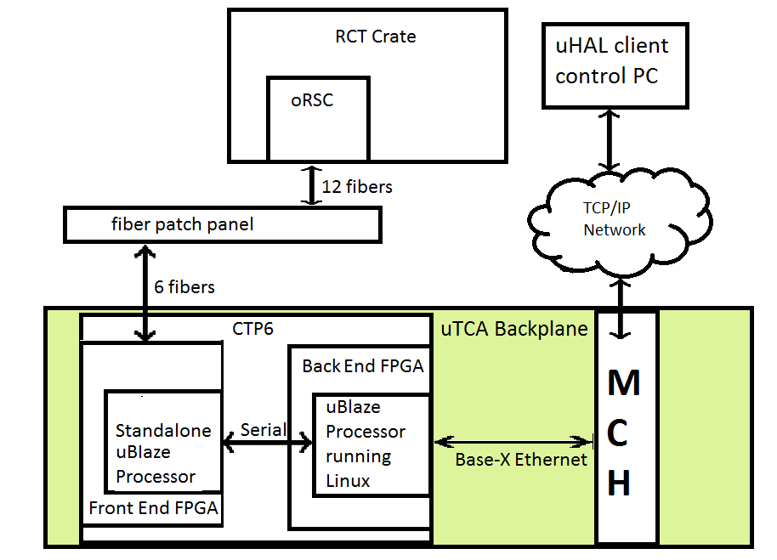
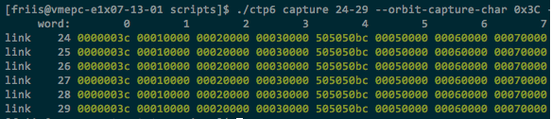
oRSC to CTP6 Integration Test
Data patterns successful transmitted from the oRSC, captured on the CTP6, and readout via embedded Linux
Fibre Capture RAM readout
SW controllable capture
Capture RAM auto clears on each capture
All six links capture expected pattern from oRSC
Capture automatically checked by host
Data flow in integration test
Patterns being successfully captured

Slide 46
Microblaze and PetaLinux
Microblaze is soft-processor Xilinx IP core
PetaLinux is a proprietary embedded Linux product owned by Xilinx
Runs on the Microblaze and ZYNQ platforms
Comes with standard drivers for GigE, I2C, SPI, USART, Flash, etc.
Housekeeping functionality can now be written by software inclined people as Linux or embedded C applications
Board | Control FPGA | Workhorse FPGA
oRSC | Microblaze | Microblaze
CTP6 | Microblaze | Microblaze
CTP7 | ZYNQ | Microblaze

Slide 47
Embedded Processor Concept
Embedded processor moves service tasks from Firmware to Software
Shortens design cycle
Remove FPGA design and integration burden for commodity interface cores
Utilize embedded system IP
Interfaces more flexible under software control
Conform to industry standards at core
Add software application above core to specialize
Ensures FPGA design focus on custom logic
Custom high speed communication interfaces
Custom physics algorithms

Slide 48
CTP7 Zynq SoC Linux Control Chip
Target AMC Board
Low Speed Peripherals (EEPROM, Clock Synths, Optical Modules, Crosspoint Switches, Console, etc.)
ZYNQ has hard ARM core
Embedded Linux on chip transforms housekeeping tasks into Linux application
Xilinx AXI chip-to-chip exposes Target FPGA into ZYNQ memory space
ZYNQ
SoC
(Linux)
SDRAM
AXI
Chip-to-Chip
Interface
SPI Config Interface
GbE Connection
microSD
Flash
Memory
Target
FPGA

Slide 49
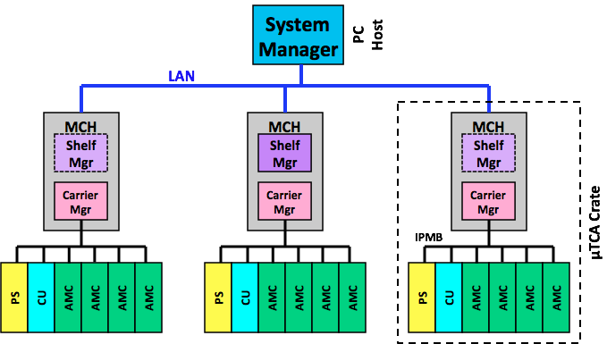
IPMI System Manger
μTCA features Gigabit Ethernet to address individual slots and IPMI to manage the power and sensors of individual cards
Commercial IPMI management tools available, but
Vendor specific
Not extensible (GUIs)

Slide 50
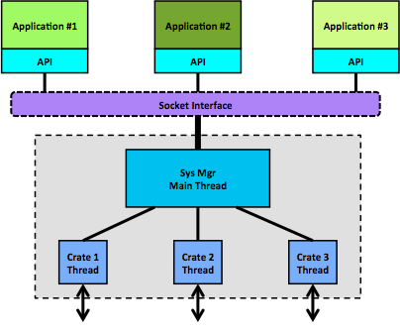
IPMI System Manger
API wrapping a socket interface
Act as a gateway for other applications into the IPMI system
Provide a robust IPMI-over-LAN connection to crates
Provide a service for automatic low-level initialization of AMC cards at start-up
GUI using System Manger API
Developed at DESY
Crate MCH

