Slide 1
Experience powering Virtex-7 FPGAs
Andrew W. Rose, Gregory M. Iles
Imperial College, London

Slide 2
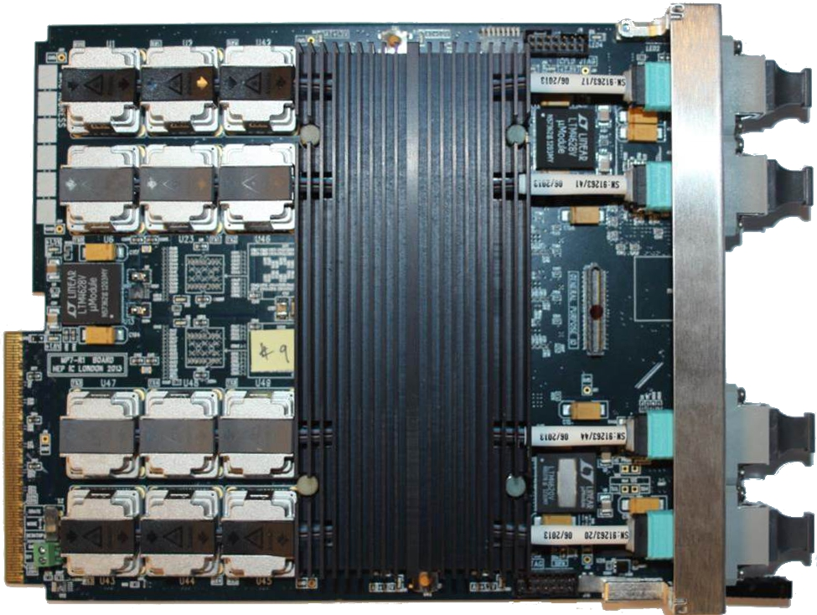
1.5Tb/s optical signal processor
Xilinx Virtex-7 FPGA:
XC7VX485T or XC7VX690T
Advanced boot-loader & diagnostics (full system test at start-up)
On-board firmware repository
2×144Mbit 550MHz QDR RAM (optional)
Been in hand for over a year
Continuous testing over that period
Exceptionally well understood
Imperial MP7 processor board
See also TWEPP 2012: https://indico.cern.ch/contributionDisplay.py?contribId=86&confId=170595&sessionId=51
https://indico.cern.ch/contributionDisplay.py?contribId=97&confId=170595&sessionId=53

Slide 3
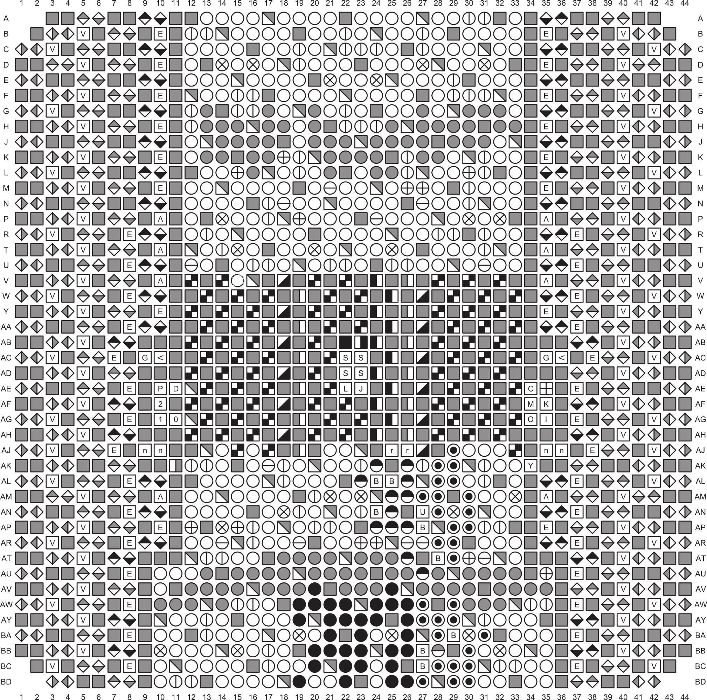
FPGA architecture
MP7 uses XC7VX485T or XC7VX690T
Pin-compatible FFG1927 package
This is how the XC7VX690T looks in the documentation:

Slide 4
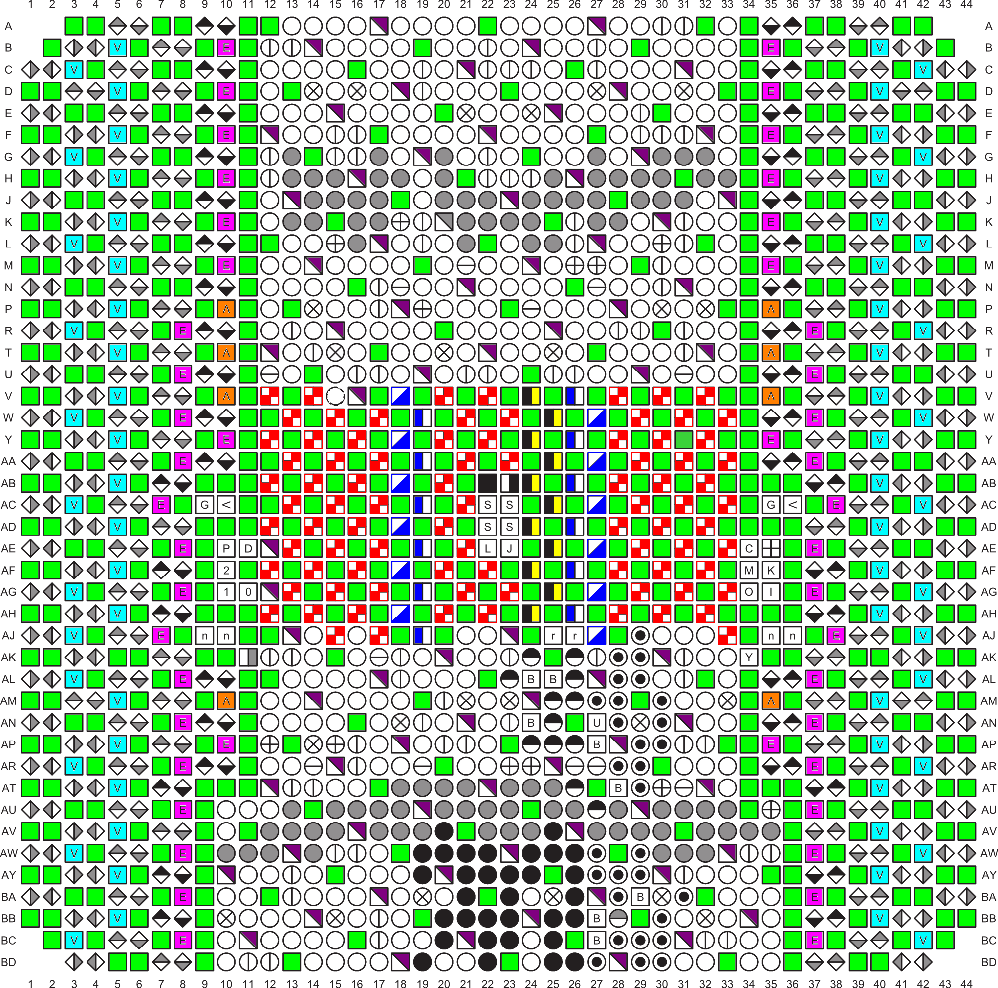
FPGA architecture
MP7 uses XC7VX485T or XC7VX690T
Pin-compatible FFG1927 package
And if we colour in the power pins:
Half of the pins on the chip are dedicated to powering the thing

Slide 5
MP7 board – Top half
Receivers
2v5
3v3
Transmitters
1v5
1v8
FPGA
Header
1v0
Transmitters
Receivers

Slide 6
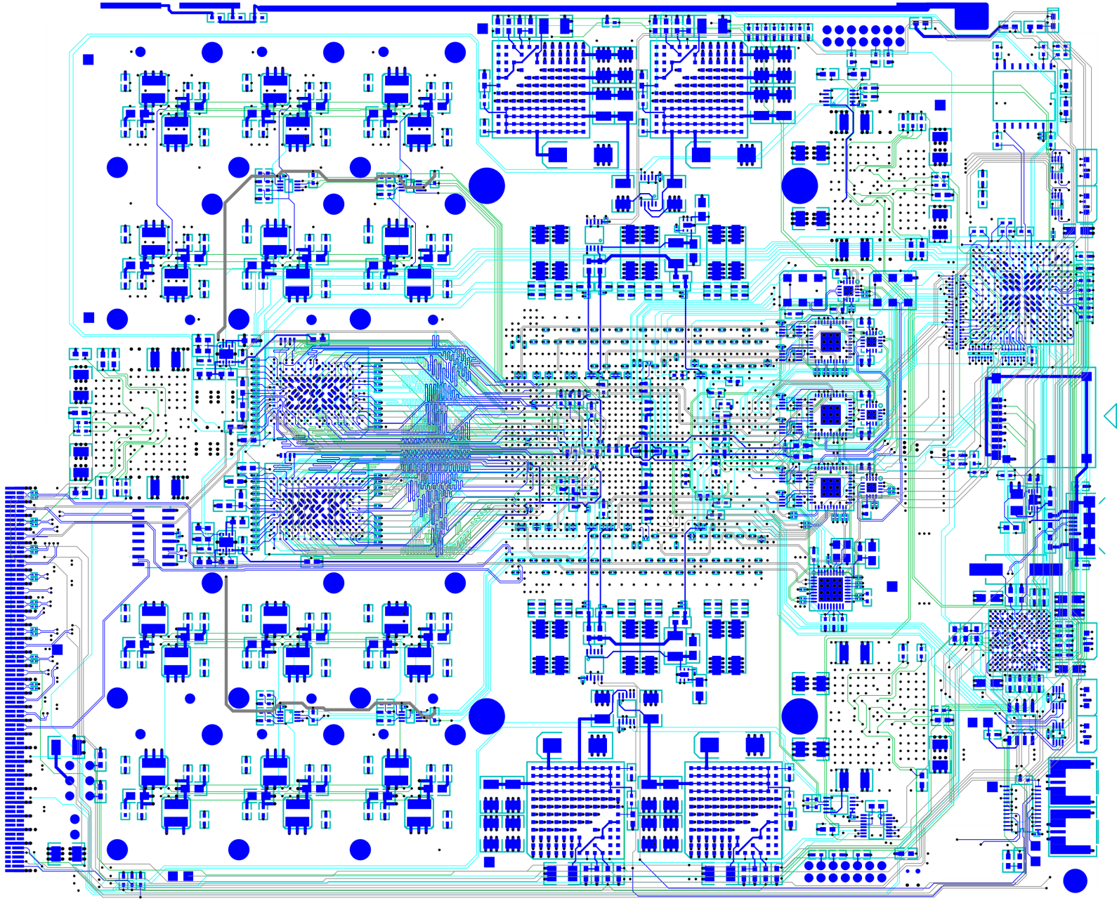
MP7 board – Bottom half
A1v2
A1v0
2v5
3v3
A1v8
CPLD
1v5
1v8
QDR
μSD
Clocking
QDR
USB
A1v0
A1v2
μC
A1v8
1v0
Clk

Slide 7
MP7 R0 power architecture
Speciality and secondary regulators
Bulk regulators

Slide 8
MGTs
MGTs
MGTs
MP7 is an optical stream processor
72 links @ >10Gb/s, fully bidirectional
7-series MGTs require:
1v0
1v2
1v8
but there are very tight constraints!

Slide 9
MGTs
The noise limits and tolerances on the MGT power supplies are tight!
There are also constraints on voltage drop across the chip
Ohmic losses in the planes required that the regulators are as close as possible to the MGTs
There are two banks of MGTs
Each needed powering independently
Space constraints also mean that the 10Gb/s signals run underneath the regulators
Noise was a concern…

Slide 10
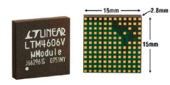
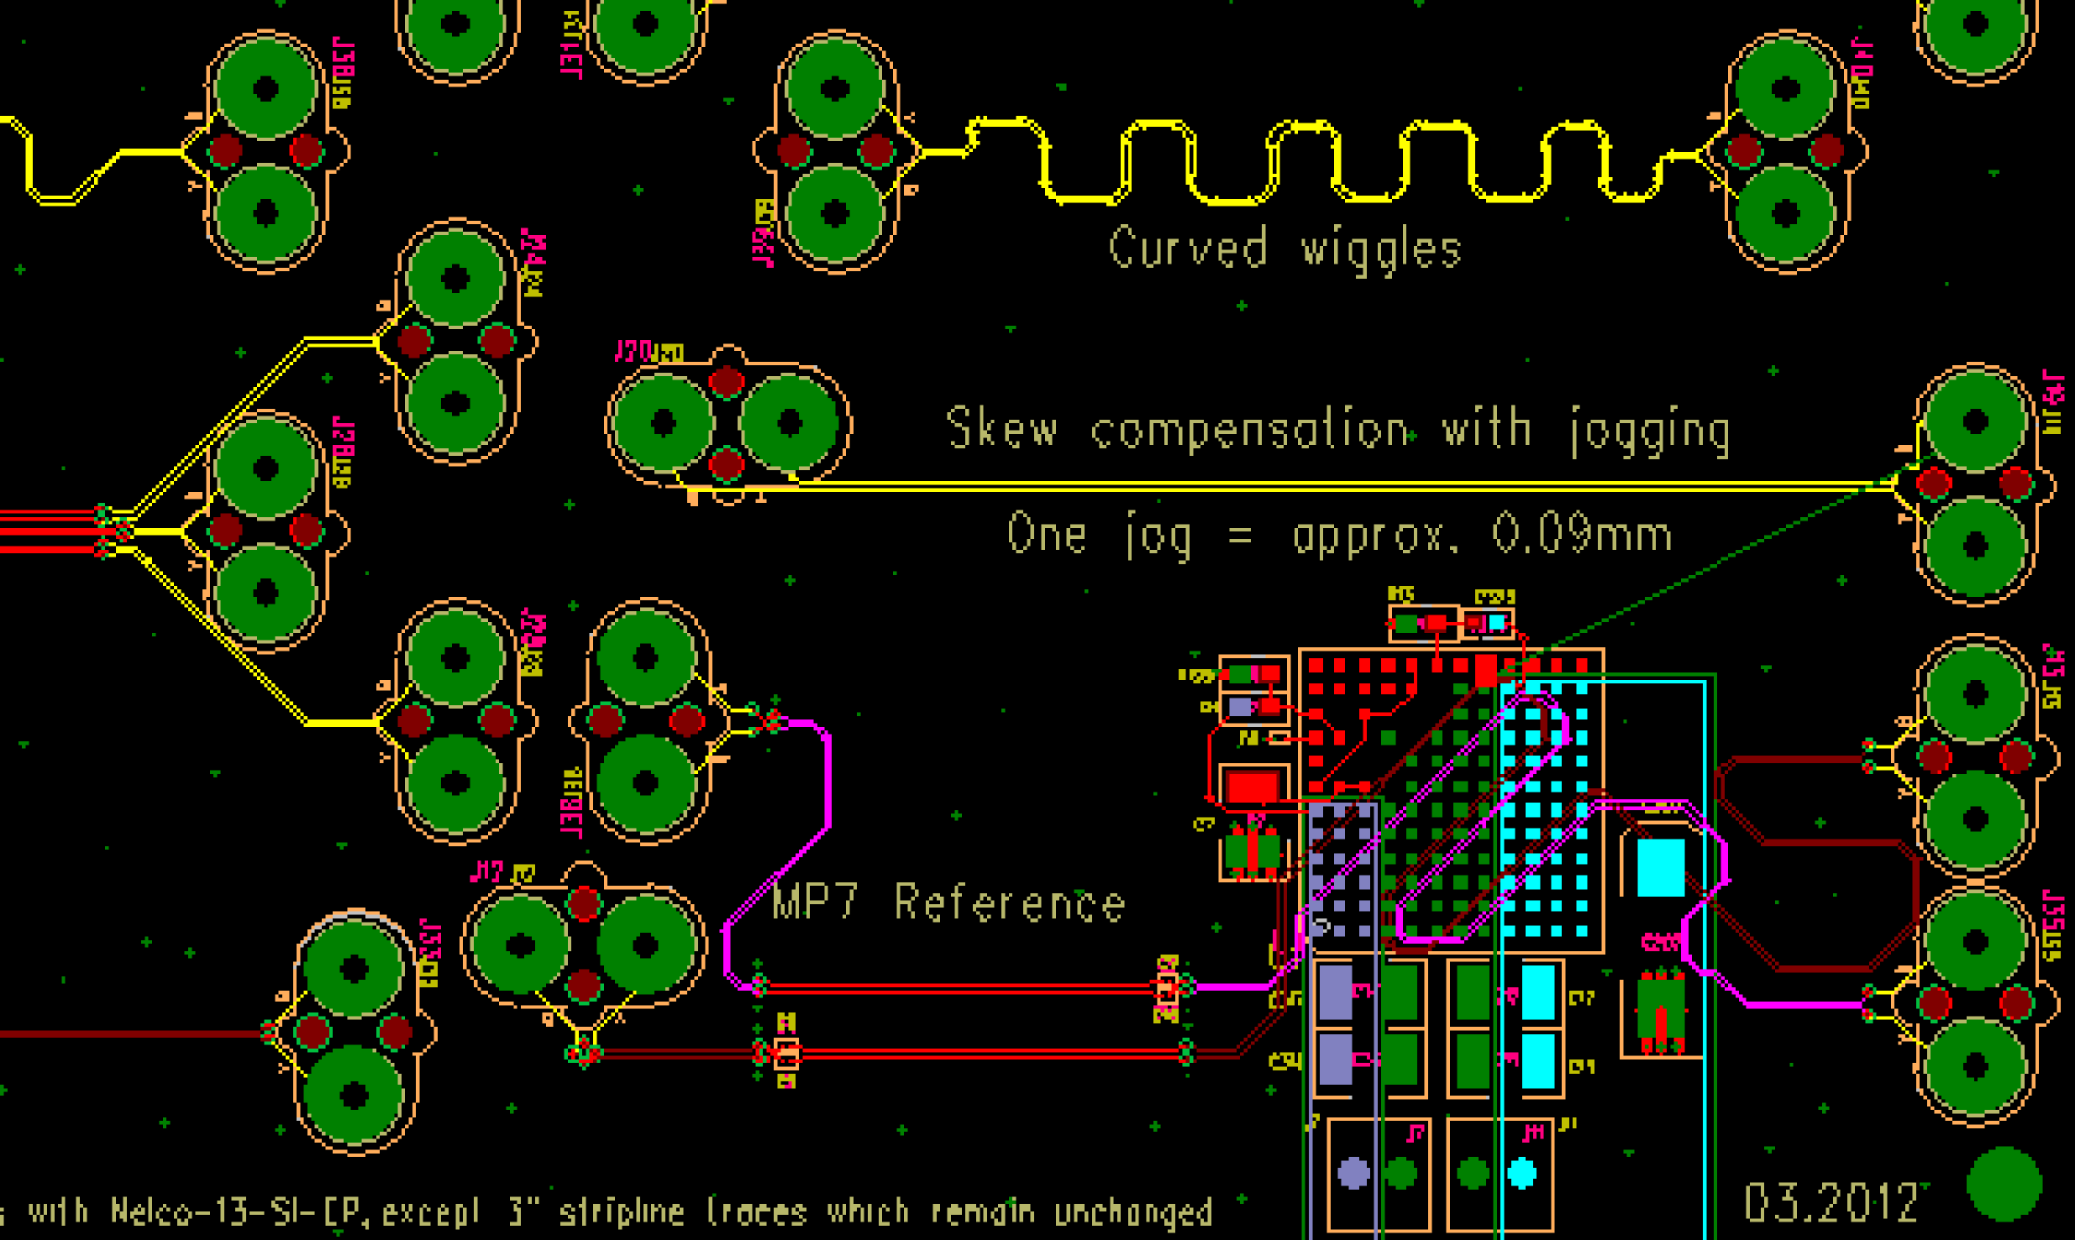
MGTs: Revision 0
Favoured LTM4606 6A ultralow-EMI switch-mode regulators by Linear, since:
These are designed for transceiver applications
Are sufficiently low that the fitted on the bottom of the board
We had used these successfully on the Mini-T5 card
Included a regulator on a test board to test for interference
Also, taped a Samtec kapton cable to top of regulator and tested 10Gb/s signal integrity that way
Good news – regulator had no effect on a 10G signal passing under it

Slide 11
MGTs: Revision 0
Card was designed before 7-series engineering silicon was available
LTM4606 should have had ~35% headroom based on Xilinx’s power estimator
When card assembled and tested, power consumption 30% to 220% higher than Xilinx had predicted
A lot of discussion with Xilinx engineers – found a lot of “features” that Xilinx weren’t aware of. The price you pay for living at the cutting edge.
Greg Iles made a huge number of measurements

Slide 12
MGTs: Revision 0
Very impressed with LTM4606
Rated 6A nominal
8A peak
But performed excellently even when run flat-out at 25% above its nominal rating

Slide 13
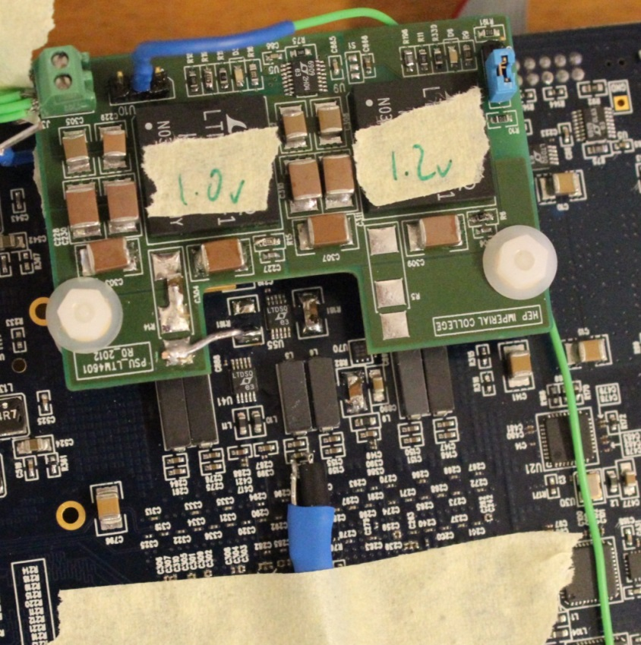
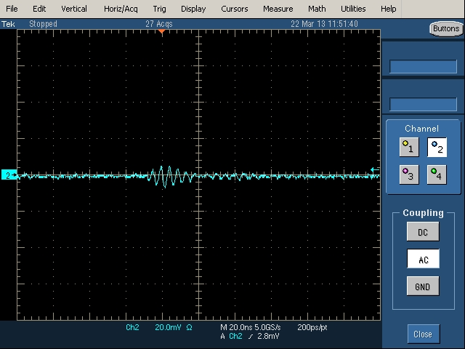
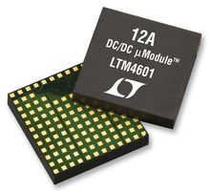
MGTs: Revision 1
We were very concerned about the possibility of power supply changes introducing noise
Several test cards were made to test alternative power supply designs on an R0 card
Noise was measured both electrically and by its effect on the error-rate of the 10Gb/s optical links
LTM4601 switch-mode regulator by Linear won the day:
Same size as the LTM4606 (although different footprint)
Similar external components
Simple replacement
LTM4601 after ferrite

Slide 14
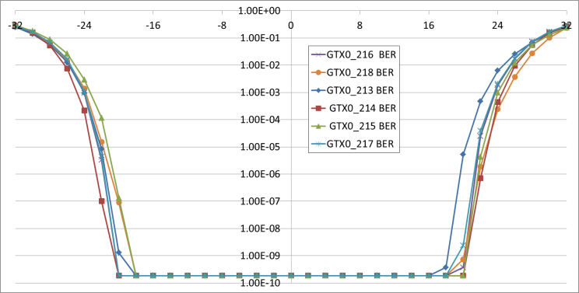
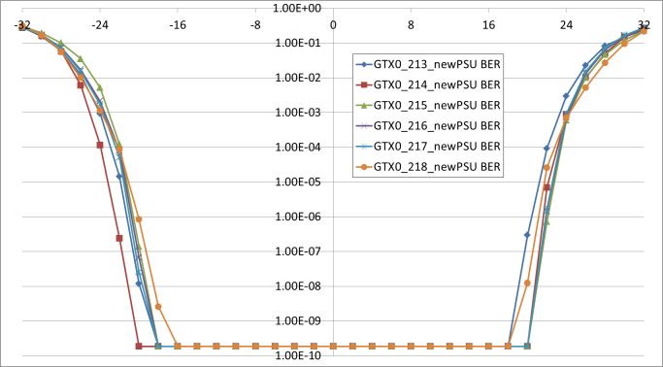
MGTs: Revision 1
Original PSU
485, RPBS7, 10G, QPLL, 24 links (one side),
Plots show bathtub from 6 different links: 1 from each quad
Statistical Floor
New PSU
Magnus Loutit
Statistical Floor

Slide 15
Core power
Large BGAs puncture the board with vast forest of vias
Increase the effective resistivity of the power planes
Core power pins are at centre of BGA
Use fills in three layers to get power into core to ensure sufficient current
Prefer layers with 1oz copper over ½oz copper layers
Use remote sense, even though the distance is only a few cm

Slide 16
Power supply monitoring
MP7 makes extensive use of LTC2990 four channel voltage/current/power and temperature monitor
Sub-millivolt resolution
1% current resolution
1% temperature resolution
10-Lead MSOP Package – size is important in the space-constrained µTCA environment
MP7 measures:
Both incoming supplies
ALL bulk supplies on the board
Subset of secondary/speciality supplies
Sensors are distributed around the board allowing an approximate temperature profile of the board

Slide 17
Power consumption sensitivity
Power consumed by the Virtex-7 can be extraordinarily sensitive to configuration flags
Unused and non-optimally configured resources can contribute massively to power consumption. Not always immediately obvious.
Need to consider the entire design (all configuration flags) before making statements about power consumption
No substitute for hands-on experience

Slide 18
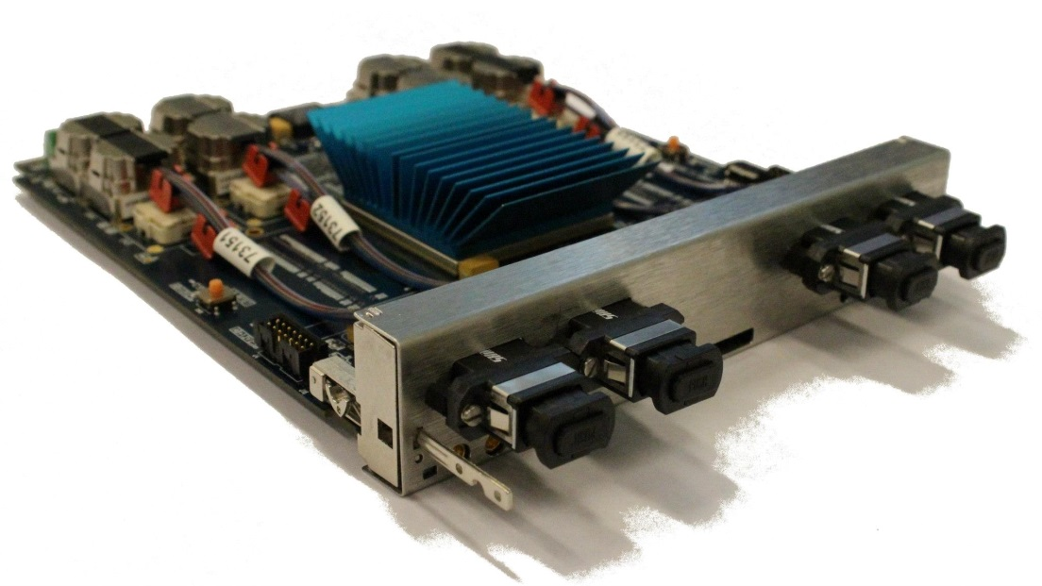
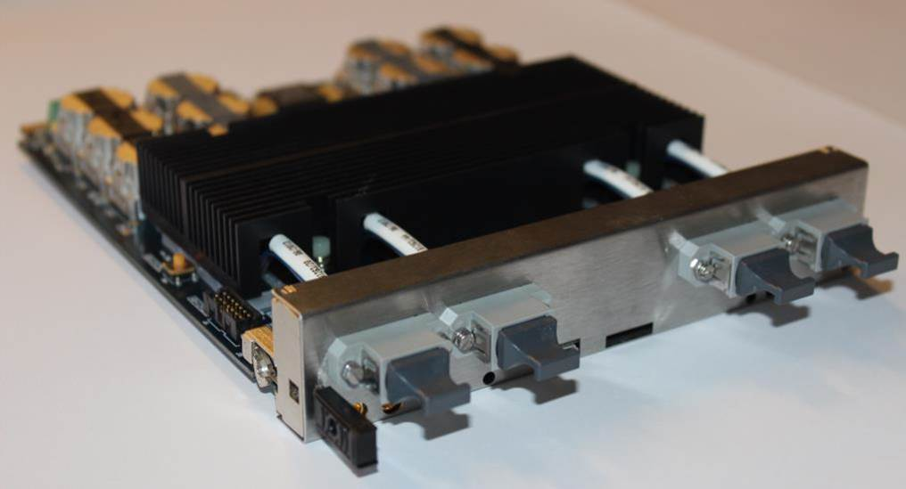
With great power come great heat dissipation…
First attempt: Off the shelf
Final version: Designed in-house
With early revision of board, 48-link design hit thermal cut-out when on the bench (no fans). Reached 60°C in a crate.
Designed a heatsink ourselves (old-school educated guesswork, no simulations) and prototyped in-house. Dissipated 40% more power than the off-the shelf part. Temperature didn’t exceed 45°C in 48-link design.
Production heatsinks manufactured externally and anodized (increase radiative transfer by further 25%)

Slide 19
Conclusions
The compact nature and excellent performance of Linear’s switch-mode modules make them an excellent match for 7-series FPGAs and the µTCA environment, where space is constrained
Xilinx power estimator should be considered exactly that… AN ESTIMATOR
Don’t rely on it being correct
It is no substitute for hands-on experience
7-series FPGAs have a large number of configuration flags and it is not always immediately obvious how these will affect power consumption

