Slide 1
Hardware acceleration "project" time
Andy Rose Alex Tapper
Ioannis Xiotidis

Slide 2
Caveat
This is a brand new course
We don't know you or your prior experience
We don't know what will work and what won't
The topic of hardware acceleration is too wide to try to teach you everything
And we do not have enough time, even if we wanted to
So…
We are not going to prescribe what you are going to do
This is an MRes… and this is generally how real-life research works
A few options :)

Slide 3
Not an option 0
Using a GPU with Pytorch/Keras :)

Slide 4
Option 1

Slide 5
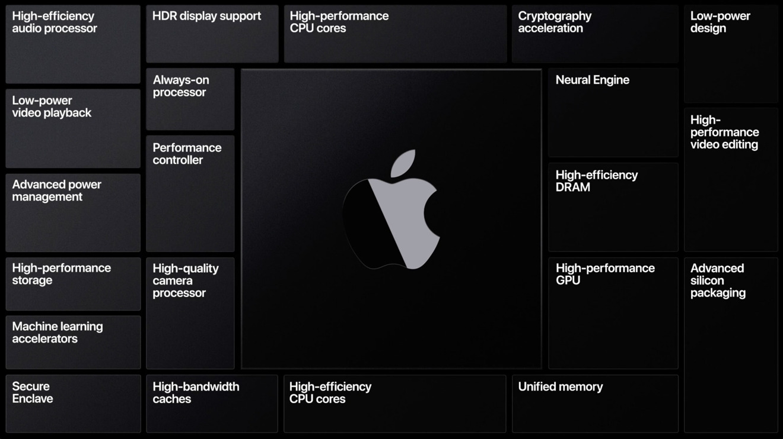
Hardware acceleration is (becoming) ubiquitous
If you have a modern phone, you have dedicated hardware in your pocket for
AES encryption / decryption
H.264 / MPEG decoding
Ray-tracing / rendering
Gzip inflate / deflate
Systolic neural inference accelerator

Slide 6
Hardware acceleration is (becoming) ubiquitous
If you have a modern phone, you have dedicated hardware in your pocket for
AES encryption / decryption
H.264 / MPEG decoding
Ray-tracing / rendering
Gzip inflate / deflate
Systolic neural inference accelerator

Slide 7
The algorithms which define the 21st Century
AES encryption / decryption
H.264 / MPEG decoding
Ray-tracing / rendering
Gzip inflate / deflate
Systolic neural inference accelerator
FFT / DFT (Everything)
PageRank / Sparse matrix multiplier (Web search)
Kalman Filter (Drones, Self-driving vehicles)
Dijkstra's algorithm (Graph mapping & routing)
SHA3-256 Hashing (Digital signatures, Blockchain)
Smith–Waterman algorithm and/or FASTA (DNA sequencing)
Proof-of-work signature (Bitcoin mining)

Slide 8
Option 1
Deep-dive into one of these algorithms
(or discuss with us if you have your own idea)
Research the principles, usage, etc.
Analyse it for bottle-necks
Analyse it for suitability for hardware acceleration
Which type? Advantages? Limitations?
Devise a hardware architecture for the algorithm on paper
Then…

Slide 9
Option 1
If you want to play with VHDL/RTL implementation – go ahead
If you want to play with manual multithreading in C++ – go ahead
If you want to play on the Intel OneAPI devcloud – go ahead
We can help you (or find someone to help you) get set up with these
If you want to play with CUDA – go ahead

Slide 10
Option 1 - Caveat
Would rather not have multiple groups doing the same algorithm
If that happens, please negotiate between yourselves
Else we will flip a coin ☺
Or play rock, paper, scissors
Or something even more frivolous

Slide 11
Option 2

Slide 12
Option 2
Design a PyTorch/Keras model or adapt a model you already have
Port it to an ultra low-latency implementation with HLS4ML
Play with the quantisation
Play with the reuse factors
Play with the pruning
Look at accuracy, resources, latency, etc.

Slide 13
Arrangements

Slide 14
Arrangements
We do not expect you to have prior experience and projects are open-ended
Projects to be done in pairs to maximise how far you get
Pick amongst yourselves else we'll pick for you :)

Slide 15
Arrangements
Report
Individual – very important
Maximum 10 pages
70% of final mark
Reports should be submitted via Blackboard [Linked] TurnItIn
Hand-in deadline 2nd May (first day of summer term)

Slide 16
Arrangements
Presentations
In pairs
10 minutes per pair
24th March 10am
20% of final mark
Presentations should be submitted via Blackboard [Linked] TurnItIn
By midnight on 23rd March

Slide 17
Arrangements
Continuous assessment
10% of final mark
This is not about getting "a right answer" but about getting a deeper understanding
Ask questions
Ask questions
Ask questions
Ask questions

Slide 18
Arrangements
Three further 2-hour sessions
24th February 10am (now)
3rd March 10am
10th March 10am
17th March 10am

Slide 19
Optional lectures
Assuming at least some people are interested, can throw in some more technical lectures on some of the tricks we play for hardware-optimising machine-learning

