Slide 1
An introduction to FPGAs and spatially-pipelined computing
Andrew W. Rose
Imperial College, London

Slide 2
CMS: Visualizing the big numbers
1 Eb/s
4 YB/yr
CMS Raw
1 Pb/s
4 ZB/yr
CMS Zero-suppressed
1 Tb/s
4 EB/yr
Five orders of magnitude
1 Gb/s
4 PB/yr
Tape storage
1 Mb/s
4 TB/yr

Slide 3
The Level-1 trigger problem
The CMS Level-1 trigger handles ~10Tb of data per second
Or ~ 250kb of data per event

Slide 4
What is so hard about that?
So…

Slide 5
So what is so hard… how processors work

Slide 6
So what is so hard… how processors work
Stop and Reload
Have a cup of tea
Biscuit, anyone?

Slide 7
So what is so hard… how triggers work
The data keeps on coming, whether you are ready or not
Like one of those tennis machines, except that missing a ball means losing your Nobel prize winning Higgs/SUSY discovery
Med
Fast
Slow
LHC

Slide 8
So what is so hard… how triggers work
The data keeps on coming, whether you are ready or not
Like one of those tennis machines, except that missing a ball means losing your Nobel prize winning Higgs/SUSY discovery
Med
Fast
Slow
LHC

Slide 9
Evolution of Microelectronics

Slide 10
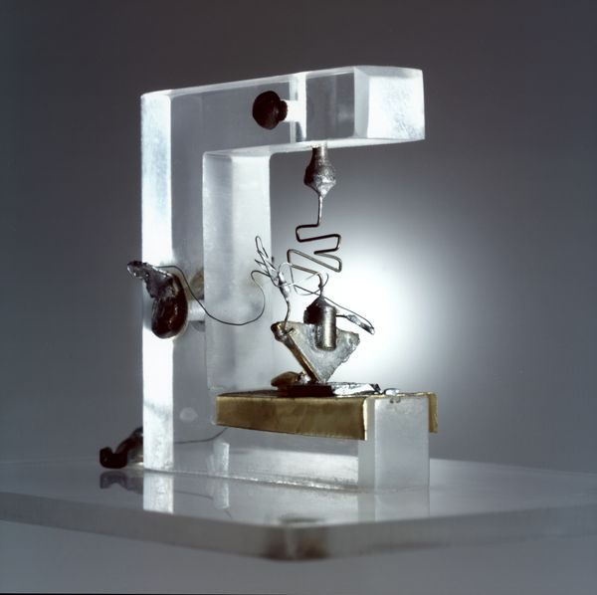
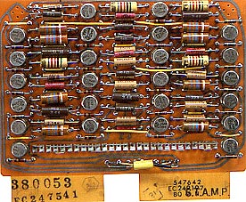
How to perform logical operations
First
solid-state transistors
Solid-state transistors
Valve transistors

Slide 11
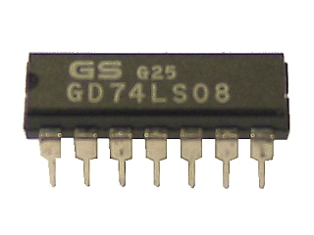
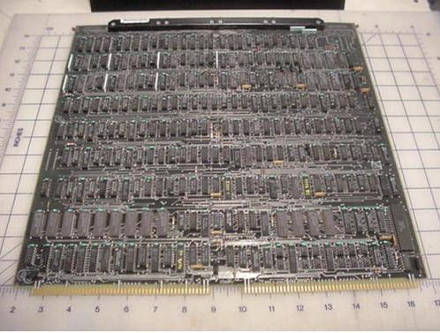
How to perform logical operations
First
multi-transistor
silicon
Packaged Logic
“Mini” processor board

Slide 12
How to perform logical operations
APV25 - Imperial College, London
$
Programmable Logic
ASIC
Qty
Application Specific Integrated Circuit (ASIC)

Slide 13
Two philosophies: Space vs. Time
Have each operation performed by dedicated logic and do that same operation on every clock cycle
Have each operation performed by the same logic, performing a different operation on every clock cycle
Parallel
Sequential
“The parallel approach to computing does require that some original thinking be done about numerical analysis and data management in order to secure efficient use.
In an environment which has represented the absence of the need to think as the highest virtue, this is a decided disadvantage”
Daniel Slotnick, 1967

Slide 14
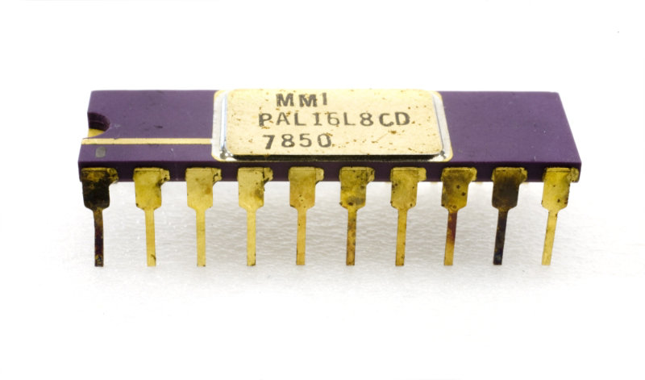
And the story diverges…
Limited further discussion of microprocessors
Programmable Array Logic
Microprocessor
Perform all logical operations in one location, but sequentially
Pack entire logic circuits in a chip

Slide 15
Sum-of-products theorem
Any Boolean operation may be expressed as
the OR of AND operations (Sum of products form)
Or
the AND of OR operations (Product of sums form)
Notes:
‘outline’ of coverage
time-plan
- What is an FPGA
- And why are they important for HEP
questions
- any time

Slide 16
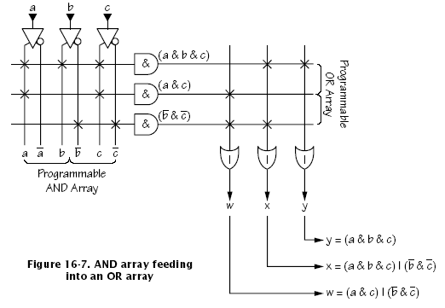
Programmable Logic Devices (PLDs)
?
?
?
?
?
?
?
?
?
?
?
?
?
?
?
?
?
?
?
?
?
?
?
?
?
?
?
Unprogrammed
Notes:
‘outline’ of coverage
time-plan
- What is an FPGA
- And why are they important for HEP
questions
- any time

Slide 17
Programmable Logic Devices (PLDs)
Programmed
Notes:
‘outline’ of coverage
time-plan
- What is an FPGA
- And why are they important for HEP
questions
- any time

Slide 18
Programmable Logic Devices (PLDs)
Originally one-time programmable
Later field reprogrammable
What did people do? Build boards with many PLDs…
Notes:
‘outline’ of coverage
time-plan
- What is an FPGA
- And why are they important for HEP
questions
- any time

Slide 19
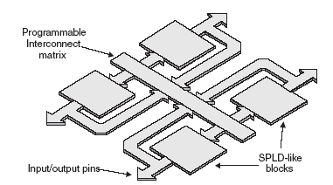
Complex PLDs (CPLDs)
Feedback
Feedback
Notes:
‘outline’ of coverage
time-plan
- What is an FPGA
- And why are they important for HEP
questions
- any time

Slide 20
Programmable Interconnect matrix

Slide 21
An alternative approach
While this was happening, SRAM was also evolving!
Why bother with the complexity of the PLD cell?
Replace the PLD cell with a simple SRAM:
Data-in becomes the “address”
Outputs the preloaded value for a given input
The Field Programmable Gate Array
(FPGA)

Slide 22
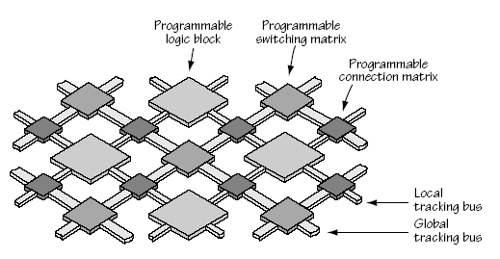
Field Programmable Gate Arrays (FPGAs)
‘Simple’ Programmable Logic Blocks
Massive Fabric of Programmable Interconnects
Notes:
A field-programmable gate array (FPGA) is a large-scale integrated circuit that can be programmed after it is manufactured rather than being limited to a predetermined, unchangeable hardware function. The term "field-programmable" refers to the ability to change the operation of the device "in the field," while "gate array" is a somewhat dated reference to the basic internal architecture that makes this after-the-fact reprogramming possible.

Slide 23
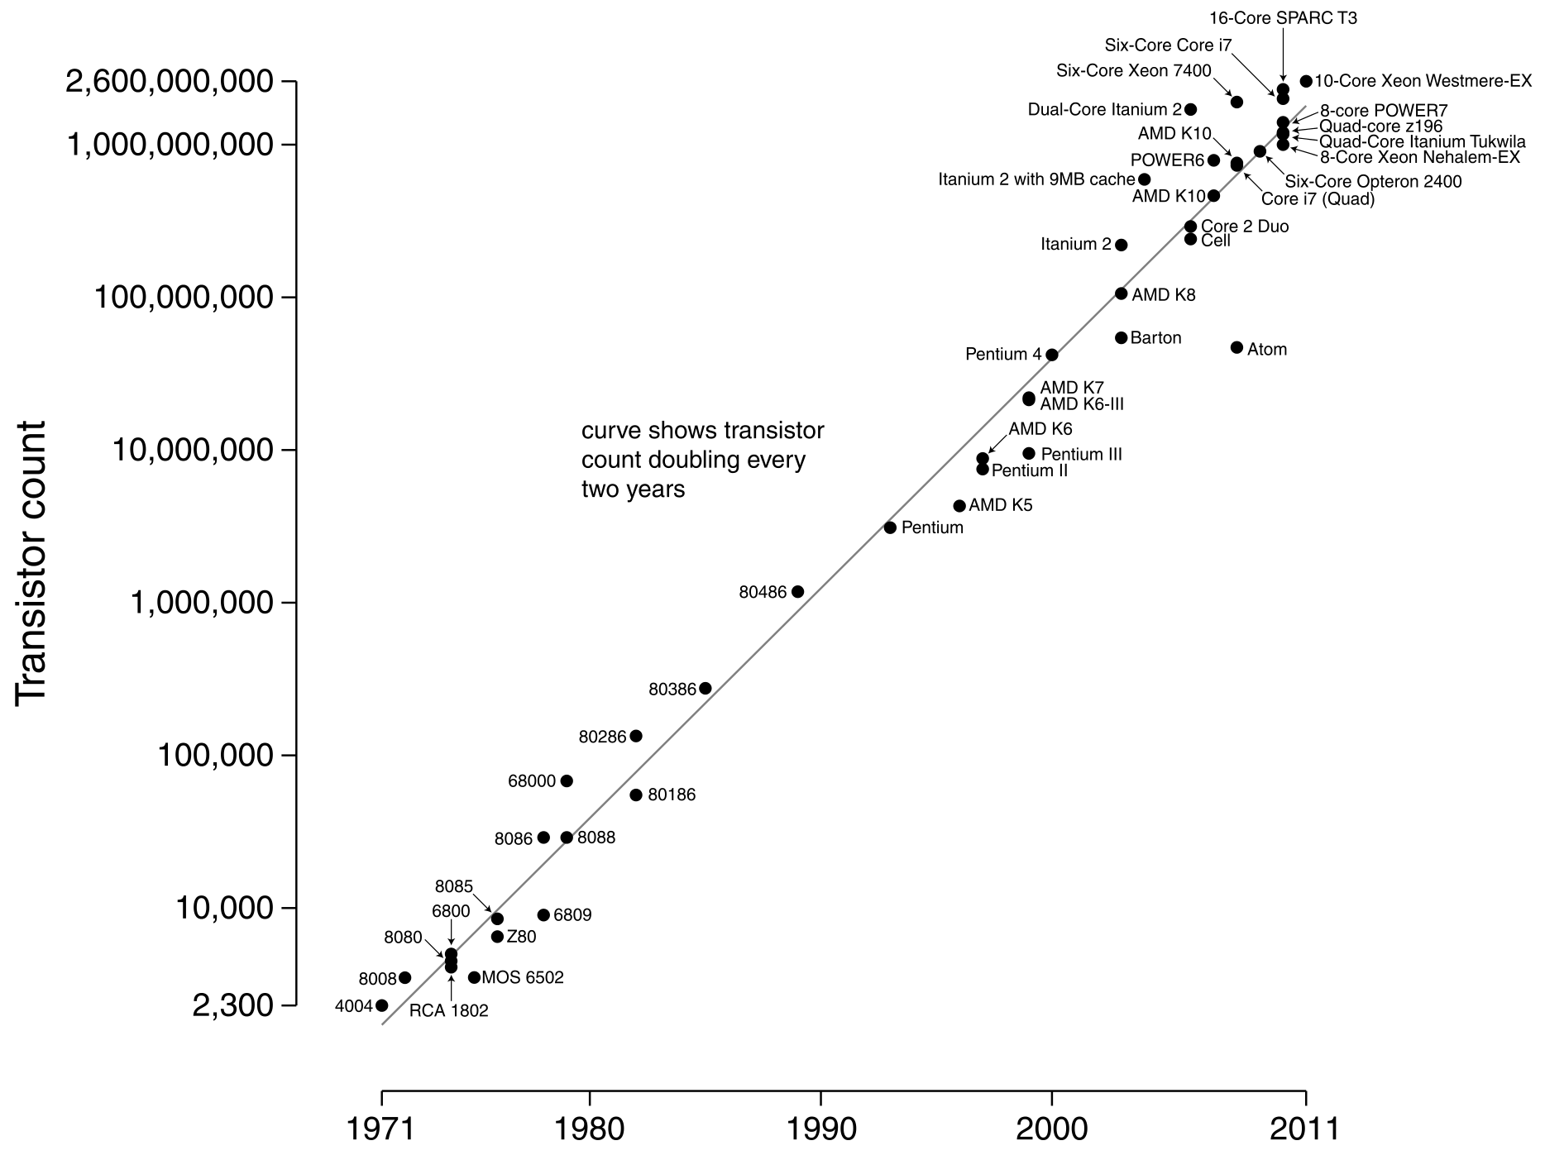
What’s the difference?
Standard CMOS Integrated Circuit fabrication process as for SRAM memory chips
Take maximum advantage of Moore’s Law!

Slide 24
Evolution of features in FPGAs

Slide 25
Xilinx 7-series Combinatorial Logic Block
Smarter than your average LUT

Slide 26
Xilinx 7-series Digital Signal Processing (DSPs)
“Logic cells for doing maths”
XC7VX690T has 3600 DSPs ≈ 1.8 billion Multiply-Accumulates/second

Slide 27
I/O
Traditionally, many hundreds of general purpose pins (Gen I/O) up to a few hundred MHz
Latest generation Gen I/O up to 1.8Gbps
Programmable logic standards
Since 2002, FPGAs have been adding dedicated Multi-gigabit transceivers
Arms race - Ever more and ever faster

Slide 28
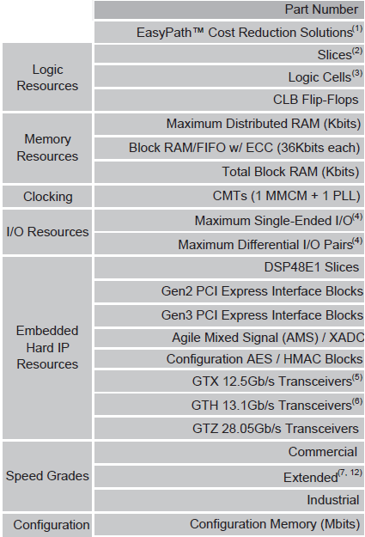
Biggest Parts Virtex 7
2.8 Tb/s – Blimey!
(280,000×
ADSL 10Mb connections)
28Gb/s

Slide 29
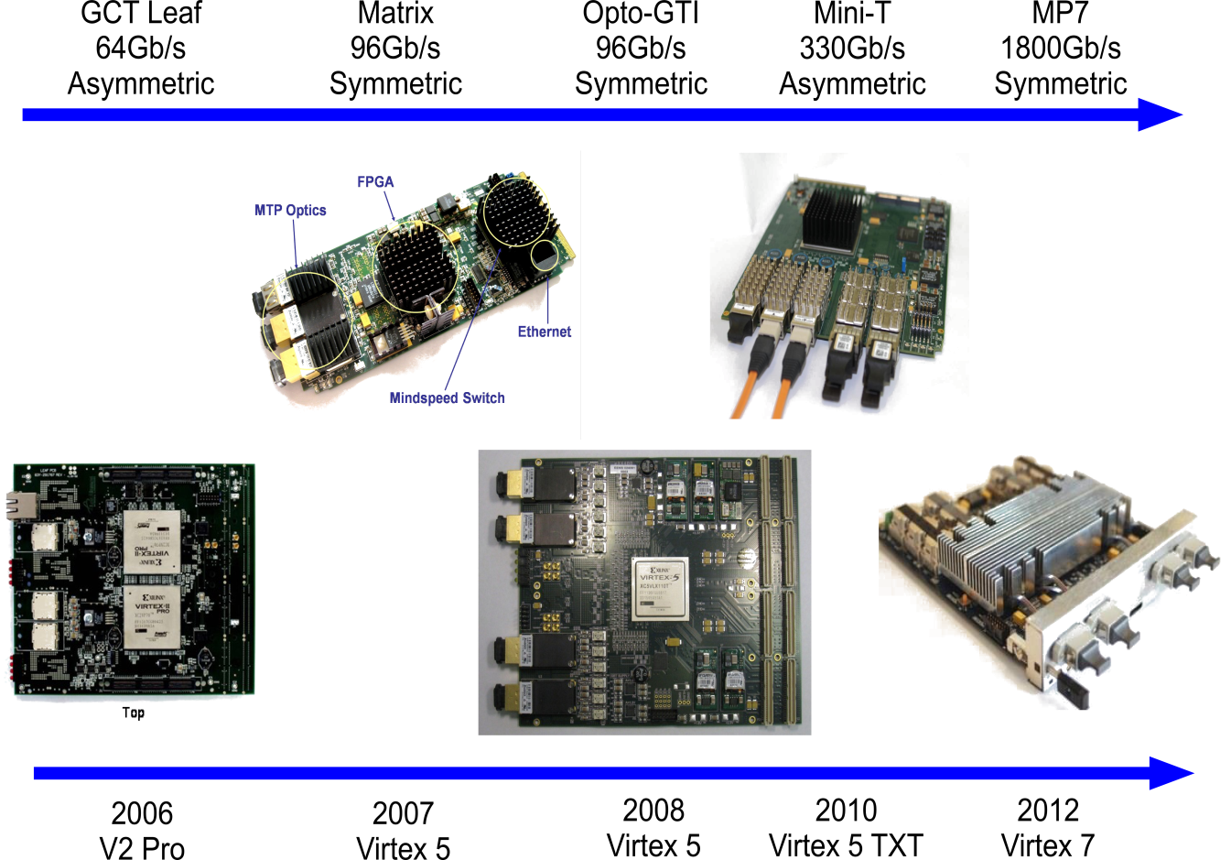
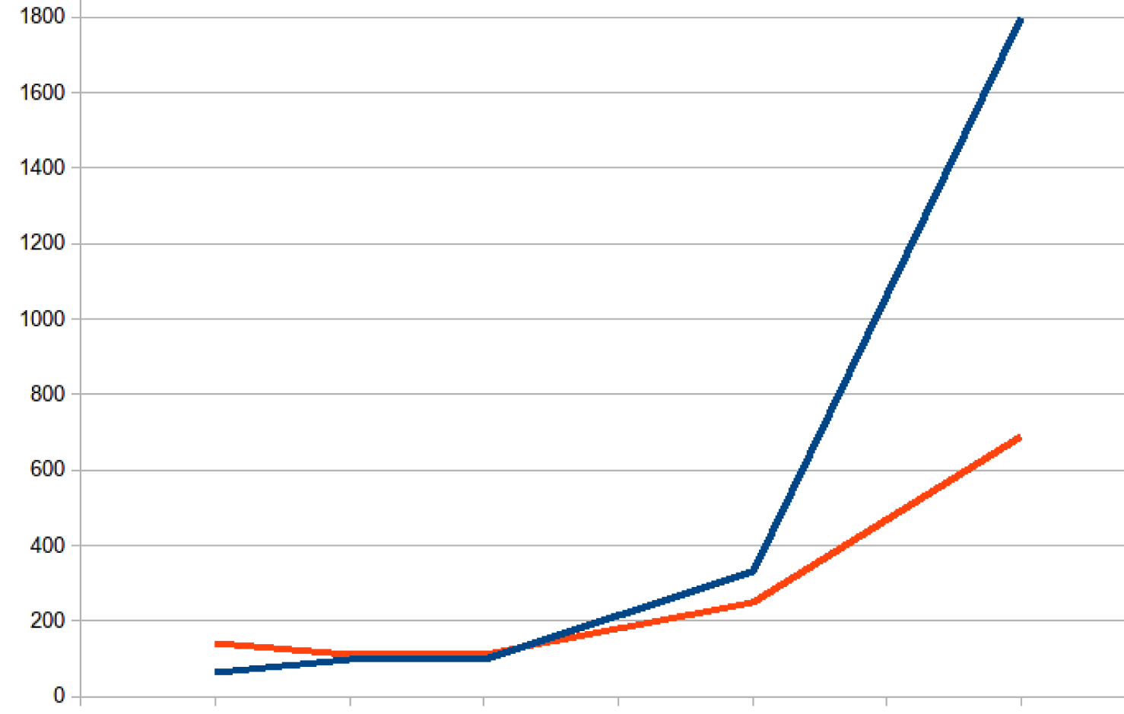
IC processing cards for CMS calo trigger
Bandwidth
Logic

Slide 30
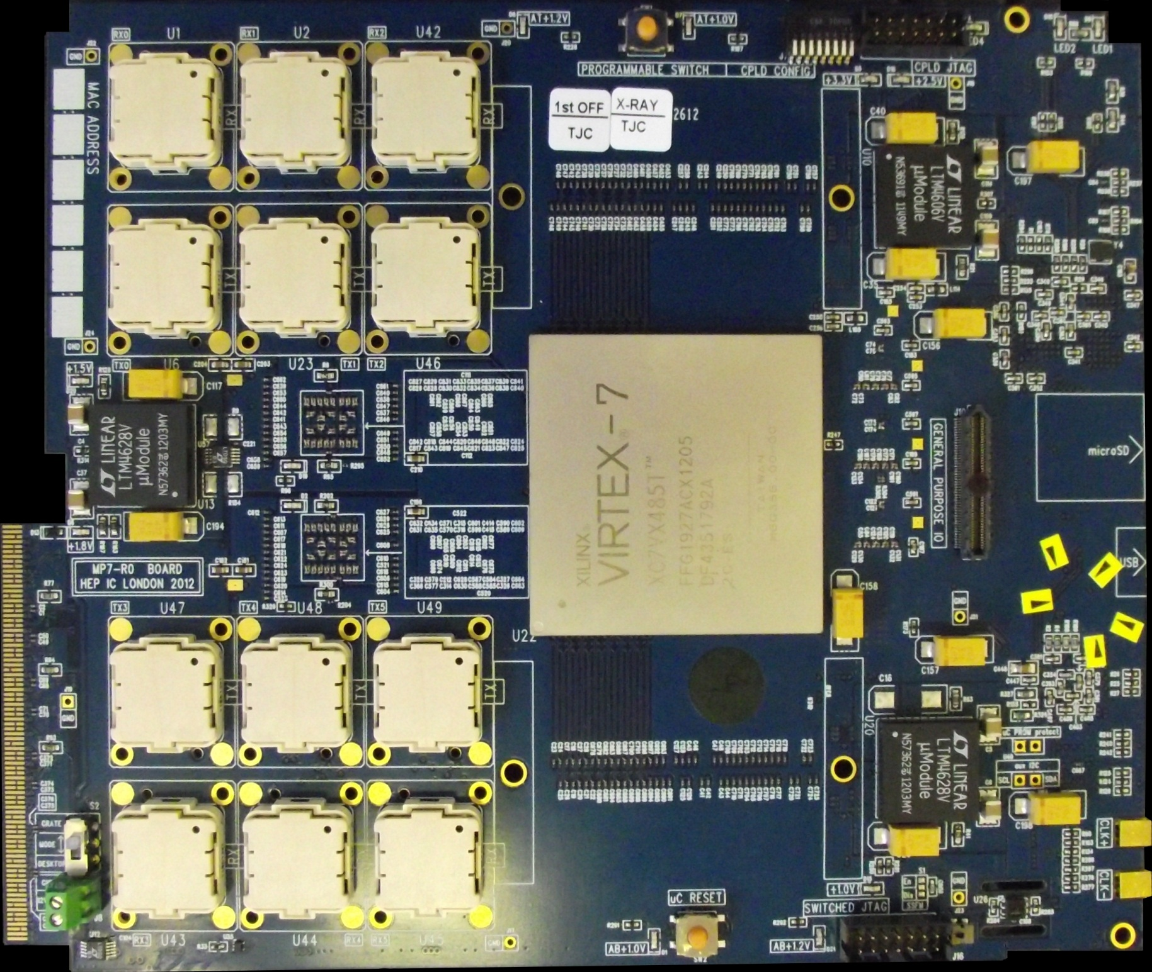
Optical mounts (6Rx + 6Tx)
× 12-channels @ 14G
Xilinx Virtex-7 FPGA
Up to 80+80 13G
30×
1.8 Gbps
low-latency LVDS IO
Backplane has low latency LVDS IO as well as standard SerDes (e.g. GbE, PCIe, etc.)

Slide 31
Receivers
2v5
3v3
Transmitters
1v5
1v8
FPGA
Header
Transmitters
1v0
Receivers

Slide 32
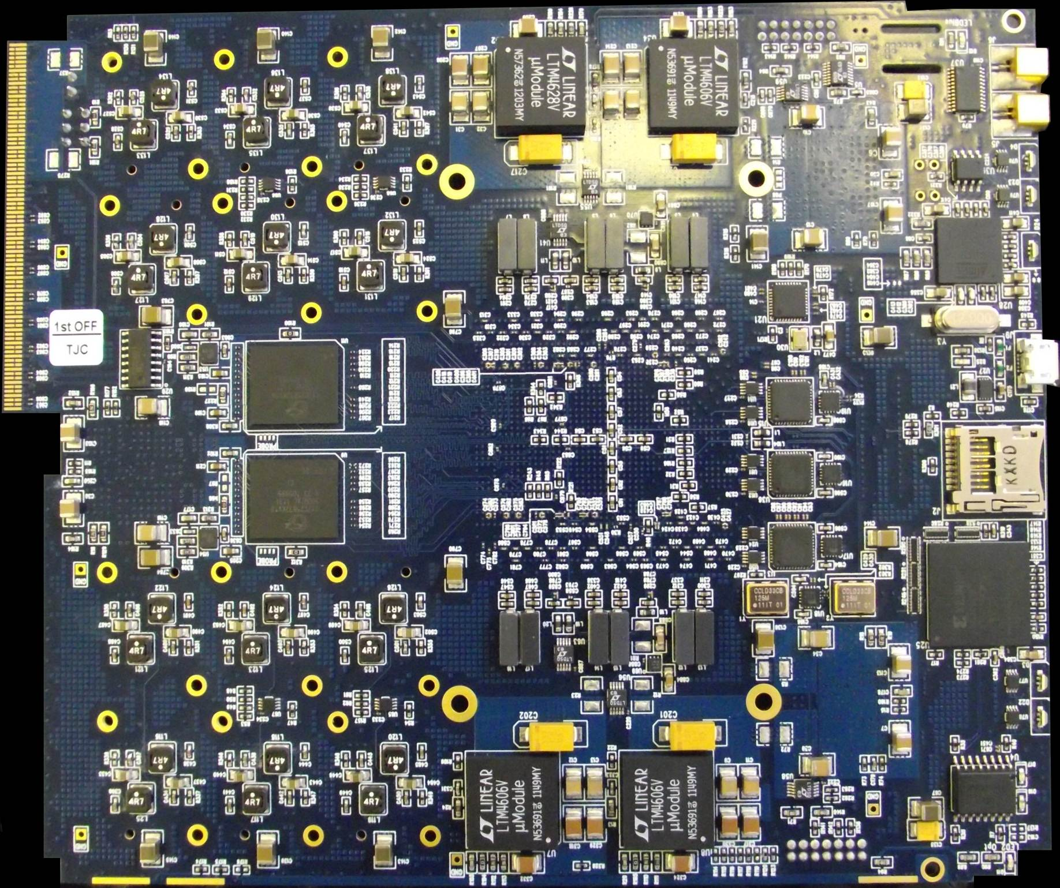
Microcontroller for crate & power management
USB2 for console / debug
32GB μSD Card acts as PROM.
Fast write capability.
Can store all firmware versions
Standard PROM for inviolate boot images

Slide 33
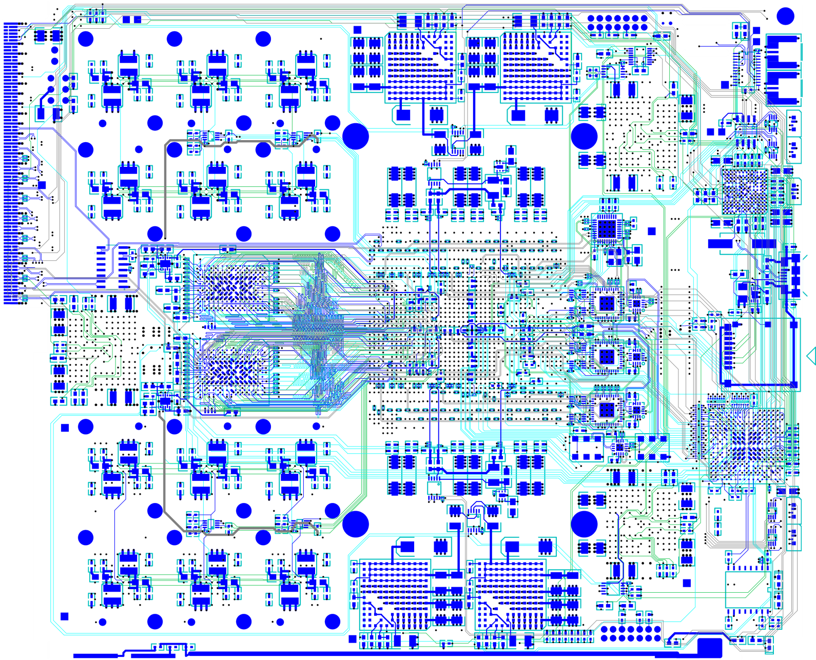
A1v0
A1v2
Clk
μC
QDR
USB
Clocking
μSD
QDR
CPLD
A1v2
A1v0

Slide 34
Recall…
PALs / PLDs / FPGAs
Microprocessors
Parallel operations across many locations
Sequential operations in one location
Can’t use “normal” programming languages like C/C++

Slide 35
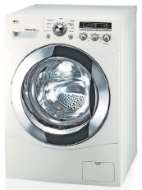
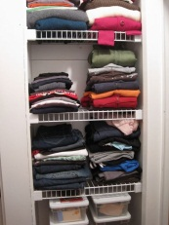
Pipelined processing
6pm | 7pm | 8pm | 9pm | 10pm | 11pm | 12pm | 01am | 02am | 03am
That would just be stupid

Slide 36
Pipelined processing
6pm | 7pm | 8pm | 9pm | 10pm | 11pm | 12pm | 01am | 02am | 03am

Slide 37
Hardware Description Languages
Need a language to describe hardware
Novelly – called a “Hardware Description Language” (HDL)
Also called FIRMWARE
Two popular languages are VHDL , VERILOG
Easy to start learning… Hard to master!
Notes:
‘outline’ of coverage
time-plan
- What is an FPGA
- And why are they important for HEP
questions
- any time

Slide 38
Hardware Description Languages
Describe Logic as collection of Processes operating in Parallel
Language Constructs for Synchronous Logic
Compiler (Synthesis) Tools recognise certain code constructs and generates appropriate logic
Not all constructs can be implemented in FPGA!
Notes:
‘outline’ of coverage
time-plan
- What is an FPGA
- And why are they important for HEP
questions
- any time

Slide 39
Example
library ieee;
use ieee.std_logic_1164.all;
entity test is
port(
x: in std_logic;
y: in std_logic;
F: out std_logic;
G: out std_logic);
end test;
architecture behavioural of test is
begin
process(x, y)
begin
-- compare to truth table
if ((x='1') and (y='1')) then
F <= '1';
else
F <= '0';
end if;
end process;
G <= x or y;
end behavioural;
Must write code with
understanding of how
it will be implemented.
Can also enter code via schematic entry:
Easier to navigate, but not vendor independent
Will there ever be a standard graphical programming language?

Slide 40
How to you know it works?
Simulate design extensively!
Much quicker than debugging inside the FPGA

Slide 41
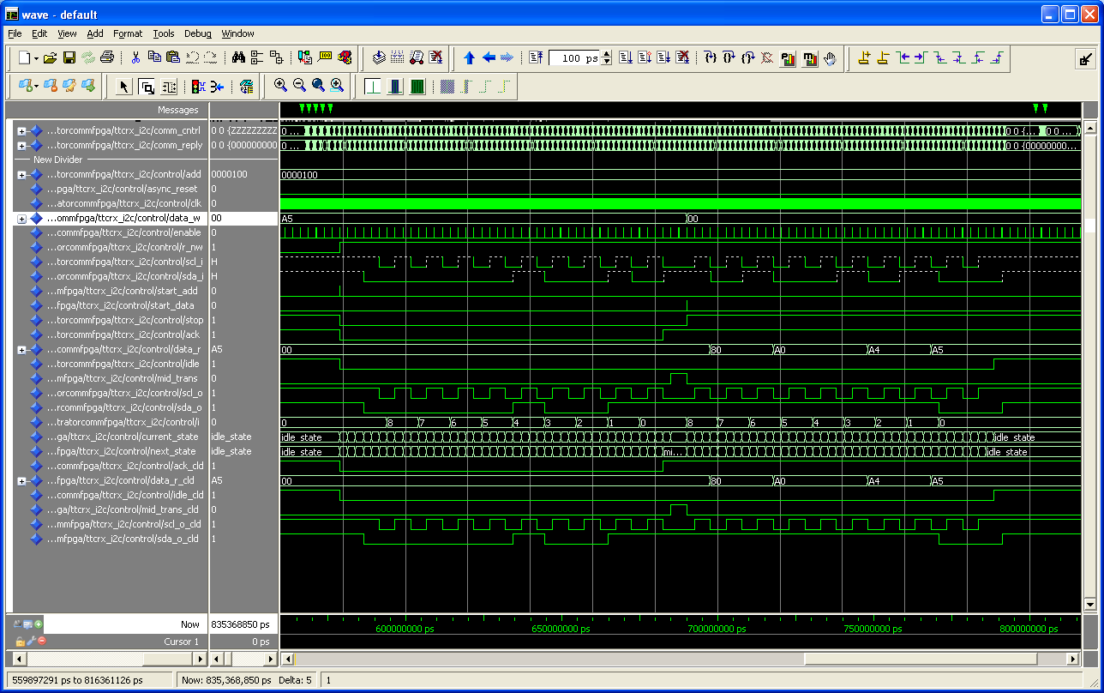

Slide 42
Testbench Suite
“Event display”

Slide 43
Testbench Suite
Clock-by-clock summary
End-of-event summary

Slide 44
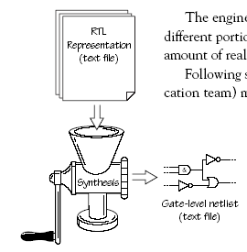
Designing Logic with FPGAs
High level Description of Logic Design (HDL)
Synthesise into a Netlist
Boolean Logic Representation
Target FPGA Device
Translate
Mapping
Routing
Bit File for FPGA
Notes:
‘outline’ of coverage
time-plan
- What is an FPGA
- And why are they important for HEP
questions
- any time

Slide 45
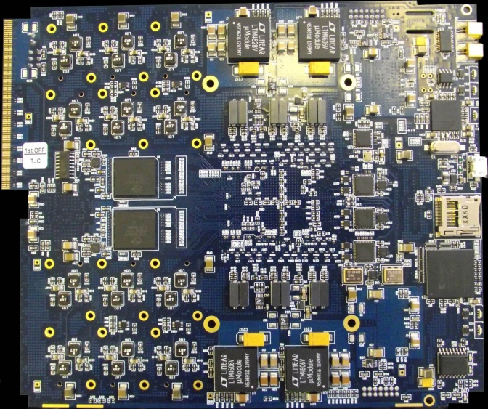
Configuring an FPGA
Millions of SRAM cells holding LUTs and Interconnect Routing
Volatile Memory: Lose configuration when board power is turned off.
Keep bit patterns describing the SRAM cells in non-Volatile Memory e.g. PROM or memory card
Configuration takes ~ secs
Notes:
‘outline’ of coverage
time-plan
- What is an FPGA
- And why are they important for HEP
questions
- any time

Slide 46
It doesn’t work: How to debug
Simulate, simulate & simulate again!
Much quicker than debugging inside the FPGA
Route out signal to periphery
Few debug pins always handy
Can connect UART for uC debug (StdIn/StdOut)
Use chipscope
Rebuild design with embedded logic analyser
Can be a bit like quantum mechanics
If you look (i.e. make a measurement) your code can behave differently
Chipscope presence can affect the original design

Slide 47
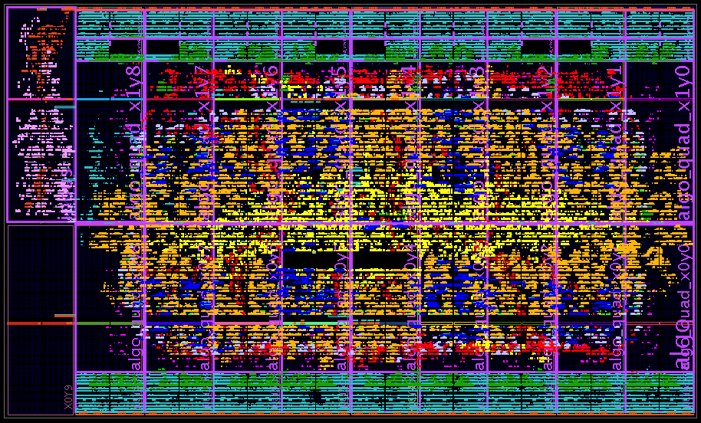
Floorplan of firmware in MP7

Slide 48
Floorplan of firmware in MP7
MGTs and DAQ buffers
Communication
Algorithms
DAQ
(work in progress)
MGTs and DAQ buffers

Slide 49
When & why should I (not) use an FPGA?
FPGAs are expensive (high-end £10k-100k cf. £100)
FPGAs are power-hungry
Programming FPGAs is like designing logic circuits not like programming sequential microcontrollers
Large firmware build-times are tens of hours or days
Floating-point ops and iterative algorithms awkward in FPGAs (That said, you “control” the silicon, so, of course, it can be done)
FPGAs best for high through-put, low- and/or fixed-latency operations

Slide 50
Conclusion
FPGAs are intrinsically parallel
Modern FPGAs are exceptionally powerful
FPGAs are a monumental PAIN IN THE BACKSIDE to program
Partly due to the clunky, verbose HDLs
Mainly due to the difficulty of conceptualizing massively parallel logic and pipelined logic
Get them right and you can do magic
Get them wrong and you unleashed a world of pain on yourself

Slide 51
Spares

Slide 52
Up against the speed of light…
Wait for the signal to propagate
“Sea-of-logic” approach
Limits clock speed
Do less each clock-cycle
Compensated for by much higher clock speeds

Slide 53
Recall: Pipelined processing
6pm | 7pm | 8pm | 9pm | 10pm | 11pm | 12pm | 01am | 02am | 03am

Slide 54
Full pipelining
If you want to get the most out of your FPGA, you need to pipeline at the full data-rate (6 or more times higher than the LHC BX clock)
Design your system to achieve this!
A lot of people still don’t get this…

Slide 55
Conventional trigger
Data is processed in regions
Boundaries between regions must be handled by sharing or duplicating inputs
Volume of data reduced at each stage by selecting and discarding candidates
When volume of data has been sufficiently reduced it can be passed to the global trigger

Slide 56
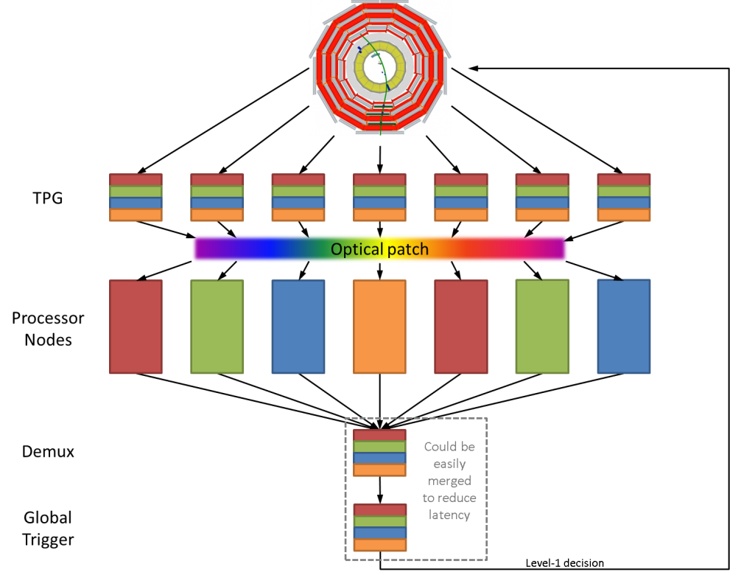
Time-multiplexed trigger
Data from an event is buffered and retransmitted to the first processing node over N bunch crossings
Data from the next event is buffered and retransmitted to the second processing node, again, over N bunch crossings
Process is repeated in round-robin fashion across ≥N processing nodes
Because both algorithm latency and data volume are constant, dataflow is fully deterministic and no complex scheduling mechanism is required

