Slide 1
The LHC and the really big data challenge
Instrumentation course guest lecture
Andrew W. Rose, Imperial College London
awr01@imperial.ac.uk

Slide 2
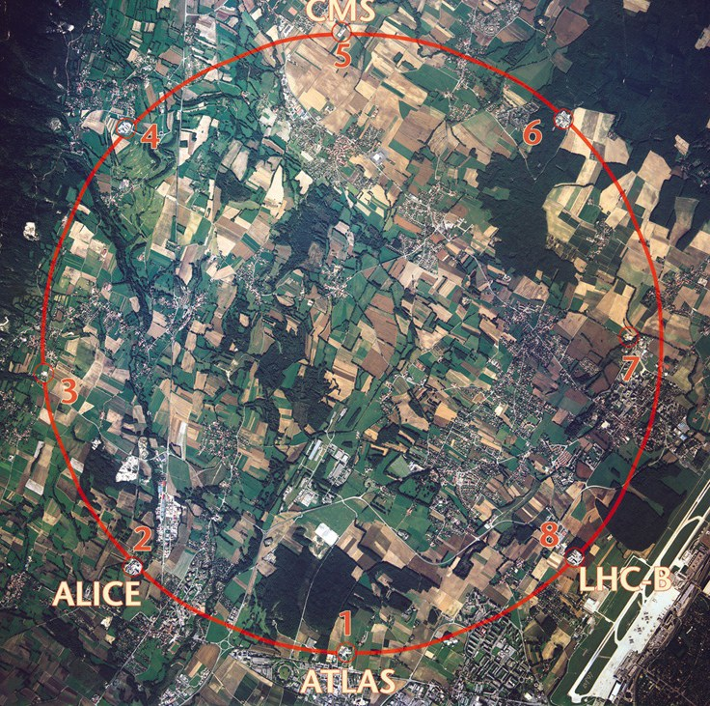
Introduction
I hope you will all be familiar to some extent with the Large Hadron Collider at CERN, Switzerland but will assume minimal background knowledge
The largest and most complex scientific endeavour in history
Most famous for its observation of the Higgs boson

Slide 3
Science: The basics
A bold statement:
Science is the art of knowing
what to record, and when

Slide 4
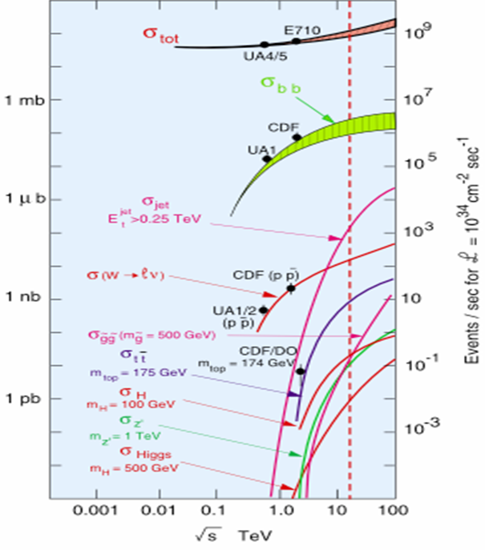
Science: The basics
Science is the art of knowing what to record, and when
With CMS & ATLAS in “discovery mode”, we care about the Higgs Boson or rarer
Higgs Boson production is ten orders of magnitude below the total interaction rate
Ten orders of magnitude

Slide 5
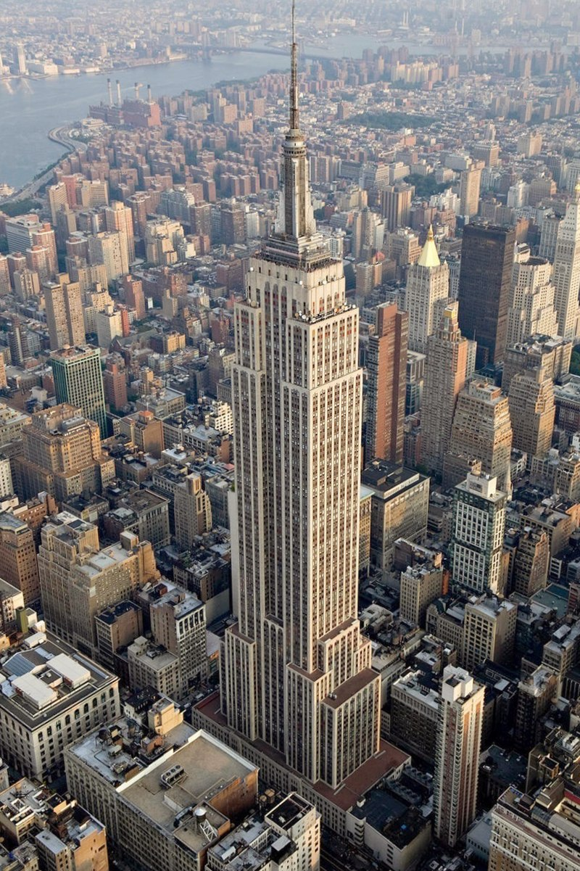
Science: The basics
Science is the art of knowing what to record, and when
With CMS & ATLAS in “discovery mode”, we care about the Higgs Boson or rarer
Higgs Boson production is ten orders of magnitude below the total interaction rate
That is a needle in a haystack the same mass as the Empire State Building

Slide 6
Science: The basics
Science is the art of knowing what to record, and when
With CMS & ATLAS in “discovery mode”, we care about the Higgs Boson or rarer
Higgs Boson production is ten orders of magnitude below the total interaction rate
That is a needle in a haystack the same mass as the Empire State Building
Or if you collided protons once per second, that is one event every 317 years

Slide 7
Science: The basics
Science is the art of knowing what to record, and when
With CMS & ATLAS in “discovery mode”, we care about the Higgs Boson or rarer
Higgs Boson production is ten orders of magnitude below the total interaction rate
That is a needle in a haystack the same mass as the Empire State Building
Or if you collided protons once per second, that is one event every 317 years
And one Higgs boson is pretty much USELESS We need loads of them to be able to study them…

Slide 8
This is why the LHC collides…
̴50 protons at a time × 40 million times a second

Slide 9
This is why the LHC collides…
̴50 protons at a time × 40 million times a second
1 Higgs boson every ̴5 seconds

Slide 10
This is why the LHC collides…
But this causes problems
̴50 protons at a time × 40 million times a second
1 Higgs boson every ̴5 seconds

Slide 11
One proton-proton collision

Slide 12
Many proton-proton collisions
25 proton-proton collisions

Slide 13
Many proton-proton collisions
Even if you get a Higgs boson, the RUBBISH makes it hard to find
25 proton-proton collisions

Slide 14
This is why the LHC collides…
This causes other problems too
̴50 protons at a time × 40 million times a second
1 Higgs boson every ̴5 seconds

Slide 15
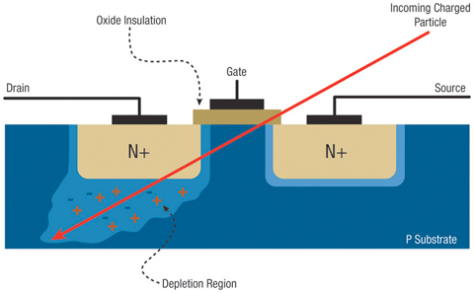
Single Event Upsets
When energetic charged particles pass through a transistor, they can change the state
And there are plenty of charged particles in the LHC experiments

Slide 16
Single Event Upsets
When energetic charged particles pass through a transistor, they can change the state
And there are plenty of charged particles in the LHC experiments
In a microprocessor
At best this corrupts the data
At worst it changes the program flow

Slide 17
Single Event Upsets
When energetic charged particles pass through a transistor, they can change the state
And there are plenty of charged particles in the LHC experiments
In a microprocessor
At best this corrupts the data
At worst it changes the program flow
There are much, much worse effects
Entire circuits reconfigured
Transistor shorts power to ground – burn out the chip
Block the ability to reset or reconfigure the chip

Slide 18
Single Event Upsets
Mitigate by having three copies of the logic and arbitrate by majority logic
Triple Redundant Logic
Deep well transistor architectures to minimize charge collection
Insulating substrates rather than semiconductors
Diamond, Sapphire, …
Or wide band gap substrates
Silicon Carbide, Gallium Nitride
Continual reconfiguration
Called "Scrubbing"
Designing radiation-hard electronics is a specialist skill

Slide 19
Single Event Upsets
Mitigate by having three copies of the logic and arbitrate by majority logic
Triple Redundant Logic
Deep well transistor architectures to minimize charge collection
Insulating substrates rather than semiconductors
Diamond, Sapphire, …
Or wide band gap substrates
Silicon Carbide, Gallium Nitride
Continual reconfiguration
Called "Scrubbing"
The best solution is to keep your most sensitive electronics as far away from radiation as possible

Slide 20
This is why the LHC collides…
But this causes problems
̴50 protons at a time × 40 million times a second
1 Higgs boson every ̴5 seconds
This causes problems too

Slide 21
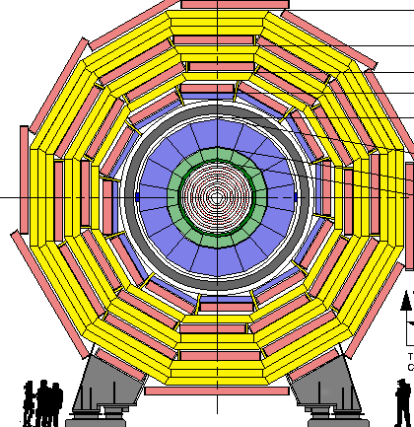
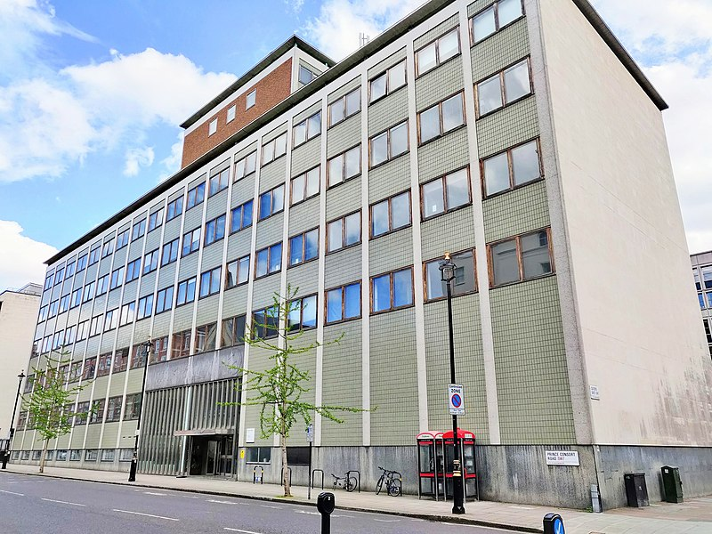
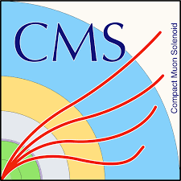
Big detectors for small particles

Slide 22
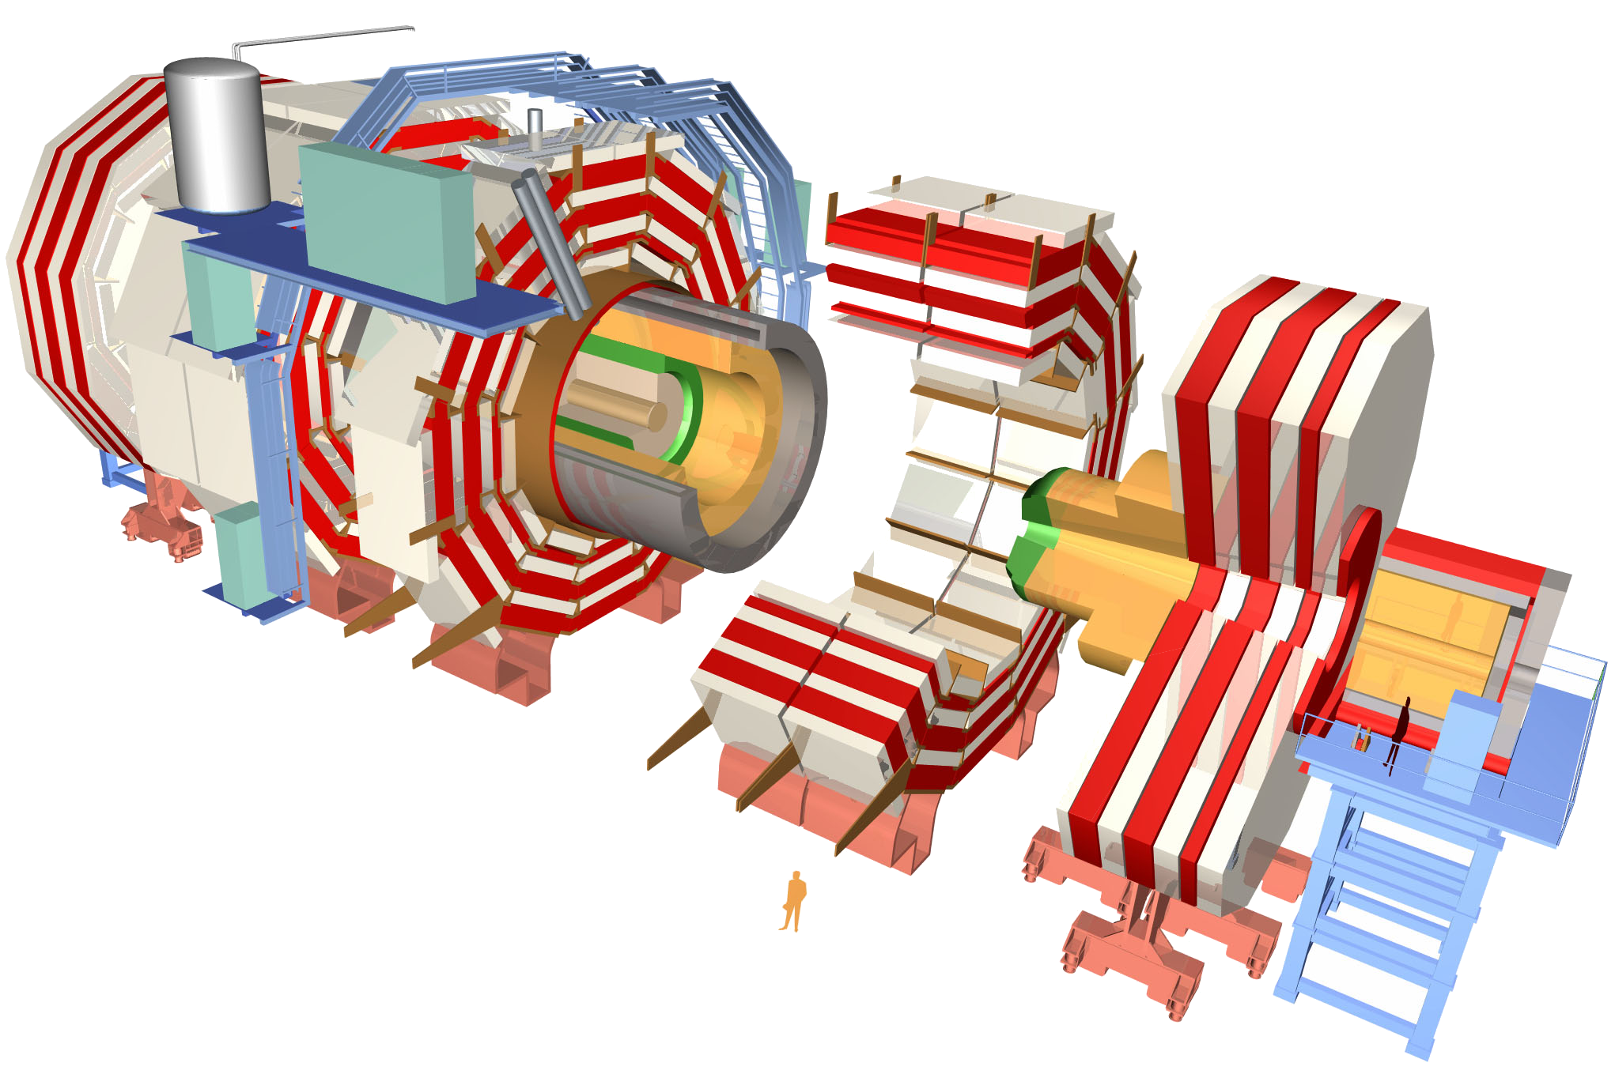
Big detectors…
~80k PbWO₄ Ecal Crystals
~15k channel Brass/Plastic sampling HCAL
~568k RPC/DT/CSC Muon channels
~65M Silicon Pixels
~10M Silicon Strips
~3500 physicists/engineers

Slide 23
Big detectors…
~80k PbWO₄ Ecal Crystals
~15k channel Brass/Plastic sampling HCAL
~568k RPC/DT/CSC Muon channels
× 40 million measurements per second
~65M Silicon Pixels
~10M Silicon Strips
~3500 physicists/engineers

Slide 24
… Bigger data
~80k PbWO₄ Ecal Crystals ≡ 40 TBit per second
~15k channel Brass/Plastic sampling HCAL
≡ 10 TBit per second
~568k RPC/DT/CSC Muon channels
≡ 23 TBit per second
× 40 million measurements per second
~65M Silicon Pixels
≡ 21 PBit per second
~10M Silicon Strips
≡ 4 PBit per second
~3500 physicists/engineers

Slide 25
… Bigger data
~80k PbWO₄ Ecal Crystals ≡ 40 TBit per second
~15k channel Brass/Plastic sampling HCAL
≡ 10 TBit per second
~568k RPC/DT/CSC Muon channels
≡ 23 TBit per second
What does that even mean?
~65M Silicon Pixels
≡ 21 PBit per second
~10M Silicon Strips
≡ 4 PBit per second
~3500 physicists/engineers

Slide 26
What does that even mean?
https://www.cisco.com/
×50
×200

Slide 27
What does that even mean?
The amount of data being produced
https://arxiv.org/pdf/2202.07659.pdf

Slide 28
What does that even mean?
The amount of data being produced
The amount of data we can store
https://arxiv.org/pdf/2202.07659.pdf

Slide 29
What does that even mean?
But do we need to store it all?
The Higgs is rare, after all
https://arxiv.org/pdf/2202.07659.pdf

Slide 30
So what do we do?
We keep the data safe on the detector

Slide 31
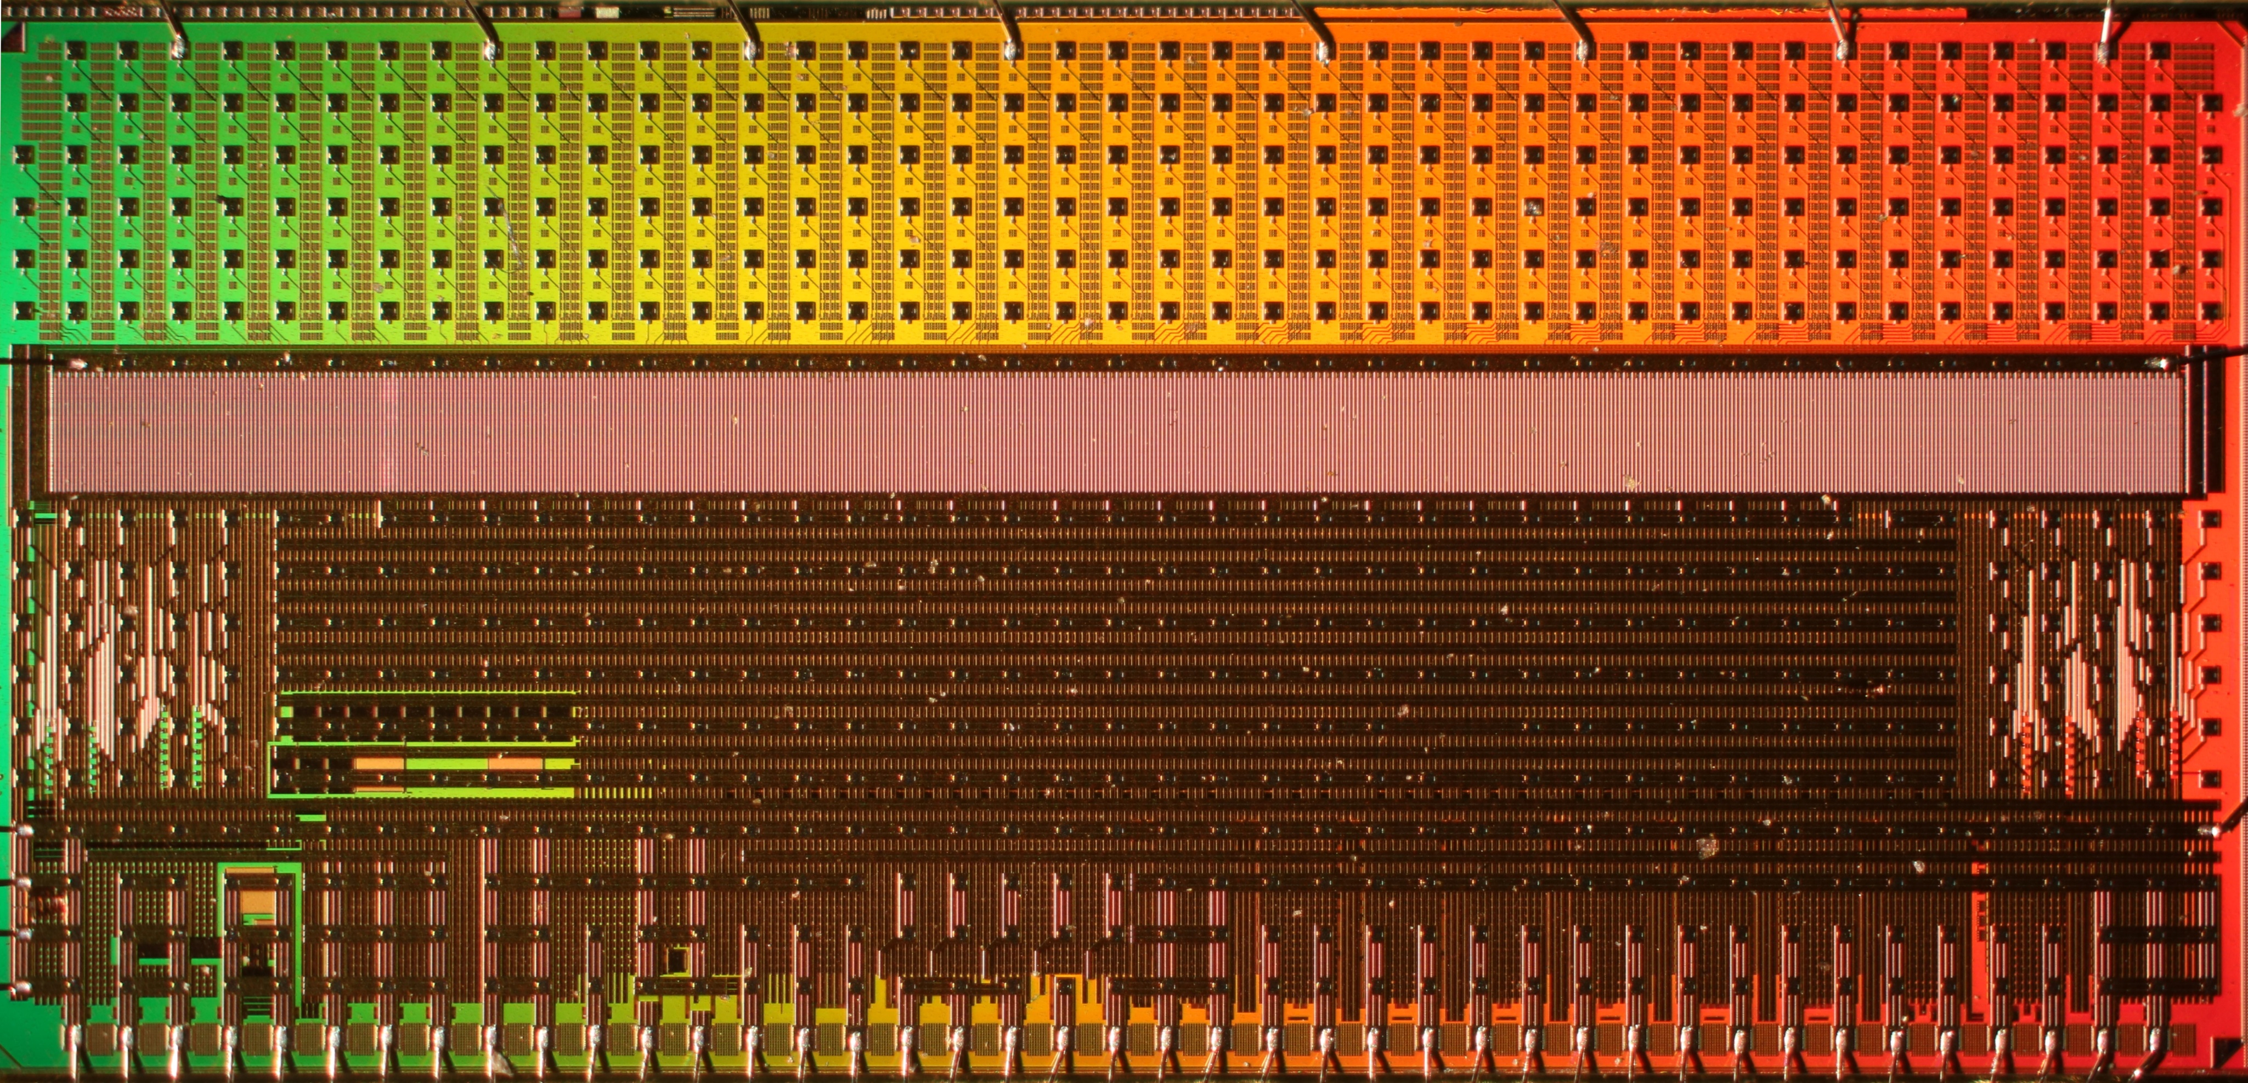
So what do we do?
Designing radiation-hard electronics is a specialist skill
We keep the data safe on the detector
CMS CBC3 ASIC Designed at Imperial College London Layout at Rutherford Appleton Lab

Slide 32
So what do we do?
We keep the data safe on the detector for several microseconds

Slide 33
So what do we do?
We keep the data safe on the detector for several microseconds
We quickly analyse some small fraction of the data and select the interesting crossings to keep

Slide 34
So what do we do?
We keep the data safe on the detector for several microseconds
We quickly analyse some small fraction of the data and select the interesting crossings to keep
Called Triggering

Slide 35
So what do we do?
We keep the data safe on the detector for several microseconds
We quickly analyse some small fraction of the data and select the interesting crossings to keep
uninteresting crossings to discard
The LHC is a discovery machine, after all
Called Triggering

Slide 36
So what do we do?
We keep the data safe on the detector for several microseconds
We quickly analyse some small fraction of the data and select the interesting crossings to keep
~30Tbps
uninteresting crossings to discard
The LHC is a discovery machine, after all
Called Triggering

Slide 37
But!
If you get it wrong
If your system fails you throw away your valuable physics
If you take too long

Slide 38
But!
If you get it wrong
If your system fails you throw away your valuable physics
If you take too long
And that is a *really, really* expensive mistake

Slide 39
So what do we do?
We keep the data safe on the detector for several microseconds
We quickly analyse some small fraction of the data and select the interesting crossings to keep

Slide 40
So what do we do?
We keep the data safe on the detector for several microseconds
We quickly analyse some small fraction of the data and select the interesting crossings to keep
But the radiation in the experiment is so intense that the programmable electronics is kept 100m away
The speed of light costs you 1μs to get the data off detector
And 1μs to get the decision back to the detector
Leaves 1.2μs for all data processing

Slide 41
So what do we do?
We keep the data safe on the detector for several microseconds
We quickly analyse some small fraction of the data and select the interesting crossings to keep
But the radiation in the experiment is so intense that the programmable electronics is kept 100m away
The speed of light costs you 1μs to get the data off detector
And 1μs to get the decision back to the detector
Leaves 1.2μs for all data processing
4800 instructions on a 4GHz CPU

Slide 42
But recall…
But this causes problems
̴50 protons at a time × 40 million times a second
1 Higgs boson every ̴5 seconds
This causes other problems too

Slide 43
A note on timescales
At 40MHz BX rate, a 4GHz CPU could perform 100 CPU operations (not enough to be useful) before the next data arrives
What technology can we use?

Slide 44
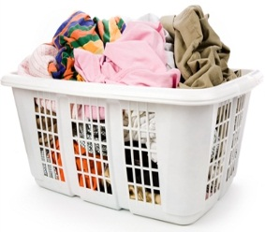
Sequential processing
6pm | 7pm | 8pm | 9pm | 10pm | 11pm | 12pm | 01am | 02am | 03am

Slide 45
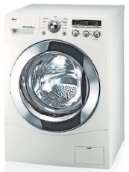
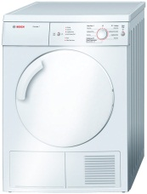
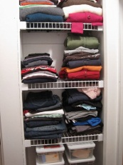
Sequential processing
6pm | 7pm | 8pm | 9pm | 10pm | 11pm | 12pm | 01am | 02am | 03am

Slide 46
Sequential processing
6pm | 7pm | 8pm | 9pm | 10pm | 11pm | 12pm | 01am | 02am | 03am
That would just be stupid

Slide 47
Sequential processing
6pm | 7pm | 8pm | 9pm | 10pm | 11pm | 12pm | 01am | 02am | 03am
That would just be stupid
But this is essentially what a PC does

Slide 48
Pipelined processing
6pm | 7pm | 8pm | 9pm | 10pm | 11pm | 12pm | 01am | 02am | 03am

Slide 49
Pipelined processing
6pm | 7pm | 8pm | 9pm | 10pm | 11pm | 12pm | 01am | 02am | 03am
So why doesn’t my PC do this?

Slide 50
Pipelined processing
6pm | 7pm | 8pm | 9pm | 10pm | 11pm | 12pm | 01am | 02am | 03am
So why doesn’t my PC do this?
Because writing code like this is *really, really* hard

Slide 51
What technology can we use?
Application-specific integrated circuits (ASICs): design encoded into silicon
Field-programmable gate arrays (FPGAs)

Slide 52
Field-Programmable Gate Arrays
Programmable circuit-on-chip

Slide 53
Field-Programmable Gate Arrays
Programmable circuit-on-chip
Upwards of 9 million logic cells & up to 12000 “math” cells
All clocked at ̴500MHz
Up to O(10¹⁵) operations/second
Fully parallel and fully pipelineable

Slide 54
Field-Programmable Gate Arrays
Programmable circuit-on-chip
Upwards of 9 million logic cells & up to 12000 “math” cells
All clocked at ̴500MHz
Up to O(10¹⁵) operations/second
Fully parallel and fully pipelineable
Rather useful when you are dealing with 30Tbps

Slide 55
Field-Programmable Gate Arrays
Programmable circuit-on-chip
Upwards of 9 million logic cells & up to 12000 “math” cells
All clocked at ̴500MHz
Up to O(10¹⁵) operations/second
Fully parallel and fully pipelineable
Rather useful when you are getting new data every 25ns

Slide 56
Field-Programmable Gate Arrays
Programmable circuit-on-chip
Upwards of 9 million logic cells & up to 12000 “math” cells
All clocked at ̴500MHz
Up to O(10¹⁵) operations/second
Fully parallel and fully pipelineable
Rather useful when you are dealing with 30Tbps
Rather useful when you are getting new data every 25ns
and *really, really* hard to program efficiently

Slide 57
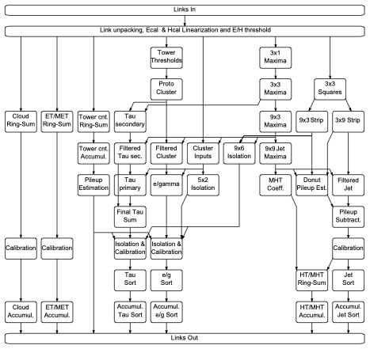
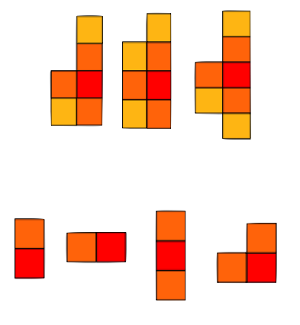
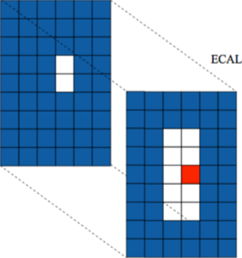
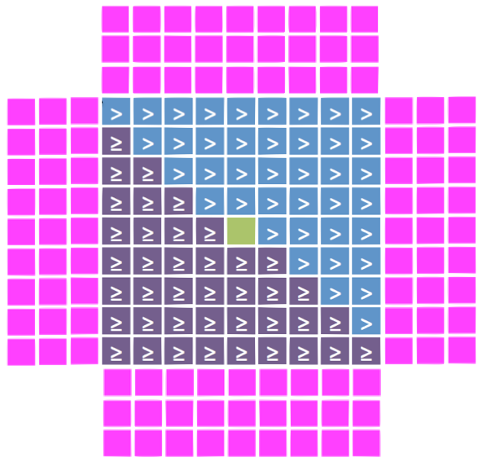
The CMS Calorimeter trigger
72 × 10 Gbps links
720 Gbps
2.3kb per 25ns
Inputs
Unpack & Linearisation
Dynamic clustering
Seeding & basic clustering
Clusters combination Filtering Sums
Jet building with pileup subtraction
EG/TAU/Jets PileUp
Isolation&Calibration
Sort
Shape veto, H/E, isolation, calibration
Cumulative sort
Outputs

Slide 58
The CMS Calorimeter trigger
72 × 10 Gbps links
720 Gbps
2.3kb per 25ns
Inputs
Unpack & Linearisation
Dynamic clustering
Seeding & basic clustering
Each box itself consists of a number of pipelined operations
Clusters combination Filtering Sums
Jet building with pileup subtraction
EG/TAU/Jets PileUp
Isolation&Calibration
Sort
Shape veto, H/E, isolation, calibration
Cumulative sort
Outputs

Slide 59
What type of algorithms are we talking about?
Remember that they have to be implemented in a fully parallel and
fully pipelined
form
Classical algorithms
Clustering in 2D or 3D
Pattern identification/matching
Kalman filtering

Slide 60
What type of algorithms are we talking about?
Remember that they have to be implemented in a fully parallel and
fully pipelined
form
Classical algorithms
Clustering in 2D or 3D
Pattern identification/matching
Kalman filtering
In future
Particle-flow – full reconstruction of particles and events
Machine-learning, BDTs and neural-nets in chip

Slide 61
Field-Programmable Gate Arrays
A chip needs to be attached to something!
Imperial’s latest platform: Serenity

Slide 62
Field-Programmable Gate Arrays
A chip needs to be attached to something!
Imperial’s latest platform: Serenity
208 optical transmit links & 208 optical receive links @ 28.5Gbps =
Skewable to
5.9 + 5.9 Tbps
7.0 + 4.8 Tbps

Slide 63
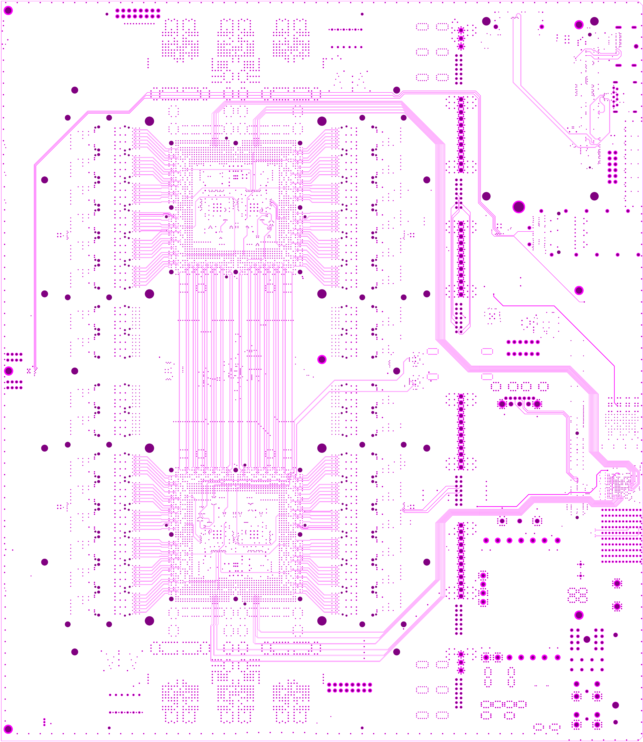
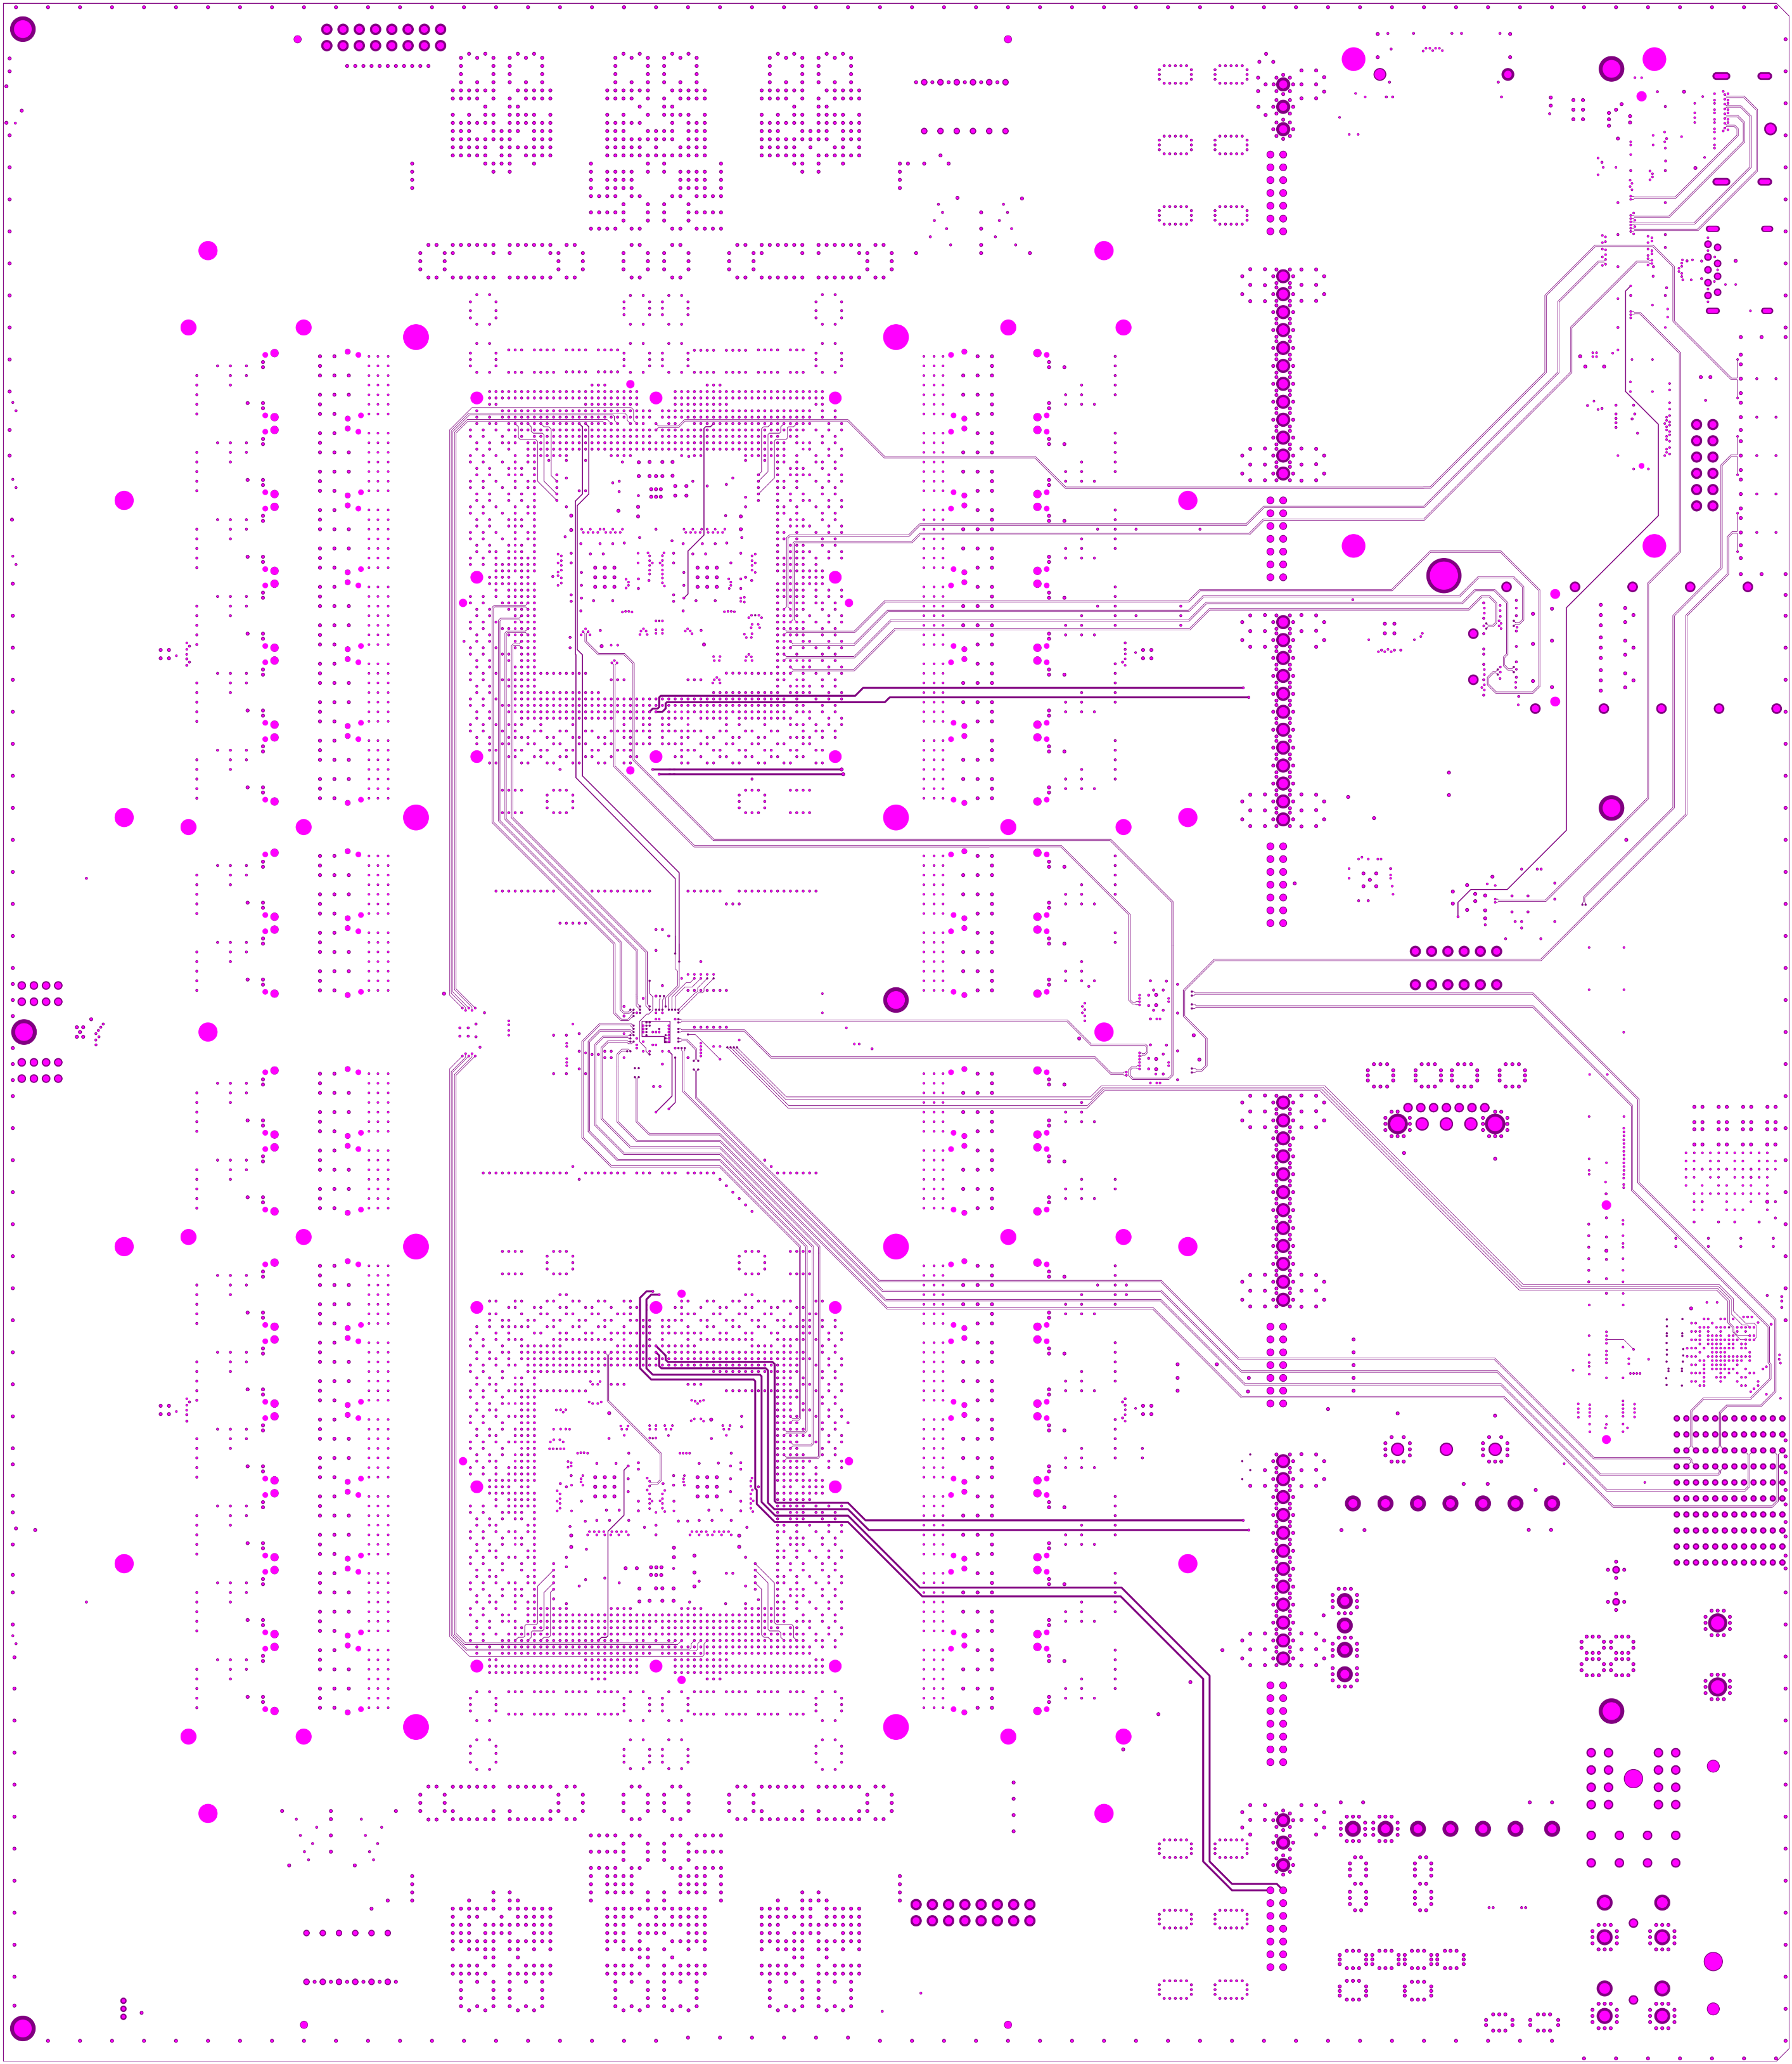
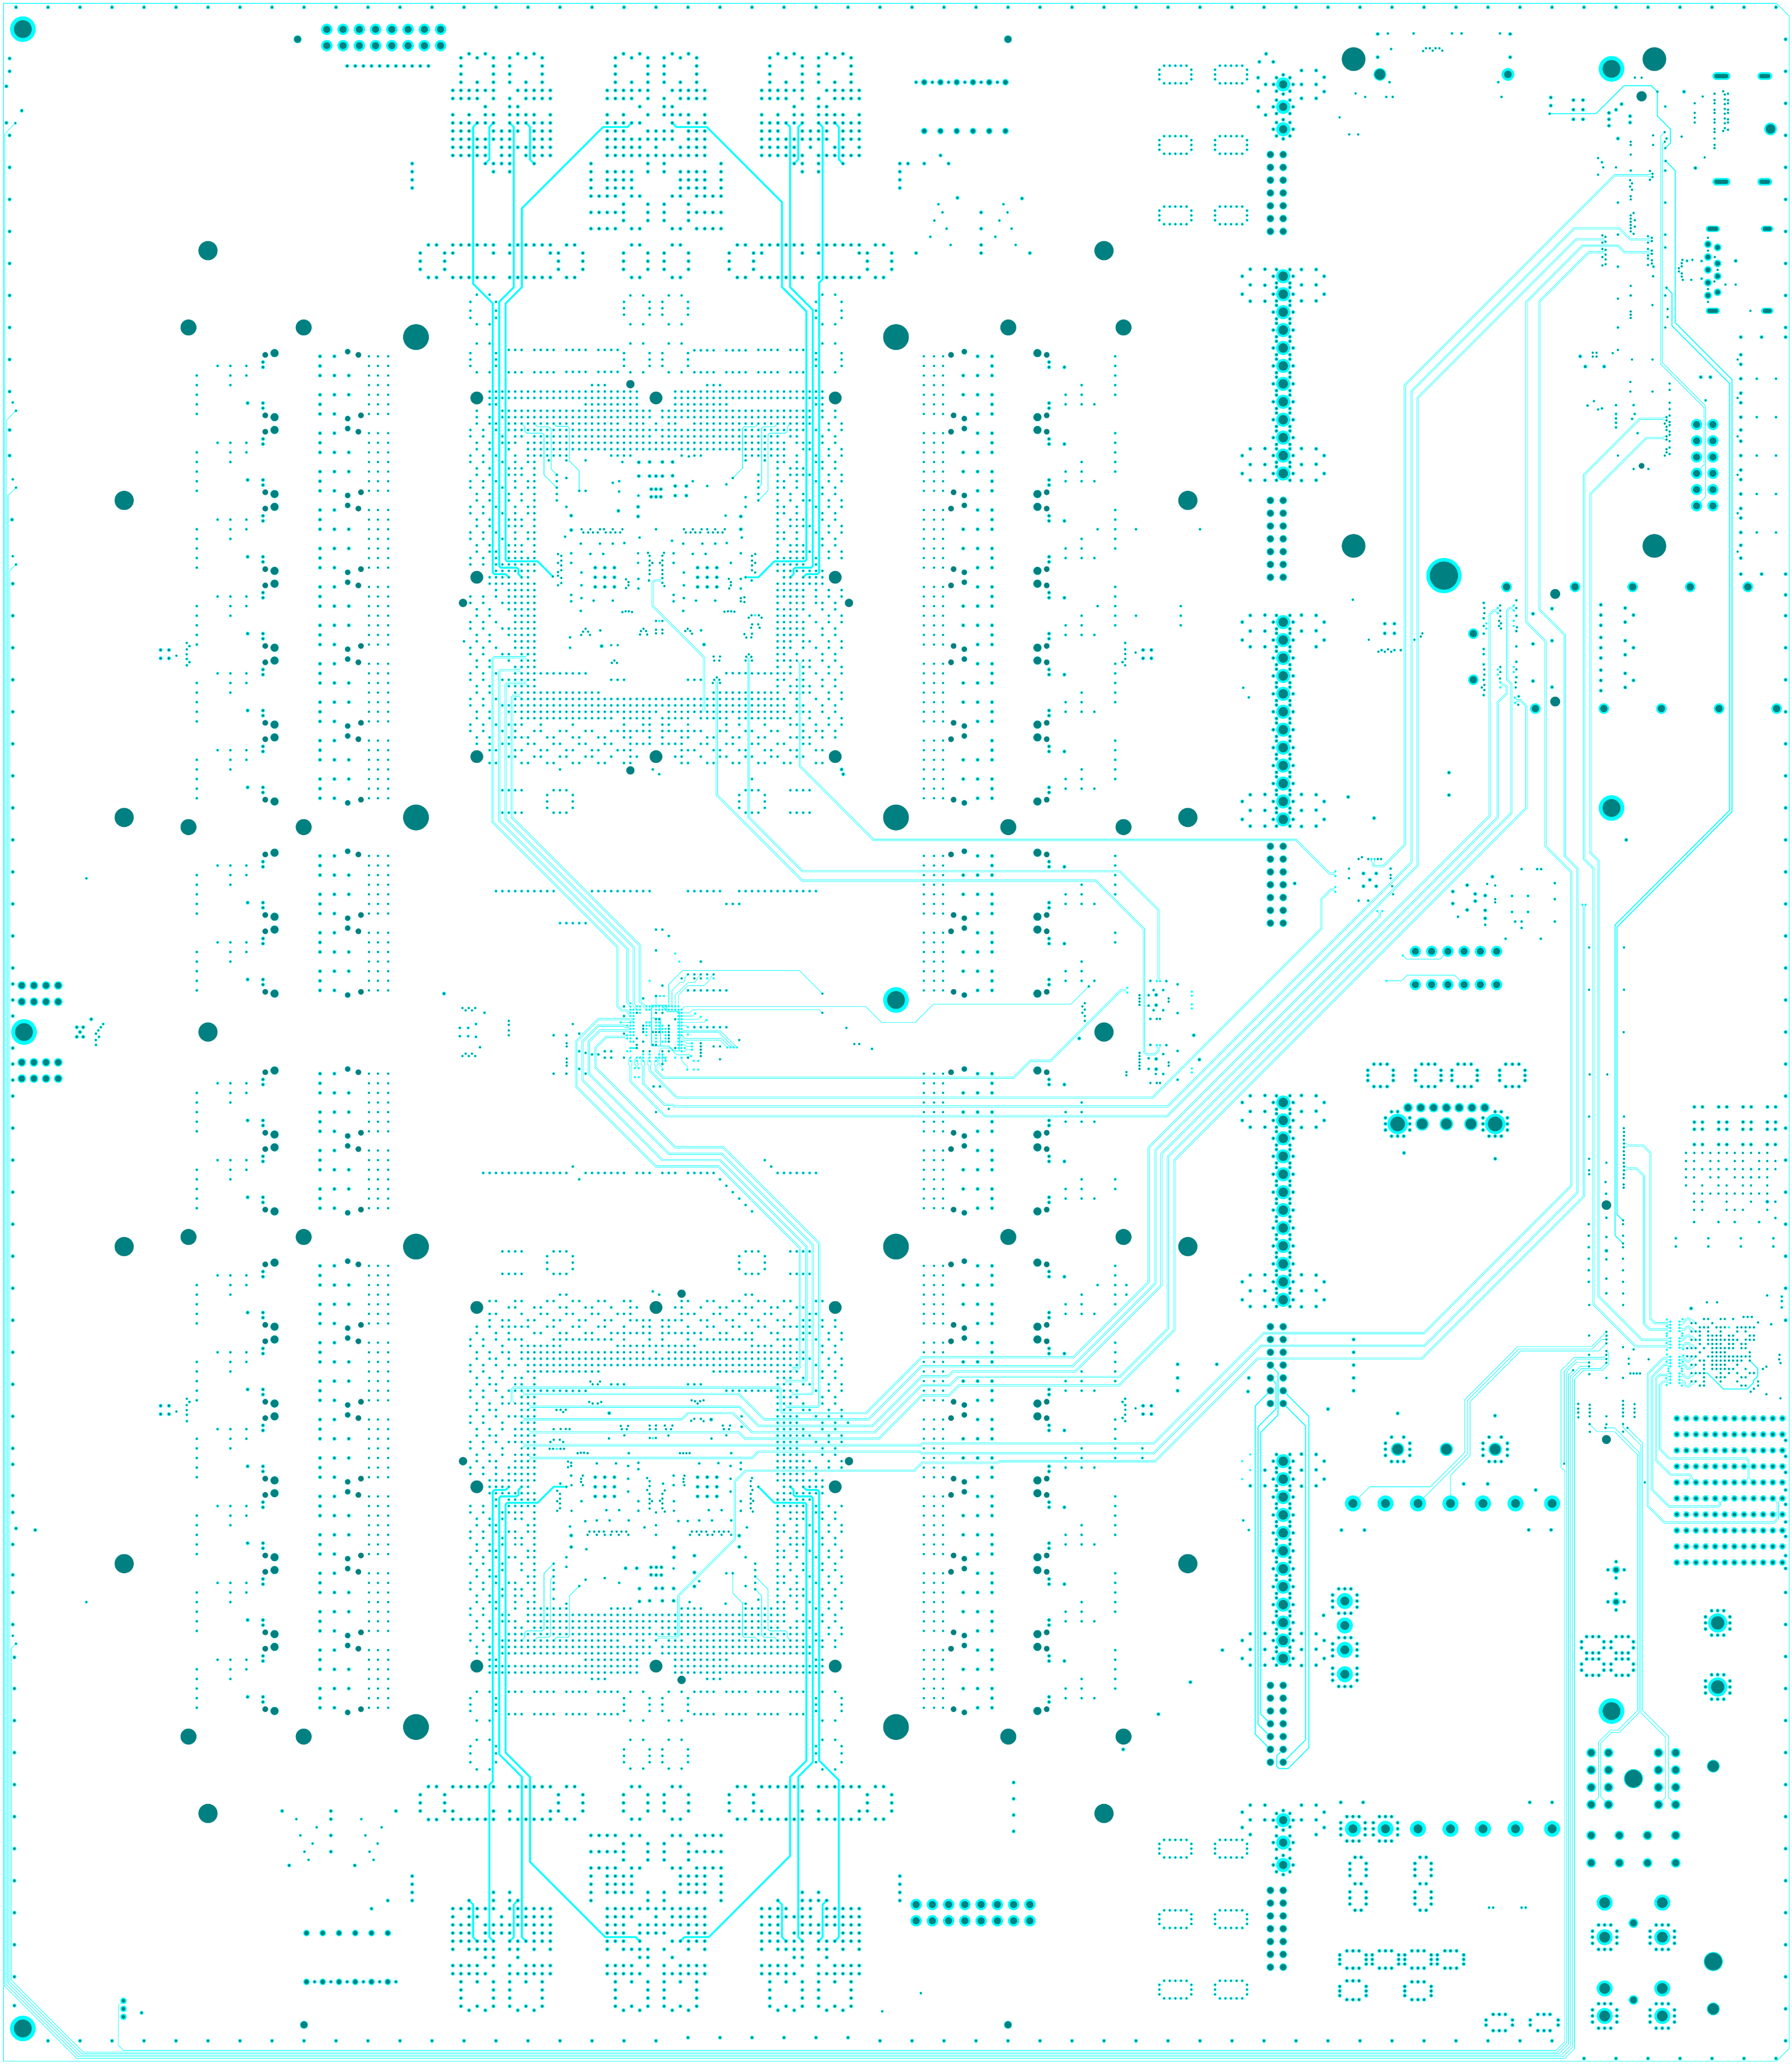
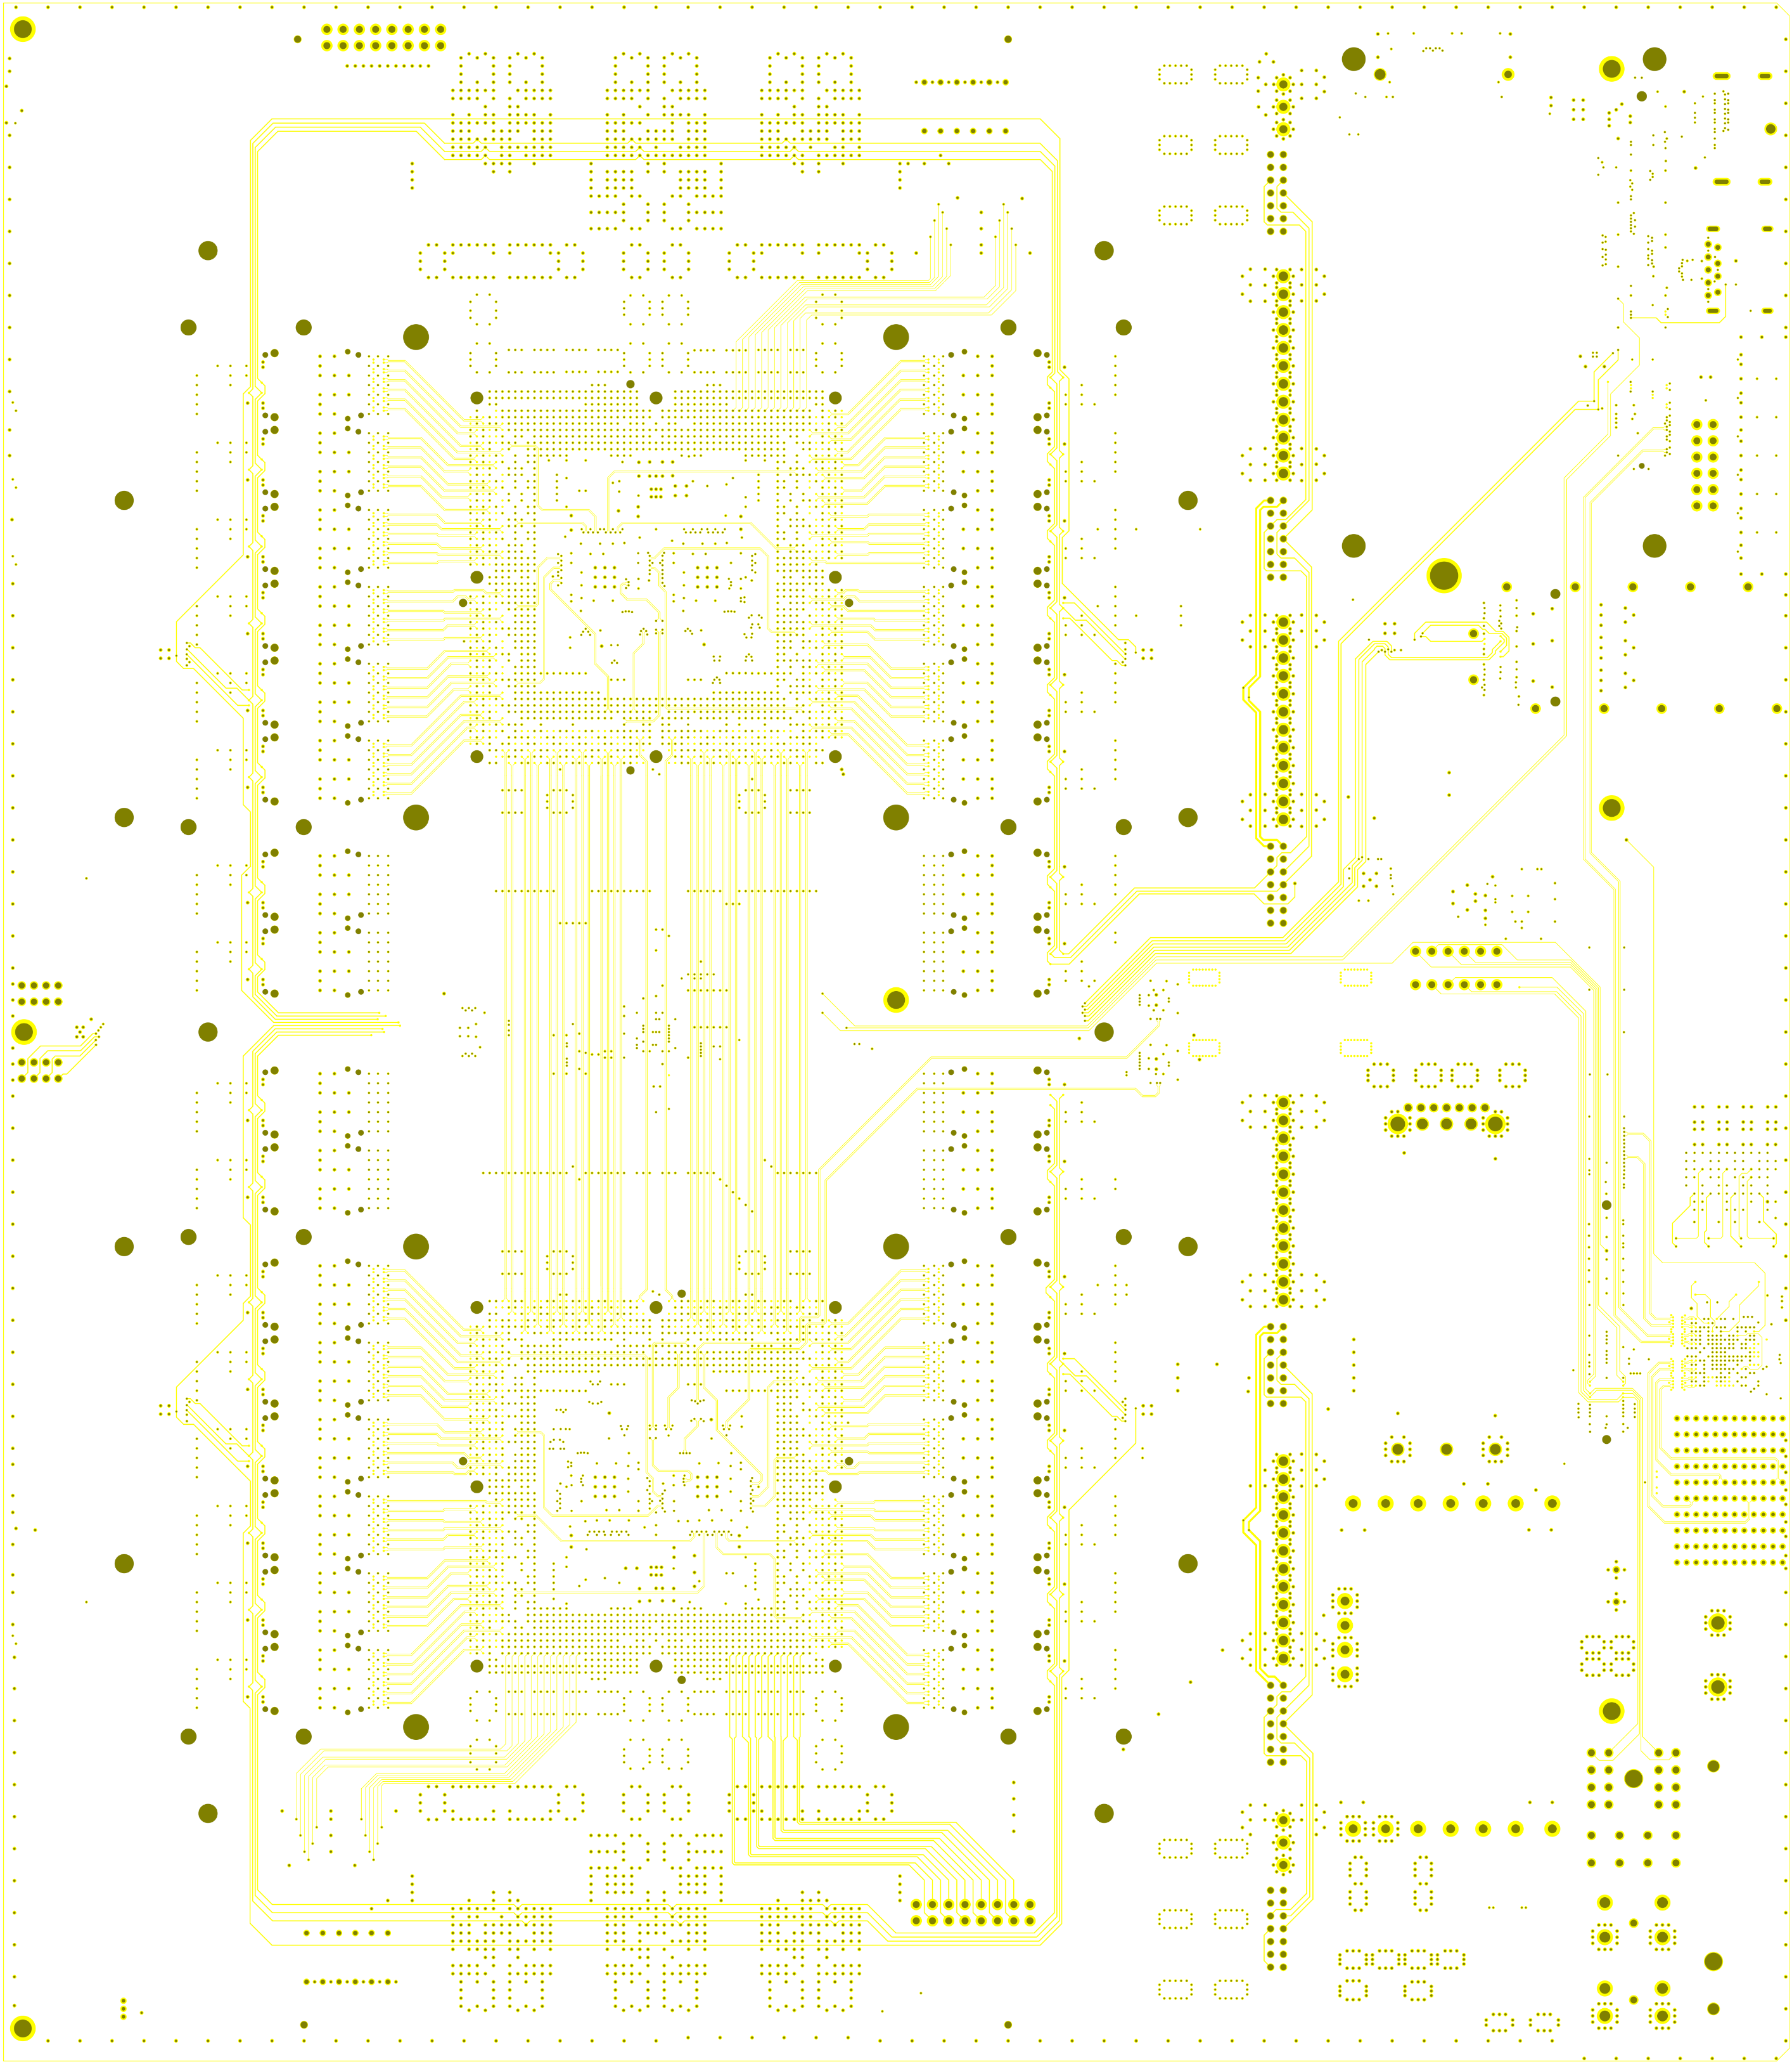
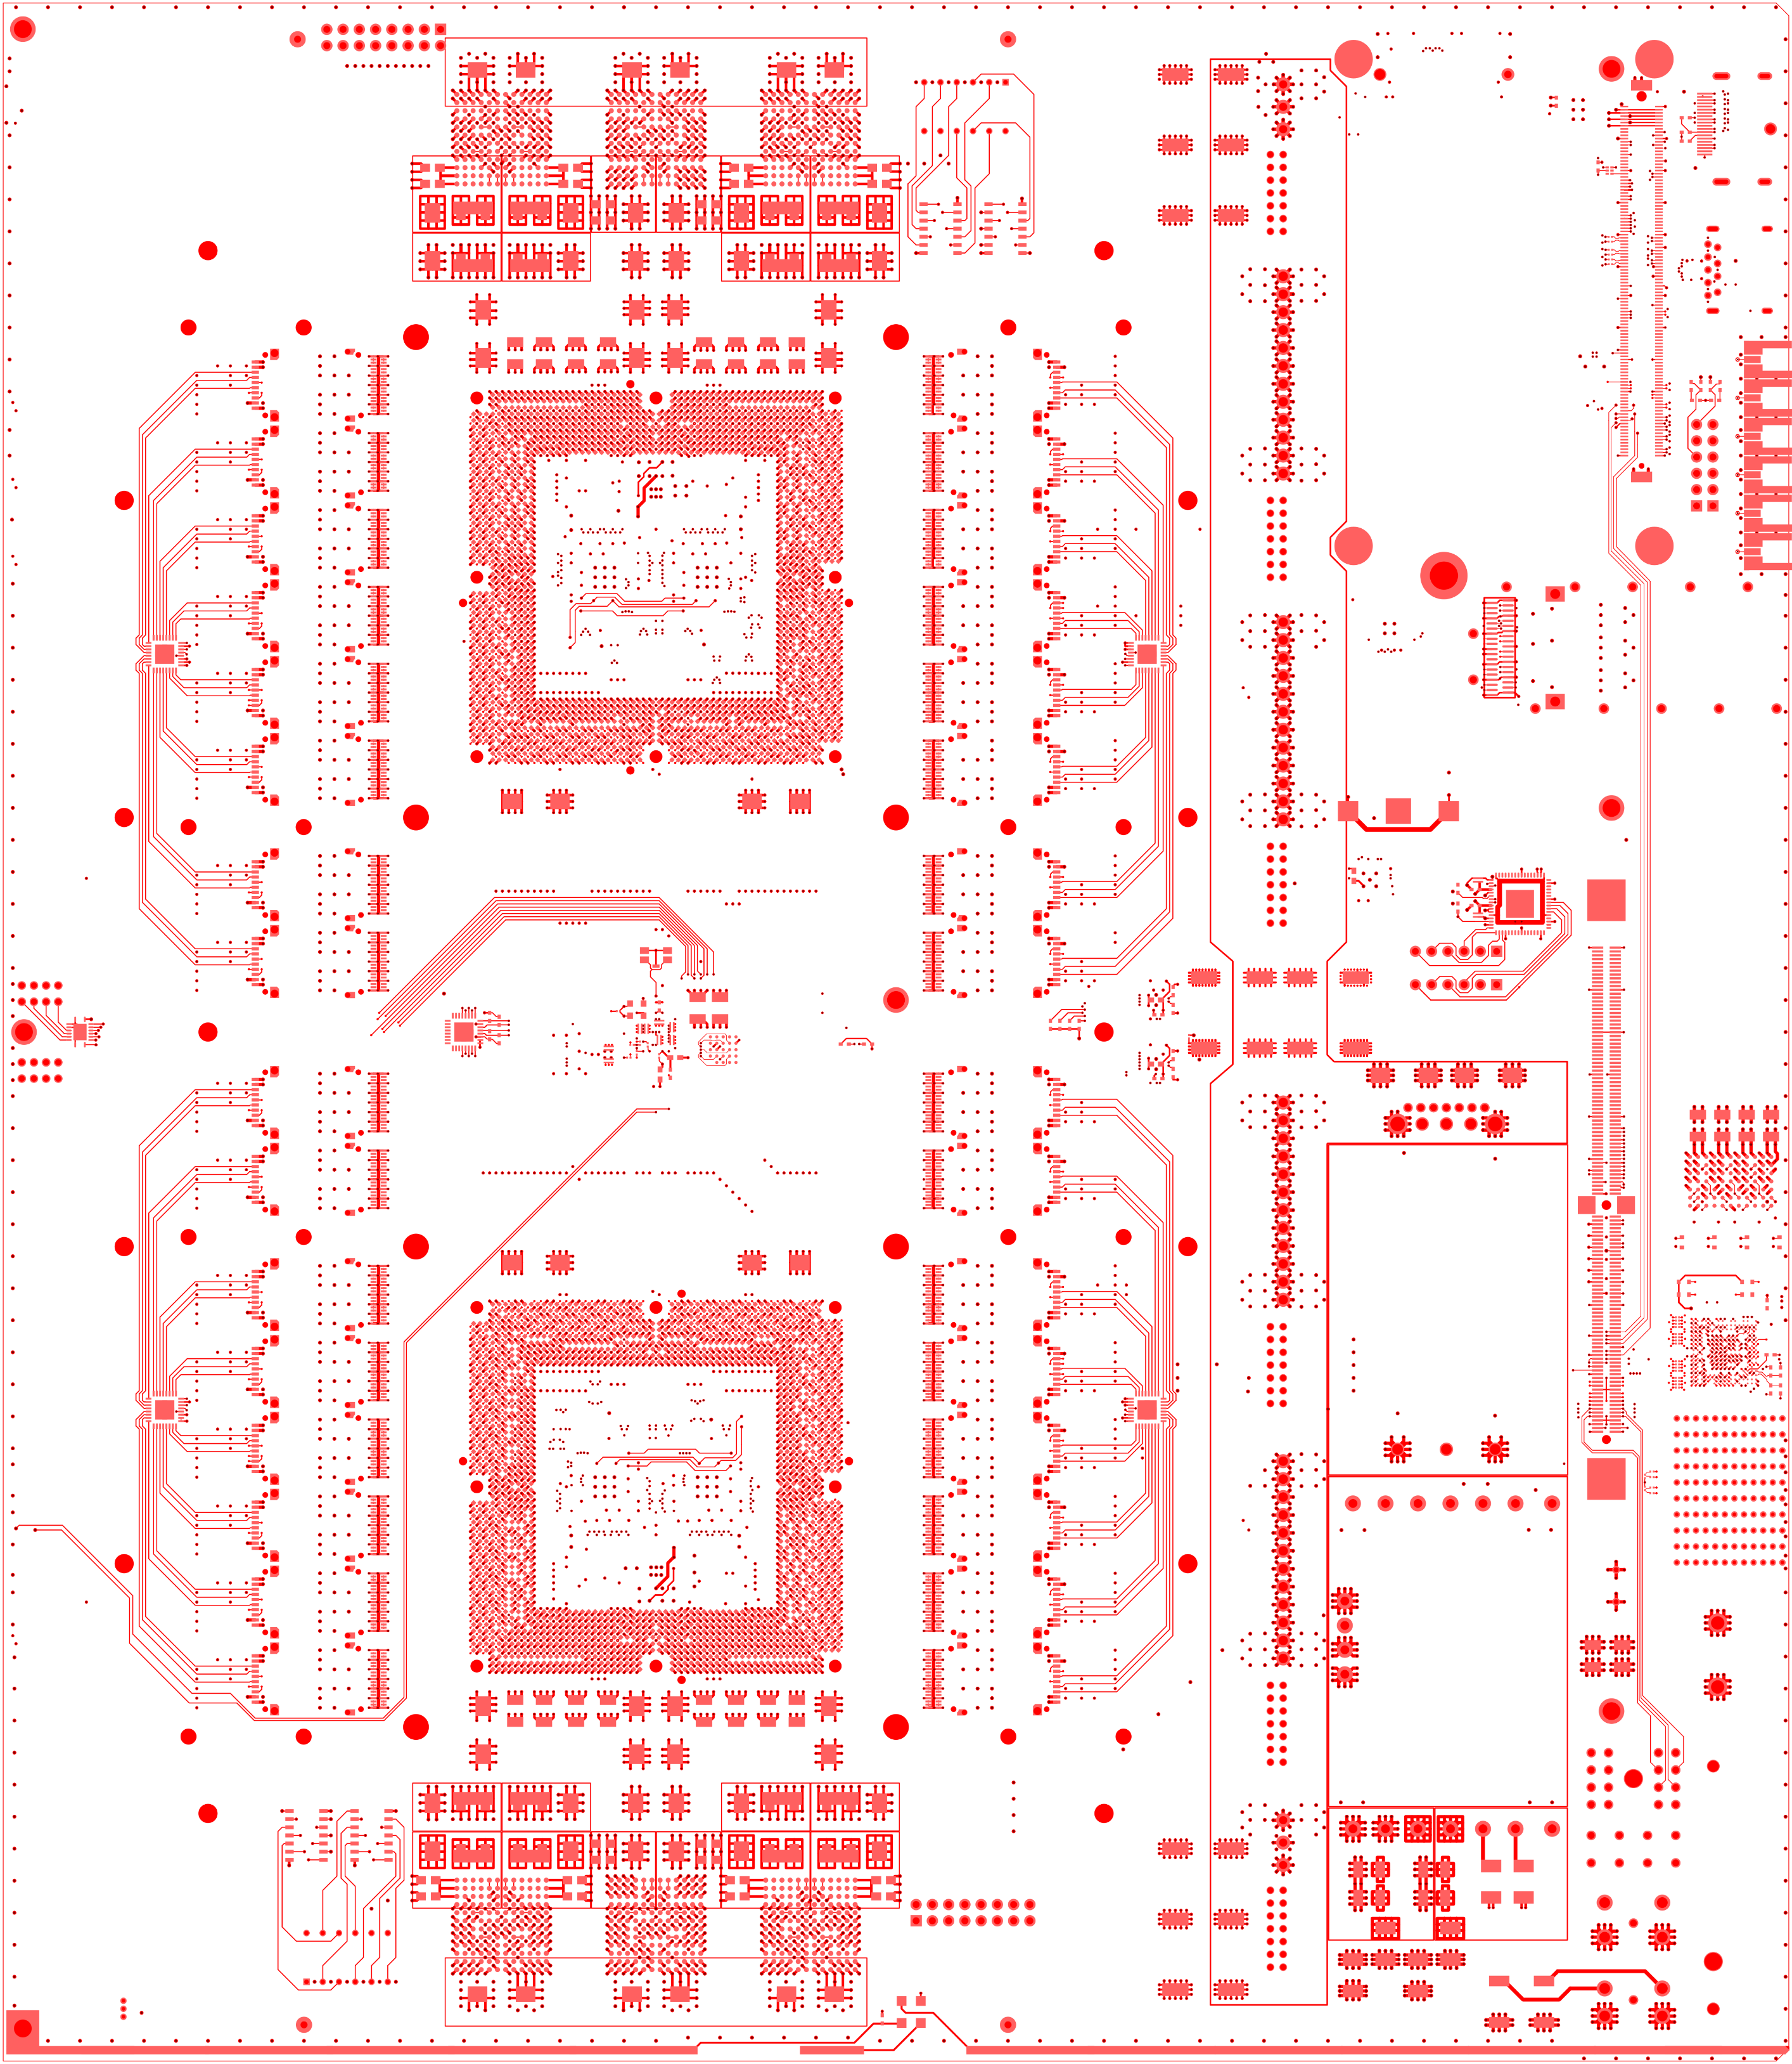
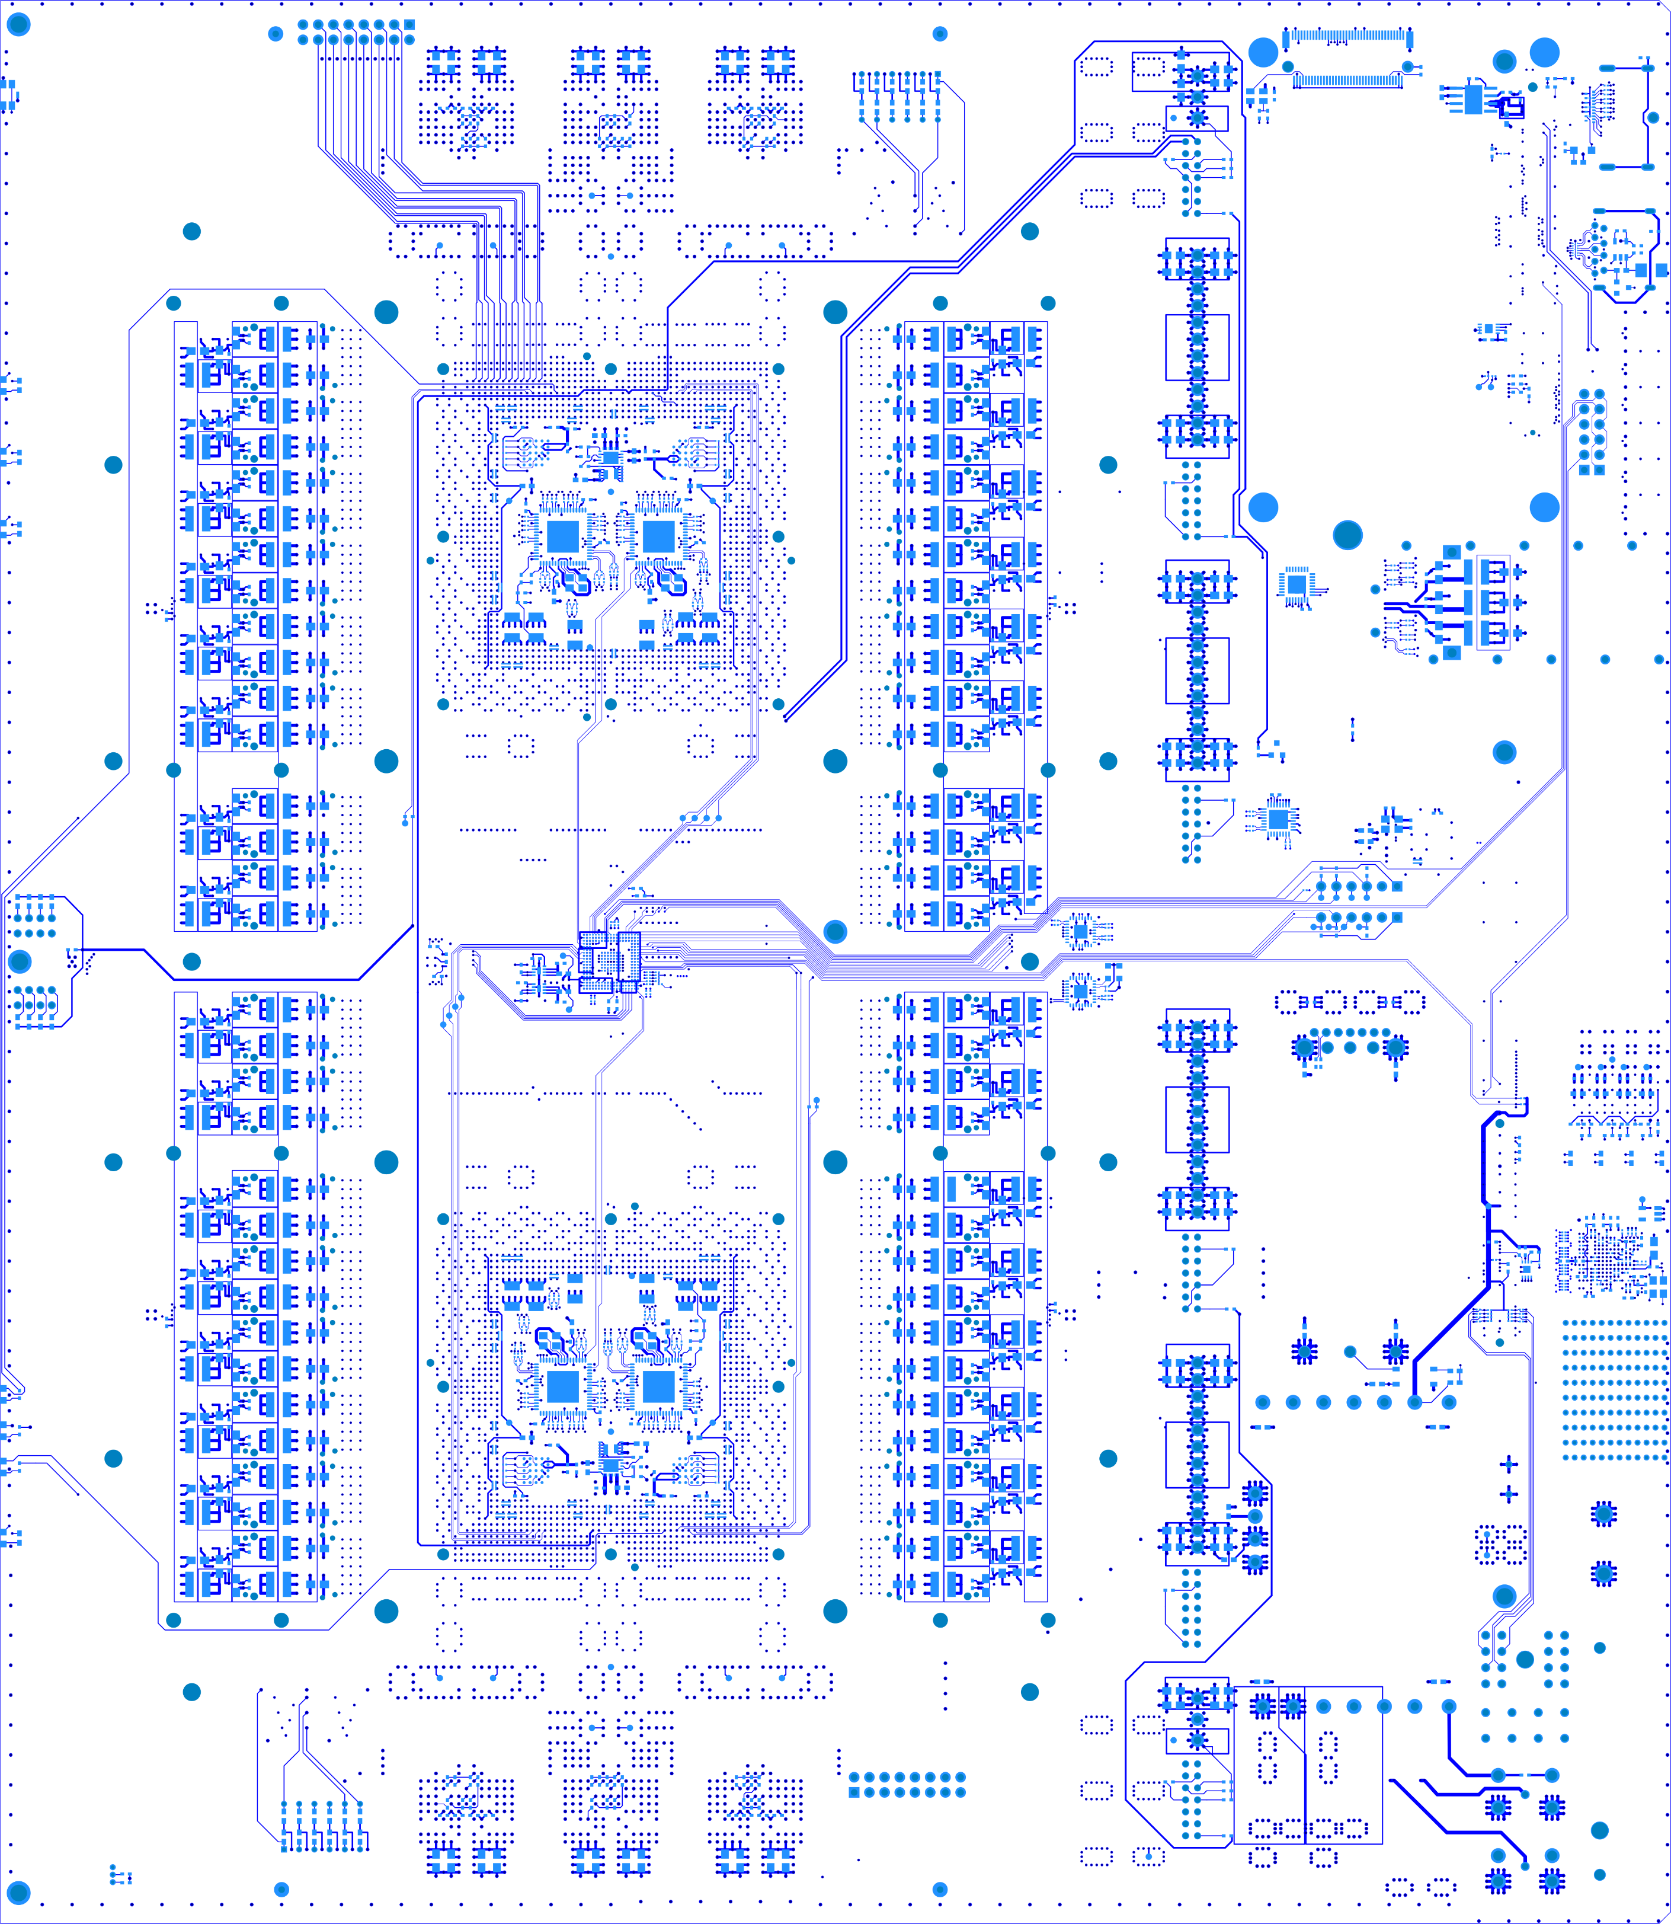
Field-Programmable Gate Arrays
A chip needs to be attached to something!
Imperial’s latest platform: Serenity
A real challenge:
30Gbps links requires ~analogue design
Each chip drawing over 100A of core power
Heat management a huge challenge
6 ground planes – need to control noise
4 power planes – need to supply 9 voltages per chip at up to 100A
6 signal layers – these are big chips

Slide 64
The future: High-luminosity LHC
150 proton-proton collisions
Up to 250 proton-proton collisions per event
Really, really hard to find the interesting event under all that rubbish
Need to sift through 300Tbps to find the interesting events

Slide 65
Conclusion
To find the interesting events at the LHC we must search through vast amounts of data

Slide 66
Conclusion
To find the interesting events at the LHC we must search through vast amounts of data
To do this requires work at the cutting edge of electronics, programming and physics

Slide 67
Conclusion
To find the interesting events at the LHC we must search through vast amounts of data
To do this requires work at the cutting edge of electronics, programming and physics
And in the future, also Machine Learning

Slide 68
Conclusion
To find the interesting events at the LHC we must search through vast amounts of data
To do this requires work at the cutting edge of electronics, programming and physics
And in the future, also Machine Learning
And this will be even more challenging at the HL-LHC
Lots of fun to be had

Slide 69
Thanks for listening
Any questions?

Slide 70
Spares

Slide 71
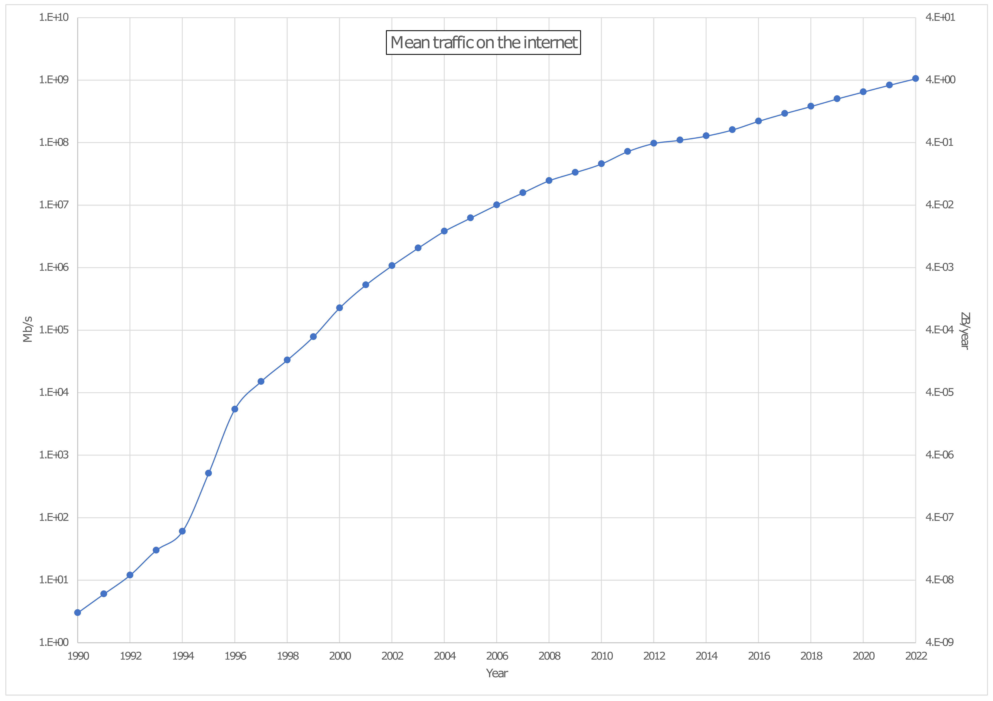
How much data?
1 Pb/s
4 ZB/yr
CMS Raw
1,000,000× Home broadband
1 Tb/s
4 EB/yr
1,000× Home broadband
1 Gb/s
4 PB/yr
CMS tape-store
1× Home broadband
1 Mb/s
4 TB/yr

Slide 72
Layered triggers
In our FPGAs we accept events at 100kHz (out of the 40MHz)
Reduced the total data volume by a factor of 400
Small enough to get through an ethernet network into PCs

Slide 73
Layered triggers
In our FPGAs we accept events at 100kHz (out of the 40MHz)
Reduced the total data volume by a factor of 400
Small enough to get through an ethernet network into PCs
Although, of course, "small" here is relative
100 kHz
~13000 CPU cores

Slide 74
Spares: Introduction to detectors

Slide 75
ONE DOES NOT SIMPLY
SEE A HIGGS BOSON

Slide 76
Heavy and unstable
If a heavy and unstable state is produced by a proton-proton collision, it decays quickly into more stable particles

Slide 77
Heavy and unstable
If a heavy and unstable state is produced by a proton-proton collision, it decays quickly into more stable particles
And I mean REALLY quickly:
Doesn't get anywhere near a detector
Higgs Boson | 1.6 × 10⁻²² seconds
W/Z Boson | 3 × 10⁻²⁵ seconds
Top Quark | 5 × 10⁻²⁵ seconds
Tau Lepton | 2.9 × 10⁻¹³ seconds

Slide 78
So we can't see the Higgs (or most other particles) directly
But you can't "see" the other particles either (in a conventional sense)
So how are particle detectors built?

Slide 79
A parallel question
How can you tell the properties of a car and how fast it is going from the outside?

Slide 80
Minimal disruption
Take a couple of snapshots
Work out how it got between them and how long it took to do so

Slide 81
Minimal disruption
Take a couple of snapshots
Work out how it got between them and how long it took to do so
Does not affect the speed/momentum/energy of the car

Slide 82
Minimal disruption
Lightweight tracker that records the position of charged particles as accurately as possible, while affecting the particle as little as possible

Slide 83
Minimal disruption
Lightweight tracker that records the position of charged particles as accurately as possible, while affecting the particle as little as possible
Join-the-dots
Apply a magnetic field to determine the charge and momentum

Slide 84
Maximal disruption
Place something very heavy in the way
Collect all the bits; measure how far the pieces get thrown
Certainly does affect the speed/momentum/ energy of the car

Slide 85
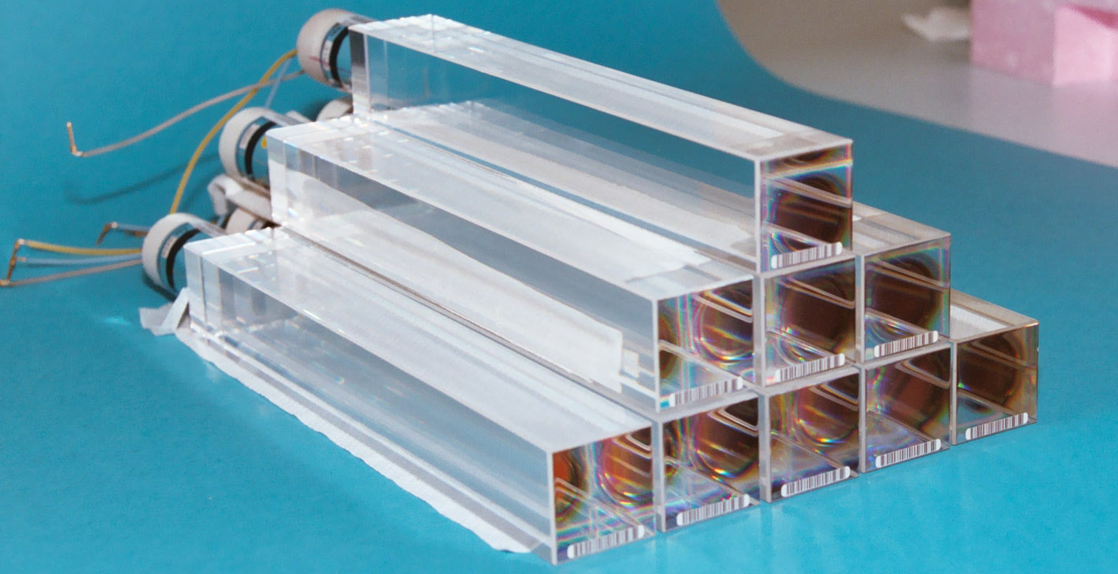
Maximal disruption
Put something very dense in the way
Brass
Steel
Tungsten
Depleted uranium
Lead tungstate crystals
Catch the light in some transparent medium using photomultipliers

Slide 86
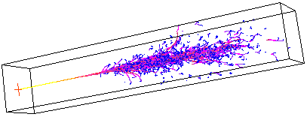
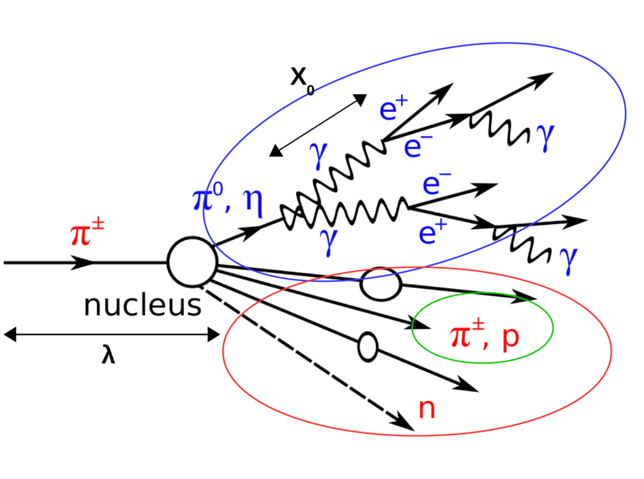
Maximal disruption
Energetic leptons particles emit photons
Energetic photons pair-produce electrons and positrons
Which emit photons
Which pair-produce electrons and positrons
Which emit photons
Which pair-produce electrons and positrons
Which emit photons…
Energetic hadrons break up into lighter hadrons
Which break up into lighter hadrons
Which break up into lighter hadrons
Which break up into lighter hadrons…
Pions decay to photons
Which pair-produce electrons and positrons…
Which emit photons…

Slide 87
The CMS detector
Particles collide here

Slide 88
The CMS detector
Pixel and strip trackers

Slide 89
The CMS detector
Calorimeters

Slide 90
The CMS detector
4T superconducting magnet

Slide 91
The CMS detector
Muon trackers

Slide 92
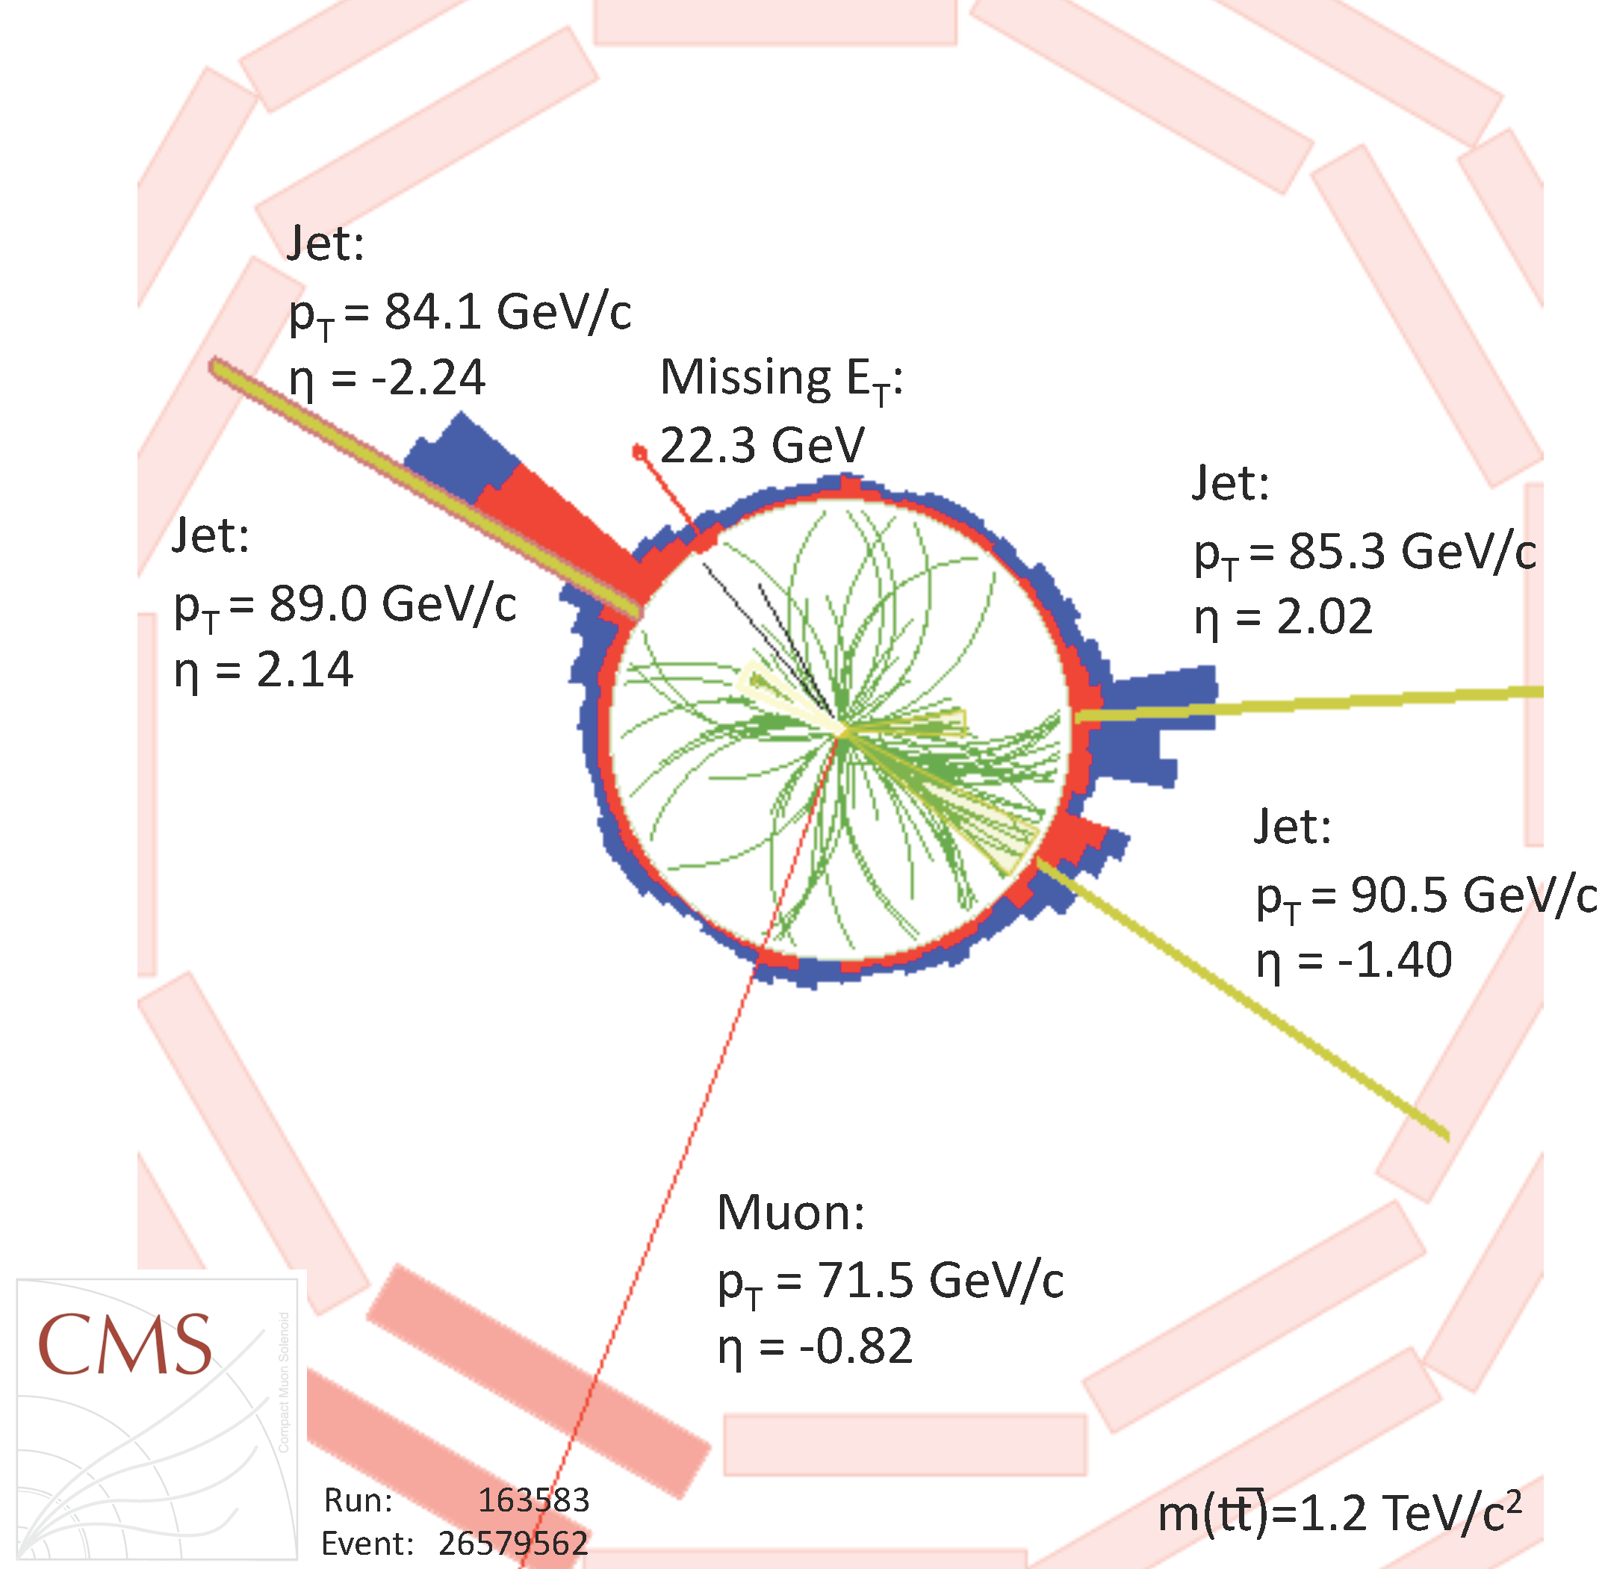
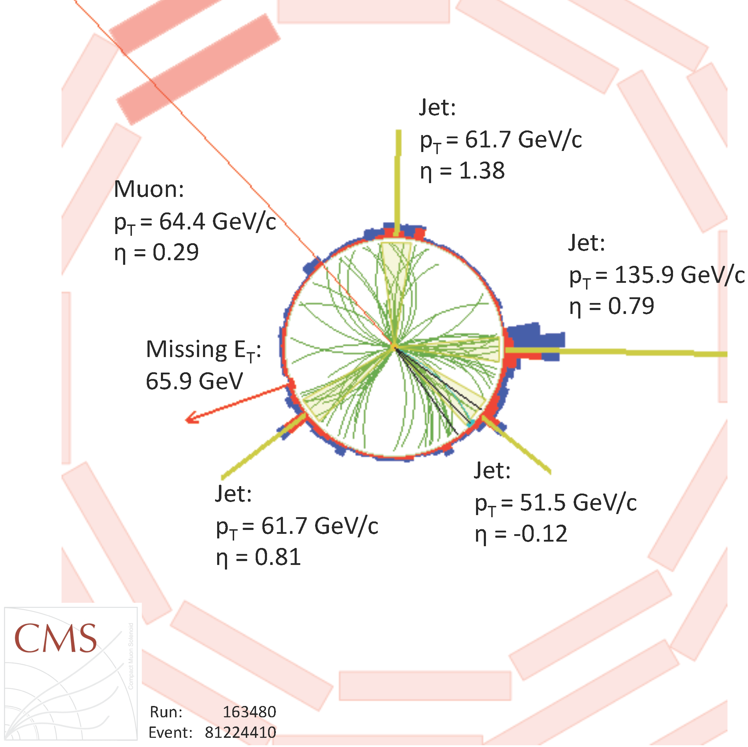
Event reconstruction
Join the tracks with the energy deposits
Apply energy and momentum conservation to reconstruct everything all the way down to the interaction point

Slide 93
Spares: Introduction to triggers

Slide 94
Reminder
Trigger basic requirements
Need high efficiency for selecting processes for physics analysis
Need large reduction of rate from unwanted high-rate processes
Robustness is essential
Highly flexible, to react to changing conditions
System must be affordable

Slide 95
The earliest trigger
Cloud-chamber images recorded on film
Need some way to trigger the camera

Slide 96
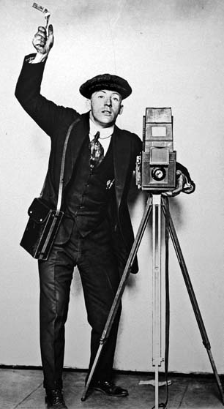
The earliest trigger
Grad student
Cloud-chamber images recorded on film
Need some way to trigger the camera
†Artist’s impression

Slide 97
The earliest trigger
Grad student
High efficiency? Nope – reflexes too slow
Large rate reduction? Better than nothing
Robustness? No – keep wanting sleep, coffee, toilet breaks, etc.
Highly flexible? Depends on the student
†Artist’s impression

Slide 98
The earliest trigger
Grad student
High efficiency? Nope – reflexes too slow
Large rate reduction? Better than nothing
Robustness? No – keep wanting sleep, coffee, toilet breaks, etc.
Highly flexible? Depends on the student
Affordable? Well that’s one thing in your favour, I suppose
†Artist’s impression

Slide 99
The earliest trigger
Grad student
High efficiency? Nope – reflexes too slow
Large rate reduction? Better than nothing
Robustness? No – keep wanting sleep, coffee, toilet breaks, etc.
Highly flexible? Depends on the student
Affordable? Well that’s one thing in your favour, I suppose
Although Rutherford & Geiger did note that “Strong coffee with a pinch of Strychnine” improved the ability to spot scintillation light
†Artist’s impression

Slide 100
The earliest trigger
Blackett pioneered a technique to trigger the camera of cloud chambers (and got the Nobel prize for this and other work)
Just missed out on discovering the positron in 1932
Stevenson and Street used this to confirm the discovery of the muon in 1937

Slide 101
The simplest trigger systems
Source: Use the signals from the Front-End of the detectors themselves
Binary: tracking detectors (pixels, strips)
Analog: tracking detectors, time of flight detectors, calorimeters, …
Front-End
Pre-amplifier
Amplifier

Slide 102
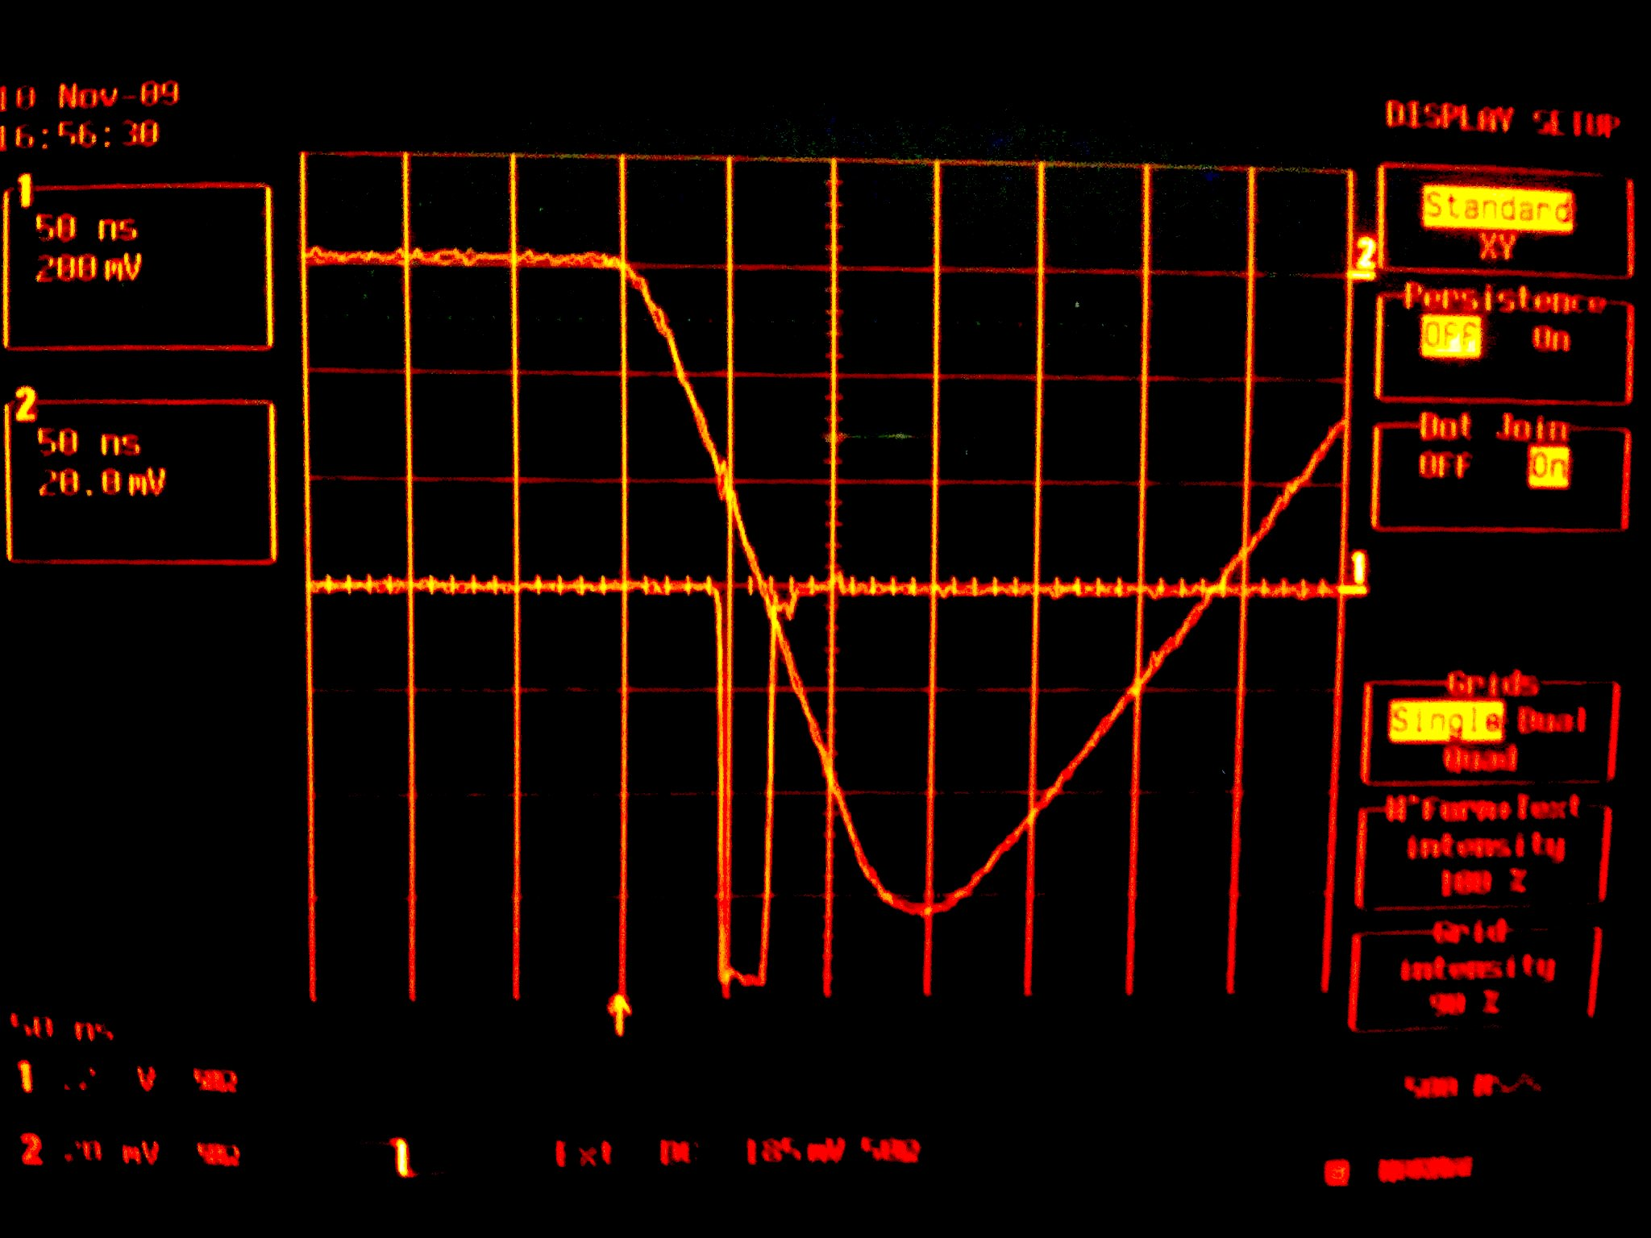
The simplest trigger systems
Source: Use the signals from the Front-End of the detectors themselves
Binary: tracking detectors (pixels, strips)
Analog: tracking detectors, time of flight detectors, calorimeters, …
The most trivial trigger algorithm: Signal > Threshold
Apply the lowest possible threshold
Identify best compromise between hit efficiency and noise rate
Accept
Source
Reject
Discriminator
Front-End
Pre-amplifier
Amplifier
Trigger signal

Slide 103
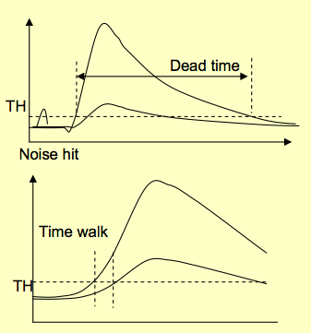
Detector signals characteristics
Pulse width
Limits the effective hit rate
Must be adapted to the desired trigger rate
Time walk
The threshold-crossing time depends on the signal amplitude
Must be minimal good trigger systems
Time walk can be suppressed by triggering on total signal fraction
Applicable on same-shape input signals with different amplitude
Scintillator detectors and photomultipliers
Leading edge
Trailing edge

Slide 104
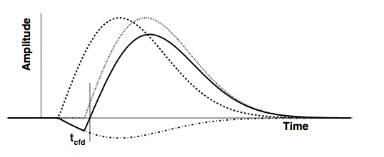
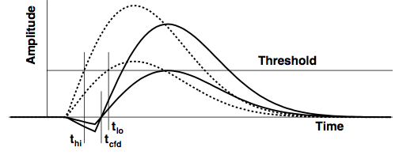
The constant fraction discriminator
Input pulse
Delayed input pulse
Attenuated inverted input
Bipolar pulse
Attenuation + configurable delay applied before the discrimination determines tCFD
If delay too short, the unit works as a normal discriminator since the output of the normal discriminator fires later than the CFD part
The output of the CFD fires when the bipolar pulse changes polarity
Signals with the same rising time, at a fraction f
at t = t_{cfd}

Slide 105
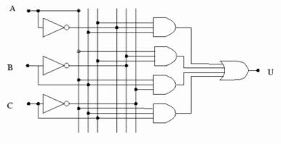
Trigger logic implementation
Once we are in the digital domain, all manipulations can be broken down to a Boolean operations
Combinatorial
Summing, Decoders, Multiplexers,…
Sequential
Flip-flops, Registers, Counters,…
AND
OR
NOT

Slide 106
Trigger logic implementation
Once we are in the digital domain, all manipulations can be broken down to a Boolean operations
Combinatorial
Summing, Decoders, Multiplexers,…
Sequential
Flip-flops, Registers, Counters,…
AND
OR
NOT
Data propagates as a wave through the logic
Operations happen at well defined times and in a well defined order

Slide 107
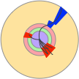
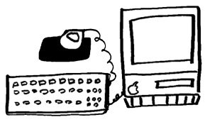
A simple trigger system
Detector
Fast links
Trigger system
start
&
FE
busy
FE
coincidence logic
FE
FE
discriminators
Front-Ends
ReadOut
delays
Digitizers (ADC, TDC,….)

Slide 108
DeadTime
The key parameter in high speed trigger systems design
The fraction of the acquisition time when no events can be recorded.
Typically of the order of few %
Reduces the overall system efficiency
Arises when a given processing step takes a finite amount of time
Readout dead-time
Trigger dead-time
Operational dead-time

Slide 109
Deadtime Example
Writing to disk or tape is much slow than accepting data into RAM
If you select an event and start writing it to disk, you cannot accept any more events until you finish writing, even if they are interesting

Slide 110
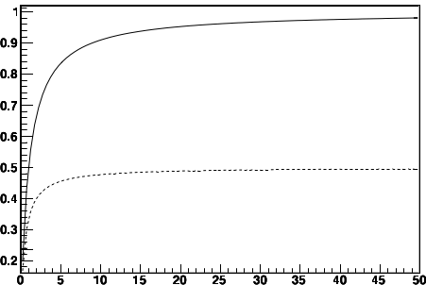
Deadtime example
For input rate, “R_{in}”, Readout rate, “R_{out}”, and time taken to write to disk, “T_{d}”
Fraction of lost events = R_{out}•T_{d}
Event output rate R_{out} = (1-R_{out}•T_{d})•R_{in}
Rout(Hz)
T_{d}=1s
for T_{d} = 1s →max rate = 1Hz
T_{d}=2s
IRREDUCIBLE!!!
Fraction of surviving events
R_{in}(Hz)
To achieve high efficiency ⟹

Slide 111
Deadtime
Writing to disk or tape is much slow than accepting data into RAM
If you select an event and start writing it to disk, you cannot accept any more events until you finish writing, even if they are interesting
Same principle applies to processing time
For example, ADCs

Slide 112
A simple trigger system: Deadtime
Fast links
Trigger system
start
&
FE
busy
FE
coincidence logic
FE
FE
discriminators
Front-Ends
ReadOut
delays
Mux
ADC

Slide 113
A simple trigger system: Deadtime
Detector
Fast links
Trigger system
start
&
FE
busy
FE
coincidence logic
FE
FE
discriminators
Front-Ends
ReadOut
delays
Mux
ADC
If ADC is the critical step for deadtime, this is clearly a really bad plan

Slide 114
A simple trigger system: Parallelism
Detector
Independent readout and trigger paths, one for each sensor element
Digitisation and DAQ processed in parallel (as much as affordable!)
Fast links
Trigger system
start
&
FE
busy
FE
coincidence logic
FE
FE
discriminators
Front-Ends
ReadOut
delays
ADCs
Mux
Much more sensible!
Potentially much more expensive!

Slide 115
A simple trigger system: Latency
Latency: Time to form the trigger decision and distribute to the digitisers
Signals must be delayed until the trigger decision is available
The more complex is the selection, the longer is the latency
Fast links
Trigger system
&
FE
FE
coincidence logic
FE
FE
discriminators
Front-Ends
ReadOut
delays
ADCs
Mux

Slide 116
A simple trigger system: Latency
Fast links
Trigger system
&
FE
FE
coincidence logic
FE
FE
discriminators
Front-Ends
ReadOut
delays
ADCs
Mux
Analogue delay-lines are a bit risky, don’t you think?
Especially for more than one channel

Slide 117
A simple trigger system: Pre-trigger
Pre-Trigger stage: very fast indicator of some minimal activity in the detector
Used to START the digitisers, with no delay
The complex trigger decision comes later
Fast links
Trigger system
Pre-trigger
&
start
FE
FE
coincidence logic
FE
FE
discriminators
Front-Ends
Start ADC
busy
ReadOut
ADCs
Mux

Slide 118
A simple trigger system: Pre-trigger
Fast links
Trigger system
Pre-trigger
&
start
FE
FE
coincidence logic
FE
FE
discriminators
Front-Ends
Start ADC
busy
ReadOut
ADCs
Mux
Assumes the digitization time is longer than the latency of the trigger system!
What if that is not true?

Slide 119
A simple trigger system: Pre-trigger
Fast links
Trigger system
Pre-trigger
&
start
FE
FE
coincidence logic
FE
FE
discriminators
Front-Ends
Start ADC
Data Valid
ReadOut
ADCs
Digital delay
A PIPELINE
Mux
Since each digitization takes a finite time
Can store the result of each digitization in RAM until trigger decision is made

Slide 120
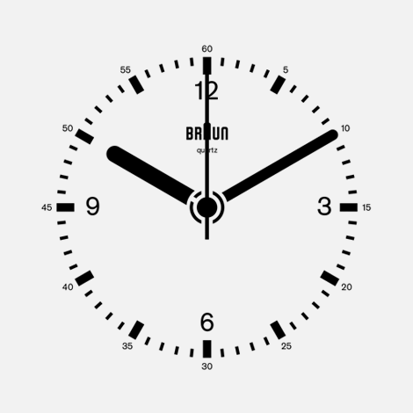
Simple trigger system: Bunched Colliders
Fast links
Trigger system
&
start
FE
FE
coincidence logic
FE
FE
discriminators
Front-Ends
ReadOut
ADCs
Digital delay
A PIPELINE
Mux
We have a master-clock – the bunch-crossings themselves!
No need for a pre-trigger

Slide 121
A Simple trigger system: Digital Triggers
Fast links
Digital Trigger system
start
FE
FE
FE
FE
Front-Ends
ADCs
ReadOut
Digital delay
A PIPELINE
Mux

Slide 122
A Simple trigger system: Digital Triggers
Fast links
Digital Trigger system
This is the fundamental design behind all modern collider trigger-systems
start
FE
FE
FE
FE
Front-Ends
ADCs
ReadOut
Digital delay
A PIPELINE
Mux

Slide 123
A trigger system: Multilayer Triggers
Fast links
Digital Trigger system
Digital Trigger system
Accept
Accept
FE
FE
FE
FE
Front-Ends
ADCs
ReadOut
Digital delay
A PIPELINE
Filter
Digital delay
A PIPELINE
Filter

Slide 124
Multilayer triggers
Each stage reduces the rate, so later stages have longer latency
Complexity of algorithms increases at each level
Dead-time is the sum of the trigger dead-time, summed over the trigger levels, and the readout dead-time
Pre-trigger: i=1

Slide 125
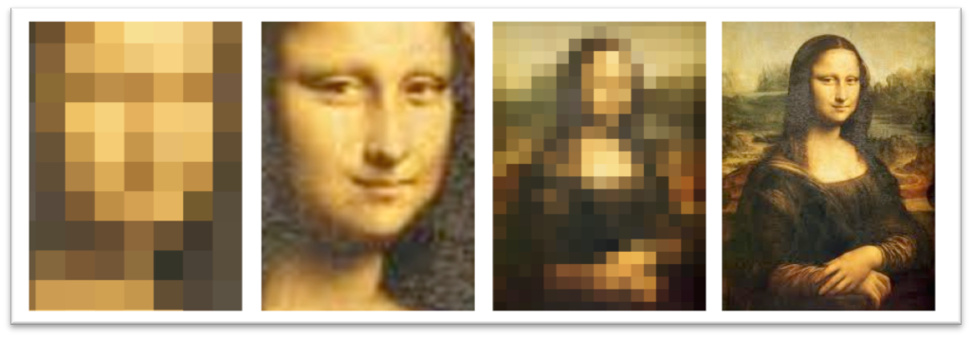
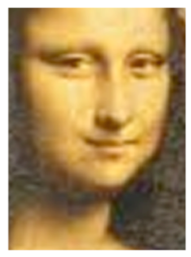
MultiLAYER triggers
Level-1
Level-2
Level-3
Analysis
Adopted in large experiments
More and more complex algorithms are applied on lower and lower data rates
Efficiency for the desired physics must be kept high AT ALL LEVELS, since rejected events are lost for ever
Low latency
Full event rate
Small event fragment size
Lower algorithmic complexity
Access to coarse granularity information
Longer latency
Lower event rate
Larger event fragment size
Higher algorithmic complexity
Access to higher granularity information
LHC experiments @ Run1
Experiment | Number of Levels (excl. analysis)
ATLAS | 3
CMS | 2
LHCB | 3
ALICE | 4

Slide 126
A trigger system: Multilayer Triggers
Fast links
Digital Trigger system
Accept
Accept
FE
FE
FE
FE
Front-Ends
ADCs
ReadOut
Digital delay
A PIPELINE
Filter
RAM
Filter
If your input rate is low enough

Slide 127
A trigger system: Multilayer Triggers
And this is exactly what the CMS Trigger does
“Standard” figure for the CMS Trigger & DAQ

Slide 128
Of course, “Low enough” is relative…

Slide 129
Synchronous or asynchronous?
Synchronous: operates phase-locked with master clock
Data move in lockstep with the clock through the trigger chain
Fixed latency
The data, held in storage pipelines, are either sent forward or discarded
Used for L1 triggers in collider experiments, exploiting the accelerator bunch crossing clock
FE data
Local
trigger decision
Pro’s: dead-time free (just few clock cycles to protect buffers)
Con’s: cost (high frequency stable electronics, sometimes needs to be custom made); maintain synchronicity throughout the entire system, complicated alignment procedures if the system is large (software, hardware, human…)
T1
T2
T3
T4
Fixed time
FE buffers
Global trigger decision going back to FE
YES
to the DAQ
data

Slide 130
Synchronous or asynchronous?
Asynchronous: operations start at given conditions (when data ready or last processing is finished)
Used for larger time windows
Average latency (with large buffers to absorb fluctuations)
If buffer size ≠ dead-time → lost events
Used also for “software filters”
FE data
Local trigger
decision+timestamp
Take data when ready
Pro’s: more resilient to data burst; running on conventional CPUs
Con’s: needs a timing signal synchronised to the FE to latch the data, needs time-marker stored in the data, data transfer protocol is more complex)
Average maximum time
FE buffers
Global trigger decision back to the FE
YES/NO
to DAQ or clear
data+timestamp

Slide 131
Synchronous or asynchronous? Why not both?
Pseudo-synchronous: operates locally phase-locked
Data move in lockstep through the trigger chain from a set of local clocks
Buffering required whenever you move between clocks
Clocks run slightly faster than source data to prevent overflow
Realignment to global clock only after the final trigger stage
Fixed latency
FE data
Local
trigger decision
Pro’s: dead-time free (just few clock cycles to protect buffers), no need for expensive globally-distributed clock, simpler alignment procedure
Con’s: must propagate timing info with data, buffering required to handle clock-domain change
T1
T2
T3
T4
Fixed time
FE buffers
Global trigger decision going back to FE
YES
to the DAQ
data

Slide 132
Conventional Architecture
Each subsystem is regionally segmented
Each region must talk to its neighbour
This is the root cause of requiring specialized boards for a given task!
Each region of each processing layer compresses, suppresses, summarizes or otherwise reduces its data and passes it on to the next level which is less regionally segmented
Detector data ordering
Globally
laterally connected system
Many, many details on time-multiplexing and conventional architectures in sections 1-3 of https://cds.cern.ch/record/1421552/files/IN2011_022.pdf (although please note that the systems proposed in section 4-9 are very outdated and should be ignored)

Slide 133
Time-multiplexed Architecture
Buffer data and stream it out optimized for processing
Spread processing over time
Stream-processing rather than combinatorial-logic
Maximise reuse of logic resources
Easiest for FPGA design tools to route and meet timing
Costs you latency, bought back by more efficient processing
Detector data ordering
Self-contained
event processing nodes
Many, many details on time-multiplexing and conventional architectures in sections 1-3 of https://cds.cern.ch/record/1421552/files/IN2011_022.pdf (although please note that the systems proposed in section 4-9 are very outdated and should be ignored)

Slide 134
High Level Trigger design principles
Offline reconstruction too slow to be used directly
Takes >10s per event
HLT usually needs << 1s
Instead, step-wise processing with early rejection
Stop processing as soon as one step fails
Event accepted if any of the trigger passes
Add a time-out to kill the Poisson tail!
Fast reconstruction & L1-guided regional reconstruction first
Precision reconstruction as full detector data becomes available

Slide 135
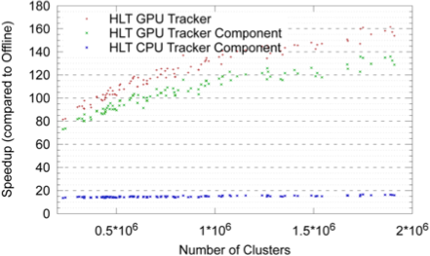
High Level Trigger design principles
Early rejection reduce data and resources (CPU, memory, etc.)
Event-level parallelism
Process more events in parallel
Multi-processing or/and multi-threading
Algorithm-level parallelism
GPUs effective whenever large amount of data can be processed concurrently (although bandwidth can be a limiting factor)
Algorithms developed and optimized offline
Common HLT-reconstruction software framework reduces maintenance and increases reliability

Slide 136
Example: CMS HLT
Approximately 38,000 cores
An equal mix of Haswell, Broadwell and Skylake
Multithreading allows the cores to share non-event data
Reduced memory footprint → can process more events: ~20% higher performance
ATLAS currently doesn't have this: a race to implement this in ATHENA for Run 3
Upgrades to add a GPU in every filter farm node is ruled out by cost and power
More likely a dedicated server sub-farm which does heavy tasks on demand
FPGAs acceleration also a (possibly better) option

Slide 137
Conclusion
Triggers are not new
but they are constantly evolving as the accelerators and detectors do
FPGAs are the weapon of choice for the Level-1 trigger
but they are not a magic bullet
The design of how you structure the transfer of data around your system is the most important decision you will make
Heterogeneous computing farms look likely to feature at HL-LHC
but it is a brave new world!

Slide 138
Conclusion
Triggers are not new
but they are constantly evolving as the accelerators and detectors do
FPGAs are the weapon of choice for the Level-1 trigger
but they are not a magic bullet
The design of how you structure the transfer of data around your system is the most important decision you will make
Heterogeneous computing farms look likely to feature at HL-LHC
but it is a brave new world!
Oh, and be very suspicious if your supervisor plies you with strong coffee and gets you to look for scintillation light

Slide 139
Spares: Introduction to FPGAs

Slide 140
And this is not a new point
“The parallel approach to computing does require that some original thinking be done about numerical analysis and data management in order to secure efficient use.
In an environment which has represented the absence of the need to think as the highest virtue, this is a decided disadvantage”
Daniel Slotnick, 1967

Slide 141
Field Programmable Gate Arrays
Programmable Logic Blocks
Massive Fabric of Programmable Interconnects
Notes:
A field-programmable gate array (FPGA) is a large-scale integrated circuit that can be programmed after it is manufactured rather than being limited to a predetermined, unchangeable hardware function. The term "field-programmable" refers to the ability to change the operation of the device "in the field," while "gate array" is a somewhat dated reference to the basic internal architecture that makes this after-the-fact reprogramming possible.

Slide 142
Combinatorial Logic Block
Registers on the output of every cell
Perfect for pipelined logic

Slide 143
Integrated Digital Signal Processing
So many registers
Perfect for pipelined logic

Slide 144
Biggest Xilinx “Ultrascale+” Devices
Upwards of 9million logic cells
All clocked at up to 500MHz
Up to O(10¹⁵) operations per second
Upwards of 12000 DSPs
All pipelined
Fully programmable
And we have a winner!

Slide 145
Biggest Xilinx “Ultrascale+” Devices
Upwards of 9million logic cells
All clocked at up to 500MHz
Up to O(10¹⁵) operations per second
Upwards of 12000 DSPs
All pipelined
Fully programmable
And we have a winner!
So what is the catch?

Slide 146
Biggest Xilinx “Ultrascale+” Devices
Incredibly hard to program efficiently
Thinking in a parallel, pipelined-fashion is exceptionally difficult
A handful of real experts in CMS
Efficient use depends on efficiently structured data
The chip is just the start – needs to be attached to something
You are also responsible for the infrastructure
Upwards of 9million logic cells
All clocked at up to 500MHz
Up to O(10¹⁵) operations per second
Upwards of 12000 DSPs
All pipelined
Fully programmable
And we have a winner!
So what is the catch?

Slide 147
Spares: Phase-2

Slide 148
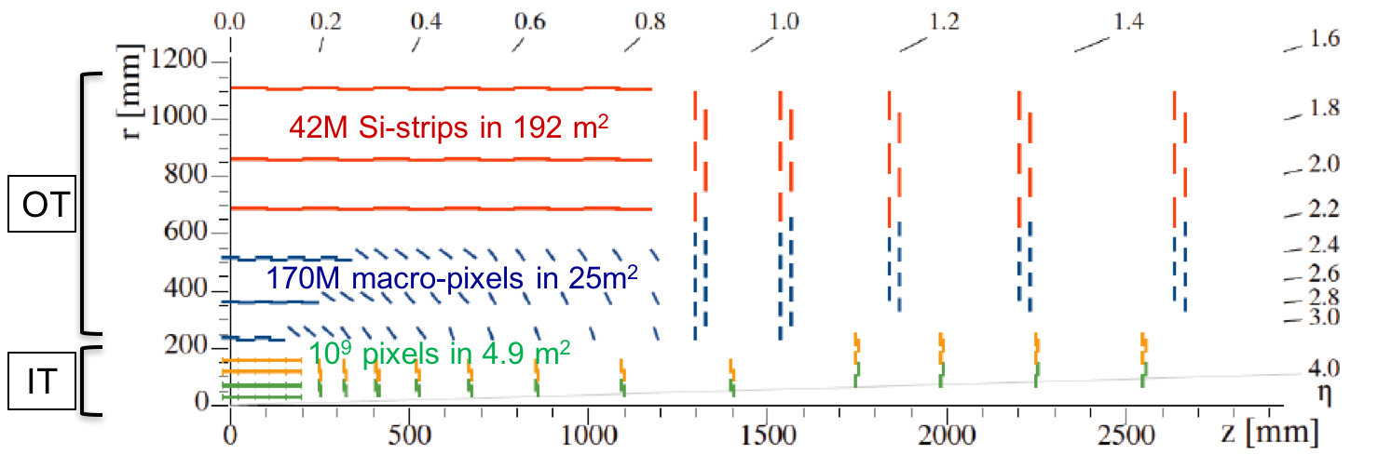
Tracker
Inner Tracker (pixel) design to extend coverage to η ≃ 3.8
OT Si-sensors ≃ 200µm thick - 90/100µm pitch - 2.5/5cm strips
OT Si-sensors ≃ 200µm thick - 90/100µm pitch - 1.5 mm macro-pixels
IT Si-silicon sensors ≤ 150µm thickness - 50x50 to 25x100µm²

Slide 149
Tracker
Inner Tracker (pixel) design to extend coverage to η ≃ 3.8
Outer Tracker design driven by ability to provide tracks at 40 MHz to L1-trigger
-

Slide 150
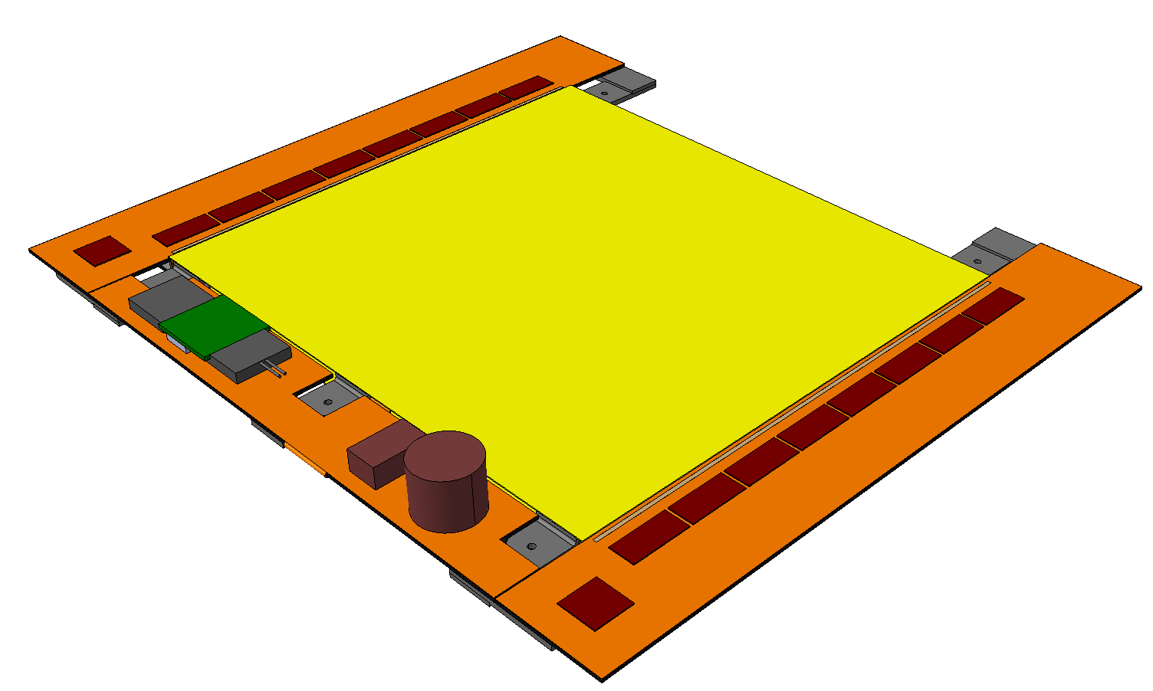
Outer tracker 2S modules
Silicon sensors
CBC
Flex PCB Hybrid
Outer
½ Module
Front End
Hybrid
Inner
Bridge
CF Stiffener
500µm CF Support
Double-Layer
Si Strip Detectors
2S Modules: Two-strip double-layers
~10k modules
42M channels
LP-GBT &
Optical VTRx
10 cm
Each 2S Module:
Sensor Area ~100 cm²
16 CBCs, each reading 254 strips
(127 from top & bottom sensors)
4064 Channels in total
Readout both L1 triggered data & Primitive trigger data
5 cm
127 Strips/CBC
~5,000 modules @ 10Gb/s + ~10,000 modules @ 5Gb/s = 100Tb/s = 395 EB/yr
8 CBCs per side
DC-DC
Converter
IC & RAL
CIC
1 per side
Service Hybrid

Slide 151
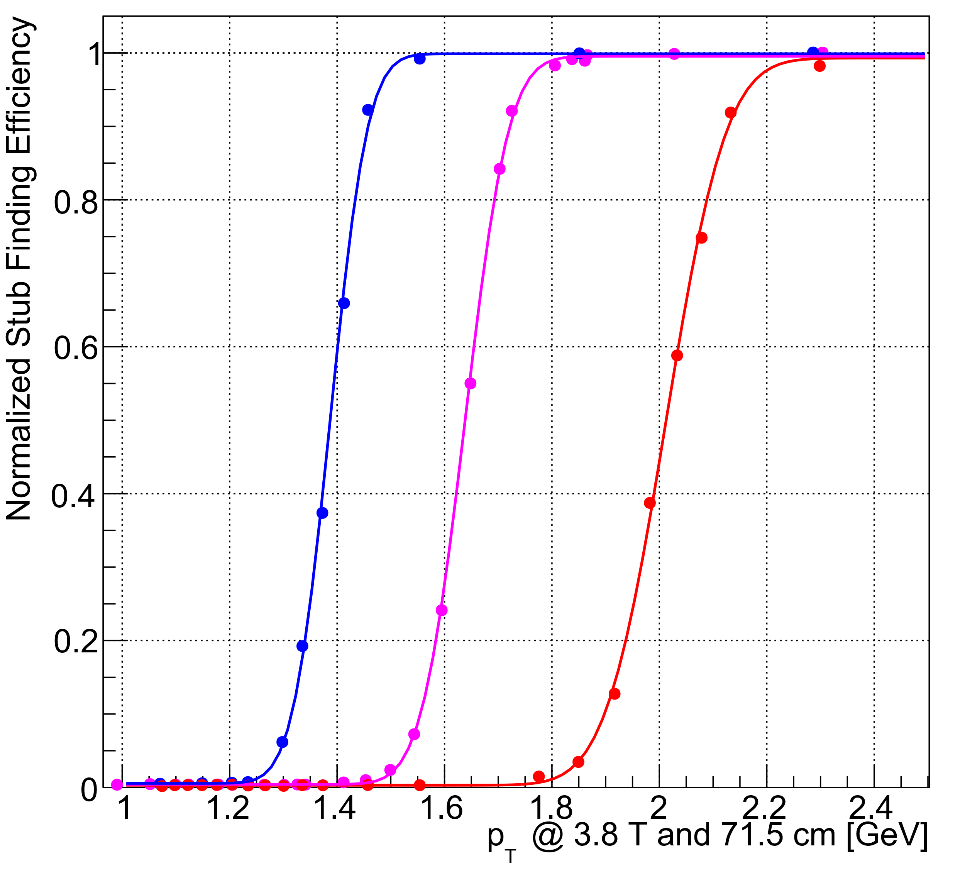
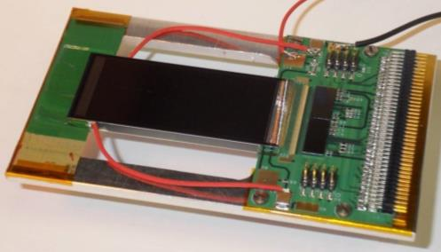
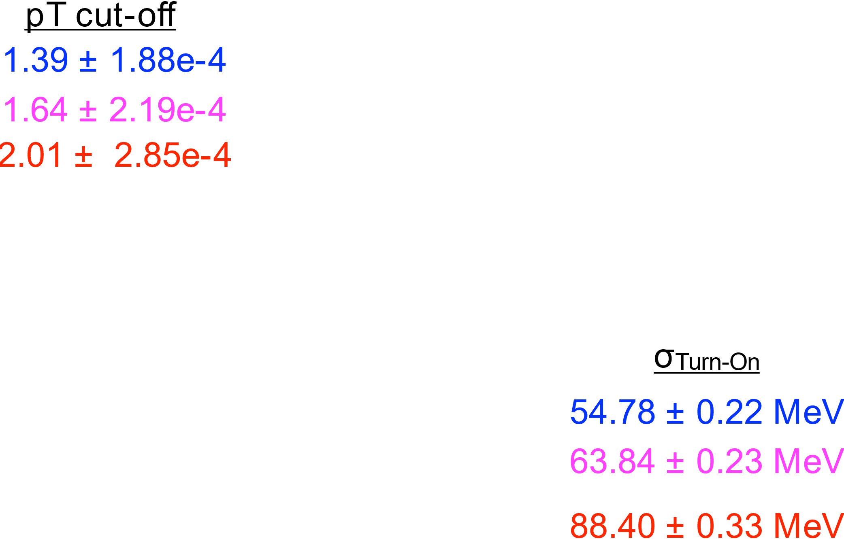
Outer tracker 2S modules: Do they work?
Stub turn-on curve for 2CBC mini-module at FNAL test-beam
Upper Sensor
2× CBC2
Lower Sensor

Slide 152
Calorimeter Endcap design
3D shower topology and time resolution of ~30ps
Electromagnetic Endcap (EE)
28 layers of Silicon sensors in W/Pb absorber (25 X₀, 1.7λ)
Hadronic Endcap (EH)
24 layers: 8 silicon + 16 silicon/scint. tiles at high/low η in stainless steel absorber (9λ)
253 tonnes Total power at end of life = 160-180 kW @-30C
520m² Scint. Tiles 2x2 and 5x5 cm² + SiPM ~400k channels
Facing a MegaGray Dose
10¹⁶ cm⁻² 1MeV Neutron equivalent fluence
600 m², 25000 modules , of hexagonal 8” sensors ~6M channels of area 0.5 and 1 cm²

Slide 153
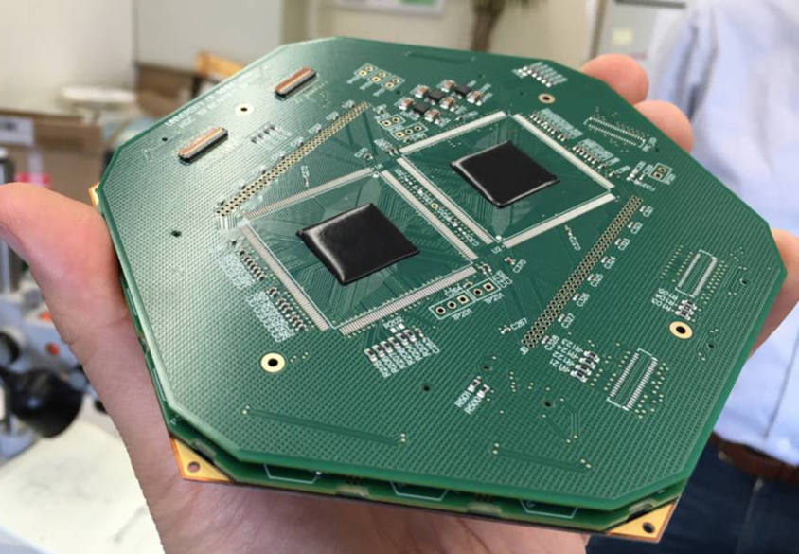
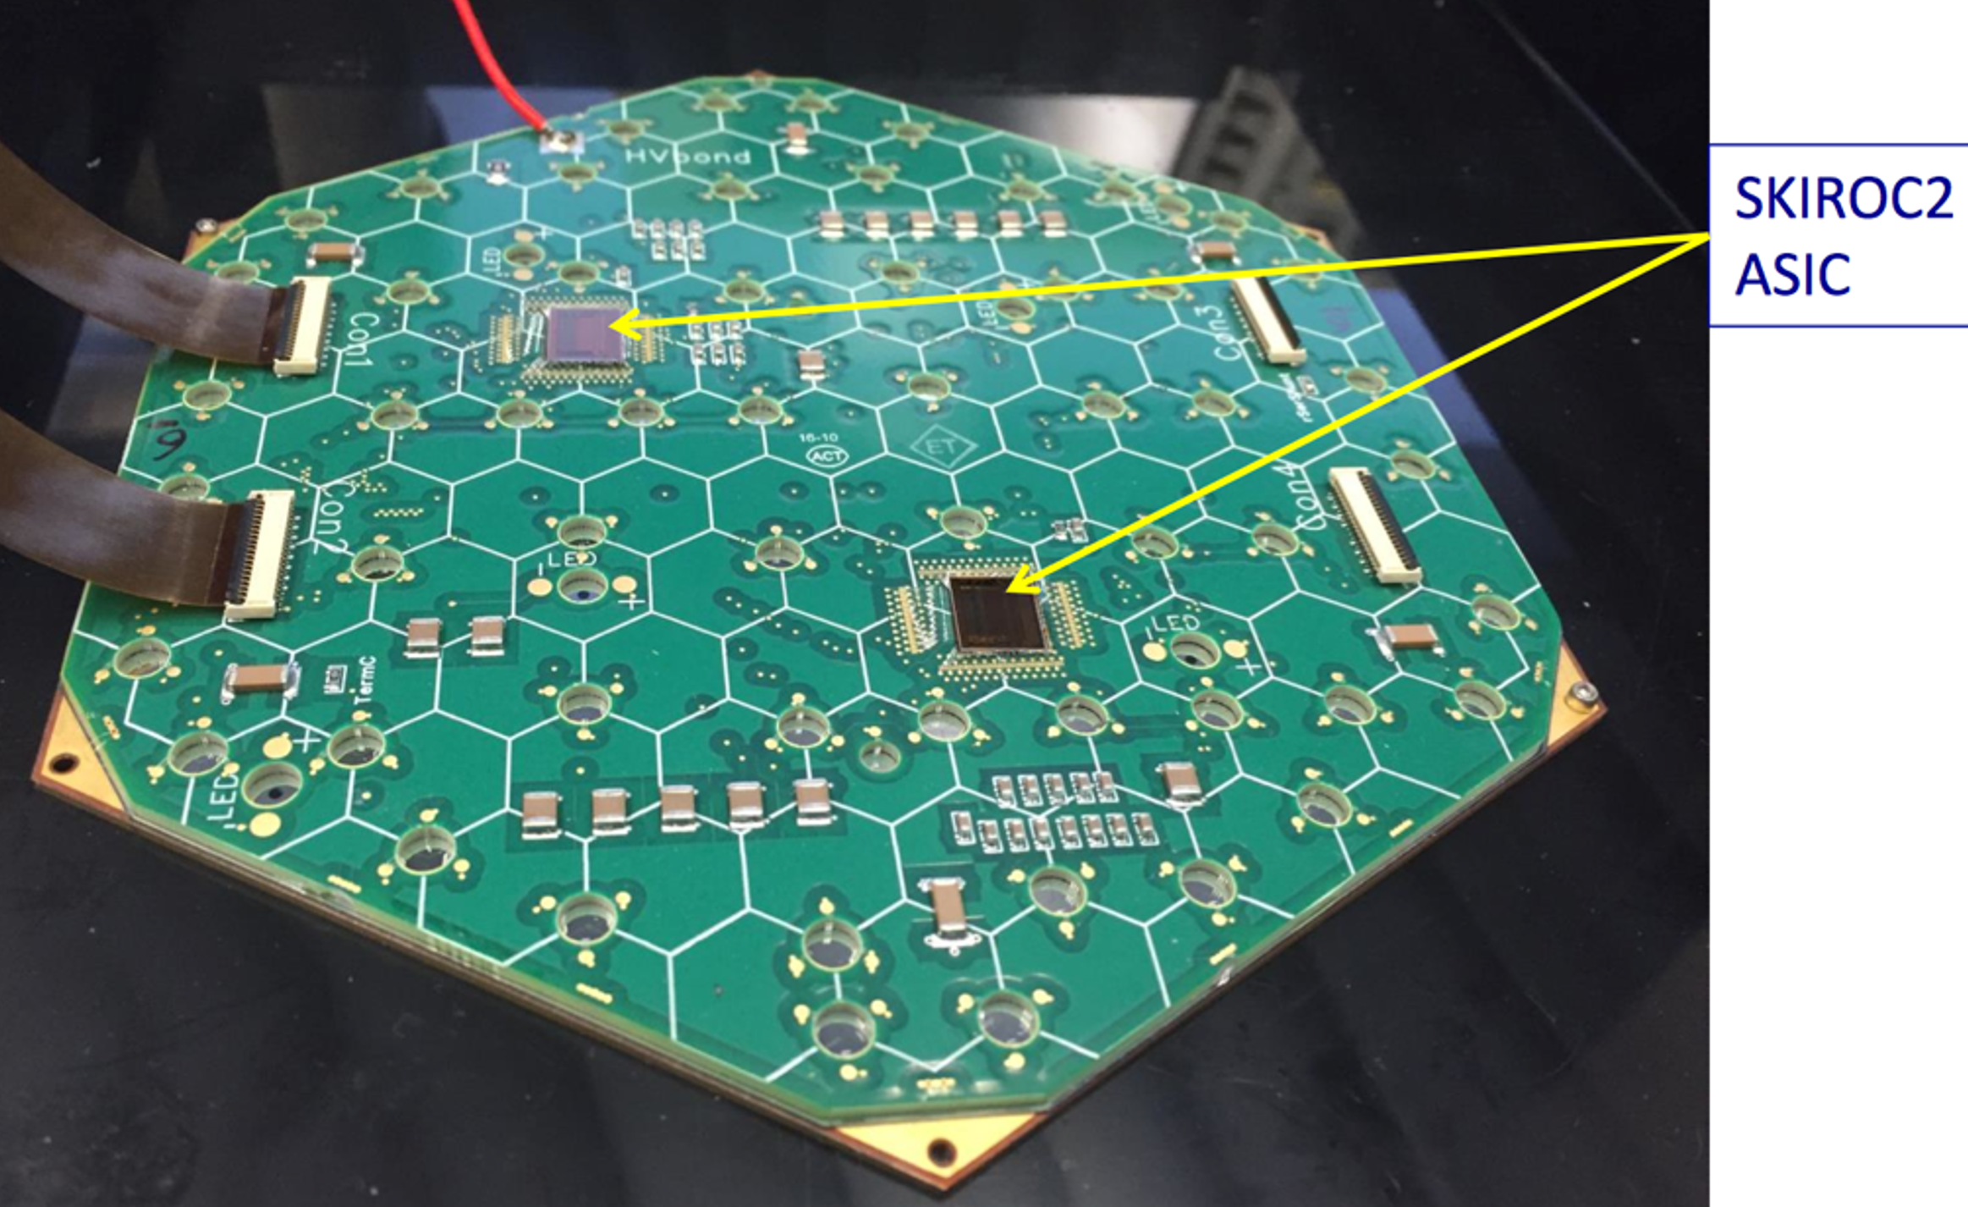
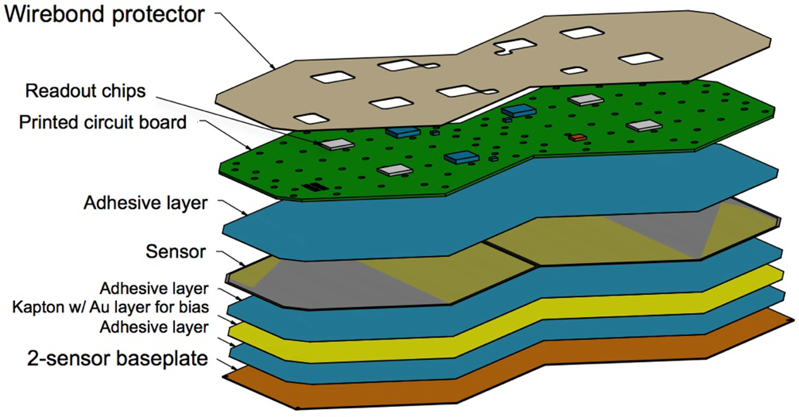
Calorimeter Endcap modules
593 m2 of silicon
6M ch, 0.5 or 1 cm2 cell-size
21,660 modules (8” or 2x6” sensors)
92,000 front-end ASICS
9,670 modules @ 10Gb/s = 100Tb/s ≈ 395 EB/yr
(Trigger data only, L1 accepted data on separate fibres)

Slide 154
Calorimeter Endcap modules: Do they work?

Slide 155
What are the firmware challenges at Phase-II?
You mean, apart from the small matter of 300Tb/s of data?
So much data it has to be zero-suppressed
No (or, at least, limited) geometric timing which can be utilized
Variable data-volume
Do you handle the worst case? Very inefficient
Do you handle the average? How do you handle overflows?
We did such a good job at Phase-I, people have very high expectations…

Slide 156
What are the firmware challenges at Phase-II?
Real-time track-finding and fitting

Slide 157
What are the firmware challenges at Phase-II?
Real-time track-finding and fitting
Real-time vertex-finding

Slide 158
What are the firmware challenges at Phase-II?
Real-time track-finding and fitting
Real-time vertex-finding
3D cluster-finding in endcap

Slide 159
What are the firmware challenges at Phase-II?
Real-time track-finding and fitting
Real-time vertex-finding
3D cluster-finding in endcap
Particle-flow

