Slide 1
IC Coder’s Club Design patterns (in C++)
Andrew W. Rose

Slide 2
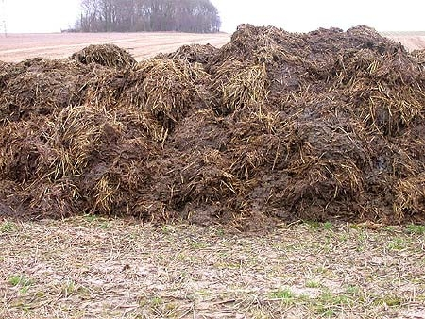
Simple exercise
You have been tasked to move this pile from A to B

Slide 3
Simple exercise
You have been tasked to move this pile from A to B
You have three resources available to you:
a) Bare hands
b) A stack of timber
c) A horse and cart

Slide 4
Simple exercise
You have been tasked to move this pile from A to B
You have three resources available to you:
a) Bare hands
b) A stack of timber
c) A horse and cart
How do you achieve the task in the quickest, least-painful way, which won’t leave you up-to-your-neck in the produce you are moving, nor smelling of it?

Slide 5
Software analogy
a) Bare hands
b) A stack of timber
c) A horse and cart

Slide 6
Software analogy
a) Bare hands
b) A stack of timber
c) A horse and cart
Do a task manually

Slide 7
Software analogy
a) Bare hands
b) A stack of timber
c) A horse and cart
Do a task manually
Design the tools yourself

Slide 8
Software analogy
a) Bare hands
b) A stack of timber
c) A horse and cart
Do a task manually
Design the tools yourself
Benefit from someone else’s hard work

Slide 9
Software analogy
a) Bare hands
b) A stack of timber
c) A horse and cart
Benefit from someone else’s hard work
This is the purpose of design patterns!

Slide 10
Motivation
I will, in fact, claim that the difference between a bad programmer and a good one is whether he considers his code or his data structures more important: Bad programmers worry about the code; good programmers worry about data structures and their relationships.
"Code and fix" development is not so much a deliberate strategy as an artefact of naïveté and schedule pressure on software developers.
Linus Torvald
Steve McConnell

Slide 11
Motivation
I will, in fact, claim that the difference between a bad programmer and a good one is whether he considers his code or his data structures more important: Bad programmers worry about the code; good programmers worry about data structures and their relationships.
"Code and fix" development is not so much a deliberate strategy as an artefact of naïveté and schedule pressure on software developers.
Stopping and thinking before you write a single line of code will save you time, effort and inconvenience in future.
Linus Torvald
Steve McConnell

Slide 12
Software Design Patterns: What are they not?
Magic
The work of superhuman intelligence
Necessary in all languages (some patterns are related to working around the constraints of the language itself)

Slide 13
Software Design Patterns: What are they?
General reusable solutions to commonly occurring problem
Formalized best practices
A set of relationships and interactions between conceptual or example classes or objects, which say nothing about the final application classes or objects that the programmer will actually implement.
Daunting at first
A guaranteed way to increase the complexity of your code unnecessarily if you use them incorrectly or inappropriately

Slide 14
Software Design Patterns
I was told that the point of Coder’s Club was to provide examples that couldn’t be found in books

Slide 15
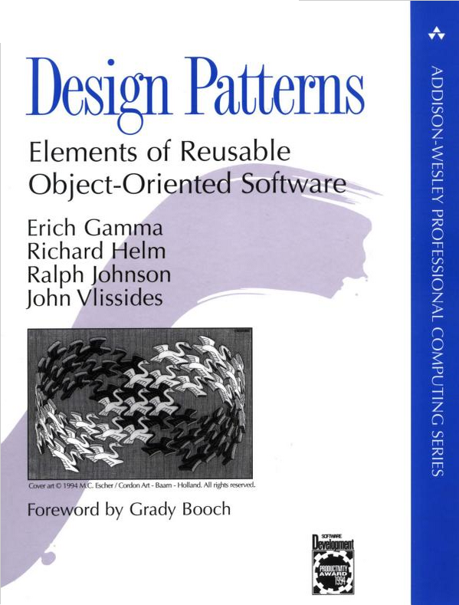
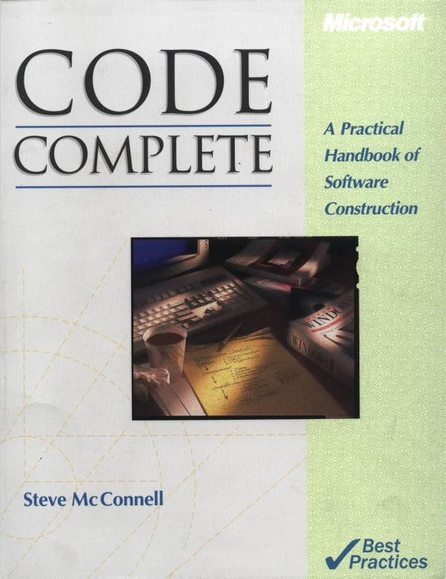
Software Design Patterns
I was told that the point of Coder’s Club was to provide examples that couldn’t be found in books
Ironic, given that the whole point of design patterns is that they are examples written in books

Slide 16
Software Design Patterns
I was told that the point of Coder’s Club was to provide examples that couldn’t be found in books
Ironic, given that the whole point of design patterns is that they are examples written in books
If you want to be a programmer, rather than someone who can string a line of C-code together, read one or both of these books

Slide 17
Software Design Patterns: Daunting
Abstract factory
Builder
Factory method
Lazy initialization
Multiton
Object pool
Prototype
Resource acquisition is initialization
Singleton
Adapter or Wrapper or Translator.
Bridge
Composite
Curiously recursive template pattern
Decorator
Facade
Flyweight
Front Controller
Module
Proxy
Twin
Blackboard
Chain of responsibility
Command
Interpreter
Iterator
Mediator
Memento
Null object
Observer or Publish/subscribe
Servant
Specification
State
Strategy
Template or Hollywood method
Visitor

Slide 18
Software Design Patterns
Abstract factory
Builder
Factory method
Lazy initialization
Multiton
Object pool
Prototype
Resource acquisition is initialization
Singleton
Adapter or Wrapper or Translator.
Bridge
Composite
Curiously recursive template pattern
Decorator
Facade
Flyweight
Front Controller
Module
Proxy
Twin
Blackboard
Chain of responsibility
Command
Interpreter
Iterator
Mediator
Memento
Null object
Observer or Publish/subscribe
Servant
Specification
State
Strategy
Template or Hollywood method
Visitor
Creational
Behavioural
Structural

Slide 19
Factory method, Builder and Abstract factory patterns (For when a constructor just won’t cut it)
A factory is a trivial concept – don’t call the object constructor directly, call a function which does it for you.
Three most common non-trivial examples are:
Factory method
Builder
Abstract factory

Slide 20
Factory method, Builder and Abstract factory patterns (For when a constructor just won’t cut it)
Consider a set of classes which differ only by the concrete implementation of their member variables.
Because they are otherwise identical, it is appropriate for these classes to inherit from a base class.
The constructor of the class may be very complicated and nevertheless it would be wholly inappropriate to expect all the concrete implementations of the class to copy-paste-and-modify the constructor.

Slide 21
Factory method, Builder and Abstract factory patterns (For when a constructor just won’t cut it)
Consider a set of classes which differ only by the concrete implementation of their member variables.
Because they are otherwise identical, it is appropriate for these classes to inherit from a base class.
The constructor of the class may be very complicated and nevertheless it would be wholly inappropriate to expect all the concrete implementations of the class to copy-paste-and-modify the constructor.
The factory method helps:
The base class includes a pure virtual method for creating the member variables.
The base class can do all the nastiness, safe in the knowledge that…
All concrete implementations have to implement the factory method

Slide 22
Factory method, Builder and Abstract factory patterns (For when a constructor just won’t cut it)
class BaseClass {
public:
BaseClass(){ …Nastiness…Complexity… makeObject() …More nastiness & complexity…Yuk…Yuk…Yuk… }
virtual AbstractMemberType* makeObject() = 0;
AbstractMemberType* mMember;
};
class ImplementationA : public BaseClass {
public:
ImplementationA() : BaseClass() { …Simplicity… }
virtual AbstractMemberType* makeObject() { return new MemberTypeA; }
};
class ImplementationB : public BaseClass {
public:
ImplementationB() : BaseClass() { …Simplicity… }
virtual AbstractMemberType* makeObject() { return new MemberTypeB; }
};

Slide 23
Factory method, Builder and Abstract factory patterns (For when a constructor just won’t cut it)
class BaseClass {
public:
BaseClass(){ …Nastiness…Complexity… makeObject() …More nastiness & complexity…Yuk…Yuk…Yuk… }
virtual AbstractMemberType* makeObject() = 0;
AbstractMemberType* mMember;
};
class ImplementationA : public BaseClass {
public:
ImplementationA() : BaseClass() { …Simplicity… }
virtual AbstractMemberType* makeObject() { return new MemberTypeA; }
};
class ImplementationB : public BaseClass {
public:
ImplementationB() : BaseClass() { …Simplicity… }
virtual AbstractMemberType* makeObject() { return new MemberTypeB; }
};
See, no superhuman intelligence required here

Slide 24
Factory method, Builder and Abstract factory patterns (For when a constructor just won’t cut it)
Often, designs start out using
Factory Method (less complicated, more customizable, subclasses proliferate)
and evolve toward
Abstract Factory, Prototype, or Builder (more flexible, more complex)
as the designer discovers where more flexibility is needed.
[Design Patterns pp. 92]

Slide 25
Factory method, Builder and Abstract factory patterns (For when a constructor just won’t cut it)
Consider a class which has a very large set of independent options which should be defined at construction time and then be immutable.
This could result in a very large number of permutations of constructors
Alternatively end up with a lot of “Set…()” methods in the class and depend on the honesty/intelligence of the end user not to use them (yeah, right)

Slide 26
Factory method, Builder and Abstract factory patterns (For when a constructor just won’t cut it)
Consider a class which has a very large set of independent options which should be defined at construction time and then be immutable.
This could result in a very large number of permutations of constructors
Alternatively end up with a lot of “Set…()” methods in the class and depend on the honesty/intelligence of the end user not to use them (yeah, right)
A Builder is a friendly class with all the Set-option method and a single get method which returns the fully-formed object

Slide 27
Factory method, Builder and Abstract factory patterns (For when a constructor just won’t cut it)
class MultiOptionClass {
private:
friend class MultiOptionClassBuilder;
MultiOptionClass(){}
};
class MultiOptionClassBuilder {
public:
MultiOptionClassBuilder() {}
void SetOptionA(…){}
void SetOptionB(…){}
:
void SetOptionN(…){}
MultiOptionClass getMultiOptionClass() { ….Construct class and apply options… }
};

Slide 28
Factory method, Builder and Abstract factory patterns (For when a constructor just won’t cut it)
Suppose you have a perfectly-formed abstract base class and associated concrete implementations.
Since the base class is abstract, we tend to know what type of object we have created, since we must chose a concrete implementations to instantiate.
In many cases, this kind of defeat the point of having an abstract base class…
An Abstract Factory helps out

Slide 29
Abstract factory case study: uHAL
uHAL is a library developed for LHC upgrades
It is a library which provides tools for describing the structure of registers within hardware and for configuring hardware either directly or indirectly over Gigabit Ethernet.

Slide 30
Abstract factory case study: uHAL
uHAL is a library developed for LHC upgrades
It is a library which provides tools for describing the structure of registers within hardware and for configuring hardware either directly or indirectly over Gigabit Ethernet.
All configurations are stored in XML files/databases
All the user wants to know is their board’s name. The end user should not need to know how they are talking to their hardware, which protocol version they are using, etc. Their software should be agnostic to all that nonsense…
Sounds like an ideal candidate for an abstract base class…

Slide 31
Abstract factory case study: uHAL
9 protocol variants denoted by the protocol field within the URI: yyy://xxx.xxx.xxx.xxx/…….
Each variant requires a different class to handle it
All the user wants to see is a (pointer to a) Client object (which, trust me, they never, ever, ever want to see inside)
Black box (which is blue)
Board Name
Client object

Slide 32
Abstract factory case study: uHAL
9 protocol variants denoted by the protocol field within the URI: yyy://xxx.xxx.xxx.xxx/…….
Each variant requires a different class to handle it
All the user wants to see is a (pointer to a) Client object (which, trust me, they never, ever, ever want to see inside)
Name to URI lookup
Protocol Name
to Client Factory
Board Name
Protocol Name
Client object

Slide 33
Abstract factory case study: uHAL
The problem: convert a string to a class type
Also: Keep the interface clean for adding more protocols later
class ClientFactory {
public:
Client* create( const std::string& aProtocol );
template <class Protocol> void addProtocol( const std::string& aProtocol );
ClientFactory();
};

Slide 34
Abstract factory case study: uHAL
The problem: convert a string to a class type
Also: Keep the interface clean for adding more protocols later
Adding protocols is as simple as
So definitely meets the second criterion
class ClientFactory {
public:
Client* create( const std::string& aProtocol );
template <class Protocol> void addProtocol( const std::string& aProtocol );
ClientFactory();
};
addProtocol< ProtocolA > ( “ProtocolA” );
addProtocol< ProtocolB > ( “ProtocolB” );
addProtocol< ProtocolC > ( “ProtocolC” );

Slide 35
Abstract factory case study: uHAL
To construct an object of a particular concrete type, the factory needs a worker who knows about that type
Use templates!
class FactoryWorkerInterface {
public:
Client* create() = 0;
};
template <class Protocol>
class FactoryWorkerImplementation {
public:
Client* create(){ return new Protocol; }
};

Slide 36
Abstract factory case study: uHAL
The factory can then associate a string with a worker object using a standard (hash) map:
The ClientFactory create() function then simply passes the job to the appropriate worker:
Neither the user nor, in fact, the factory ever see the pointer to the concrete object, only the pointer to the abstract Client.
std::map< std::string , FactoryWorkerInterface* > mListOfWorkers;
Client* ClientFactory::create( const std::string& aProtocol ){
return mListOfWorkers[ aProtocol ] -> create();
}

Slide 37
The Singleton pattern
Let us consider the factory we have just created:
Is there ever a use case for having more than one copy of this factory?

Slide 38
The Singleton pattern
Let us consider the factory we have just created:
Is there ever a use case for having more than one copy of this factory? NO!
Is there a good reason not to have multiple copies of this factory?

Slide 39
The Singleton pattern
Let us consider the factory we have just created:
Is there ever a use case for having more than one copy of this factory? NO!
Is there a good reason not to have multiple copies of this factory? YES!
In our example the map only has 9 entries but it could, in principle, have many thousands of entries. We do not want to fill this map many times over.

Slide 40
The Singleton pattern
Let us consider the factory we have just created:
Is there ever a use case for having more than one copy of this factory? NO!
Is there a good reason not to have multiple copies of this factory? YES!
In our example the map only has 9 entries but it could, in principle, have many thousands of entries. We do not want to fill this map many times over.
One option is to create a global copy of the factory but global variables are evil
They pollute the global namespace
Consume resources even if not used
Are inherently unsafe
Do not stop the user creating a second copy of the factory anyway

Slide 41
The Singleton pattern
Let us consider the factory we have just created:
Is there ever a use case for having more than one copy of this factory? NO!
Is there a good reason not to have multiple copies of this factory? YES!
In our example the map only has 9 entries but it could, in principle, have many thousands of entries. We do not want to fill this map many times over.
One option is to create a global copy of the factory but global variables are evil
They pollute the global namespace
Consume resources even if not used
Are inherently unsafe
Do not stop the user creating a second copy of the factory anyway
Use the Singleton pattern

Slide 42
The Singleton pattern
class SingletonClass {
private:
SingletonClass(){}
static SingletonClass* mInstance;
public:
static SingletonClass& getInstance()
{
if( !mInstance )
{
mInstance = new SingletonClass;
… Initialize the Singleton Class …
}
return *mInstance;
}
};
SingletonClass* SingletonClass::mInstance = NULL;

Slide 43
The Singleton pattern
class SingletonClass {
private:
SingletonClass(){}
static SingletonClass* mInstance;
public:
static SingletonClass& getInstance()
{
if( !mInstance )
{
mInstance = new SingletonClass;
… Initialize the Singleton Class …
}
return *mInstance;
}
};
SingletonClass* SingletonClass::mInstance = NULL;
The constructor is private
The class contains a static pointer to itself
Remembering to instantiate the static member variable

Slide 44
The Singleton pattern
class SingletonClass {
private:
SingletonClass(){}
static SingletonClass* mInstance;
public:
static SingletonClass& getInstance()
{
if( !mInstance )
{
mInstance = new SingletonClass;
… Initialize the Singleton Class …
}
return *mInstance;
}
};
SingletonClass* SingletonClass::mInstance = NULL;
The class is accessed via a static member function

Slide 45
The Singleton pattern
class SingletonClass {
private:
SingletonClass(){}
static SingletonClass* mInstance;
public:
static SingletonClass& getInstance()
{
if( !mInstance )
{
mInstance = new SingletonClass;
… Initialize the Singleton Class …
}
return *mInstance;
}
};
SingletonClass* SingletonClass::mInstance = NULL;
The constructor is only called the first time getInstance() is invoked. If it is never used, no resources are consumed

Slide 46
The Singleton pattern: Caveats
Care must be taken with Singletons in multithreaded code (mutex locks!)
Singletons can be (and frequently are) overused and used inappropriately
When used inappropriately, they can suffer the same problems as global variables (which are evil)

Slide 47
The Template (Hollywood) pattern
What do Hollywood directors say to amateurs?

Slide 48
The Template (Hollywood) pattern
What do Hollywood directors say to amateurs? “Don’t call us, we’ll call you”

Slide 49
The Template (Hollywood) pattern
What do Hollywood directors say to amateurs? “Don’t call us, we’ll call you”
When you first learn to code you start with “Hello World”, where the top-level entity controls program-flow and all function calls come from above.

Slide 50
The Template (Hollywood) pattern
What do Hollywood directors say to amateurs? “Don’t call us, we’ll call you”
When you first learn to code you start with “Hello World”, where the top-level entity controls program-flow and all function calls come from above.
Can very quickly becomes unsustainable in large or complex programmes, especially with multiple developers.

Slide 51
The Template (Hollywood) pattern
What do Hollywood directors say to amateurs? “Don’t call us, we’ll call you”
When you first learn to code you start with “Hello World”, where the top-level entity controls program-flow and all function calls come from above.
Can very quickly becomes unsustainable in large or complex programmes, especially with multiple developers.
Alternative paradigm: control from the bottom up:
Divide the program into conceptual steps
Provide pure virtual functions (“templates”) for each step
Have the base class control program flow

Slide 52
The Template (Hollywood) pattern
class BaseClass {
public:
BaseClass(){}
void run(){
while( … )
…Some Code… taskA() …Do Something Else… taskB() …More nastiness & complexity… taskC() …Yuk…Yuk…Yuk…
}
virtual … taskA( … ) = 0;
virtual … taskB(… ) = 0;
virtual … taskC(… ) = 0;
};
class ImplementationA : public BaseClass {
public:
virtual … taskA( … ) { … };
virtual … taskB(… ) { … };
virtual … taskC(… ) { … };
};

Slide 53
The Template (Hollywood) pattern
class BaseClass {
public:
BaseClass(){}
void run(){
while( … )
…Some Code… taskA() …Do Something Else… taskB() …More nastiness & complexity… taskC() …Yuk…Yuk…Yuk…
}
virtual … taskA( … ) = 0;
virtual … taskB(… ) = 0;
virtual … taskC(… ) = 0;
};
class ImplementationA : public BaseClass {
public:
virtual … taskA( … ) { … };
virtual … taskB(… ) { … };
virtual … taskC(… ) { … };
};

Slide 54
Object Pool pattern
Some objects are very costly (in time) to instantiate
Threads
Large amounts of memory
Sockets
But may be used frequently, albeit for a very short time
Creating a new object each time would just be stupid

Slide 55
Object Pool pattern
An Object Pool creates the objects outside the time-critical code

Slide 56
Object Pool pattern
An Object Pool creates the objects outside the time-critical code
In the time-critical section, the code takes ownership of an object in the pool, uses it, cleans it and returns it.

Slide 57
Object Pool pattern
An Object Pool creates the objects outside the time-critical code
In the time-critical section, the code takes ownership of an object in the pool, uses it, cleans it and returns it.
If the object is not returned in a clean state
the next user of the object cannot guarantee the object’s behaviour
there is a security risk (confidential data in a memory)

Slide 58
Object Pool pattern
An Object Pool creates the objects outside the time-critical code
In the time-critical section, the code takes ownership of an object in the pool, uses it, cleans it and returns it.
If the object is not returned in a clean state
the next user of the object cannot guarantee the object’s behaviour
there is a security risk (confidential data in a memory)
An Object Pool with unclean objects is often called a CESSPOOL
Think plagues and velociraptors…

Slide 59
And finally…

Slide 60
Curiously Recursive Template pattern (CRTP)
Let’s jump straight in with an example

Slide 61
Curiously Recursive Template pattern (CRTP)
Let’s jump straight in with an example
template < class T >
class BaseClass {
public:
…
};
class DerivedClass : public BaseClass< DerivedClass > {
public:
…
};

Slide 62
Curiously Recursive Template pattern (CRTP)
Let’s jump straight in with an example
Note straight-off: This base class cannot be used for polymorphism. Each base class is custom to its derived type.
template < class T >
class BaseClass {
public:
…
};
class DerivedClass : public BaseClass< DerivedClass > {
public:
…
};

Slide 63
Curiously Recursive Template pattern (CRTP)
In normal (runtime) polymorphism the base class is unaware of which concrete type it is
In CRTP (also called static or compile-time polymorphism), the base class can do things like:
template < class T >
class BaseClass {
public:
… some_function( … )
{
… static_cast<T*>(this) …
T::static_function();
}
};
The base class can cast itself to the derived type
It can access static members of the derived type

Slide 64
CRTP common use-case
Using runtime polymorphism, if an object is copyable, then every derived type must implement the clone() method, so that the object is copied as the derived type, not the base type.
class Shape {
public:
virtual Shape* clone() = 0;
};
class Circle : public Shape {
public:
virtual Shape* clone() { return new Circle( *this ); }
};
class Square : public Shape {
public:
virtual Shape* clone() { return new Square( *this ); }
};

Slide 65
CRTP common use-case
Using runtime polymorphism, if an object is copyable, then every derived type must implement the clone() method, so that the object is copied as the derived type, not the base type.
class Shape {
public:
virtual Shape* clone() = 0;
};
class Circle : public Shape {
public:
virtual Shape* clone() { return new Circle( *this ); }
};
class Square : public Shape {
public:
virtual Shape* clone() { return new Square( *this ); }
};
Tedious
Tedious

Slide 66
CRTP common use-case
Using runtime polymorphism, if an object is copyable, then every derived type must implement the clone() method, so that the object is copied as the derived type, not the base type.
class Shape {
public:
virtual Shape* clone() = 0;
};
template < class T >
class ShapeCRTP {
public:
virtual Shape* clone() return new T( static_cast<T&> ( *this ) );
};
class Circle : public ShapeCRTP< Circle > {};
class Square : public ShapeCRTP< Square > {};
Do it once for all derived types

Slide 67
Conclusions
This was just a brief summary of some of the most common and useful design patterns (at least in my experience)
Software design patterns are not magic and they do not solve all of your problems
They do, however, point you to best practice and help you become a better programmer
If you want to be a programmer, rather than someone who codes, read at least one of the following:

Slide 68
Exercise
You have (an arbitrary number of) independent classes and you want to track how many objects of each type are created.
Using CRTP, design a utility class which
Counts the number of objects created for an arbitrary number of arbitrary classes
Counts the number of objects which are alive at any particular time
Adds a static “usage_stats()” function to each class which prints to std::cout a message of the form:
Class ‘ClassTypeID’ | xxx copies created | yyy copies currently alive

Slide 69
Spare

Slide 70
Software Design Patterns: Used in anger
Abstract factory
Builder
Factory method
Lazy initialization
Multiton
Object pool
Prototype
Resource acquisition is initialization
Singleton
Adapter or Wrapper or Translator.
Bridge
Composite
Curiously recursive template pattern
Decorator
Facade
Flyweight
Front Controller
Module
Proxy
Twin
Blackboard
Chain of responsibility
Command
Interpreter
Iterator
Mediator
Memento
Null object
Observer or Publish/subscribe
Servant
Specification
State
Strategy
Template or Hollywood method
Visitor

